Slide 1

ALICE BCM & Subdetectors
Observations during kicker failure
Mateusz Lechman

Slide 2
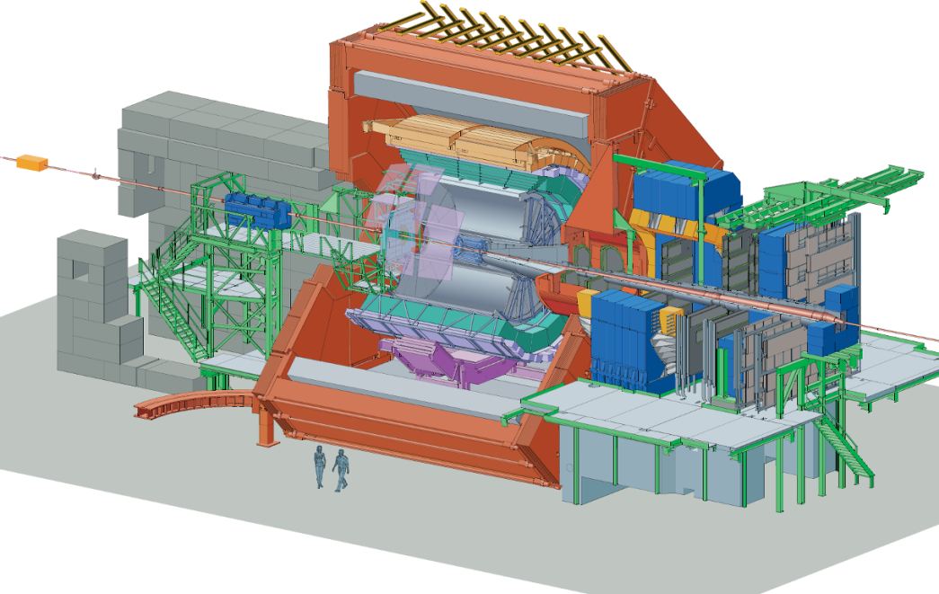
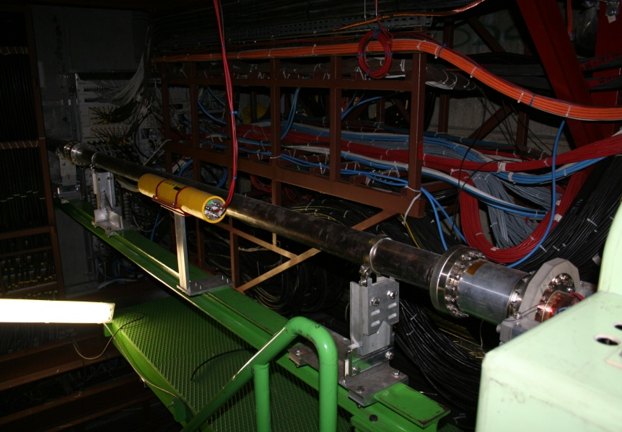
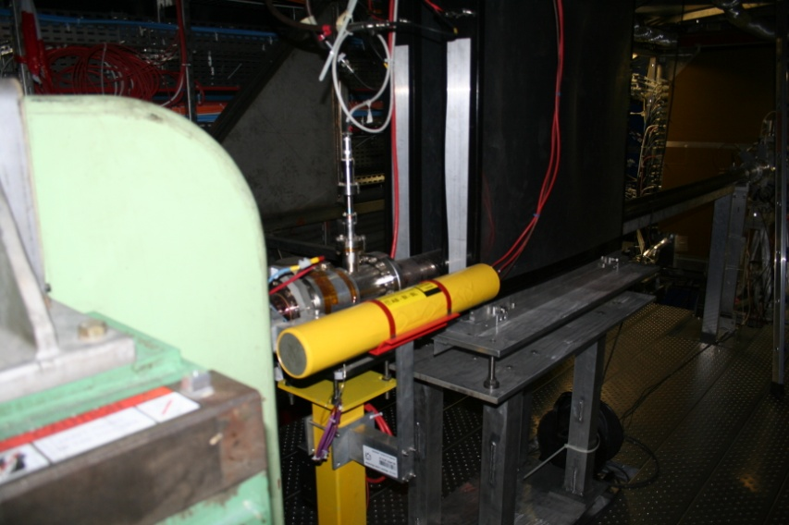
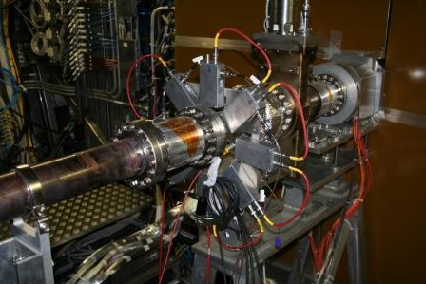
BCM response and thresholds studies
BCM-A
z = + 6 m, r = 10 cm
BLM-MWBMD
BCM C
z = -18.5 m, r=10 cm
Source: A. Di Mauro, ALICE-LHC Interfaces-TF250310

Slide 3
BCM response and thresholds studies
Beam dump logic:
  Fast abort on RS1 (integration over 40 μs) or RS2 (integration over 80 μs) coincidences:
  dump the beam if 3 adjacent diamond sensors out of 4 show a current > thr_{RS1} or thr_{RS2} , respectively
  Slow abort on RS32-Sum (1.28 ms):
  Sorting out the two highest and the lowest of 8 sensors, dump the beam if RS32-Sum > thr_{RS32}
Source: A. Di Mauro, ALICE-LHC Interfaces-TF250310

Slide 4
Main observations:
The Beam Condition Monitoring system sent the signal to dump the beam two times on 28/07/2011: at 16:30 and 18:03.
The values of the threshold for the beam background were exceeded:
  16:30 - 80 times (the RS1 and RS2 conditions on station A)
  18:03 - 3559 times (the RS32Sum condition on station A)
Values from station A were higher that those from station C
  2 – 25 times

Slide 5
Summary - station A
Event | 16:30 | 18:03
Max RS1 value [nA] | 40449 | 1145000
RS1 Threshold [nA] | 500
Max RS2 value [nA] | 20071 | 840930
RS2 Threshold [nA] | 250
RS32Sum [nA] | 1200 | 56947
RS32Sum [nA] | 16

Slide 6
Summary - station C
Event | 16:30 | 18:03
Max RS1 value [nA] | 1566 | 456159
RS1 Threshold [nA] | 500
Max RS2 value [nA] | 1414 | 404604
RS2 Threshold [nA] | 250
RS32Sum [nA] | 73 | 5883
RS32Sum [nA] | 16

Slide 7
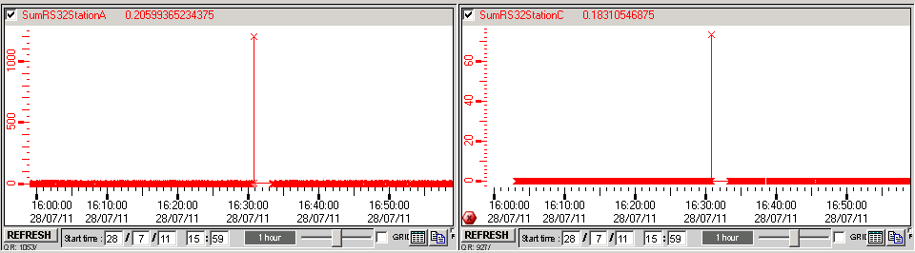
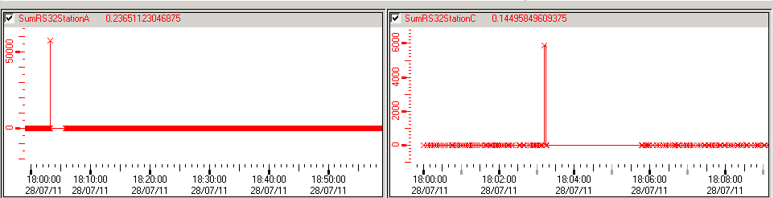
RS32Sum plots (PVSS):
16:30
18:03

Slide 8
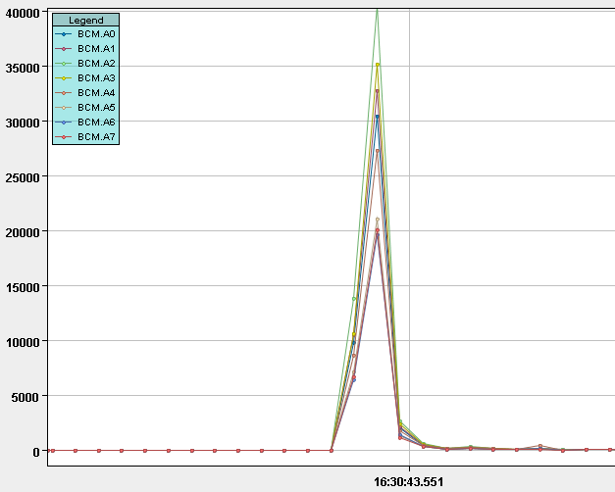
PM Report - 16:30 – station A
RS1, sampling 40 microseconds

Slide 9
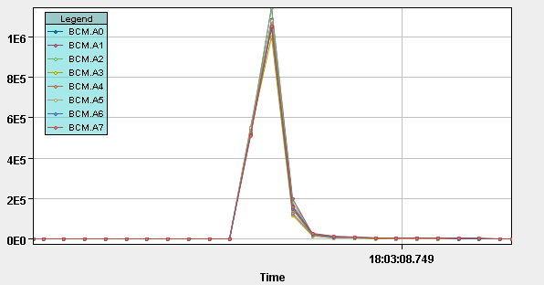
PM Report - 18:03 – station A

Slide 10
ITS = SPD+SDD+SSD
PHOS
TRD
HMPID
EMCAL
ALICE Status
2x
2x
2x
5
4
3
2x
6
2
7
TPC
1
2x
8
0
ITS
9
17
10
16
11
15
12
13
14
0
4
1
3
2

Slide 11
Affected subdetectors
Subdetector | Event 16:30 | Event 18:03
EMCAL (electromagnetic calorimeter) | no issues | HV-related errors (incl. +13 LV) for SMC1,2,3 (not SMC0 or SMC4); 110 < phi < 170
FMD (silicon detector) | no issues | FMD 2&3 errors
HMPID | 1 chamber trip | all 48 HV channels tripped
MCH - C side | HV trips | also LV trips; recovered
MTR – C side | ~30% tripped | ~30% tripped
PHOS (calorimeter detector) | HV-related errors (incl. +13,-6 LV) for mod 2,3 (not 4) | HV-related errors (incl. +13,-6 LV) for mod 2; recovery OK

Slide 12
Affected subdetectors
Subdetector | Event 16:30 | Event 18:03
TPC (gaseous detector) | FC trip; OROC C01 HW | FC (Field Cage)trip; OROC (outer readout chamber) A03,C00,C01,C02,C04,C05,C06,C07,C10,C12,C16,C17 HW trip; Skirt A,C trip + 1 DCS board went to no control (power-cycled for recovery) – probably evidence of SEU (Single Event Upset) ~0.5 m from beam pipe
TRD (gaseous detector) | all HV (anode) channels tripped | many HV (~all of anode) channels tripped; 2 DCS board went to no control (power-cycled for recovery)
SDD – silicon drift detector |  | injectors to calibrate drift velocity: 50 % of them on the layer closer to Beam Pipe are not working – under investigation if permament (most serious incident)

Slide 13
Conclusions
Many (9 of 17) subdetectors affected
All subsystems but SDD recovered using standard procedures
SDD calibration system - investigation ongoing
We are close to limits of safety

