Slide 2
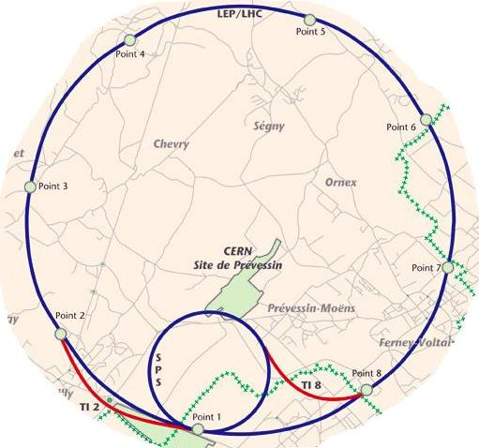
Beam Permit Loop Route

Slide 3
Beam Permit Loop Route

Slide 4
Beam Permit Loop Route
~27km

Slide 5
Beam Permit Loop Route
~45km

Slide 6
Beam Permit Loop Route
~45km
IR6 around LHC = 190us
CCR to IR6 = 95us
Link through CCR adds ~30us

