Slide 1

Overview of single bunch asynchronous dump failures on collimators
Luisella LARI
For the collimator team
Special thanks to R.W.Assmann, R.Bruce, A.Rossi
BE/ABP
9th March 2012
MPP meeting

Slide 2
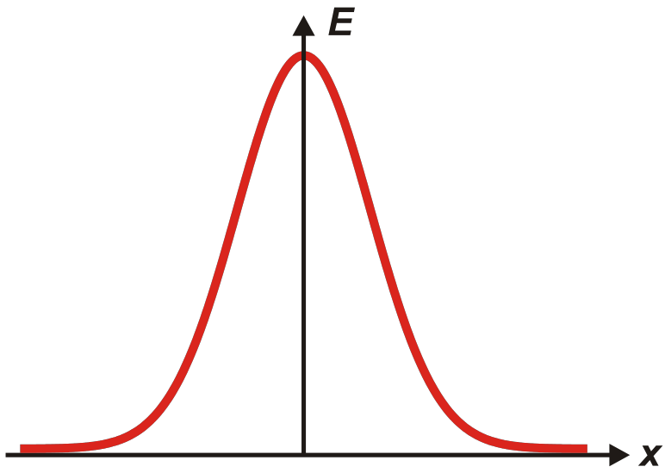
Summary of what was done
Scan over the MKD pre-fire pulse form to find the angle for which the TCDQAs are by-passed for possible misalignment → for each MKD failure mode (each 1 MKD studied separately)
Once find the angles → scan all over the LHC machine to find the elements that are touched by the beam 1 or 2 kicked, playing with the location of the faulty MKD:
  Results for impacts with beam center
  Results for impact with 1/2/3 sigma x
Particular attention was done for possible interactions with TCTs and/or TCLAs.
1 jaw
1 jaw
2 σ_{x}
1 σ_{x}

Slide 3
Reference case
”Configuration for 2012”
Collision energy = 4TeV,
Crossing and Spectrometers switched ON [4TeV→145 μrad half crossing angle in IP1 and IP5]
Physics run with 0.6 m beta* in IP1/5 & 3.0 m beta* in IP2/IP8 (i.e. SEP OFF),
Ref. optics “as-built” thin V6.503
Transverse normalized emittance 3.5 μm rad
7TeV
ON
2.5

Slide 4
Collimator Aperture → 4 TeV
Ref: Evian 2011 – R.Bruce
Beam 1
&
Beam 2
TCP.IP7 | 4.3
TCSG.IP7 | 6.3
TCLA.IP7 | 8.3
TCP.IP3 | 12
TCSG.IP3 | 15.6
TCLA.IP3 | 17.6
TCT.IP1.IP2.IP5.IP8 | 9.0
TCL.IP1.IP5 | 10
TCLI/TDI.IP2 | Tot opened
TCDQ.IP6 | 7.6
TCSG.IP6 | 7.1

Slide 5
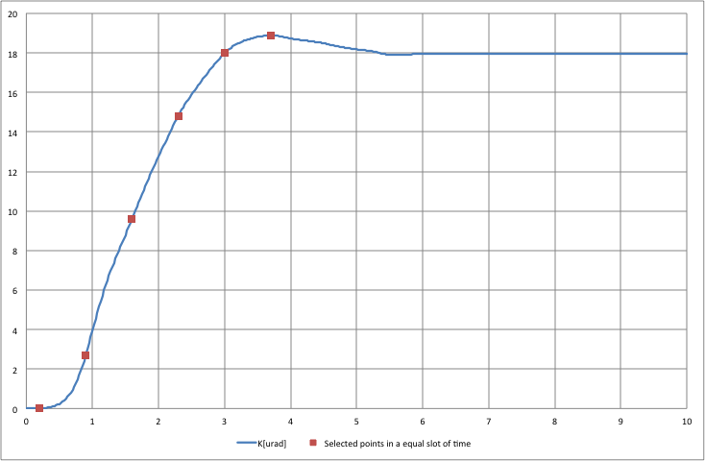
Scan over the MKD pre-fire pulse form (1)

Slide 6
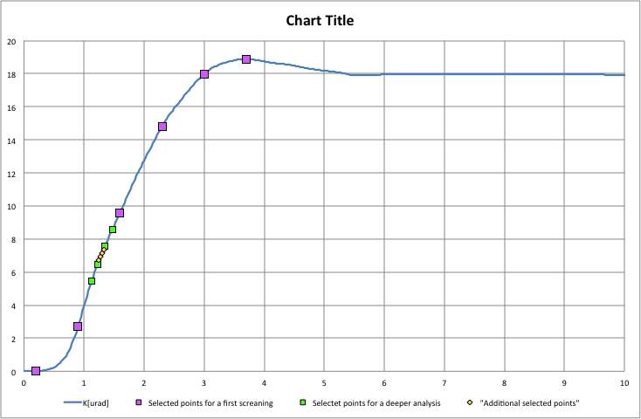
Scan over the MKD pre-fire pulse form (2)
by considering B1 or B2 and
by the location of the MKD with problem
Around 7μrad TCDQAs by passed →TCSG@IP6
But if we are looking for the effects on the downstream elements (TCT, TCLA)→ the worst is to consider an error in the alignment of the TCDQAs position (i.e. max 1.5 mm) → means GO TO ANGLE > 7 μrad

Slide 7
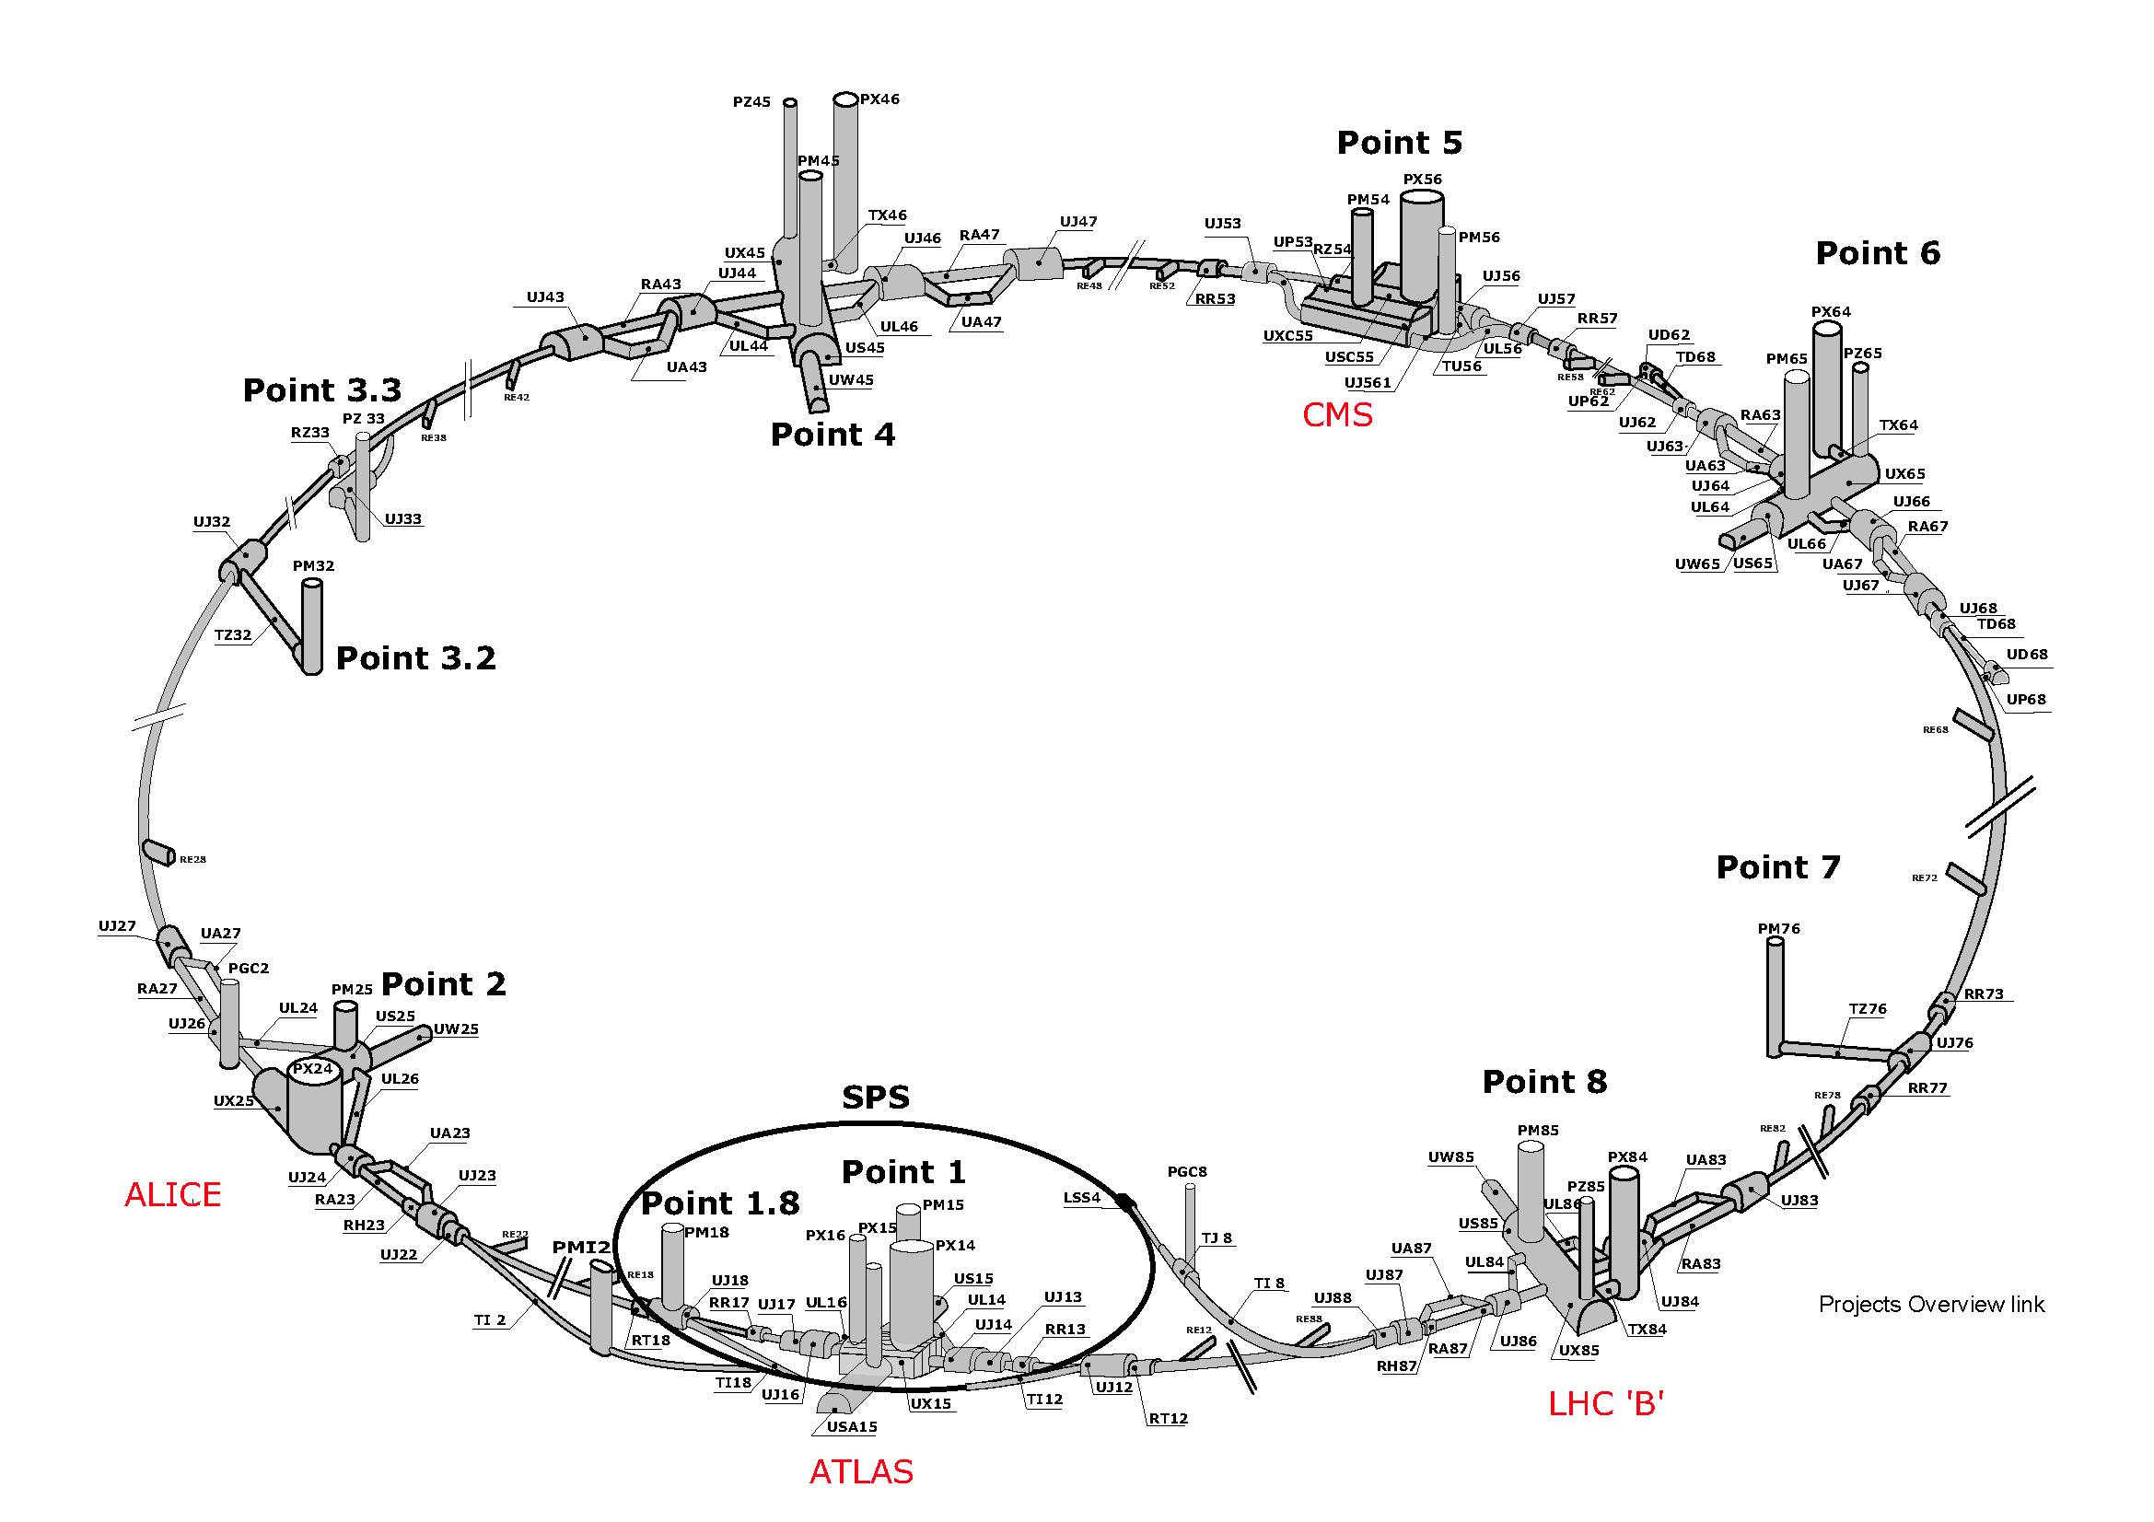
Point 7!
Beam 2
Beam 1
In MADX to select the “worst” scenario for further studies

Slide 8
Beam1
Failure MKD.A5L6.B1
1.95 [μs]; +12.39910241 [μrad]
% of intercepted beam, Gaussian distribution (error function)

Slide 9
Beam1
Failure MKD.A5L6.B1
1.95 [μs]; +12.39910241 [μrad]
mm [abs] inside the jaw

Slide 10
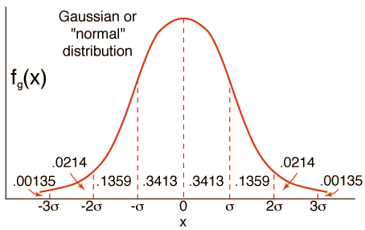
Beam1
Failure MKD.A5L6.B1
1.95 [μs]; +12.39910241 [μrad]
Sigma (x) inside one jaw

Slide 11
Beam2
Same failure situation for the different MKD locations
% of intercepted beam, Gaussian distribution (error function)

Slide 12
Beam2
Same failure situation for the different MKD locations
mm [abs] inside the jaw

Slide 13
Beam2
Same failure situation for the different MKD locations
Sigma (x) inside one jaw

Slide 14
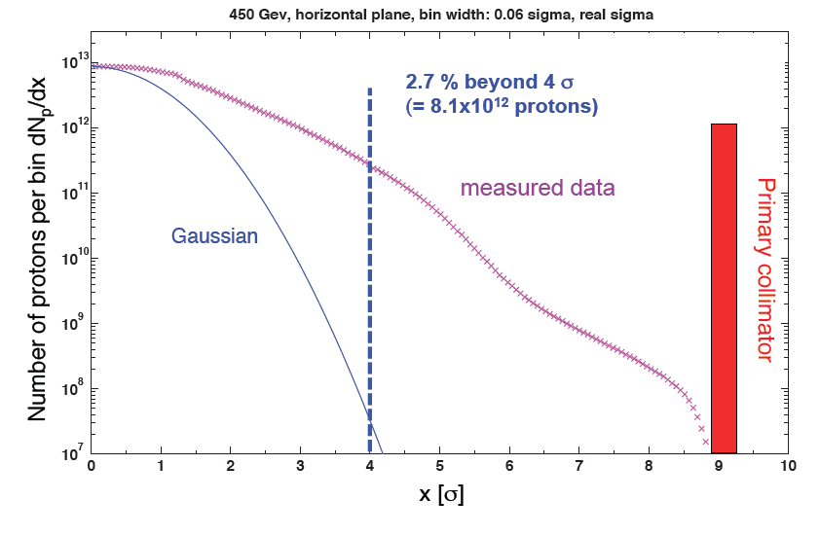
Conclusion → Next steps
First selection of cases for B1 and B2 using this preliminary studies with tight collimation settings.
Following SixTrack simulations using realistic beam distribution.
Consider magnet errors could change the hierarchies of the impacted collimators.
Changing the aperture of collimators → change the pattern of the loads on downstream collimators/beam elements (needed FLUKA simulations).
Courtesy F. BURKART

Slide 15
Additional slides
Luisella LARI
BE/ABP
9th March 2012
MPP meeting

Slide 16
Collimator Aperture → 7 TeV
Beam 1
&
Beam 2
TCP.IP7 | 6 → 4.3
TCSG.IP7 | 7 → 6.3
TCLA.IP7 | 10 → 8.3
TCP.IP3 | 15 → 12
TCSG.IP3 | 18 → 15.6
TCLA.IP3 | 20 → 17.6
TCT.IP1.IP2.IP5.IP8 | 8.3 → 9.0
TCL.IP1.IP5 | 10
TCLI/TDI.IP2 | Tot opened
TCDQ.IP6 | 8 → 7.6
TCSG.IP6 | 7.5 → 7.1

Slide 17
Optics IP6
Beam 1
&
Beam 2

