Slide 1
TDC with Uncontrolled Delay Lines:
Calibration Approaches and Precision Improvement Methods
Wu, Jinyuan (Presenter, Fermilab)
W. Zhang, C. Edwards, D. Gong, X. Huang, C. Liu, T. Liu, T. Liu, J. Olsen, H. Sun, Q. Sun, J. Wu, J. Ye, L. Zhang
Sept. 2022

Slide 2
Introduction
Delay line based TDC was developed in ASIC in 1990’s.
The TDC was transplanted into FPGA in 2000 to 2010 with simplifications with uncontrolled delay line.
ETROC designed, fabricated and tested in 2018 to 2022 is an attempt of transplanting the simplified TDC with uncontrolled delay line back to ASIC.

Slide 3
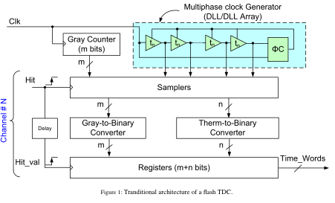
TDC with Adjustable Delay Line
IN
The input signal propagates in the delay chain.
The “snapshot” is taken into the register array.
The position of the signal transition is encoded into arrival time relative to the CLK.
A fast clock (e.g. 320 MHz) is sent to the delay chain.
The delay cells are adjusted to match the clock period.
CLK

Slide 4
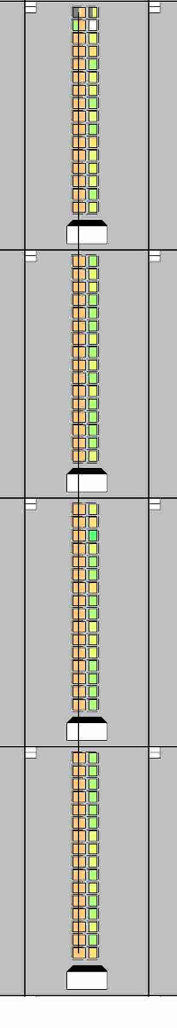
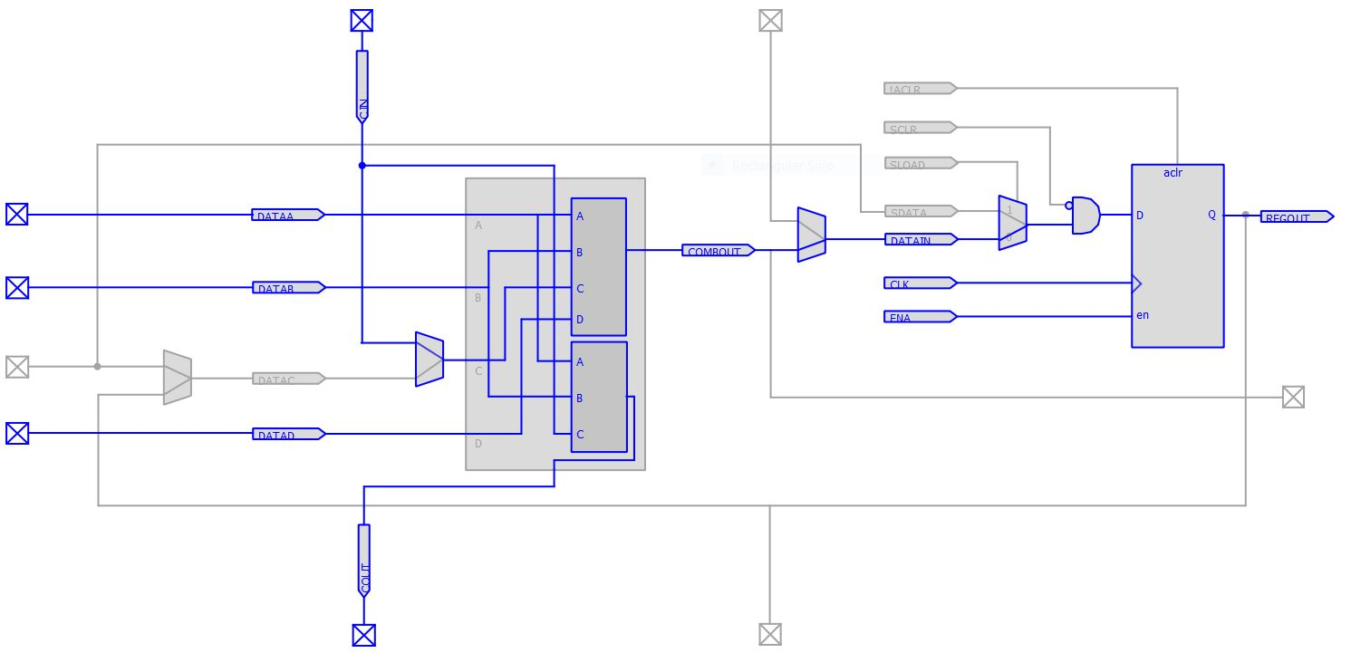
Un-adjustable Delay Lines in FPGA
IN
N₂-N₁=(1/f)/Δt
CLK
1/f: Clock Period
Δt: Average Bin Width
For each input, make two measurements.
The extra measurement can be used to calibrate VTC variations.

Slide 5
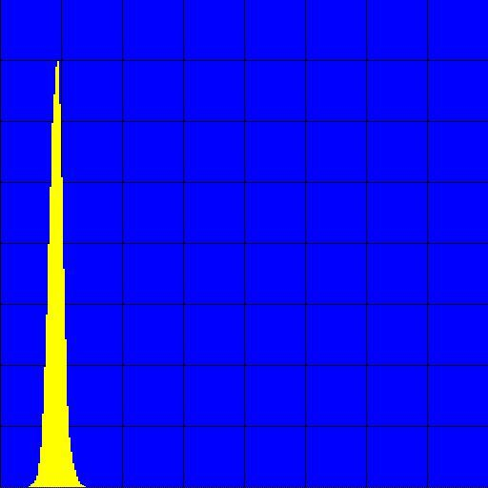
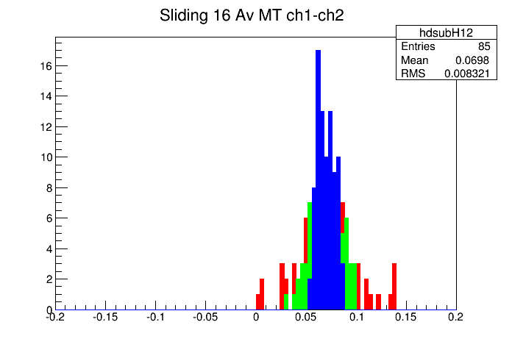
FPGA TDC
The delay line is implemented using carry chain inside FPGA.
Today FPGA TDC precision is better than 20 ps, some high-end ones better than 6 ps.
It is not necessary to control the delay line speed.

Slide 6
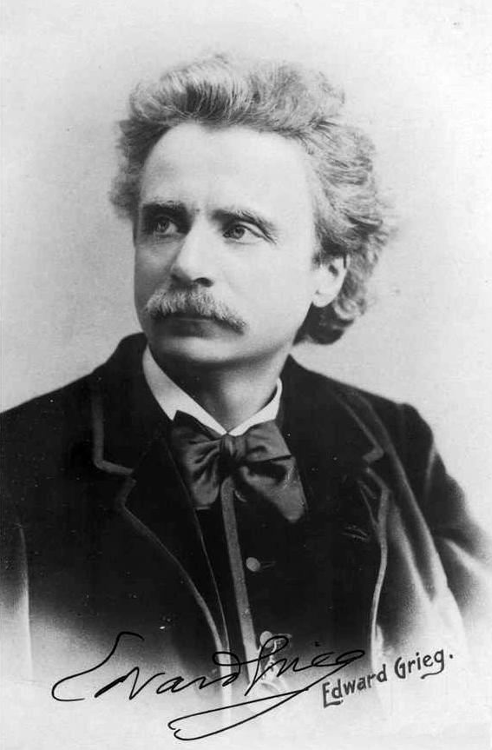
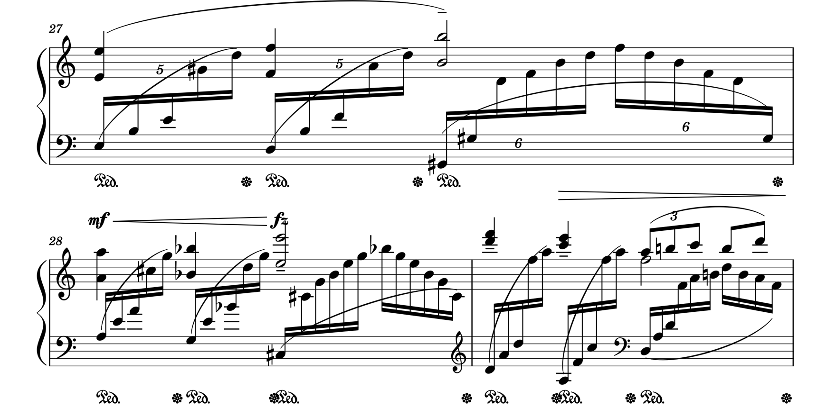
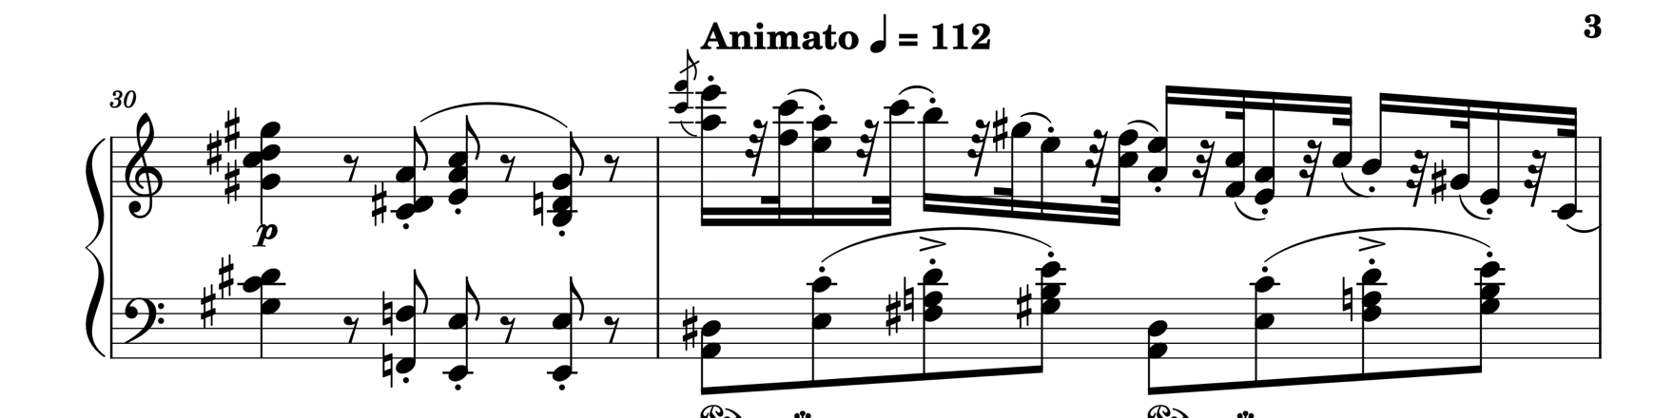
Learning From Edvard Grieg
By Elliott &amp; Fry - Public Domain, https://commons.wikimedia.org/w/index.php?curid=5517478
Piano Concerto, Op. 16
A beat can be divided into 5, 6 notes, not always 4.

Slide 7
Uncontrolled Delay Line in ASIC TDC

Slide 8
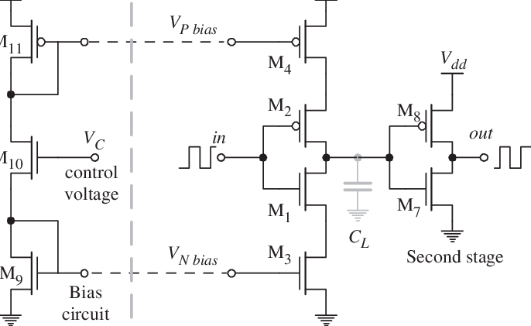
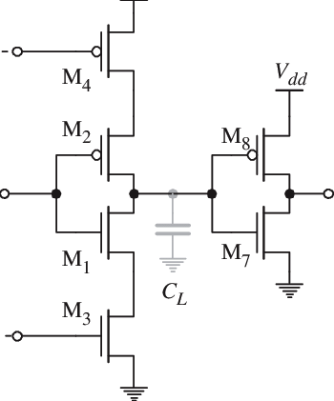
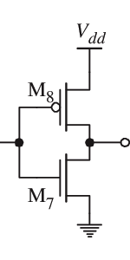
Advantage of TDC with Uncontrolled Delay Line: (1) Full Speed Operation
In controlled delay line, transistors are starved. The delay cell runs slower than in normal condition.
In uncontrolled delay line, transistors are fully powered. The delay cell runs at full speed.

Slide 9
Advantage of TDC with Uncontrolled Delay Line: (2) Single Gate Delay
If even-odd DNL is not tolerated, at least TWO invertor delays are needed between delay taps.
If DNL can be calibrated, delay between taps can be just a SINGLE invertor delay.

Slide 10
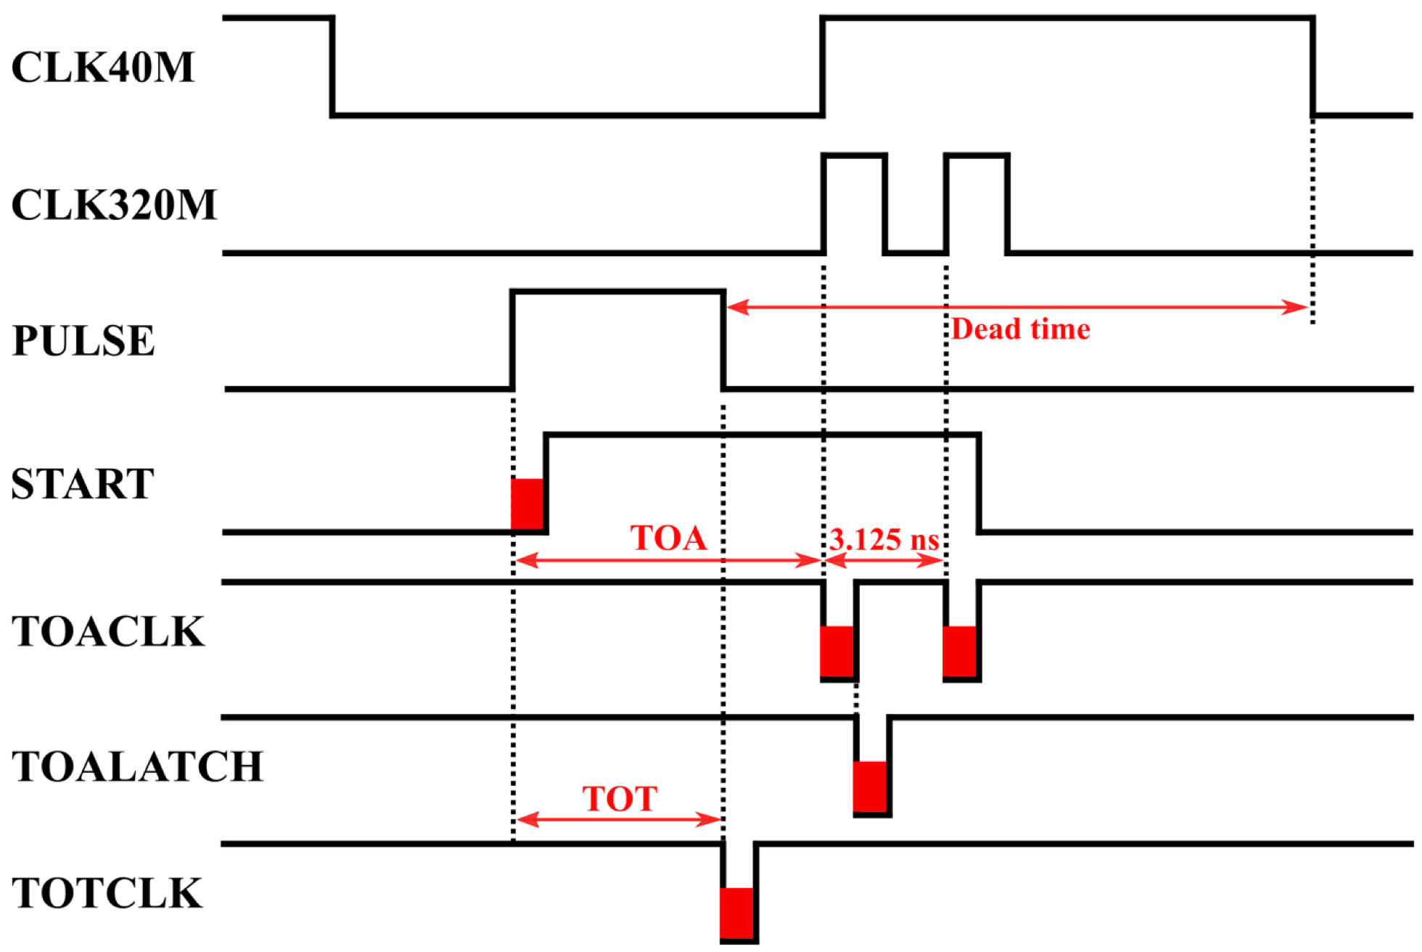
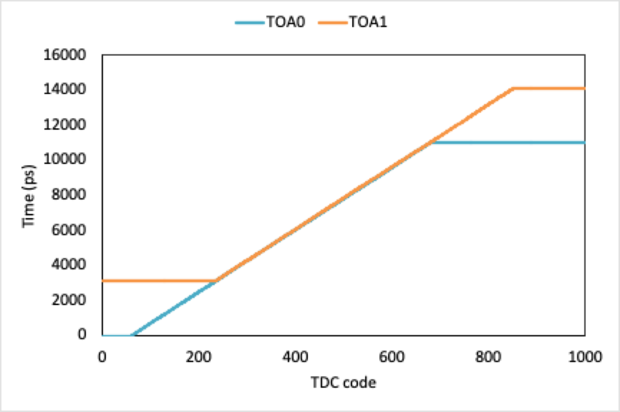
Advantage of TDC with Uncontrolled Delay Line: (3)Multiple Measurements
IN
The TDC with uncontrolled delay line usually needs two measurements for each hit.
The two data samples can be used for temperature tracking and calibration.
The two samples can also be averaged for a finer precision.
CLK

Slide 11
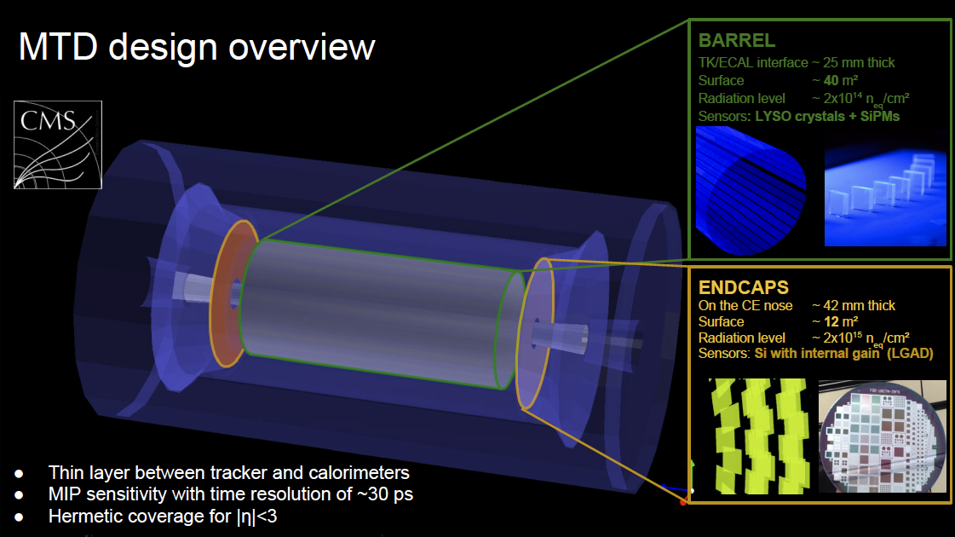
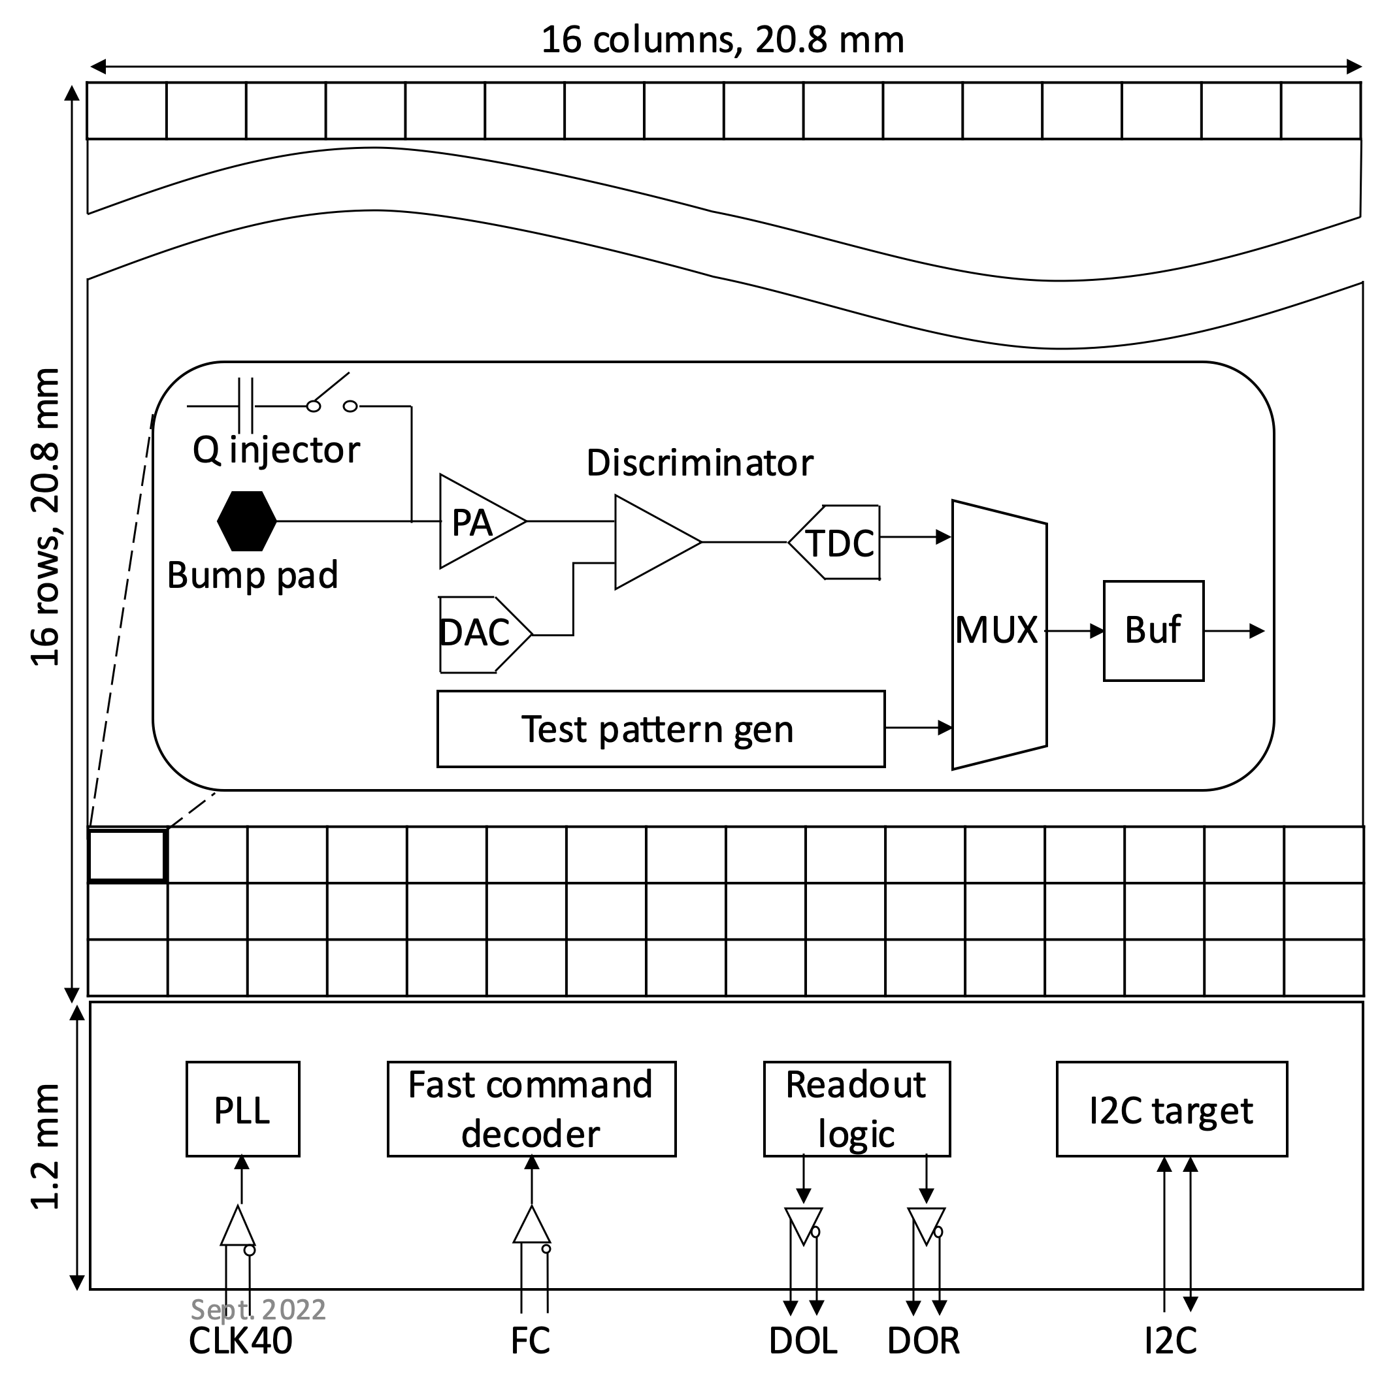
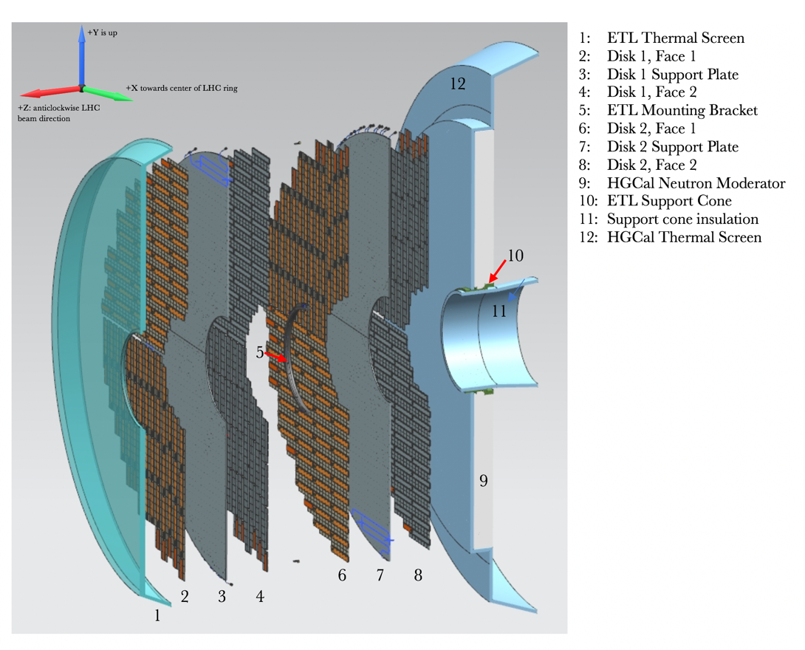
TDC in End Cap Timing Read Out Chip (ETROC)
The ETROC ASIC interfaces 16 x 16 = 256 pixels.
The arrival time and pulse width of each hit are digitized with a TDC.

Slide 12
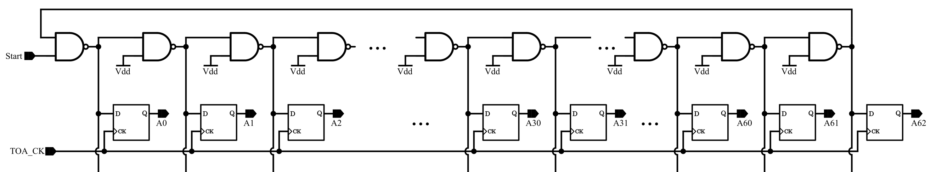
ETROC TDC: Transplanting Uncontrolled Delay Line Back to ASIC TDC
HF
TOA0
CAL(TOA1-TOA0)
TOT
Hit Flag
Time Of Arrival
Calibration Code
Time Over Threshold
The delay chain is not controlled so that it runs at full speed.
Temperature variations and uneven width of the bins are corrected in digital domain.
Two samples also help improving measurement precision.
Note that the delay cells are inverting NAND gates with single gate delay (17 ps in 65 nm Technology).
No hit no flip: very low power consumption.

Slide 13
Bin Widths
Bin widths is measured using two clocks generated using PLL with slow drift phase relationship:
  System clock: 40.000 MHz
  Test hit generation: 40.001 MHz
The relative phase drift between system clock and test hits is 0.625 ps per step.
DNL of even-odd bins can be measured at certain temperature.

Slide 14
Calibration Table
For each hit, two time of arrival are measured and output as two TDC codes.
Using the bin width data, two calibration tables for both TDC codes can be accumulated.
The TDC codes are converted into time (in unit of ps) using the calibration table.

Slide 15
Effects of Temperature Variations
Measurements are performed on an ETROC TDC at two different temperatures, one at room temperature (about 25 degree C) and another at a higher temperature (heated with a hot air gun to about 40 degree C).
A very notable phenomenon is the shift of the calibration code, TOA1-TOA0 (dTOA).
If calibrated correctly, fine measurement precision (~6 ps) can be achieved.
If calibrated wrong, incorrect results are seen.
High Temperature
Room Temperature
Calibrated Appropriately
Wrong Calibration
t1 = LUT(TOA0) * [(dTOA)_{current temperature}/(dTOA) _{lookup table temperature}]

Slide 16
Arithmetic Average of Two Measurements
The standard deviation of two measurements in this situation is about 6 ps.
When an arithmetic average is calculated for each hit, the standard deviation improves to better than 5 ps.

Slide 17
Improving Measurement Precision
Adding more bins will subdivide existing bins further. (The delay element shown above may be 1.5-unit NAND delay.)
Adding more sampling edges provides more measurement results for averaging.

Slide 18
Summary
Without controlling the delay line, the TDC structure is simpler, and the power consumption is reduced. (ETROC TDC: 37 μW/CH)
In the TDC with uncontrolled delay line, single invertor at full speed minimize tap delay allowed by the ASIC fabrication technology, resulting finer bin width. (17 ps @ 65 nm fab. tech.)
Extra measurements in double-strobe scheme are not wasted. They are averaged for finer measurement precisions. (6 ps -> 5 ps)

Slide 19
The End
Thanks

Slide 20
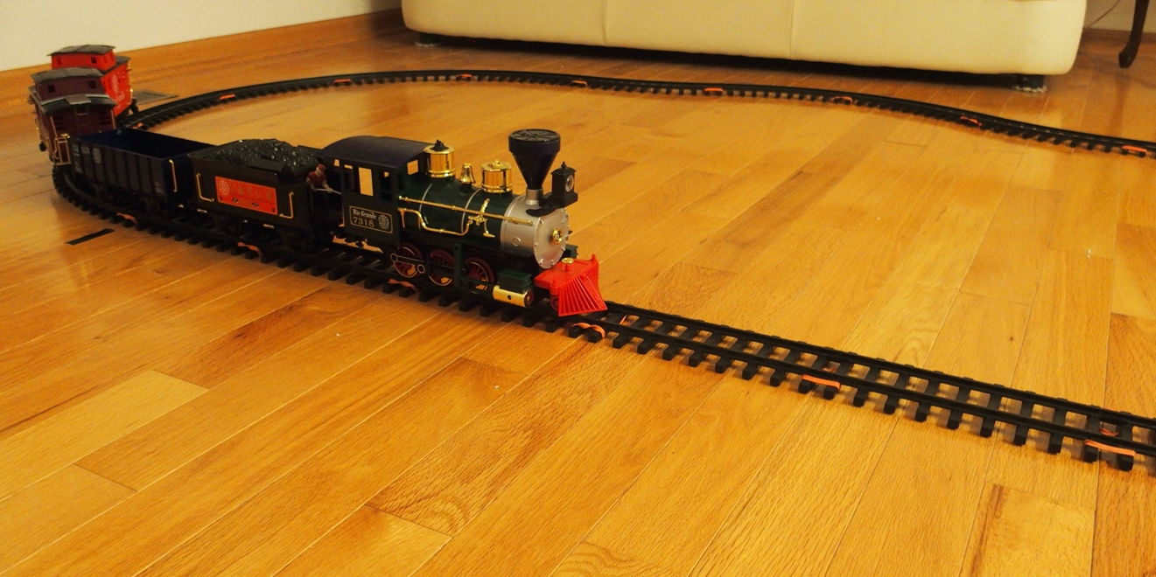
Good Things in ASIC But Not in FPGA
The phase detector, charge pump and voltage-controlled delay cells are available in ASIC but difficult to implement in FPGA.
Pro:
  The delay cells are adjusted to a known speed. (e.g., 100 ps/tap)
Con:
  The delay cells are slowed down, rather than running at the full speed.
  Charge pump consumes extra power.
  Delay chain must always run.
V

Slide 21
Temperature and Power Supply Voltage Calibration
N₂
Temperature and power supply voltage will cause the delay cell speed change.
With multiple measurements, the variation can be corrected.
The delay cell always run at full speed rather than being slowed down.
Corrected Time
N₁

Slide 22

Delay Line Based TDC
IN
CLK
The input signal propagates in the delay chain.
The “snapshot” is taken into the register array.
The position of the signal transition is encoded into arrival time relative to the CLK.

Slide 23
Histogram
The measurements are taken at room temperature and under hair dryer blow.
The temperature variation can be corrected.
Extra samples helps improving measurement precision.
It works.
High Temperature
Room Temperature
RT Data
RT Bin Width
Two Single Peaks:
6.4 ps each
RT Data
HT Bin Width
Two Samples Averaged:
5.4 ps

Slide 24
Mainstream ASIC TDC in History (& Today)
A fast clock (e.g. 320 MHz) is sent to the delay chain.
The delay cells are adjusted to match the clock period.
The outputs of the delay taps are routed to a set of FF registers.
The leading edge of the HIT signal captures the delay pattern.

Slide 25
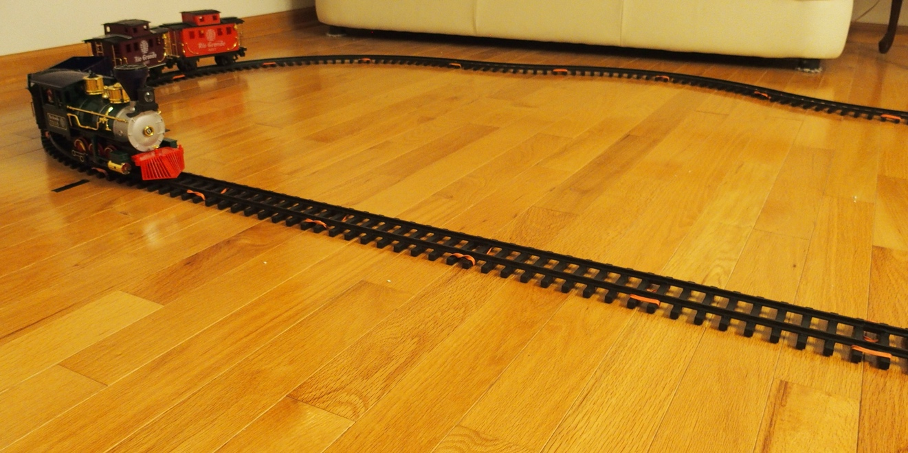
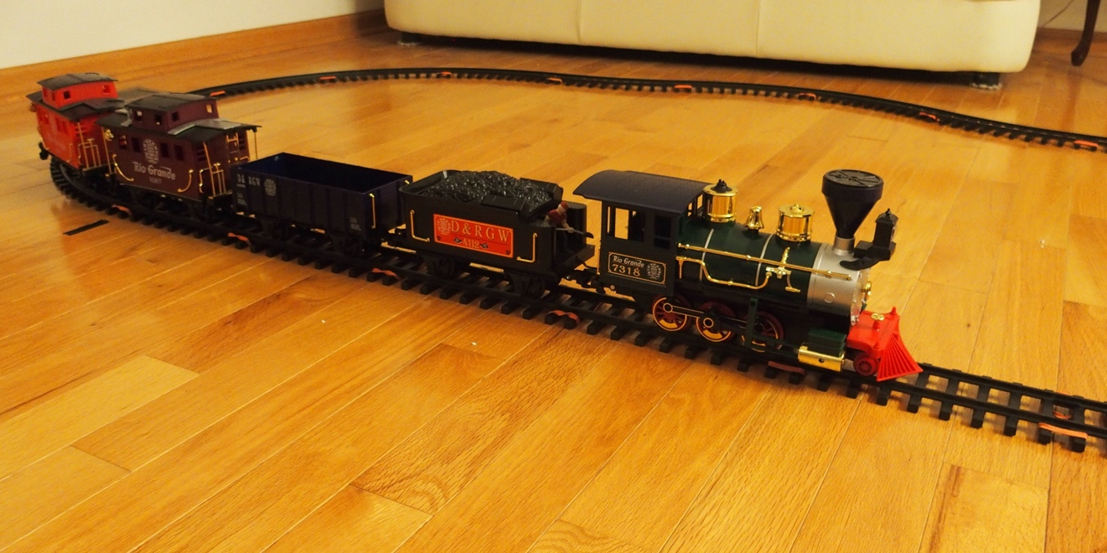
Un-adjustable Delay Lines FPGA
IN
N₂-N₁=(1/f)/Δt
CLK
1/f: Clock Period
Δt: Average Bin Width
For each input, make two measurements.
The extra measurement can be used to calibrate temperature variation as well as increase measurement precession.

