Slide 1

Waveform Sampler: A 2.56GS/s 12-bit Time-Interleaved
Pipelined-SAR ADC with on-chip Memory
Xianshan Wen¹, Tao Fu¹, Liang Fang¹, Guanhua Wang¹, Sandeep Miryala², Tiehui Ted Liu², and Ping Gui¹
¹Department of Electrical and Computer Engineering
Lyle School of Engineering
Southern Methodist University, Dallas, TX, USA
²Fermi National Acceleratory Lab , Batavia, IL, USA

Slide 2
Outline
Single-channel 320MS/s 12-bit ADC
2.56GS/s 12-bit Waveform Sampler (WS)
  Interleaving 8 channels
  V1: with on-chip DFF based memory
  V2: with latch-based memory, radiation tolerance
  Integration with ETROC2
Summary

Slide 3
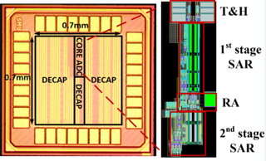
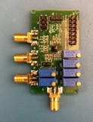
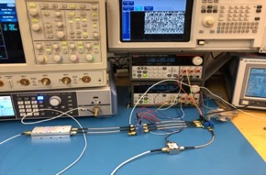
Single-Channel 320MS/s 12-bit Pipelined-SAR ADC
Originally designed for 5G application before ETROC started
Chip design submitted in May 2019; Measurement completed in Oct. 2019
Specs | Measurement Results
Sampling Rate | Up to 350 MS/s
ENOB (Effective Number of Bits) | 10.2 bits @ 30MHz and 9.6 bit at @170MHz
Power Consumption | 2.86mW (when continuous operating)
Core area | 0.05mm x 0.3mm
Topology | Pipelined-SAR
Technology | 65nm CMOS

Slide 4
Single-Channel 320MS/s 12-bit Pipelined-SAR ADC
SAR ADC for its low power operation and scalability with CMOS
Pipelined SAR for high resolution and high sampling rate
12-bit by design to achieve 10-bit ENOB,
6+7 including 1 bit interstage redundancy

Slide 5
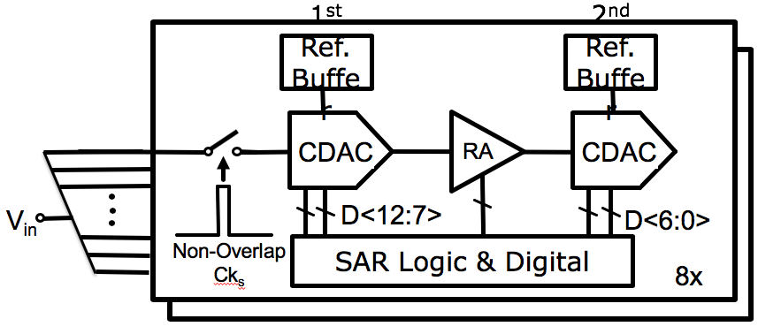
Waveform Sampler (WS) v1:
Interleaving 8 Channels for 2.56GS/s
Interleaving 8 channels in time-domain to get overall sampling rate of 2.56GS/s
  Inter-channel timing skew, gain and offset mismatches
  Intra-channel mismatches
Various calibrations to minimize mismatches
Clock and Input distribution network
On chip memory for data storage

Slide 6
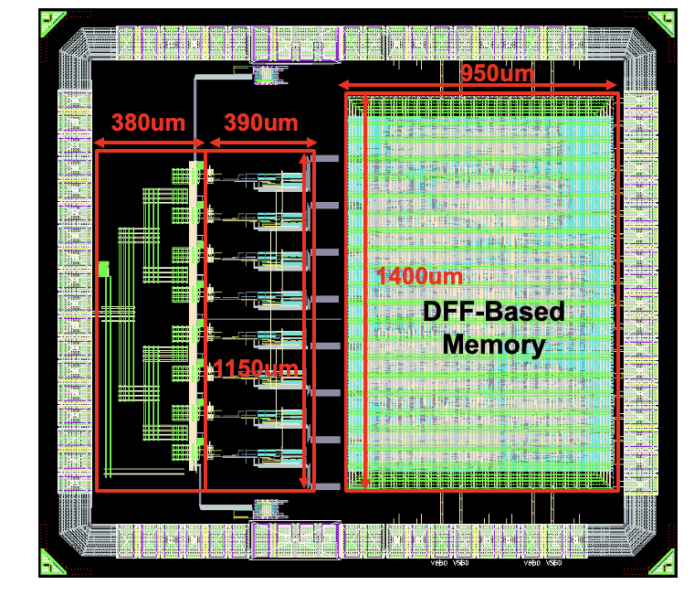
Chip Layout of WS v1 with DFF-based Memory
8 sub-memories (8 x 512 depth x 13b width)
capturing time frame: 4096x (1/(2.56GS/s))= 1.6us (64 bunch crossings)
Twisted differential clock and inputs layout to minimize noise coupling
Symmetrical Y-tree distribution maintains minimum clock skew
Foreground calibrations:
  Intra-channel: comparator offset and DAC mismatches
  inter-channel: gain, offset, and timing skews
Notes:
write in parallel @320MHz and read in series @30MHz.

Slide 7
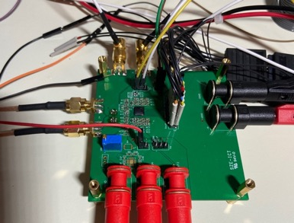
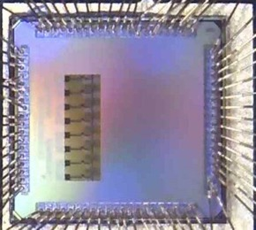
Measurement Performance of WS v1
I2C
Memory
2mm
8-channel
WS Core
I2C
2.25mm
Chip design submitted in March 2020 right before COVID lockdown; Measurements completed in November 2020
Specs | Measurement Results
Sampling Rate | Up to 2.56 GS/s
ENOB (Effective Number of Bits) | 9 bit at @1.225 GHz input
Power Consumption of ADC Core | 92 mW (when continuous operating) 6 mW in power down mode
Core area | 1mm x 0.8mm
Topology | Pipelined-SAR
Technology | 65nm CMOS

Slide 8

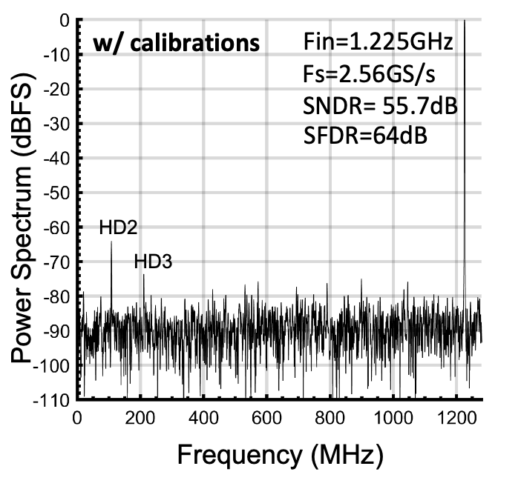
Measurement Results of WS v1
Fin=1.225GHz, Fs=2.56GS/s
SNDR=55.7dB
ENOB= 9.0bit

Slide 9
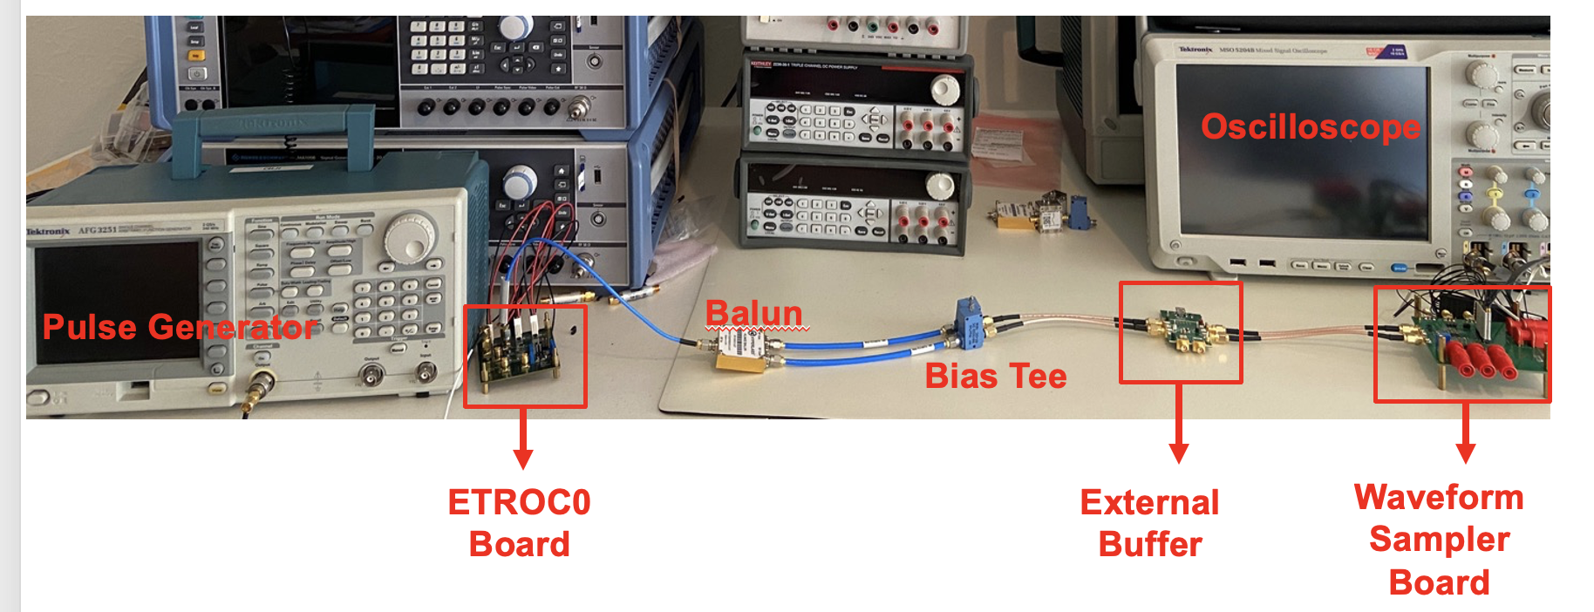
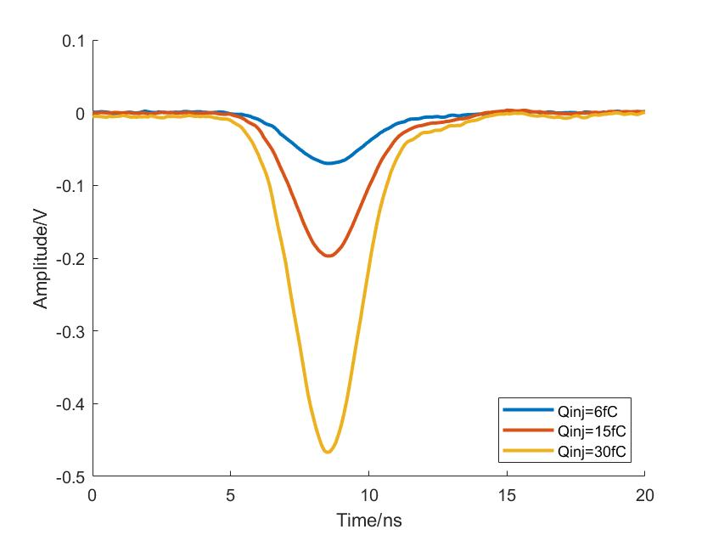
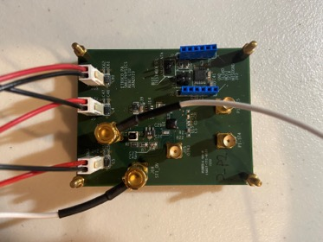
ETROC0 Output by the Oscilloscope
ETROC0 output observed with Oscilloscope
ETROC0 test board
10GS/s Oscilloscope
Input
Pulse

Slide 10
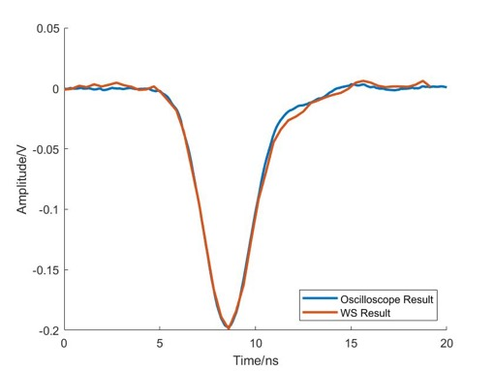
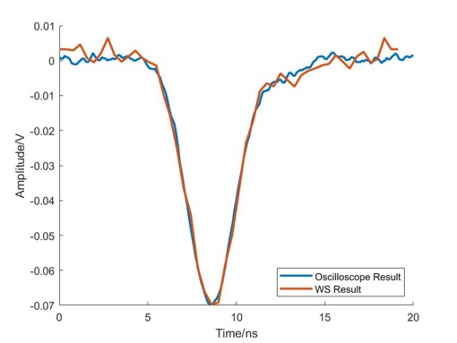
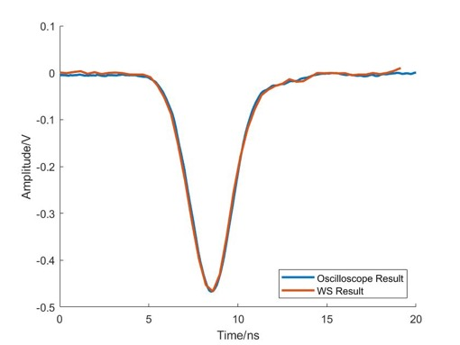
Reconstructed WS v1 Output v.s. ETROC0 Output
6fC Charge Injection
15fC Charge Injection
30fC Charge Injection
Good agreement between scope captured output and WS reconstructed output

Slide 11
Modifications on WS v2 for integration with ECTROC2
  Adding a high-linearity amplifier between ETROC preamp and WS
    Single-ended to differential conversion
    Extra gain for small sensor output under radiation
  Latch-based memory implemented for low power operation
  Modifying transistor sizing following CERN radiation design guidelines
  PLL clock delivery to WS in ETROC2
  WS power-down mode

Slide 12
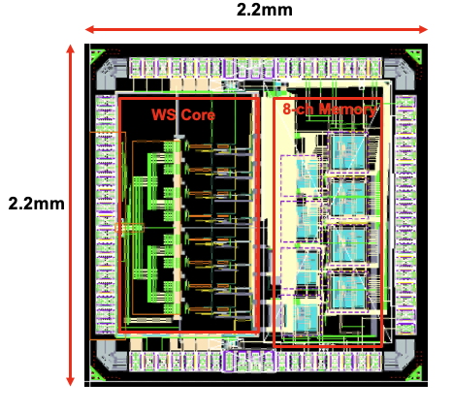
Latch-Based Memory for
Low Power and Radiation Tolerance
Implementation by CERN ASIC Support
Latch-based memory, writing @ 320MHz
13b width x 1024 depth (time frame of 400ns, i.e. 16 bunch crossing)
Write enable and power down control
Power consumption including control circuits and readout logic:
  In normal operation mode: < 30mW
  In power down mode: << 0.1mW
Implemented with standard cells => Intrinsically TID hard (100Mrad)
√

Slide 13
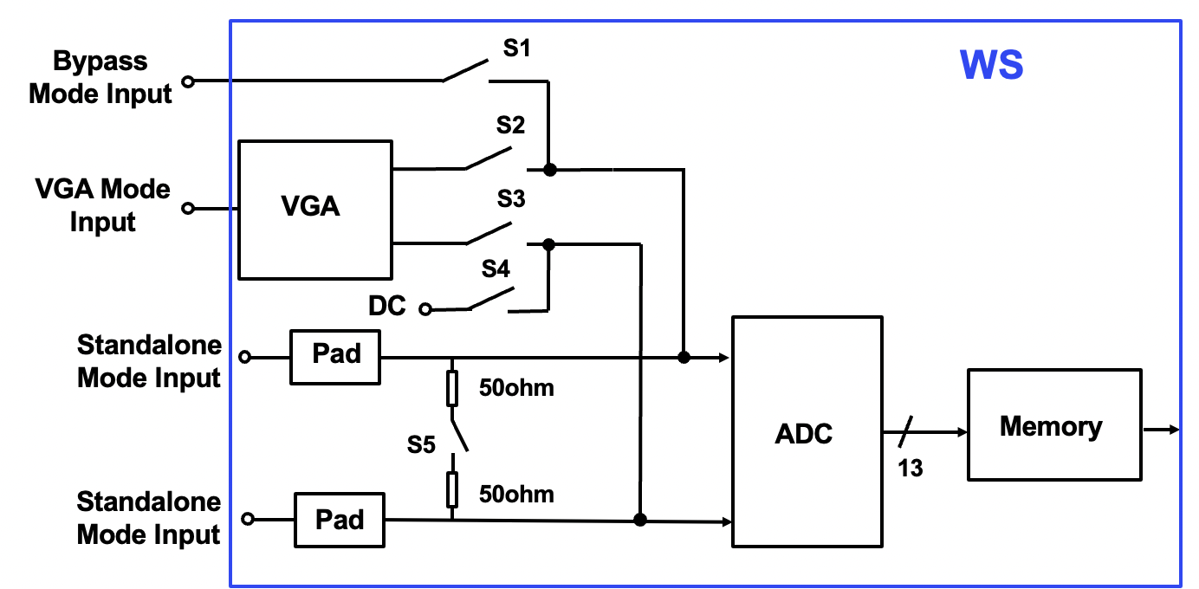
WS v2 with Different Configuration Modes
Bypass
Mode Input
Amplification
Mode Input
Amplifier
Standalone
Mode Input
Standalone
Mode Input
Standalone mode: to evaluate the performance of ADC alone (for testing purpose)
Amplification mode: to evaluate the functionality of Amplifier+ADC
(Amplifier)-Bypass mode: when signal from preamp is relatively large

Slide 14
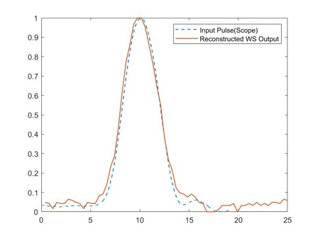
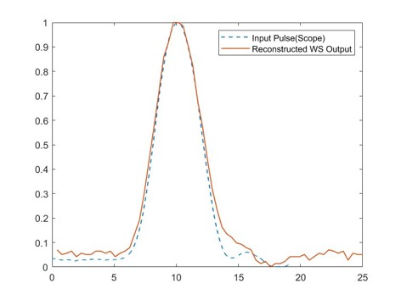
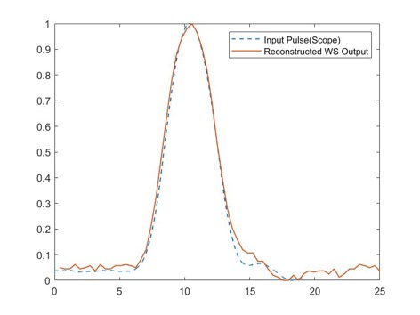
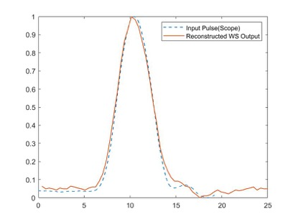
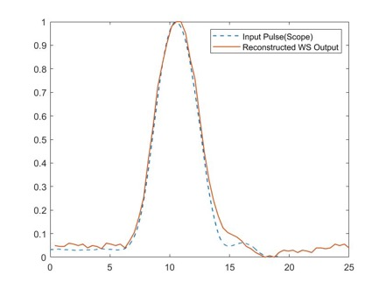
Pulse Waveform Measurements (WS Standalone Mode)
Input Amp:
~120mV
Output Amp:
~124mV
Input Amp:
~140mV
Output Amp:
~142mV
Input Amp:
~160mV
Output Amp:
~162mV
Input Amp:
~180mV
Output Amp:
~182mV
Input Amp:
200mV
Output Amp:
~196mV
X axis: Time (ns)
Y axis: Normalized Amplitude
Good agreement between scope captured signals and WS reconstructed waveforms

Slide 15
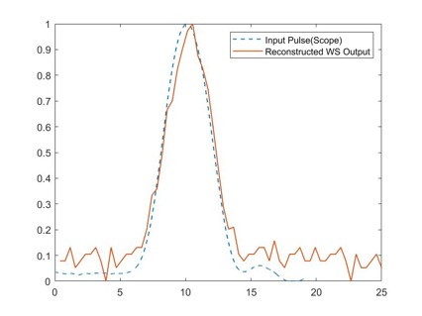
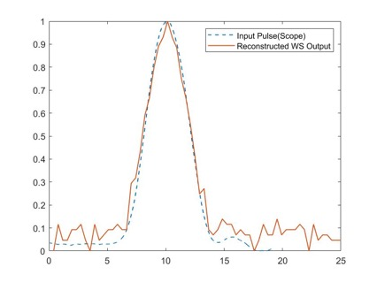
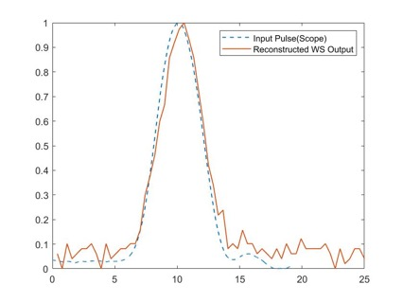
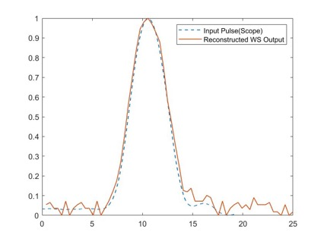
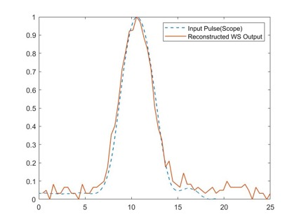
Pulse Waveform Measurements (Amplifier-Bypass Mode )
Input Amp:
~120mV
Output Amp:
~103mV
Input Amp:
~140mV
Output Amp:
~116mV
Input Amp:
~160mV
Output Amp:
~133mV
Input Amp:
~180mV
Output Amp:
~145mV
Input Amp:
~200mV
Output Amp:
~162mV
Good agreement between scope captured and WS reconstructed waveforms
Some attenuation on the signals due to long traces and transmission gates

Slide 16
Baseline Measurement using Amplifier-Bypass Mode
Good linearity between the input baseline and WS output

Slide 17
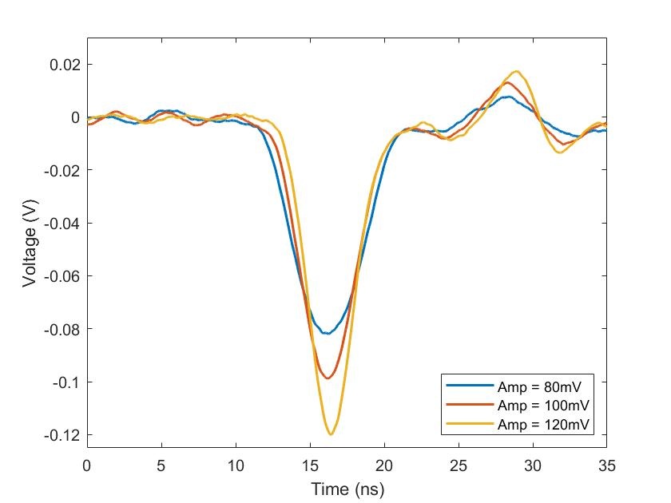
Amplification Mode Measurement with ETROC0
S1
ETROC0
S2, S3 close
S1, S4, S5 open
S2
PreAmp
(wi Buf)
AMP
On-Chip
Amplifier
S3
On-board
50ohm
S4
DC
Pad
50ohm
S5
ADC
13
50ohm
Pad
ETROC0 output observed with oscilloscope

Slide 18
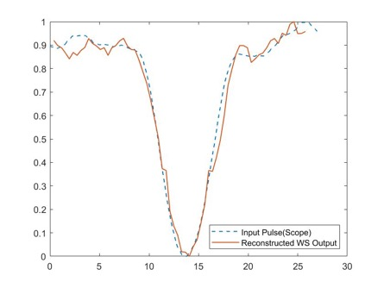
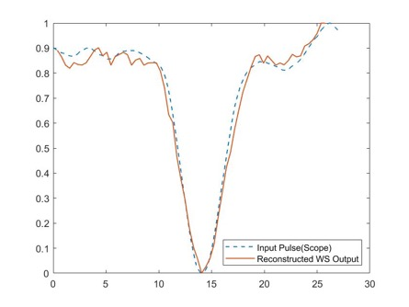
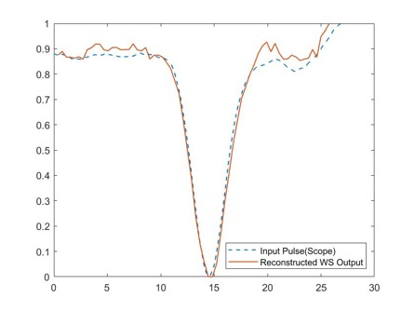
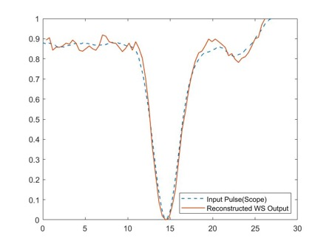
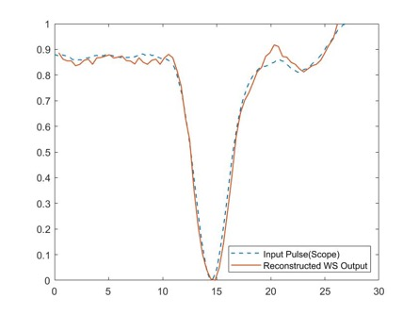
Pulse Waveform Measurements (Amplifier + WS)
Input Amp:
~80mV
Output Amp:
~380mV
Input Amp:
~100mV
Output Amp:
~430mV
Input Amp:
~120mV
Output Amp:
~490mV
Input Amp:
~140mV
Output Amp:
~530mV
Input Amp:
~160mV
Output Amp:
~580mV
Good agreement between ETROC0 outputs captured by scope and constructed with Amplifier+WS
(normalized waveform; without any calibrations)

Slide 19
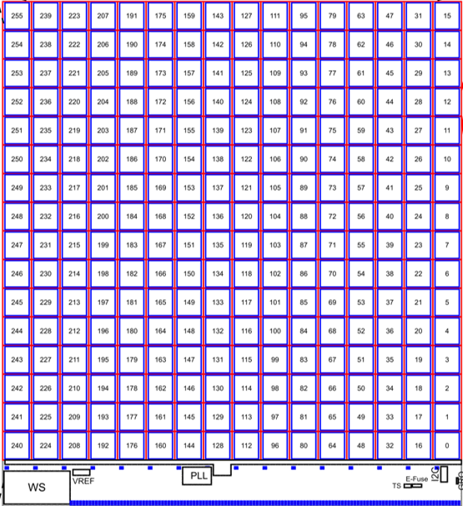
Clock Delivering from PLL to WS
The 2.56GHz clock needs to be delivered from PLL to WS with a rather long distance of 6.5mm

Slide 20
Clock Delivering from PLL to WS
Inverter Chain
2.56GHz
Differential
Sine Wave
from PLL
2.56GHz
Digital Signal
to WS
CML-to-CMOS
Converter
CML-to-CMOS Converter + Inverter Chain is chosen for the clock delivering:
  Lower jitter: Digital signal less sensitive to noise
  Robust against mismatches
  Lower design complexity: no need of biasing circuits for drivers along the signal trace.
The clock delivery can be disabled when WS is not in use to minimize switching noise

Slide 21
Power-on/Power-down Control
Two operation modes:
  Mode1: Once received ‘ws_start’, WS switches to power-on mode for 400ns (till the memory is full). It then automatically switches to power-down mode.
  Mode2: Once received ‘ws_start’, WS switches to power-on mode and keep operating till it receives ‘ws_stop’.
‘ws_start’ and ‘ ws_stop’ will be controlled via fast command.
When WS is in power-down mode, the memory keeps the recorded data and the data can be read out via I2C (‘rd_en’ controlled via slow command).
When WS is not in use, the clock driver for 2.56GHz clock delivery can be powered-down as well, which will also power down the memory
To use the WS:
Power on clock delivery -> Send ‘ws_start’/‘ws_stop’ via fast command -> Send ‘rd_en’ via slow command -> Power down clock delivery when not in use

Slide 22

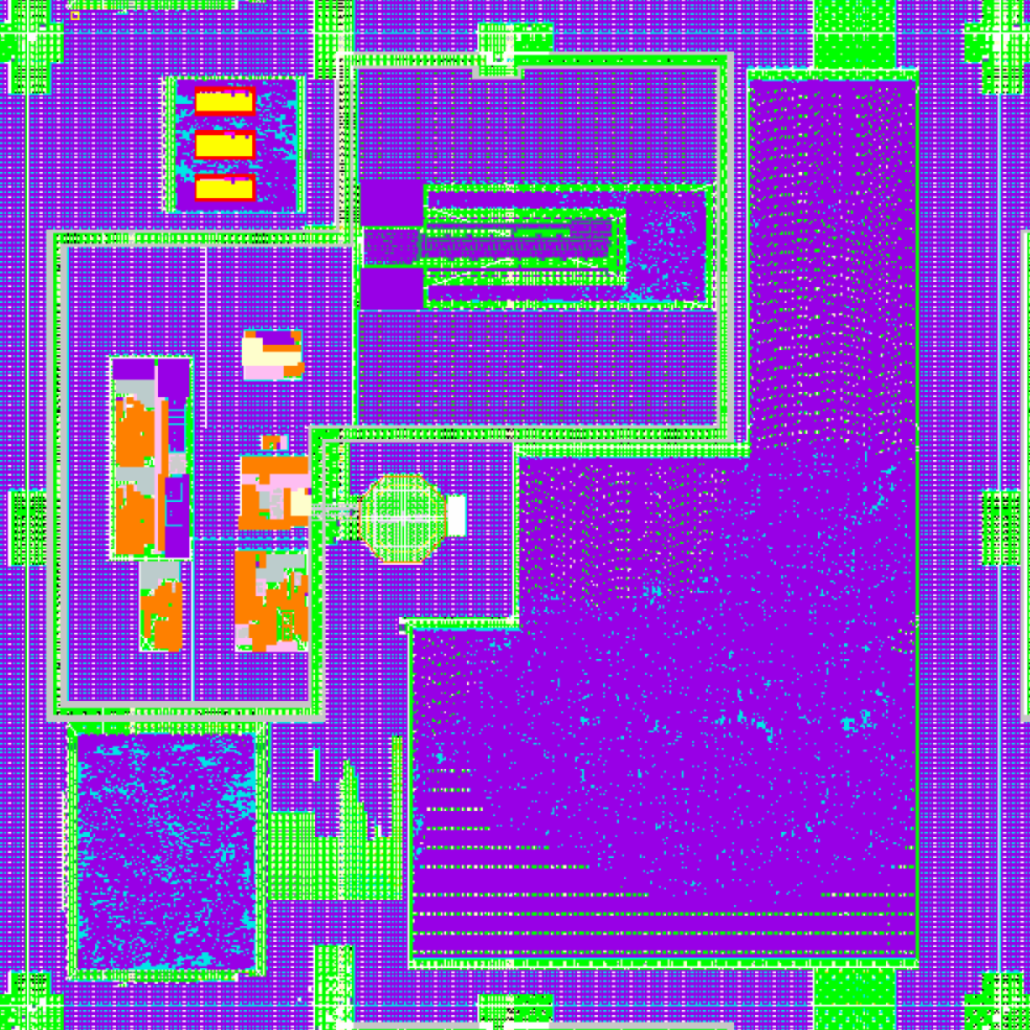
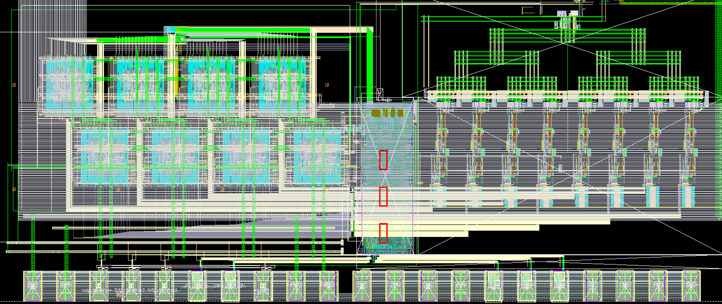
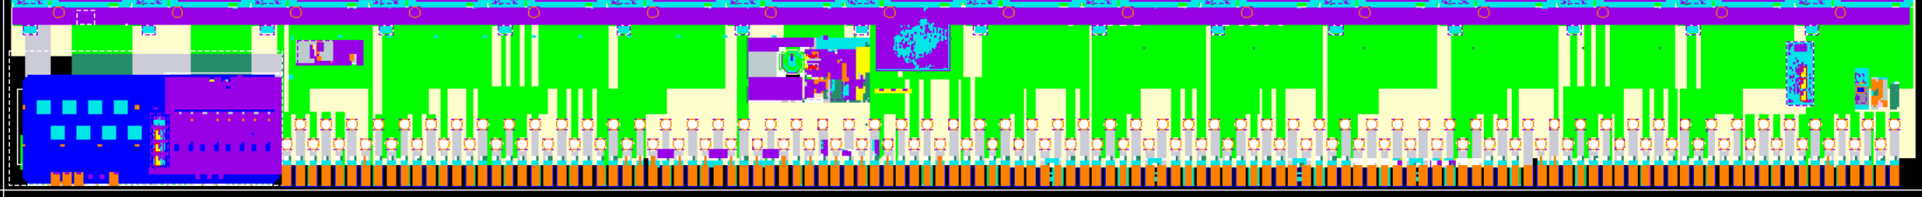
Completed ETROC2 Layout
TDC
Discri.
PreAmp
Pixel Readout
VRef
PLL
Global Digital
I2C
EFuse
Temp
Sensor
GRO
WS

Slide 23
Summary
A 2.56GS/s 12-bit waveform sampler has been implemented and validated in 65nm CMOS
The WS along with the clock driver has been integrated in ETROC2
TID testing is not performed yet due to covid. Will be done after ETROC2 chip submission.
More details about this work:
L. Fang, X. Wen, T. Fu, G. Wang, S. Miryala, T. Liu and P. Gui, “A 2.56 GS/s 12-bit 8x-Interleaved ADC with 156.6 dB FoMs in 65 nm CMOS”, IEEE Transactions on Very Large Scale Integration (VLSI) Systems, vol. 30, no. 2, pp. 123-133, Feb. 2022.

Slide 24
Acknowledgement
CERN ASIC Support Team on the memory design and Implementation
  Marco Andorno, Alessandro Caratelli, and Kostas Kloukinas
US Department of Energy for the funding of this work
Thank you for your attention!

