Slide 1
An FPGA-based readout chip emulator for the CMS ETL detector upgrade
L. Zhang,¹ C. Edwards,² D. Gong,² X. Huang,¹ J. Lee,³ C. Liu,¹ T. Liu,¹ T. Liu,² J. Olsen,² Q. Sun,² J. Wu,² J. Ye,¹ and W. Zhang¹
¹ Southern Methodist University, ² Fermi National Accelerator Laboratory, ³ University of Illinois Chicago
TWEPP 2022 Topical Workshop on Electronics for Particle Physics
Bergen, Norway, September 21, 2022

Slide 2
Outline
Introduction of the CMS MTD ETL
Motivation of the ETROC emulator
Hardware design and testing of the ETROC Emulator
Design and verification of fast commands
Design and verification of pixel data readout
Summary

Slide 3
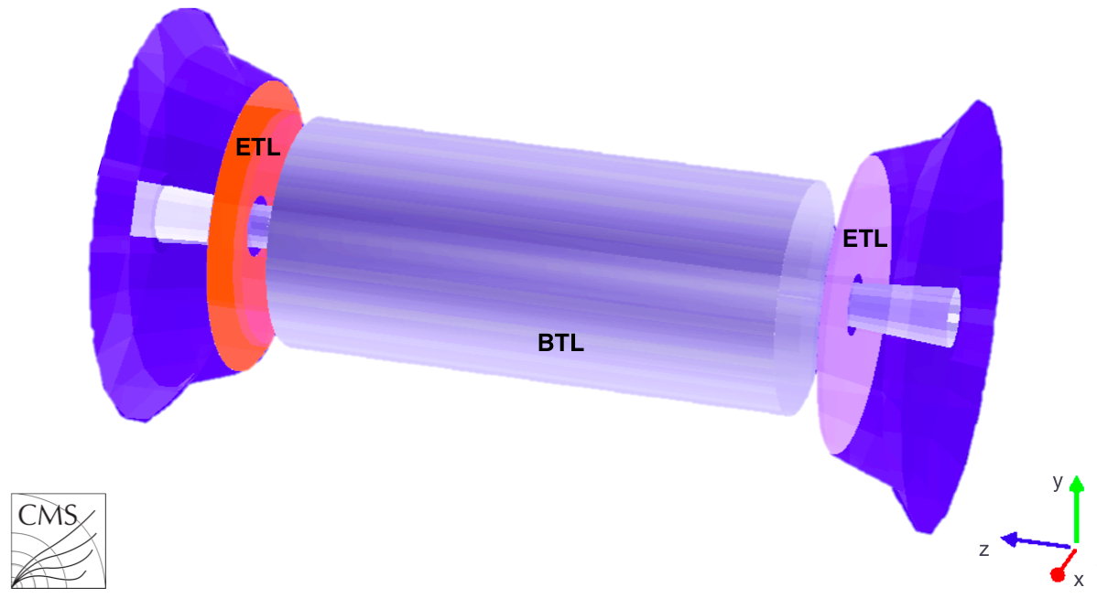
Introduction of CMS MTD ETL
The CMS MIP Timing Detector (MTD), including Barrel Layer (BTL) and Endcap-Timing Layer (ETL), is under development for the HL-LHC upgrade.
Two ETL disks per endcap will be mounted.
  About 3 m from the interaction point
  315 < r < 1200 mm
  Surface ~ 14 m²; ~ 9 M channels
ETLs use Low-Gain Avalanche Detector (LGADs)
  Each LAGD has 16 ✕ 16 pixels
  Each pixel is 1.3 mm ✕ 1.3 mm
  An LGAD is bump-bonded to a readout ASIC called ETROC (see next slide)
  Each ETROC reads out 16 ✕ 16 pixels
  2 hits per track, 50 ps res. per hit, 35 ps per track

Slide 4
Introduction of ETROC
16 columns, 20.8 mm
An Endcap Timing Read-Out Chip (ETROC) [1] is being developed for the CMS MIP Timing Detector (MTD)
Each pixel has a Trans-Impedance Amplifier (pre-amplifier), a discriminator whose threshold can be programmed with a Digital-to-Analog Converter (DAC), a Time-to-Digital Converter (TDC) [2], and buffers.
The global readout logic circuit has a Phase-Locked Loop (PLL), a fast command decoder, a digital readout logic circuit, and an I2C target module.
16 rows, 20.8 mm
Q injector
Discriminator
PA
TDC
Bump pad
DAC
MUX
Buf
Test pattern gen
1.2 mm
PLL
Fast command decoder
Readout logic
I2C target
[1] Ted Liu’s talk on ETROC on Sep. 20, 2:20 PM
[2] Jinyuan Wu’s talk on TDC on Sep. 22, 11:20 AM
CLK40
FC
DOL
DOR
I2C

Slide 5
Motivation of ETROC Emulator
ETROC Module
ETROC emulator
Multiple ETROCs are connected to a readout board.
Each readout board consists of a VTRx+ module, two lpGBT chips, and a GBT SCA.
Using optical fibers, the VTRx+ module communicates with the off-detector Data Acquisition (DAQ) board.
The 1st lpGBT recovers clocks and fast commands for the ETROCs, while both lpGBT chips transmit the data from ETROCs to the DAQ board.
The GBT SCA provides slow control of the ETROCs.
A power board is mounted to the readout board to provide supply voltages.
The ETROC emulator would allow us
  Verify ETROC digital design in an FPGA
  Decouple system development from the ETROC development
  Optimize system development at an earlier stage
ETROC
ASIC
FPGA
Readout board
lpGBT2
CLK
lpGBT1
GBT SCA
Power board
EC
VTRx+
fibers
DAQ

Slide 6
Block diagram of ETROC Emulator
SMA
ETROC Emulator
DAQ emulator
40M
14 pair twinax
14 pair twinax
Each Emulator uses an Intel Cyclone 10 GX FPGA 10CX220YF780E5G to emulate the functions of 4 ETROC chips.
To ease the hardware/firmware test, we also emulate the counterparts located on the readout board and the DAQ board.
To generate four clock outputs, we use a clock fanout chip.
CLKin
Fan out
PLL
PLL
PLL
FCout
FCin
Command decoder
Command generator
Lout/Rout
Lin/Rin
Readout logic
PLL
Data checker
SCL/SDA/RSTBn
24 pin ribbon
24 pin ribbon
I2C target
I2C controller
SCL/SDA/RSTn
FPGA
1.2V
mon
flash
DC-DC/LDOs
JTAG
Emulator Board

Slide 7
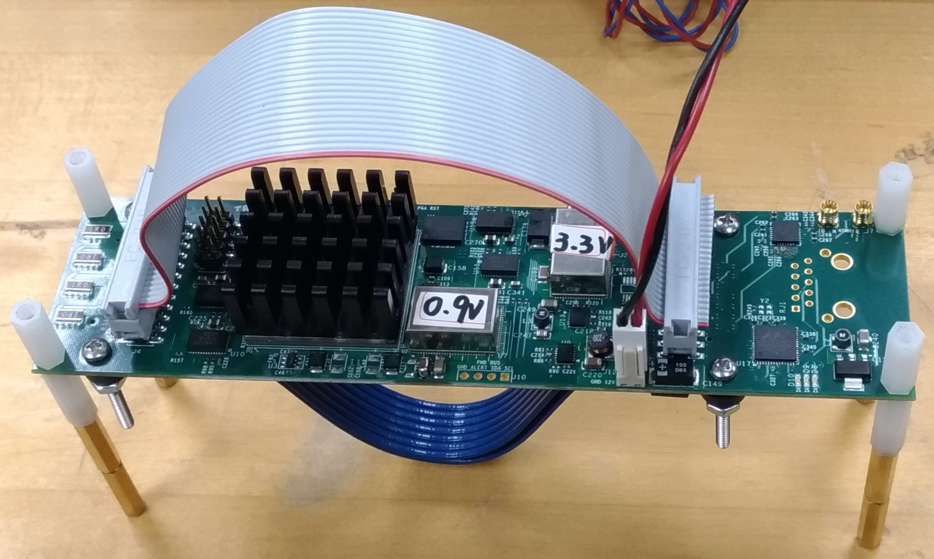
Board photograph
The PCB has 10 layers.
The Emulator is 165 mm long and 43 mm wide. The width of the emulator matches that of the ETROC modules.
The Emulator uses a single 12 V power supply.
The Emulator has a flat ribbon cable for slow control signals and a Twinax cable for fast differential signals.
The emulator has a pair of clock inputs.
Flat ribbon cable
for I2C signals
MMCX connector for 40MHz test clock
43 mm
165 mm
Cyclone 10 GX w/ heat sink
twinax cable for clocks,
fast commands and data
12V power connector

Slide 8
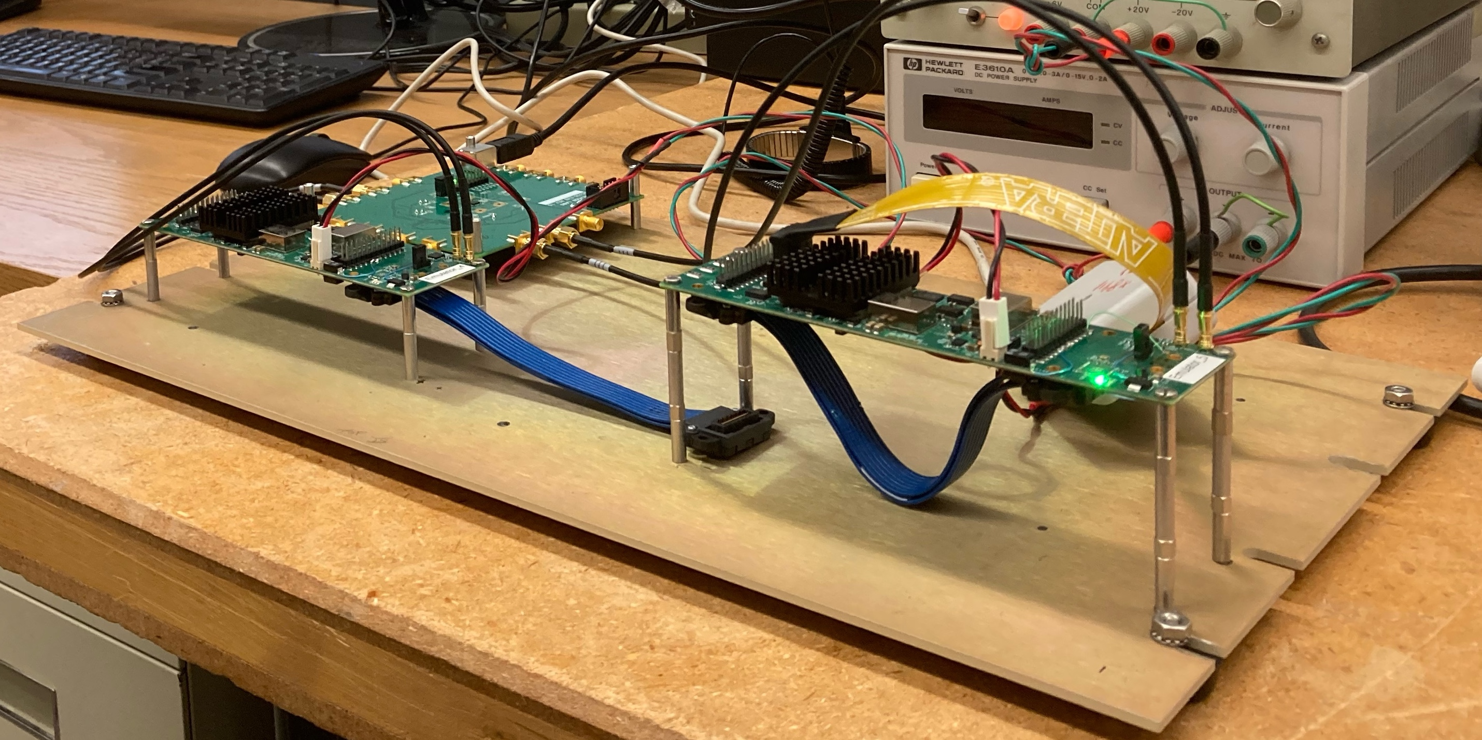
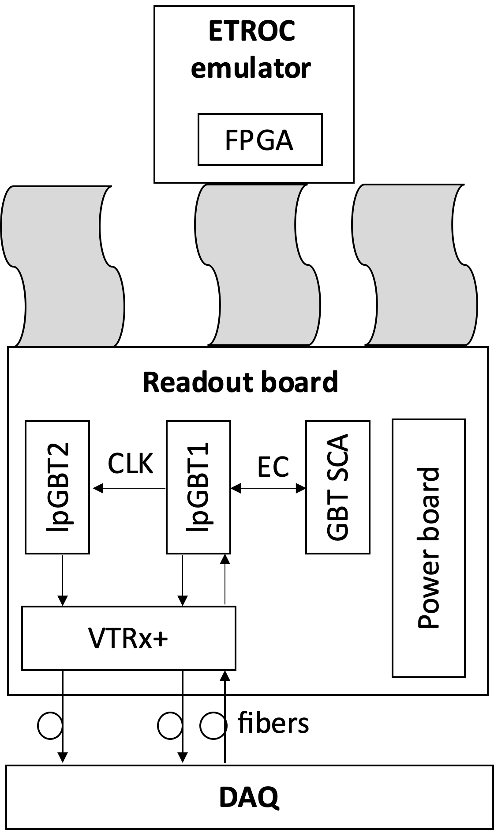
ETROC Emulator Testing
The emulator may work in a self-loopback mode.
Or may interconnect together to emulate the readout system.
Fast
Command
Readout
DATA

Slide 9
Fast command definition
Bit 7 | Bit 6 | Bit 5 | Bit 4 | Bit 3 | Bit 2 | Bit 1 | Bit 0 | meaning
1 | 1 | 1 | 1 | 0 | 0 | 0 | 0 | Idle
0 | 0 | 1 | 1 | 0 | 0 | 1 | 1 | Link reset
0 | 1 | 0 | 1 | 1 | 0 | 1 | 0 | BCR (Bunch counter reset at BC0, reset the counter to zero)
0 | 1 | 0 | 1 | 0 | 1 | 0 | 1 | Sync for trigger path
0 | 1 | 1 | 0 | 0 | 1 | 1 | 0 | L1A-CR(counter reset)
0 | 1 | 1 | 0 | 1 | 0 | 0 | 1 | Charge injection
1 | 0 | 0 | 1 | 0 | 1 | 1 | 0 | L1A
1 | 0 | 0 | 1 | 1 | 0 | 0 | 1 | L1A & BCR
1 | 0 | 1 | 0 | 0 | 1 | 0 | 1 | WS Start
1 | 0 | 1 | 0 | 1 | 0 | 1 | 0 | WS Stop
Other combinations currently are NOT used in ETROC2 |  |  |  |  |  |  |  | ETROC2 will ignore other combinations
Fast
Command
Readout
DATA
Only four commands are generated in the current firmware.
  Idle: no command is sent. Used for alignment as well.
  BCR: resets the bunch crossing counter, which rounds back after 3564 * 25ns (default).
  L1A: Level-1 trigger acceptance
  L1A & BCR
A complete command decoder is implemented in the firmware. The Emulator can accept all commands from the readout board.
Sept. 2022
ETRCO Emulator
9

Slide 10
Fast command in logic analyzer
BCR 8’H5A
L1A 8’H96
fast commands | Binary |  |  |  |  |  |  |  | hex
 | Bit 7 | Bit 6 | Bit 5 | Bit 4 | Bit 3 | Bit 2 | Bit 1 | Bit 0
IDEL | 1 | 1 | 1 | 1 | 0 | 0 | 0 | 0 | F0
BCR | 0 | 1 | 0 | 1 | 1 | 0 | 1 | 0 | 5A
L1A | 1 | 0 | 0 | 1 | 0 | 1 | 1 | 0 | 96
L1A & BCR | 1 | 0 | 0 | 1 | 1 | 0 | 0 | 1 | 99
IDLE 8’HF0

Slide 11
Data flow
Switching
Cell
Switching
Cell
Switching
Cell
Fast
Command
Readout
DATA
Switching
Cell
Switching
Cell
Switching
Cell
Switching
Cell
Switching
Cell
Switching
Cell
Switching
Cell
Switching
Cell
Switching
Cell
A pixel transmits its data before its upstream neighbor if it is not empty. The data pass through the pixels with empty data and propagate downstream
The control signals propagate in the opposite direction.
Switching
Cell
Switching
Cell
Switching
Cell
Clock Cycle 1
Clock Cycle 2
Clock Cycle 3

Slide 12
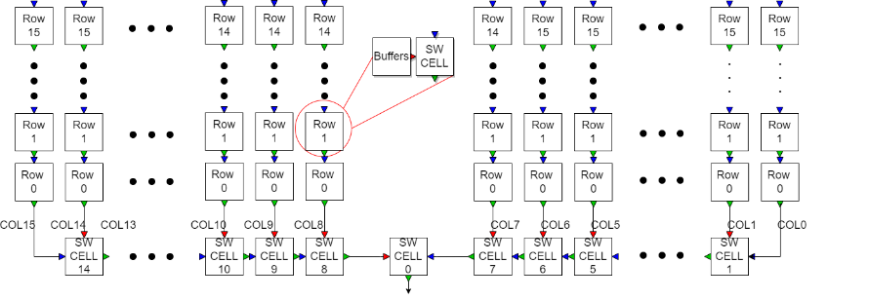
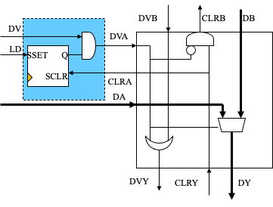

Data flow inside ETROC
The top of this block diagram is a 16x16 pixel array. Each pixel has a test pattern generator, a circular buffer, an event buffer, and a switching cell. The switching cells in each column control the data transferring order.
At the bottom of the pixel array, we use extra 15 switching cells to deliver the data to a global readout.

Slide 13
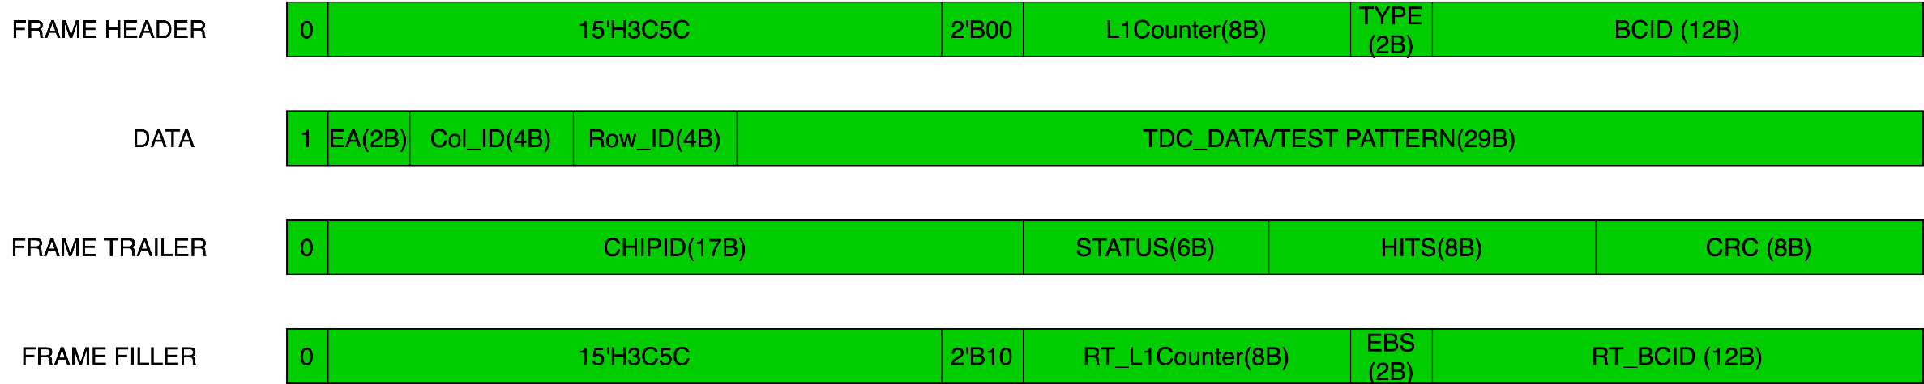
ETROC2 frame definition
A regular data frame composes of a header, variable (0-256) pixel data words, and a trailer.
When there is no hit available, a filler is sent.
Each header, data word, trailer, or filler has 40 bits.
EA |  | meaning
0 | 0 | no error
0 | 1 | single bit error, but corrected
1 | 0 | two or more bit error and no correction
1 | 1 | Reserved
Type |  | meaning
0 | 0 | regular data
0 | 1 | random test pattern
1 | 0 | counter test pattern
1 | 1 | reserved
Status |  |  |  |  |  | meaning
 |  |  |  |  | X | The L1 event buffer is full, and events may be lost
 |  |  |  | X |  | The L1 Event buffer is almost full (# of hits in the buffer >= 96). The threshold can be user defined.
 |  |  | X |  |  | L1 Event buffer half full (# of hits in the buffer is >= 64)
 |  | X |  |  |  | single bit error occurs, but is corrected in least one pixel (OR EA[0] of all hit pixels)
 | x |  |  |  |  | 2 or more bits error occurs and is not corrected in least one pixel (OR EA[0] of all hit pixels)
x |  |  |  |  |  | reserved
EBS |  | meaning (2 MSB of the number of hits left in the event buffer)
0 | 0 | Hits in the L1 event buffer is less than 32
0 | 1 | Hits in the L1 event buffer is from 32 to 63
1 | 0 | Hits in the L1 event buffer is from 64 to 95
1 | 1 | Hits in the L1 event buffer is larger than 96

Slide 14
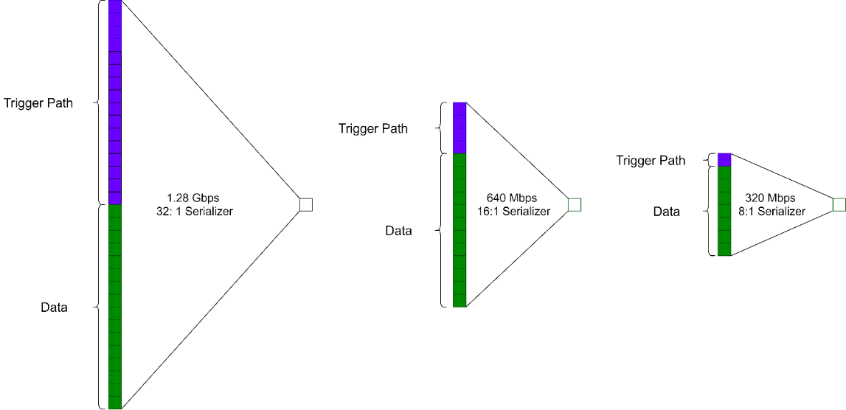
Integrated trigger path
The trigger data and the pixel data can share the output bandwidth. The trigger/data ratio is programmable.
The granularity of trigger signals is programmable: the whole chip is divided into 4x4, 2x2, 2x1, or 1x1 blocks.
15
11
7
3
3
1
1
0
14
10
6
2
13
9
5
1
2
0
12
8
4
0

Slide 15
Data + trigger
Data word
(40 bits/word)
16 bits
24 bits
0x3c5c (for fillers)
Trigger
(n bit/25 ns)
Chop and Merge
Bit Stream
Consider at 320 Mb/s, 1 (or n) trigger bit is to be transmitted every 25 ns, then 7 (or 8-n) bits can be used to transmit data/header/trailer/filler.
The 40-bit data words are chopped into segments 7 (or 8-n) bits each.
On the receiving side:
  The position of trigger bits is unknown
  The boundary of data words is unknown
Received
Contents

Slide 16
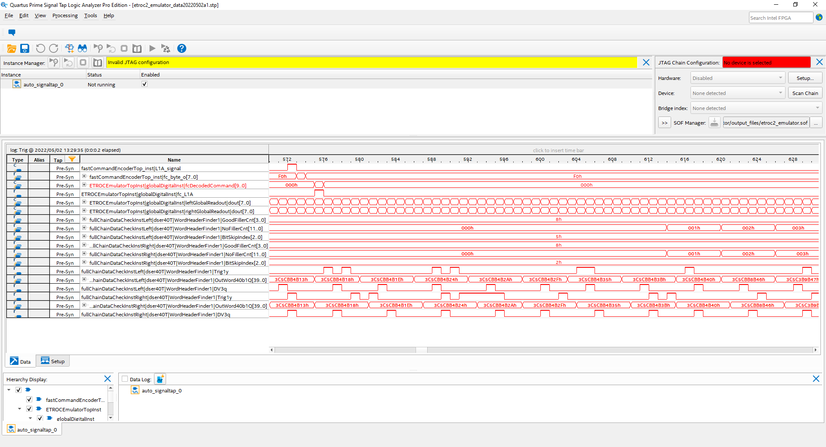
Firmware Alignment, Signal Tap Output
TRIG (left)
Word40b (left)
DV (left)
TRIG (right)
Word40b (right)
DV (right)

Slide 17
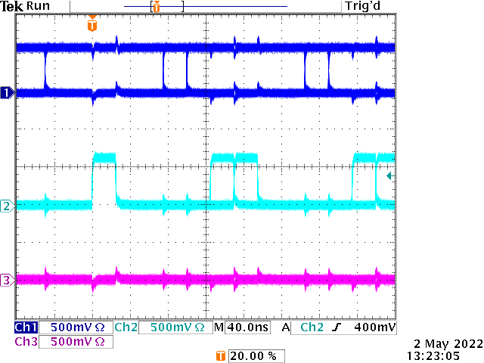
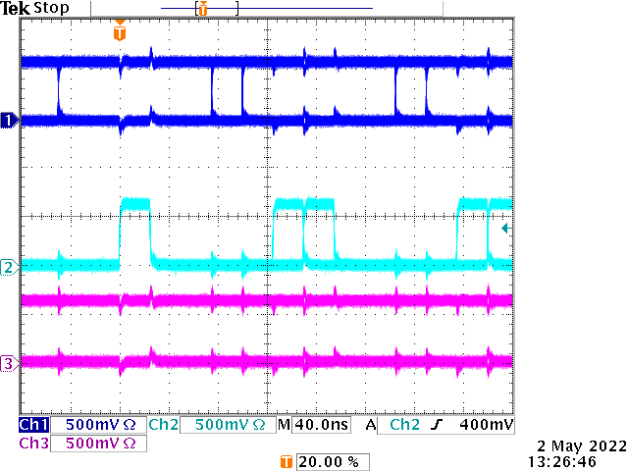
Oscilloscope Screenshots
Word40b
Word40b
DV
DV
BAD
BAD
A few signals can be brought out of the FPGA so that we can monitor the operation.
The misalignment signal (BAD) has been monitored over many hours without errors.
Long-term running in FPGA is planned, which helps to catch problems that may not be seen in simulation.

Slide 18
Summary
An ETROC emulator has been designed to decouple the ASIC development and the system tests and to verify the readout logic.
The emulator board has been tested and released.
A simplified version of firmware with the latest fast command and output data format has been implemented in the emulator and tested with loopback cables or with two emulator boards. The firmware is growing and is being improved.
The emulator is being used in the system development.

Slide 19
Extra slides

Slide 20
Block Diagram
Sync
Ctrl
NoFillerCnt12b
ClkCnt3b
==
BitSkipIndex3b
GoodFillerCnt4b
RE-
SYNC
Skip
(The current bit is the trigger bit.
The Shift Register is skipping this bit.)
Descrambler
&&
BitCntTMP6b
== 3C5C
== 3C5C
== 3C5C
== 3C5C
Shifter Register 161 bits
(4x40 bits + 1 pipeline stage)
BitCnt6b
RAM
Buffer
== 39
320 MHz
Software
40 MHz
TRIG
word40b
DV
All 8 trigger bit positions are assumed and checked.
Bit patterns with at least 4 fillers/header aligned are used to find data word boundary.
Note that a data valid signal DV is required.

Slide 21
Overall block diagram
TDCs
Mux
Circular buffers
Event buffers
Switch network
Frame builder
Test pattern generators
Data stream buffer
Serializer
deserializer
Data extractor
Data checker
The data are generated either from a Time-to-Digital Converter (TDC) or a test pattern generator.
The Time of Arrival, Time Over Threshold, and a Calibration code are measured in TDCs, as well as a Dada Valid bit.
Pixel data are stored in circular buffers every bunch crossing.
Once an L1A is asserted, the data stored in circular buffers are transferred to an L1A event buffer.
A switching network transmits the trigger-selected data of all channels to a global data stream buffer.
The data in the global data stream buffer are encoded into frames and serialized into a serial bitstream.
On the receiver side, the serial bit stream is deserialized. After the frame boundary is identified, the data are extracted and checked.

Slide 22
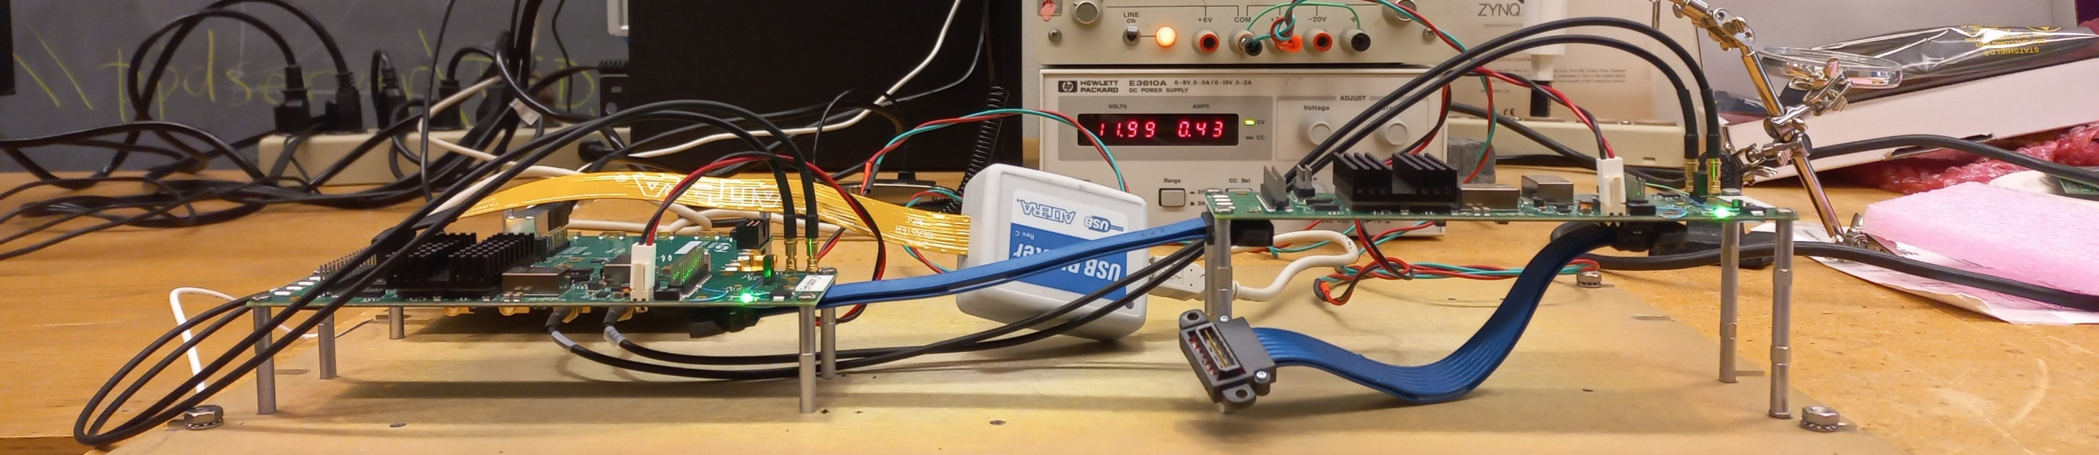
Test ongoing
A test of the connection between two emulator boards, one to emulate the RB and the other one to emulate ETROC, is ongoing at FNAL and SMU.
Setup at FNAL
RB emulator
ETROC emulator

Slide 23
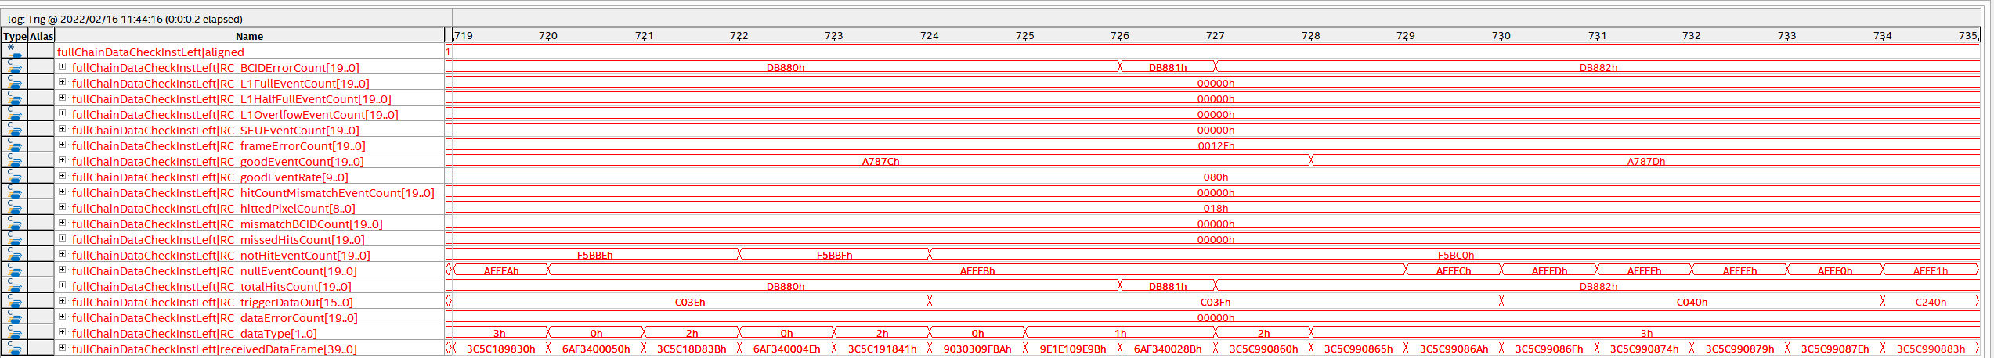
Logic analyzer results
BCID error count (memory bypass)
Full/half full/overflow event counts
SEU event (Hamming code error) counts
Frame error count
Good event count
Hit count mismatch
Hit pixel count (only 24 pixels)
Not hit event count
Missed hit count
Total hit count
Null event count
Trigger data out
Data error count
Data type
Header
Trailer
Header
Trailer
Header
Data
Trailer
Filler

Slide 24
Frame headers
Bit# | 39 | 38 | 37 | 36 | 35 | 34 | 33 | 32 | 31 | 30 | 29 | 28 | 27 | 26 | 25 | 24 | 23 | 22 | 21 | 20 | 19 | 18 | 17 | 16 | 15 | 14 | 13 | 12 | 11 | 10 | 9 | 8 | 7 | 6 | 5 | 4 | 3 | 2 | 1 | 0
header | 0 | 15'H3C5C |  |  |  |  |  |  |  |  |  |  |  |  |  |  | 2'B00 |  | L1counter, 8b |  |  |  |  |  |  |  | Typ2b |  | BCID, 12b
bin | 0 | 0 | 1 | 1 | 1 | 1 | 0 | 0 | 0 | 1 | 0 | 1 | 1 | 1 | 0 | 0 | 0 | 0 | 0 | 1 | 1 | 0 | 0 | 0 | 1 | 0 | 0 | 1 | 1 | 0 | 0 | 0 | 0 | 0 | 1 | 1 | 0 | 0 | 0 | 0
hex | 3 |  |  |  | C |  |  |  | 5 |  |  |  | C |  |  |  | 1 |  |  |  | 8 |  |  |  | 9 |  |  |  | 8 |  |  |  | 3 |  |  |  | 0
Type 01 random pattern L1counter 98
BCID 2096
Header
Trailer
Header
Trailer
Header
Data
Trailer
Filler
Bit# | 39 | 38 | 37 | 36 | 35 | 34 | 33 | 32 | 31 | 30 | 29 | 28 | 27 | 26 | 25 | 24 | 23 | 22 | 21 | 20 | 19 | 18 | 17 | 16 | 15 | 14 | 13 | 12 | 11 | 10 | 9 | 8 | 7 | 6 | 5 | 4 | 3 | 2 | 1 | 0
header | 0 | 15'H3C5C |  |  |  |  |  |  |  |  |  |  |  |  |  |  | 2'B00 |  | L1counter, 8b |  |  |  |  |  |  |  | Typ2b |  | BCID, 12b
bin | 0 | 0 | 1 | 1 | 1 | 1 | 0 | 0 | 0 | 1 | 0 | 1 | 1 | 1 | 0 | 0 | 0 | 0 | 0 | 1 | 1 | 0 | 0 | 0 | 1 | 1 | 0 | 1 | 1 | 0 | 0 | 0 | 0 | 0 | 1 | 1 | 1 | 0 | 1 | 1
hex | 3 |  |  |  | C |  |  |  | 5 |  |  |  | C |  |  |  | 1 |  |  |  | 8 |  |  |  | D |  |  |  | 8 |  |  |  | 3 |  |  |  | B
Type 01 random pattern
L1counter 99
BCID 2107
Bit# | 39 | 38 | 37 | 36 | 35 | 34 | 33 | 32 | 31 | 30 | 29 | 28 | 27 | 26 | 25 | 24 | 23 | 22 | 21 | 20 | 19 | 18 | 17 | 16 | 15 | 14 | 13 | 12 | 11 | 10 | 9 | 8 | 7 | 6 | 5 | 4 | 3 | 2 | 1 | 0
header | 0 | 15'H3C5C |  |  |  |  |  |  |  |  |  |  |  |  |  |  | 2'B00 |  | L1counter, 8b |  |  |  |  |  |  |  | Typ2b |  | BCID, 12b
bin | 0 | 0 | 1 | 1 | 1 | 1 | 0 | 0 | 0 | 1 | 0 | 1 | 1 | 1 | 0 | 0 | 0 | 0 | 0 | 1 | 1 | 0 | 0 | 1 | 0 | 0 | 0 | 1 | 1 | 0 | 0 | 0 | 0 | 1 | 0 | 0 | 0 | 0 | 0 | 1
hex | 3 |  |  |  | C |  |  |  | 5 |  |  |  | C |  |  |  | 1 |  |  |  | 9 |  |  |  | 1 |  |  |  | 8 |  |  |  | 4 |  |  |  | 1
Type 01 random pattern
L1counter 100
BCID 2113

Slide 25
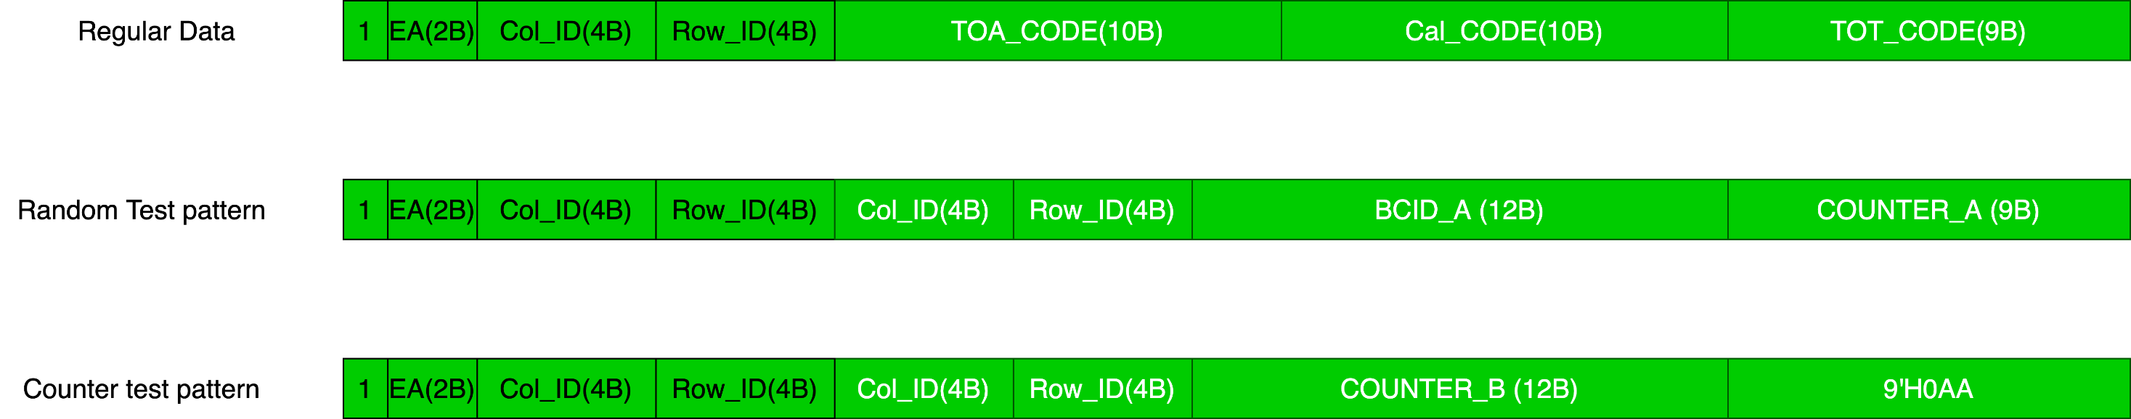


Pixel data word definition
The test pattern is fake data generated in each pixel. Only L1 selected hits are included in the data frame. The pixel is hit or not is randomly determined with a programmable occupancy.
Pixel column and row are repeated in the test pattern.
The data of different pixels in a frame have same BCID.
Counter_A increases if the pixel is hit and accepted by the L1A. In other words, Counter_A is a consecutive count (0, 1, 2, …) for each pixel on the receiver side.
Counter_B in the data field increases 41 (default) for each data frame.

Slide 26
Frame data
Column 8
Row 1
BCID 2127
Counter 442
Bit# | 39 | 38 | 37 | 36 | 35 | 34 | 33 | 32 | 31 | 30 | 29 | 28 | 27 | 26 | 25 | 24 | 23 | 22 | 21 | 20 | 19 | 18 | 17 | 16 | 15 | 14 | 13 | 12 | 11 | 10 | 9 | 8 | 7 | 6 | 5 | 4 | 3 | 2 | 1 | 0
data | 1 | EA, 2b |  | Col, 4b |  |  |  | row, 4b |  |  |  | Col, 4b |  |  |  | row, 4b |  |  |  | BCID, 12b |  |  |  |  |  |  |  |  |  |  |  | counter, 9b
bin | 1 | 0 | 0 | 1 | 0 | 0 | 0 | 0 | 0 | 0 | 1 | 1 | 0 | 0 | 0 | 0 | 0 | 0 | 1 | 1 | 0 | 0 | 0 | 0 | 1 | 0 | 0 | 1 | 1 | 1 | 1 | 1 | 1 | 0 | 1 | 1 | 1 | 0 | 1 | 0
hex | 9 |  |  |  | 0 |  |  |  | 3 |  |  |  | 0 |  |  |  | 3 |  |  |  | 0 |  |  |  | 9 |  |  |  | F |  |  |  | B |  |  |  | A
Header
Trailer
Header
Trailer
Header
Data
Trailer
Filler
Bit# | 39 | 38 | 37 | 36 | 35 | 34 | 33 | 32 | 31 | 30 | 29 | 28 | 27 | 26 | 25 | 24 | 23 | 22 | 21 | 20 | 19 | 18 | 17 | 16 | 15 | 14 | 13 | 12 | 11 | 10 | 9 | 8 | 7 | 6 | 5 | 4 | 3 | 2 | 1 | 0
data | 1 | EA, 2b |  | Col, 4b |  |  |  | row, 4b |  |  |  | Col, 4b |  |  |  | row, 4b |  |  |  | BCID, 12b |  |  |  |  |  |  |  |  |  |  |  | counter, 9b
bin | 1 | 0 | 0 | 1 | 1 | 1 | 1 | 0 | 0 | 0 | 0 | 1 | 1 | 1 | 1 | 0 | 0 | 0 | 0 | 1 | 0 | 0 | 0 | 0 | 1 | 0 | 0 | 1 | 1 | 1 | 1 | 0 | 1 | 0 | 0 | 1 | 1 | 0 | 1 | 1
hex | 9 |  |  |  | E |  |  |  | 1 |  |  |  | E |  |  |  | 1 |  |  |  | 0 |  |  |  | 9 |  |  |  | E |  |  |  | 9 |  |  |  | B
Column 15
Row 0
BCID 2127
Counter 155

Slide 27
Frame trailers
Bit# | 39 | 38 | 37 | 36 | 35 | 34 | 33 | 32 | 31 | 30 | 29 | 28 | 27 | 26 | 25 | 24 | 23 | 22 | 21 | 20 | 19 | 18 | 17 | 16 | 15 | 14 | 13 | 12 | 11 | 10 | 9 | 8 | 7 | 6 | 5 | 4 | 3 | 2 | 1 | 0
trailer | 0 | Chip ID loaded from e-fuses, 17b |  |  |  |  |  |  |  |  |  |  |  |  |  |  |  |  | Status, 6b |  |  |  |  |  | # of Hits, 8b |  |  |  |  |  |  |  | CRC, 8b
bin | 0 | 1 | 1 | 0 | 1 | 0 | 1 | 0 | 1 | 1 | 1 | 1 | 0 | 0 | 1 | 1 | 0 | 1 | 0 | 0 | 0 | 0 | 0 | 0 | 0 | 0 | 0 | 0 | 0 | 0 | 0 | 0 | 0 | 1 | 0 | 1 | 0 | 0 | 0 | 0
hex | 6 |  |  |  | A |  |  |  | F |  |  |  | 3 |  |  |  | 4 |  |  |  | 0 |  |  |  | 0 |  |  |  | 0 |  |  |  | 5 |  |  |  | 0
Chip ID 17’H1ABCD
Status 0 (no error, not full)
# of hits 0
Header
Trailer
Header
Trailer
Header
Data
Trailer
Filler
Bit# | 39 | 38 | 37 | 36 | 35 | 34 | 33 | 32 | 31 | 30 | 29 | 28 | 27 | 26 | 25 | 24 | 23 | 22 | 21 | 20 | 19 | 18 | 17 | 16 | 15 | 14 | 13 | 12 | 11 | 10 | 9 | 8 | 7 | 6 | 5 | 4 | 3 | 2 | 1 | 0
trailer | 0 | Chip ID loaded from e-fuses, 17b |  |  |  |  |  |  |  |  |  |  |  |  |  |  |  |  | Status, 6b |  |  |  |  |  | # of Hits, 8b |  |  |  |  |  |  |  | CRC, 8b
bin | 0 | 1 | 1 | 0 | 1 | 0 | 1 | 0 | 1 | 1 | 1 | 1 | 0 | 0 | 1 | 1 | 0 | 1 | 0 | 0 | 0 | 0 | 0 | 0 | 0 | 0 | 0 | 0 | 0 | 0 | 1 | 0 | 1 | 0 | 0 | 0 | 1 | 0 | 1 | 1
hex | 6 |  |  |  | A |  |  |  | F |  |  |  | 3 |  |  |  | 4 |  |  |  | 0 |  |  |  | 0 |  |  |  | 2 |  |  |  | 8 |  |  |  | B
Chip ID 17’H1ABCD
Status 0 (no error, not full)
# of hits 2

Slide 28
Frame fillers
Bit# | 39 | 38 | 37 | 36 | 35 | 34 | 33 | 32 | 31 | 30 | 29 | 28 | 27 | 26 | 25 | 24 | 23 | 22 | 21 | 20 | 19 | 18 | 17 | 16 | 15 | 14 | 13 | 12 | 11 | 10 | 9 | 8 | 7 | 6 | 5 | 4 | 3 | 2 | 1 | 0
filler | 0 | 15'H3C5C |  |  |  |  |  |  |  |  |  |  |  |  |  |  | 2'B10 |  | RT L1counter, 8b |  |  |  |  |  |  |  | EBS, 2b |  | RT BCID, 12b
bin | 0 | 0 | 1 | 1 | 1 | 1 | 0 | 0 | 0 | 1 | 0 | 1 | 1 | 1 | 0 | 0 | 1 | 0 | 0 | 1 | 1 | 0 | 0 | 1 | 0 | 0 | 0 | 0 | 1 | 0 | 0 | 0 | 0 | 1 | 1 | 0 | 0 | 0 | 0 | 0
hex | 3 |  |  |  | C |  |  |  | 5 |  |  |  | C |  |  |  | 9 |  |  |  | 9 |  |  |  | 0 |  |  |  | 8 |  |  |  | 6 |  |  |  | 0
RT L1 counter 100
EBS 00 (L1buffer < 32)
RT BCID 2144
Header
Trailer
Header
Trailer
Header
Data
Trailer
Filler
Bit# | 39 | 38 | 37 | 36 | 35 | 34 | 33 | 32 | 31 | 30 | 29 | 28 | 27 | 26 | 25 | 24 | 23 | 22 | 21 | 20 | 19 | 18 | 17 | 16 | 15 | 14 | 13 | 12 | 11 | 10 | 9 | 8 | 7 | 6 | 5 | 4 | 3 | 2 | 1 | 0
filler | 0 | 15'H3C5C |  |  |  |  |  |  |  |  |  |  |  |  |  |  | 2'B10 |  | RT L1counter, 8b |  |  |  |  |  |  |  | EBS, 2b |  | RT BCID, 12b
bin | 0 | 0 | 1 | 1 | 1 | 1 | 0 | 0 | 0 | 1 | 0 | 1 | 1 | 1 | 0 | 0 | 1 | 0 | 0 | 1 | 1 | 0 | 0 | 1 | 0 | 0 | 0 | 0 | 1 | 0 | 0 | 0 | 0 | 1 | 1 | 0 | 0 | 1 | 0 | 1
hex | 3 |  |  |  | C |  |  |  | 5 |  |  |  | C |  |  |  | 9 |  |  |  | 9 |  |  |  | 0 |  |  |  | 8 |  |  |  | 6 |  |  |  | 5
RT L1 counter 100
EBS 00 (L1buffer < 32)
RT BCID 2149

