Slide 1
System development of Silicon Photonics links for CERN Experiments and Accelerators
Carmelo Scarcella, S. Detraz, M. Lalovic, L. Marcon, L. Olantera,
T. Prousalidi, U. Sandven, C. Sigaud, C. Soos, J. Troska
CERN EP-ESE-BE
22nd September 2022
TWEPP 2022
carmelo.scarcella@cern.ch

Slide 2
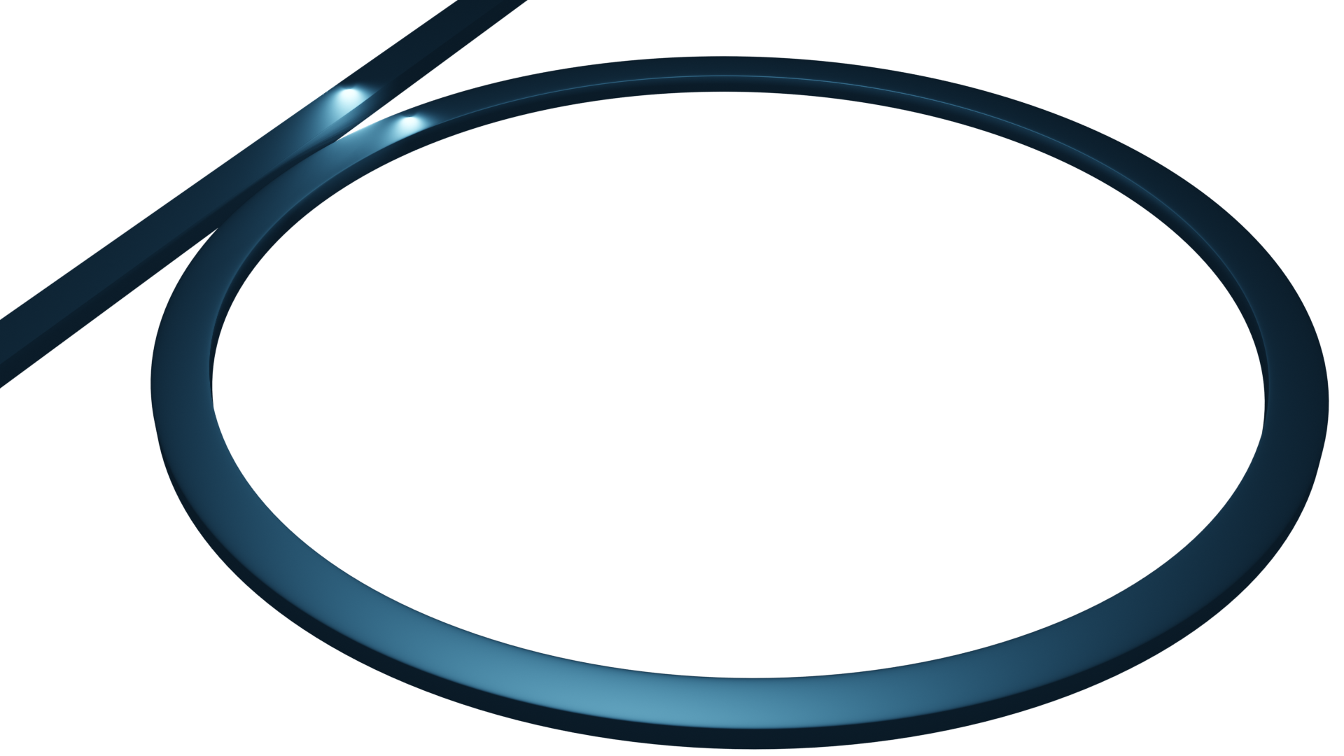
Future high-speed links for High Energy Physics at CERN
Silicon Photonics as promising technology
Experimental results on µ-ring optical modulators
Future activity
carmelo.scarcella@cern.ch
TWEPP 2022
2

Slide 3
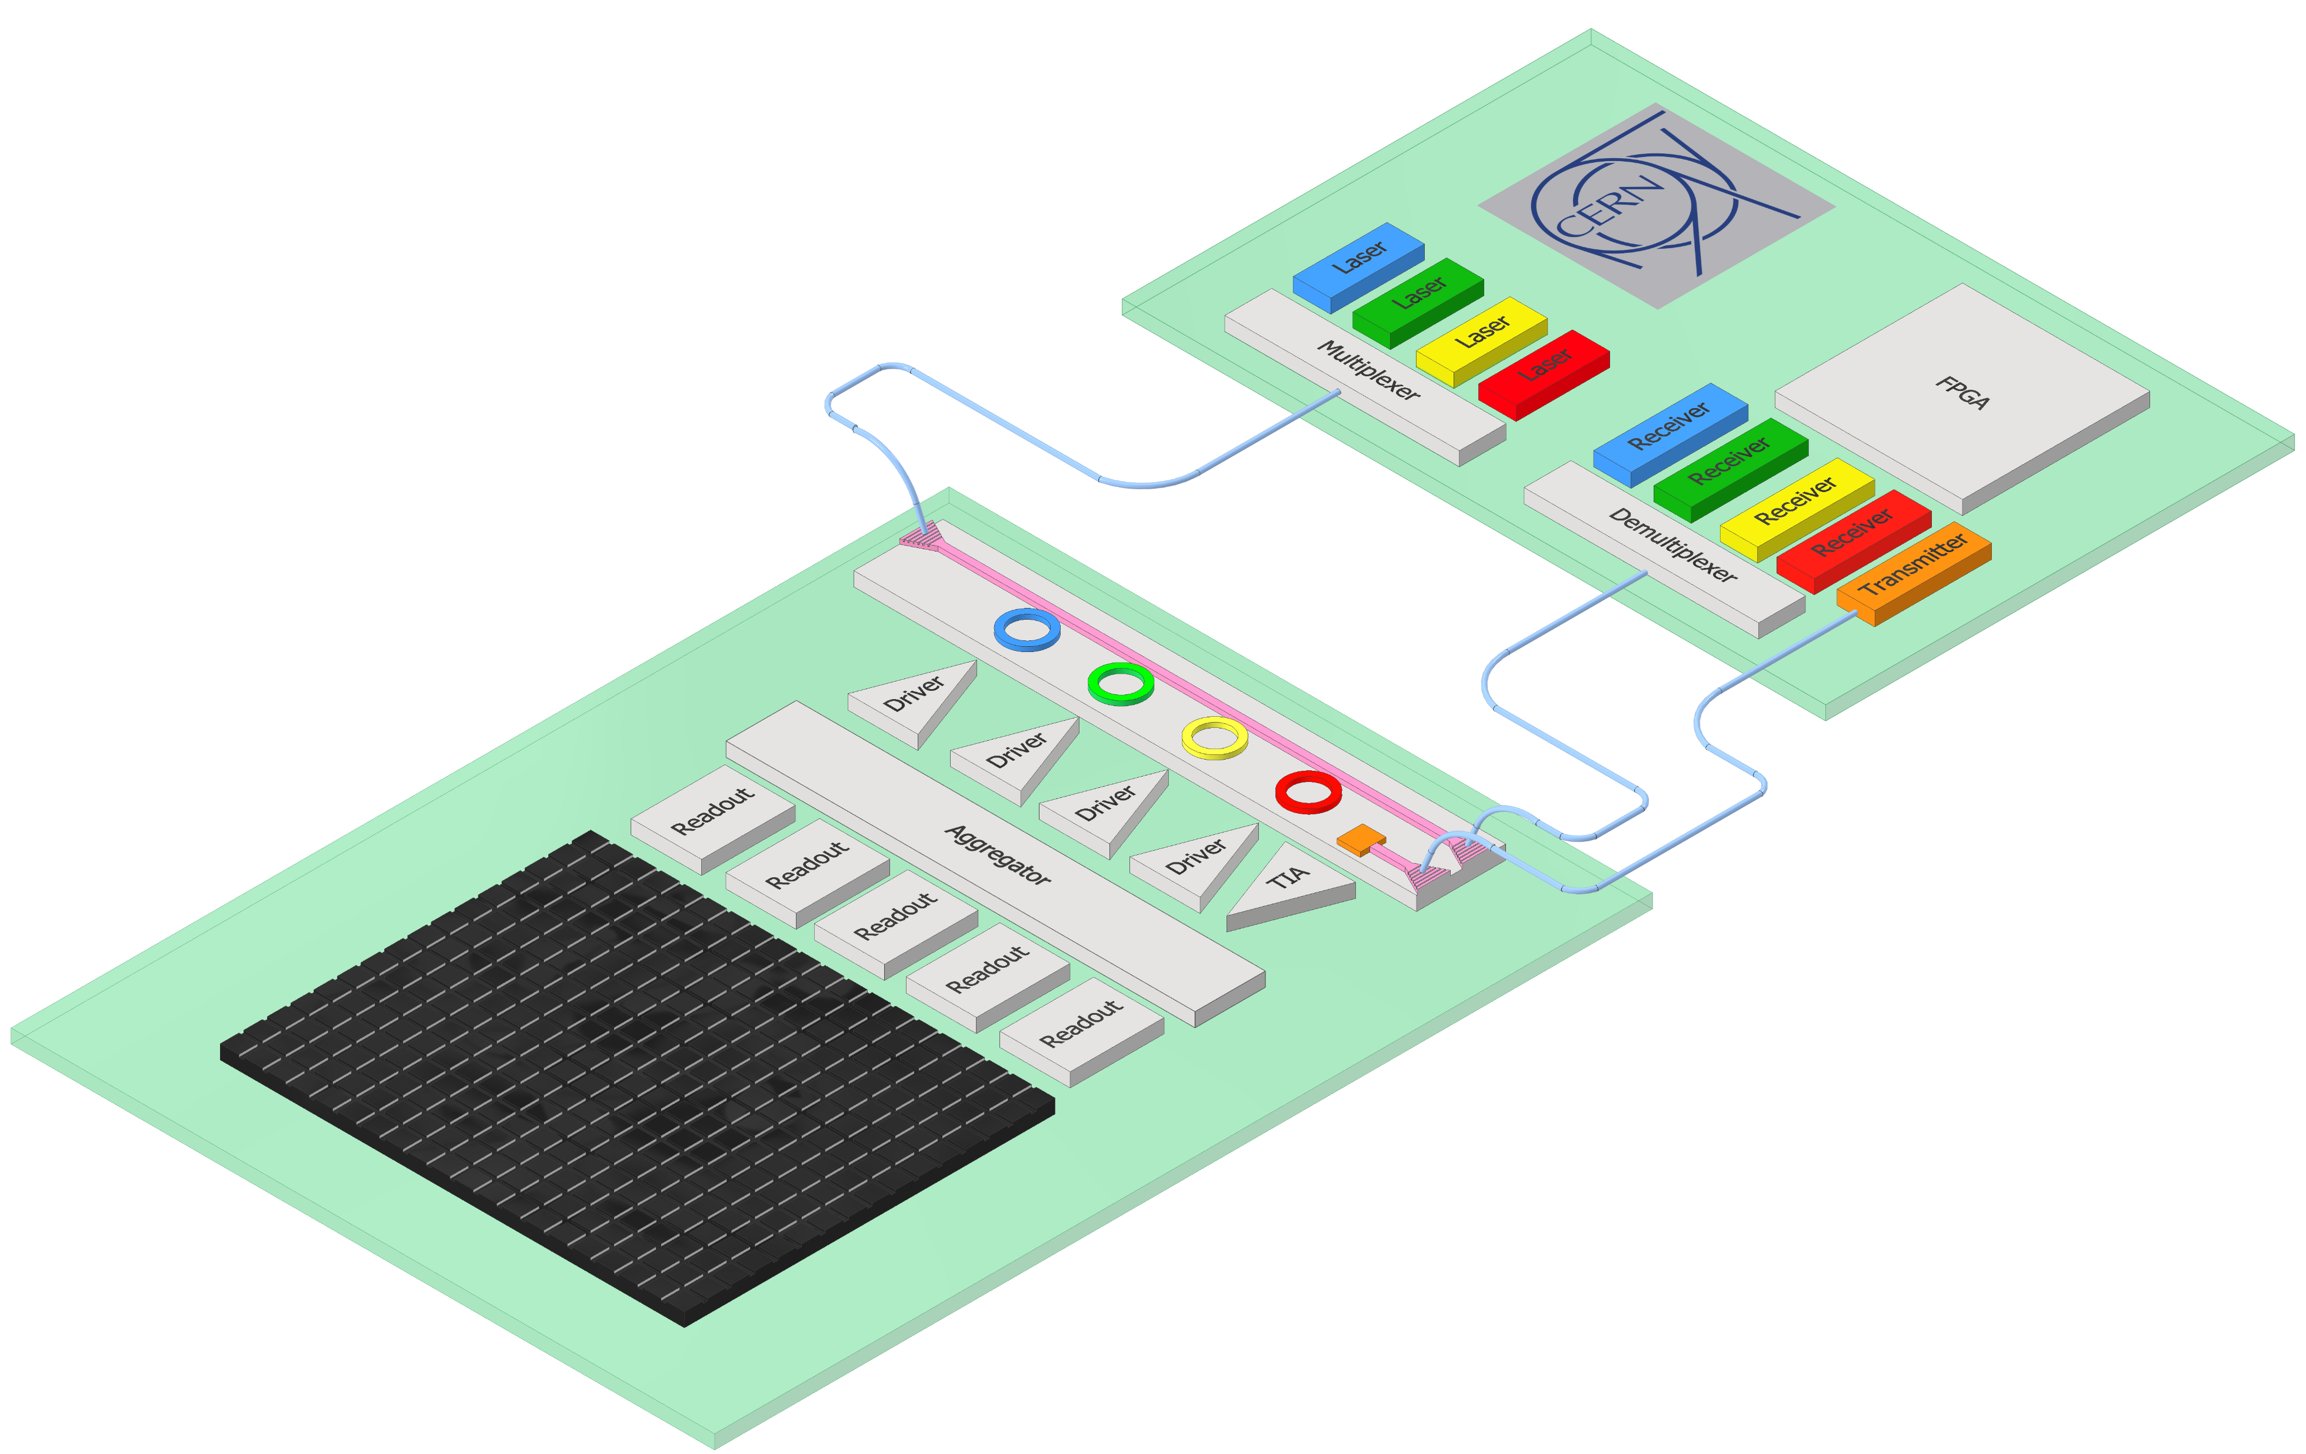


Future HEP link architecture
CERN EP R&D programme WP6
Photonic Integrated Circuits (PICs)
Wavelength division multiplexing:
  Lane: 25 Gbps NRZ
  Fibre: 100 Gbps
Laser sits outside of radiation environment
Low power / Low mass
  Depending on the level of integration
RadHard “promise”
PIC
>> 100 m Single-mode fiber
Particle sensor
System concept
TWEPP 2022
carmelo.scarcella@cern.ch
3

Slide 4
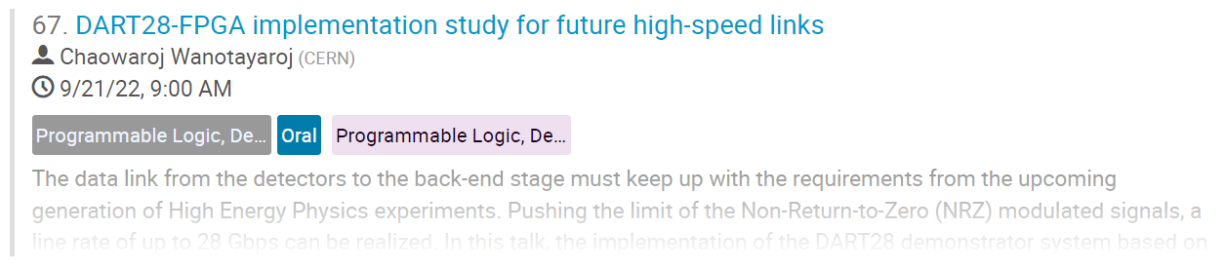
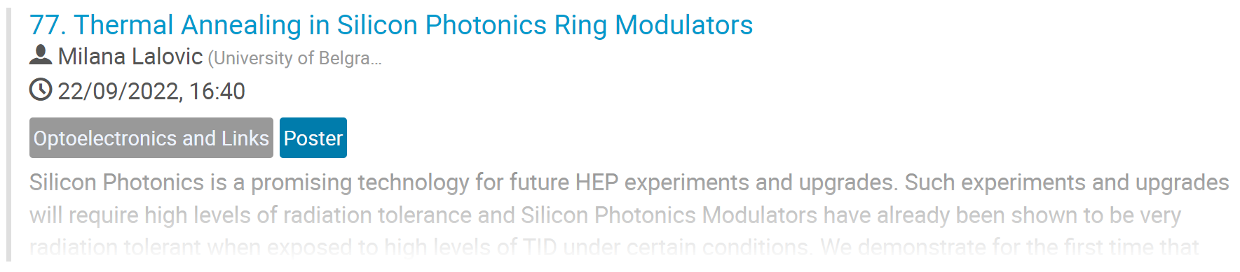
Future HEP link architecture
CERN EP R&D programme WP6
Photonic Integrated Circuits (PICs)
Wavelength division multiplexing:
  Lane: 25 Gbps NRZ
  Fibre: 100 Gbps
Laser sits outside of radiation environment
Low power / Low mass
  Depending on the level of integration
RadHard “promise”
PIC
>> 100 m Single-mode fiber
Particle sensor
System concept
TWEPP 2022
carmelo.scarcella@cern.ch
4

Slide 5
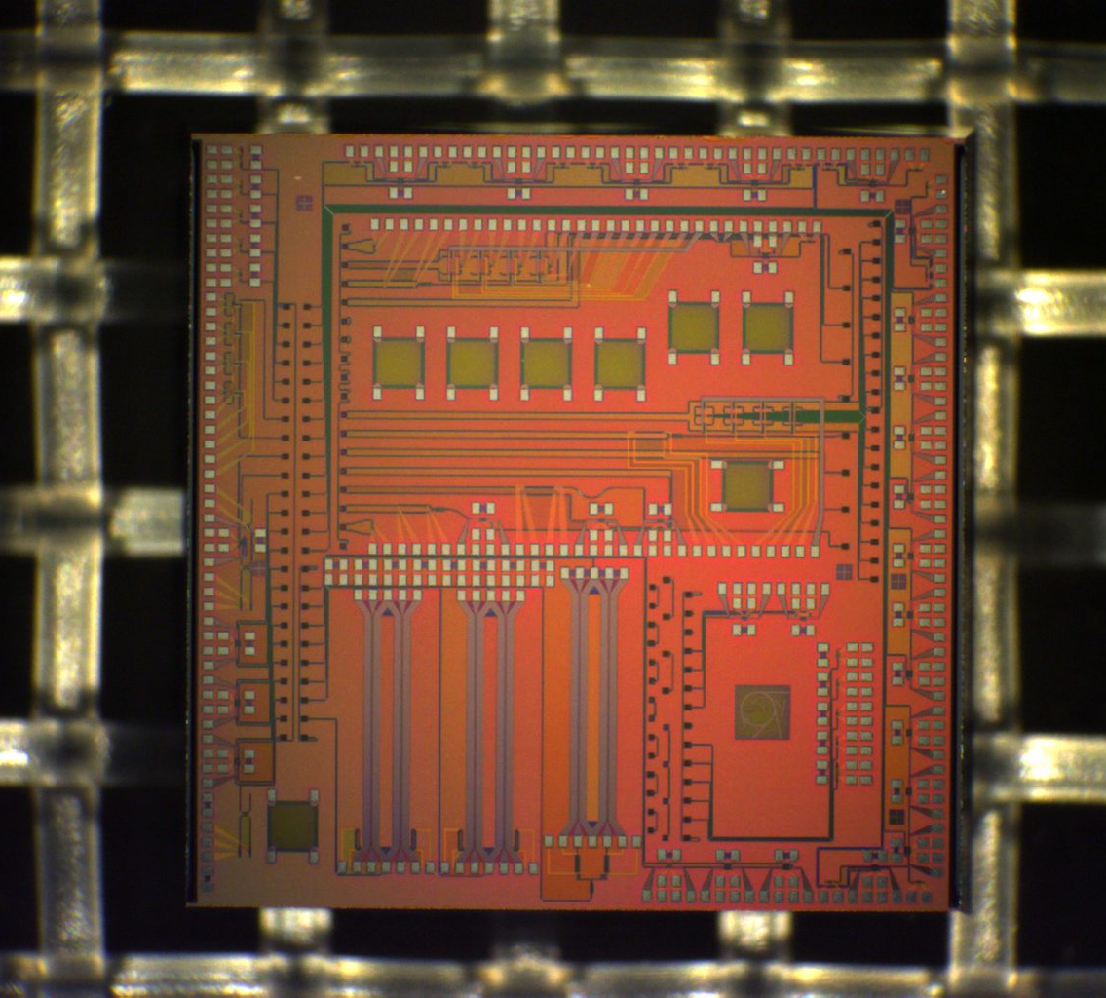
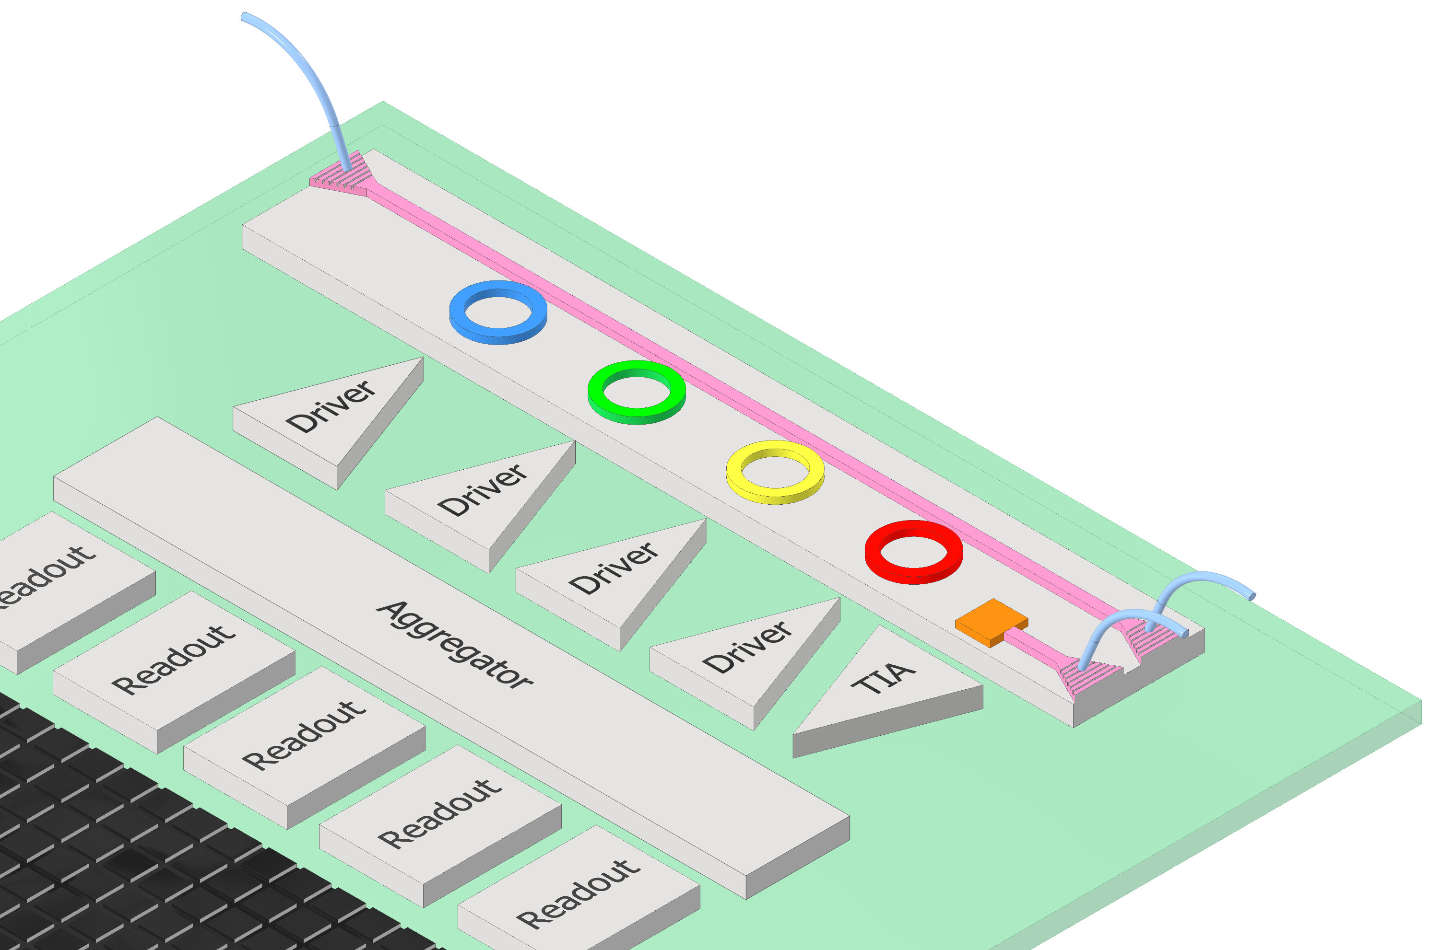
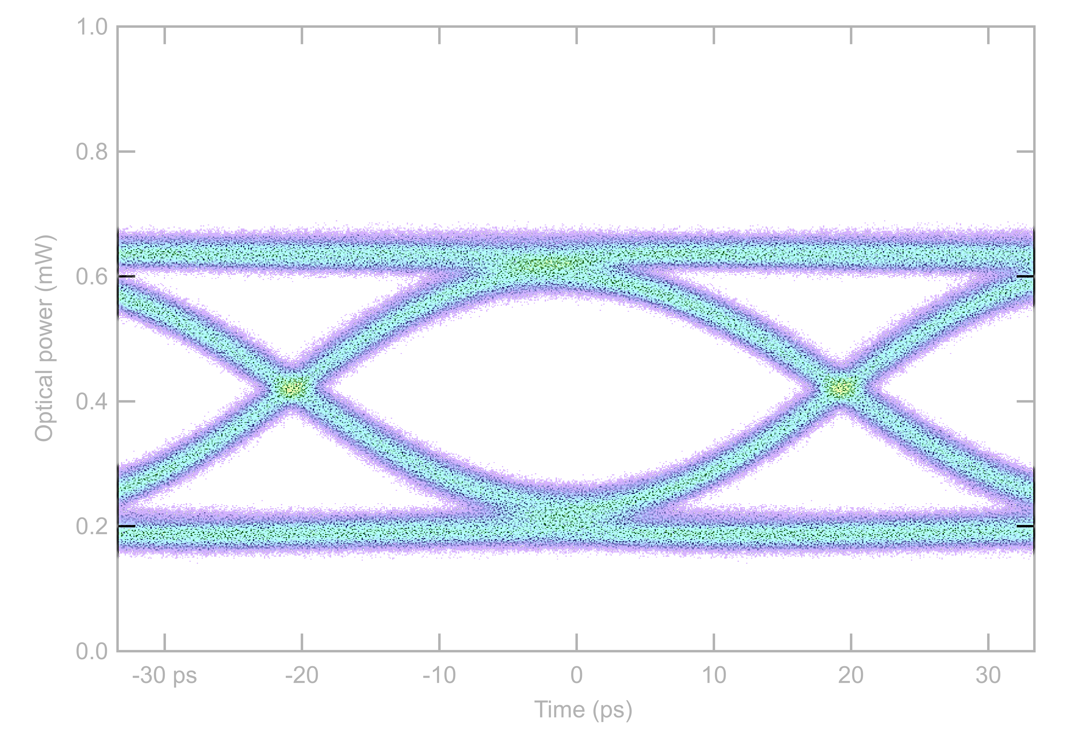
Front-end optical transceiver
Silicon Photonics test chip (PIC)
Silicon Photonics Integrated Circuits (PICs)
CMOS technology
  Fiber couplers
  Silicon waveguides
  Optical modulators
  Germanium photodiodes
Second iteration of PIC designed at CERN
  Radiation tolerance study
  Data link development
Single-mode fiber
DC Lasers
450 nm
PIC
5 mm
Modulator
Tx channel
Photodiode
Rx channel
Particle sensor
TWEPP 2022
carmelo.scarcella@cern.ch
5

Slide 6
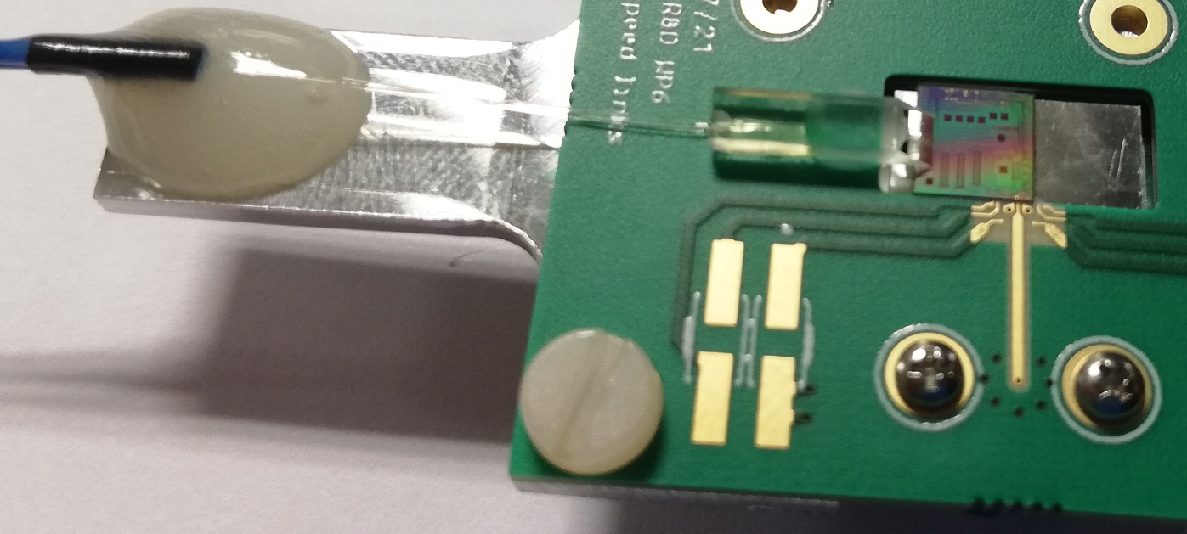
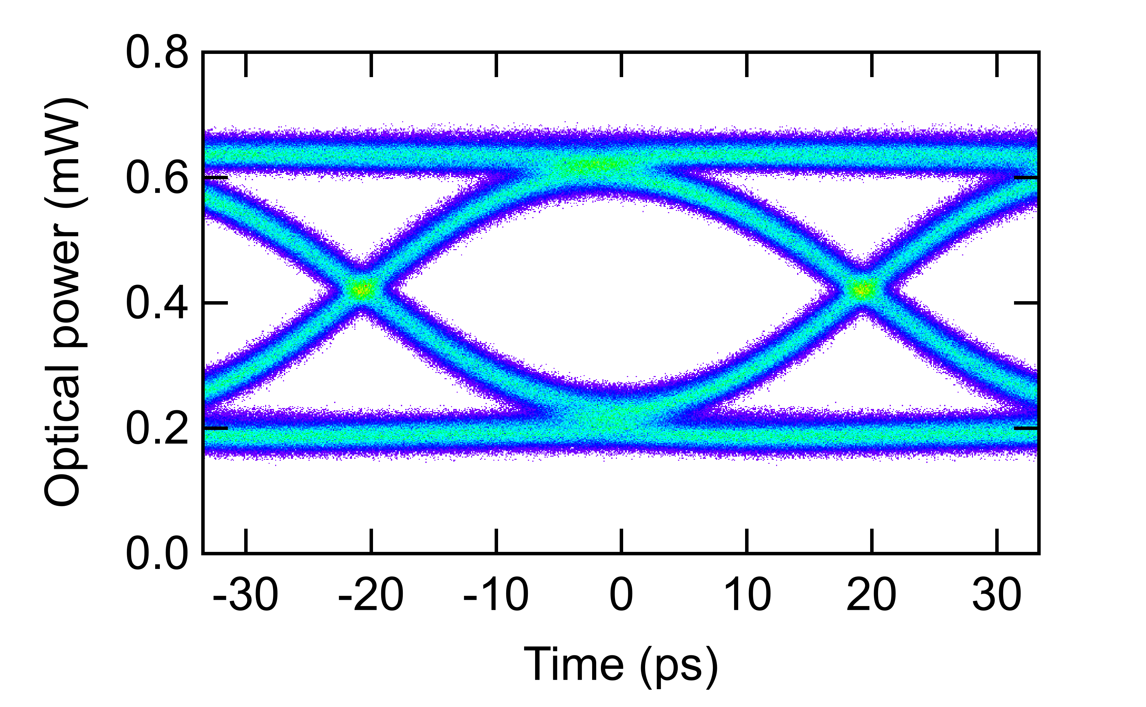
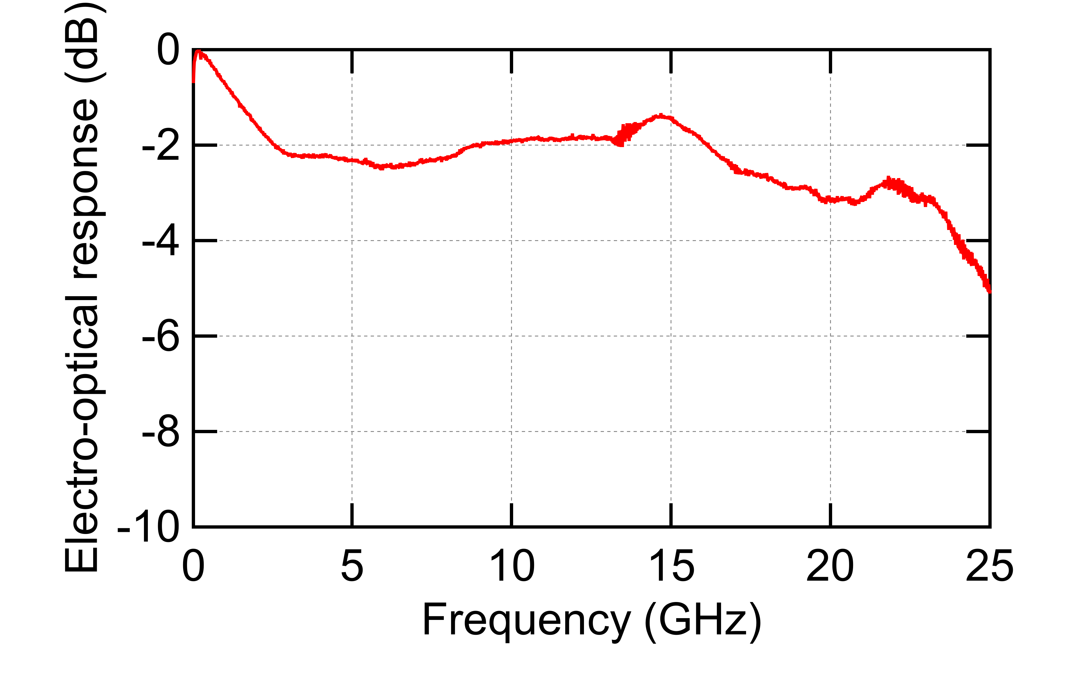
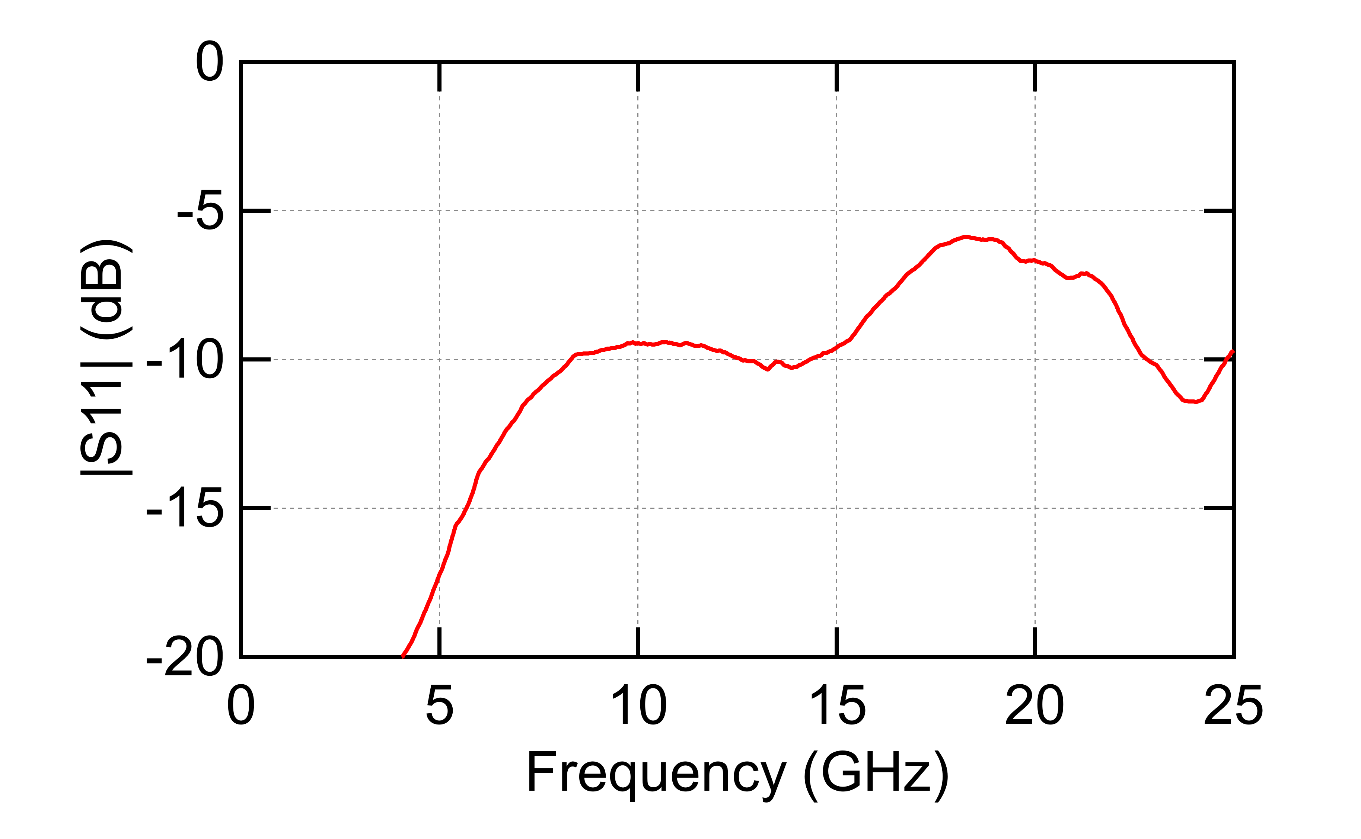
High-speed “driverless” test board
Single-mode fibers
PIC
PIC mounted onto a test board with access to electrical and optical ports
Wide open eye diagram at 25 Gb/s
Electro-optical response shows ~ 20 GHz bandwidth
Moderate return loss |S11|
2.92 mm coaxial connector
25 Gb/s optical eye diagram
TWEPP 2022
carmelo.scarcella@cern.ch
6

Slide 7
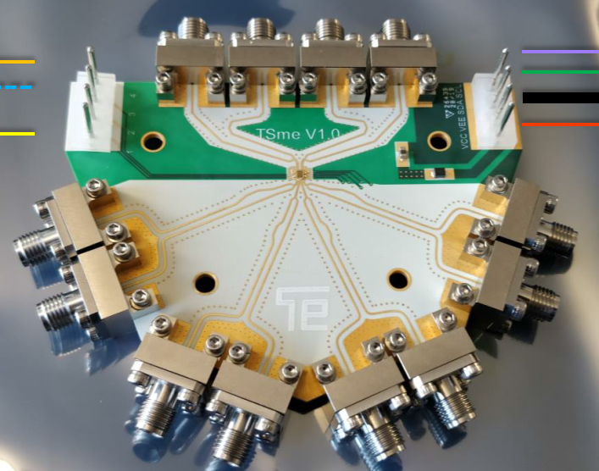
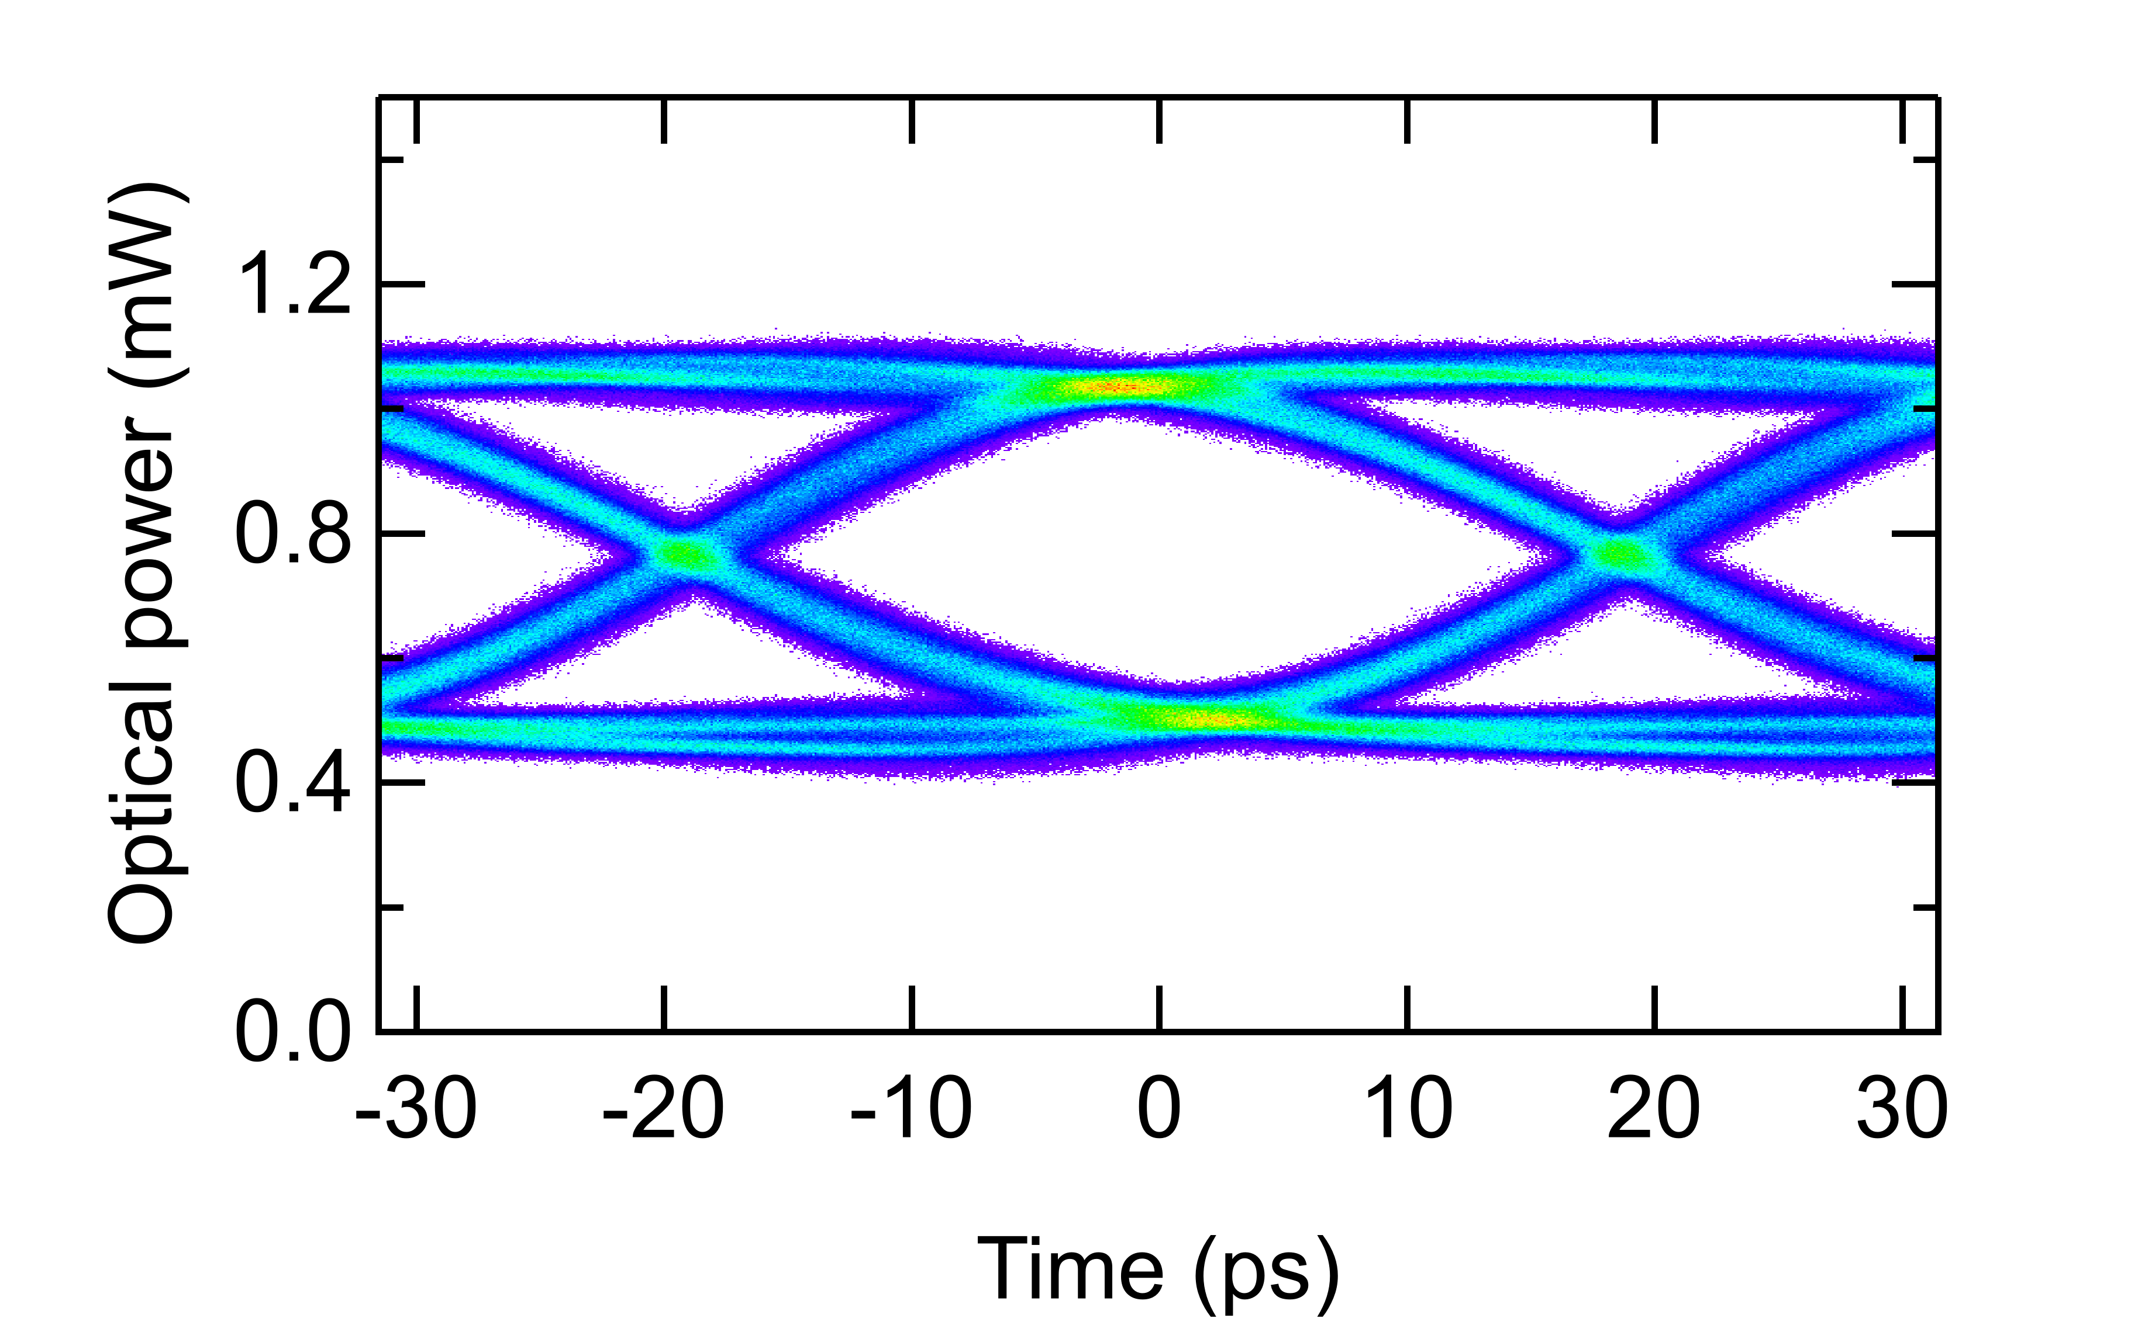
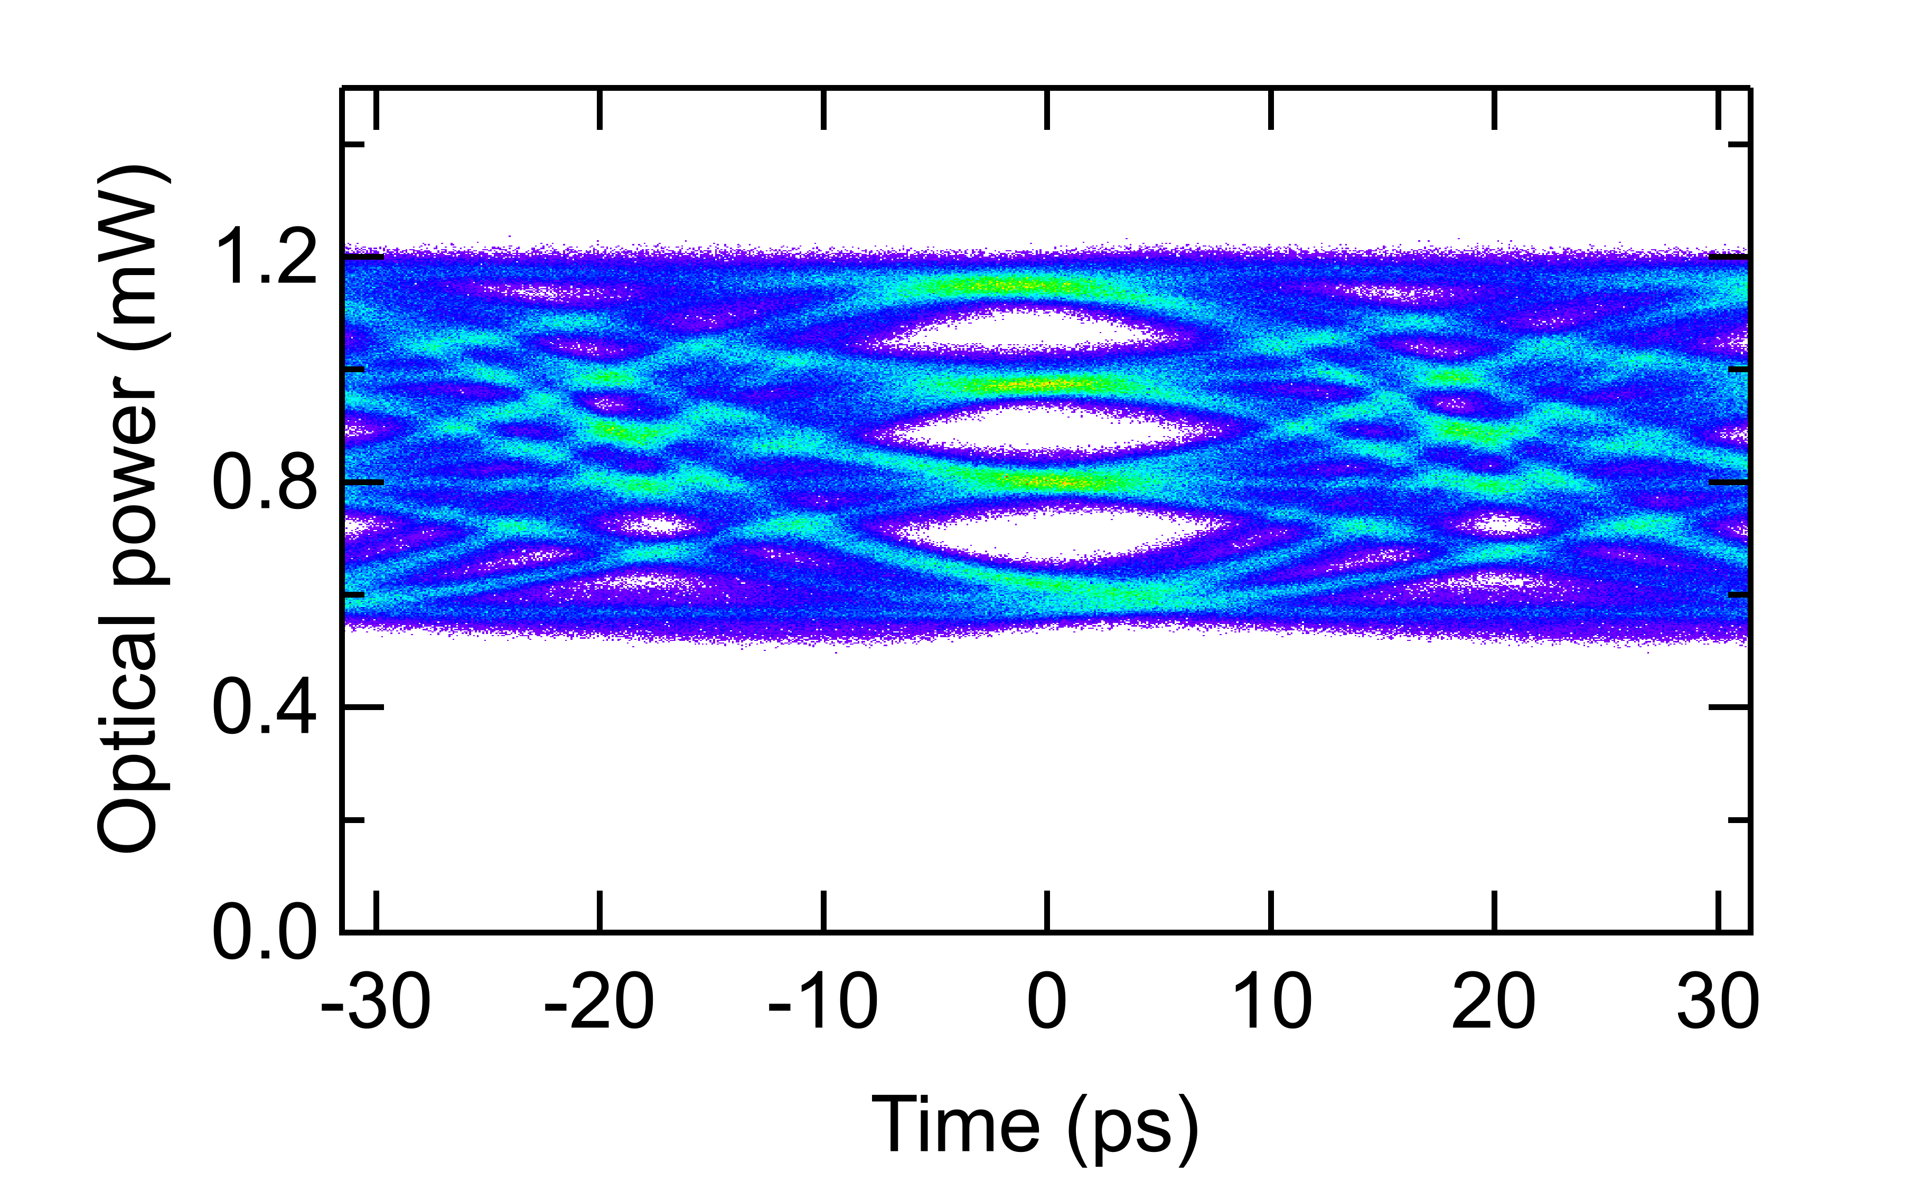
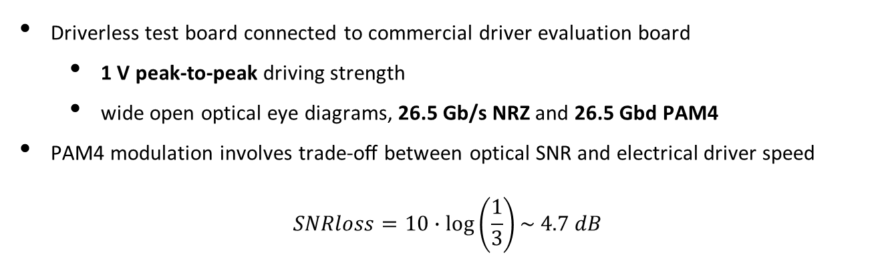
Ring modulator coupled to a commercial driver
Driverless test board connected to commercial driver evaluation board
  1 V peak-to-peak driving strength
  wide open optical eye diagrams, 26.5 Gb/s NRZ and 26.5 Gbd PAM4
PAM4 modulation involves trade-oﬀ between optical SNR and electrical driver speed
$$SNRloss=10∙\log\left(\frac{1}{3}\right)\sim 4.7 dB$$
NRZ 26.5 Gb/s
PAM4 26.5 Gbd (53 Gb/s)
TWEPP 2022
carmelo.scarcella@cern.ch
7

Slide 8
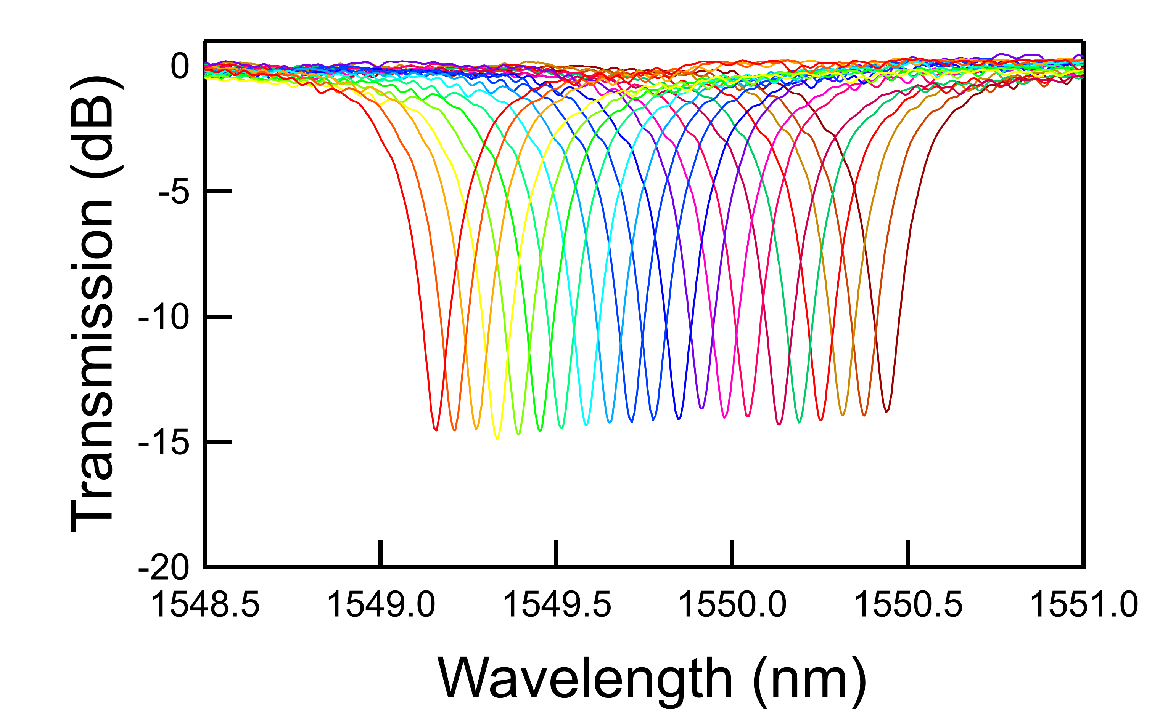
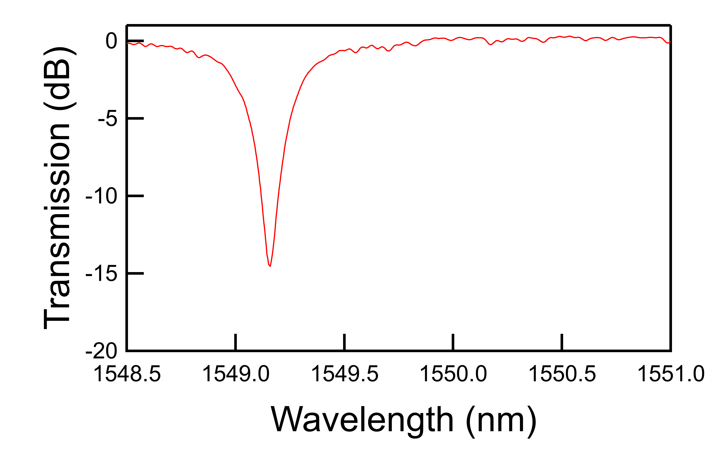
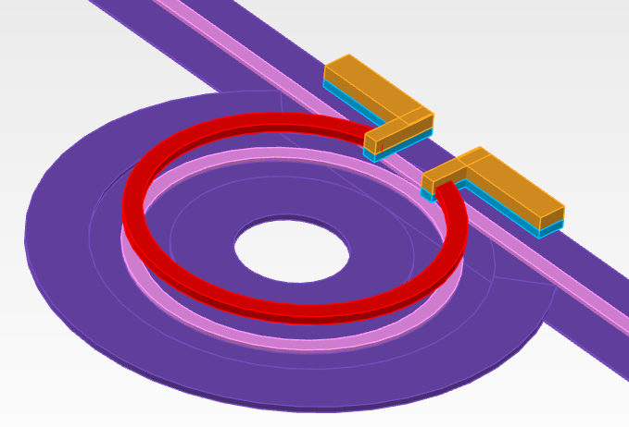
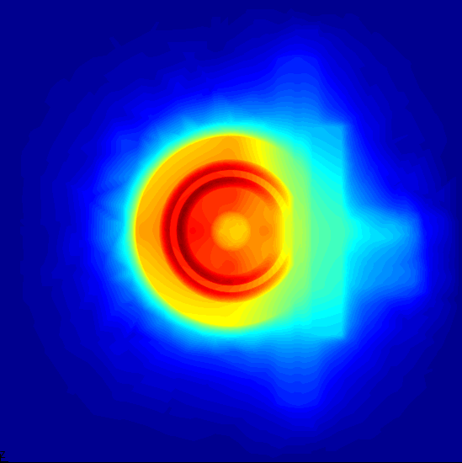
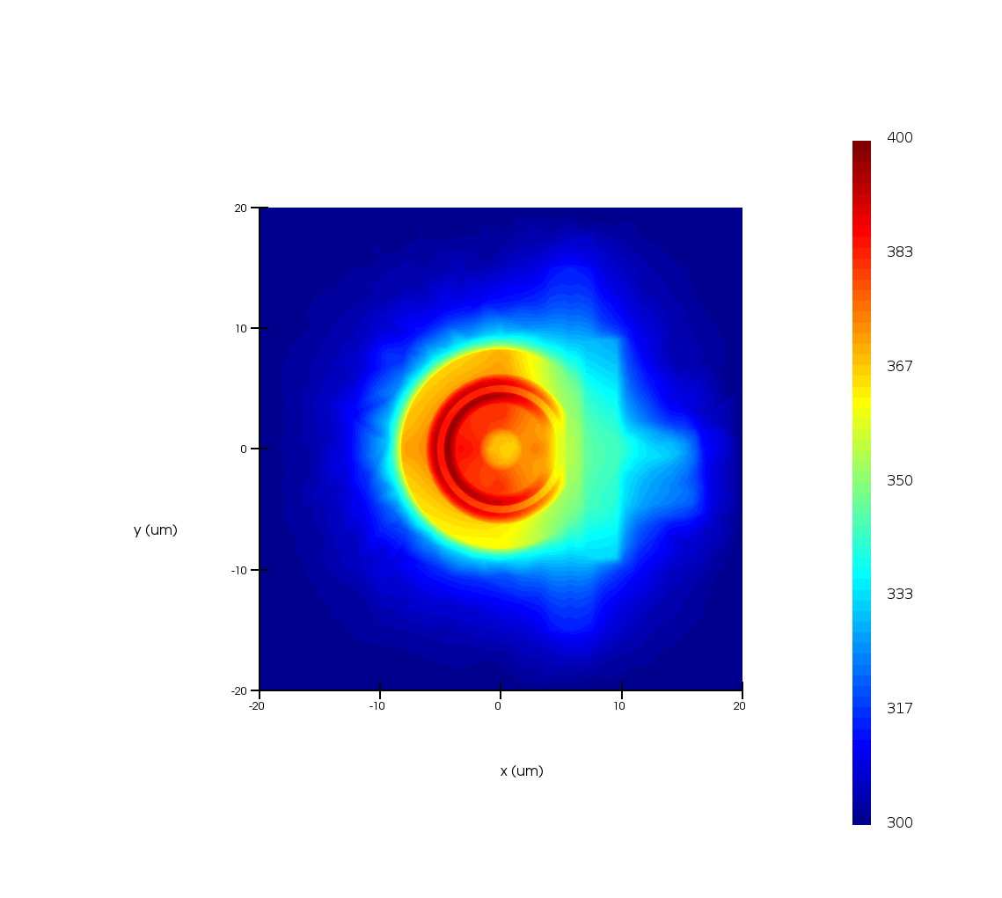
Resonance wavelength tuning
input
laser
Ring modulators are highly selective wavelength filters
Resonance wavelength (λ_{res}) depends on environmental and fabrication parameters
λ_{res} needs to be aligned to the input laser
Thermo-optic effect in Silicon to adjust λ_{res} (Δλ_{res} ~70 pm/°C)
Tungsten µ-heater on top of the ring waveguide for local and active tuning of λ_{res}
λ_{res}
From 17 °C to 34 °C
input laser
SiO₂
Temperature
400 K
10 µm
Si waveguide
µ-heater
300 K
TWEPP 2022
20 µm
carmelo.scarcella@cern.ch
8

Slide 9
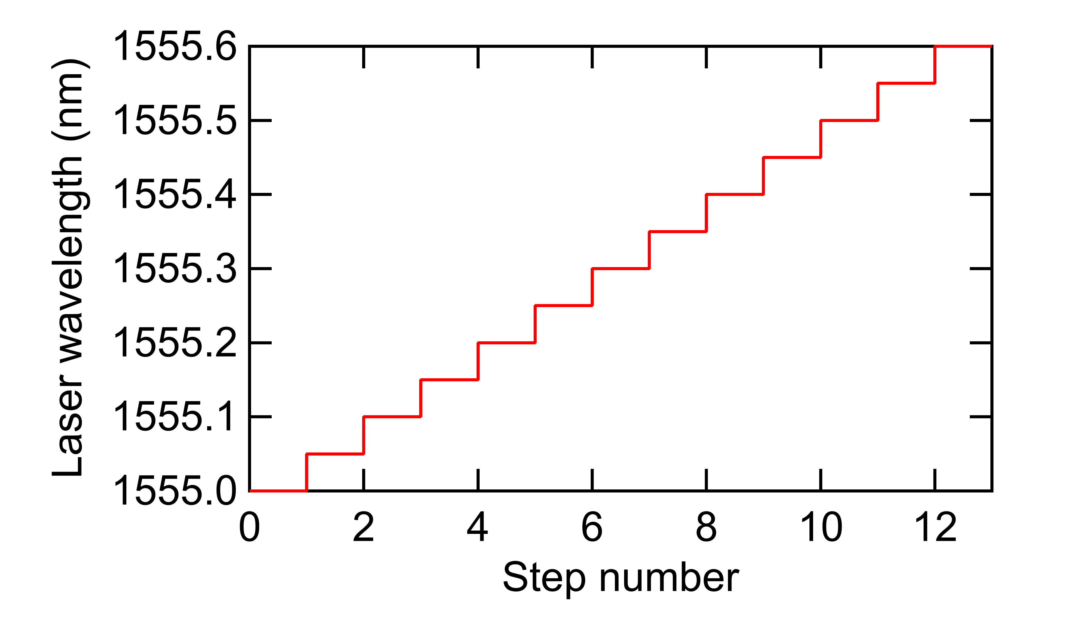
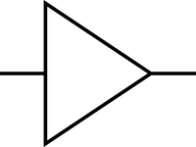
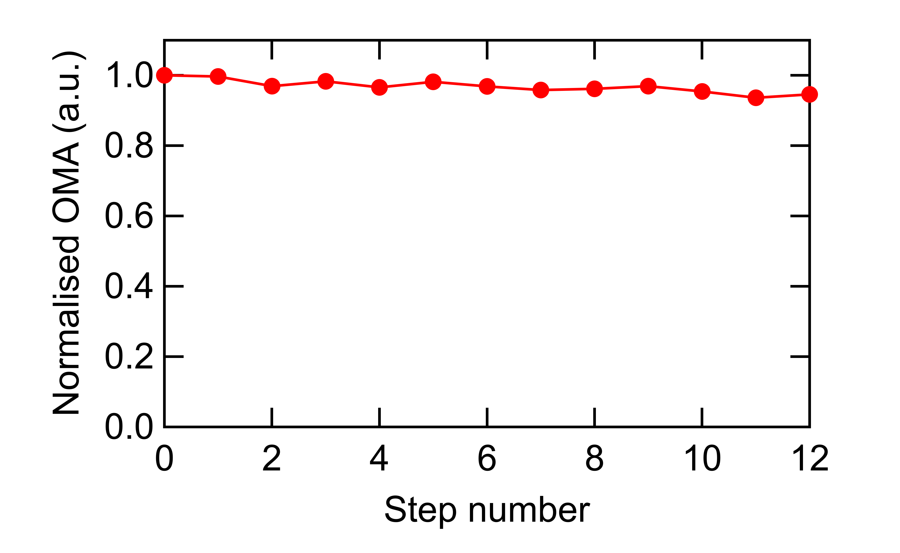

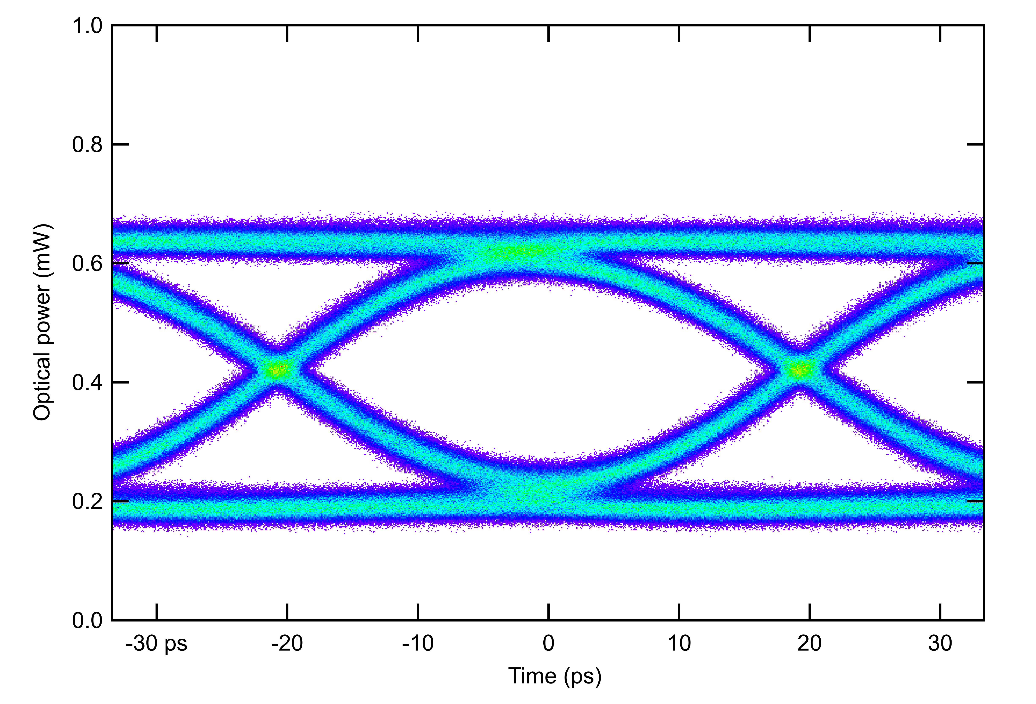
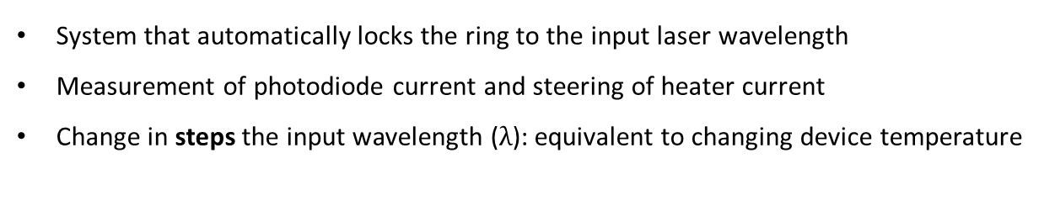
Control system for wavelength stabilisation
System that automatically locks the ring to the input laser wavelength
Measurement of photodiode current and steering of heater current
Change in steps the input wavelength ($λ$): equivalent to changing device temperature
Optical data out
Input laser
Electrical
Data in
_{Δλ(V)}
µ-heater
_{Δλ(T)}
Photodiode
OMA
Drop port
setpoint
-
+
error
PID controller
TWEPP 2022
carmelo.scarcella@cern.ch
9

Slide 10
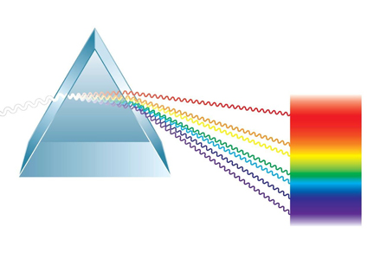
4 channel WDM demonstration block diagram
Wavelength division multiplexing (WDM)
4-channel external laser COMB with ~ 5 nm wavelength grid spacing
Ring modulators driven by a 2-channel pattern generator
4 wavelengths separated using DEMUX and measured using oscilloscope
Modulated outputs
DC laser COMB
pattern generator
1545 nm laser
MUX
DEMUX
MUX
1550 nm laser
PIC
Amplifier
1555 nm laser
1560 nm laser
SCOPE
Single-mode fiber
TWEPP 2022
carmelo.scarcella@cern.ch
10
Notes:
10

Slide 11
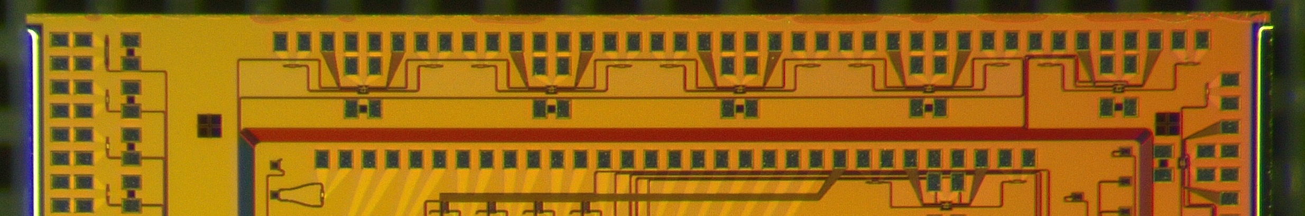
4-channel WDM transmitter - Measurement results
Modulated outputs
DC laser COMB
Optical waveguide
Bond pad
500 µm
TWEPP 2022
carmelo.scarcella@cern.ch
11
Notes:
11

Slide 12
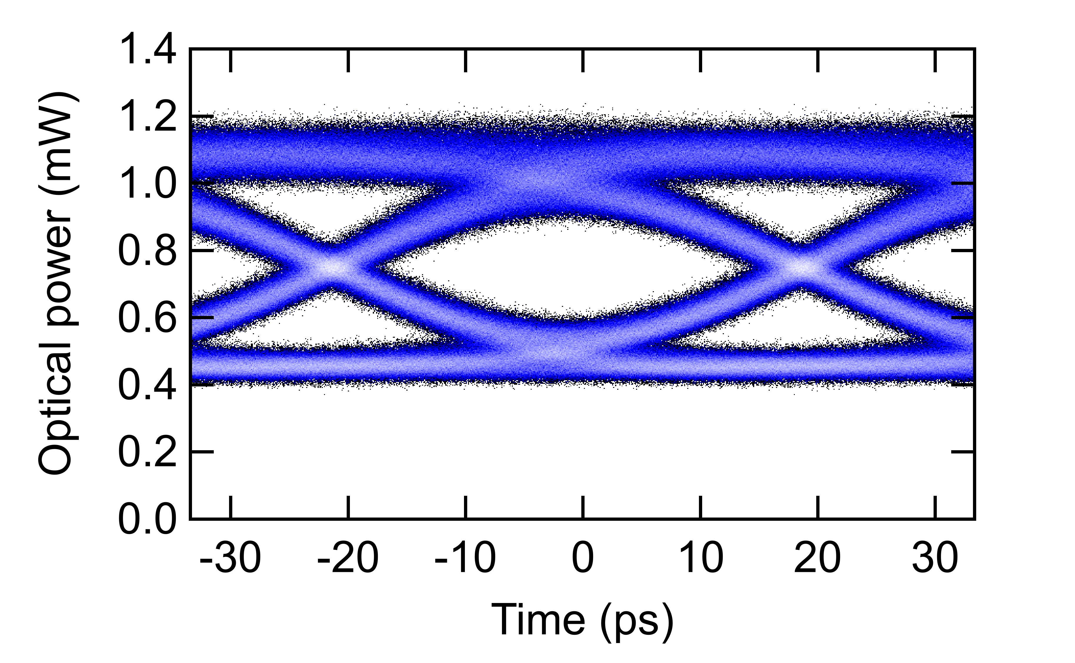
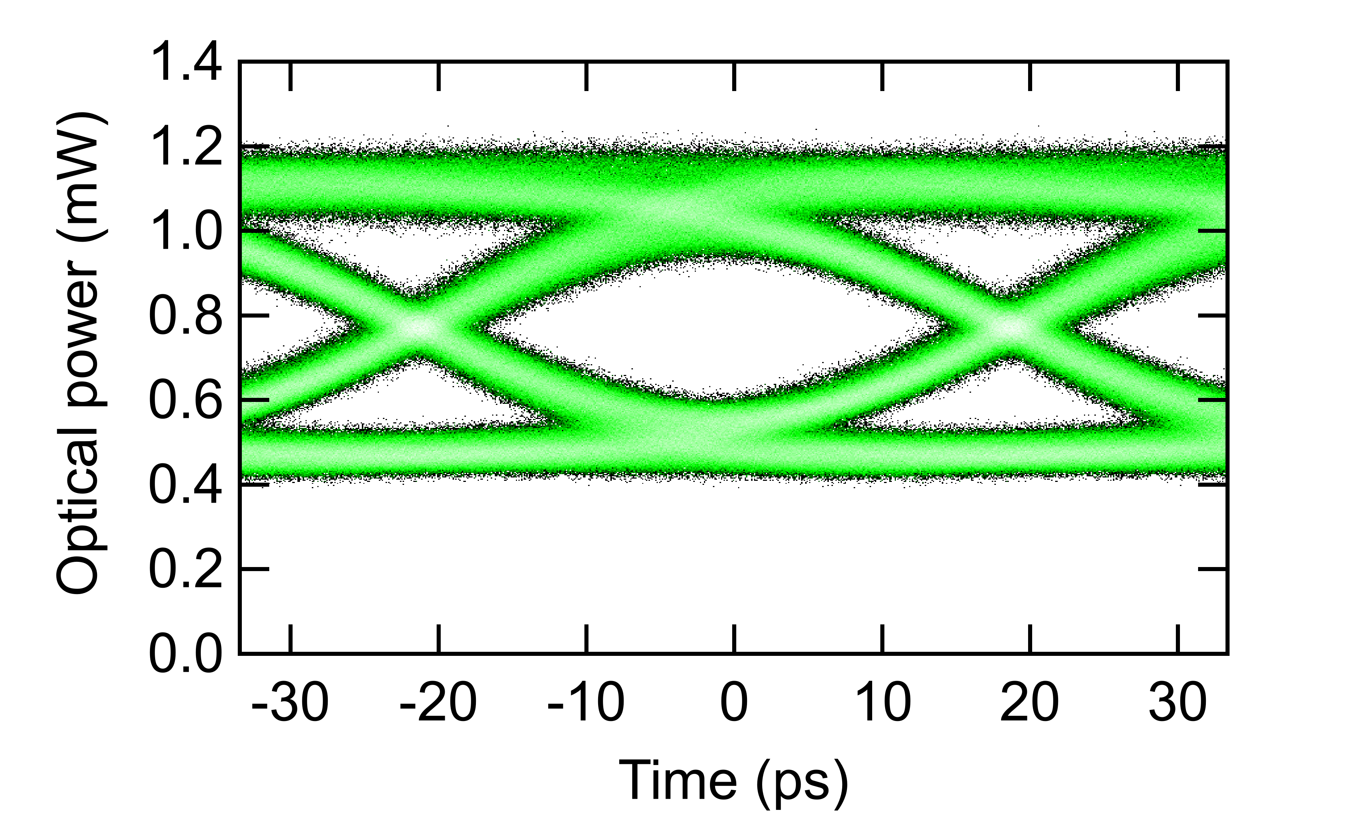
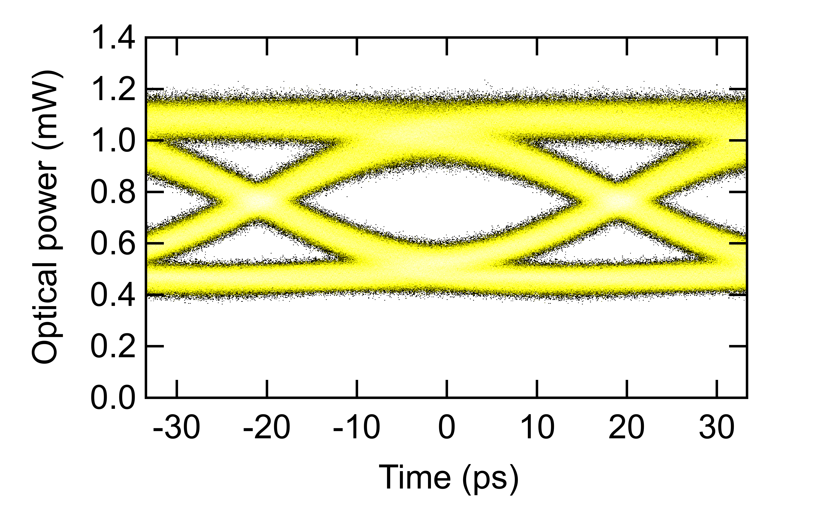
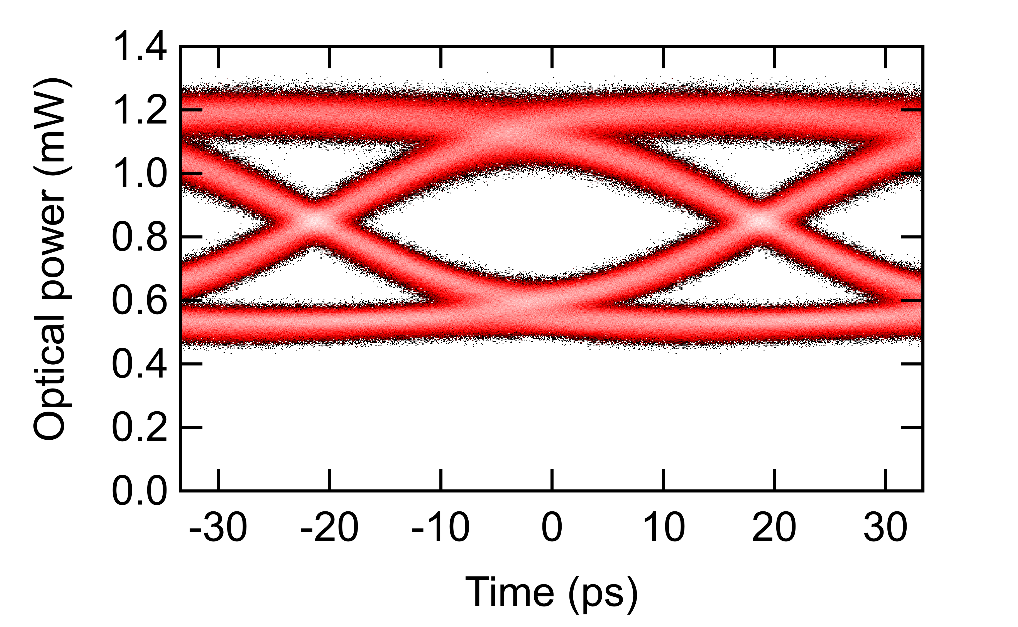
4-channel WDM transmitter - Measurement results
Wide open 4x25 Gb/s NRZ optical eye diagrams
Good channel uniformity
Modulated outputs
DC laser COMB
Electrical data in
TWEPP 2022
carmelo.scarcella@cern.ch
12
Notes:
12

Slide 13
Conclusions
Presented the progress on the system development on Silicon Photonics links for HEP
Uplink
  25 Gb/s NRZ and 25 Gbaud PAM4 operation of ring modulators integrated on CERN PIC
  Compensation of slow temperature changes by thermally tuning the ring modulator resonance wavelength
  First demonstration of 4x25 Gb/s Wavelength Division Multiplexing (WDM) transmitter
Downlink
  Demonstration of radiation tolerant receiver based on Silicon Photonics presented during TWEPP 2021
TWEPP 2022
carmelo.scarcella@cern.ch
carmelo.scarcella@cern.ch
13
13

Slide 14
Next photonic test chip
  Radiation tolerance
    Modelling radiation damage
    Radiation tolerance enhancement by design
  Data link design
    Thermal control of ring modulators
    Integration of modulators with electrical drivers
    Wavelength Division Multiplexing
    Aligning with industry emerging standards for COTS components
  New PIC design iteration
  Tape out on the 5th October 2022
  Turn around time 12 months!
TWEPP 2022
carmelo.scarcella@cern.ch
14

Slide 15
Back-up slides
TWEPP 2022
carmelo.scarcella@cern.ch
15

Slide 16
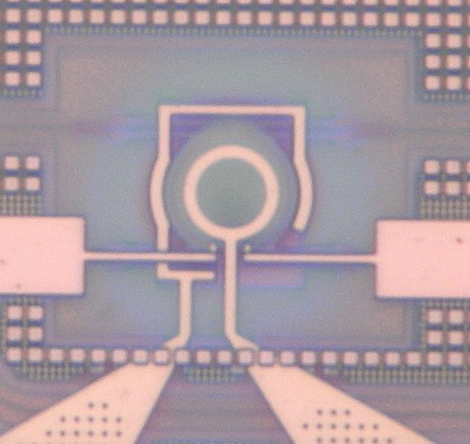
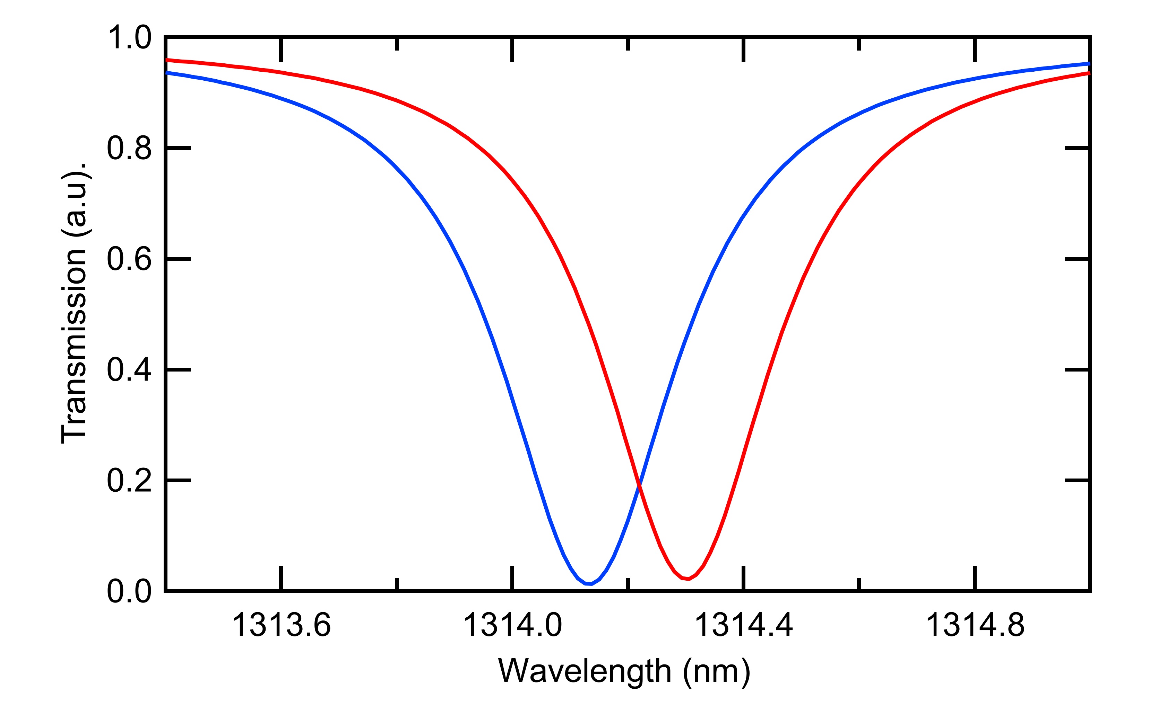
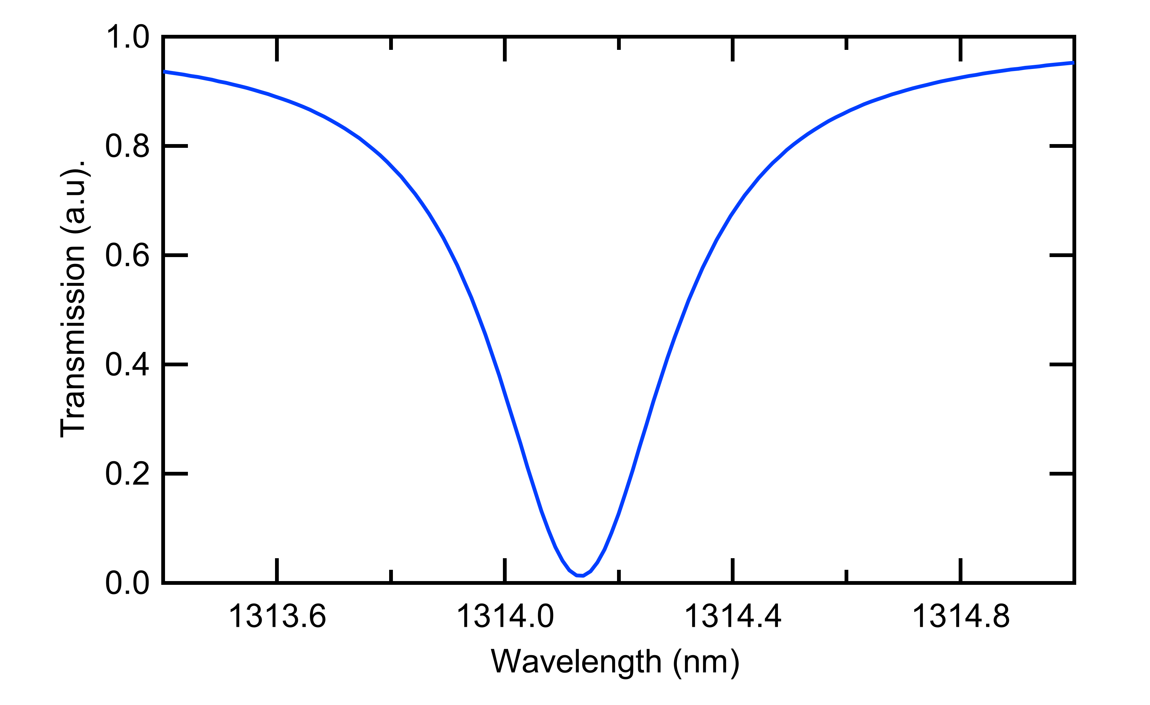
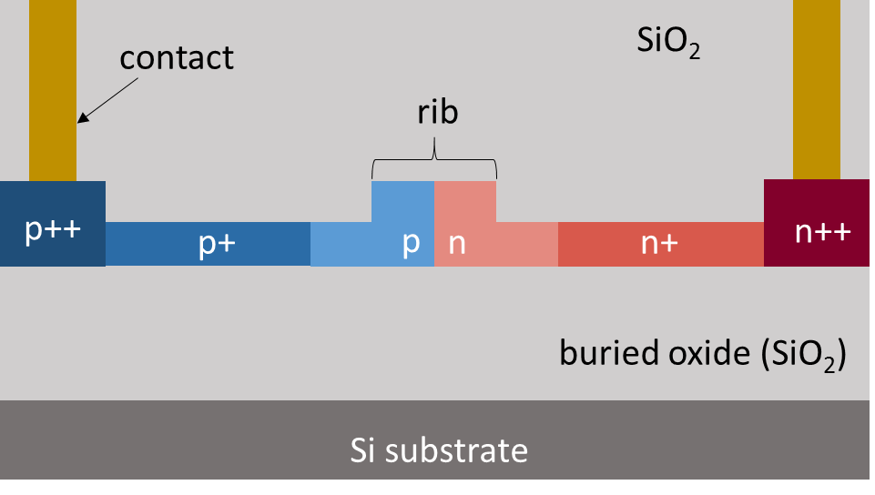
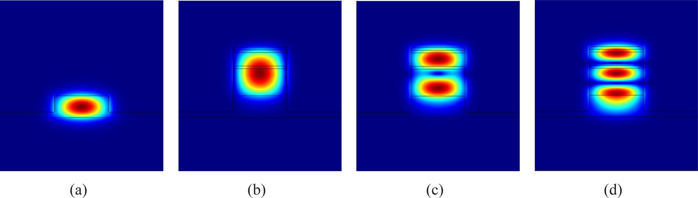
Si µ-ring modulator
CERN custom design
Selective wavelength filters
Small footprint (radius ~ 5µm)
Small driving voltage amplitude (down to 1 Vpp)
Optically narrowband (< 1nm)
Thermally sensitive (< 1 K)
Input laser
Optical data
10 µm
_{Δλ(V)}
Waveguide
Electrical
data
p-n junction
Electrical contacts
-
V
+
Input
laser
V₀
V₁
Waveguide cross-section
Reverse biased pn Junction
TWEPP 2022
carmelo.scarcella@cern.ch
16

Slide 17
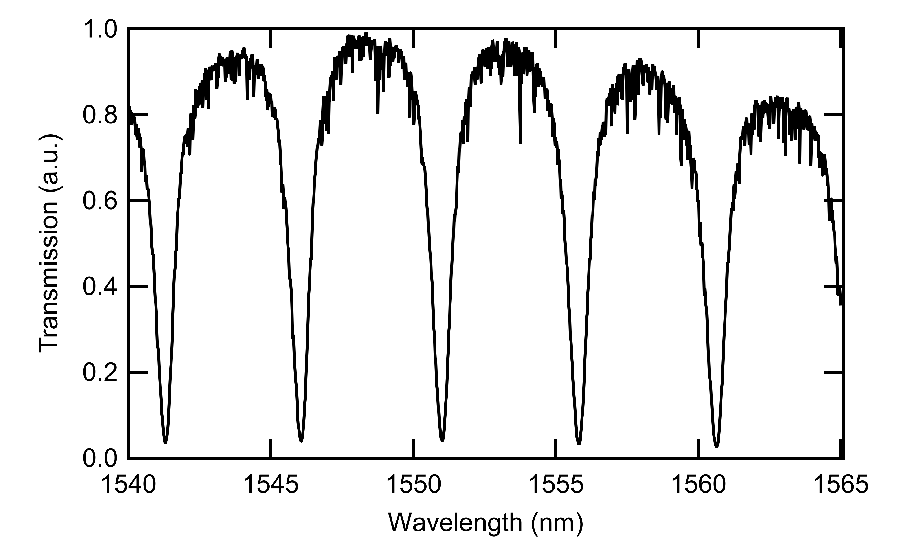
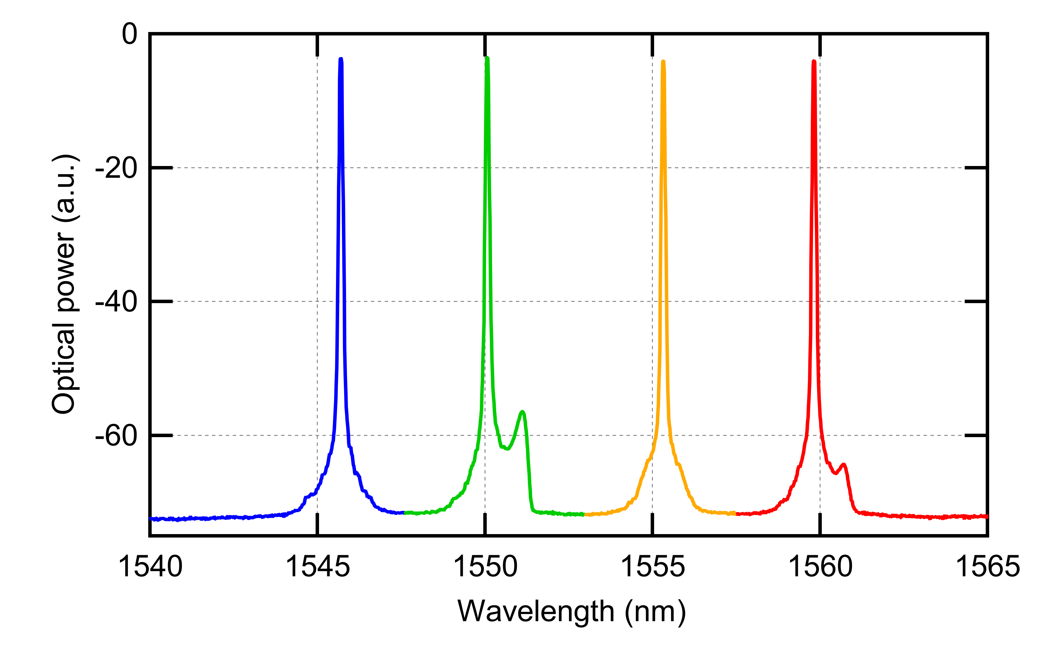
4 channel WDM transmitter
CW laser COMB
Modulated outputs
r r+∆L r+2∆L r+3∆L
Wavelength division multiplexing (WDM)
Four ring modulators coupled to the same waveguide
Ring radius difference induces uniformly spaced resonance notches
4-channel external laser COMB with ~ 5 nm wavelength grid spacing
Resonance wavelength of each modulator aligned to the corresponding laser using thermal tuning
r = radius
TWEPP 2022
carmelo.scarcella@cern.ch
17

Slide 18
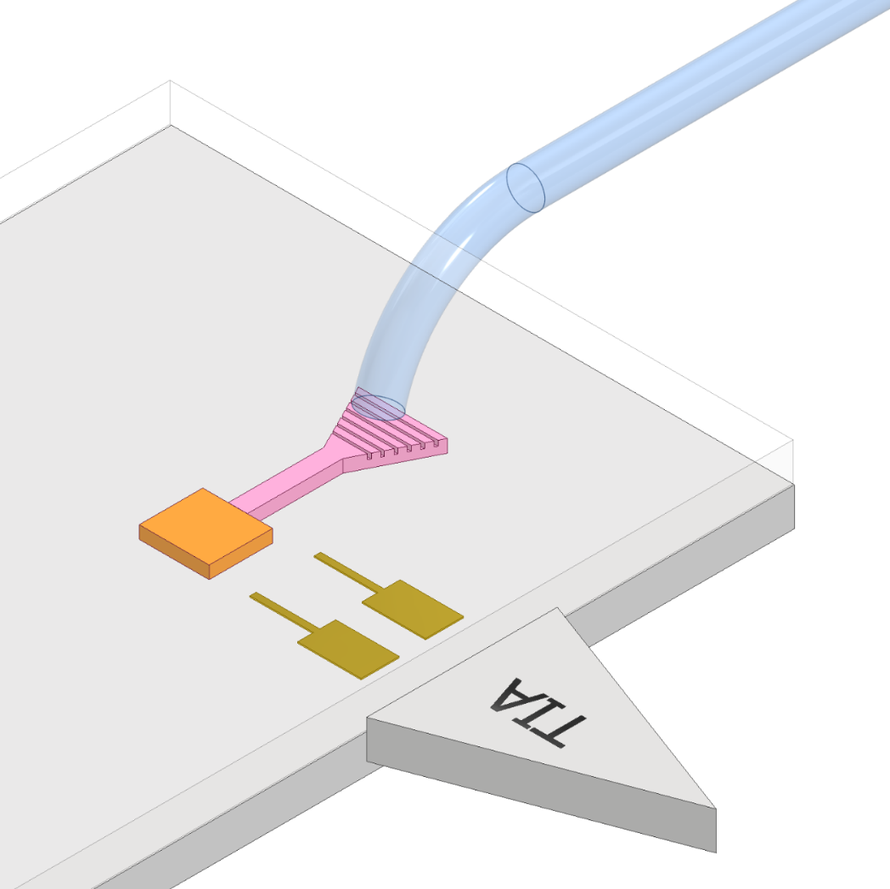
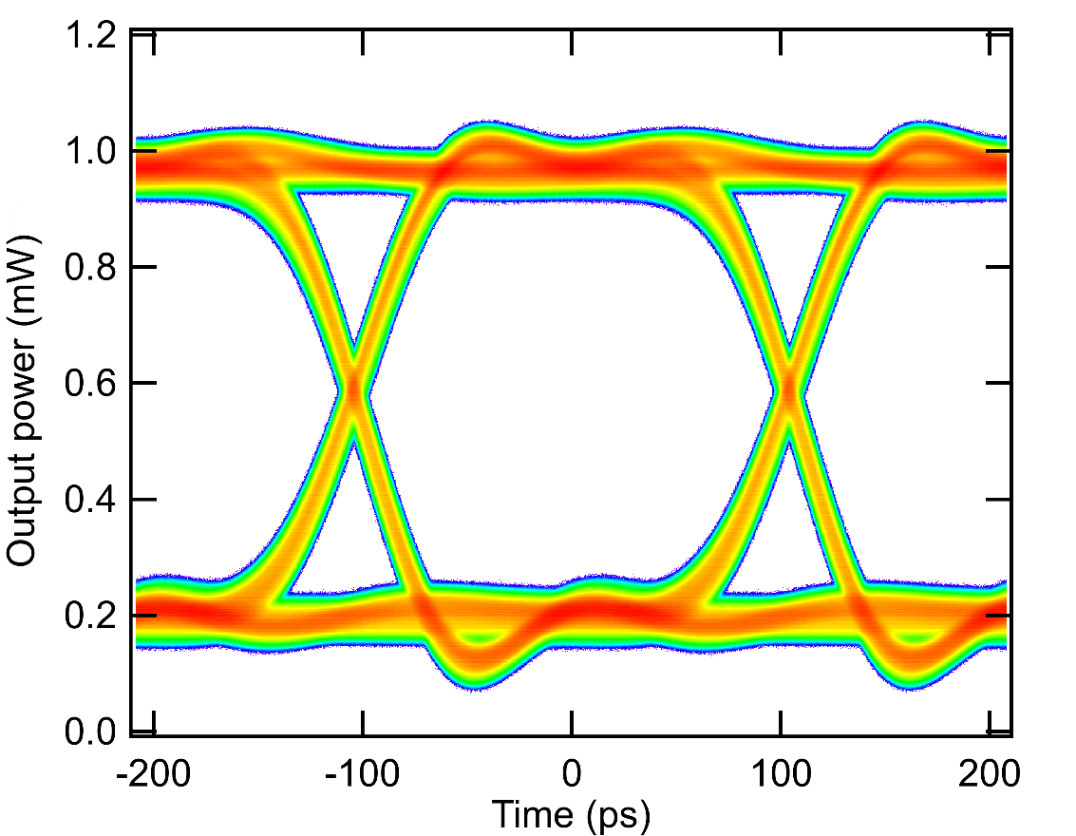
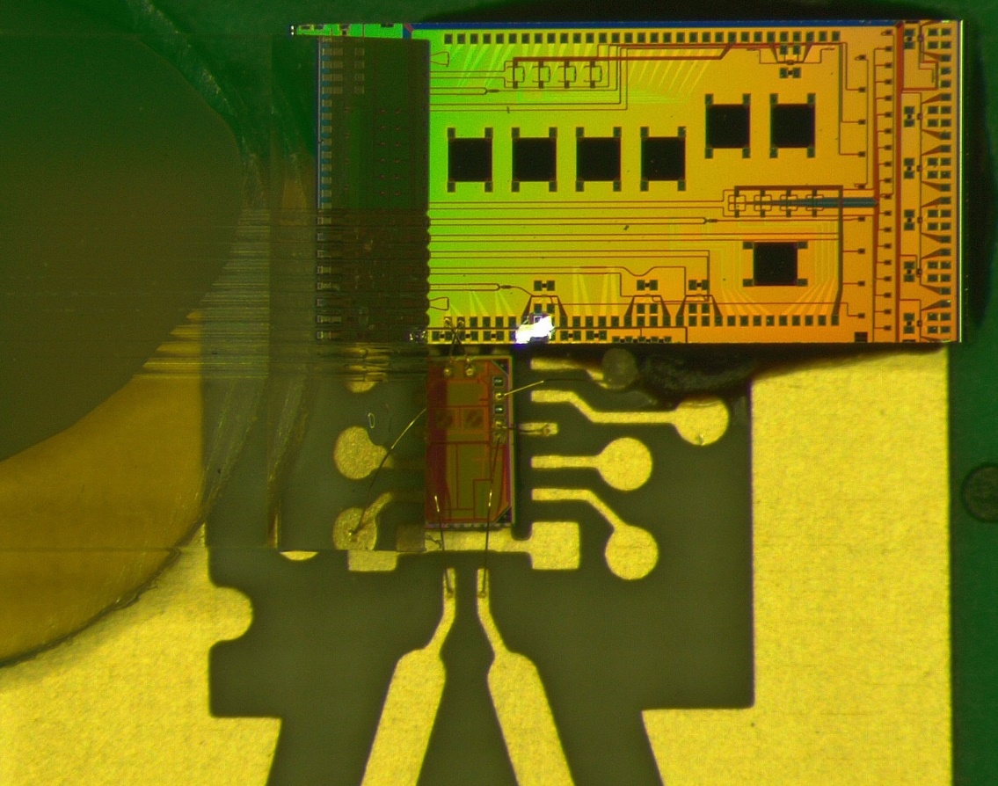
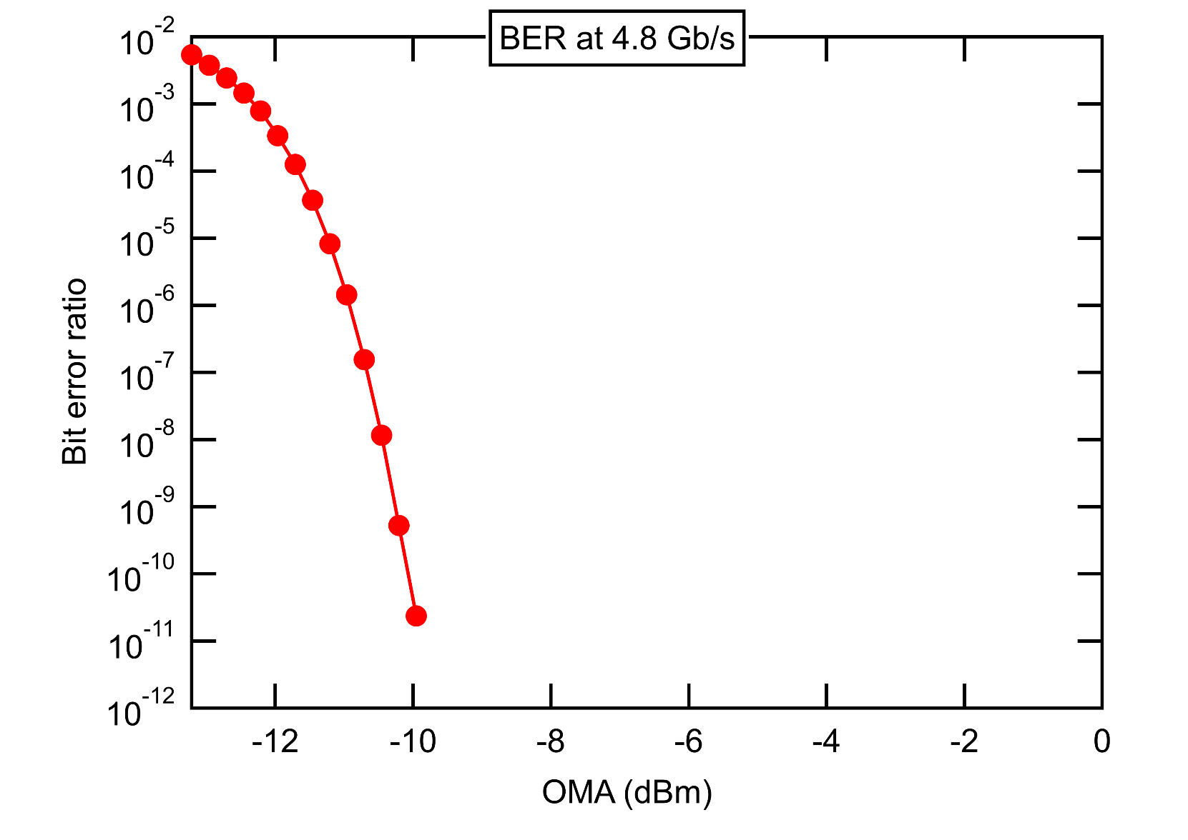
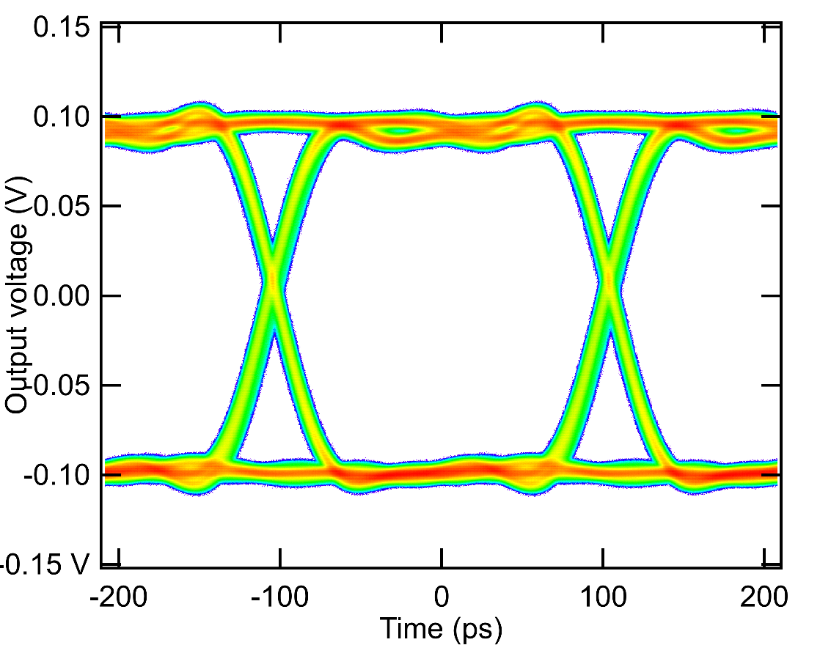
SiPh radiation tolerant receiver demonstration
Radiation tolerant receiver based on on-chip Ge photodiode and transimpedance amplifier (TIA)
Downstream requires relatively low data rate (2.56 / 5.12 Gbps)
First demo using GBTIA (5 Gbps radiation-hard optical receiver)
Open eye diagram at the output of the receiver board
Receiver sensitivity ~ - 10 dBm
Ge PD
PIC
Downstream
GBTIA
Digital Data out
Presented to TWEPP 2021, T. Prousalidi et al., “Towards Optical Data Transmission for High Energy Physics using Silicon Photonics”
TWEPP 2022
carmelo.scarcella@cern.ch
18

