Slide 1

Timing Compensated Link
How much your clock phase can change between different runs?
TWEPP 2022 – Topical Workshop on Electronics for Particle Physics – Bergen, Norway
Eduardo Mendes – CERN EP-ESE – 22/09/2022
eduardo.brandao.de.souza.mendes@cern.ch
Notes:
- Present the fundamentals so everyone is in the same page

Slide 2
Timing Compensated Link
How much your clock phase can change between different runs?
TWEPP 2022 – Topical Workshop on Electronics for Particle Physics – Bergen, Norway
… and why do we care?
Eduardo Mendes – CERN EP-ESE – 22/09/2022
eduardo.brandao.de.souza.mendes@cern.ch
Notes:
- More importantly, let’s start answering the question on why do we care if the clock phase change

Slide 3
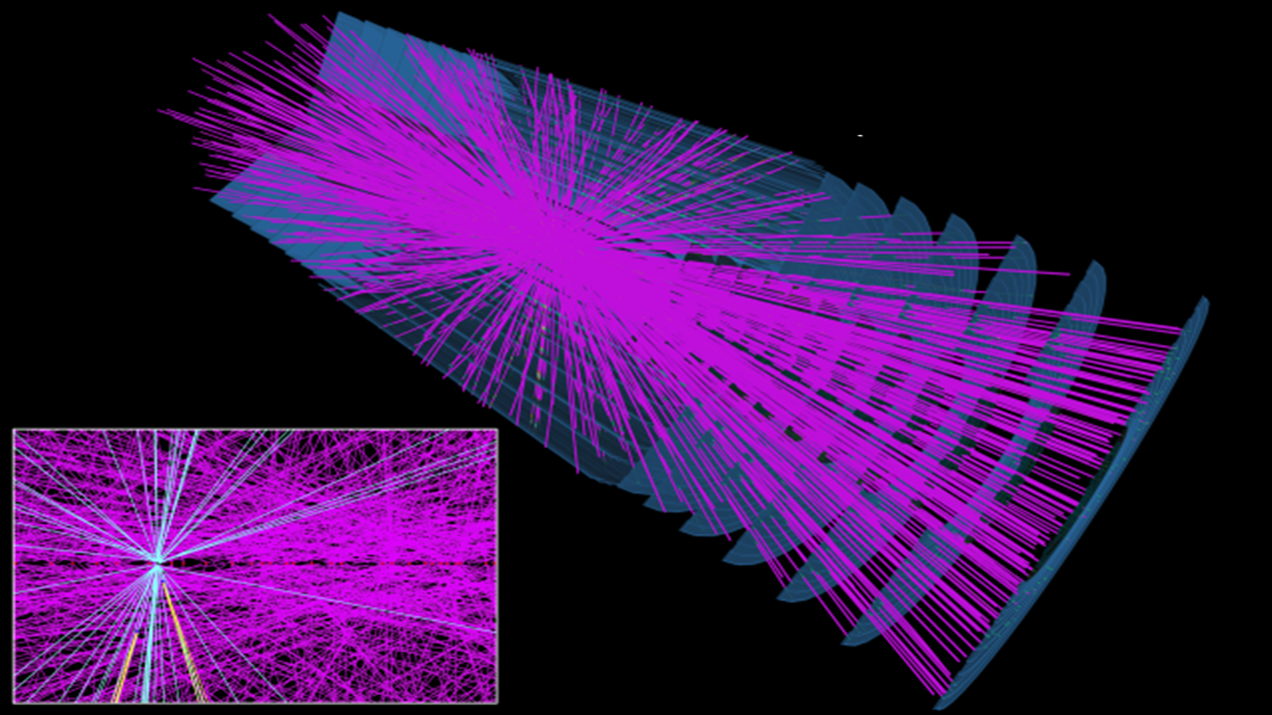
…
Simulated HL-LHC collision event in the ATLAS detector
…
Notes:
This picture is an example of a crossing for HL-LHC in the ATLAS detector
What do you think when you see that?

Slide 4
…
Simulated HL-LHC collision event in the ATLAS detector
…
Lots of collisions happening
in same crossing(high pile-up)
Notes:
Lots of collisions happening in the same crossing: what people call a high pile-up
This makes challenging to distinguish between two different collisions

Slide 5
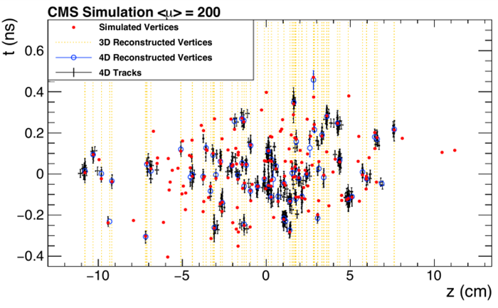
Timing helps removing pile-up
CMS and ATLAS
  Building timing detectors for phase-2 upgrades
Stringent constraints regarding clock quality
Josh Bendavid (CERN/LPC), Oct 2017
CMS detector performance for HL-LHC
Experiment Axis
Notes:
In order to overcome this challenge, i.e. to mitigate the pile-up, CMS and ATLAS will use timing
You can see here in this plot how timing is effective
Explanation plot: In the x-axis we have the experiment axis. The red dots show the simulate vertices.

Slide 6
Timing helps removing pile-up
CMS and ATLAS
  Building timing detectors for phase-2 upgrades
Stringent constraints regarding clock quality
Josh Bendavid (CERN/LPC), Oct 2017
CMS detector performance for HL-LHC
Experiment Axis
Notes:
Using a 3-D reconstruction, it is not possible to distinguish between some vertices.

Slide 7
Timing helps removing pile-up
CMS and ATLAS
  Building timing detectors for phase-2 upgrades
Stringent constraints regarding clock quality
Josh Bendavid (CERN/LPC), Oct 2017
CMS detector performance for HL-LHC
Experiment Axis
Notes:
However, using timing, i.e. a 4-D reconstruction, the tracks can be better estimated.
This poses important constraints regarding clock quality

Slide 8

The LHC Clock
LHC
Notes:
You understand why timing is important for the HL-LHC
Let’s now understand where the clock comes from in the LHC

Slide 9
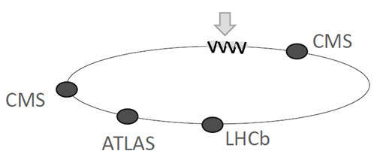
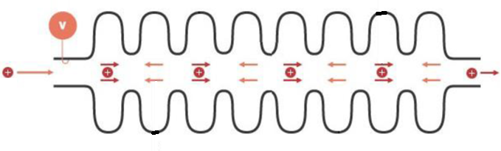
LHC Radio-Frequency
RF cavities accelerate the proton beam
RF cavities
A voltage generator induces an electric field inside the RF cavity oscillating at 400MHz
CMS
ALICE
ATLAS
LHCb
protons
Notes:
The RF is responsible for accelerating the particle beam
The RF cavities accelerate using a 400MHz electric field. This field is such that.

Slide 10

LHC Radio-Frequency
RF cavities accelerate the proton beam
RF cavities
A voltage generator induces an electric field inside the RF cavity oscillating at 400MHz
Protons always feel a force in the forward direction
CMS
ALICE
ATLAS
LHCb
protons
Notes:
Protons will always feel a force in the forward direction, i.e. to accelerate them

Slide 11

LHC Radio-Frequency
RF cavities accelerate the proton beam
RF cavities
A voltage generator induces an electric field inside the RF cavity oscillating at 400MHz
Protons always feel a force in the forward direction
CMS
ALICE
ATLAS
LHCb
protons
Protons never feel a force in the backward direction
Notes:
They never feel a force in the backward direction
It’s a complex control scheme but you could imagine that as someone giving a kick to a ball with a certain frequency.

Slide 12
LHC Radio-Frequency
RF generates the Bunch Clock
Buckets
LHC RF
~400.8MHz
0 1 2 3 4 5 6 7 8 9 10 11 12 13
Bunch
Bunch
Beam
Bunch
Clock
~40.08MHz
Notes:
This 400MHz RF clock is such that each edge is a bucket but only 1 out of 10 are filled with actual particles
This gives origin to the so-famous 40MHz bunch clock

Slide 13
LHC Radio-Frequency
RF generates the Bunch Clock
Buckets
LHC RF
~400.8MHz
0 1 2 3 4 5 6 7 8 9 10 11 12 13
Bunch
Bunch
Beam
Bunch
Clock
~40.08MHz
The Bunch Clock is phase-locked to the particle bunches
Notes:
The BC is phase-locked to the particle bunches
It is a very important clock in the LHC because…

Slide 14
Bunch Clock
In LHC detectors, all happens synchronously to the bunch clock…
Notes:
Several things are happening synchronously to the bunch clock such as…

Slide 15
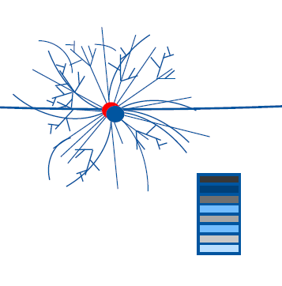
Bunch Clock
In LHC detectors, all happens synchronously to the bunch clock…
collisions
Notes:
The collisions themselves

Slide 16
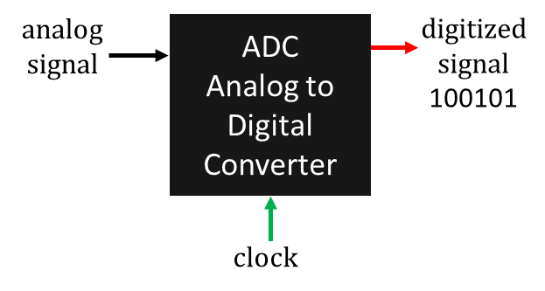
Bunch Clock
In LHC detectors, all happens synchronously to the bunch clock…
collisions
signal sampling
Notes:
Sampling of analog signals in the front-end

Slide 17
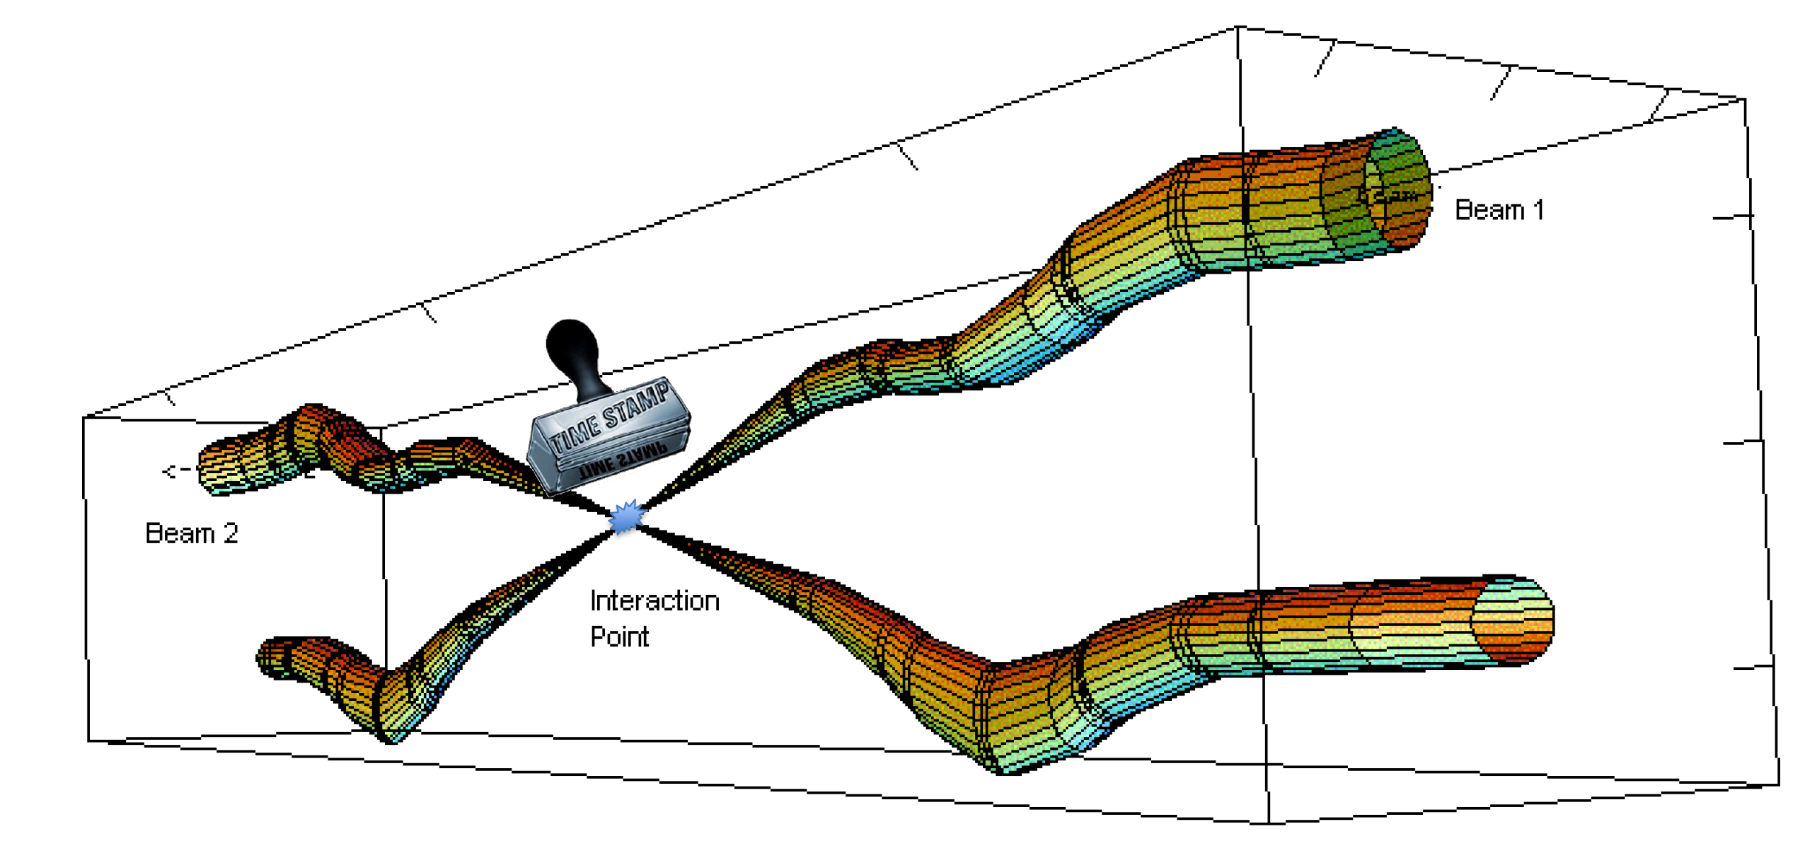
Bunch Clock
In LHC detectors, all happens synchronously to the bunch clock…
collisions
signal sampling
event time stamping
… and more
Notes:
And time stamping for an event
Just to name a few…

Slide 18
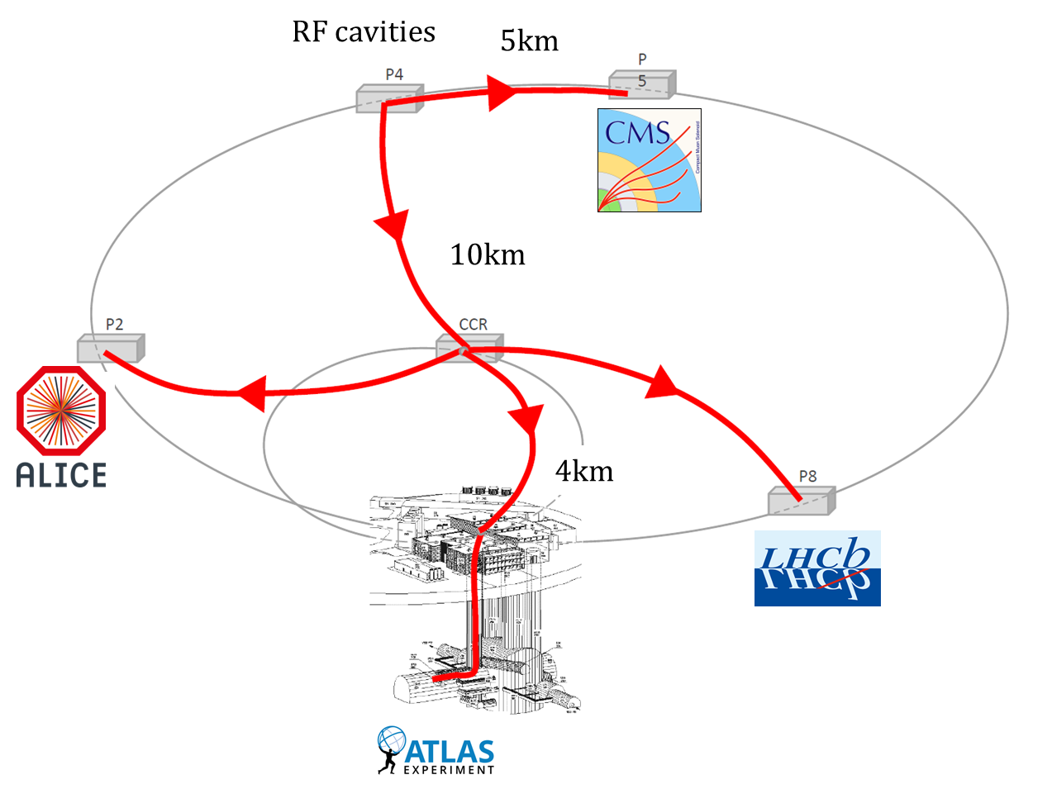
Bunch Clock distribution
The Bunch Clock is distributed to the four LHC experiments…
Notes:
This clock has to be distributed from the RF to the experiments
Currently there is a direct link to CMS and a link going to the CCR to the other three experiments

Slide 19
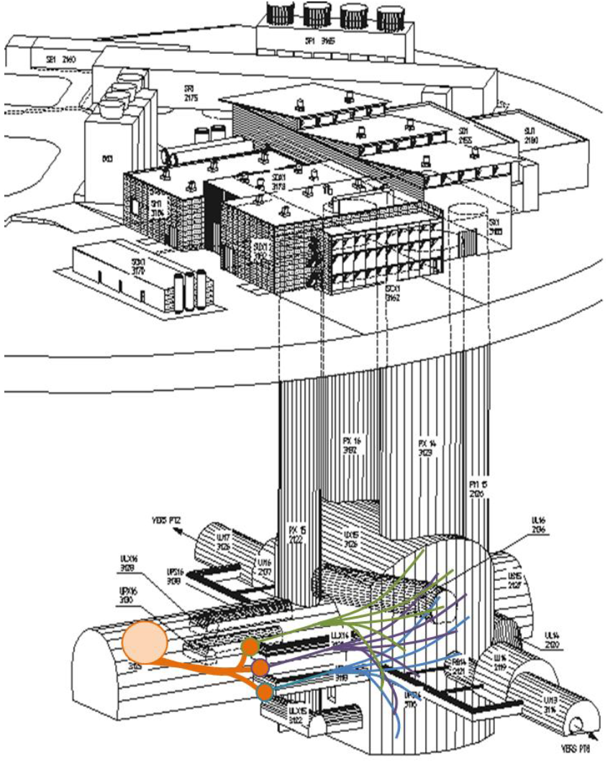
…
Bunch Clock distribution
…
Within each experiment, the Bunch Clock is distributed to thousands of destinations…
Notes:
Within an experiment, this clock is further distributed to thousands of destinations…

Slide 20
…
Bunch Clock distribution
…
Within each experiment, the Bunch Clock is distributed to thousands of destinations…
But how do we distribute a clock?
Notes:
But how do we distribute a clock?

Slide 21
…
Bunch Clock distribution
…
Within each experiment, the Bunch Clock is distributed to thousands of destinations…
But how do we distribute a clock?
Notes:
My talk is focused on timing distribution inside an experiment

Slide 22
Timing distribution techniques
Notes:
Distributing a clock means making a copy in some distant destination…

Slide 23
Pure Clock Link
Tx
photo
diode
reference
clock
laser
Rx
recovered
clock
Notes:
The simplest way to transmit a clock is using a pure clock link
For instance here, we have an optical link and the clock electric signal is transformed into light using a laser
In the receiving side, a photo-diode is used to retrieve the electrical signal
Although very interesting, this scheme is not so efficient…
Particularly for clock distribution to thousands of destinations inside an experiment where data also has to be sent for control, trigger, etc.

Slide 24
Self-synchronous link
Data
Source
Serializer
0100011101
0111011100
…
0 1 0 0 0 1 1 1 0 1 0 1 1 1 0 1 1 1 0 0
xN
reference
clock
Frequency multiplier
Notes:
For this reason, typically we use a self-synchronous link for timing distribution inside an experiment
Here you can see what a transmitter look like. You have a data-source in which you want to send several bits at each reference clock signal.
We need then a frequency multiplier (a PLL) and a serializer.
You can see here that the data is then serialized and converted into an optical signal.

Slide 25
Self-synchronous link
Data
Source
Clock and Data
Recovery
Data
Sink
Serializer
Deserializer
0100011101
0111011100
…
0 1 0 0 0 1 1 1 0 1 0 1 1 1 0 1 1 1 0 0
CDR
xN
÷N
reference
clock
Frequency multiplier
Frequency divider
recovered
clock
Notes:
In the receiving side, we first need to recover the high-speed clock using a clock and data recovery circuitry
The data is then deserialized and the clock is divided to retrieve the original frequency

Slide 26
Self-synchronous link
Data
Source
Clock and Data
Recovery
Data
Sink
Serializer
Deserializer
0100011101
0111011100
…
0 1 0 0 0 1 1 1 0 1 0 1 1 1 0 1 1 1 0 0
CDR
xN
÷N
reference
clock
Frequency multiplier
Frequency divider
recovered
clock
The recovered clock can have multiple phases depending on restart of frequency divider…
Notes:
Depending on when the frequency divided is started, the recovered clock can have multiple phases…

Slide 27
Self-synchronous link
Data
Source
Clock and Data
Recovery
Data
Sink
Serializer
Deserializer
0100011101
0111011100
…
0 1 0 0 0 1 1 1 0 1 0 1 1 1 0 1 1 1 0 0
CDR
xN
÷N
reference
clock
Frequency multiplier
Frequency divider
recovered
clock
… a Header 01 is used to recover the clock and data with a fixed-phase
Notes:
To ensure a fixed-phase and data retrieval, a header is used at the beginning of a frame to recover the clock and data
The recovered clock is shifted (or reset) until the recovered clock has the good phase

Slide 28
Self-synchronous link
Data
Source
Clock and Data
Recovery
Data
Sink
Serializer
Deserializer
0100011101
0111011100
…
0 1 0 0 0 1 1 1 0 1 0 1 1 1 0 1 1 1 0 0
CDR
xN
÷N
reference
clock
Frequency multiplier
Frequency divider
recovered
clock
… a Header 01 is used to recover the clock and data with a fixed-phase
Notes:
You can imagine this as if the clock is travelling in the optical link…

Slide 29

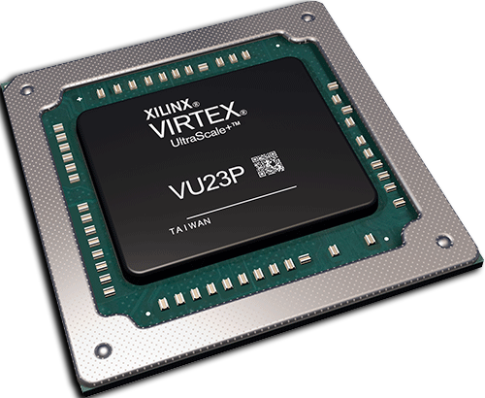
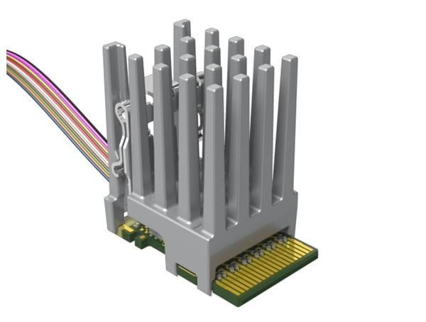
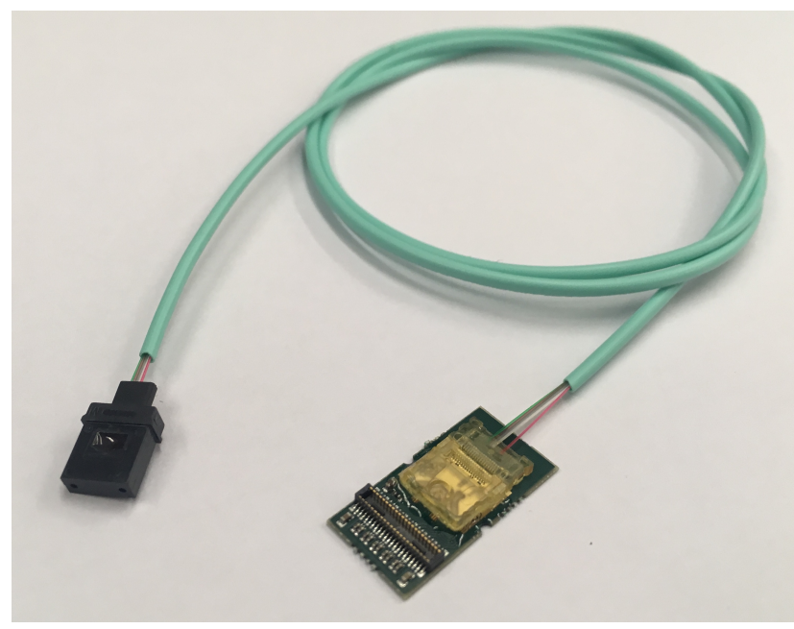
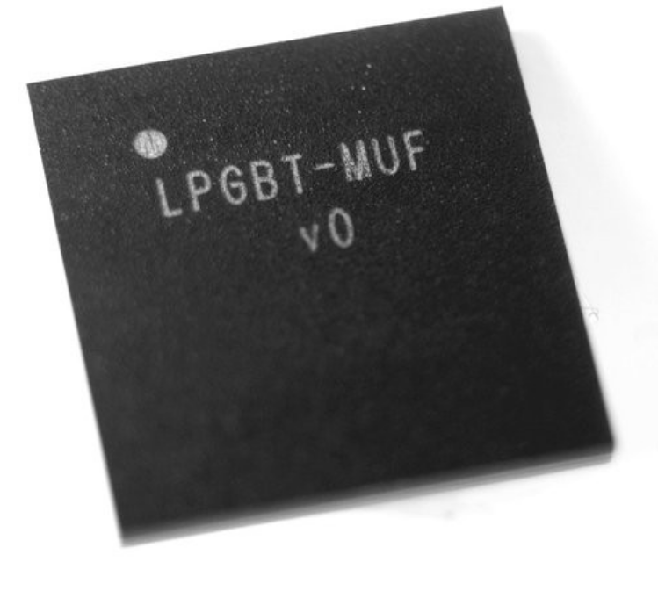
Self-synchronous link
Example: Versatile Link+ for phase-2 upgrades
0100011101
0111011100
…
0 1 0 0 0 1 1 1 0 1 0 1 1 1 0 1 1 1 0 0
CDR
xN
÷N
Firefly
VTRx+
lpGBT
FPGA
Notes:
- An example of hardware implementing this is the versatile link+ where we have an FPGA and commercial optical module in one side and the VTRx+ and lpGBT in the radiation zone

Slide 30
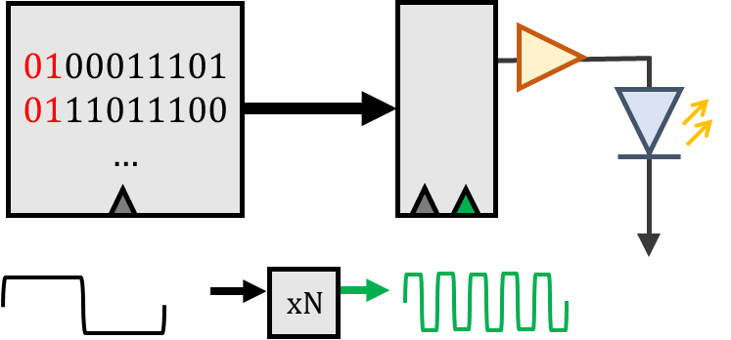
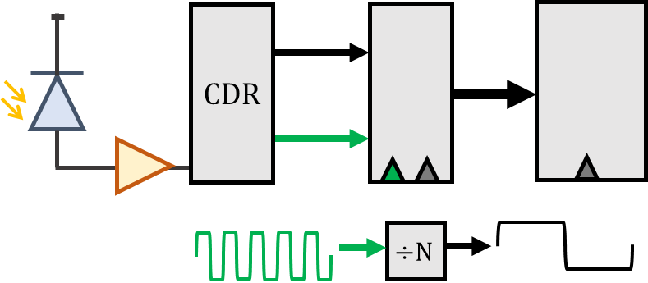
Bidirectional self-synchronous link
reference
clock
Downlink
recovered clock
PLL
Notes:
Typical links are actually bidirectional where the recovered clock is cleaned and re-used for data transmission

Slide 31
Bidirectional self-synchronous link
Temperature variations in fiber change phase of recovered clock
reference
clock
Downlink
recovered clock
Δ
Tx
Rx
Temperature
PLL
Temperature
Rx
Tx
Notes:
During our research we understood that if there are long-term phase variations in the link it may be required to mitigate that
This was the motivation behind the timing compensated link
One cannot directly measure the phase between the reference clock and recovered clock as they are far apart

Slide 32
Bidirectional self-synchronous link
Temperature variations in fiber change phase of recovered clock
reference
clock
Downlink
recovered clock
Δ
Tx
Rx
Temperature
PLL
Temperature
Rx
Tx
Uplink
recovered
clock
2Δ
Temperature
Notes:
Therefore, we rely on a phase measurement between the reference clock and uplink recovered clock…
A hypothesis is used to correlated the downlink phase variation to the roundtrip phase variation

Slide 33

Timing Compensated Link
TCLink implementation
reference
clock
Downlink
recovered clock
phase
detector
Loop
Filter
Phase
Shifter
Tx
Rx
PLL
Rx
Tx
Uplink
recovered
clock
Notes:
So this is how the TCLink works…
We use a phase detector to measure the phase and we can correct that using a very fine phase shifter which has a bin size of around 1.5ps
Such scheme exists since a long time in the field of timing distribution

Slide 34
Timing Compensated Link
TCLink implementation: fully integrated in FPGA
reference
clock
Downlink
recovered clock
phase
detector
Loop
Filter
Phase
Shifter
Tx
Rx
PLL
Xilinx Ultrascale FPGA
Rx
Tx
Uplink
recovered
clock
Notes:
What is innovative about TCLink is that all the blocks are integrated in the same FPGA
It does not require any external hardware…
Specific to ultrascale FPGAs

Slide 35
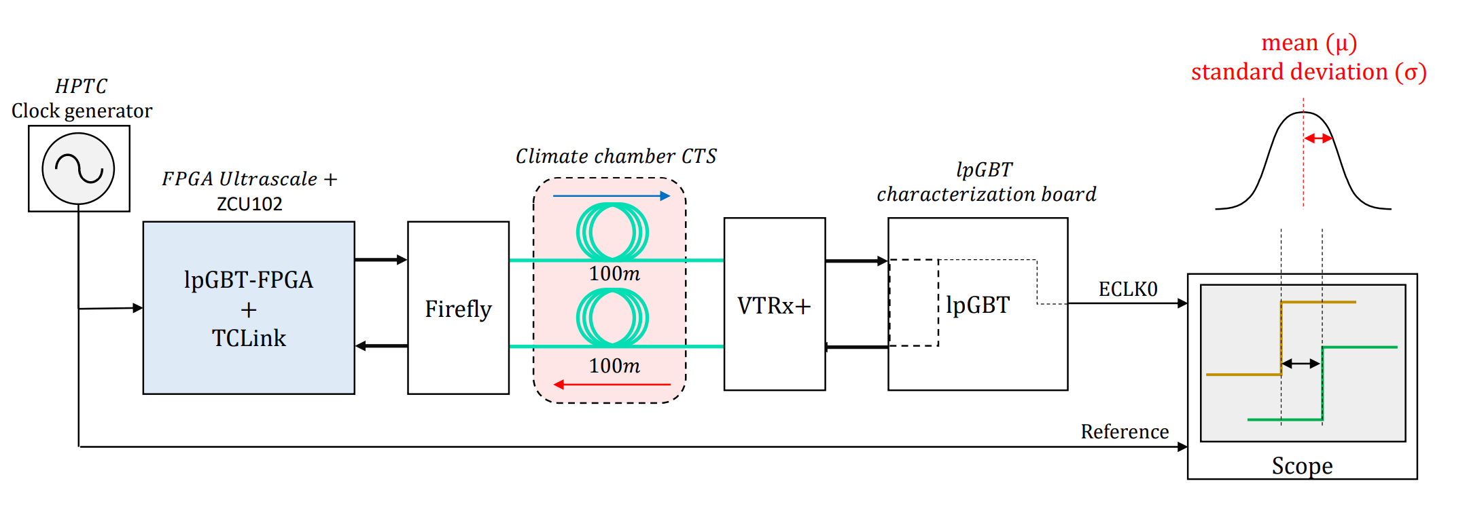
Timing Compensated Link
Let’s see its performance…
Notes:
To demonstrate how this works, I show you an example of measurement I have shown in TWEPP 2019
In this setup, we have an FPGA board implementing the lpGBT-FPGA and a firefly module. Then 100m of optical fiber in a climate chamber and a VTRx+ and lpGBT.
We are measuring the phase between the reference clock and the ELINK recovered clock.

Slide 36
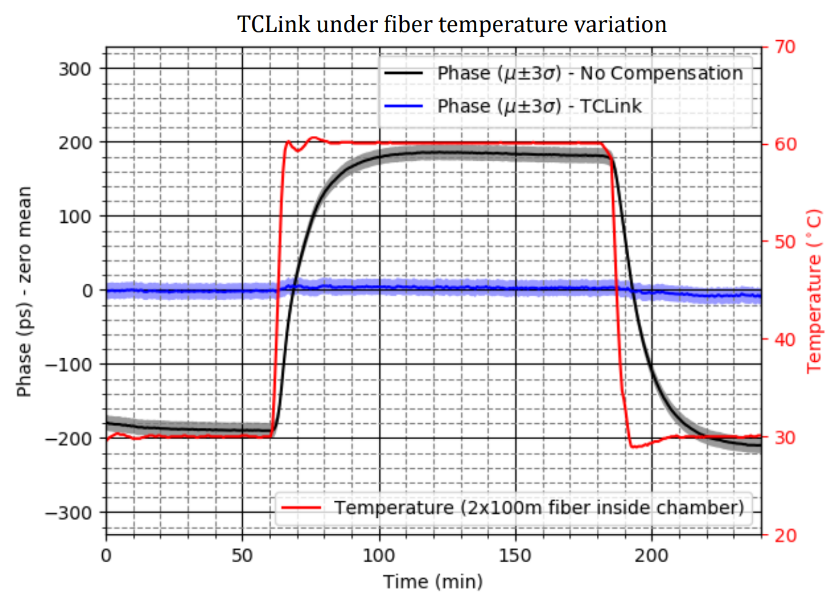
Timing Compensated Link
TCLink performance
  Controller tracks well phase changes due to fiber temperature drift
  Paper link here!
Notes:
You can see in this plot the phase versus time. We did a huge variation in temperature of 30degC here for illustration.
One can note that when no compensation is employed the phase has an excursion of 400ps compared to almost nothing when TCLink is operating.
Presented in TWEPP 2019

Slide 37

Overview of an experiment
ASIC
Point-to-point links
FPGA
Notes:
Now, when we look at the big picture inside an experiment.
We don’t have a single link..

Slide 38
Overview of an experiment
ASIC
Point-to-point links
FPGA
ASIC
FPGA
ASIC
FPGA
ASIC
Notes:
We have several front-ends

Slide 39

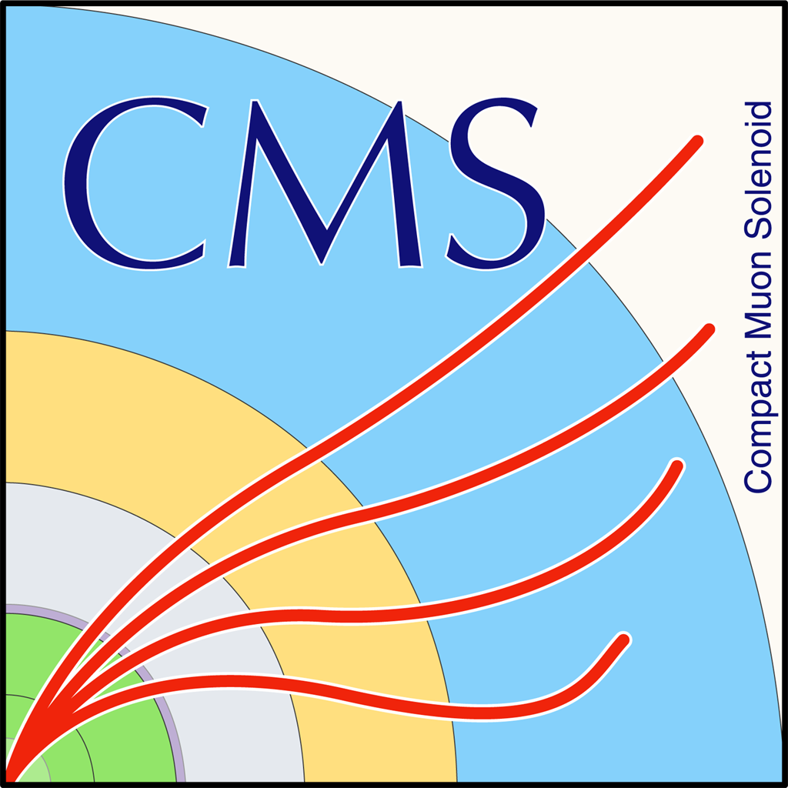
Overview of an experiment
ASIC
Point-to-point links
FPGA
FPGA
ASIC
FPGA
…
FPGA
ASIC
FPGA
Being evaluated for Phase-2 upgrades
FPGA
ASIC
Notes:
And the timing distribution looks more like that - several cascaded links.

Slide 40
Overview of an experiment
ASIC
Point-to-point links
FPGA
FPGA
ASIC
For more details, see the talk: “Design and Prototyping of the CMS Phase-2 Trigger and Timing Distribution System” from Jeroen Hegeman
FPGA
…
FPGA
ASIC
FPGA
Being evaluated for Phase-2 upgrades
FPGA
ASIC
Notes:
More example can be found in the talk from my colleague Jeroen on the CMS timing distribution system

Slide 41




Overview of an experiment
Clocks are not ideal in reality…
ASIC
FPGA
FPGA
ASIC
FPGA
FPGA
ASIC
FPGA
FPGA
ASIC
Notes:
In reality, a system looks more like that…
The clocks are not ideal and therefore they have some jitter…

Slide 42




Overview of an experiment
Clocks are not ideal in reality…
lpGBT
PLL
PLL
FPGA
FPGA
PLL
lpGBT
FPGA
PLL
PLL
FPGA
lpGBT
FPGA
PLL
FPGA
lpGBT
Notes:
Thanks to careful selection of PLLs and the lpGBT ASIC great performance, jitter can be reduced to 5ps rms
This is a simplistic view. The real merit here of achieving a good jitter is in the highly competent people designing the back-end and front-end boards used by the experiments as in the DTH for example.

Slide 43

Characterizing a clock
Notes:
How do we characterize a clock?

Slide 44
Basic principle of clock characterization
Measure the phase difference between a REF clock and the CUT
Reference
Clock
Under Test
Notes:
The basic principle of clock characterization is measuring the phase between the clock we want to test and an ‘ideal reference’
The reference can be a physical signal or a software reconstructed waveform with an ideal period

Slide 45
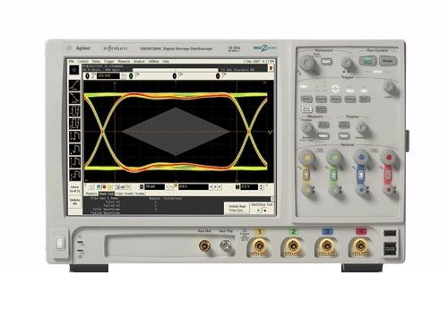
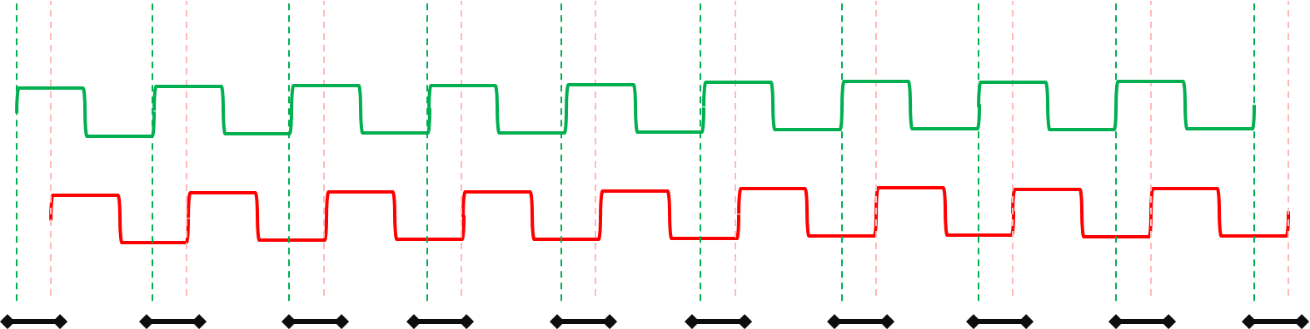
Time Interval Error Jitter
Time-based measurement
  Based on oscilloscope
  Nowadays we obtain O(5ps)
  Taken into account for physics simulation
Events
Mean - μ
Standard Deviation - σ
histogram
Time (ps)
Notes:
If we measure this phase and plot a histogram, we measure TIE jitter
We are interested in the standard deviation of this histogram
Nowadays we can obtain around 5ps rms
This kind of effect is taken into account in the physics simulation

Slide 46
Time Interval Error Jitter
Time-based measurement
  Based on oscilloscope
  Nowadays we obtain O(5ps)
  Taken into account for physics simulation
Events
Mean - μ
Standard Deviation - σ
histogram
~10ms
Time (ps)
Notes:
- Since the phase deviation is measured on a window of around 10ms, this only accounts for fast variations in a clock phase

Slide 47
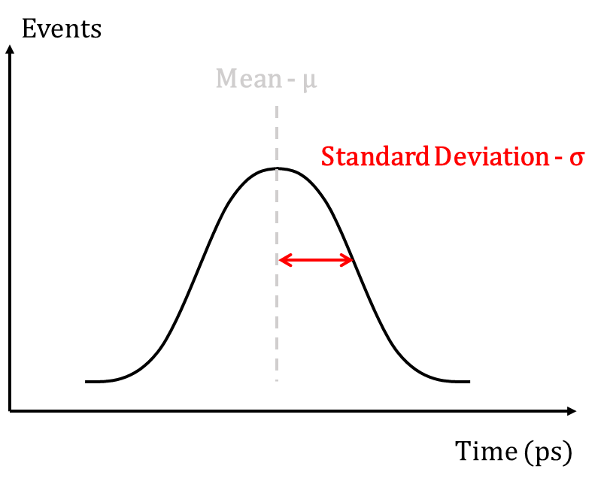
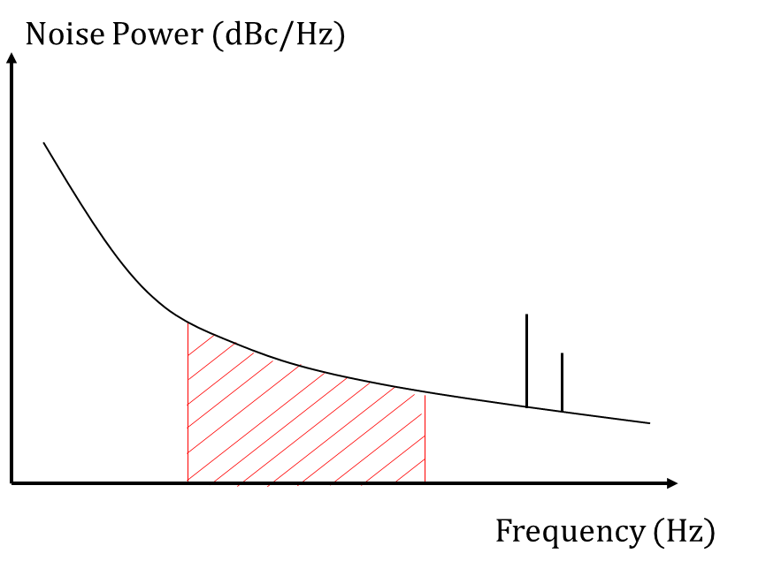
Measuring clock quality
Clock
Quality
Fast
Variations
(<1s)
time
freq.
TIE Jitter
Phase
Noise
Notes:
In the big picture, we can measure fast phase variations using TIE jitter or phase noise
However, slow phase variations are also important in a system

Slide 48
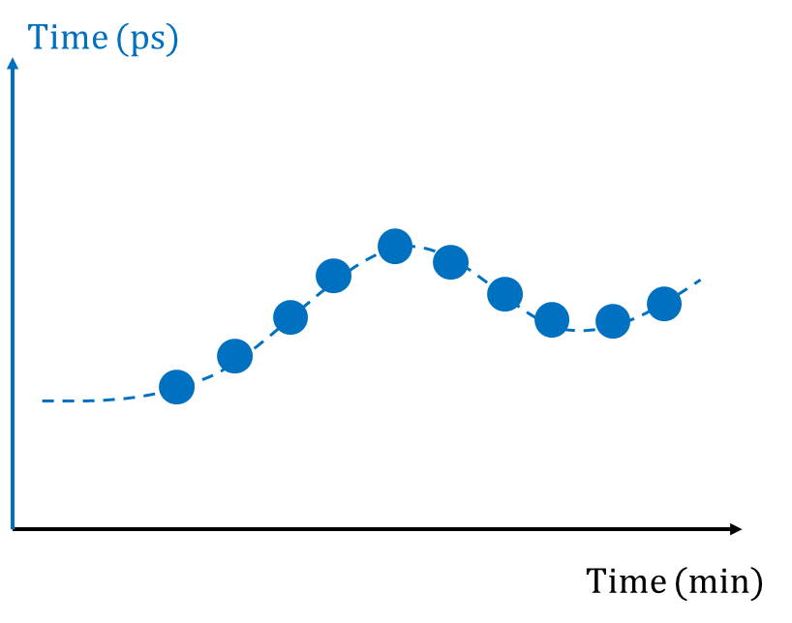
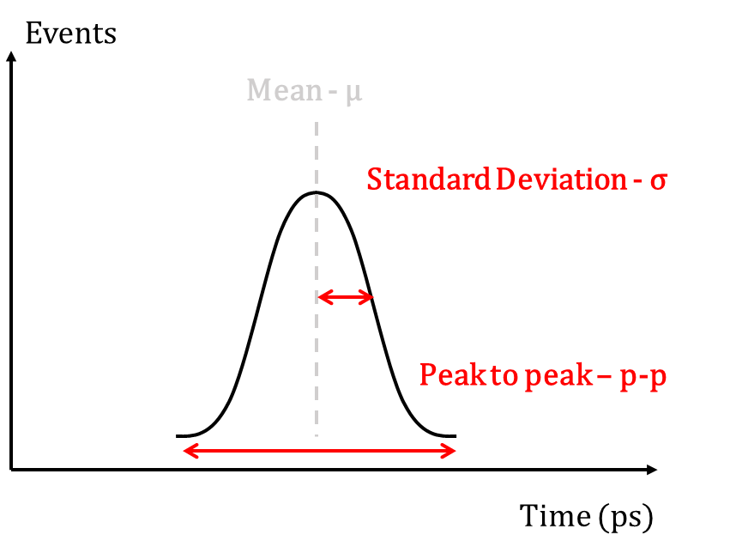
Measuring clock quality
Clock
Quality
Fast
Variations
(<1s)
Slow Variations
(>1s)
time
freq.
trend
restart
TIE Jitter
Phase
Noise
Phase
Time Trend
Phase
Determinism
Notes:
In particular, in this talk I am focusing in phase determinism
From now on, we will talk only about that

Slide 49
Phase-determinism (reproducibility)
How much phase average change after restarts (e.g. power cycles)?
Reference
Clock
Under Test
Average
Notes:
How much the phase average changes after restarts?

Slide 50
Phase-Determinism (reproducibility)
Time-based measurement
Events
TIE plot
Events
Phase determinism
Mean - μ
Mean - μ
histogram
of means
Repeat measurement several times
restarting system
Standard Deviation - σ
Standard Deviation - σ
Peak to peak – p-p
Time (ps)
Time (ps)
Notes:
We capture the phase histogram between two clocks and we are interested in the mean
We make a histogram of means and obtain phase determinism
The most important value here seems to be peak-peak which shows an offset between clocks

Slide 51
Phase-determinism in an experiment
ASIC
At each restart, phase is slightly different
FPGA
FPGA
ASIC
FPGA
FPGA
ASIC
FPGA
RUN - 1
FPGA
ASIC
Notes:
Let me illustrate here with an example. Imagine we have a first run and all clocks are aligned.
You can see I am ignoring jitter here…

Slide 52
Phase-determinism in an experiment
ASIC
At each restart, phase is slightly different
FPGA
FPGA
ASIC
FPGA
FPGA
ASIC
FPGA
RUN - 2
FPGA
ASIC
Notes:
Now in the next run, you restart your system or power-cycle and we can see that some of them are off….

Slide 53
Phase-determinism in an experiment
ASIC
At each restart, phase is slightly different
FPGA
FPGA
ASIC
FPGA
FPGA
ASIC
FPGA
RUN - 3
FPGA
ASIC
Notes:
And in the next one again…

Slide 54
Phase-determinism in an experiment
ASIC
At each restart, phase is slightly different
FPGA
FPGA
ASIC
FPGA
FPGA
ASIC
FPGA
RUN - 4
FPGA
ASIC
Notes:
And so on…
The big deal here is that these phase jumps remain like that during the whole duration of the run
Therefore all timing measurements will be impacted. Can this be modelled in physics as a random like jitter or do we need new tools for that? I can’t fully answer this questions…
But first of all… let’s try to understand where these jumps can come from…

Slide 55
Phase variation sources
Notes:
But where does these phase variations come from?

Slide 56
Where phase variations come from?
(1) Unit Interval phase variations
0100011101
0111011100
…
0 1 0 0 0 1 1 1 0 1 0 1 1 1 0 1 1 1 0 0
CDR
xN
÷N
Notes:
So there are two main natures of phase variations
The first one is what I call the Unit Interval Level

Slide 57
Where phase variations come from?
(1) Unit Interval phase variations
0100011101
0111011100
…
0 1 0 0 0 1 1 1 0 1 0 1 1 1 0 1 1 1 0 0
CDR
xN
÷N
Unit Interval ~ 100ps
Notes:
The Unit Interval is the highest frequency period in the design
Typically in our 10Gb/s links, the UI is 100ps

Slide 58
Multiply-divide phase variations
Unit Interval level
reference
clock
recovered
clock
xN
÷N
Frequency multiplier
Frequency divider
Notes:
The most known source if phase variations are what I call multiply-divide
This happens whenever we multiply a clock and divide afterwards. This kind of operation is present in high-speed links, PLLs, etc…
The frequency here can change because the frequency divider can start at different periods…

Slide 59
Multiply-divide phase variations
Unit Interval level
PLLs and FPGA SerDes can suffer from this
  Typically, not so hard to find root-cause…
reference
clock
recovered
clock
Th
Th
xN
÷N
Frequency multiplier
Frequency divider
Notes:
So as you can see here, the recovered clock phase can change with a period of the high-speed clock
This is analogous to what I mentioned earlier for the header…
This kind of variations are relatively easy to spot because we only need to understand the multiply/divider factors in a circuit

Slide 60
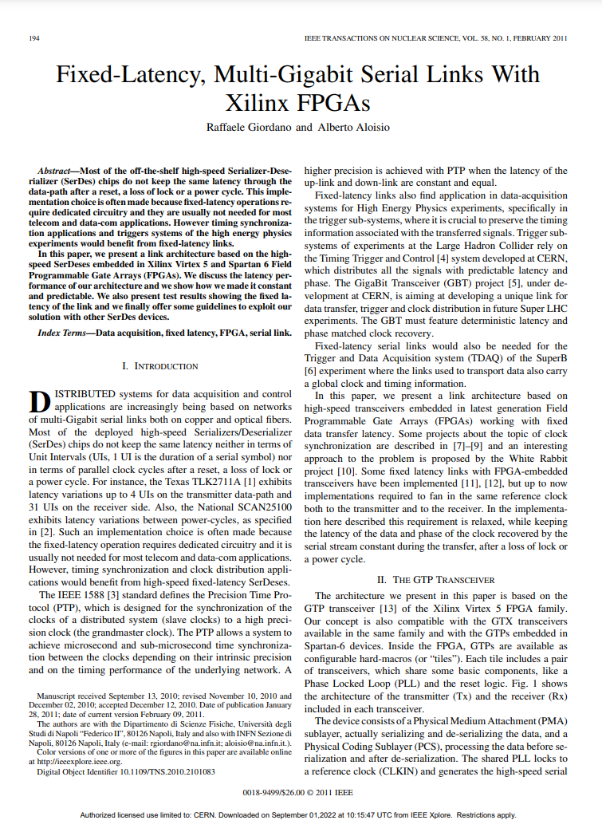
Multiply-divide phase variations
Unit Interval level
UI level fixed-phase FPGA SerDes appeared first in IEEE TNS 2011(link here)
  Techniques applied in main CERN projects for timing distribution (GBT-FPGA, TTC-PON, …)
Notes:
In what concerns FPGA SerDes, the implementation of fixed-phase appeared in IEEE TNS 2011
The same techniques described in this paper are implemented in many CERN projects for timing distribution such as GBT-FPGA, TTC-PON, etc
At that time we were very happy with our performance

Slide 61
Where phase variations come from?
(2) sub-Unit Interval phase variations
0100011101
0111011100
…
0 1 0 0 0 1 1 1 0 1 0 1 1 1 0 1 1 1 0 0
CDR
xN
÷N
Notes:
The second type of phase variations are the sub-UI level

Slide 62
Where phase variations come from?
(2) sub-Unit Interval phase variations
0100011101
0111011100
…
0 1 0 0 0 1 1 1 0 1 0 1 1 1 0 1 1 1 0 0
CDR
xN
÷N
Sub-UI variations are in the order of ~10s of ps
Notes:
The second type of phase variations are the sub-UI level
They are in the order of 10s of ps. To understand them, we need to understand details in the circuit.

Slide 63
Where phase variations come from?
(2) sub-Unit Interval phase variations
0100011101
0111011100
…
0 1 0 0 0 1 1 1 0 1 0 1 1 1 0 1 1 1 0 0
CDR
xN
÷N
Sub-UI variations are in the order of ~10s of ps
Notes:
Let’s use an example for the transmitter

Slide 64
Calibration-related phase-variations
sub-Unit Interval Level
  Example: mesochronous clock-domain-crossing (CDC)
Fabric
SerDes
0100011101
0111011100
xN
Notes:
Now, there is another class of phase variations that I call calibration-related
These are very dependent on particular design choices in a circuit
For this example let’s consider a register-based clock domain crossing in the FPGA SerDes
We have here a parallel clock in the SerDes which is sent to the fabric for the user clocking his logic
Mesochronous CDC refers to the fact that we are talking about the same frequency but an unknown phase

Slide 65
Calibration-related phase-variations
sub-Unit Interval Level
  Example: mesochronous clock-domain-crossing (CDC)
Fabric
SerDes
0100011101
0111011100
xN
Clock tree delay
Notes:
In reality, the clock tree induces a delay in the clock going to the fabric

Slide 66
Calibration-related phase-variations
sub-Unit Interval Level
  Example: mesochronous clock-domain-crossing (CDC)
Fabric
SerDes
0100011101
0111011100
Reg CDC
xN
Clock tree delay
Notes:
Therefore, we need a clock domain crossing to handle these phase differences

Slide 67
Calibration-related phase-variations
sub-Unit Interval Level
  Example: mesochronous clock-domain-crossing (CDC)
Fabric
SerDes
0100011101
0111011100
Reg CDC
xN
Clock tree delay
Notes:
Since this delay is not known a priori…

Slide 68
Calibration-related phase-variations
sub-Unit Interval Level
  Example: mesochronous clock-domain-crossing (CDC)
Fabric
SerDes
0100011101
0111011100
Reg CDC
Phase
Shifter
xN
Clock tree delay
Notes:
A phase shifter is used to ensure no metastability occurs in the register based CDC
Every time you restart the transceiver, the phase shifter will have a slightly different value

Slide 69
Calibration-related phase-variations
sub-Unit Interval Level
  Example: mesochronous clock-domain-crossing (CDC)
Fabric
SerDes
0100011101
0111011100
Reg CDC
Phase
Shifter
xN
Clock tree delay
Notes:
Phase between reference clock and transmitted data change

Slide 70
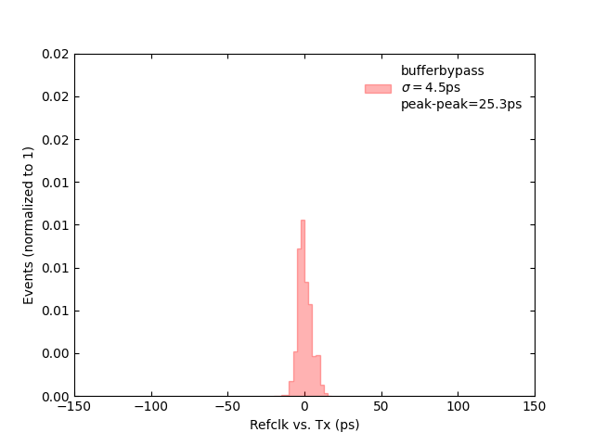
Calibration-related phase-variations
  Example for Ultrascale Transmitter
sub-Unit Interval Level
3x Unit Interval
Clock
gen
Probability density function
Scope
FPGA
Tx
Notes:
If we measure the phase between the reference clock and the transmitter data of the FPGA this is the histogram we obtain
I remind you the measurement here is the mean phase for several resets. The histogram is the mean phase…
It looks like the phase does not change..

Slide 71
Calibration-related phase-variations
  Example for Ultrascale Transmitter
sub-Unit Interval Level
3x Unit Interval
Clock
gen
Probability density function
Scope
FPGA
Tx
Notes:
But we decided to look for more details…

Slide 72
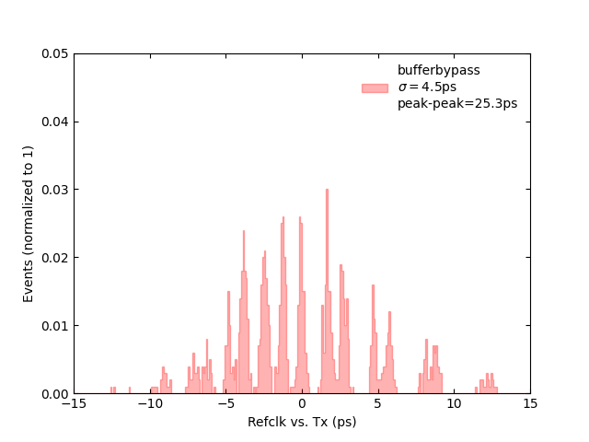
Calibration-related phase-variations
  Example for Ultrascale Transmitter
sub-Unit Interval Level
0.3x Unit Interval
Clock
gen
Probability density function
Scope
FPGA
Tx
Notes:
And if we zoom the timescale to 30ps we actually observe there are different gaussians here…

Slide 73
Calibration-related phase-variations
  Example for Ultrascale Transmitter
sub-Unit Interval Level
Phase shifter bin size~1.5ps
Clock
gen
Probability density function
Scope
FPGA
Tx
Notes:
Indeed, we find out the phase step used for the phase aligner

Slide 74
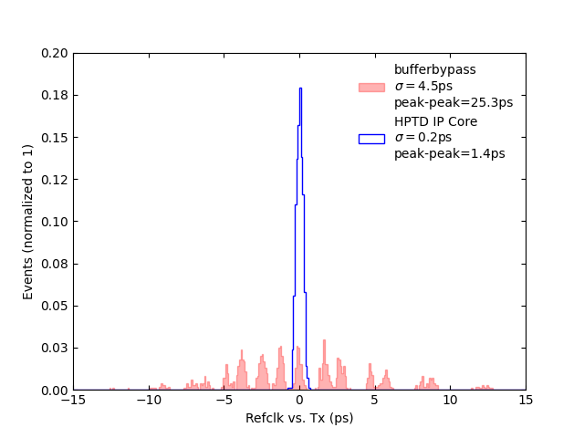
Calibration-related phase-variations
  Example for Ultrascale Transmitter
sub-Unit Interval Level
Clock
gen
Probability density function
Scope
FPGA
Tx
Notes:
We managed to solve that using our own core for phase alignment improving the way it is done… You can observe in blue here our results.

Slide 75
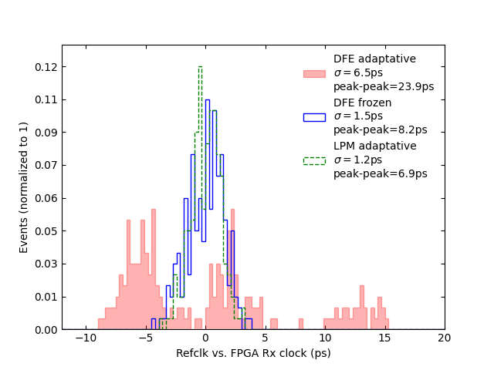
Calibration-related phase-variations
  Example for Ultrascale Receiver
sub-Unit Interval Level
DFE: Discrete Feedback Equalizer
LPM: Low-Power Mode equalizer
Probability density function
Notes:
Another example of calibration related phase variations was what we observed with the receiver equalizer
If set in the Discrete Feedback Equalizer mode, a non-linear equalizer, every time the circuit was initialized the calibration calculated different values and we observed phase shifts up to 24ps range
In this case, simply freezing the parameters or using the low-power mode, a linear equalizer, the jumps were gone

Slide 76
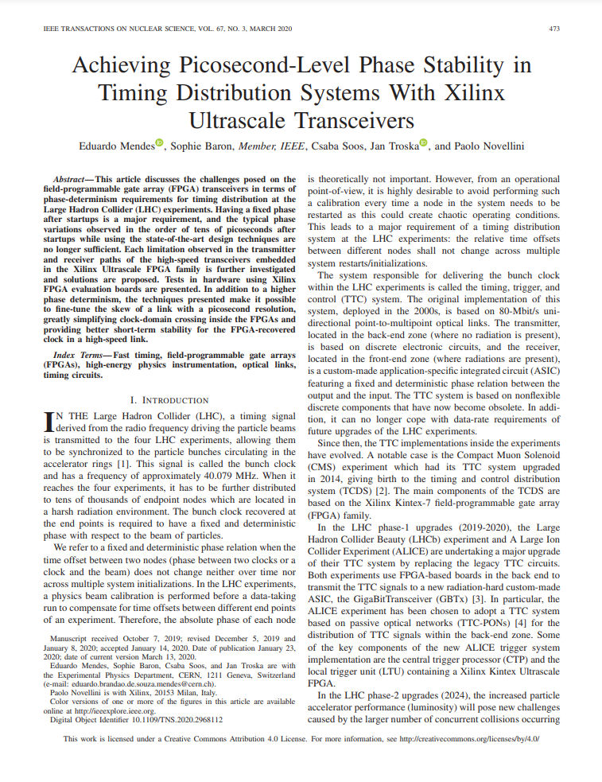
Calibration-related phase-variations
  First published by our team in 2020 IEEE TNS (link here)
  Close collaboration with Xilinx
sub-Unit Interval Level
Notes:
The results have been discussed in our paper published in 2020 in IEEE TNS
Indeed, a close collaboration with Xilinx was required because these effects are very technology dependent

Slide 77
Calibration-related phase-variations
  First published by our team in 2020 IEEE TNS (link here)
  Close collaboration with Xilinx
  Results have been applied in several institutes and companies worldwide
    Thanks to CERN Open Hardware License
    IEEE TNS most popular paper of 04/20
sub-Unit Interval Level
Notes:
However, we are not the only ones caring about
Many companies and institutes have contacted us to use our results in diverse fields
And they are publicly available thanks to the CERN Open Hardware License

Slide 78
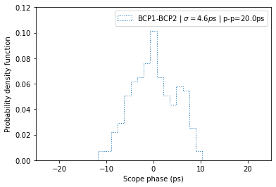
Typical phase jumps
Example: BCP board for CMS
Clock
gen
Scope
Probability density function
BCP1
FPGA
BCP2
FPGA
Notes:
So what are the phase jumps we can obtain nowadays?
Here is a result from my colleague Nikitas using the Barrel Calorimeter Processor board
In a link with a single hop and an FPGA-FPGA link we obtain around 4.6ps rms or 20ps pk-pk
We obtained similar values for other links based on eval. Boards. The result has been cross-checked extensively.

Slide 79
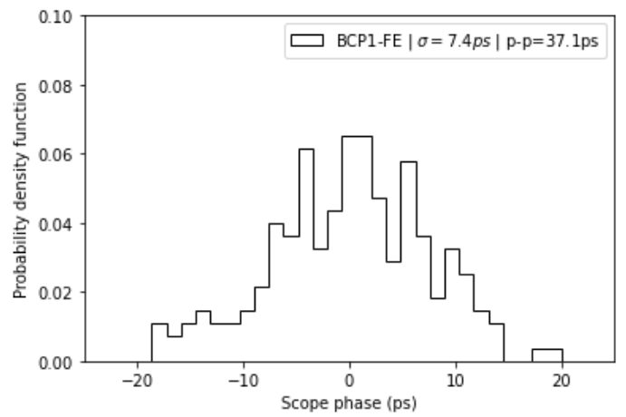
Typical phase jumps
Example: BCP board for CMS
Clock
gen
Scope
Probability density function
BCP1
FPGA
BCP2
FPGA
BCP3
FPGA
FE
lpGBT
Notes:
In a link with three hops, he obtained around 7ps rms or 40ps peak-peak for 200 resets at a constant temperature
So this is a representative value we would obtain in a timing distribution link
This means we can have an offset as big as 40ps between different nodes in a system

Slide 80
Typical phase jumps
Example: BCP board for CMS
Clock
gen
For more details, see the poster: “Clock stability measurements using the Barrel Calorimeter Processor V1” from Nikitas Loukas and Stephen Goadhouse
Scope
Probability density function
BCP1
FPGA
BCP2
FPGA
BCP3
FPGA
FE
lpGBT
Notes:
For more information you can visit his poster in this conference…

Slide 81
Is it stable enough?
Specifications are not so clear as these phase jumps have not been simulated in the physics
Experts agree the value should be AGAPe
Notes:
Are the metrics we obtain enough?
The only ones that can definitively answer these questions are the ones simulating its effect in physics
The only think all experts agree is that the value should respect the AGAP golden number

Slide 82
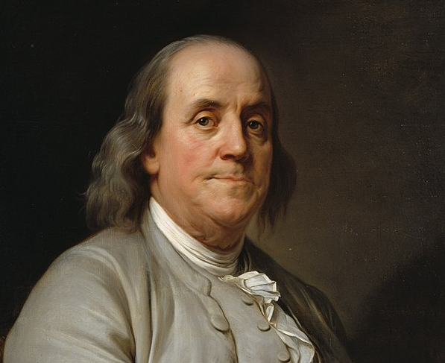
Is it stable enough?
Specifications are not so clear as these phase jumps have not been simulated in the physics
Experts agree the value should be As Good As Possible
“If better is possible, good is not enough”
- Benjamin Franklin
Notes:
As Good as Possible…

Slide 83
Is it stable enough?
Specifications are not so clear as these phase jumps have not been simulated in the physics
Typical values being discussed and simulated by detector physicists
Probability density function
Notes:
But only the physics will ultimately tell us if these results are enough

Slide 84
Looking forward in the future
Notes:
So what is the future for timing distribution?

Slide 85
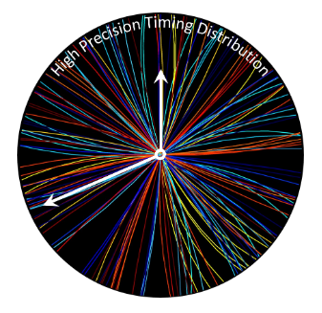
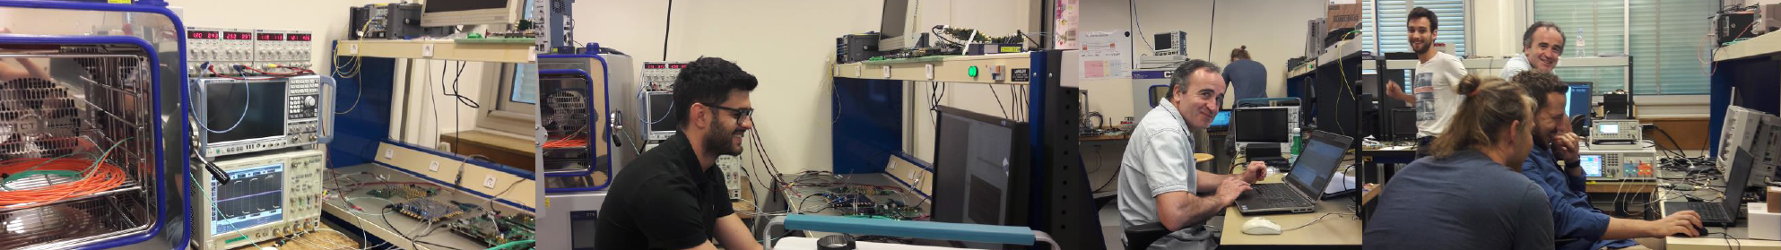
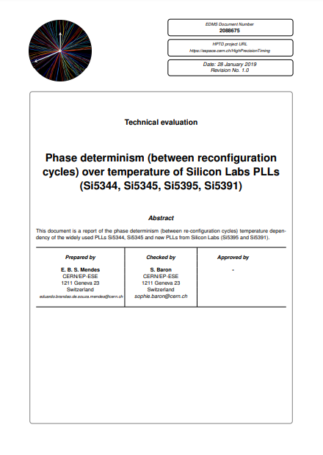
CERN R&D in precision timing distribution
CERN HPTD interest group founded in 2018
  +100 members – 12 meetings
Interdisciplinary collaboration: ASIC, FPGA, board design, physics, etc…
Notes:
In order to support High Precision Timing CERN has founded the HPTD interest group in 2018
We have more than 100 members and 12 meetings and host users in the timing lab for measurements
It is a interdisciplinary group of people tackling precision timing challenges

Slide 86
For more details, see the contributions:
“RAFAEL: A Clock and Data Fan-Out ASIC for CMS HL-LHC Upgrades” from Fabrice Guilloux et al.
“Radiation-Tolerant All-Digital Clock Generators for HEP Applications” from Stefan Biereigel et al.
“Evaluation of GBT-FPGA for Timing and Fast Control in CBM experiment” from Vladimir Sidorenko et al.
“The ALICE central trigger system for LHC Run3” from Marian Krivda et al.
“Design and testing of long Flexible Printed Circuits for the ATLAS High Granularity Timing Detector demonstrator” from Marisol Robles et al.
CERN R&D in precision timing distribution
CERN HPTD interest group founded in 2018
  +100 members – 12 meetings
Interdisciplinary collaboration: ASIC, FPGA, board design, physics, etc…
Notes:
Many of them are presenting in this conference…

Slide 87
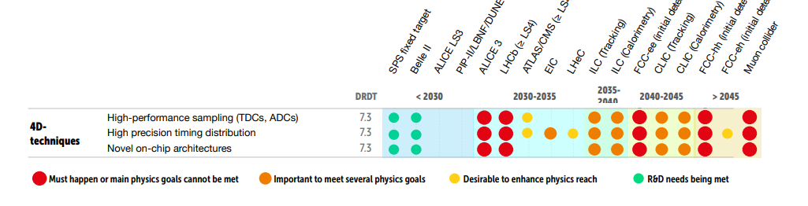
Looking further in the future…
ECFA 2021 detector R&D Roadmap (link here)
  High-precision timing will remain a hot topic in the next decades for HEP
Notes:
Looking forward in the future, 4-D reconstruction techniques remain a key topic for HEP in the next decades
In fact, here you can see in the European Committee for Future Accelerators 2021 roadmap that high-precision timing distribution is a Must Happen

Slide 88
Looking further in the future…
ECFA 2021 detector R&D Roadmap (link here)
  High-precision timing will remain a hot topic in the next decades for HEP
For more details, see the talk: “ECFA roadmap implementation for future R&D in electronics” from Francois Vasey
Notes:
More information tomorrow

Slide 89
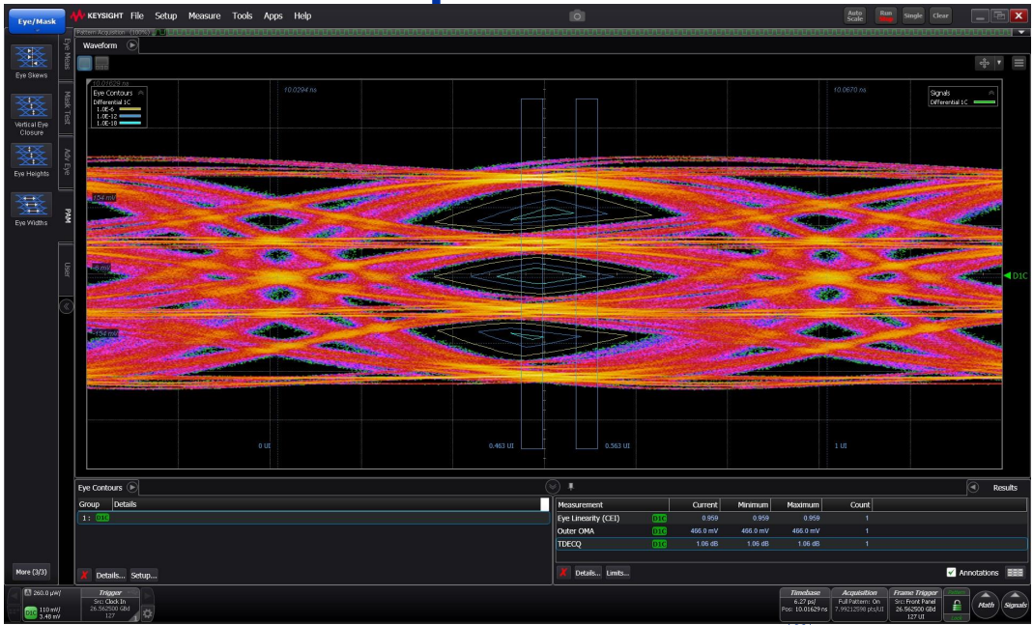
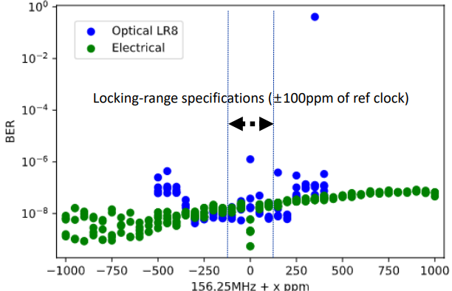
Looking further in the future…
Exciting challenges to come
  COTS electronics will present ever higher complexity
  Just as an example, for newer optical modules, data-rate is narrow…
Notes:
COTS electronics will present ever higher complexity and therefore new exciting challenges will emerge in the field
For instance, with modern PAM-4 transceiver not even the data-rate is guaranteed

Slide 90
Looking further in the future…
Exciting challenges to come
  COTS electronics will present ever higher complexity
  Just as an example, for newer optical modules, data-rate is narrow…
For more details, see the talk: “DART28-FPGA implementation study for future high-speed links” from Chaowaroj (Max) Wanotayaroj
Notes:
You can see more in the talk of Max…

Slide 91
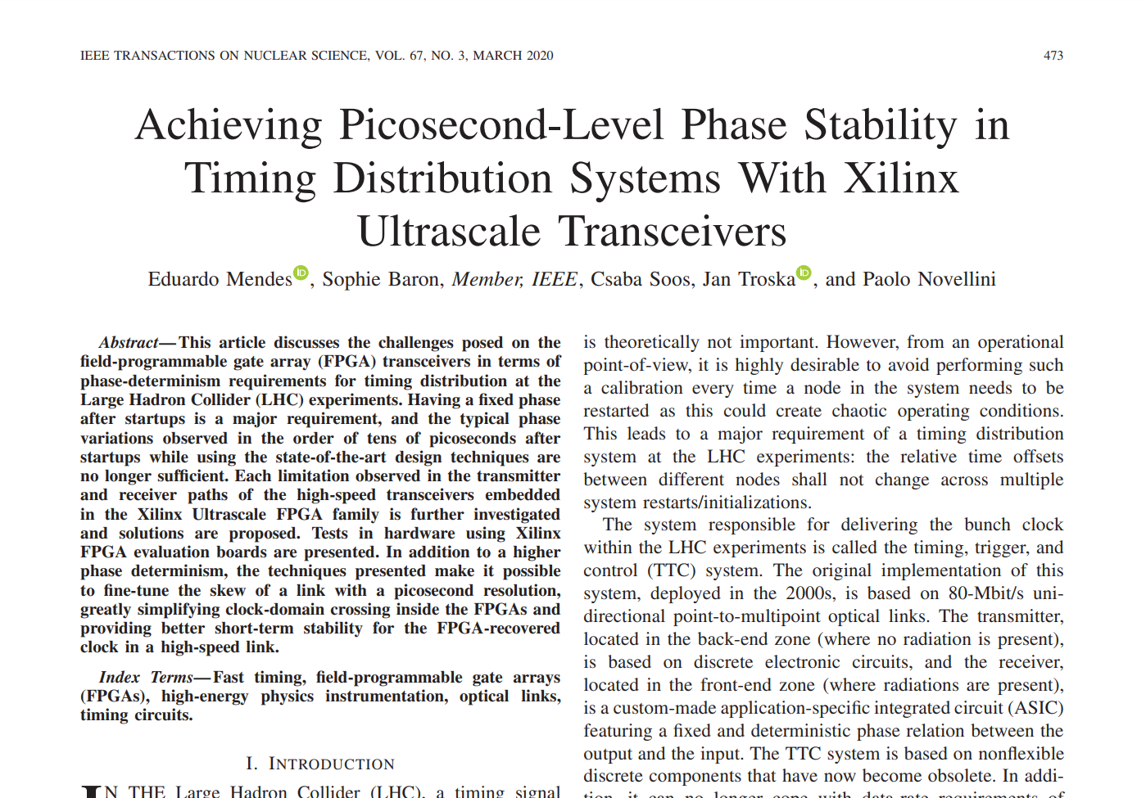
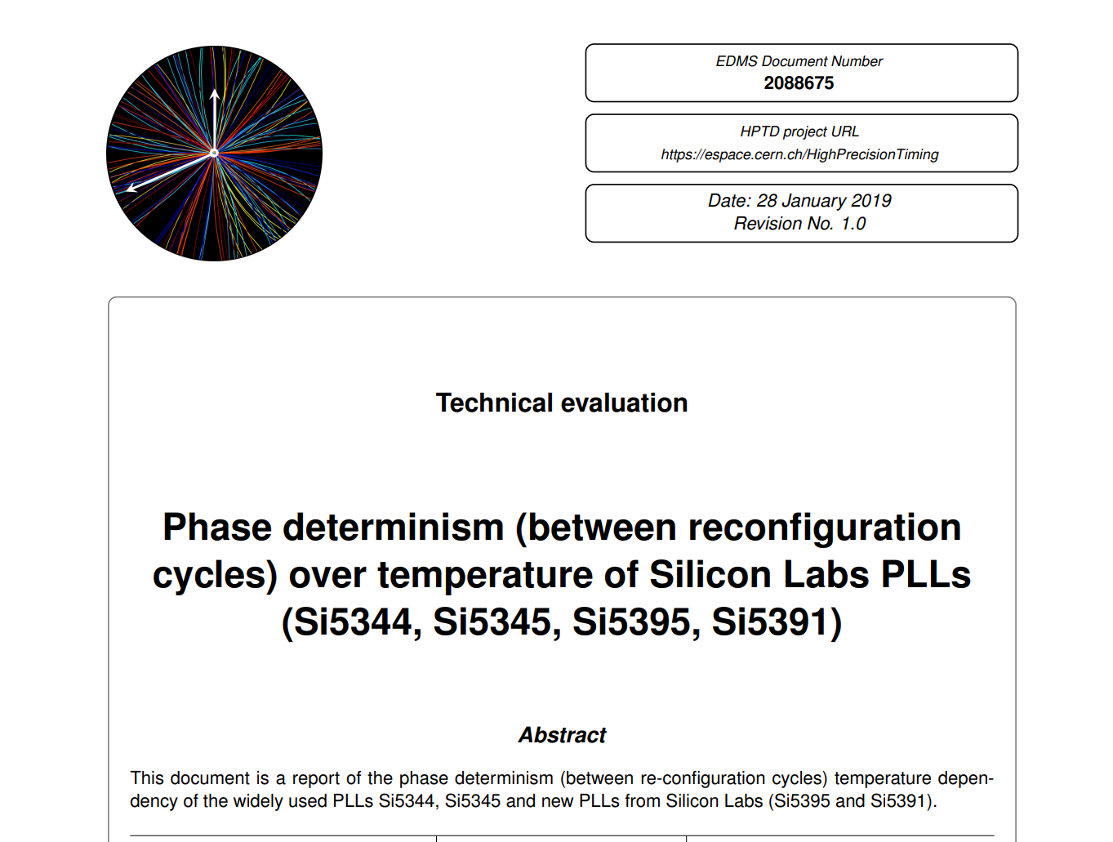
Looking further in the future…
Current performances depend on specific hardware
  Not guaranteed in the future…
  Market not necessarily focused in same problematics…
Notes:
Our current performance is very dependent on the current technology we use
Paper is dependent on FPGA family, reports on specific PLL vendors

Slide 92
Looking further in the future…
Current performances depend on specific hardware
  Not guaranteed in the future…
  Precision of timing distribution will not improve as a mere consequence of moving to higher technology nodes…
Very important for CERN to keep active in high-precision timing and maintain this knowledge in the long-term
Notes:
Differently than speed, power, etc. We should not expect an improvement in timing as a mere consequence of moving to higher technology nodes…
Very important for CERN to keep active investigation in timing

Slide 93

Thanks
Subscribe to the High Precision Timing Distribution group for more information (search and subscribe)
Next HPTD meeting: 08/11/2022
Notes:
If you are interested to know more, we have a HPTD meeting on 8 November where these topics on high precision timing distribution will be discussed
You can subscribe to our interest group here
Otherwise, thank you so much for your attention…

Slide 94
Credits & Acknowledgements
Thanks to Alex Kluge and the TWEPP committee for the invitation
Thanks to colleagues who helped this talk
  Sophie Baron, Jan Troska, Csaba Soos, Daniel Hernandez, Max Wanotayaroj, Nour Guettouche, Philippa Hazell, Stefan Biereigel, Garance (EP-ESE)
  Nikitas Loukas (University of Notre dame)
  Jeroen Hegeman (EP-CMX)
  Paolo Novellini (Xilinx)

Slide 95
References & Useful links
TCLink
  Paper: https://pos.sissa.it/370/057/pdf
  Gitlab: https://gitlab.cern.ch/HPTD/tclink
Papers on phase-determinism
  UI-level phase fixed: https://ieeexplore.ieee.org/document/5703158
  Sub-UI level phase fixed: https://ieeexplore.ieee.org/stamp/stamp.jsp?tp=&arnumber=896
HPTD Interest Group
  Workspace: https://espace.cern.ch/HighPrecisionTiming
ECFA 2021 detector R&D roadmap
  Document: https://cds.cern.ch/record/2784893

