Slide 1
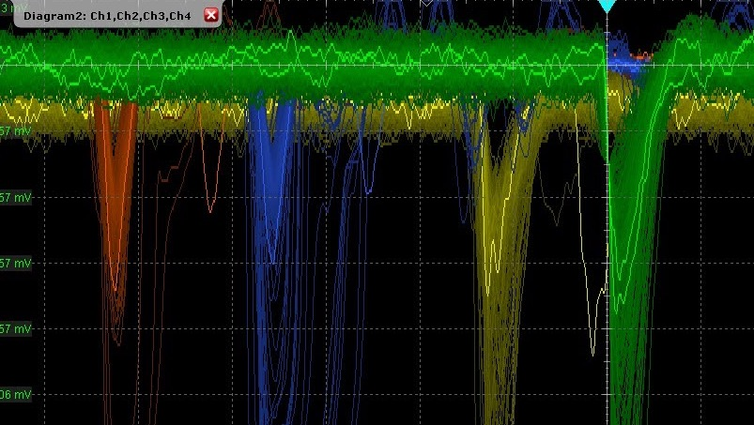



Measuring charged-particles with 10ps time resolution using innovative 3D trench-type silicon pixel sensors
Alessandro Cardini, INFN Cagliari
on behalf of the TimeSPOT Team

Slide 2
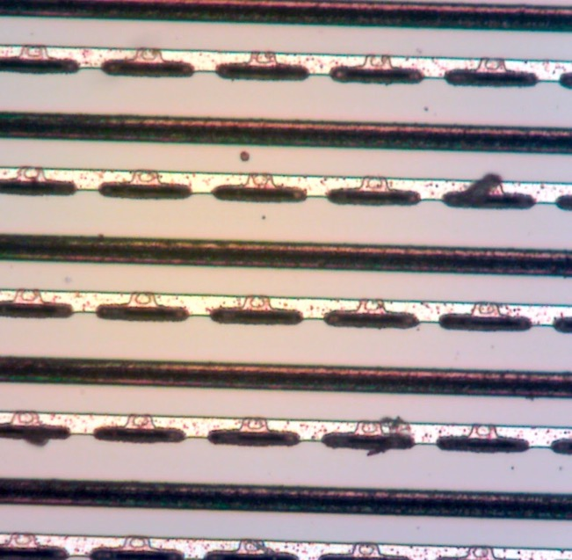
Outline
Challenges in tracking at high luminosities
The development of the TimeSPOT 3D trench pixels
Experimental results
Conclusions and outlook
55µm x 55 µm
TimeSPOT 3D-trench pixels in a strip-like configuration

Slide 3
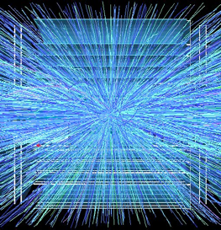
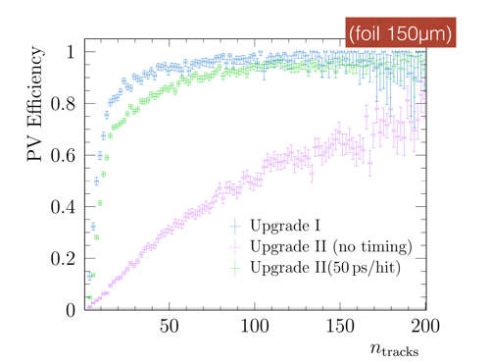
Present and future challenges in tracking
Adding the track time information
Future and today’s upgraded colliders will operate at extremely high instantaneous luminosities
  Very important radiation damage to tracking detectors
  Extremely difficult event reconstruction due to large pile-up ➔ adding the time information (at the track or hit level) will help recovering tracking and vertexing capabilities
ATLAS & CMS Phase-II upgrades (2026): mostly “traditional” tracker + single timing layer
  𝜎_{t} ≈ 30 ps, 𝜎_{s} ≈ 100-300 µm, F ≈ 10¹⁵ 1 MeV n_{eq}/cm²
LHCb Upgrade-2 (2030s): time information on each pixel
  𝜎_{t} = 30-50 ps, 𝜎_{s} ≈ 10 µm, F = 10¹⁶ to 10¹⁷ 1 MeV n_{eq}/cm²
FCC-hh (2040s ?): further improve the radiation hardness
  𝜎_{t} = 10-20 ps, 𝜎_{s} ≈ 10 µm, F = 10¹⁷ to 10¹⁸ 1 MeV n_{eq}/cm²
Adding time information
LHCb upgrade-2 Workshop, March 2020
LHCb
Spatial resolution, time precision and radiation hardness are required at the same time! → 4D tracking detectors

Slide 4
Requirements for (some) future upgrades
Possible users of 4D tracking detectors: LHCb Run5, NA62(x4), CMS-PPS & ATLAS-AFP Run4, FCC-hh, …
  O(10µm) spatial resolution, requiring a pixel pitch of O(50µm)
  Hit time stamping better than 50 ps (sigma) on the full chain (sensor + FEE + digitization)
  Radiation hardness to high fluences for sensors: 10¹⁶ ÷ 10¹⁷ 1 MeV n_{eq}/cm²
  Radiation hardness to high doses for electronics: >1 Grad
  A detection efficiency of 99% per layer is usually needed (this also requires a high fill factor)
  The material budget must be kept below 0.5÷1.0 % X₀ per layer
  The FEE should provide the required time resolution at O(10 µW/pixel) and should be capable of handling a huge data amount of data O(100 Gbps/cm²)

Slide 5
Why 3D sensors?
Original idea: S. Parker, 1997
Key points
  Short inter-electrode drift distance (tens of µm) give rise to extremely fast signals (d<<L)
  Active volume and electrode shape can be designed for maximum performance
  Unmatched radiation hardness (> 10¹⁷ 1MeV n_{eq}/cm², NIMA, 979 (2020) 164458)
  3D columnar geometry is a production-ready technology (ATLAS IBL, ATLAS-P2)
p+
n+
p+
e
n
h
L
h
n
e
n+
d
Planar sensor
3D sensor

Slide 6

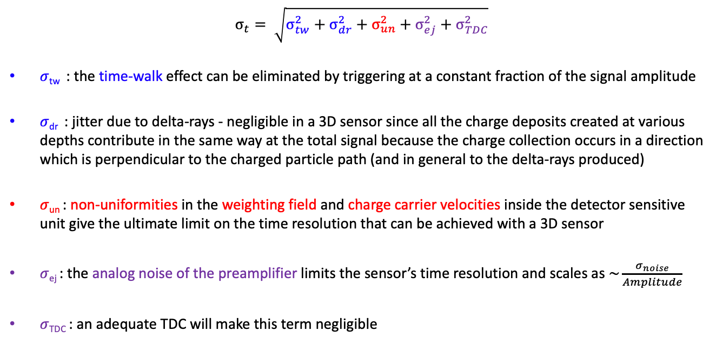
Limits to the time resolution of a 3D sensor
$$σ_{t}= \sqrt{σ_{tw}^{2}+σ_{dr}^{2}+σ_{un}^{2}+σ_{ej}^{2}+σ_{TDC}^{2}}$$
𝜎_{tw} : the time-walk effect can be eliminated by triggering at a constant fraction of the signal amplitude
𝜎_{dr} : jitter due to delta-rays - negligible in a 3D sensor since all the charge deposits created at various depths contribute in the same way at the total signal because the charge collection occurs in a direction which is perpendicular to the charged particle path (and in general to the delta-rays produced)
𝜎_{un} : non-uniformities in the weighting field and charge carrier velocities inside the detector sensitive unit give the ultimate limit on the time resolution that can be achieved with a 3D sensor
𝜎_{ej} : the analog noise of the preamplifier limits the sensor’s time resolution and scales as $\sim \frac{σ_{noise}}{Amplitude}$
𝜎_{TDC} : an adequate TDC will make this term negligible
X
physics
X
detector
electronics
X
$$σ_{t}≅ \sqrt{σ_{un}^{2}+σ_{ej}^{2}}$$

Slide 7
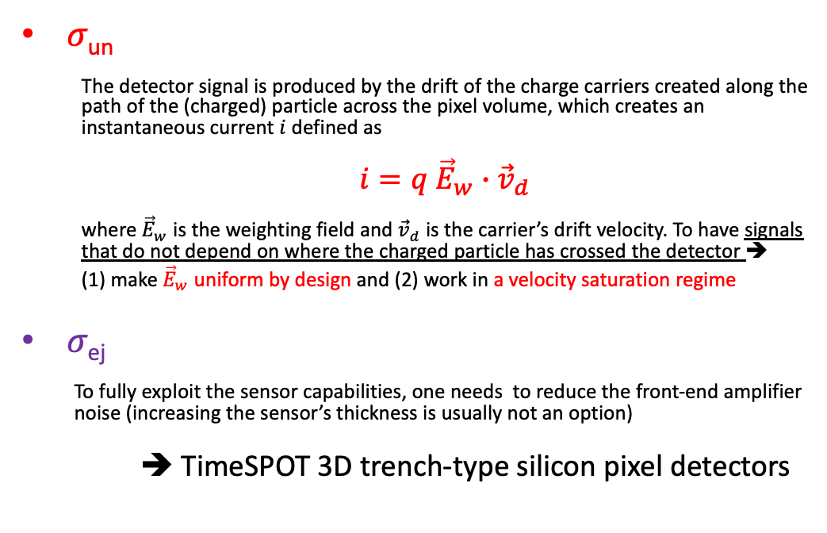
Toward an optimized 3D sensor design
𝜎_{un}
  The detector signal is produced by the drift of the charge carriers created along the path of the (charged) particle across the pixel volume, which creates an instantaneous current $i$ defined as
  $i=q {\vec{E}}_{w}∙{\vec{v}}_{d}$
  where ${\vec{E}}_{w}$ is the weighting field and ${\vec{v}}_{d}$is the carrier’s drift velocity. To have signals that do not depend on where the charged particle has crossed the detector ➔
  (1) make ${\vec{E}}_{w}$ uniform by design and (2) work in a velocity saturation regime
𝜎_{ej}
  To fully exploit the sensor capabilities, one needs to reduce the front-end amplifier noise (increasing the sensor’s thickness is usually not an option)
➔ TimeSPOT 3D trench-type silicon pixel detectors

Slide 8
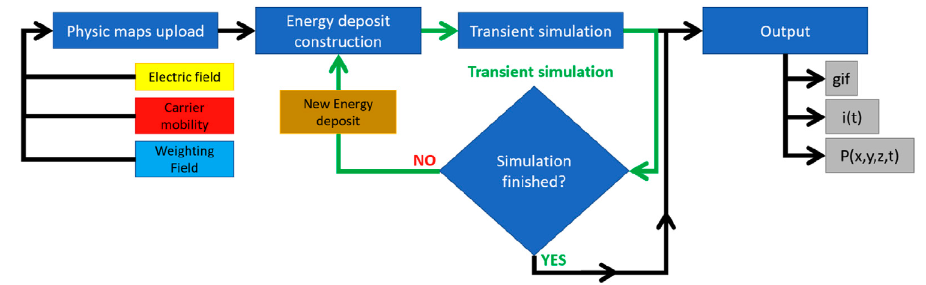


A custom full sensor simulation: TCoDE
https://github.com/MultithreadCorner/Tcode
TCAD
The carrier motion is calculated using a 4th order Runge-Kutta algorithm and the thermal diffusion equation
The contribution of each carrier to the current induced on the readout electrode is determined with the Ramo theorem
TCoDE usess a multi-threaded approach (based on the Hydra libraries): each carrier is followed in separate threads, either in CPU or GPU

Slide 9
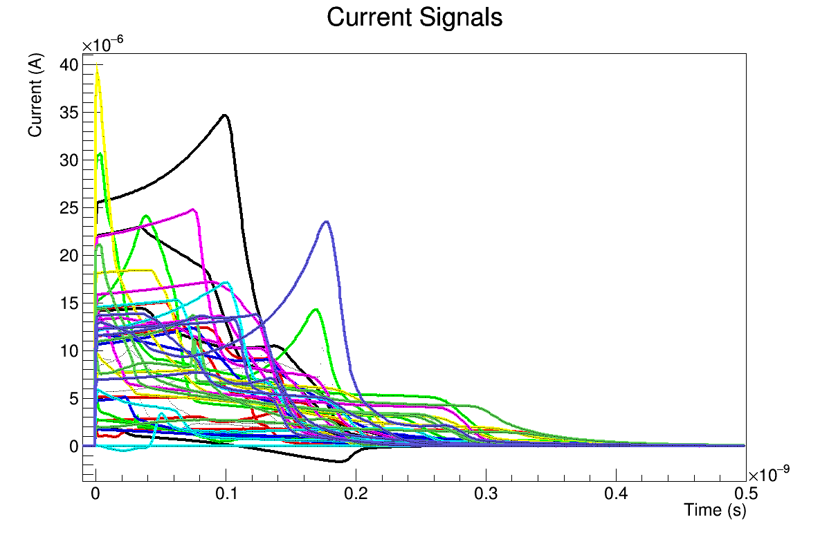
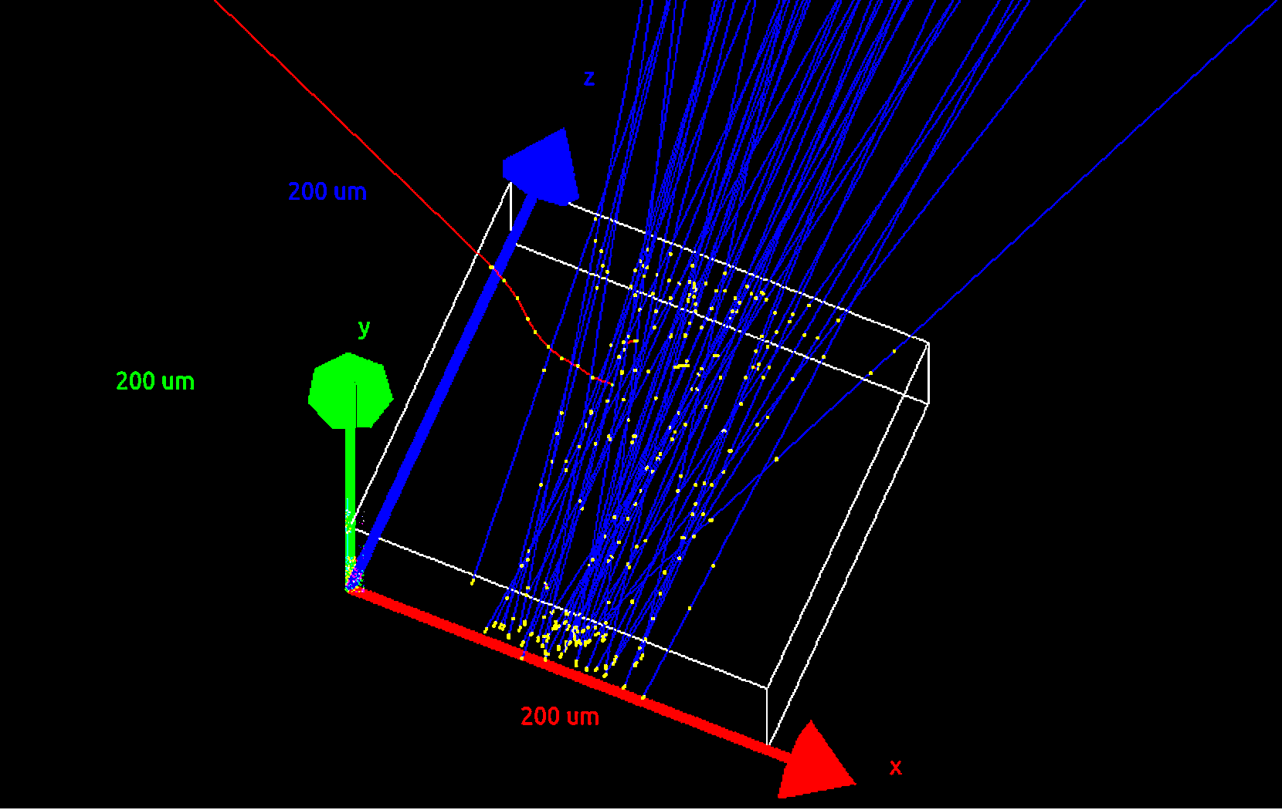

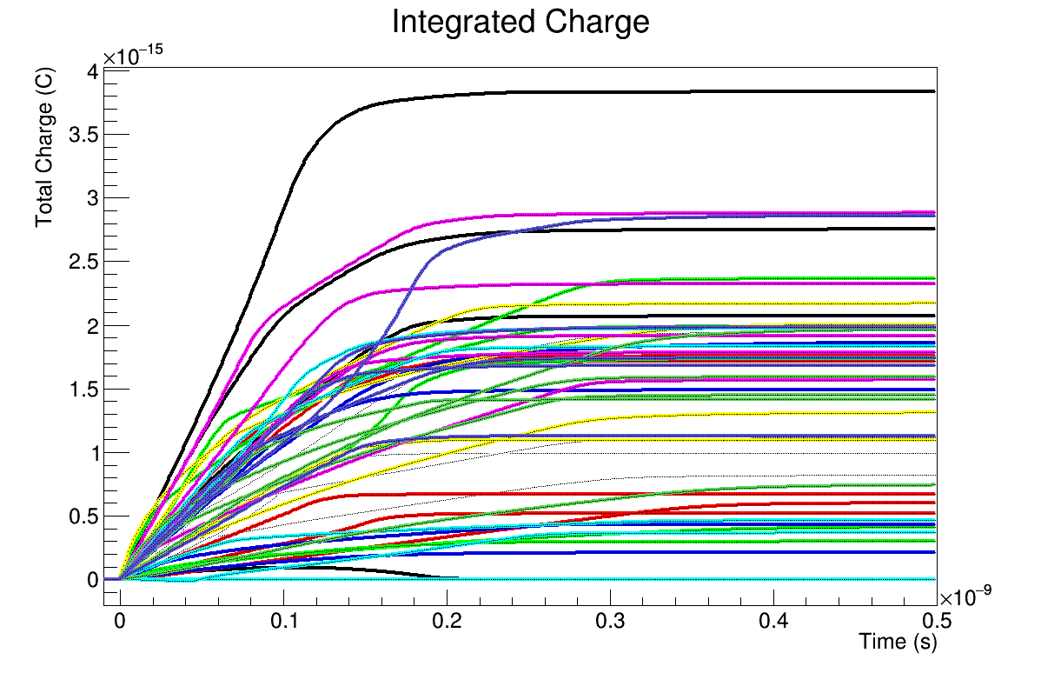
Why another custom simulation?
Example: simulating 50 charged 10 GeV pions crossing a TimeSPOT pixel with GEANT4 and reconstructing the induced signals with TCoDE:
1h40’ in single-thread on an Intel®Xeon®CPU X5450 (10 GB RAM)
Estimated that a similar simulation would take 2-3 months using TCAD on the same hardware
About 2’ in multi-thread on a gaming laptop

Slide 10
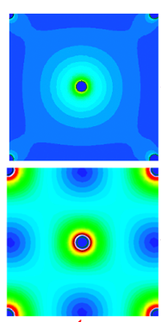
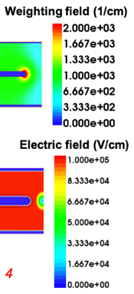
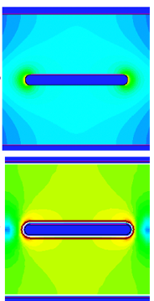
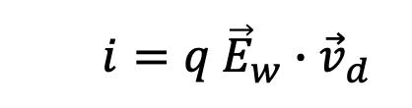
Comparison between 3D geometries
Simulated weighting field and velocity maps are much more uniform in the trench geometry - both in magnitude and direction
This is essential to guarantee, via Ramo theorem, signals which are largely independent on where the charged particles crossed the detector
5 columns
3D trench
  $i=q {\vec{E}}_{w}∙{\vec{v}}_{d}$
TCAD simulations, Vbias = – 100 V

Slide 11
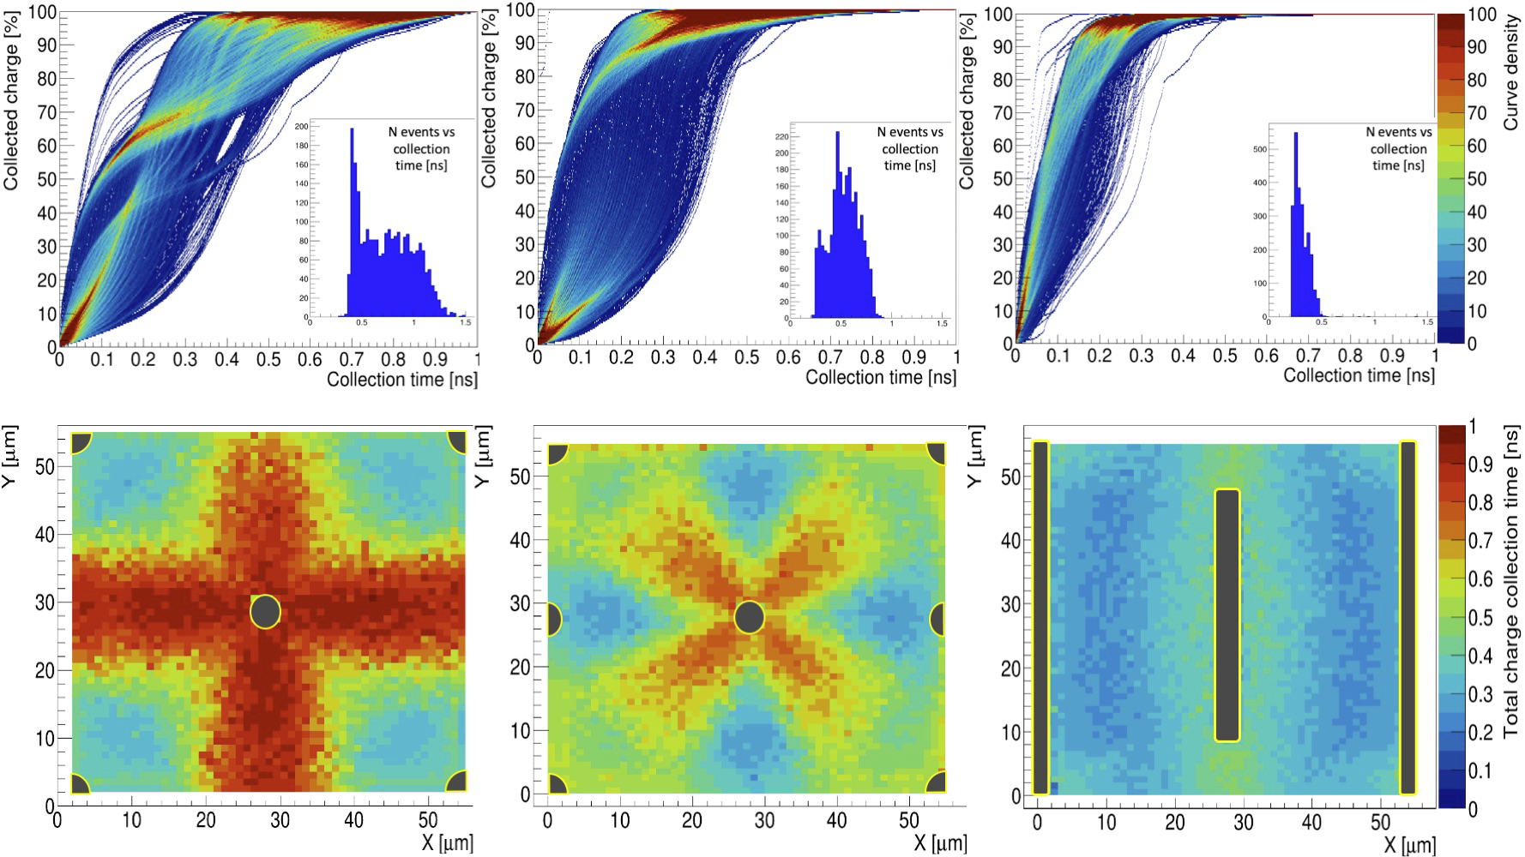
Comparison between 3D geometries
Charge collection curves (top) and total charge collection vs. impact point 2D maps (bottom) obtained with 3000 simulated MIPs uniformly crossing a 3D pixel over its active area, in three different pixel geometries (5 and 9 columns, trench)
➔ Shorter and much more uniform charge collection time for the 3D trench geometry
TCAD+TCoDE simulations, Vbias = – 100 V

Slide 12
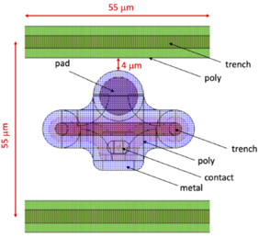
The trench-type TimeSPOT 3D pixels
55 µm x 55 µm pixels (to be compatible with existing FEE, for example the Timepix family ASICs)
In each pixel a 40 µm long n++ trench is placed between continuous p++ trenches used for the bias
150 µm-thick active thickness, on a 350 µm-thick support wafer
The collection electrode is 135 µm deep

Slide 13
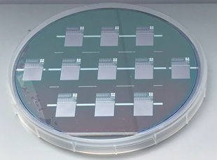
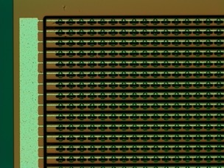

The TimeSPOT 3D sensors fabrication
Single sided (Si-Si) process with a support wafer
Two batches were produced in 2019 and 2021 at Fondazione Bruno Kessler (FBK, Trento, Italy) using the Deep Reactive Ion Etching Technique (DRIE) Bosch process, 6” wafers
High aspect ratios (30:1) and good dimensional uniformity
Photolithography performed with a stepper machine (min. feature size 350 nm, alignment accuracy 80 nm, max. exposure area 2x2 cm²)
Many devices were designed and fabricated (single, double pixels, 10 pixel-strips, various pixel matrices, …)

Slide 14
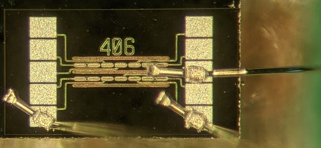
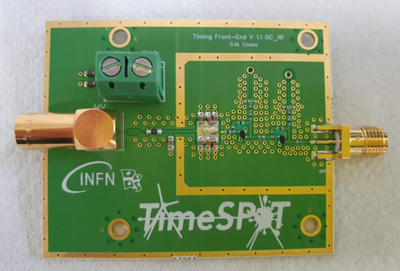
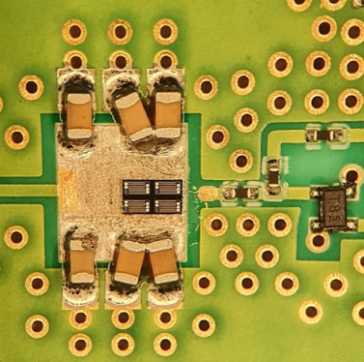
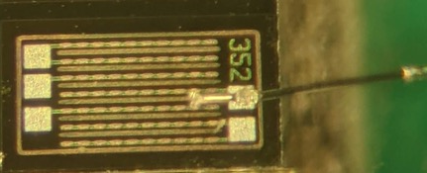
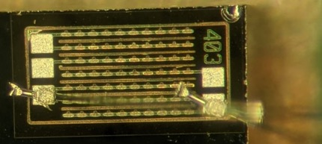
Characterization of 3D trench pixels with custom FEE
We have characterized single-pixels and various pixel-strips (10-30 pixels) test structures, connected to home-made custom front-end electronics boards featuring a two-stage transimpedence amplifier made with fast SiGe BJTs - to fully exploit the sensor speed one needs to readout the sensor’s current
1 pixel
1 pixel-strip
3 pixel-strip

Slide 15
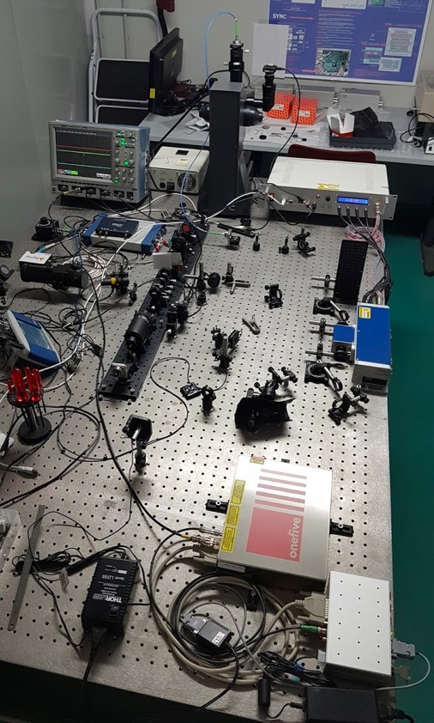
Testing 3D pixels in the lab
The complete characterization of these very high-performance sensors also needs to be performed in the laboratory with a dedicated setup – to verify that the whole pixel area is active and how it performs from the timing perspective
At INFN Cagliari we developed a new testing station
  1030 nm, 100 fs, 2 nJ per pulse, 40 MHz laser
  Pulse-picker to select pulses down to O(kHz)
  Mono-mode fiber to the microscope laser port
  Pin-hole to collimate laser spot on microscope image plane
  IR camera to verify sensor position and laser focusing depth
  XY 3D sensor moving system for automatic sensors’ scans
  4 ch. 20 Gs/s 8 GHz oscilloscope for waveform readout

Slide 16
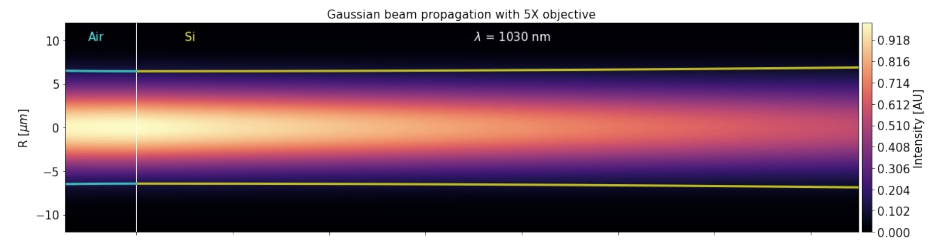
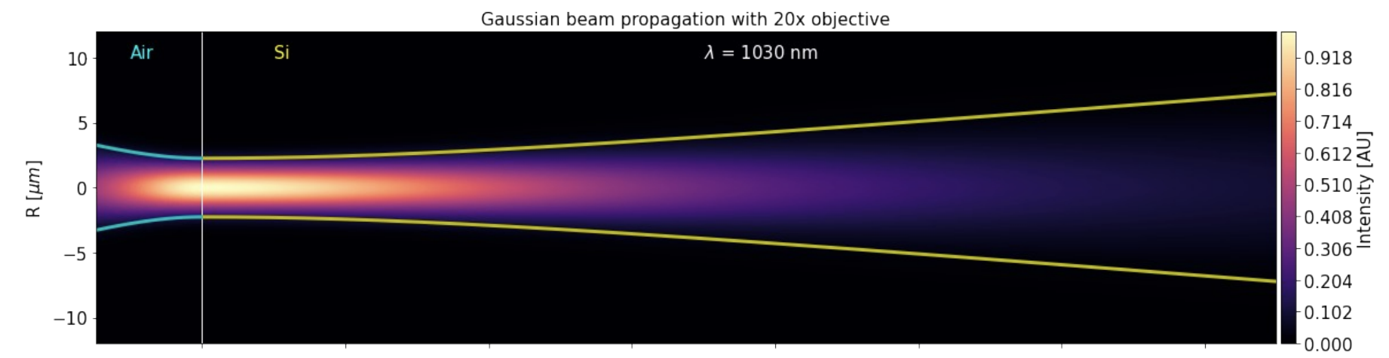
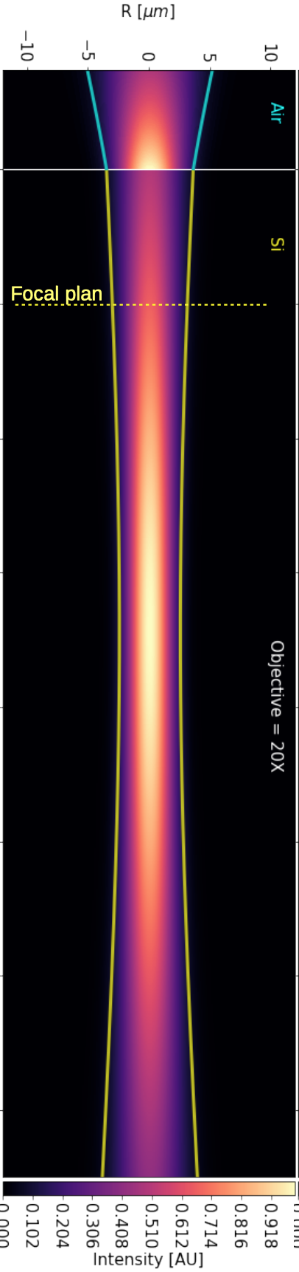
Both optics provide a quasi-cilindrical energy deposit in the sensor; this emulates a MIP crossing the sensor
Fiber port with pinhole
Camera
150 µm
At 1030 nm, ~1/3 of the laser pulse energy is absorbed in 150 µm of Si
5x
20x
20x
Objective (5X, 10X or 20X)

Slide 17
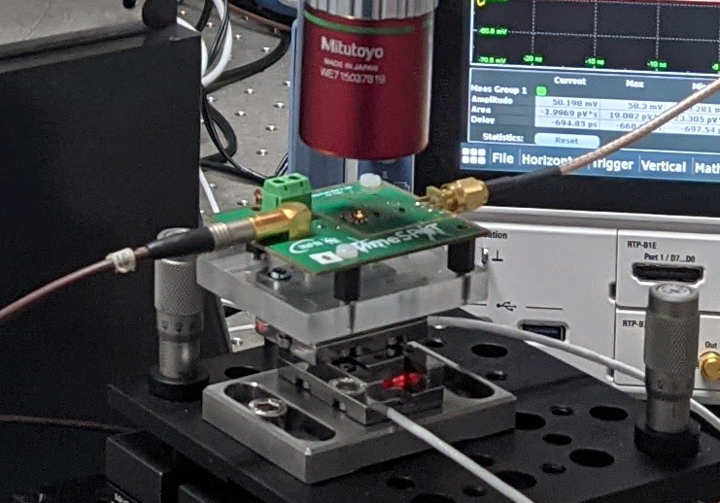
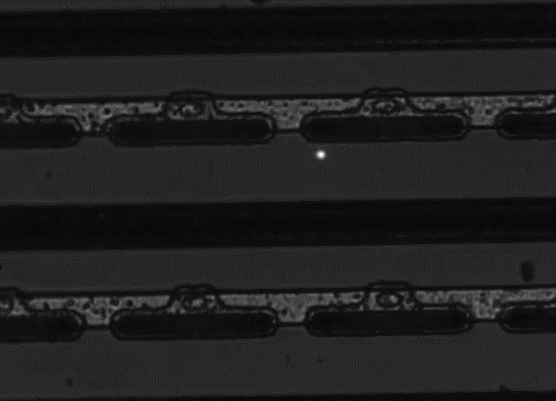
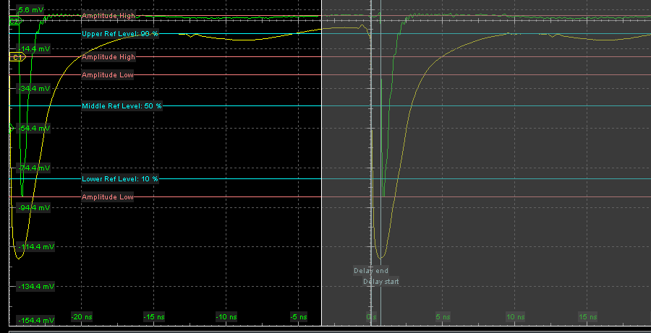
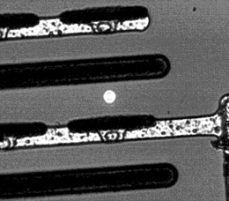
Measurements with IR laser
We measure, over the full pixel area:
  DUT amplitude response vs. position
  DUT timing performance vs. position
Calibration of deposited energy based on test beam data
To precisely characterize the DUT time response, we require an accurate (~ 1 ps) time reference:
  Use previous laser pulse (40 MHz laser jitters <<1ps)
  Measure the same laser pulse with another sensor providing the required time stamping accuracy
pixel
Averaged DUT signal
Averaged REF signal

Slide 18
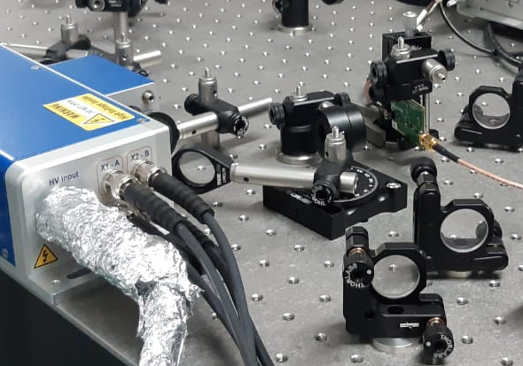
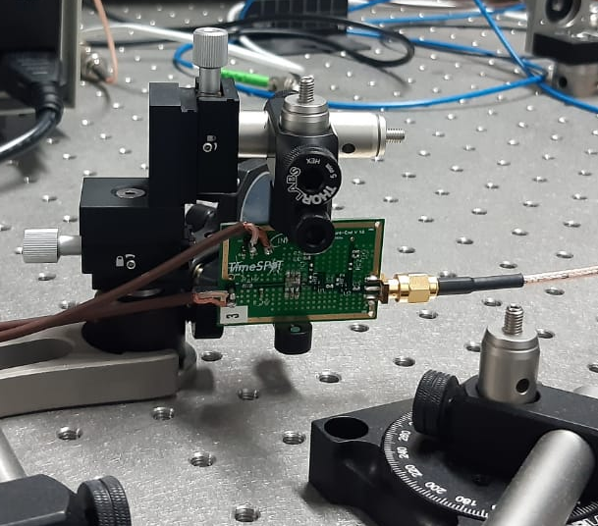
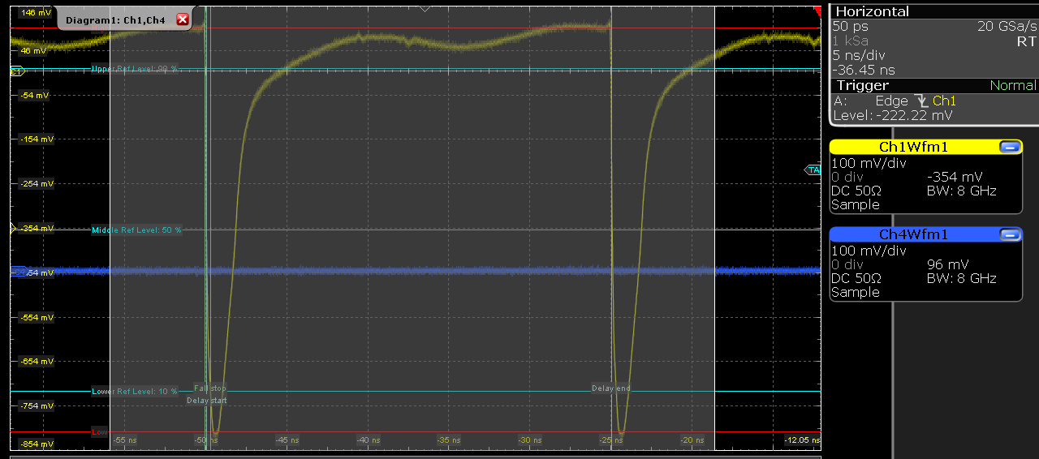
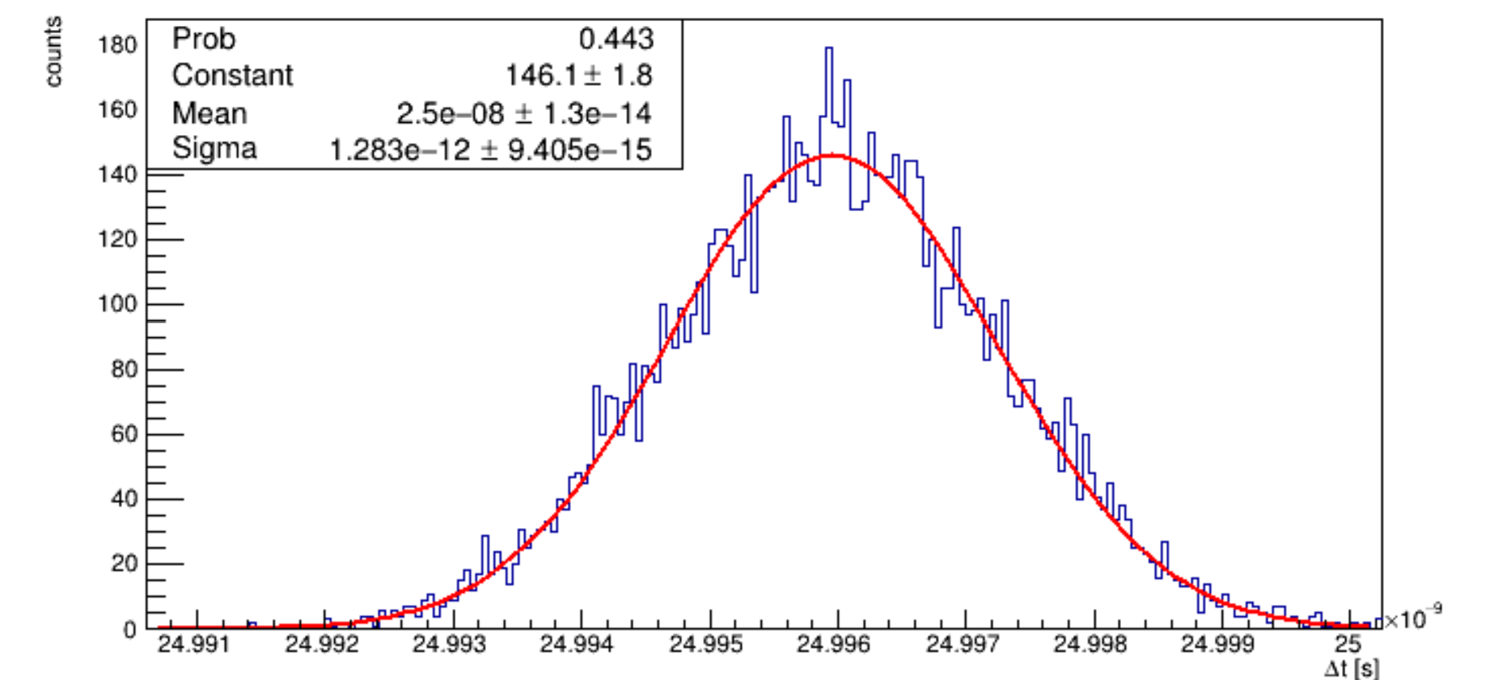



Time reference accuracy
Laser reflection from a mirror (unfocused)
Sub-ps timing accuracy can be obtained with a TimeSPOT 3D multi-pixel sensor with custom FEE using a laser intensity providing an energy deposit equivalent to ~10 MIPs
New FEE board with 3D sensor
$$σ_{t}=\sqrt{σ_{laser}^{2}+σ_{detector}^{2}}$$
$$σ_{t}=\frac{σΔt}{\sqrt{2}}=907 fs$$
V_{bias} = -50V
~10 MIP deposit
$∆$t

Slide 19
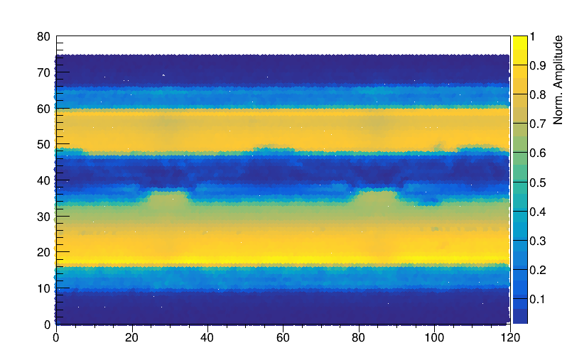
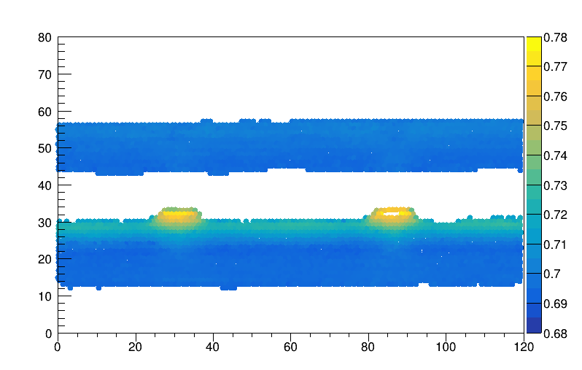
Amplitude and ToA maps
y (µm)
y (µm)
Average Time of Signal Arrival (ns)
x (µm)
x (µm)
pixel
Amplitude map: in yellow where the laser could properly excite the pixel, i.e. no metal on top
Time of Arrival map: for this particular pixel @50V bias, the max. timing spread is less than 20ps

Slide 20
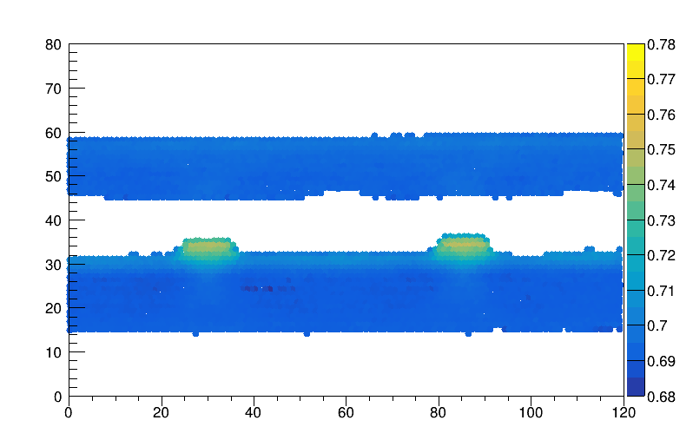
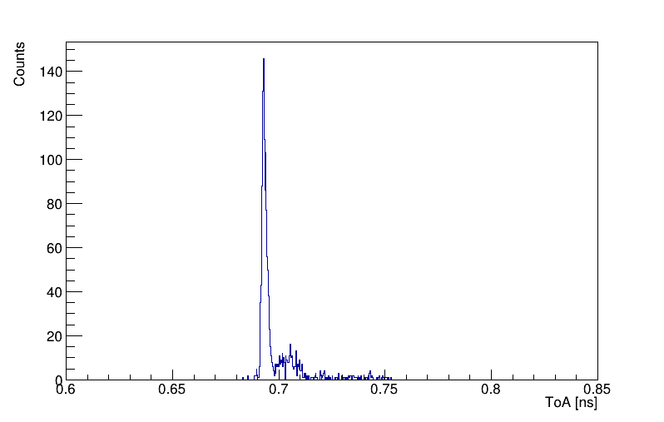
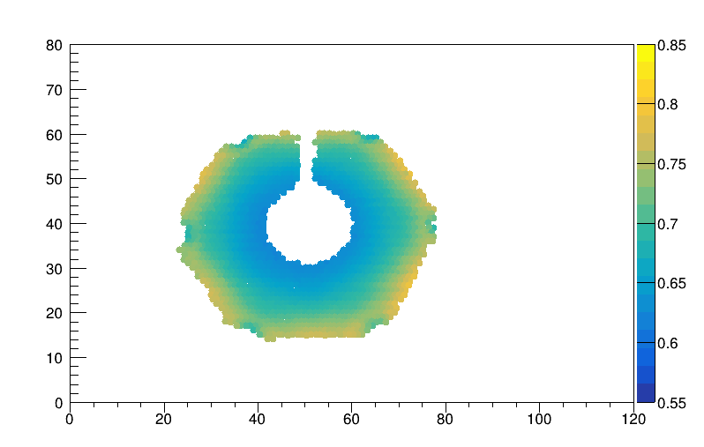
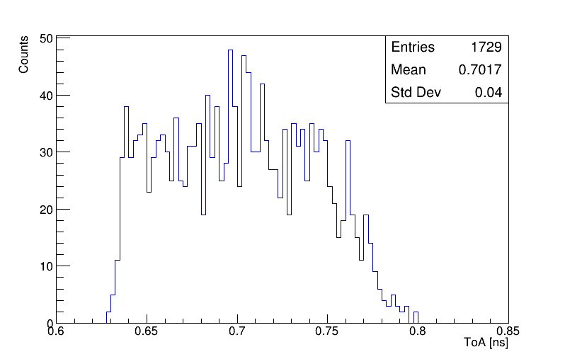
Example: Trench vs Hexagonal geometries
y (µm)
ToA (ns)
(Half) 3D trench pixel
3 ps
20 ps
100 V
y (µm)
x (µm)
For excellent timing performance, ToA uniformity is the key element
ToA (ns)
Hexagonal pixel
200 ps
100 V
130 ps
x (µm)

Slide 21
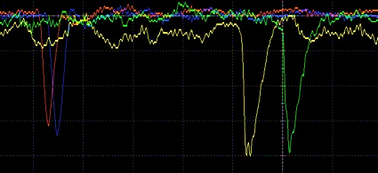
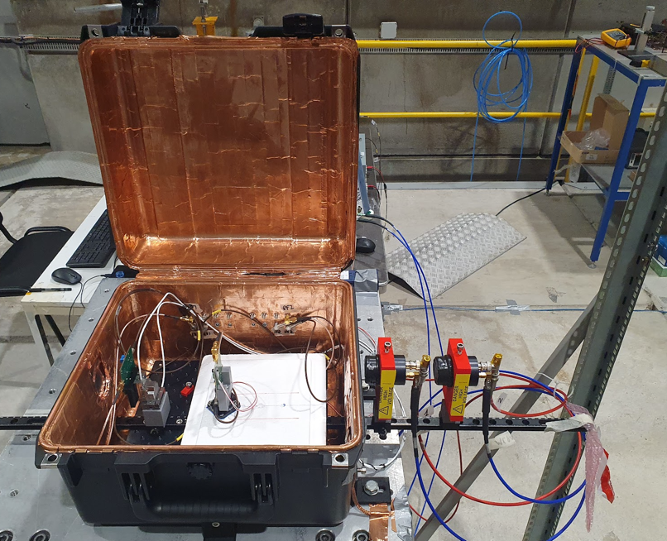
2022 SPS/H8 beam test measurements
180 GeV/C π⁺ beam
10⁶ pions per spill (4 sec.) on a beam spot of 8mm RMS transverse size
2 MCP-PMTs on the beam line to time-stamp the arriving particle (σ_{avg} = 5 ps)
One fixed sensor (DUT). Another sensor, used as trigger, is mounted on piezoelectric slides to precisely align the two 3D sensors with beam. All is mounted in a RF-shielded box
Readout with 8 GHz bandwidth 20 GS/s scope, trigger on the AND of one 3D sensor and one MCP-PMT
Possibility of operating the fixed sensor down to -40°C using dry ice to test irradiated sensors
Sensor1
MCP2
Sensor2 (DUT)
MCP1
MCP1 (trigger)
MCP2
π⁺ beam
Sensor 1 on piezo
(trigger)
Sensor 2
(DUT)

Slide 22
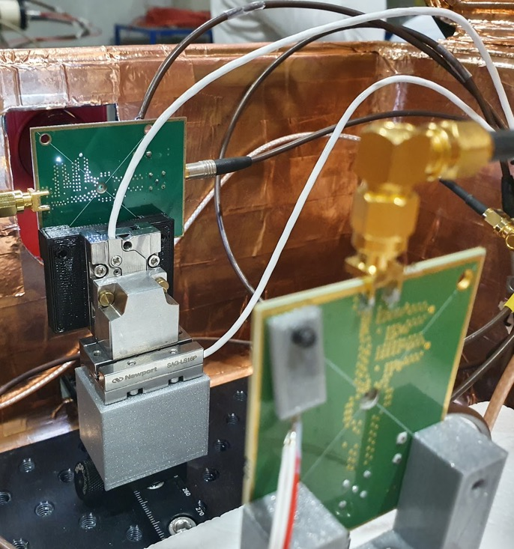
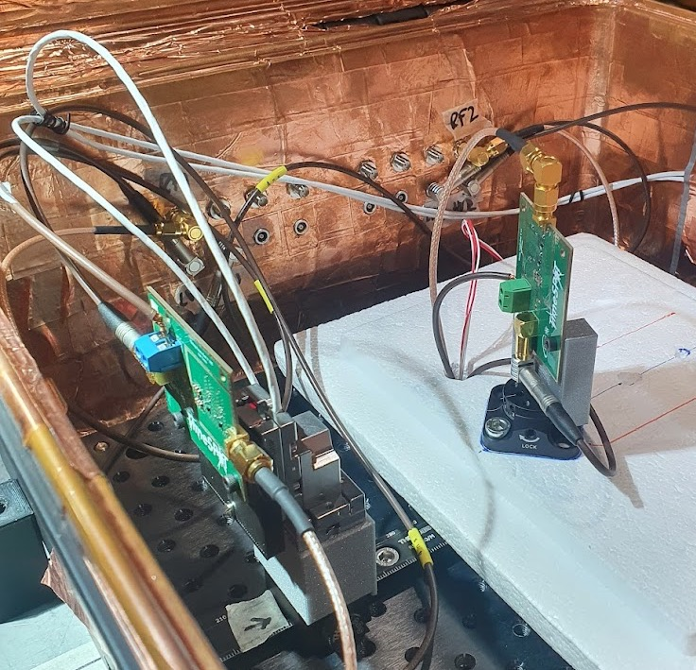
π⁺ beam
Pt100
π⁺ beam

Slide 23
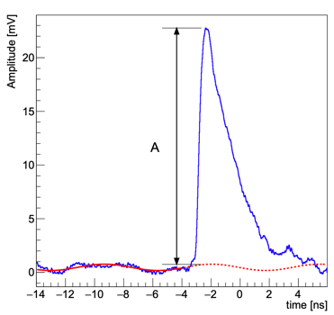
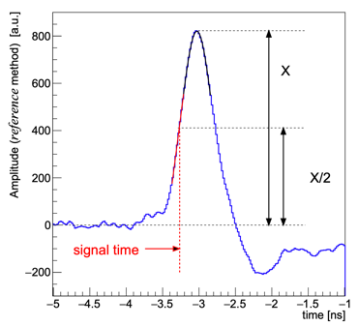
Pixel waveforms data analysis
For each sensor’s waveform:
  Signal baseline (red-dashed line) is evaluated on an event-by-event basis
  The signal amplitude A is measured (w.r.t. to the event baseline)
  Signal time of arrival evaluated with various methods:
    Leading-edge: time at 20mV signal amplitude, linear interpolation around threshold
    Spline: a traditional CFD at 35% with rising edge interpolated with a spline
    Reference: subtract each waveform from a delayed (by half of the signal rise time) copy of itself, then on the resulting signal we trigger at X/2 height

Slide 24
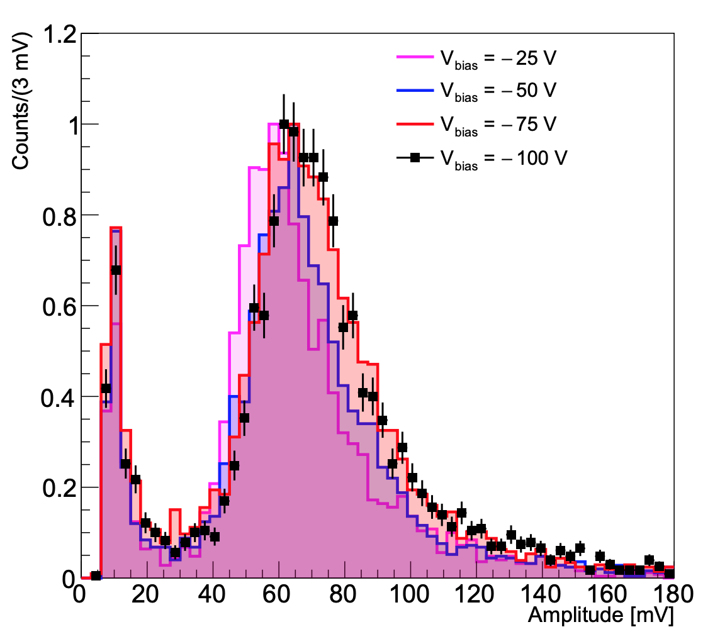
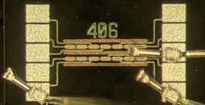
Single 3D pixel - amplitude
Preliminary
Non-irradiated pixel
Normal pion incidence
Unbiased trigger – i.e. not triggering on DUT
The shape of the Landau distributions as a function of V_{bias} indicate a very good sensor performance even at low V_{bias}

Slide 25


Single 3D pixel – timing performances
Preliminary
Preliminary
𝜎_{eff} = 11.5 ps
@ 100V
3D pixel time distribution w.r.t. MCP-PMTs: symmetric with only a small tail due to late signals
Time distribution fitted with two gaussians, slightly time shifted, to include late signal contributions
Excellent timing performances with CFD-based methods, but also using a leading edge algorithm

Slide 26


Efficiency: setup
π⁺ beam
Single pixel (trigger)
Trenches (5 µm wide) are non-active volumes, channeled particles will not be seen
Tilt the sensors with respect to normal incidence to recover geometrical efficiency
Efficiency is measured by triggering on the single pixel (55 µm x 55 µm, on piezos) centered on the triple strip (165 µm x 550 µm, the DUT) and counting the fraction of signals seen by the DUT (reaodut by a single FE channel)
Rotate the DUT around the trench direction
Triple strip (DUT) @ 20°
π⁺ beam

Slide 27

Efficiency: the method
Preliminary
(red line includes noise contribution)
𝜀 = seen/all
Preliminary
At normal incidence
Plot the time distribution of all triple-strip signals w.r.t. MCP-PMTs and count as ‘seen’ the ones under the peak
3D pixel detection (geometrical) efficiency at normal incidence is in agreement with calculated fraction of active area

Slide 28


Efficiency: results
Preliminary
Total signal amplitude on triple strip
Preliminary
@100V V_{bias}
π⁺ beam
The inefficiency (at normal incidence) due to the 3D pixel dead-area of the trenches is fully recovered by tilting the sensors around the trench axis at angles larger than 10°

Slide 29

Tilted sensors: timing performances
Rotation 1
Rotation 2
Rotation 1
Preliminary
Rotation 2
π⁺ beam
Single Pixel @ 50V

Slide 30

Tilted sensors - time distributions
@ 0°
@ 10°
@ 20°
Single Pixel
Single Pixel
Single Pixel
Preliminary
Preliminary
Preliminary
In a tilted sensor, every charged track crosses both fast and less-fast regions of the pixels, thus providing a more uniform timing response
Note that 3D detectors are required to be operated titled w.r.t normal incidence to recover the detection efficiency

Slide 31


Charge sharing
π⁺ beam
DUT
A 4-channels analog FEE board was used to measure the charge sharing between two adjacent pixels (DUT)
A single pixel, used as trigger, defines where the beam impacts on the DUT
The two adjacent pixels, the single pixels used as trigger and one of the two MCP-PMTs were acquired with the oscilloscope
Single pixel (trigger)

Slide 32

Charge sharing: results
@ 20° tilt angle
1
2
Preliminary
Preliminary
When a particle crosses two pixels we define a cluster:
  the cluster amplitude is the sum of the two pixels individual amplitudes
  the cluster time of arrival (ToA) is the average of the two pixels ToAs weighted with their amplitudes
The cluster total amplitude follows the expected Landau distribution
The cluster ToA is more accurate than the ToA from each of the two individual pixels

Slide 33



Irradiated sensors – the setup
3D sensors were irradiated at the Triga Mark II reactor at the Jožef Stefan Institute in Lubjiana, Slovenjia
Fluences: 10¹⁵, 10¹⁶ and 2.5·10¹⁶ 1MeV n_{eq}, sensors not annehaled
2.5·10¹⁶ 1MeV n_{eq} is what one would expect on LHCb vertex detector after LHC Run5 on innermost sensors
Irradiated sensors were tested below -20°C to reduce leakage current
Characterization of irradiated single pixels and triple-pixel-strips structures
π⁺ beam
Dry ice
Dry ice
DUT
Single pixel (trigger)

Slide 34


Irradiated sensors – working point
1
Single pixel non irradiated – 0°
Increasing HV
Preliminary
Preliminary
With a slightly larger bias voltage (w.r.t. non-irradiated pixel working point ) the signal amplitude of irradiated sensors is recovered!

Slide 35


3D irradiated pixel – timing performance
1
Preliminary
@150V, 0°
𝜎_{eff} = 10.3 ps
Preliminary
Excellent time resolution (𝜎_{eff} = 10.3 ps) measured at 150V on a single pixel irradiated with fluences of 2.5·10¹⁶ 1-MeV neutron equivalent

Slide 36


Irradiated sensors – efficiency
Triple pixel-strip
1
Preliminary
Preliminary
@130V V_{bias}
(100V)
π⁺ beam
The inefficiency (at normal incidence) due to the dead-area of the trenches is fully recovered by tilting the sensors around the trench axis also for sensors irradiated with fluences of 2.5·10¹⁶ 1-MeV neutron equivalent

Slide 37
Conclusions
Unprecedented results on trench 3D trend silicon pixels timing performances have been presented
The time resolution of a single 3D trench pixel sensor was measured at SPS/H8 with a 180 GeV/c π⁺ beam and found to be of about 11ps @ V_{bias} = 100V (dominated by FEE noise)
The sensor detection efficiency is fully recovered for incident angles larger than 10° with respect to normal incidence
Sensors irradiated at a fluence of 2.5·10¹⁶ 1-MeV n_{eq} at V_{bias} exceeding 100V perform as the non-irradiated sensors, both in timing performances and in efficiency
3D devices confirm their expected theoretical performance in timing and the trench geometry appears to be the right direction to go
VERY IMPORTANT: The front-end electronics is the limiting factor to the system performance

Slide 38


… and Outlook
The TimeSPOT collaboration has developed and produced an ASIC (CMOS 28nm) to read a small pixel matrix
3D pixel matrices has just been bump-bonded to ASICs and the assemblies are being tested in the laboratory with laser and radioactive sources
→ see Adriano Lai’s talk

Slide 39
Thank you very much!
Publications by the TimeSPOT Collaboration
  3D trenched-electrode sensors for charged particle tracking and timing, NIM A, (2019)
  Simulation of 3D-Silicon sensors for the TIMESPOT project NIMA, 936-, (2019)
  Development of 3D trenched-electrode pixel sensors with improved timing performance JINST, 14-, C07011 (2019)
  Sensors, electronics and algorithms for tracking at the next generation of colliders NIMA, 927-, (2019)
  Combined TCAD and Geant4 simulations of diamond detectors for timing applications NIMA, 936-, (2019)
  A Timing Pixel Front-End Design for HEP Experiments in 28 nm CMOS Technology, 15th Conference on Ph.D. Research in Microelectronics and Electronics, 2019
  First results of the TIMESPOT project on developments on fast sensors for future vertex detectors, NIMA, 2020
  Timing characterisation of 3D-trench silicon sensors, JINST, 2020
  Intrinsic time resolution of 3D-trench silicon pixels for charged particle detection, arXiv:2004.10881, JINST, 2020
  High-resolution timing electronics for fast pixel sensors, arXiv:2008.09867, to appear in JINST
  A. Loi et al., Timing Optimisation and Analysis in the Design of 3D silicon sensors: the TCoDe Simulator, JINST (2021) 16:P02011
  D. Brundu et al., Accurate modelling of 3D-trench silicon sensor with enhanced timing performance and comparison with test beam measurements, JINST 16 (2021) 09, P09028.
  L. Piccolo et al., First Measurements on the Timespot1 ASIC: a Fast-Timing, High-Rate Pixel-Matrix Front-End, arXiv:2201.13138
  Brundu D, et al. (2022) Modeling of Solid-State Detectors Using Advanced Multi-Threading: The TCoDe and TFBoost Simulation Packages. Front. Phys. 10:804752. doi: 10.3389/fphy.2022.804752

Slide 40

Backup Slides

Slide 41


Simulating energy deposits in silicon pixels
IR laser
X10 obj.
Red laser
X10 obj.
IR laser
X5 obj.
MIP
The charge deposits in simulation are obtained using GEANT4 (for MIPs) or analytically (for IR and red laser beams)

Slide 42



DC electrical characterization of 3D trench pixels
IV-curves on 18x18 pixel matrices (pixels connected with temporary metal): ~10 pA/pixel – good!
Full depletion @ ~7V
Measured pixel capacitance ~100 fF/pixel in agreement with simulation
MOS capacitor effect

Slide 43

Fitting the time distribution: 𝜎_{eff}
where f₁ is the fraction of the Gaussian core and μ is defined as
𝜎_{eff} takes into account the two-Gaussian behaviour

