Slide 1
CRaTeBo, an FPGA radiation-testing platform
P. Gkountoumis, R. Ferraro, S. Danzeca
Notes:
FPGA and system level testing

Slide 2
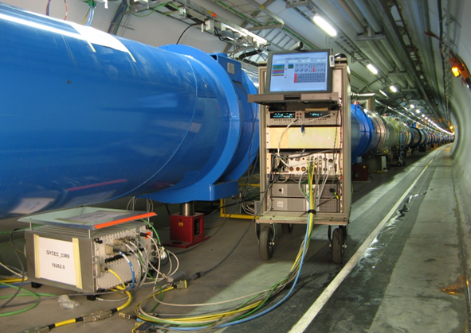
Context
A large number of electronic systems are placed inside the LHC radiation environments where they can be exposed to high level of doses and fluences
The digital part of those systems is usually controlled by either microcontrollers, processors or FPGAs
FPGAs are usually preferred as they allow:
  High Speed of operation
  High Capacity for logic designs
  Re-programmability
@ Courtesy of the TE/MPE Group
  Numerous I/Os compatible with different protocols (SERDES, LVDS, LVCMOS, SLVS etc..)
FPGAs are ones of the most complex components to be tested under radiation
FPGA qualification for CERN applications might require several years of work

Slide 3
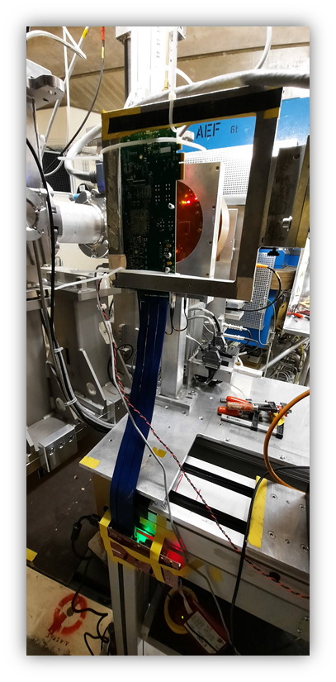
Motivations
FPGAs are usually tested for SEEs with proton beams:
  Pros: - Small beam size allows targeting only the FPGA --> DevKit boards can be used
  Cons: - High TID cumulated (can be a problem for flash-based FPGAs but also for application tests instead of FPGA qualification)
  - Low availability of beam time nowadays
Another options is neutron spallation facilities:
  Pros: - Negligible TID
  Cons: - Flux can be low (not always a problem)
  - Low availability as well
The CERN High energy AcceleRator Mixed field facility (CHARM) is another option:
  Pros: - Positions with low TID and enough fluence to cumulate statistics (Position 0)
  - Positions with high availabilities (systems can stay weeks or months)
Cons: - The whole irradiation room is irradiated and so is the test board (High Possibility of Single Event Latchups (SELs) on commercial boards
@ PolarFire devkit at PSI

Slide 4
Our proposal
Installation of a permanent FPGA Test setup in position 0 at CHARM
  Will provide high availability for testing
  Avoid complex setups and minimize installation time
  Will provide a turnkey remote testing solution for CERN and external users - minimize developing time and cost
Requires custom-made test board compatible with the following requirements:
  High Radiation Tolerances:
    1) No destructive events tolerated (SELs, SEB etc...)
    2) Low non-destructive SEE cross-section on the communication part to avoid false errors on the test
    3) Low non-destructive SEE cross-section on the power/peripheral parts to avoid test downtime
    4) High tolerance to TID/DDD to avoid replacing too often the board
  Use of COTS as much as possible to reduce board price
  Fast communication link to test high-speed applications
  Possibility to test different FPGAs
  Possibility to connect custom electronics to test complete FPGA applications

Slide 5
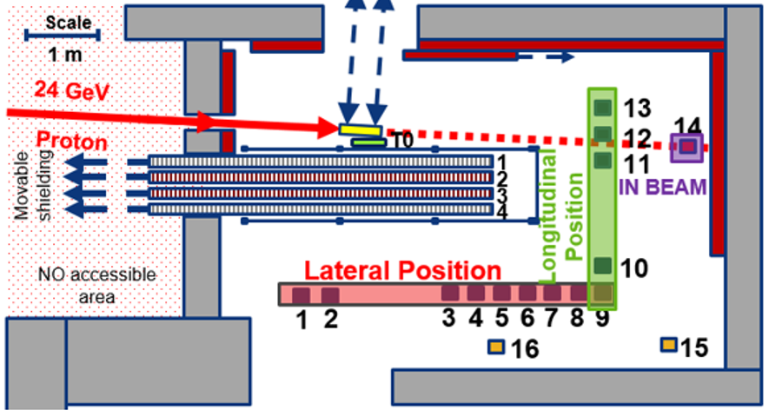
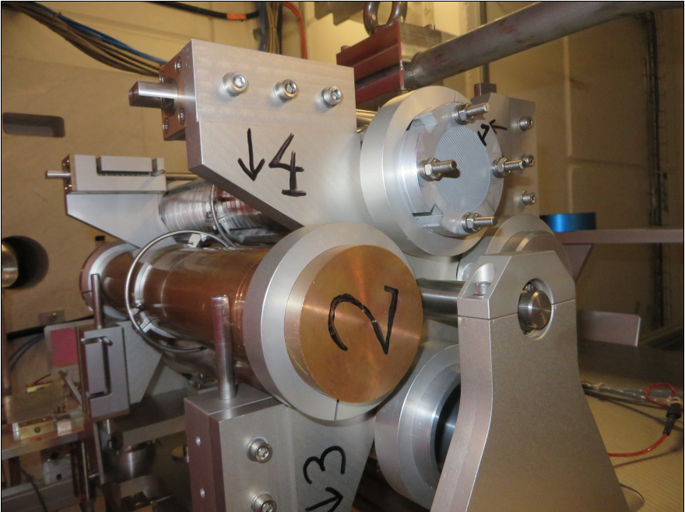
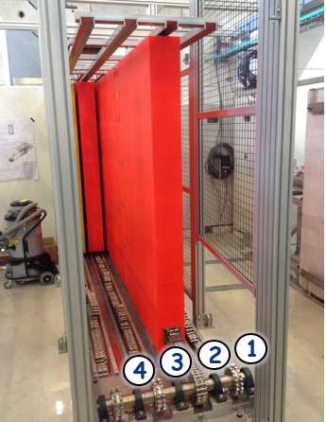
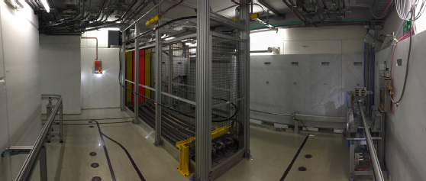
CHARM Mixed Field Facility
Primary 24 GeV proton beam coming from PS impinges a target
Secondary radiation fields similar to the LHC radiation fields.
Radiation field can be modulated with:
Target:
Shielding:
Positions:
Cu - Copper
Al - Aluminium
AlH - Aluminium Hole
C – Concrete (1,4)
I – Iron (2,3)
Lateral (1:9)
Longitudinal (9:13)
1
2
3
13
4
12
5
CRaTeBo, an FPGA radiation-testing platform
Notes:
mixed-radiation fields composed of electrons, photons, and hadrons (neutrons, protons and pions), which can replicate a wide number of real radiation environments such as space, atmosphere, or accelerator complexes

Slide 6
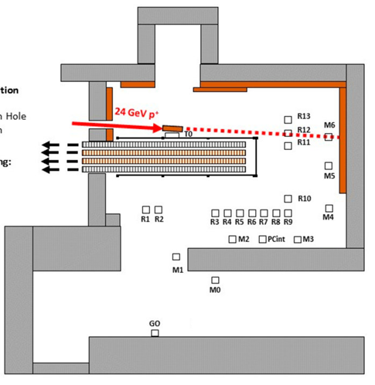
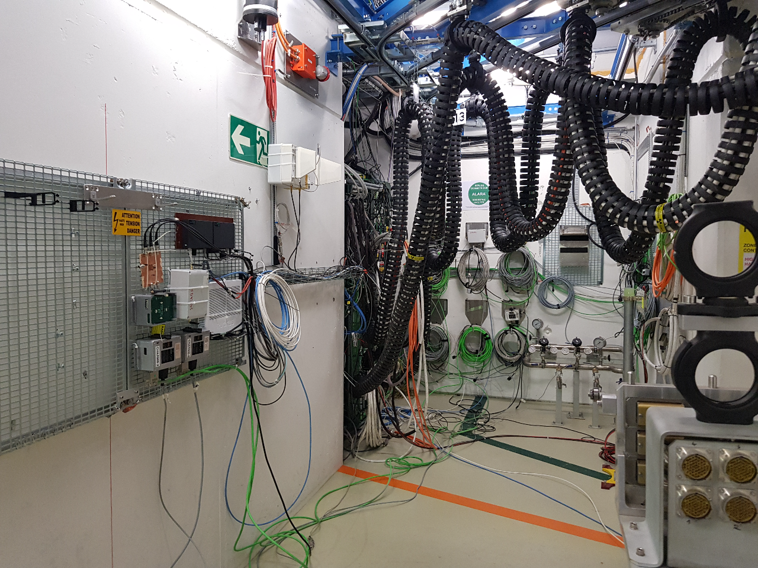
CHARM Position Grid 0 (G0)
Tester Board will be placed on the grid in Position 0 and connected via a fiber to the back-end located in the control room through the Patch Panel:
Different position maybe possible if required higher dose levels
Position 'G0'
Patch-Panel
Position 'G0'
Patch-Panel
CRaTeBo, an FPGA radiation-testing platform

Slide 7
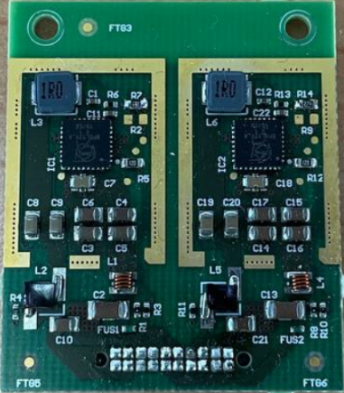
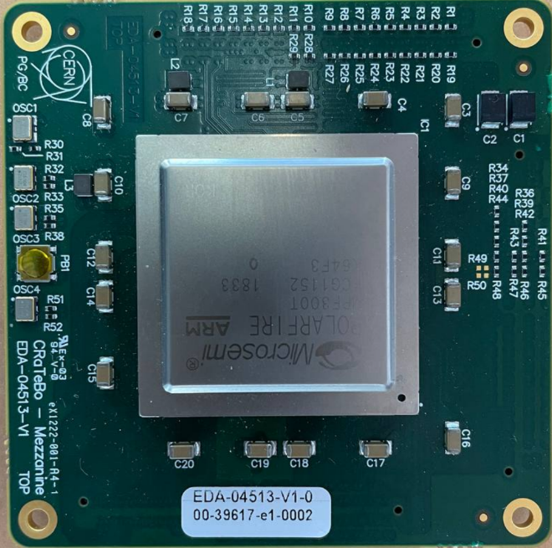
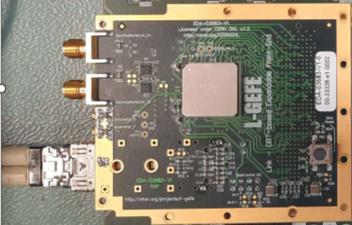
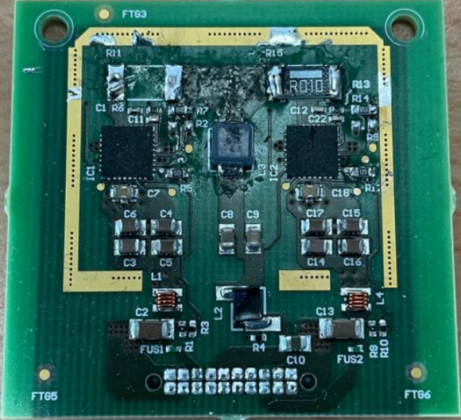
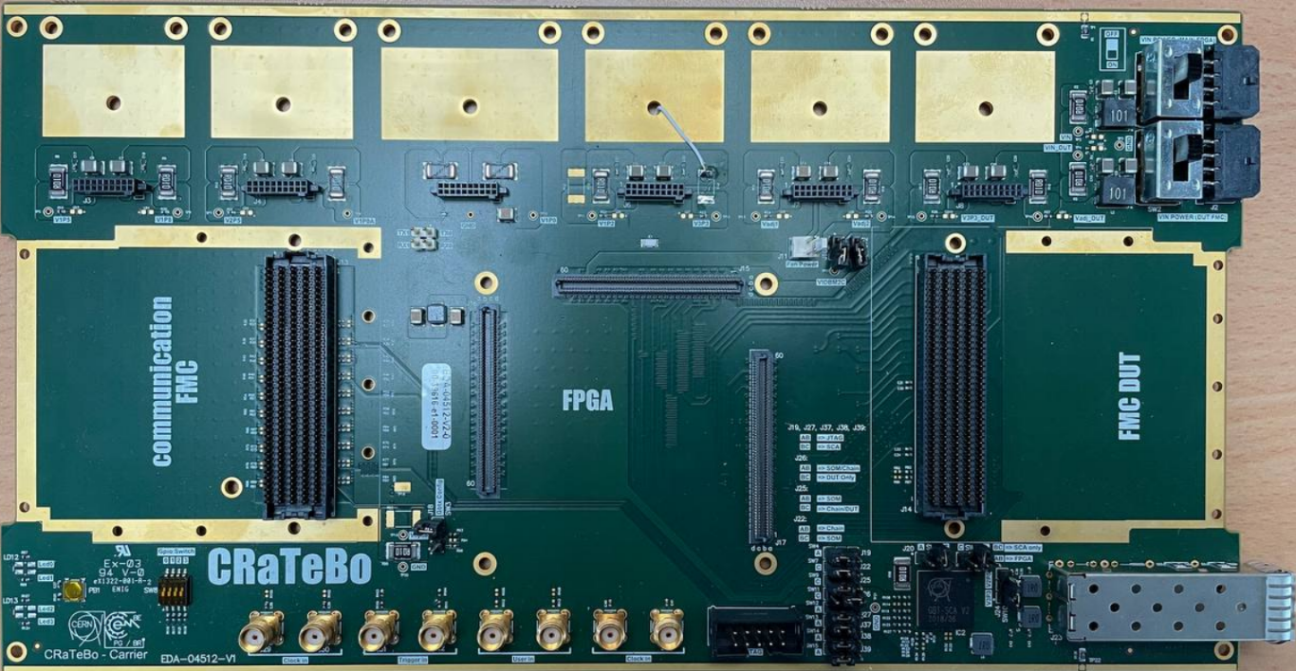
Test Board Concept
CHARM Radiation tolerant Tester Board (CRaTeBo)
The different parts of the board are on pluggable modules to allow:
  Replace them preventively when they reach their TID limits
Communication modules on FMC mezzanine:
  Allows using existing CERN radiation-hard optical link FMC module
  Allows the use of different communication modules
FPGA on custom System on Module (SoM)
  Allows placing different FPGAs to be tested
Power modules
  Commercial or RadHard versions (bPOL12)
Standard HPC-FMC connector
  Allow connecting Front-End electronics to the FPGA
  for more complex application tests/wireless modules
Slow Control Adapter (SCA) on carrier
  TID up to 1 MGy
  Embedded ADC for board monitoring
  JTAG over optical link
SCA
CRaTeBo, an FPGA radiation-testing platform

Slide 8
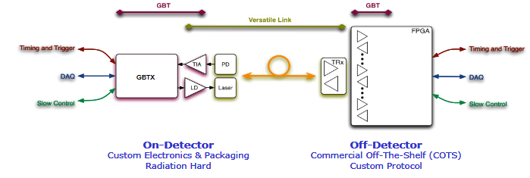
Communication module
Use the existing mezzanine of the Link-GBT Based Expandable Front-End (L-GEFE) project of CERN
Utilizes the versatile system from CERN:
  On detector electronics - Radiation tolerant system comprised of:
    Gigabit Transceiver ASIC (GBTx) for data transmission at 4.8 Gbps and clock distribution (Radiation tolerant up to 1 MGy)
    Versatile Optical transceiver (radiation tolerant up to 500 kGy)
Of detector electronics – based on commercial evaluation boards.
GBTX
VTRX

Slide 9
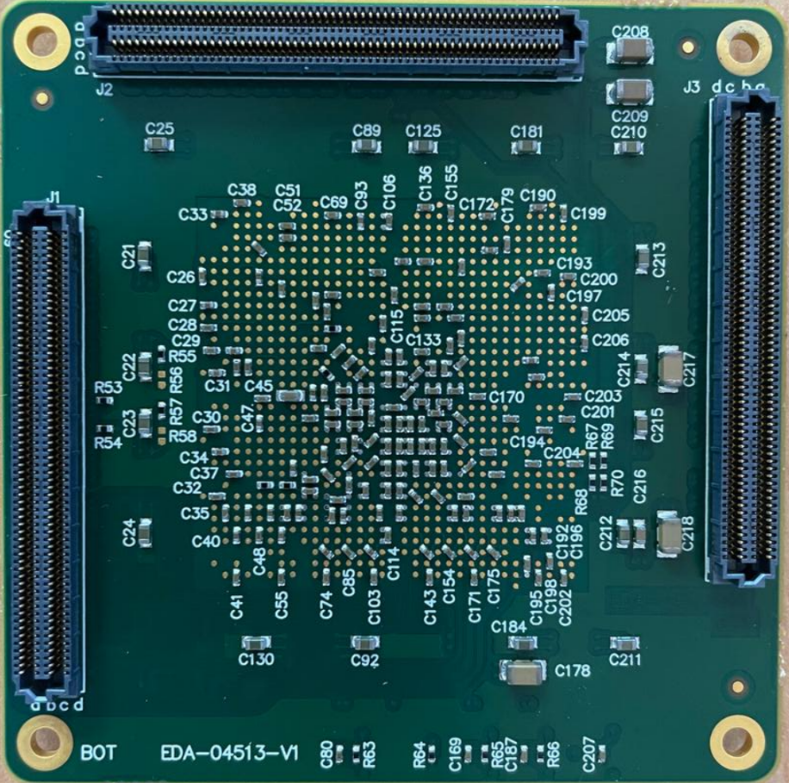
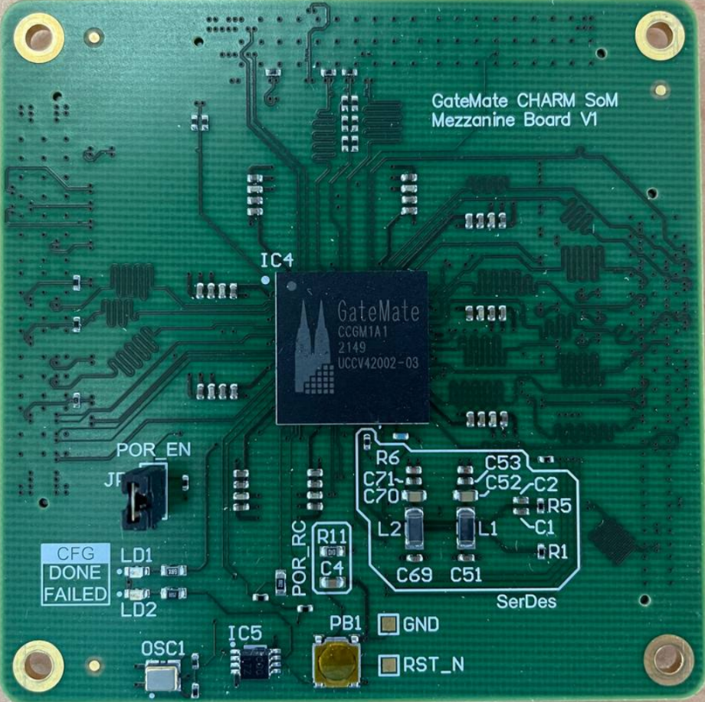

FPGA System on Module (SoM)
The recent qualification of the PolarFire FPGA at CERN showed its strong robustness (TID up to 5.2kGy and re-programmability of at least 2.2kGy) and therefore the first FPGA SoM is based on it.
No standard FPGA SoM architecture exists on the market, so a custom one was decided and developed for the project
A second SoM is designed for GateMate FPGA
  Radiation test to check BRAM sensitivity is scheduled at CHARM next week with CRaTeBo
  In collaboration with Fachhochschule Dortmund
More information about GateMate FPGA on the next presentation by Rudy Ferraro
PolaFIre MPF300TS-1FCG1152I
GateMate

Slide 10
Carrier Architecture
GBT system already implemented on FMC
Elinks (max 3.2 Gbps):
  40x80 Mbps
  20x160 Mbps
  10x320 Mbps
FPGA reconfiguration using the SCA (JTAG)
Environmental monitoring (Voltages/temperature)
UART/SFP
Trigger/Clock inputs
FMC DUT - ANSI/VITA57 HPC compatible
User LEDs and switches
Carrier
ADC/voltage measurements
SCA
JTAG
GBTX FMC
SOM
User LEDs
FPGA
GBTx
E-Links (40 x 80 Mbps)
HPC FMC
FMC DUT
VTRX
Switches
MPF300TS-1FCG1152I
DC-DC Converters
x6
UART
SFP+
Trigger
Clock in
Clock in
Data
Pluggable modules
Configuration

Slide 11
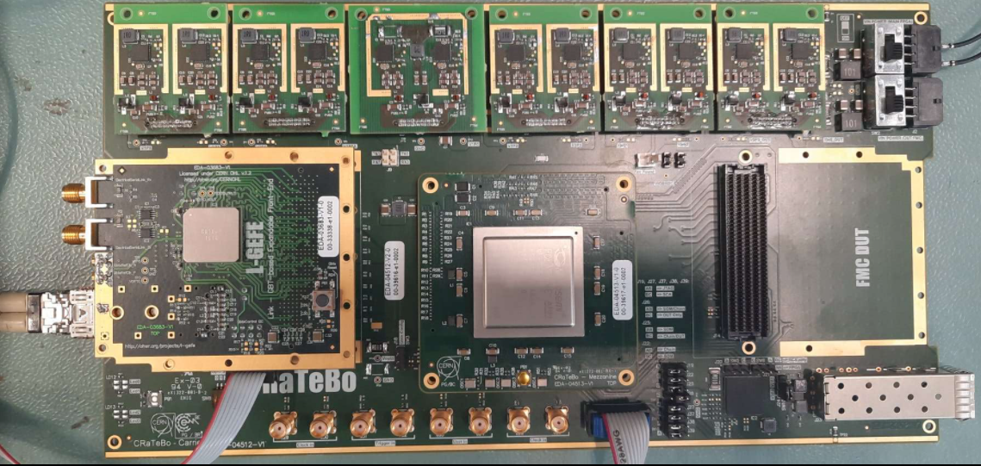

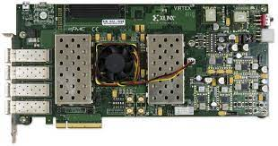
Back-end system
Use of VC709 Xilinx evaluation board
We have extensively exercised the VC709 as a back-end for GBTx and have available firmware
Data can be transmitted via 1 Gbps Ethernet and UDP/IP protocols to a PC
Software development in C++ and Qt – accessible remotely
Alternative option is to use PCIe for full bandwidth utilization (user bandwidth 3.36 Gbps)
1 Gbps Ethernet
4.8 Gbps
VC709
PCIe
CRaTeBo

Slide 12
Back-end firmware architecture
Keep it transparent to the user (commands just propagated from PC to SoM)
Use 1 Gbps Ethernet
GBT FPGA core for optical communication with GBTx
IC core for dynamic reconfiguration of the GBTx
Slow Control core for SCA communication (monitoring + FPGA reprogramming)
User logic if necessary to reduce bandwidth or provide extra functionality
Virtex-7
Eth. wrapper
IC
UDP core
FIFO
GBT FPGA
FIFO
User Logic
IP core
1000Base-X
SC/HDLC
Notes:
Provide the flexibility of easy integration for the user logic

Slide 13
Status, testing and pending actions
We have already produced 3 prototypes
Boards are partially tested:
  Power and voltage levels/JTAG & UART communication/FPGA programmability
  Back-end fiber communication/GBTX functionality
  Unidirectional E-Link communication (FPGA to Backend)/FPGA Clock reception (from GBTx)
Pending (Hardware testing/firmware/software):
  Test SFP+/Trigger&Clock inputs/HPC signals on DUT
  Back-end firmware finalization
    Modify existing HDLC core and add JTAG programming functionality
  Perform major software modifications
  Developing of web interface for remote access and control

Slide 14
Conclusions
CHARM radiation tester board will provide a novel testing setup but also will provide remote access to the users (no physical presence will be required)
It will minimize installation, developing time and cost
It provides a flexible option for multiple configurations including FPGA and system testing.
It will provide high availability for testing (permanently placed in G0 at CHARM)
Provides fast communication links to test high-speed applications
High radiation tolerant board (replacing SoM every ~2 years (min) – rest board every ~400 years (min) in G0 in continuous operation)

Slide 15
Thank you for your attention!

Slide 16
Powering Module(s)
Custom made modules - 2 options
  CERN radiation tolerant DC-DC (bPOL12V) converters up to 500 kGy. Expensive and can add noise to the system.
  Alternative commercial DC-DCs tested and validated at CERN (eg LT1959)
FMC DUT power levels (3.3V, 12V, Vadj) are provided by separate modules and connector.
  Decoupling the DUT can help the carrier not to suffer from potential SEL,SEB on the DUT side
1.5V
1.2V
DC-DC module

