Slide 1
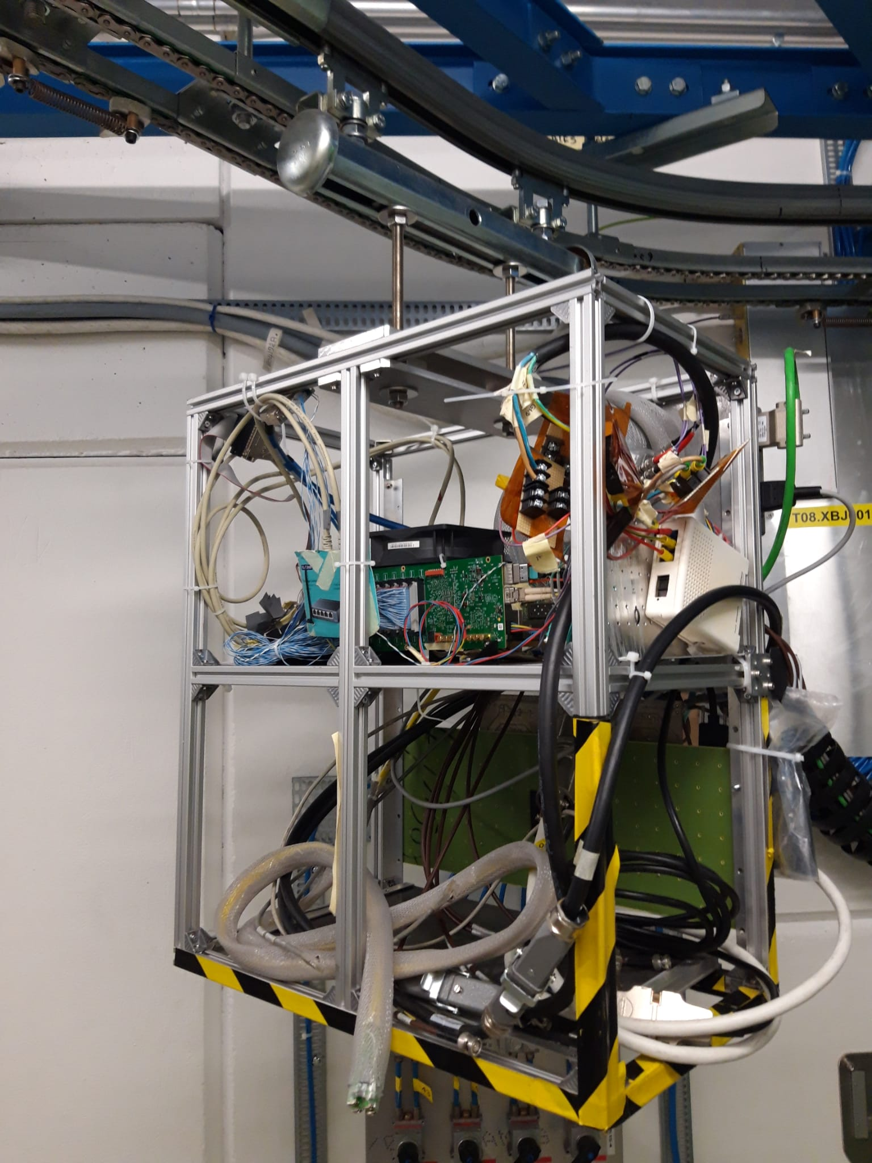

Irradiation at CHARM of a HL-LHC prototype board for the CMS Muon DT On detector electronics based on the PolarFire FPGA
2 OBDT-v1 boards
C.F. Bedoya, I. Redondo, A. Navarro, J. Sastre, D. Redondo, C. de Lara, J. León, J.M. Cela, C. Carrillo (CIEMAT)

Slide 2
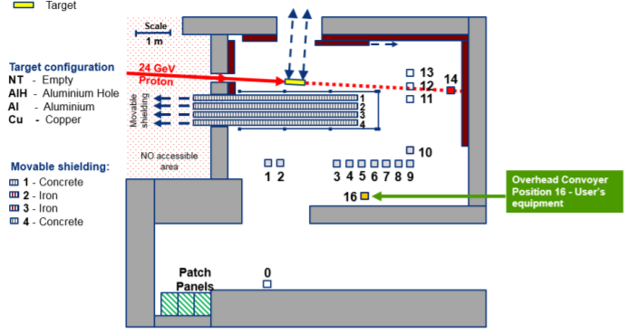
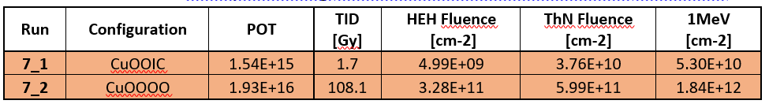
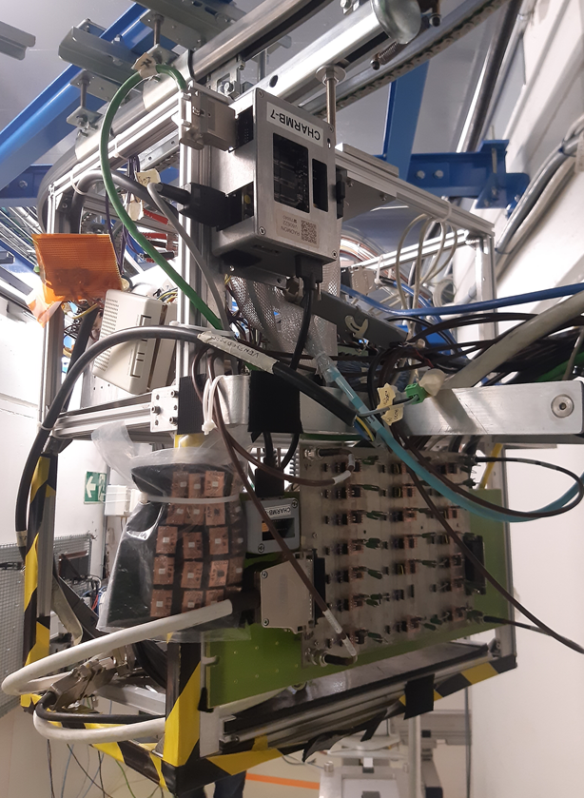
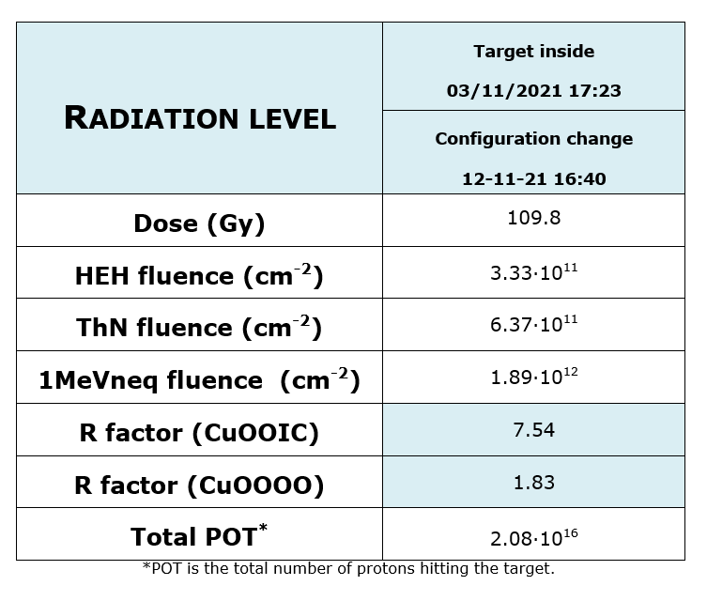
CHARM FACILITY AND DOSIMETRY
~12 days
Dosimetry provided by CHARM facility through this report.
    Thanks to M. Brucoli and S. Danzeca for providing data vs. time .
Most of the time without shielding, but for the first night with the CuOOIC shielding
  1 % of the dose received at lower rate (1/5 of the TID rate), larger relative fraction of neutrons.
C. F. Bedoya - Twepp 2022 FPGA Working group
Notes:
copper target, Iron, Concrete

Slide 3
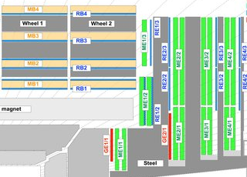
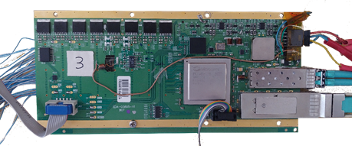
The OBDT (On-detector Board for Drift Tubes)
Muon DT electronics
Time digitization (~1 ns) of DT cells
OBDT v1:
240 input differential channels
3.3V and 5V power (linear regulators)
CERN´s GBTx for communication
CERN´s SCA chip for slow control and monitoring
PUFO fw:
CMS long. view
OBDT v1 board but with a different firmware
Firmware from OBDT modified to use the input signals as output signals
Hits are produced at a fixed value with respect to the arrival of the BC0 (117 signals GPIO)
Rest of the logic is the same as the OBDT
Microsemi Polarfire FPGA (MPF300T-1FCG1152E)
  Time digitization through ISERDES
  Buffer and data funneling
  Data transmission through GBTx protocol
  elink for fast synchronization and slow control
Power temp sensor
SCA
GBTx
Firmware included TMR in logic and CRC in RAMs
(nothing on iserdes and TX/RX)
Optics Temp sensor
Polarfire
SFP+ (TCDS, clock and synchronization commands)
QSFP (output readout data in GBTx protocol but from FPGA)
C. F. Bedoya - Twepp 2022 FPGA Working group

Slide 4
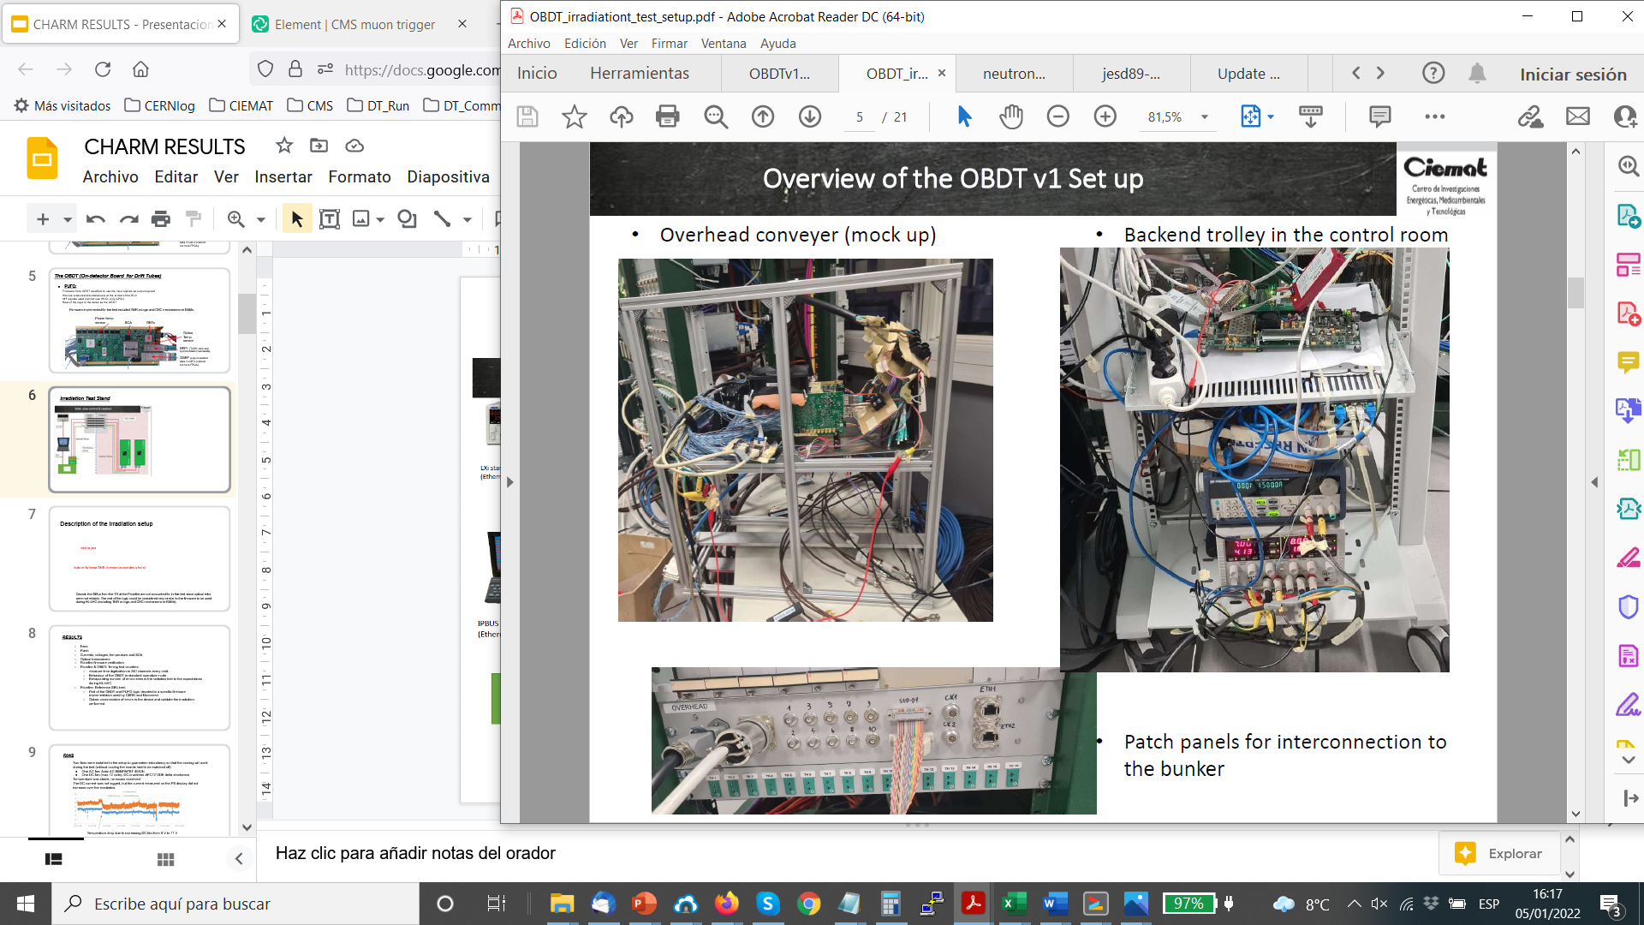
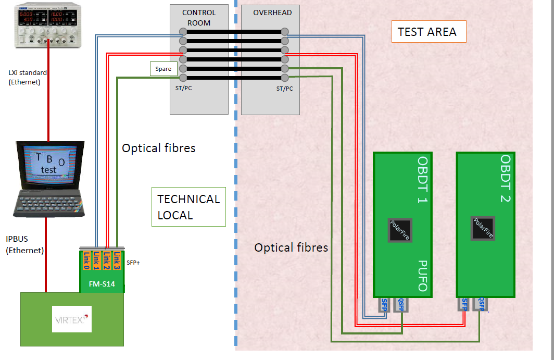

Irradiation Test Stand
VC707 evaluation board
FM-S14 optical expansor
XM105 for copper link
Rasp. pi for remote reconfiguration
Custom PCBs for voltage translation
Hits were sent from PUFO to OBDT
OBDT time digitized and forward to VC707 simultaneously through optical link and copper link
C. F. Bedoya - Twepp 2022 FPGA Working group

Slide 5
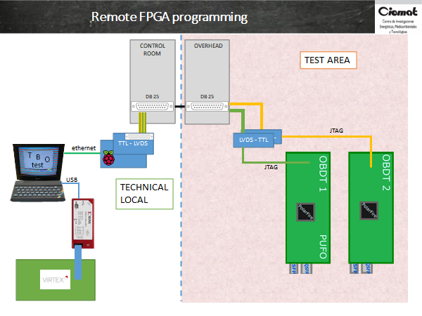
POLARFIRE FPGA FIRMWARE´s VERIFICATION
Raspberry pi running Direct C libraries from Microsemi+ custom TTl to LVDS and LVDS to TTL converters (DS90LV048 and DS90LV047 had already been validated under radiation)
We built a system to program and verify remotely the Polarfire´s FPGAs firmware (that could cope with the 35 meters which prevented Flashpro/USB cables or expansors)
Remote FPGA verify worked fine before the radiation test (bunker zone)
First time we tried a verify during radiation was on Friday Nov. 5th at 13:00, after 15.55 Gy, and firmware verification was NOT working.
IDCODEs were being read properly but the verification was failing at 66% and 45% of the process on each FPGA respectively. Same issue happened a couple more times we tried (some times not at 66% but at other values)
However at the end of the irradiation period we were capable of loading the firmware remotely so the programming system seemed to work fine after 109,8 Gy (though still the verify was incorrect)
C. F. Bedoya - Twepp 2022 FPGA Working group

Slide 6
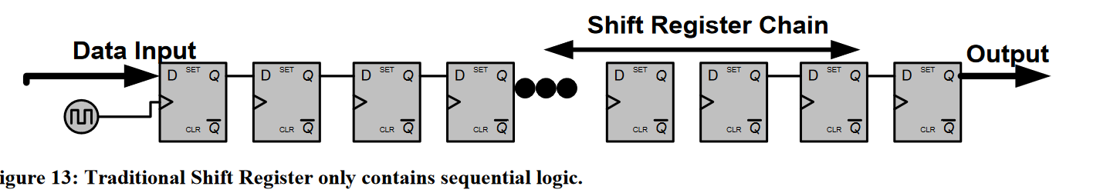
Polarfire SEU-reference test
A reference logic was implemented both in OBDT and PUFO to obtain SEU values comparable to the ones reported in the literature[ref]
Firmware logic structures of the SEU reference test:
FF All 1s : Flip-flop chain feed with 1s
FF All 0s : Flip-flop chain feed with 0s
CKBRD 40 MHZ: Flip-flop chain feed with a fast checkerboard 1010101 @40 MHz
CKBRD 10 MHZ: Flip-flop chain feed with a fast checkerboard 111100001111000011110000 @ 40 MHz
LSRAM: Errors detected in 17 bit words in a 2¹⁷ positions RAM memory. Errors detected when scrubbing all the RAM.
C. F. Bedoya - Twepp 2022 FPGA Working group

Slide 7
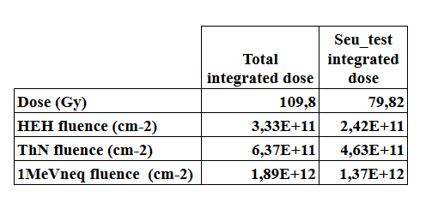
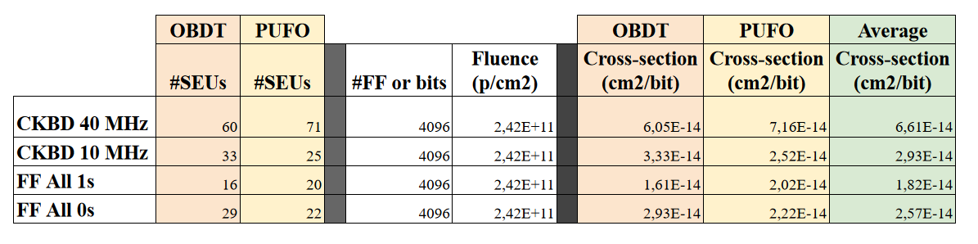
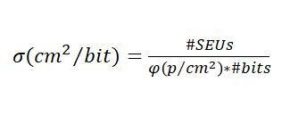
Polarfire SEU-reference test
Unfortunately there was a problem with the logging of the data until November 6th and this reference test was not working during the low dose period
Other periods where the monitoring was not working have also been removed.
Cross section
C. F. Bedoya - Twepp 2022 FPGA Working group

Slide 8
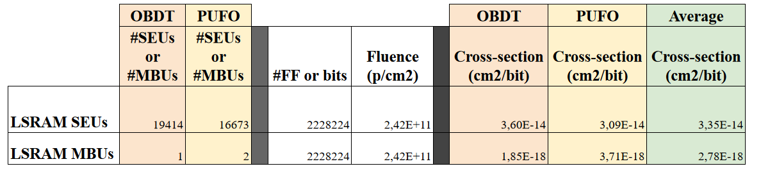
Polarfire SEU-reference test
LSRAM error counters:
Instantiated one LSRAM with 2¹⁷ positions of 17 bit word each.
The firmware was scrubbing all the RAM memory and counting when the word was not the one expected.
Few times we could find that the LSRAM error counter has a very high value, manifested as a crazy running of the SEU counter.
Could be SEFI but in reality the rest of the system was working fine. More likely is part of the logic that affects the SEU-reference counters
We are cataloguing those as MBU (Multiple Bit Upsets) or larger logic upsets
C. F. Bedoya - Twepp 2022 FPGA Working group

Slide 9
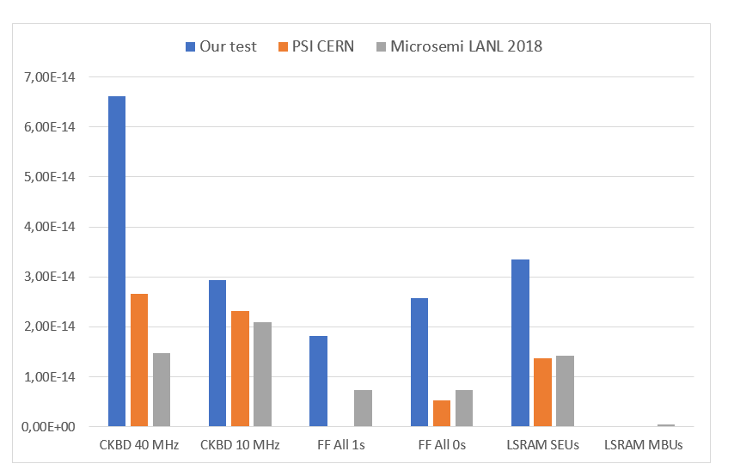
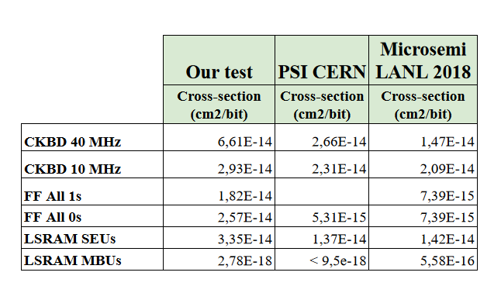
Polarfire SEU-reference test: LSRAM results
Qualitative comparison with other irradiation tests on Polarfire devices with same or very similar reference logic:
Microsemi results can be found: >10 MeV neutron field
https://www.microsemi.com/document-portal/doc_download/1244460-polarfire-neutron-see-test-report
PSI CERN results can be found: 200 MeV protons
https://edms.cern.ch/ui/#!master/navigator/document?D:100764438:100764438:subDocs
Caveats: different particles, energies, different clock frequencies, different firmware implementations…
C. F. Bedoya - Twepp 2022 FPGA Working group

Slide 10
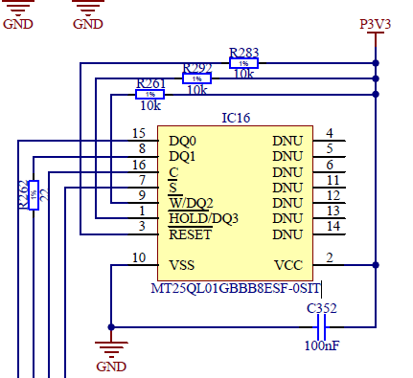
FLASH MT25QL01GBBB8ESF-0SIT
* Before CHARM:
we could reload the Polarfire with the fw stored on the flash, it worked fine (we load a different fws and verify that they have changed)
* During CHARM:
we did not load the Polarfire because we did not want to break the test in the middle of the irradiation period
* Last day of CHARM (Nov 12th):
Tried to load the Polarfire from the Flash:
it did not work during radiation time
it did not work once radiation was over
Polarfire is loaded in Master mode. It could be the Polarfire logic that was not working or it could be the flash being dead.
However the Polarfire could be programmed through JTAG at the end of the irradiation.
Summary, the mechanism did not work after the full irradiation (109.8 Gy). Further radiation tests devoted specifically to the FLASH will be required.
C. F. Bedoya - Twepp 2022 FPGA Working group

Slide 11
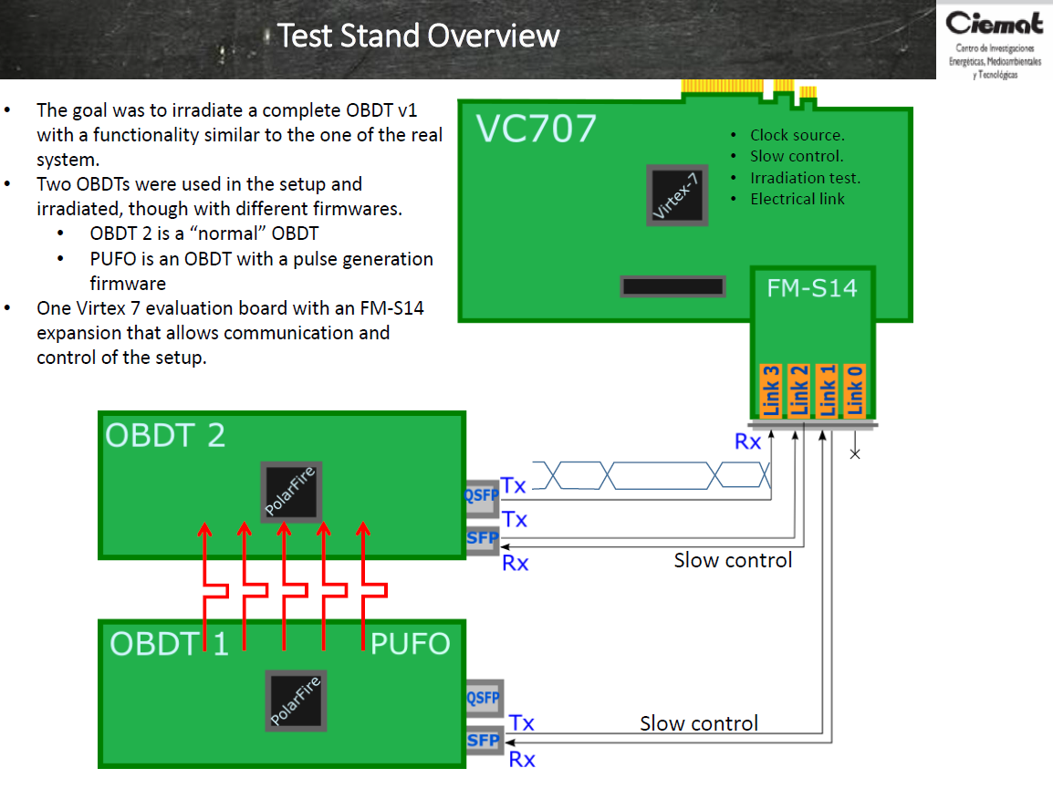
Polarfire & OBDT: Timing test counters
Hit errors counters:
an expected hit it is not received,
the hit is received with wrong timing
or there is more than one hit received in a time window.
Triple counters monitoring:
A: Hits read through link 3 from OBDT 2 (normal optical readout) and error counters implemented in the VC707
B: Error counters implemented in Polarfire and read through link 3
C: Error counters implemented in Polarfire and read through an electrical link
electrical link
C. F. Bedoya - Twepp 2022 FPGA Working group

Slide 12
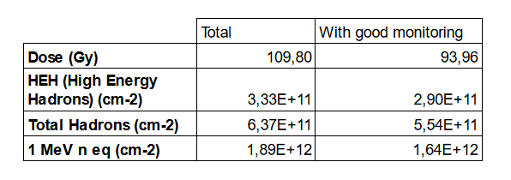
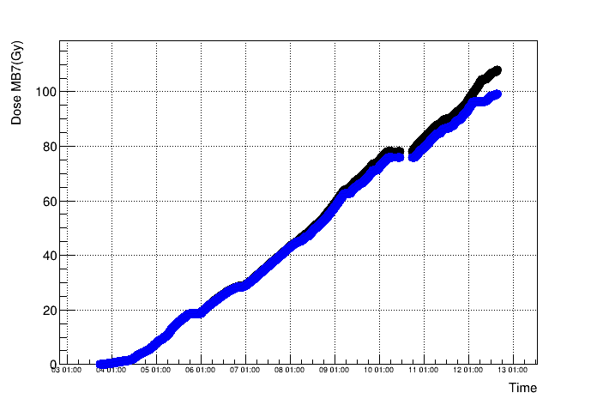
Dose collected during the test at CHARM
November 3rd, 2021 to November 12th, 2021
During this period (10 days 24h shift) there are times in which the data is not reliable and has been removed.
Basically there are the following causes in which the monitoring was not operational (efficiency 85%):
Monitoring routines crashed but we did not realize from the dashboard or not properly launched
Measurement of optical power and wrong interconnection afterwards
Periods where verify or tests on purpose were being done
Periods where the SFP+ that recovered the clock was not working properly and the clock was unstable
Black: Total integrated dose
Blue: Dose with good monitoring
C. F. Bedoya - Twepp 2022 FPGA Working group

Slide 13
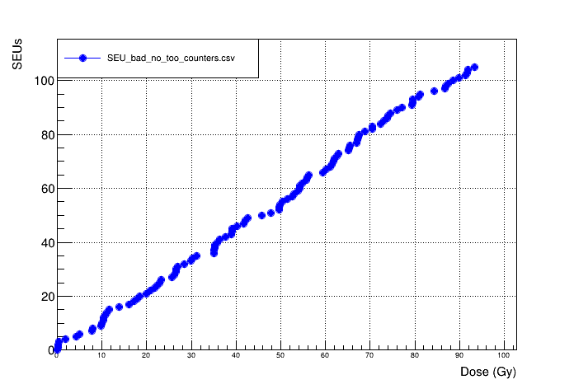
Polarfire & OBDT: Timing test counters:
Missing hit, wrong timing or duplicated hit all considered as failures of SEU type (could be in the OBDT or in the PUFO)
Typically all of the SEUs affected all of the channels simultaneously, meaning, the SEU was not on the time measurement itself but in the BC0, reset distribution or similar logic.
If all channels equal errors simultaneously => 1 SEU
Crosschecked the counters seen from the three different monitoring paths, coherent result.
Electrical path allowed to identify some burst of errors in the optical path that were not real SEUs (clearly due to link instabilities) (17 events)
107 real SEUs counted through all the irradiation campaign
Caveat: the SEUs from the TX at the Polarfire are not accounted for in this test since optical links were not reliable. The rest of the logic could be considered very similar to the firmware to be used during HL-LHC (including TMR in logic and CRC mechanisms in RAMs).
The cross section obtained with this number of failures and the amount of logic contained in the Polarfire firmwares is 2.33 10⁻¹⁵ cm²/bit
C. F. Bedoya - Twepp 2022 FPGA Working group

Slide 14
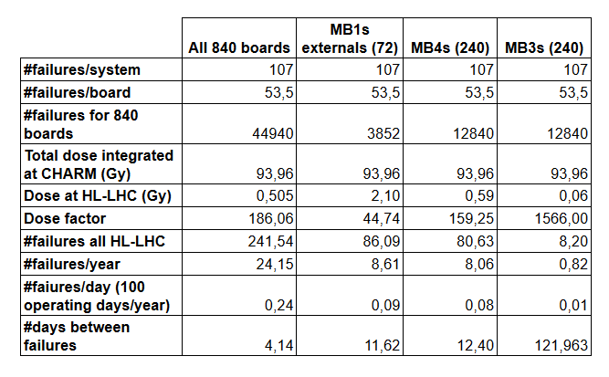
Polarfire extrapolation of SEUs to HL-LHC for DT
C. F. Bedoya - Twepp 2022 FPGA Working group

Slide 15
Summary
The OBDT v1 with a firmware similar to what expected in HL-LHC has been tested under radiation at CHARM
  The electronics could be very similar though we had commercial optical transceivers (dominant source of problems in this test)
No latch-up has been seen in the Polarfire FPGA
No loss of configuration has been seen.
No SEFI has been identified (electrical FF test has been operating correctly all the time).
Major sensitivity observed in the Optical transceivers and in the Flash
Cross sections have been measured in a benchmark system and with the expected firmware. Numbers are adequate for our application.
Extrapolated number of errors to HL-LHC is acceptable for our application. (~4 days without SEU failures for the full system (it contains 1000 boards))
C. F. Bedoya - Twepp 2022 FPGA Working group

Slide 16
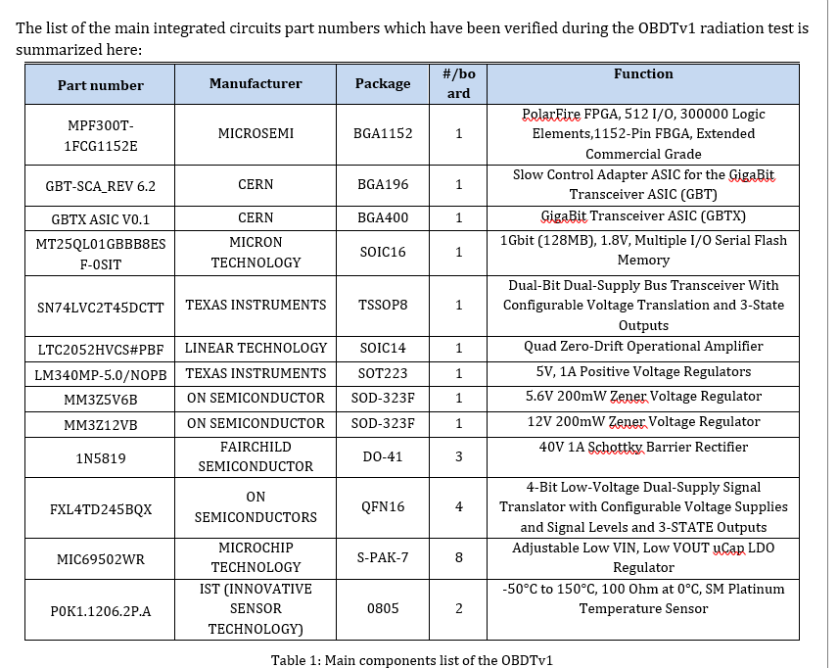
C. F. Bedoya - Twepp 2022 FPGA Working group

Slide 17
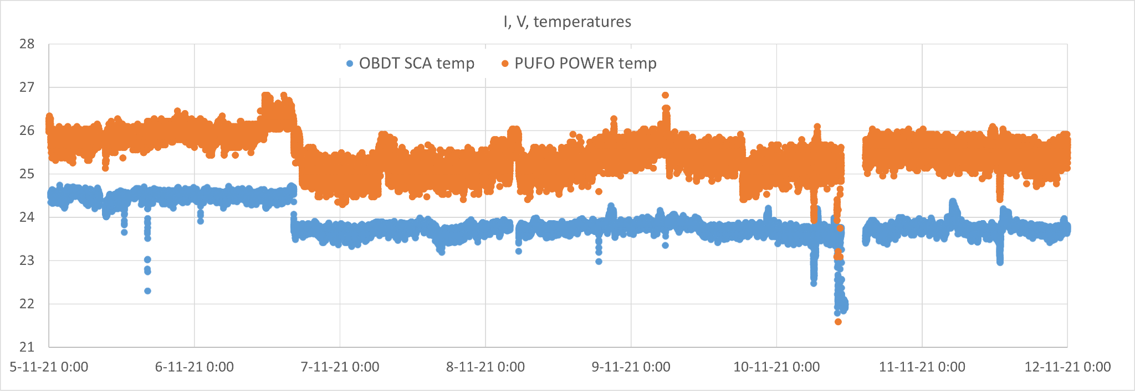
FANS
Two fans were installed in the setup to guarantee redundancy so that the cooling will work during the test (without cooling the boards had to be switched off)
One AC fan: Axial AC EBMPAPST 4650N
One DC fan (max 12 volts): DC brushless AFC1212DE delta electronics
Temperature was relatively stable, no issues of fans not working or degrading observed
The current of the DC fan was not logged, but the current measured on the power supply display did not increase over the irradiation period.
Temperature drop due to increasing DC fan from 8 V to 11 V
Both fans worked satisfactorily throughout the test (109.8 Gy) and both remained operational
C. F. Bedoya - Twepp 2022 FPGA Working group

Slide 18
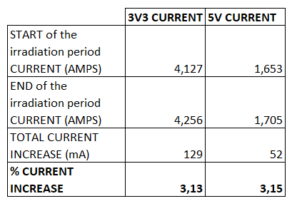
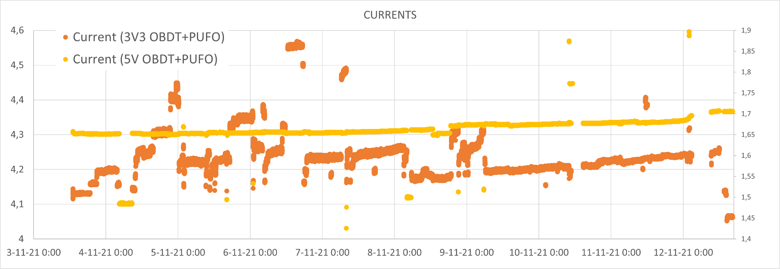
POWER SUPPLY CURRENTS
Besides of the sporadic increases related with malfunctioning of the optical modules, the average current increase in the system has been approximately a 3% in both power rails.
(Regulators GND current?)
C. F. Bedoya - Twepp 2022 FPGA Working group

Slide 19
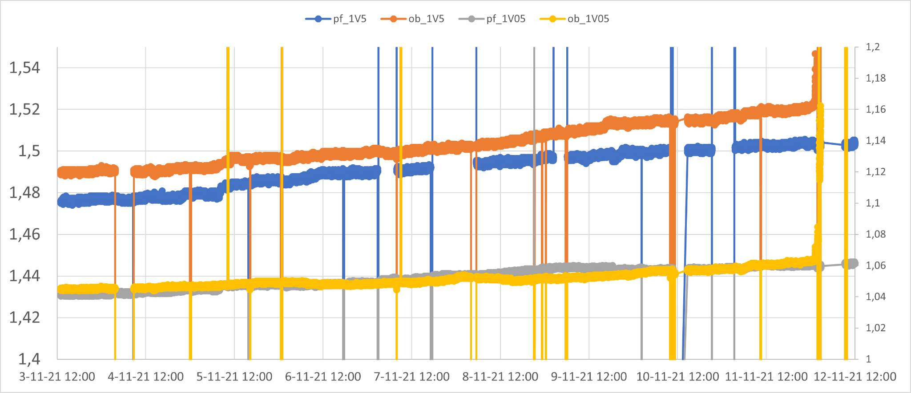
POWER SUPPLY VOLTAGES
Voltages at the output of the Micrel MIC69502WR regulator also seen an increase <1% throughout the radiation period
Compatible with previous irradiation tests of this technology
C. F. Bedoya - Twepp 2022 FPGA Working group

Slide 20
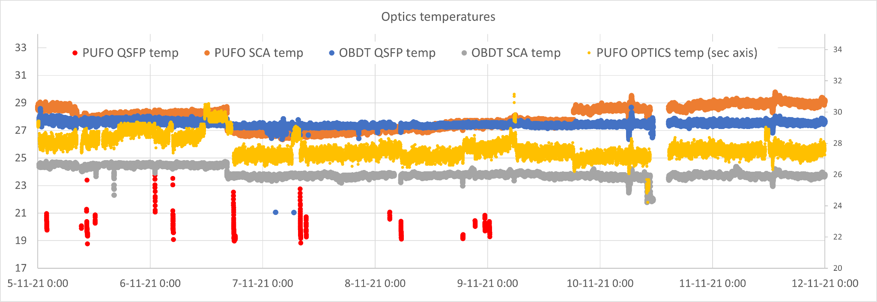
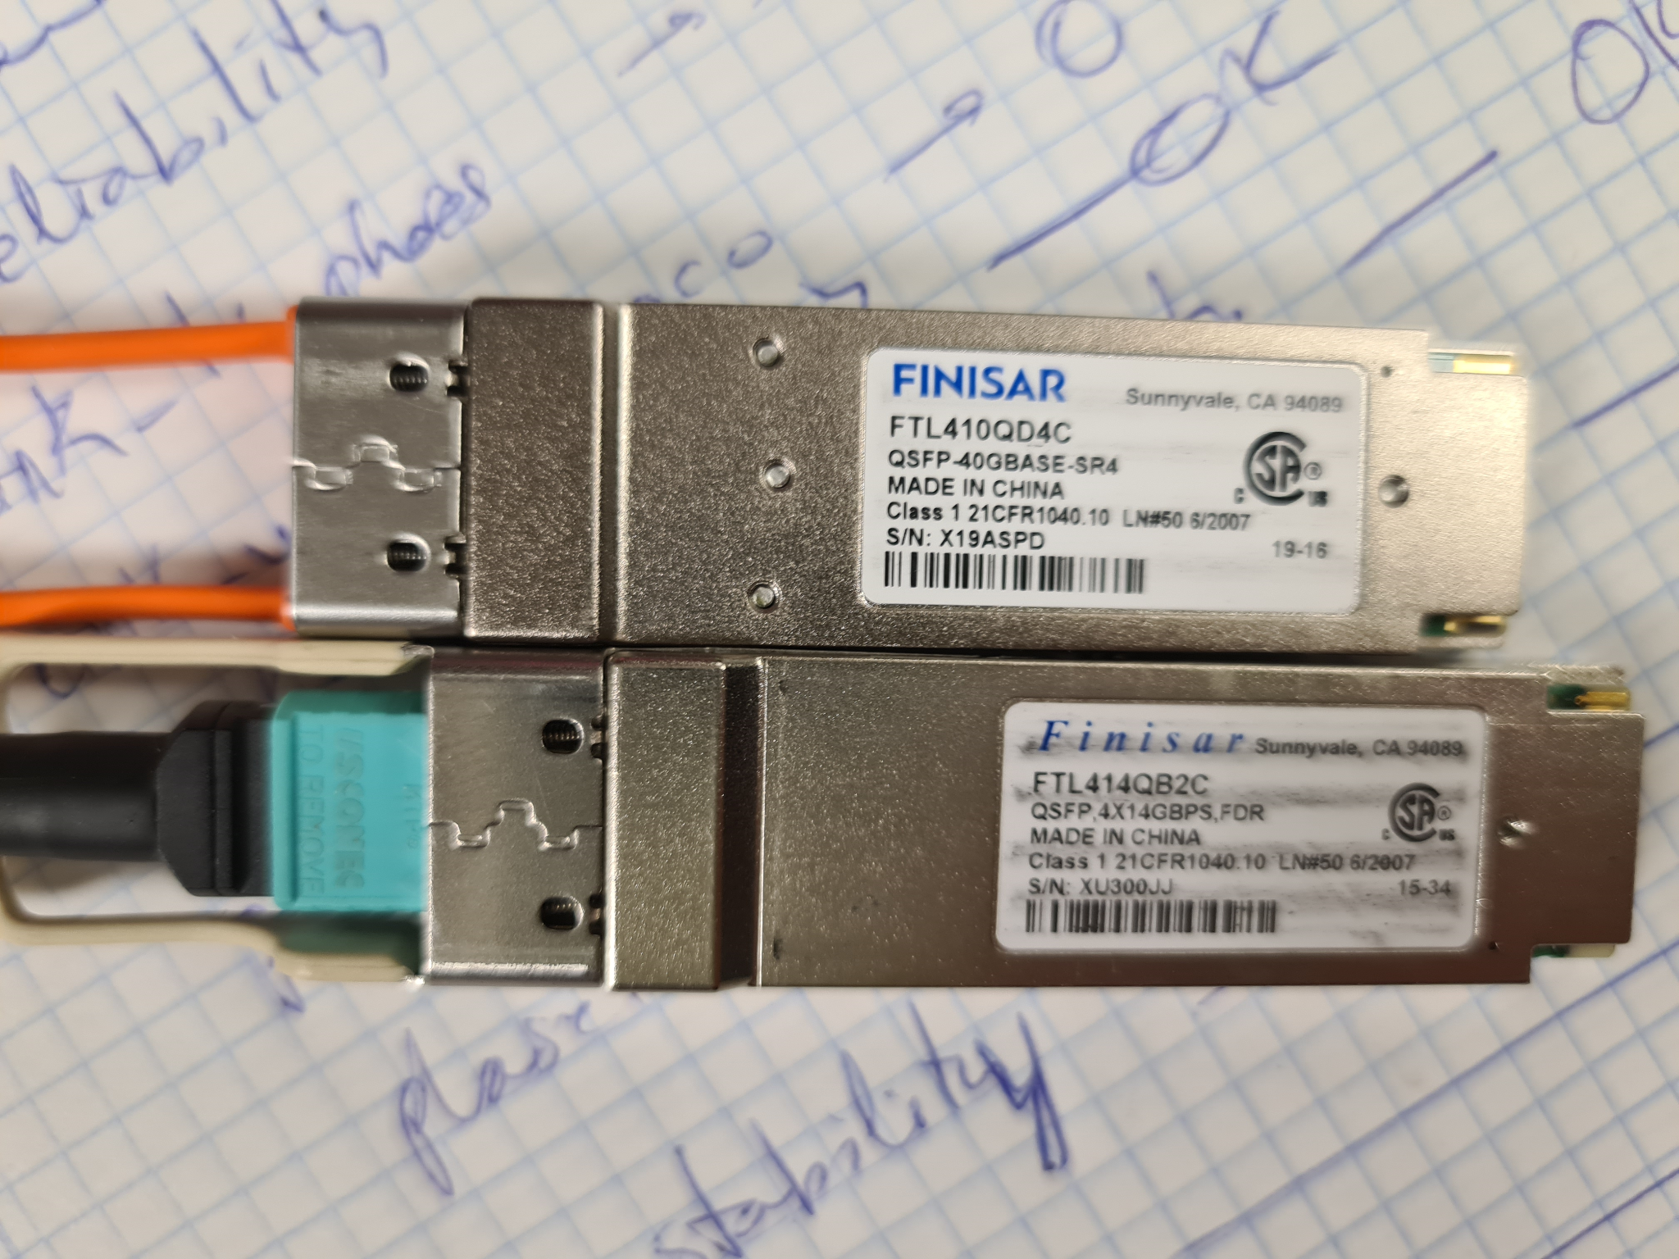
OPTICAL TRANSCEIVERS
These devices are not radiation tolerant, indeed it was clear that they were the main source of troubles during the test
An parallel electrical link was developed to read Polarfire (OBDT and PUFO) status from remote.
Commercial optical transceivers installed on the OBDTs:
SFP+ OBDT: AA13323A3ME (Avago)
SFP+ PUFO: FTLX8574D3BCL (Finisar)
QSFP OBDT: FTL414QB2C (Finisar), beige handle
QSFP PUFO: FTL410QD4C (Finisar), orange handle. Internal I2C temperature reading failed since the beginning of the test. Currents sporadically increased because of it.
C. F. Bedoya - Twepp 2022 FPGA Working group

Slide 21
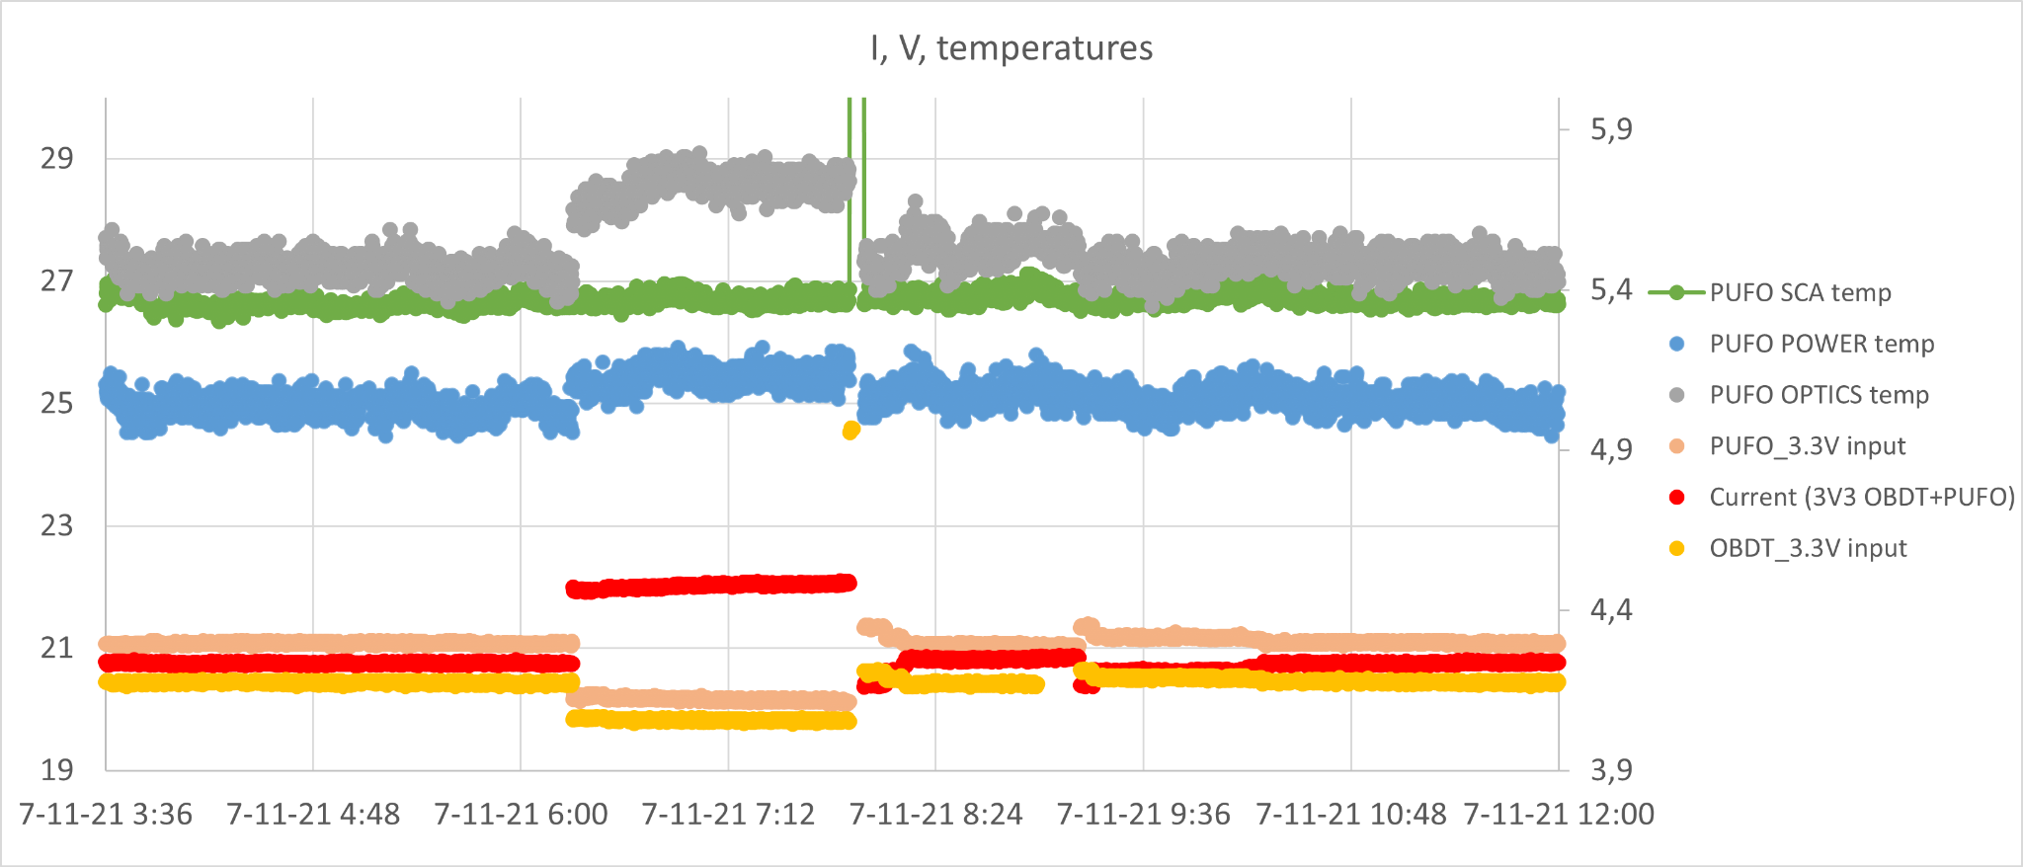
QSFP PUFO: FTL410QD4C (Finisar)
PUFO optics´s temperature in grey (read from a PT1000 which is nearby) has increased significantly following the input currents.
This temperatures increases are correlated with increases in the input current (red) that, among others, serves the QSFP
Total current is increased by 0.4 A. This increases the voltage drop of the incoming power cables and thus, the voltage seen at the PUFO 3.3V input is lower (though large enough for the board to operate).
The PUFO SCA temperature is much smoother (green)
The rest of the test metrics was unaltered during the high current period and SEUs could be measured correctly.
Currents and temperatures recover after a power cycle
C. F. Bedoya - Twepp 2022 FPGA Working group

Slide 22
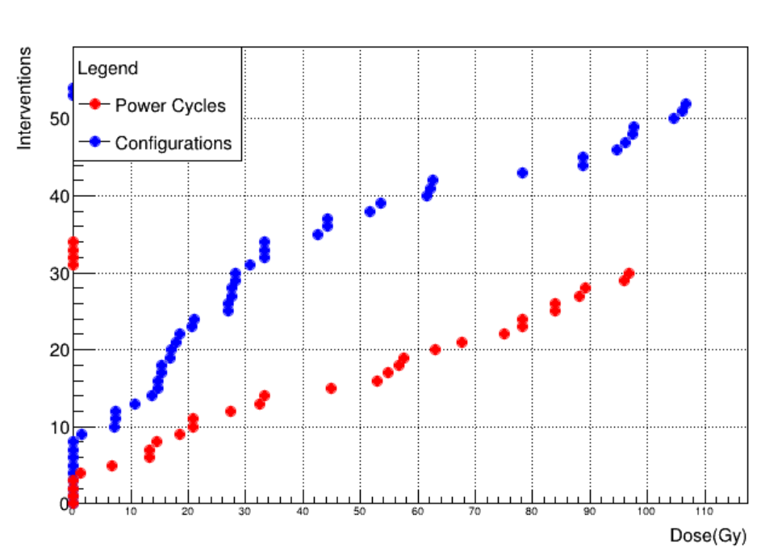
Manual Interventions: Power cycles and reconfigurations
Power cycles (red)
Exclusive configurations (blue)
All these power cycles belong to two types:
  Interventions (17) to recover commercial optical transceivers.
  Shifter actions without system malfunctioning (making verifies, etc)
If we were to operate with these optical transceivers: for a total dose of 109,8 Gy it would result in 3,67 power cycles/year. (Using the actual dose expected per chamber)
(Note however that the actual BER of this optical transceivers is larger than just these power cycles, so still, we would not recommend to use them)
C. F. Bedoya - Twepp 2022 FPGA Working group

Slide 23
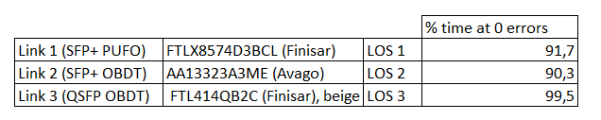
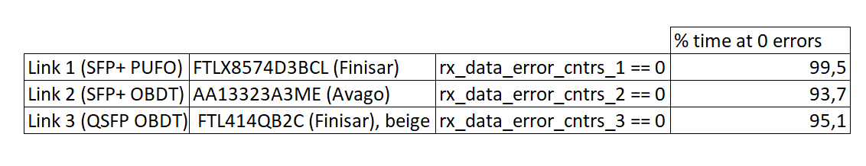
ESTIMATION OF THE FAILURE RATE OF THE OPTICAL TRANSCEIVERS
Beyond the power cycles, made an estimation of the failure rate based on two variables (none of them is perfect):
LOS (Loss of signal) at the VC707 side, no light at the optical receiver
RX_data_error variable provided by the GBT VHDL as data received being corrected (data is then valid. This variable is only relevant during periods when LOS is ok)
Some of the SFP+ LOS events had some impact because the clock was lost, this data has been removed from the measurements
C. F. Bedoya - Twepp 2022 FPGA Working group

Slide 24
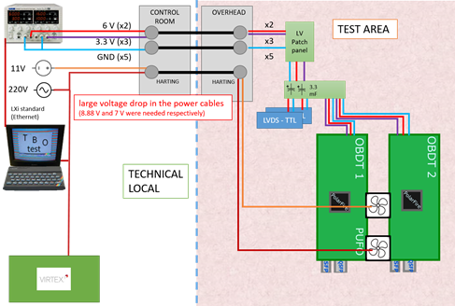
Power distribution, ground problems
35 meters long cables are installed between the power supply and the OBDT boards. The section of the cables was 1.5 mm² and this implied that a significant voltage drop (maximized the number of cables that we could use)
Voltage drop is dependent on the current and current consumption (configured and locking to the clock). Current between 1 Amp to 2.4 Amps => voltage drop from 1.3 volts to 3.2 volts
Maximum input voltage is 6 volts for the regulators.
Problems with the grounding for the secondary link (copper)

Slide 25
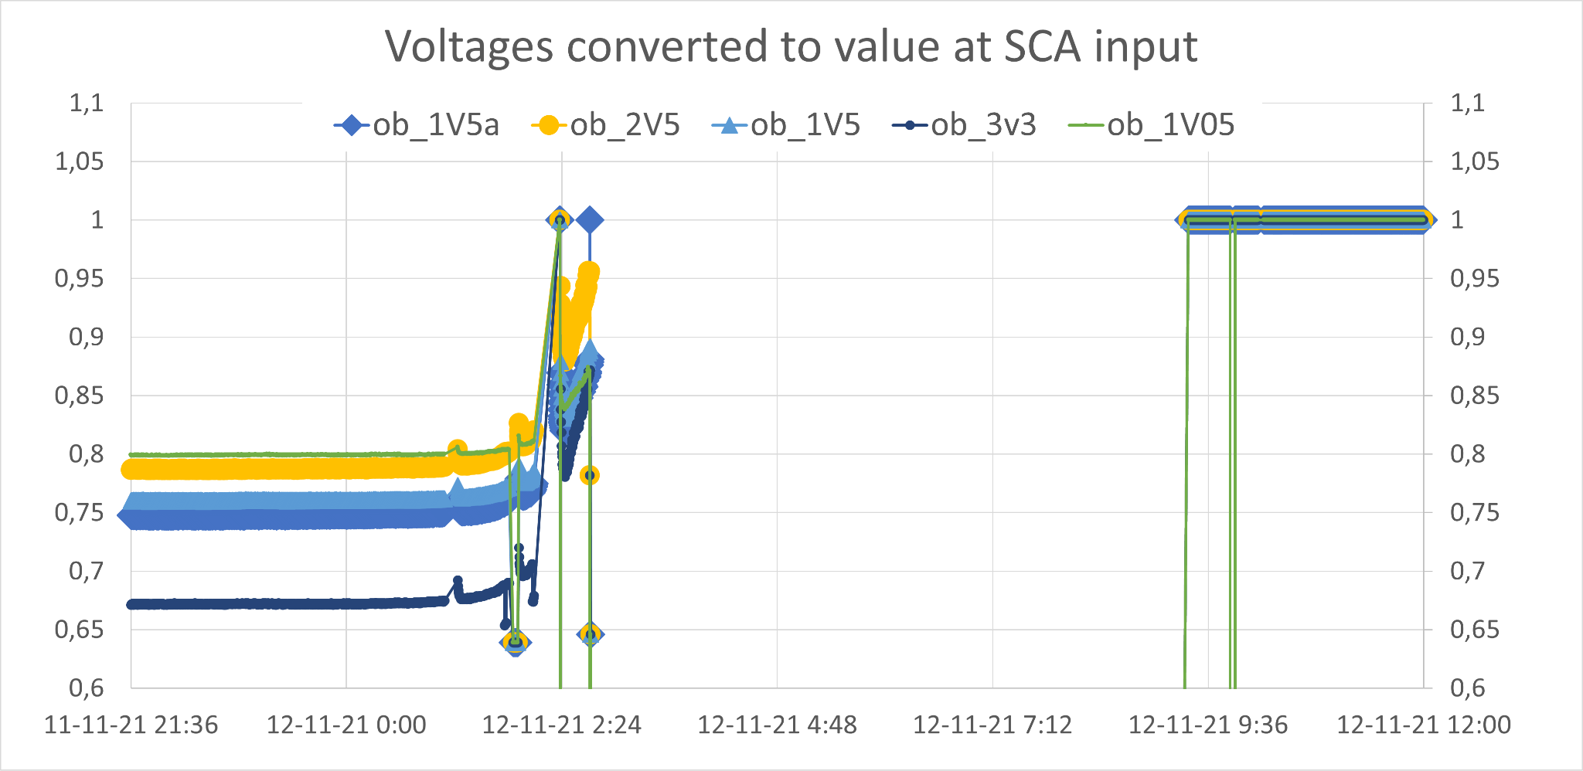
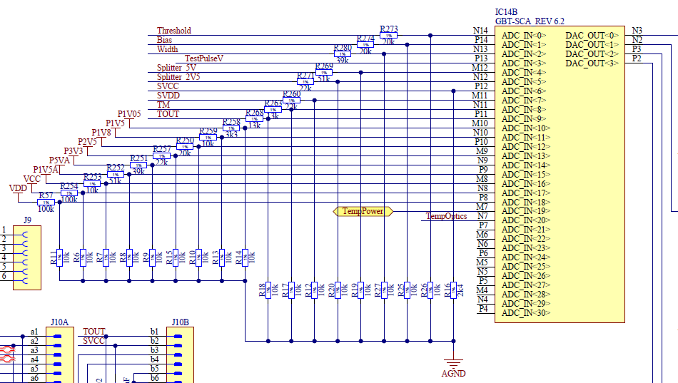
CERN´s SCA event
Last day (November 12th at around 02:46, after 98.77 Gy):
Temperatures and voltages of the OBDT as measured by the SCA started to increase gradually until they reached saturation point (unphysical temperatures)
It did not seem a real increase, currents were stable, temperature from the remote sensor was stable, it was an SCA artifact
ADC values were incorrect but the rest of the SCA functionality was intact
Similar behaviour as when a high voltage is present at SCA pins input and the ADC saturates.
Post mortem analysis of the OBDT would be needed to understand why this happened
Ramping
SCA saturated, end of scale values
C. F. Bedoya - Twepp 2022 FPGA Working group

Slide 26
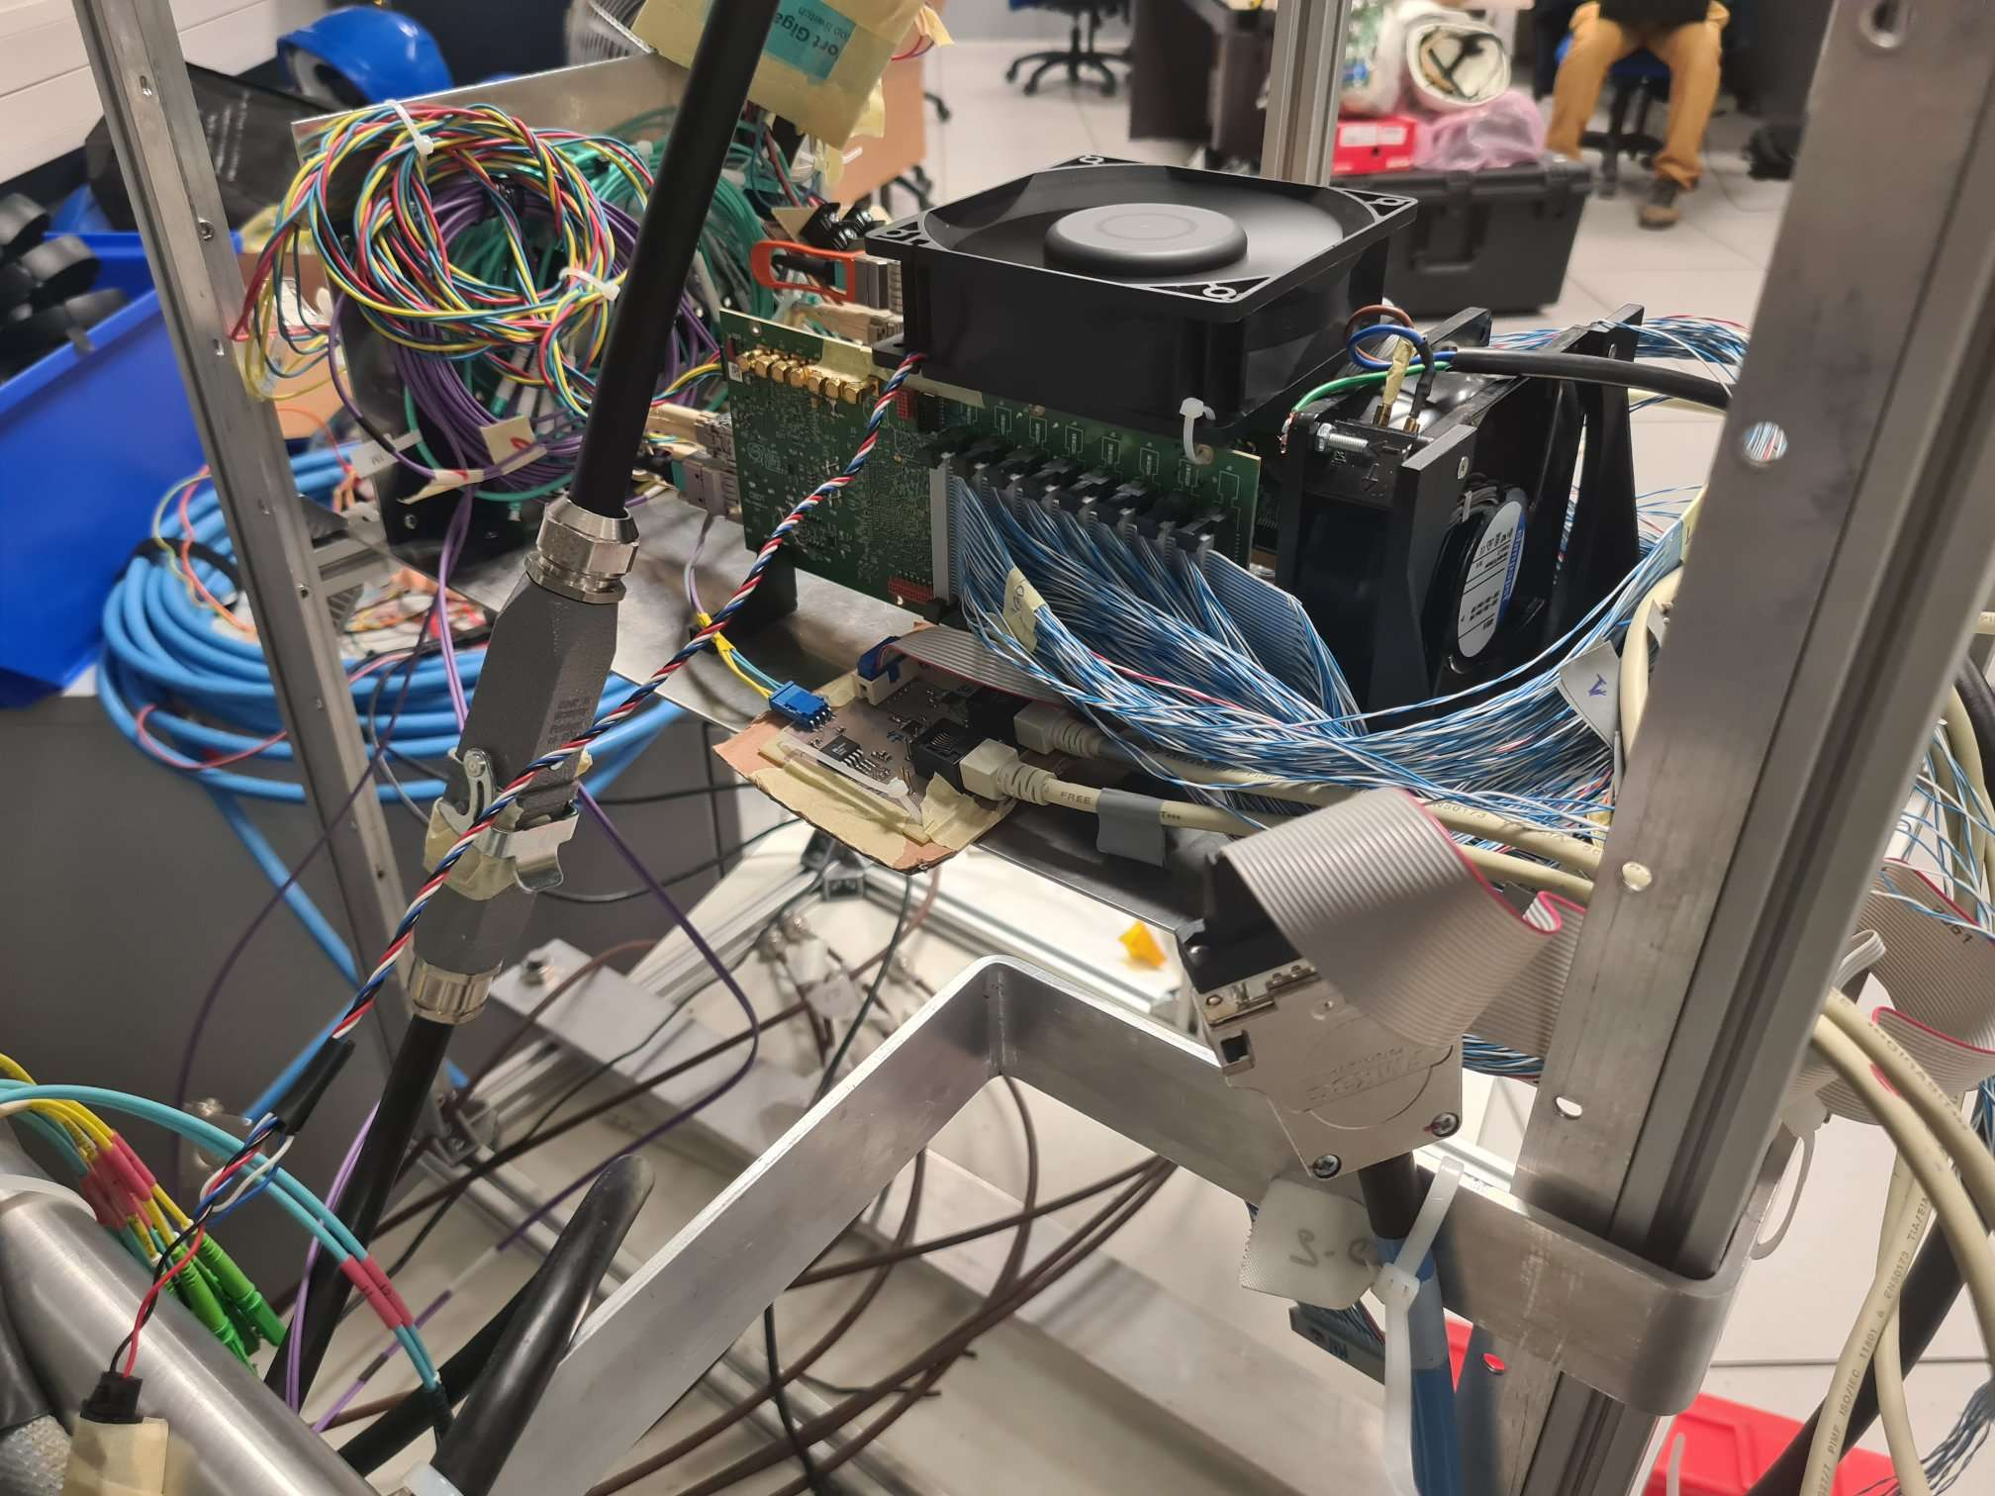
Backup
C. F. Bedoya - Twepp 2022 FPGA Working group

Slide 27
RESULTS
Fans
Currents, voltages, temperature. SCA event (in the backup)
Optical transceivers
Flash
Polarfire firmware verification
Polarfire: Reference SEU test:
  Part of the OBDT and PUFO logic devoted to a specific firmware implementation used by CERN and Microsemi
  Obtain cross-section of errors in the device and validate the irradiation performed
Polarfire & OBDT: Timing test counters:
  measure time digitization in all the channels every orbit.
  Behaviour of the OBDT in standard operation mode
  Extrapolating number of errors seen in the radiation test to the expectations during HL-LHC
C. F. Bedoya - Twepp 2022 FPGA Working group

Slide 28
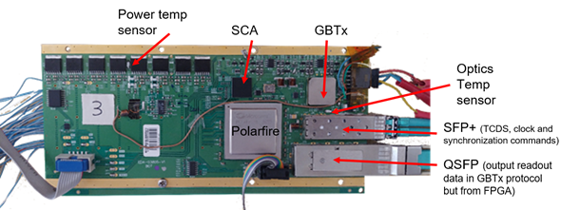
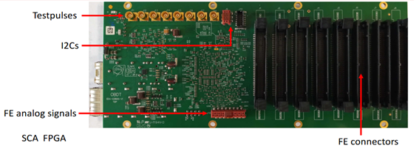
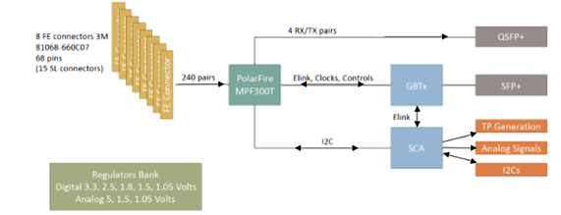

Slide 29
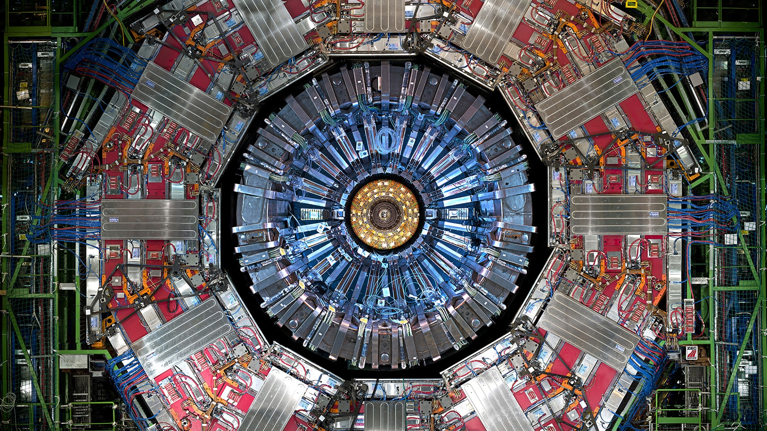

Slide 30
QSFP PUFO: FTL410QD4C (Finisar)
PUFO QSFP temperature reading not working.
Recovered briefly just right after power cycles.
Temperature of PUFO optics had sporadic increases which seemed real (and they were correlated with total currents increases). This sensor is a PT1000 read by the SCA which is placed close to the PUFO QSFP (and to the SPF+)

Slide 31
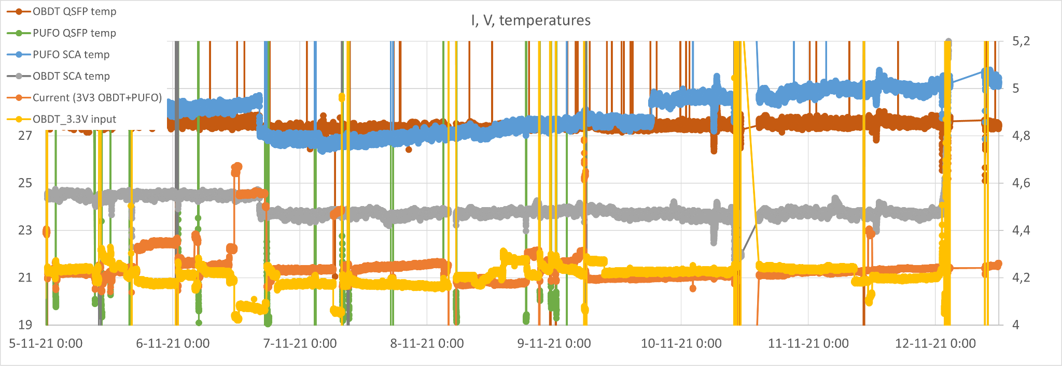
POLARFIRE FPGA FIRMWARE´s VERIFICATION
Not clear why but PUFO SCA temp increases a lot when a remote Polarfire FPGA Verify is performed and does not recover afterwards
OBDT SCA temp is not altered and no other symptom is detected
Remote FPGA verify worked fine before the radiation test (bunker zone)
First time it was tried was on Friday Nov. 5th at 13:00, after 15.55 Gy, and it was not working.
IDCODEs were being read properly but the verification was failing at 66% and 45% of the process on each FPGA respectively each time we performed it during the irradiation
However at the end of the irradiation period we were capable of loading the firmware remotely…

Slide 32
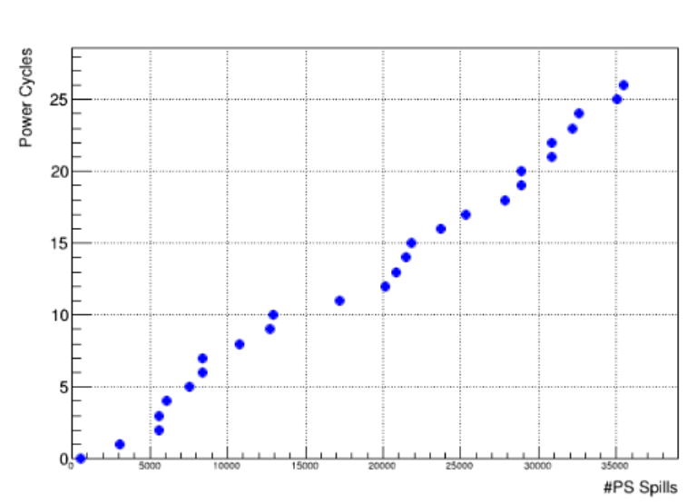
Manual interventions: Power cycles
Most of the interventions (17) to recover commercial optical transceivers.
Rest due to shifter actions (making verifies, fixing sw, etc)
If total dose is 200 Gy (tbc) it would result in one power cycle every 4x HL-LHC dose in our hottest area.

Slide 33
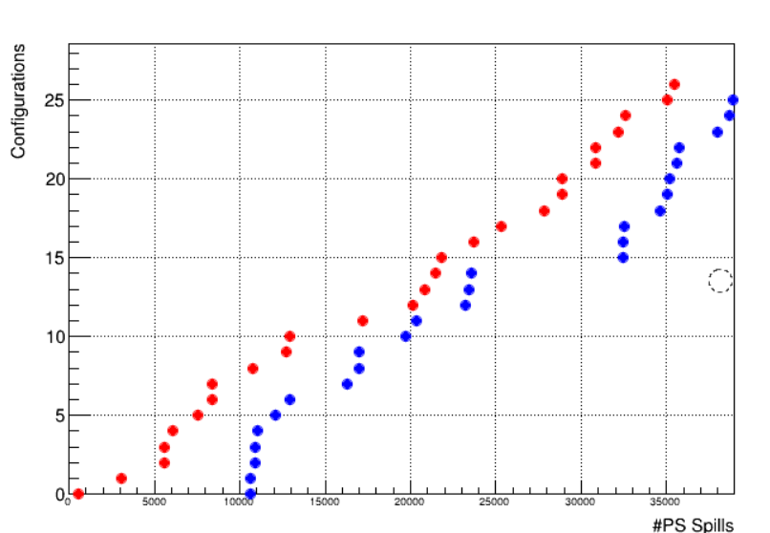
Manual interventions: Configurations
Power cycles (red)
Exclusive configurations (blue)
Configuraciones exclusivas
Clara ha hecho este plot, lo ha juntando con el de los power cycles, aqui en rojo (siguiente slide) para ponerlo en el mismo plot
(notese que las configuraciones empiezan mas tarde)

Slide 34
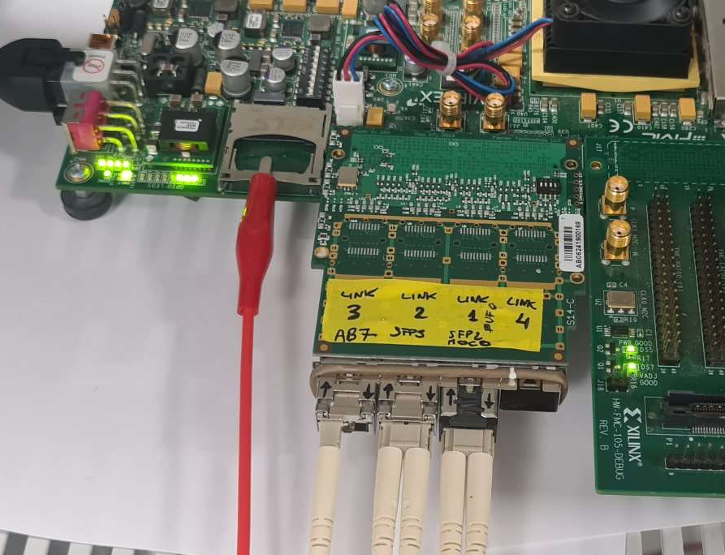

Slide 36
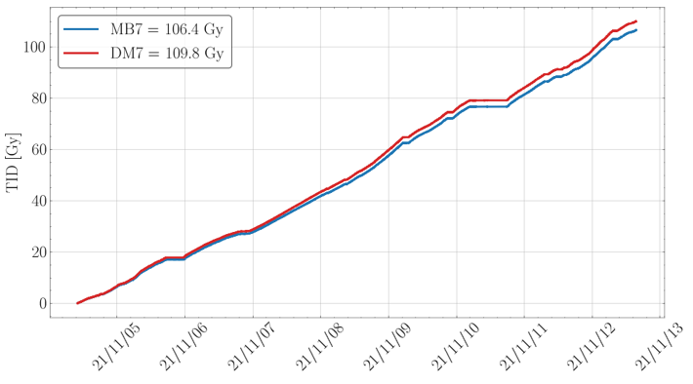
Dosimetry provided by CHARM facility through this report.
  Thanks to M. Brucoli and S. Danzeca for providing data vs. time .
Most of the time without shielding, but for the first night with the CuOOIC shielding
  1 % of the dose received at lower rate (1/5 of the TID rate), larger relative fraction of neutrons.
Dosimetry
MB7 closer to our boards
TOTAL received

Slide 37
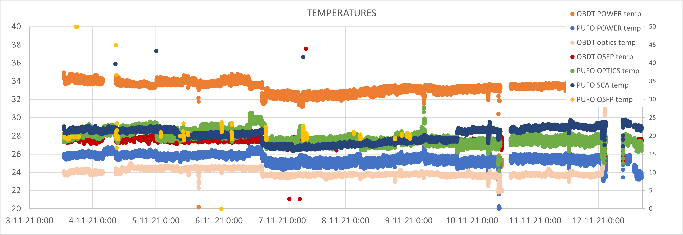
TEMPERATURES

Slide 38
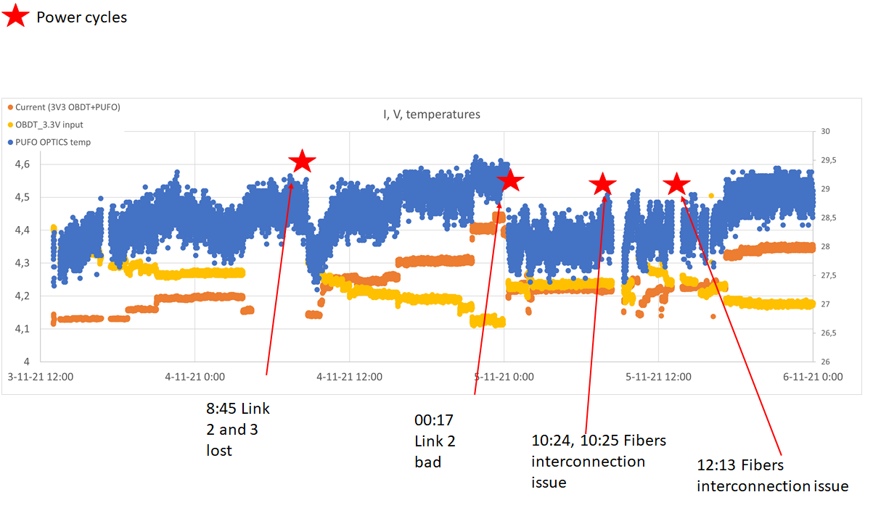
FURTHER DETAILS ABOUT THE POWER CYCLES
Day 3rd to 6th

Slide 39
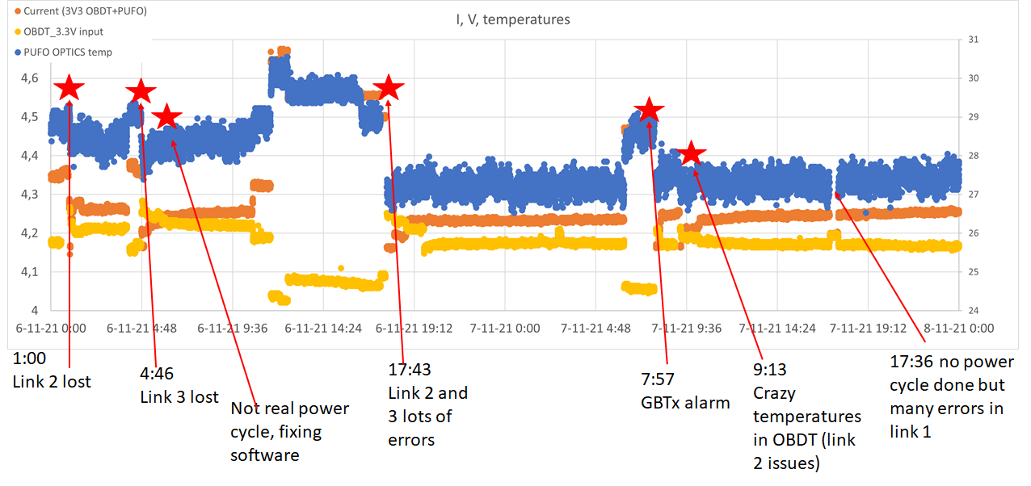
Day 6th to 8th

Slide 40

Day 8th to 10th

Slide 41

Day 10th to 12th

Slide 42




Polarfire SEU-reference test
A few examples of how the number of SEUs in this reference test where increasing versus the integrated dose

Slide 43


Polarfire & OBDT: Timing test counters:
Expected dose in the CMS detector during HL-LHC
Extrapolation of the #SEUs for the OBDT at HL-LHC
Gy
The cross section obtained with this number of failures and the amount of logic contained in the Polarfire firmwares is 2.33 10⁻¹⁵ cm²/bit
Expected SEU rate in the detector during HL-LHC with the firmware used at CHARM (TMR included)

