Slide 1

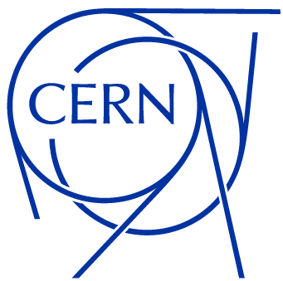

Electro – optical DC Beam Position Monitor
Antonio Cristiano, Michał Krupa
SY-BI-BP

Slide 2
Outline
Introduction: Evaluation of unbunched beam position
Working principles:
- Pockels effect
- DC electric field detection in the frequency domain
Proof of concept laboratory test bench and its results
Current status
Summary

Slide 3
Outline
Introduction: Evaluation of unbunched beam position
Working principles:
- Pockels effect
- DC electric field detection in the frequency domain
Proof of concept laboratory test bench and its results
Current status
Summary

Slide 4
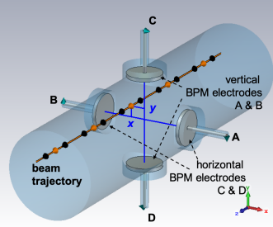
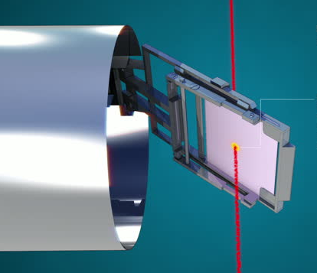
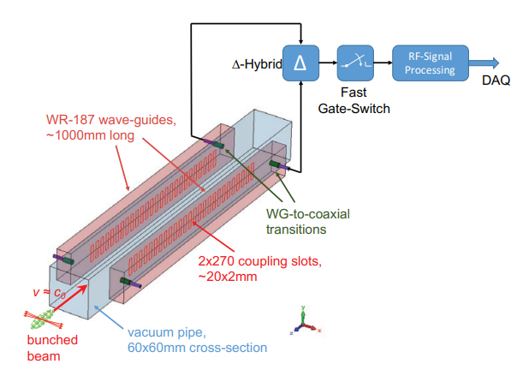
Evaluation of unbunched beam position
Standard BPM
Screens
Schottky monitor

Slide 5
Evaluation of unbunched beam position
Standard BPM
Screens
Schottky monitor
DC Insensitive

Slide 6
Evaluation of unbunched beam position
Standard BPM
Screens
Schottky monitor
DC Insensitive
Destructive interaction with the particle beam

Slide 7
Evaluation of unbunched beam position
Standard BPM
Screens
Schottky monitor
DC Insensitive
Destructive interaction with the particle beam
Complex
Costly

Slide 8
Outline
Introduction: Evaluation of unbunched beam position
Working principles:
- Pockels effect
- DC electric field detection in the frequency domain
Proof of concept laboratory test bench and its results
Current status
Summary

Slide 9
Electro-Optical crystals and Pockels effect
V

Slide 10
Electro-Optical crystals and Pockels effect
V
E=V/d
d

Slide 11
Electro-Optical crystals and Pockels effect
V
Input
Polarization state
E=V/d
d
E^{Opt}
Output
Polarization state
Laser beam

Slide 12
Electro-Optical crystals and Pockels effect
V
Input
Polarization state
Random polarization
E=V/d
d
z
E^{Opt}
E^{Opt}
x
Transmission
direction
Output
Polarization state
Laser beam

Slide 13
Electro-Optical crystals and Pockels effect
V
Input
Polarization state
Random polarization
E=V/d
d
z
E^{Opt}
E^{Opt}
Photodetector
x
Transmission
direction
Transmission
direction
Output
Polarization state
Laser beam

Slide 14
Electro-Optical crystals and Pockels effect
Input
Polarization state
V
Output
Polarization state
Random polarization
z
E=V/d
d
E^{Opt}
E^{Opt}
Transmission
direction
Photodetector
x
Transmission
direction
Laser beam

Slide 15
Outline
Introduction: Evaluation of unbunched beam position
Working principles:
- Pockels effect
- DC electric field detection in the frequency domain
Proof of concept laboratory test bench and its results
Current status
Summary

Slide 16
DC electric field detection
DC Bias
Modulation
signal
Feedback signal
Data processing system
z
Bias field [kV/m] | 85.3
External field [kV/m] | 0
Feedback field [kV/m] | 0
E^{Opt}
Photodetector
Transmission
direction
x
Transmission
direction

Slide 17
DC electric field detection
DC Bias
Modulation
signal
Feedback signal
Data processing system
z
Bias field [kV/m] | 85.3
External field [kV/m] | 0
Feedback field [kV/m] | 0
E^{Opt}
Photodetector
Transmission
direction
x
Transmission
direction

Slide 18
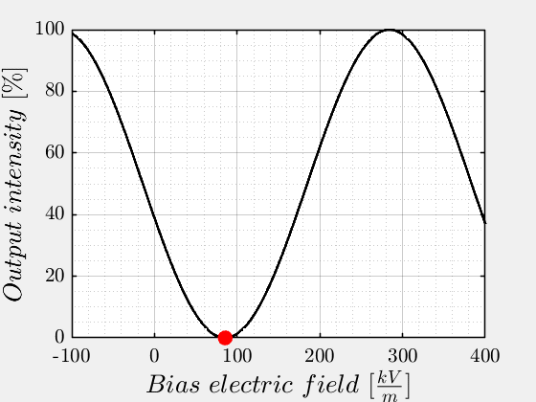
DC electric field detection
DC Bias
Modulation
signal
Feedback signal
Data processing system
z
Bias field [kV/m] | 85.3
External field [kV/m] | 0
Feedback field [kV/m] | 0
E^{Opt}
Photodetector
Transmission
direction
x
Transmission
direction

Slide 19
DC electric field detection
DC Bias
Modulation
signal
Feedback signal
Data processing system
z
Bias field [kV/m] | 85.3
External field [kV/m] | 0
Feedback field [kV/m] | 0
E^{Opt}
Photodetector
Transmission
direction
x
Transmission
direction

Slide 20
DC electric field detection
DC Bias
Modulation
signal
Feedback signal
Data processing system
z
E^{Opt}
Photodetector
Transmission
direction
x
Transmission
direction
y
External field
to measure

Slide 21
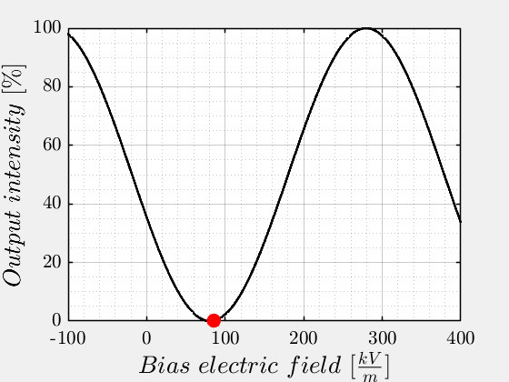
DC electric field detection
DC Bias
Modulation
signal
Feedback signal
Data processing system
z
Bias field [kV/m] | 85.3
External field [kV/m] | 30
Feedback field [kV/m] | 0
E^{Opt}
Photodetector
External field
to measure
Transmission
direction
x
Transmission
direction

Slide 22
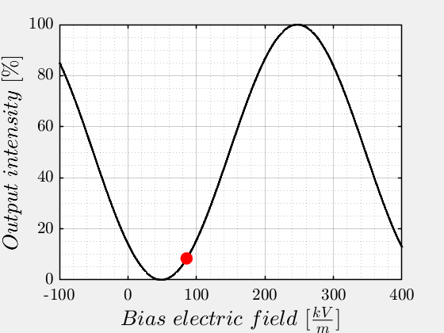
DC electric field detection
DC Bias
Modulation
signal
Feedback signal
Data processing system
z
Bias field [kV/m] | 85.3
External field [kV/m] | 30
Feedback field [kV/m] | 0
E^{Opt}
Photodetector
External field
to measure
Transmission
direction
x
Transmission
direction

Slide 23
DC electric field detection
DC Bias
Modulation
signal
Feedback signal
Data processing system
z
Bias field [kV/m] | 85.3
External field [kV/m] | 30
Feedback field [kV/m] | 0
E^{Opt}
Photodetector
External field
to measure
Transmission
direction
x
Transmission
direction

Slide 24
DC electric field detection
DC Bias
Modulation
signal
Feedback signal
Data processing system
z
Bias field [kV/m] | 85.3
External field [kV/m] | 30
Feedback field [kV/m] | -38
E^{Opt}
Photodetector
External field
to measure
Transmission
direction
x
Transmission
direction

Slide 25
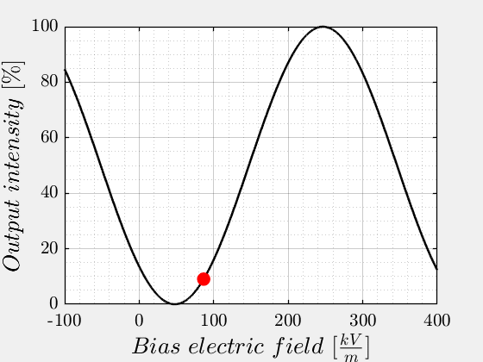
DC electric field detection
DC Bias
Modulation
signal
Feedback signal
Data processing system
z
Bias field [kV/m] | 85.3
External field [kV/m] | 30
Feedback field [kV/m] | -38
E^{Opt}
Photodetector
External field
to measure
Transmission
direction
x
Transmission
direction

Slide 26
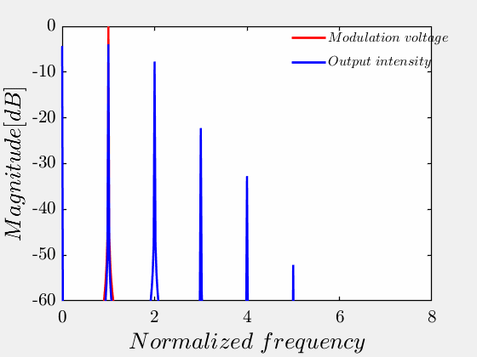
DC electric field detection
DC Bias
Modulation
signal
Feedback signal
Data processing system
z
Bias field [kV/m] | 85.3
External field [kV/m] | 30
Feedback field [kV/m] | -38
E^{Opt}
Photodetector
External field
to measure
Transmission
direction
x
Transmission
direction

Slide 27
DC electric field detection
DC Bias
Modulation
signal
Feedback signal
Data processing system
z
Bias field [kV/m] | 85.3
External field [kV/m] | 30
Feedback field [kV/m] | -38
E^{Opt}
Photodetector
External field
to measure
Transmission
direction
x
Transmission
direction
The Feedback field to apply, in order to minimize the odd harmonics, is proportional to the External field to be measured.
The proportionality factor depends on the properties (geometry, material etc..) of the crystals.

Slide 28
Outline
Introduction: Evaluation of unbunched beam position
Working principles:
- Pockels effect
- DC electric field detection in the frequency domain
Proof of concept laboratory test bench and its results
Current status
Summary

Slide 29
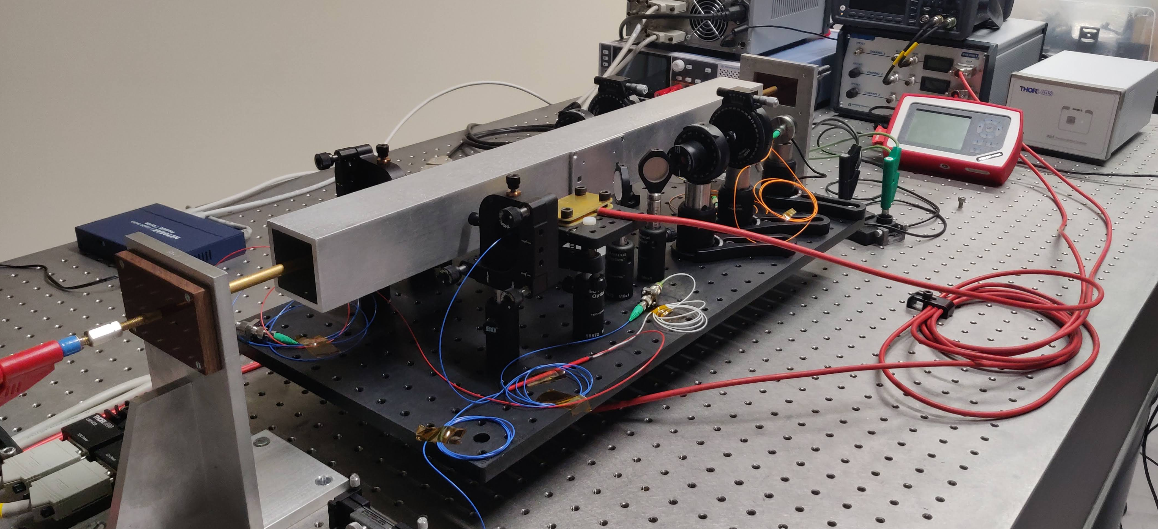
Proof-of-concept laboratory test bench
With the collaboration of Franck Guy Guillot-Vignot and Romain Ruffieux

Slide 30
Proof-of-concept laboratory test bench
With the collaboration of Franck Guy Guillot-Vignot and Romain Ruffieux

Slide 31
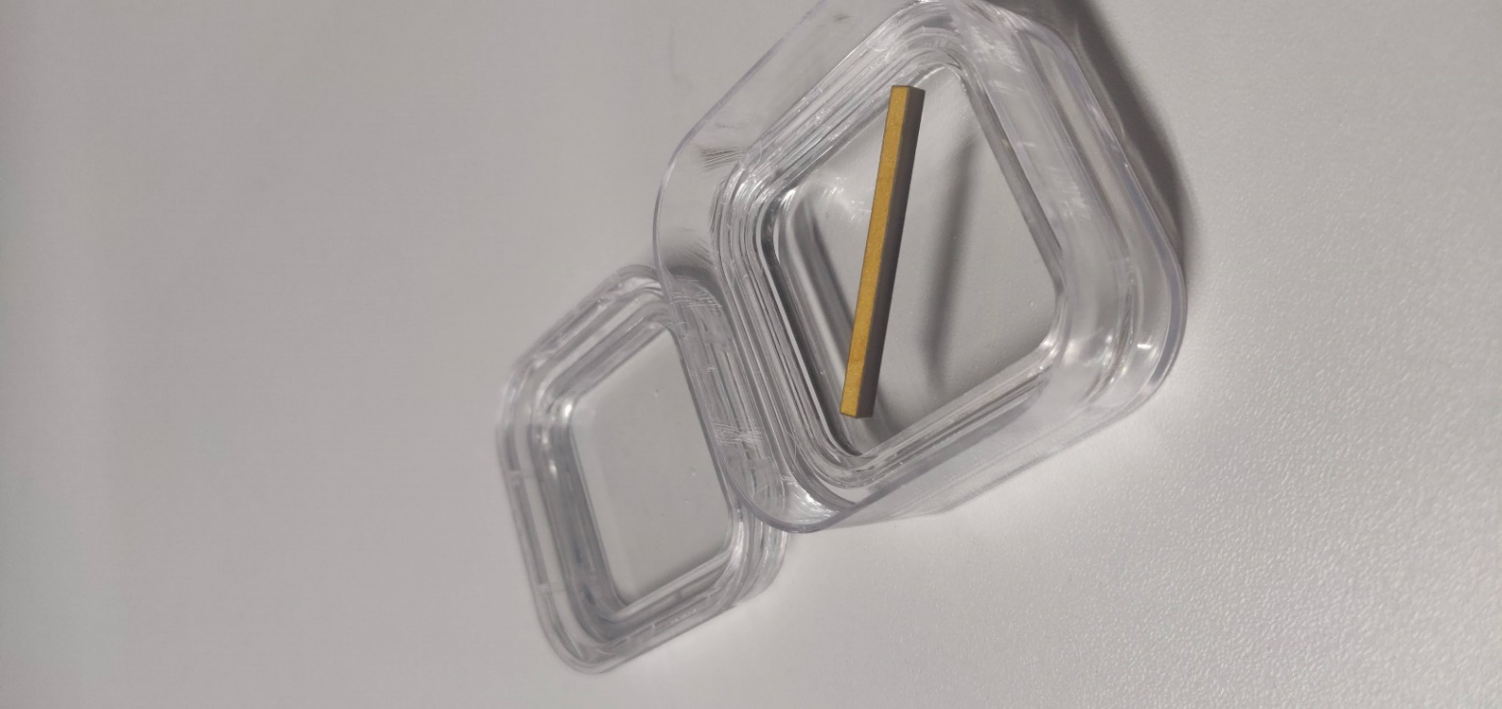
Proof-of-concept laboratory test bench
External crystal modulated through PCBs
With the collaboration of Franck Guy Guillot-Vignot and Romain Ruffieux

Slide 32
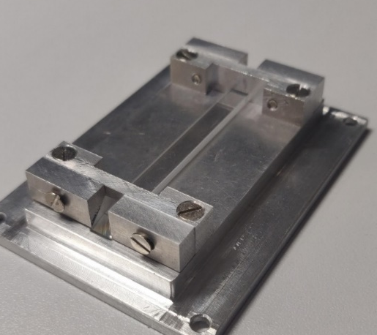
Proof-of-concept laboratory test bench
LiNbO3 5%MgO doped
50x2x5mm
External crystal modulated through PCBs
With the collaboration of Franck Guy Guillot-Vignot and Romain Ruffieux

Slide 33
Experimental results

Slide 34
Outline
Introduction: Evaluation of unbunched beam position
Working principles:
- Pockels effect
- DC electric field detection in the frequency domain
Proof of concept laboratory test bench and its results
Current status
Summary

Slide 35
…but where is the BPM?
Off-centered unbunched beam

Slide 36
…but where is the BPM?
Off-centered unbunched beam
Electromagnetic
DC field lines

Slide 37
…but where is the BPM?
Polarizer
Polarizer
Off-centered unbunched beam
Birefringent
crystals
Electromagnetic
DC field lines

Slide 38
…but where is the BPM?
Bias voltage
+
Modulation voltage
Polarizer
Polarizer
Off-centered unbunched beam
Birefringent
crystals
Electromagnetic
DC field lines

Slide 39
…but where is the BPM?
Bias voltage
+
Modulation voltage
Polarizer
Polarizer
Off-centered unbunched beam
Birefringent
crystals
Laser
Acquisition and
post processing system
30 dB dynamic range on first harmonic power compensation.
Electromagnetic
DC field lines

Slide 40
…but where is the BPM?
Bias voltage
+
Modulation voltage
Polarizer
Polarizer
Off-centered unbunched beam
Birefringent
crystals
Feedback voltage 1
Laser
Photodetector and real time processing system
Electromagnetic
DC field lines

Slide 41
…but where is the BPM?
Bias voltage
+
Modulation voltage
Polarizer
Polarizer
Off-centered unbunched beam
Birefringent
crystals
Feedback voltage 1
Laser
Photodetector and real time processing system
Electromagnetic
DC field lines

Slide 42
…but where is the BPM?
Bias voltage
+
Modulation voltage
Polarizer
Polarizer
Off-centered unbunched beam
Birefringent
crystals
Feedback voltage 1
Laser
Photodetector and real time processing system
Electromagnetic
DC field lines
Feedback voltage 2

Slide 43
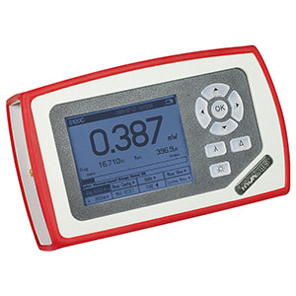
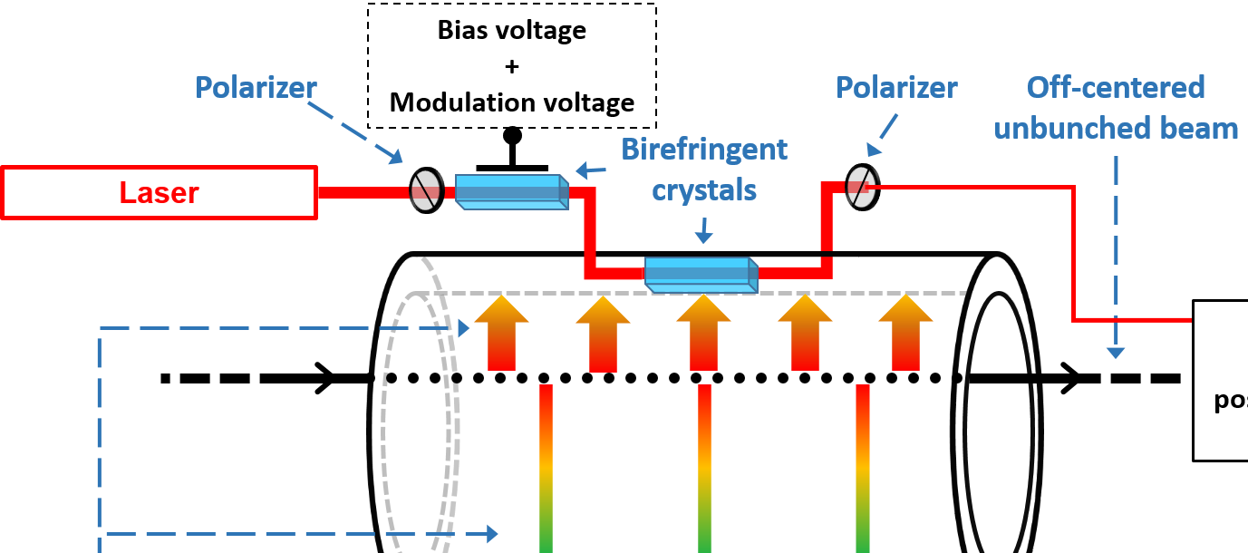
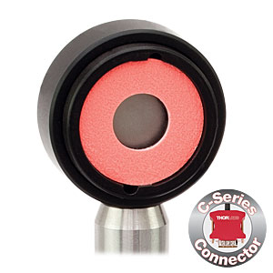
…but where is the BPM?
Oscilloscope
Raw data
Postprocessing
Signal analyzer
~32 dBm of peak dynamic range
S122C GE Photodiode

Slide 44
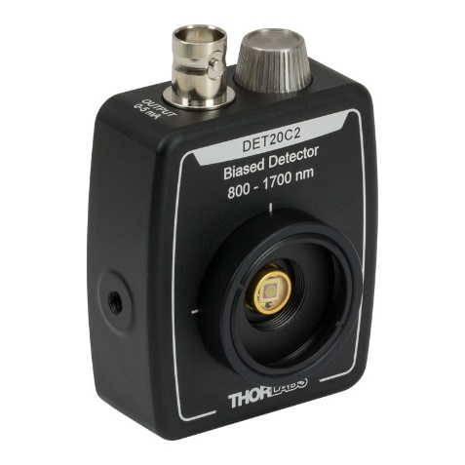
…but where is the BPM?
VFC-HD
1st Harmonic
Control signal
A
24-bit ADC
f
24-bit DAC
DET20C2
Photodiode

Slide 45
Outline
Introduction: Evaluation of unbunched beam position
Working principles:
- Pockels effect
- DC electric field detection in the frequency domain
Proof of concept laboratory test bench and its results
Current status
Summary

Slide 46
Summary
Theoretical study of detection technique
✓
Development of one optical chain mathematical model
✓
Model validation through experimental results
Design of a laboratory test bench with one optical chain
✓
Experimental results
✓
Custom acquisition chain and feedback loop for two optical branches
In progress

Slide 47
Thank you for the attention!

Slide 48
Backup slides

Slide 49
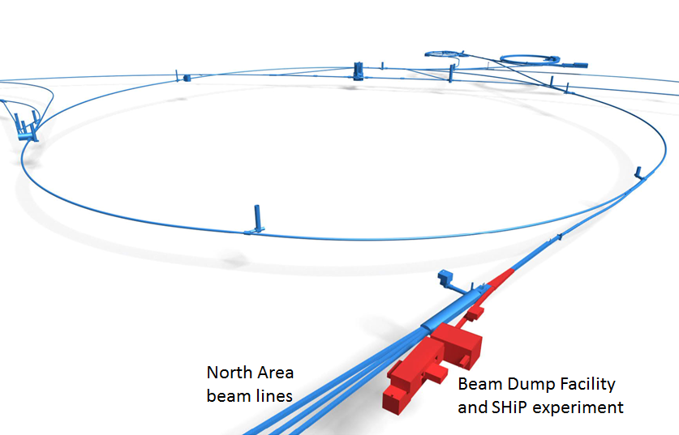
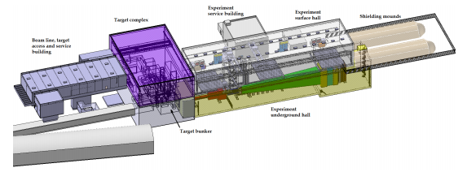
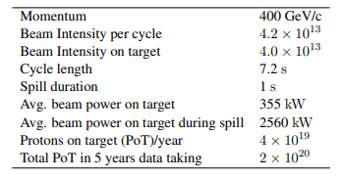
Search for hidden particle (SHiP) experiment at CERN
Fig.2 Position of the proposed facility
Fig.1 Overview of the proposed facility¹
Table 1 Cycle parameters foreseen for SHiP¹
1-Ahdida, C., et al. "SPS Beam Dump Facility--Comprehensive Design Study." arXiv preprint arXiv:1912.06356 (2019).

Slide 50
One branch optical chain
DC Bias
Modulation
signal
Feedback signal
Data processing system
z
Bias field [kV/m] | 0
External field [kV/m] | 0
Feedback field [kV/m] | 0
E^{Opt}
Photodetector
Transmission
direction
x
Transmission
direction
Length = 40 mm
Cross section = 3x3 mm
C_{L} ≃ 10 pF
E_{π} = 198.7 kV/m
V_{π} = 597 V
Length = 50 mm
Cross section = 2x5 mm
E_{π} = 159 kV/m
V_{π} = 318 V

Slide 51
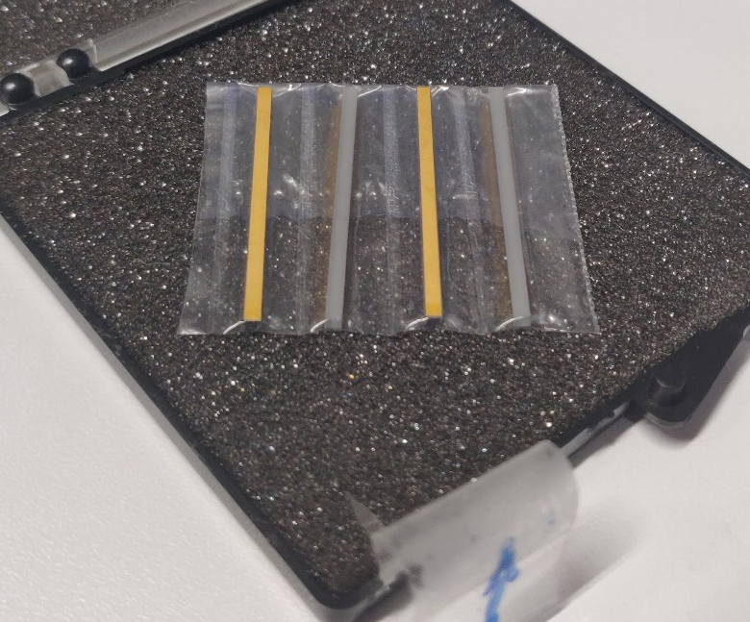

Electro-Optical crystals purchased
Seller : Photonics Solutions Ltd
Length : 50 mm
WxT : 5x2 mm
Material : MgO LiNbO3(5%)
Coating : AR coating @1550nm at input and output surfaces
Seller : United Crystals Inc.
Length : 40 mm
WxT : 3x3 mm
Material : MgO LiNbO3(5%)
Coating : AR coating @1550nm at input and output surfaces
Coating : Cr, Au electrode coatings on z-planes
Seller : MolTech
Length : 40 mm
WxT : 2x2 mm
Material : LiTaO3
Coating : AR coating @1550nm at input and output surfaces
Coating : Cr, Au electrode coatings on z-planes

Slide 52
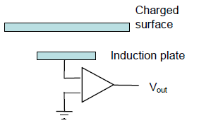
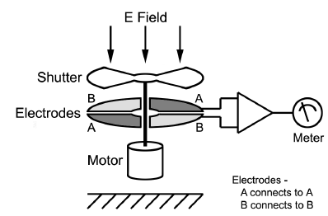
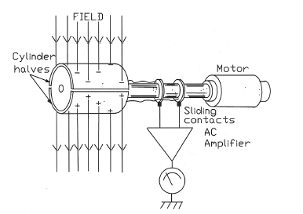
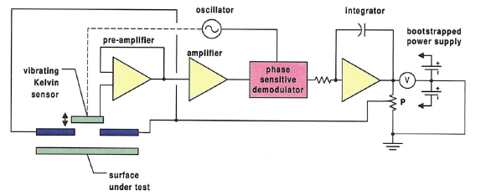
DC Field sensing
Different non-contact methods are available to measure DC electrostatics fields
Fig.3 Induction probes
Fig.4 Field mill
Fig.5 Cylindrical field mill
Fig.6 Oscillating plate sensors
Frequent re-zero going needed
More complex and expensive than induction probes
Large field’s source needed
Large size of the mills
More complex and expensive than induction probes
Large dimension ( min150mm x 22mm)
Complex structure
Highly sensitive to charged particles accumulation
Metallic sensors disturbs the electric field being measured
Not compatible with the accelerator environment

Slide 53






Jones calculus
The state of polarization of a plane wave in the x-y plane, propagating along z-axes can be described as:
When the wave enters in the matter, if the reference crystal is different, the new components will be:
At the end of the matter it accumulates a phase delay proportional to the refractive indices of the material as:
In the reference system of the input light:

Slide 54


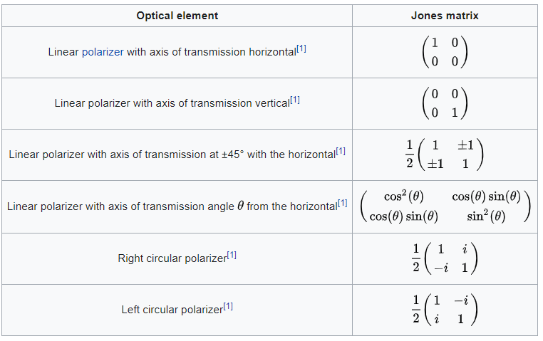
Jones calculus
Through the matrix:
The relation between the input light and the output light can be rewritten as :
The values of the components of the matrix M depend on several factor. They are listed for different optical components, as shown in the next figure.
Table 2. Jones matrices

Slide 55
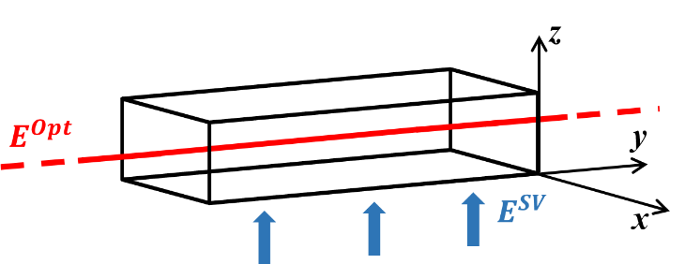




Pockels effect
In the case in exam, the electric induction of the material can be written as:
Instead of the permittivity, it is studied the impermeability tensor, that is:
The tensor can be expanded, with respect to the field applied, as :
And can be easily rewritten as:

Slide 56
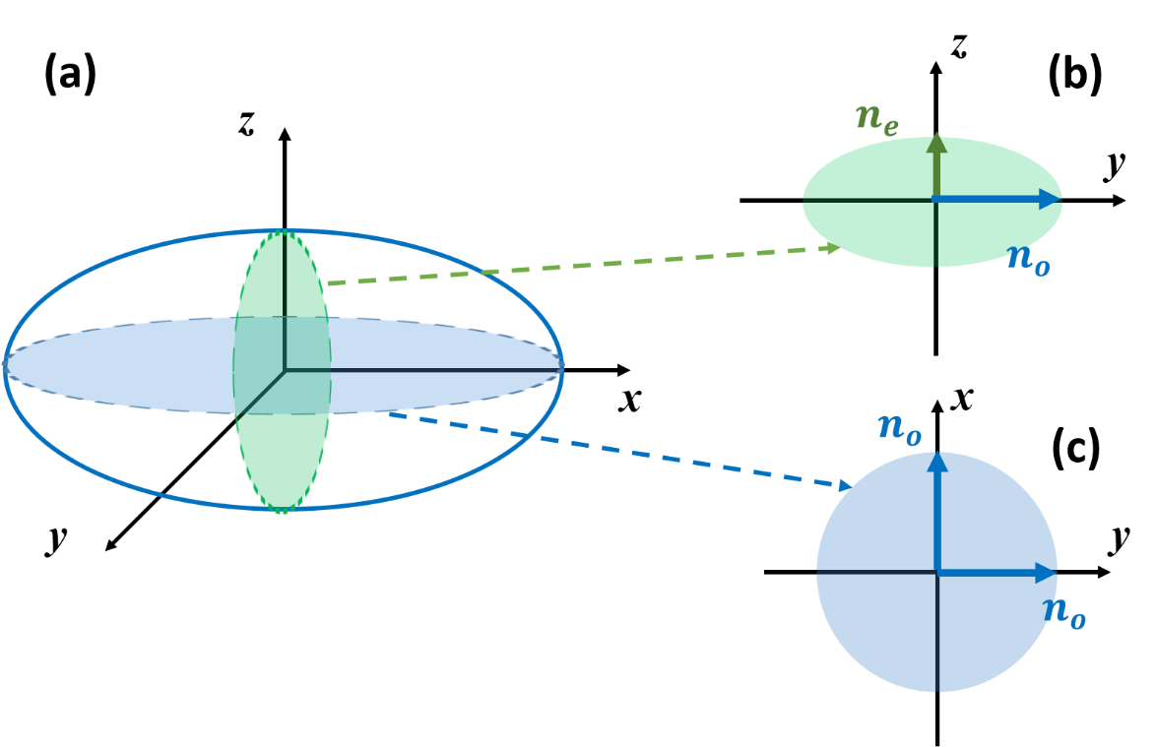
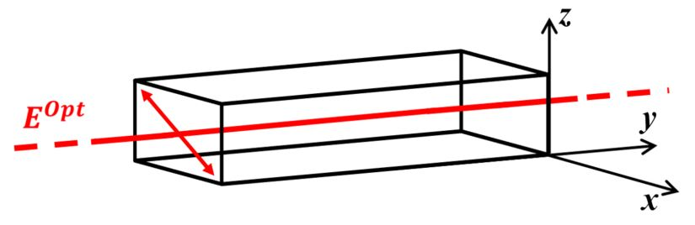
Birefringency and Pockels effect
Fig7. LiNbO₃ crystal crossed by an optical beam
Fig.8 Ellipsoid of indices of LiNbO₃

Slide 57
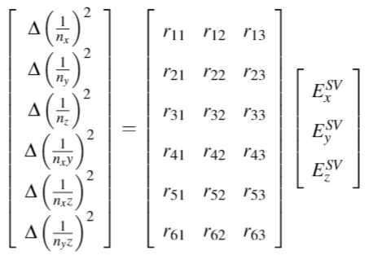
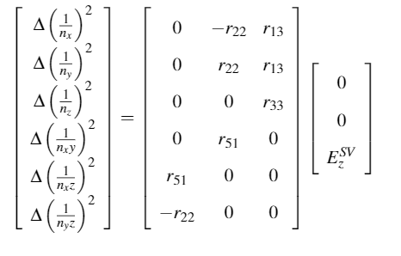


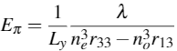
Birefringency and Pockels effect
Electro-optic tensor
In case of fig.9
Fig.9 Pockels crystal crossed by an optical beam and subject to a slow varying electric field
Optical beam propagating along y-direction
An important parameter to consider for the geometry of the crystals is:

Slide 58
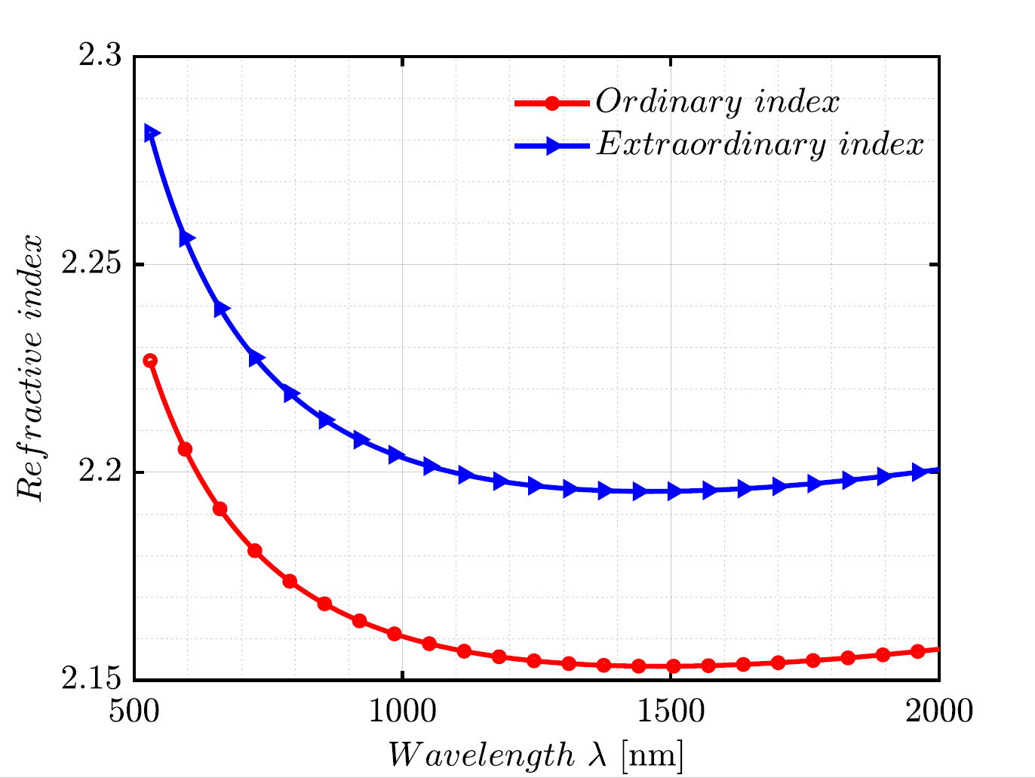
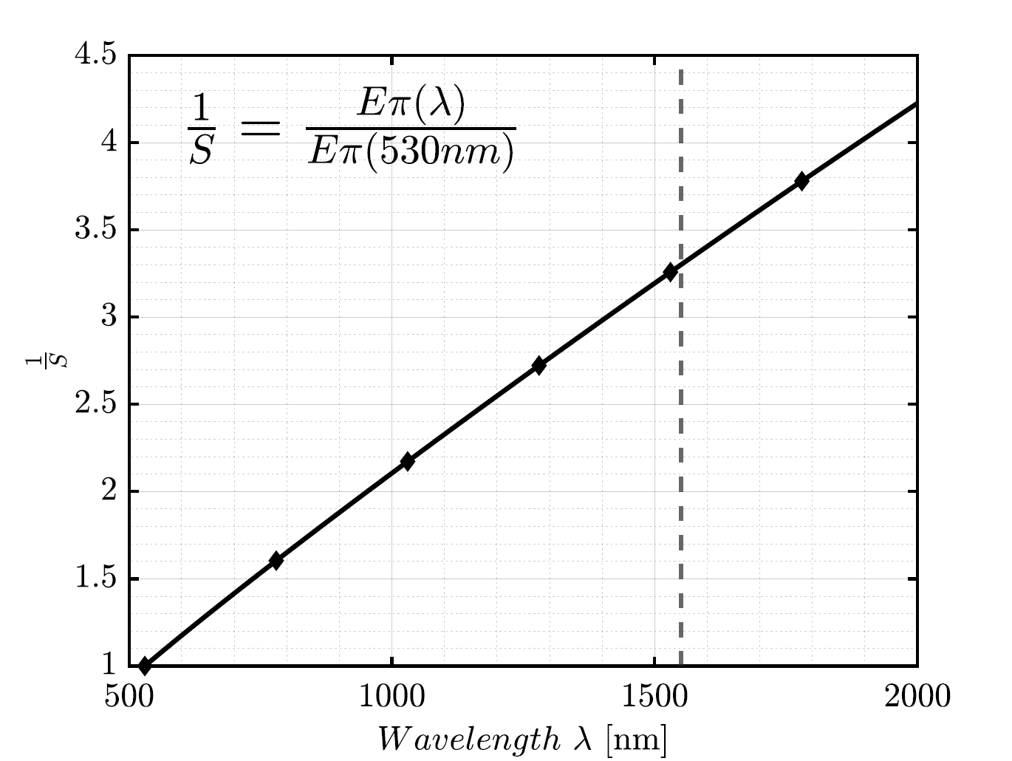
Optical beam’s wavelength choice
Fig.10 Refractive indices value of LiNbO₃ with respect to optical beam’s wavelength computed through Sellmeier equation⁷
Fig.11 The inverse of the sensitivity of the system with respect to the optical beam’s wavelength
7-Zelmon, David E., David L. Small, and Dieter Jundt. "Infrared corrected Sellmeier coefficients for congruently grown lithium niobate and 5 mol.% magnesium oxide–doped lithium niobate." JOSA B 14.12 (1997): 3319-3322..

Slide 59
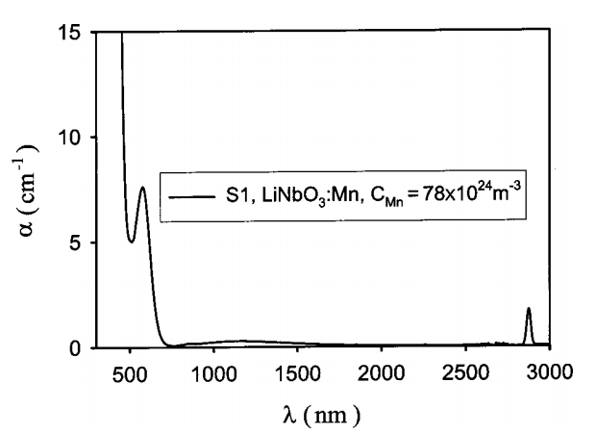
Optical beam’s wavelength choice
1. Responsivity of the photodiode
2. Photorefractive effect
3. Availability of optical components
After a commercial survey, 1550 seemed to be the wavelength with the most of the components available on the market.
Fig.12 Responsivity of commercial photodiodes with respect to the wavelength⁸
Fig.13 Absorption coefficient versus optical beam’s wavelength⁹
8 - https://www.thorlabs.com/newgrouppage9.cfm?objectgroup_id=3328
9 - Yang, Yunping, et al. "Photorefractive properties of lithium niobate crystals doped with manganese." JOSA B 20.7 (2003): 1491-1502.

Slide 60
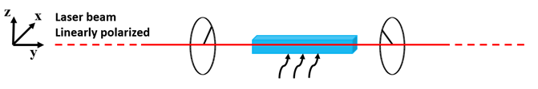

Crystal’s length choice
Electric field
Fig.12 Optical path including polarizer, one LiNbO₃ crystal, one analyzer
A lower value of E_{π} has benefits for the crystal:
Requires a lower voltage to be modulated
It has an increased sensitivity to the electric field in which is submerged
E_{π1}
E_{π2}
E_{π3}
Fig.14 The value of E_{π} with respect to the voltage applied for different crystal’s lengths

Slide 61
Modulation’s amplitude

