Slide 1
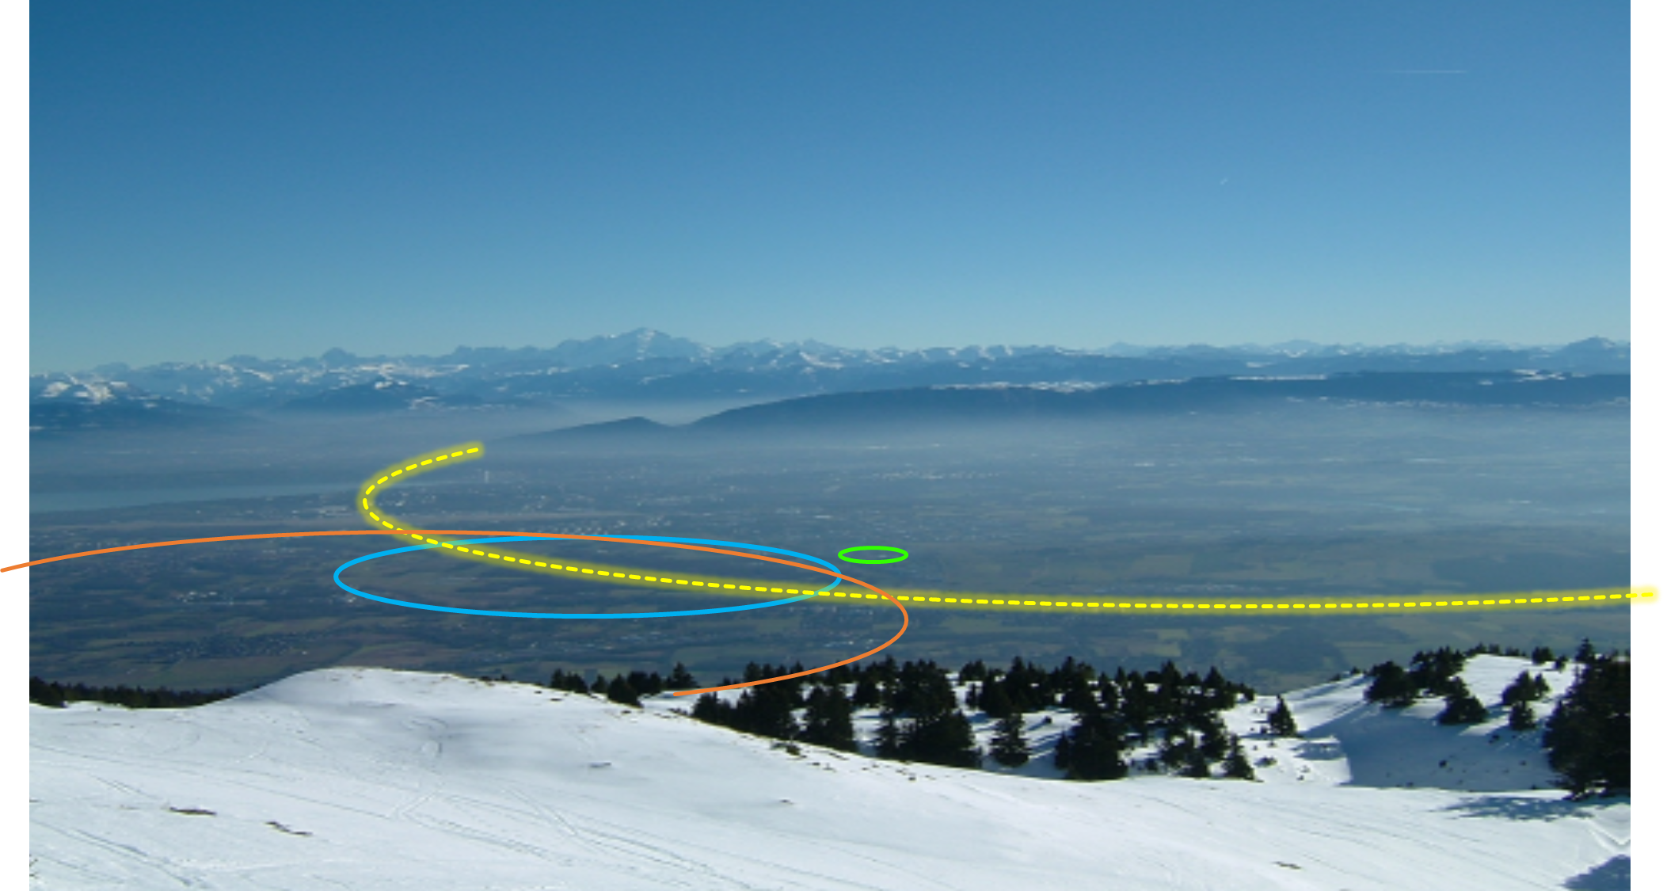
The FCC Feasibility Study and Global Collaboration
Emmanuel Tsesmelis
CERN
Head of Associate Member State and Non-Member State Relations
Convenor of FCC Global Collaboration Working Group
1st Joint CERN-Estonia Liaison Committee Meeting
10 March 2022
PS
LHC
FCC
SPS
Work supported by the European Commission under the HORIZON 2020 projects EuroCirCol, grant agreement 654305; EASITrain, grant agreement no. 764879; ARIES, grant agreement 730871, FCCIS, grant agreement 951754, and E-JADE, contract no. 645479
Photo: J. Wenninger

Slide 2
The Future Circular Collider

Slide 3

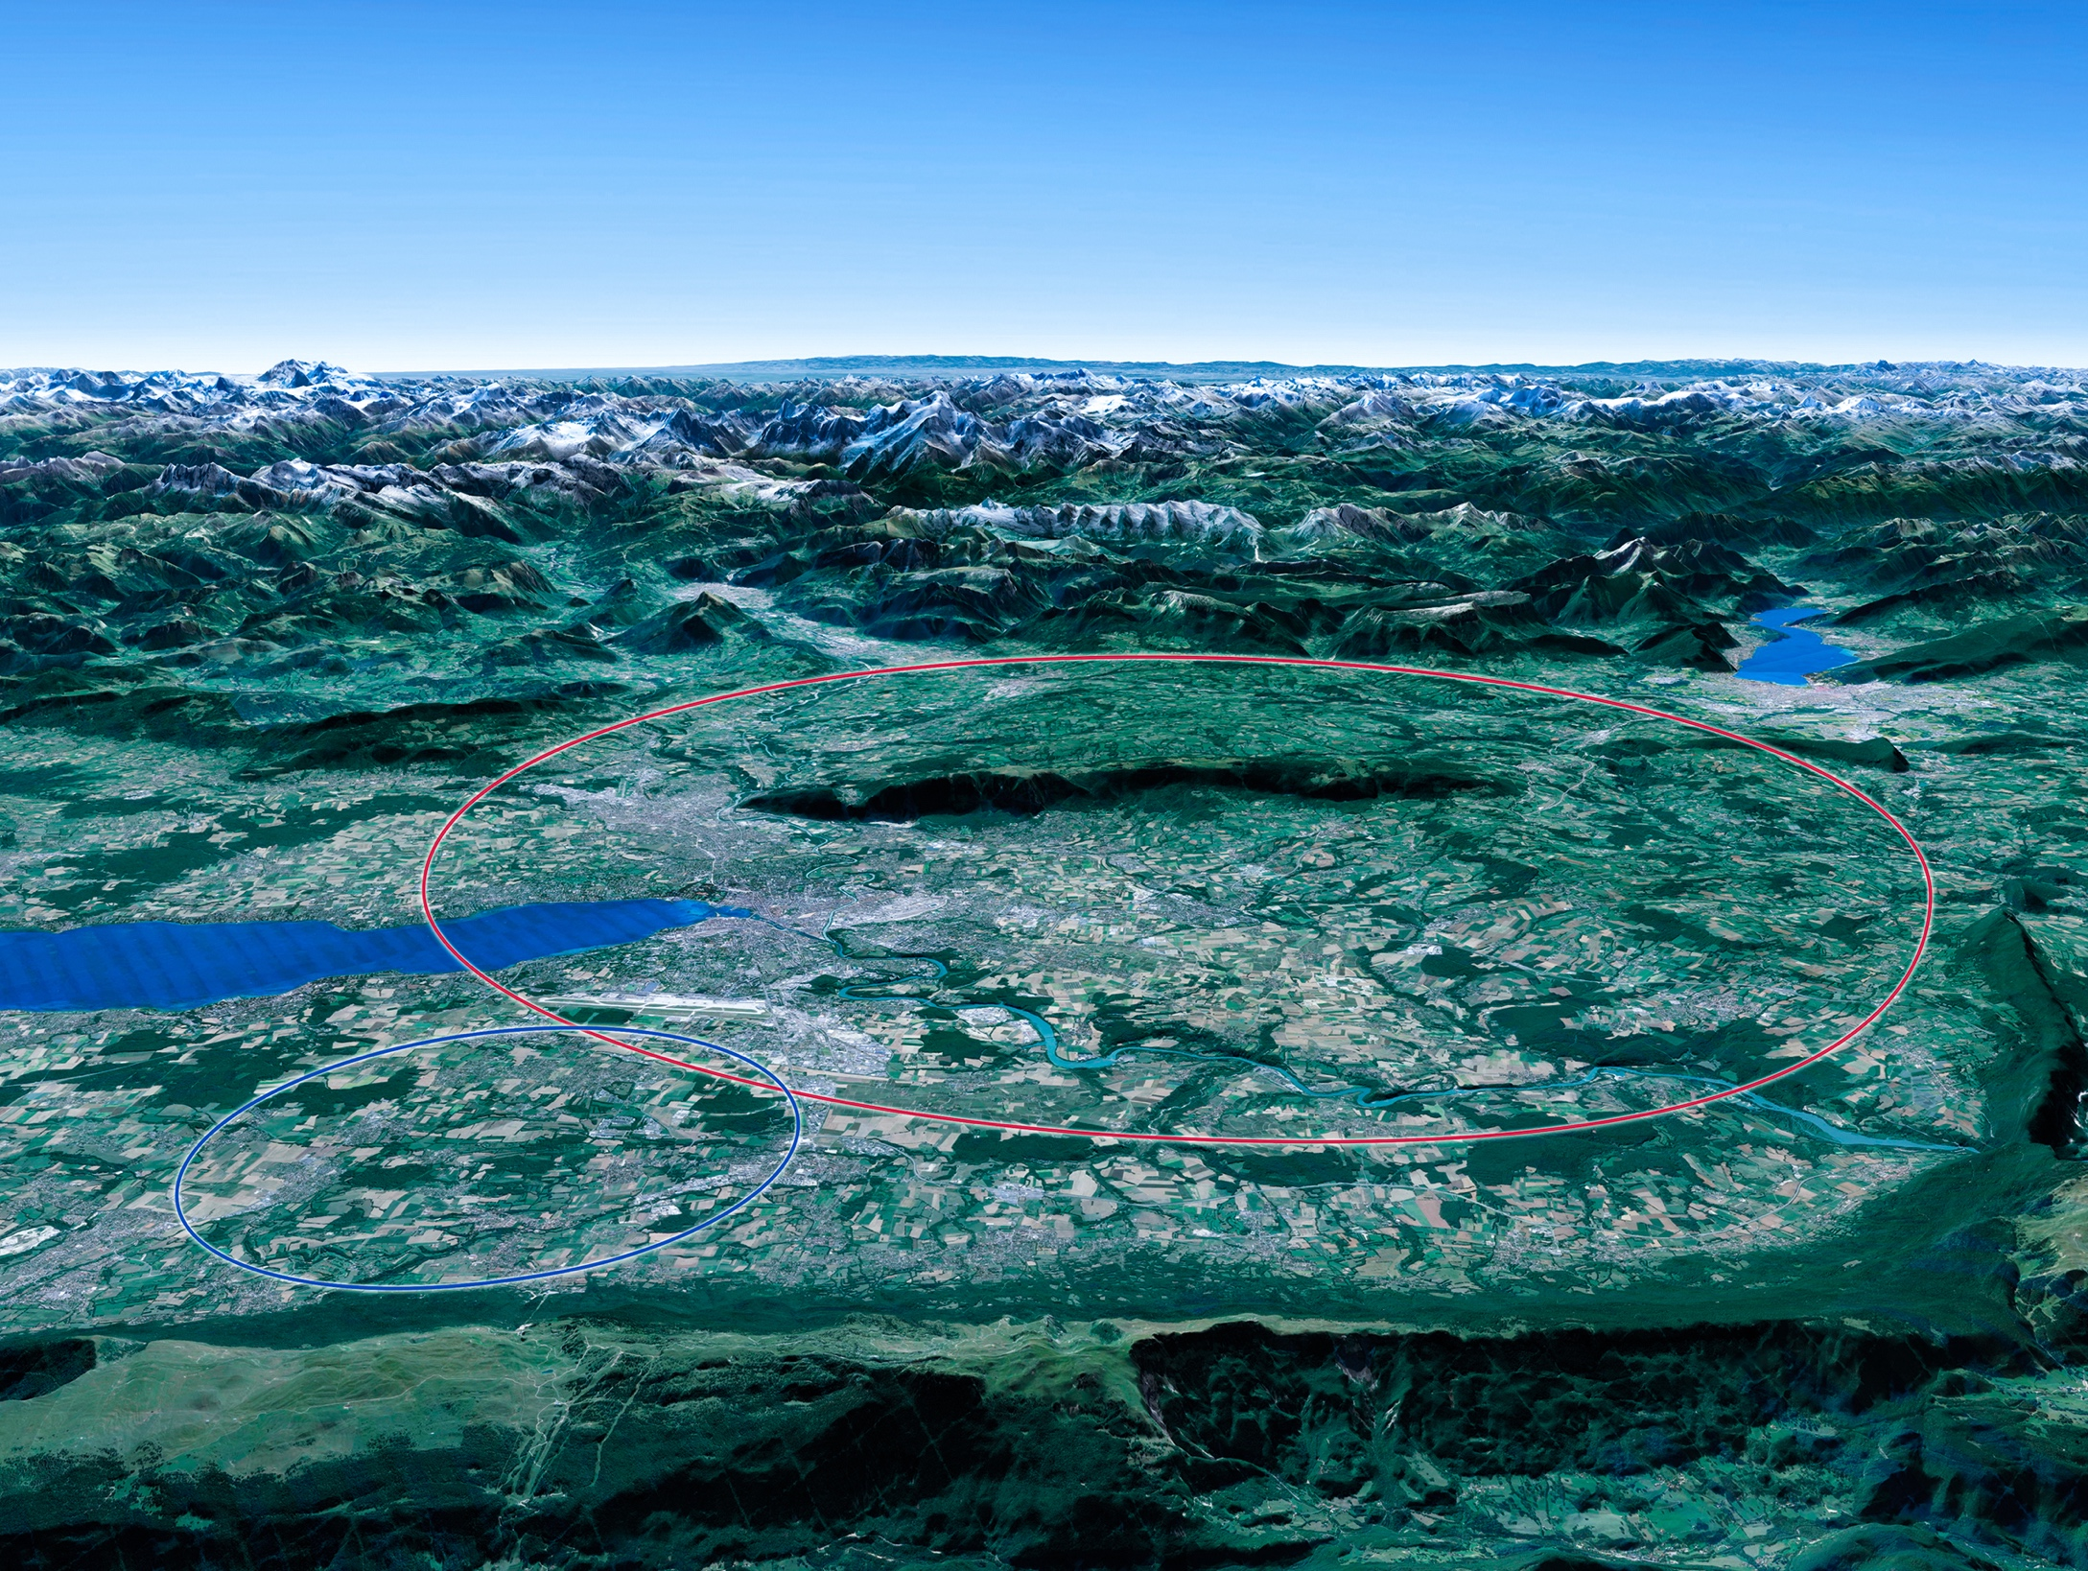

Scientific Priorities for the Future
Implementation of the recommendations
of the 2020 Update of the European Strategy
for Particle Physics:
Fully exploit the HL-LHC.
Build a Higgs factory to further understand this unique particle.
Investigate the technical and financial feasibility of a future energy-frontier 100 km collider at CERN.
Ramp up relevant R&D.
Continue supporting other projects around
the world.
LHC
Notes:
For information, the ESPPU recommendations in more detail:
Full exploitation of the HL-LHC
An electron-positron Higgs factory is the highest priority after the LHC
Ramp up R&D efforts for advanced accelerator technologies
Support long-baseline neutrino projects in Japan and US
Investigation of feasibility of a future 100 TeV hadron collider at CERN
THIS IS THE LAST SLIDE IN THE “RESEARCH” SECTION

Slide 4


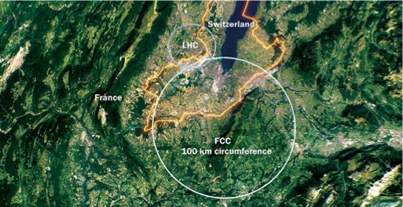
Future Circular Collider Study
Phase-1 started in 2014 Leading to CDR
International FCC collaboration (CERN as host lab) to study:
proton-proton collider (FCC-hh)
  defines infrastructure requirements
  80-100 km infrastructure in Geneva area
electron-positron collider (FCC-ee) as first step
proton-electron (FCC-he) option
~16 T ⇒ 100 TeV pp in 100 km

Slide 5

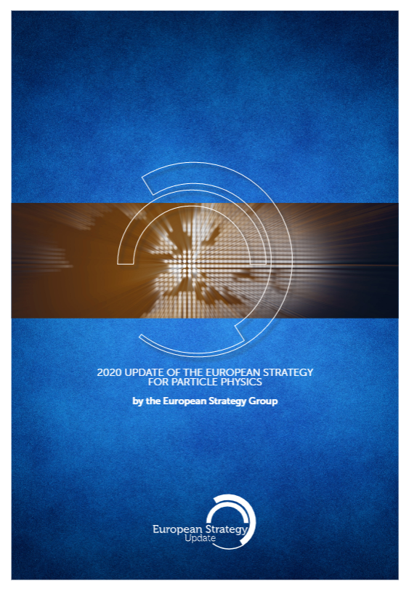
Phase-2 - FCC Feasibility Study
FCC Feasibility Study (FS) will address a recommendation of the 2020 update of the European Strategy for Particle Physics (ESPP):
“Europe, together with its international partners, should investigate the technical and financial feasibility of a future hadron collider at CERN with a centre-of-mass energy of at least 100 TeV and with an electron-positron Higgs and electroweak factory as a possible first stage.
Such a feasibility study of the colliders and related infrastructure should be established as a global endeavour and be completed on the timescale of the next Strategy update.”
Complete Feasibility Study by end 2025

Slide 6
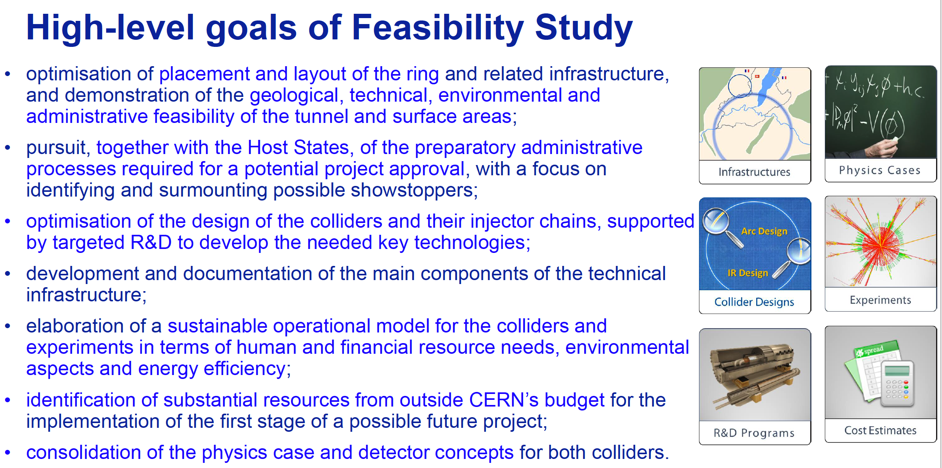
High-level Goals of Feasibility Study
Increasing international collaboration as a prerequisite for success:
links with science, research & development and high-tech industry will be essential to further advance and prepare the implementation of FCC

Slide 7

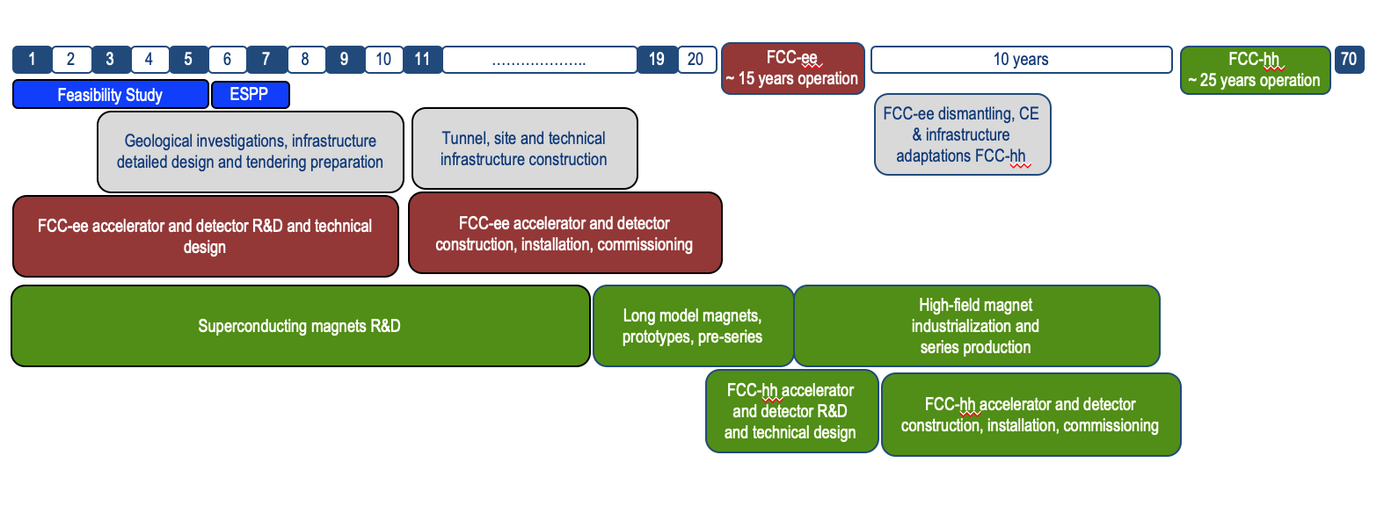
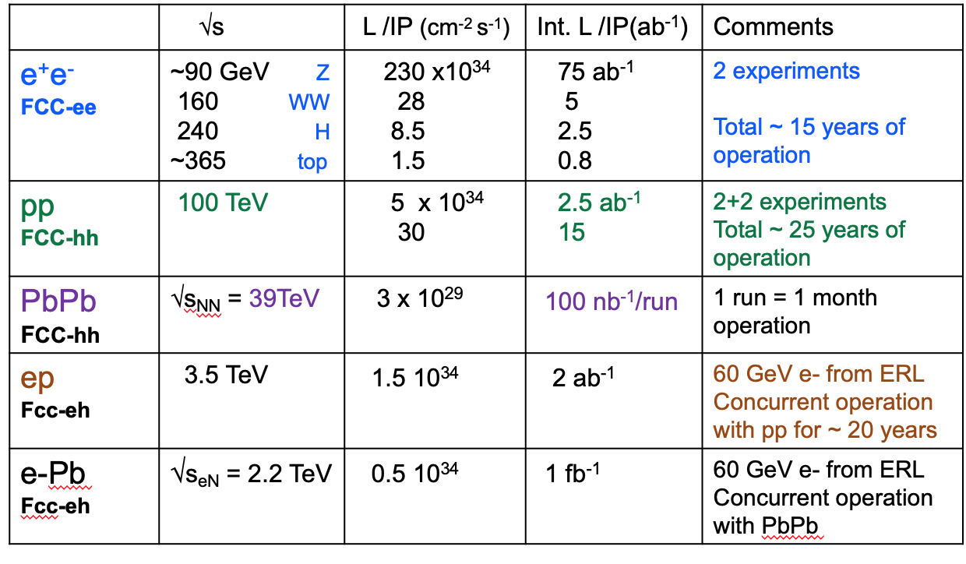
Timeline of the FCC Integrated Programme
Technical
schedule
2-4 experiments
20-30
Feasibility Study: 2021-2025
If project approved before end of
decade → construction can start
beginning 2030s
FCC-ee operation ~2045-2060
FCC-hh operation 2070-2090++
F. Gianotti

Slide 8
FCC Collaboration & Governance Structure

Slide 9
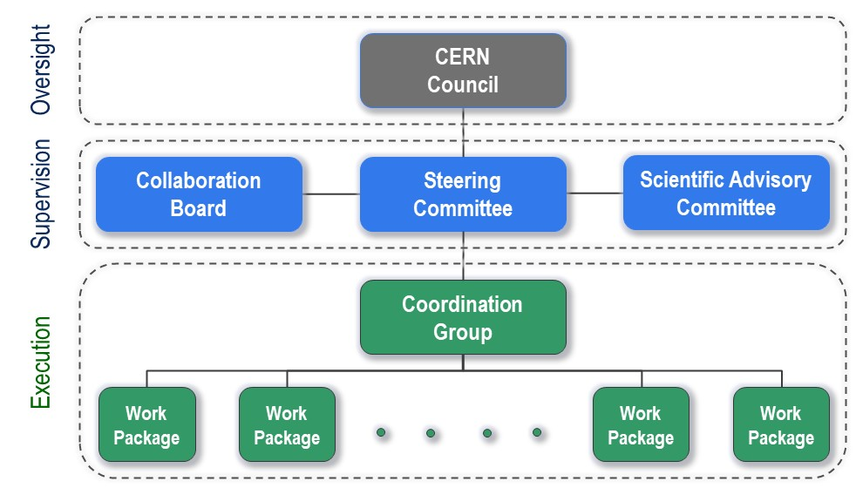
FCC Organisational Structure
FCC Organisational Structure
  Ownership of the Feasibility Study by the Council.
  Effective and timely supervision.
  Integration of scientific and technical advice.
  Participation of stakeholders that can potentially make significant financial and technical contributions to a possible future project.
  Execution of Feasibility Study.

Slide 10

FCC Feasibility Study – Coordination Team and Contactpersons
EU Projects
NN
Study Support Unit
IT: Sylvain Girod
Procurement: Adam Horridge
Quality control: NN
Resources: Sylvie Prodon
Scheduling, quality mangement: NN
Secretariat: Julie Hadre
Collaboration building
Emmanuel Tsesmelis
Study Support and Coordination
Study Leader: Michael Benedikt
Deputy Study Leader: Frank Zimmermann
Communications
Panagiotis Charitos, James Gillies
Physics, Experiments and Detectors
Patrick Janot
Christophe Grojean
Physics programme
Matthew McCullough, Frank Simon
Accelerators
Tor Raubenheimer
Frank Zimmermann
Project organisation model
Technical Infrastructures
Klaus Hanke
Host State processes and civil engineering
Timothy Watson
Organisation and financing models
Paul Collier (interim)
FCC-ee collider design
Katsunobu Oide
FCC-hh design
Massimo Giovannozzi
Technology R&D
Roberto Losito
FCC-ee booster design
Antoine Chancé
FCC-ee injector
Paolo Craievich, Alexej Grudiev
FCC-ee energy calibration polarization
Alain Blondel, Jorg Wenninger
FCC-ee MDI
Manuela Boscolo, Mike Sullivan
Integration
Jean-Pierre Corso
Geodesy & survey
Hélène Mainaud Durand
Electricity and energy management
Jean-Paul Burnet
Cooling and ventilation
Guillermo Peon
Cryogenics systems
Laurent Delprat
Computing and controls infrastructure, communication and network
Dirk Duellmann
Safety
Thomas Otto
Operation, maintenance, availability, reliability
Jesper Nielsen
Transport, installation concepts
Cristiana Colloca
Administrative processes
Friedemann Eder
Placement studies
Johannes Gutleber, Volker Mertens
Environmental evaluation
Johannes Gutleber
Tunnel, subsurface design
John Osborne
Surface sites layout, access and building design
Detector concept
Mogens Dam
Physics performance
Patrizia Azzi, Emmanuel Perez
Software and computing
Gerardo Ganis, Clément Helsens
Financing model
Florian Sonnemann
Procurement strategy and rules
In-kind contributions
Operation model
Paul Collier, Jorg Wenninger

Slide 11
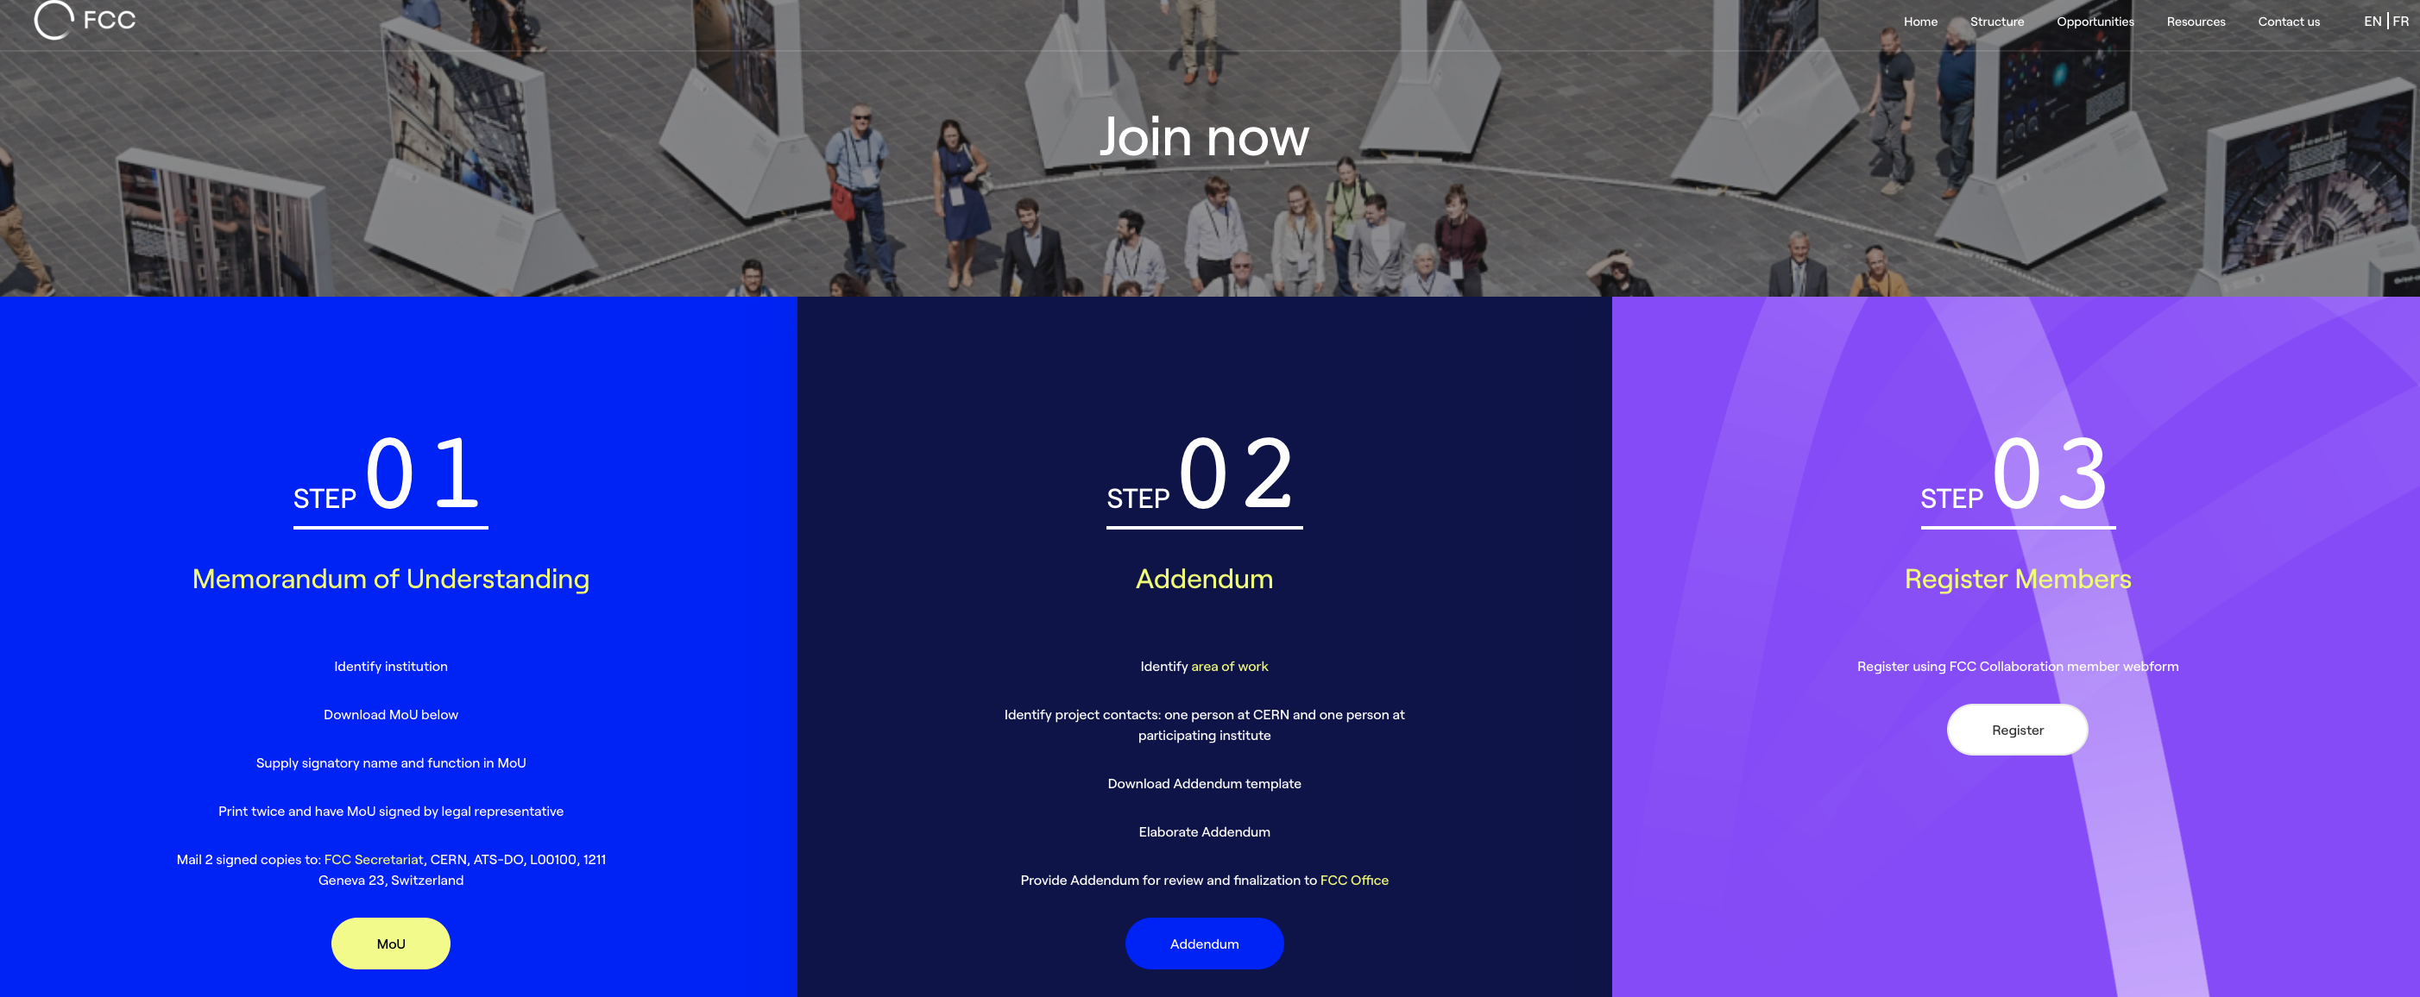
FCC Feasibility Study Collaboration Membership
Participation in FCC through MoU and Addenda.
The FCC MoU for the first phase of the study is being updated to cover the Feasibility Study.
The current participating institutes who wish to take part in the Feasibility Study can continue to participate on the basis of the previously signed MoU until the updated MoU is signed.
https://fccis.web.cern.ch/join-now

Slide 12

Status of Global FCC Collaboration
Increasing international collaboration as a prerequisite for success:
links with science, research & development and high-tech industry will be essential to further advance and prepare the implementation of FCC
147
Institutes
30
Companies
34
Countries
EC
H2020

Slide 13

FCC Global Collaboration Working Group
From ESPP 2020: “Such a feasibility study of the colliders and related infrastructure should be established as a global endeavour….”
→ FCC Global Collaboration Working Group active since spring 2021
Engage with institutes/countries/regions with mature communities, and the potential to contribute substantially to the Organization’s long-term scientific objectives, to facilitate participation in FCC FS.
Work with national laboratories, institutes, universities and industry in MS, AMS and NMS to:
  Encourage an expanded membership and explore opportunities for future prospective participants.
  Explore opportunities for future prospective participants in defining areas of collaboration.
  Prepare the foundations for research and contributions by industry.
  Liaise with national contact persons and forums.
Continue the two-sided approach from the FGC Working Group and from the
FCC-Physics, Experiment & Detectors Informal Forum of National Contacts to strengthen global FCC collaboration.

Slide 14
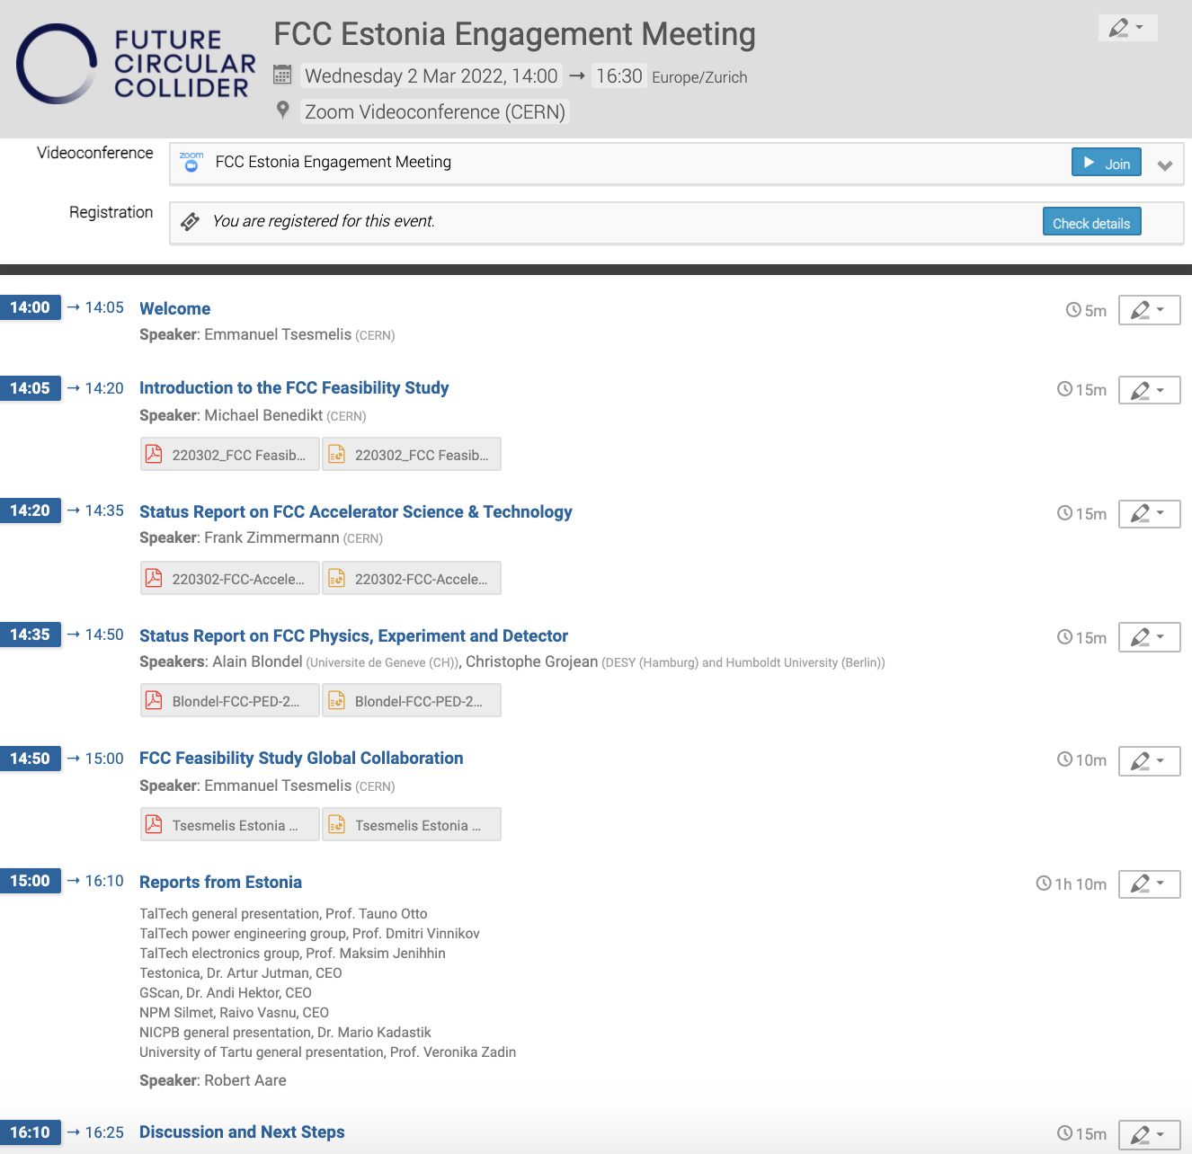
FCC Engagement Meeting with Estonia –
2 March 2022
Interested entities from Estonia
  National Institute for Chemical Physics and Biophysics
  Tallinn University of Technology
  University of Tartu
  GScan (industry)
  NPM Silmet (industry)
  Testonica (industry)

Slide 15

FCC Week 2022
Paris, 30 May - 3 June 2022
We are looking forward
to seeing all collaborators there !

Slide 16
Status and Outlook
First phase of FCC design study completed
  Baseline machine designs with performance matching physics requirements
  Documented in 4 CDRs
Integrated FCC programme submitted to the European Strategy Update (2019/2020)
  Request for feasibility study as basis for project decision by 2026/2027.
Next step – prove feasibility by 2025/2026:
  Concrete local/regional implementation scenarios in collaboration with Host State authorities.
  Accompanied by machine optimisation, physics studies and technology R&D
  Performed via global collaboration and supported by EC H2020 Design Study FCC-IS
Long-term goal: world-leading research infrastructure for the 21st century to push the particle-physics precision and energy frontiers well beyond present limits.
Success of FCC relies on strong global participation in all domains.
The FCC looks forward to strengthen the collaboration with global partners.

