Slide 1
Pion reconstruction in the ATLAS detector using Graph Neural Networks
Piyush Karande, PhD
Staff Research Engineer
Dhanush Hangal, PhD
Post-doctoral Staff
Lawrence Livermore National Laboratory
June 3, 2022

Slide 2
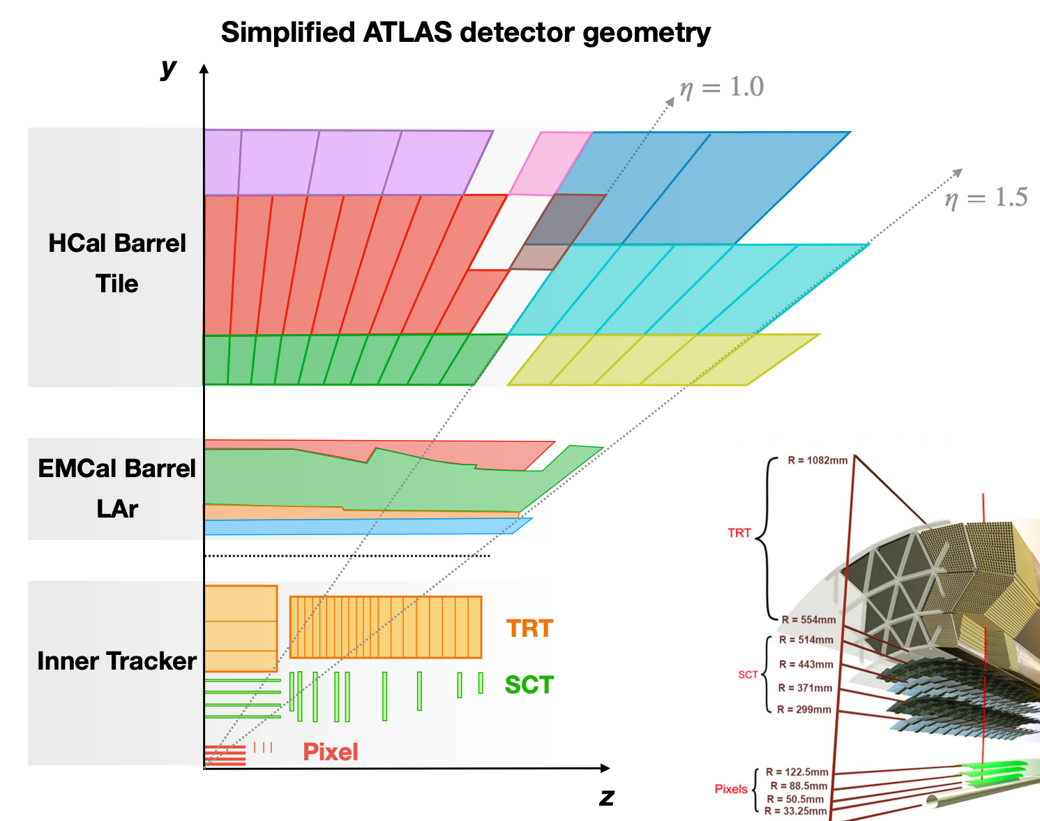
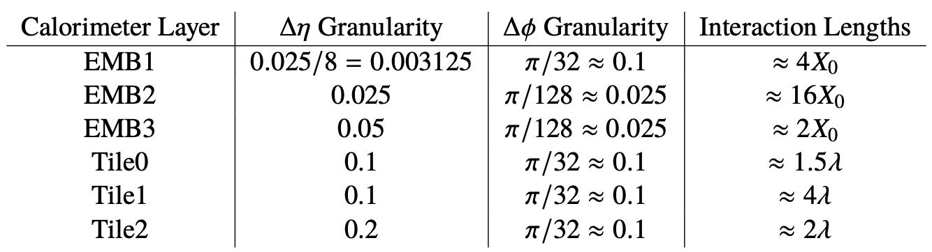
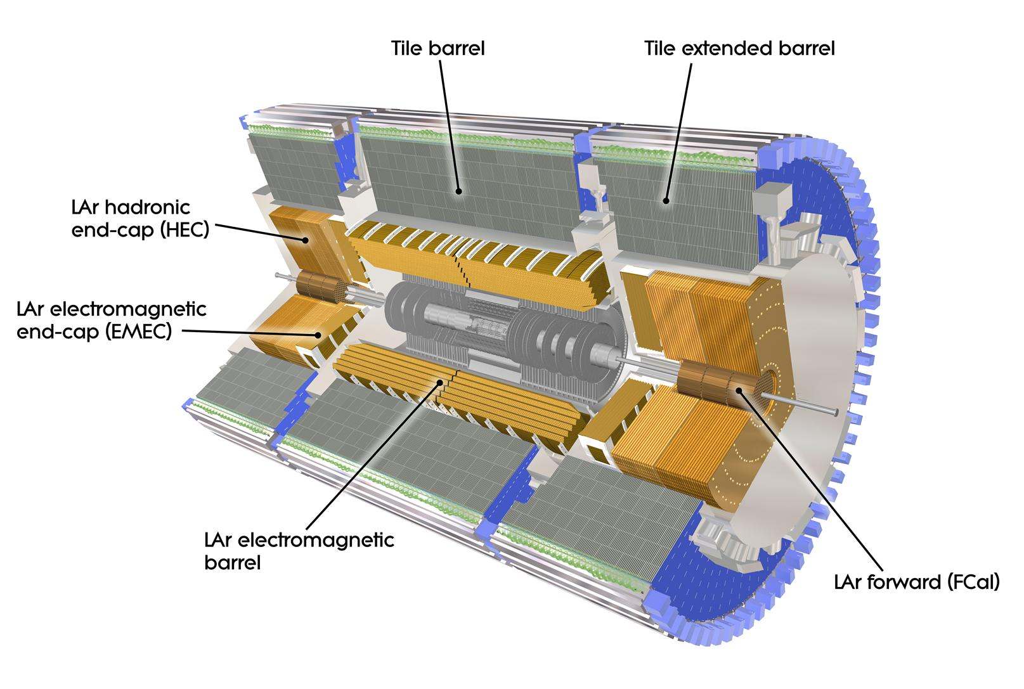
ATLAS Detector Geometry
ATL-PHYS-PUB-2020-018
Notes:
This is a representation of ATLAS geometry, specifically the ATLAS calorimeters showing the different layers and the segmentation of the hadronic calorimeter. The segmentation of the EM calorimeter is too fine to be shown here.
The granularity of the different calorimeter layers including the EmCal in the barrel region are shown in this table, ranging from 0.003 in EMB1 to 0.2 in Tile 2.

Slide 3
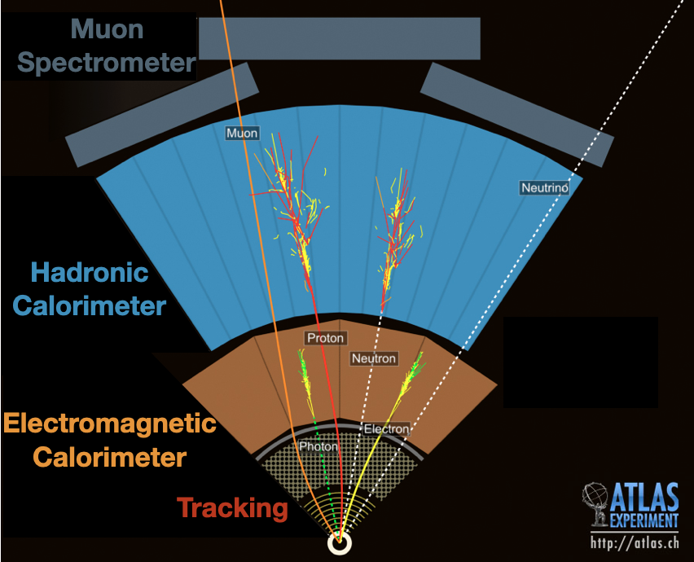
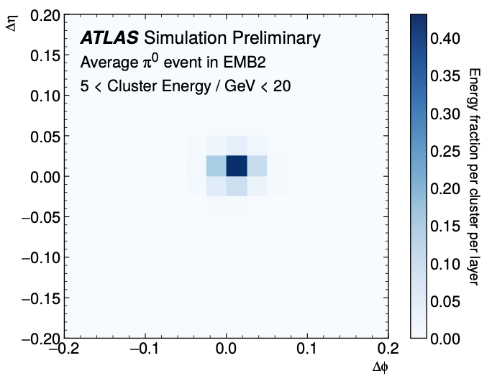
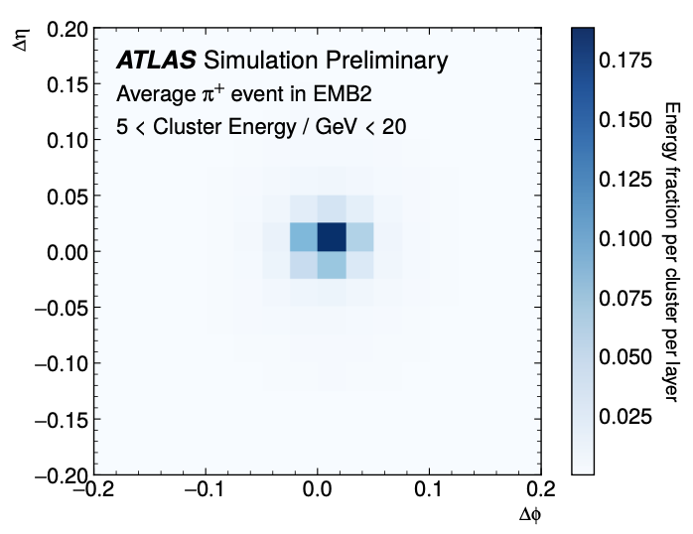
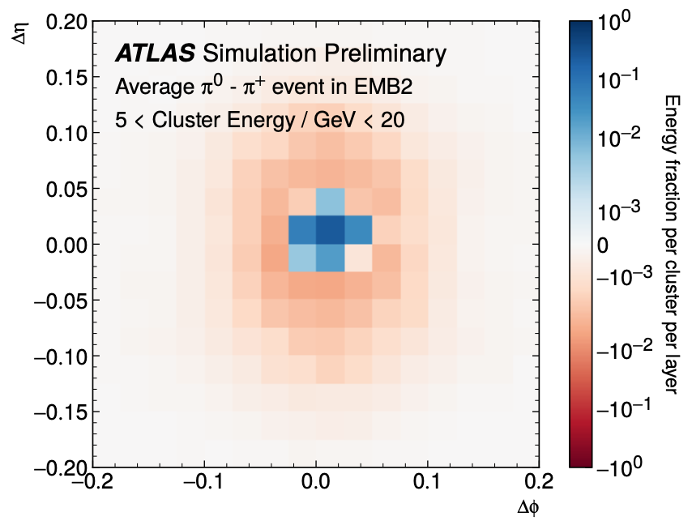
Dataset and ML Problem
Dataset:
  Simulated single pion showers (𝜋⁰ and 𝜋⁺)
  Topo-clusters: 3D objects representing local particle showers
  Previous approach: image representation of each layer of calorimeter
ML Problems:
  Pion classification: 𝜋⁰ or 𝜋⁺
  Energy regression: pion energy
Neutral pions
Charged pions
Difference
ATL-PHYS-PUB-2020-018

Slide 4
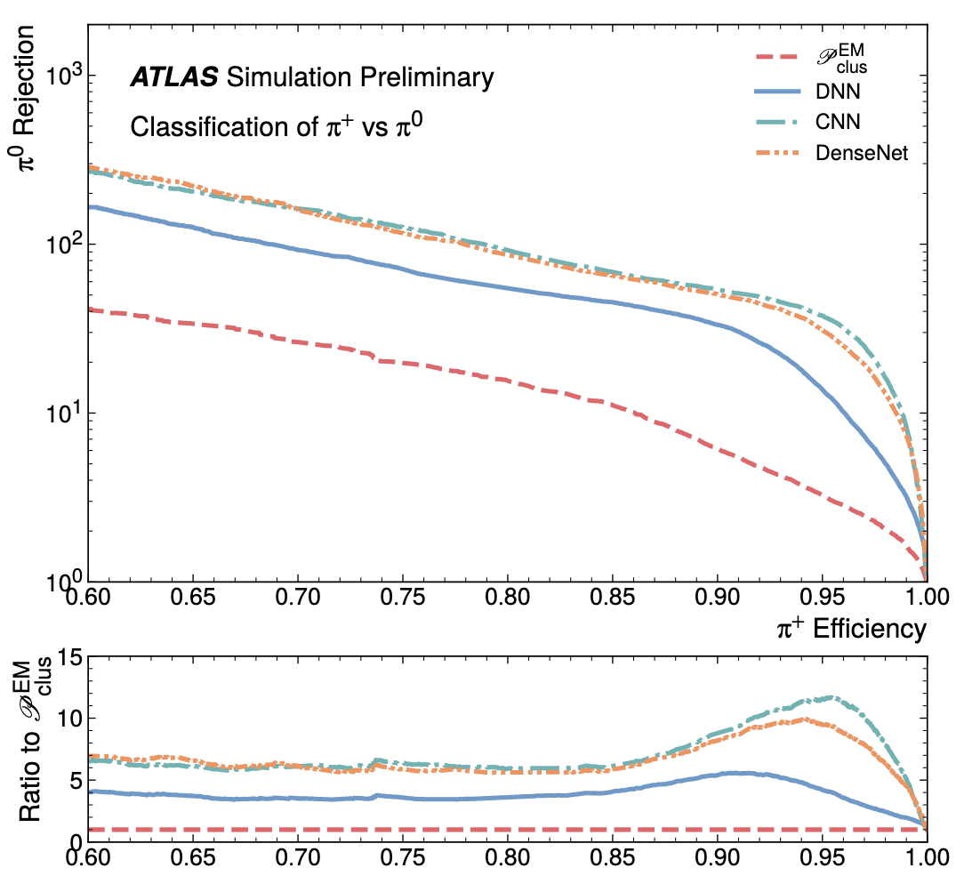
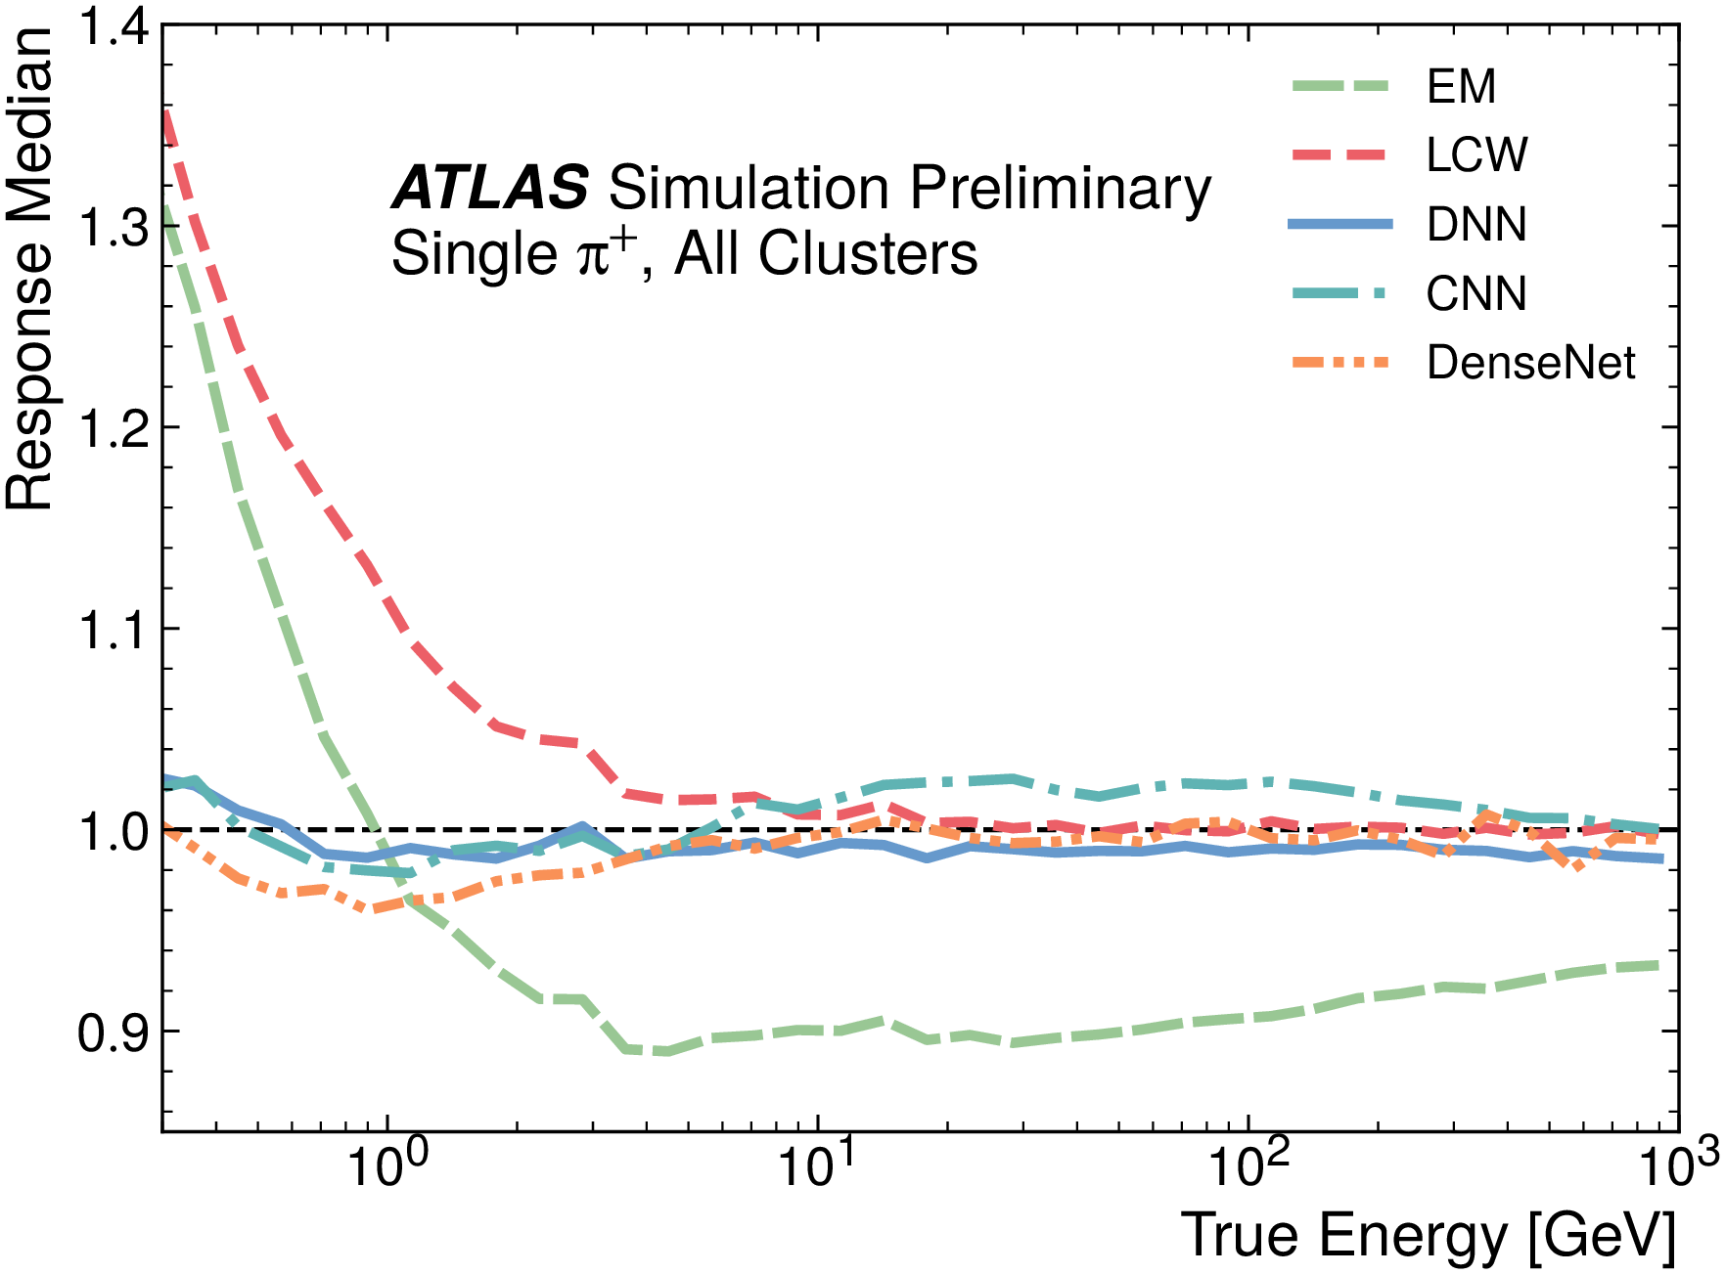
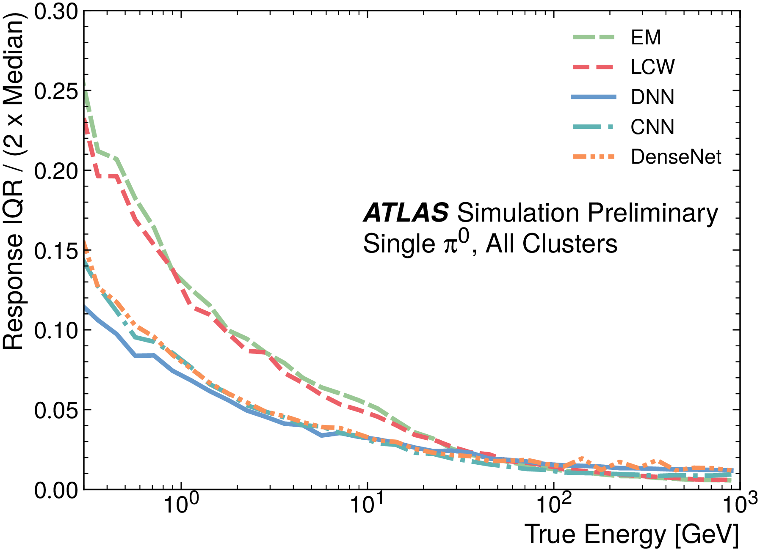
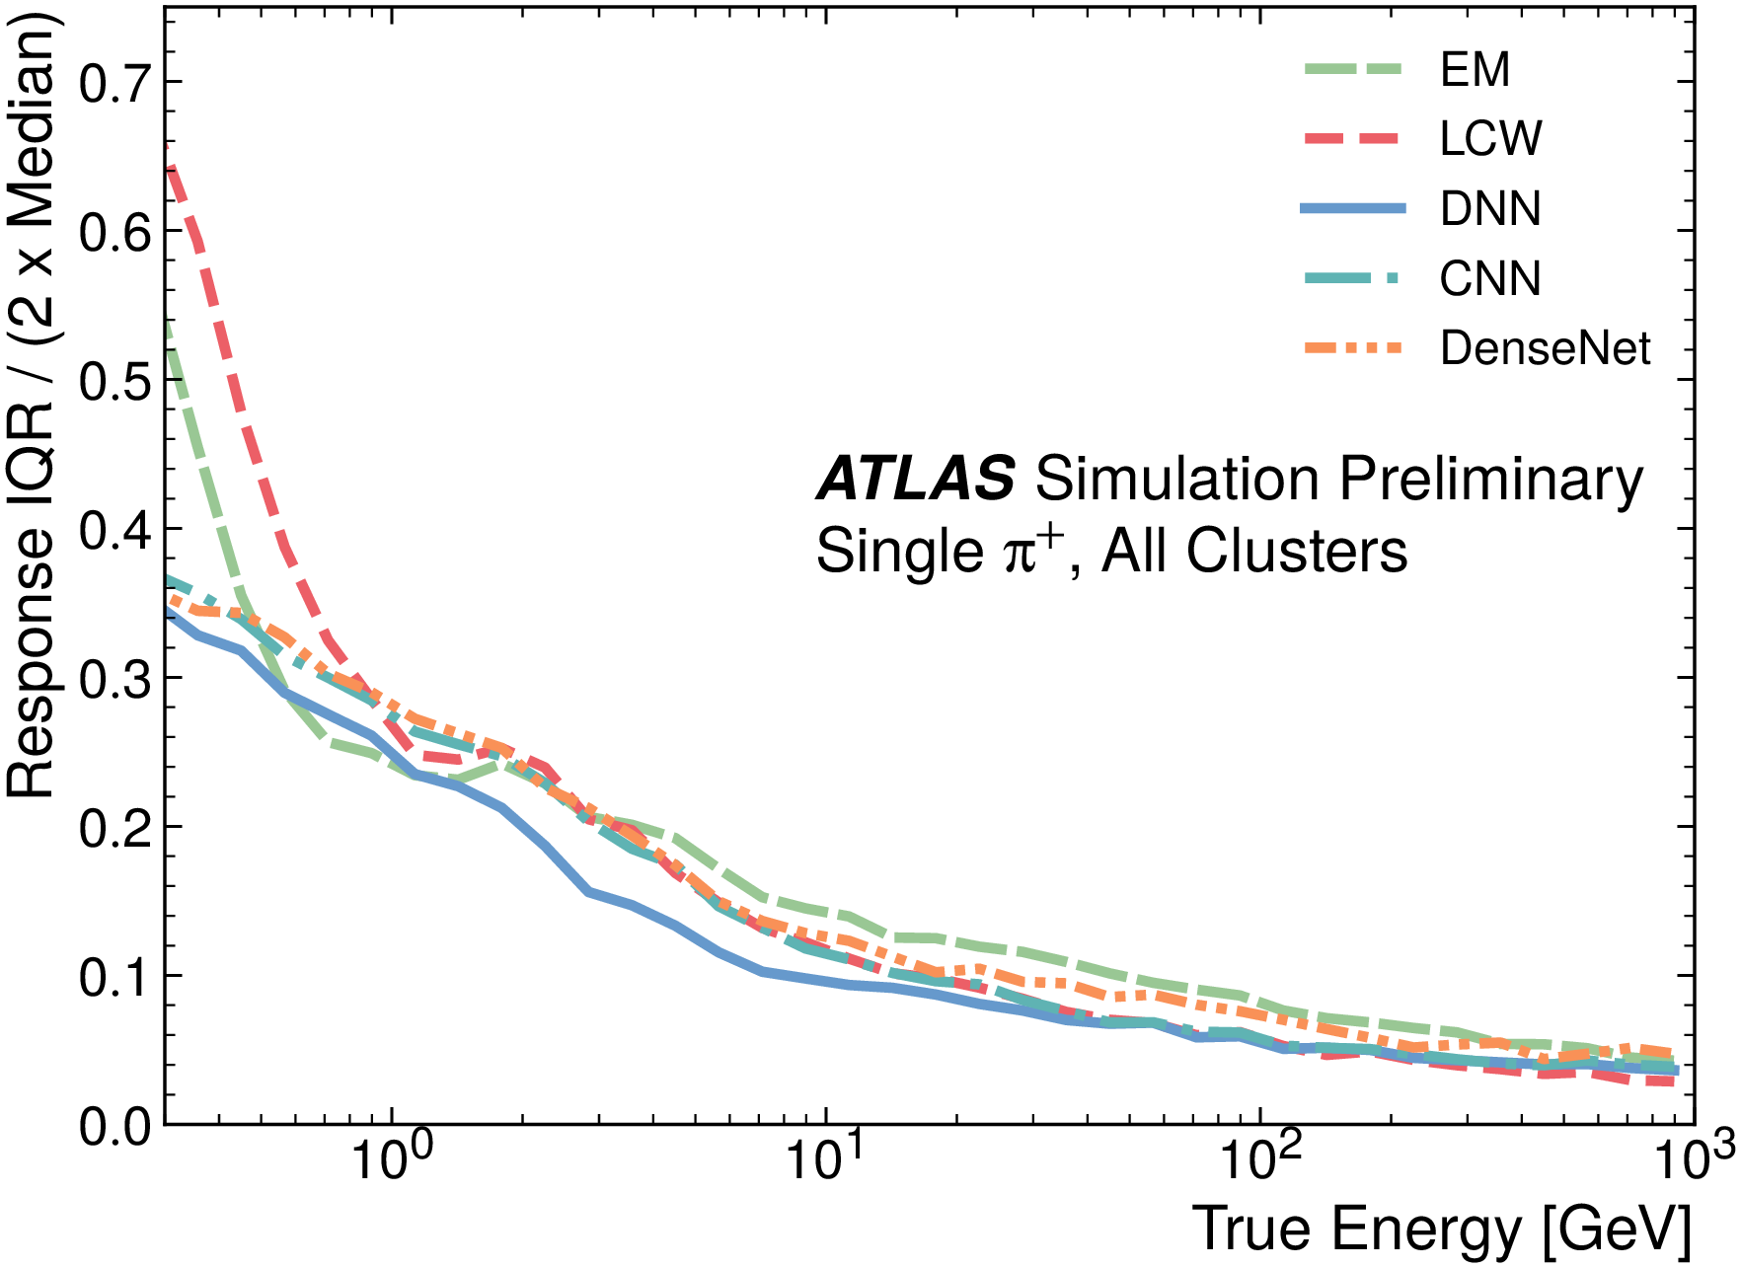
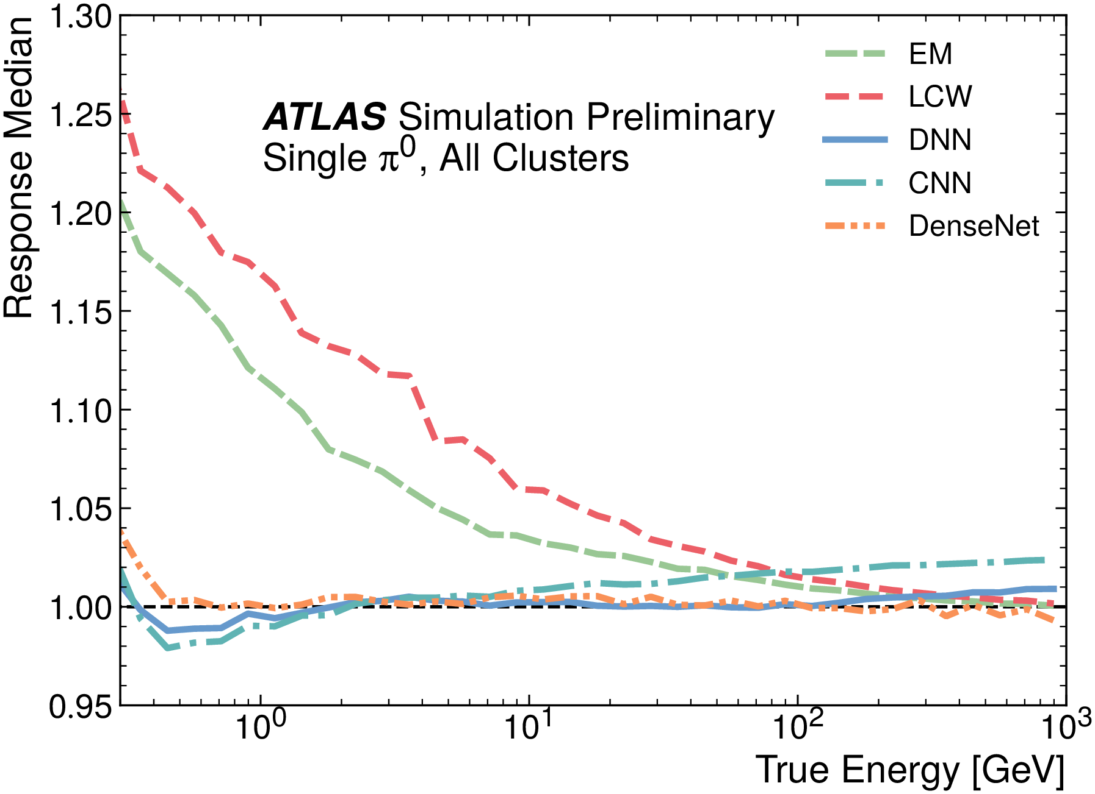
Results: Image-based approach
Image-based methods outperform the baseline classification and energy calibration methods.
Drawbacks: Sparse images of varying dimensions, restricted η range (|η| < 0.7) due to changes in detector geometry.
Classification
Regression
Inter-Quantile Range (IQR)
Response
Baseline methods
ML methods
ATL-PHYS-PUB-2020-018

Slide 5
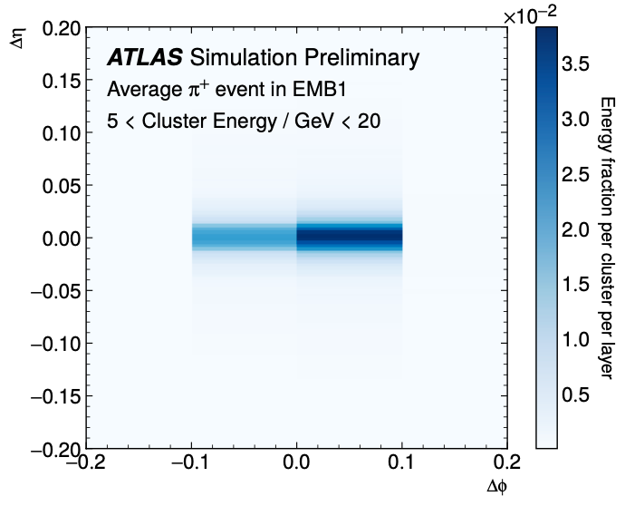
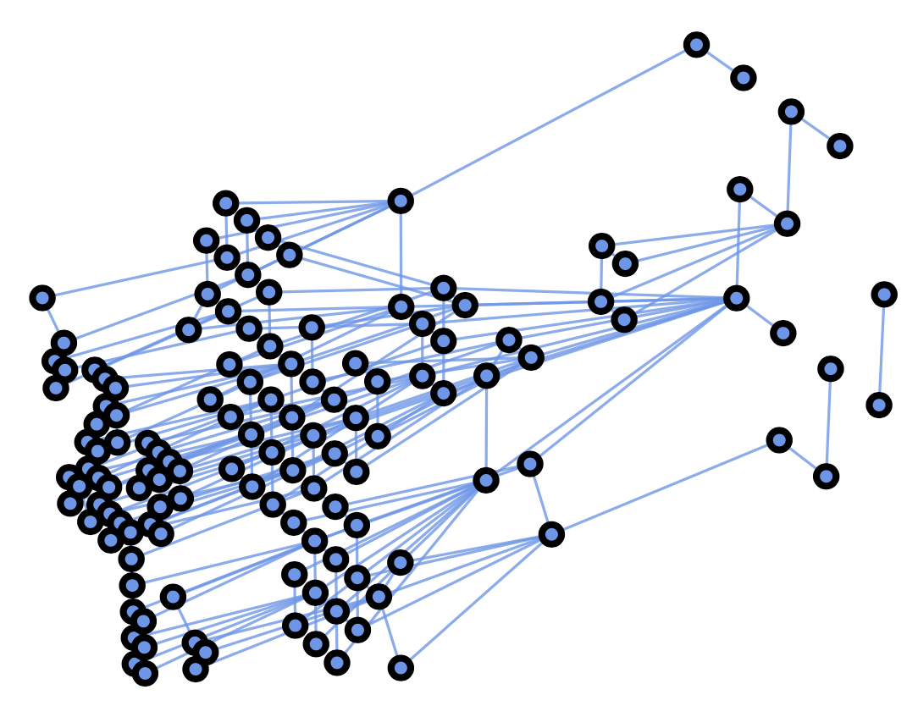
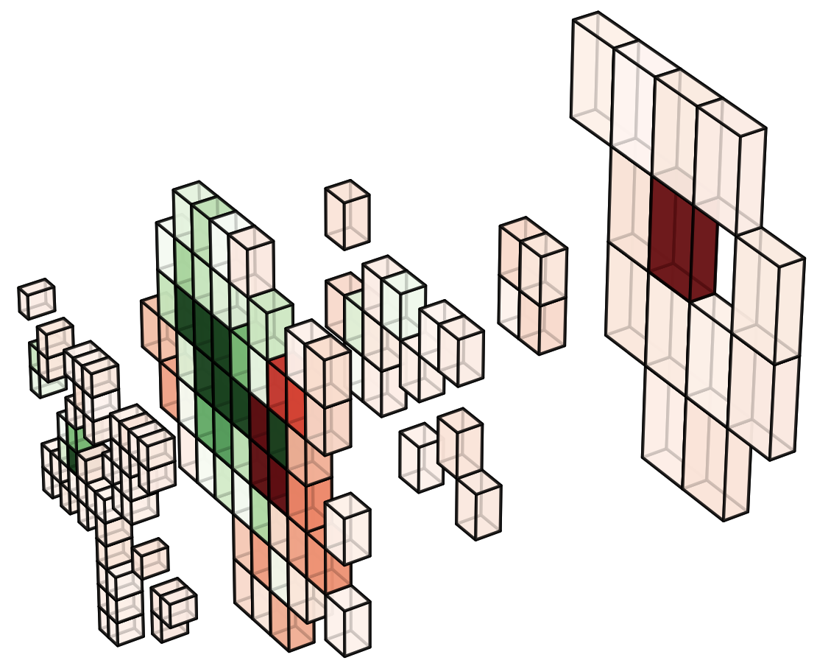
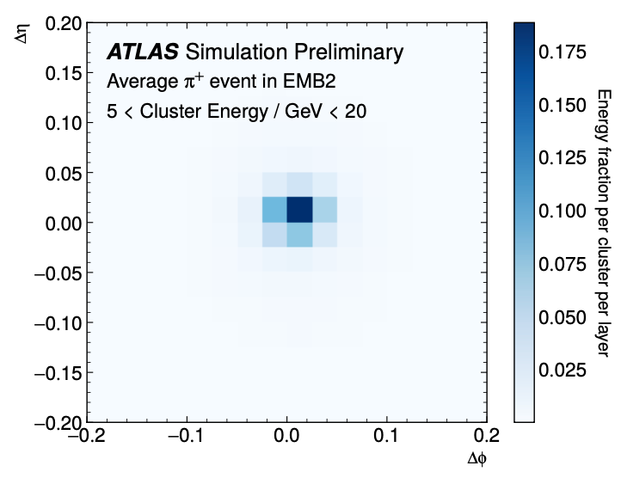
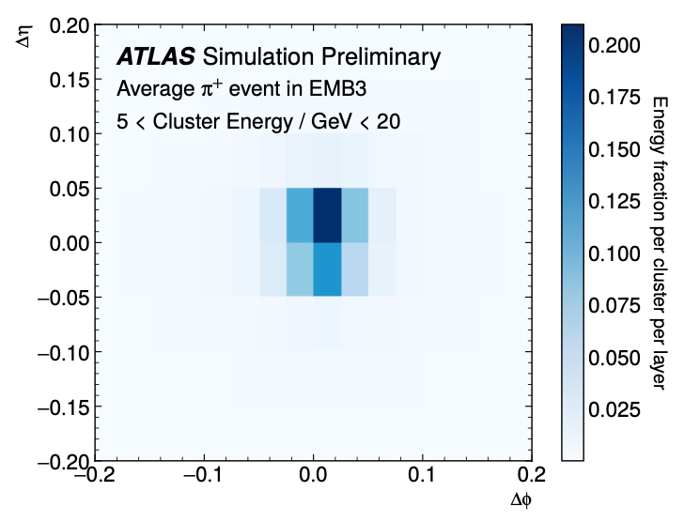
Graph Neural Network Approach
Representing topo-clusters as graphs is more suited to handle its non-uniform 3D structure compared to a series of calorimeter images
More flexibility to include different calorimeter layer geometries/granularities
Improved ability to perform cluster classification and energy calibration out to forward regions
Topo-cluster
Image-based representation
Graph-based representation
ATL-PHYS-PUB-2020-018
Mach. Learn.: Sci. Technol. 2 021001

Slide 6
Topo-Cluster Graph Representation
Nodes: Cells from the topo-cluster with features such as
  cell energy
  sampling layer
  cell location (η, ϕ)
  cell size
Edges: One-hot encoded vector defining geographical connections between nodes
Global Node: total cluster energy
Target: pion type (𝜋⁰ or 𝜋⁺) and calibrated cluster energy

Slide 7
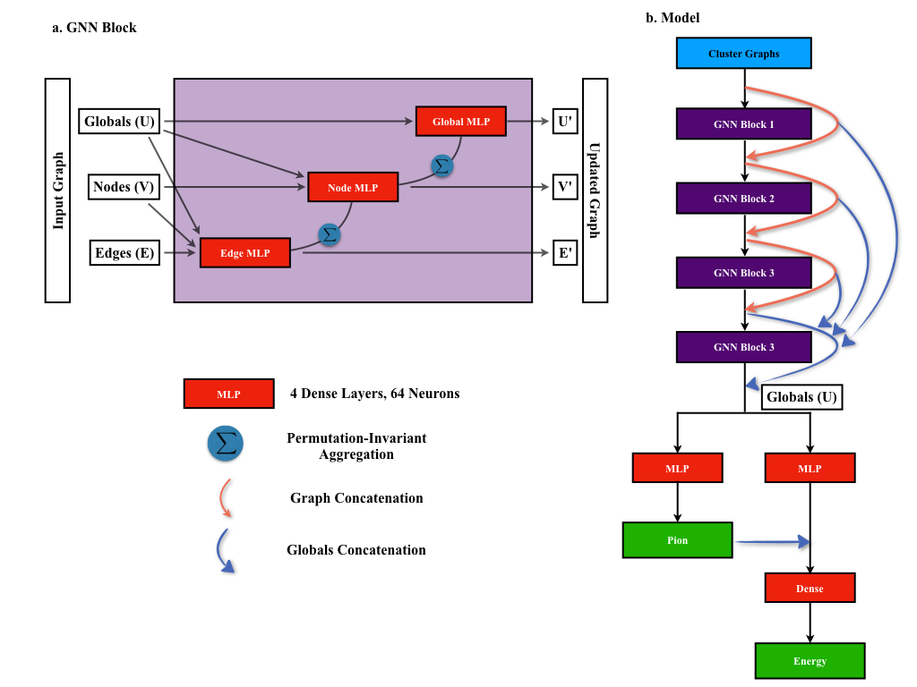

GNN Model
Graph Nets library by DeepMind
  Highly customizable graph blocks
  Lightweight
  Not actively developed or widely used
Model
FullGNN Block
$$ℒ=αℒ_{Reg}+(1−α)ℒ_{Class}$$

Slide 8
GNN Results: Classification
Comparison with Image-based approaches
Performance on expanded Detector Regions
Graph ML method
Graph ML method
Image ML method
|η| < 0.7
|η| < 3
Baseline method
Baseline method
ATLAS-JETM-2022-002

Slide 9
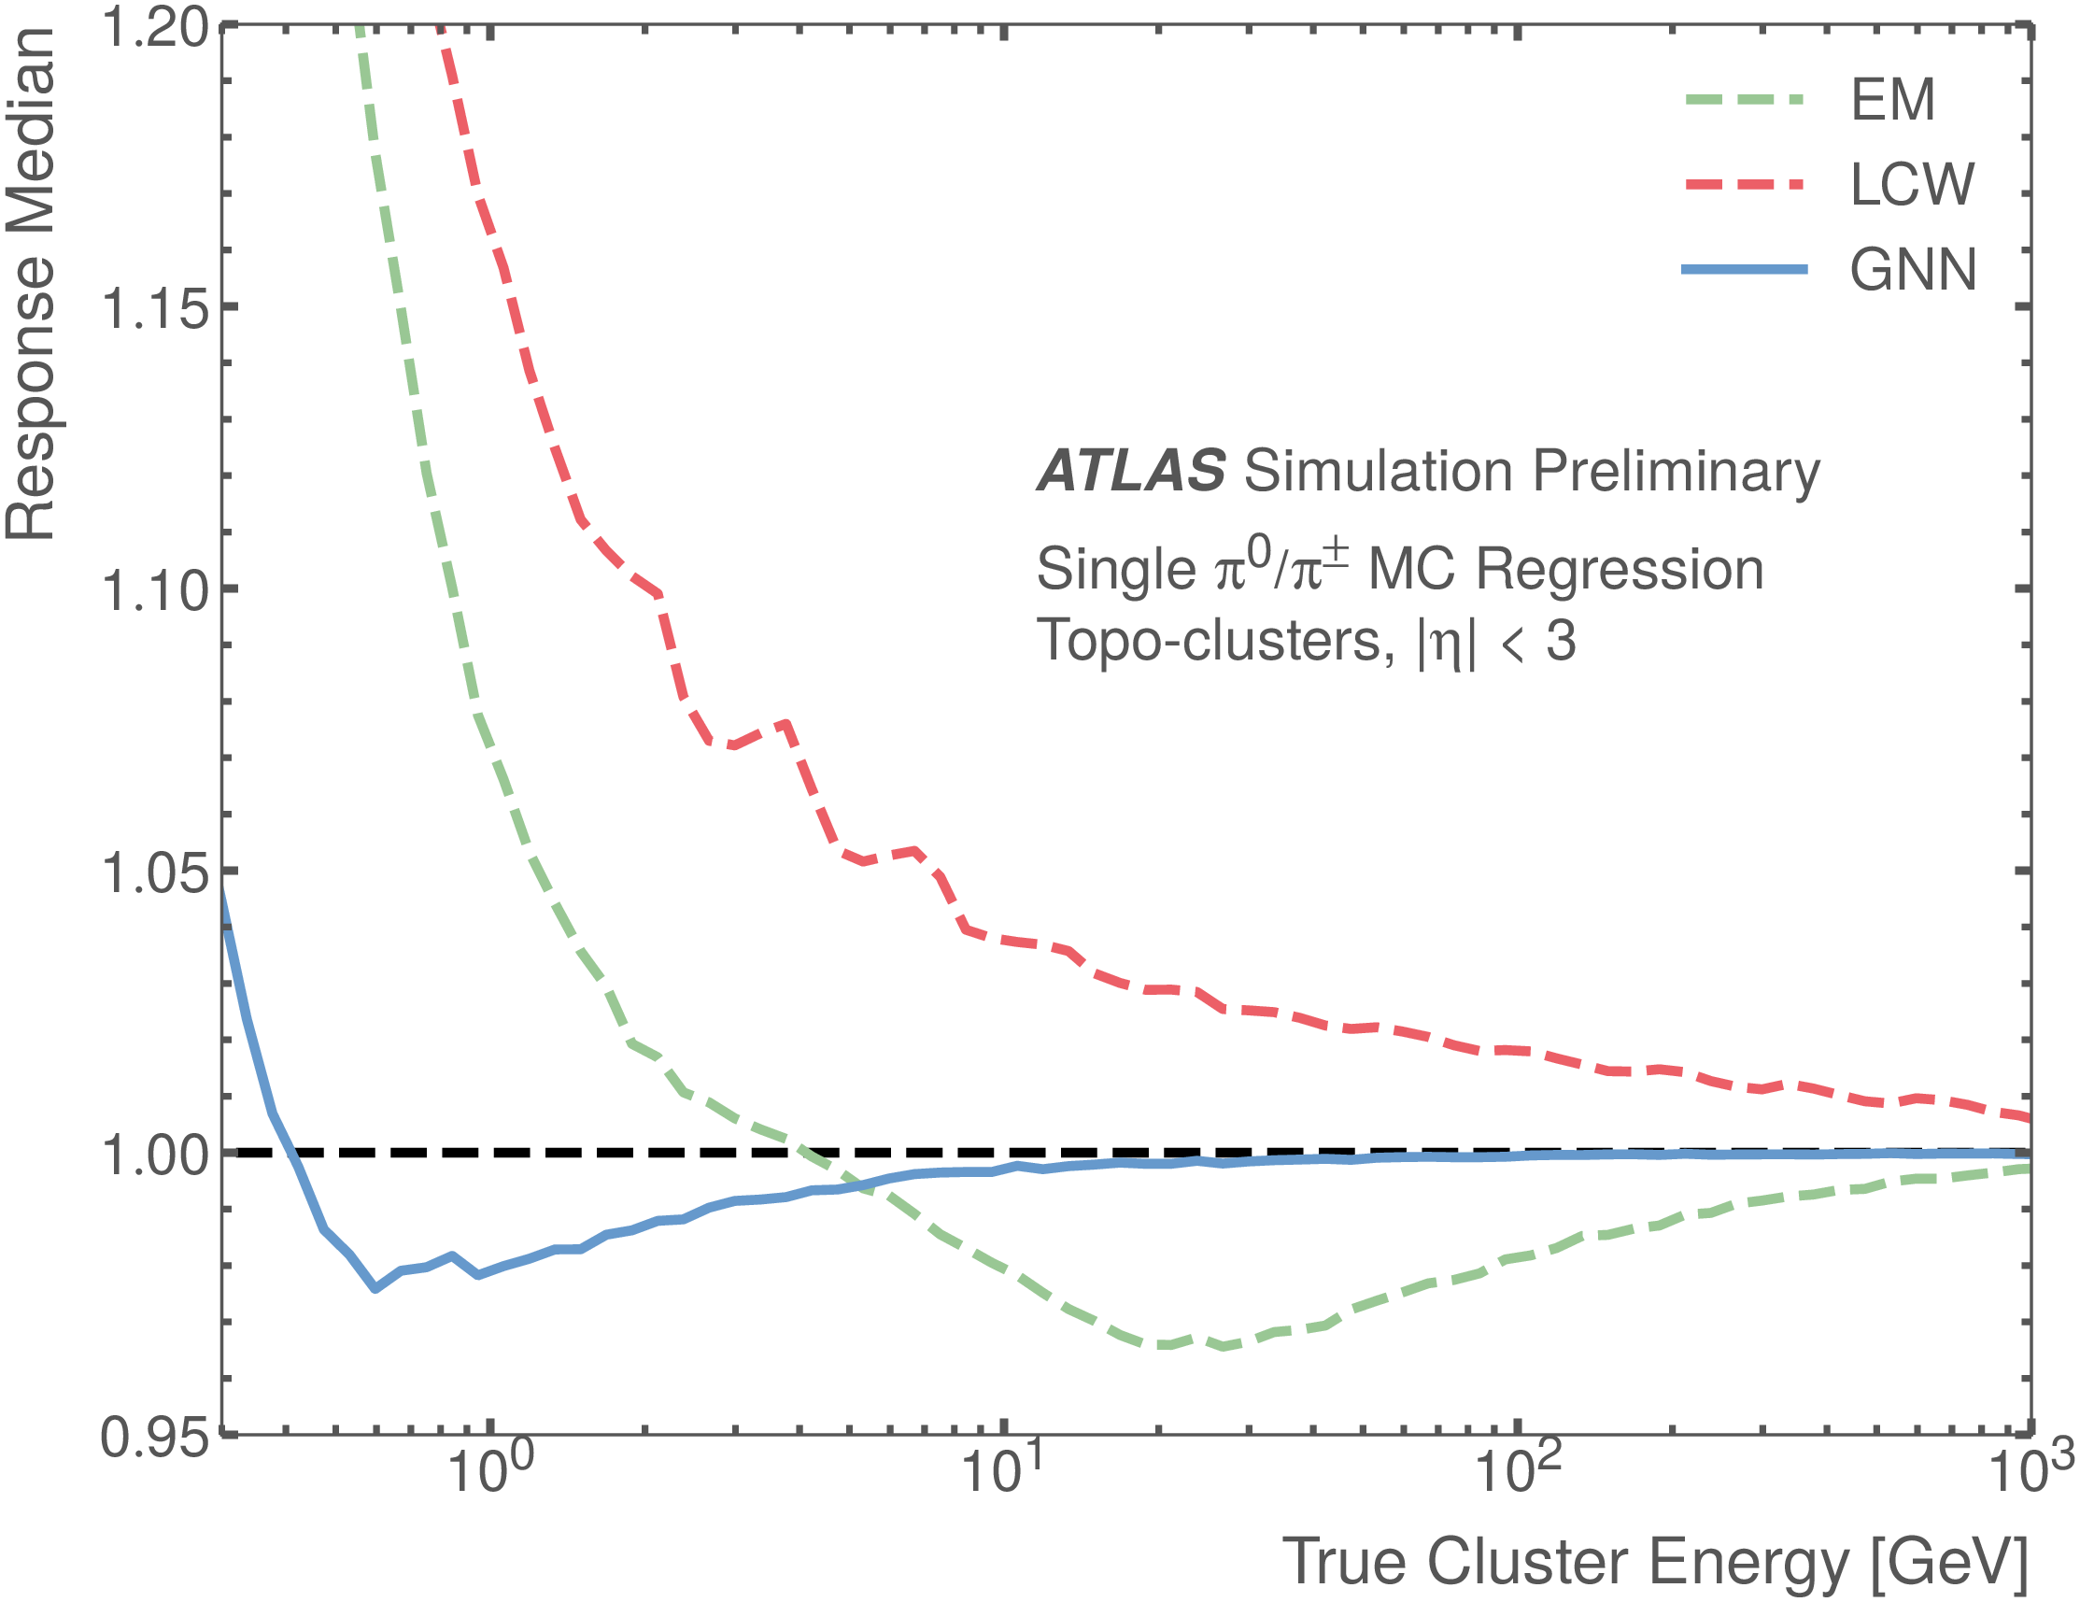
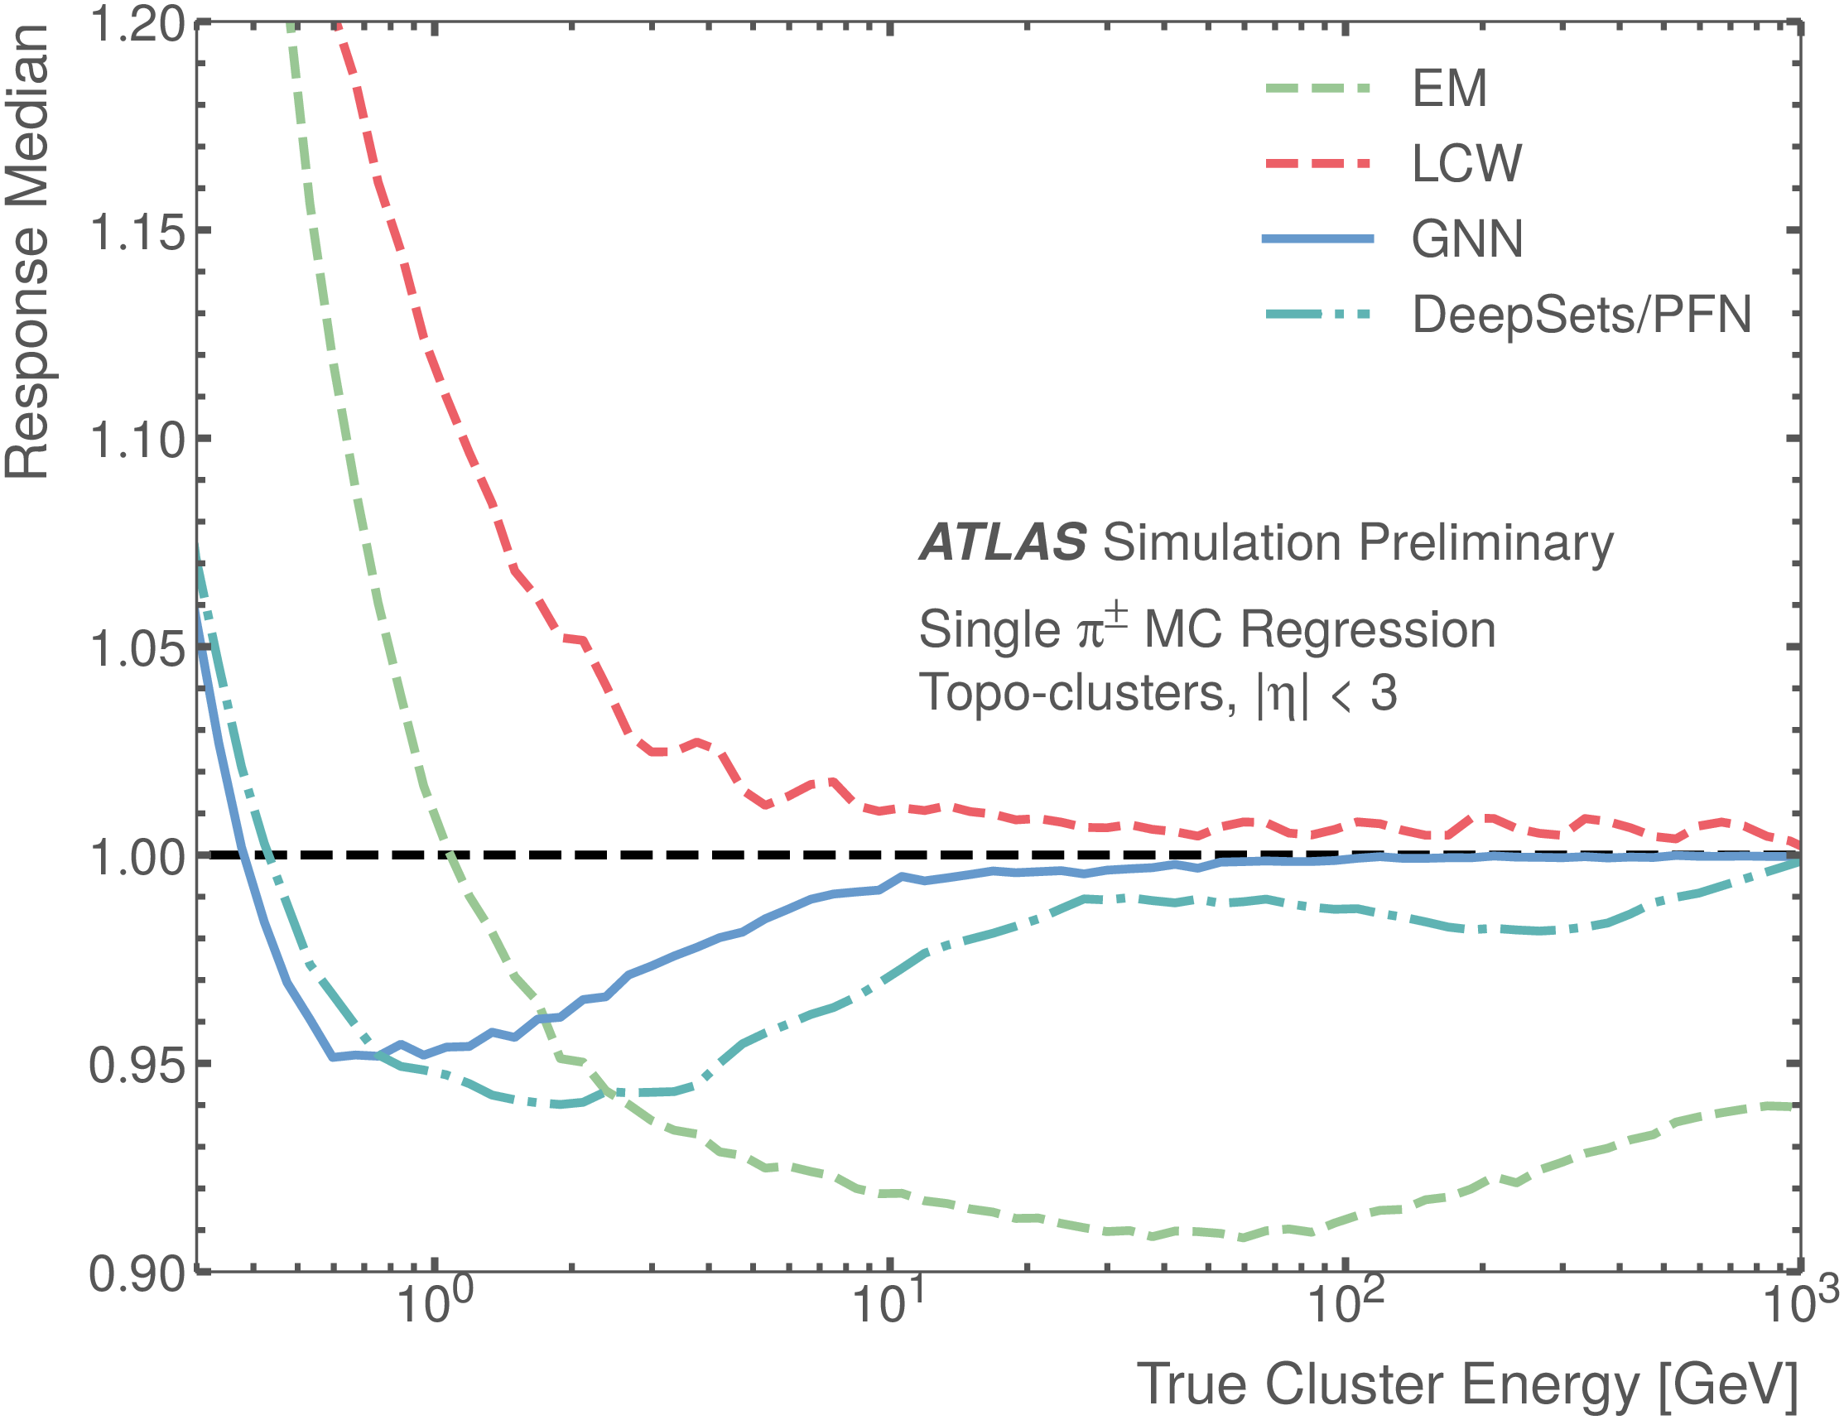
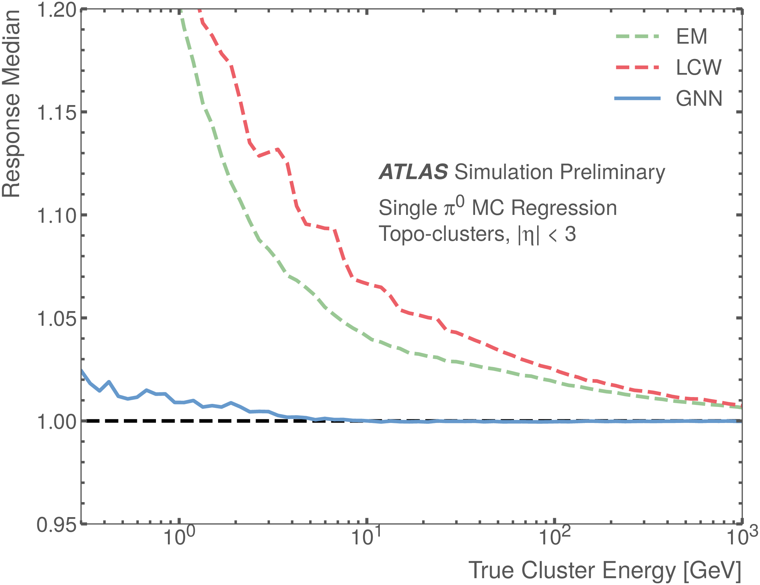
GNN Results: Regression
Significant improvement in the cluster energy response using the GNN model compared to EM and LCW scales
Response Medians
Mixed Neutral and Charged Pions
Charged Pions
Neutral Pions
Baseline methods
Baseline methods
Baseline methods
ATLAS-JETM-2022-002

Slide 10
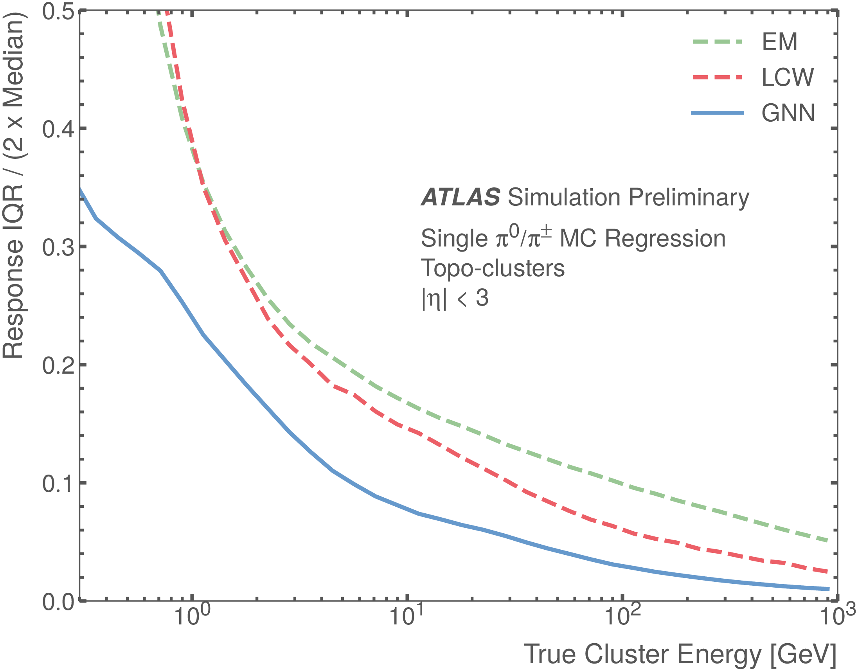
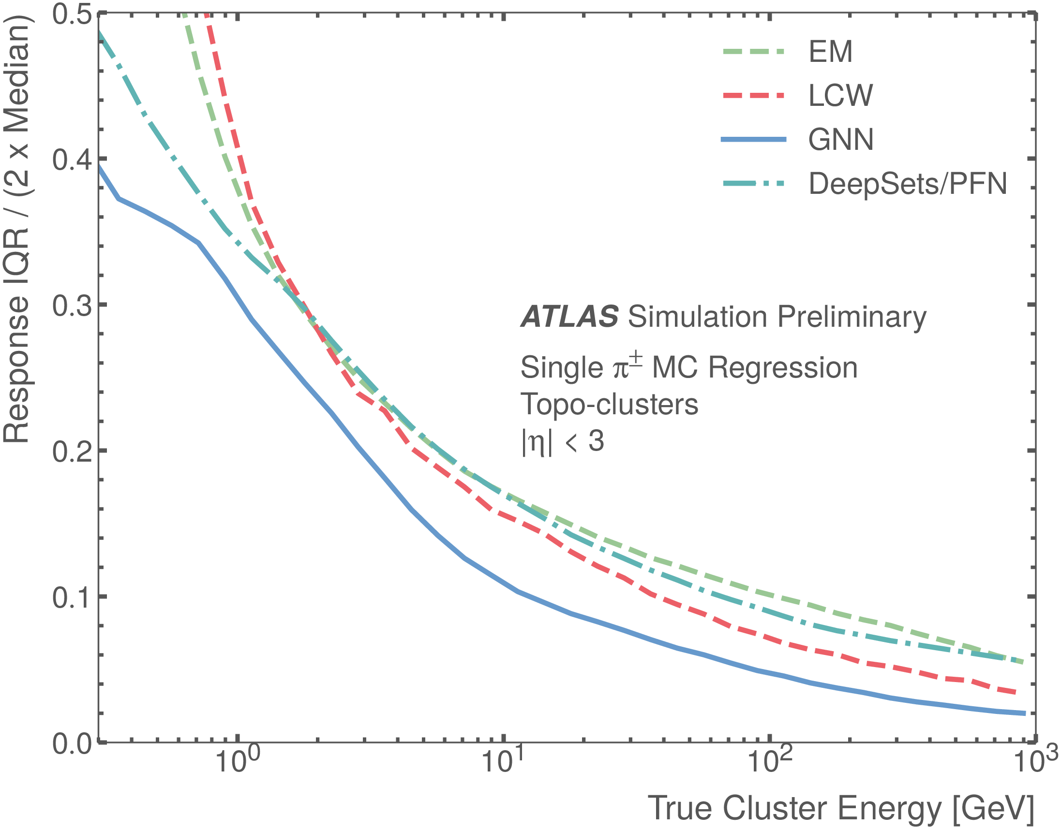
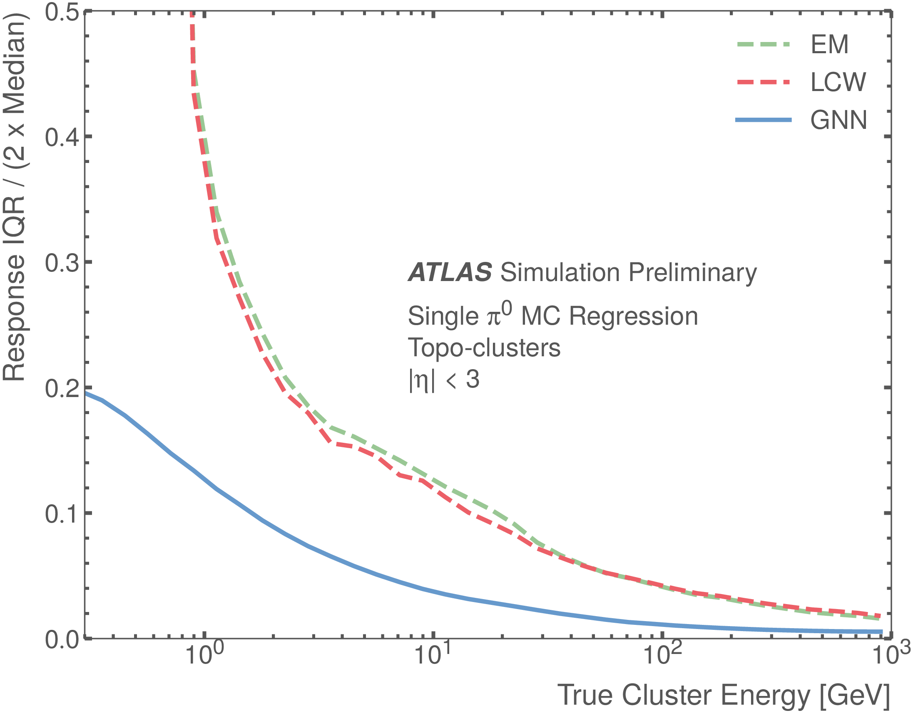
GNN Results: Regression
Significant improvement in the cluster energy response using the GNN model compared to EM and LCW scales
Inter-Quantile Range (IQR)
Mixed Neutral and Charged Pions
Charged Pions
Neutral Pions
Baseline methods
Baseline methods
Baseline methods
ATLAS-JETM-2022-002

Slide 11
Next Steps
Addition of tracks to graph-based representations of topo-clusters as additional inputs
Use trained GNN models for inference within ATLAS software framework ATHENA
  involves conversion to ONNX model
  successfully implemented this previously with the image-based models

