Slide 1
Innovation and industry programmes: report from WP14
May 2, 2022
Marcello Losasso – CERN

Slide 2








WP14: THANKS to industries and labs (equally represented)
Industries in WP14 are 50% of the total of ARIES industrial partners

Slide 3
The Objectives and Tasks of the WP14
Evaluate, assess and develop technology inside ARIES with the final aim to provide society with identified commercial applications of the supported research potential.
This is done via:
implementing PoC for innovative actions
Implementing research projects in industries
increasing synergies in consortium between laboratories, industries, universities, applied research institutes

Slide 4
Deliverables for WP14
Deliverables
D14.1 | Set-up of PoC innovation funding scheme | 14.2 | M12 | 23/04/2018
D14.2 | Academia meets industry /1&2 | 14.3 | M24/M36 | 09/05/2019
D14.3 | Production of material samples of C-based and metal-diamond composites | 14.4 | M24 | 30/10.2018
D14.4 | 1st long length of industrial HTS | 14.5 | M30 | 31/10/2019
D14.5 | Real-time event distribution network brought to openly accessible product grade level | 14.6 | M50 | 20/05/2021

Slide 5
Milestones for WP14
Milestones
MS42 | Appointing of an Industrial Advisory Board, (IAB) | 14.3 | M12 | 09/04/2018
MS47 | Reviewed requirements document | 14.6 | M12 | 18/04/2018
MS45 | First HTS Short Length produce via new process | 14.5 | M14 | 13/06/2018
MS43 | 1st academia-meets-industry event | 14.3 | M24 | 30/04/2019
MS44 | 2nd academia-meets-industry event | 14.3 | M36 | 27/07/2021

Slide 6
MS42: Set-up of Industry Advisory Board
The IAB, as foreseen in the GA and CA, is the body mandated for advising the ARIES Project Coordinator on matters relating with industrial collaborations and to support the managing of the PoC fund;
Jean-Luc Lancelot (France, SigmaPhi)
Julio Lucas (Spain, Elytt),
John Allen (UK, Elekta),
Tomas Eriksson (Sweden, GE),
Michael Peiniger (Germany, Research Instruments)
IAB COMPOSITION
object of MS42
One of the tasks of the IAB was to act as Evaluation Committee of the PoC of the ARIES project.

Slide 7
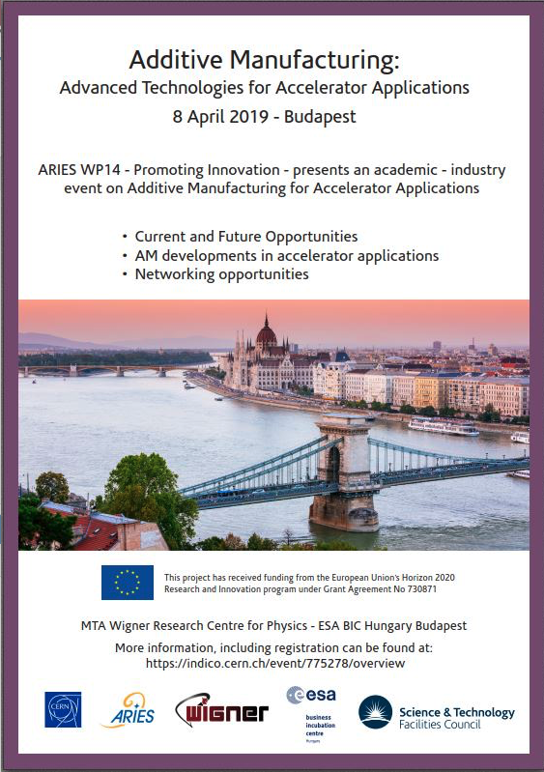

MS43 & MS44 – academy-meets-industry events:
https://indico.cern.ch/event/775278/
https://indico.cern.ch/event/1048728/

Slide 8
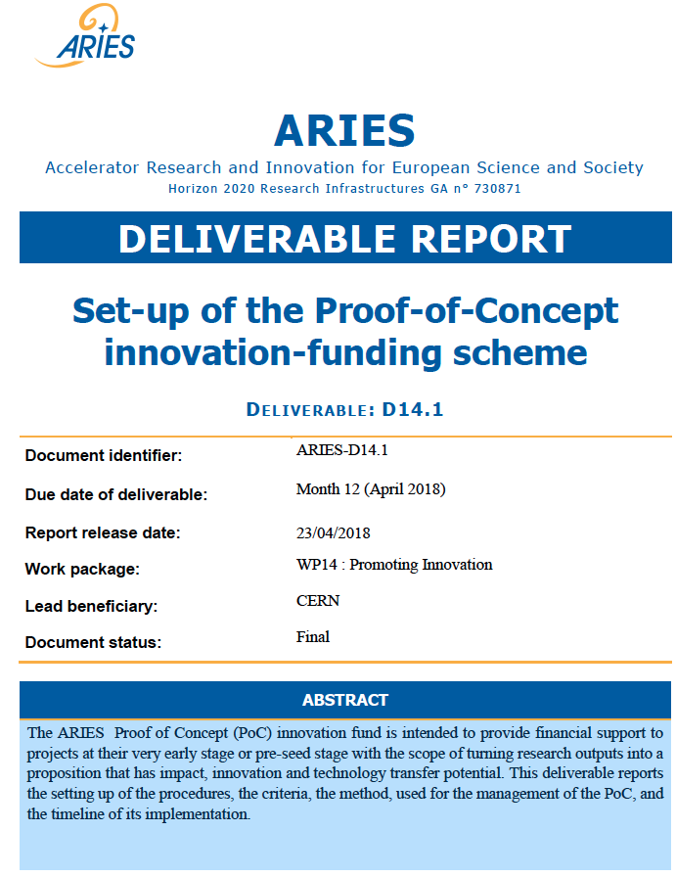
D14.1: Set-up of Proof-of-Concept innovation-funding scheme
WP14 tasked to identify and support testing and validation of 4-6 key technologies with potential for market applications, at the level of 40-60 k€ each: motivation for a PoC PoC as first-of-a-kind within a H2020 projects
General aim of PoC is:
Increase the level of innovation and TT from accelerator science, increase the impact of research, concepts & technology arising from ARIES.
To pre-industrialise complex components of particle accelerators and demonstrating to industry the possibility to invest and engage with a target to commercialization, minimizing risks associated with innovation for SMEs.
https://edms.cern.ch/document/1818311/1.0
Overview - Method and Procedures
How to apply - Timeline

Slide 9
D14.1: Set-up of Proof-of-Concept innovation-funding scheme
PoC Fund in ARIES is a tool helping to bridge the gap between research infrastructures and marketable innovation, providing incentive to the beneficiaries to get actively involved in TT activities.
PoC was a first-of-a-kind such implementation within a H2020 projects,
PoC ambition is:
i) To develop and use incentives for academic research groups to collaborate with SMEs and larger industries
ii) To advance the technology readiness levels in order to enable the uptake and exploitation of specific technologies developed in ARIES by the industrial participants in the project or other industrial partners.

Slide 10
Projects awarded
https://indico.cern.ch/event/1008814/contributions/
Atomic Layer Deposition: innovative approach for next generation particle accelerators – CEA -Dr. T. Proslier
Accelerator Diagnostics using innovative Adaptive Optics (InnoAdo) - University of Liverpool - Prof. C. P. Welsch
Development of hybrid electron accelerator system for the treatment of marine diesel exhaust gases - RTU - Prof. T. TORIMS
Investigation of new methods for the manufacturing of Cu-C composites with tailored thermo-physical properties - RHP Technology GmbH – SME - Dr E. Neubauer

Slide 11
some takeaways from PoC exercise:
The PoC helped deploying resources in short amount of time. It provided money and more general support (networks, visibility, competences and know-how from cross-cutting domains) to innovative projects
There have been identified and prospected commercialization, depending on the specific project, at prototype level. Patents submitted
PoC has helped to develop collaborative R&D at Eu level, the creation of communities able to set roadmaps. PoC is a way to engage partners for more demanding developments. EC values the possibilities of engaging into R&D industries together with accelerator community
Reporting considered reasonable, the general scheme considered excellent. But level of effort (money) should be increased. Reporting and monitoring should be increased to check that money is spent in proper way, to identify earlier market possibilities and to steer developments.
The process applied, the scheme used, the lesson learned have been a valuable experience for designing the IIF for I-FAST. A document on this was prepared and handed over to PC

Slide 12
WP14.3 Relation with industry - highlights
W14.3 aims to increasing synergies between laboratories, universities, specialized institutes and applied research institutes.
  Jointly with WP3, TIARA and AMICI, acted to promote a pilot EC action to finance a large program of accelerator relevant projects. Meeting organized on Feb 6/7 2018, in Brussels, with participation of industries and EC.
  A workshop in CERN, on Dec 1, 2017, organized in cooperation among WP3 and WP14, on EB application for diesel motor exhaust gas purification.
  A workshop organized with AMICI in CERN, on May 16th 2018, with participation of IPR experts from 4 EU laboratories, to address the problematic of IPR in collaborations.

Slide 13
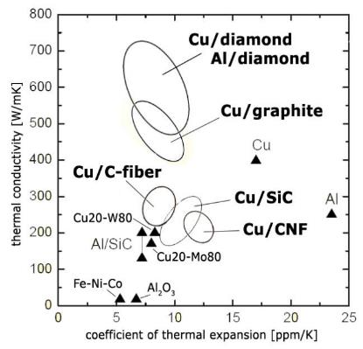
Materials for extreme thermal management applications- Task 14.4 – led by F.Carra
Samples produced by industries (RHP and Brevetti Bizz) in shapes required by testing devices, and in excess of the deliverable requirements, using advanced techniques: Spark-Plasma-Sintering and Additive Manufacturing
tested in the frame of WP17 activities. CuCD samples were tested in the “Multimat” experiment at the CERN HiRadMat facility under high intensity proton pulses of 440 GeV/c, to acquire their dynamic response.
Multimat experiment was a success:
collected data matches well the results of simulations and will help improving constitutive models for the less known composite materials.
Applications for cooling of electronics or laser components
Potential application for collimators in LHC
F.Carra presented in Nov 2019 status of task activities.

Slide 14
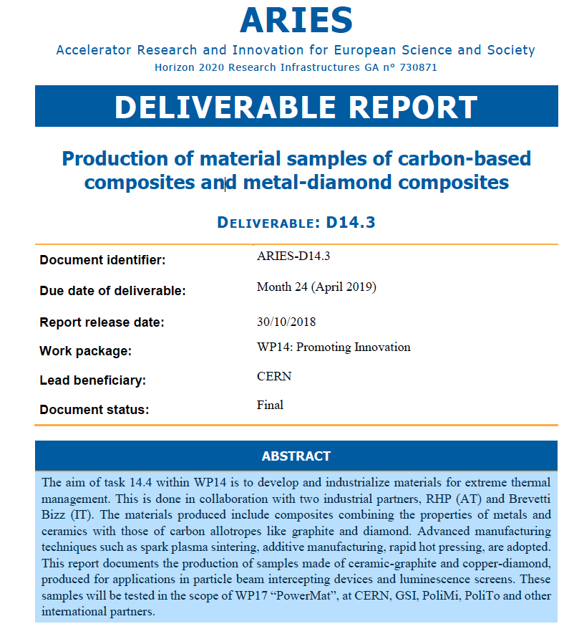
D14.3
Deliverable D14.3 reports activity of the task: the production of samples of composites material carbon-based and metal-diamond
→ materials tailored to achieve
high thermal, electrical and mechanical performance, and low density.
Very good collaboration and
synergy with WP17
https://edms.cern.ch/document/1818318/1.1

Slide 15
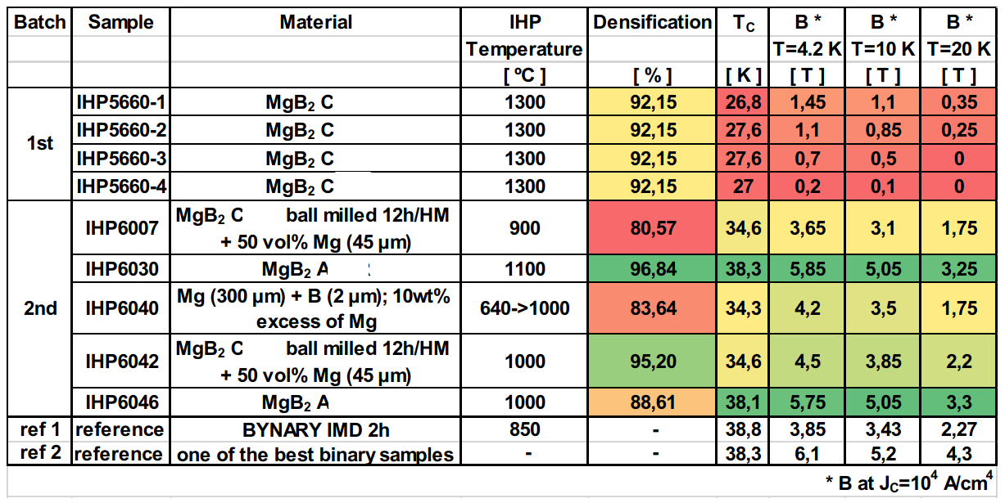
AM for MgB₂
  4 samples of MgB₂ on metal substrate (July 2018) → poor sc properties
  5 samples of MgB₂ on metal substrate (22 March 2019) → much better results
RHP research has developed in 3 directions:
    1 - reduction of MgO content [additive prior to hot-pressing]
    2 – optimization of bulk MgB₂ processing [changes in gas pressure in the furnace]
    3- granulometry [pulverization of bulk material and spherodisation].
Samples produced by RHP were tested
by UNIGE, and compared with reference
high performance sintered powders

Slide 16
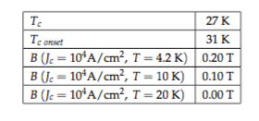
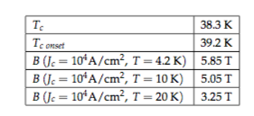
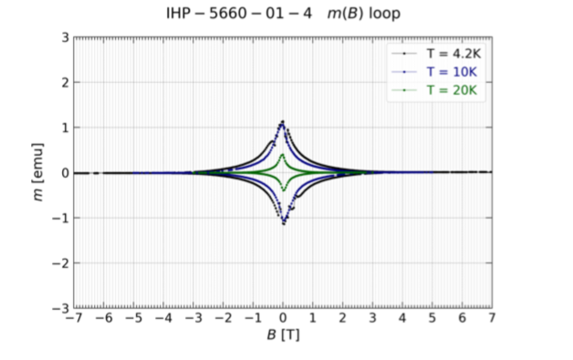
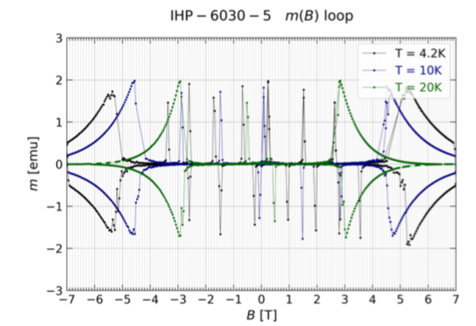
WP14.4 - MgB₂ AM
thanks to D.Mattera, C.Senatore (UNIGE)
from first batch of samples
(October 2018)
to second batch of samples
(March 2019)

Slide 17


WP14.5 HTS innovative process for accelerator magnet conductor
Lucio ROSSI – Task Leader
Thibault LECREVISSE – Deputy Task Leader
Alexander USOSKIN – Ulrich BETZ – Industrial Partner
Marc DHALLÉ
Carmine SENATORE

Slide 18
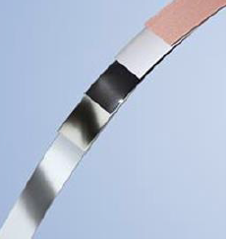
Engineering current density J_{e}(B,T=4 K) Performance target
Objective was to set up a NEW industrial optimized process to produce 450 m of tapes with Increased J_{e} by a factor 2 wrt EUCARD-2
  from J_{e} (4.2 K, 20 T) = 400-600 A/mm²
  to J_{e} (4.2 K, 20 T) = 800-1000 A/mm²
To complete the industrialization process:
Increase repeatibility and scale the process
Increase production yield with attempt to produce 100m lenghts with proper current
Tape bending with 50 µm thickness; problem to be solved in an industrial process.
The total material put in working was 1000 m but the produced high current lenghts were less than 200 meters.
Technical results are «easier» than industrialization process.
Tape Q065-18 (with 2x 7μm Cu) reached a very high performance of 1150 A/mm² at 4.2 K, 19 T, 90°

Slide 19
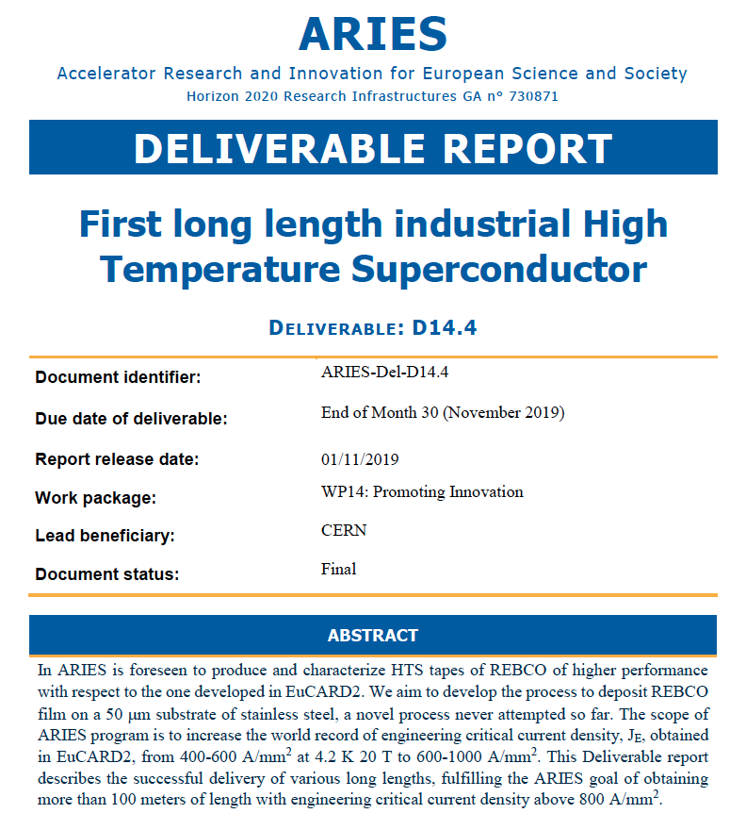
WP14.5: HTS cable development for accelerators magnets
Activity of the task reported in D14.4
manufacture of HTS coated conductor depositing REBCO (Rare-Earth Barium Copper Oxyde) on a 50 𝛍m thick substrate.
The use of such thin SS tape is an absolute novelty in the panorama of coated conductor.
Bruker HTS GmbH (BHTS) adapted the equipment and the process and obtained tapes with record current density, beyond the ARIES goal.
Unexpected issue (a bi-directional bending) has adversely affected the process that had to be adjusted to mitigate the effect. This caused a reduction of the critical current of 30%, but Jc is still fulfilling the goal of ARIES (> 100 m with > 800A/mm2 at 4.2K, 18 T).
In total 413 m of HTS tape of 12 mm width and 50 μm substrate thickness have been produced.
https://edms.cern.ch/document/1818319/1.0

Slide 20

WP14.6 : Accelerator Timing System
Task 14.6.–J.Gutleber → Industrialization of Realtime Event Distribution Network - REDNet Accelerator Timing System
Central Timing System is a distributed and scalable system for syncronizing the operation of numerous devices distributed across the accelerator (beam diagnostic, power supplies, i/o digital….)
CTS developed based on CERN know-how.
Cosylab and CERN together developed a similar system called RedNET for the project MedAustron.
In the scope of ARIES, REDNet system has been upgraded, customized and supplied to a specific user (ADAM)
Notes:
Realtime Event Distribution Network

Slide 21
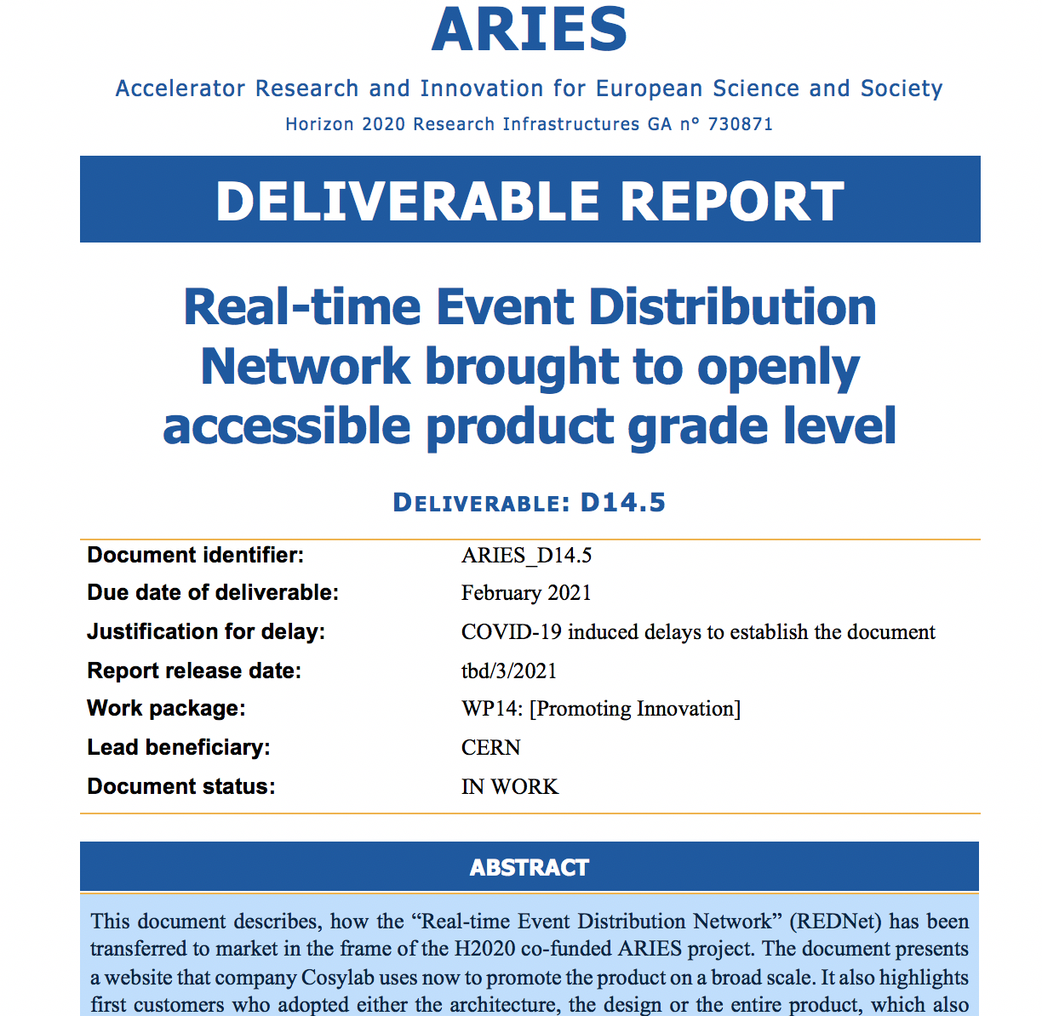
WP14.6 : Accelerator Timing System
Activity of the task reported in D14.5
product line developed by Cosylab is now marketed by Cosylab under the name C-MTS
Work started in MS47 with the setting-up of the high-level requirements of a generic PA timing system, and definition of how these requirements are managed.
MS48 summarises the high-level architecture of the REDNet (“Realtime Event Distribution Network”)
A product originated in the HEP domain, with prospected customers small / medium sized PA for medical and industrial applications
Tangible impact that ARIES project created : technology has been effectively transferred from physics research in CERN to market as a co-construction process with industry
A content page added to the website
of cosylab to promote the product
and to present results of the action
in the frame of ARIES
https://www.cosylab.com/main-timing-system/

Slide 22
Conclusion
  WP14 has timely and successfully delivered. However COVID -> put-off some of the activities
  PoC demonstrated to be a valid tool for fostering innovation, engaging industries, and convincing EC
  PoC exercise needs scaling
  Activity in WP14 has set important basis for I-FAST
  Industries leading specific actions were embedded in the WP14 plan of work
  Remarkable results from industrial developments

