Slide 1
Testing of magnets and components at cryogenic temperatures, report from TNA WP9¶
Marta Bajko CERN
For the ARIES ANNUAL MEETING 2022

Slide 2
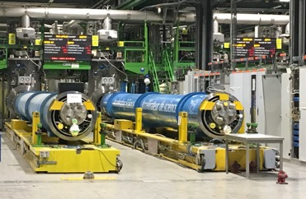
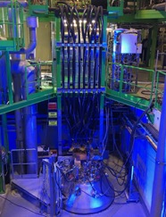
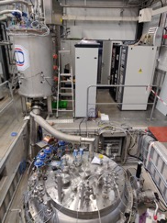
WP9 TNA : tasks 9.1 and 9.2.
WP9 (Magnet Testing) offered Transnational Access (TA) to the magnet testing Magnets or instrumentation at CERN ( MagNet) and University of Uppsala (Gersemi).
The activity of the MagNet Transnational access has been set up within a Superconducting(Sc) Magnet Test Facility at CERN. This test facility composed by a high number of vertical cryostats and feed boxes, is essentially dedicated to the CERN projects and within those activities is allowing to perform Sc magnet test and qualifications.
The FREIA Laboratory host the "Gersemi" vertical cryostat test facility allowing to test Sc magnets and radio frequency cavities.

Slide 3
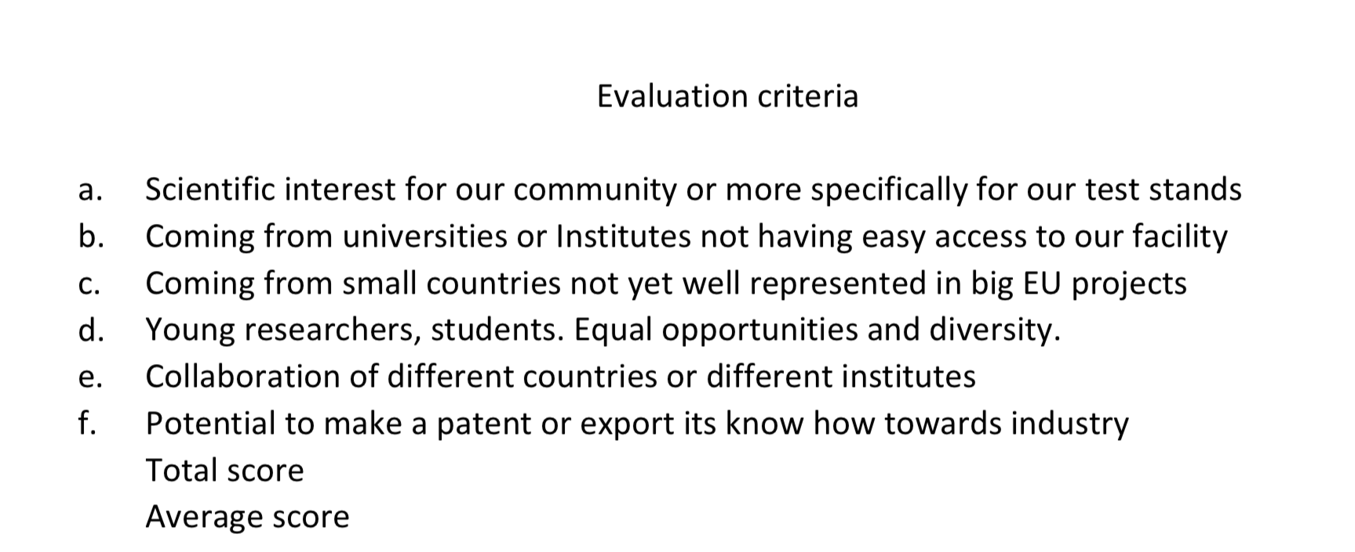
ARIES TNA
(https://aries.web.cern.ch/application-and-follow-procedures)
User Selection Pannel and Evaluation Criteria
WP9 has a common Selection Panel for both tasks 9.1 and 9.2. The entire panel has expertise in superconducting magnets. The selection panel is made of experts coming from 4 different worldwide laboratories:
Roger Ruber FREIA ( DWPL TNA, Gersemi)
Marta Bajko CERN (WPL TNA, MagNet)
GianLuca Sabbi LBNL
Tatsu Nakamoto KEK

Slide 4
The engagement evolution of the TNA
Intial engagement
These engagements has been based on the experience of MagNet within the EUCARD2 TNA project that has been successfully completed.
Reviewed engagement (from 2020)
These engagements has been reviewed to insure at MagNet higher priority CERN projects ( HL-LHC) and to cope with the delayed start of the installation recently built in FREIA.

Slide 5

Summary Status of WP9
The TNA is composed by two laboratories: CERN and FREIA.
MagNet (@CERN)
GERSEMI (@FREIA)**
** Gersemi started late as the test stand construction was longer than expected
Nationality and gender distribution of users @ MagNet

Slide 6
Summary of PROJECT in ARIES TNA WP9
Task 9.1.MagNet

Slide 7
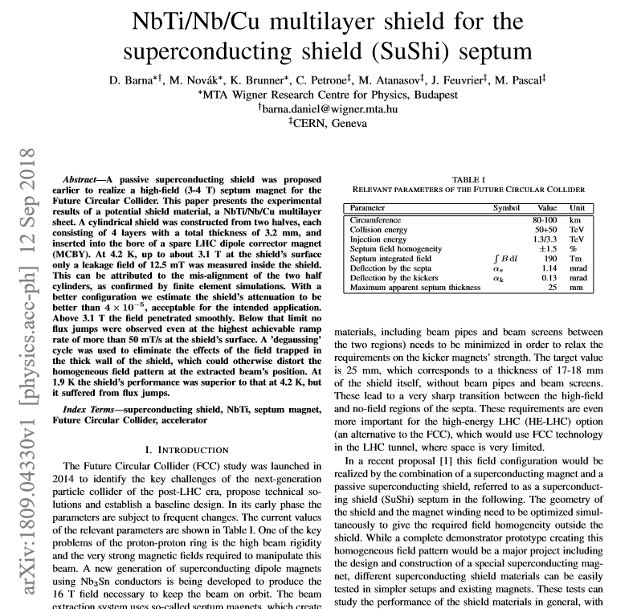
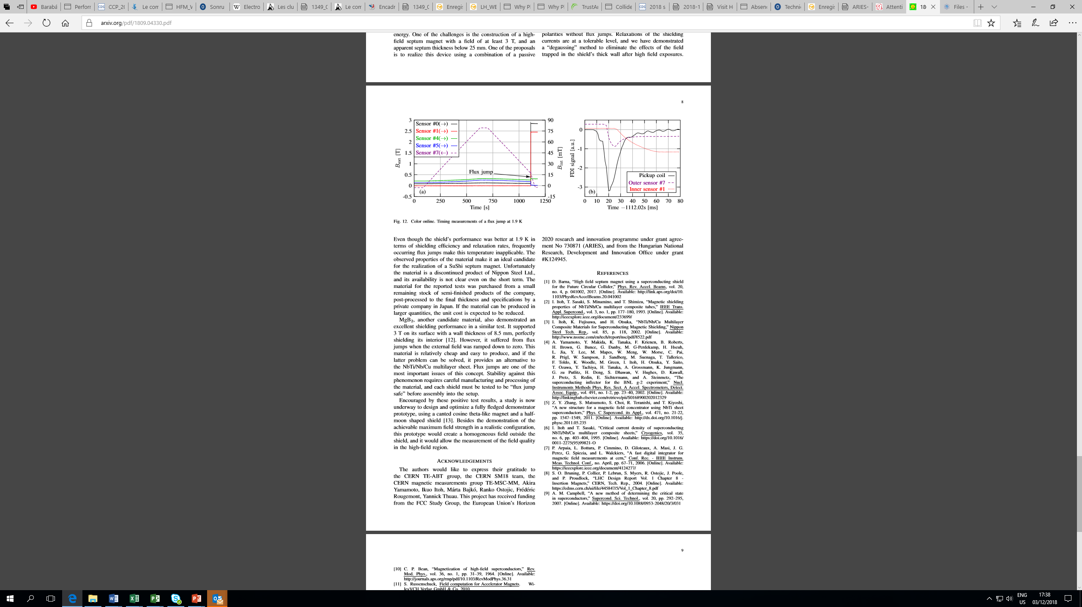
Sushi
To demonstrate the capability of shielding a NbTi/Nb/Cu for a massless septum magnet.
Barna, is involving now eastern European and Japanese industry to a larger project: building the septa and the shield itself.
They uses a vertical cryostat and a magnet.
440 Accesses
The difficulties for the Sushi team is […] to protect the superconductor and even before to detect and distinguish between a quench and a flux jump.
Test @ MagNet

Slide 8
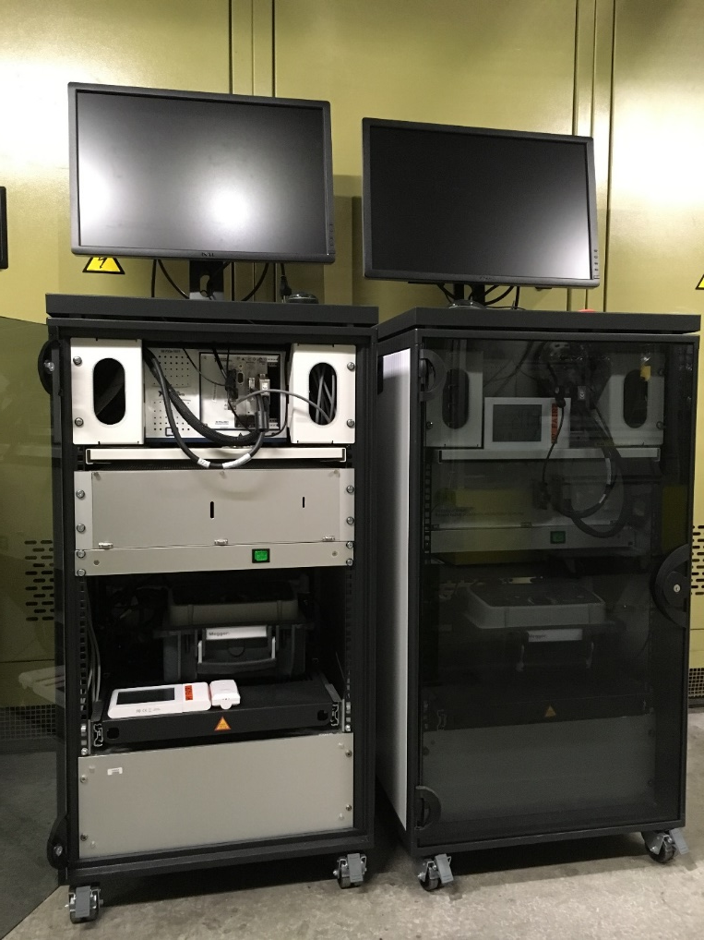
Automated HV Testing of Sc Coils
To automat High Voltage Testing of Superconducting Coils
Varadine is proud of his students having developed a system that turned to be efficient in the test and found users at bug laboratories
New release has been tested in November
Hardware and software renewed
New functionalities (safety & HV feature) implemented
This equipment, developed by MSc students found users:@ GSI for SFRS magnets and @ CERN SM18 for HL-LHC magnets!!
They uses any cryostat ( horizontal or vertical) with any magnet.
288 Accesses
Test @ MagNet

Slide 9
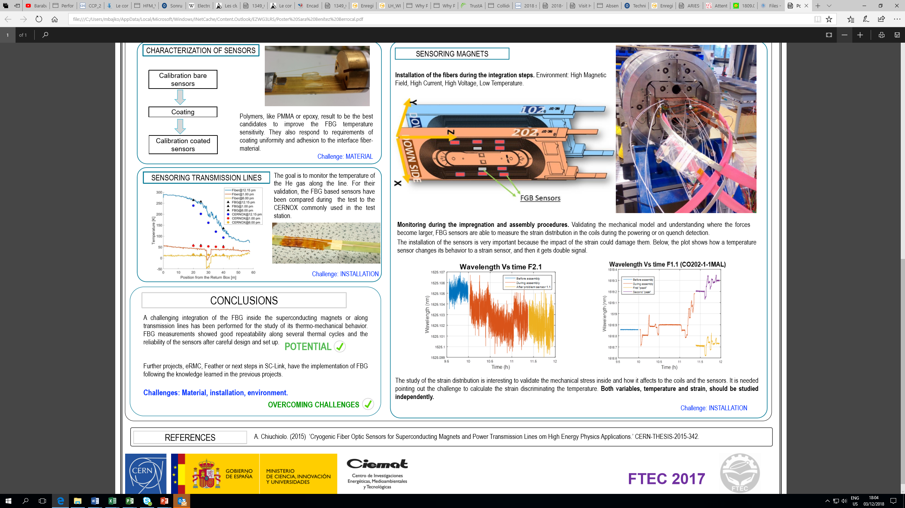
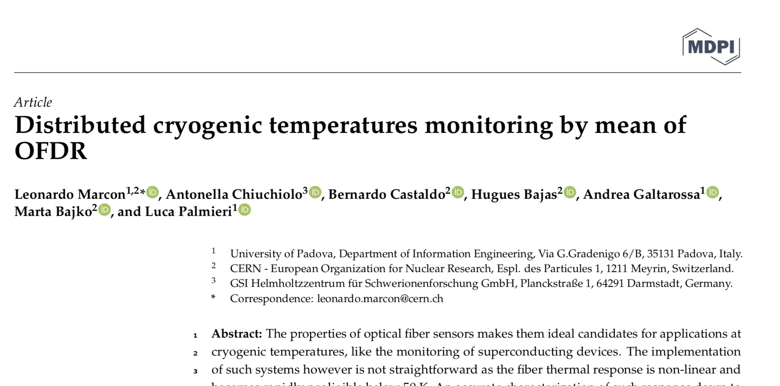
Monitoring by distributed optical fibre sensors
To demonstrate the feasibility of the quench monitoring in a SC link and and HTS magnet.
L. Palmieri is willing to take up the challenge in integrating a continues fiber into a coil after a successful test in a transmission line.
They uses a magnets and transmission lines in development at CERN
192 Accesses
Test @ MagNet
To be presented also @OFS 2022 in Alexandria, Virginia.

Slide 10
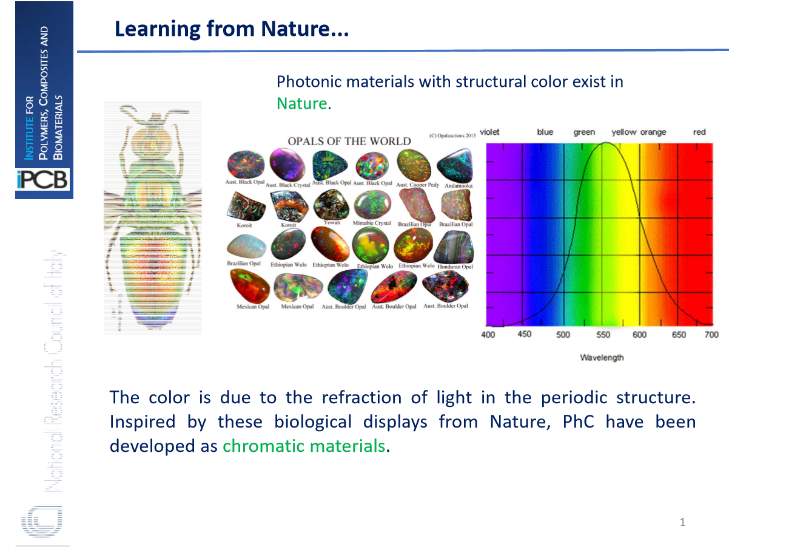
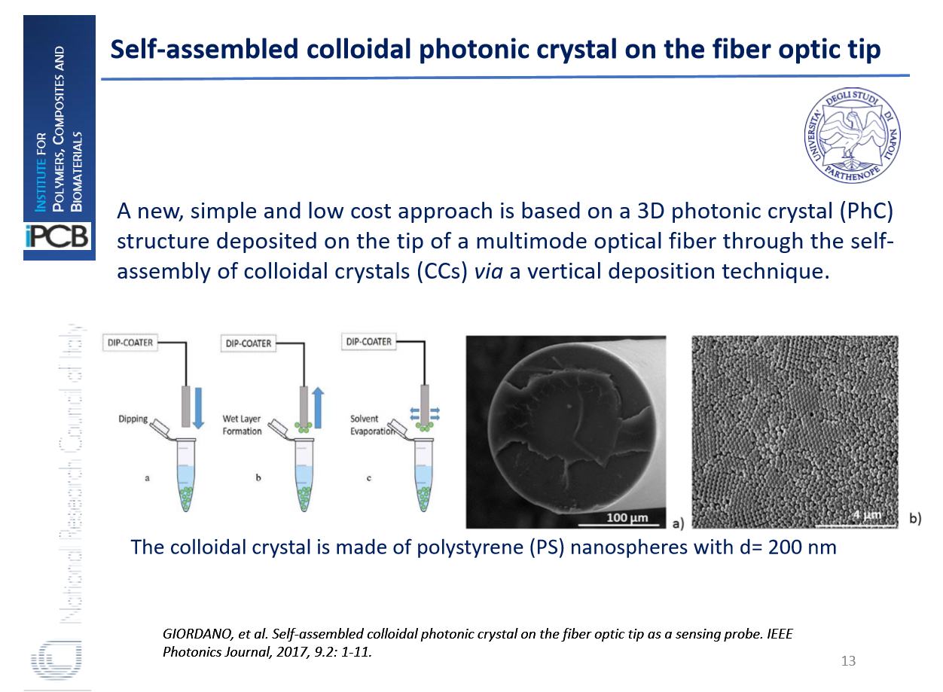
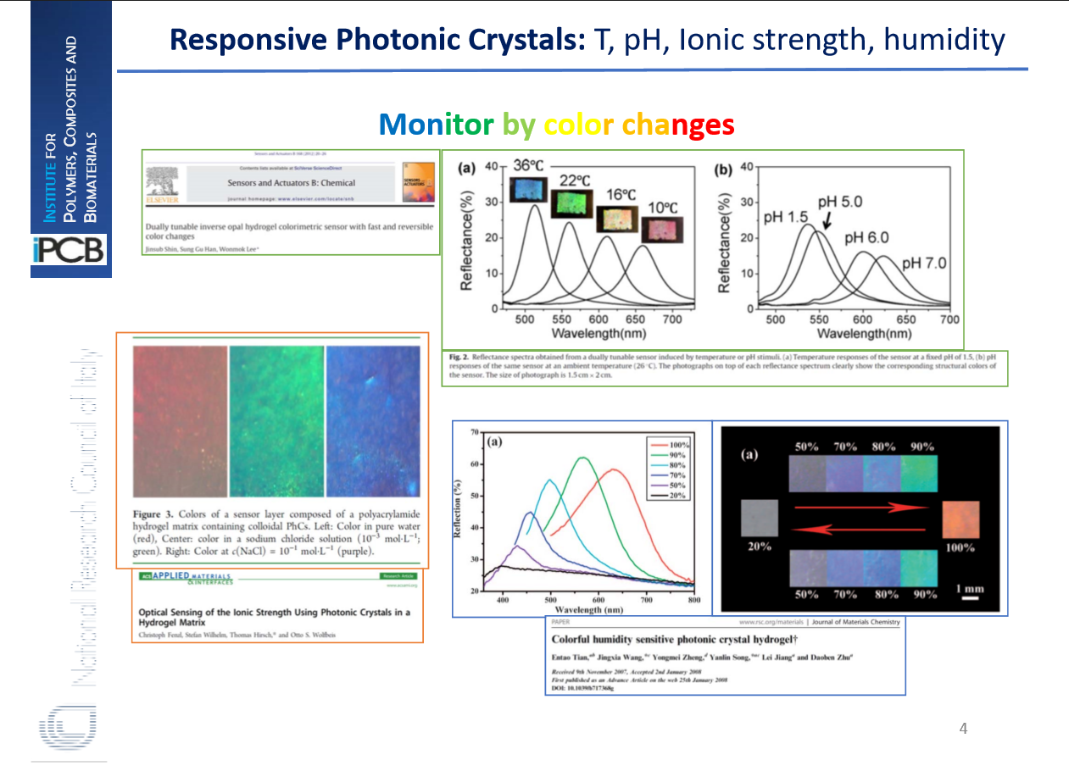
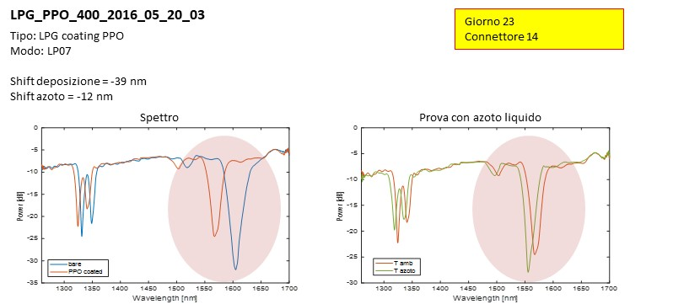
CRYOPAL
To find new materials usable for the temperature monitoring at cryogenic conditions.
Inspired by nature : Giordano et all, our old users of the facility, proposed to create and TEST in MagNet new sensors
They uses the cryo cooler
24 Accesses
First test during the first discussions on the installations
Thermal Response Characterization of Different Optical Fibers Samples at Cryogenic Temperatures by Leonardo Marcon et all , 27th International Conference on Optical Fiber Sensors .
Test @ MagNet
Cryogenic test facility instrumentation with fiber optic and fiber optic sensors for testing superconducting accelerator magnets” (December 2017, IOP Conference Series Materials Science and Engineering 278(1):012082. DOI: 10.1088/1757-899X/278/1/012082)

Slide 11
ReBCO –CORC-CIC
ReBCO CORC-CIC
For the purpose of future superconducting detector magnets and busbars for accelerator application, a development is on-going of ReBCO-based Conductor-On-Round-Core Cable-In-Conduit (ReBCO-CORC-CIC) conductors. This activity has already been on- going for some five years, and in the coming months it is foreseen to test a prototype conductor in the SULTAN test facility at EPFL, location PSI, in a 12 T magnetic field back-ground and at variable temperature.
Before shipping the conductor to EPFL/PSI for test at 4.3 K, the test of the conductor at 77 K (in liquid nitrogen) is foreseen and without back-ground field, which involves running some 20 kA current through the sample, measuring the voltage taps on the conductor, and checking the sensors.
Expert in the Sc magnet domains: Ten Kate et all, applied for a test at 77 K and high current
Expert in the Sc magnet domains: Ten Kate et all, applied for a test at 77 K and high current
https://ris.utwente.nl/ws/portalfiles/portal/63693761/thesis_final_Tim_Mulder.pdf
The 5 users used 24 access to a high current power converter
Test @ MagNet

Slide 12
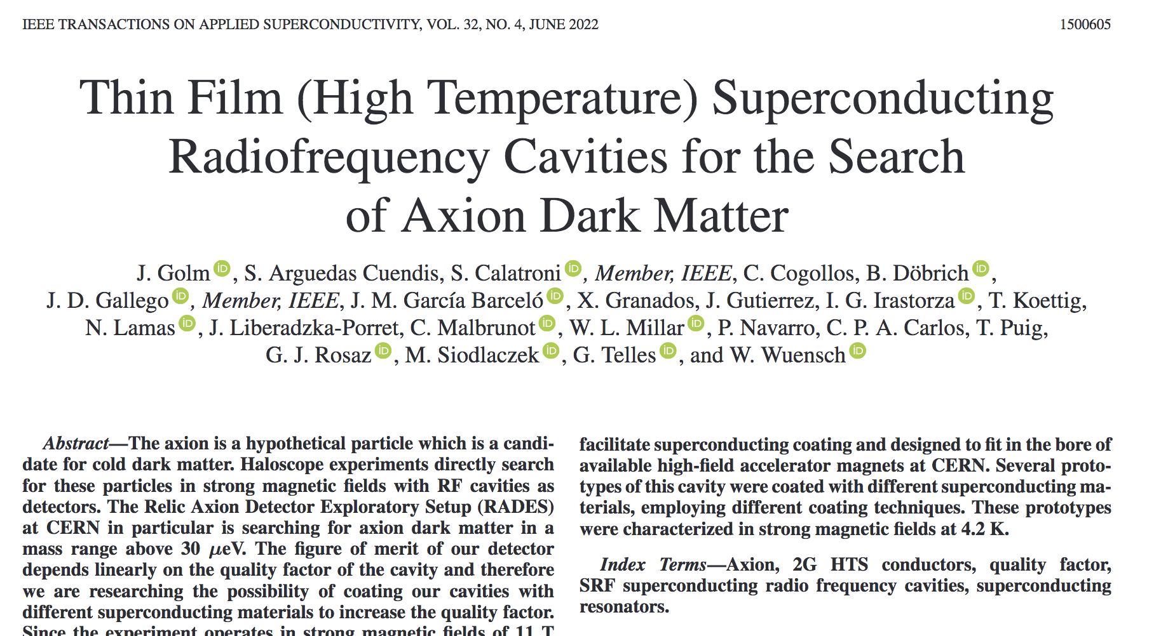
RADES
RADES
(Relic Axion Detector Exploratory Setup)
is a project with the goal of directly searching for axion dark matter employing custom-made microwave filters in magnetic dipole fields.
With a final goal to look for Axions: Irastorza et all, asked for equipment qualification for a detector at low temperature and high magnetic field
The 8 users used 760 access to a vertical cryostat and 11 T magnet
Test @ MagNet
https://arxiv.org/pdf/2110.01296.pdf

Slide 13
Summary of PROJECT in ARIES TNA WP9
Task 9.2.GERSEMI

Slide 14
Star up of "Gersemi" Facility at FREIA, Uppsala University
The FREIA Laboratory started preparation of the "Gersemi" vertical cryostat test facility in 2014 within a collaboration agreement between CERN and Sweden. After a one year design phase, a public tender was published in 2015. The commercial contract for the manufacturing and installation of the vertical cryostat system was signed in April 2016.
The delivery of the vertical cryostat system was delayed due to technical difficulties during manufacturing. The vertical cryostat, liquid bath insert, valve box, and transfer lines were finally completed during January 2018. Factory tests followed and the complete system was transported to Uppsala in several parts between March and May 2018. Installation work was completed during June, and a first commissioning phase started end June with some minor equipment missing from the manufacturers delivery scope. This revealed some minor bugs in the control software which were quickly fixed. During August a second commissioning phase was started continuing into September. This revealed a cold leak in the liquid helium circuit. After extensive testing the so-called valve box cryostat was opened and the leak could be located at one cold valve. The valve was dismounted by FREIA personnel and shipped back to the sub-contractor of the manufacturer.
At present the test stand is completed and operational

Slide 15
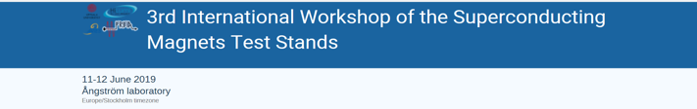
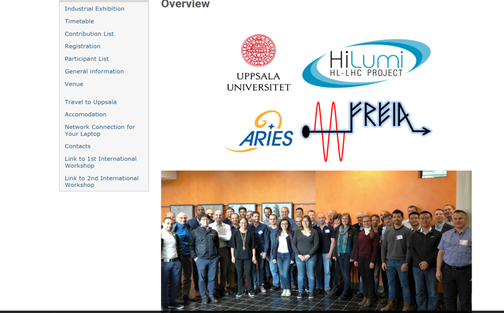
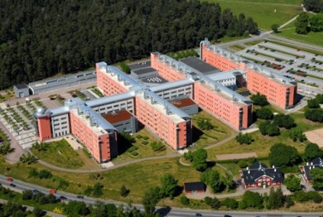
Users event @ GERSEMI
With 45 participants and 35 talks
Ångström Laboratory, Lägerhydddsvägen 1, Uppsala

Slide 16
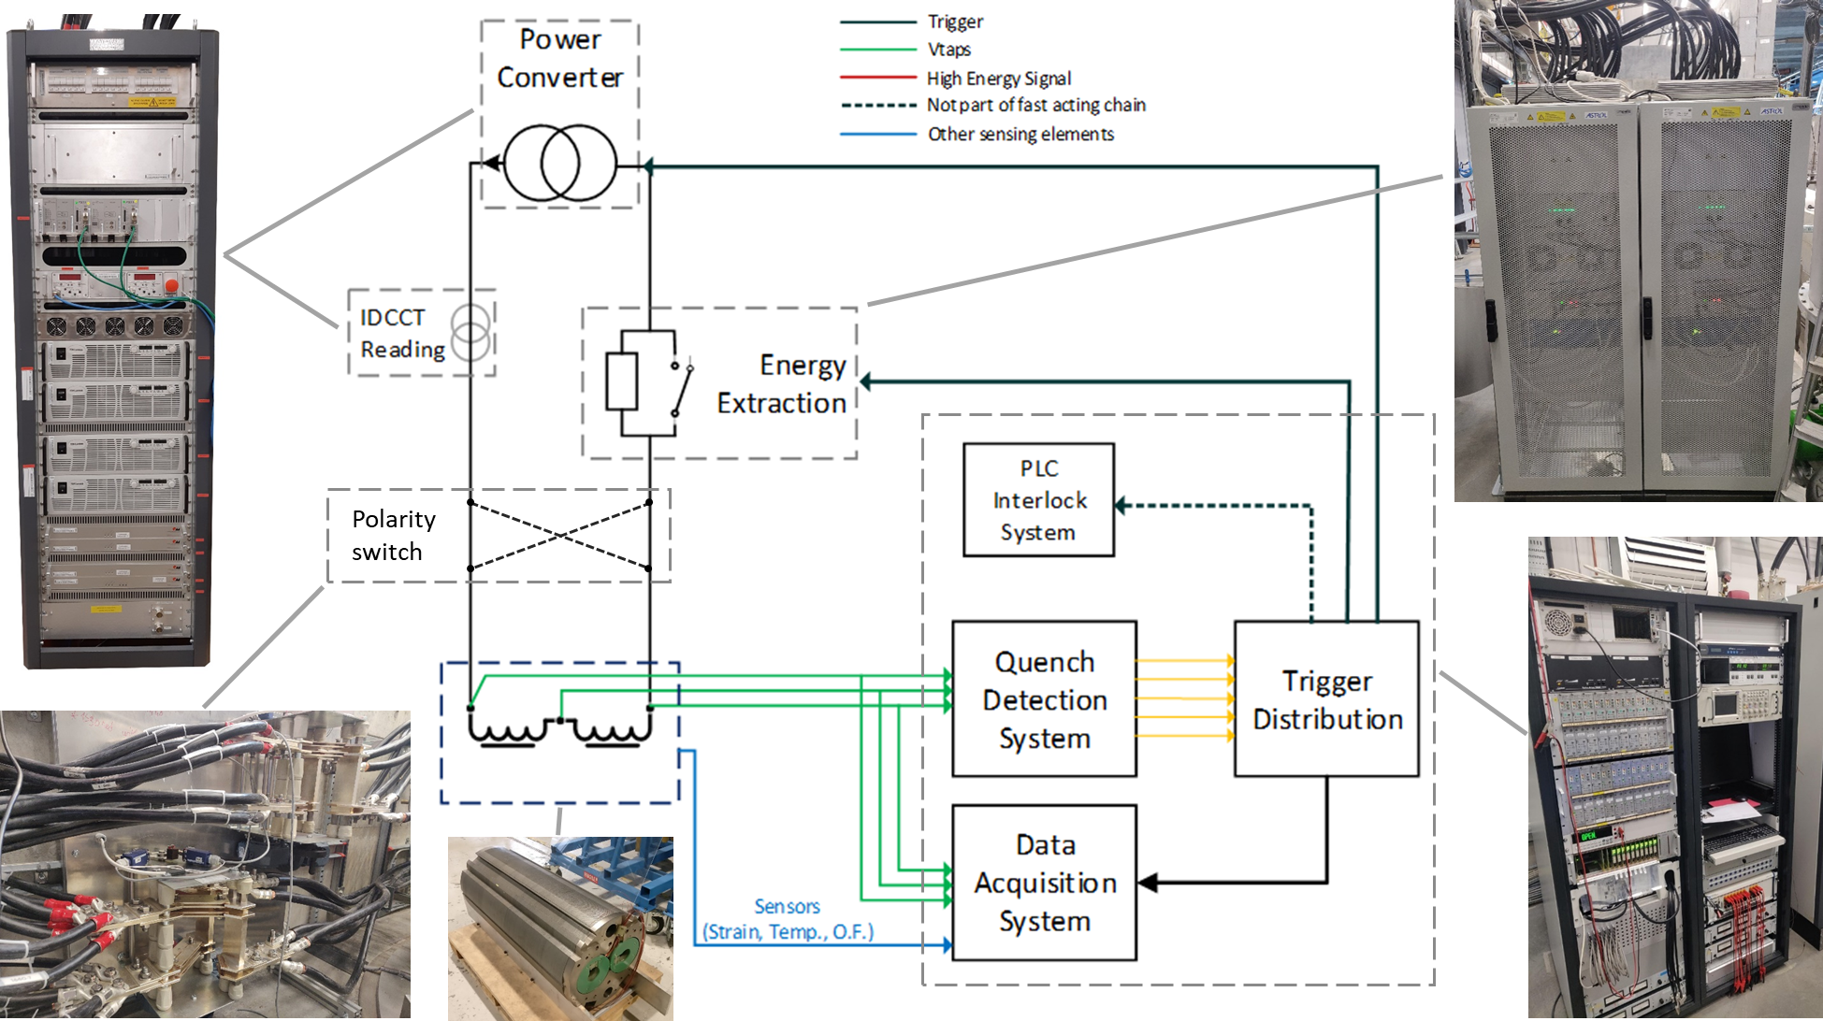

WP9.2 The Gersemi TNA
2x 2 kA power supplies
2x energy extraction
Polarity reversing switch
Safety PLC and control system
Test of SC magnets (<350kJ)
3.2m x ø1.1m total volume
2.65m x ø1.1m below lambda plate
48 HF acquisition channels
72 LF acquisition channels
1 uQDS (to detect symmetric quenches)
Gersemi is a facility to test superconducting magnets at 4.3 K and 1.9 K

Slide 17
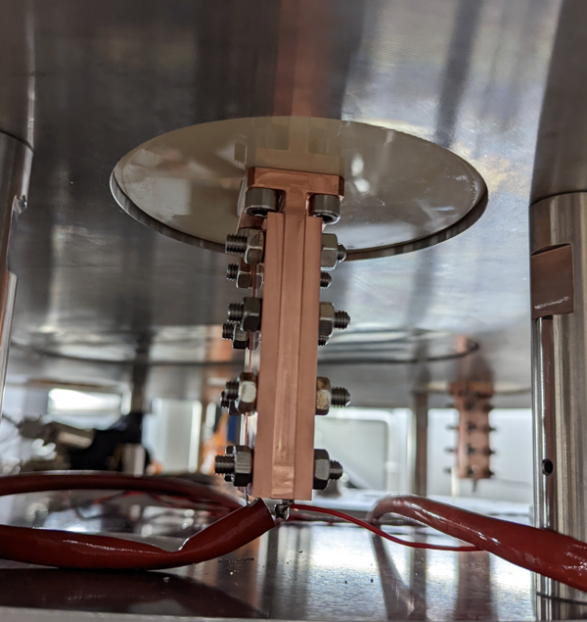
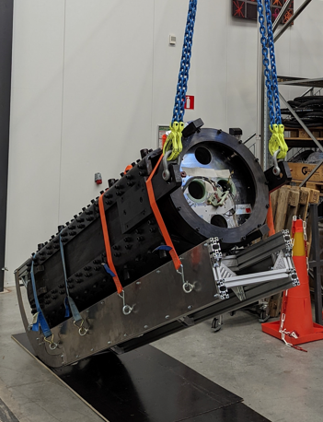
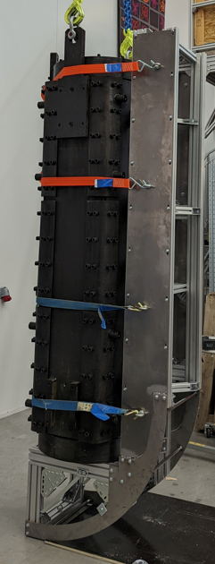
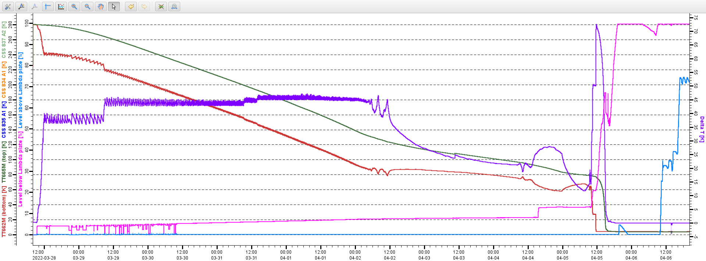
Recent Improvements@ GERSEMI
Fully instrumented insert with new copper clamps for the magnet’s leads
Rotating sleigh
Copper clamps below the lambda plate to attach the magnet’s leads to the insert’s leads (above the lambda plate)
Platform to rotate magnets – tested up to 5 t
Controlled cooldown of long magnet
from 300K to 4.3K ( in 10 days of 2.2 m long magnet)

Slide 18
Future tests and improvements @ GERSEMI
Improve the HV breakdowns on the insert, which is currently limited by some connectors on the top flange
Test the SuShi CCT magnet at 450 A and 4.3 K
This test will consist of the first powering of the CCT (canted cosine theta) SuShi (Superconducting Shield) magnet. This magnet uses a CCT like magnet with a superconducting shield installed in its aperture to create a field-free channel

Slide 19
Summary
ARIES TNA within WP9 gave the great opportunity of a high number of users from 9 different countries to the the unique infrastructure as is the MagNet to perform important measurements and qualifications of Sc magnets, Sc conductors or instrumentations of 6 different scientific projects.
In all cases the test infrastructure needed was a key point as their needs were in a specified domain where low temperature, high current and high magnetic fields were crucial.
The Gersemi test facility , once set up within a collaboration agreement between CERN and Sweden, could made this new facility known by the community and start their ”new carrier” in this domain complementing its “ big sister” the MagNet for the next decades.
As an image of the CERN international collaboration tradition, the ARIES project founded by the EU, could once again bring together the scientific community of a precise domain, sharing infrastructures and services now together with a Swedish University.
I close here this chapter within ARIES TNA WP9 and hope that even without a formal project, the tradition of the TNA will be encored at CERN and in the EU institutions and will continued in a way or other in the next coming years at the service of science.

