Slide 1
Industrial and Societal Applications – WP3
A. Faus-Golfe on behalf of WP3
IJCLab – IN2P3 – CNRS

Slide 2
Tasks
Task 3.1. Coordination and Communication (Rob Edgecock - HUD)
Task 3.2. Low energy electron beam applications: new technology development (Andrzej Chmielewski - INCT)
Task 3.3. Low energy electron beam applications: new applications (Frank-Holm Roegner - FEP)
Task 3.4. Medium energy electron beams (Angeles Faus-Golfe - CNRS)
Task 3.5. Radioisotope production (Conchi Oliver - CIEMAT)

Slide 3
Deliverables & Milestones
D3.1 | Application of electron beams in the environmental area | INCT | M24 | Done
D3.2 | Evaluation of new technology for electron beam accelerators | INCT | M30 | Done
D3.3 | Comparison of different accelerator options for ^{99m}Tc and therapeutic isotope production | HUD | M36 | Done
D3.4 | Design of a compact 140 MeV electron linear accelerator | CNRS | M40 | Done
MS13 | Current applications of e-beam accelerators up to 10 MeV | INCT | M12 | Done
MS14 | New industrial applications of electron beams | FEP | M18 | Done
MS15 | Medical applications of high energy electrons beams | CNRS | M24 | Done
MS16 | Study of different options for PET isotope production | CIEMAT | M30 | Done
Notes:
Already accomplished all the tasks and deliverables!!!

Slide 4
Main Achievements T3.2 and T3.3
Low-energy e-beam applications: new technology and applications
Many activities studying the use and development of e-beams
(300 Kev to 10 MeV):
New environmental applications:
  Residual marine ballast water treatment
  Sewage sludge treatment, biogas production, MPs, etc
  Marine diesel exhaust treatment: PoC, Hertis
Document preservation
Food irradiation
Virus inactivation
High-beam power for high-dose rate
Basic process:
H₂O → [2.7] OH• + [2.6] e⁻_{aq} + [0.6] H• + [2.6] H₃O⁺ + [0.45] H₂ + [0.7] H₂O₂ - G-value: molecules/100 eV - radicals react with biological, organic and inorganic matter
Notes:
In the following I will present some highligths.

Slide 5
EB-technology against biohazards
Inactivation of viruses for vaccine production
Current method: Chemical inactivation
Aim: Elimination of drawbacks
Novel method: low energy e-beam irradiation
Notes:
The aim is to be faster and without loosing too much antigens.

Slide 6
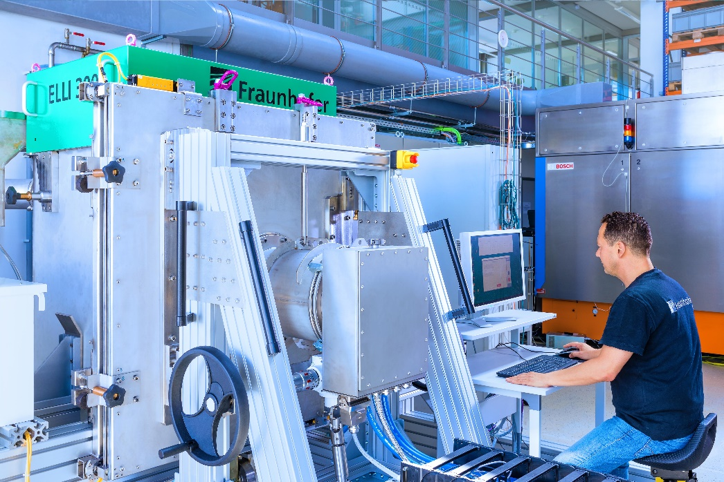
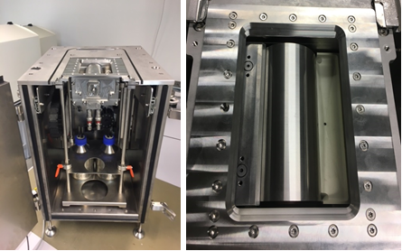
EB-technology against biohazards
Inactivation of viruses for vaccine production
  First prototype machine, developed by Fraunhofer-consortium (FEP, IZI, IPA) works well and produces inactivated suspensions in the range of some liters per hour
  Evaluated results for a lot of real types of vaccines
  First positive results on Corona-virus as well!
  High dose rate enables high preservation of important antigens
  300 keV accelerator for compact design
  First industrial licensing acquired!

Slide 7
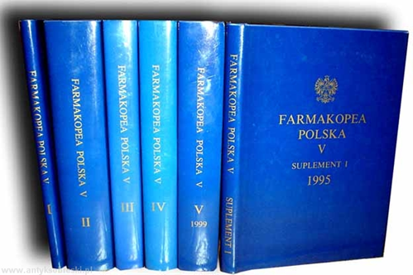




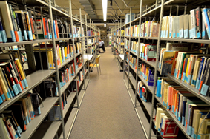

EB has been used for ~200m³ of archives, documents, books, etc
EB for Preservation of Cultural Heritage
Faculty of Modern Languages Library
The Sejm (Polish Parliament) Library
The Office for Registration of Medicinal Products, Medical Devices and Biocidal Products
University of Warsaw – Library
Valuable objects - original music notation composed by Ignacy Paderewski (stored in The Frederyk Chopin University of Music Library)

Slide 8
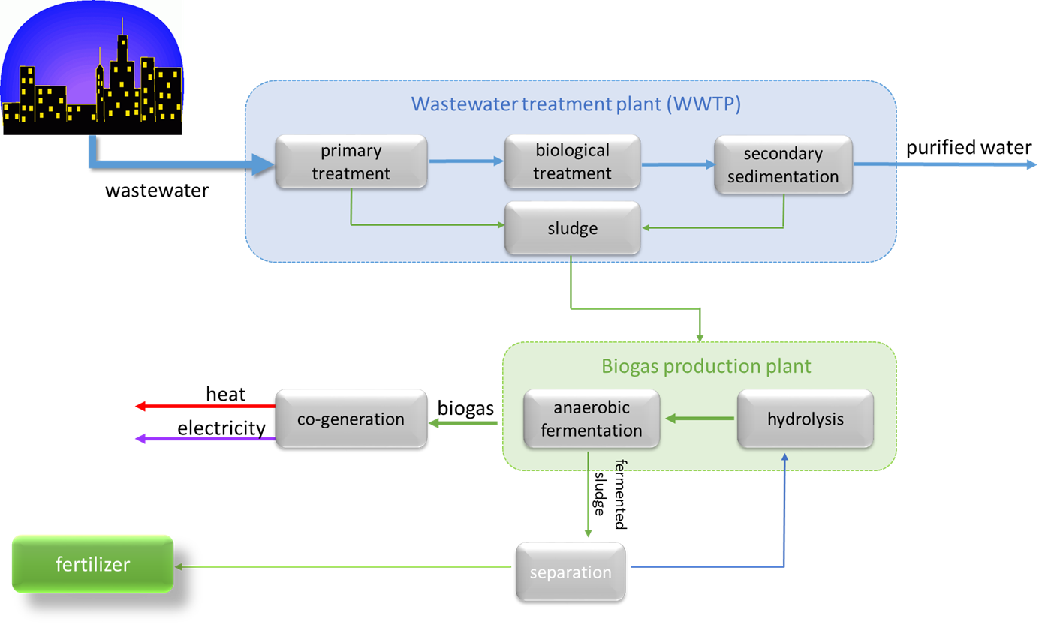


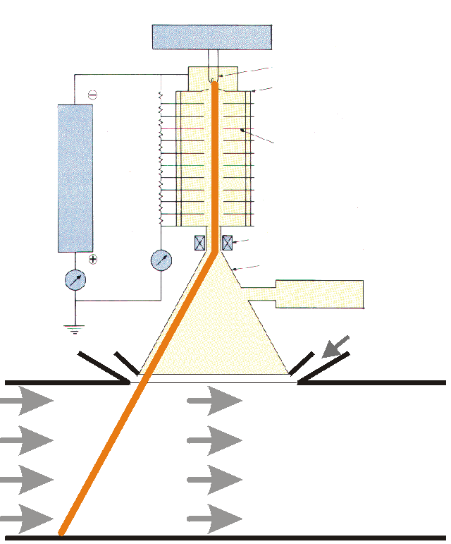
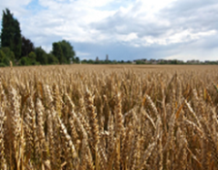


EB-system for Hybrid Biogas
Advantage of proposed solution:
Environmental friendly technology
Biogas production is disposal of problematic wastes
Production of renewable power through combined heat and power cogeneration
Production of microbiologically safe organic fertilizer due to electron beam hygenization
Technology can be applied in any place with sufficient biomass resources while there is no need for external electric energy supply
Also shows potential for modern contaminants: microplastics, PPCP, POPs, AMR, etc

Slide 9
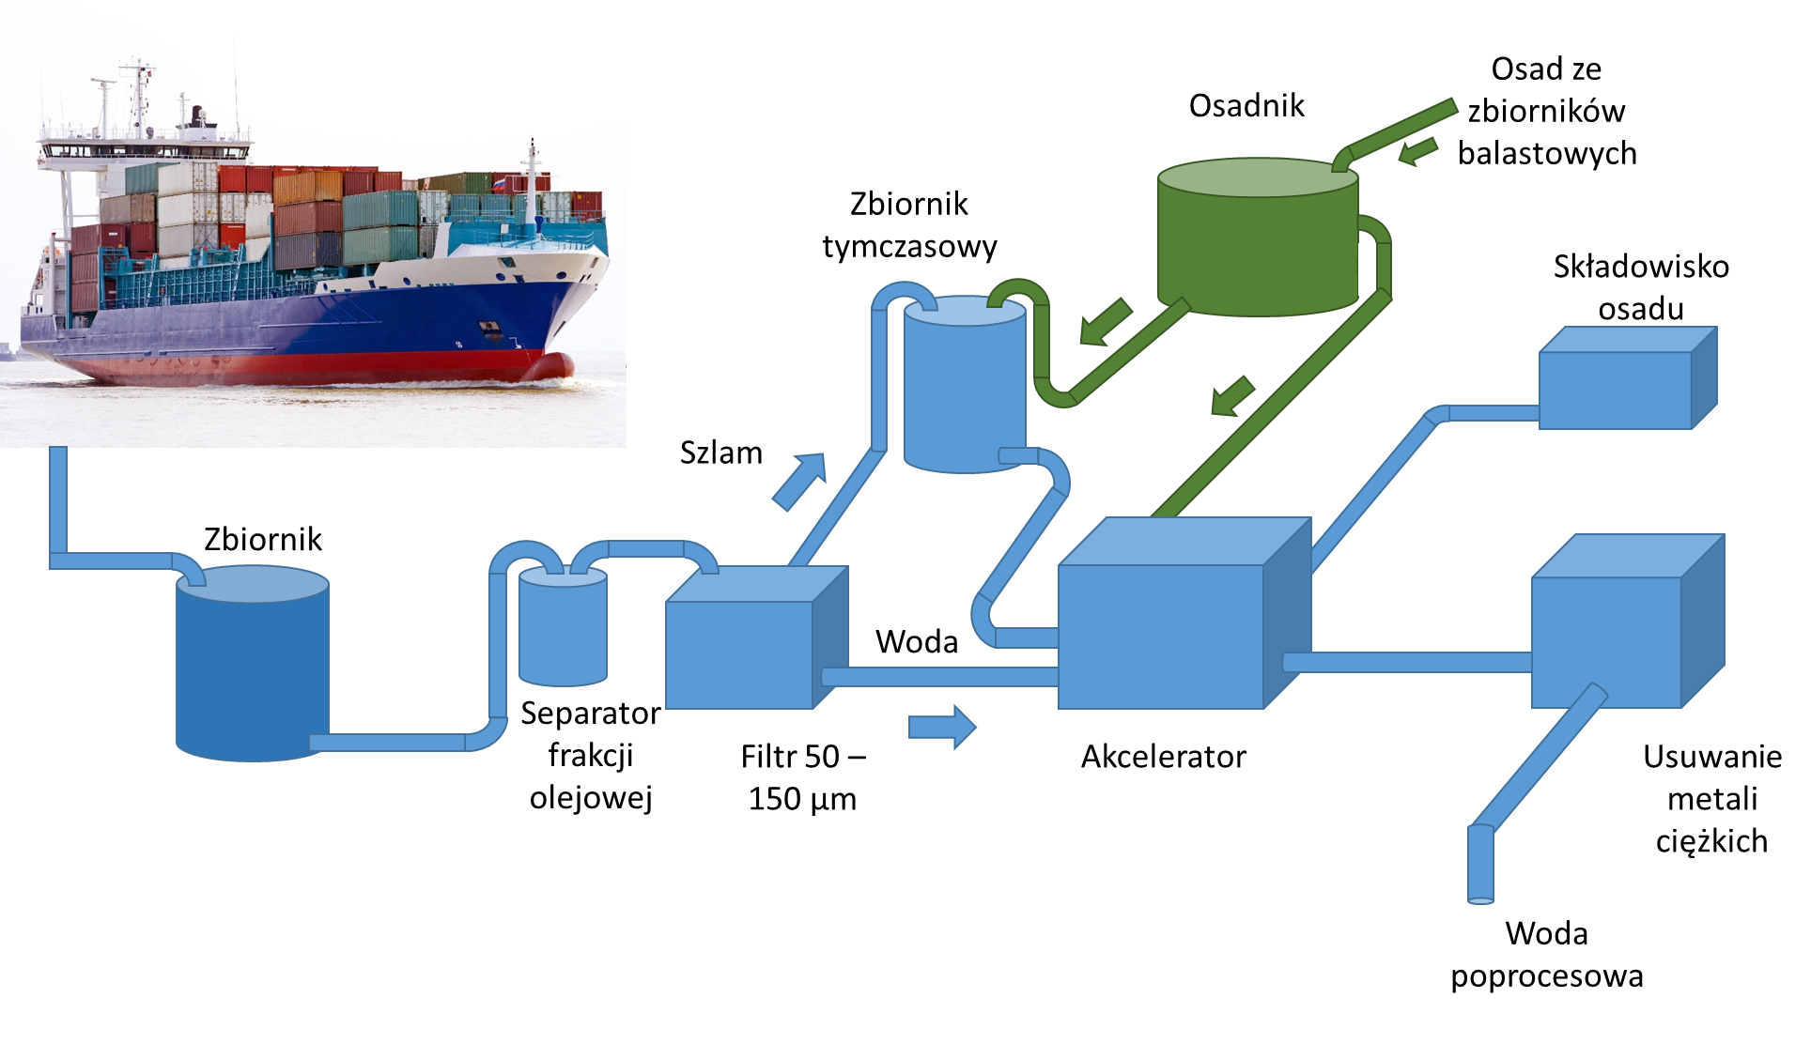
EB for ballast water discharge
Ballast water discharge typically contains a variety of biological materials, including plants, animals, viruses, and bacteria. These materials often include non-native, nuisance, exotic species that can cause extensive ecological and economic damage to aquatic ecosystems, along with serious human health issues including death.
Vibrio cholerae (O1 i O139) less than 1 CFU (colony forming unit - cfu) per 100 ml or less than 1 CFU per 1 gram (wet mass) zooplankton sample;
Escherichia coli less than 250 CFU in 100 ml;
Enterococci less than 100 CFU in 100 ml.
Green “dock”

Slide 10
Some Outputs
Four H2020 and other multi-national proposals: HERTIS - Hybrid Exhaust Gas Cleaning Retrofit Technology for International Shipping PHOEBe - Production of High-Quality Organic Fertiliser using Electron Beams ATChem - Advanced Technology as a Solution to Halogen-based Persistent and Mobile Chemicals RADAGASS - Reduction in AMR Transmission by the Destruction of AMR Microorganisms, Genes and Antibiotics in Sewage Sludge and Animal Waste Using Electron Beams
Three PhDs: - Urszula Gryczka ”Effect of ionizing radiation on polysaccharides” INCT, Warsaw, Defended March 23rd, 2021 - Dagmara Chmielewska-Śmietanko “Electron Beam for Preservation of Biodeteriorated Cultural Heritage Paper-Based Objects”, INCT - Malgorzata Siwek, “Study of Electron Beam Treatment for the Removal of Microplastics from Sewage Sludge”,HUD

Slide 11

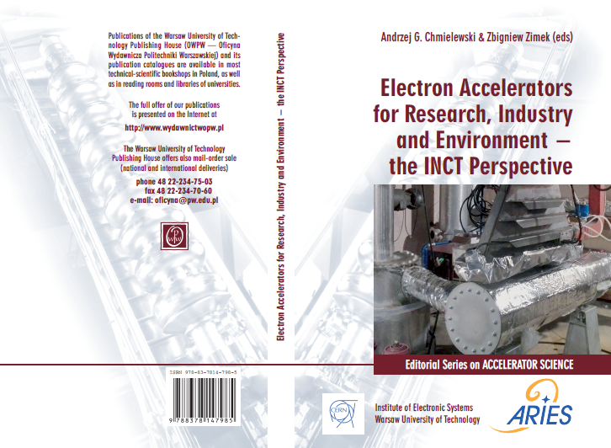
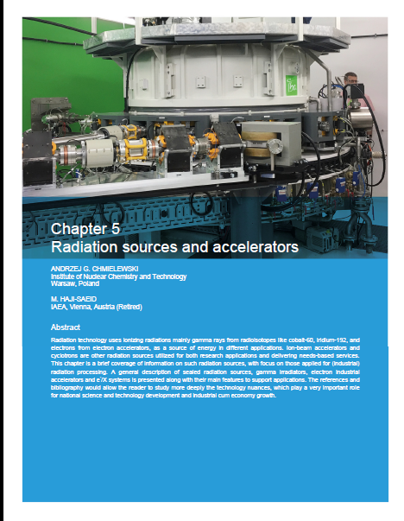


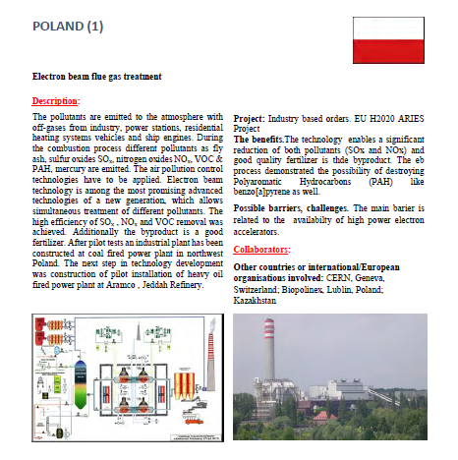
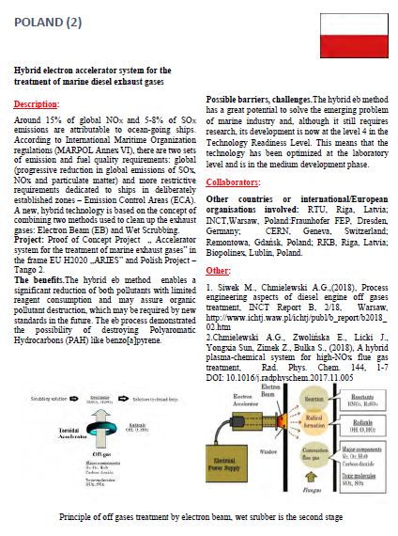
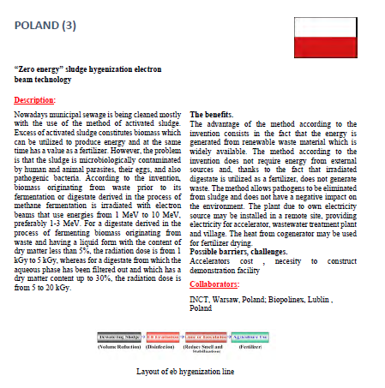
Some Outputs
Three books

Slide 12
Future in I.FAST WP12
Strategy for Implementing new Societal Applications
3rd May Wednesday 15:00 - 15:15 (CERN)
Andrea Sagatova - - Slovak Technical Univ.
Sub-task 12.3: Environmental applications of electron beams
Toms Torims – RTU, Andrzej Chmielewski - INCT
Design of Advanced Electron Accelerator Plant for Biohazard Treatment
4th May Wednesday 15:15 - 15:30 (CERN)
Andrzej Chmielewski - INCT

Slide 13
Main Achievements T3.4
Medium energy e-beam: new Radiotherapy applications
  Study of the applications of e-beams up to 140 MeV in the medical and other areas
  Study of the construction of high performance electron linear accelerator up to 140 MeV
Parameters
Energy | 70 – 140 [MeV]
Charge (variable) | 0.00005 – 2 [nC]
Normalized emittance | 3-10 [mm mrad]
RF frequency | 3.0 [GHz]
Repetition rate | 50 [Hz]
Bunch length, rms | < 10 [psec]
Energy spread, rms | < 0.2 %
Bunches per pulse | 1

Slide 14
New e- linac therapies and accelerator designs
Very High Energy Electrons (VHEE) RT accelerator design, in particular for Grid mini-beam and FLASH ultra-high dose rate delivery modes:
  Dose rates: 2 Gy/min - 100 Gy/sec
  Beam sizes: 0.5 mm - 10 cm
  Homogeneous beam: +/- 2-3%
for single or multiple beams and single or multiple fractions in biological and preclinical applications.
PhD: B. Bai, Injector linac optimizations for FCCee and applications for PRAE, University: Paris-Saclay / University Chinese Academy of Sciences, 2021.

Slide 15
Very High Energy Electrons RT: VHEE’20 workshop
Accelerators for VHEE RT
Normal Conducting RF linacs:
eRT6-Oriatron at CHUV, ElectronFlash at IC, CLEAR at CERN, CLARA at Daresbury and AWA at ANL
Super Conducting RF linacs:
ELBE Center of High Power Radiation Sources at HZDR and PITZ at DESY in Zeuthen
Laser Plasma Facilities:
DRACO at ELBE LOA at IPP
https://indico.cern.ch/event/939012/
X-band π-mode Distributed Coupling RF structures
Accelerator technologies for VHEE RT
High-gradient RF structures where more than 100 MeV/m are now achievable.
Some promising R&D are:
distributed coupling accelerator
use of cryogenic copper
higher frequencies millimetric waves (~100 GHz) and higher repetition rates using THz sources
Left: Breakdown probability measurement in a single cell cryogenic test. Right: Quality factor for cryogenic copper accelerator structures
Built and tested structures to 230 MeV.

Slide 16
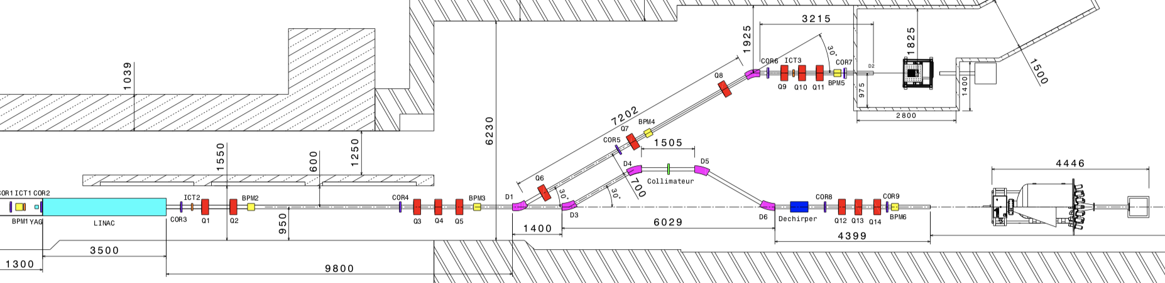
Possible designs for a compact e- linacs for VHEE applications
S-BAND LINACS
PRAE Accelerator Layout
S-band HG TW linac
X-BAND LINACS
Preliminary design of FLASH facility for CHUV Laussane
C-BAND LINACS
X-band HG CLIC unit
C-band linacs HG SW wave
PHASER facility sketch for 80-150 MeV high-energy electrons

Slide 17
Future in I.FAST WP12
Strategy for Implementing new Societal Applications
3rd May Wednesday 15:00 - 15:15 (CERN)
Andrea Sagatova - Slovak Technical Univ.
Sub-task 12.2: Novel forms of radiotherapy
Angeles Faus-Golfe - CNRS

Slide 18
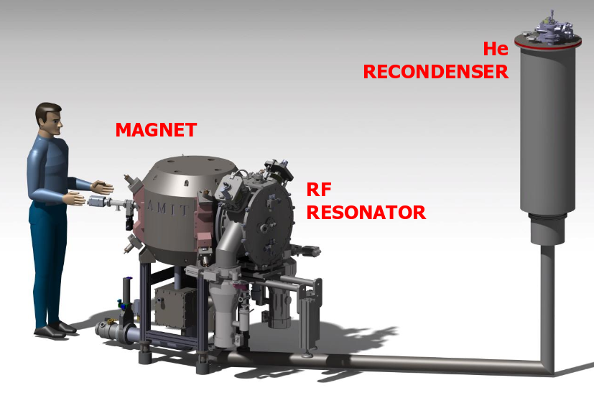
Main Achievements T3.5
Radioisotope production: AMIT cyclotron
Advance Molecular Imaging Technology (AMIT) Cyclotron
Development of a compact mini-cyclotron for ¹¹C and ¹⁸F single doses production
Cyclotron to be installed in (or near) the hospitals
  Compactness requirement → high magnetic field
  Low maintenance and power consumption
Optimization of AMIT cyclotron:
Ion Source Validation and characterization
Beam Dynamics
Optimization of the autonomous Cooling Supply system

Slide 19
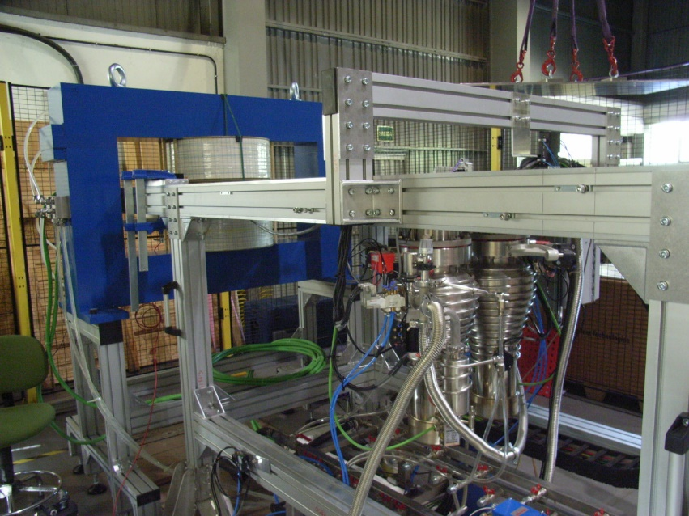
Ion source characterization in a devoted Ion Source Test Bench
Devoted Ion Source Test Bench at CIEMAT
The measurements of the discharge characteristics and extracted ion current have provided relevant information for the final operation of the cyclotron:
  Discharge characteristics curves
  Beam extraction regimes
  Influence of different plasma conditions →
  Optimizing IS input parameters
  Cathode lifetime
  Plasma expansión gap studies
AMIT Beam dynamics
Fine tune analysis of the different cyclotron configuration parameters
Determination of the adequate beam extraction positions for a suitable beam transportation to the target
Assessment of the beam residual stripping interactions in AMIT cyclotron, optimizing the beam injection conditions to control the pressure level and minimize the stripping losses.
PhD: P. Calvo, Optimizing the radioisotope production of the novel AMIT superconducting weak focusing cyclotron, 2020 https://iopscience.iop.org/article/10.1088/1748-0221/16/03/T03008

Slide 20
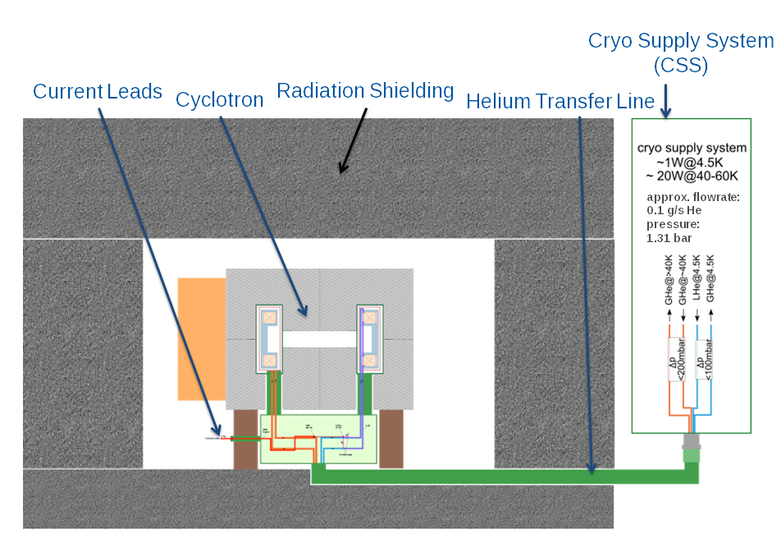
AMIT SC magnet
Main goals:
Very compact design of the whole magnet
Stable operation of a superconducting magnet.
Minimized thermal losses for superconducting operation. Cryogenic supply out of high radioactive environment.
Easy accessibility for particle chamber, target and ion source. Removable poles for magnetic shimming
The optimization of the autonomous Cryogenic Supply System, originally designed by CERN, has been performed in the ARIES framework, including among other modifications:
    Added injection line for hybrid usage (closed and/or open circuit): Helium will be cooled down by cryocooler inside CSS, but additional liquid can be injected from external Dewar
    Pipes modified to match the cyclotron
    Additional by-pass valve to reduce the cool down time
    Filter for particles coming from coils given the required high purity He for an efficient liquefaction

Slide 21
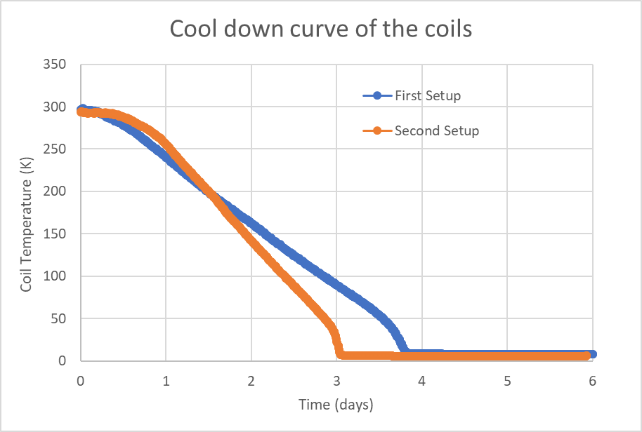
Test of adapted CSS + cyclotron
  First test of cyclotron using adapted CSS and original Transfer line (TFL)
  Coils were cooled up to 11 K (not enough)
  Heat from the transfer line was measured: 0.7 W (too much)
    A new transfer line was designed and developed at CIEMAT
    Some minor modifications were also included in current leads to minimize heat
  A set of operational parameters was tested
  Superconducting state of the coils was reached by means of the CSS (<6.1 K)
  Pressure values of 2.1 bar or more are needed
  It took about to 5 days to reach steady-state conditions from ambient with no cryogens used
  Additionally, a new helium compressor was installed for higher mass flow for speed up the cool down time. It was reduced about 20%
  Also the warm up time was reduced in about 25%
  The cryogenic development is considered completed
Thesis: Development of a Novel Concept of Efficient Superconducting Magnet for Radioisotope Production Cyclotron, J. Munilla, 2020
21
Notes:
21

Slide 22
FFAG optics design - HUD
75 keV to 28 MeV
Protons and alphas
High current: 4mA protons, 800µA alphas
^{99m}Tc production with internal target looks feasible
PhD: David Bruton - UoH
Rhodotron for ^{99m}Tc production - IBA
Photo-production of ⁹⁹Mo via ¹⁰⁰Mo(γ,n)⁹⁹Mo
Direct replacement of reactor produced ⁹⁹Mo
Uses new version of Rhodatron: TT300-HE
125kW of electrons at 40 MeV
North Star Medical (US) buying 8, first 2 operational 2021

Slide 23
Future in I.FAST WP12
Strategy for Implementing new Societal Applications
3rd May Wednesday 15:00 - 15:15 (CERN)
Andrea Sagatova - Slovak Technical Univ.
Sub-task 12.5: Accelerator production of radioisotopes for imaging and therapy
Diego Obradors, Conchi Oliver – CIEMAT

Slide 24
Conclusions
WP3 has done all
  Milestones
  Deliverables
  Objectives
A lot has been achieved
It has had significant impacts in health, industry and the environment
Collaborations have been created with new partners
Funding proposals have been submitted to other sources

Slide 25
ATChem
H2020 Green Deal Area 8.1 – persistent and mobile chemicals
ATChem: 19 partners, 9 MEUR
Removal and destruction of PFAs and MPs as carriers from waste water
PFAs: - perfluoroalkyl and polyfluoroalkyls, >300 chemicals one of the strongest bonds in nature many are toxic and they bioaccumulate most Europeans exceed TWI level
Structure: WP2: Novel detection techniques WP3: Toxicity measurements (using worms) WP4: Removal techniques (foam fractionation, membranes, gels) WP5: Destruction techniques (e-beam, ultra-sound, plasma) WP6: Pilot plant tests WP7: Dissemination, outreach, policy-making
Result: June/July

Slide 26
RADAGASS
JPIAMR-ACTION Joint Transnational Call for Proposals 2021
RADAGASS: 4 partners, 3 countries, 610 kEUR
Sewage sludge and animal waste: important sources of AMR growth
Use of electron beams for destruction of AMR and antibiotics
Structure: WP2: Destruction of AMR bacteria, genes, antibiotics in sludge WP3: Destruction of antibiotics in animal slurry in Brazil WP4: Impact and implementation
Result: Outline proposal stage: May

