Slide 1
Efficient Energy Management for Particle Accelerators
5th ARIES Meeting, May 3 2022, CERN
Mike Seidel for WP4, EPFL/PSI
PSI, CERN, CEA/Saclay, Univ.Uppsala, GSI, ESS

Slide 2
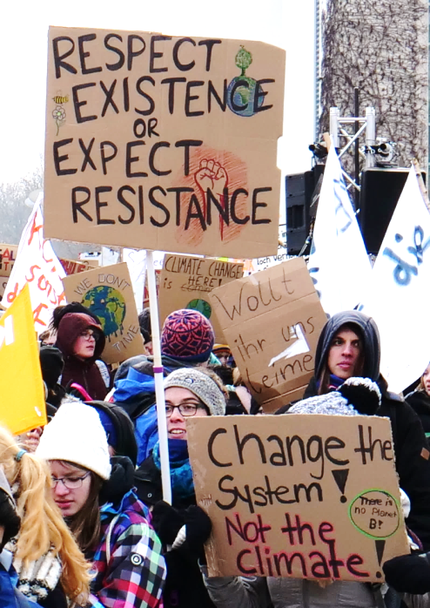
Context – Climate Change and Energy Problem
As a science community we should aim at developing solutions and not to be a part of the problem.
increasing energy efficiency
energy management, adapt to use future fluctuating energy supply
ARIES WP4 addresses 4 topics with networking and individual R&D projects:
Networking (ESSRI workshop)
efficient klystron (RF source as part of accelerator power conversion)
efficient moderator of a neutron source (conversion to neutron flux)
high Q superconducting cavities (low losses @2K)
pulsed magnets (low power beam transport)
School Strike for Climate
Wikipedia

Slide 3
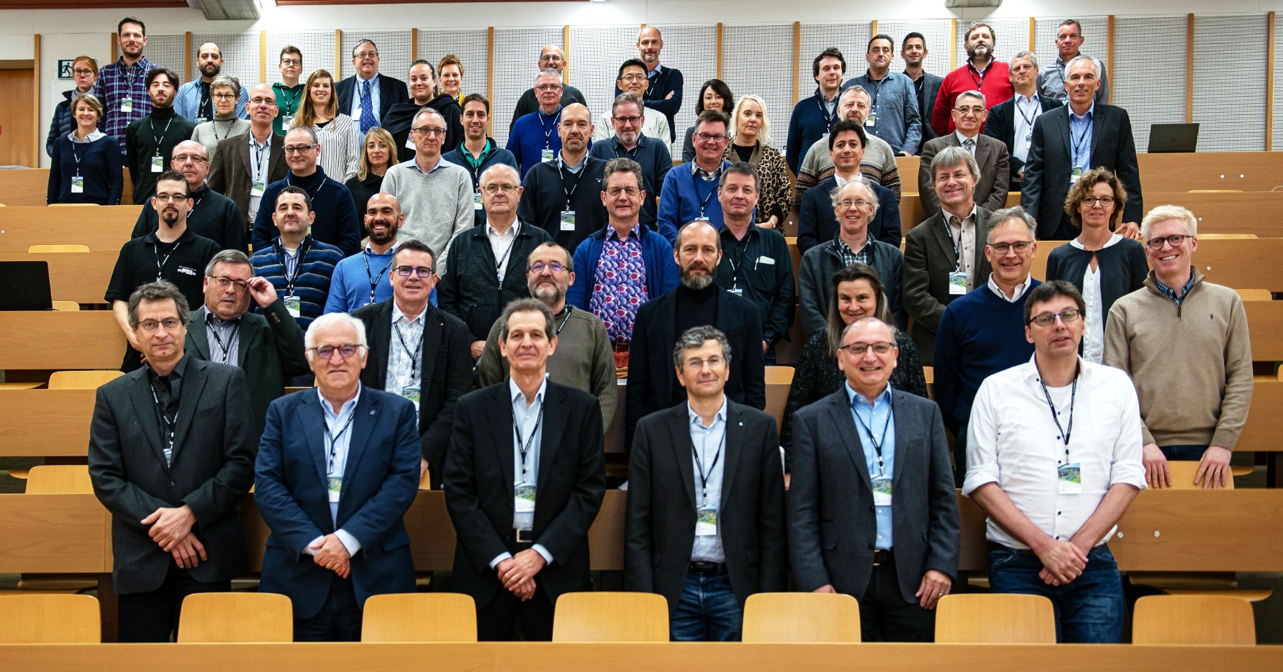
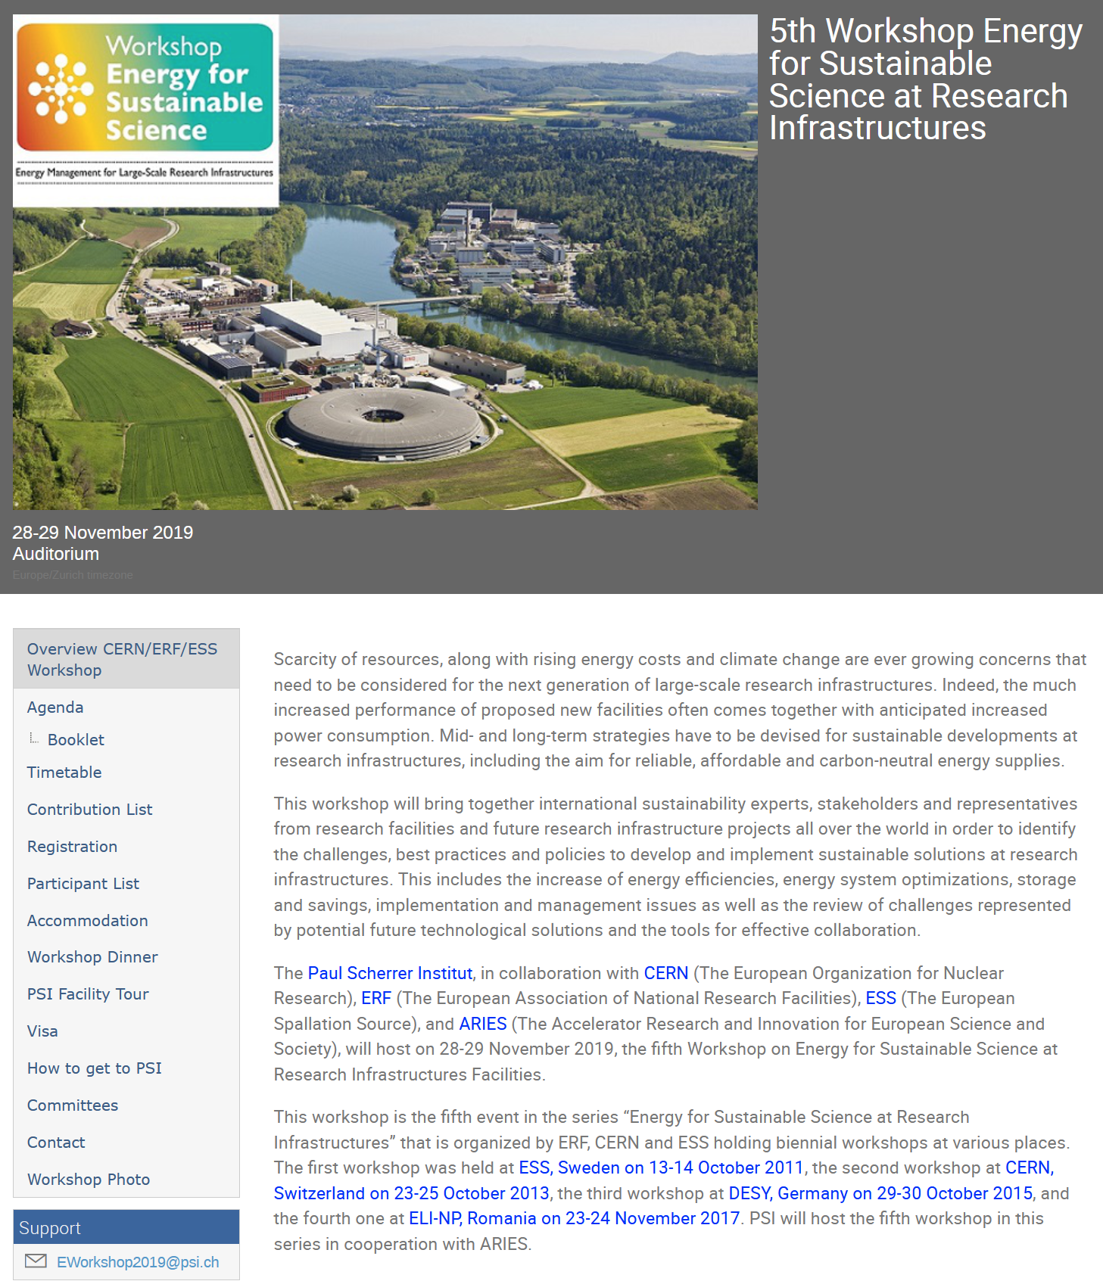
Task 1 (Networking): Workshop on Sustainable Infrastructures
Paul Scherrer Institut, November 28-29, 2019
Organizing Committee
Carlo Bocchetta, ESS
Frederick Bordry, CERN
Florian Gliksohn, ERF
Joachim Grillenberger, PSI
Frank Lehner, DESY
Thomas Schmidt, PSI
Carlo Rizzuto, ELI
Mike Seidel, chair, PSI
https://indico.psi.ch/event/6754/
88 registered particpants

Slide 4
lifecycle management
ecological diversity
Swiss energy strategy
water consumption
large systems energy storage
ESS cryo sytems
fuel cells
ESS Linac
new theme
high magnetic field facility
energy monitoring DESY
Sustainable technology developments by RI’s
Energy management at
research infrastructures
catalysis research
stand-alone s.c. magnet cooling
energy research @PSI
Energy efficient technologies
Cryogenic systems and conventional cooling
use of waste
heat @ESS
MYRRHA, ADS
high performance computing
MgB₂ cables
sustainable accelerators @ DESY
s.c. cavities
energy management ALBA
solid state modulators
RF power systems
helium-neon refrigerator
Square Kilometre Array

Slide 5
Power Flow in Accelerator based RI
conversion of Grid power to specific radiation for research
primary beam production
conversion to specific secondary radiation
Accelerator
& auxiliary systems
conversion target
undulators/magnets
colliding beam insertion
…
radiation to experiments
grid power
primary beam
electrons
protons
ions
X-rays
neutrons
muons
exotic particles
chained factors, conceptual and technological advancements needed
not just brightness but also quality of secondary radiation is key

Slide 6
Task 2: Efficient RF Generation lead: CEA in collaboration with Uppsala Univ., CERN, ESS, PSI
Klystron, invented 1940ies, efficiency of industrial types ca 50% at max
DC beam passes through input
  Electron beam is velocity modulated by RF voltage, bunches of electrons formed
Output cavity is excited by the bunches, power is coupled out to load
RF input
RF output
Cathode
(DC Beam)
simulation tools:
microwave studio
Collector
[C.Marchand, CEA]

Slide 7
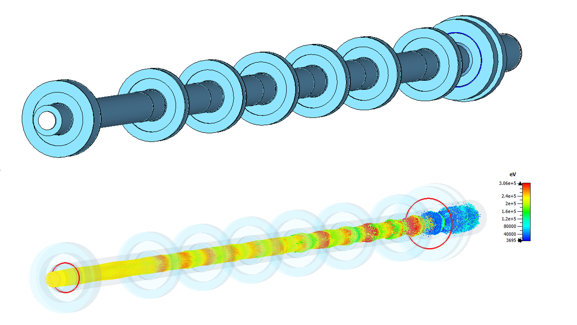
Efficient Klystron Deliverable core team: P. Hamel, S. Arsenyev, C. Marchand, J. Plouin, CEA Paris-Saclay
Outcome of study:
optimized design for 12GHz klystron → could be part of a compact light source
interaction line for optimized bunching, double gap output cavity for maximized power coupling
design respects surface field limit of 100MV/m
efficiency: 65.5% with realistic simulations and boundary conditions

Slide 8
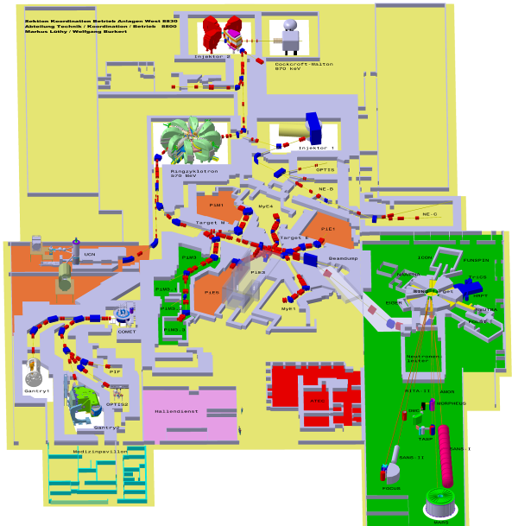
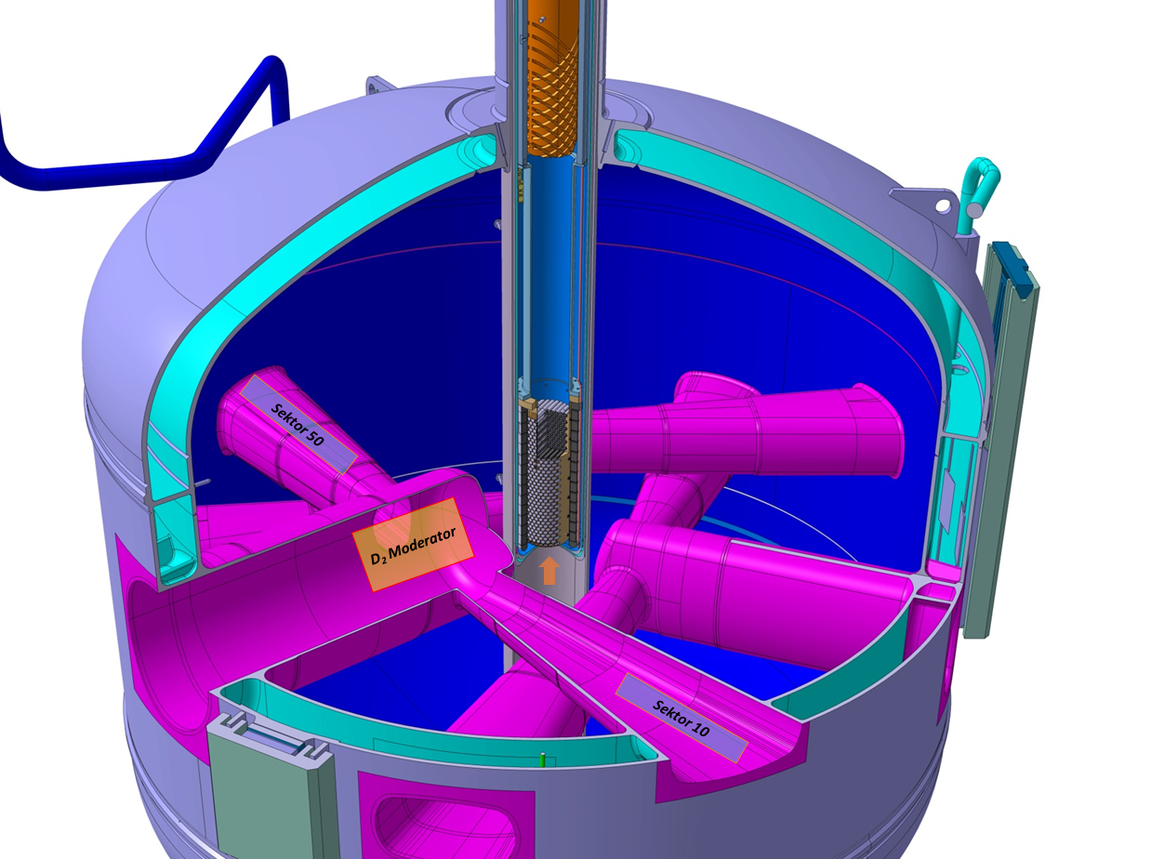
Task 3: Efficient Neutron Production, Lead PSI + ESS
moderator vessel
D₂O
Ring Cyclotron 590 MeV
beam loss ≈ 10⁻⁴
2.4 mA /1.4 MW
D₂
proton therapie center [250MeV sc. cyclotron]
Muon production
target
20 l of liquid D₂
T = 25 K, P =1.5 bars
Heat load ≈1 kW
goal: study cold moderation in D₂ & geometry, to improve the rate of neutrons scattered into neutron guide
neutron transport simulations
fluid dynamics of D₂ under power deposition by p-beam
concept: re-entrant hole, emptied during operation, to maximize neutron flux
SINQ spallation source

Slide 9
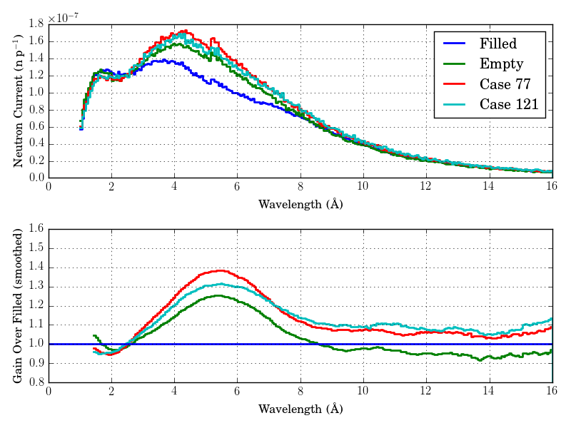
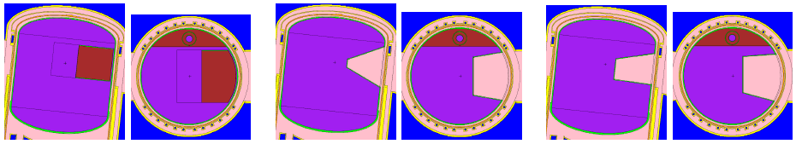
Efficient Moderator core team: S.Jollet, Y. Charles (fluid dynamics), R.M. Bergmann, D.Kiselev, M.Wohlmuther (neutronics)
neutron yield w/o re-entrant cavity in moderator
predicted gain: 1.25 to 1.31 at medium wavelength
figure: pairs of top and side view
left: current geometry (re-entrant hole in red)
center: result of parametric scan optimization
right: geometry by “genetic optimization”
Outcome of study:
understanding of fluid dynamics and neutron yield of present geometry
proposal of improved geometry
neutrons: λ=h/p, 2Å = 2×10⁻¹⁰m = 25meV

Slide 10
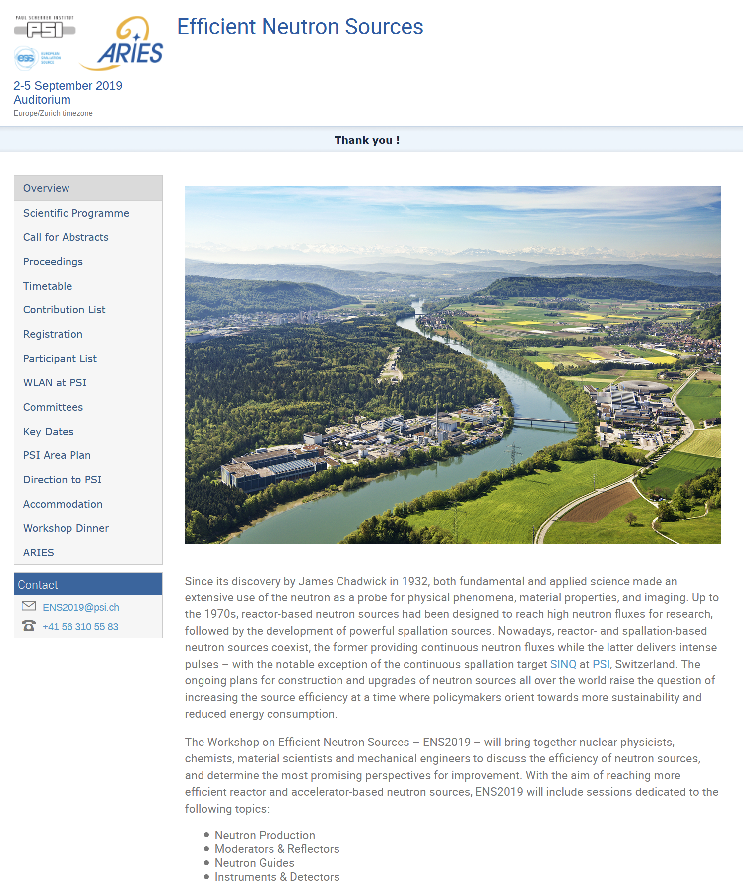
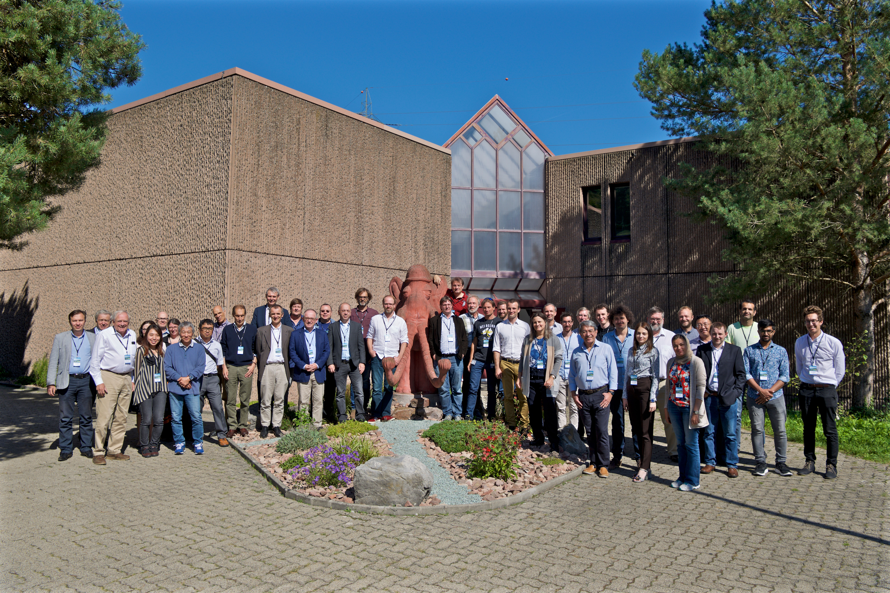
Workshop Efficient Neutron Sources
PSI, Sep 2-5, 2019
co-organised by ESS & PSI
63 participants (even Argentina)
rich documentation on website
John Carpenter
engineered first spallation neutron source (Argonne, 1980)

Slide 11
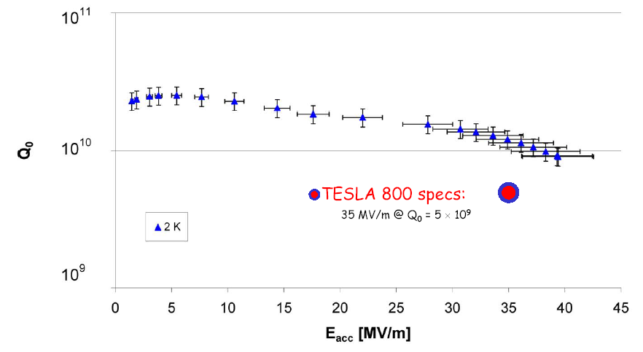
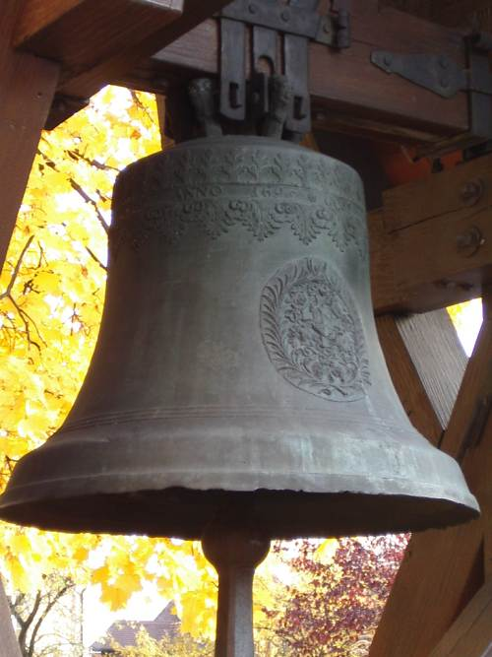
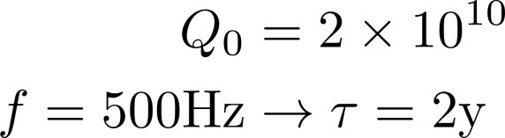
Task 4: High Efficiency SRF Beam acceleration lead: CERN
if a church bell had the same low damping:
s.c. resonators have extremely low losses and high Q, e.g. 2×10¹⁰@1.3GHz (E-XFEL)
measurement:
E-XFEL
however, cooling efficiency is much reduced due to Carnot efficiency at low T:

Slide 12
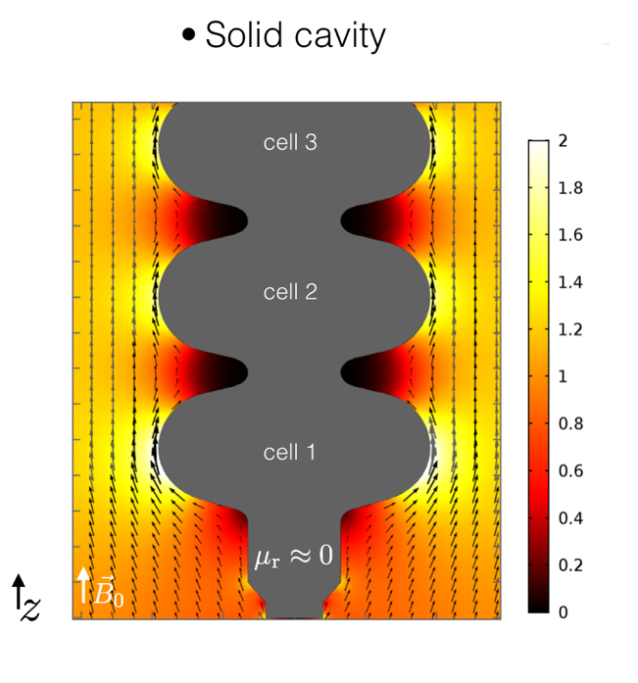
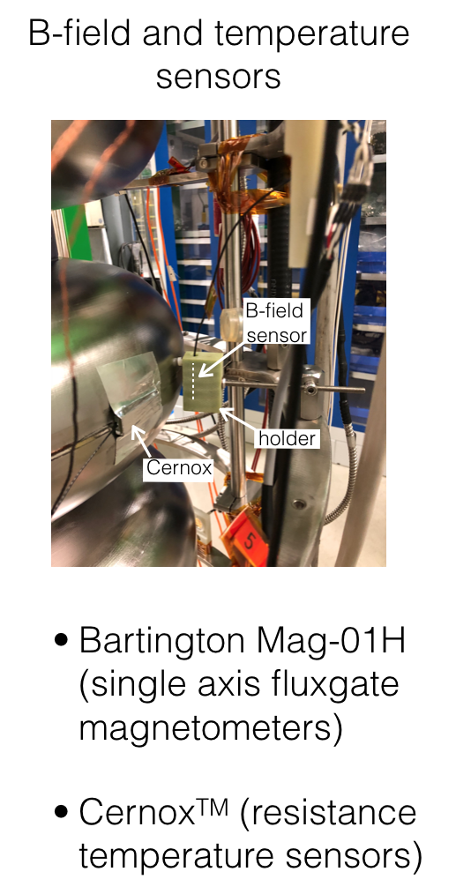
High Efficiency SRF Beam acceleration lead: CERN, A. Ivanov, F. Gerigk, S. Papadopoulos, S. Ramberger, A. Macpherson
to further improve the quality factor of s.c. resonators, systematic limitations are studied in detail:
reduce external magnetic field by shielding to avoid trapping of flux
study the mechanism of flux trapping with the aim to avoid it
  → choice of Nb material, detailed cool down proc.
Simulation of flux expulsion on multicell bulk Nb cavity
Experimental set-up to measure flux expulsion during cool-down.
Outcome of study:
design & verification of magnetic shielding for a test setup
developed instrument “flux lens” for quick and reproducible measurements of the flux expulsion efficiency of Niobium sheet material

Slide 13
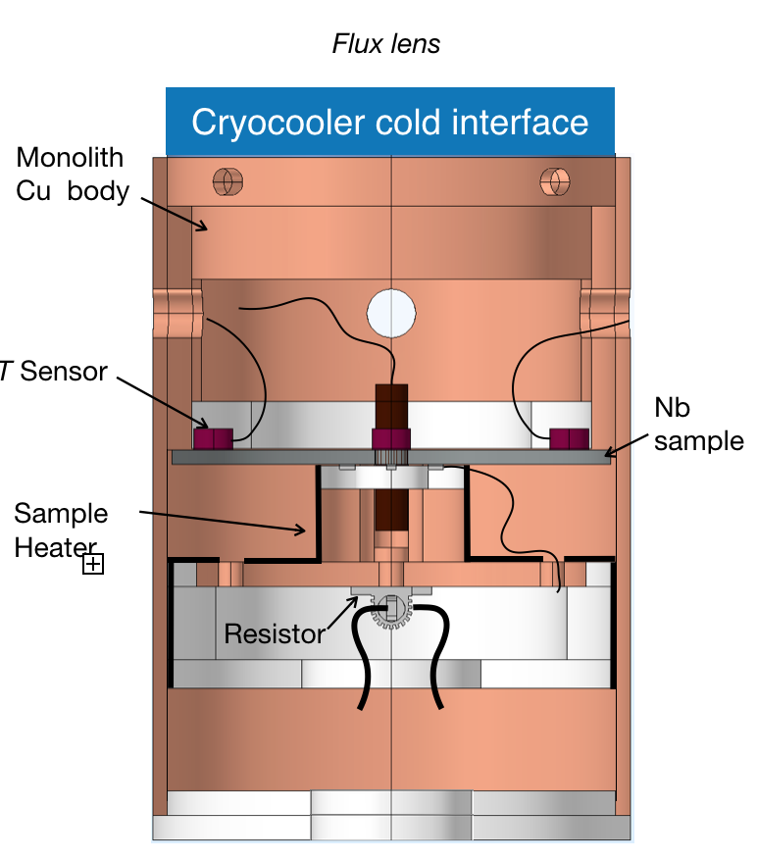
Magnetic flux lens: a novel stand-alone instrument to measure efficiency of flux expulsion
Concept
Design
Nb sample is shaped like a disc and symmetrically
cooled towards the center —> expelled flux will be “collected” at the aperture
Acts as lens —> the stronger the field is enhanced in the center the better the material quality (higher flux expulsion efficiency)
Device allows to test flux expulsion vs T-gradient
(gradient at cool down allows depinning of trapped flux)

Slide 14
Flux trapping workshop @ CERN, 8-9 Nov 2018
64 participants from the North America, Asia & Europe.
Supported by ARIES. Milestone: MS18, report
https://indico.cern.ch/event/741615/overview

Slide 15
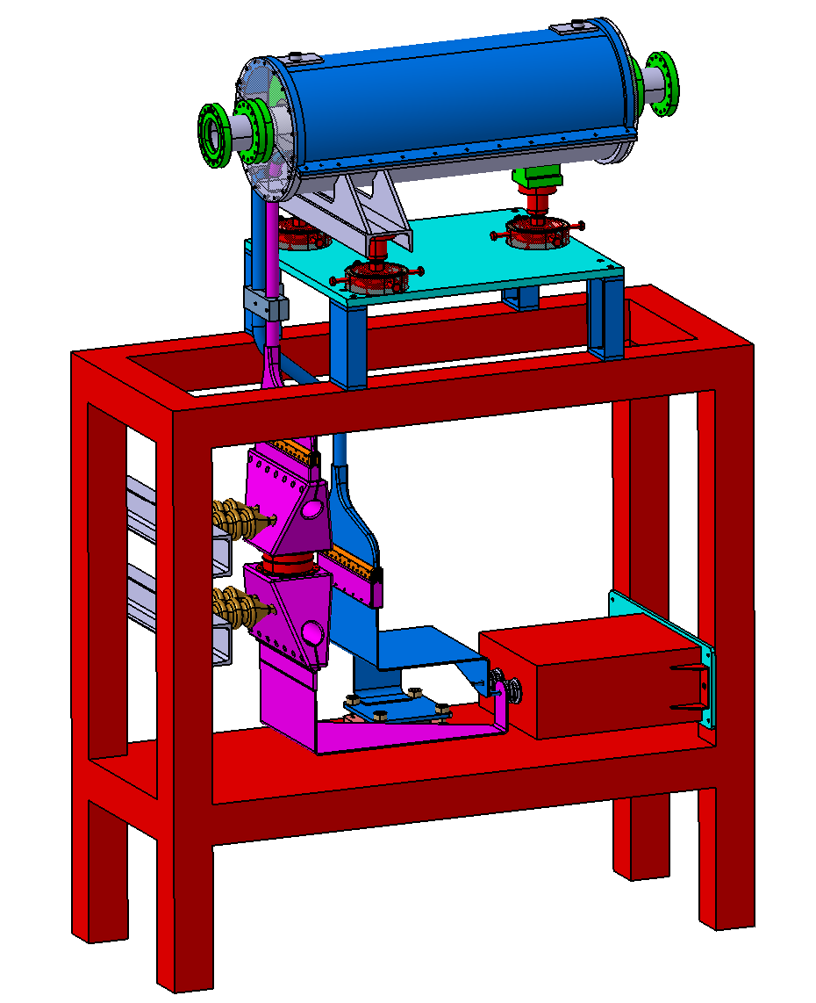
Task 5: Pulsed Magnets for beam Transfer Channels in lead: GSI, S. Heberer, P. Gehrke, P.Spiller et al
low average power; high field; compact; energy recovery in capacitive storage
complexity added by pulsing circuit; field precision potentially challenging
 | Prototype Quadrupole
Gradient | 80 T/m
Length | 0.65 m
Pulse length | 90 ms (beam 1 ms)
Peak current | 400 kA
Peak voltage | 17 kV
Energy @17 kV | 65 kJ
Inductivity | 535 nH
Capacitor | 450 mF
Forces | 200 kN
Engineering model of the prototype quadrupole magnet incl. support

Slide 16
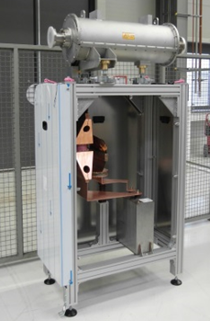
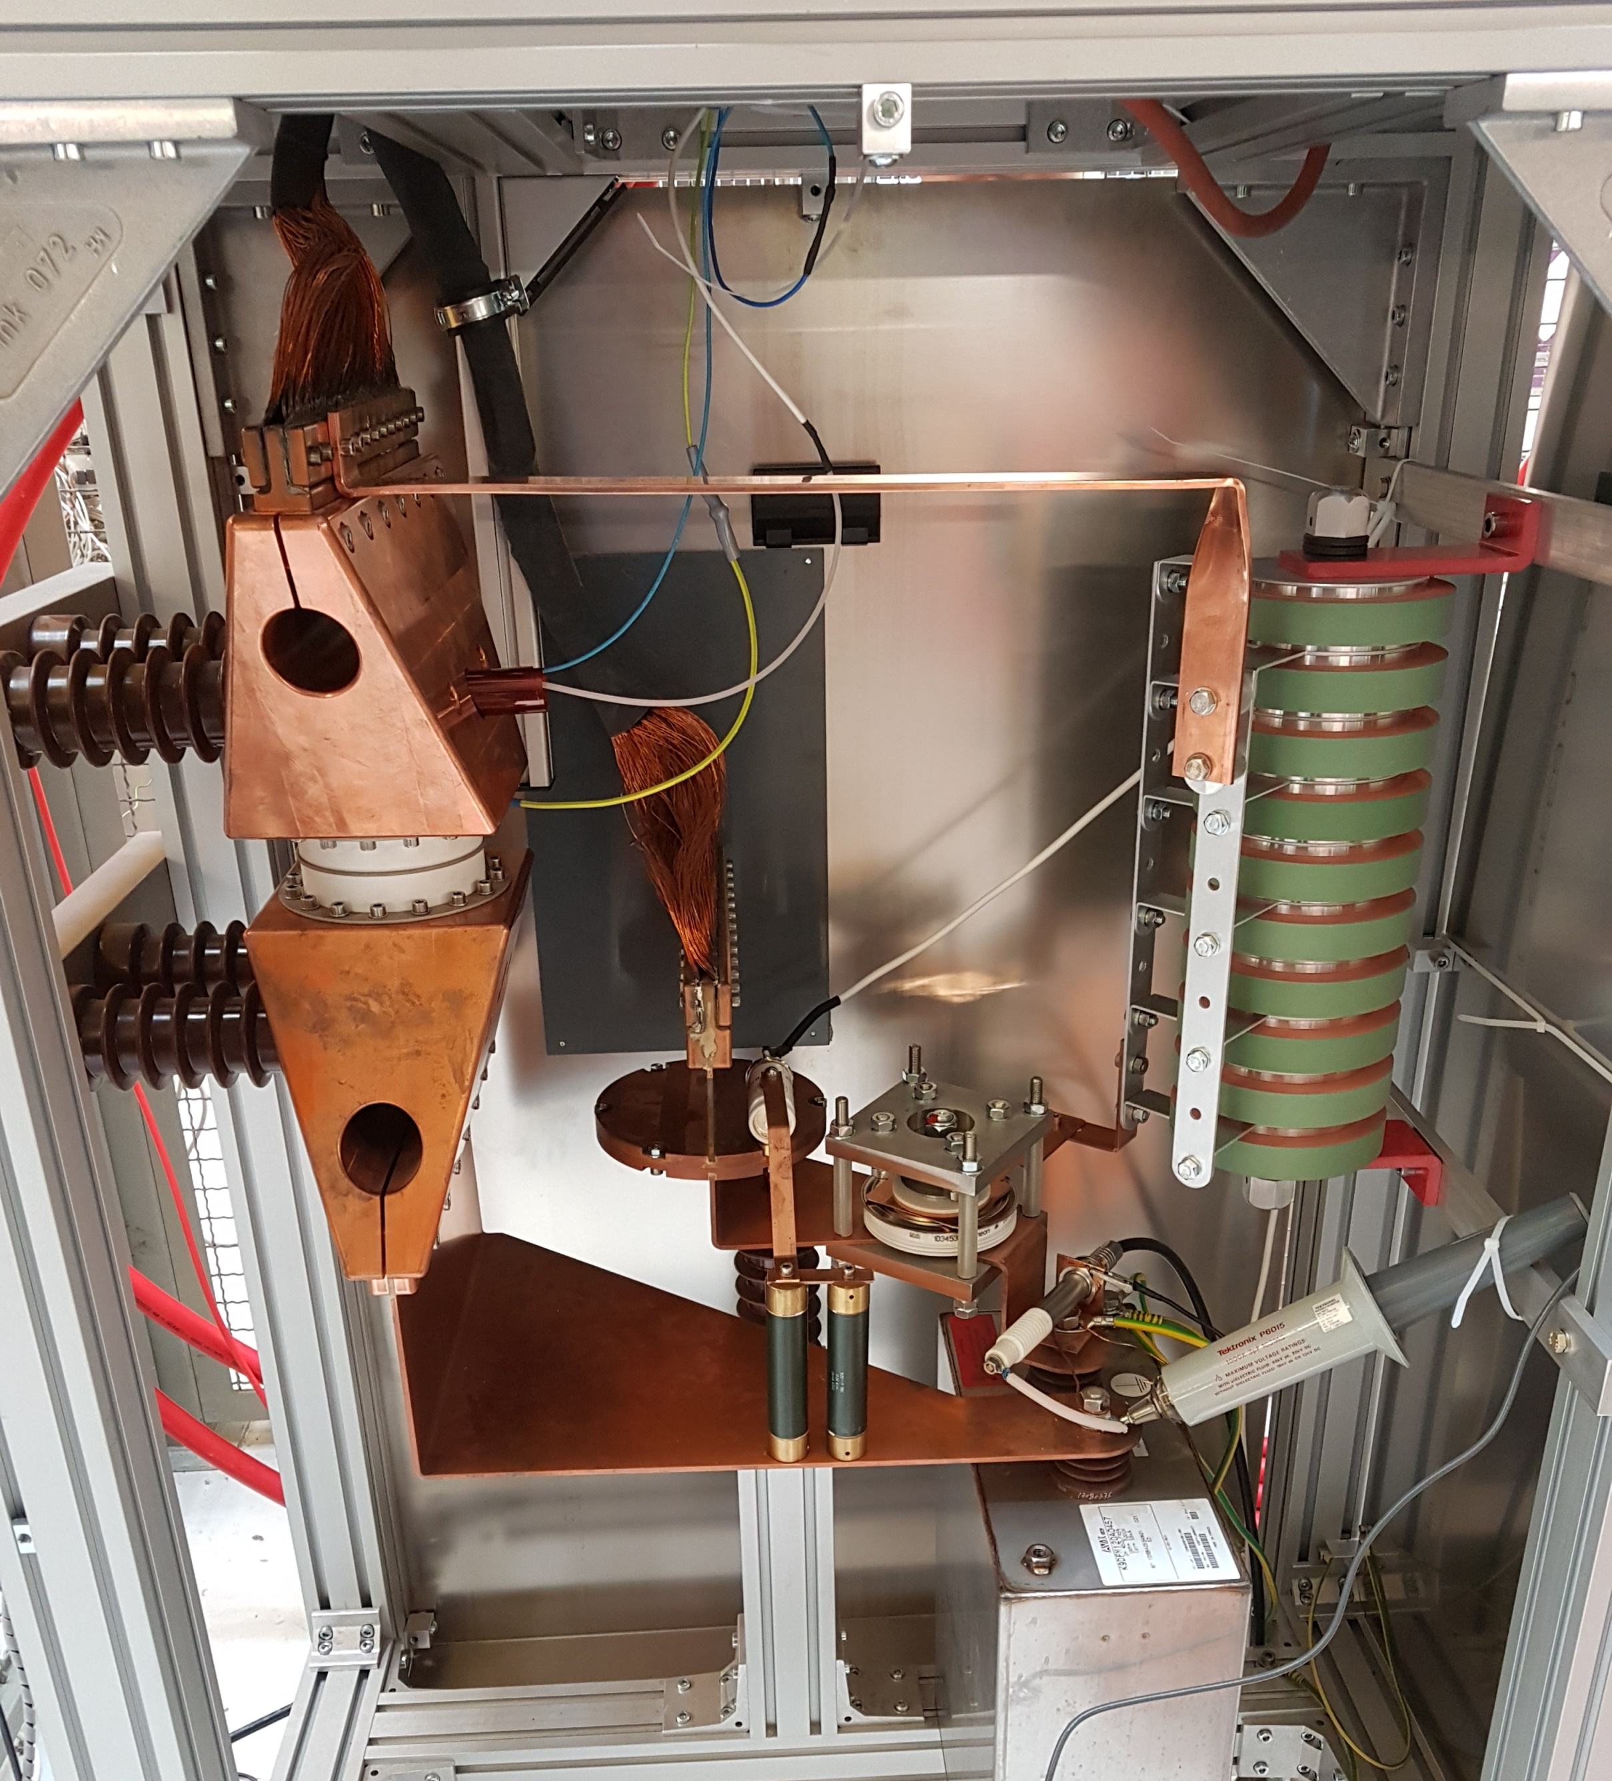
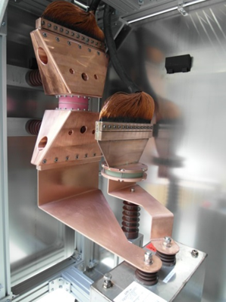
Pulsed Magnets for beam Transfer Channels
in lead: GSI, S. Heberer, P. Gehrke, P.Spiller et al
Assembly of HV-Diode, damping resistor, main switch and trigger unit, safety discharge circuit
Quadrupole
Outcome of study:
simulation and optimization of pulse forming network to minimize ohmic losses and maximize energy recovery for next pulse
28% energy recovery achieved, energy efficiency improved by 80%
prototype circuit build and tested
Pulsed power unit
Main Switch
Safety discharge circuit
Diode with clamping unit
Capacitor

Slide 17
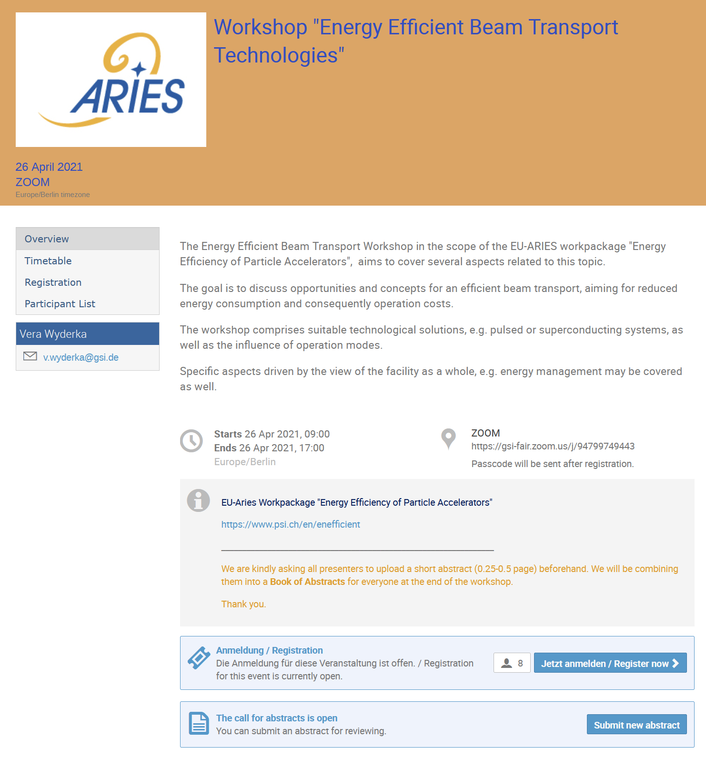
last virtual Workshop organised by GSI
April 26, 2021,
Efficient Beam Transport

Slide 18
Summary
Efficient Energy Management for Particle Accelerators
Task 4.1: General [M.Seidel]
Workshop on sustainable research infrastructures November 2019 at PSI; very broad program, good visibility; awareness for sustainability aspects strongly enhanced in accelerator and HEP community
Task 4.2: Efficient RF Generation [C.Marchand]
Design and simulation work on a 12 GHz high efficiency kladistron is performed by an ARIES co-financed postdoc; 65% efficiency obtained in realistic simulations
Task 4.3: Efficient Neutron Production [M.Wohlmuther, S.Jollet]
Monte Carlo simulations on an efficient neutron source; target and moderator geometry optimization, multi-physics simulations: radiation transport, thermomechanical simulations to consider target/moderator assembly incl. 2-phase D₂O; new type of 2-phase simulations established with concept proposals for SINQ
Task 4.4: High Efficiency SRF Beam acceleration [F.Gerigk]
experimental and theoretical work on flux trapping and magnetic shielding; ARIES co-financed Post-Doc; understanding of magnetic shielding & Nb sample test device
Task 4.5: Pulsed Magnets with Energy Recovery [P.Spiller]
a prototype pulsed quadrupole power supply has been set up; with circuit recovering 28% of energy from pulse to pulse

