Slide 1
European Network for Novel Accelerators (EuroNNAc) - Report from WP5
ARIES Yearly Meeting 2022, 03 May 2022, Remote
Ralph W. Aßmann (DESY & INFN), M. Ferrario (INFN), B. Holzer (CERN),
P. Nghiem (CEA), A. Specka (CNRS), R. Walczak (Oxford)

Slide 2
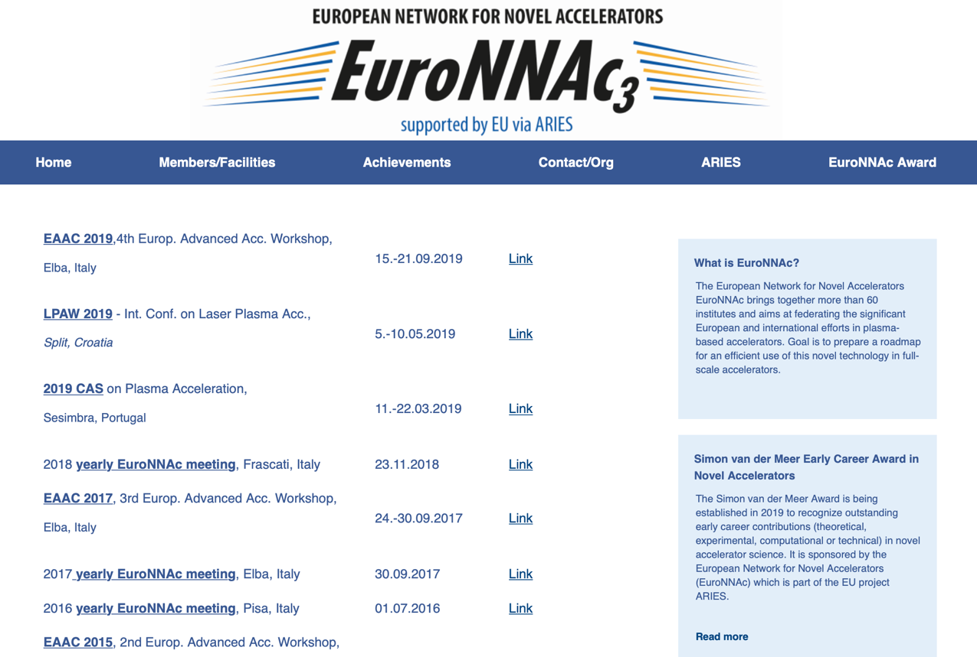
Website: https://www.euronnac.eu

Slide 3
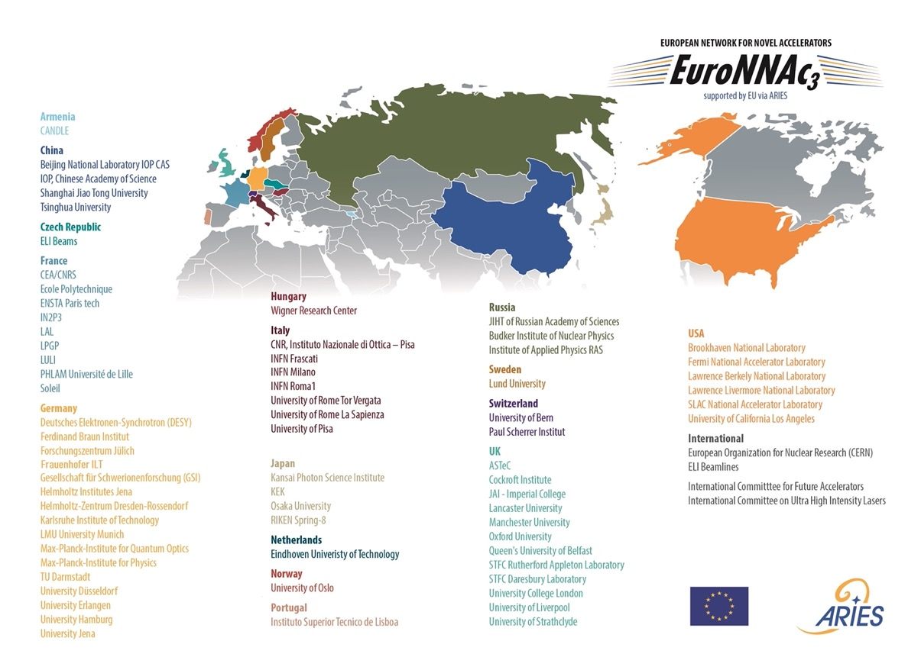
EuroNNAc3 in 2022 > 65 institutes

Slide 4
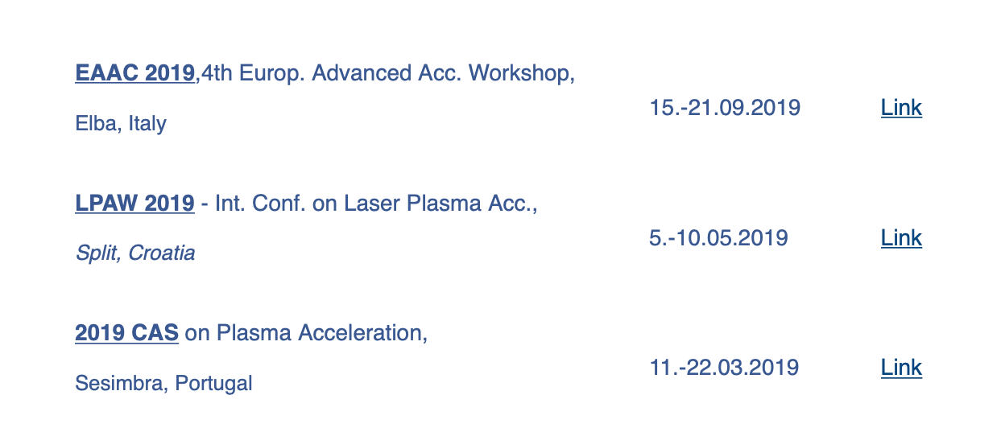
Sponsored Schools & Workshops

Slide 5
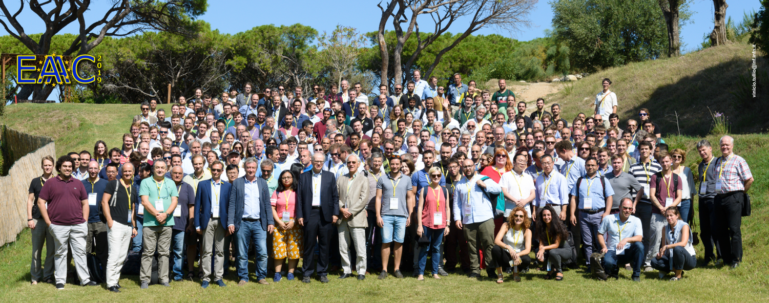
EAAC 2019 – Elba, Italy, 15 – 21 Sep 2019
Had to limit participation for the first time
Number of participants: 267 (> 70 applications not accepted)
Number of countries: 17
Male/Female: 84 % / 16 %

Slide 6
Scientific Work EAAC 2019
Number of presentations: 301
Number of plenary talks: 28 (86%/14 % male/female)
Simon van der Meer talk 1
Number of WG’s: 8
Number of WG talks: 138 (160 in 2017)
Number of posters: 121 (92 in 2017)
Number various: 5
Program committee: 28 (82%/18% male/female)

Slide 7
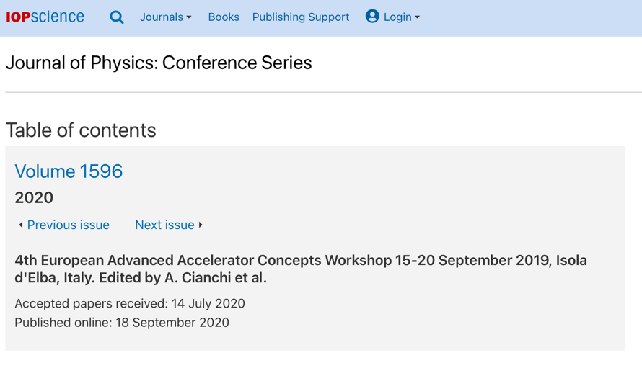
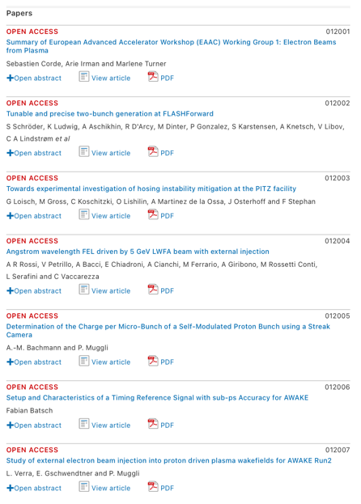
Proceedings: IOP Volume 1596
Many thanks to Lead Editor A. Cianchi and the editor team
66 peer-reviewed publications, all open access
For many students the first peer-reviewed publication: important lesson in publishing

Slide 8
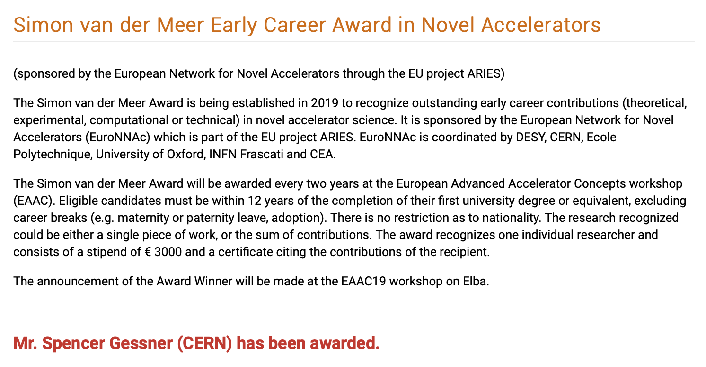
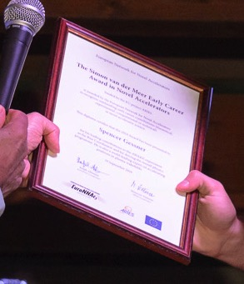
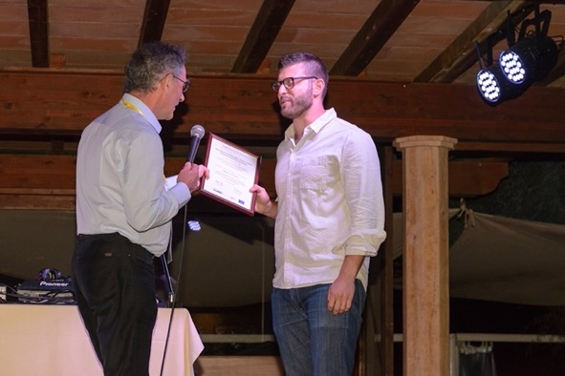
Simon van der Meer Award: 1st Time
Got permission of son of Simon van der Meer to use name for this award!

Slide 9
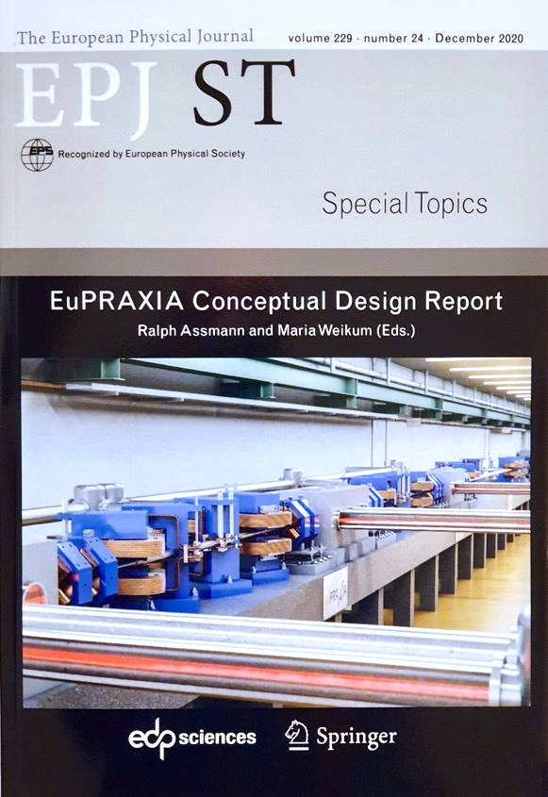
EuPRAXIA Project – Outcome of EuroNNAc
First ever conceptual design of a plasma accelerator facility
Funded by EU as Horizon2020 design study
CDR published after peer review in European Physics Journal – Special Topics
  255 contributors, almost all also in EuroNNAc
  > 650 pages
  Two construction sites: beam-driven (Frascati) and laser-driven (ELI-Beamlines OR EPAC/Rutherford/STFC OR CNR Pisa)
Cost of 570 M€ out of which 117 M€ have already been obtained.
ESFRI application submitted, found eligble and defended last week in hearing.
Decision in July.

Slide 10
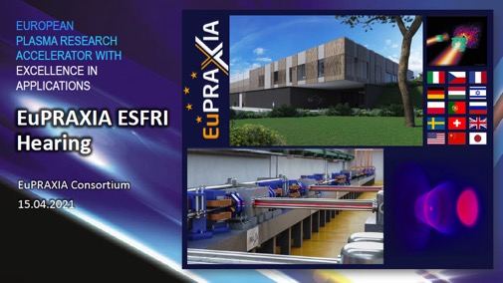
EuPRAXIA – Towards ESFRI
Sep 2020 Submitted
Nov 2020 Found eligible for ESFRI Roadmap
Detailed assessment through
ESFRI panels
30 Mar 2021 Critical questions received
6 Apr 2021 Dry run with INFN president plus
Italian representatives
12 Apr 2021 Additional support letters on
financial side submitted
(CNRS, STFC, Queen’s University)
15 Apr 2021 ESFRI Hearing
June 2021 Decision: Placed on 2021 Update
of ESFRI roadmap (only acc. project,
1st plasma acc. project ever)

Slide 11
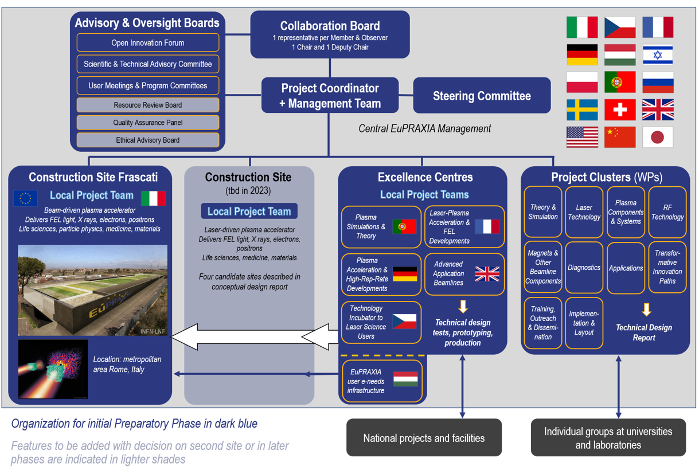
EuPRAXIA Organigramm

Slide 12
Strategic Input to the Science Community
Input 2018 European strategy for Particle Physics

Slide 13
Input 2018 European strategy for Particle Physics
→ Followed up with various talks, e.g. in ECFA seminar and newsletter late 2019

Slide 14
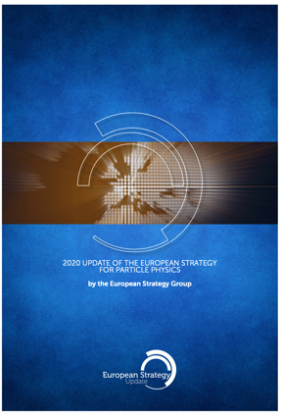

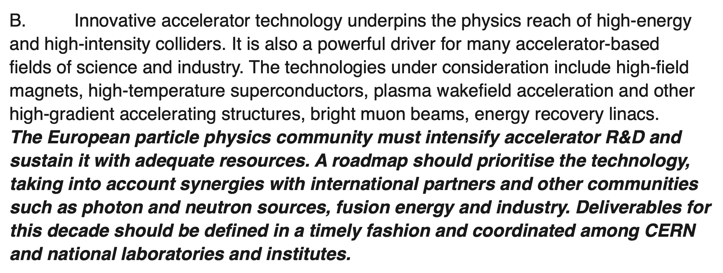
Outcome Strategy

Slide 15
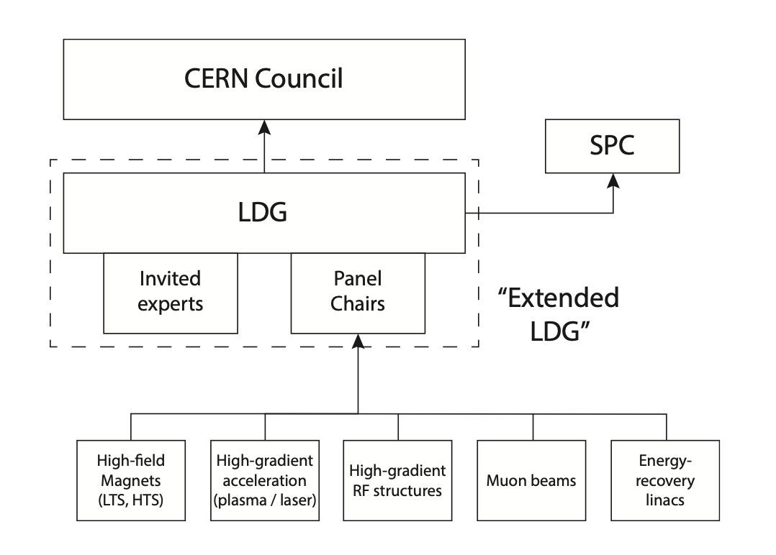
Expert Panel: High Gradient Acceleration Plasma and Laser
Organization adapted from D. Newbold
Council = Governing body of CERN (European Organization for Nuclear Research) – Funding Agencies from CERN member states
CERN Scientific Program Committee
Lab Directors Group – Directors of big European Partcile Physics Labs / Org.
Selects, approves chairs/members of expert panels
By way of its target and organization: Particle-Physics centric. Keen to cross-connect to other science fields.
5 Targeted Accelerator R&D Expert Panels

Slide 16
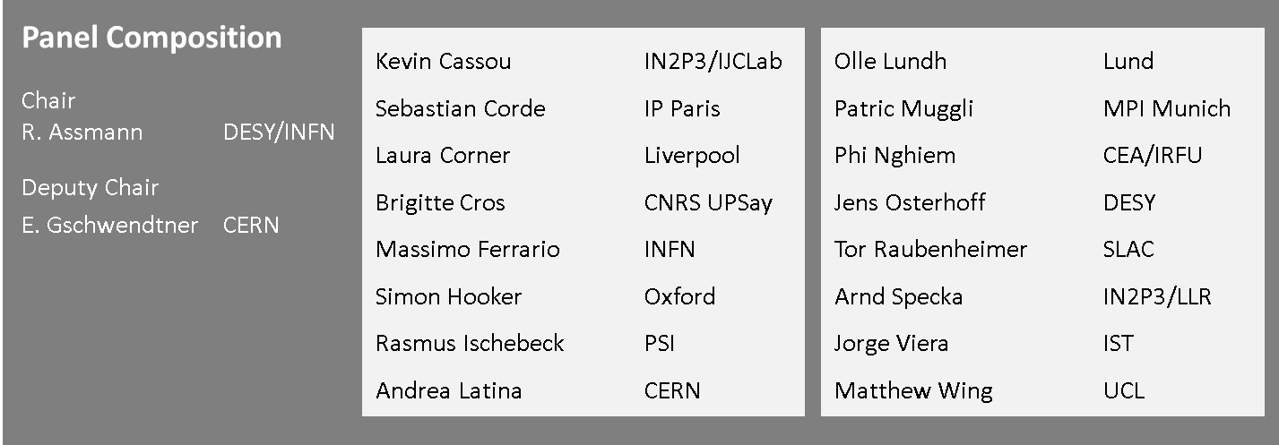
Expert Panel: High Gradient Acceleration Plasma and Laser
Given the success of our field and the large effort outside Particle Physics, not all advanced accelerator groups are represented in this panel. Committed to an open process
→ Please give us input – there will be plenty of opportunity…
Associated members added case by case

Slide 17
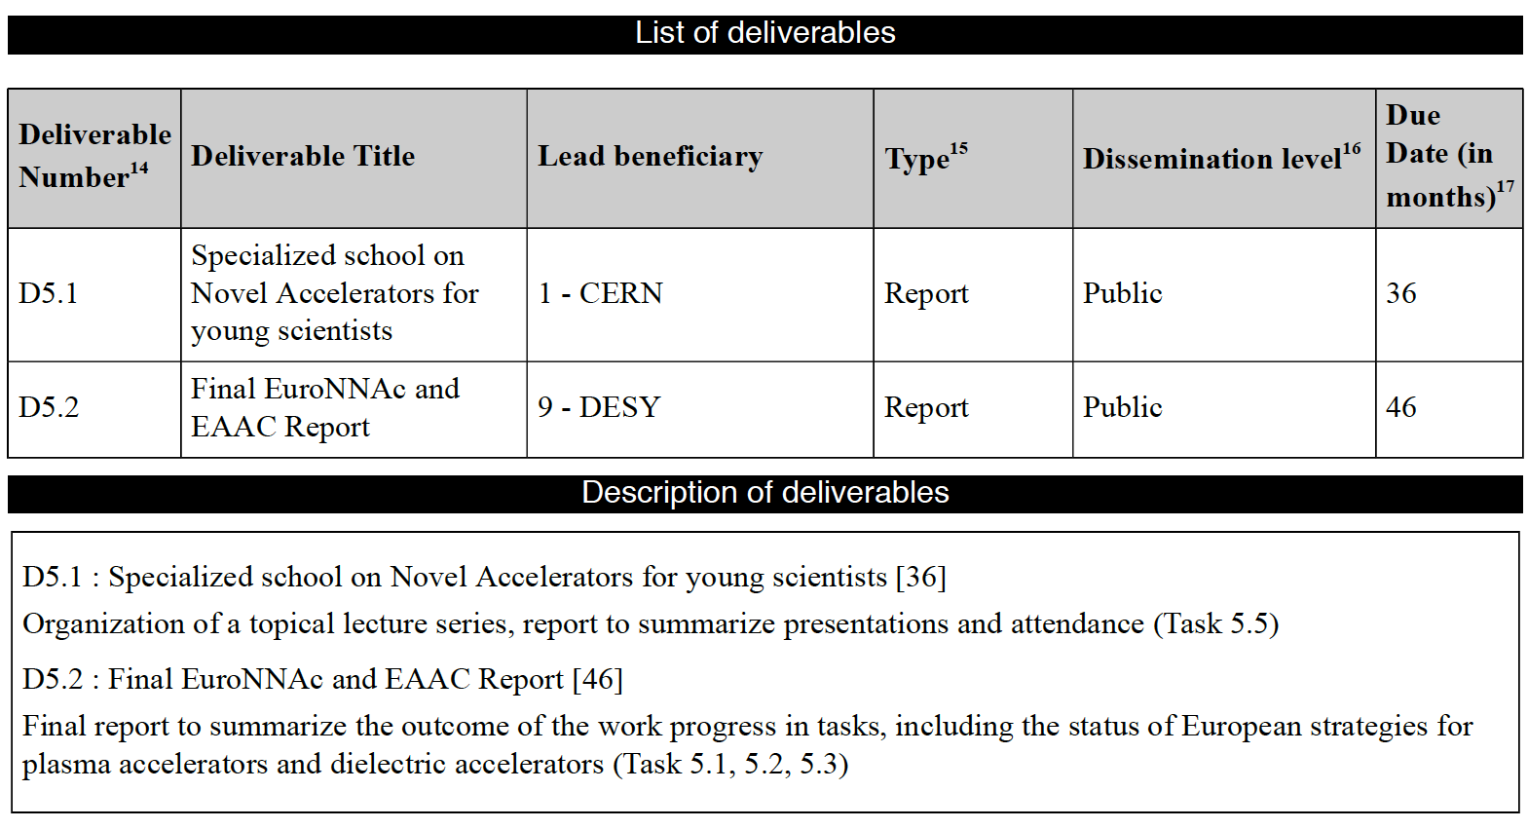
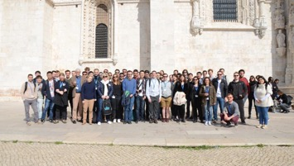
WP5 Deliverables: Done (Milestones: All Done)
All DONE.

Slide 18
Conclusion
ARIES, WP5 and EuroNNAc played an important role in the European and international development of novel accelerators.
WP5 ran over 4 years of ARIES:
  Novel accelerators became a much bigger activity, visible by large workshops, important publications and “big” proposals (e.g. EuPRAXIA on ESFRI?)
  Several major efforts ongoing in Europe: EuPRAXIA, AWAKE, ALEGRO, …
  ARIES/EuroNNAc-sponsored EAAC as a central discussion forum for this field
  Many good young scientists and students involved and supported
  First explicit mentioning of plasma and laser accelerators in the 2020 update of the European strategy for particle physics
  Forming of a European expert panel for defining an accelerator R&D roadmap
Thanks for the good collaboration and support from all the other ARIES WP‘s and the ARIES management!

