Slide 1
Magnetic field penetration method for developing superconducting thin films for SRF
Daniel Turner
Lancaster University
Daresbury Laboratory
The 5th ARIES Annual Meeting, 03-02 May 2022

Slide 2
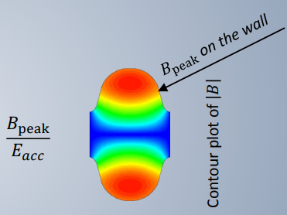
SRF limitations
SRF cavities have a large Q₀ (10¹⁰) and are more efficient than normal conducting cavities for continuous wave applications.
Currently the material used in SRF cavities is bulk Nb.
  Element with the largest Tc.
  Critical fields (approx.) :
    B_{c1} =170 mT
    B_{c2} =240 mT ≈ B_{sh} – The superheating field.
  Imperfections on the surface cause localised heating due to the B field, and therefore local quenches.
  Theoretical accelerating gradient limit is 57 MV/m.
  Starting to reach the limits of Nb cavities ~ 40 MV/m.
Erk JENSEN, RF Basics and TM Cavities, SRF 2019 Tutorials
Increasing E_{acc} allows smaller accelerators to be built, therefore saving money on infrastructure.

Slide 3
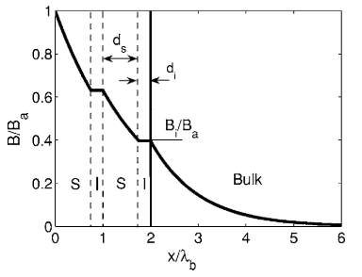
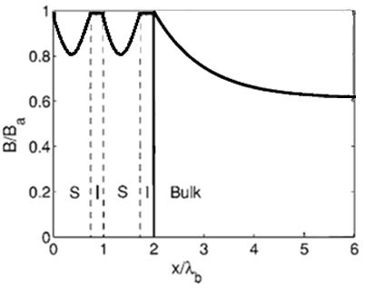
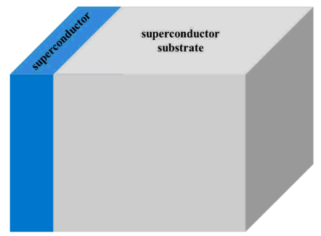
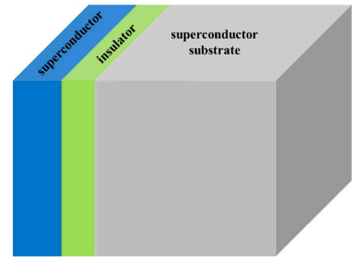
Increasing SRF accelerating gradient (E_{acc})
Gurevich proposed to use the multilayer structures to increase E_{acc}:
  Superconducting-Superconducting bi layer – Consists of a ‘dirty’ SC layer with a larger λ_{L}, followed by SC bulk with smaller λ_{L}.
  Superconducting Insulating Superconducting structure – SC layers separated by a dielectric/insulating layer.
Gurevich, A. (2006). Enhancement of rf breakdown field of superconductors by multilayer coating. Applied Physics Letters, 88(1), 012511. https://doi.org/10.1063/1.2162264
Schematic of a SIS multilayer in a VSM setup.
Kubo, T. (2017). Multilayer coating for higher accelerating fields in superconducting radio-frequency cavities: a review of theoretical aspects. In Superconductor Science and Technology (Vol. 30, Issue 2). https://doi.org/10.1088/1361-6668/30/2/023001
Schematic
Bi-Layer
SIS Structure

Slide 4
Increasing SRF accelerating gradient (E_{acc})
Gurevich proposed to use the multilayer structures to increase E_{acc}:
  Superconducting-Superconducting bi layer – Consists of a ‘dirty’ SC layer with a larger λ_{L}, followed by SC bulk with smaller λ_{L}.
  Superconducting Insulating Superconducting structure – SC layers separated by a dielectric/insulating layer.
Gurevich, A. (2006). Enhancement of rf breakdown field of superconductors by multilayer coating. Applied Physics Letters, 88(1), 012511. https://doi.org/10.1063/1.2162264
But first – These structures need to be tested:
  Depositing small samples is faster, easier and cheaper than cavities.
  Flat samples are easier to deposit than 3D structures.
  DC can provide insight into critical fields of superconductors.
  Allows coating parameter optimization, and insight for materials that are potentially useful for SRF applications.
Schematic of a SIS multilayer in a VSM setup.
What do we want from a local magnetometer:
To imitate cavity operation – Magnetic field applied from one side of the sample.
Applied field much smaller than the sample to eliminate edge effects.
Kubo, T. (2017). Multilayer coating for higher accelerating fields in superconducting radio-frequency cavities: a review of theoretical aspects. In Superconductor Science and Technology (Vol. 30, Issue 2). https://doi.org/10.1088/1361-6668/30/2/023001
Schematic
Bi-Layer
SIS Structure

Slide 5
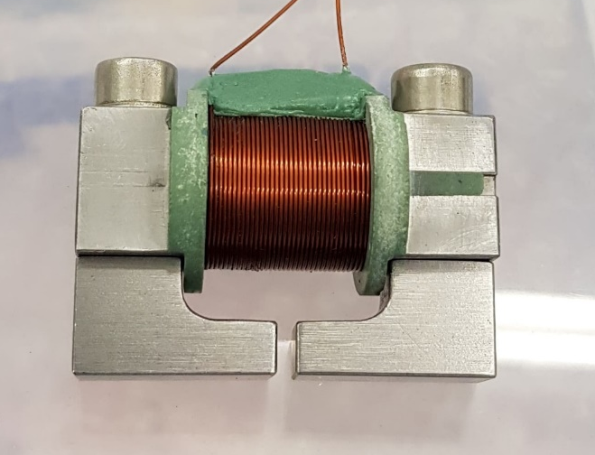
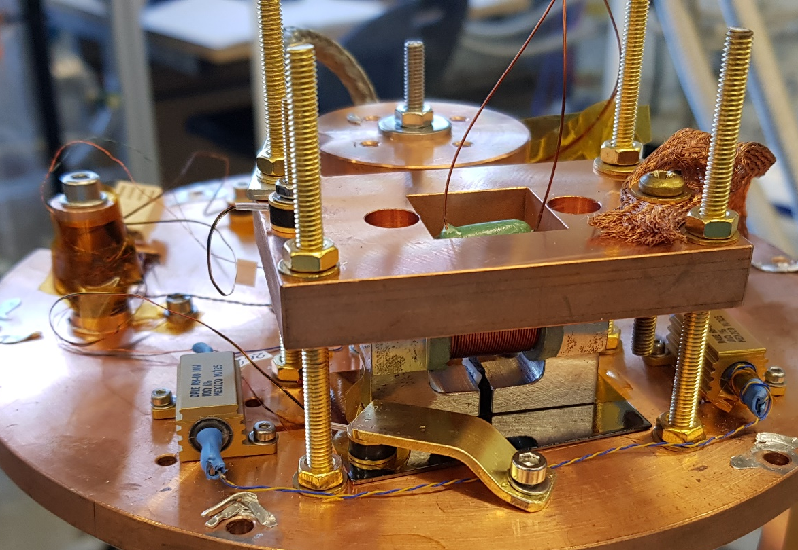
Field penetration concept
HP1
Sample
Width
HP2
DC magnetic field parallel to the surface.
Field local to the sample surface:
  Avoid edge effect.
  Allow possibility if sample scanning.
Magnetic field applied from one side of the sample to the opposing side, similar to an SRF cavity.
Applied and penetrated field measured by Hall probe sensors.
Length

Slide 6
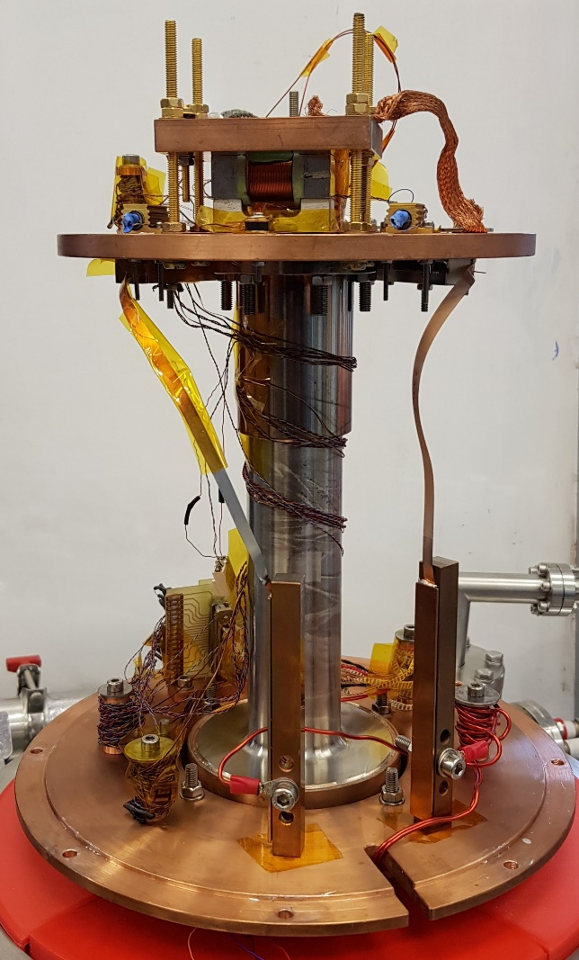
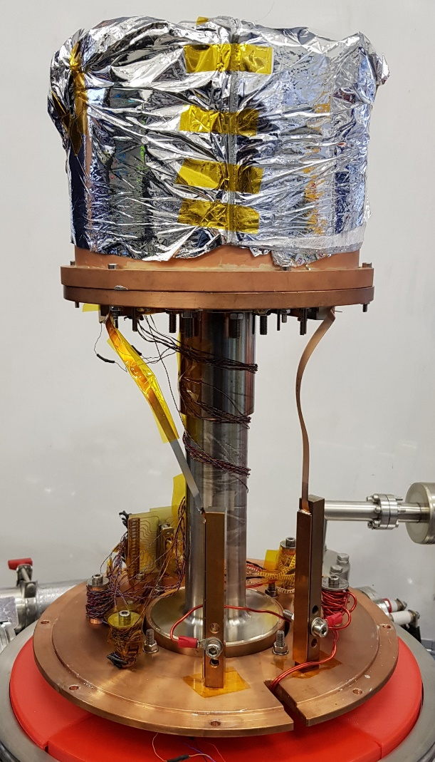
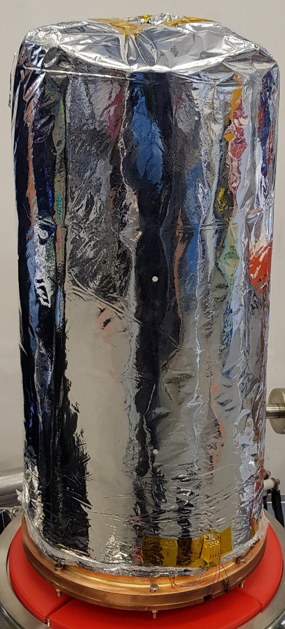
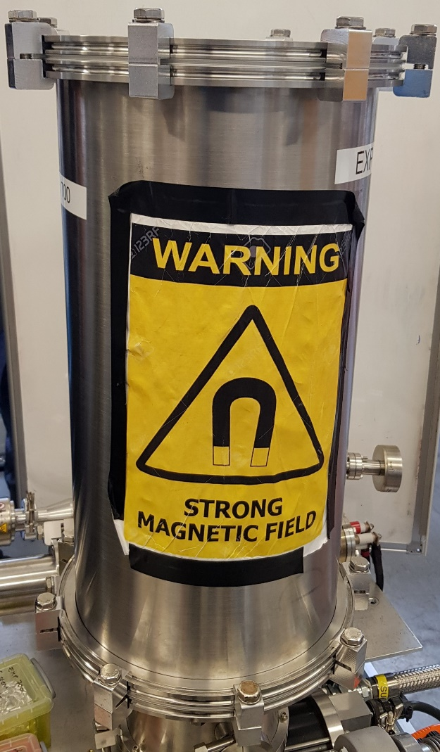
Cryogenic facility
Thermal radiation shields
Stage 2 – Sample testing stage, T≈2.6 K
LTS to HTS join
6
Stage 1 – Thermalisation of wires, heat sink for heat shields, and normal conducting to HTS join

Slide 7
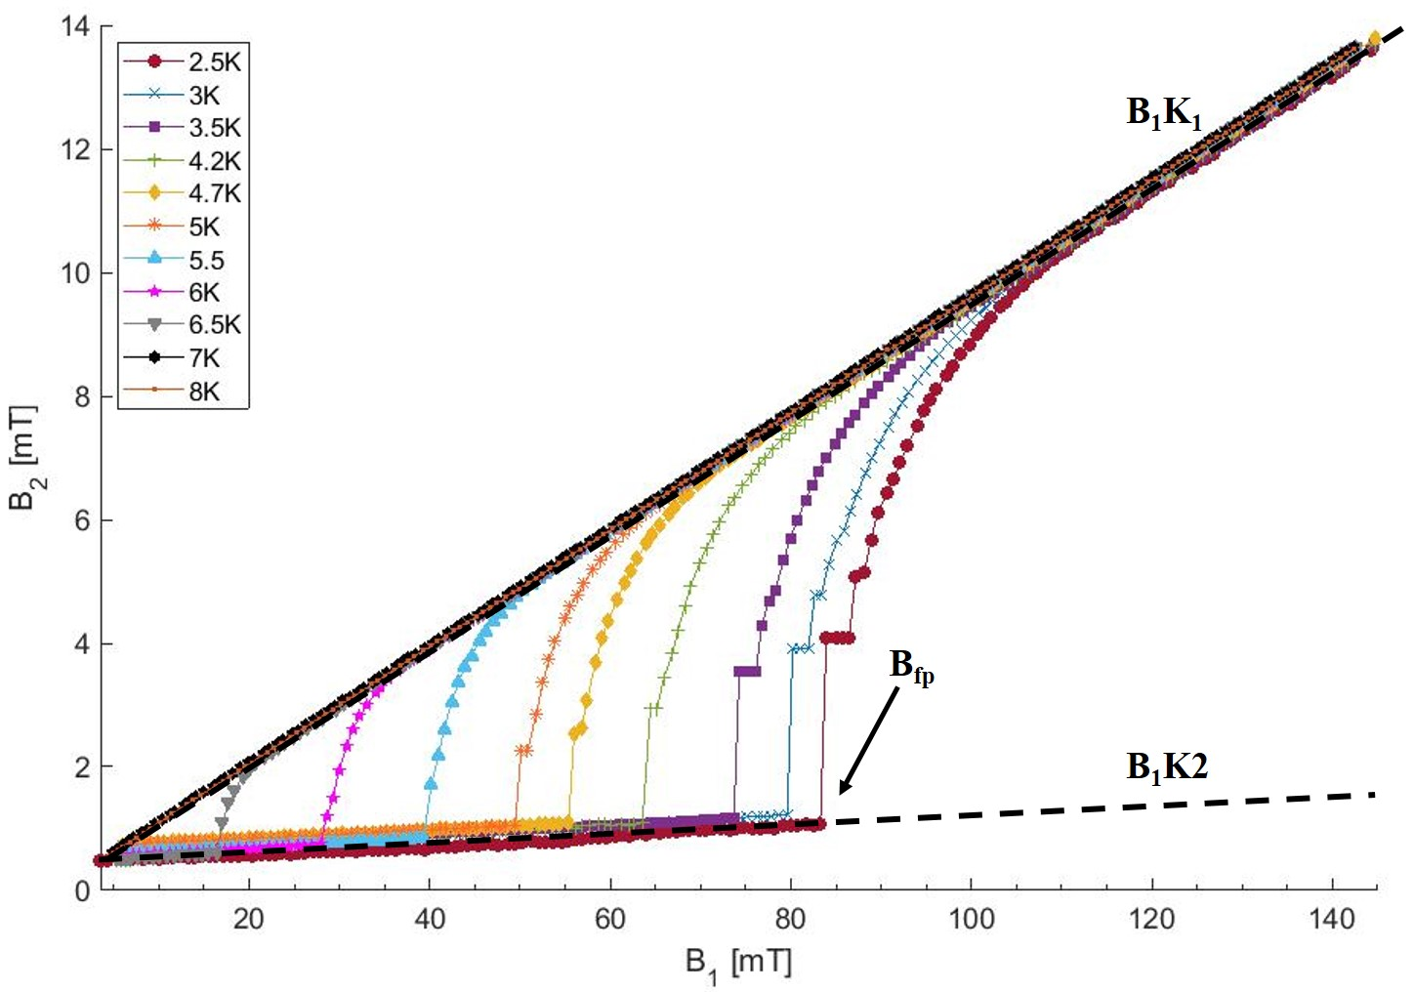
Type I results - Pb
Method:
Zero field cool-down from above T_{c} (≈7.2 K).
Increase the applied magnetic field (B₁).
Small increase in Hall probe sensor 2 (B₂) indicating B leaking around the sample, indicated by line B₁K₂.
Sharp increase in B₂, indicates the field of full flux penetration (B_{fp}).
After B_{fp}, the area the magnetic field has penetrated becomes normal conducting, such that B₂(B₁) lies on B₁K₁.
Magnet is degaussed, the sample is heated above T_{c}, and the test is repeated at the next set T.
Goodfellows Ltd
Purity of 99.99 %
10 µm thick
50 × 50 mm² cross section
B₁K₂
Note: B_{fp} is the field at which the applied field has broken through the sample, and not B_{c1}.

Slide 8
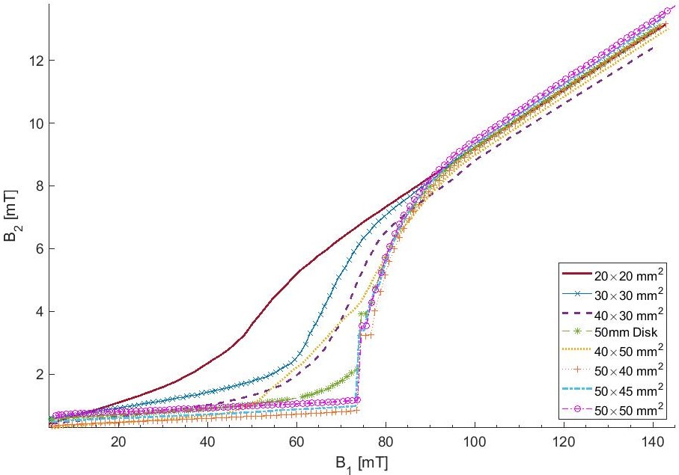
The effect of geometry
Multiple Pb sample sizes tested at 3.5 K
Starting with a sample size of 50 × 50 mm², the sample was slowly reduced.
Comparing the raw data (left) it can be seen that reducing the sample size increases B₁K₂.
Reducing the sample ‘length’ has a greater affect on B₁K₂ than the width.
B₁K₂ is not always linear, which can skew B_{fp} results using the normalisation method.
It is still possible to extract B_{fp}.
Length Width

Slide 9
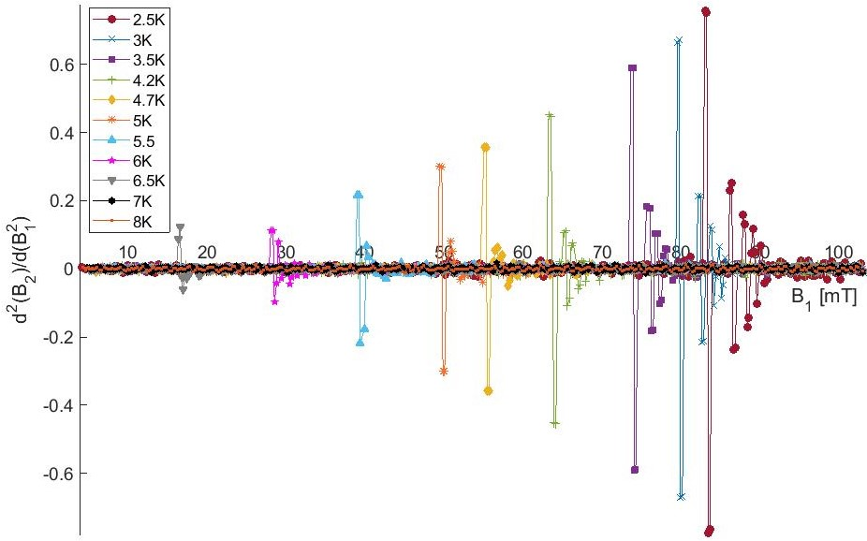
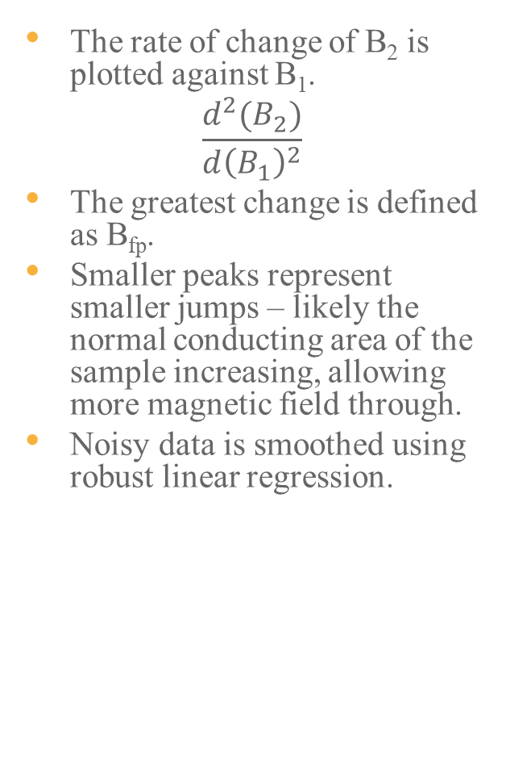
Finding B_{fp}
Second derivative method
The rate of change of B₂ is plotted against B₁.
$$\frac{d^{2}{(B}_{2})}{d{\left(B_{1}\right)}^{2}}$$
The greatest change is defined as B_{fp}.
Smaller peaks represent smaller jumps – likely the normal conducting area of the sample increasing, allowing more magnetic field through.
Noisy data is smoothed using robust linear regression.
Goodfellows Ltd
Purity of 99.99 %
10 µm thick
50 × 50 mm² cross section

Slide 10
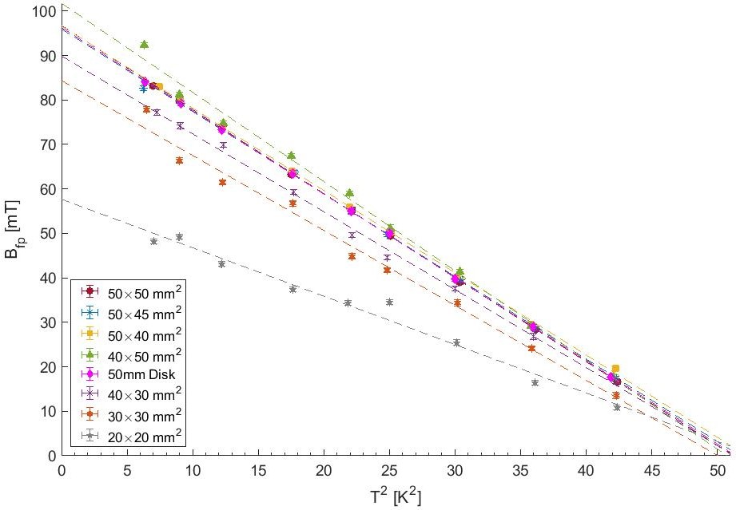
B_{fp} as a function of T²
B_{fp} taken using the second derivative method
7%
B_{fp} as a function of T² has a linear trend.
B_{fp}(0 K) and T_{c}(0 mT) can be extracted from this graph.
7% decrease in B_{fp} when the sample size is reduced to 40×30 mm² (from 50×50 mm²).
10% decrease in B_{fp} when the sample size is reduced to 30×30 mm² (from 50×50 mm²).
Therefore sample size should be kept as large as possible to ensure reliable results.
10%
Length Width

Slide 11
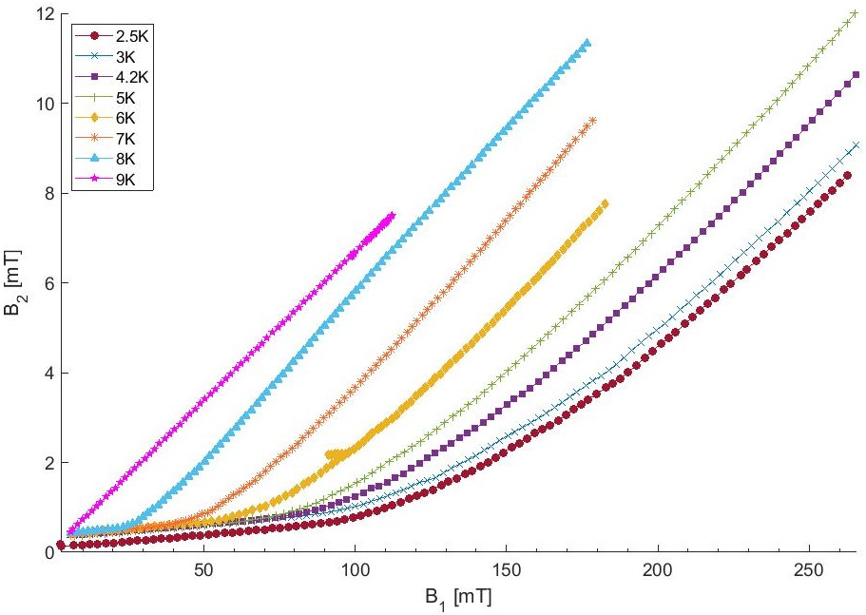
Type II results - Nb
(Left) Raw data for 3.6 µm of Nb on a Cu disk with a diameter of 50 mm.
Three Nb samples of varying thickness were deposited at STFC Daresbury Laboratory courtesy of Reza Valizadeh, with thickness’ of 1.3, 3.6 and 5.1 µm to determine the effect of thickness on B_{fp}.
The transition for Nb is much more gradual than compared to Pb.

Slide 12
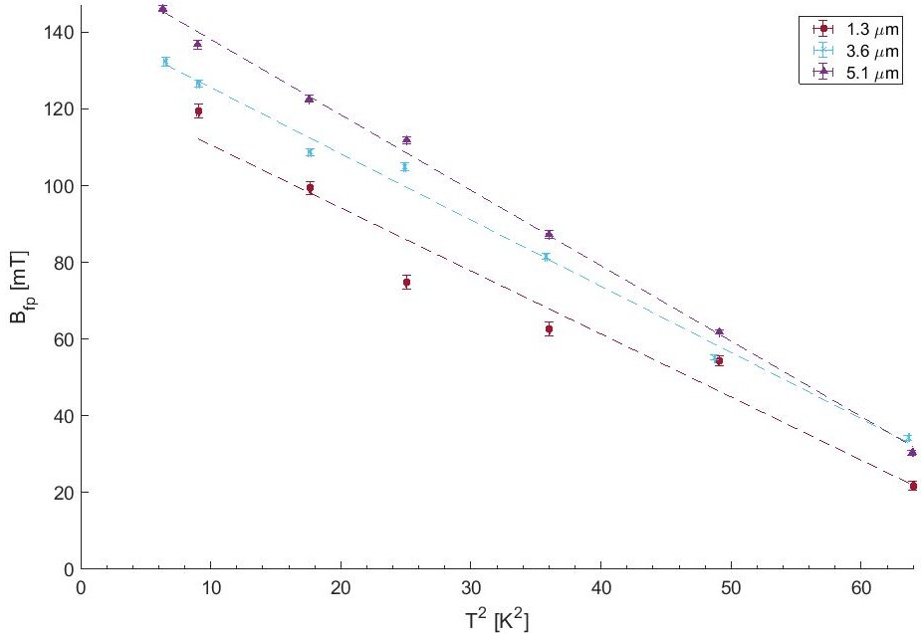
Type II results - Nb
The data is much noisier for the Nb samples.
Thicker samples have an increased B_{fp}.
More thickness’ need to be tested to try and determine a relationship in B_{fp} and thickness.

Slide 13
ARIES WP15 – SRF thin film program
The aim of the program was to develop superconducting cavities using thin film coatings:
  Cu is cheaper than bulk Nb.
  Improved thermal stability.
  Insensitive to the earths magnetic field, so magnetic shielding not required.
  Deposited Nb free from impurities unlike bulk Nb sheets.
The surface quality of the substrate affects the growth of the Nb film.
Cu substrates were polished using; Chemical polishing (SUBU) at either CERN or INFN LNL, electropolishing (EP), both EP and SUBU or Tumbling.
Nb thin films were deposited on the surface of the substrates at INFN Legnaro, University of Siegen and STFC Daresbury laboratory.
Superconducting properties of the samples were then tested using vibrating sample magnetometry (VSM) at the Institute of Electrical Engineering in Bratislava, and a new technique developed at STFC Daresbury.

Slide 14
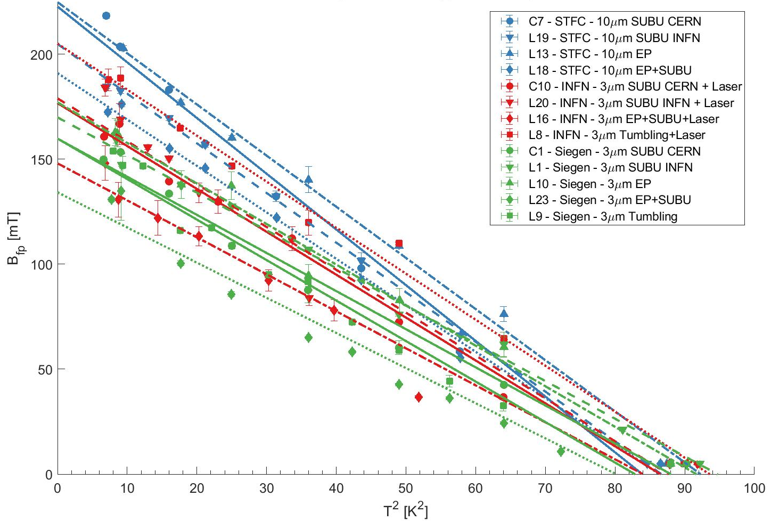
The effect of polishing – ARIES samples
13 samples were tested using the field penetration method.
All deposition run had a varying factor.
  STFC samples were 10µm instead of 3µm.
  INFN samples had been laser treated post deposition.
STFC samples (due to a greater thickness) have a greater B_{fp}.
Samples deposited at INFN LNL have the next best B_{fp} performance, followed by the samples deposited at University of Siegen.

Slide 15
The effect of polishing – Aries samples
STFC |  | Siegen |  | INFN (with laser polishing sample surface)
Polishing method | B_{fp}(0 K) [mT] | Polishing method | B_{fp}(0 K) [mT] | Polishing method | B_{fp}(0 K) [mT]
EP | 224.7±8.5 | EP | 177.0±6.1
 |  |  |  | Tumbling | 205.0±7.8
SUBU CERN | 222.6±0.9 | SUBU INFN | 169.9±5.1 | SUBU INFN | 178.9±2.2
SUBU INFN | 204.8±6.9 | SUBU CERN | 159.7±1.4 | SUBU CERN | 176.7±4.3
 |  | Tumbling | 159.8±1.6
EP + SUBU | 191.0±4.3 | EP + SUBU | 134.2±1.1 | EP + SUBU | 148.0±3.7
Largest B_{fp}(0 K)
Lowest B_{fp}(0 K)

Slide 16
Conclusion
An idea for a field penetration measurements has been realised in the facility;
  The facility has been designed, built, commissioned and is now in full time operation.
    A cryogen free system has been designed, built and tested at Daresbury Laboratory
    Applies a local DC field from one side to the other, T_{min} = 2.5 K, B_{max} ~ 612 mT at I = 8 A
    Data acquisition is fully automated.
The effect of sample geometry has been tested using a Pb sample.
The effect of (Type II) sample thickness has been tested using Nb samples deposited.
Multiple Nb samples deposited by ARIES WP15 partners with various substrate treatments have been tested:
  Magnetic Field Penetration of Niobium Thin Films Produced by the Aries Collaboration (vrws.de)
The ARIES thin film Nb samples have been laser treated and tested, with recent surface analysis measurements. Correlation between the magnetic field penetration method and surface analysis are ongoing.
This work has led to my PhD thesis.
Non-Nb films such as NbTiN and Nb₃Sn.
Future plans for the facility within IFAST WP9:
  SIS structures – Test thin films shielding substrate
  Compare DC magnetometry with RF tests
  Final stage – Implement the best films into cavity.
Notes:
This is a unique facility built on a novel idea, and it has already proven that it is a useful facility probing into the surface quality of superconductors.
PhD thanks to ARIES collaboration.

Slide 17
Acknowledgements
CERN: A. Sublet
IEE: E. Seiler, R. Ries
INFN: C. Pira, E. Chyhyrynets
RTU: A. Medvids, P. Onufrievs
Siegen University: M. Vogel, S. Leith
STFC/CI: O.B. Malyshev, R. Valizadeh, K. Dumbell, J.T.G. Wilson, J. Conlon,
L. Smith, F. Lockwood Estrin, F. Walk, N. Pattalwar, S. Pattalwar, A. May
Lancaster University/CI: G. Burt
University of Victoria: T. Junginger
This research has been supported by European Commission’s ARIES collaboration H2020 Research and Innovation Programme under Grant Agreement no. 730871.

Slide 18
Published papers
Daniel A Turner et al, “No interface energy barrier and increased surface pinning in low temperature baked niobium”, Scientific Reports 12 (1), 1-9 (2022).
Proceedings
Daniel A Turner et al, “Characterization of flat multilayer thin film superconductors”, in proc SRF 2019
Daniel A Turner et al, “Magnetic field penetration of niobium thin films produced by the aries collaboration”, in proc SRF 2021
Oleg B. Malyshev, Daniel A Turner et al, “Main Highlights of ARIES WP15 Collaboration”, in proc SRF 2021
R Valizadeh, AN Hannah, S Aliasghari, OB Malyshev, GBG Stenning, Daniel A Turner, K Dawson, VR Dahnak “PVD Depostion of Nb3Sn thin film on copper substrate from an alloy Nb3Sn target”, Proc. IPAC'19, 2818-2821
Submitted papers
Daniel A Turner, Oleg B Malyshev, Graeme Burt, Tobias Junginger, Reza Valizadeh, Lewis Gurran, “A facility for the characterisation of planar multilayer structures with preliminary Niobium results” – Submitted to Superconducting science and technology (2022)
Soon to be submitted papers
Daniel A Turner et al, “The effect of laser treatment on sputtered niobium thin films on copper substrates using a magnetic field penetration facility” – Submission by the end of this month

Slide 19
Thank you for your attention

Slide 20
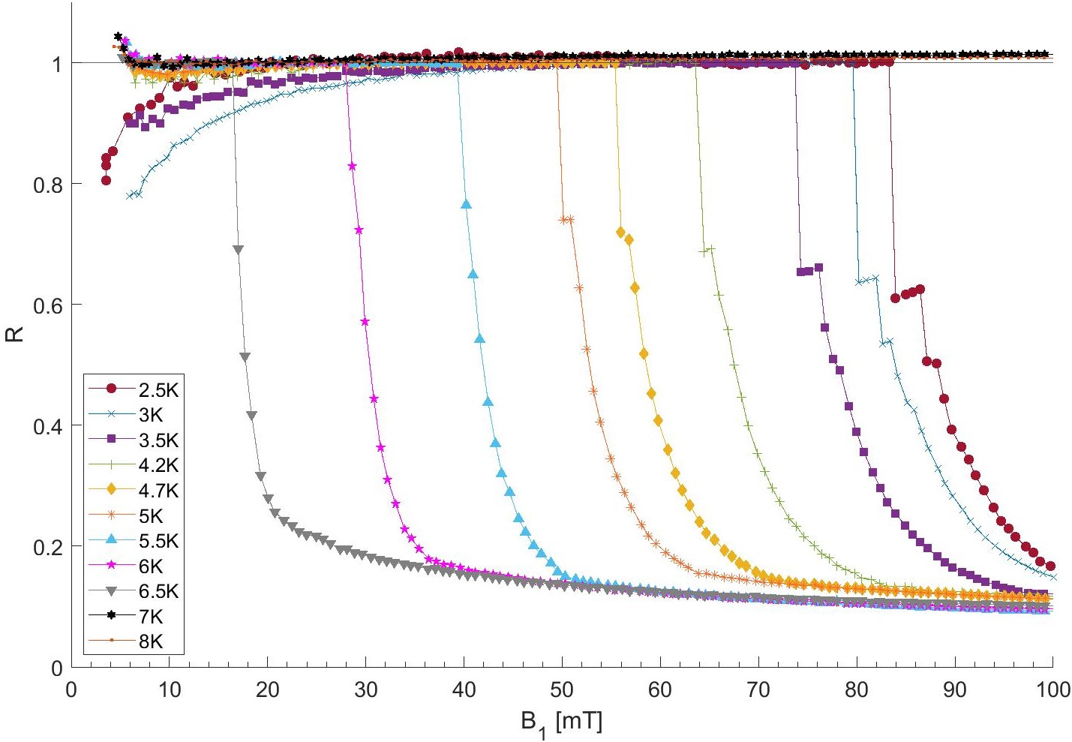
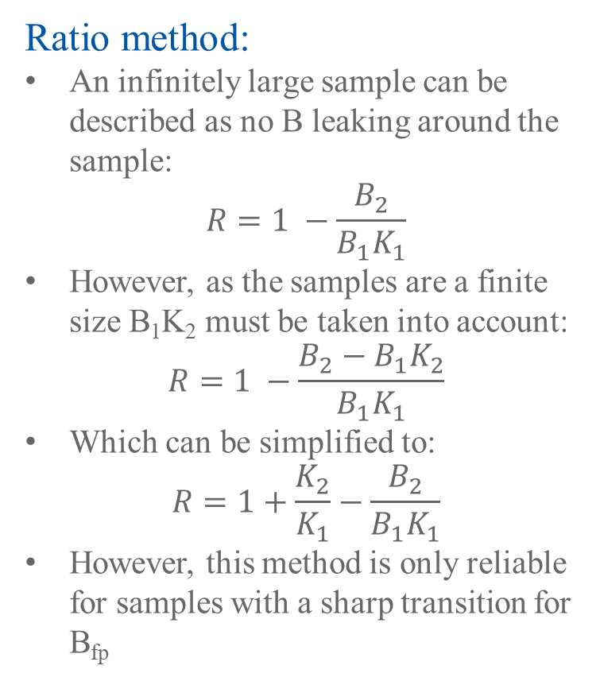
Finding B_{fp}
Ratio method:
An infinitely large sample can be described as no B leaking around the sample:
$$R=1 −\frac{B_{2}}{B_{1}K_{1}}$$
However, as the samples are a finite size B₁K₂ must be taken into account:
$$R=1 −\frac{B_{2}−B_{1}K_{2}}{B_{1}K_{1}}$$
Which can be simplified to:
$$R=1+\frac{K_{2}}{K_{1}}−\frac{B_{2}}{B_{1}K_{1}}$$
However, this method is only reliable for samples with a sharp transition for B_{fp}
Normalisation method

Slide 21
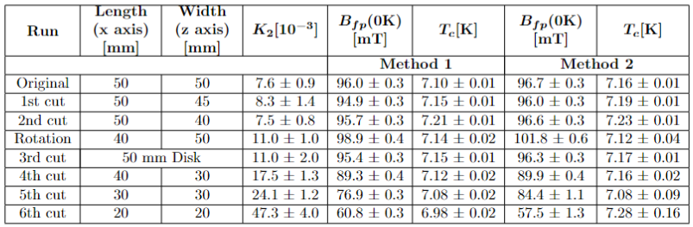
Data for the Pb sample
A comparison for the leakage factor and extrapolated values for B_{fp} and T_{c} using the Normalisation method (Method 1) and the second derivative method (method 2)

Slide 22
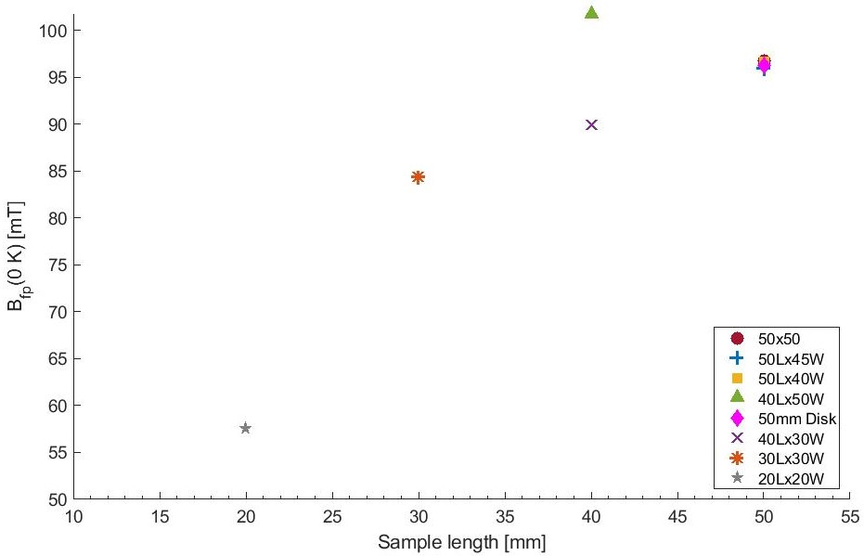
B_{fp}(0K) as a function of sample length
Pb - B_{fp} taken using the second derivative method

