Slide 1
Scintillation detectors with PMT readout
E.Kravchenko
BINP/NSU

Slide 2
Main stages of work
PMT characterization:
  PMT gain measurement (1-2 h)
  PMT linearity measurement (1-2 h)
Detection of cosmic muons (1-2 h)
Assembling and testing of large area scintillation detector (1-2 h)
Detection of extensive air showers (18 hours - 1 night)

Slide 3
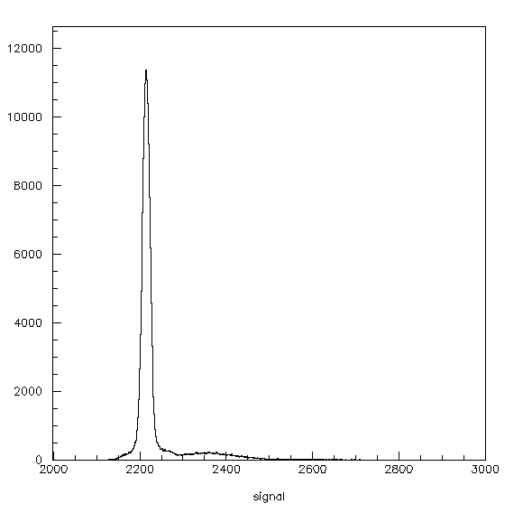
PMT characterization
PMT gain measurement –
single photoelectron spectrum
PMT linearity measurement --
two photodiods method

Slide 4
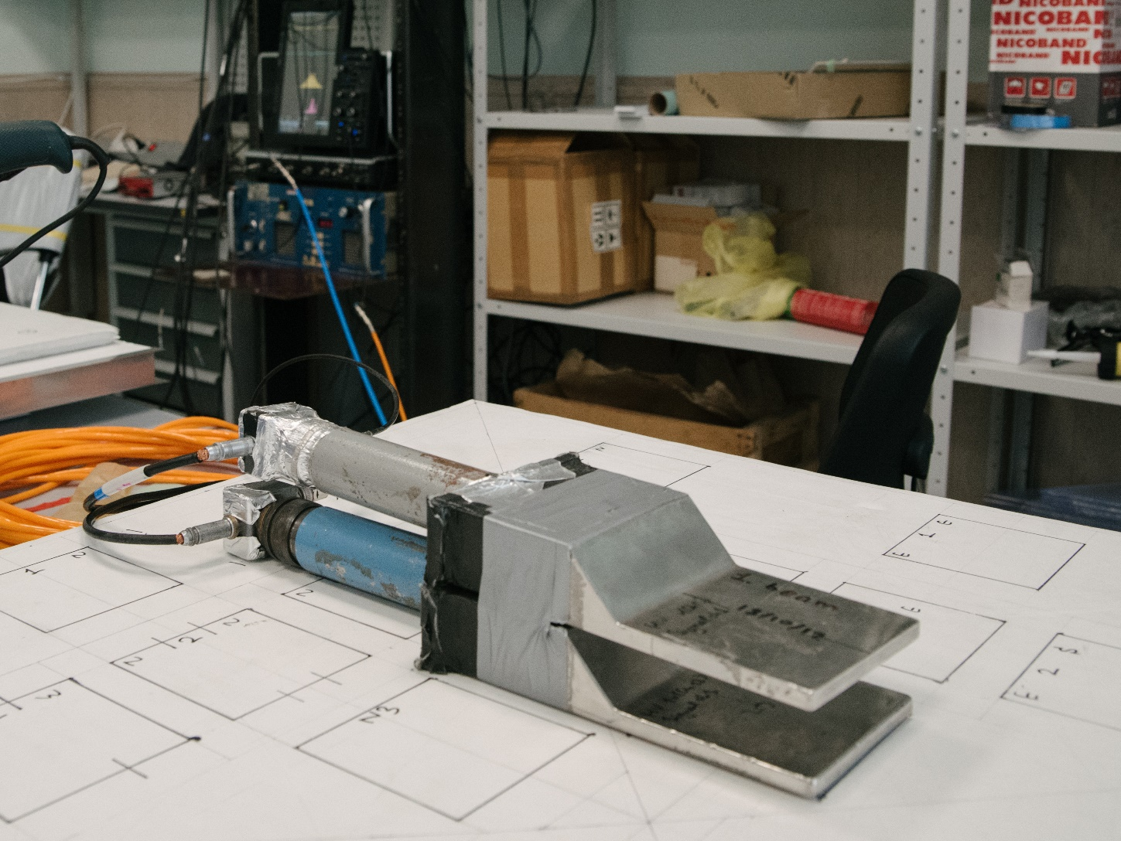
Detection of cosmic muons
Two counters coincidence load
measurement depending on
the HV supply voltage

Slide 5
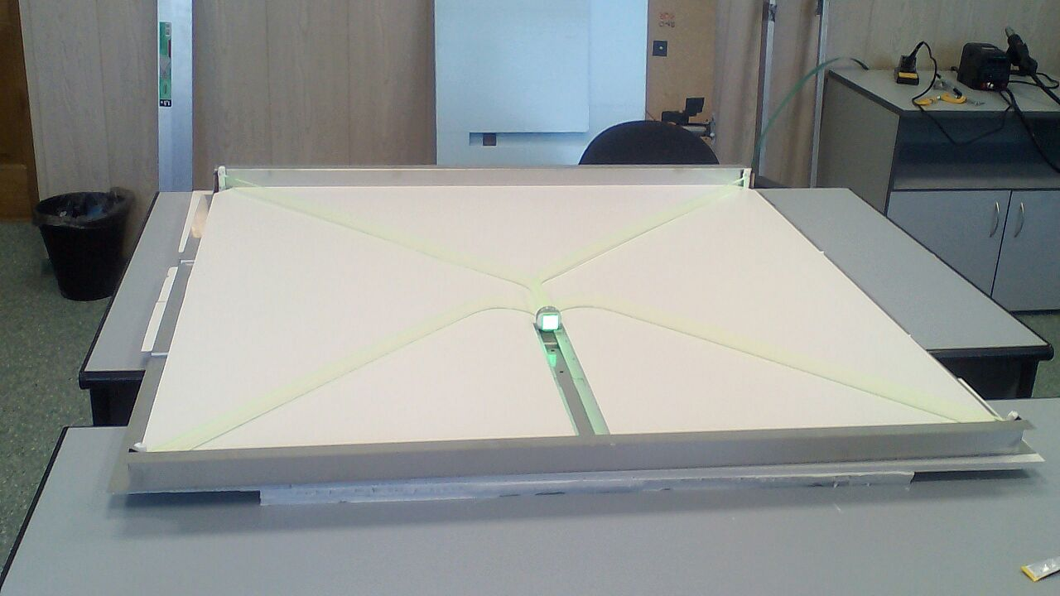
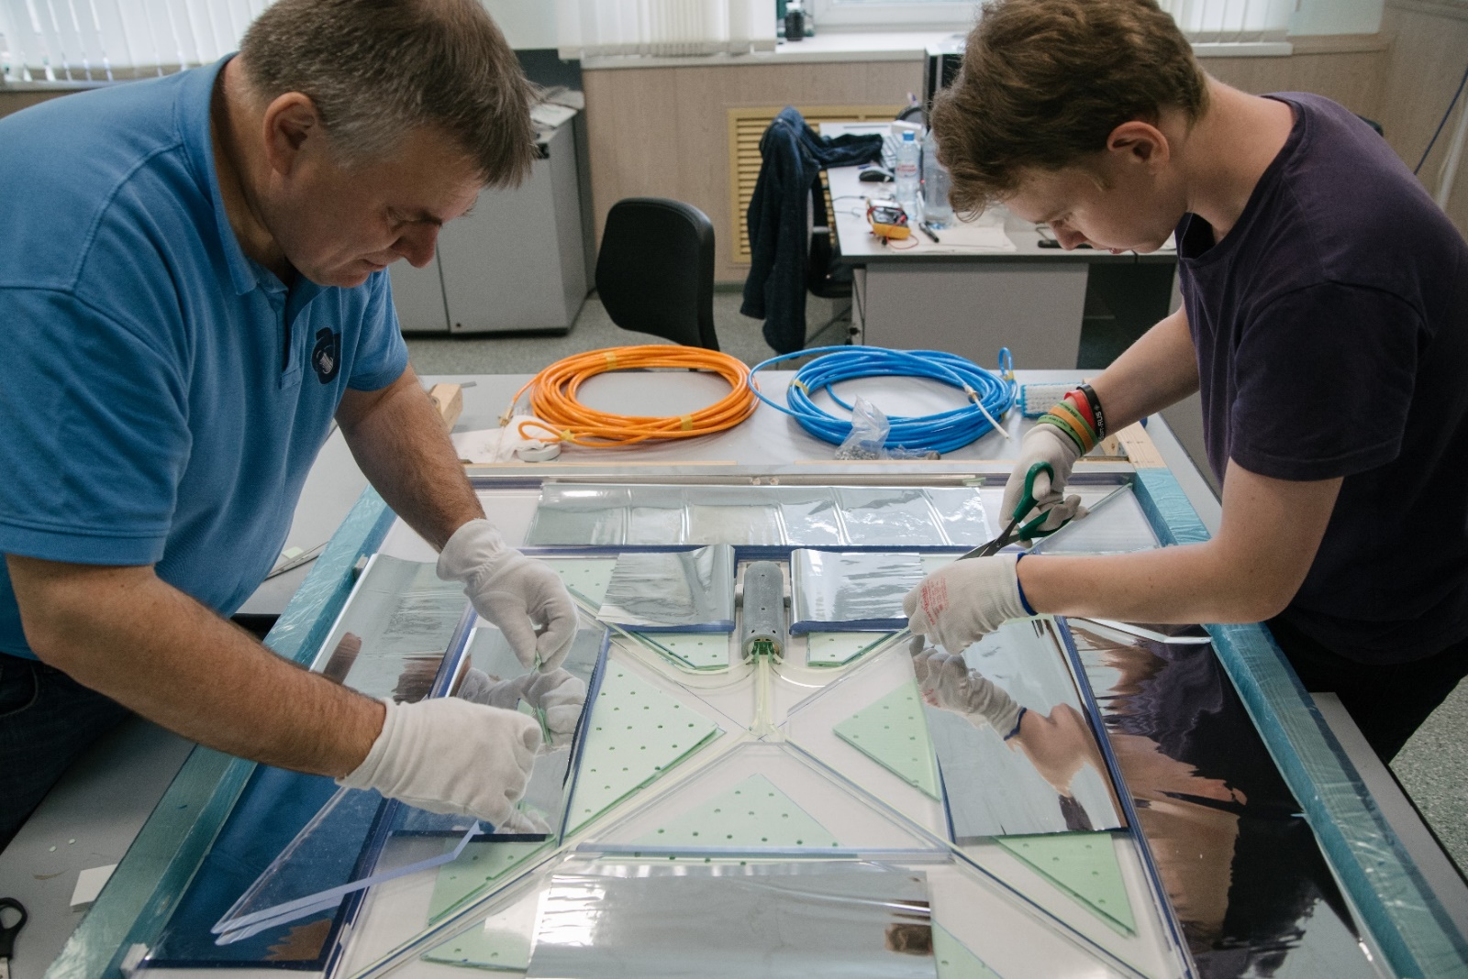
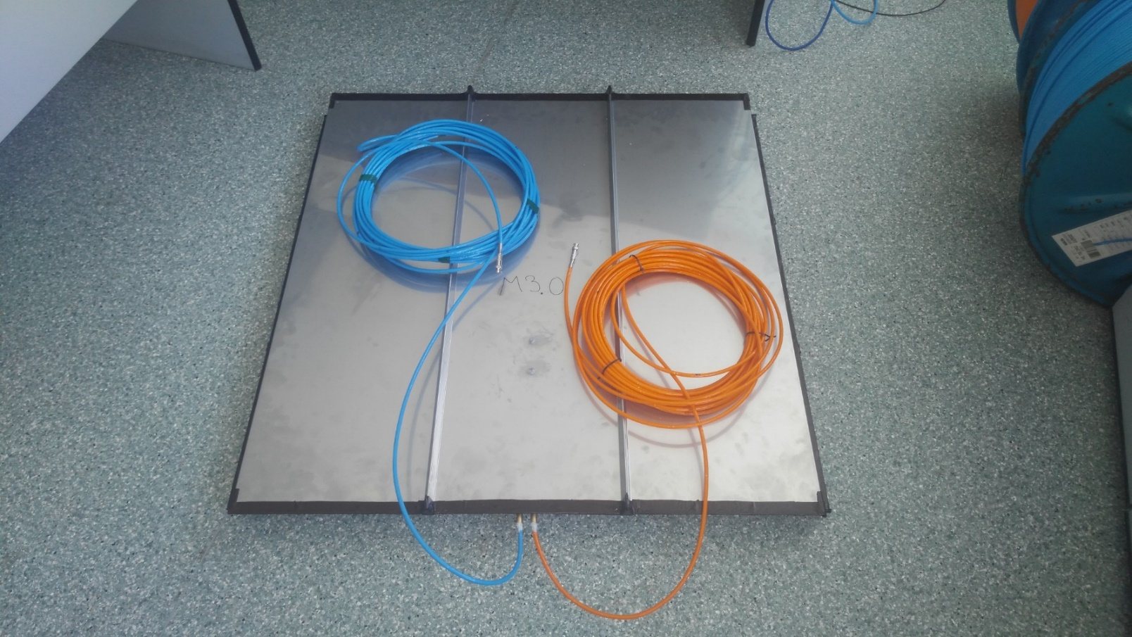
Assembling and testing of large area scintillation detector

Slide 6
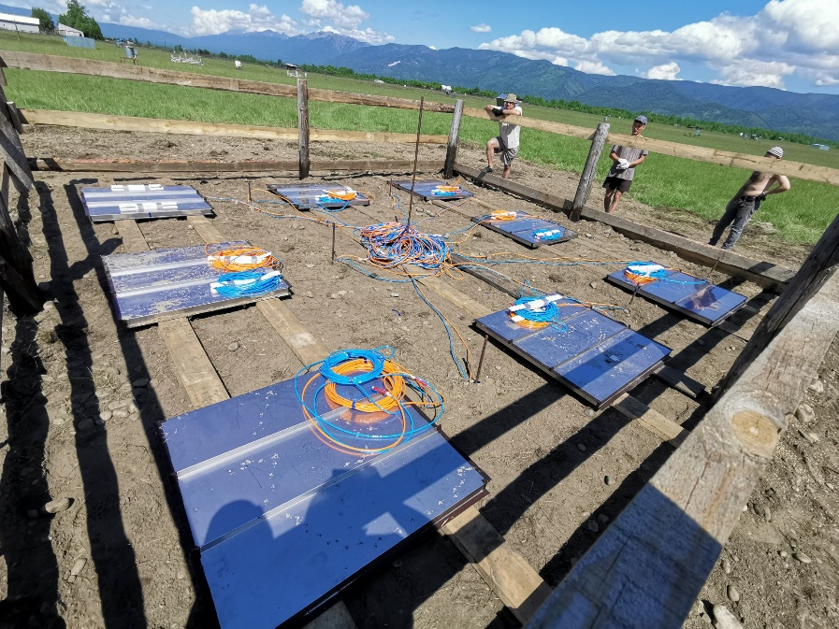
Detection of extensive air showers
To make trigger from two adjacent
large area scintillation counters
To measure integral amplitude spectrum
(about one of night data collection).

Slide 7
Organization of work
Day #1 -> upto 6 students are working simultaneously at 3 workplaces (PMT measurements + muon detection)
Day#2 -> data analysis + assembling of the counter + report preparation
8 days -> 6 x 4 groups = 24 students

