Slide 1
OP Planning
Thanks to D. Cotte and A. Huschauer

Slide 2
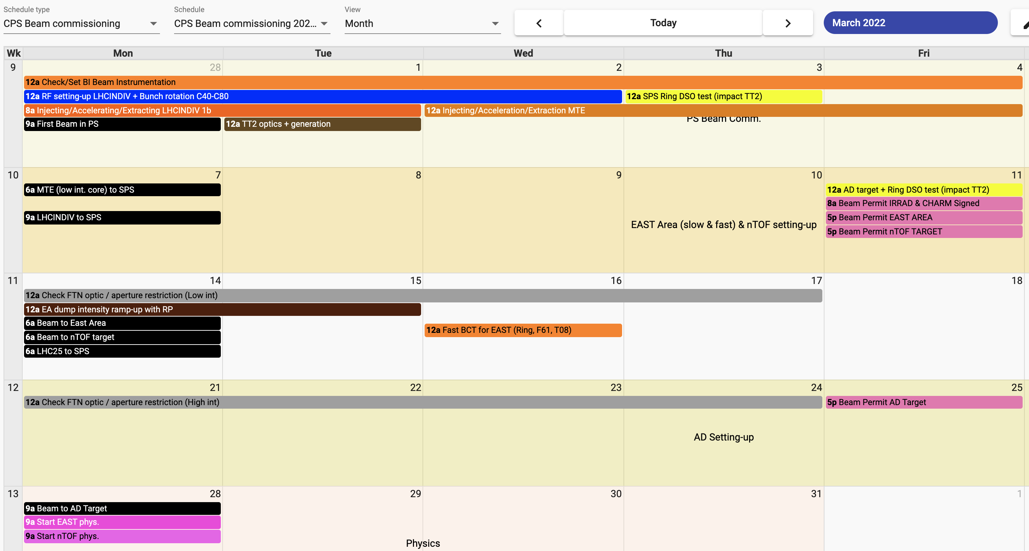
Changes since planning was presented:
  Most probably beam will be taken already from Friday 25th since the hw commissioning is well in advance
  Monday morning a few hours beam stop for DSO tests

Slide 3
Beam parameters for beam commissioning in PS
Week 2022 | Beams Milestone | N_{b [p/p]} | Comment
9 | LHCPILOT/INDIV | 1.2⋅10¹¹ | Check systems, PU, RF, start 40/80 MHz RF, transition crossing
 | MTE @ low intensity and various configurations (island/core/both) | 0.5⋅10¹² 1⋅10¹³ | optimise extraction bump and check extraction efficiency 200MHz cavity phasing ?
10 | TOF @ low intensity | < 2⋅10¹² | To D3. (check cycle in PS, Bunch Rotation, TT2)
10 | EAST beams | 10⋅10¹⁰ 60⋅10¹⁰ | Setting-up EAST cycles
11 | LHC25 Multi-bunch beam | 1.2⋅10¹¹ | RF splitting, bunch rotation
11-12 | TOF @low + high intensity to FTN | Up to 8.5⋅10¹² | Check TT2-FTN optics, Check Beam size on target, SIS interlock (Physics start W13)
11 | EAST beams (Fast and Slow extraction) to EAST | Int. Ramp-up | Fast extraction for BCT calibration, Slow Extraction for RP intensity ramp-up on the dump. (Physics start W13)
~13 | AD beam to FTA | Up to 1600⋅10¹⁰ | Check BTI247/8, FTA losses with new BLM. (Pbar to ELENA W15)

Slide 4
Beam Instrumentation (Priority List)
For the first beam 28th of February. (priority 1)
  BTP :
    BPM00,10,20,30,60, BCT10
  PS-Ring :
    BPM(00to97) for PS orbit, Sensitive BPM83/93, BTV42, BSGF42, Ring BCT, BLM(1to100), Diamond BLMDO, WCM95, WCM03(x2)
For the first beam in TT2.(priority 2)
  TT2 :
    BPM (Low and Wide band), BLM(F16), BCT(F16), BTV(F16), 3xBSGs, 3xBFSs
Later. (priority 3)
  BGI82/84, BWS54/64/65/68/85, RAL12 + SEM48,52,54, Wideband PU94/00.

