Slide 1
Process fabrication II
E. Giulio Villani
Instrumentation Training Lectures, Oxford 29/04/2022

Slide 2
Overview
Semiconductor fabrication process II
  Implantation
    Introduction
    Tools/equipment
    Ions interaction/dopants profiles
    Masking
    Channeling
    Implantation damage and annealing
    Example
  Metallization
    Introduction
    Tools/equipment
Instrumentation Training Lectures, Oxford 29/04/2022

Slide 3
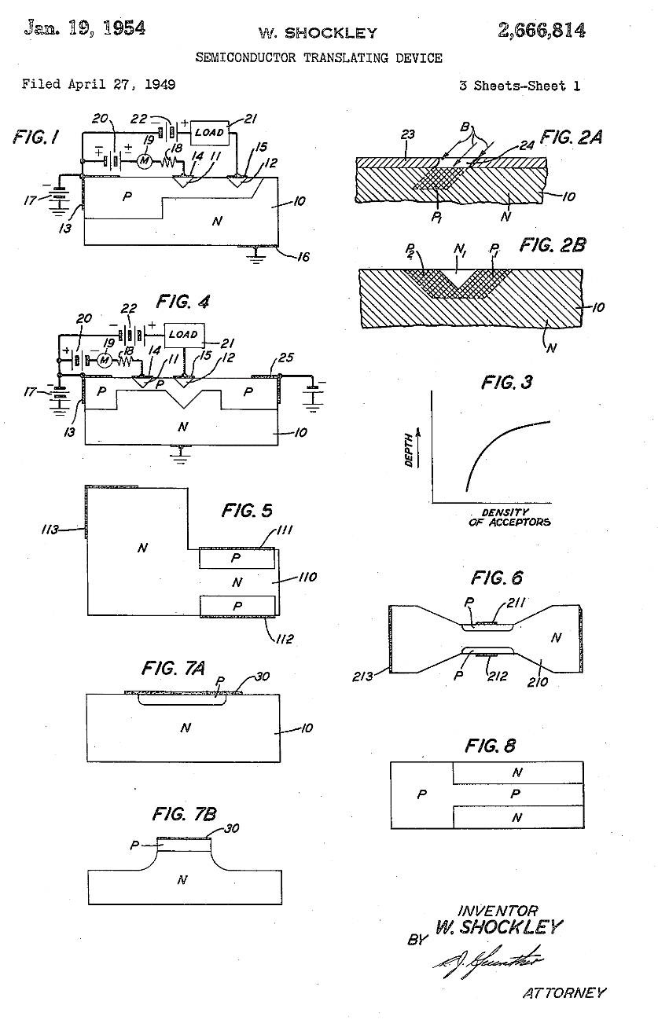

Ion Implantation Introduction
…the layer is formed by bombardment of one face of the N-type body with nuclear particles and the N-type zones in the layer are produced by masking the surface areas of the layer from the bombarding particles.
Technique to introduce atoms of dopants into a semiconductor material and create regions of different electrical characteristics
Historically proposed by Shockley in 1949, became common in the 70’s
Ionized gas ions are accelerated by strong electric field and injected into a target wafer ( a few nm to a few µm depth). Ion implanters spin-off from particle accelerator technology
1
Instrumentation Training Lectures, Oxford 29/04/2022

Slide 4
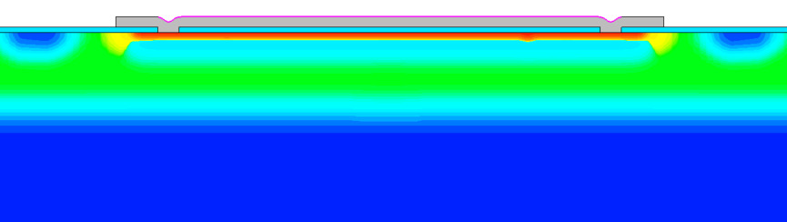
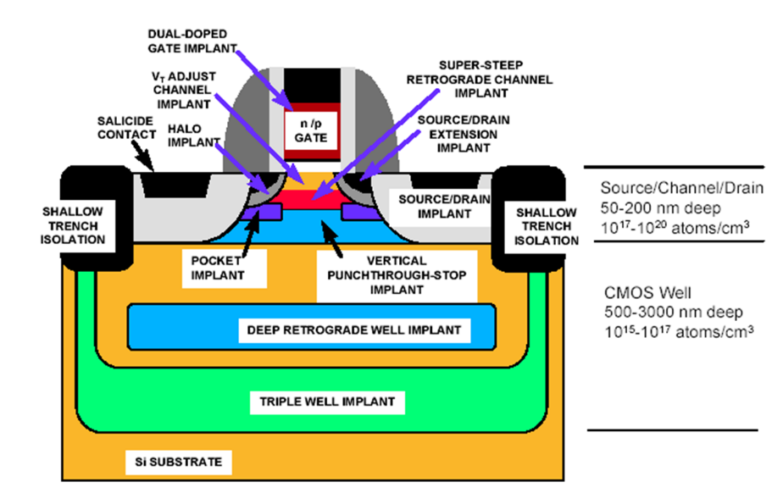
Ion Implantation Introduction
B⁺
P⁺
B⁺
Pros
• Precise control of dose and depth profile, complex profiles
• RT process (can use photoresist as mask)
• Wide selection of masking materials e.g. photoresist, oxide, poly-Si, metal
• Excellent dose uniformity across wafers
• Little lateral dopant diffusion, important for small devices
P-epi
4 implantations process, 1 metal layer
>10 implantations process
2
Instrumentation Training Lectures, Oxford 29/04/2022

Slide 5
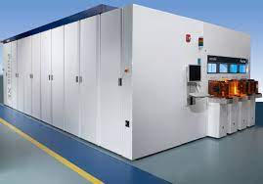
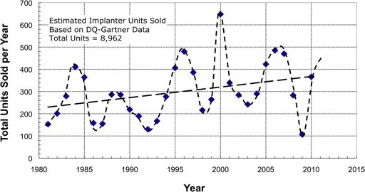
Ion Implantation Introduction
Cons
Equipment very expensive (> 1M$)
Radiation damage: reticle damage due to implantation not always possible to correct
Difficult to obtain very shallow and very deep doping
Masks material can be scattered into the wafer, creating impurities and defects
Estimates of the number of commercial ion implanters sold per year, mainly for IC fabrication, showing the ‘5 year cycle’
3
Instrumentation Training Lectures, Oxford 29/04/2022

Slide 6
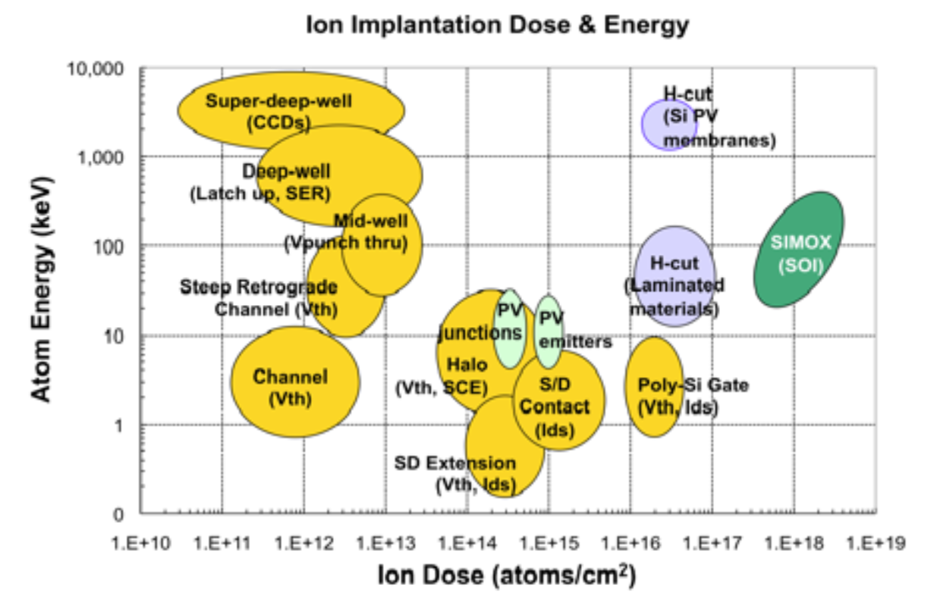
Ion Implantation Introduction
Ions used: As, B, P, In, O, Ar
Energy: 1 - ∼1000’s keV
Flux: 10¹² – 10¹⁴ cm⁻² s⁻¹
Dose: 10¹¹ – 10¹⁸ cm⁻²
Uniformity: ± 1% across 12’’ wafers
Absolute dose accuracy: ± 10 -15 %
Temperature: RT
Dose and atom energy regions for CMOS transistor doping (gold), high dose hydrogen implants for Si layer splitting (lavender), and direct implantation of oxygen to form Silicon-on-Insulator (SOI) wafers (green).
4
Instrumentation Training Lectures, Oxford 29/04/2022

Slide 7
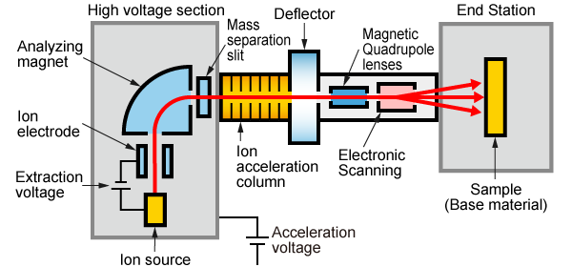
Ion Implantation tools
Typical ion implanter for semiconductor process consists of several elements
1: Ion source
2: Analyzing Magnetic
3: Ion Accelerator
4: Beam manipulating system
5: End station
5
Instrumentation Training Lectures, Oxford 29/04/2022

Slide 8
Ion Implantation tools
Ion source:
  Filament emits thermionic electrons, accelerated to gain enough energy (20 – 30 kV)
  The electrons collide with the molecules or atoms (AsH₃, PH₃, BCl₃) and ionize them
  A negative bias to the end side of the chamber extracts the positive ions towards the magnetic analyzer
6
Instrumentation Training Lectures, Oxford 29/04/2022

Slide 9
Ion Implantation tools
  Magnetic analyzer
    Plasma provides positive ions, (B¹¹)⁺, BF₂⁺, (P³¹)⁺, (P³¹)⁺⁺
    The correct ions need to be separated to choose what to implant (e.g. acceptors B¹¹, or donors P³¹)
    A magnetic mass analyzer selects the desired species via a magnet (< 1 T) which bends the ion beam: only one mass will have the correct radius of curvature to exit through the slit (~ mm’s) and hit the wafer
7
Instrumentation Training Lectures, Oxford 29/04/2022

Slide 10
Ion Implantation tools
Accelerator
  N-sections LINAC, giving a total x n acceleration at relatively low voltage: E ~ 1000’s keV, I ~ mA
  Single charge ion ⇒ E = e * HV
  n⁺ charge ion ⇒ E = n* e * HV
8
Instrumentation Training Lectures, Oxford 29/04/2022

Slide 11
Ion Implantation tools
Beam manipulating system
  After acceleration the ion beam is focused ( ~ few cm²)
  A small deflection via electrostatic means is applied to discard neutral components to a beam stop
  The ion beam passes through an electrostatic deflection system and scanned over the wafer (~ Ø 20 cm)
9
Instrumentation Training Lectures, Oxford 29/04/2022

Slide 12
Ion Implantation tools
End station
  Wafers mounted on rotating disc (15-25 wafers/disc)> 50 wafers/hr
  Dose measurement performed by integrating the ion current via a Faraday cup
  Complex design of the Faraday cup is needed for high current implanters
10
Instrumentation Training Lectures, Oxford 29/04/2022

Slide 13

Ion interactions/doping profile
The many-body problem of Ion-solid interaction where one ion (M₁, n₁ ≠ Z₁ ) interacts with all target atoms M₂ nuclei and electrons in a solid is practically intractable: some simplifying assumptions are introduced:
Classical mechanics used to describe the motion of ion and nuclei
Binary collision approximation (BCA) to calculate the ion trajectories
Adiabatic approximation : nuclear and electronic systems are treated separately
11
Instrumentation Training Lectures, Oxford 29/04/2022

Slide 14

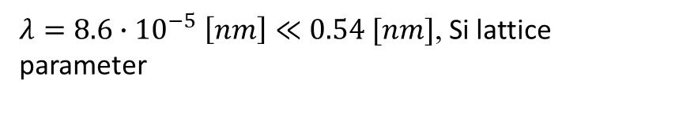

Ion interactions/doping profile
Classical mechanics : ions move as classical point-like particles: e.g. for lightest ion B¹¹ @ E =10 keV
Usually in implantation processes ion energy is not large enough to penetrate the coulomb barrier of the target nuclei, i.e. no nuclear reactions.
$λ=8.6∙{10}^{−5} \left[nm\right]≪0.54 [nm]$, Si lattice parameter
$$B11 @ 1MeV β=0.01$$
12
Instrumentation Training Lectures, Oxford 29/04/2022

Slide 15
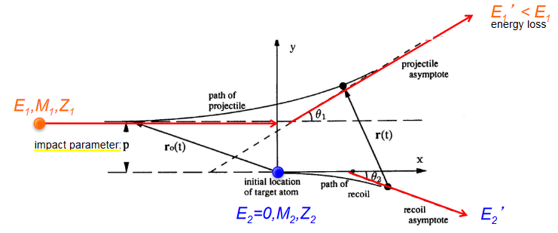
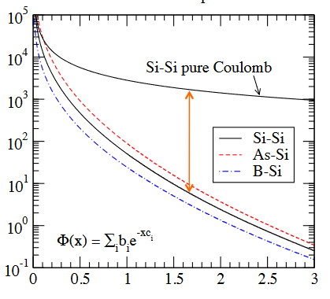

Ion interactions/doping profile
Binary collision approximation : ion movement is described as a series of successive elastic two-body Coulombic interactions, using a screened potential (i.e. negative charge of ion and target reduces the Coulomb potential strength)
potential energy [eV]
[Å]
13
Instrumentation Training Lectures, Oxford 29/04/2022

Slide 16

Ion interactions/doping profile
Adiabatic approximation : Scattering of ions with target described using two separate processes:
collisions with nuclei (energy loss and geometry of trajectory)
collisions with electrons (energy loss only).
S_{n} screened potential classical two-body scattering
S_{e} interactions of ion with target electrons (Lindhard’s Bethe-Bloch)
14
Instrumentation Training Lectures, Oxford 29/04/2022

Slide 17
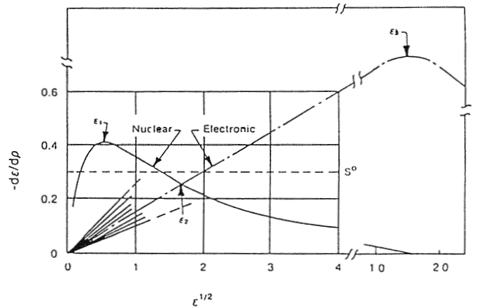
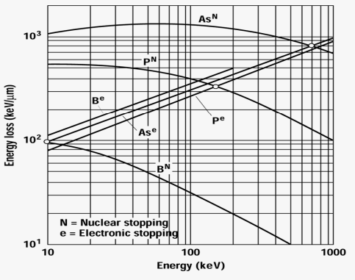
Ion interactions/doping profile
At low energy, nuclear collisions dominate: as at the end of its range the ion has low energy, S_{n} dominates leading to more crystalline damage
At high energy, electronic collisions dominate, from scattering of electrons ~ Ohm’s law
Nuclear and electronic stopping powers versus energy in reduced units
E₂(As)=800 keV
E₂(B) = 16 keV
15
Instrumentation Training Lectures, Oxford 29/04/2022

Slide 18
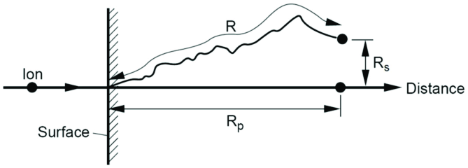

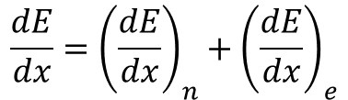

Ion interactions/doping profile
From $\frac{dE}{dx}$ ,the total energy stopping power, one can estimate the average ion range
R: range
R_{p}: projected range along axes of incident ion, with straggle ΔR_{p}
R_{s} perpendicular distance
$$\frac{dE}{dx}={\left(\frac{dE}{dx}\right)}_{n}+{\left(\frac{dE}{dx}\right)}_{e}$$
$$R=\int_{0}^{E}{\frac{dE}{−\frac{dE}{dx}}}$$
16
Instrumentation Training Lectures, Oxford 29/04/2022

Slide 19
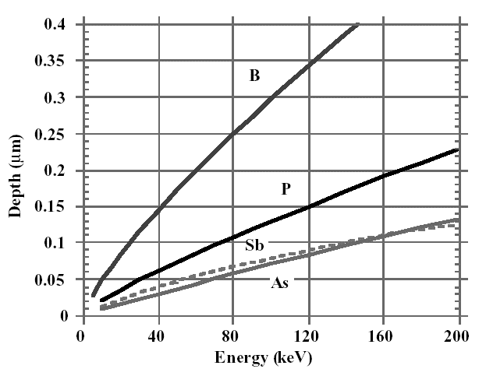
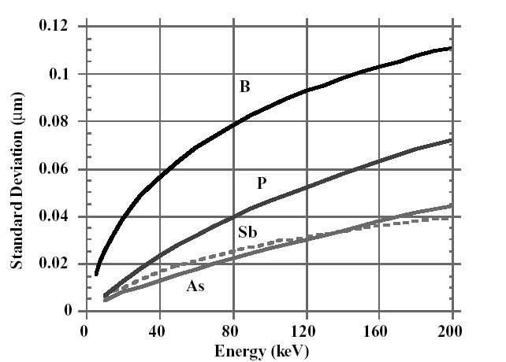

Ion interactions/doping profile
Projected range Rp and Straggle ΔRp for common dopants
Transverse spread increases with R_{p} ($R=(1+M2/3M1)Rp$
limiting factor on lower limit of mask opening, which affects maximum device density
Projected range R_{p}
Straggle ΔR_{p}
17
Instrumentation Training Lectures, Oxford 29/04/2022

Slide 20
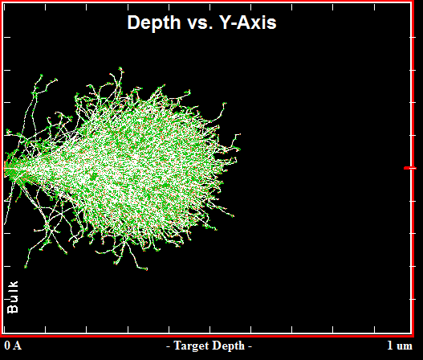
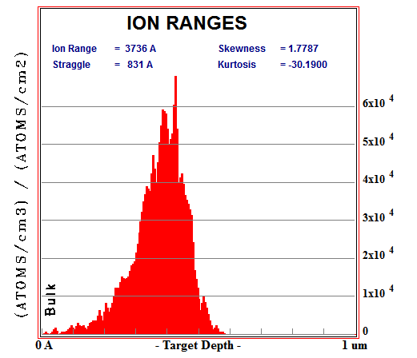
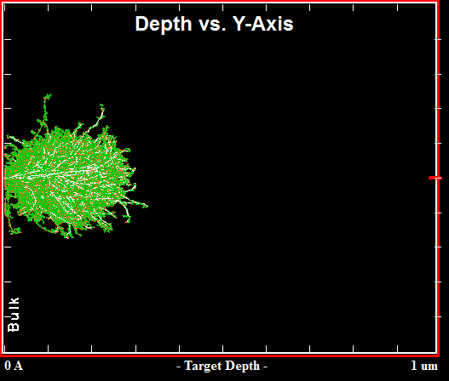
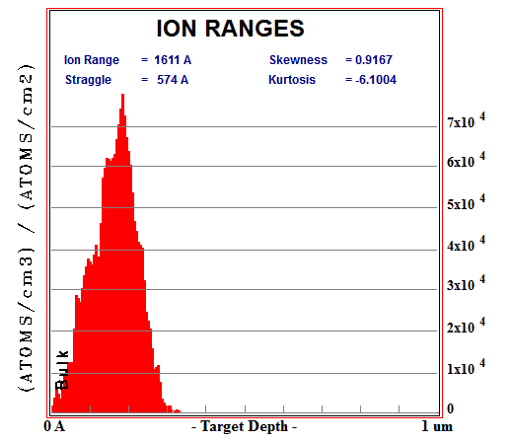
Ion interactions/doping profile
B¹¹(120keV) in Si
R_{p}
Example of MC (>5000 runs) ion range simulations (SRIM) of B¹¹ and P³¹ implanted in amorphous Si
No annealing, i.e. no dopants activation, no thermal diffusion
P³¹(120keV) in Si
R_{p}
18
Instrumentation Training Lectures, Oxford 29/04/2022

Slide 21
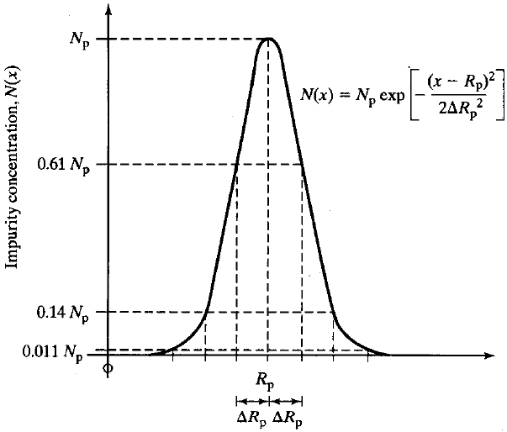
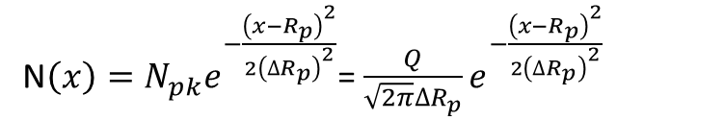
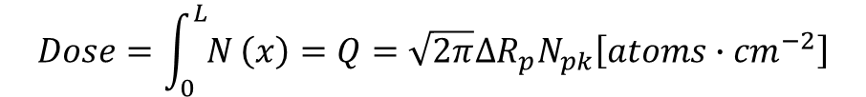
Ion interactions/doping profile
The range distribution of implanted impurities is described, as a first approximation, by a symmetrical Gaussian distribution ( 2 moments: R_{p} : projected range, ΔR_{p} : straggle)
N$\left(x\right)=N_{pk}e^{−\frac{{\left(x−R_{p}\right)}^{2}}{{2\left({∆R}_{p}\right)}^{2}}}$= $\frac{Q}{\sqrt{2π}{∆R}_{p}}e^{−\frac{{\left(x−R_{p}\right)}^{2}}{{2\left({∆R}_{p}\right)}^{2}}}$
$$Dose=\int_{0}^{L}{N}\left(x\right)=Q={\sqrt{2π}{∆R}_{p}N}_{pk}\left[atoms∙{cm}^{−2}\right]$$
19
Instrumentation Training Lectures, Oxford 29/04/2022

Slide 22
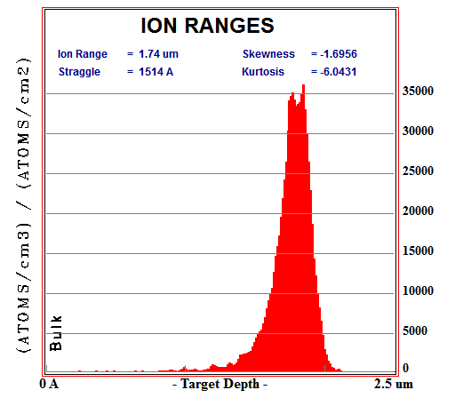
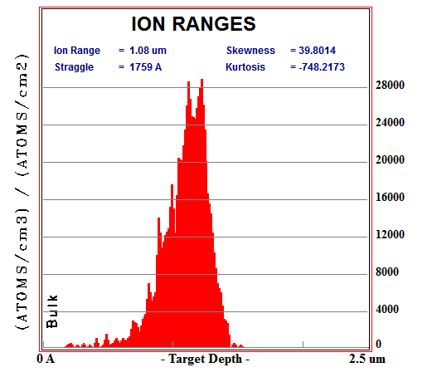





Ion interactions/doping profile
B(1000keV) in Si
$$Q=m_{0}=\int_{−∞}^{+∞}{N\left(x\right)dx}$$
$$R_{p}=m_{1}=\int_{−∞}^{+∞}{xN\left(x\right)dx}$$
Higher moments are needed to describe realistic profiles:
  skewness (γ), describing asymmetry of distribution
  kurtosis (β), describing peak sharpness of the profile
P(1000keV) in Si
$${∆R}_{p}=m_{2}=\int_{−∞}^{+∞}{{(x−R_{p})}^{2}N\left(x\right)dx}$$
$$γ=m_{3}=\frac{1}{{{∆R}_{p}}^{3}}\int_{−∞}^{+∞}{{(x−R_{p})}^{3}N\left(x\right)dx}$$
$$β=m_{4}=\frac{1}{{{∆R}_{p}}^{4}}\int_{−∞}^{+∞}{{(x−R_{p})}^{4}N\left(x\right)dx}$$
20
Instrumentation Training Lectures, Oxford 29/04/2022

Slide 23
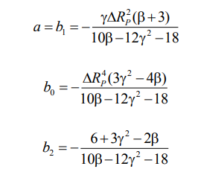


Ion interactions/doping profile
$$\frac{df}{dx}=\frac{\left(x−a\right)f}{b_{0}+b_{1}x+b_{2}x^{2}}$$
Pearson distribution function defined as DE solution
Analytical description of doping profiles can be obtained from Pearson distribution
Coefficients of Pearson’s equation are related to the four moments
Explicit formula for the implanted profile can be obtained
Generic profile formula from Pearson distribution
21
Instrumentation Training Lectures, Oxford 02/05/2022

Slide 24
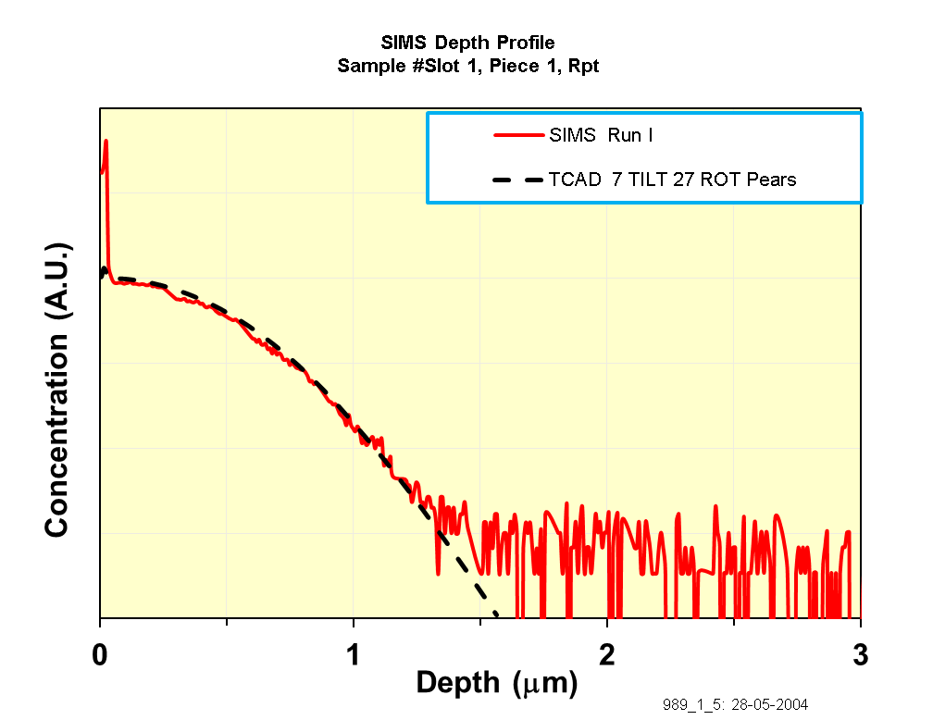
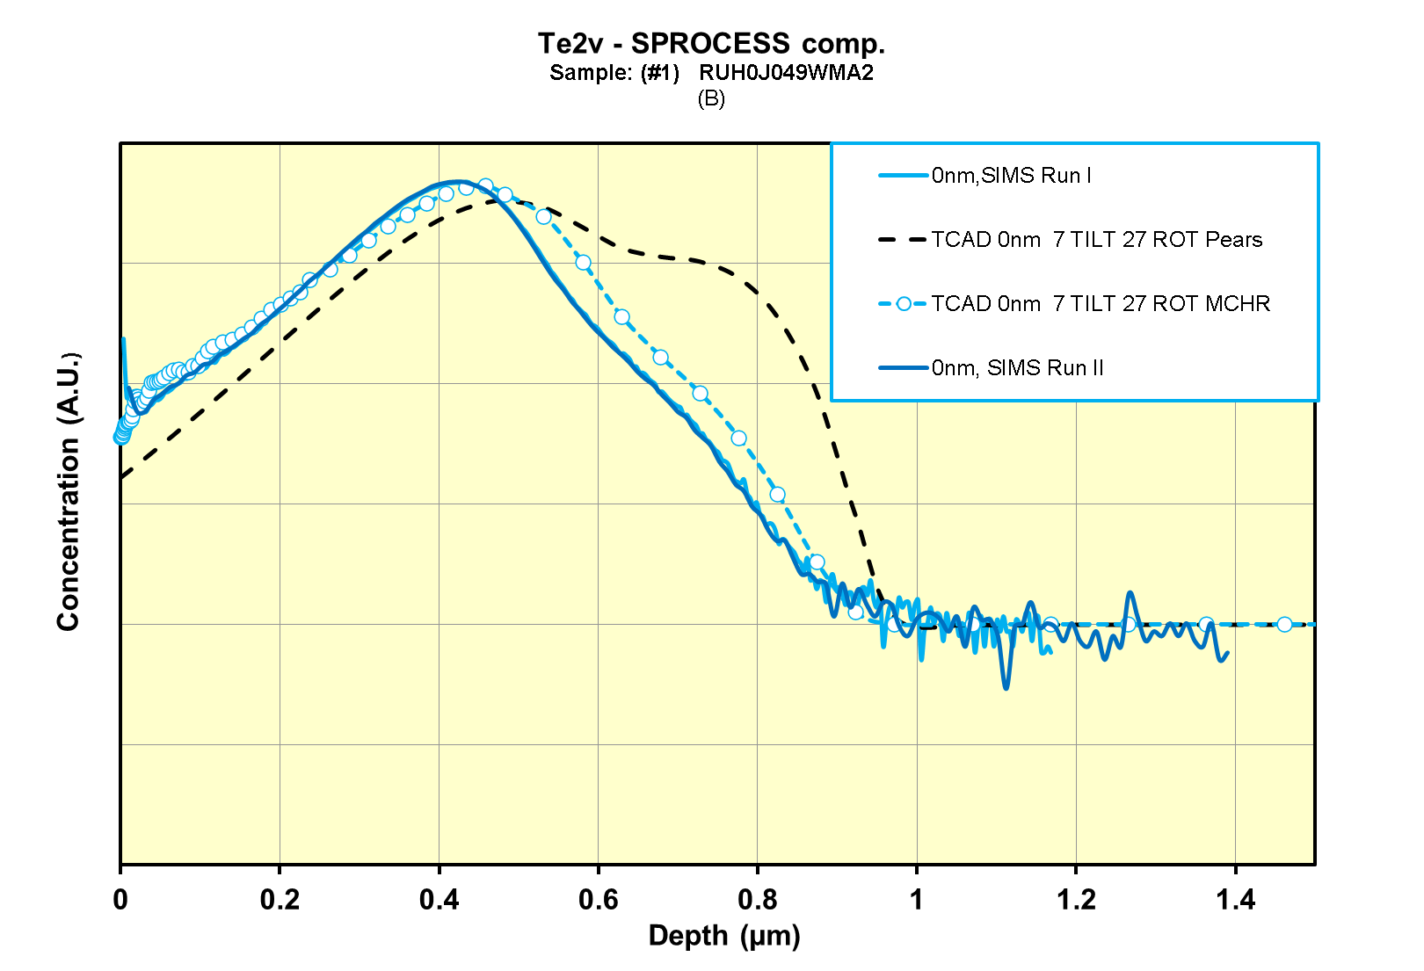
Ion interactions/doping profile
Analytical doping profiles description reasonably accurate for heavy ions
Lighter ions more accurately described using MC (crystal orientation depending)
SIMS and Pearson IV distribution – 31P
SIMS, Pearson IV distribution and MC run – 11B
22
Instrumentation Training Lectures, Oxford 02/05/2022

Slide 25
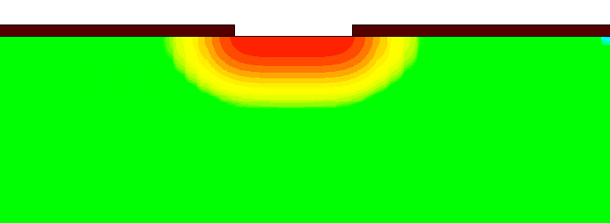
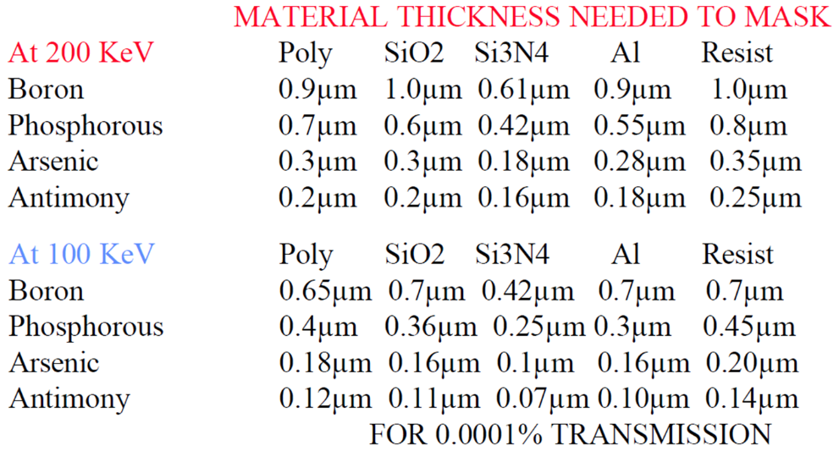
Masking
mask
Si
Lateral scatter around the impact point
Purpose of the mask is to Implant only in certain parts of the wafer, using a suitably thick mask (i.e. that its R_{p} lies within the mask material)
The thickness of the mask should be large enough that the tail of the implant profile in the silicon should not significantly alter the doping concentration (C_{B})
23
Instrumentation Training Lectures, Oxford 29/04/2022

Slide 26
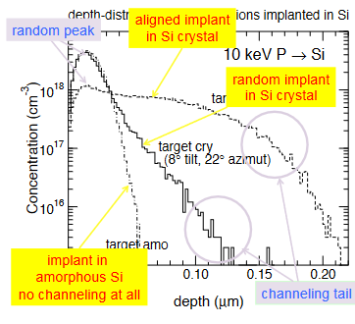
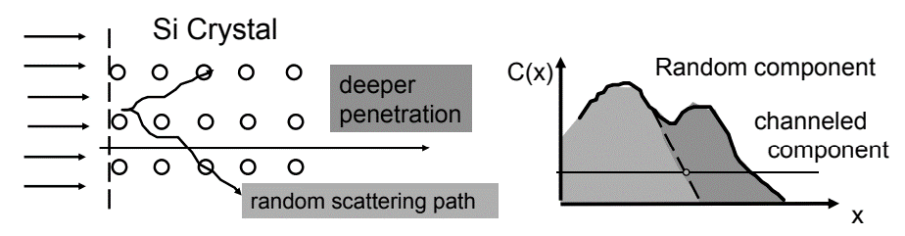
Channeling
During ions implantation in a periodic structure, directional effects due to nuclear scattering might confine the ions into regions minimizing interactions along the path.
Channelling: Average penetration depth is larger, affecting the final doping profile
24
Instrumentation Training Lectures, Oxford 29/04/2022

Slide 27
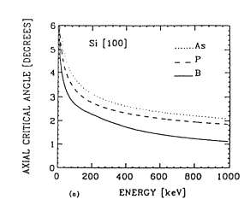
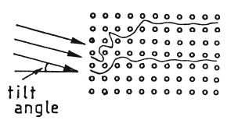
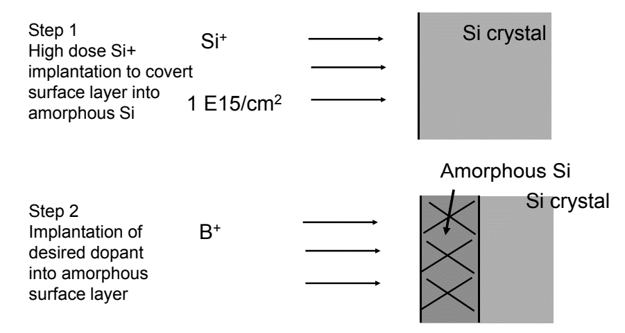
Channeling
To minimize channelling:
pre-amorphization of the wafer via implantation
the wafer is tilted by some degrees with respect to ion beam: the value of the critical angle below which there is channelling depends on crystal orientation and energy of the ion. In practice a tilting angle of 7 degrees is used
25
Instrumentation Training Lectures, Oxford 29/04/2022

Slide 28
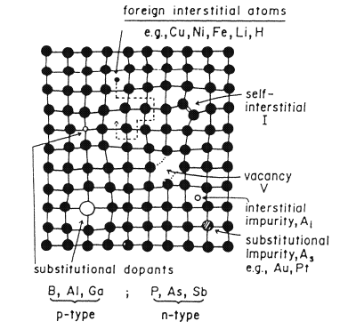
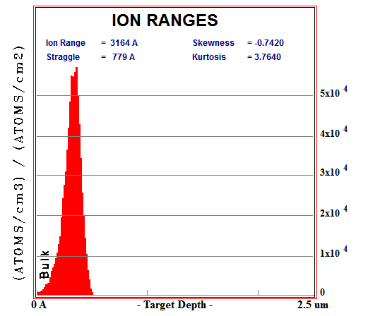
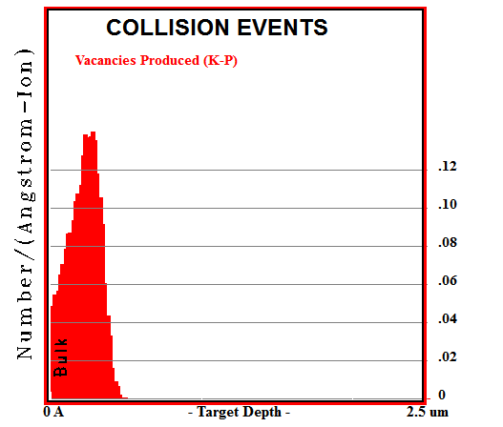
Implantation damage and annealing
Ion implantation creates defects in the target crystal, by displacing atoms from their regular lattice sites (see radiation damage lectures)
The elementary radiation defect consists of Frenkel defect, i.e. displaced atom (interstitial) plus the related vacancy.
More complex defects form as a result of accumulation and clustering of interstitials and vacancies (divacancies V-V, vacancy impurities, like V-O, As-I…)
26
Instrumentation Training Lectures, Oxford 29/04/2022

Slide 29
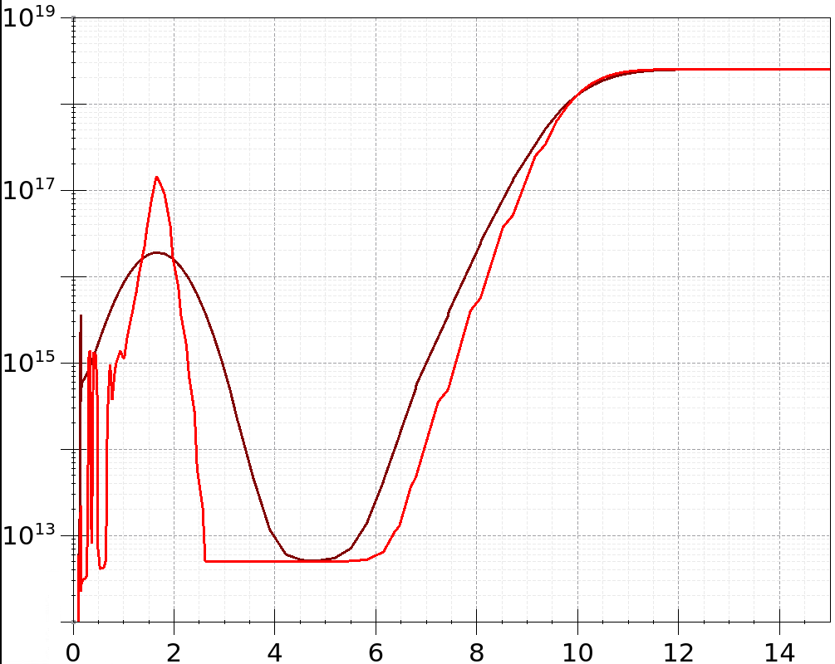
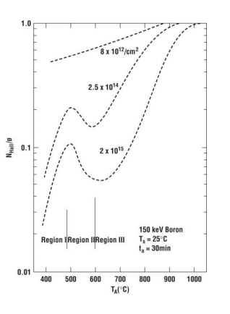
Implantation damage and annealing
Doping profiles from ¹¹B implantation in <100> Si, as implanted and after thermal annealing
After implantation process a thermal treatment is required to activate electrically the dopant (i.e. to have them moved to substitutional positions) and to restore the crystalline order of the semiconductor.
Annealing at high temperature (~1000°C) could result in perfect crystal, but leads to dopant diffusion. Particularly serious issue in modern technologies, where very shallow junctions are used
As implanted
Thermally annealed
Isochronal annealing of boron. The ratio of the free-carrier to dose (fraction of boron atoms located in substitutional lattice points ) is plotted versus the anneal temperature for three doses of boron.
27
Instrumentation Training Lectures, Oxford 29/04/2022

Slide 30
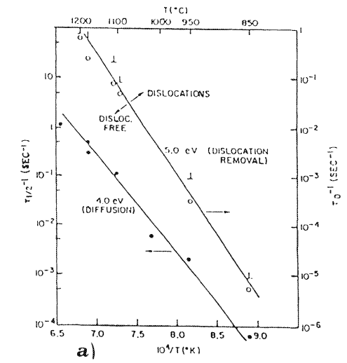
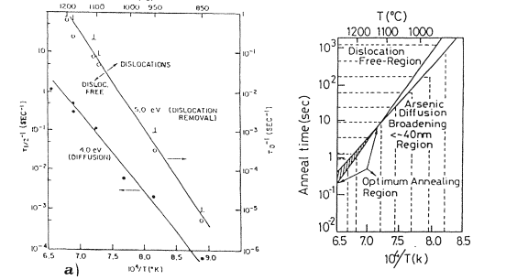
Implantation damage and annealing
Activation energy for removal of point defects (V and I) usually higher than that of impurity diffusion.
Different slopes in Arrhenius plots allow to use high temperature to enhance annealing and depress diffusivity:
Rapid Thermal Annealing (RTA)
Dislocation removal rate in As implanted Si and As diffusivity vs. 1/T
28
Instrumentation Training Lectures, Oxford 29/04/2022

Slide 31
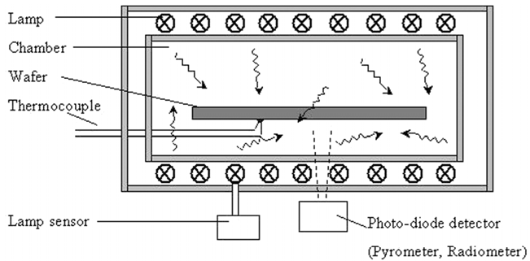
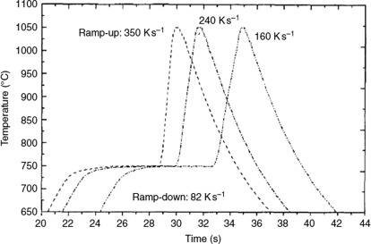
Implantation damage and annealing
Rapid thermal annealing of wafers (RTA) optimizes the defects suppression, whilst minimizing dopants diffusion
Wafers are rapidly heated by lamps (10’s kW) to 1000 C for 1 – 20 secs max
29
Instrumentation Training Lectures, Oxford 29/04/2022

Slide 32
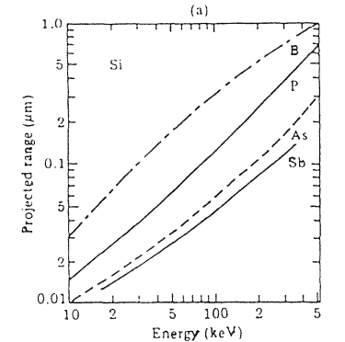
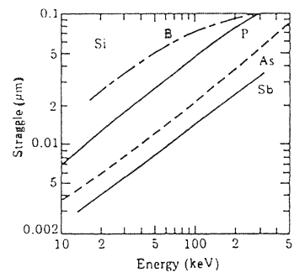

Example
Estimate the dose ϕ, energy E required for B11 to get an implanted depth x_{pk} = 0.3 µm with N_{Apk} = 5e16 cm⁻³ in a Silicon substrate of doping N_{abulk} = 1e14 cm⁻³
Assume both R_{p} and ∆R_{p} $∝ \sqrt{E}$
$R=4{∙10}^{−3}E−7.8{∙10}^{−6}E^{2}$
$∆R=1.4{∙10}^{−3}E−4.4{∙10}^{−6}E^{2}$
Parabola through 3 points for B11 range and straggle
N_{Apk}
N_{Abulk}
x_{j1}
x_{pk}
x_{j2}
30
Instrumentation Training Lectures, Oxford 29/04/2022

Slide 33




Example
$R=4{∙10}^{−3}E−7.8{∙10}^{−6}E^{2}$
$∆R=1.4{∙10}^{−3}E−4.4{∙10}^{−6}E^{2}$
<R>=294.8 nm
$∆R$=74.4 nm
$$Φ=\frac{{5∙10}^{16}}{{6∙10}^{4}}={0.83∙10}^{12}$$
From expression of R_{p} = 0.3 µm determine E required for 0.3 depth :
E = 92 keV, from which ∆ R_{p} = 0.0915 µm
Assuming Gaussian profile, the dose required is then:$\int_{0}^{L}{N}\left(x\right)=Q={\sqrt{2π}{∆R}_{p}N}_{pk}$≃ 2.5*0.0915*1e-4* 5e16=1.14e12 cm⁻²
10k runs SRIM B¹¹(92keV) in Si
31
Instrumentation Training Lectures, Oxford 29/04/2022

Slide 34
Overview
Semiconductor fabrication process II
  Implantation
    Introduction
    Tools/equipment
    Ions interaction/dopants profiles
    Masking
    Channeling
    Implantation damage and annealing
    Example
  Metallization
    Introduction
    Tools/equipment
32
Instrumentation Training Lectures, Oxford 29/04/2022

Slide 35


Schottky diode on P-type Si wafer
Metallization
Once devices have been fabricated in the wafer (Front End of Line), metal layers are deposited to form conductive connections
Modern technologies moved from Al to Cu to reduce resistivity in interconnect in Back End of Line (BEOL). This is a more complex process (Dual Damascene process) than sputtering
Al guard ring
Al cathode
33
Instrumentation Training Lectures, Oxford 29/04/2022

Slide 36

Metallization
Sputtering (PVD, Physical Vapor Deposition) is one of the most common method to deposit thin film of metal
Good step coverage obtained by reducing the mean free path of sputtered atoms (increasing Ar ions, magnetron sputtering)
Sputtering also used to clean wafer before deposition, by Ar⁺ etching
Cathode (target -) is the material to deposit, generally cooled
An inert gas (Ar) is ionized, accelerated and collides with the target. Ejected atoms have energies ~ 10’s eV
Some atoms sputters off and, after scattered paths, land and deposit onto the wafer (+)
34
Instrumentation Training Lectures, Oxford 29/04/2022

Slide 37
Process fabrication II Summary
Introduction to Ion Implantation
  Characteristics, tools and equipment
  Ion interactions, masking and channeling, doping profiles
  Implantation damage and annealing required
Metallization
Purpose, Tools/equipment
    Thank you
    giulio.villani@stfc.ac.uk
35
Instrumentation Training Lectures, Oxford 29/04/2022

