Slide 2



RF issues with (beyond) ultimate LHC beams in the PS in the Lin4 era
H. Damerau
Acknowledgments:
S. Hancock, W. Höfle, A. Marmillon, M. Morvillo, C. Rossi, E. Shaposhnikova
51
LIU Day
01 December 2010

Slide 3
Outline
Introduction
  Impact of 2 GeV upgrade, longitudinal constraints
Limitations according to observations
  Transition crossing
  Coupled-bunch instabilities, impedance sources
  Transient beam loading
What to improve or add?
  Beam-control, low-level RF (LL-RF)
  2.8 – 10 MHz, 20 MHz, 40 MHz, 80 MHz
Summary

Slide 4
Introduction
High-intensity studies in 2010 (LHC25/LHC50):
  Compromise transverse emittance to produce high-intensity and longitudinally dense bunches in PSB
  Simulate (longitudinal) beam characteristics with Linac4 good for ~ 2 · 10¹¹ ppb (at PS ejection)
Main longitudinal limitations:
  Coupled-bunch instabilities → Beam stability
  Transient beam loading → Beam quality
Which longitudinal improvements required to digest Linac4 beam in PS?
( )
No special RF manipulation schemes, explore potential of present production procedures only
No complete exchange of RF systems

Slide 5
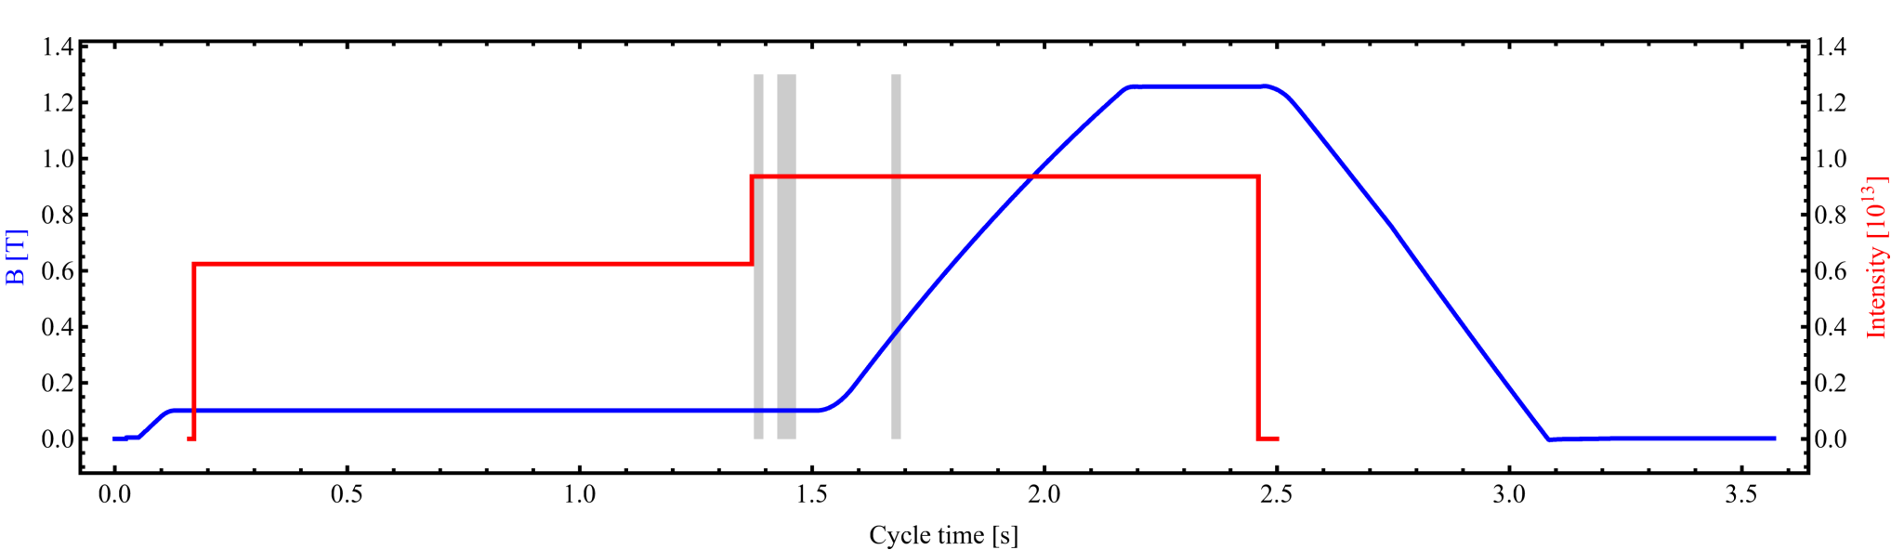
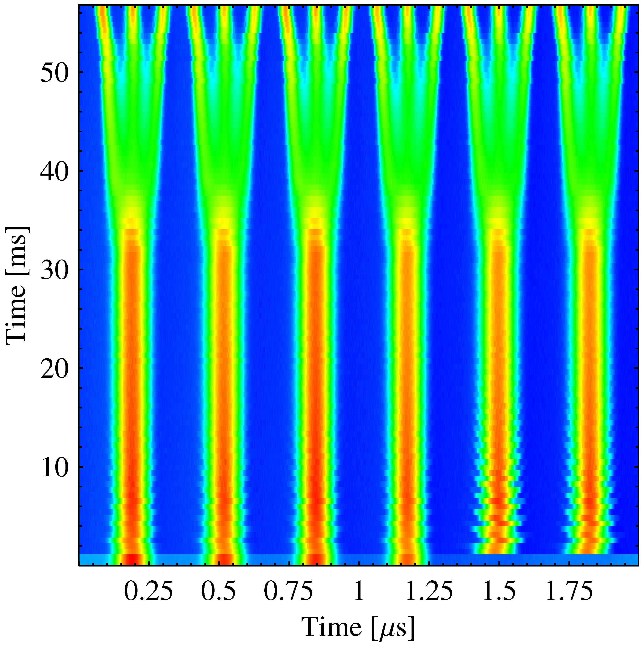
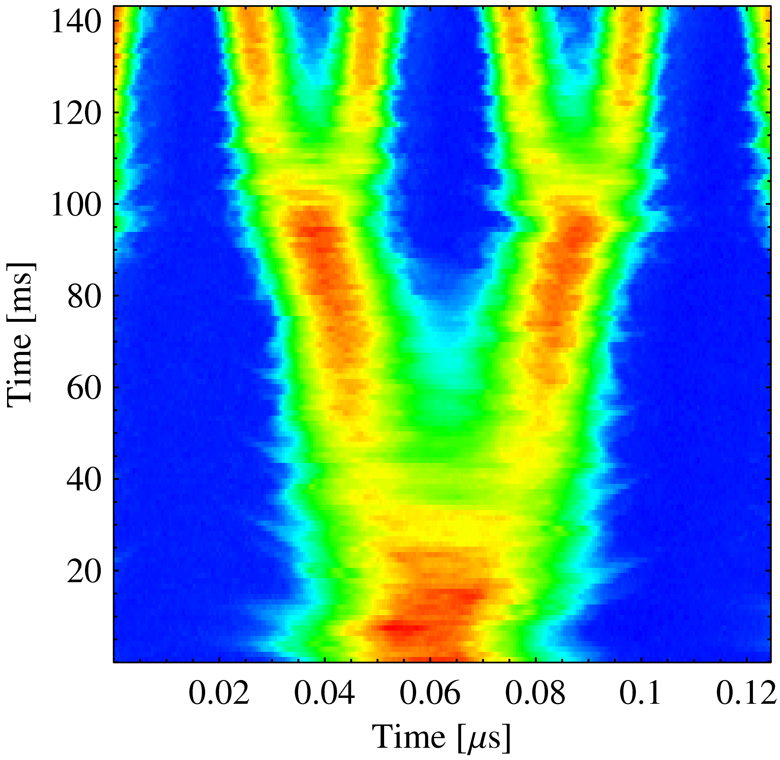
The nominal LHC25 cycle in the PS
γ_{tr}
Reminder
Inject 4+2 bunches
Eject 72 bunches
(sketched)
Low-energy BUs
h = 7
h = 21
High-energy BU
h = 84
Triple splitting after 2nd injection
Split in four at flat top energy
2nd injection
1.4 GeV
26 GeV/c
→ Each bunch from the Booster divided by 12 → 6 × 3 × 2 × 2 = 72

Slide 6
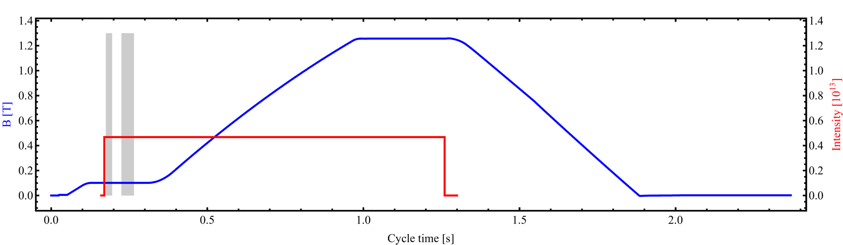
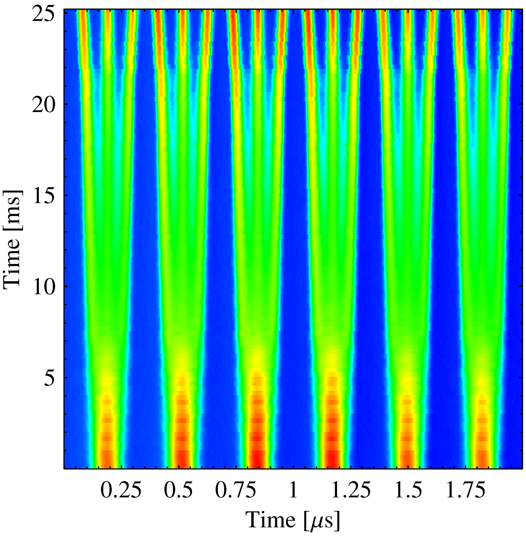
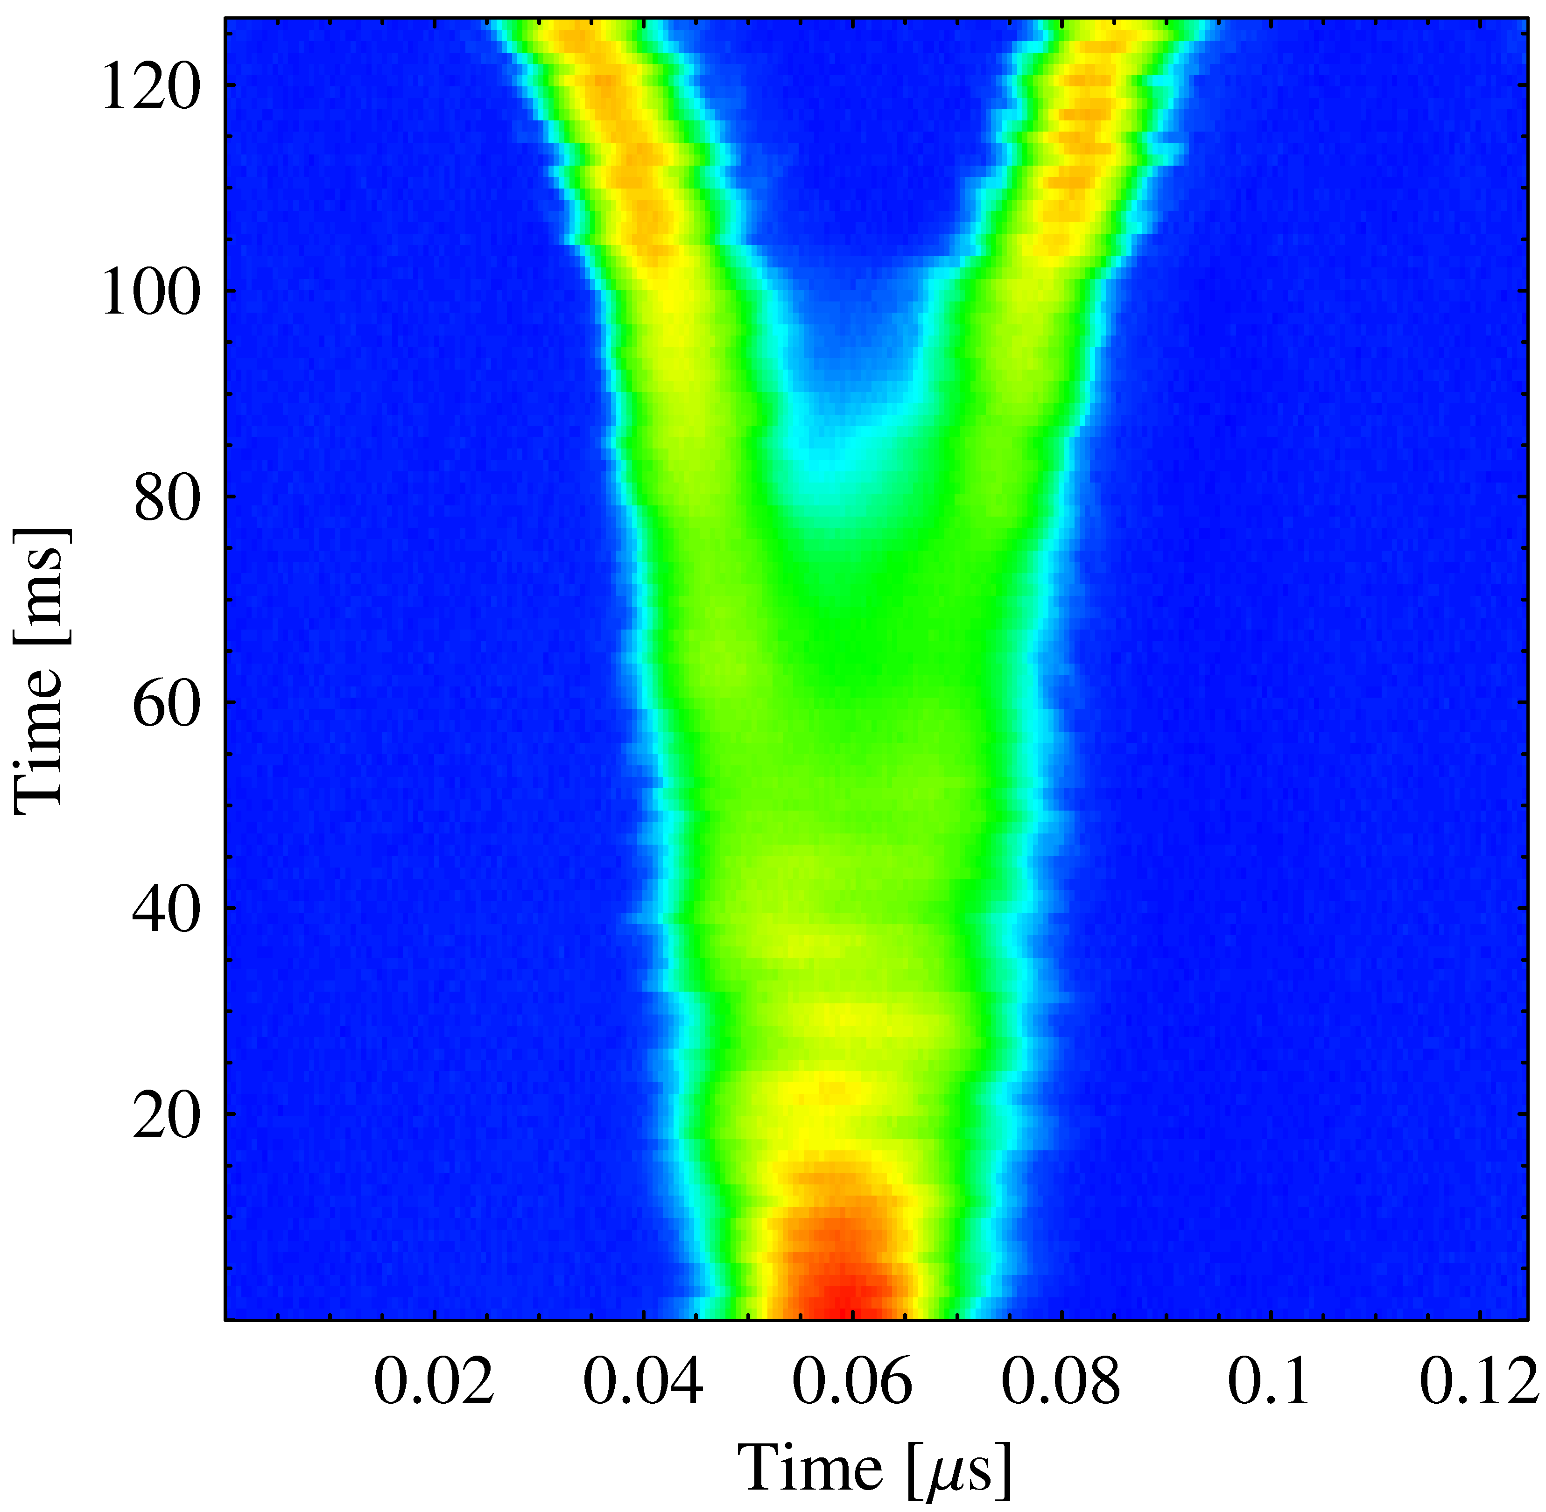
The LHC50 (ns) cycle in the PS
Reminder
Inject 3×2 bunches
Eject 36 bunches
(sketched)
γ_{tr}
h = 21
h = 7
h = 84
Low-energy BUs
Triple splitting after 1st injection
Split in two at flat top energy
1st injection
1.4 GeV
26 GeV/c
→ Each bunch from the Booster divided by 6 → 6 × 3 × 2 = 36

Slide 7
Intensities to anticipate?
Brightness from Linac2 allows to produce ≅ 1.5 · 10¹¹ ppb (at PS ejection) with 25 ns bunch spacing, double-batch
Space charge ratio (at PSB injection): βγ²_{Lin4}/βγ²_{Lin2} ≅ 2
Achievable with Linac4 (at PS ejection):
≅ 3.0 · 10¹¹ ppb, 25 ns bunch spacing, double-batch
≅ 1.5 · 10¹¹ ppb, 25 ns bunch spacing, single-batch
≅ 3.0 · 10¹¹ ppb, 50 ns bunch spacing, single-batch
LHC ultimate, 25 ns: 1.7 · 10¹¹ ppb (at SPS ej.) →
2.1 · 10¹¹ ppb (at PS ej.)
Same luminosity, 50 ns: 2.4 · 10¹¹ ppb (at SPS ej.) →
3.0 · 10¹¹ ppb (at PS ej.)

Slide 8
Longitudinal beam parameters
Beam | Int. [10¹² p/ring] Inj. from PSB | ε_{l} at inj. [eVs] | Int. [10¹¹ ppb] Ej. from PS | ε_{l} at ej. [eVs]
LHC25, nominal | 1.6 (DB) | 0.9 (SB) 1.3 (DB) | 1.3 | 0.35
LHC25, ultimate | 2.5 (DB) |  | 2.1
LHC50, nominal | 1.6 (SB) |  | 1.3
LHC50, ultimate | 2.5 (SB) |  | 2.1
LHC50, beyond ult. | 3.5 (SB), 1.8 (DB) |  | 3.0
SB: single-batch, DB: double-batch transfer

Slide 9
Outline
Introduction
  Impact of 2 GeV upgrade, longitudinal constraints
Limitations according to observations
  Transition crossing
  Coupled-bunch instabilities, impedance sources
  Transient beam loading
What to improve or add?
  Beam-control, low-level RF (LL-RF)
  2.8 – 10 MHz, 20 MHz, 40 MHz, 80 MHz
Summary

Slide 10
Consequences of 2 GeV at injection
Influence of 1.4 GeV or 2 GeV on RF manipulations?
Bucket area:
Synchrotron frequency:
Buckets at E_{kin} = 2 GeV some 50 % larger than at 1.4 GeV
RF manipulations take 50 % longer for the same adiabaticity: Splitting on flat-bottom 25 ms (at 1.4 GeV) → 38 ms (2 GeV)
No major changes required for the RF to inject at E_{kin} = 2 GeV

Slide 11
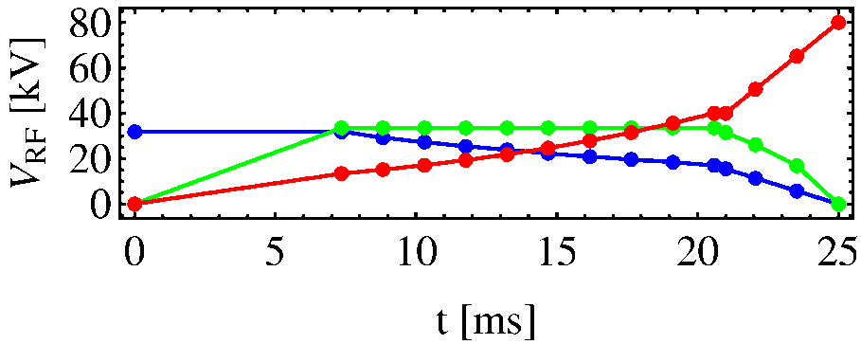
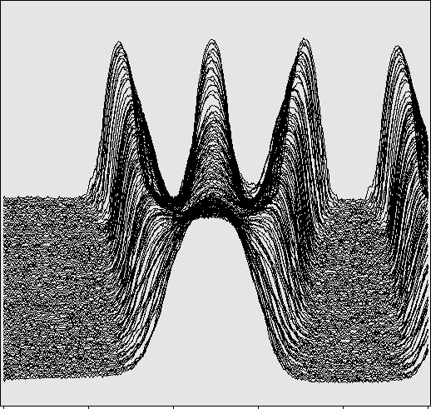
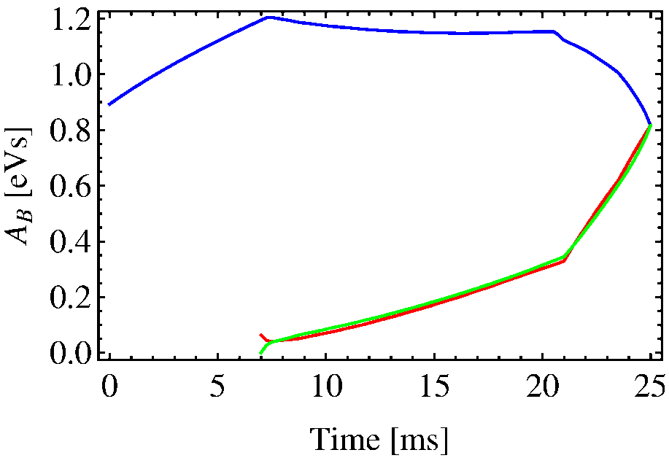
Longitudinal emittance limitation (injection)
Longitudinal beam quality required for PS from PSB:
V_{h7}, V_{h14}, V_{h21}
A_{B}/3 (surrounding)
A_{B} (outer)
25 ms
A_{B} (center)
0
500
Time [ns]
At 1.4 GeV injection energy, longitudinal emittance at injection must not exceed 1.3 eVs per bunch (~ 0.9 eVs in single-batch)
At 2 GeV, up to 2 eVs per injected bunch will be swallowed (double-batch)
Modification of tuning groups does not improve that bottleneck

Slide 12
Control of longitudinal emittance along cycle
Observe peak detected signal (from wall-current monitor) ~ inverse bunch length
Ultimate intensity: 1.9 · 10¹¹ ppb
Nominal: 1.3 · 10¹¹ ppb
Beam current transformer
LHC25 ultimate
BU3
ΔR
BU2
Peak detected WCM
BU4
Beam essentially stable
BU1
100 ms/div
200 ms/div
→ Blow-up 1 adjusts emittance to 1.3 eVs for triple splitting
→ Blow-up 2 increases emittance for loss-free transition crossing
→ Blow-up 3 avoids unstable beam directly after transition crossing
→ Blow-up 4 allows to fine-adjust the final emittance during acceleration
Small increase in emittance (~ 5-10%) improves stability significantly.

Slide 13
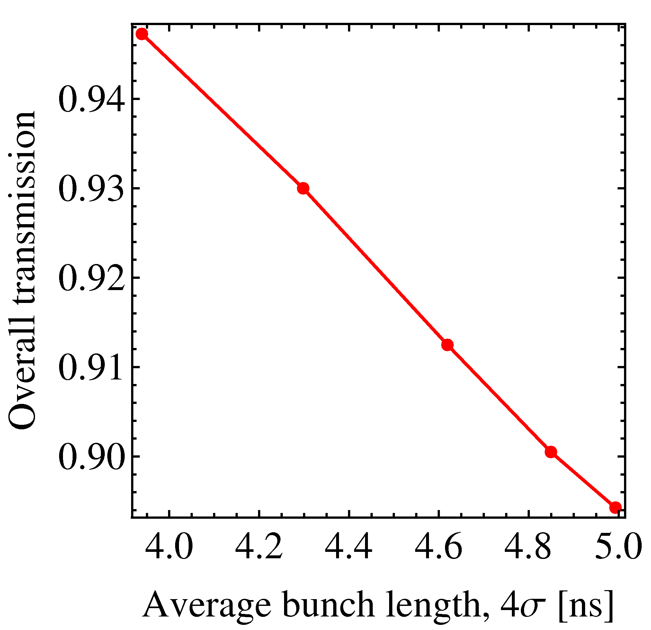
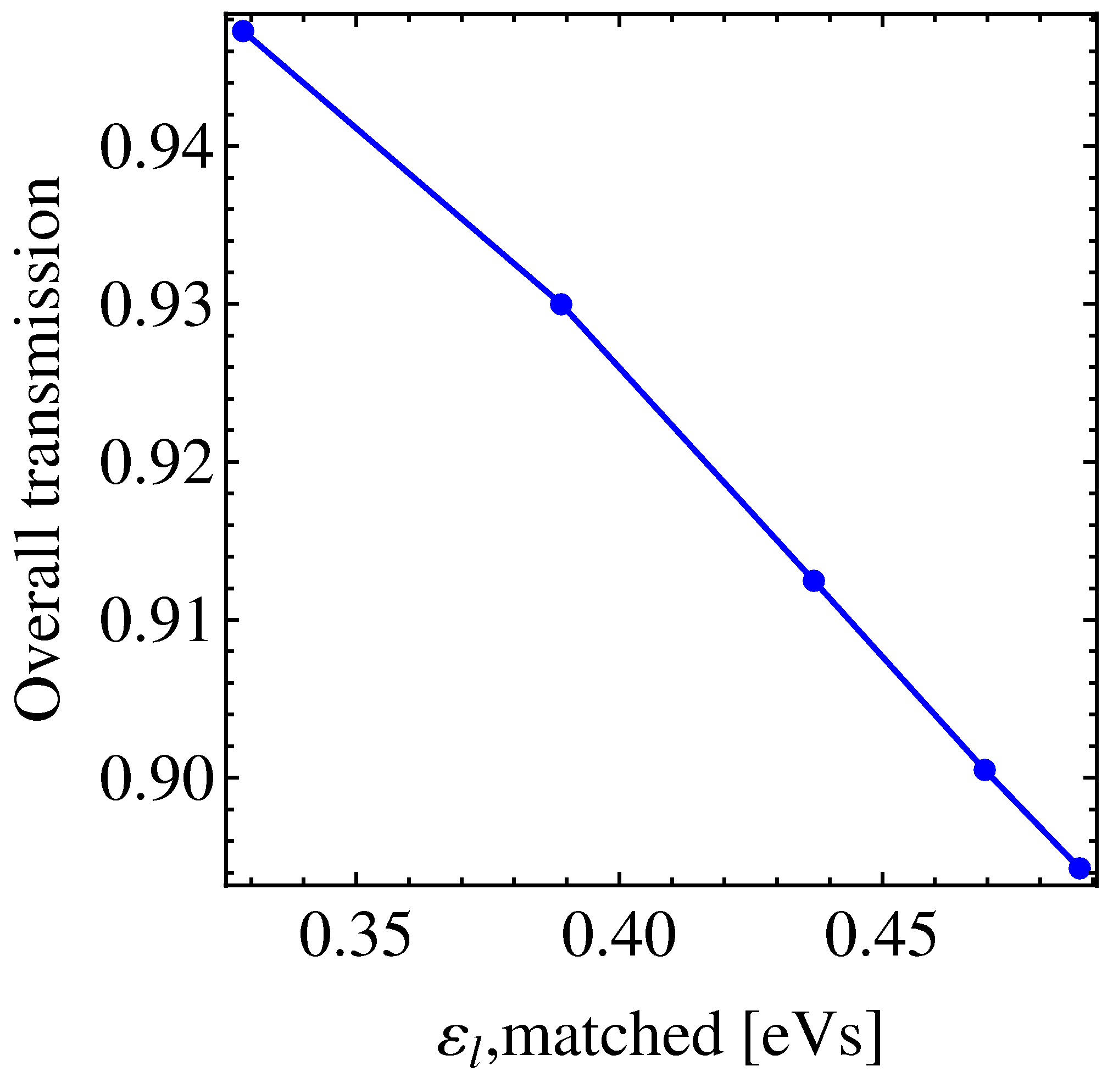
Longitudinal emittance limitation (ejection)
Long. beam quality required for SPS? Is ε_{l} = 0.35 eVs written in stone?
Dependence of beam transmission in SPS from injected beam quality:
Versus 4σ bunch length
Versus longitudinal emittance
N_{ej}/N_{inj}
N_{ej}/N_{inj}
nominal
No increase in bunch length at PS-SPS transfer permissible
Generate the same bunch length with larger ε_{l}? More bunch rotation V_{RF}?
Systematic MDs in 2011 evaluating that route

Slide 14
Outline
Introduction
  Impact of 2 GeV upgrade, longitudinal constraints
Limitations according to observations
  Transition crossing
  Coupled-bunch instabilities, impedance sources
  Transient beam loading
What to improve or add?
  Beam-control, low-level RF (LL-RF)
  2.8 – 10 MHz, 20 MHz, 40 MHz, 80 MHz
Summary

Slide 15
Transition crossing
What matters is longitudinal density at transition:
Beam | Int. [10¹¹ ppb] at ejection | Intensity [10¹¹ ppb] | Long. emittance ε_{l} [eVs] | Density at γ_{tr} [10¹² p/eVs]
LHC25, nominal | 1.3 | 5.2 | 0.6 | 0.9
LHC25, ultimate | 2.1 | 8.4 | 0.6 | 1.4
LHC50, nominal | 1.3 | 2.6 | 0.6 | 0.43
LHC50, beyond ult. | 3.0 | 6.0 | 0.6 | 1.0
SFTPRO/CNGS |  | 17 | 1.4 | 1.2
AD |  | 40 | 2.3 | 1.8
TOF |  | 89 | 2.6 | 3.4
Longitudinal beam density of ultimate beams well below present limitations (with e.g. TOF or AD beams)
No problem up to 2 · 10¹¹ ppb (at PS ej.) during ultimate LHC25 tests
No limitation at transition crossing expected for (beyond) ultimate beams

Slide 16
Observations: acceleration and flat-top
Stable beam until transition crossing, bunch oscillations slowly excited during acceleration with only slightly reduced ε_{l}
Measure bunch profiles starting after last blow-up to arrival on flat-top every 70 ms (for 15 ms, 5-7 periods of f_{s})
γ_{tr}
h = 7
h = 21
High-energy BU
a)
b)
Analyze mode spectrum of 10 cycles at each point and average

Slide 17
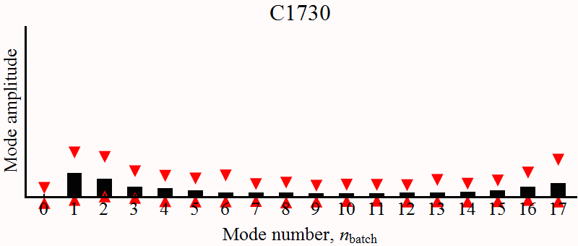
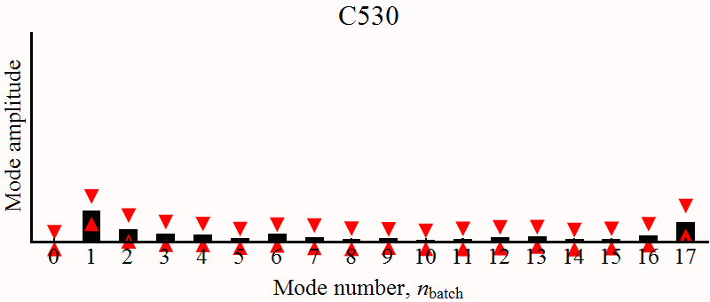
Mode spectra during acceleration
Does the coupled-bunch mode spectrum change at certain points in the cycle? Excitation of resonant impedances?
LHC25
5.2 · 10¹² ppb, ε_{l} = 0.9 eVs
Below nominal
LHC50
2.6 · 10¹² ppb, ε_{l} = 0.5 eVs
• Modes close to bunch (~ h_{RF}f_{rev}) frequency (n = 1, 2, 16, 17) strongest
• Form of mode spectrum remains unchanged all along acceleration
• Similar instabilities with LHC25 and LHC50 suggest scaling ~ N/ε_{l}

Slide 18
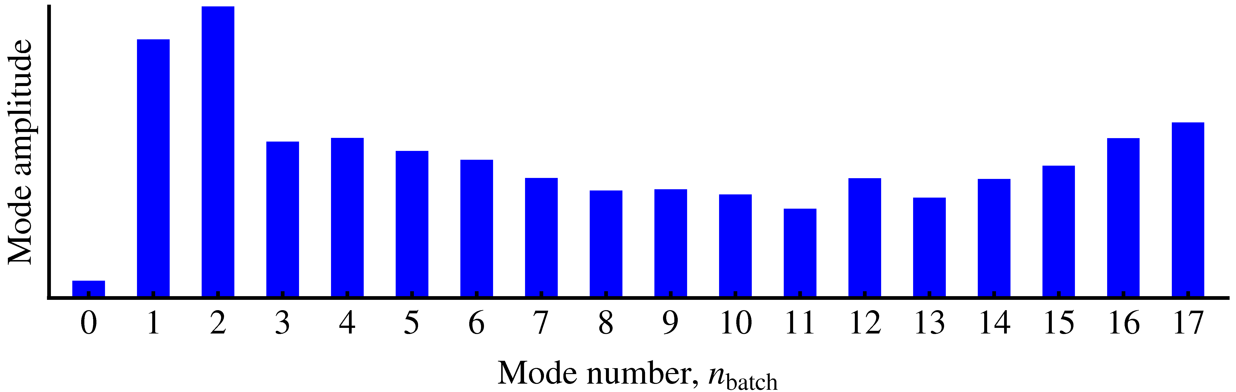
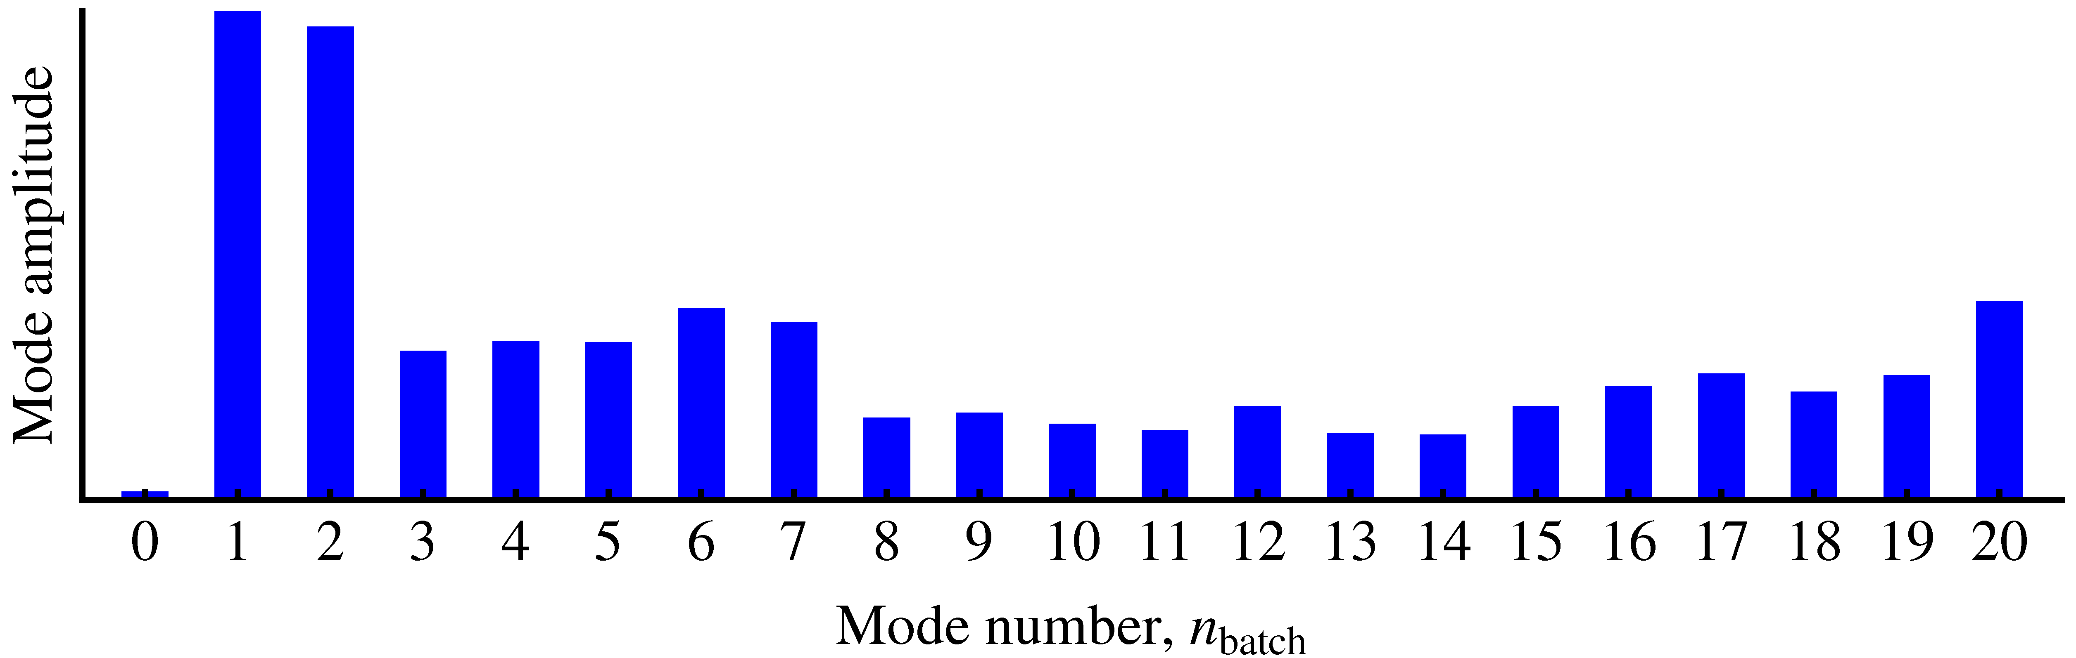
Mode spectra with full machine
What is the influence of the gap of three empty bunch positions?
Mode spectra close to arrival on flat-top (C2010)
6 bunches (b) injected, 18 b accelerated on h = 21
→ 6/7 filling
7 bunches (b) injected, 21 b accelerated on h = 21
→ Full ring
• Again, modes close to RF harmonic are strongest: n = 1,2,19,20
• 1/7 gap for extraction kicker has little effect on mode pattern observed

Slide 19
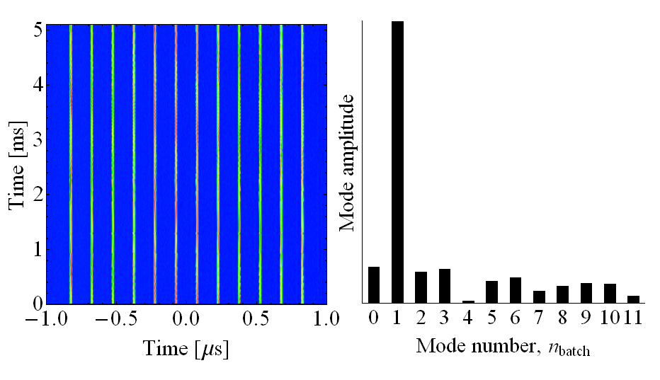
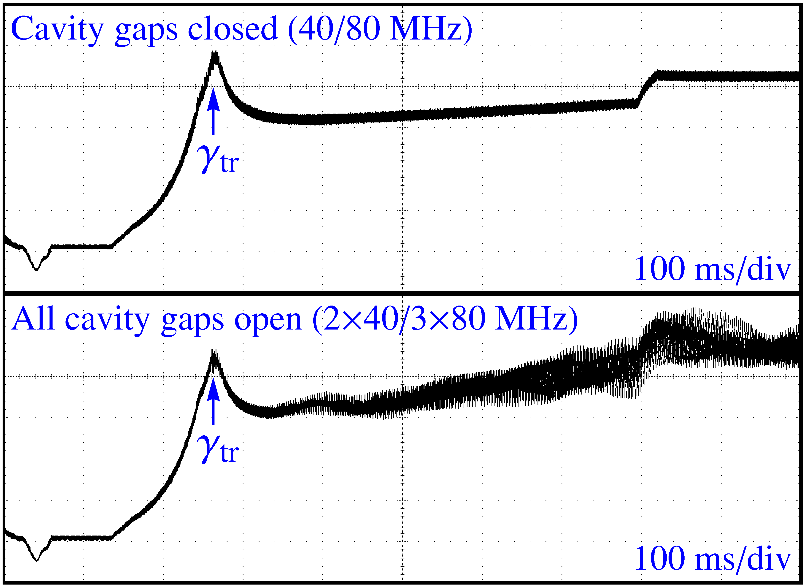
Quadrupole coupled-bunch with 150 ns
Longitudinally unstable beam with a total intensity of only 1 · 10¹² ppp:
→ Beam sweeps into resonance
No dipole, but quadrupole coupled-bunch oscillations
Strength depends on number of 40/80 MHz cavities with gap open
• Small longitudinal emittance during acceleration: ε_{l} = 0.3 eVs
• Short bunches with large high frequency spectral components
• Couple to 40/80 MHz cavities as driving impedance

Slide 20
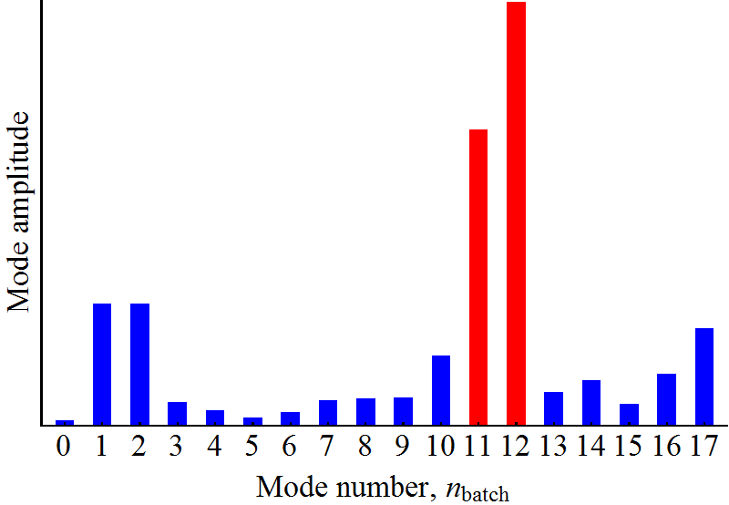
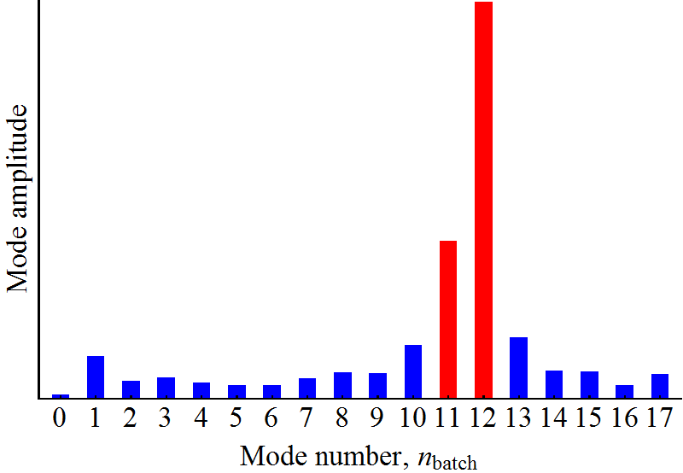
Mode spectra of oscillations on the flat-top
Compare both LHC beam variant with 18 bunches in h = 21 on flat-top:
LHC50
LHC25
V_{RF} = 20 kV, 2.6 · 10¹² ppb, ε_{l} = 0.65 eVs
V_{RF} = 10 kV, 5.2 · 10¹² ppb, ε_{l} = 1.3 eVs
• Very different from mode spectrum during acceleration
• Coupled-bunch mode spectrum reproducible and similar in both cases
• Mode spectrum very similar for the same longitudinal density ~ N/ε_{l}
• Stronger oscillations are observed for bunches at the end of the batch → filling time small enough to empty during gap (~ 350 ns) → 10 MHz
• Major impedance change acceleration/flat-top with 10 MHz cavities

Slide 21
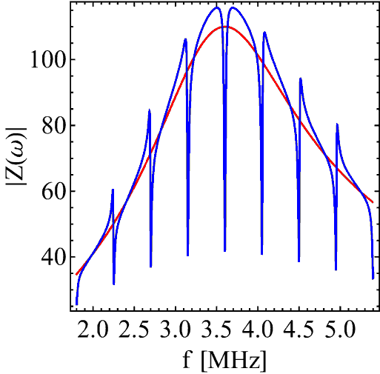
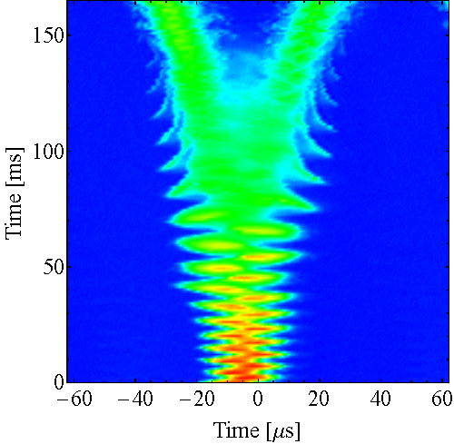
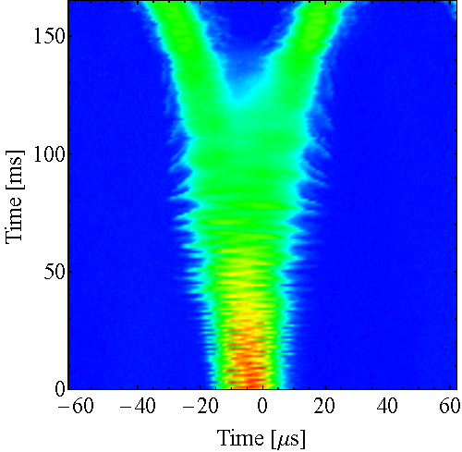
Active: 1-turn delay feedback
Z [Ω]
Comb-filter FB: Decreases residual impedance at f_{rev} harmonics
Local feedback around each of the 10 MHz cavities (ten systems)
f [MHz]
F. Blas, R. Garoby, PAC91, pp. 1398-1400
LHC50ns ultimate, splitting on flat-top
FB OFF
FB ON
Especially effective on the flat-top → Impedance source 10 MHz cavities
More measurements with LHC-type beams required

Slide 22
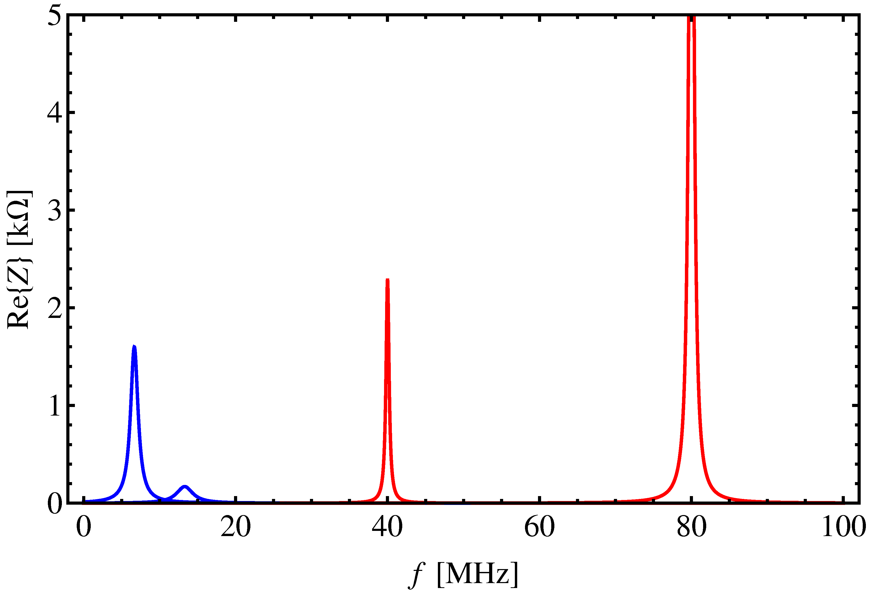
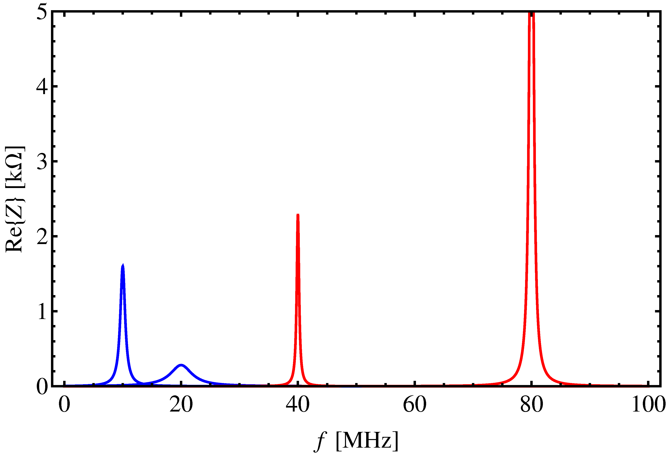
Longitudinal impedance model
Main longitudinal impedances are the RF systems
LHC75, LHC150ns
LHC25, LHC50ns
80 MHz
80 MHz
10 x 6.7 MHz
h = 168
10 x 10 MHz
h = 168
13.3 MHz, h = 28
20 MHz, h = 42
40 MHz
40 MHz
h = 84
h = 84
• Impedance model changes along the cycle (tuning, gap relays, etc.)!
• Coupled-bunch oscillations during acceleration and on the flat-top (LHC25, LHC50, LHC75) mostly driven by 2.8 – 10 MHz RF
• Short bunches of LHC150ns couple to 40 MHz and 80 MHz cavities
• Effect of 200 MHz RF cavities?

Slide 23
Outline
Introduction
  Impact of 2 GeV upgrade, longitudinal constraints
Limitations according to observations
  Transition crossing
  Coupled-bunch instabilities, impedance sources
  Transient beam loading
What to improve or add?
  Beam-control, low-level RF (LL-RF)
  2.8 – 10 MHz, 20 MHz, 40 MHz, 80 MHz
Summary

Slide 24
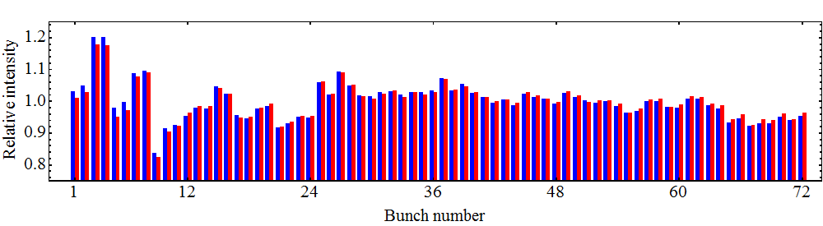
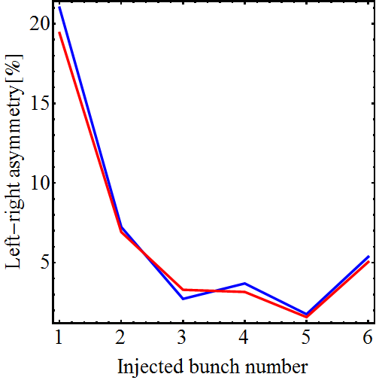
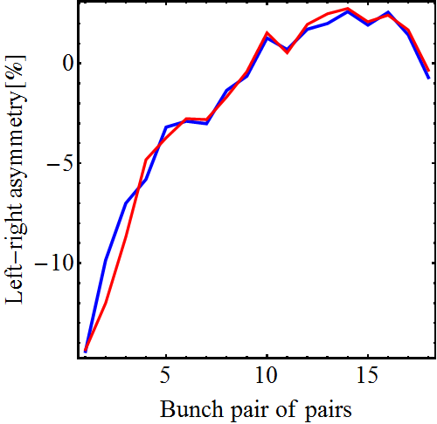
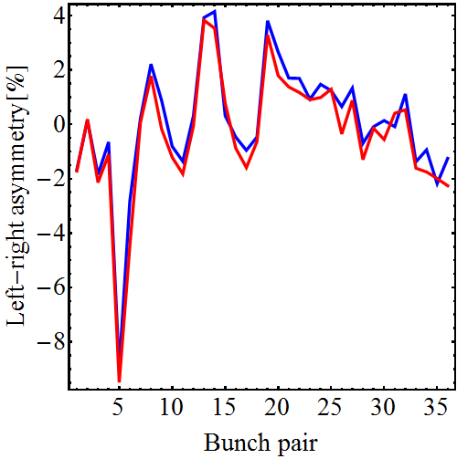
Asymmetry during splittings: transient BL
Bunch profile integral
Gauss fit integral
N ≅ 1.8 · 10¹¹ ppb, average over ten cycles
Triple split
1st double split
2nd double split
Transient BL causes relative intensity errors of up to 20 % per splitting at the head of the bunch train

Slide 25
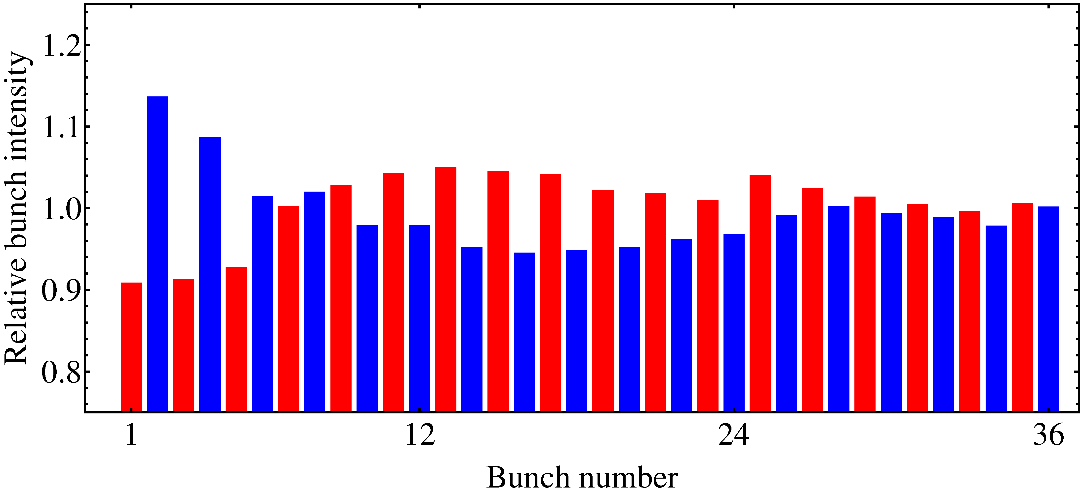
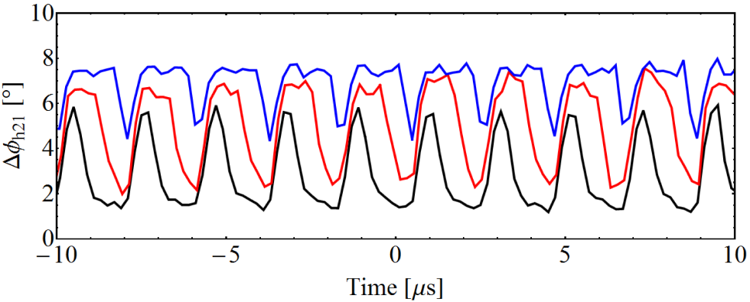
50 ns: transient beam loading
Bunch intensity along batch:
N_{b} = ~ 1.9 · 10¹¹ ppb
Fast phase measurement 10/20 MHz returns during h = 21 → 42 splitting:
36 bunches (6/7 filling)
24 bunches (4/7 filling)
12 bunches (2/7 filling)
More than 20 % intensity spread at the head of the bunch train

Slide 26
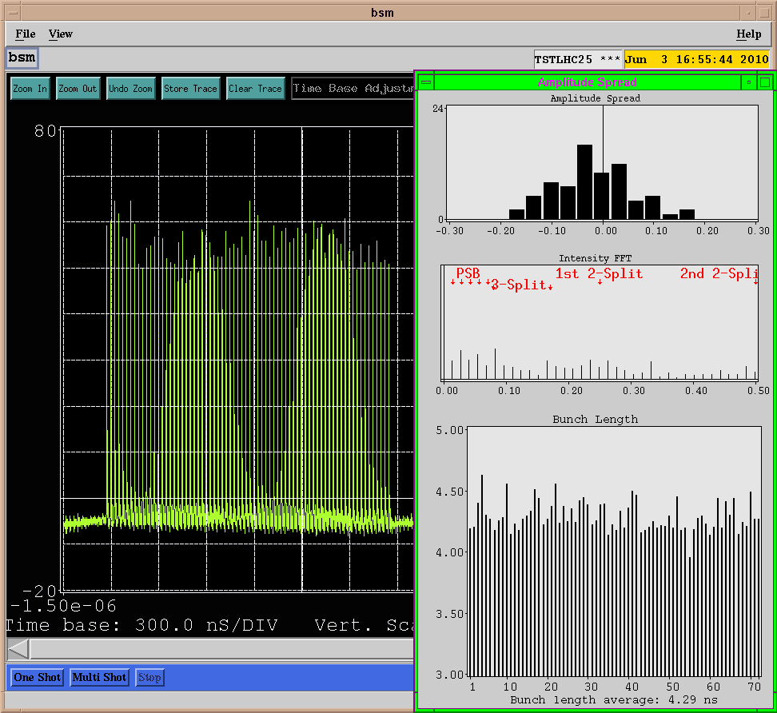
Beam quality at extraction (25ns)
Without coupled-bunch feedback
N ≅ 1.8 · 10¹¹ ppb
Longitudinal emittance ~ 0.38 eVs slightly above nominal

Slide 27
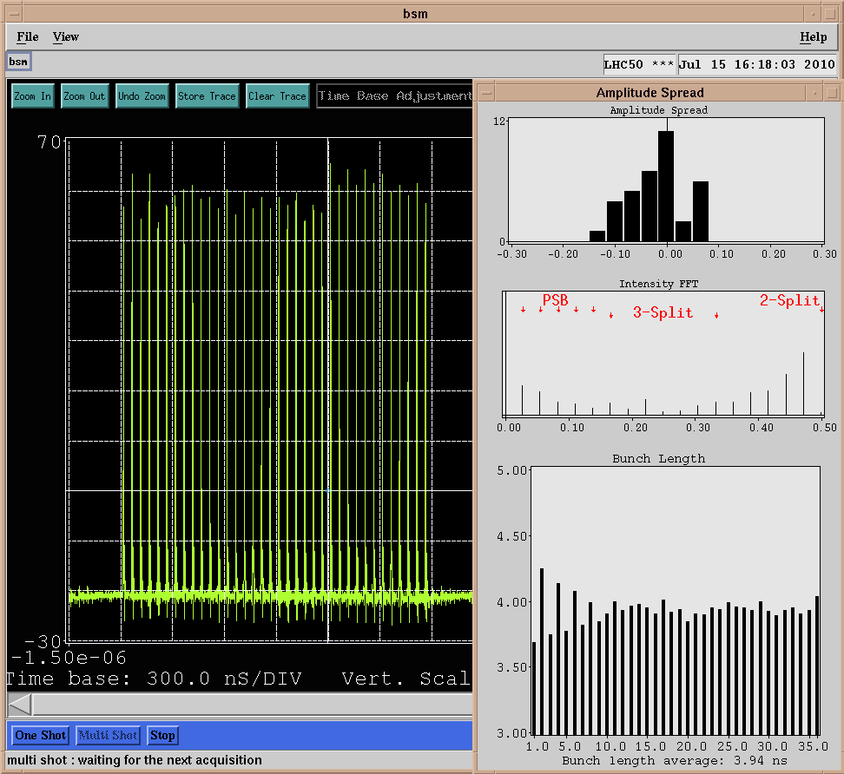
Beam quality at extraction (50ns)
With coupled-bunch feedback
N ≅ 1.9 · 10¹¹ ppb
Longitudinal emittance close to nominal

Slide 28
Outline
Introduction
  Impact of 2 GeV upgrade, longitudinal constraints
Limitations according to observations
  Transition crossing
  Coupled-bunch instabilities, impedance sources
  Transient beam loading
What to improve or add?
  Beam-control, low-level RF (LL-RF)
  2.8 – 10 MHz, 20 MHz, 40 MHz, 80 MHz
Summary

Slide 29
What can be improved?
Suppress coupled-bunch oscillations
  New coupled-bunch feedback
  Reduce coupling impedances of RF systems
Reduce transient beam-loading
  Detuning of unused cavities
  Gap short-circuits
  1-turn delay feedbacks (comb-filter feedbacks)

Slide 30
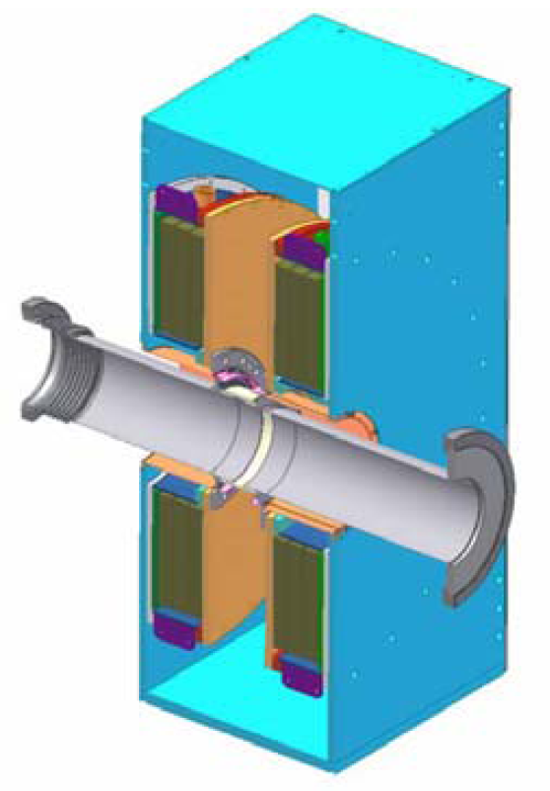
Improvements of LL-RF systems
Fully digital beam control
  Flexibility, stability, optimized loop characteristics
  Improve interaction between various loops: tuning, AVC, etc.
  No major impact on beam stability nor transient effects
New coupled-bunch feedback
  Detect synchrotron frequency side-bands at harmonics of f_{rev} ≠ h_{RF} and feed them back to the beam
  Present system limited to components at h_{RF} – 1 and h_{RF} – 2
  New electronics (based on 1-turn feedback board) will remove that limitation + quadrupole modes
  Dedicated kicker cavity (0.4 – 5 MHz) damping all modes coupled-bunch modes? If needed!
  Needs its own strong wide-band feedback!
M. Paoluzzi et al., PAC2005

Slide 31
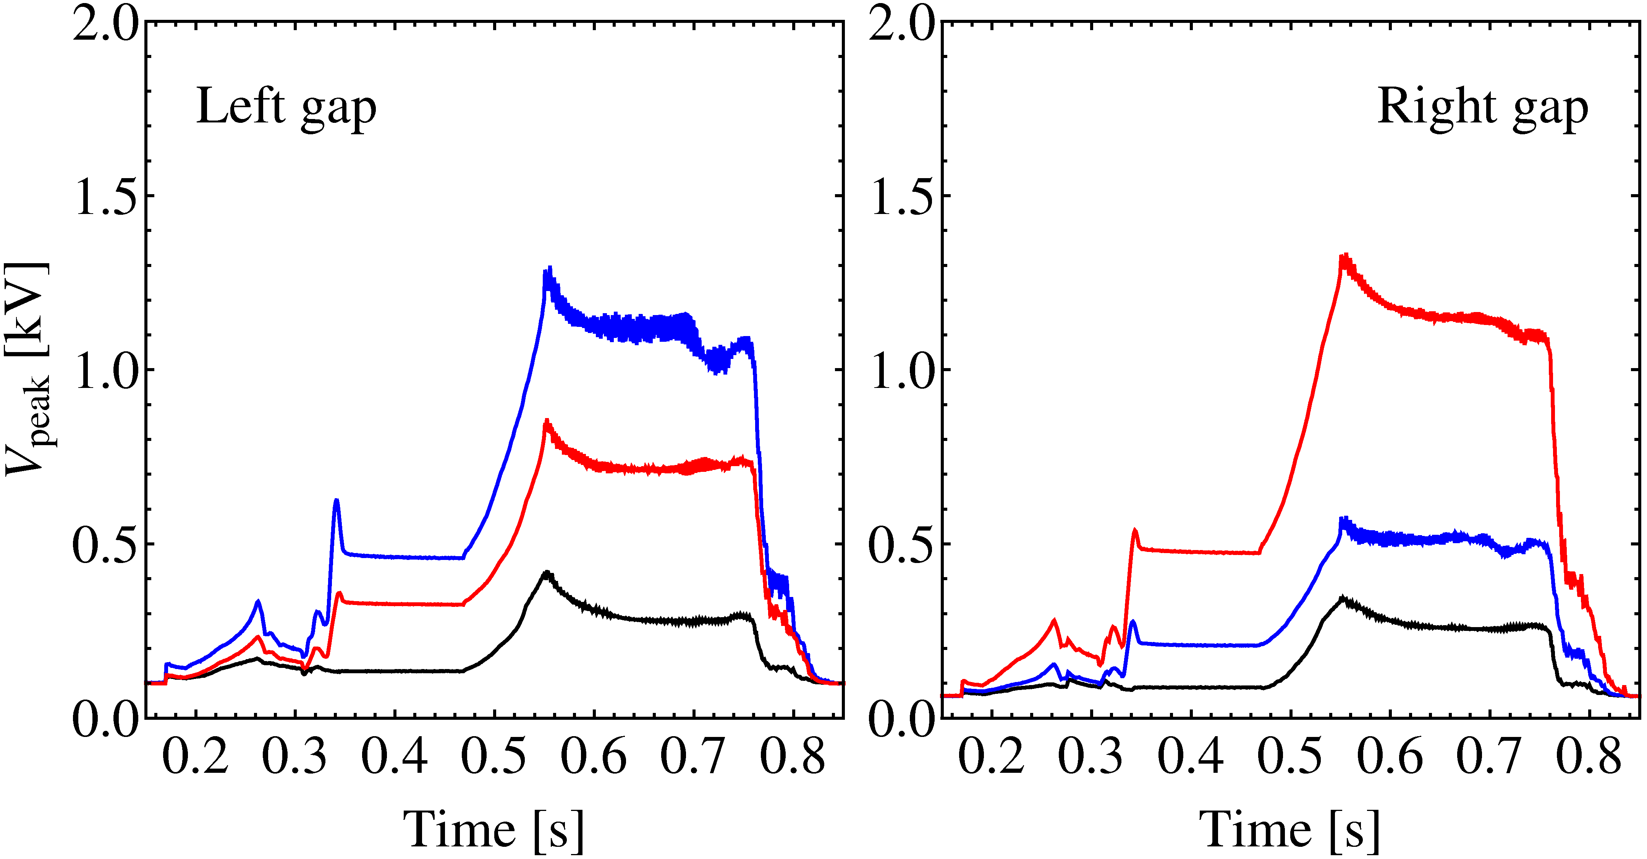
2.8 – 10 MHz RF system
Recent improvements:
  2nd gap relay decreasing impedance of unused cavities
  Tune unused cavities to parking frequency
Flexible new 1-turn delay FB
  Prototype tests beginning 2011
Beam induced voltage, e.g. C10-46
Right open
Left open
Both gaps closed
Change tuning group structure?
Improve direct feedback around the amplifier?
Rebuilt power amplifier (tube per cavity half)?

Slide 32
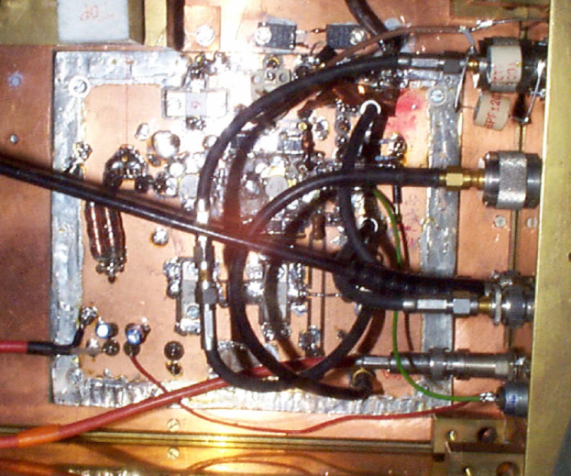
2.8 – 10 MHz cavity amplifier
High-power stage:
  RS1084 tube with 70 kW anode dissipation
Feedback amplifier:
  Presently: two stage design with 1+2 YL1056 tubes: 26 dB gain
  Tests replacing pre-driver tube by MOSFET in 2000/2001: 30 dB, but no reliable operation. Radiation? Electronic problem?
R. Garoby et al., PAC89
A. Labanc, diploma thesis, 2001
Evaluate potential of transistorized FB amplifier
  Replacement of pre-driver only or pre-driver/driver by MOSFETs
  Expected improvement of loop delay and loop delay: 3...6 dB
Study coupling between two resonators in each cavity
  What could be gained driving each resonator with its own amplifier?

Slide 33
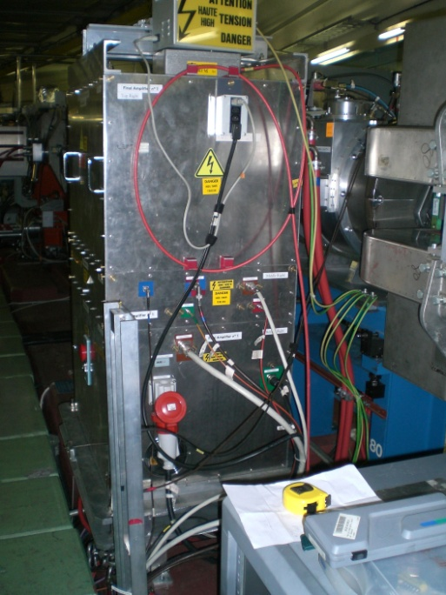
20 MHz RF system
Insignificant impedance contribution during acceleration since each of two gaps short-circuited by a relay
Margin increasing feedback gain?
  Feedback amplifier already close to cavity
Add 1-turn delay feedback to reduce impedance at f_{rev} harmonics
  Straight-forward since frequency fix
Add slow phase (forward vs. return) phase control to improve stability
13/20 MHz
1-turn delay feedback most promising to reduce beam loading effects with splitting on flat-bottom

Slide 34
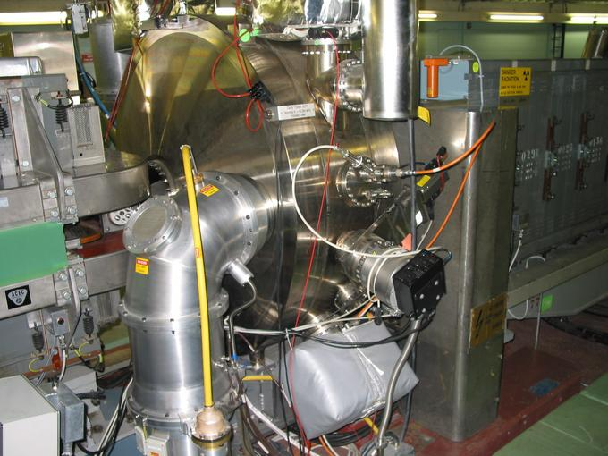
40 MHz RF system
Margin increasing feedback gain?
  Not with present hardware
  Develop new feedback amplifiers to be installed in grooves between ring and tunnel?
Improve residual impedance of unused cavity?
  Gap relay impossible as cavity in primary vacuum
  Pneumatic gap short-circuit not for PPM operation
  Add 1-turn delay feedback with switchable notch on h_{RF} as gap relay substitute?
Detune cavity in-between f_{rev} harmonic when not in use?
More voltage per cavity?
Renovate existing slow tuning loop
Add slow phase control loop to improve reliability
40 MHz

Slide 35
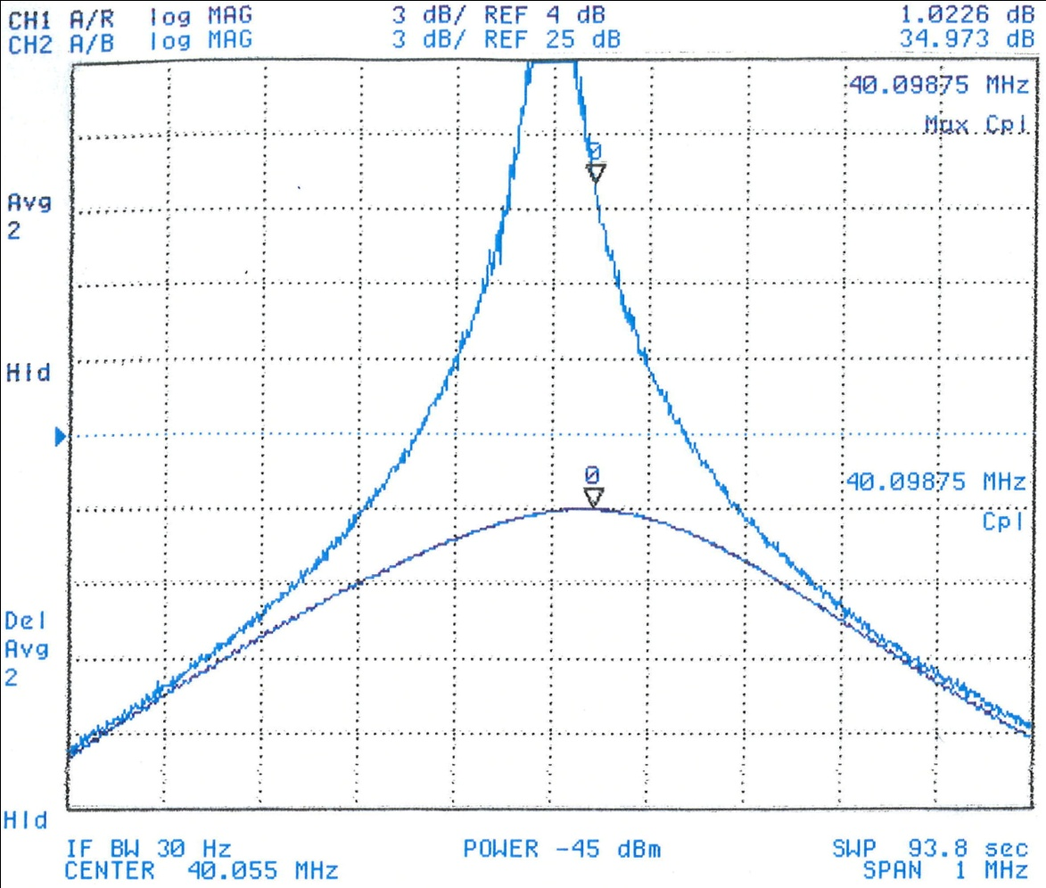
40 MHz RF system
Expected improvement:
Reducing delay of wide-band feedback: To be studied
Detuning in-between f_{rev} harmonics: ~ 4 dB more impedance reduction (37% less)
Notch filter feedback: > 10 dB more gain
Power limit of amplifiers?
f_{rev}
Open loop
Courtesy of A. Marmillon
Closed loop
C40-77
Reduce transient effects during bunch splitting on the flat-top
Reduce coupled-bunch excitation of short bunches during acceleration

Slide 36
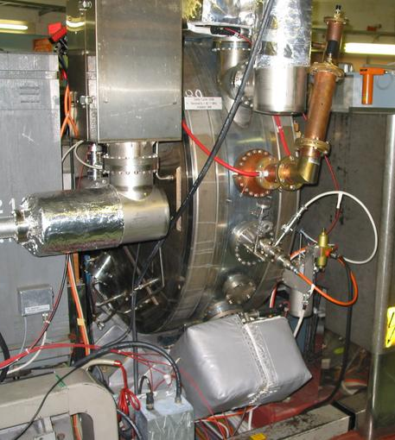
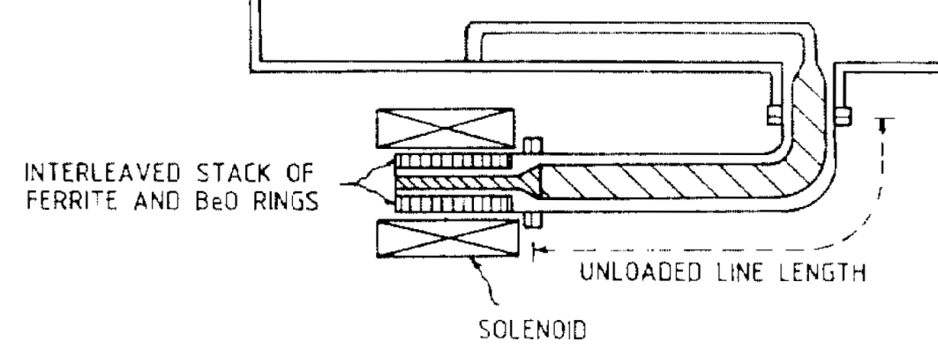
80 MHz RF system
Possible improvements very similar to those for 40 MHz RF cavities:
  Increased direct feedback gain only with new amplifier close to the cavity
  Add 1-turn delay feedback with switchable notch
  Add fast ferrite tuner to allow fast tuning between protons/ions (Δf = 230 kHz) and detuning in-between beam components when not in use
  More voltage? Per cavity? Add fourth 80 MHz installation?
  Add slow tuning loop
  Add slow phase control loop
80 MHz
PETRA cavity tuner: Δf = 400 kHz at 52 MHz
R. M. Hutcheon, Perpendicular biased ferrite tuner, PAC87

Slide 37
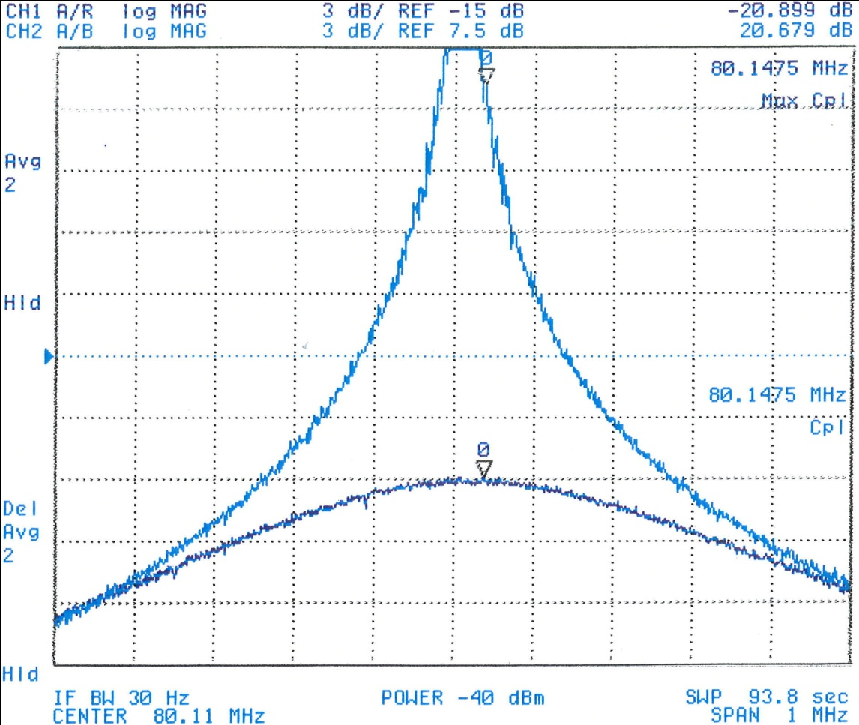
80 MHz RF system
Expected improvement:
Reducing delay of wide-band feedback: To be studied
Detuning in-between f_{rev} harmonics: ~ 2 dB more impedance reduction (20% less)
Notch filter feedback: > 10 dB more gain
Power limit of amplifiers?
f_{rev}
Open loop
Courtesy of A. Marmillon
Closed loop
C80-89
Flexibility to operate protons and ions simultaneously
Reduce coupled-bunch excitation of short bunches during acceleration
Additional cavity: short bunches with relaxed longitudinal emittance

Slide 38
Summary
Main longitudinal limitations:
1. Coupled-bunch instabilities during acceleration and on flat-top
  New coupled-bunch feedback: based on 1-turn delay electronics
  Longitudinal kickers: 10 MHz RF cavities or dedicated wide-band cavity?
  Impedance reduction of all cavities, especially 2.8 – 10 MHz
2. Transient beam loading during bunch splitting manipulations
  Distributed issue: all RF systems for bunch splittings concerned
  10 MHz: new 1-turn delay feedback, new feedback amplifier or completely new amplifier?
  20 MHz: 1-turn delay feedback
  40 MHz: 1-turn delay feedback, new feedback amplifier?
  80 MHz: 1-turn delay feedback, new feedback amplifier, fast ferrite tuner?
Still room for studies and improvements!

Slide 39
Thank you for your attention!

