Slide 1
Task 9.5: Lasertreatment of Nb films
Arturs Medvids
Laboratory of Semiconductor Physics, Institute of Technical Physics, Faculty of Materials Science and Applied Chemistry, Riga Technical University, P. Valdena 3/7, Riga, LV-1048, Latvia
17.02.2022.

Slide 2
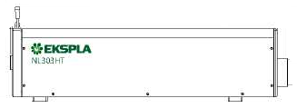
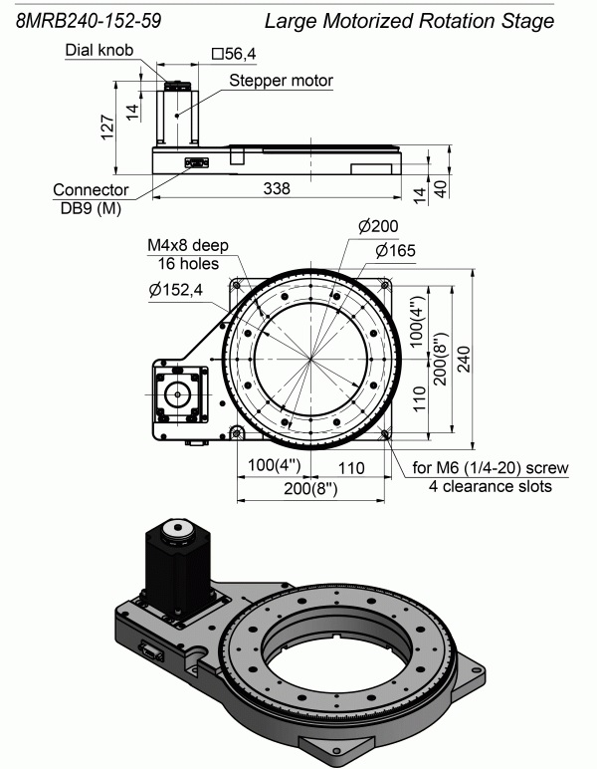
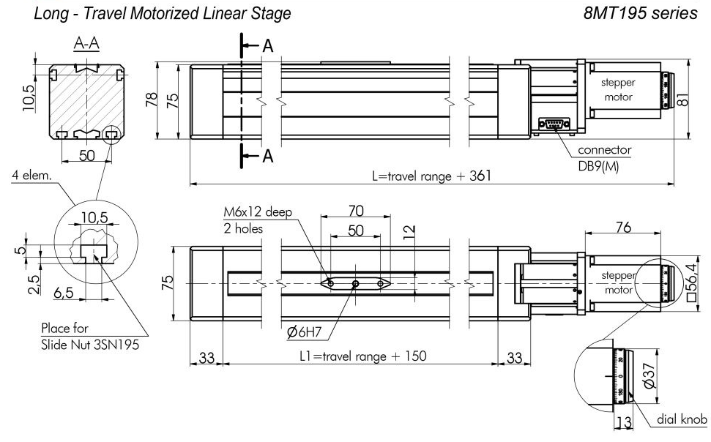
The motorized laser facility for irradiation inner surface of RF cavity
Mirror
Laser

Slide 3
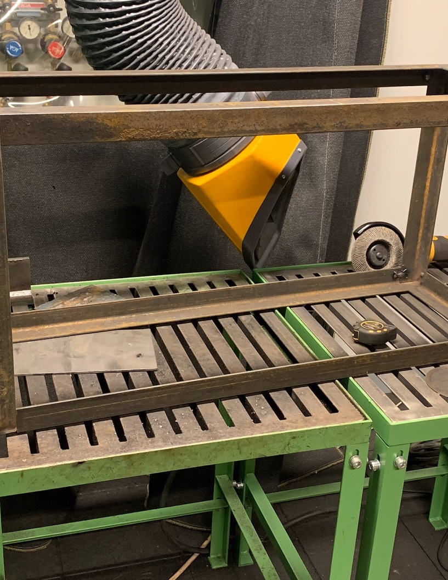
Vacuum box

Slide 4
Conclusion
1. Assembly of the facility for irradiation inner surface of RF cavity.
2. Software development for synchronization of both rotation and linear stages.

Slide 5
Thank you very much
for your attention!

