Slide 1



EW & Higgs Boson:
Experimental Review (LHC)
B.Mellado
University of the Witwatersrand/iThemba LABS
CTEQ Summer School 2022, Pittsburg
14-15/07/2022

Slide 2

Outline
The EW Lagrangian
W Mass
Top Quark mass and cross-sections
Higgs boson: The main channels
  Mass
  Sensitivity to coupling strength
  Spin/CP quantum numbers

Slide 3
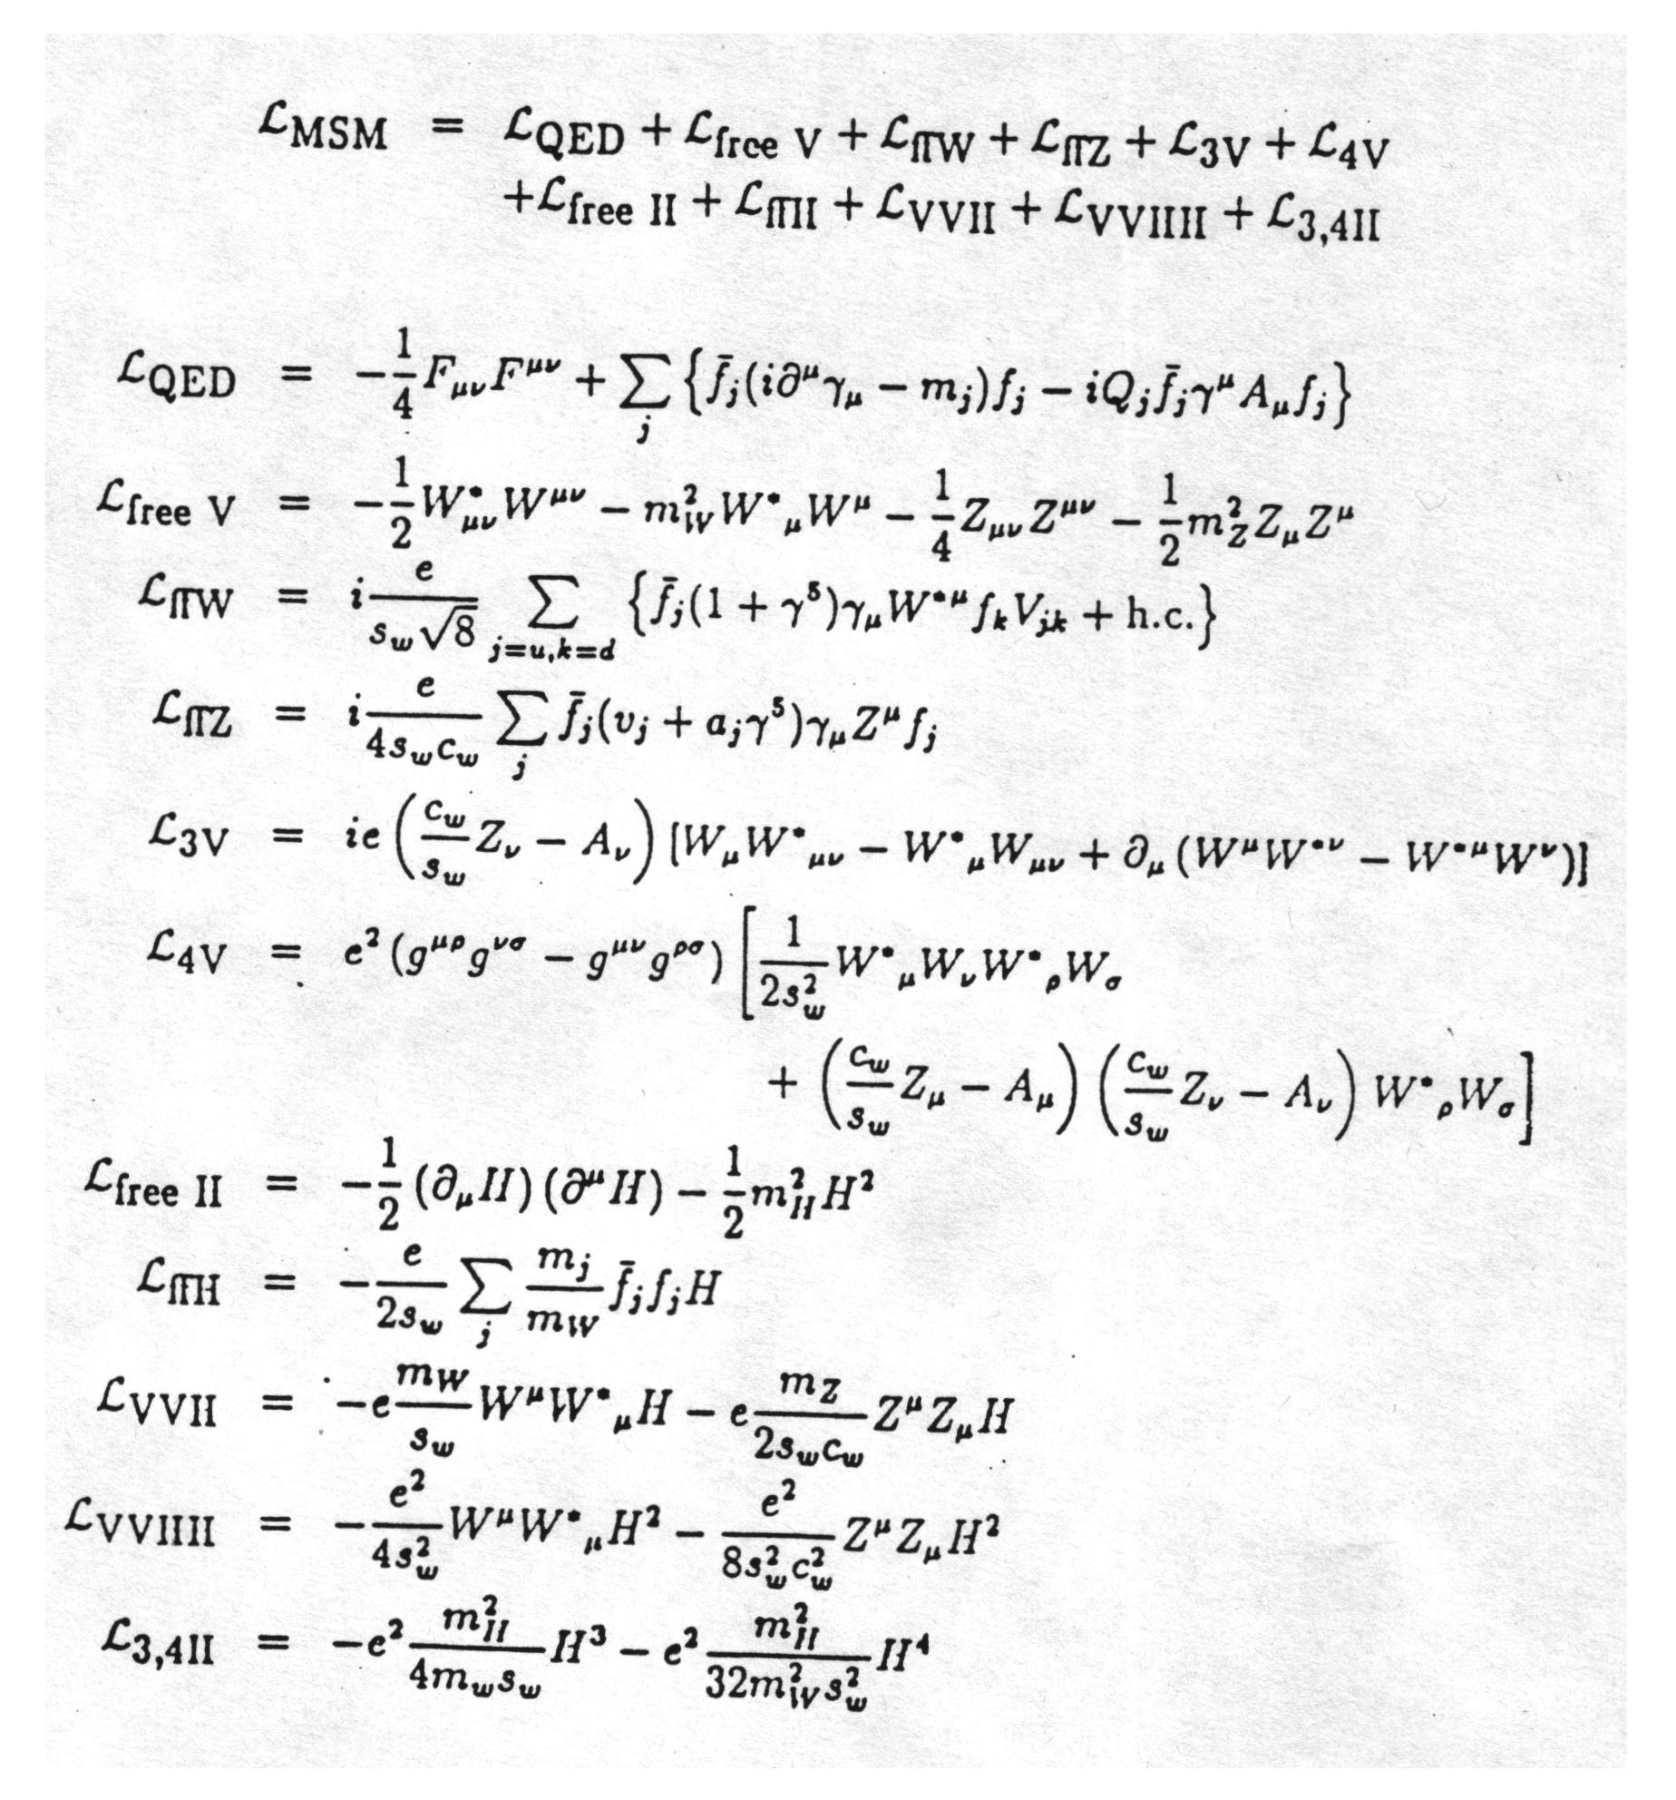
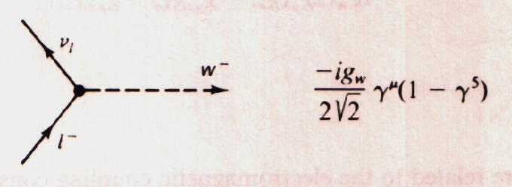
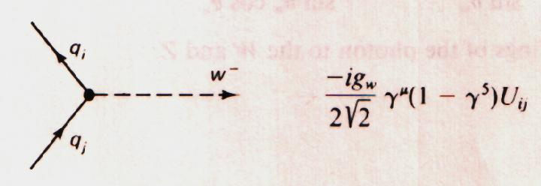
Electroweak Lagrangian
Important for M_{W}
Important for m_{top}

Slide 4
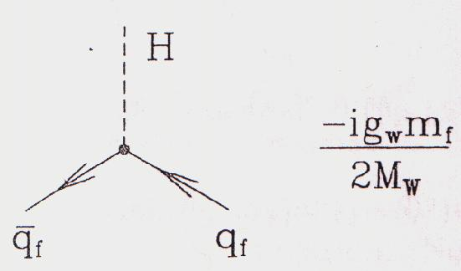
Electroweak Lagrangian
Higgs couples to all fermions in proportion to their mass
Important for m_{top}

Slide 5
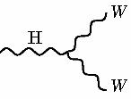
Electroweak Lagrangian
Higgs couples to W and Z
WWH vertex
ZZH vertex
Important for M_{W}

Slide 6
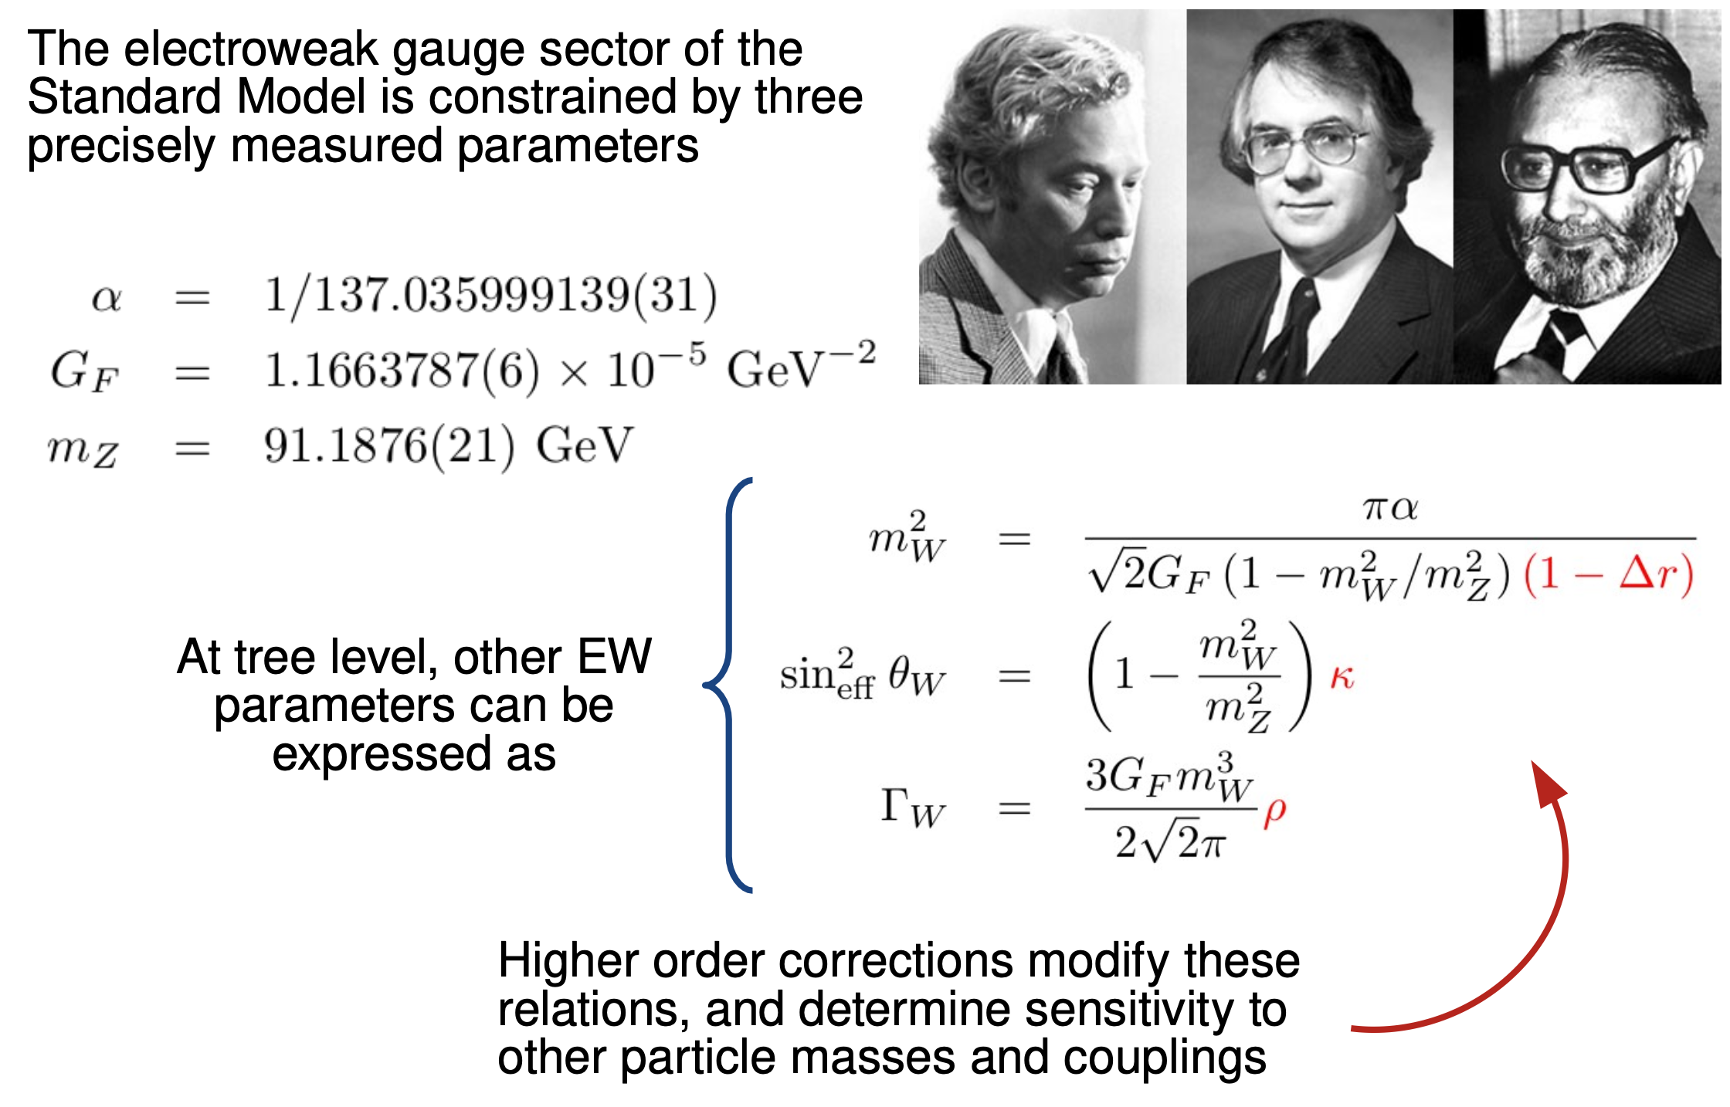
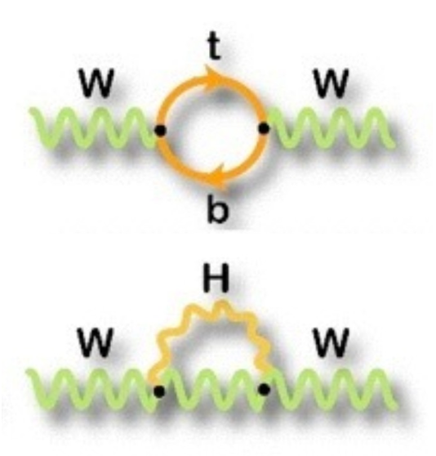

Slide 7
The W Mass Measurement

Slide 8
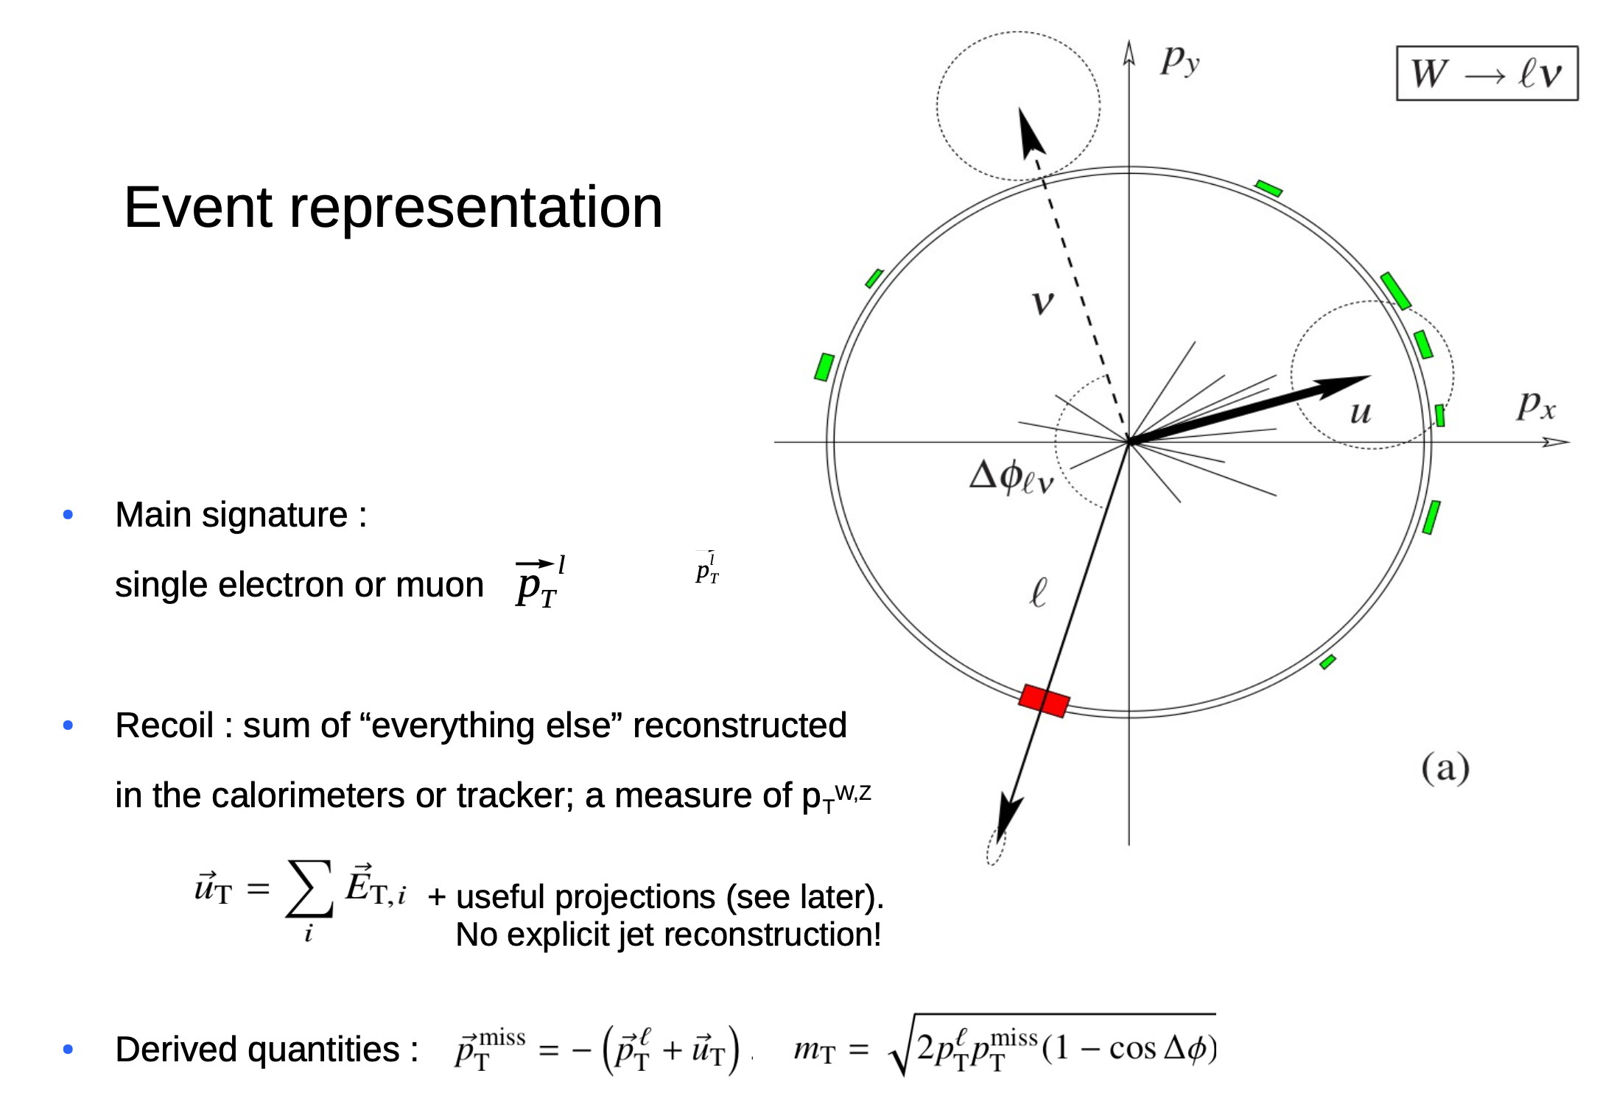
M.Boonekamp

Slide 9
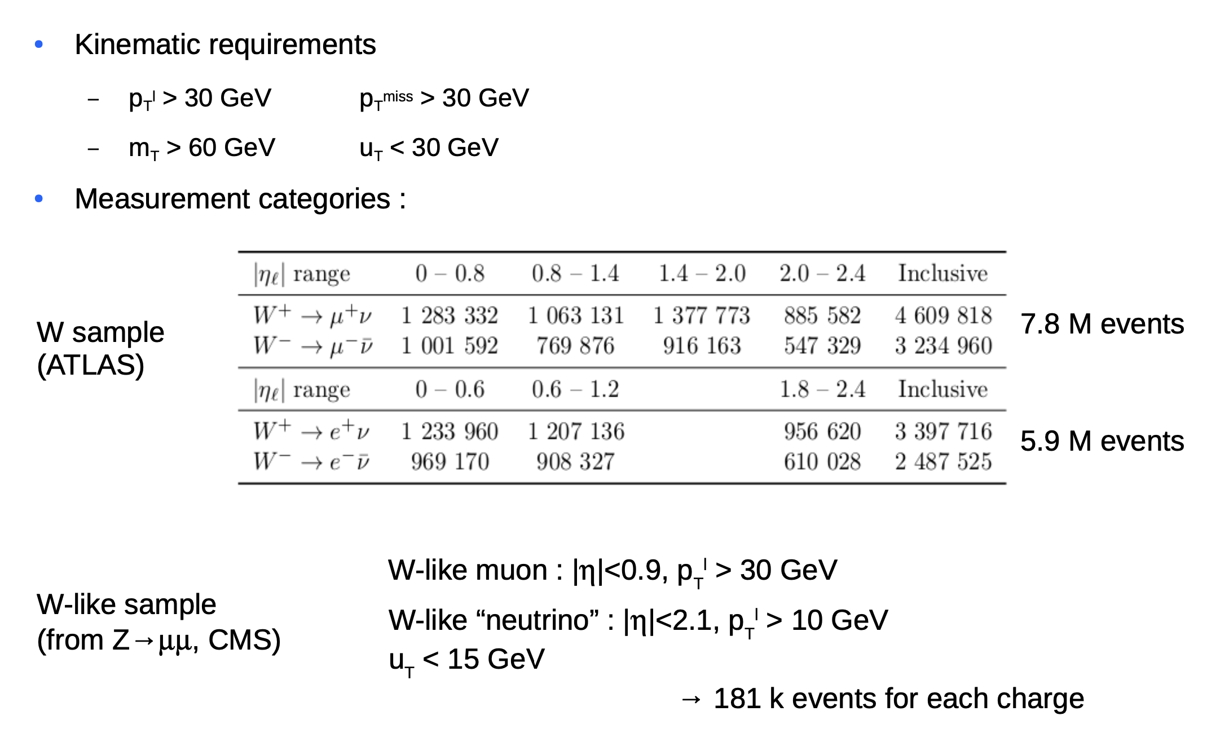
Event Selection

Slide 10
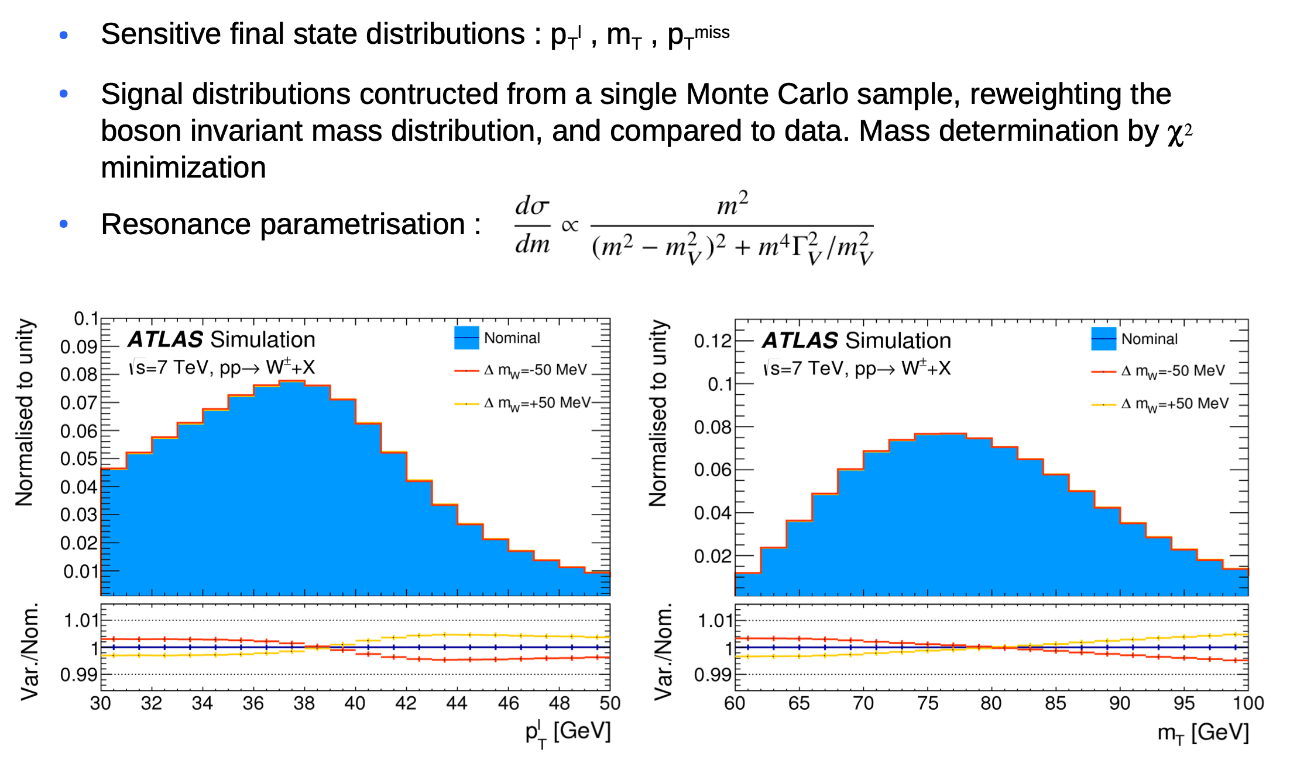
Sensitive Observables

Slide 11
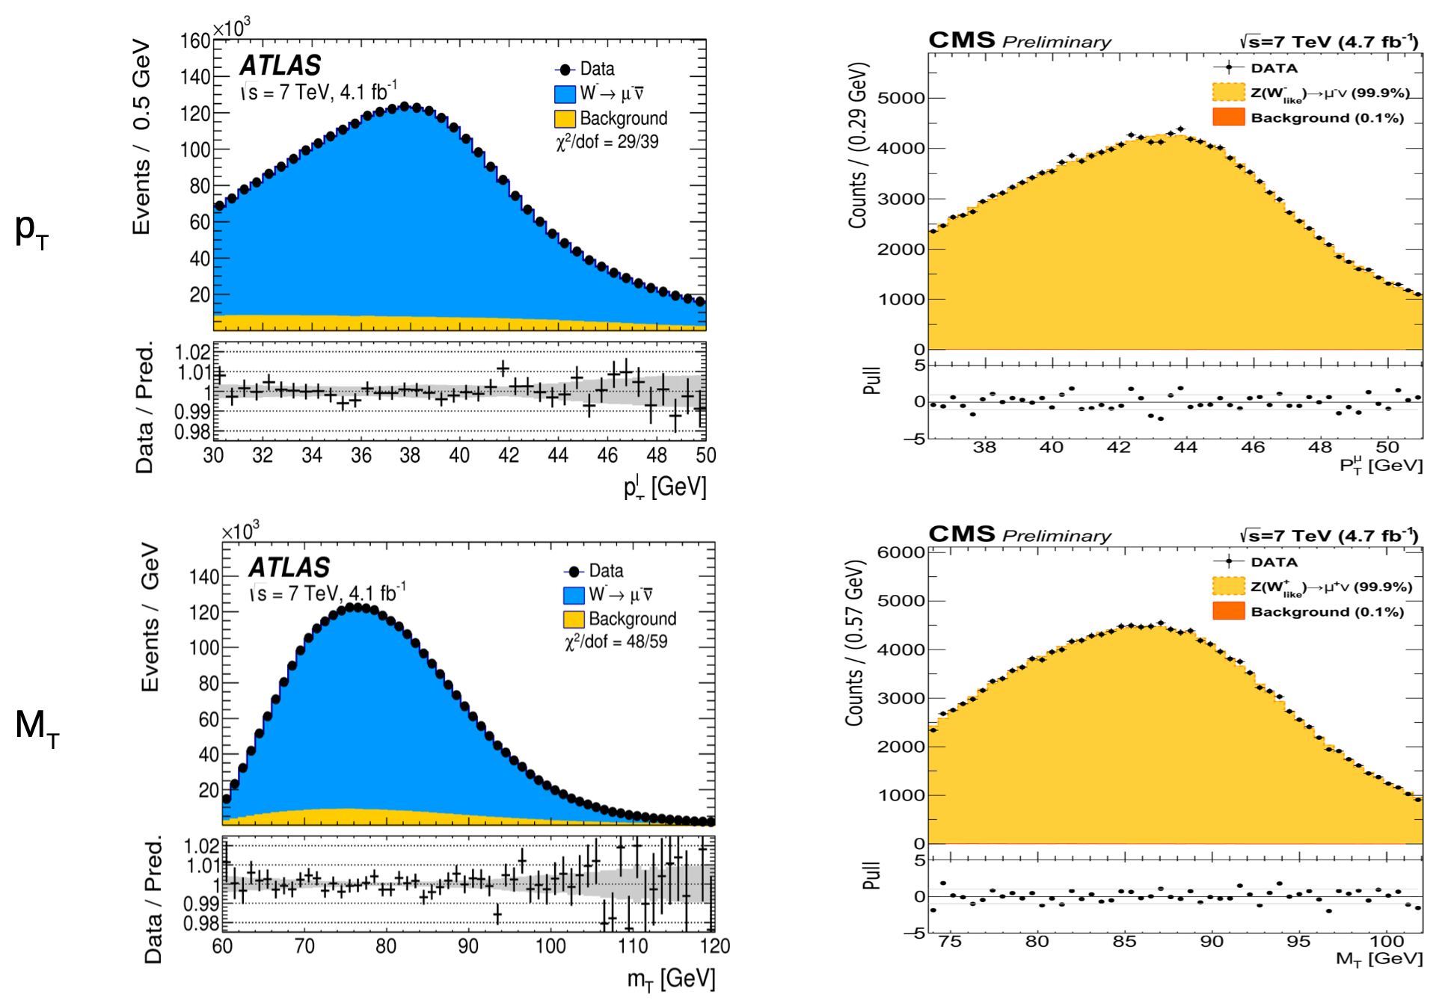

Slide 12
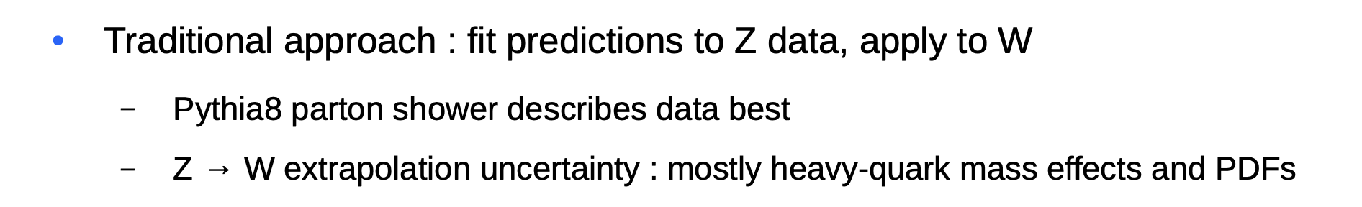
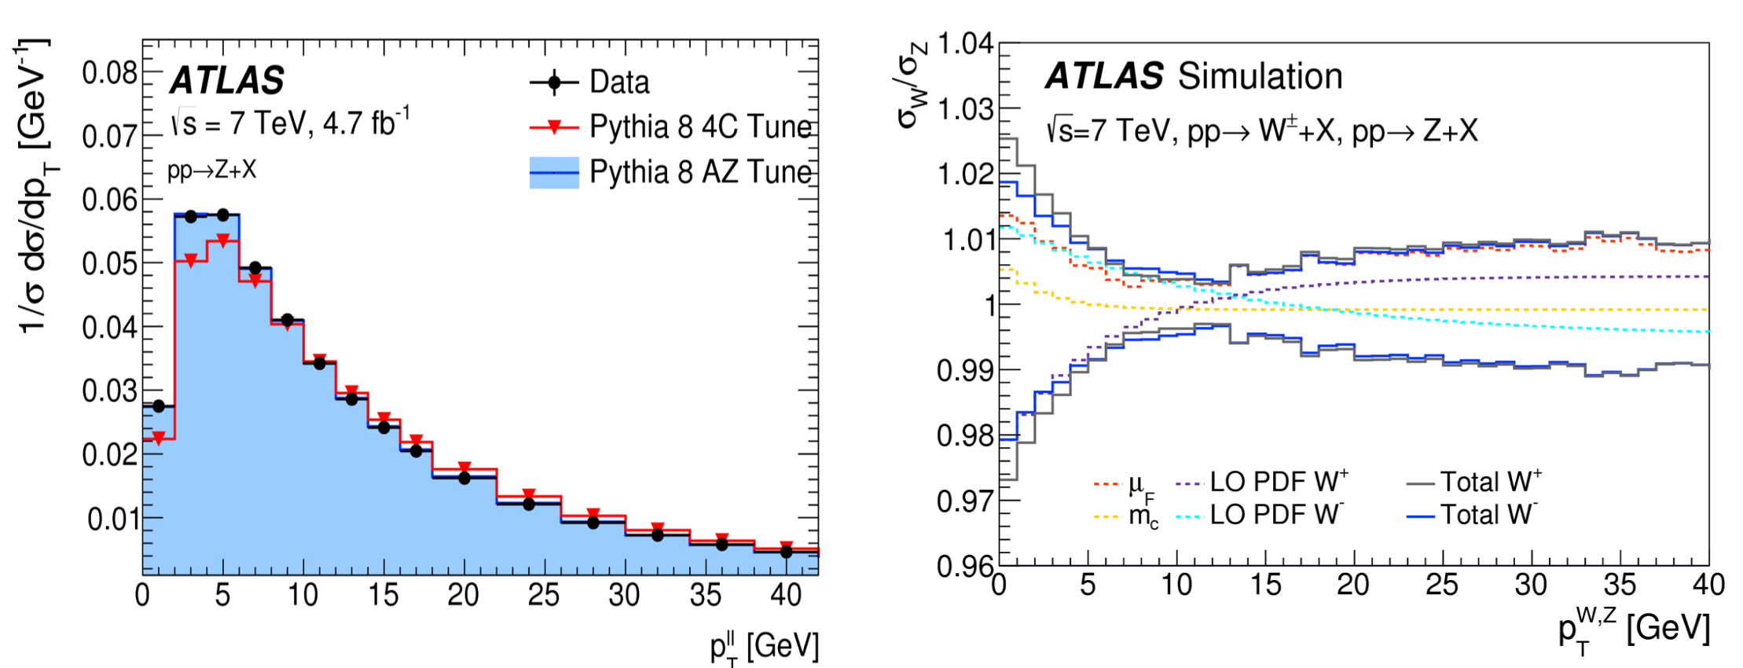
The Z/W boson transverse momentum

Slide 13
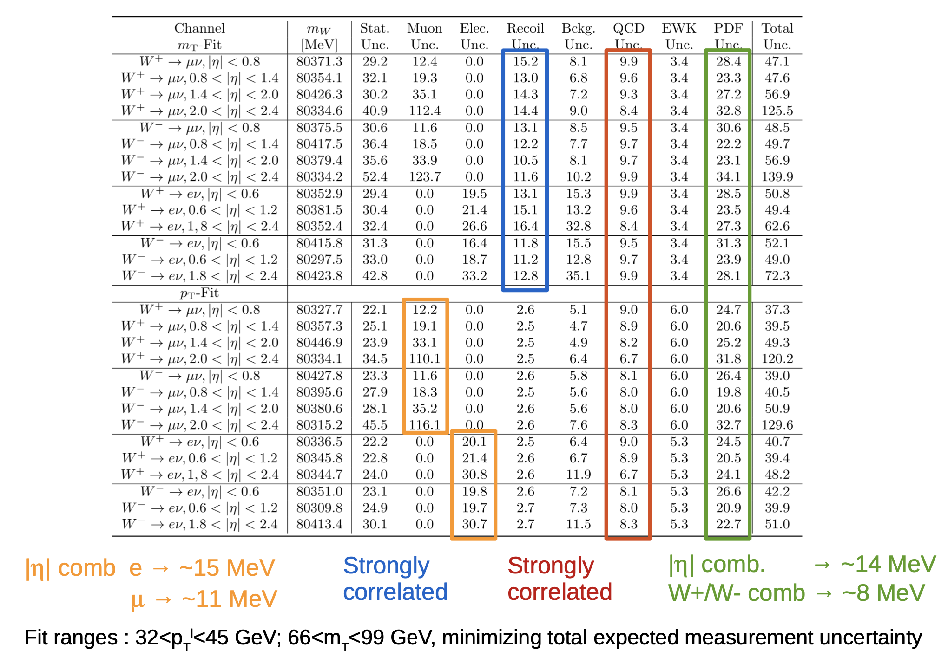

Slide 14
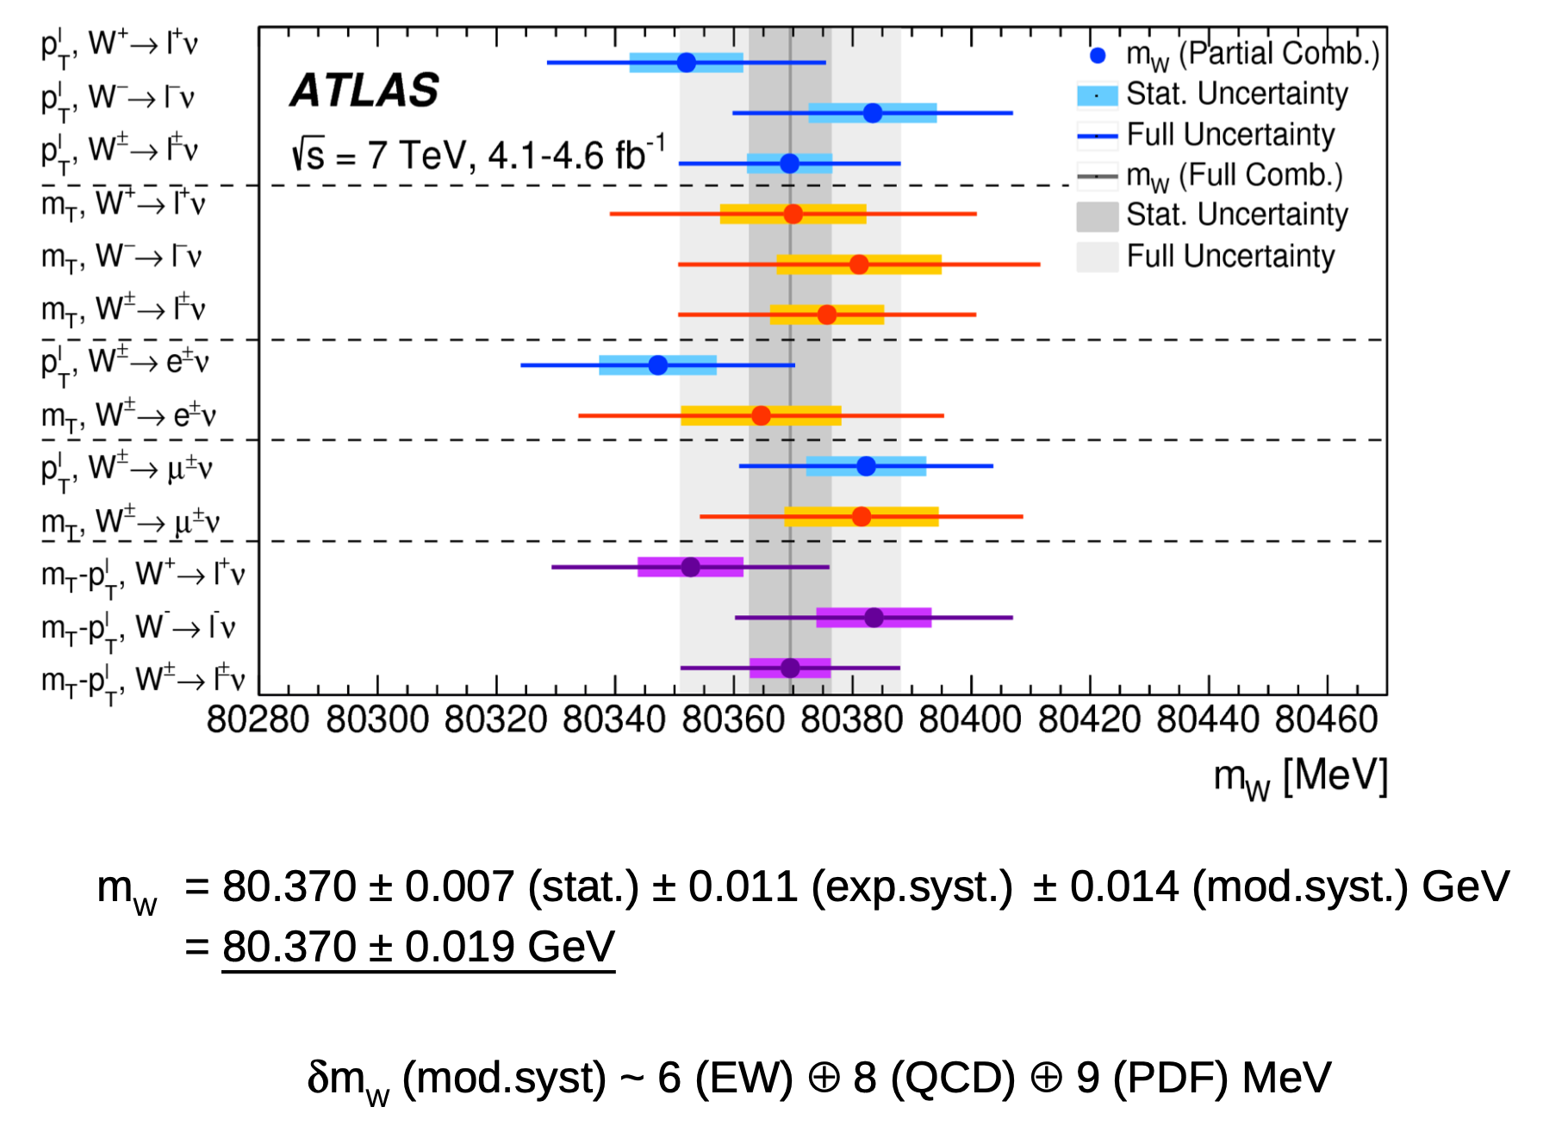

Slide 15
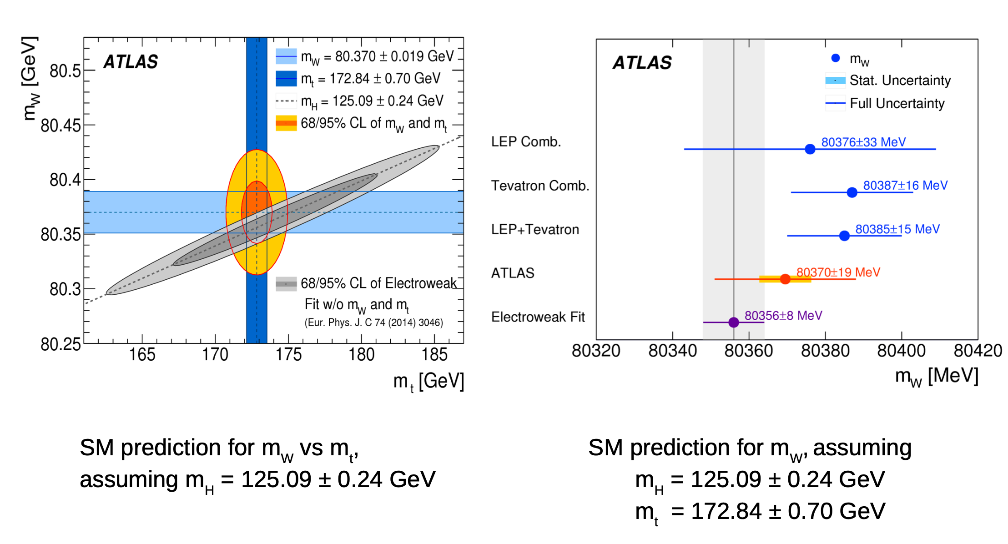
Consistency with the SM

Slide 16
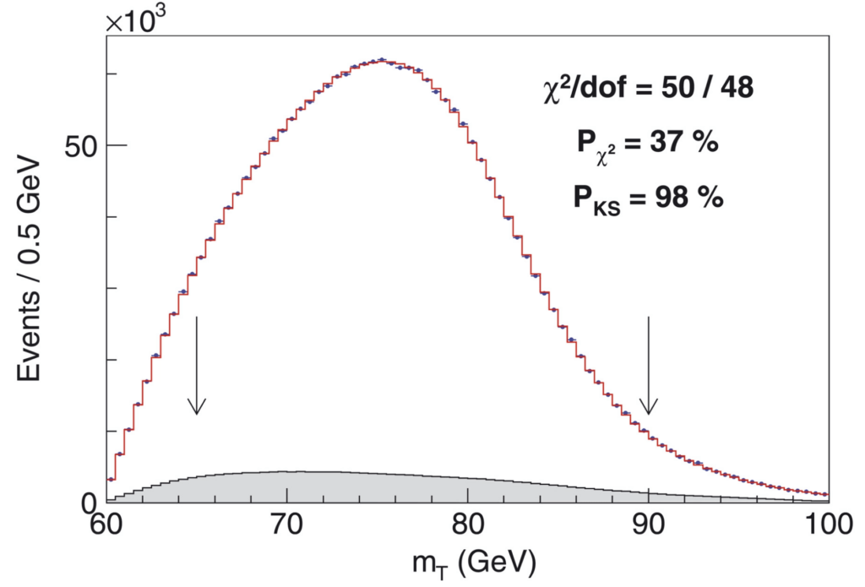
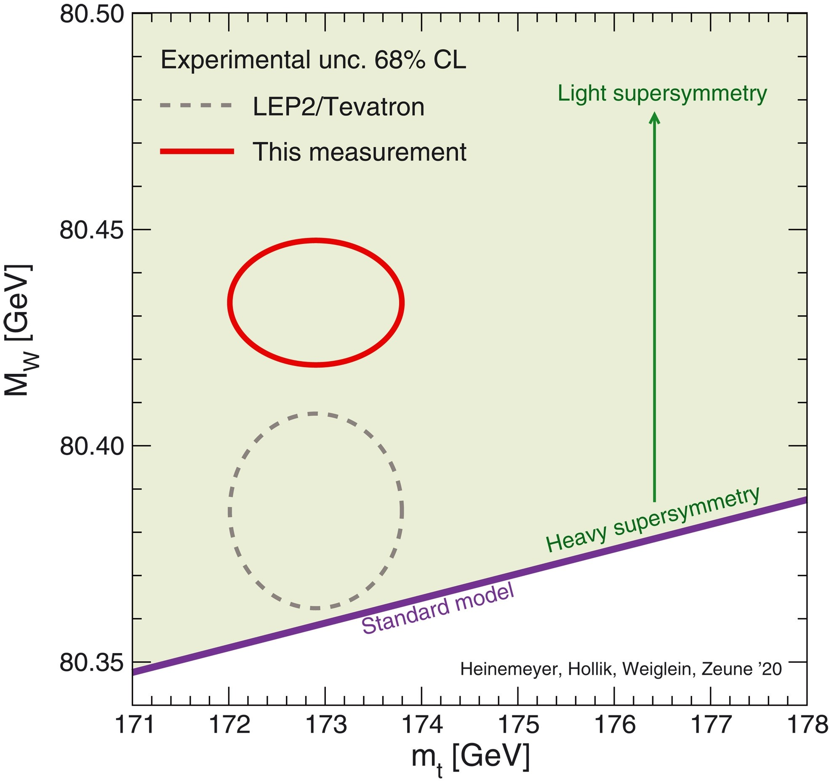
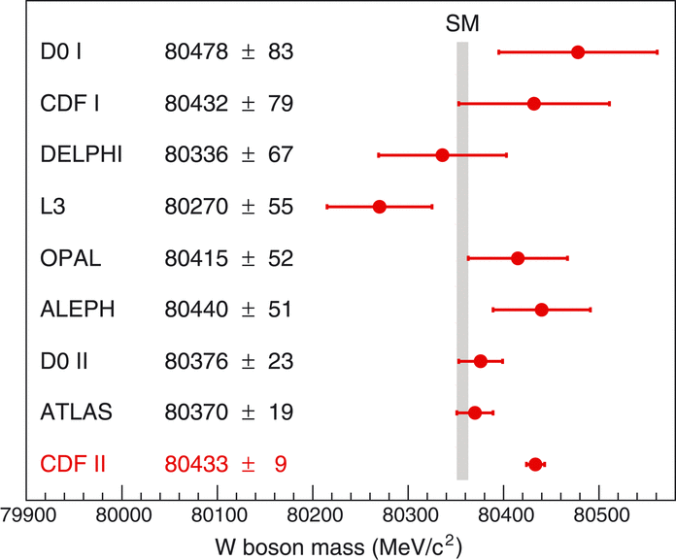
https://www.science.org/doi/10.1126/science.abk1781
Recent new measurement from the CDF experiment at the Tevatron (FermiLab) with best measurement so far and higher than the SM.
Is this another anomaly?

Slide 17
The Top Quark Mass and Cross-Section Measurement

Slide 18
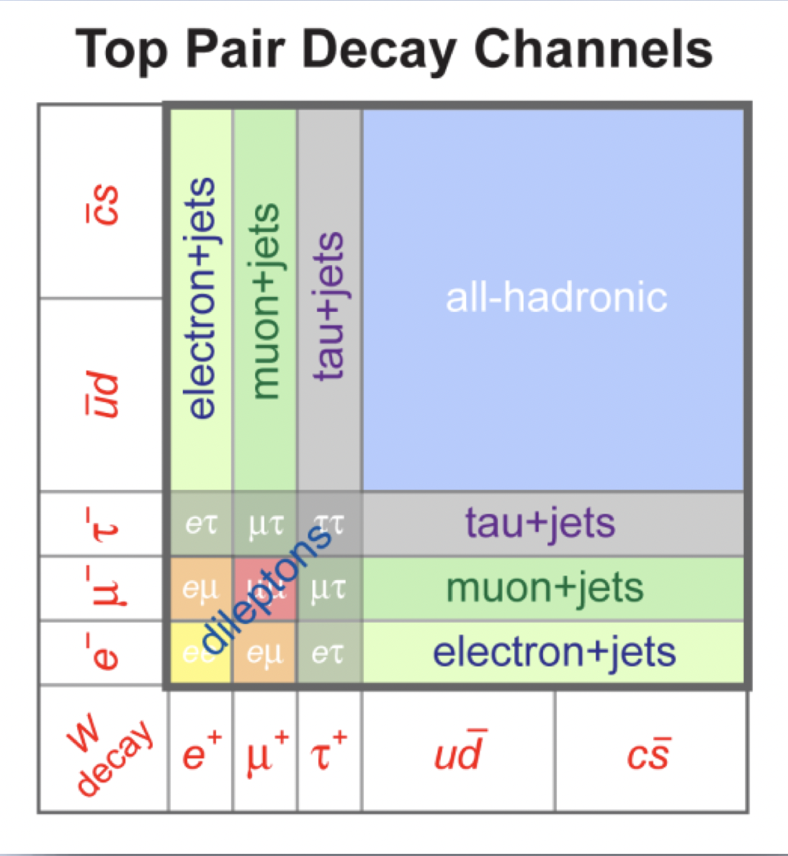

Slide 19
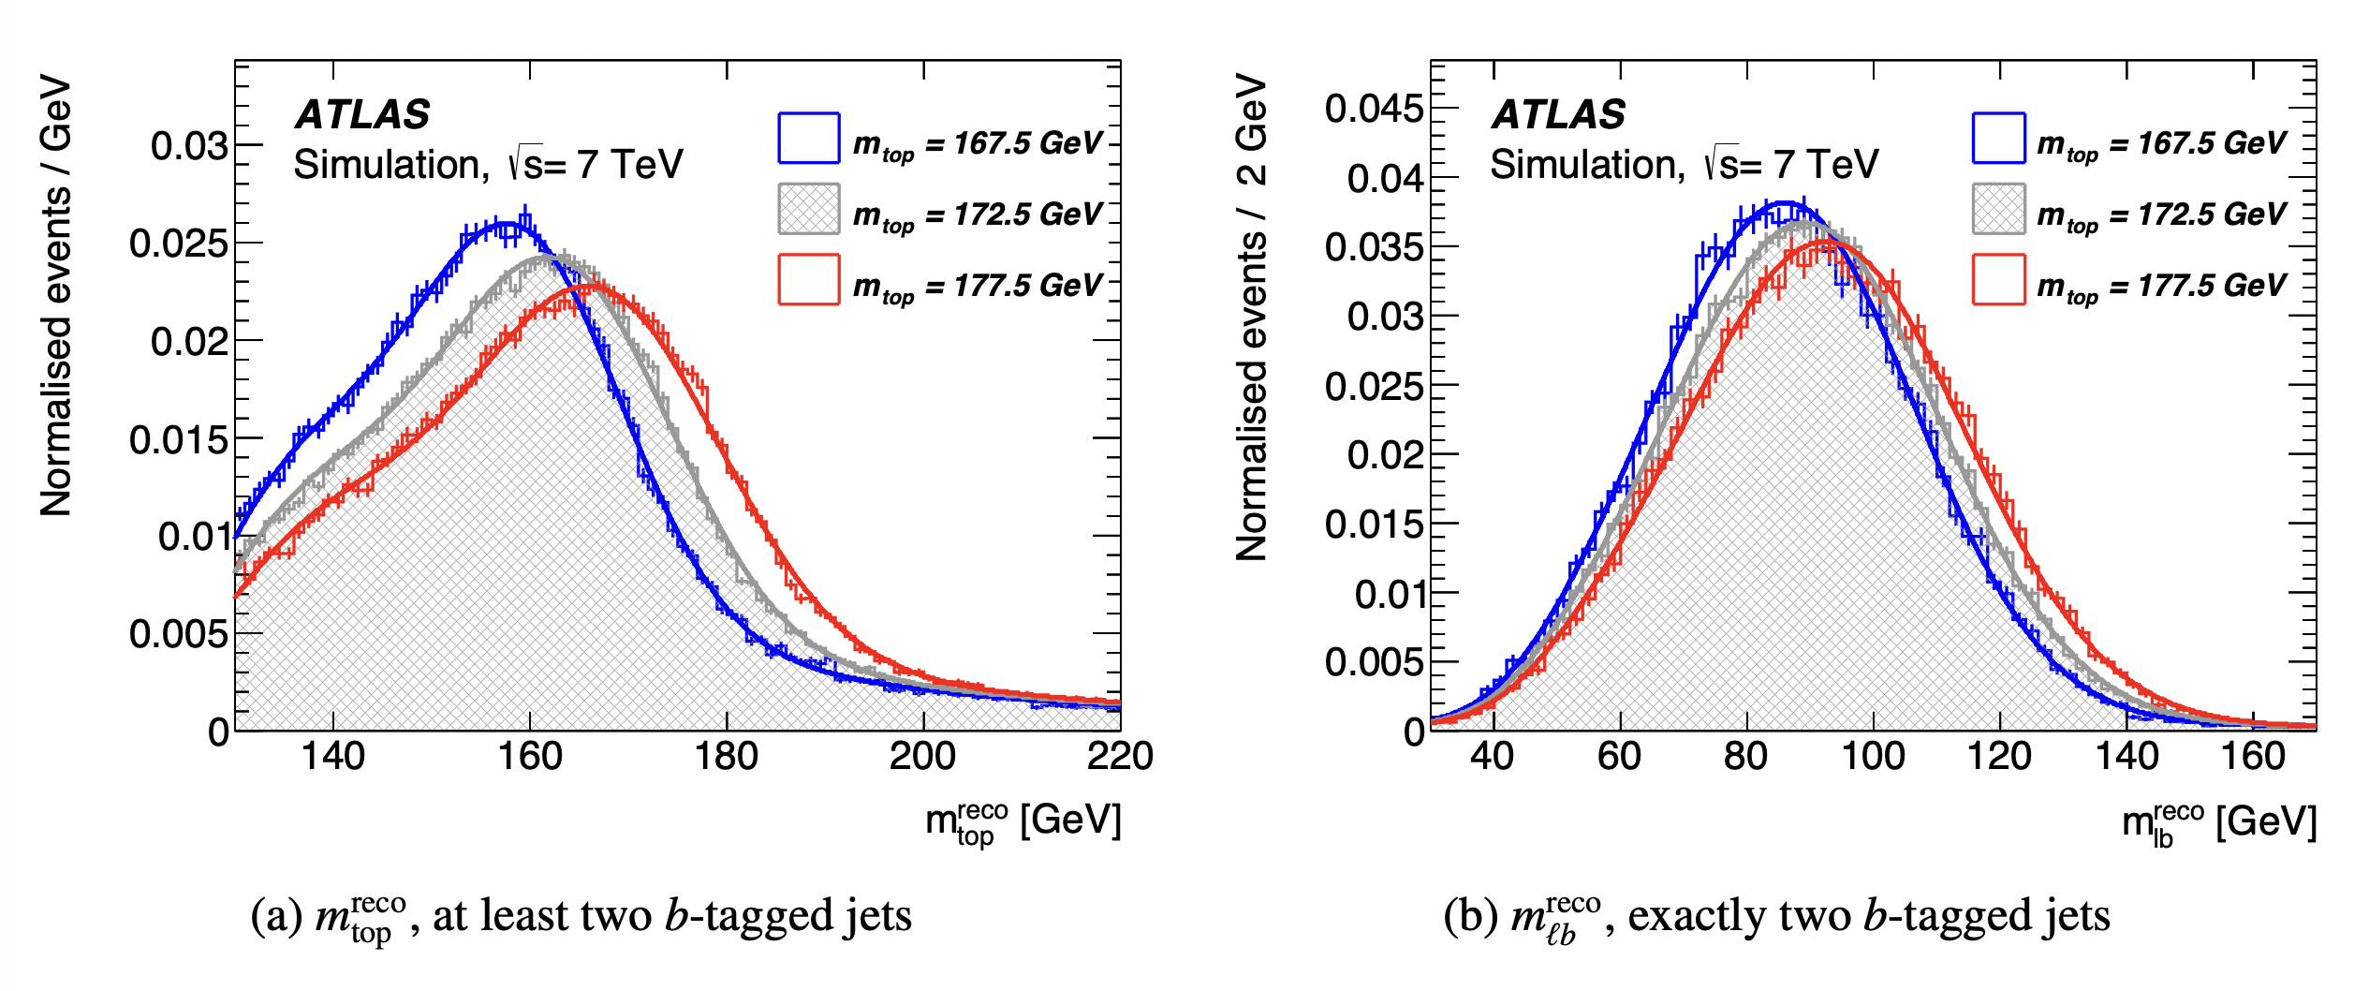
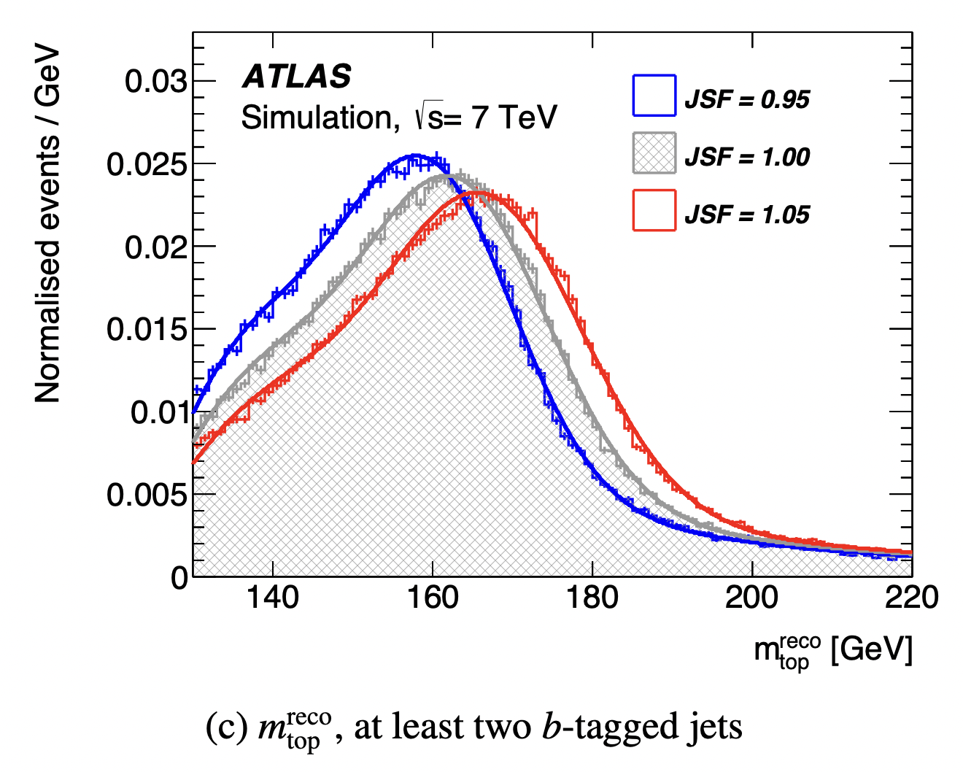
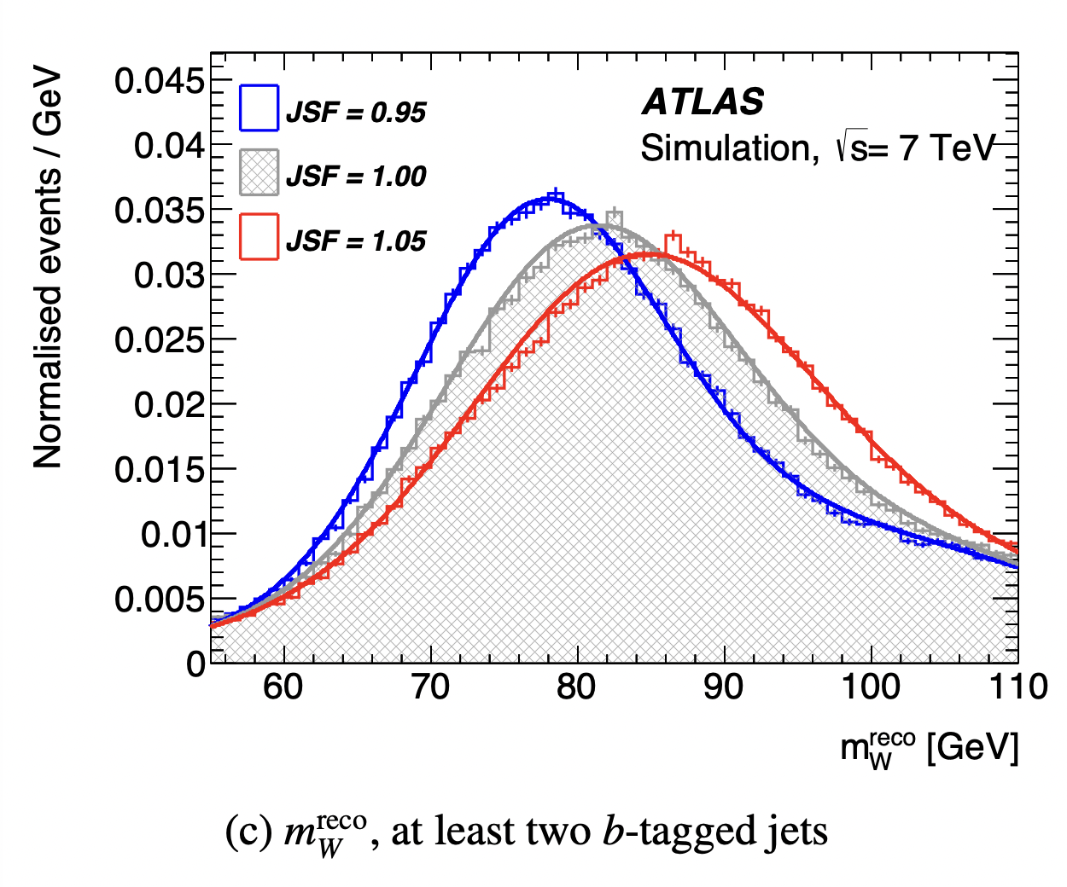
https://arxiv.org/pdf/1503.05427.pdf
Most precise measurement of the top quark mass comes from the semi-leptonic channel.
Perform likelihood fit with top quark mass and jet energy scale factors, where W mass is fixed.

Slide 20
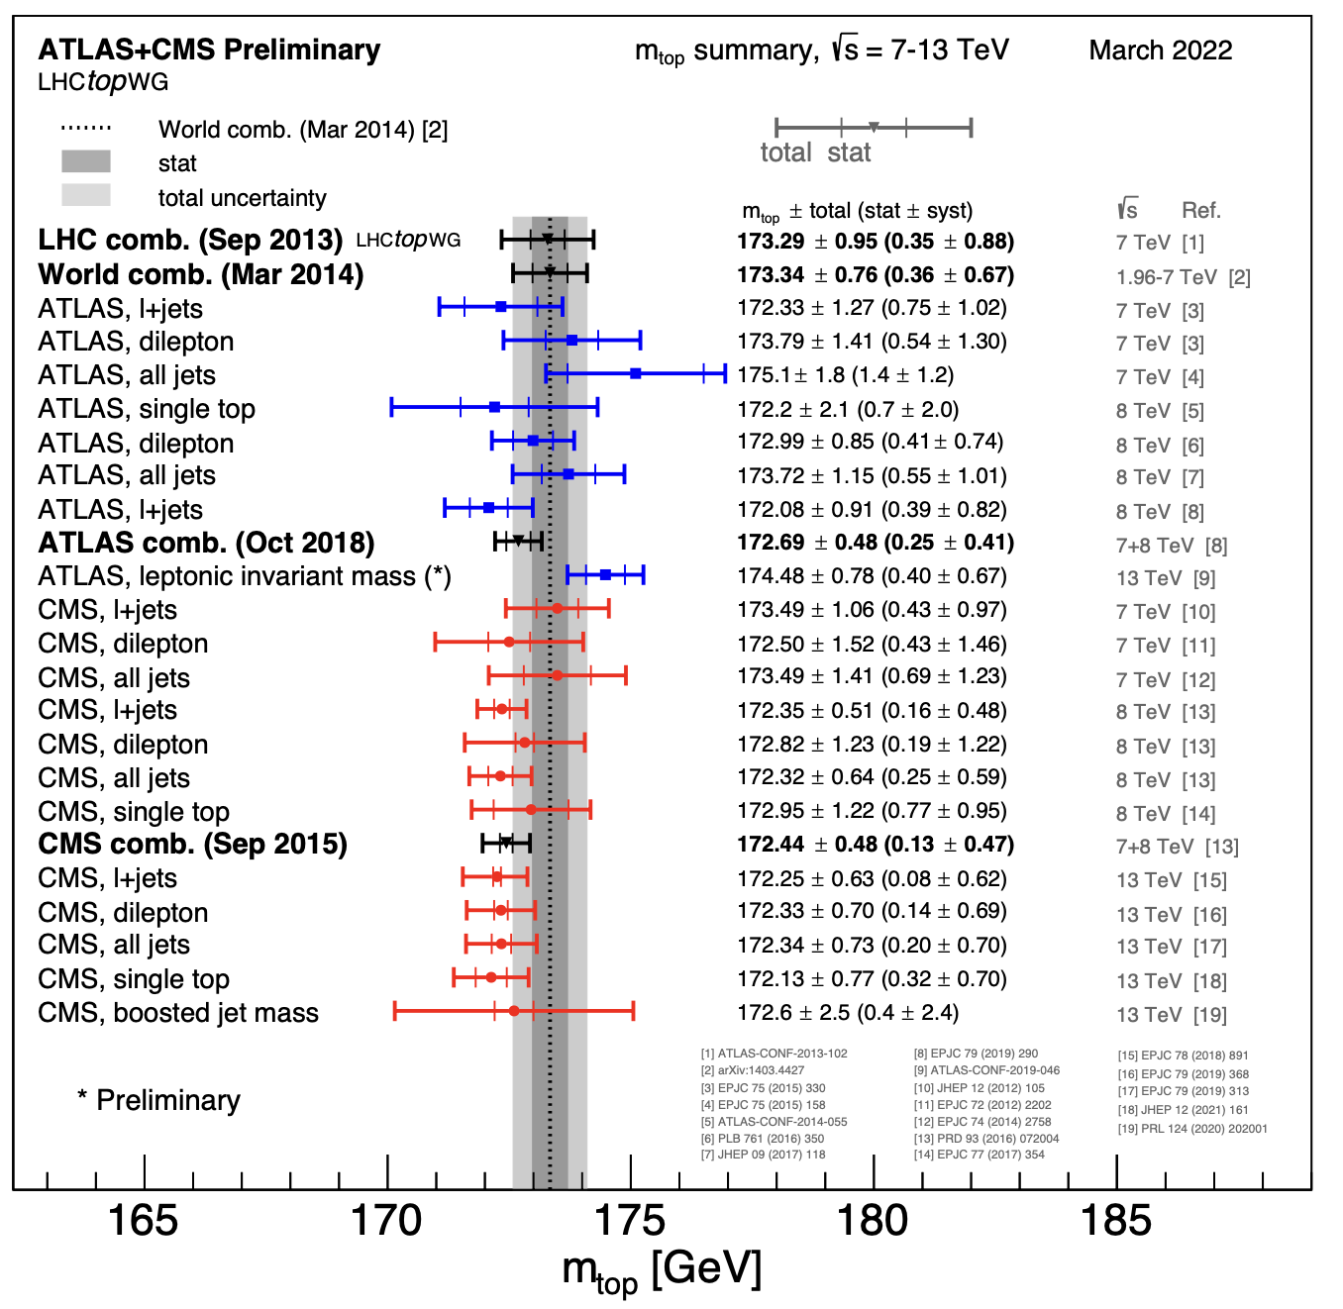

Slide 21
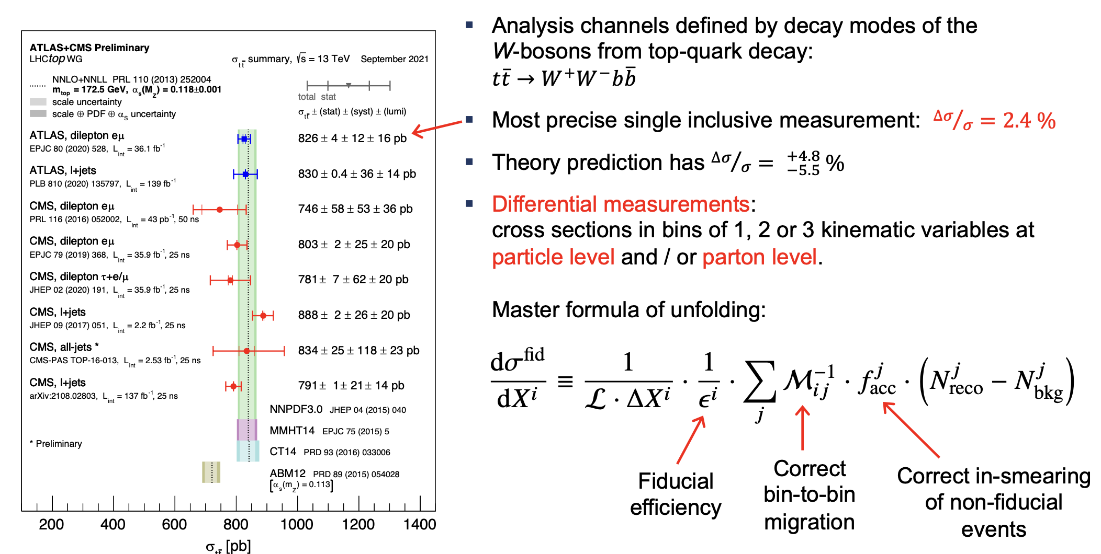
Wolfgang Wagner

Slide 22
Single Top Quark Production

Slide 23
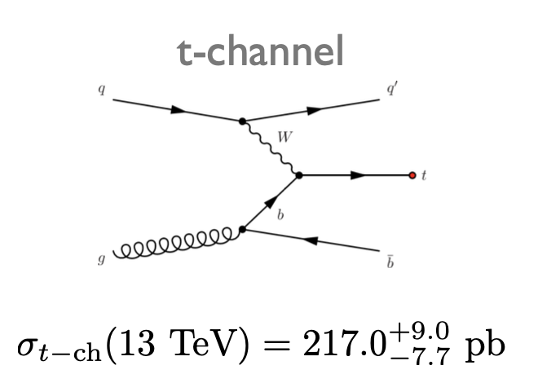
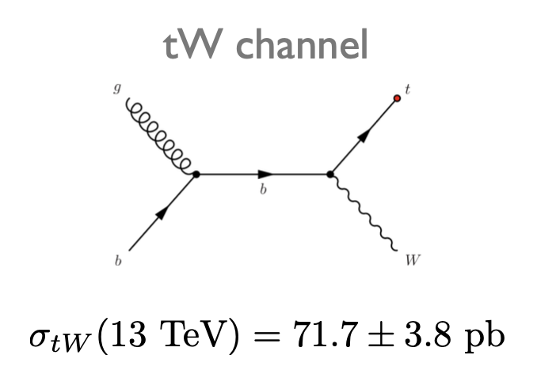
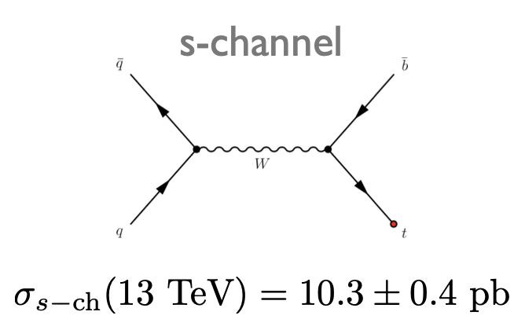

Slide 24
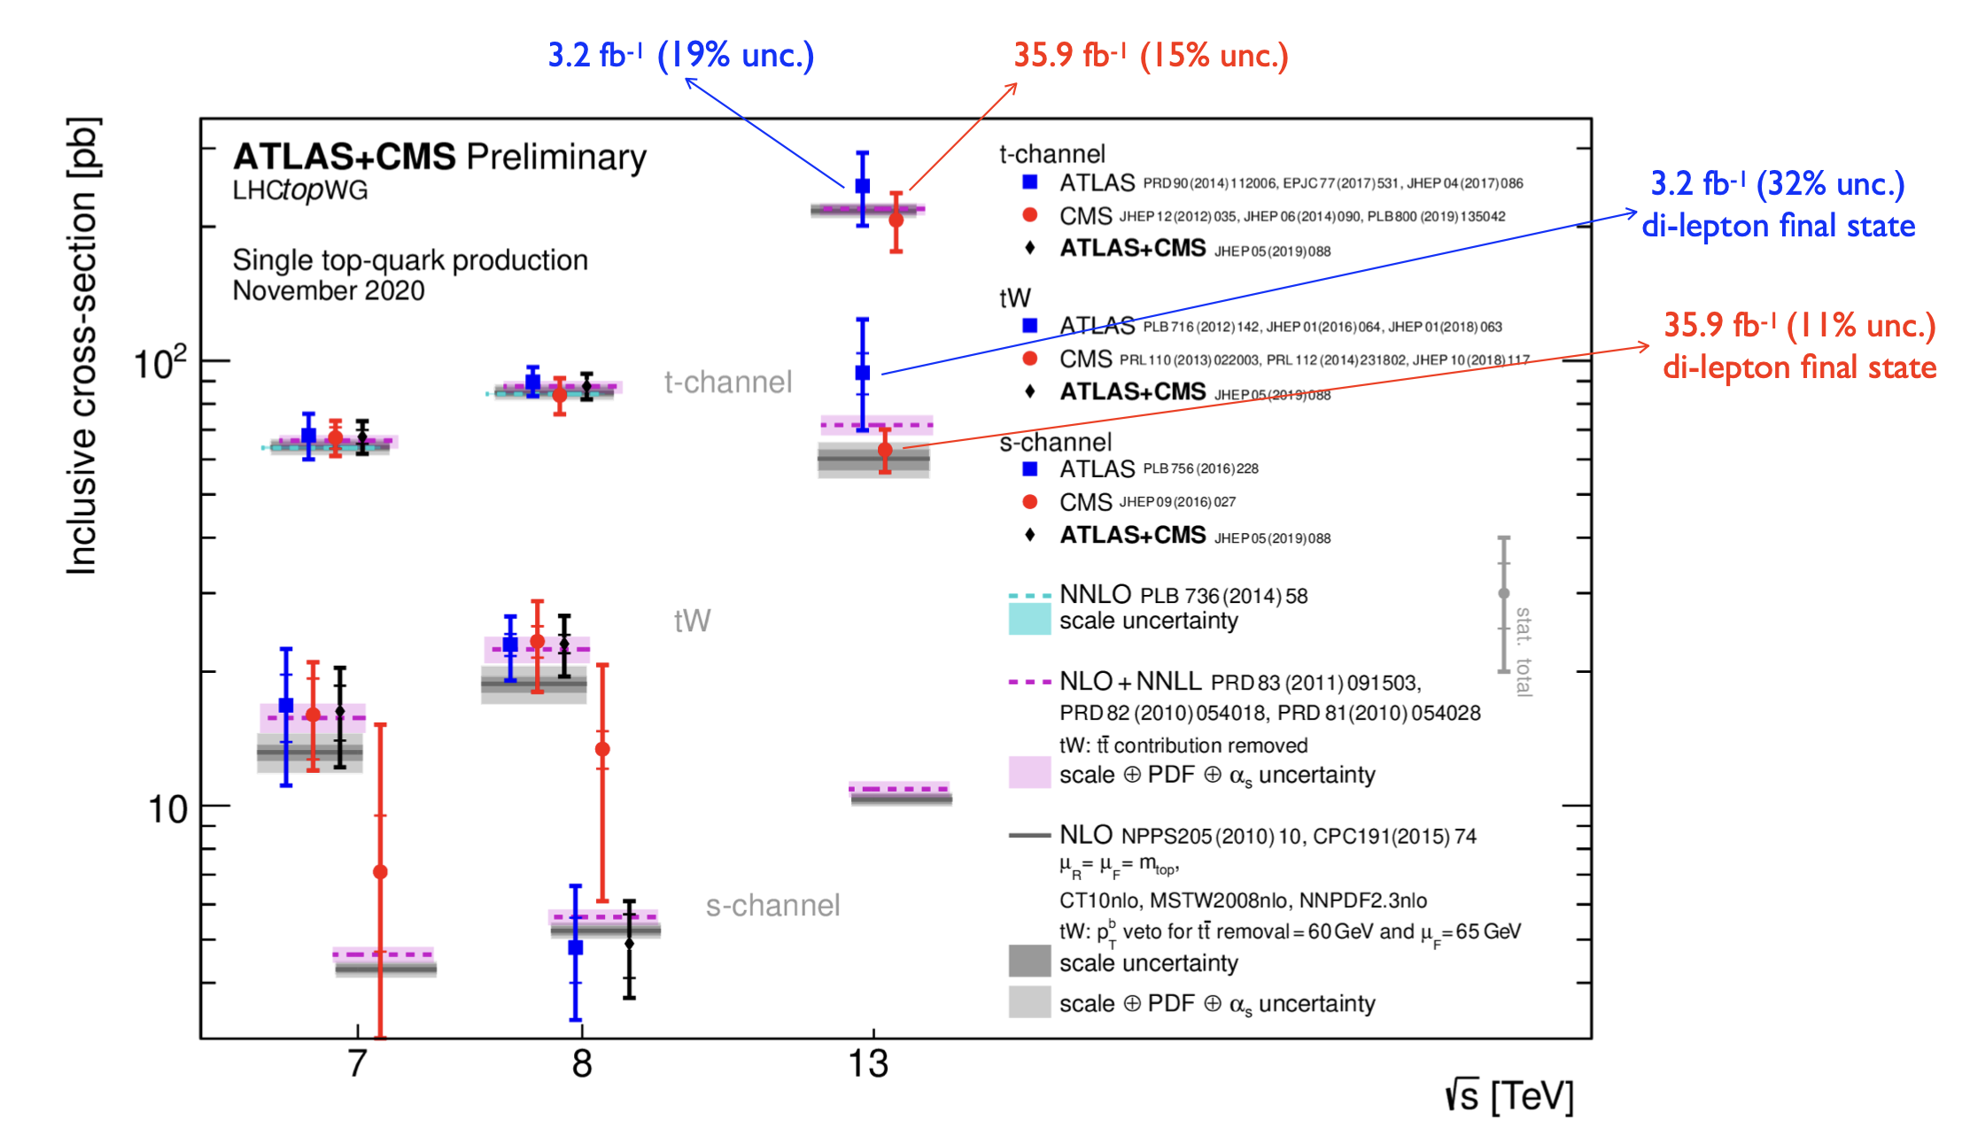
Lidia Dell’Asta

Slide 25
Higgs boson Decays

Slide 26
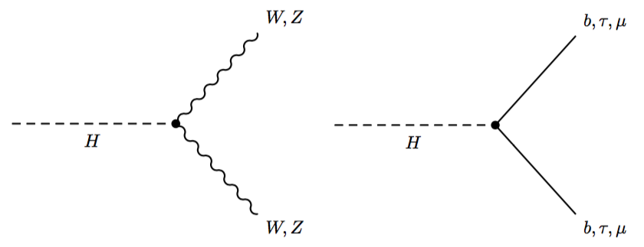
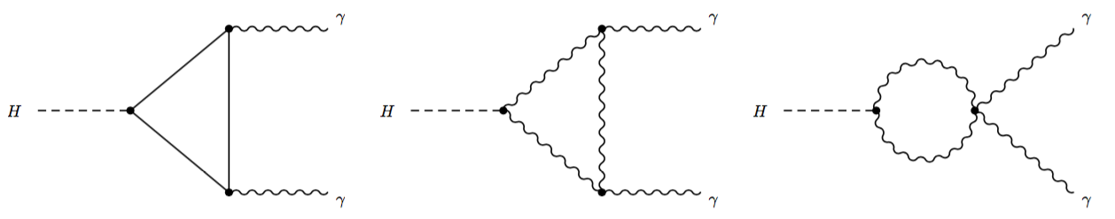
Tree-level decays
Loop-induced decays

Slide 27
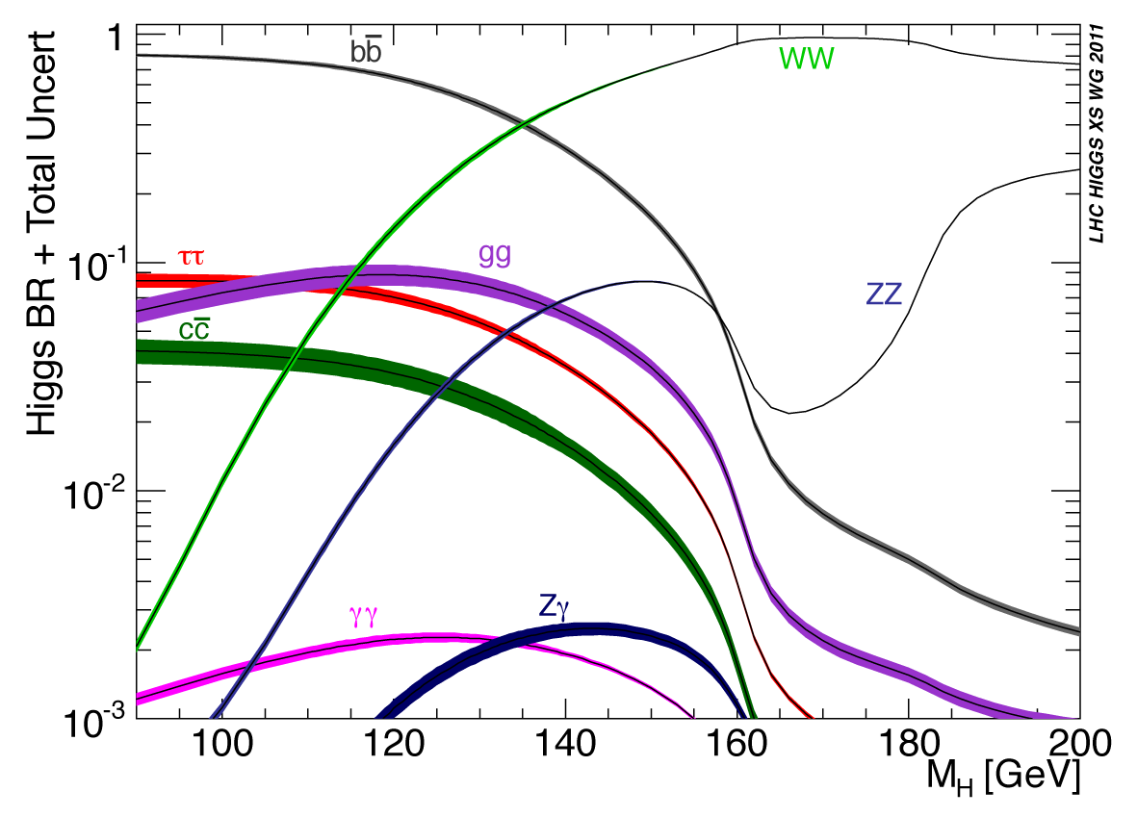
Main Decay Modes

Slide 28
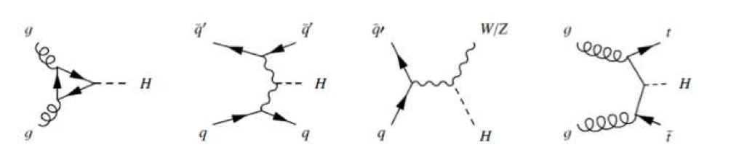
Higgs production at Hadron Colliders
Gluon-gluon fusion
Vector Boson Fusion
Associated Production

Slide 29
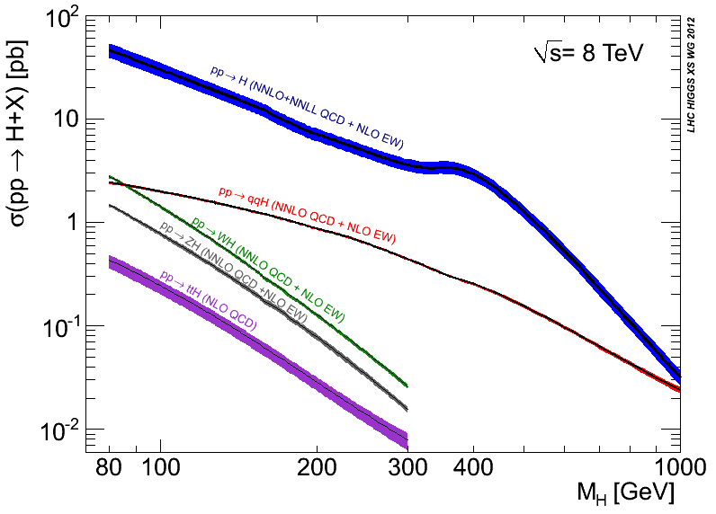
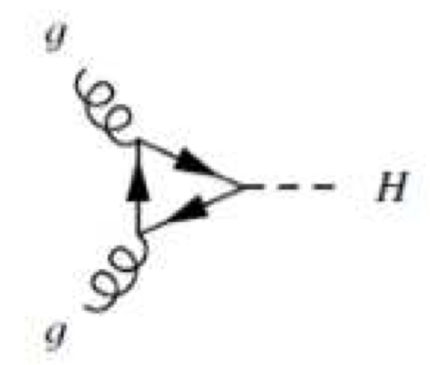
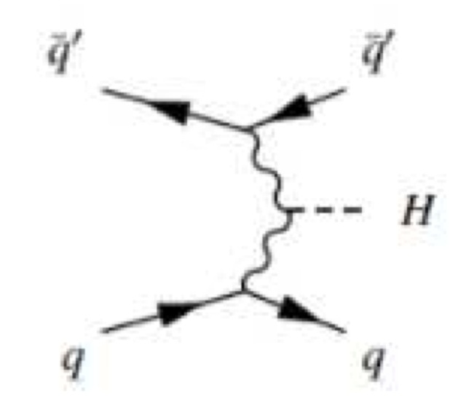
Higgs Cross-Sections at LHC

Slide 30
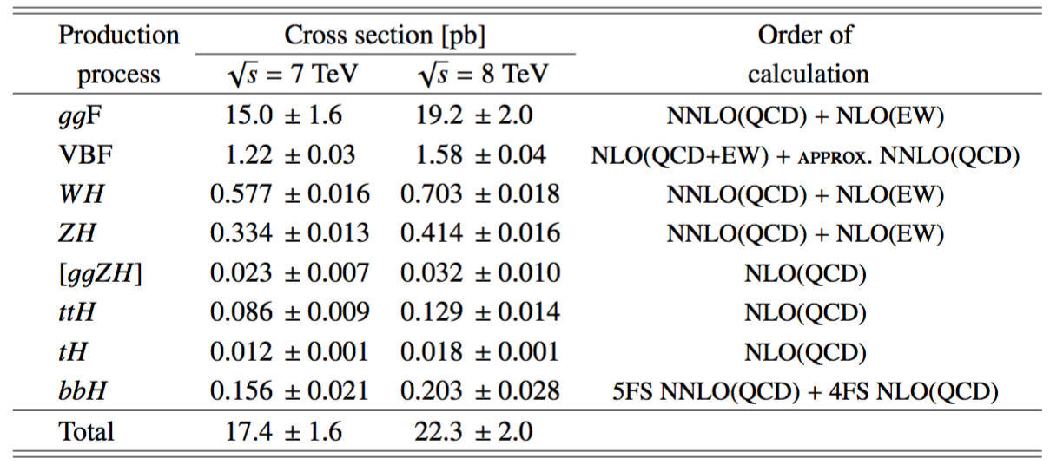

Slide 31
The Main Channels

Slide 32

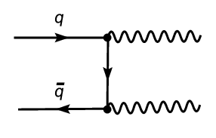

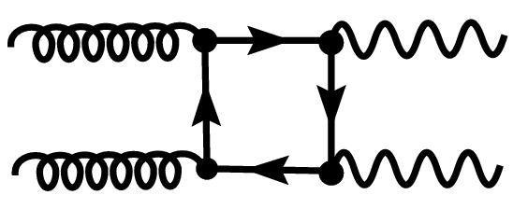

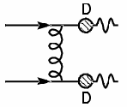
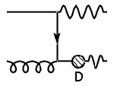
Higgs decay to γγ
γγ Backgrounds
Reducible γj and jj
Backgrounds
q→π⁰

Slide 33
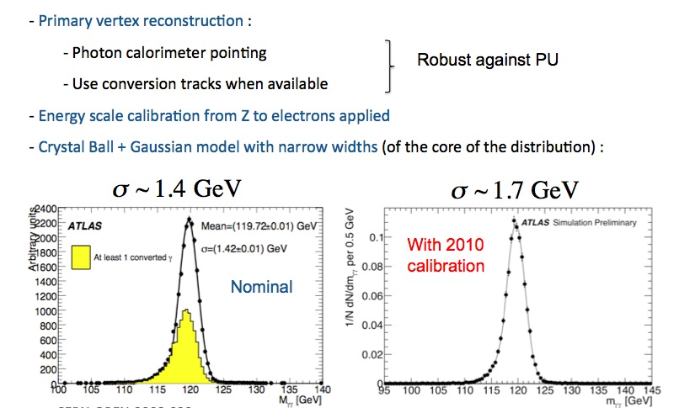
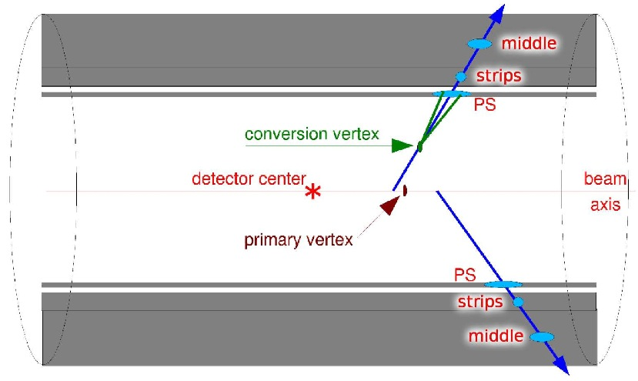
Diphoton Invariant Mass

Slide 34
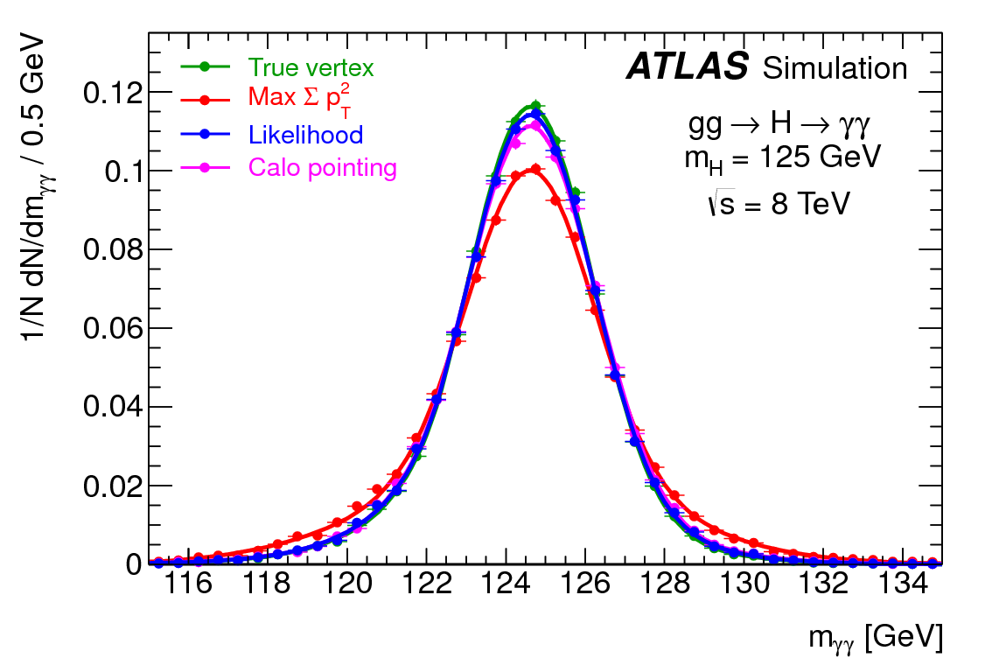

Slide 35
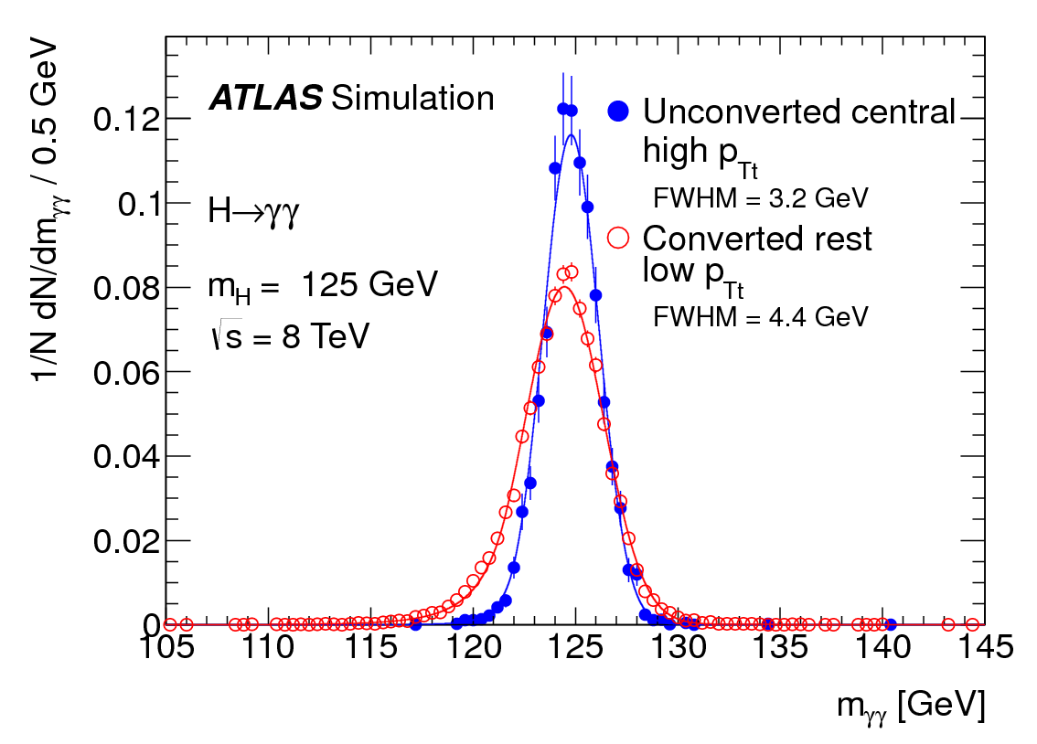

Slide 36
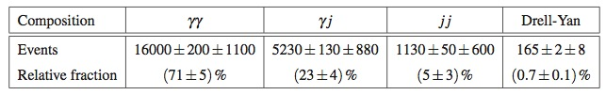
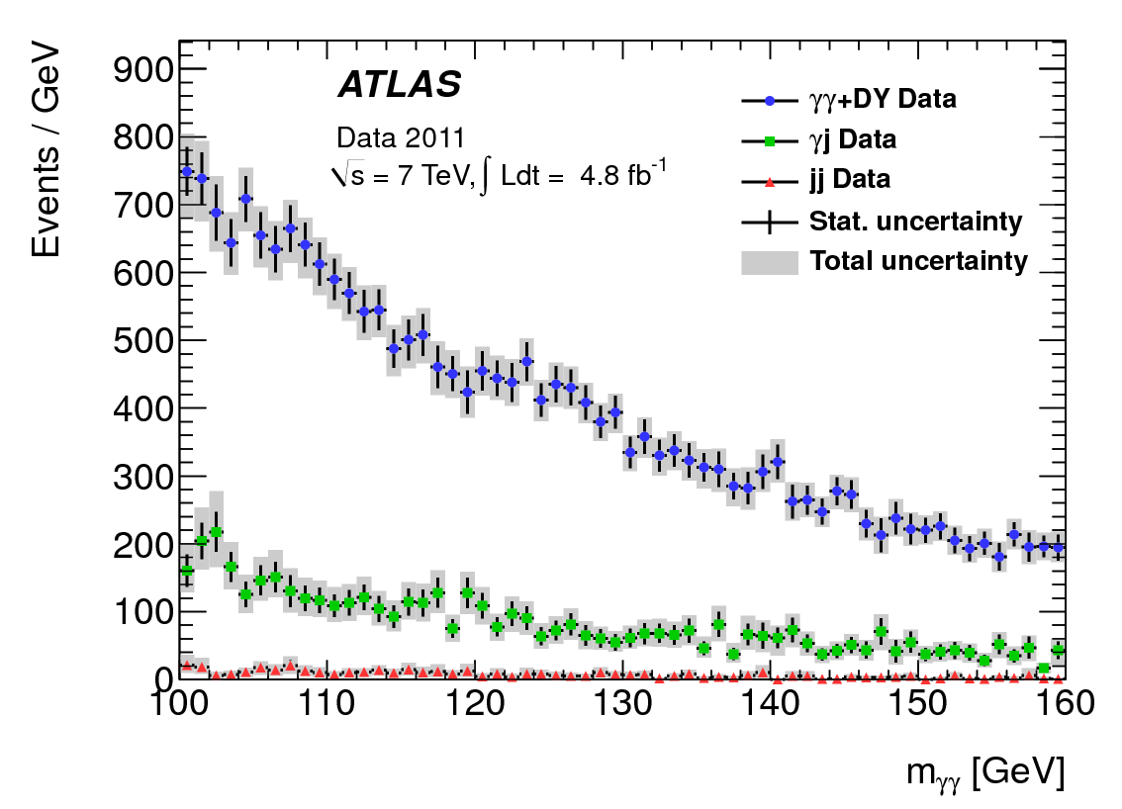
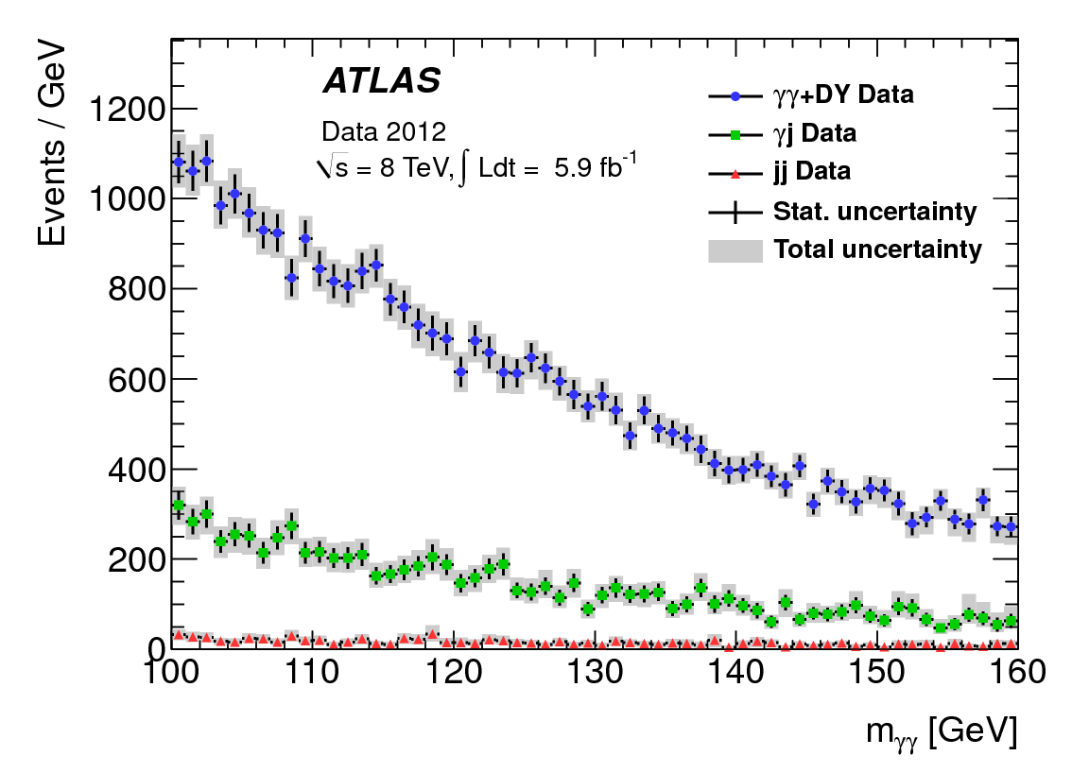
Background Composition

Slide 37

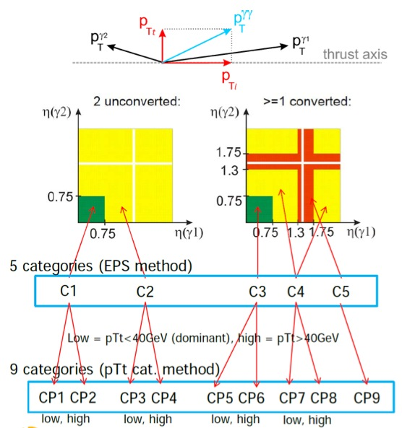

Categorization
+ 2j (VBF)

Slide 38
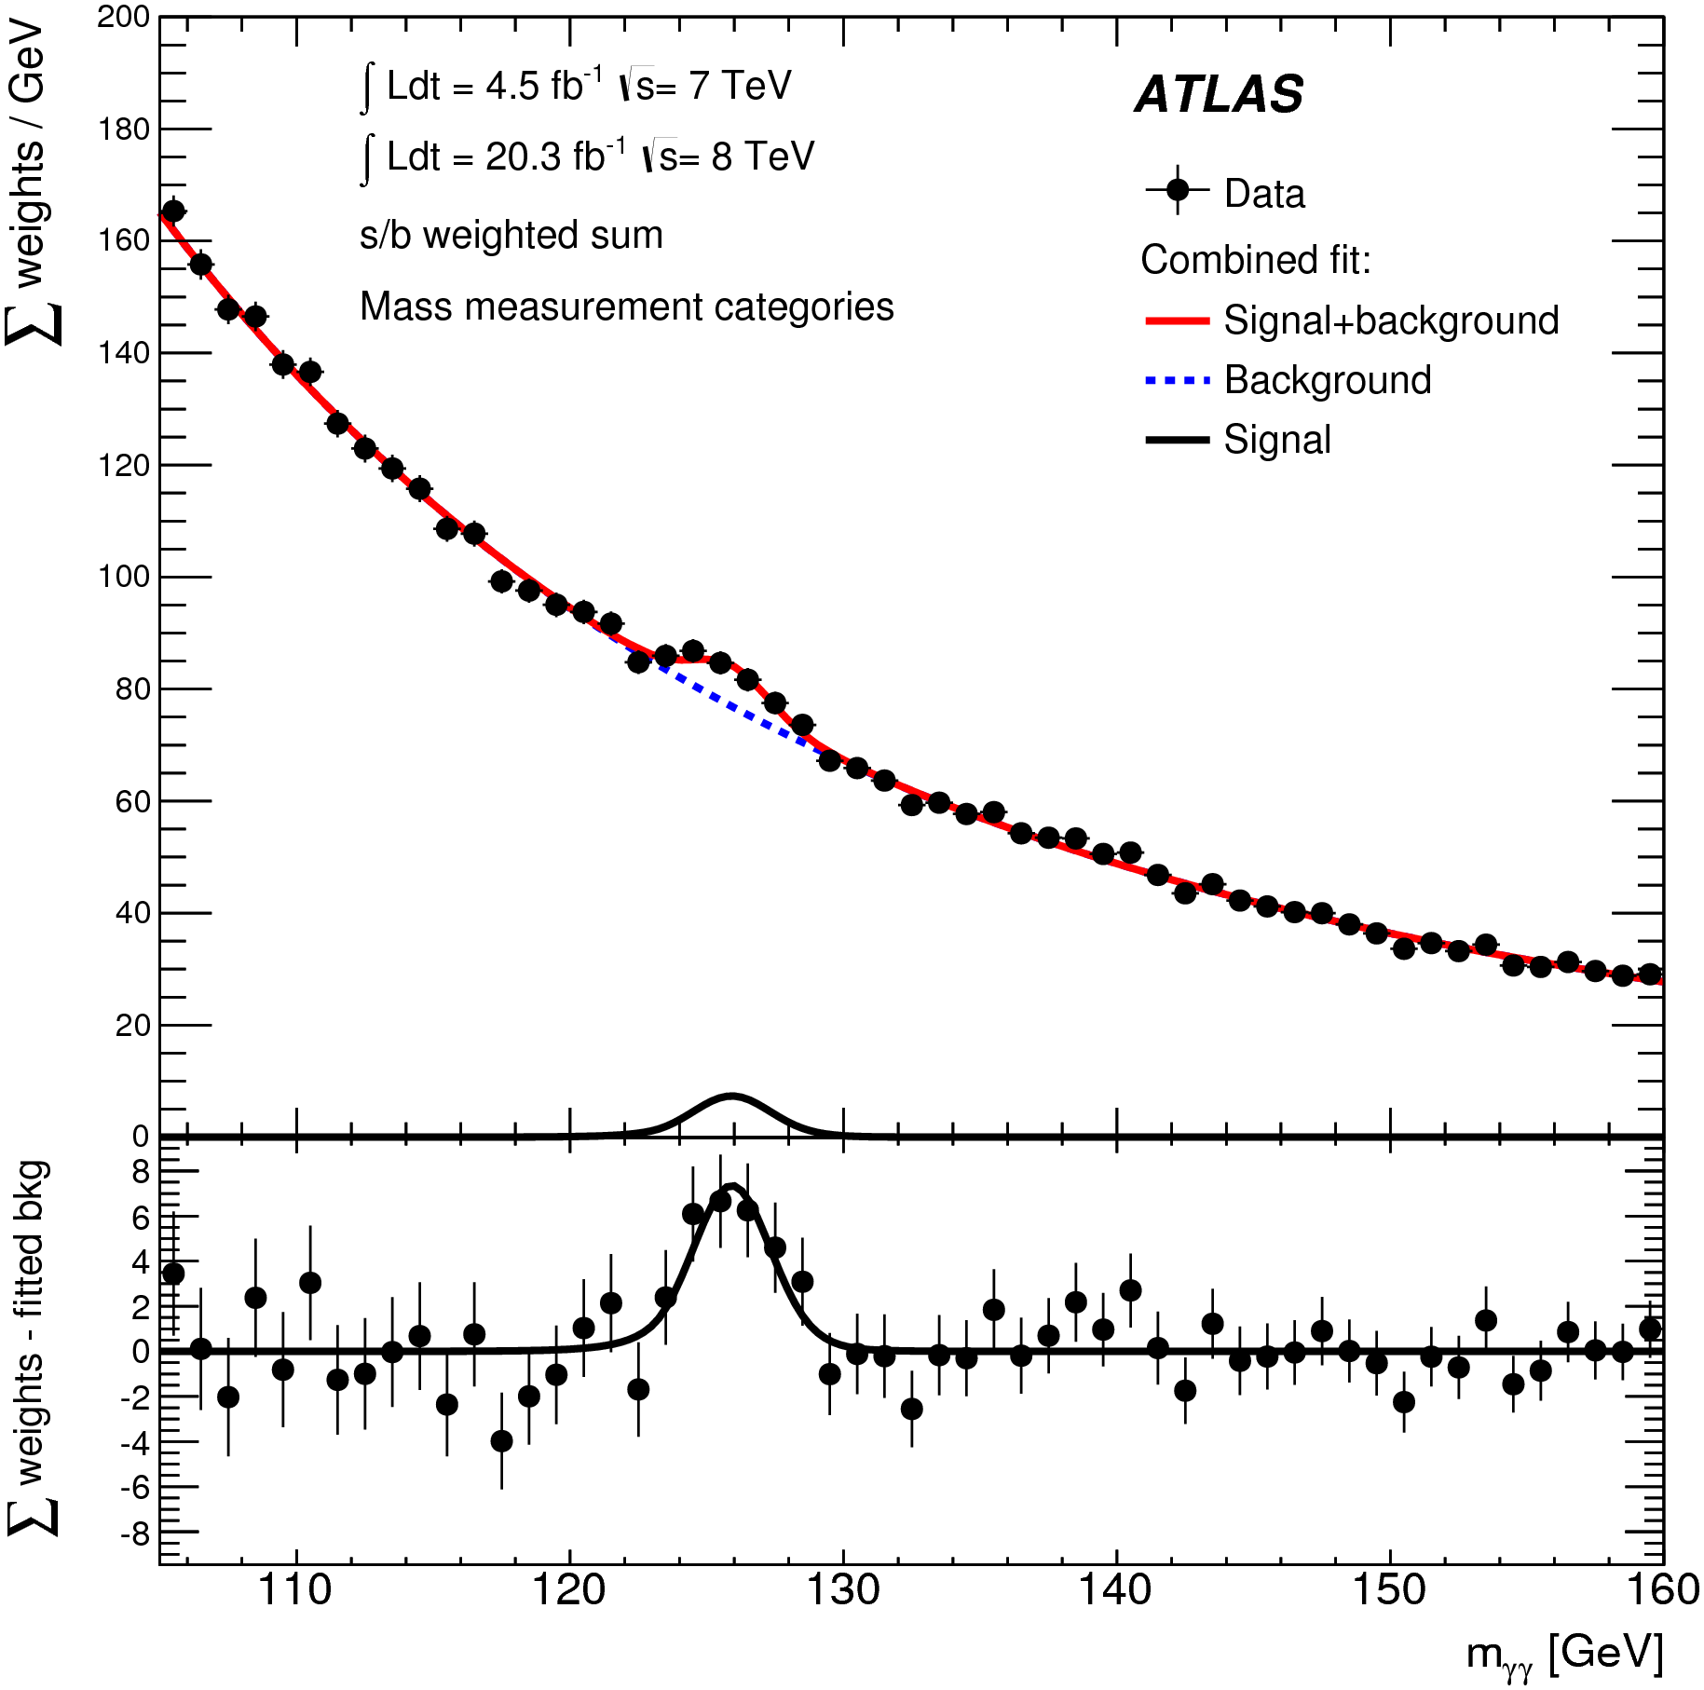
Di-photon Invariant mass distribution; analysis for data, showing weighted data points with errors, and the result of the simultaneous fit to all categories. The fitted signal plus background is shown, along with the background-only component of this fit.
Notes:
Mention that it is S/B weighted

Slide 39





Higgs decay to Z⁰Z⁰
Irreducible Z⁰Z⁰ backgrounds
Reducible 4l backgrounds
Z
Z

Slide 40



Mass resolution plots after the application of a mass constraint.
Gain in resolution ~15-20%

Slide 41


Invariant mass distribution of the second lepton pair: μμ and ee. The kinematic selections of the analysis have been applied. Isolation requirements have been applied on the first lepton pair. No charge requirements were applied to the second lepton pair.

Slide 42


Distribution of the MVA (BDT) ZZ* output, versus m_{4l}; for the selected candidates in the m_{4l} range of 110--140 GeV
Distribution of the four-lepton invariant mass for the selected candidates in the m_{4l} range 80--170 GeV

Slide 43



Higgs decay to W⁺W⁻
Two leptons + neutrinos
No mass peak
Event counting experiment
W⁺W⁻ backgrounds
+ Single top
& non-resonant WWbb

Slide 44


The reconstruction of missing energy is real is a crucial element to the search. Shown are the METRel distribution of the neutrino momenta in the presence of two charged leptons
Overall, good control of the data
A real challenge this time around!

Slide 45

Search is performed in jet bins

Slide 46

Flow chart for Back. Extraction
Complete propagation of systematic errors

Slide 47


Candidate for VBF production
Require two isolated leptons and large MET. Reconstruct transverse mass. Categorization in jet multiplicity.
Notes:
Look up the MT of the event

Slide 48


Di-b invariant mass after background subtraction except for di-boson processes, for all channels
Di-tau invariant mass before and after background extraction

Slide 49
Mass measurement
The Higgs boson mass is a fundamental parameter of nature that is not predicted by the theory

Slide 50



ATLAS and CMS measurements are compatible and lead to 0.2% accuracy measurement

Slide 51


Slide 52


Slide 53
Sensitivity to Coupling Strength
Preprint including ATLAS/CMS combination available at arXiv:1606.02266v1

Slide 54




Signal Strengths
Coupling Modifiers

Slide 55


Slide 56


Slide 57


Slide 58


Slide 59


Slide 60


Slide 61

Introducing ratios. Has some advantages such as cancellation of experimental and some theoretical uncertainties, such as the lack of knowledge of total width and others

Slide 62


Slide 63


Slide 64


Slide 65


Slide 66


Slide 67


Slide 68
Spin/CP Quantum numbers: Exploration in Decay

Slide 69



Spin/CP in H->ZZ->4l
Phys.Lett. B726 (2013) 120-144
Exploit full 4-lepton kinematics, combined into a multivariate analysis (BDT)
Most sensitive channel in decay to 0⁻

Slide 70



Data show compatibility with the SM 0⁺ hypothesis while other alternative hypotheses considered are excluded at a confidence levels above 95%
Phys.Lett. B726 (2013) 120-144
Observation

Slide 71


CMS-PAS-HIG-14-014
CP-violating
CP-conserving
Λ - Scale of new physics

Slide 72


Spin-1
Spin-2

Slide 73


Slide 74




Slide 75


Probabilities build with LO ME from MCFM, MadGraph and FeynRules
Interference-related probabilities used in the Spin-0 study

Slide 76


Slide 77

Exclusion of Spin-1 hypotheses

Slide 78
Exclusion of Spin-2 hypotheses

Slide 79

Spin/CP Quantum numbers: Exploration in Production

Slide 80




SM Higgs via VBF
Qualitative remarks
Unlike QCD partons that scale like 1/P_{T}², here P_{T}~sqrt(1-x)M_{W}
Due to the 1/x behavior of the Weak boson the outgoing parton energy (1-x)E is large  forward jets
At high P_{T}

Slide 81
Well-defined prediction of the SM. Kinematics of scattered quarks, very sensitive to new physics
Scattered fermions
ϕ
η
Central Jet Veto
Higgs Decay Products

Slide 82




T.Plehn, D.Rainwater and D.Zeppenfeld
Phys.Rev.Lett. 88 (2002) 051801

Slide 83

C. Englert, D. Gonsalves-Neto, K.Mawatari and T. Plehn, JHEP 1301 (2013) 148
A. Djouadi, R.M. Godbole, B.M., K.Mohan, Phys. Lett. B723 307-313
General tensor form of HVV coupling, where H is a scalar
SM
CP-violating
CP-conserving
Extension of the SM high higher dimension operators. Where the Lambdas are effective coupling strengths.

Slide 84

In the above mention papers we realized that the kinematics of the scattered quarks have more information about the tensor structure of the HVV coupling than hitherto believed
Problem with unitarization

Slide 85

Spin-2

Slide 86

Associated VH production [ Z(→ll)H(→bb) ]

Slide 87


Associated VH production

Slide 88

Questions

