Slide 1
Jacopo & Erik
Muon identification purity/efficiency

Slide 2
Various
Cuts at theta > 10 degrees
At E > 10 GeV and at E < 100 GeV
Normalized statistics between me and Erik (5%)
Jacopo cut on the matching in HCAL energy hit deposition removed
Same error calculation
Plug is out
We use 9 layers, we skip the same one

Slide 3
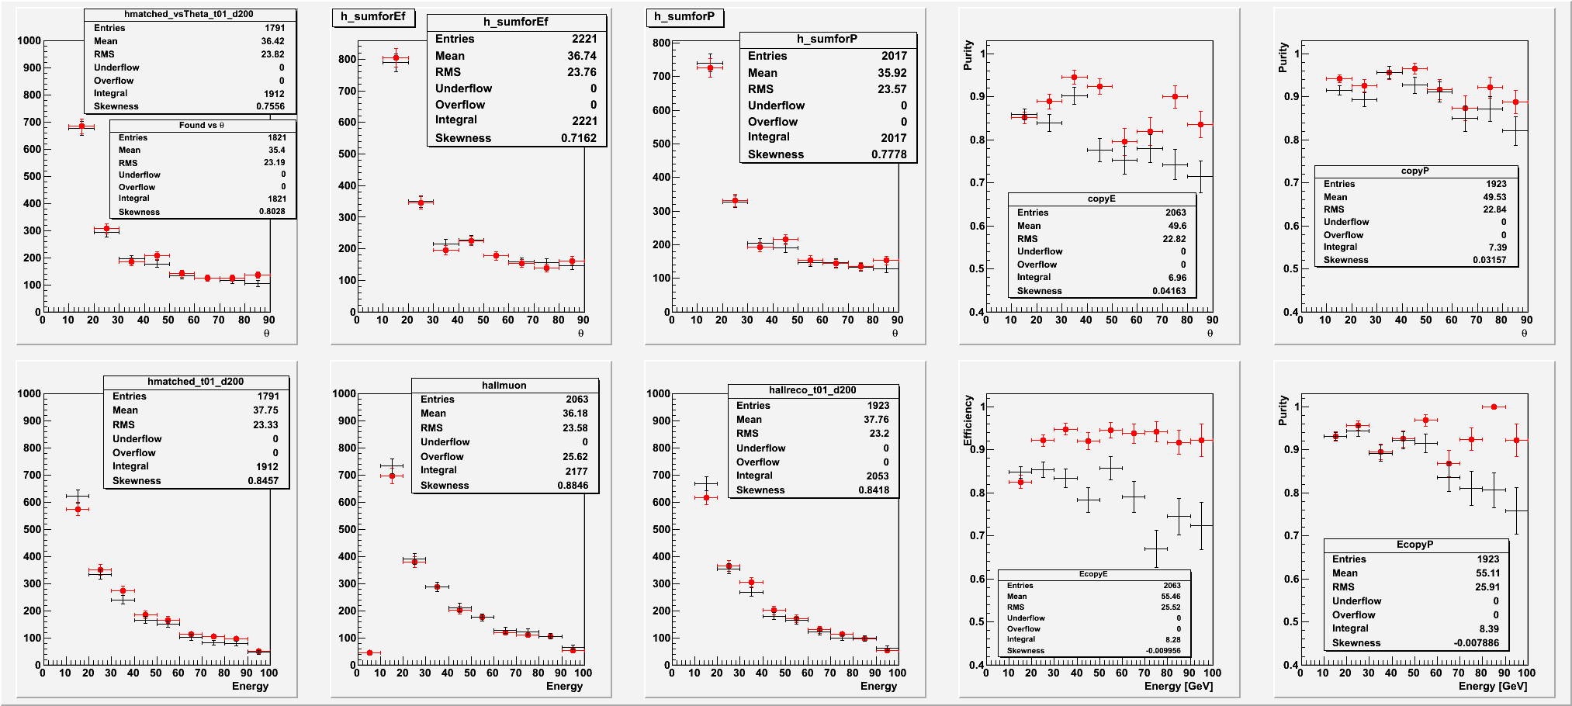
Matched & rec Muons θ distribution
Red Erik
Black Jacopo

Slide 4
Dividing: Purity θ distribution

Slide 5
Matched & all Muons θ distribution

Slide 6
Dividing: Efficiency θ distribution
Efficiency

Slide 7
Matched & rec Muons Energy distribution

Slide 8
Dividing: Purity Muons Energy distribution

Slide 9
Dividing: Matched & all Muons Energy distribution

Slide 10
Dividing: Efficiency Muons Energy distribution

Slide 11
Differences
Erik uses an older version of Pandora and Marlin, his code would not run in the latest Marlin
Jacopo has an energy based definition of Ef. and Purity
Erik checks that the MC behind a track is a muon
Jacopo takes the MC muons which decay inside a sphere from the IP

