Slide 1
Injection kicker timings
Rebecca Ramjiawan, Yann Dutheil
FCC-ee injection meeting, CERN
Tuesday 22nd February 2022

Slide 2
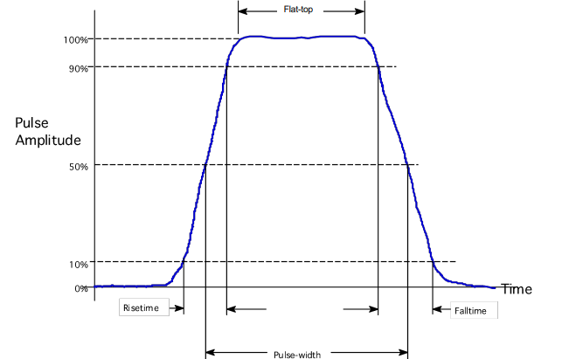
Rise/fall time is defined between two values, e.g 10%-90%, 1%-99%.
The more critical the rise time the larger the specification.
Pulse width can be defined as FWHM, flat-top etc., depending on experiment.
[1]

Slide 3
Dipole kicker parameters (conventional bump injection)
System specifications
Deflection angle: 12.5 µrad
Integrated magnetic field $$\int{Bdl}$$: 7.6 mTm
Available length for kicker: few metres
Rise time: ideally few 100 ns, could tolerate $$∼1 μs$$ (would lose halo particles)
Beam envelope at kicker (5 sigma - $$t\overline{t}$$): 2.517 mm x 0.064 mm
Pulse flat-top: ? - Revolution period/# batches - $$304 μs$$ if a single batch
Repetition rate: ? - 1/booster-cycle-length - alternating top-up injection every 5.6 - 50.95 seconds.
2 $$×$$ 5.6 seconds $$⭬$$ 0.09 Hz ($$t\overline{t}$$),
2 $$×$$ 50.95 seconds $$⭬$$ 0.01 Hz (Z-mode).

Slide 4
Open questions
How many batches for injection into collider? There will be hardware considerations to take into account for this, but what are the experimental constraints? I found this [M. Aiba FCC week 2015] which says 2-4 batches are optimum but I can’t find anything else saying this. This [A. Niemi 2020] suggests one batch is the only mode considered.
Pulse flat-top: $$304 μs$$ (1-batch), $$152 μs$$ (2-batch), $$76 μs$$ (3-batch)
Repetition rate: 0.01-0.09 Hz (1-batch, 1-cycle)
Flat-tops of $$>300 μs$$ do exist and are used e.g for extraction/dump kickers. These typically do not have as tight restrictions on rise/fall times. Often have fall times which are a reasonable fraction of the flat-top.

Slide 5
Kicker rise/fall times
Linac: 2 bunches (100 ns separation) at 100-200 Hz rep rate (5-10 ms train separation)
SPS: 1190 bunches, 3 pairs interleaved injection so 17.5 ns bunch spacing in trainlets (15-20 ns trainlet separation). SPS is 6.9 km/23 μs, 9240 buckets at 200 MHz. 1190 bunch train (17.5 ns separation = 22.77 μs). Abort gap 230 ns.
14 injections into booster (10 with 1188, 4 with 1190). Booster cycle 326 μs. Fill with 14 SPS trains 317.8 μs, ~5-8 μs abort gap.
91.174 km collider ring $$⭬$$ 304.12 μs
9600 bunches, 17.5 ns separation $$⭬$$ 168μs
Rise and fall times should fit within 130 μs?
CDR
Nov2021

Slide 6
Kicker systems case studies
System | XFEL KL kickers [2] | ISIS as RAL [3] | LHC abort MKD [4] | LCLS BYKIK [5]
Flat-top | 300 μs | 600 μs | 90 μs | 68 μs
Rise/fall time | 20 μs | 14 ms | 2.85 μs/1.8 ms | 100 ns
Deflection | 500 μrad | 95 mrad | 17.7 μrad
Integrated field | 33.4 mTm | 450 mTm | 428 mTm | 5 mTm
Current | 600 A | 2800 A | 18.5 kA | 60 A
Voltage | 100 V | 1350 V | 30 kV solid-state switch | IGBT solid state switch
Repetition rate | 10 Hz | 10 Hz | 0.016 Hz | 120 Hz
Kicker type | Stripline | Laminated window-frame | C-shaped magnets | Magnetic kicker

Slide 7
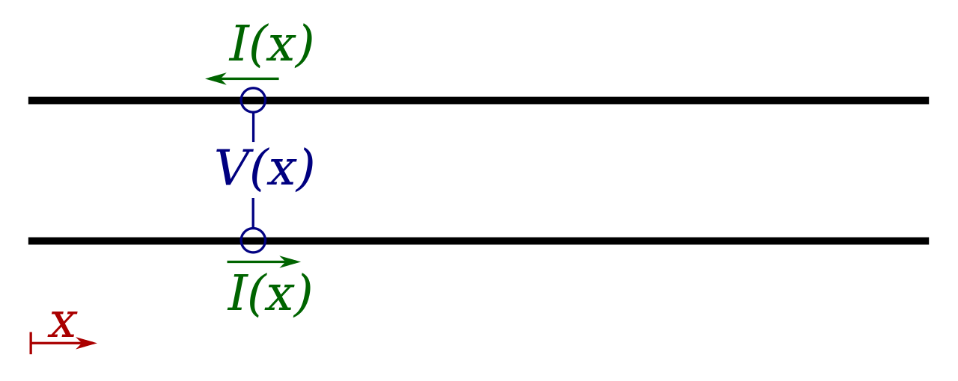
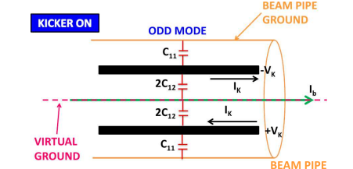
Stripline kickers (electrostatic)
[7]
The conducting strips and the beam pipe walls form two coupled transmission lines. When a current ﬂows in opposite directions in the two strips, a traveling electromagnetic wave is induced between them, moving upstream.
Fast rise times, but only capable of small deflections.
[6]
[8]

Slide 8
Stripline kicker parameters (conventional bump injection)
Design parameters
$$Θ_{E}\left[rad\right]= \tan^{-1}\left[\frac{E\left[V/m\right]l\left[m\right]}{p\left[\frac{GeV}{c}\right]β×{10}^{9}}\right]$$
$$β= 0.999987$$
p = 182.5 GeV/c
Kicker magnetic length: 0.5 m
Kicker type: stripline
Rise time: 100s ns
Magnetic length: 1 m
Plate separation: 20 mm
Integrated electric field (182.5 GeV): 2.28 MVm
Voltage pulses: 45 kV
$$Θ_{E}\left[rad\right]≃ \frac{|V\left[V\right]|l\left[m\right]}{{d\left[m\right]p10}^{9}β}$$

Slide 9
Dipole kicker parameters (conventional bump injection)
Dipole kicker parameters (conventional bump injection)
Design parameters
Design parameters
Kicker magnetic length: 0.5 m
Kicker type: C-shaped, length 50 mm
Rise time: 1 μs
Magnetic field (182.5 GeV): 0.015 T
Magnetic length: 0.5 m
Aperture: 20 mm x 15 mm
Coil turns N = 1
Current I: 179 A
Magnetic inductance (a middle cell): 47.1 nH
Switch voltage: 5.9 kV for 16.67 Ω characteristic impedance (FCC-ee CDR)

Slide 10
Thank you for listening

Slide 11
Multipole kicker parameters (MKI)
System specifications
Injected beam deflection angle: 29 μrad
$$\int{Bdl}$$: 17.7 mTm
Magnetic field (182.5 GeV): 0.035 T
Available length: few metres
Rise time: few $$μs$$
Beam envelope (5 sigma- ttbar): 2.517 mm x 0.064 mm
Injected beam-stored beam separation: 2.28 mm (Z-mode), 5.03 mm (ttbar)

Slide 12
Multipole kicker parameters (MKI)
Design parameters
Magnetic field (182.5 GeV): 0.035 T
Magnetic length: 0.5 m
Aperture: 20 mm x 15 mm
N = 1 (turns)
Current I = 418 A
Switch voltage: (16.67 Ω impedance): 13.9 kV

Slide 13
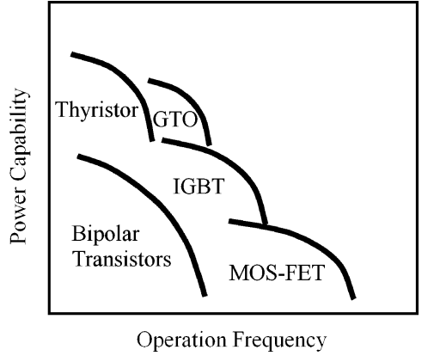
Relative power and frequency capabilities of different semiconductor devices.

