Slide 1
Off-Momentum MKI Matching
And Initial Look at Tracking with Errors
FCC-ee Injection Meeting 22-02-22
Patrick Hunchak
Patrick Hunchak and Michael Hofer

Slide 2
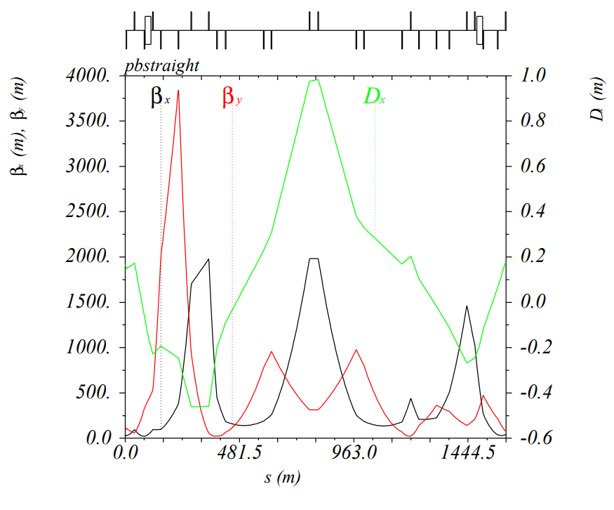
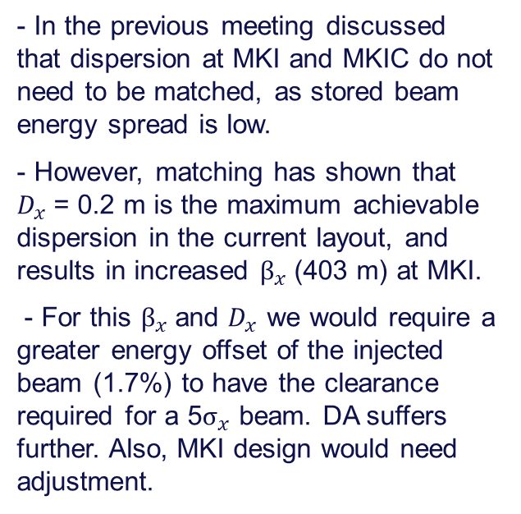
Matching for Off-Momentum MKI
FCC-ee Injection Meeting 22-02-22
- In the previous meeting discussed that dispersion at MKI and MKIC do not need to be matched, as stored beam energy spread is low.
- However, matching has shown that
$D_{x}$= 0.2 m is the maximum achievable dispersion in the current layout, and results in increased $β_{x}$(403 m) at MKI.
- For this $β_{x}$and $D_{x}$ we would require a greater energy offset of the injected beam (1.7%) to have the clearance required for a 5$σ_{x}$ beam. DA suffers further. Also, MKI design would need adjustment.
MKI

Slide 3
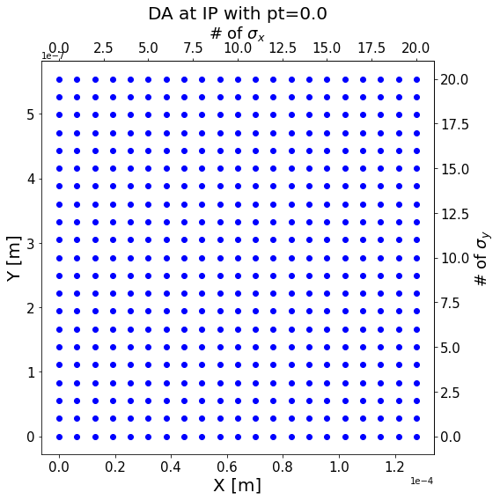
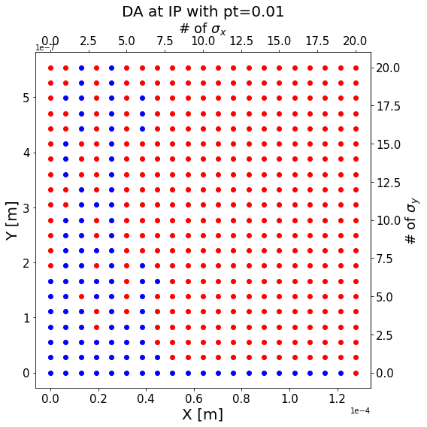
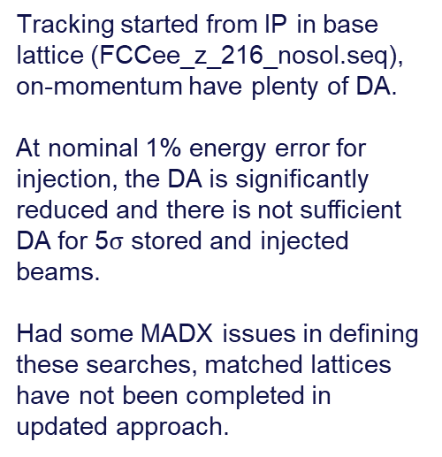
Off-Momentum Dynamic Aperture
FCC-ee Injection Meeting 22-02-22
Tracking started from IP in base lattice (FCCee_z_216_nosol.seq), on-momentum have plenty of DA.
At nominal 1% energy error for injection, the DA is significantly reduced and there is not sufficient DA for 5$σ$ stored and injected beams.
Had some MADX issues in defining these searches, matched lattices have not been completed in updated approach.

Slide 4
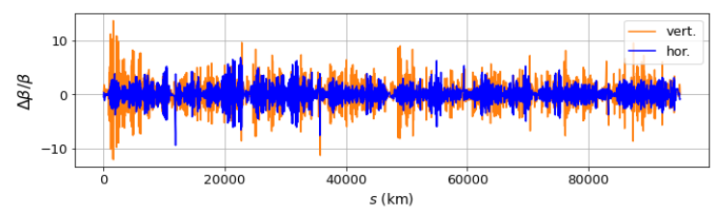
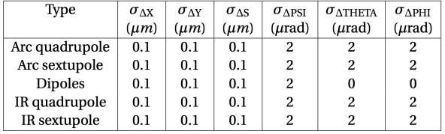
Initial Misalignment Tracking Results
FCC-ee Injection Meeting 22-02-22
Working to include lattice errors to study the efficiency of the various injection approaches in a more realistic machine.
Correcting realistic misalignments in a lattice is time consuming. We are using smaller misalignments to approximate a corrected lattice.
Charles, ttbar lattice after corrections
https://indico.cern.ch/event/1085318/contributions/4582685/subcontributions/356825/attachments/2354694/4018268/FCC_collaboration_Nov2021.pdf
Wu, Carlier, Pieloni
https://indico.cern.ch/event/1119730/contributions/4701839/attachments/2380319/4066993/EPOL_Yi.pdf

Slide 5
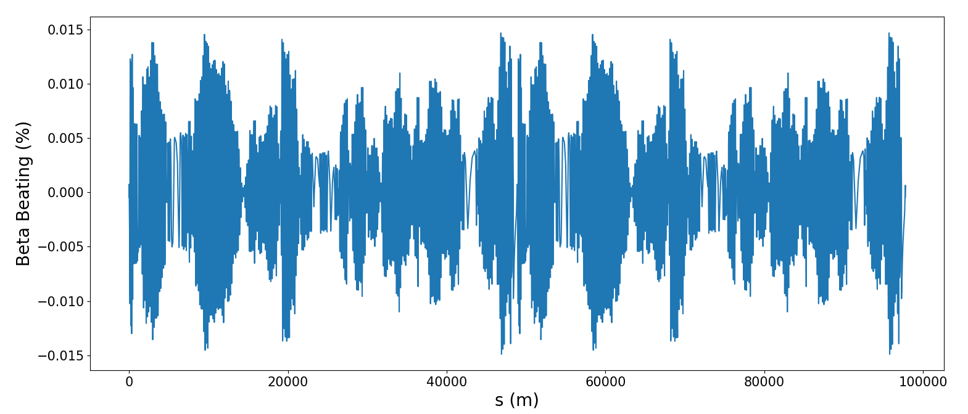
Initial Misalignment Tracking Results
FCC-ee Injection Meeting 22-02-22
Working to include lattice errors to study the efficiency of the various injection approaches in a more realistic machine.
Correcting realistic misalignments in a lattice is time consuming. We are using smaller misalignments to approximate a corrected lattice.
More misalignments to be included, find levels that provide manageable errors. See effects on DA, orbit, and injection efficiencies.
Wu, Carlier, Pieloni
https://indico.cern.ch/event/1119730/contributions/4701839/attachments/2380319/4066993/EPOL_Yi.pdf

Slide 6
Thank you.
FCC-ee Injection Meeting 22-02-22
6

