Slide 1



Previous work on FCC-ee Booster collective effects
M. Migliorati
E. Carideo, D. Quartullo, M. Zobov

Slide 2
Parameter list comparison: Z-pole and booster (injection)
parameter | Z | Booster
Beam energy (GeV) | 45.6 | 20
Bunch population [10¹¹] | 1.7 | .213
Energy spread(SR/BS) [10⁻³] | 0.38/1.32 | .166
Energy loss/turn (MeV) | 36.0 | 1.33
RF frequency (MHz) | 400 | 400
RF voltage (MV) | 100 | 60
Arc optics |  | 60°ph adv | 90°ph adv
Mom compaction [10⁻⁶] | 14.8 | 14.8 | 7.27
Synchrotron tune | 0.025 | 0.030 | 0.021
Bunch length [mm](SR/BS) | 3.5/12.1 | 1.26 | 0.88

Slide 3
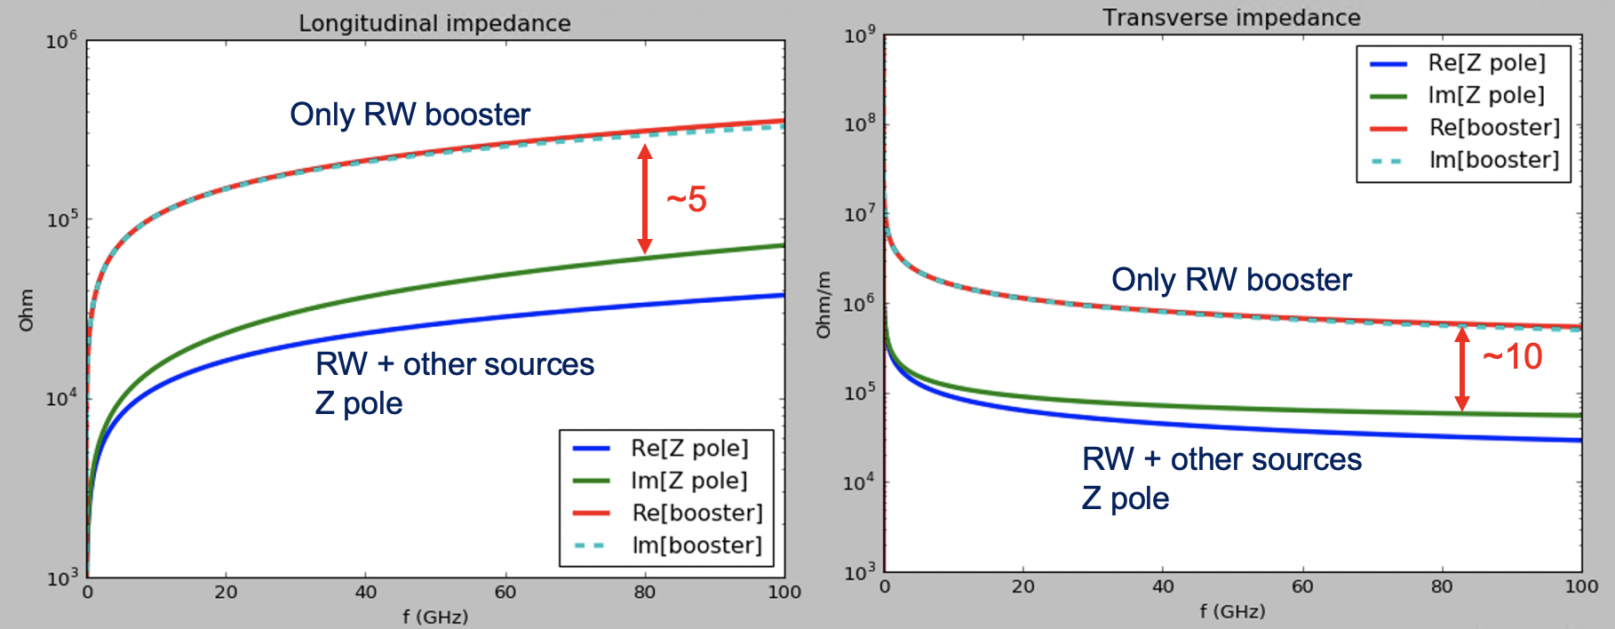
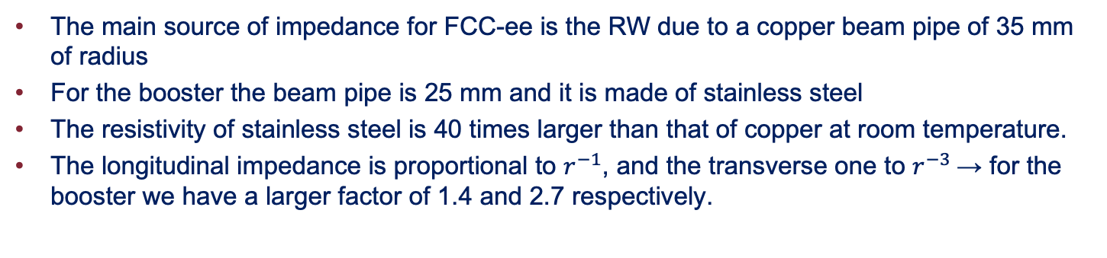
RW impedance in the Booster
The main source of impedance for FCC-ee is the RW due to a copper beam pipe of 35 mm of radius
For the booster the beam pipe is 25 mm and it is made of stainless steel
The resistivity of stainless steel is 40 times larger than that of copper at room temperature.
The longitudinal impedance is proportional to $r^{−1}$, and the transverse one to $r^{−3}$→ for the booster we have a larger factor of 1.4 and 2.7 respectively.

Slide 4
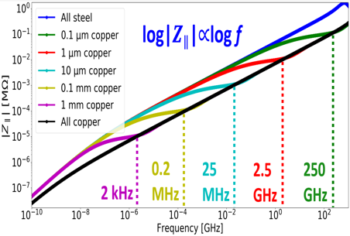
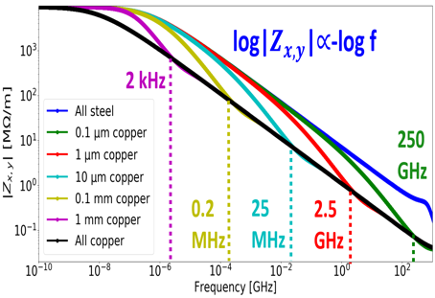
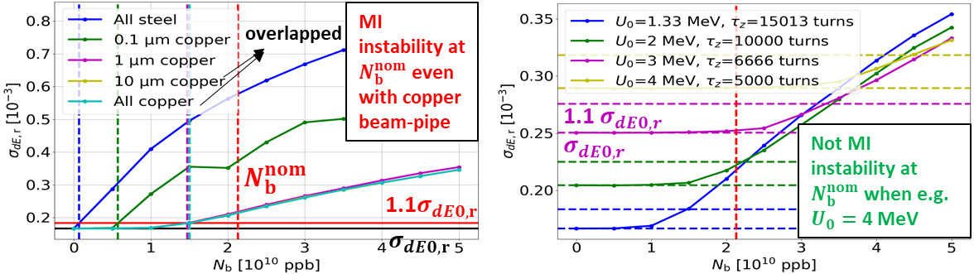
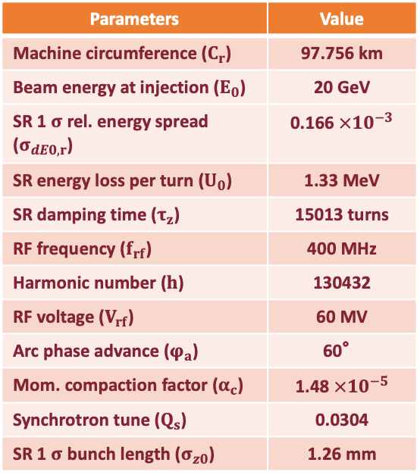

FCCee-Booster Beam Dynamics Studies
1) Simulated parameters
2) RW-impedance evaluation with IW2D adding a copper layer to beam-pipe
Parameters | Value
Machine circumference ($C_{r}$) | 97.756 km
Beam energy at injection ($E_{0}$) | 20 GeV
SR 1 $σ$ rel. energy spread ($σ_{dE0,r}$) | 0.166$×{10}^{−3}$
SR energy loss per turn ($U_{0}$) | 1.33 MeV
SR damping time ($τ_{z}$) | 15013 turns
RF frequency ($f_{rf}$) | 400 MHz
Harmonic number ($h$) | 130432
RF voltage ($V_{rf}$) | 60 MV
Arc phase advance ($φ_{a}$) | 60°
Mom. compaction factor ($α_{c}$) | 1.48$×{10}^{−5}$
Synchrotron tune ($Q_{s}$) | 0.0304
SR 1 $σ$ bunch length ($σ_{z0}$) | 1.26 mm
3) BLonD longitudinal beam dynamics simulations
4) BLonD simulations using 1 $μm$ copper-layer increasing SR power-loss
No tracking code simulations had been performed in the transverse plane for TMCI

Slide 5
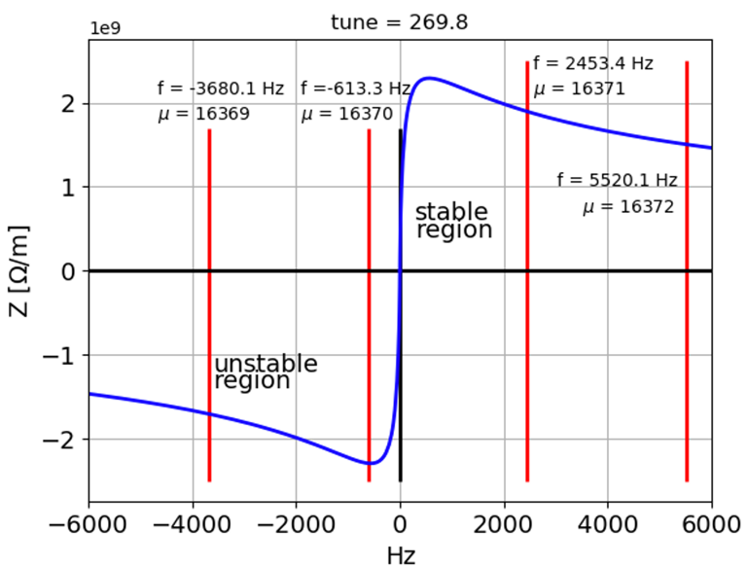
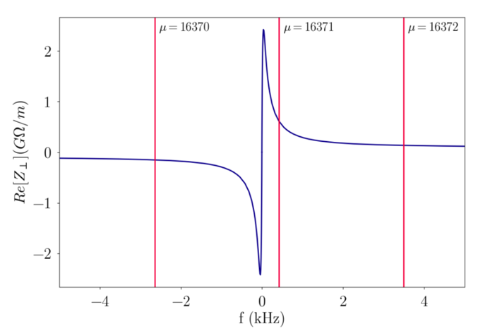
RW Transverse coupled bunch instability
60º optics
Z pole: real part of the RW impedance for a copper beam pipe of 35 mm.
Booster: real part of the RW impedance for a stainless steel beam pipe of 25 mm.
For the booster, the peak of the impedance at low frequency is similar to that of the Z-pole , even in presence of stainless steel. However, a variation of the fractional part of the tune here affects only slightly the growth rate. The rise time is in the order of few turns.

