Slide 1
CERN Innovation Programme on Environmental Applications
Enrico Chesta
08/03/2022

Slide 2
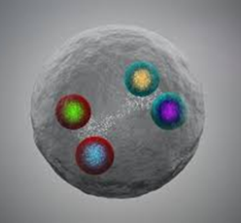

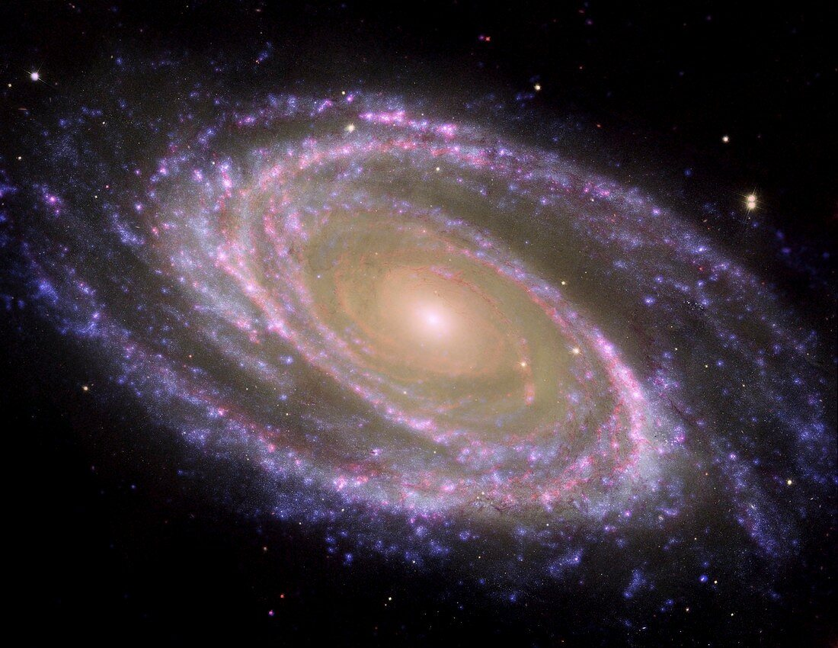
The Question
10⁻³²
10⁻²⁸
10⁻²⁴
10⁻²⁰
10⁻¹⁶
10⁻¹²
10⁻⁸
10⁻⁴
10⁴
10⁸
10¹²
10¹⁶
10²⁰
10²⁴
10²⁸
[cm]
Big Bang
Proton
Atom
Radius of Earth
Earth to Sun
Radius
Galaxies
Universe
CERN can help to explore the secrets of matter
CERN can help to understand the mysteries of the universe
Can CERN help to tackle climate and environmental issues on a global scale?

Slide 3

The Answer
Harnessing CERN’s unique skillset to help preserve the planet
Initiative endorsed by the Director General and the Enlarged Directorate in January 2022
Supported by HSE in the frame of CERN’s Year of Environmental Awareness
Coordinated by the Knowledge Transfer group to maximise positive impact on society
Entirely based on the ingenuity and expertise of CERN technical departments and community

Slide 4
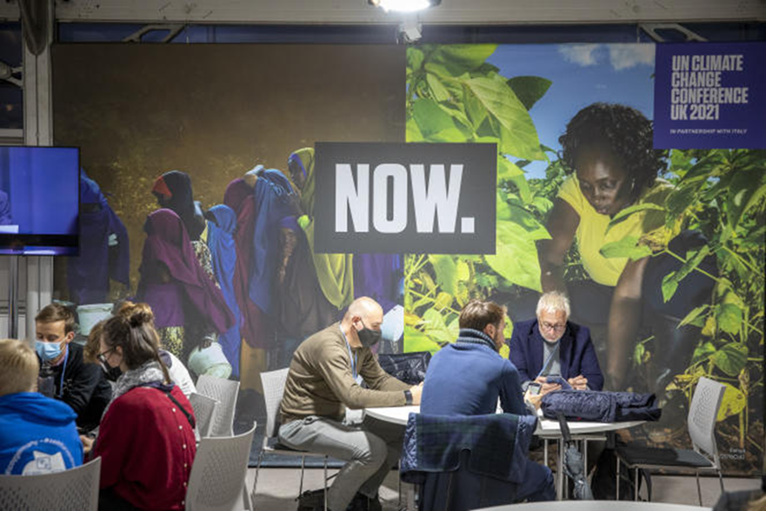
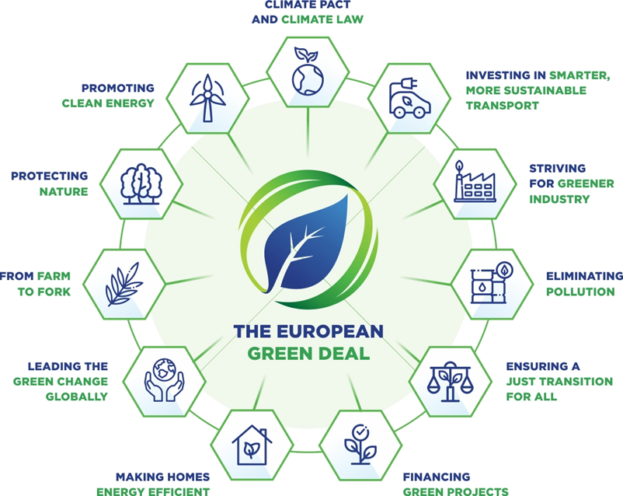
Environment: a clear priority at international level
The latest UN reports are very worrying: climate change threat cannot be ignored
Important resources are being invested at every level to support the ecological transition
New disruptive technologies for the environment are being developed at a fast pace
Source: https://euinasean.eu/eu-green-deal/

Slide 5

Environment: a clear priority for CERN
Three main development directions have been identified for environment and sustainability:
Identify and develop CERN’s technologies that may contribute to mitigating the impact of society on the environment
Minimise the Laboratory’s impact on the environment by implementing CEPS (CERN Environmental Protection Steering) recommendations and defining a Green Procurement strategy
Pursue actions and technologies aiming at energy saving and reuse, under the supervision of CERN’s Energy Management Panel

Slide 6
Environmental Applications: Key Areas for CERN

Slide 7




CERN Environmental Applications: Examples
Technologies for green hydrogen production, transport and storage
High performance solar thermal or photovoltaic panels
Superconducting links for high current transmission with minimal losses
Compact nuclear reactors or fusion systems based on HFM
RENEWABLE AND
LOW-CARBON ENERGY
Advanced power distribution systems for future electric/hybrid planes
Decarbonized or low emission maritime vessels
Hydrogen tanks and fuel cells for long-haul trucks or small planes
High speed levitating rail systems in partly evacuated tubes
CLEAN TRANSPORTATION AND FUTURE MOBILITY
Distributed sensors for ground/air monitoring of physical parameters
Instruments and technologies for remote sensing and Earth observation
Artificial Intelligence and big data expertise for digital twin modelling
Accelerator systems applied to exhaust gas treatments
CLIMATE CHANGE AND
POLLUTION CONTROL
Advanced cooling systems based on CO2 to reduce F-gases emissions
Fast computing power saving techniques based on machine learning
Systems to remove residuals of anti scaling and bacteria treatments
Infrastructure operation optimisation based on motor sensors
SUSTAINABILITY AND
GREEN SCIENCE

Slide 8
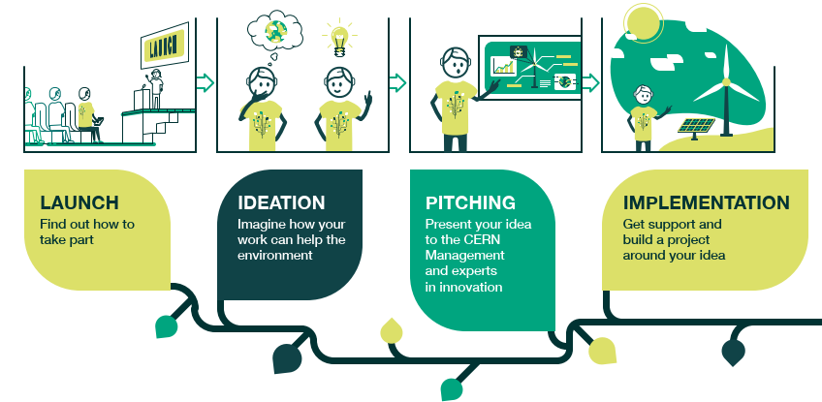
CIPEA: the way to achieve positive impact

Slide 9
CIPEA: practical information and timeline
IDEATION
PITCHING
IMPLEMENTATION
March-May 2022
June 2022
Starts in July 2022
Brainstorming phase over 3 months to collect ideas for feasibility assessment
Submit your project/idea before 27/05/2022
Required elements:
  Contact details of project proponent
  (individual or team involving CERN MPs)
  CERN technology/facility/expertise on
  which the project is based
  Target environmental area of application
  and key addressed challenge
  Short project description with rough
  estimation of required resources
Support strategies will be defined for the most promising projects
Options include:
  Use of internal instruments like the KT Fund
  or the Impact Fund
  Establishment of bilateral partnerships with external organisations
  Coordination or participation to EU or national projects
A KT Fund session with focus on environmental
projects will be organised in September
CERN Innovation Day on Environmental Applications - sharing, discussing and prioritising collected ideas/projets
KT team will be available during every phase to advise and support!

Slide 10
Please get involved: your contribution makes the difference!
https://kt.cern/environment/CIPEA

