Slide 1
Higgs@10 Communications and Outreach Campaign 2022
A multi-channel, multi-audience communications and outreach campaign.
Ana Godinho (IR-ECO)
Teacher and Student Forum | 22.03.2022

Slide 2
Themes and Messaging
Celebration
The discovery of the Higgs boson changed the field of particle physics and its future perspective
10 years on
We know much more today about the building blocks of the Universe and their interactions than we did 10 years ago and are following interesting leads via the full exploitation of the LHC and its high luminosity upgrade (HL-LHC)
Preparing the future
CERN is investigating the feasibility of a future collider as a crucial tool to unlock the outstanding mysteries of the universe. The new collider could have a 100km circumference and reach collision energies of at least 100TeV enabling the search of new physics.

Slide 3
Celebration
The result of decades of incremental research
Questions answered, remaining questions, and new questions
Impact beyond the field of particle physics (astroparticle physics, cosmology,…)
Discovery underpinned by cutting edge technological innovation (accelerators, detectors, computing)
Applications in society
10 years on
Compelling results over the decade
Interesting leads from research at the LHC
Full exploitation of LHC and HL-LHC
A decade of successful international collaboration
Preparing the future
Physics case for a future collider
FCC Feasibility study
Accelerator R&D programme
Scientific diversity programme
Example of successful international collaboration
A model for global scientific projects
Framework for unprecedented global collaboration
CERN’s history of successful ambitious projects
Cutting-edge technological innovation (e.g. HL-LHC)
Current and potential applications in society
Cutting-edge technological innovation
Potential applications to societal challenges – health, environment
Proven socio-economic benefits (business opportunities, capacity-building, job creation)
Socio-economic benefits of HL-LHC (and upgrades?)
Continued socio-economic benefits, including opportunities for industry and job creation
Inspiration for fundamental research and careers in STEM
Inspiration for fundamental research and careers in STEM
Inspiration for fundamental research and careers in STEM
The cost of a future collider (will be distributed amongst global community and over several decades)
Themes and Topics

Slide 4
Target audiences*
Decision-makers
CERN community
Teachers and students
Industry
Media (as a vector)
Particle physics community
Local communities
General public
* Not listed in order of priority

Slide 5
Components of the campaign
Events
Products
Channels
Higgs symposium (core pillar)
Run3 first physics Live
Local public events
home.cern
Social media
CERN Courier
CERN Bulletin
Education programmes
voisins.cern
Media relations
Visual identity kit
Videos and animations
home.cern Higgs “portal”
Backgrounders
Education resources
Digital communication kit
Exhibition

Slide 6
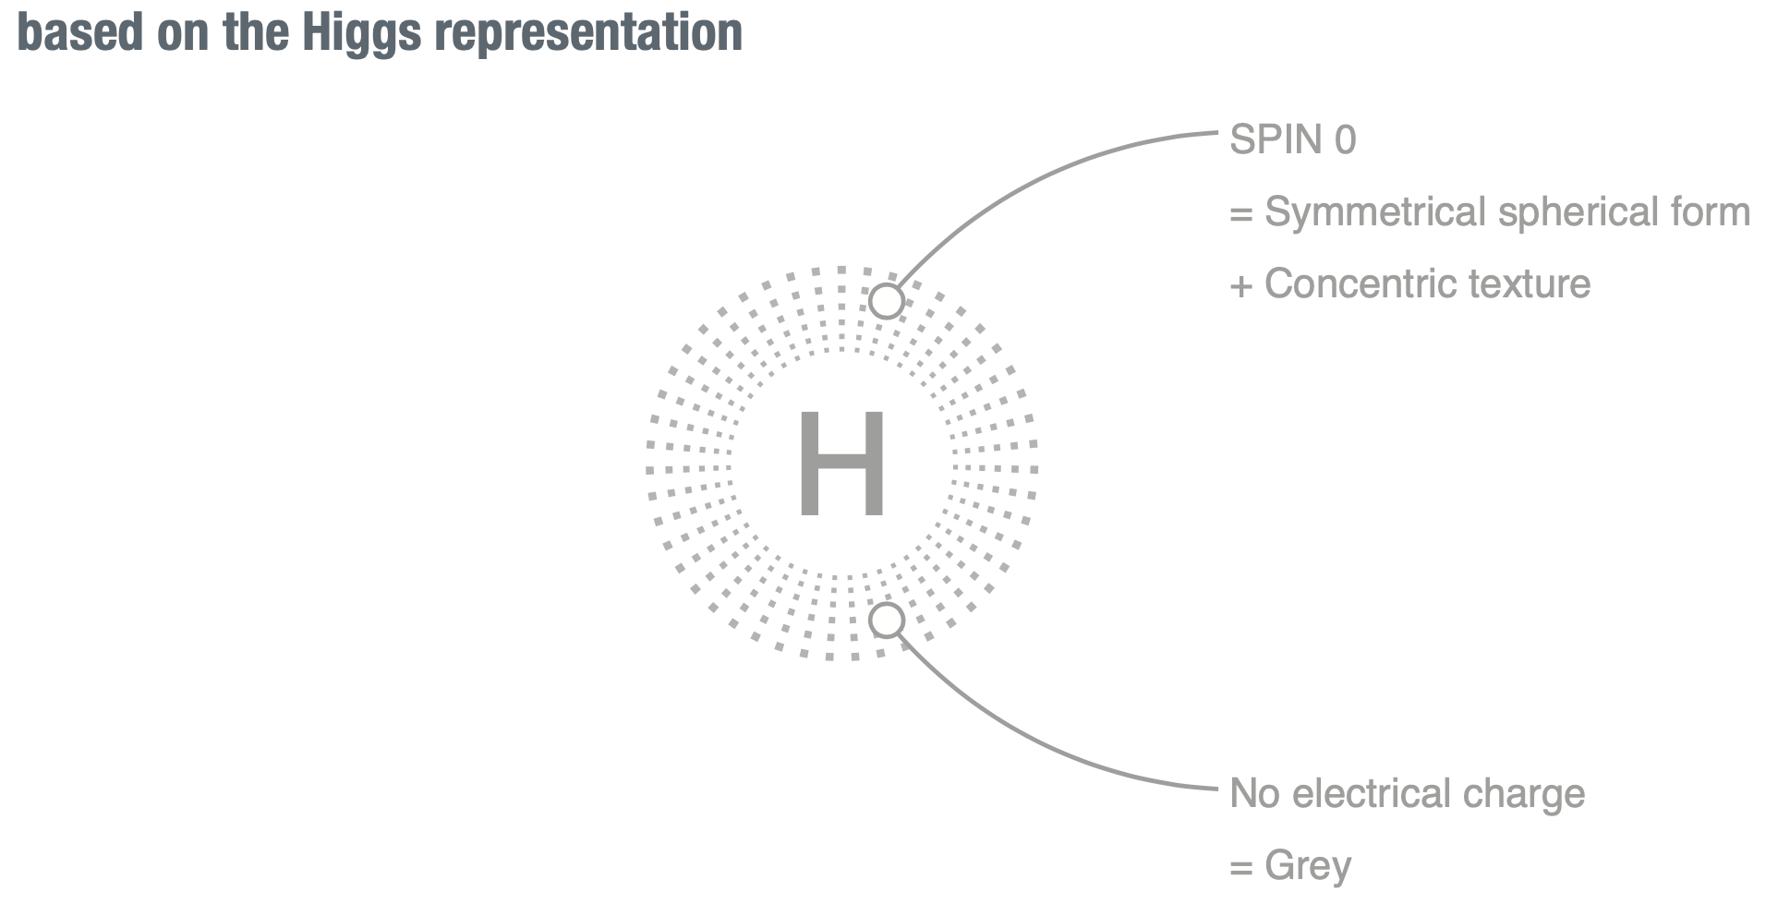



Celebration
10 years on
Preparing the future
Logo

Slide 7


Visual identity pack (online)
Colour and pattern palette
Language palette

Slide 8
Higgs scientific symposium
+
Media briefing / Interviews
Celebration
10 years on
Preparing the future
When: 4 July 2022
Morning (9-12h30) – plenary-type talks on past, present and future
  Last talk summarise the progress made to date, and what lies ahead (Fabiola)
  Aiming for diversity (gender, age)
  English and French webcast - TBC
Afternoon (14-18h) – presentation of new Higgs results (parallel session-like)
Where: CERN Main Auditorium + webcast + live broadcast on CERN social media channels
Target audiences:
Particle physics community
CERN community
Media
Teachers and Students
Status
Speakers being invited and accepting
Save-the-date before Easter

Slide 9
Live of Run3 first physics
+
Media Update
10 years on
Preparing the future
Live with running commentary from 4 LHC experiments, CCC (main hub), data centre
  streamed on CERN and experiments’ social media channels (Facebook, YouTube, Twitter) + CERN webcast
Media update on the day + VNR (Video News Release) aired via satellite to EBU
When: around 15 June, but firm date after LHC re-start (planned for Easter)
  Supporting products
  Pre-recorded interviews with LHC experiment spokesperson and others, theorist, Director ATS
  Run3 physics backgrounder
  Animation (countdown – beam synchronisation – collisions – new energy record)
  Event displays on the day
Status
Production truck confirmed
Volunteers being recruited
Interviewees and questions

Slide 10
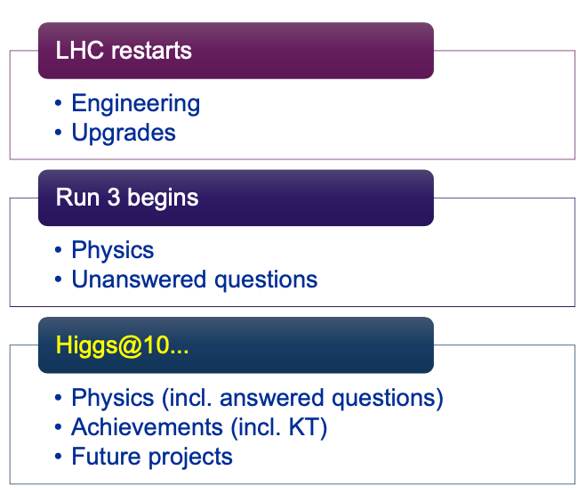
Media + Social media
Celebration
10 years on
Preparing the future
3 milestones
Media:
Media update
Backgrounders & video
Media training
(Mid-April)
#restartingLHC [Mar-Apr]
(Mid-June*)
Media:
Media update + VNR
Backgrounders & video
Media training
#LHCRun3 [Apr-Jun]
(4 July)
Media:
Press release + VNR
Press briefing
Backgrounders & video
Media training
#Higgs10 [Jun-Jul]

Slide 11
Higgs@10 content
Celebration
10 years on
Preparing the future
First level answer
Link to…
Questions
What is the Higgs boson?
What have we learnt about the Higgs in the last 10 years?
What are we still looking for?
What does it mean for me?
Home.cern
Higgs quick facts
Home.cern, Courier
Evergreen content (existing and new)
Bulletin articles
Courier features
Status
Drafting Higgs quick facts and 2nd level content
Developing Layouts

Slide 12
Public events
Celebration
10 years on
Preparing the future
Screenings of Particle Fever + Q&A
In local communities (Divonne, Bellegarde, Gex/Saint-Genis, Annemasse, Bonneville, Meyrin) [Apr-Jun]
At Globe as part of Cineglobe, with webcast [3 July]
  Two screens – outside and inside Globe; Q&A inside
  DG confirmed for Q&A
Nuit de la Science (Geneva) [9-10 July]
  Higgs-related hands-on activity
Status
Identified speakers for local Q&As
Securing venues
Preparing Cineglobe logistics

Slide 13
Partners
LHC experiments
Machine OP team
EPPCN
Interactions
IPPOG
Directorate (Governance)
Thank you!
Happy to take questions

