Slide 1




TPA Laser Experiment on the MPW2
HVCMOS MAPS chip
Francisco Rogelio Palomo Pintoª , Sebastian Pape^{b,c}, Michael Moll^{b}, J.María Hinojo Monteroª
fpalomo@us.es,
ª Electronic Engineering Department of School for Engineering in University of Seville, Spain
^{b} EP-DT CERN
^{c} TU Dortmund University
Dec 2nd 2022 https://indico.cern.ch/event/1132520/

Slide 2

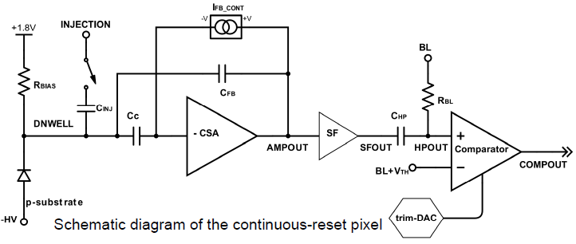
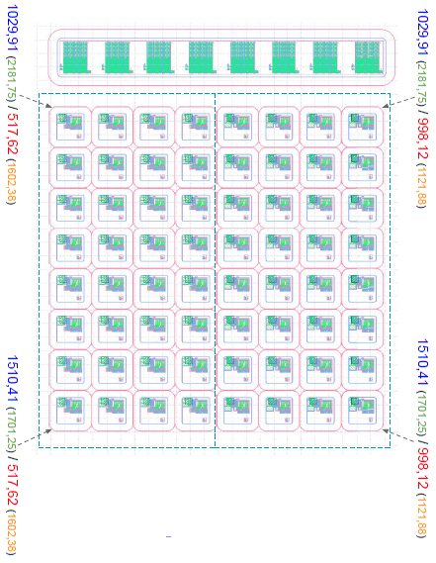
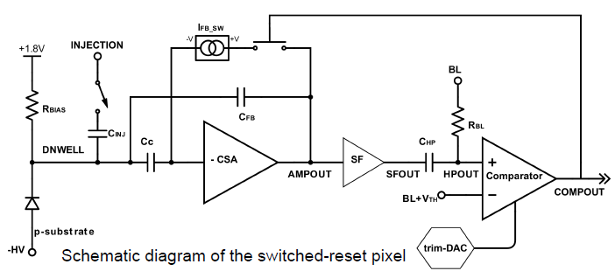
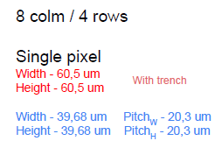
General Description
MPW2 Chip Pixels
APM1
Columns 0-3
r0c0
r0c4
r0c7
r1c1
Vth defines the comparator threshold
BL (baseline) defines an offset to the analog output to ensure signal stability
r7c0
r7c7
Each APM (Analog Pixel Matrix) flavour has 4 cols / 8 rows
Size of a single pixel (with trench)
Width - 60,5 um
Height - 60,5 um
Size of a single pixel (without trench)
Width - 39,68 um Trench_{W} - 20,3 um
Height - 39,68 um Trench_{H} - 20,3 um
APM2
Columns 4-7

Slide 3
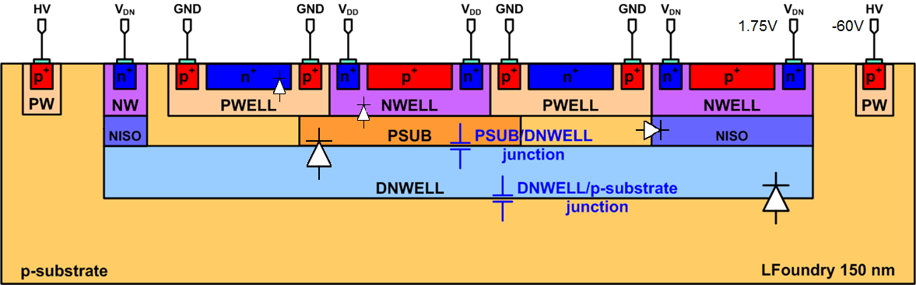
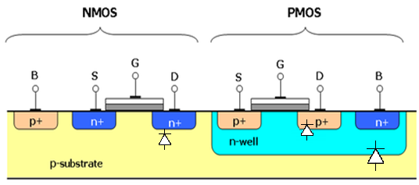
General Description
8 μm
~10 μm
~280 μm
The experiment purpose is to get signals from the chip under femtosecond TPA laser excitation at different chip depths (z-scan mode). The hope is to get signals from every pixel layer in order to clasify them as proper detections (dnwell-psubs diode), parasitic detections (other inter-layers reverse biased pn diodes) or single event effects (laser voxel in the electronics zone, near to the die Surface, signal produced by the pn isolating diodes between the diffusion and the embedding well )

Slide 4
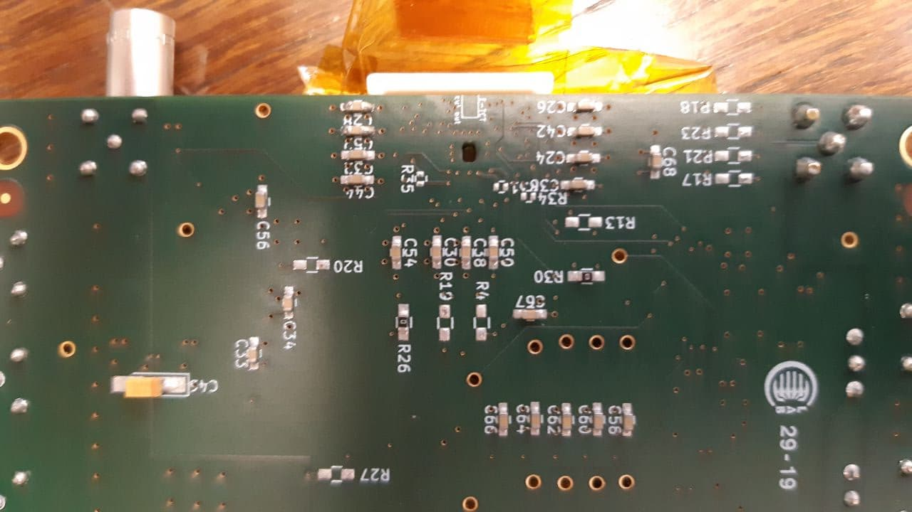
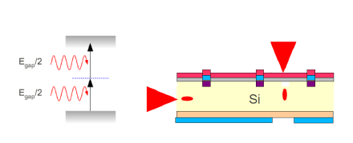
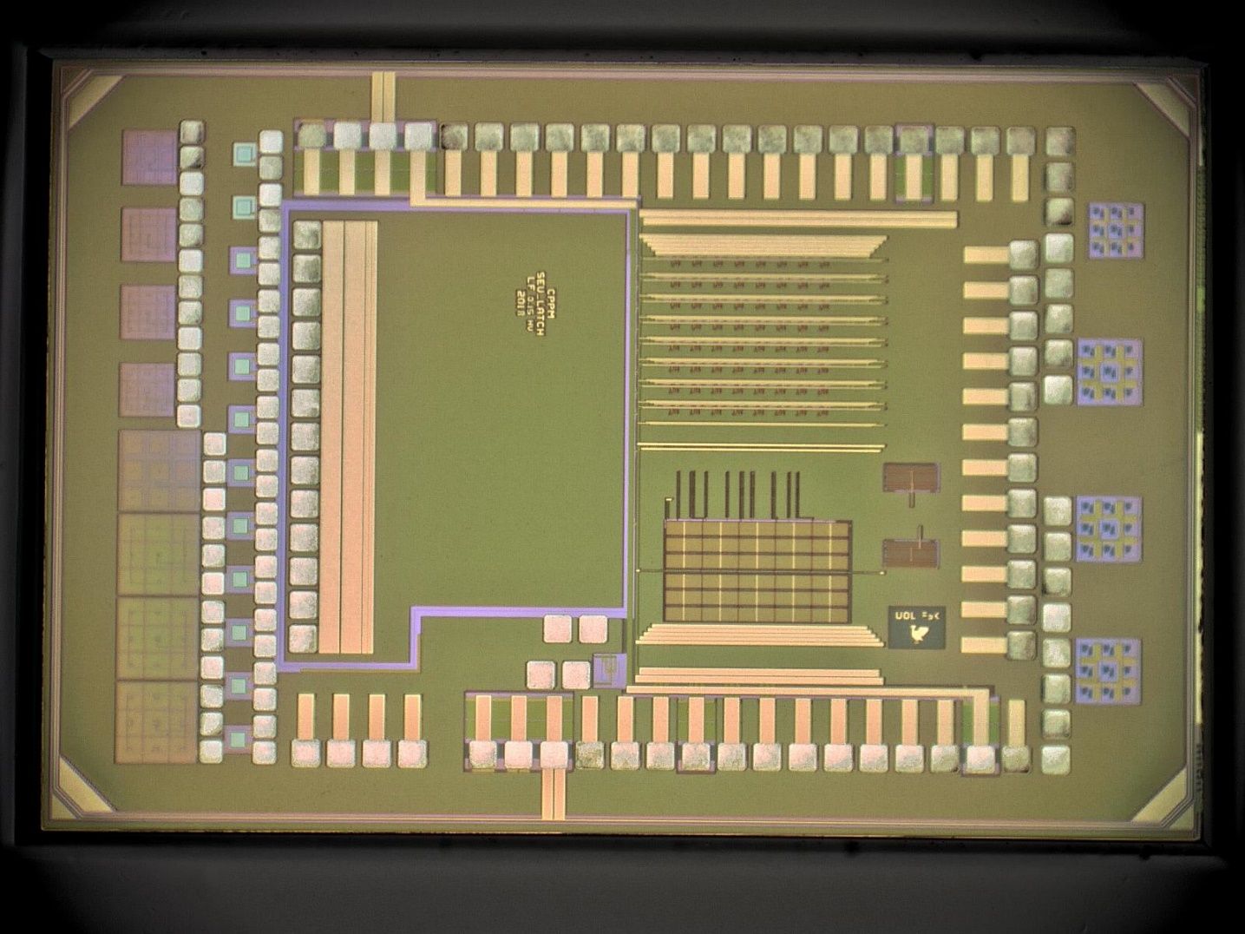
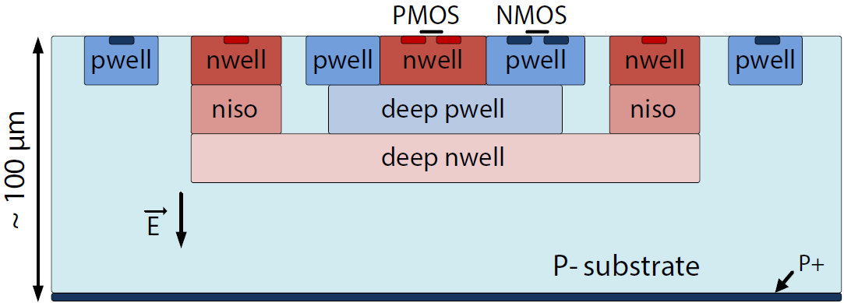
General Description
The MPW2 card has a window to the MPW2 chip, designed for backside laser illumination. At 1550 nm, 400 fs, the silicon is transparent below a light intensity threshold so the photoionization (light absorption) happens only around the focus point (voxel volume). A z-scan means to precisely position the voxel volumen along different die depths, also moving the beam along the pixel area. That way any particular volume can be excited to generate a signal in the collecting electrodes.
8x8 active pixel matrix
60x60 μm² pixel size
1.9 kΩ-cm substrate resistivity
no backside metallization
280 μm
MPW2 Chip Pixels

Slide 5
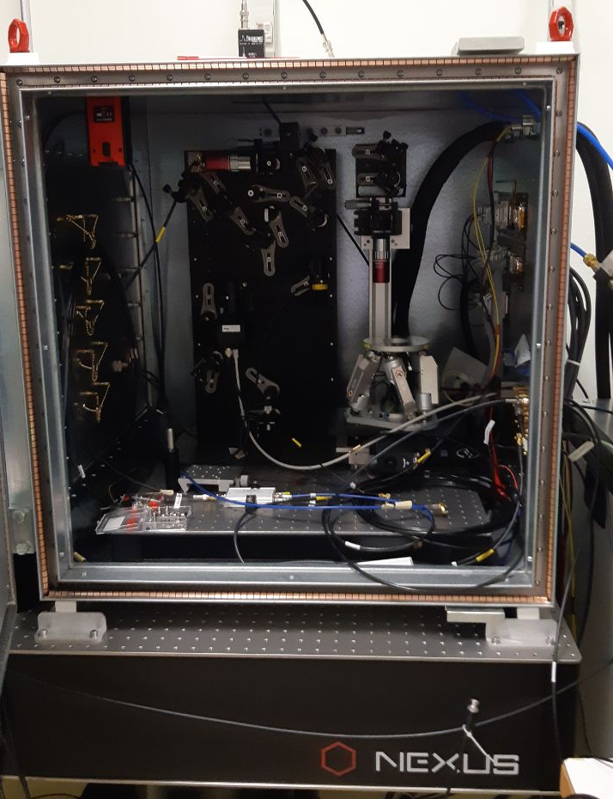
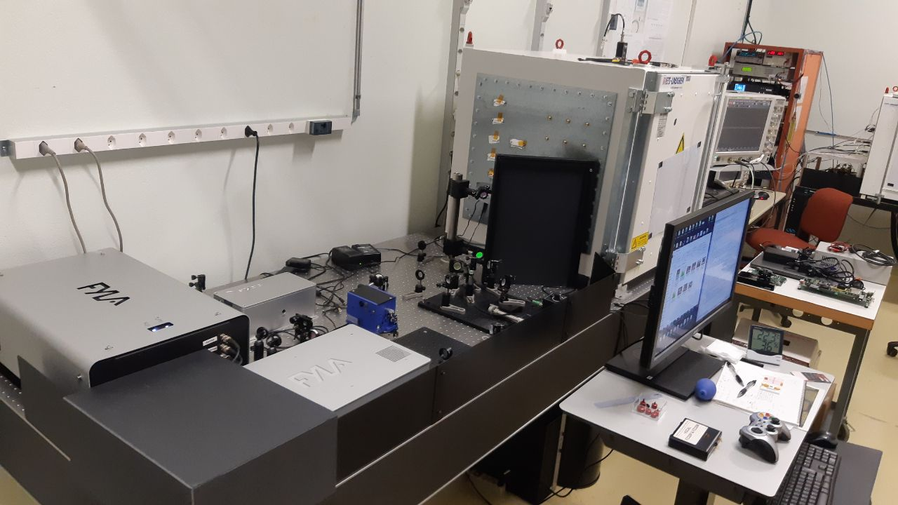
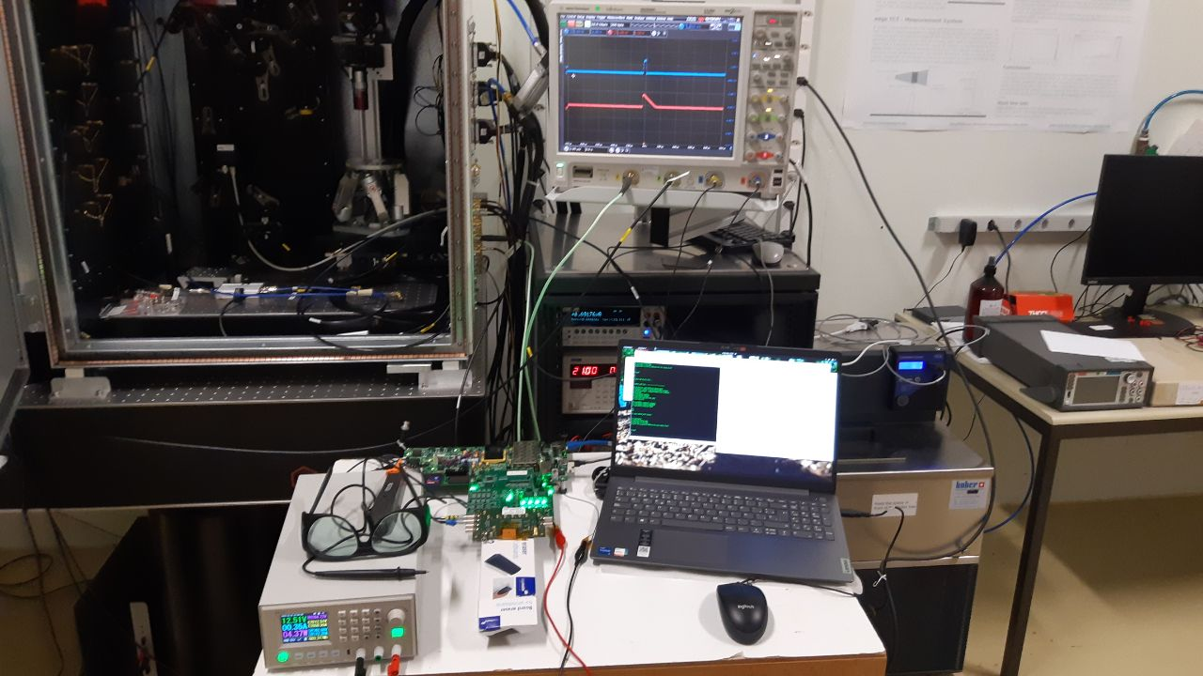
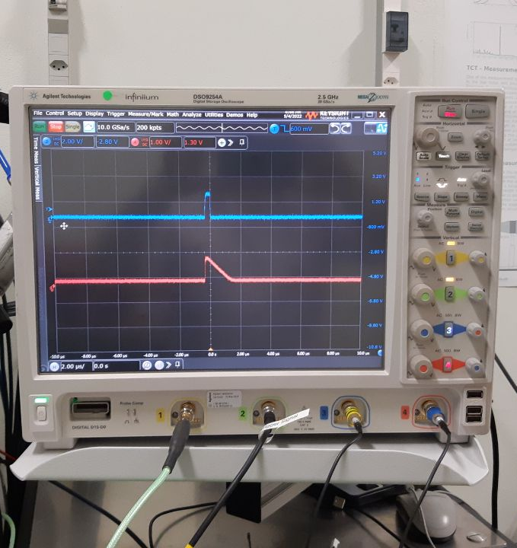
General Description
SSD Laser for TPA
1550 nm, ~400 fs,
magnetoacustic pulse
picker (selectable single
shots). Different depths
by focusing, different
XY positions by a hexa-
pod platform, EMI iso-
lated, batiment 28
basement@CERN

Slide 6
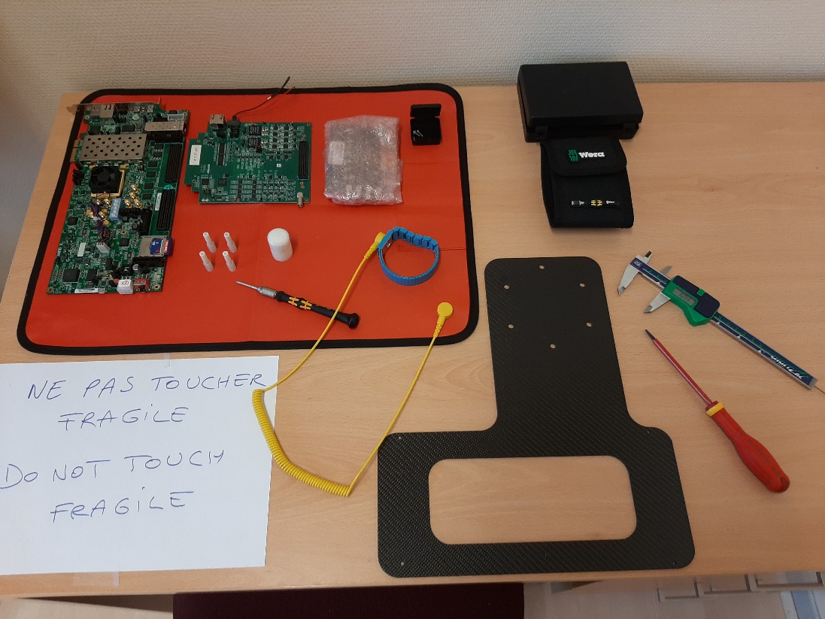
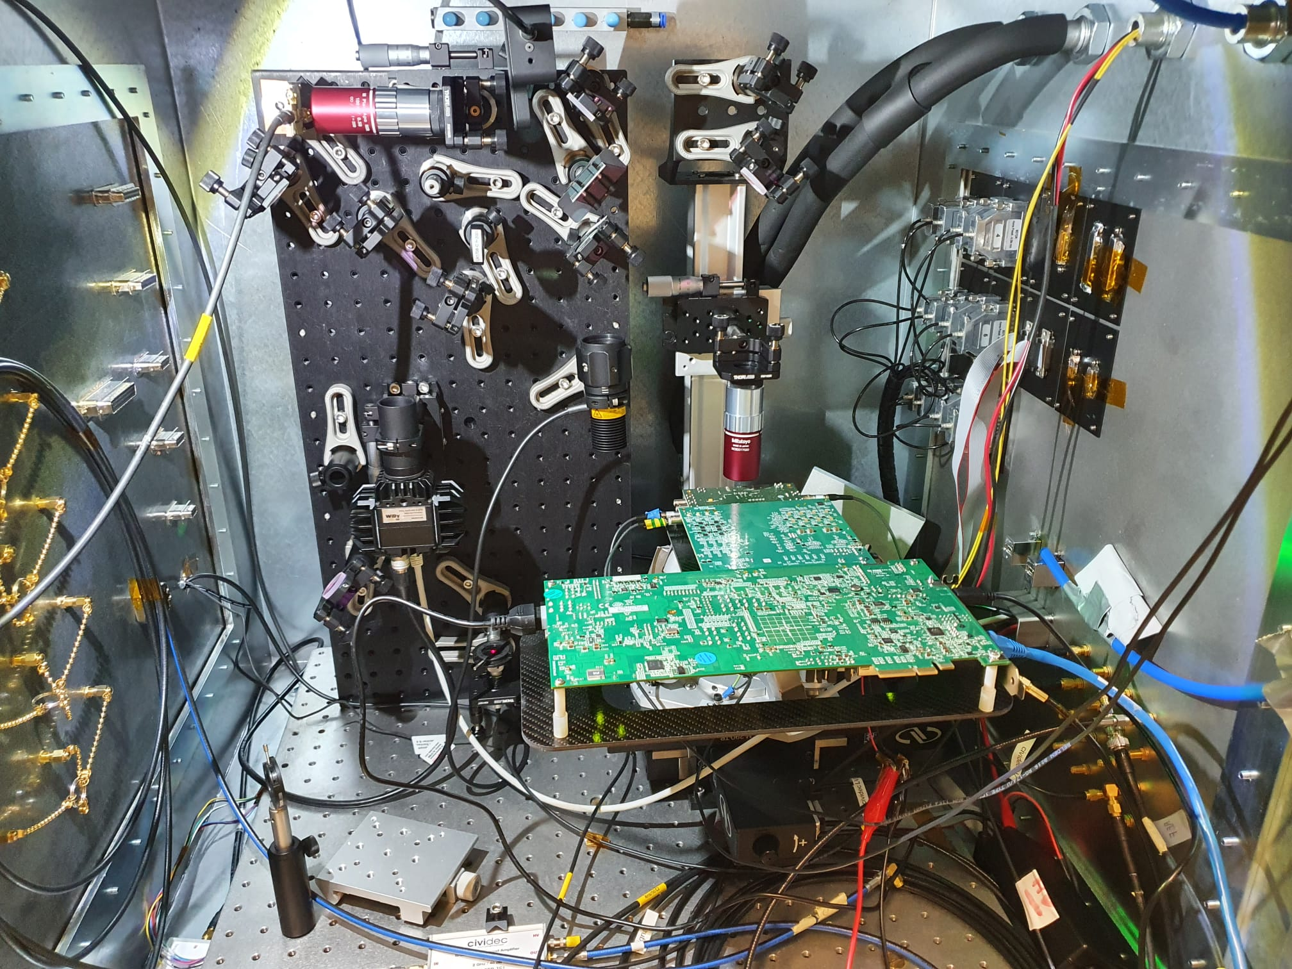
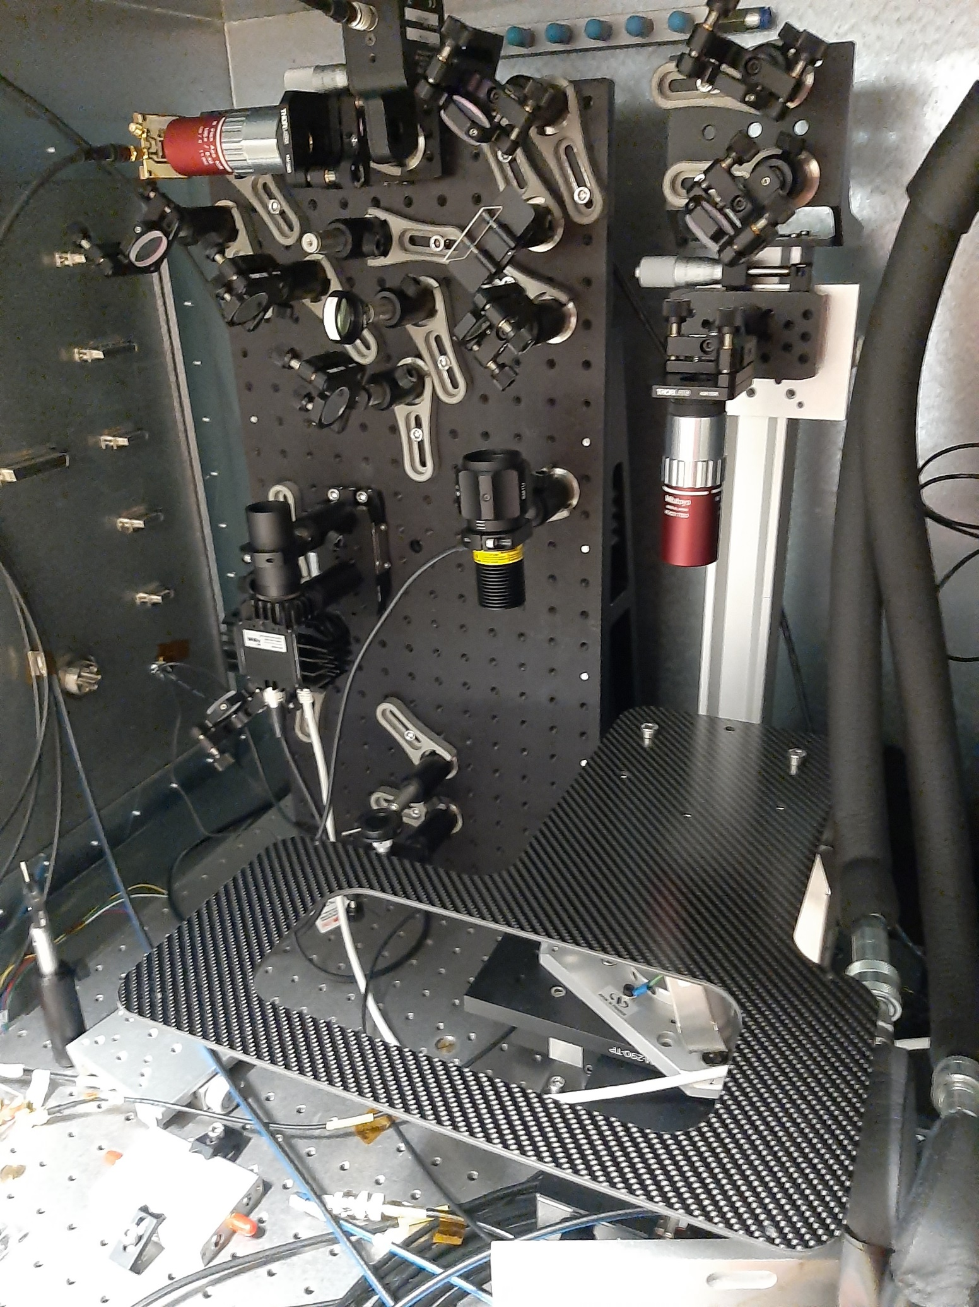
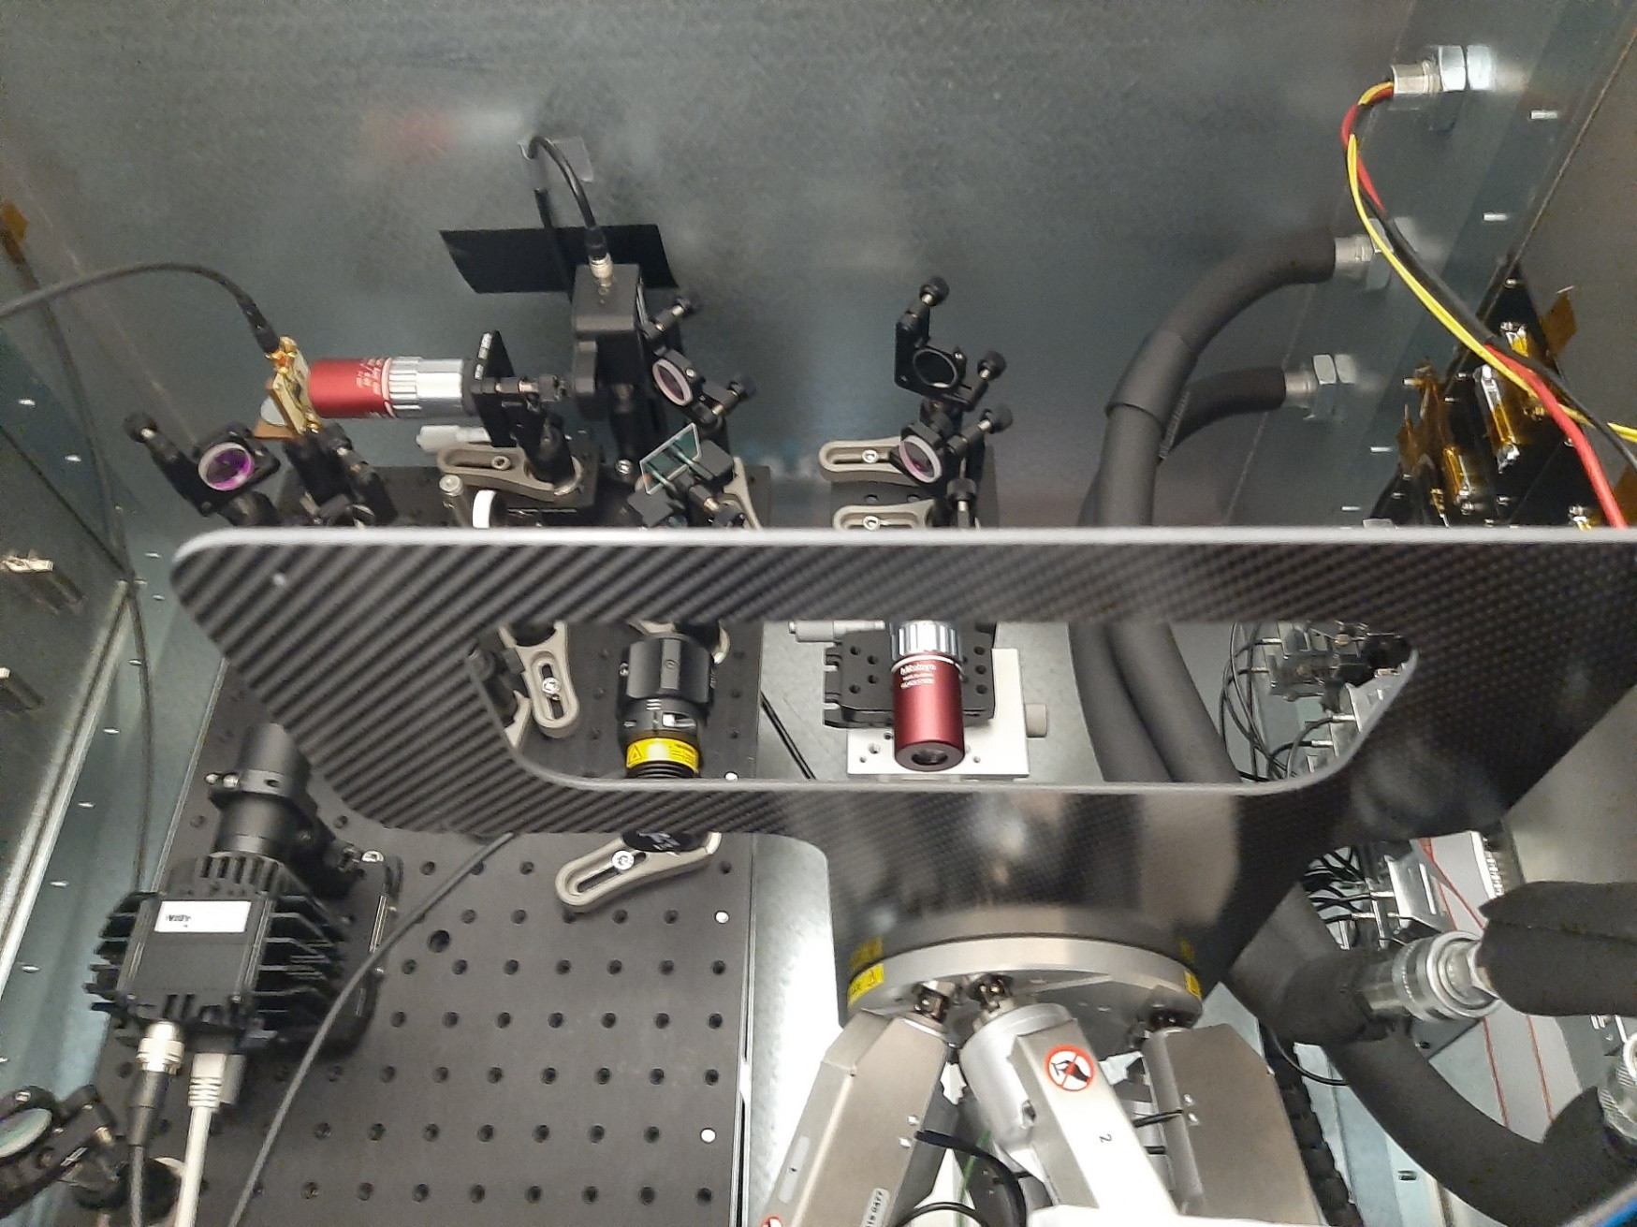
General Description
MPW2 + Caribou + FPGA in the setup, mounted on a
costume made rigid carbon fibre holder manufactured by Ruddy Constanzi (SSD, CERN)

Slide 7
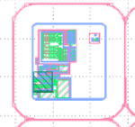
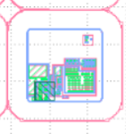
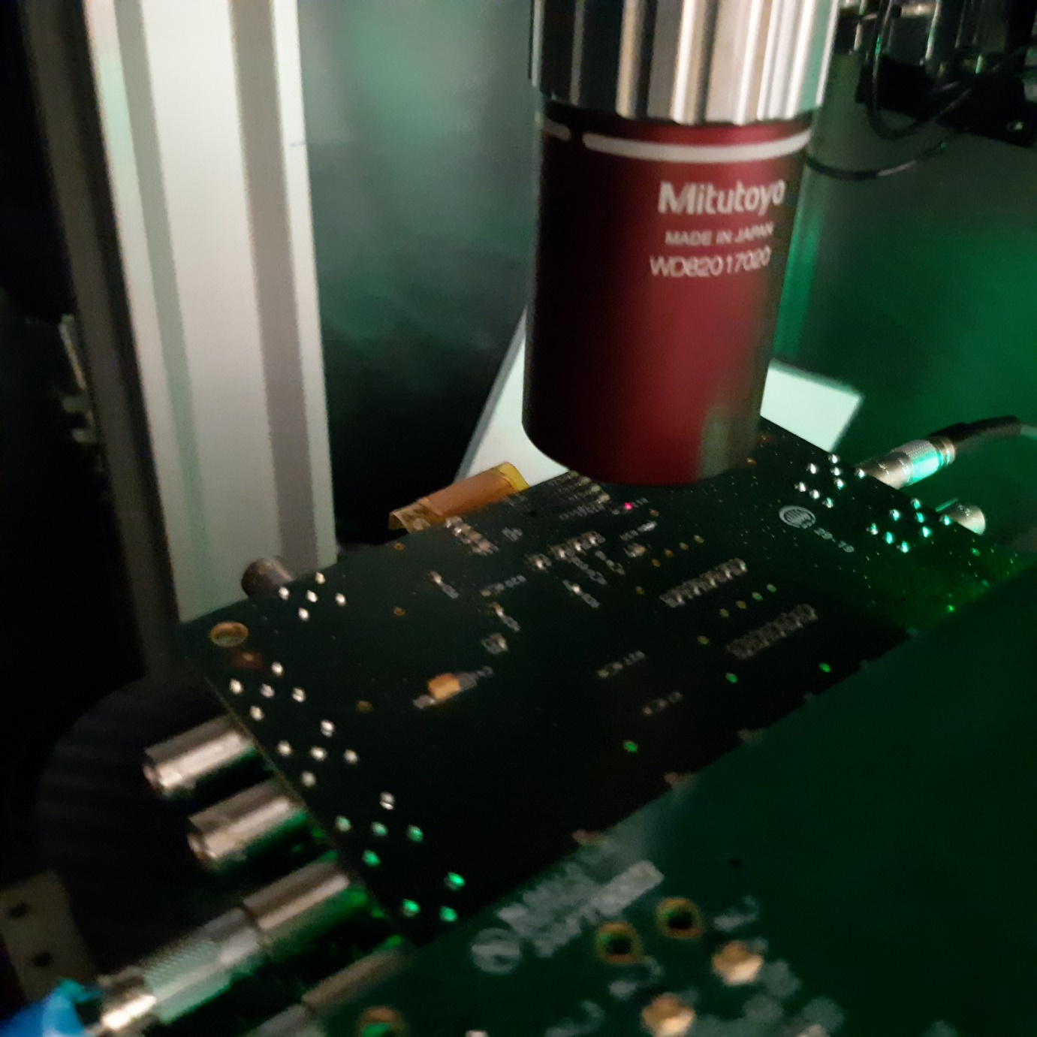
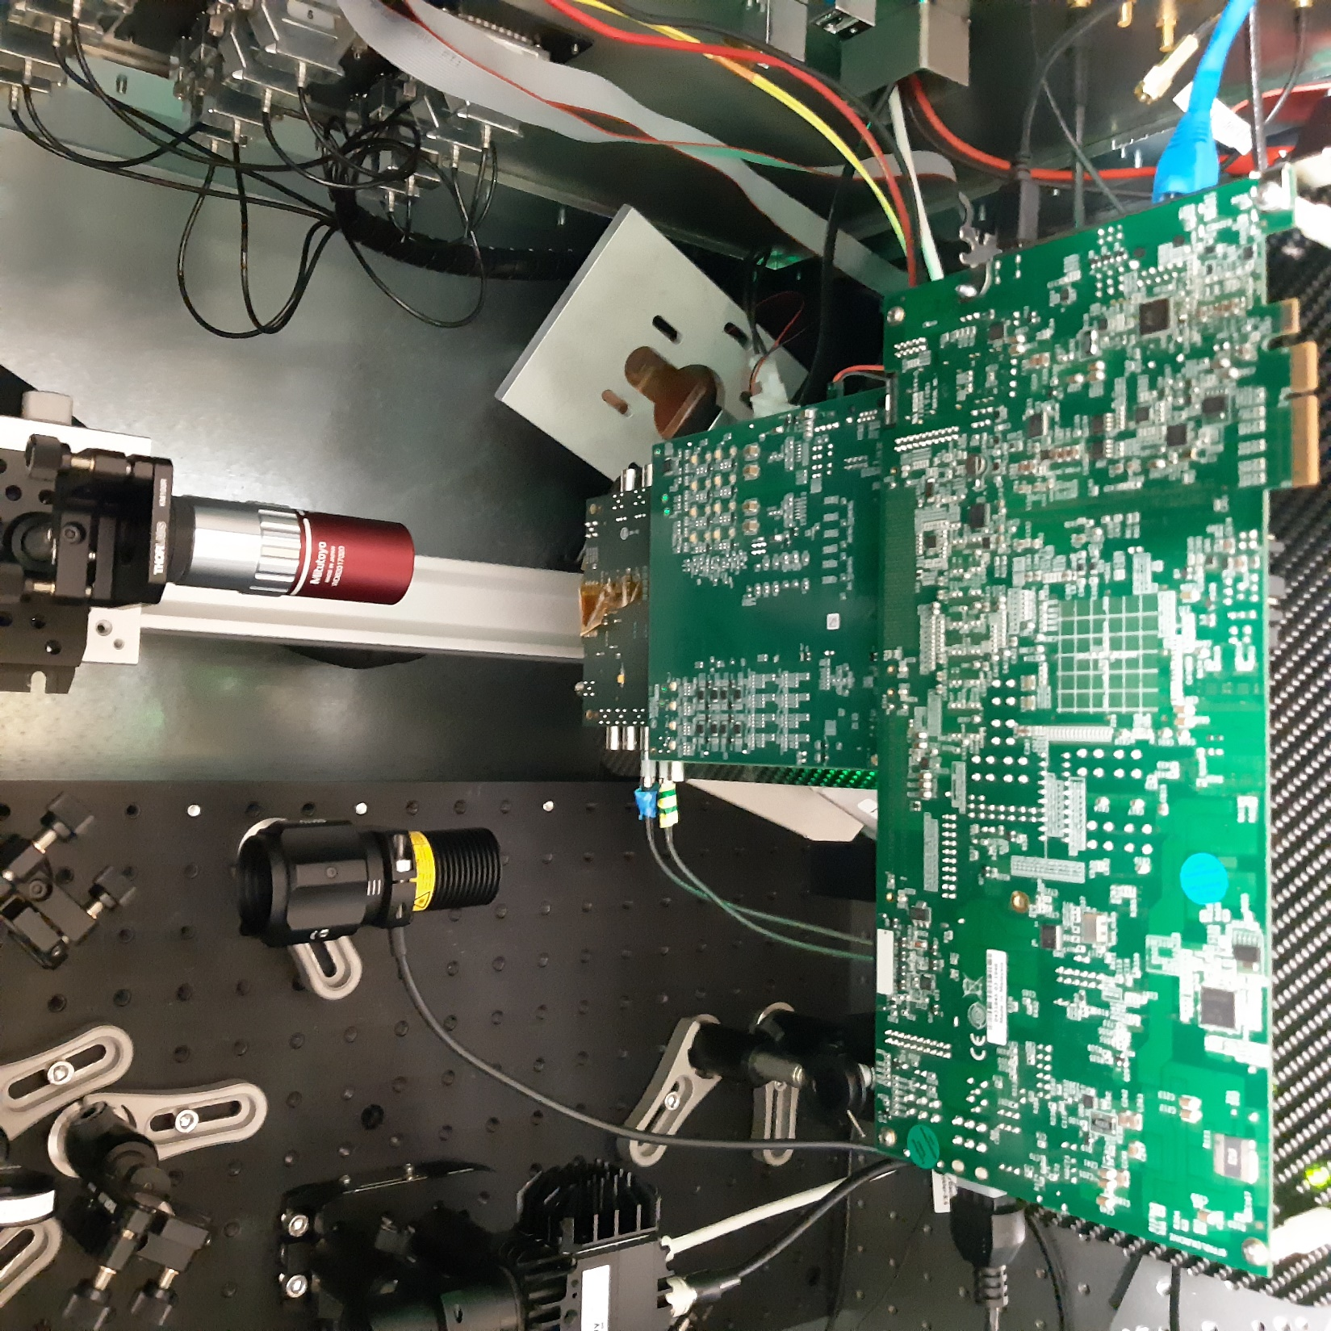
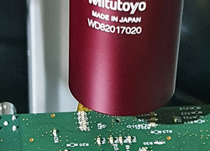
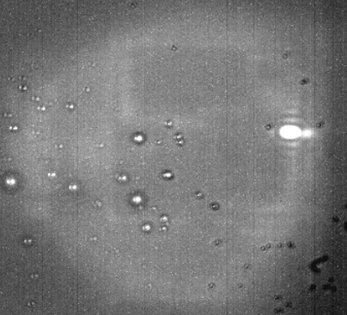
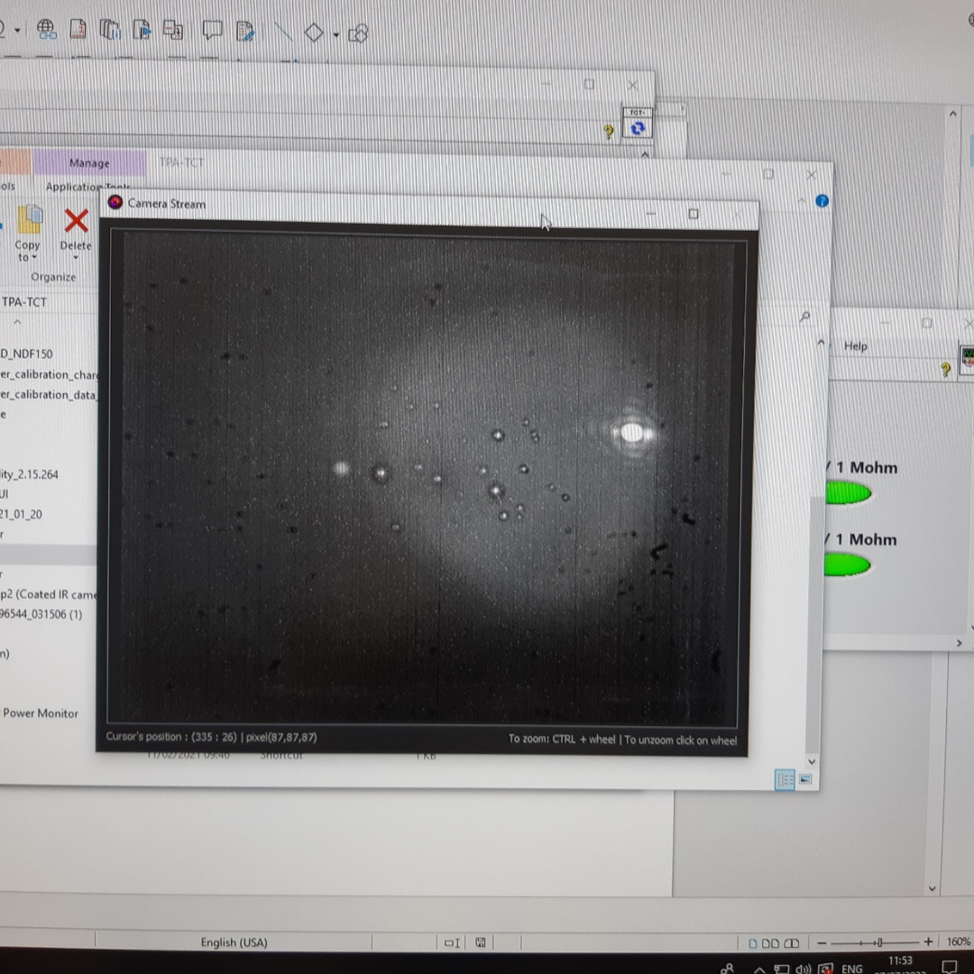
Locating the target (backside shot)
Pixel 0,0 frontside
view
Pixel 0,0 backside
view
Pixel 0,0 under the IR
microscope (backside)
0,25 nJ per pulse

Slide 8
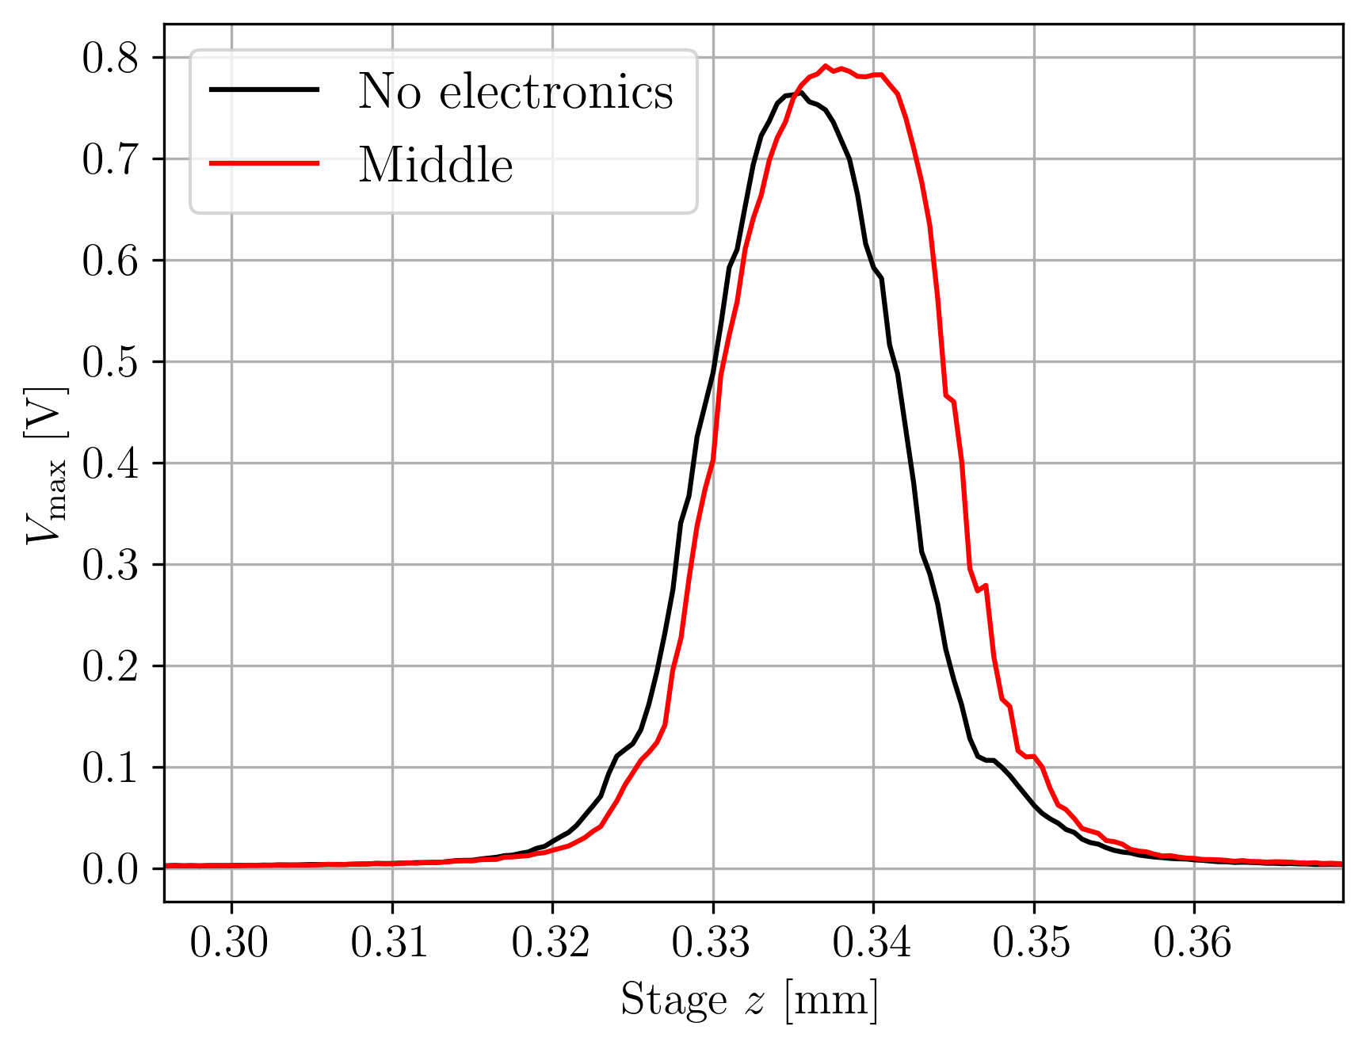
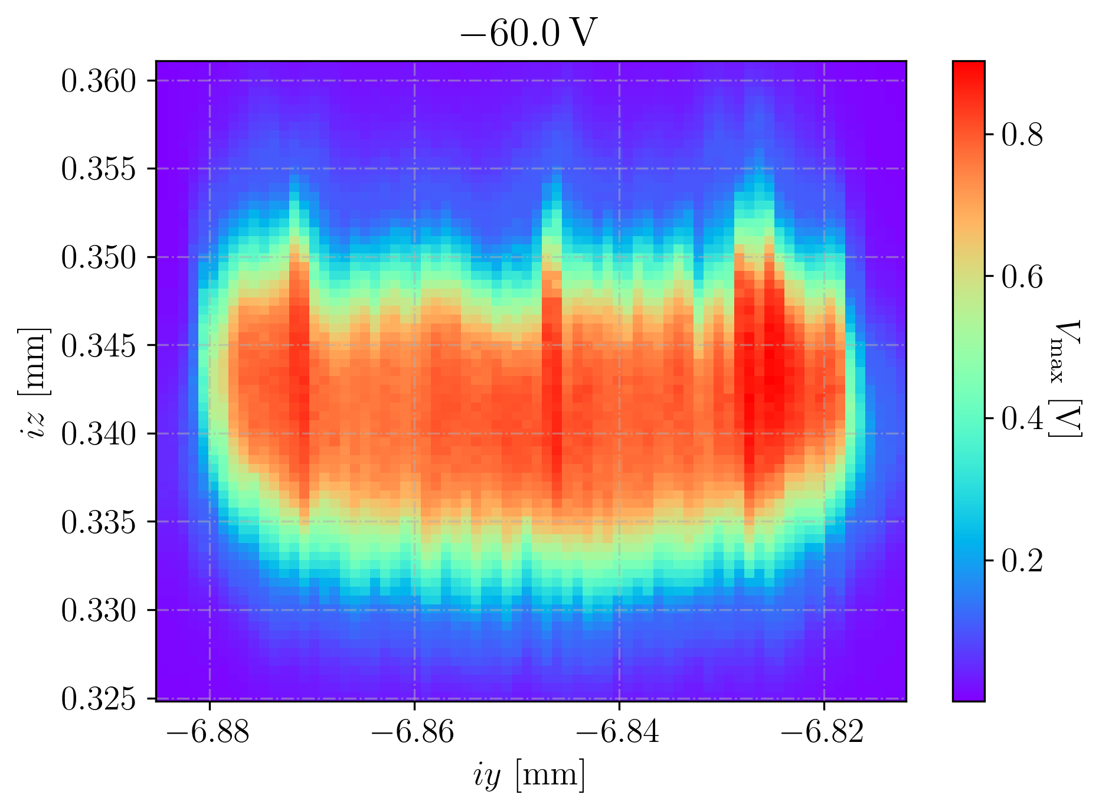



Pixel 0,0 (APM1)
0,25 nJ per pulse
Reflection at metals
from electronics
94 μm
2022_07_08_12_05_07_MPW2
2022_07_08_12_14_26_MPW2
2022_07_08_16_07_18_MPW2
YZ-Scan across the electronics
0μm top side
-49μm middle side
-94μm bottom side
z-scale corrected for refraction on Air-Silicon interface factor 3.77 on the
stage measurements
$$w_{0}=1.5 μm$$
Moritz Wiehe et al., TNS 68(2) 2021
Notes:
La profundidad en z hay que multiplicarla por 3.77 , mirar el artículo de TPA de Moritz et al. La medida en Y no hay que corregirla.
YZ depth in Z and Y limits, Vmax view
XY la información de profundidad en z está en el log file, no en el dataset
Z stage coordinates: z=0.355mm topside -> 0 in absolute coordinates
z=0.330mm downside->94.25 um in absolute coordinates
es el resultado de multiplicar por 3.77
0,355-0,330=0.025 mm in stage coordinates
0-0.025*3.55=94,25um
0.355 – 0.342 = 0.013 mm in stage coordinates
equivalent to 49 um in absolute coordinates
En las medidas YX hay un error de más menos 3 um por descalibración del soporte en cada movimiento (estimado).

Slide 9
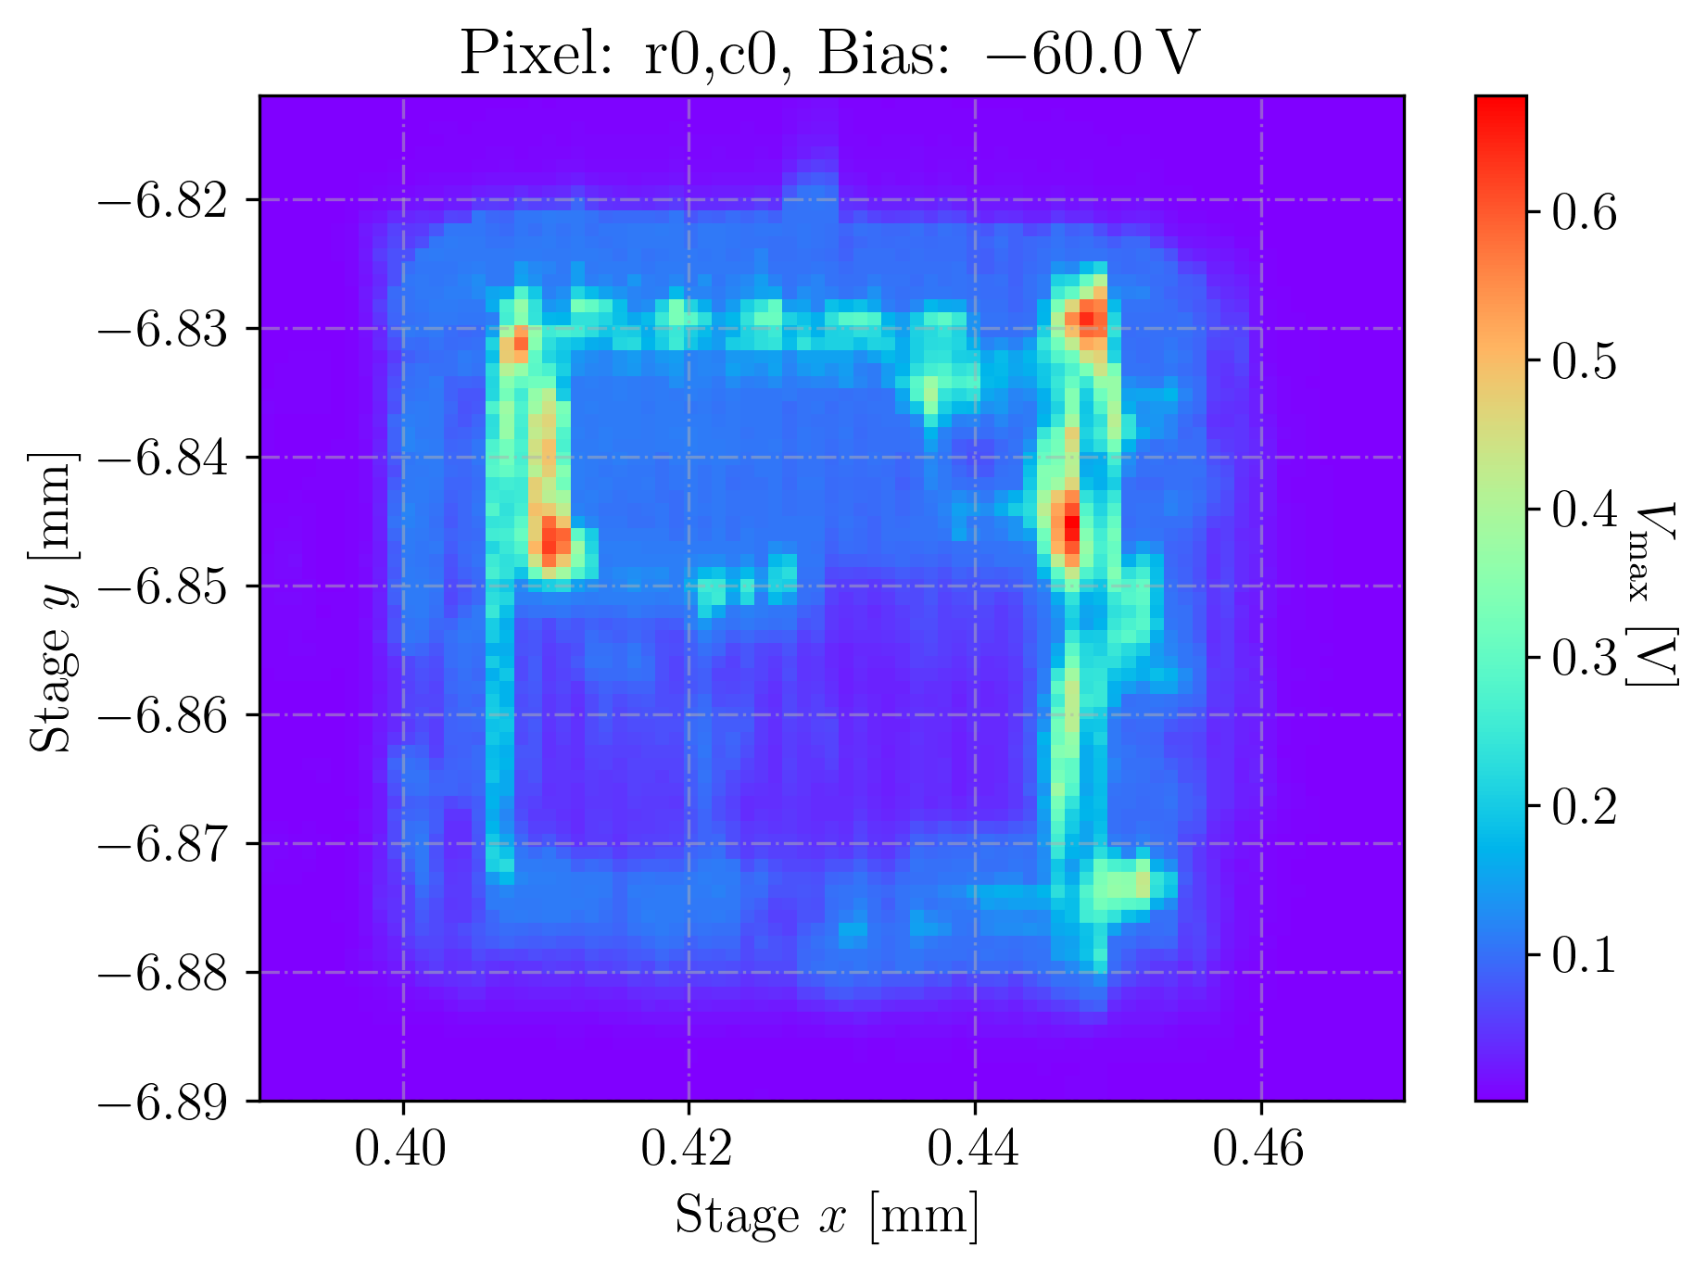
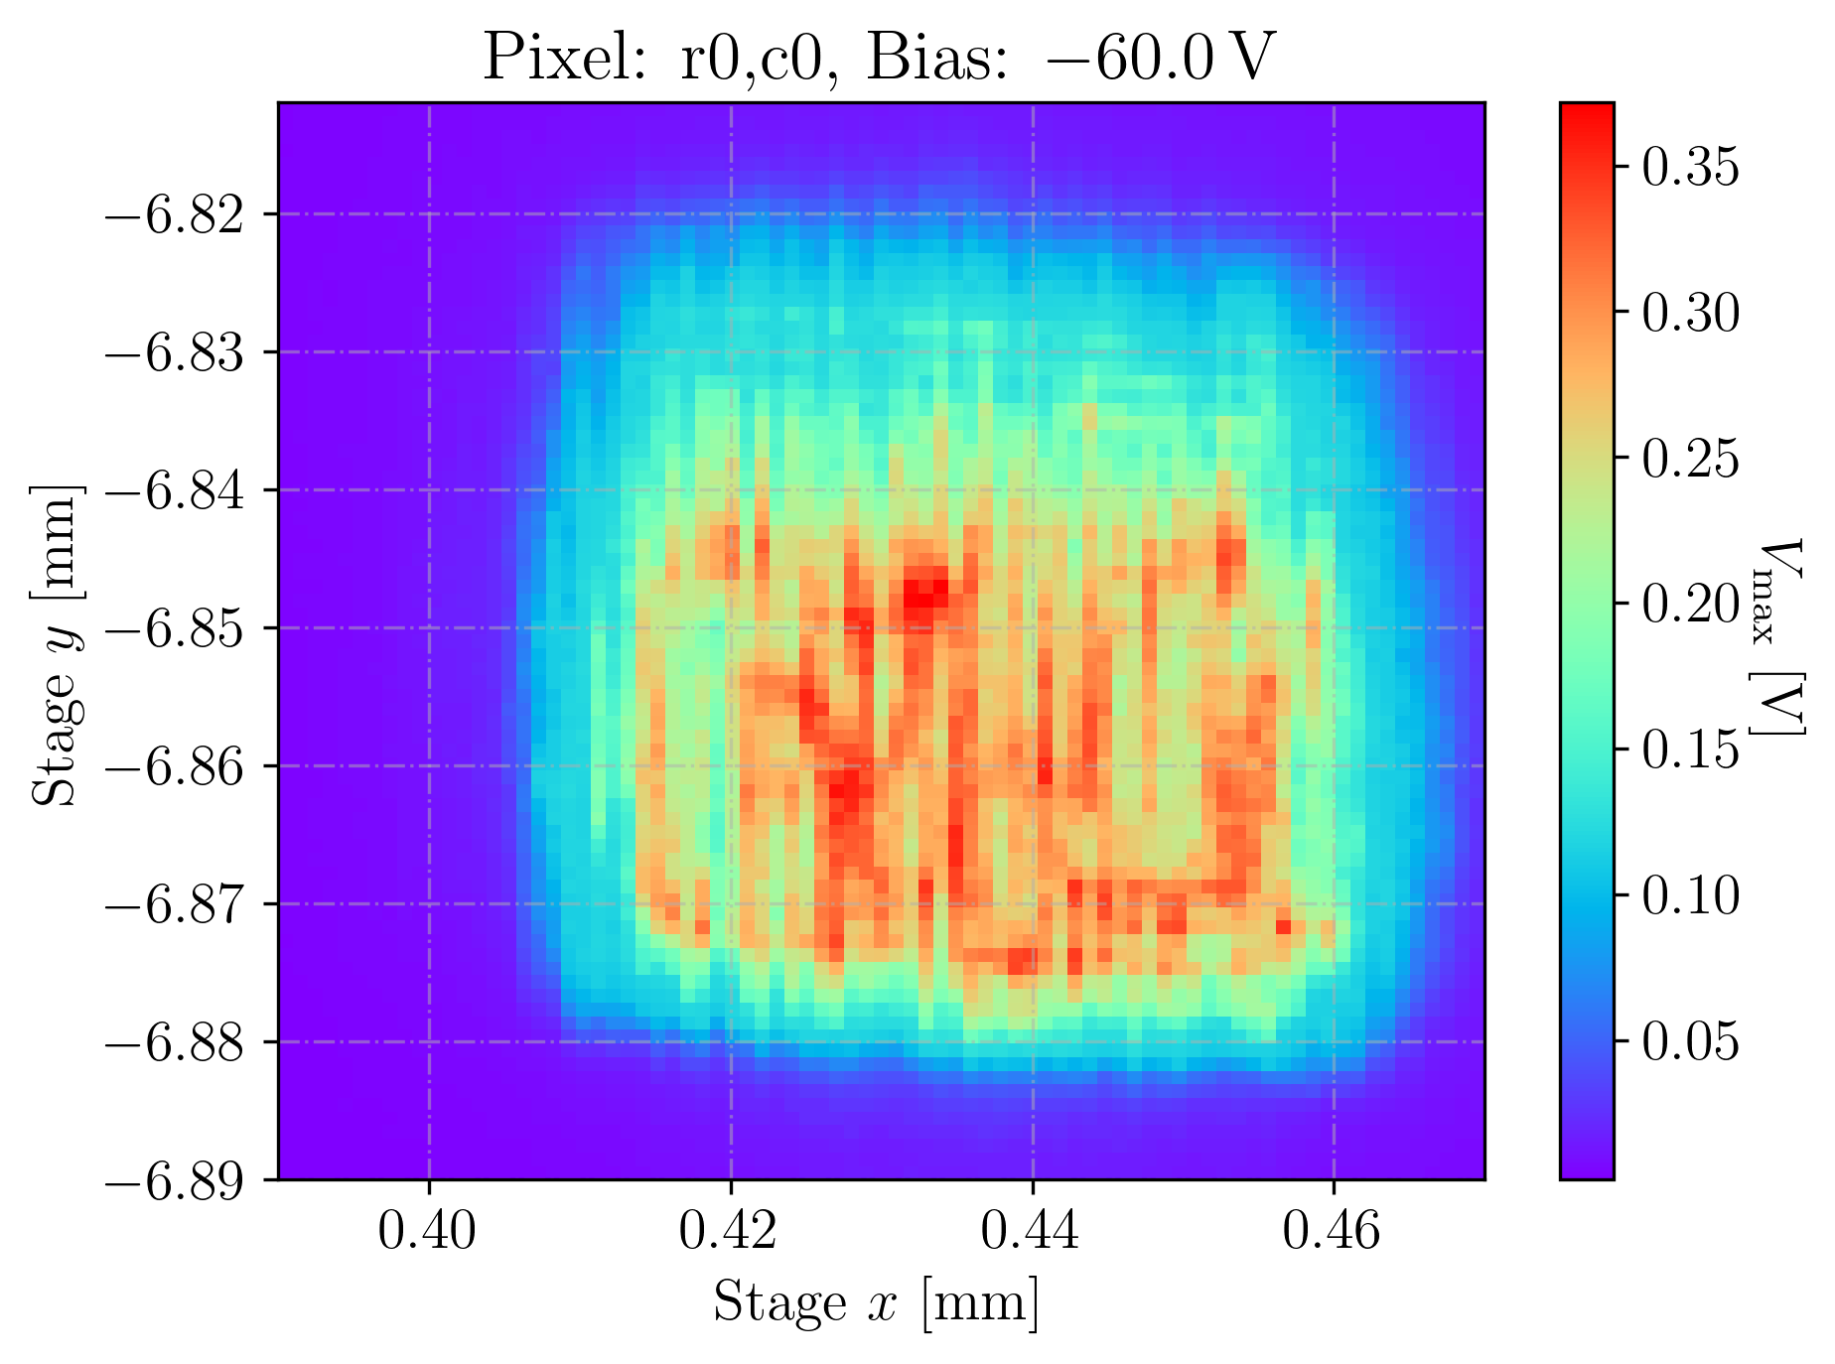
Pixel 0,0 (APM1)
2022_07_08_14_40_24_MPW2
2022_07_11_12_34_21_MPW2
XY-Scan with focus at the top side electronics (±3μm) :
Metal layers on the DNWell implant gives bigger signal due to light reflection
XY-Scan with focus at the back side
(-94±3μm) :
0,25 nJ per pulse
Notes:
cotejar con layout

Slide 10
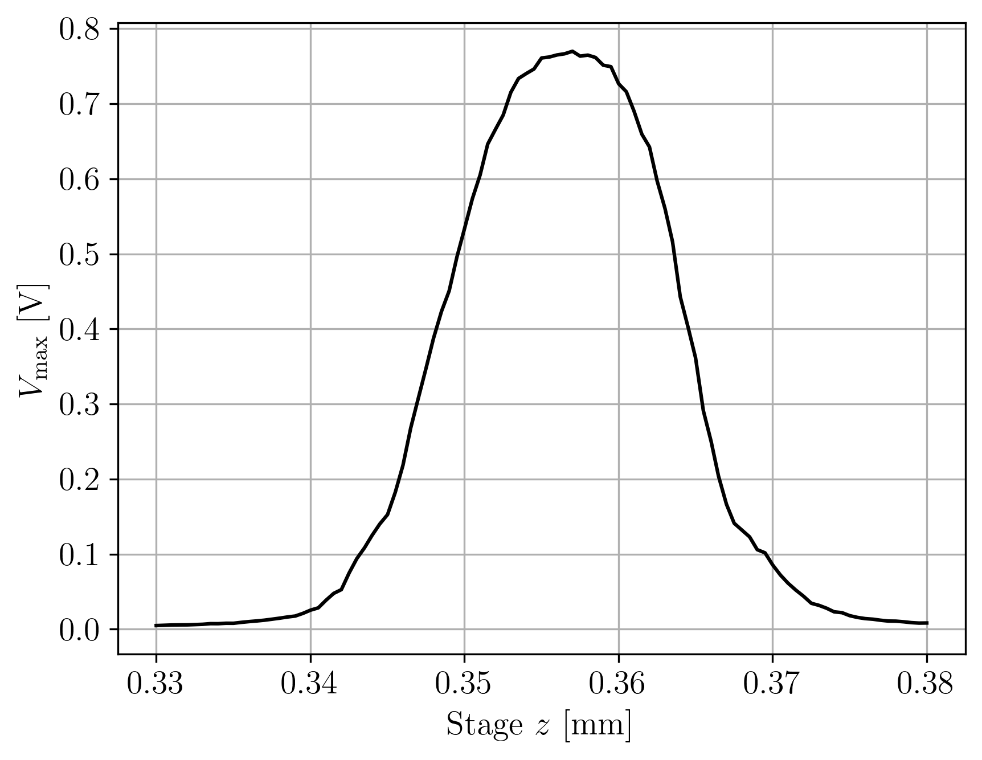
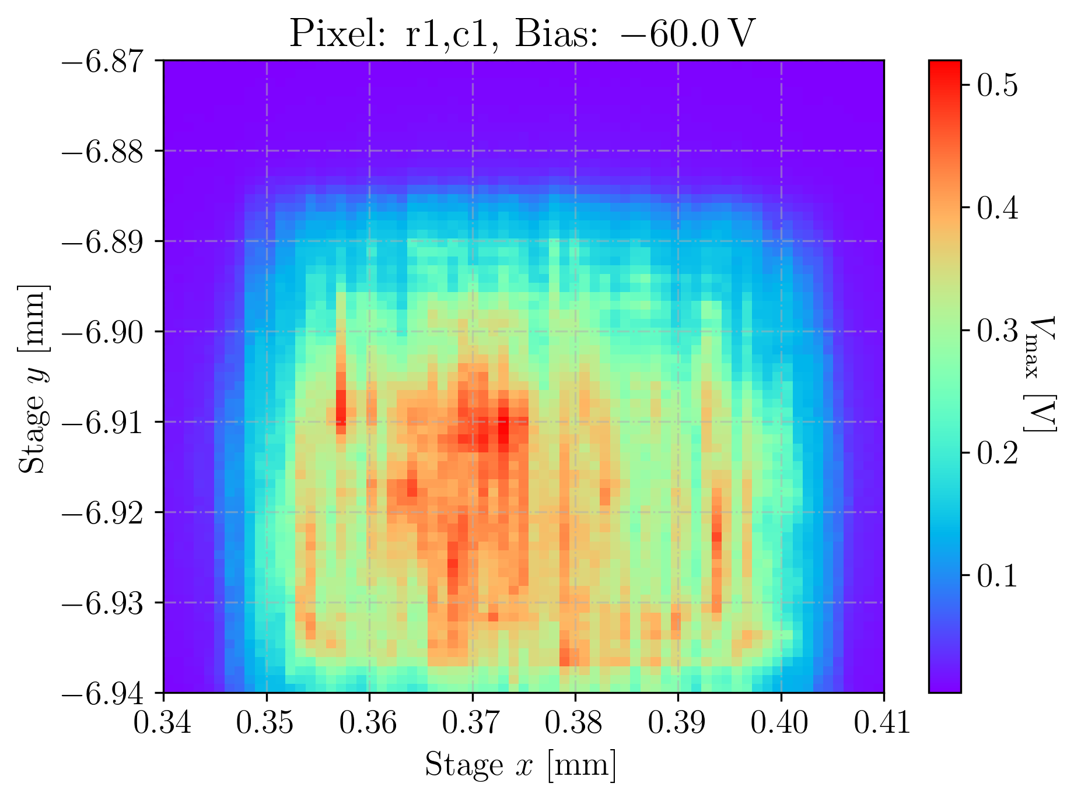
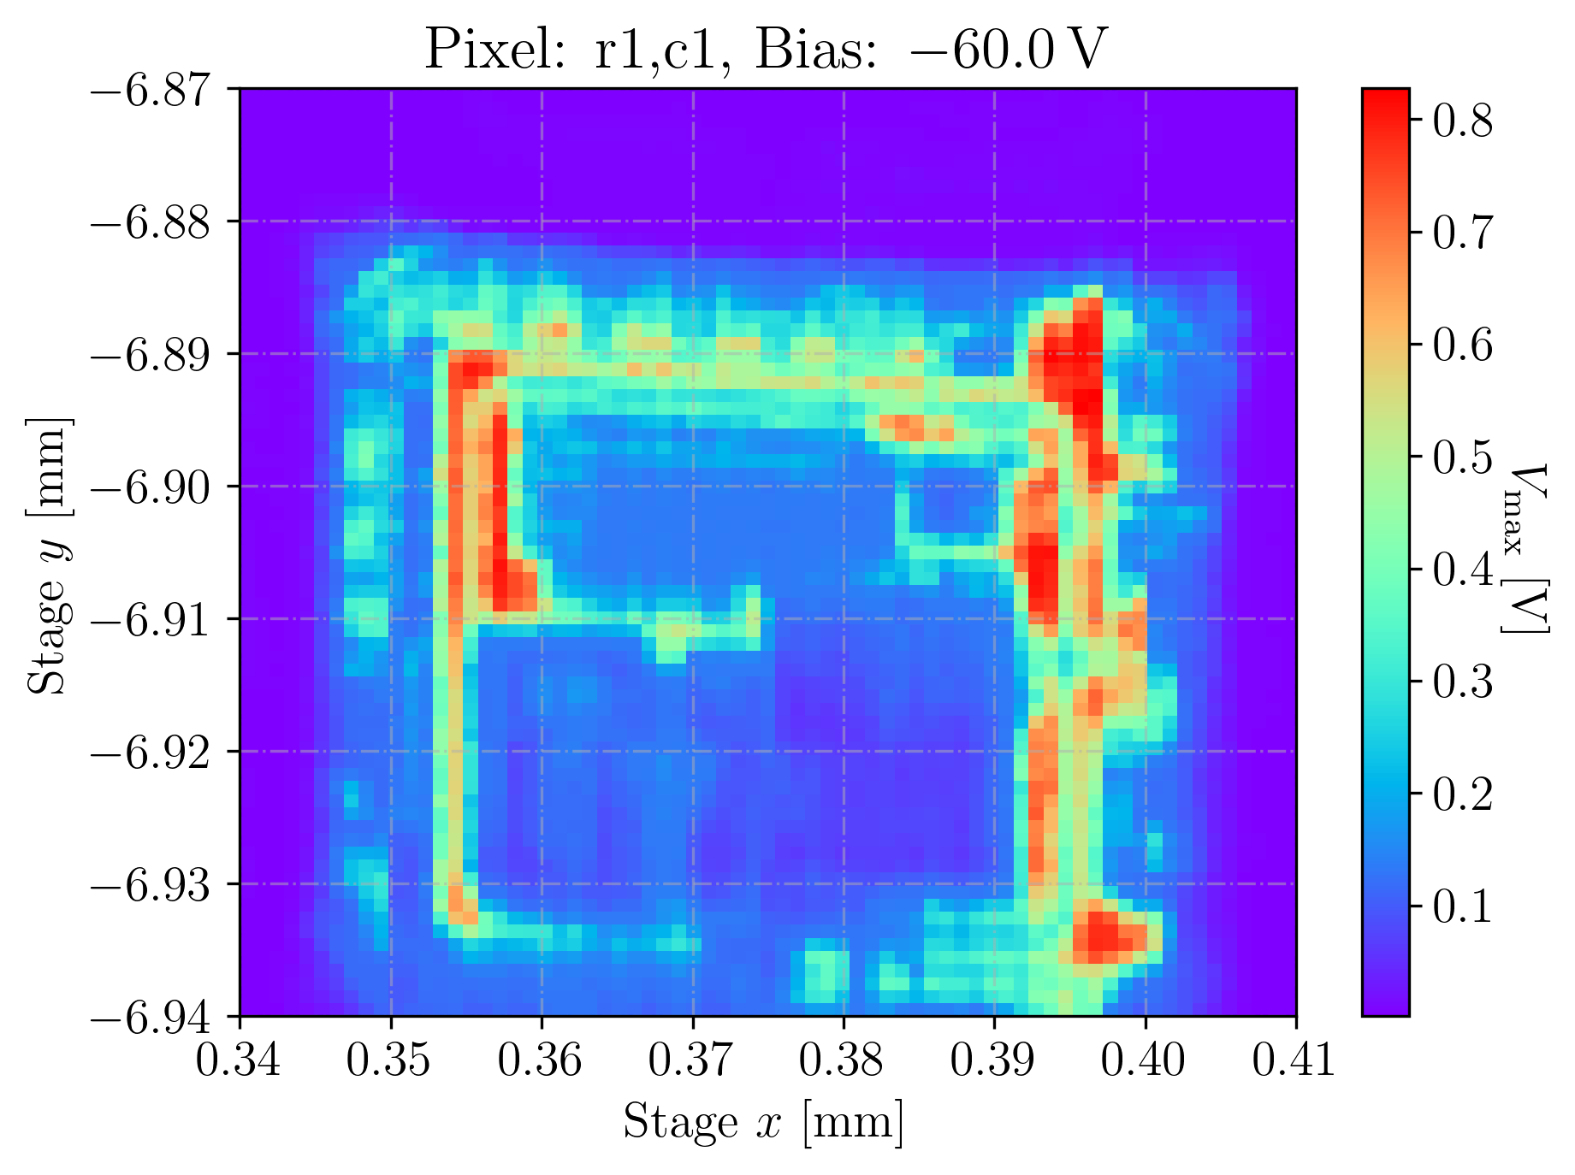
Pixel 1,1 (APM1)
2022_07_11_16_53_15_MPW2
2022_07_11_17_14_49_MPW2
2022_07_11_19_31_19_MPW2
non-metalised part
XY-Scan with focus at the back side
(-94 μm with ±3μm):
XY-Scan with focus at the top side electronics
(±3μm) :
0,25 nJ per pulse
Notes:
cotejar con layout

Slide 11
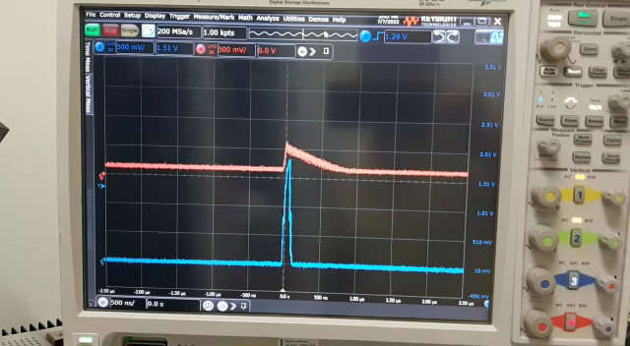
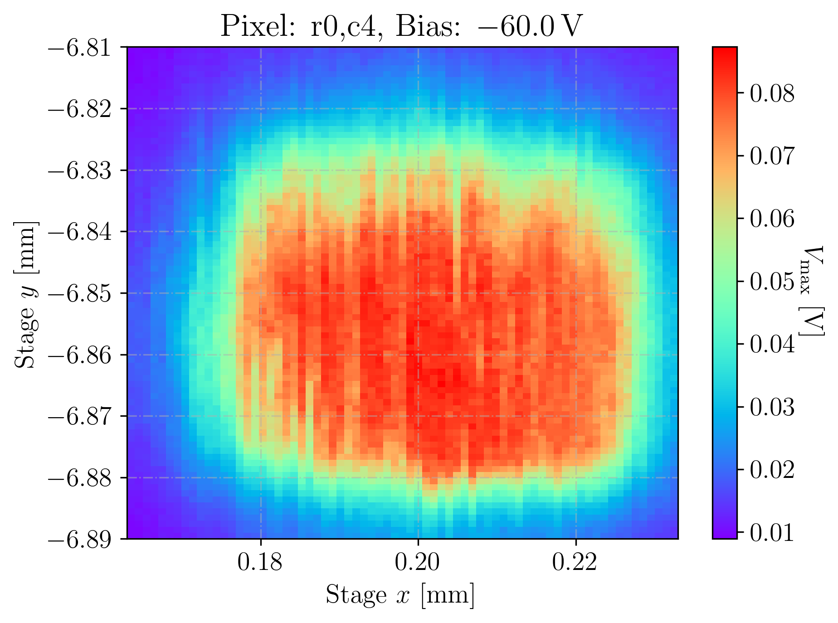
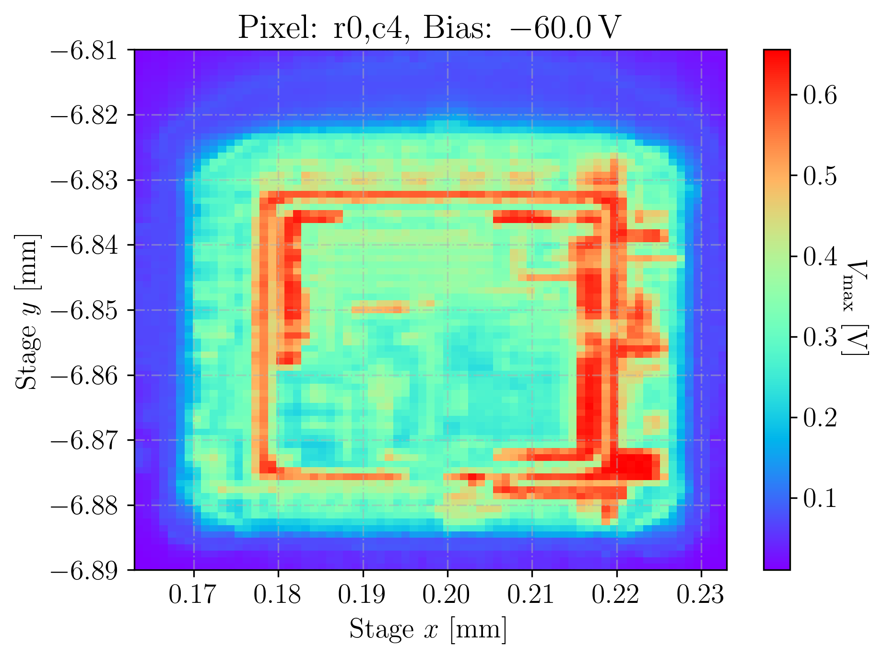
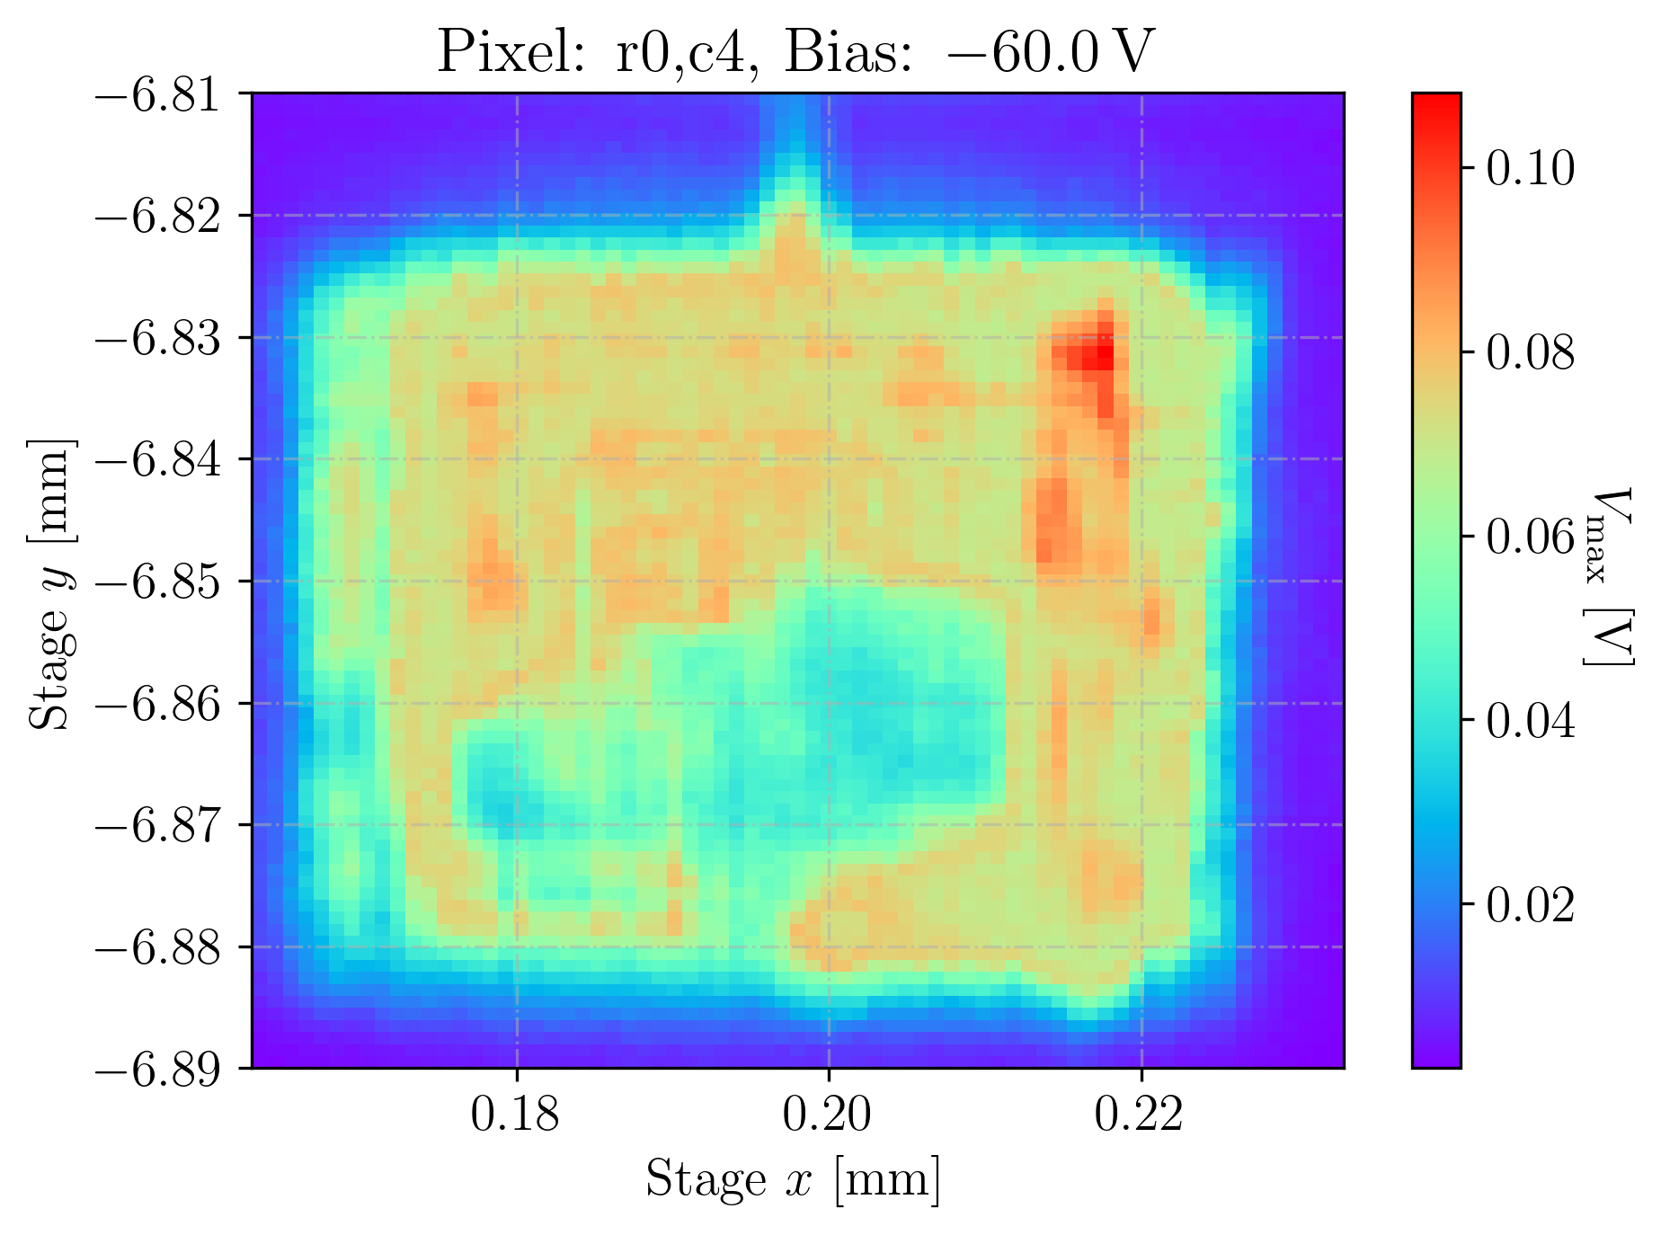
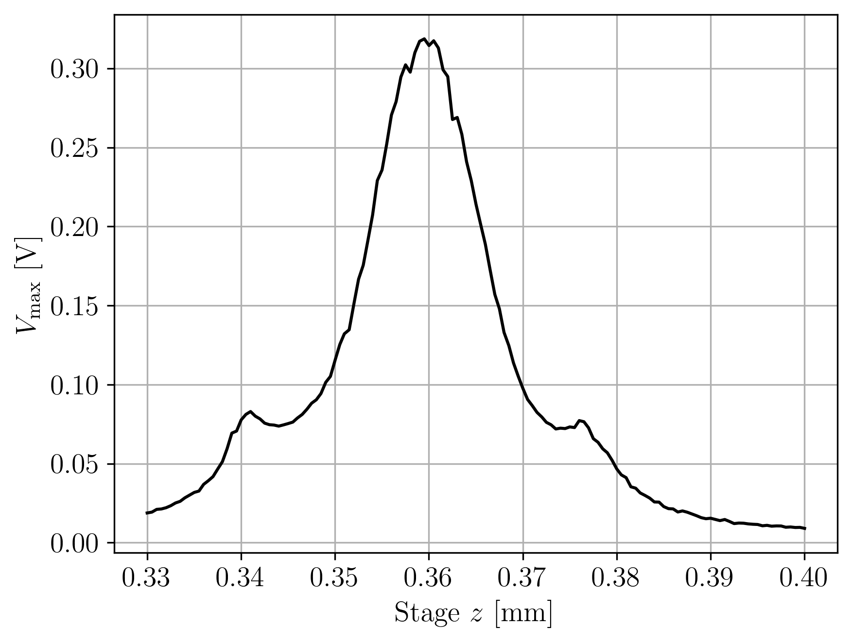
Pixel 0,4 (APM2)
XY-Scan with focus at the back side (-94 μm ±3μm):
2022_07_13_10_00_30_MPW2
2022_07_13_10_21_42_MPW2
2022_07_13_11_35_35_MPW2
2022_07_13_13_54_27_MPW2
0,25 nJ per pulse
XY-Scan with focus at the middle (-49μm ±3μm):
(nwell ring clearly shown in the response)
XY-Scan with focus at the top side (±3μm) :
non-metalised part
Notes:
cotejar con layout

Slide 12
Conclusions
TPA method can make detailed maps of the electric field, useful to
determine the homogeneity of the field
It is specially appropriate for MAPS because of the in-pixel electronics interference
ZY maps gives the depletion depth (and the depletion volumen)
XY maps gives the CCE in the in-pixel detector volume
Probably the best method for quality assesment and with no radiation damage
Complementary to the proton microprobe technique, that can be considered the
second testing technique for MAPS detectors before going to a full testbeam in a
telescope
Notes:
cotejar con layout

Slide 13

Thanks for your attention
fpalomo@us.es

