Slide 1

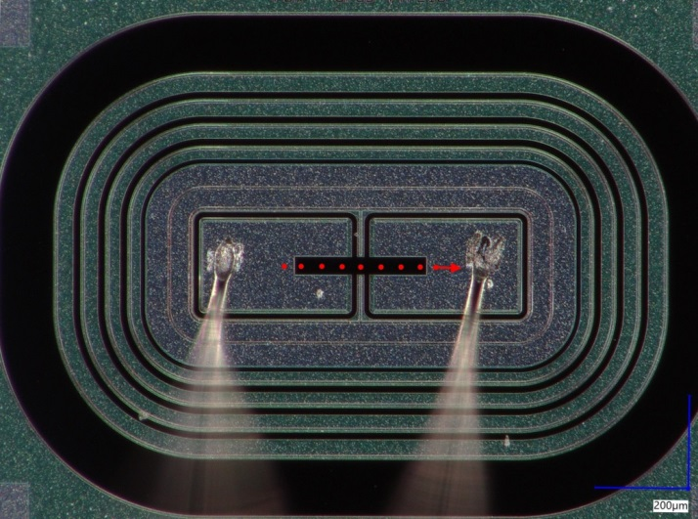
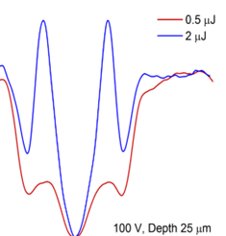
Study of UFSD Type 10 with SPA-TCT and femtosecond laser from ELI BeamlinEs
41st RD50 Collaboration Meeeting, Sevilla, Spain, 29th of November – 2nd of December 2022
Gordana Lastovicka-Medin¹, Mateusz Rebarz², Jovana Doknic¹, Ivona Bozovic¹ Gregor Kramberger³, Jakob Andreasson² , Jii Kroll⁴
¹University of Montenegro in Podgorica, ²ELI Beamlines in Prague, ³Institute Jozef Stefan in Ljubljana
Institute of Physics at the Czech Academy of Science

Slide 2
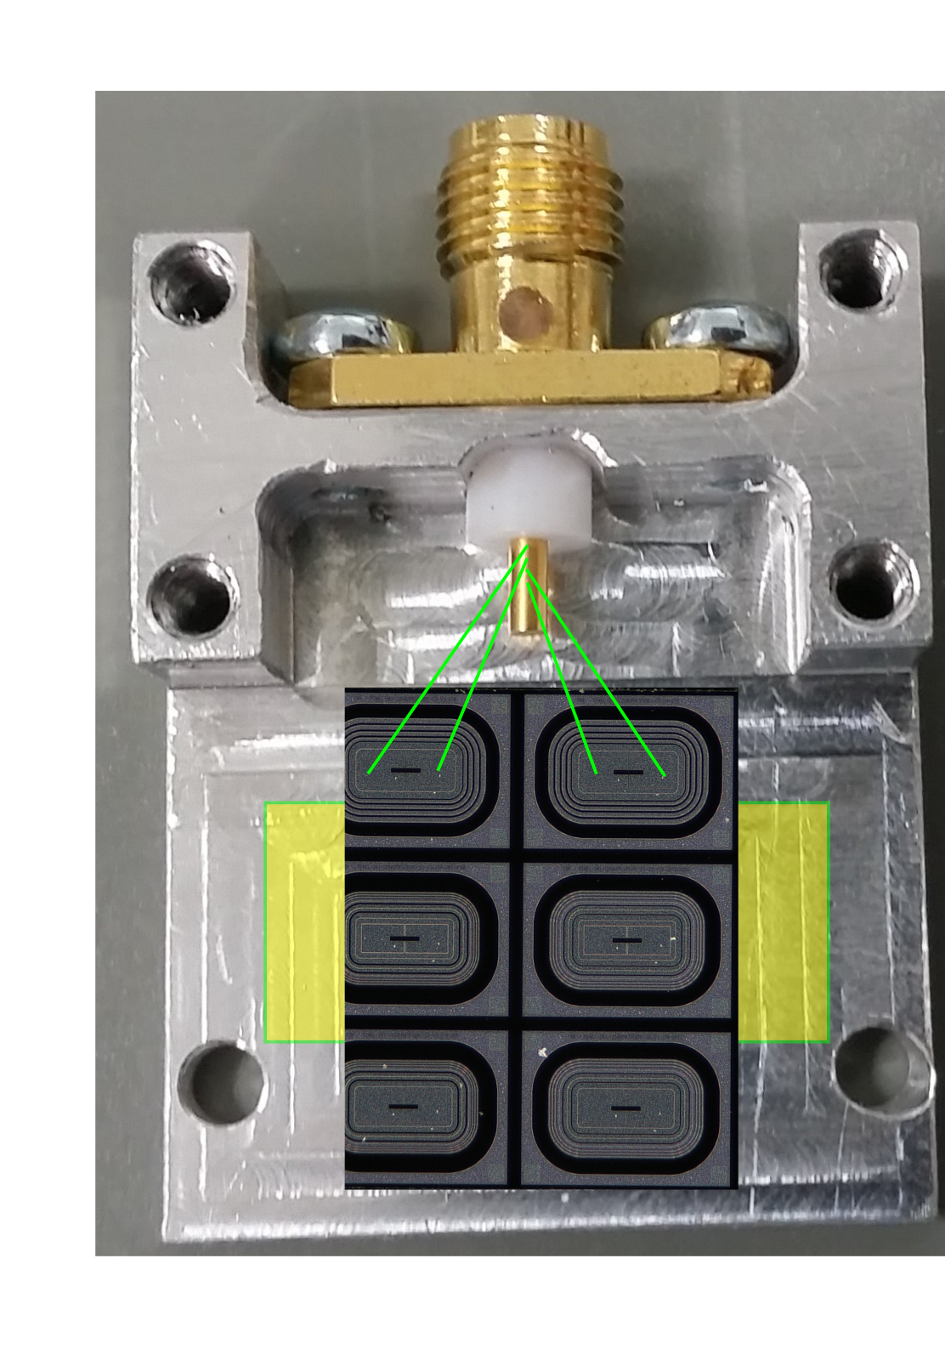

Slide 3
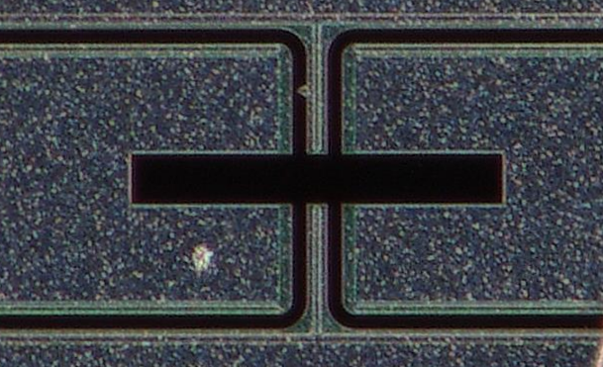
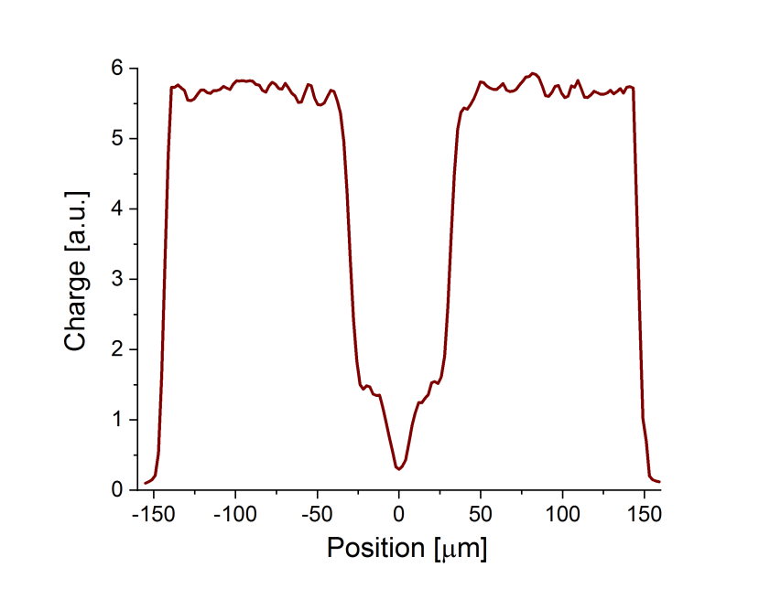


Opening window
Opening window width measured under microscope is ≈284 um.
$$284 μm$$
The width of the scan by SPA exhibits slightly bigger value 290 um (TPA exhibits better spatial resolution giving 285 +/- 1 um, see talk by Ivona).
Example X profile by SPA
Since this value does not change and the study focuses on IP distance the shorter X-scans were performed for the most of experiments to save time.
The region of interest was -60 to 60 μm where position 0 was defined as the center of the window.
IP
$$290 μm$$
P-structure

Slide 4

Device Under Test (DUT):
UFSD Type 10 with 2 P-stops
The nominal inter-gap distance for type 10 is a bit different wrt the same structures produced in the batches UFSD 4 or UFSD 3.2.
The nominal IP width (gain-gain distance) is 49 um.
epi layer is 45 um instead of the typical 55um used in UFSD 3.2 and UFSD 4.0
UFSD type 10
2 p-stops layout (each pixel is surrounded by a proper p-stop),

Slide 5

$$284 μm$$

Slide 6
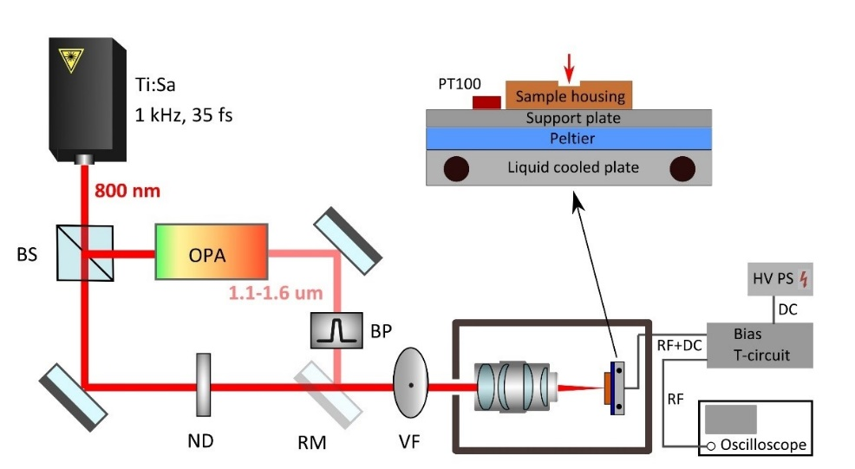
Experimental Technique: TCT
Place | ELI Beamlines
Operational modes | Single and two photon absorption (SPA and TPA)
Pulse energy on sample Wavelength Pulse width in sensor | Variable by ND filters (accuracy: 0.2 pJ) 800 nm (SPA), 1550 nm (TPA) 1550 nm, ~ 150 fs 800 nm, ~ 50 fs
Focus waist radius | 0.85 μm (SPA), 1.5 μm (TPA)
Rayleigh length | 3.31 μm (SPA), 7.74 μm (TPA)
Sample cooling | Down to -25 deg. C
Sample movement | X, Y, Z
Bias voltage Detection | up to or > 720 V 6 GHz (20 GSa) oscilloscope and leakage current measurement (accuracy: 0.1 μA)
Schematic view of the setup for TCT-SPA and TCT-TPA measurements at ELI Beamlines (BS – beam splitter, OPA - optical parametric amplifier, BP - bandpass filter, ND - neutral density filter, RM - removable mirror, VF - variable filter)
Ref: G. Lastovicka-Medin et al, Femtosecond laser studies of the Single Event Effects in Low Gain Avalanche Detectors and PINs atELI Beamlines, Nuclear Inst. and Methods in Physics Research, NIM A, 2022

Slide 7
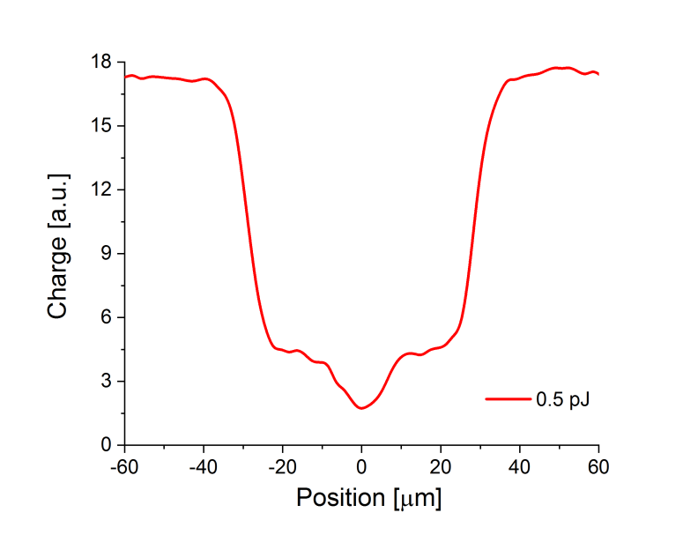
X-profile shape
GAIN
GAIN
GAIN=1

Slide 8
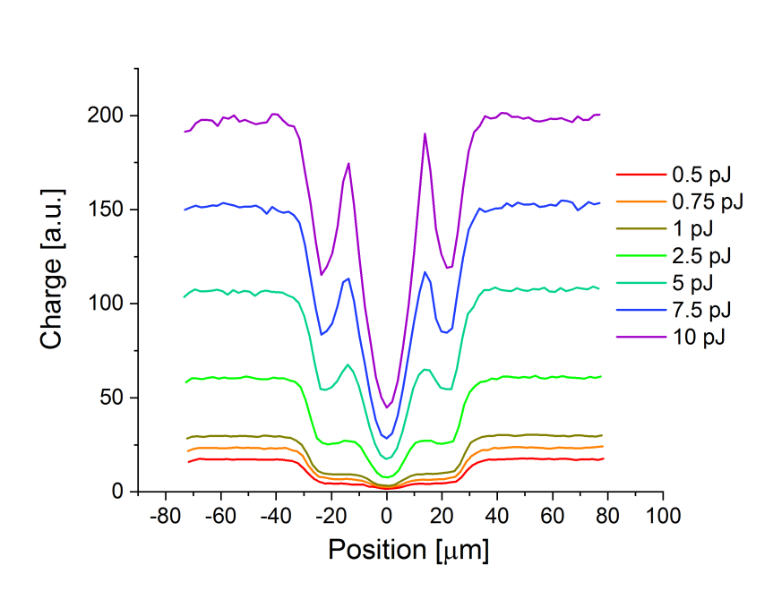
IP vs Power (laser pulse energy)
Spikes observe in charge distribution in no-gain region; more enhanced with increased laser power;
They appears on the sides of the central hollow (more or less at +/- 15 μm).

Slide 9
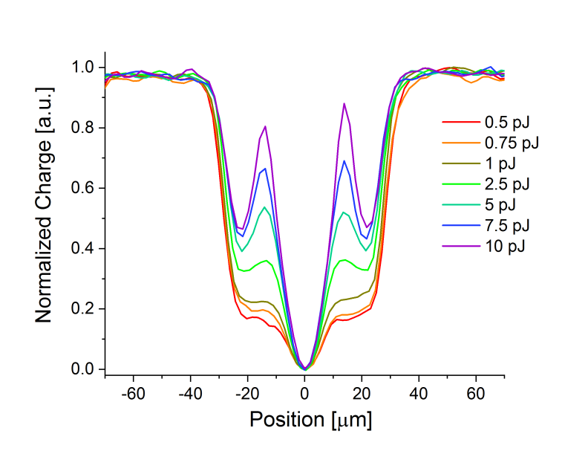
IP vs Power (laser pulse energy)
The same data plotted as in previous slide, but distributions are normalized

Slide 10
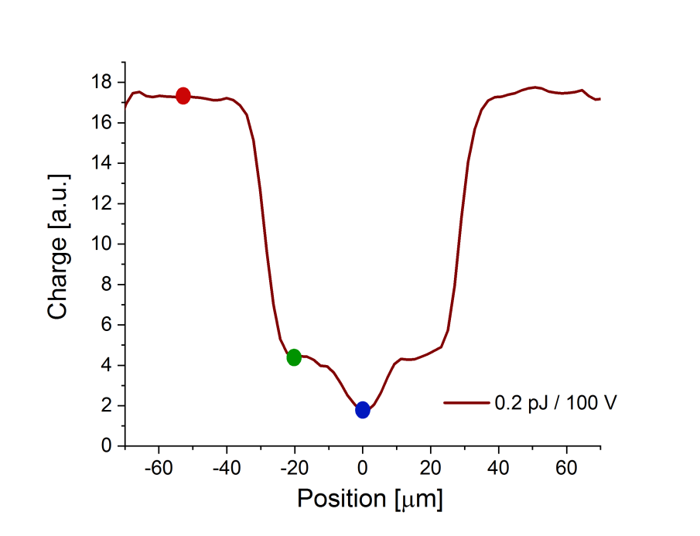
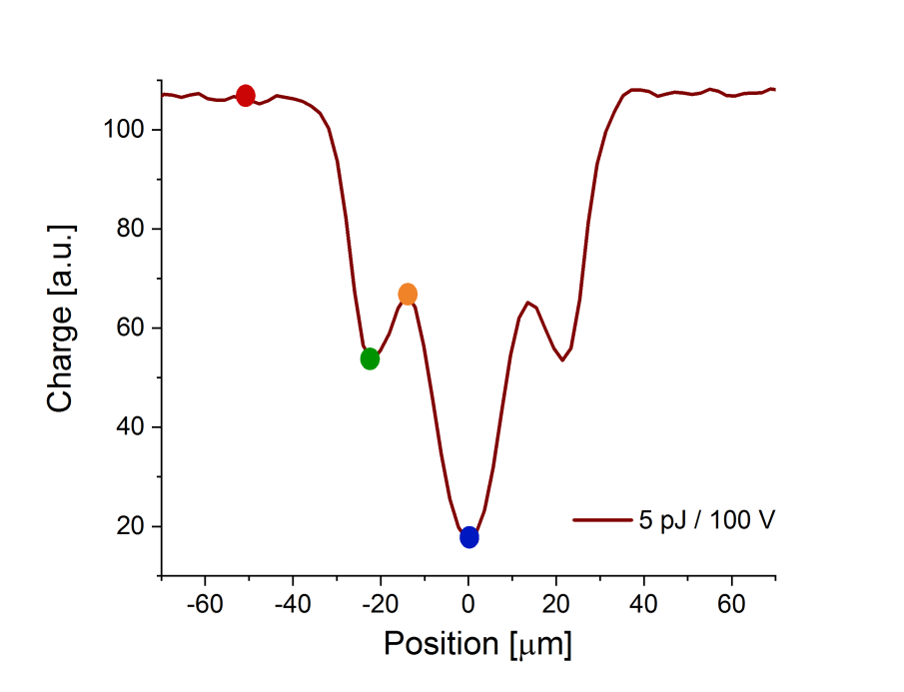
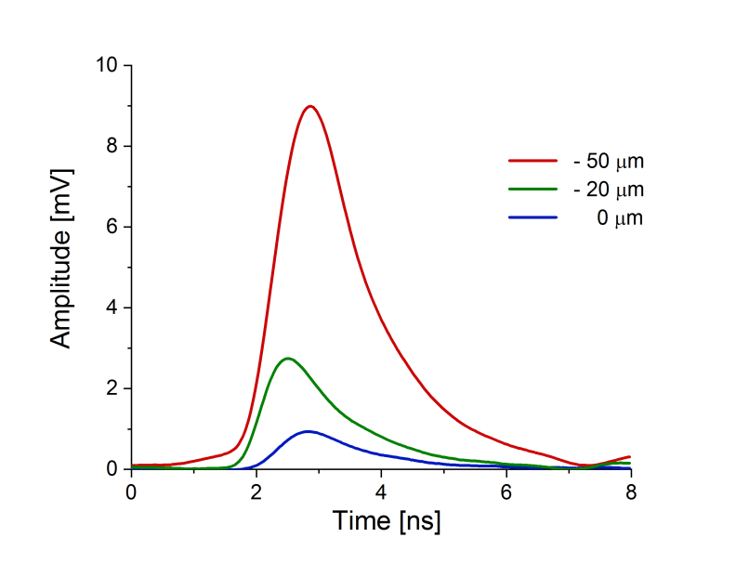
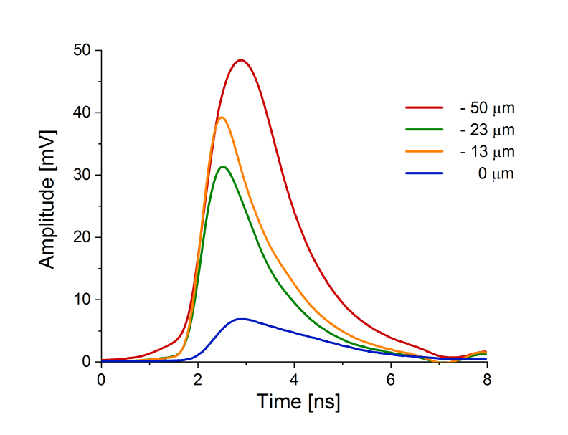
Waveform vs X-position and power
very fast signal; maybe some gain for orange
5 pJ/100 V
0.2 pJ/100 V
delayed peak - gain suppressing to high power.
delayed due to generation inside the low field and longer drift paths.

Slide 11
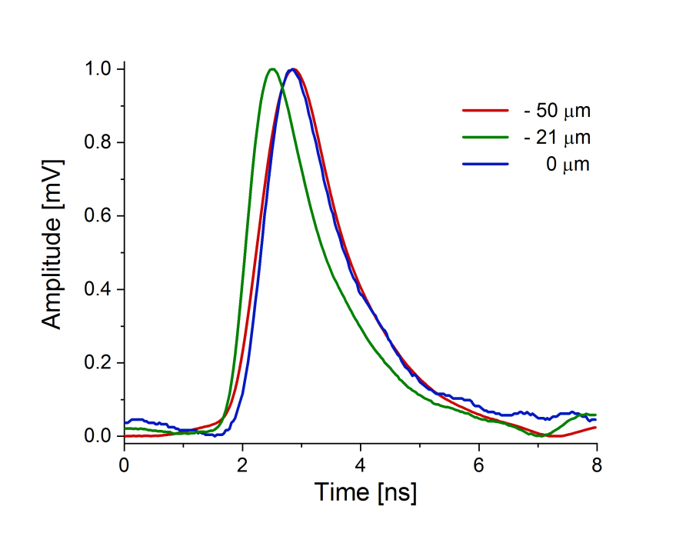
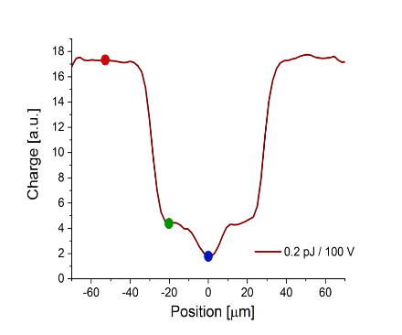

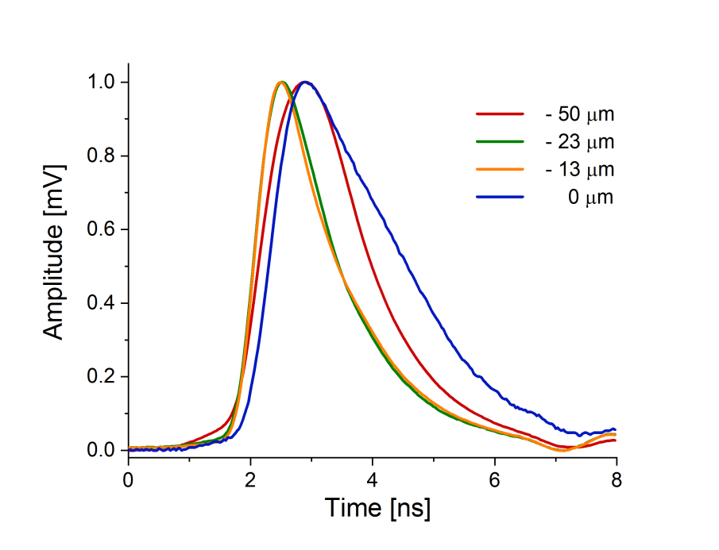
The same waveforms as in previous slide but normalized to better compare the shapes

Slide 12
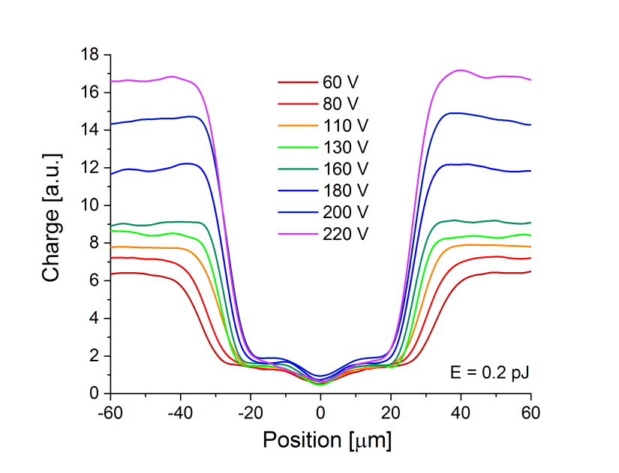
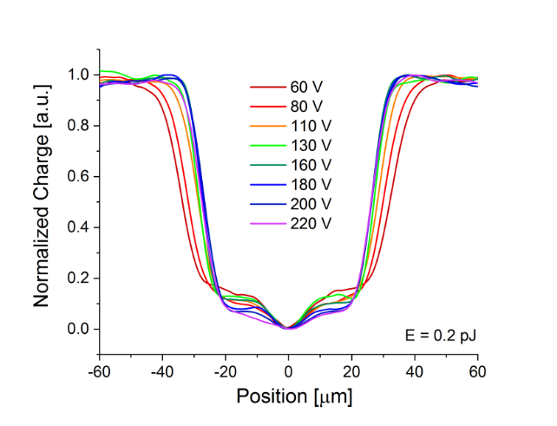
IP vs Bias at low power
At medium laser power
(1 pJ) the side bands around the central hollow appears at higher bias
Same data as above but normalized for better comparison
There is a clear general trend that IP distance decreases with increasing bias.

Slide 13
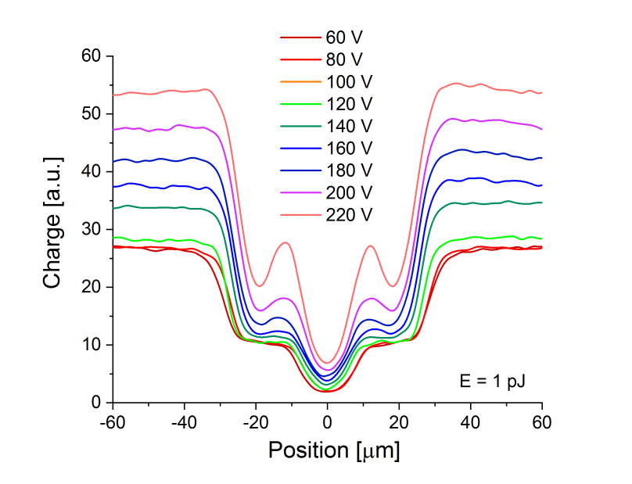
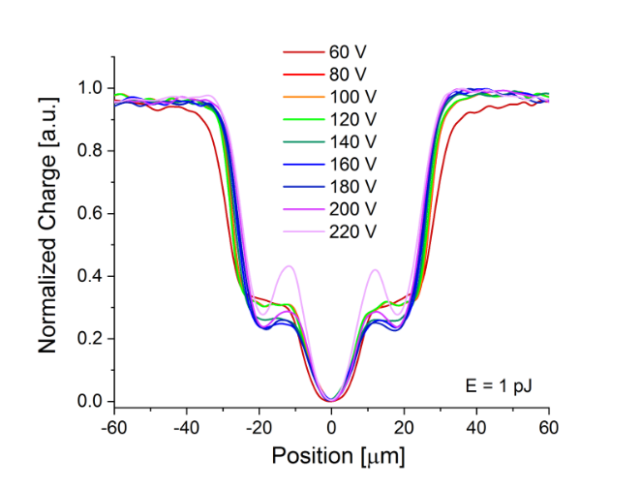
IP vs Bias at medium power

Slide 14
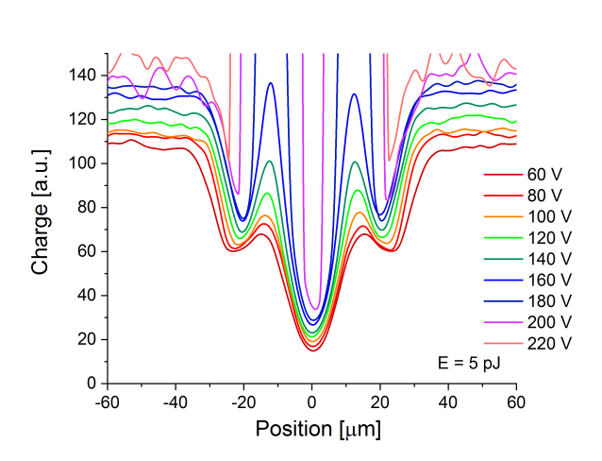
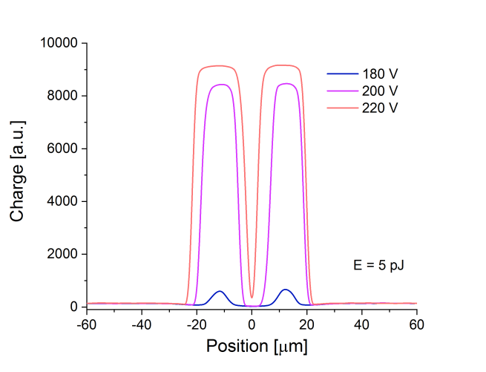
IP vs Bias at high power
At high laser power (5 pJ) extremely strong side bands appear around the central hollow.

Slide 15
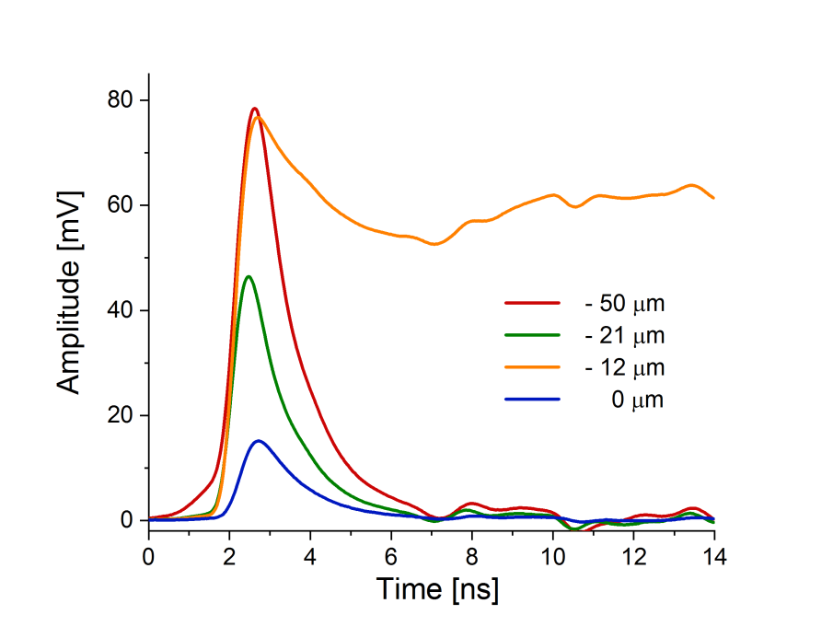
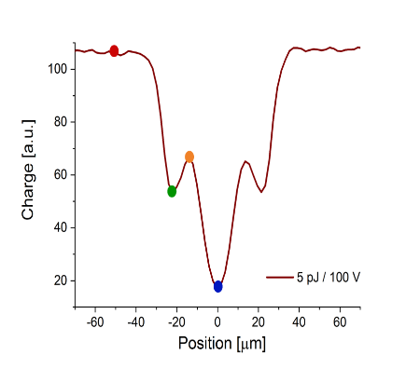
Waveforms recorded at high power and bias (5 pJ/180 V) at selected positions
When we look at the waveforms it is visible that the very strong side bands seems to be correlated to the fact that the waveforms at the corresponding positions (orange one) are extremely broadened.
Reminder:

Slide 16
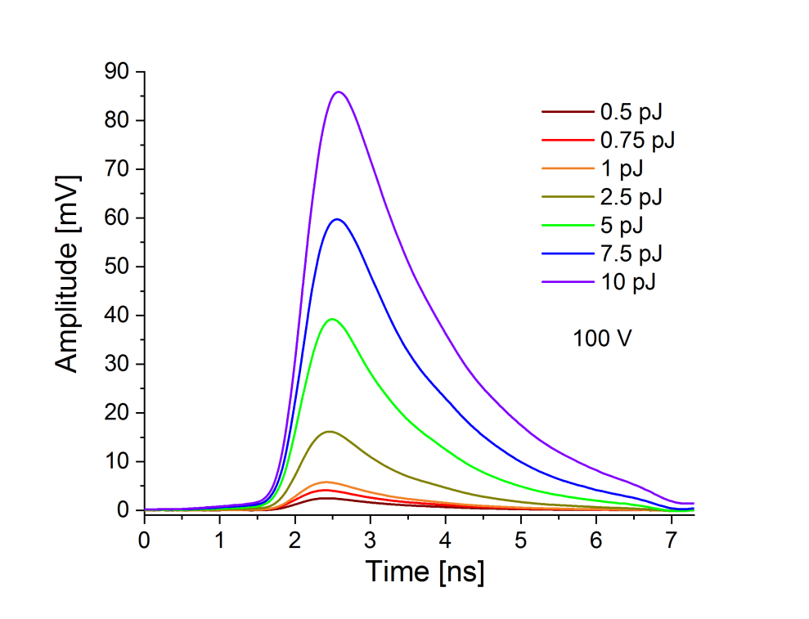
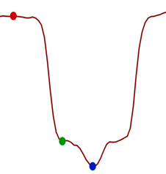
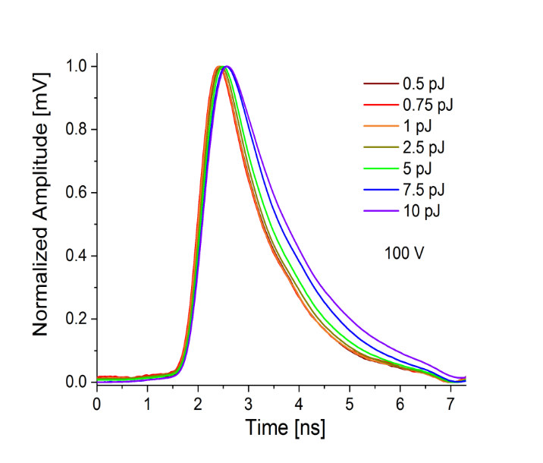
Waveform vs X-position and power
Single waveforms (original and normalized) recorded at “strong field” area (position indicated by red vertical line on X-profile)

Slide 17
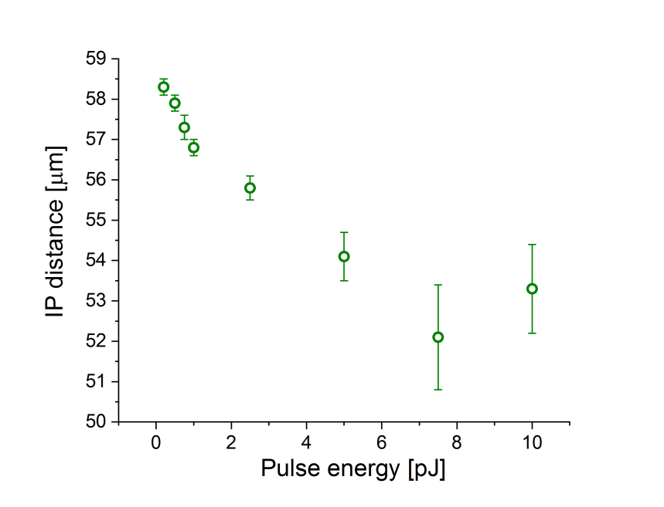
IP vs Power (laser pulse energy)
Interpad distance decreases with increased laser bias

Slide 18
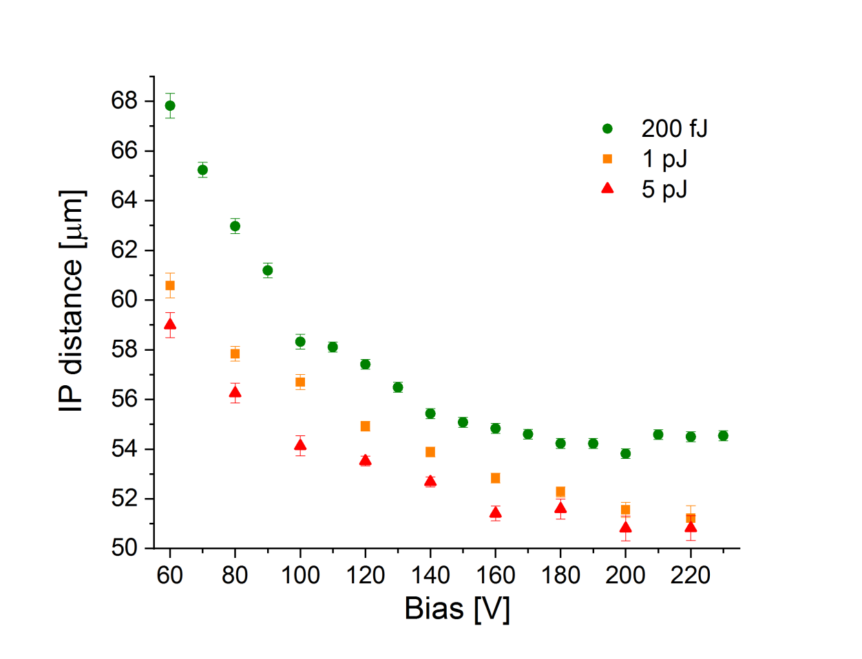
IP vs Bias
Interpad distance decreases with increased laser bias
Interpad distance decreases with increased laser power

Slide 19
CONCLUSIONS
UFSD Type 10 that is reference CMS LGAD sensor has been tested.
All the X-profiles have a characteristic hollow in the center : P - structure
At higher laser power the strong side bands around the central hollow appear in the X-profiles (waveforms are highly broadened)
IP distance decreases with increasing power (pulse energy)
IP distance decreases with increasing bias
Since we have very good resolution, we can accurately determine not only 50%-50% of points, but also knowing how much we get for a PIN with a MIP particle we cam exactly define how much IP is as a function of the bias if we set a threshold at 5fC. Such measurements we believe will be nicely advanced with the test beam with ETROC + LGAD from CMS.

Slide 20
Backup

Slide 21
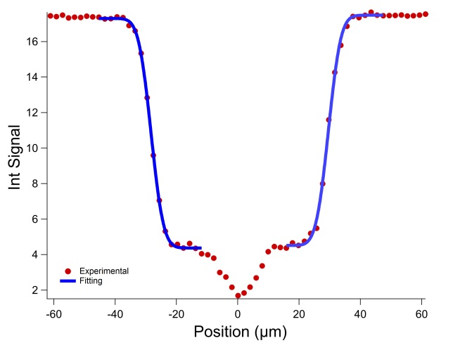
How to find IP distance: fitting procedure
To find the edges of the pixels "error function" is fit to every slope individually. The difference between the edges is considered IP distance.
In principle, any other sigmoid function (for example Boltzmann) can be used

