Slide 1

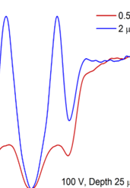
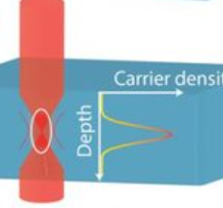
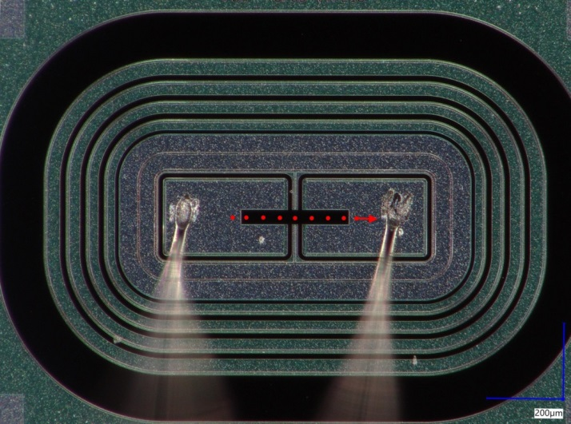
TPA vs SPA: Case study of UFSD Type 10 (2 P-stops)
Gordana Lastovicka-Medin¹, Mateusz Rebarz², Jovana Doknic¹, Ivona Bozovic¹, Gregor Kramberger³, Jiri Kroll⁴, Jakob Andreasson²
¹University of Montenegro in Podgorica, ²ELI Beamlines in Prague,
³Institute Jozef Stefan in Ljubljana ⁴Institute for Physics at the Czech Academy of Science

Slide 2
Device Under Test (DUT):
UFSD Type 10 with 2 P-stops
UFSD type 10: 2 p-stop layout (each pixel is surrounded by a proper p-stop), The nominal IP width (gain-gain distance) is 49 μm.
The nominal inter-gap distance for type 10 and type 4 is a bit different wrt the same structures produced in the batches UFSD 4 or UFSD 3.2.
epi layer is 45 μm instead of the typical 55 μm used in UFSD 3.2 and UFSD 4.0

Slide 3
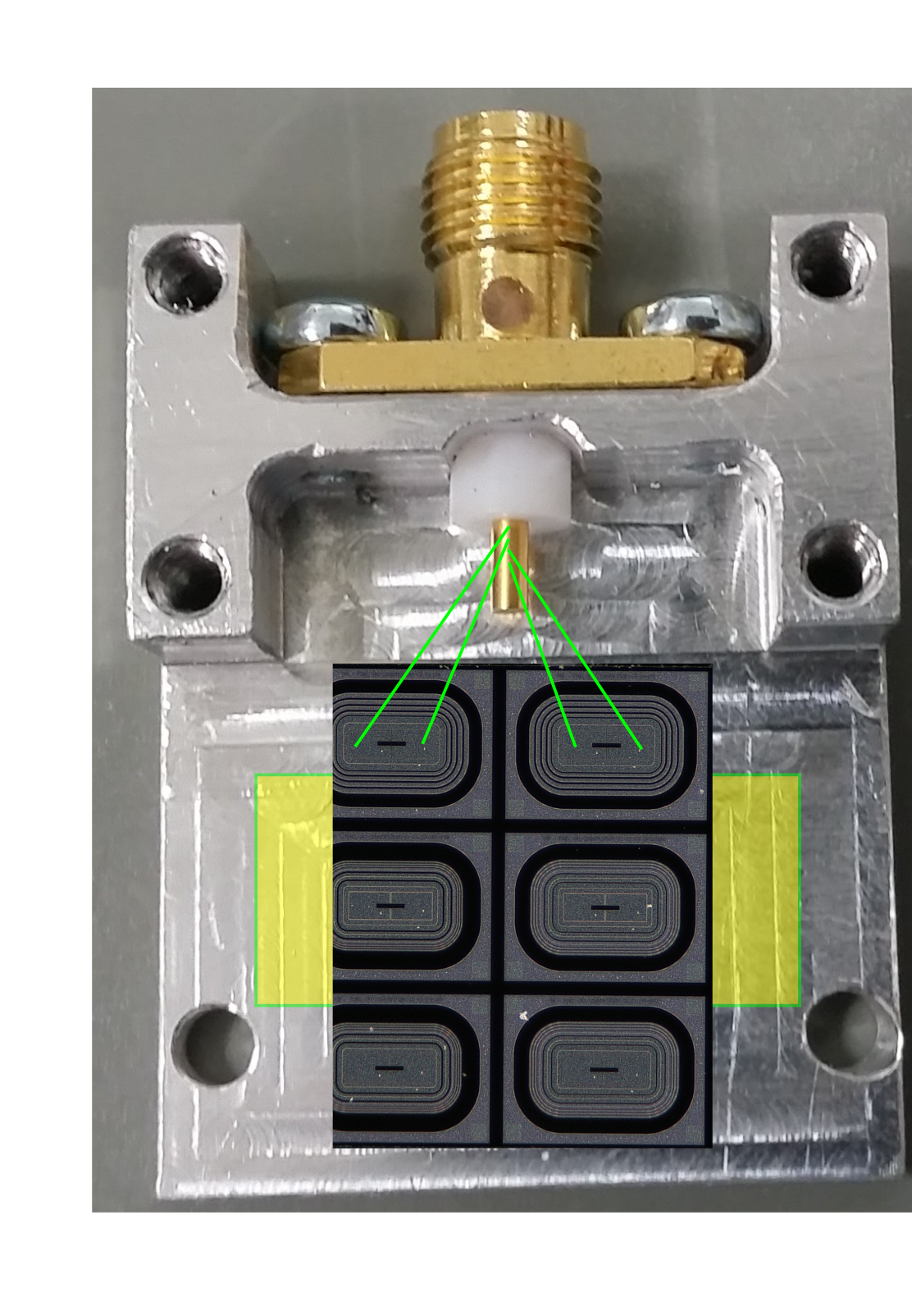

Slide 4
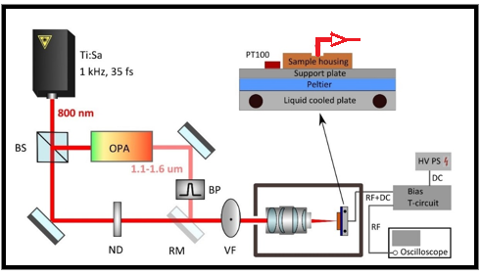
Experimental Technique: TCT
Place | ELI Beamlines
Operational modes | Single and two photon absorption (SPA and TPA)
Pulse energy on sample Wavelength Pulse width in sensor | Variable by ND filters (accuracy: 0.2 pJ) 800 nm (SPA), 1550 nm (TPA) 1550 nm, ~ 100 fs 800 nm, ~ 50fs
Focus waist radius | 0.85 μm (SPA), 1.5 μm (TPA)
Rayleigh length | 3.31 μm (SPA), 7.74 μm (TPA)
Sample cooling | Down to -25 deg. C
Sample movement | X, Y, Z
Bias voltage Detection | up to or > 720 V 6 GHz (20 GSa) oscilloscope and leakage current measurement (accuracy: 0.1 μA)
Schematic view of the setup for TCT-SPA and TCT-TPA measurements at ELI Beamlines (BS – beam splitter, OPA - optical parametric amplifier, BP - bandpass filter, ND - neutral density filter, RM - removable mirror, VF - variable filter)
Ref: G. Lastovicka-Medin et al, Femtosecond laser studies of the Single Event Effects in Low Gain Avalanche Detectors and PINs atELI Beamlines, Nuclear Inst. and Methods in Physics Research, NIM A, 2022

Slide 5
TPA vs SPA
1550 nm, ~ 100 fs, 1 kHz
All the values in Z direction (depth) were corrected by refractive index of Si at 1550 nm (n=3.4757) thus the values on the graphs correspond to the real depth in the sensor.
The main purpose of TPA study was checking the depth dependence.
Similarly, to SPA all the measurements were performed with external amplifier. The minimal laser pulse energy giving measurable signal was 0.5 μJ

Slide 6
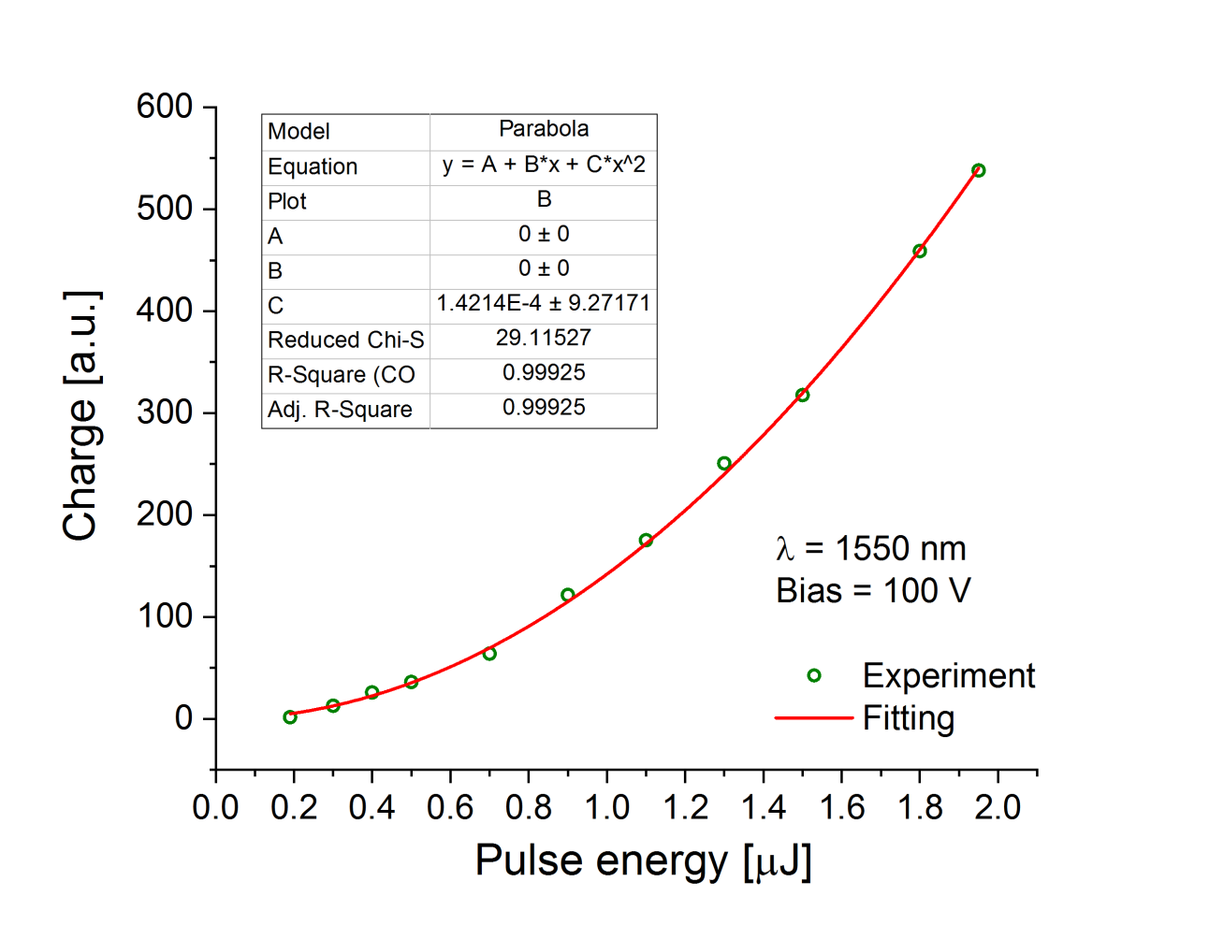
“Charge vs Pulse Energy

Slide 7
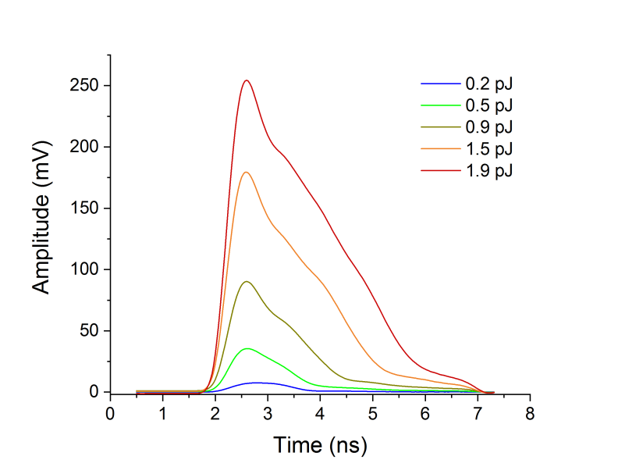
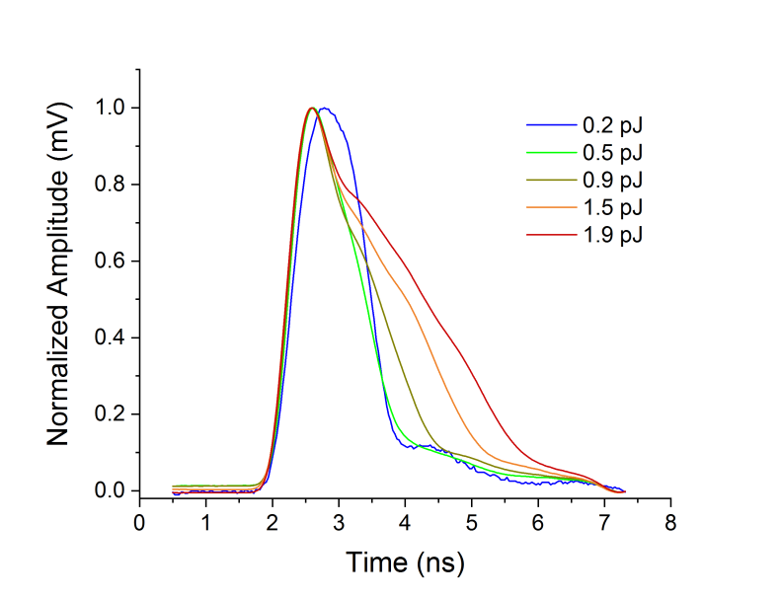
Example waveforms
Example waveforms normalized
The waveforms for higher power are significantly broadened so only the lowest value 0.5 μJ giving reasonable signal was used in TI study

Slide 8
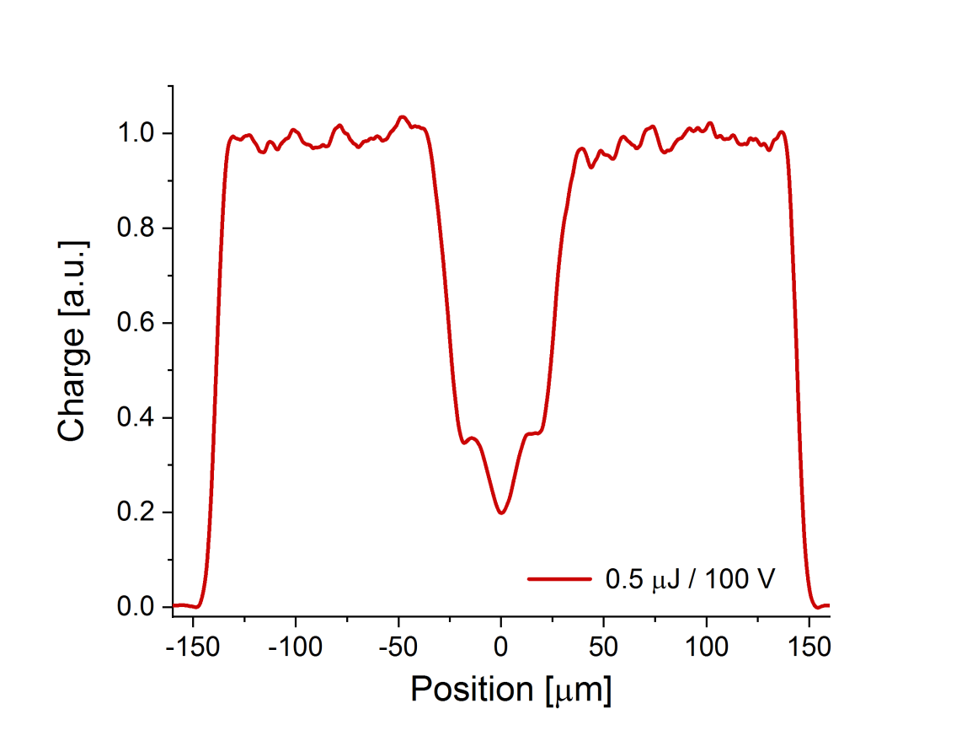
X-profiles
X-profile
The shape: the same like in SPA.
They have the same characteristic hollow in the center (for all powers/bias/depth).
TPA offers better spatial resolution than SPA (focal spot is smaller in SPA but the signal is generated also out of focus).
This is visible if we compare rising slope of the signal measured on the opening window edge.

Slide 9
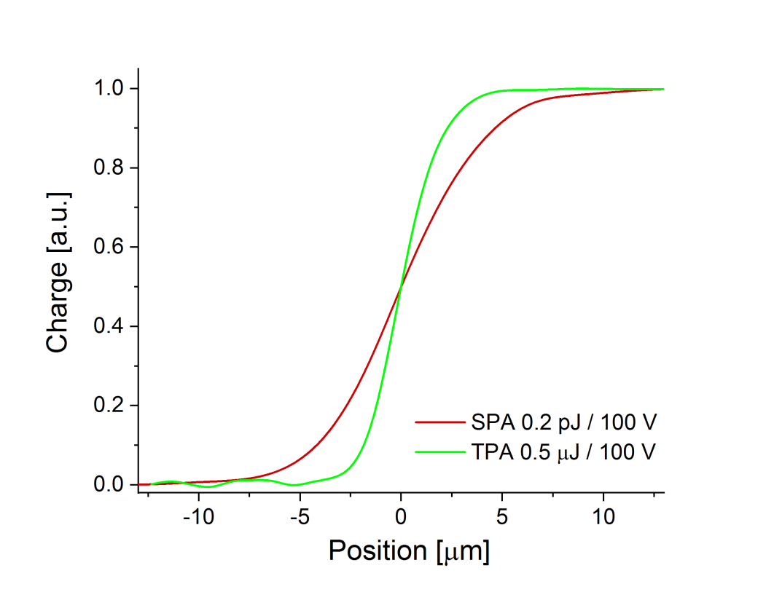
Edge steepness

Slide 10
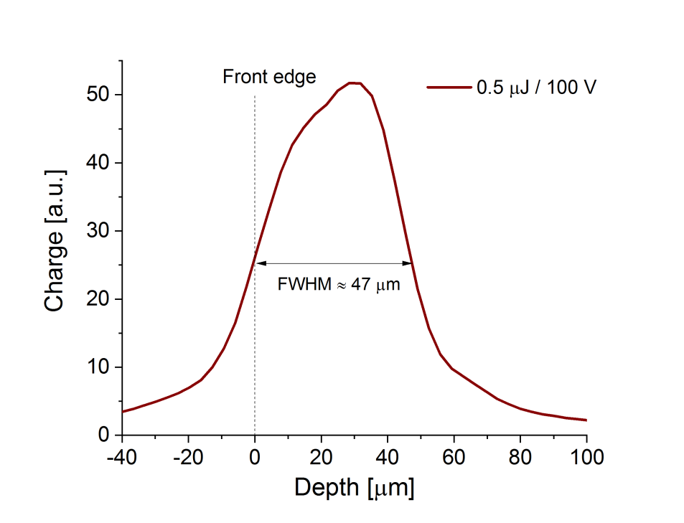
Z-scan
Z
FWHM of the Z-scan is about 47 μm what corresponds to the thickness of the sensor (49 μm).
It was assumed that the front edge of the sensor corresponds to the middle of the rising slope

Slide 11
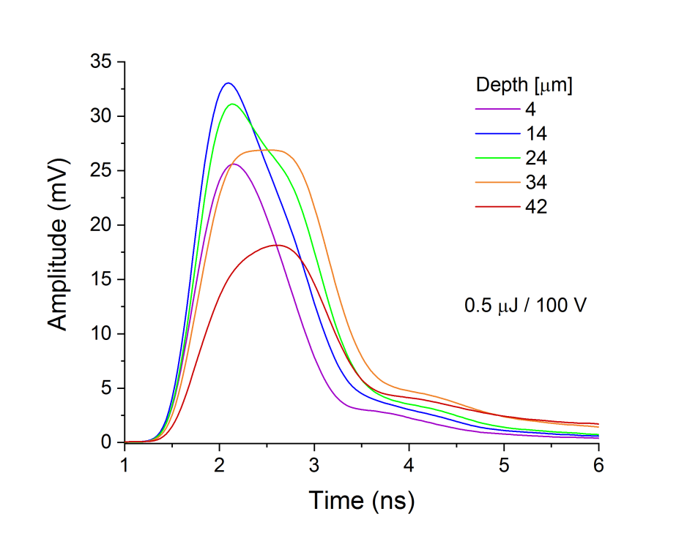
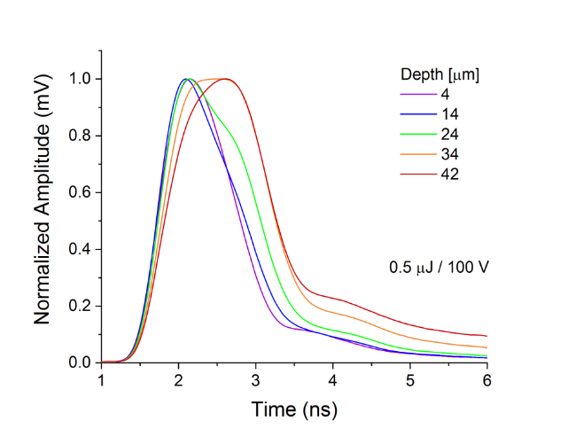
The recorded waveforms
0.5 pJ
The shape of the individual waveforms depends on the depth.

Slide 12
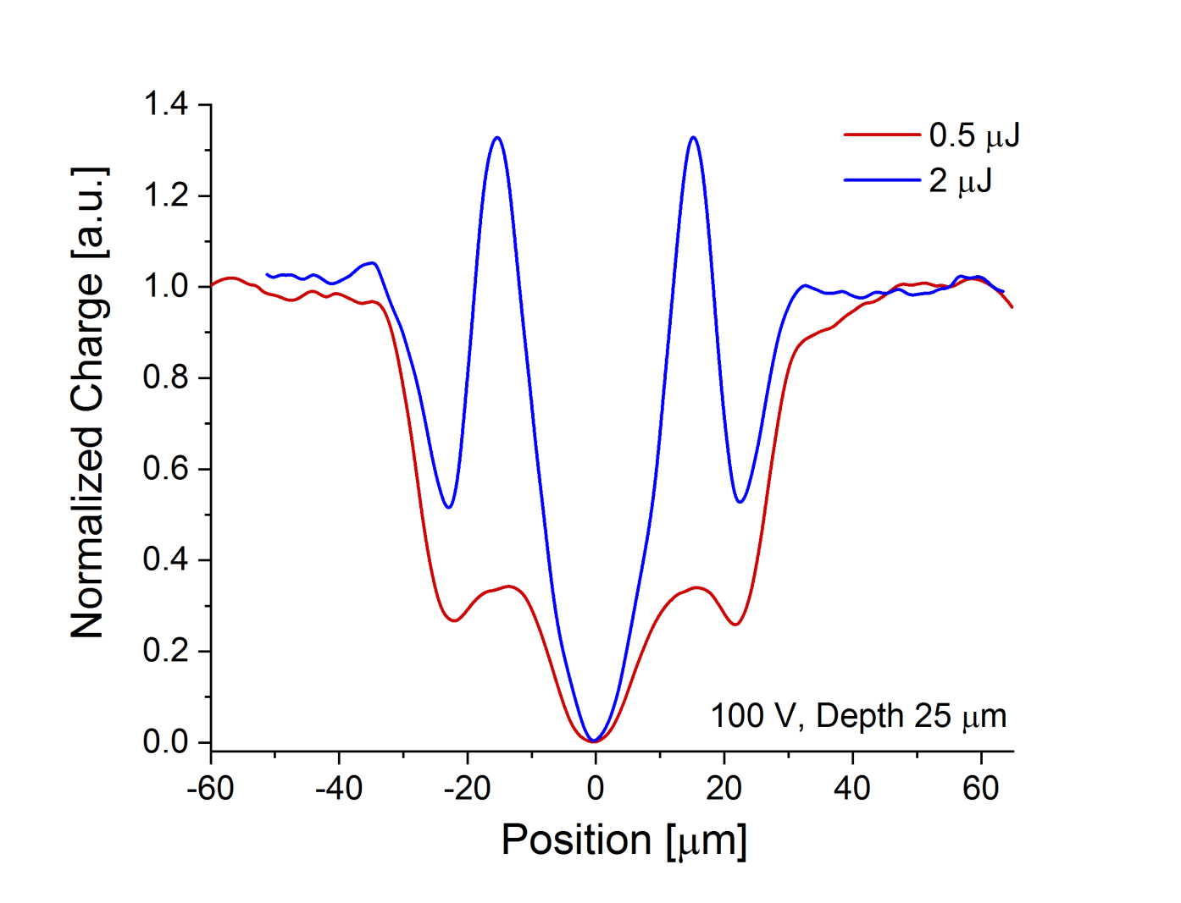
TPA : power dependence
The full X-profiles were measured by TPA for different powers.
Only two values 0.5 and 2 uJ were used however it's visible that power effect is similar to that observed at SPA.
At higher laser power stronger side bands appear around central hollow.
Presented profiles were measured at depth of 25 um.
Normalized X profiles obtained by TPA for two different laser pulse energy

Slide 13

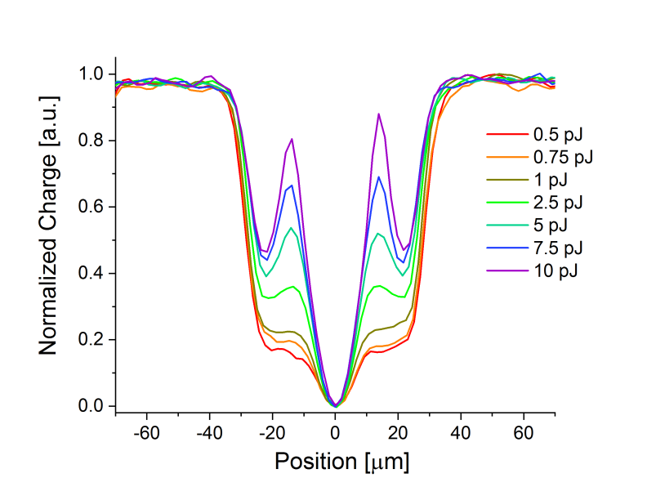
TPA
SPA
800 nm of wavelength correspond to depth of 20-25 microns inside LGAD

Slide 14
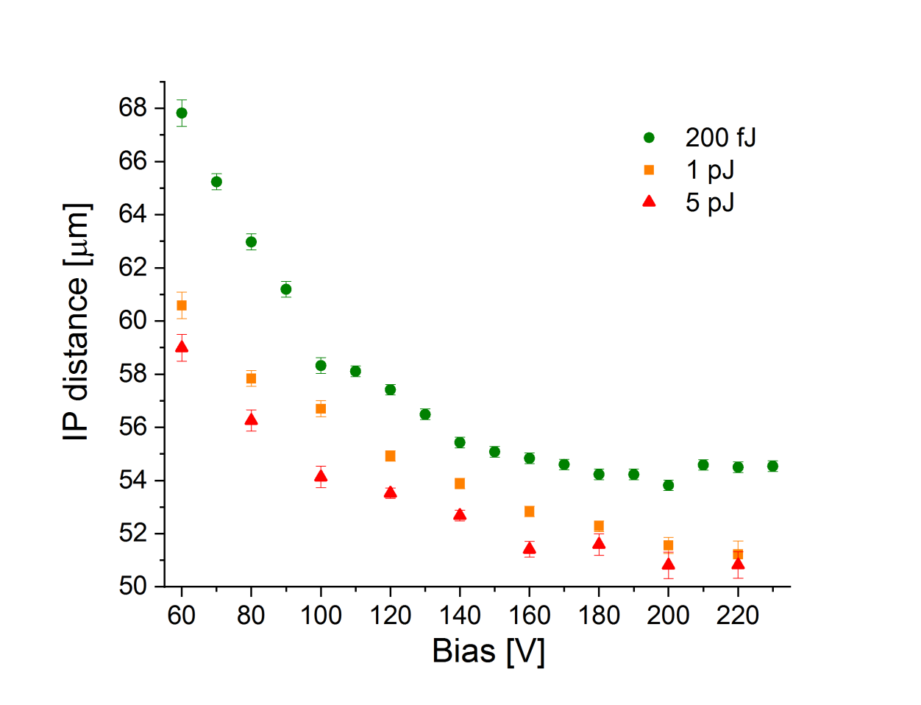
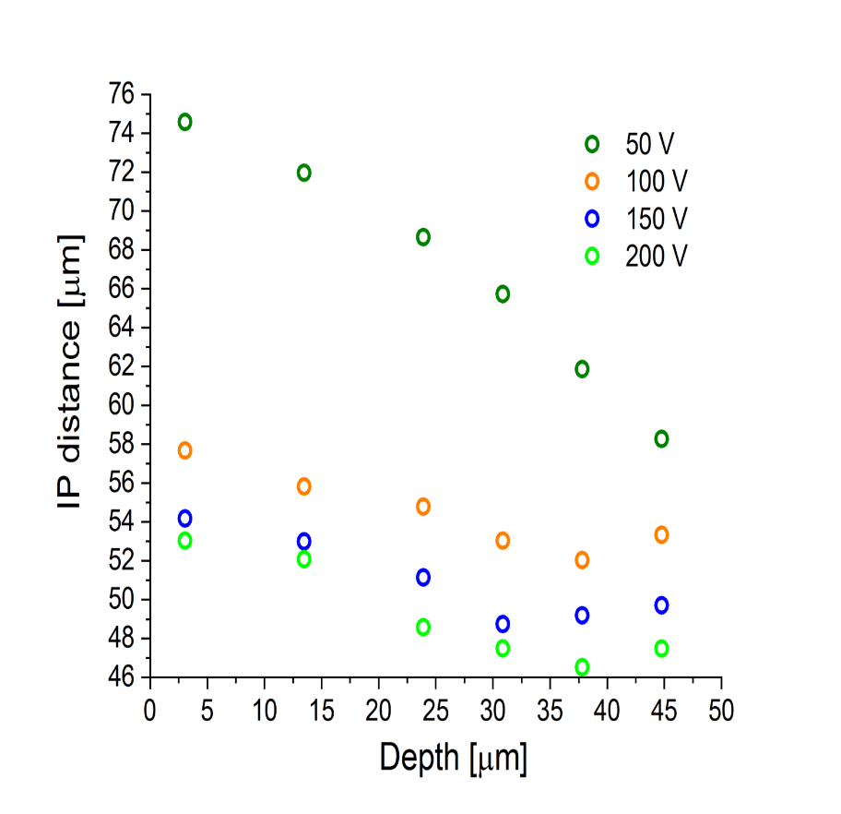
SPA
TPA
800 nm of wavelength correspond to depth of 20-25 microns inside LGAD

Slide 15
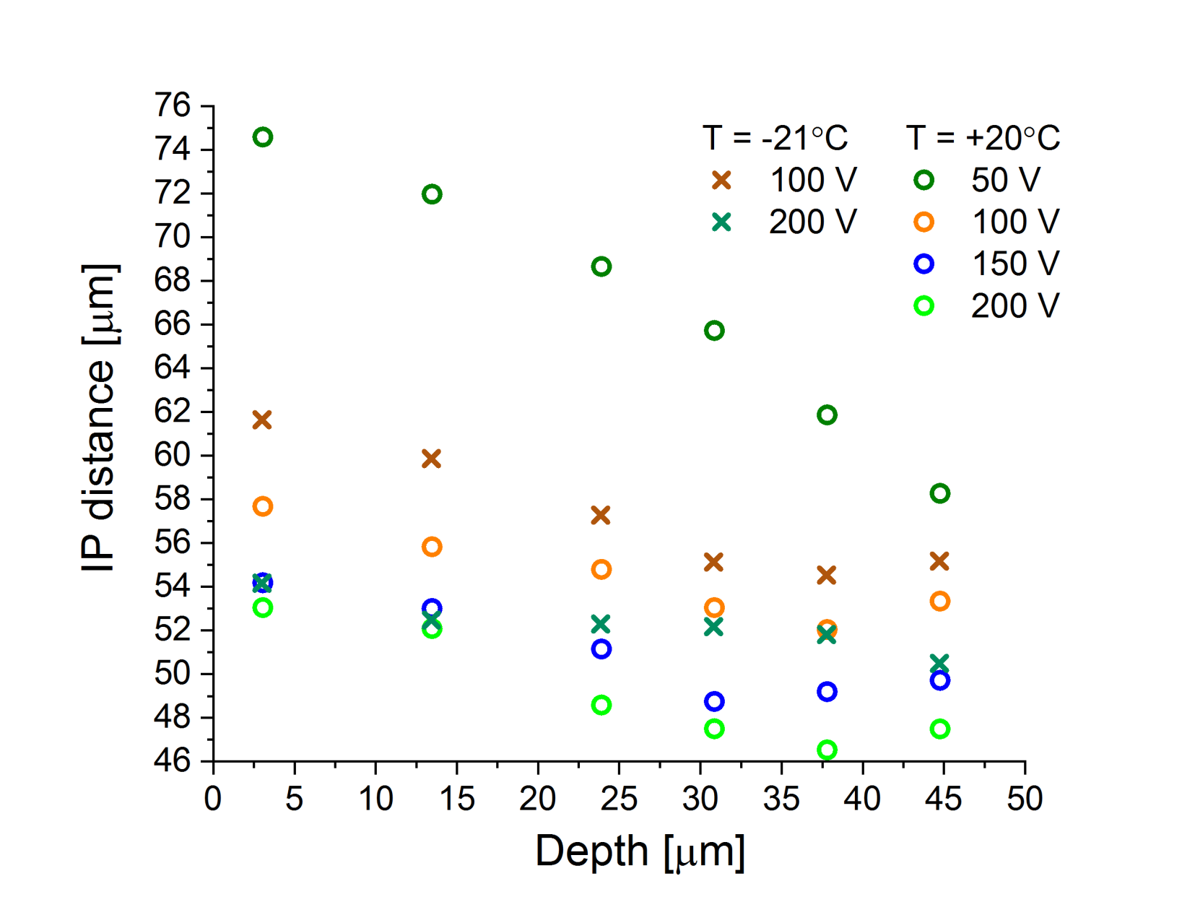
IP distance vs depth: temperature effect
The general trend of decreasing IP vs depth is clear for depths < 49 um but the region close to the back side of the sensor (> 40 um) seems to behave differently.
Further, more detailed studies, are probably needed to confirm and explain this effect.

Slide 16
Test of Leakage Current in the positions of spikes
We monitored carefully the leakage current especially in the positions corresponding to the spikes.
We didn't observe any changes (jump) of leak current when we perform scan over this region.
The waveforms are significantly broadened but the leak current stayed the same.
It's actually not surprising.
We know from our mortality study (Single Event Burnout) that shape of the waveform is much more sensitive than leak current.
Typically we observed the waveform broadening (and deformation) when first instabilities occurred in the system whereas the current jump was observed just before sensor damage.

Slide 17
Test on how pulse duration influences the sensor signal
We also performed a test how pulse duration influences the sensor signal.
We used SPA at 800 nm because we can manipulate pulse duration at this wavelength.
We changed a pulse duration between 50 and 500 fs and we didn't see any difference in the signal (same shape and amplitude).
This is what was expected but finally we tested it.
Pulse duration does not seem to be problem as long as we stay in fs regime (when the pulse is much shorter than the response of the sensor).

Slide 18
CONCLUSIONS
UFSD Type 10 that is reference CMS LGAD sensor has been tested.
All the X-profiles have a characteristic hollow in the center
At higher laser power the strong side bands around the central hollow appear in the X-profiles (waveforms are highly broadened)
IP distance decreases with increasing power (pulse energy)
IP distance decreases with increasing bias
IP distance decreases with increasing depth however this effect is unclear for the positions close to the back side of the sensor (no dependence or even slightly opposite trend)
Very good agreement between SPA and TPA is achieved.
Since we have very good resolution, we can accurately determine not only 50%-50% of points, but also knowing how much we get for a PIN with a MIP particle we cam exactly define how much IP is as a function of bias if we set a threshold at 5fC. Such measurements we believe will be nicely advanced with the test beam with ETROC + LGAD from CMS.
Thank you.

Slide 19
