Slide 1


Radiation damage investigation of epitaxial p-type Schottky diodes using TCAD simulation
Rodney Aiton, Yebo Chen, Christoph Klein, Thomas Koffas, Matthew Kurth, Adnan Malik, Angela Mccormick, Garry Tarr, Robert Vandusen, Giulio Villani, Dengfeng Zhang, Hongbo Zhu

Slide 2
Outline
Introduction
  Motivation
  Introduction of TCAD
  Devices simulated with TCAD
  Take the thin interface oxide layer into consideration
Procedure of Simulation
  Simulation of the device manufactory process
  Simulation using SDEVICE
Comparison between Measurement and Simulation
Summary and Next

Slide 3
Introduction
Motivation
  To investigate the radiation damage of epitaxial p-type silicon devices
  Properties extracted from the IV and CV measurements to simulate
  To summarize a radiation damage model
Technology computer-aided design (TCAD)
  Branch of electronic design automation that simulates the manufacturing and semiconductor device operation of semiconductors
  Tools used
    SPROCESS
      To simulate the fabrication of devices
    SDEVICE
      To simulate the operation of devices under applied voltage

Slide 4
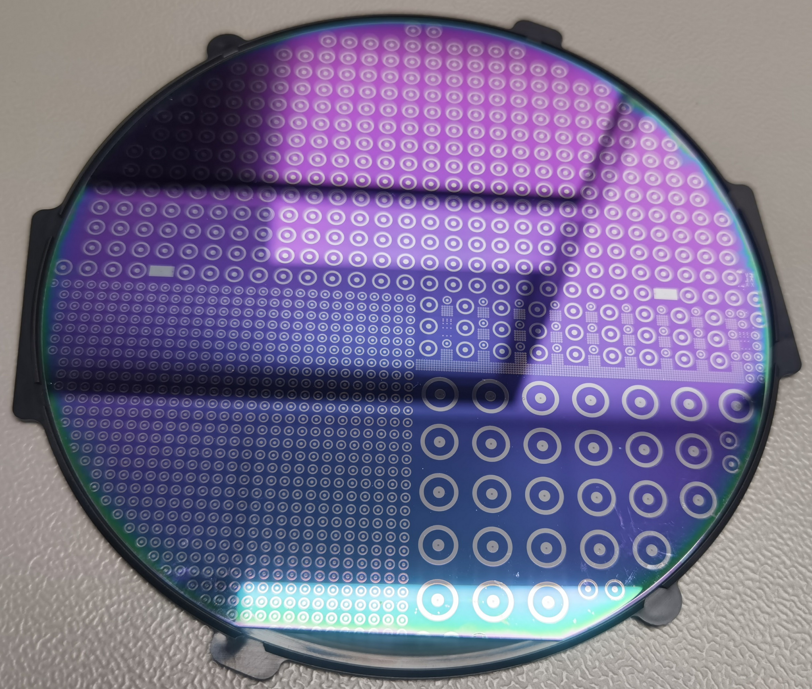
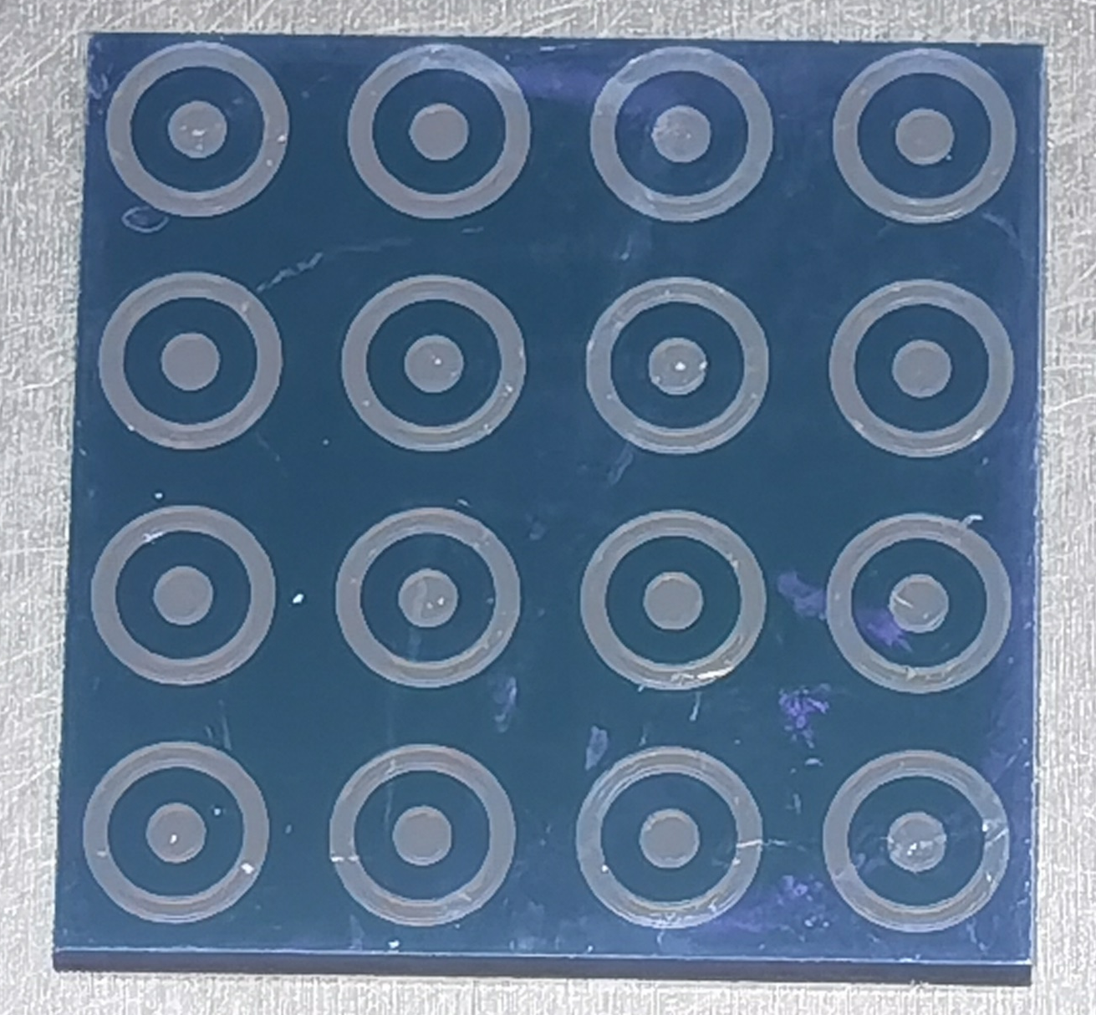
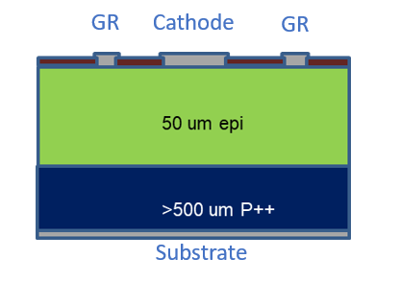
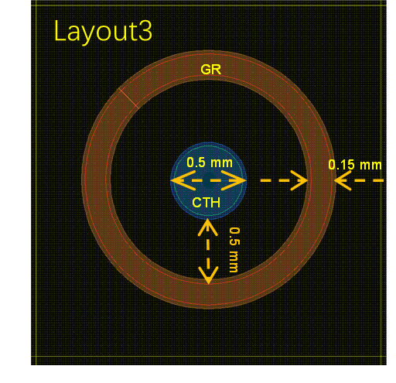
Introduction
Devices simulated with TCAD
  Epitaxial p-type Schottky diodes
    Substrate
      5×10¹⁸ cm⁻³ Boron doping
      > 500 μm thickness
    P-type epitaxial layer
      10¹³ cm⁻³ Boron doping
      50 μm thickness
    10×10 mm diodes diced from the same wafer
      0.5mm cathode diameter
      Non-irradiated
      Neutron irradiated
        10¹², 10¹³, 10¹⁴, 10¹⁵, 10¹⁶ 1MeV n_{eq}/cm²
10mm
6 5
2 1
3 4
7 8

Slide 5
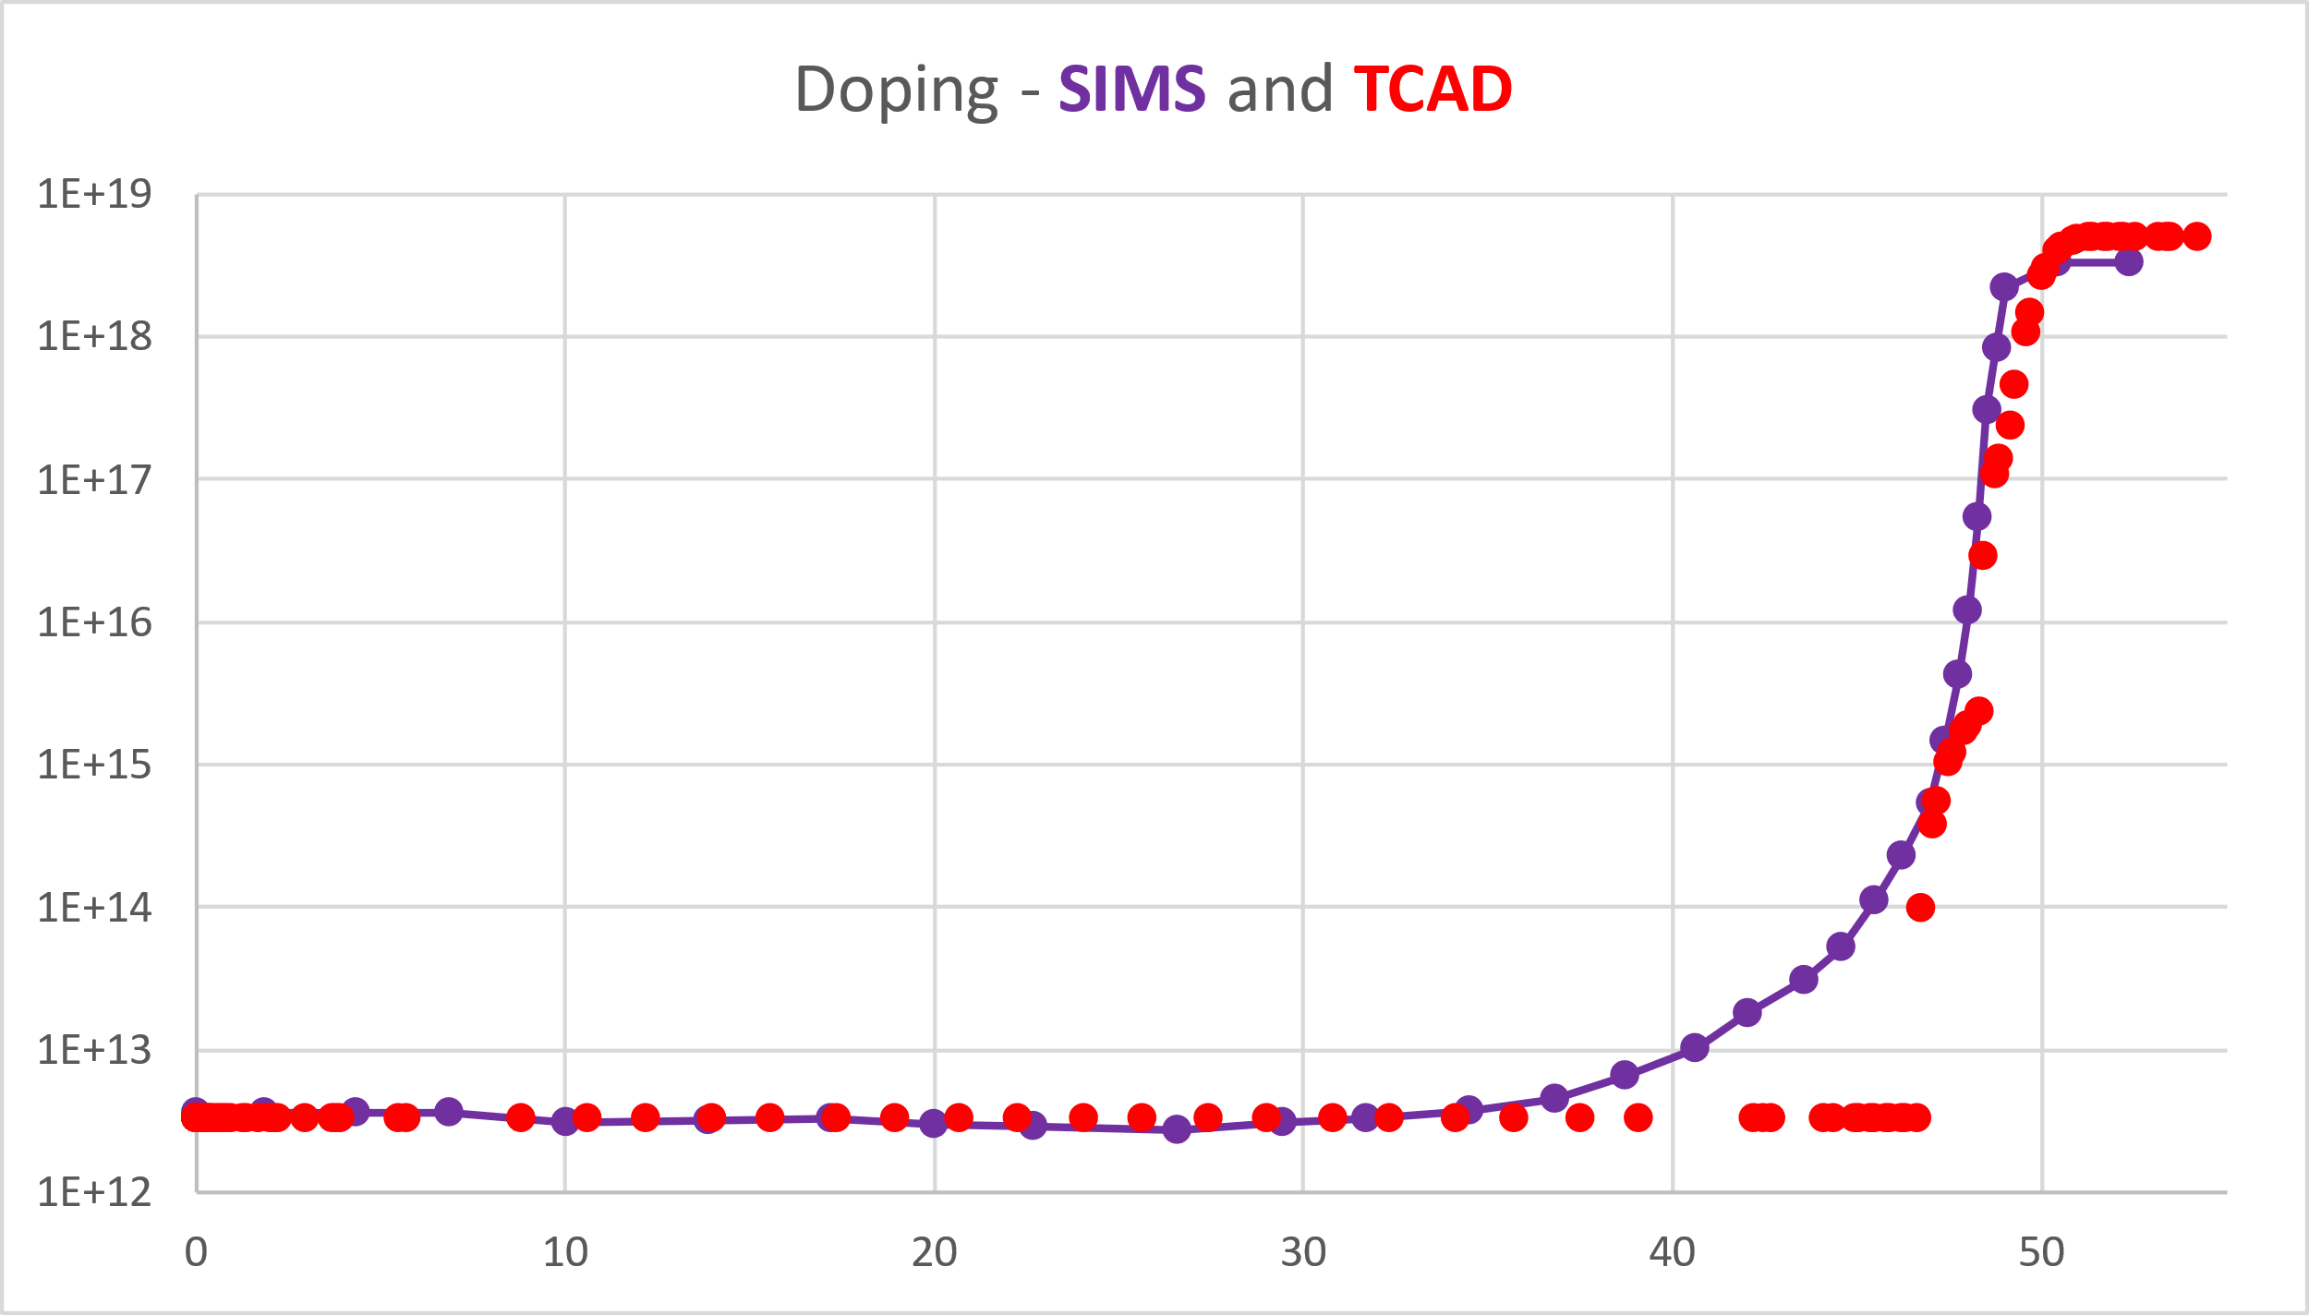
Introduction
Devices simulated with TCAD
  Differences of simulation
    Doping in P-type epitaxial layer
      Secondary Ion Mass Spectrometry (SIMS) from wafer supplier
        3.3×10¹² cm⁻³

Slide 6
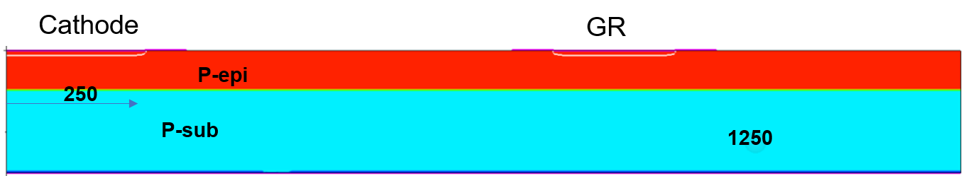

Introduction
Devices simulated with TCAD
  Differences of simulation
    Structure
      Substrate thickness
        >500μm $→$ 100μm
      Only half device 0.5mm cathode is simulated, but Cylindrical symmetry is exploited to get an equivalent 3D simulation

Slide 7
Introduction
Take the thin interface oxide layer into consideration
  The breakdown voltage is much higher than expected from earlier TCAD simulation
    Wafers were left exposed in air after etching and prior to Al deposit
    The silicon surface is oxidized to form an additional silicon dioxide layer

Slide 8
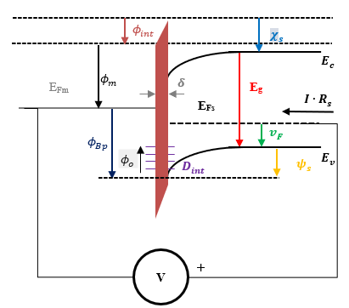
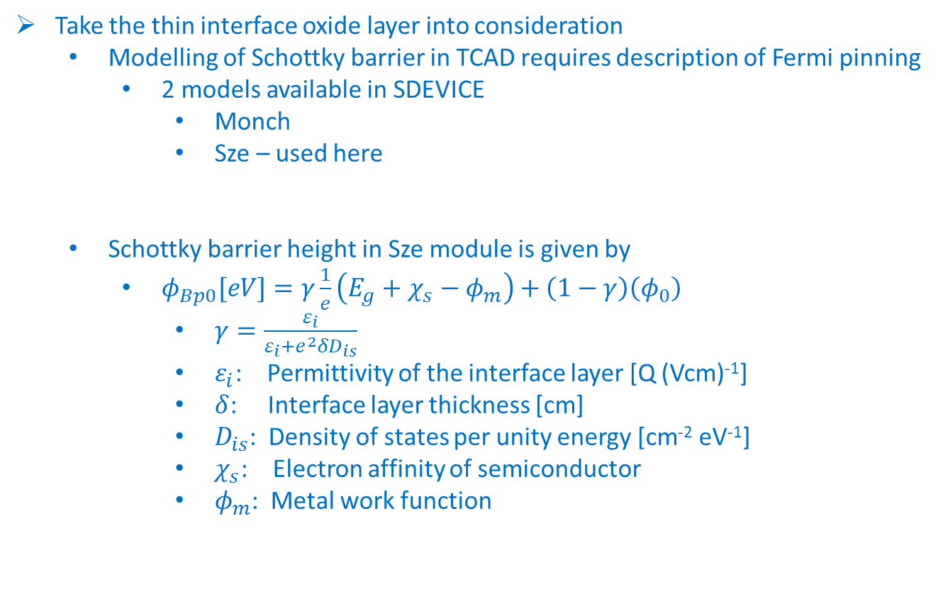
Introduction
Take the thin interface oxide layer into consideration
  Modelling of Schottky barrier in TCAD requires description of Fermi pinning
    2 models available in SDEVICE
      Monch
      Sze – used here
  Schottky barrier height in Sze module is given by
    $φ_{Bp0}[eV]=γ\frac{1}{e}\left({E_{g}+χ_{s}−φ}_{m}\right)+\left(1−γ\right)\left(φ_{0}\right)$
      $γ=\frac{ε_{i}}{ε_{i}+e^{2}δD_{is}}$
      $ε_{i}$: Permittivity of the interface layer [Q (Vcm)⁻¹]
      $δ$: Interface layer thickness [cm]
      $D_{is}$: Density of states per unity energy [cm⁻² eV⁻¹]
      $χ_{s}$: Electron affinity of semiconductor
      $φ_{m}$: Metal work function

Slide 9
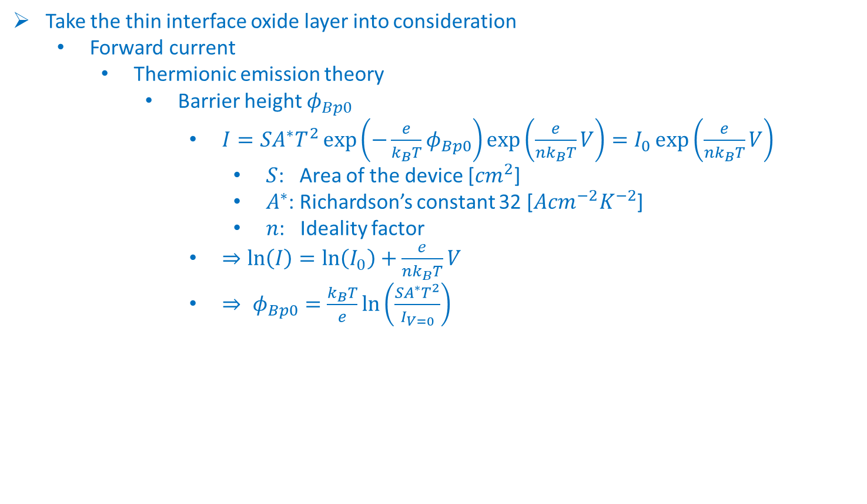
Introduction
Take the thin interface oxide layer into consideration
  Forward current
    Thermionic emission theory
      Barrier height $φ_{Bp0}$
        $I=SA^{∗}T^{2}\exp\left(−\frac{e}{k_{B}T}φ_{Bp0}\right)\exp\left(\frac{e}{nk_{B}T}V\right)=I_{0}\exp\left(\frac{e}{nk_{B}T}V\right)$
          $S$: Area of the device [${cm}^{2}$]
          $A^{∗}$: Richardson’s constant 32 [$A{cm}^{−2}K^{−2}$]
          $n$: Ideality factor
        $⇒\ln\left(I\right)=\ln\left(I_{0}\right)+\frac{e}{nk_{B}T}V$
        $⇒ φ_{Bp0}=\frac{k_{B}T}{e}\ln\left(\frac{SA^{∗}T^{2}}{I_{V=0}}\right)$

Slide 10
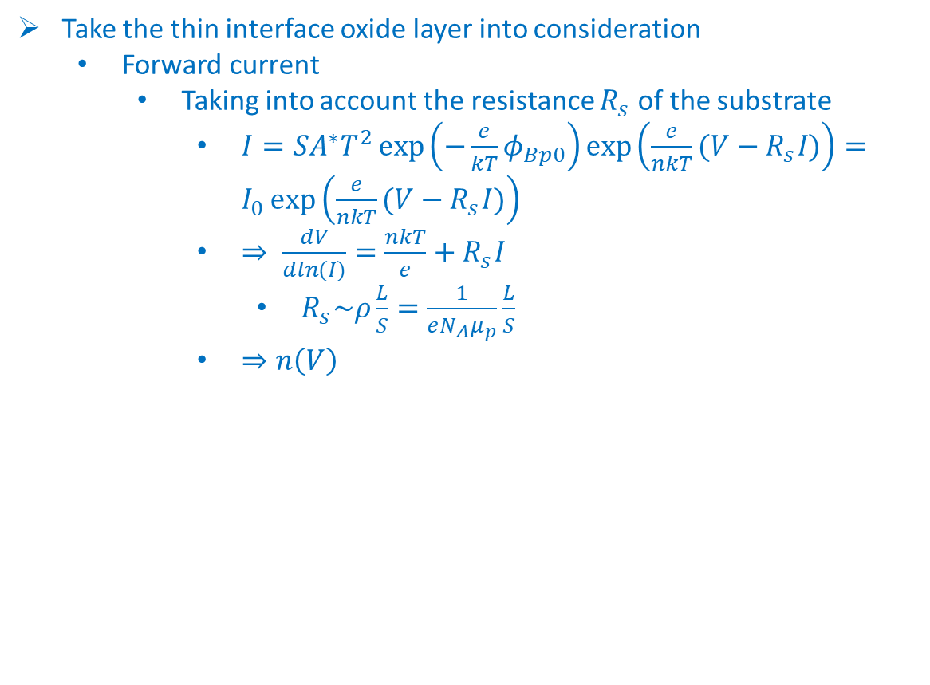
Introduction
Take the thin interface oxide layer into consideration
  Forward current
    Taking into account the resistance $R_{s}$ of the substrate
      $I=SA^{∗}T^{2}\exp\left(−\frac{e}{kT}φ_{Bp0}\right)\exp\left(\frac{e}{nkT}(V−R_{s}I)\right)=I_{0}\exp\left(\frac{e}{nkT}(V−R_{s}I)\right)$
      $⇒ \frac{dV}{dln(I)}=\frac{nkT}{e}+R_{s}I$
        $R_{s}\sim ρ\frac{L}{S}=\frac{1}{eN_{A}μ_{p}}\frac{L}{S}$
      $⇒n\left(V\right)$

Slide 11

Introduction
Take the thin interface oxide layer into consideration
  Forward current (Forward bias: 0 – 5V with GR floating)
    $Φ_{b0}$ and $n\left(V\right)$ extracted
    The calculation of resistivity still needs further investigation

Slide 12
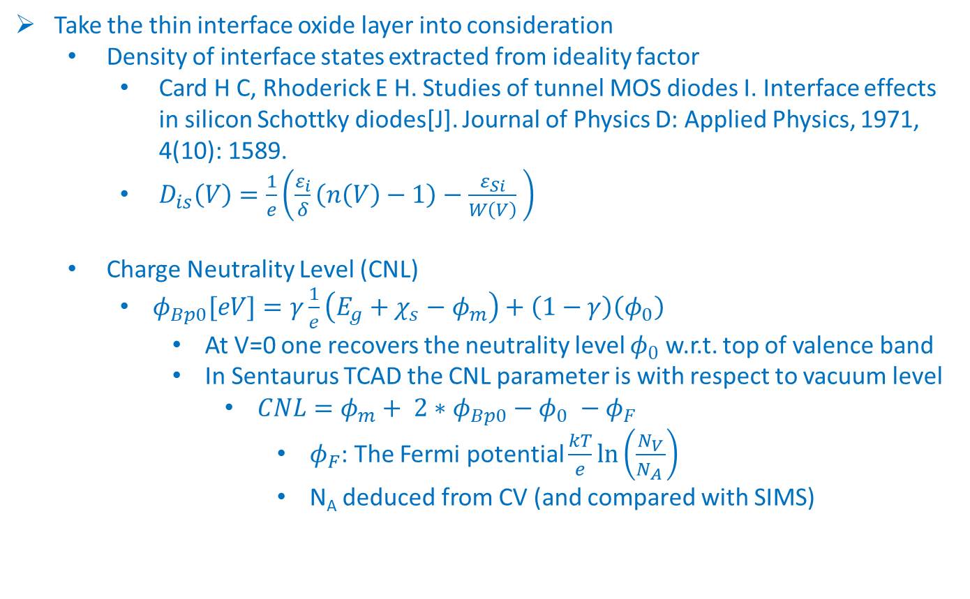
Introduction
Take the thin interface oxide layer into consideration
  Density of interface states extracted from ideality factor
    Card H C, Rhoderick E H. Studies of tunnel MOS diodes I. Interface effects in silicon Schottky diodes[J]. Journal of Physics D: Applied Physics, 1971, 4(10): 1589.
    $D_{is}\left(V\right)=\frac{1}{e}\left(\frac{ε_{i}}{δ}\left(n\left(V\right)−1\right)−\frac{ε_{Si}}{W\left(V\right)} \right)$
  Charge Neutrality Level (CNL)
    $φ_{Bp0}[eV]=γ\frac{1}{e}\left({E_{g}+χ_{s}−φ}_{m}\right)+\left(1−γ\right)\left(φ_{0}\right)$
      At V=0 one recovers the neutrality level $φ_{0}$ w.r.t. top of valence band
      In Sentaurus TCAD the CNL parameter is with respect to vacuum level
        $CNL=φ_{m}+ {2∗φ}_{Bp0}−φ_{0} −φ_{F}$
          $φ_{F}$: The Fermi potential $\frac{kT}{e}\ln\left(\frac{N_{V}}{N_{A }}\right)$
          N_{A} deduced from CV (and compared with SIMS)

Slide 13
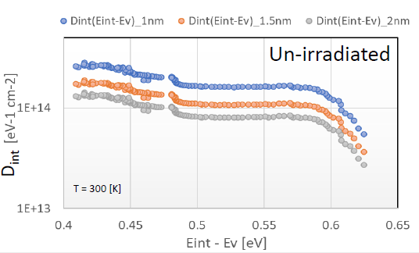
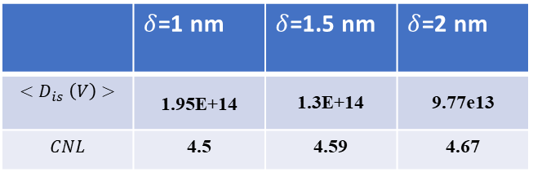

Introduction
Take the thin interface oxide layer into consideration
  Calculate the $D_{is}(V)$ and $CNL$ for 𝛿 of native oxide layer
    The $D_{is}$ used in TCAD simulation is the average
      Seem not possible to include $D_{is}$ energy dependence in TCAD
    We assume three 𝛿 values for the native oxide layer
      1.0nm, 1.5nm, 2.0nm
 | $δ$=1 nm | $δ$=1.5 nm | $δ$=2 nm
$${<D}_{is}\left(V\right)>$$ | 1.95E+14 | 1.3E+14 | 9.77e13
$$CNL$$ | 4.5 | 4.59 | 4.67

Slide 14
Procedure of Simulation
Simulation of the device manufactory process using SPROCESS
  Substrate definition and initialization
    Substrate structure
    100μm thickness
    5×10¹⁸ cm⁻³ Boron doping
  Thermal P-type epitaxial layer growth
    50μm thickness
    3.3×10¹² cm⁻³ Boron doping
    Temperature ramping from 550℃ to 1000℃ in 1 minute
    Annealing
      1000℃ for 20 hours

Slide 15
Procedure of Simulation
Simulation of the device manufactory process using SPROCESS
  SiO2 anisotropic deposit
    500nm thickness
  Mask of cathode and GR
    1000nm thickness
  Anisotropic etching of SiO2
    Plasma etching in reality but very anisotropic
  Aluminum isotropic deposit
    1000nm thickness
  Mask of cathode and GR
    2500nm thickness
  Anisotropic etching of aluminum
    1100nm thickness

Slide 16
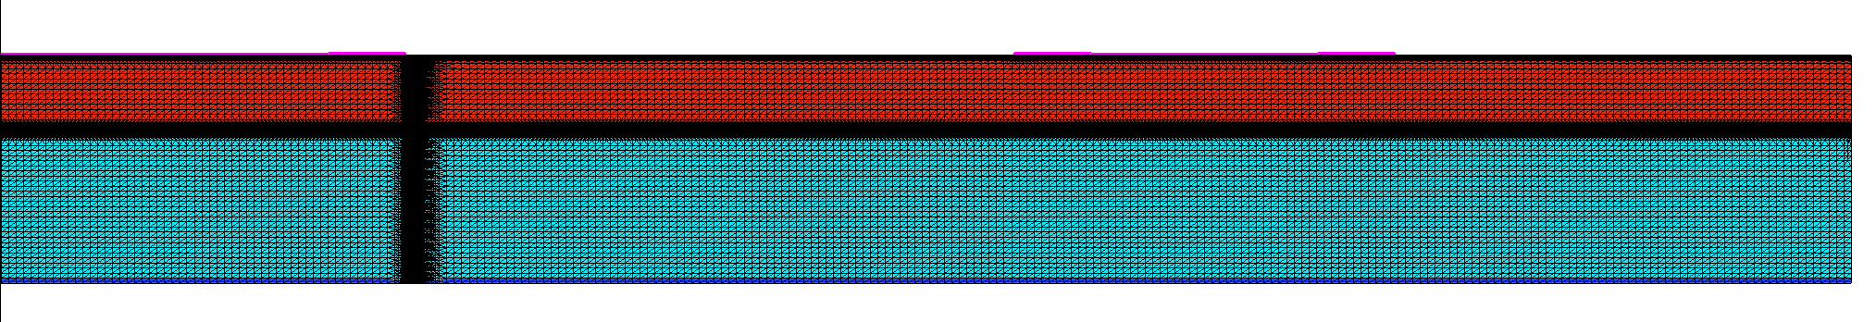
Procedure of Simulation
Simulation of the device manufactory process using SPROCESS
  Highly doping at the bottom
    10²⁰ cm⁻³
    Ohmic contact
  Re-meshing
    More meshes in the area of interest
Cathode
GR
Substarte

Slide 17
Procedure of Simulation
Simulation using SDEVICE
  Physics models
    SDEVICE parameters for optical generation
      OpticalGeneration (QuantumYield (StepFunction (EffectiveBandgap))
      ComplexRefractiveIndex (CarrierDep(Imag) WavelengthDep(Imag))
        Extinction coeff. only
      OpticalSolver (OptBeam (LayerStackExtraction (WindowName = "LaserW“ Position = (0, Y_hit, Z_hit) Mode = ElementWise
        Laser window of 5 x 5 um2, centre position retrieved from .gds, default NumberOfCellsPerLayer
      Wavelength= 1.064
        Incident light wavelength [um]
      Intensity= @<????*exp(-0.036*@Silicide_Thick@)*0.966>@
        Depends on the simulation run, i.e. effective value of Laser power density
      PolarizationAngle= 0 Theta= 90 Phi = 0

Slide 18
Procedure of Simulation
Simulation using SDEVICE
  Physics models
    SDEVICE parameters for mobility and recombination
      Temperature = 21°C
      Fermi
      SRH (DopingDependence TempDependence ElectricField (Lifetime = Hurkx ))
      Mobility( PhuMob Enormal (Lombardi PosInterfaceCharge), HighFieldSaturation(GradQuasiFermi)
      UniBo for impact ionization (incl. Auger, GradQuasiFermi)
      Excluded flat elements by using FlatElementExclusion

Slide 19
Procedure of Simulation
Simulation using SDEVICE
  Math models
    Cylindrical
      To make effectively a 3D simulation from the 2D mesh
    Pardiso(iterativeRefinement)
    ParallelToInterfaceInBoundaryLayer(FullLayer -ExternalBoundary)
    Geometricdistances
      At interfaces
    e/hMobilityAveraging=ElementEdge
      For interface mobility degradation
    NonLocal meshes at contacts (Length = 40 nm)
    RefDens_eGradQuasiFermi_ElectricField=1e10
    TrapsDLN=30
    Traps(Damping=100)
    At high fluences (1e15) explicit traps filling at the beginning of transient simulation, then ‘unfreezing’ before charge injection (longer initial transients)

Slide 20
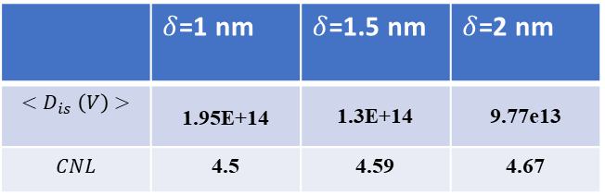
Procedure of Simulation
Simulation using SDEVICE
  Pinning parameters used in Sentaurus TCAD
    In Sentaurus TCAD, the pinning effect at the Schottky contacts is enabled by specifying pinning in the electrode section and model used
      { Name = "CathodeR" Voltage = 0.0 Material=Aluminum Schottky(Pinning(Model="Sze")) Resistance=1E2 }
    The pinning parameters are added in the Schottky subsection of the electrode section of the sdevice parameter file
      Electrode = "CathodeR" {
      Schottky {
      ###Fermi pinnning params
      Pinning_d =@dint_thick@
      Pinning_CNL =@CNL@
      Pinning_Nint =@Nint@
      }
      }
 | $δ$=1 nm | $δ$=1.5 nm | $δ$=2 nm
$${<D}_{is}\left(V\right)>$$ | 1.95E+14 | 1.3E+14 | 9.77e13
$$CNL$$ | 4.5 | 4.59 | 4.67

Slide 21
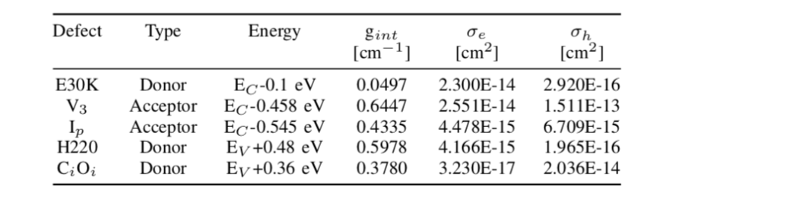

Procedure of Simulation
Simulation using SDEVICE
  Radiation model
    Hamburg Penta Trap Model (HPTM)
      Trap concentration of defects
        $N=g_{int}∙Φ_{neq}$
        A factor 1.66 has been applied to $g_{int}$ to account for Neutron irradiation

Slide 22
Comparison between Measurement and Simulation
IV simulation
  Non-irradiated
    𝛿 = 1.0nm, 1.5nm, 2.0nm
    No breakdown below -400V
    𝛿 should be between 1.5 and 2.0 nm

Slide 23
Comparison between Measurement and Simulation
IV simulation
  Non-irradiated
    𝛿 = 1.75nm
    More consistent with the measurements
      Use this value to do more simulations

Slide 24
Comparison between Measurement and Simulation
IV simulation
  Neutron irradiated - 10¹² and 10¹⁵ [1MeV n_{eq}/cm²]
    𝛿 = 1.75nm
    Current compliance in simulation
      1×10⁻⁵A
    Relatively consistent with the measurements

Slide 25
Summary
Summary
  P-type epitaxial Schottky diodes simulated with TCAD
  The thickness of the native interface oxide layer is around 1.75nm
  Simulations of IV relatively consistent with the measurements
Next
  Simulation optimization
  More simulations should be done
    Other Neutron fluence
    CV and CCE
Thanks!

Slide 26
BACKUP

Slide 27
FWD IV – GR Floating

Slide 28
REV IV – GR Floating

Slide 29
REV IV – GR Grounded

Slide 30
REV IV – GR at the Same Potential as Cathode

Slide 31
CV – GR Floating
Plot of each diode looks similar
Just diodes #1 shown here

