Slide 1



Pulsed and continuous neutron beams at the CNA HISPANOS facility
Carlos GUERRERO
Universidad de Sevilla, 41012 Seville, Spain
Centro Nacional de Aceleradores (CNA), 41092 Seville, Spain
41st RD50 Workshop on Radiation hard semiconductor devices for very high luminosity colliders

Slide 2
Some general considerations

Slide 3
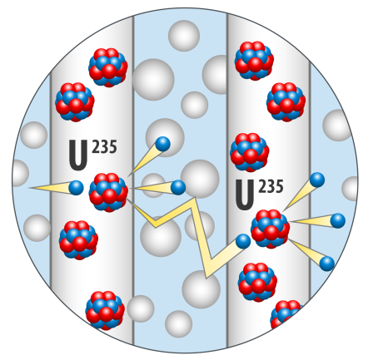
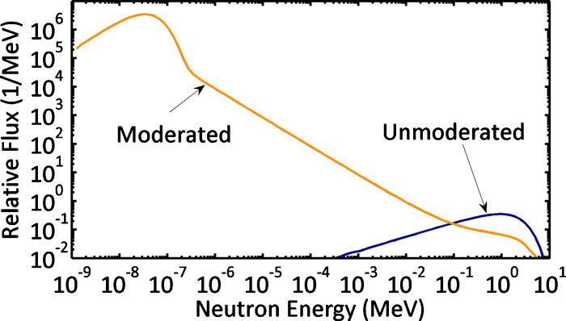
Neutron moderation process
Continuous neutron scattering end up with the neutrons in thermal equilibrium with the medium:
MB distrib. with characteristic kT

Slide 4
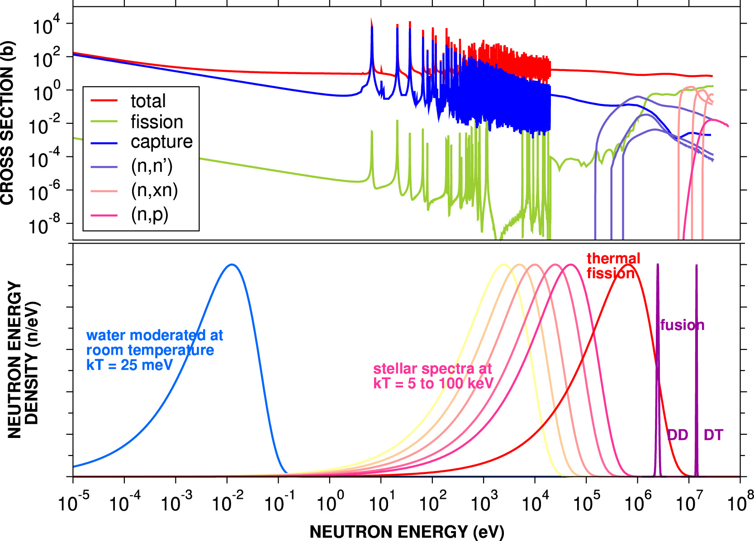
Neutron energy ranges
Colonna et al., PPNP 2018

Slide 5
Continuous vs. pulsed beams: time-of-flight
Continuous: Neutrons of all energies “together”:
=> integral effects (not a problem if spectrum adequate)
Examples:
- Irradiation (thermal, atmospheric, etc.)
- Production of radioisotopes
- Activation for a given spectrum
Pulsed: allows for time-of-flight
  => time of arrival provides neutron kinetic energy
  => differential experiments => X(E_{n})
neutron time-of-flight
experiment
Time-of-Flight to E_{n} relation (non-rel.):
=> E_{n} resolution increases with L
neutron
start
neutron
stop
time

Slide 6
Neutron production

Slide 7
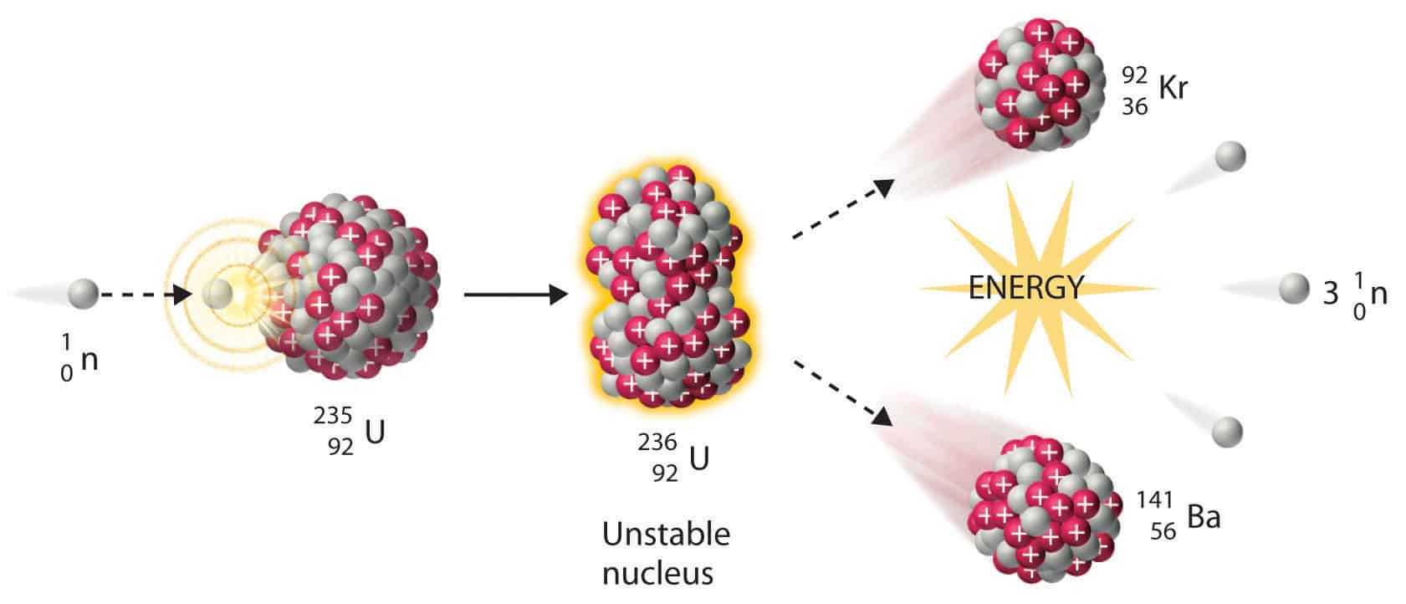
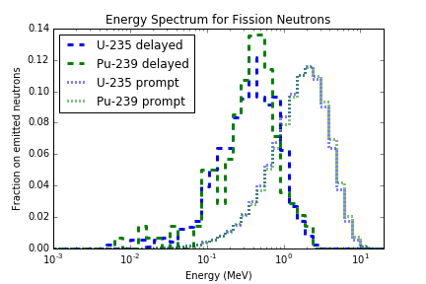
Neutrons produced by fission

Slide 8
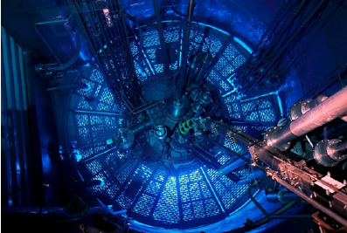

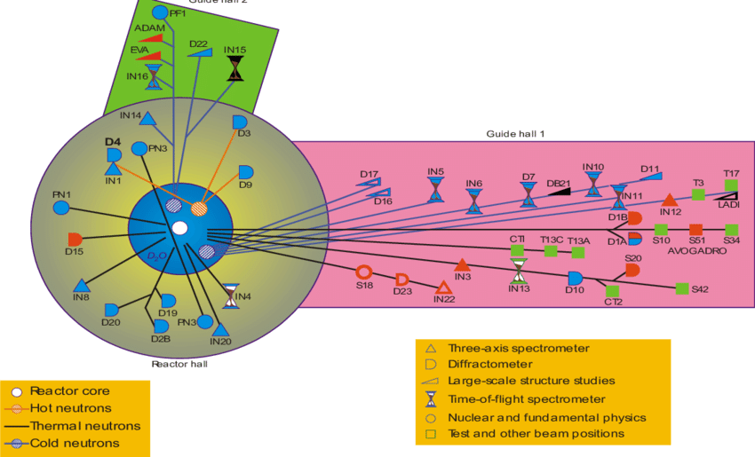
ILL (France): 10¹⁵ n/cm²/s @core (~meV)

Slide 9
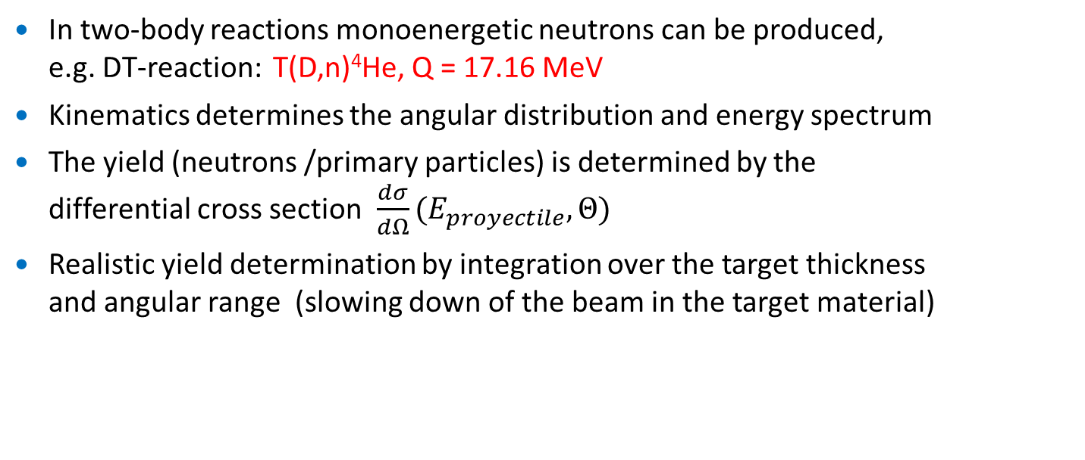
Neutron producing nuclear reactions (I)
In two-body reactions monoenergetic neutrons can be produced,
e.g. DT-reaction: T(D,n)⁴He, Q = 17.16 MeV
Kinematics determines the angular distribution and energy spectrum
The yield (neutrons /primary particles) is determined by the
differential cross section $\frac{dσ}{dΩ}(E_{proyectile},Θ)$
Realistic yield determination by integration over the target thickness
and angular range (slowing down of the beam in the target material)
$$n_{tar}$$
$${dN}_{n}$$
$$Θ$$
$$N_{p}$$

Slide 10
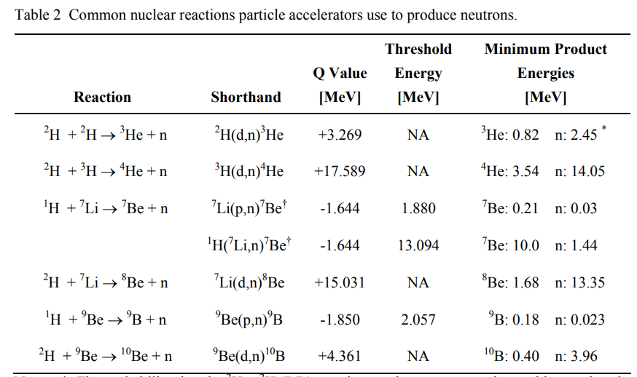
Neutron producing nuclear reactions (II)

Slide 11
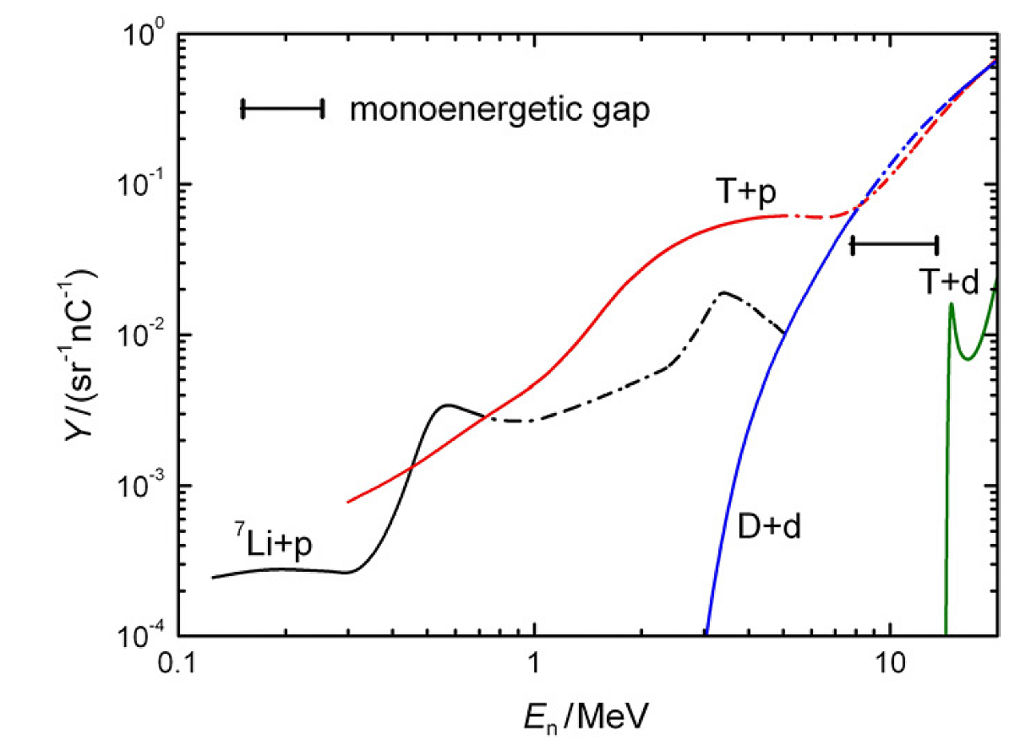
Monoenergetic (& quasi) neutron beams
(7.7 – 13.2 MeV)
dashed lines: quasimonoenergetic range
indicated, due to breakup T(p,n), D(d,n)
⁷Li(p,n)⁷Be*
Reaction | ⁷Be* Exc. Energy (MeV) | Q-value (MeV) | Threshold (MeV)
⁷Li(p,n)⁷Be | 0 | -1.644 | 1.881 forward 1.920 backward
⁷Li(p,n)⁷Be* | 0.429 | -2.073 | 2.371 forward 2.421 backward
⁷Li(p,n³He)⁴He | break-up | -3.229 | 3.692
⁷Li(p,n)⁷Be** | 4.57 | -6.214 | 7.110 forward 7.260 backward

Slide 12
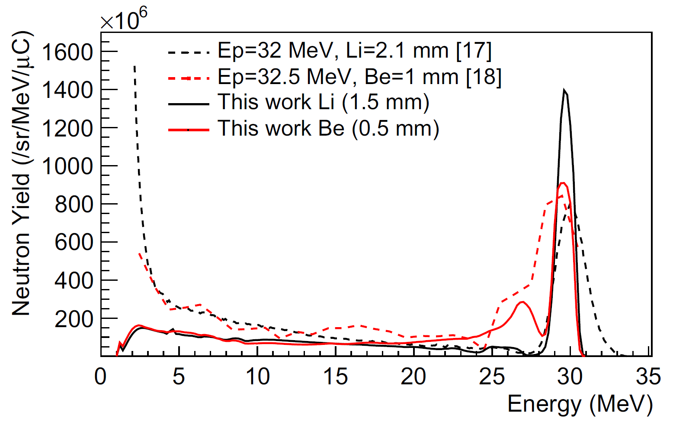
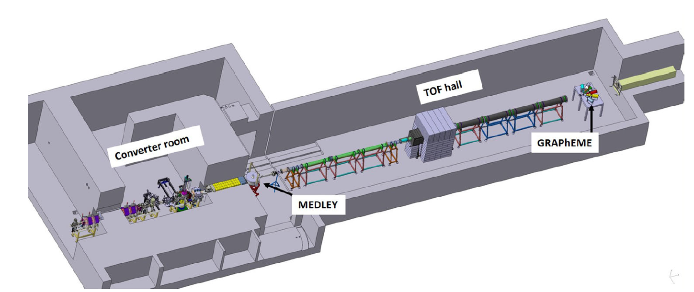
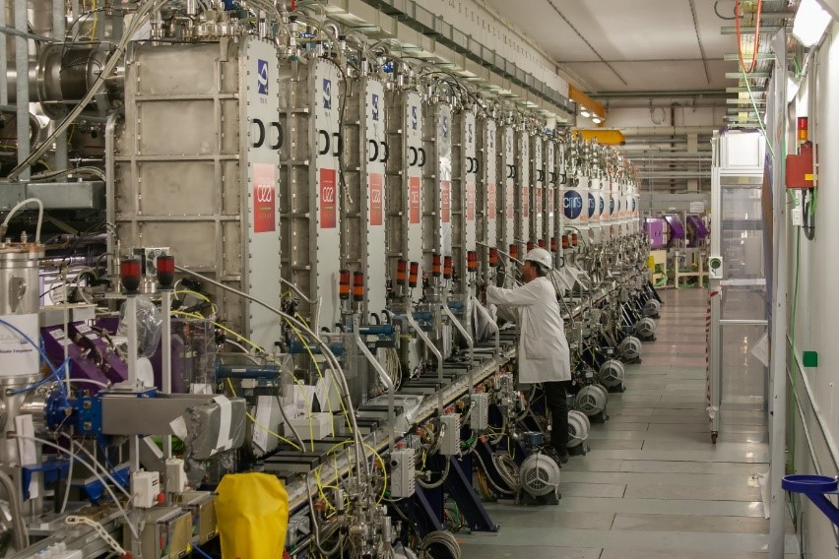
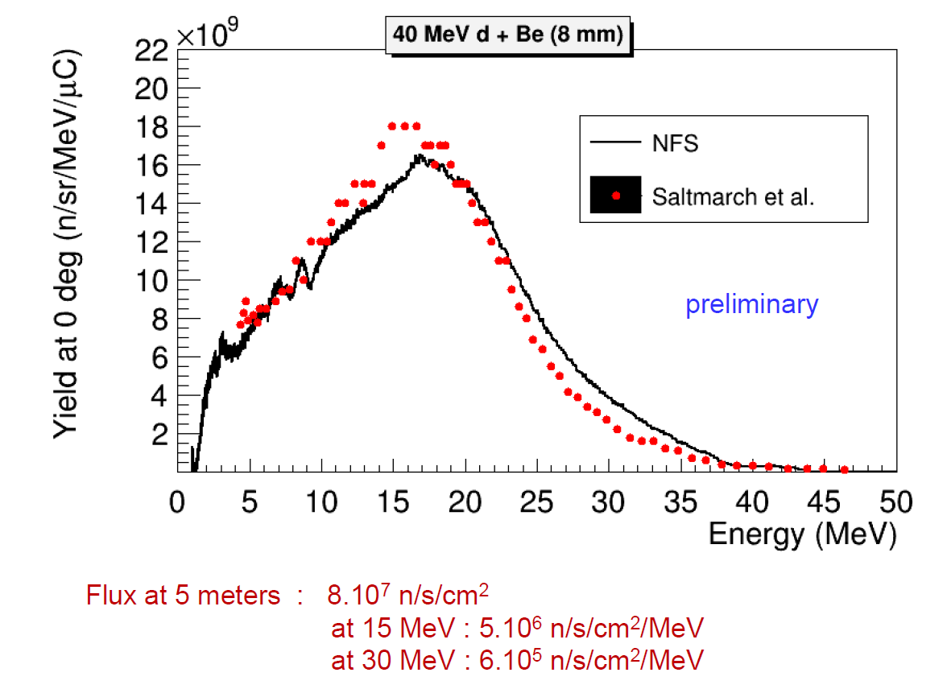

Nuclear reactions with high energy ions
GANIL’s SPIRAL-2, a Superconducting Linear Accelerator:
40 MeV deuteron and 33 MeV protons
Beam current 5 mA, i.e. rotating target
Flight path 5 to 10 meters
Frequency=0.25-1 MHz
Flight path: 5 – 30 m
Energy range: 0.1- 40 MeV
Low γ-flash background
Low instantaneous flux
High repetition rates

Slide 13
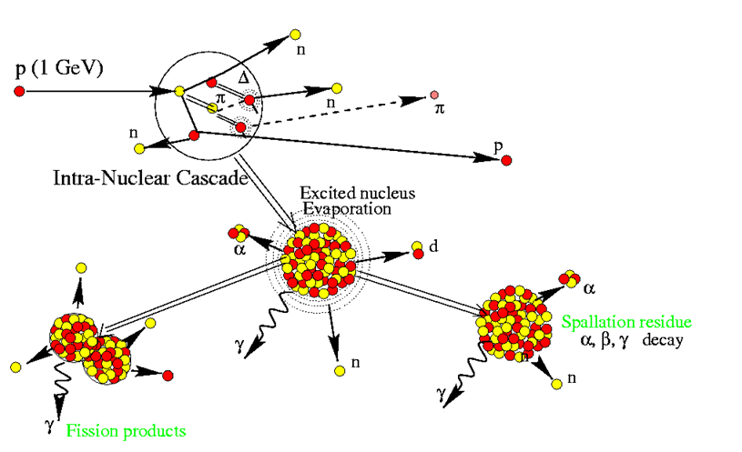
Neutron production by spallation
Relativistic protons
impinging on heavy
target nuclei
Fast neutrons emitted
during collision
and afterwards from
excited residual nuclei
γ-flash from pion decay
Nucleon-Nucleus collisions at relativistic energies
T_{coll} < 10⁻²²s : Collisions of the projectile nucleon with nucleons in the target (Intranuclear Cascade, emission of fast particles π,n,p,…)
T_{equil}> 10⁻²¹s – 10⁻¹⁶s Reorganisation of the residual nuclei, thermalization,
particle evaporation (n,p,d,α,…), gamma ray emission

Slide 14
n_TOF at CERN

Slide 15
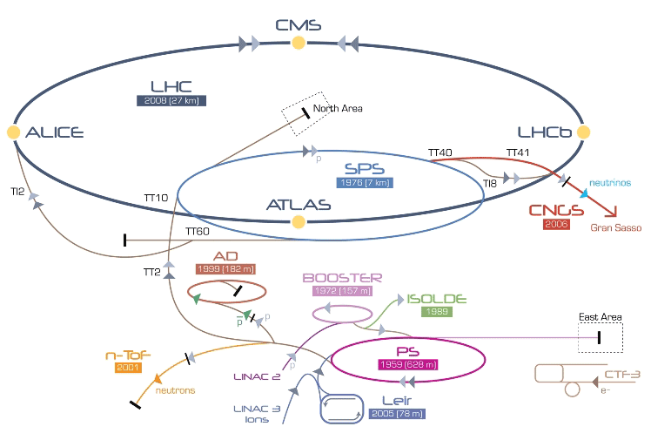
The n_TOF facility at CERN (I)

Slide 16
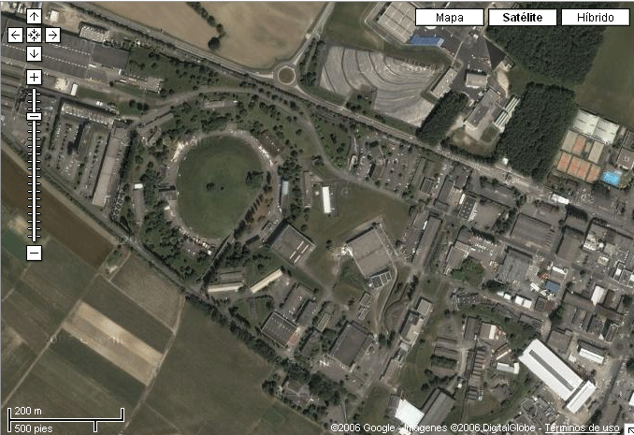
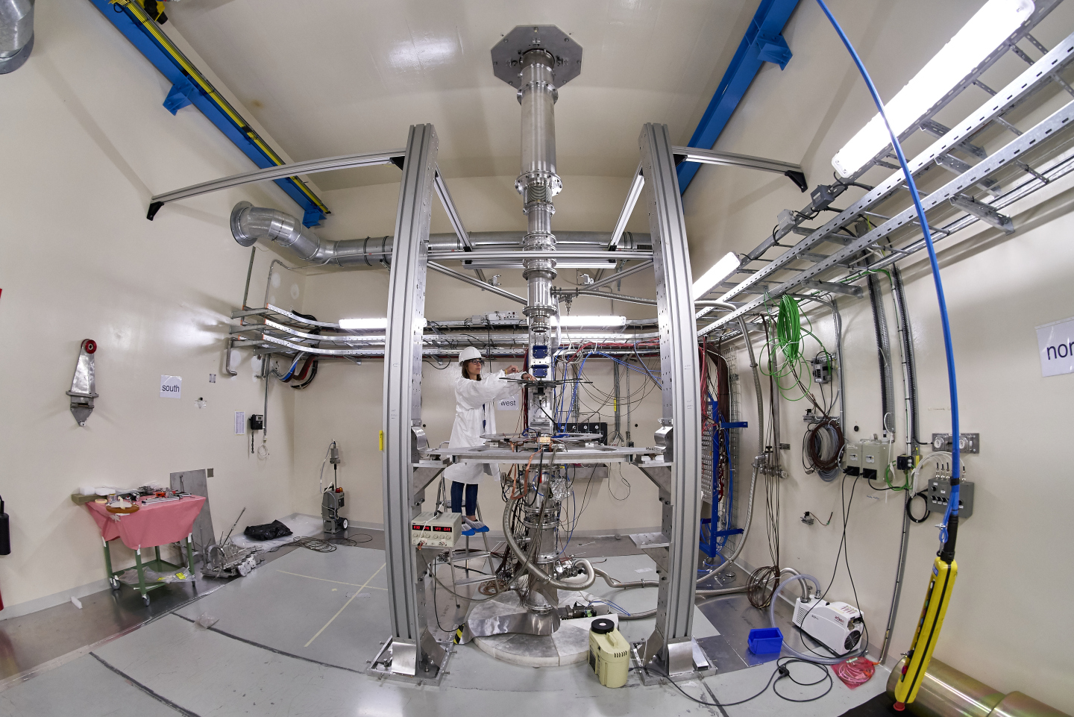

The n_TOF Facility at CERN (II)
n_TOF-EAR1 200 meters
n_TOF-NEAR
3 meters
n_TOF-EAR2
20 meters
Booster
1.4 GeV
Pb Spallation Target
Proton Beam
20 GeV/c
7x10¹² ppp
PS 20 GeV
Neutron Beam
10º prod. angle
Linac
50 MeV

Slide 17
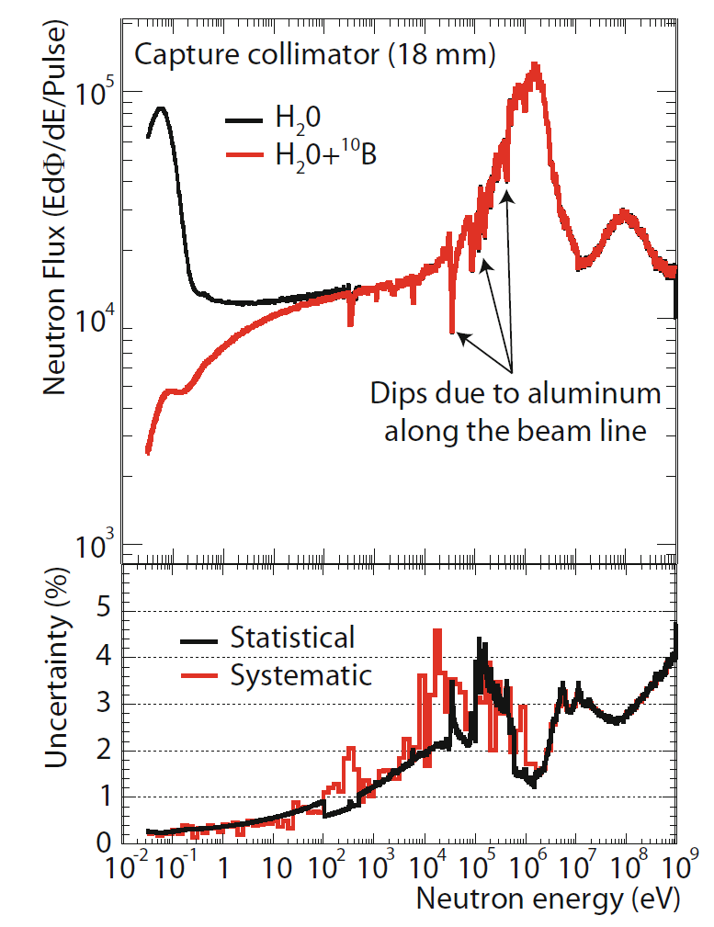
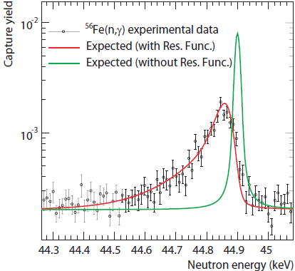
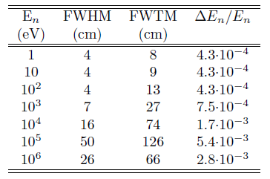
The n_TOF Facility at CERN (III)
MeV to GeV range
Three pulsed beams available:
- EAR1 (185 m): ~ 10⁶ -10⁷ neutrons/pulse
- EAR2 (20 m): ~10⁸ neutrons/pulse
- NEAR (3 m): expected 10⁹ neutrons/pulse
ENERGY RESOLUTION

Slide 18
HISPANOS at CNA

Slide 19
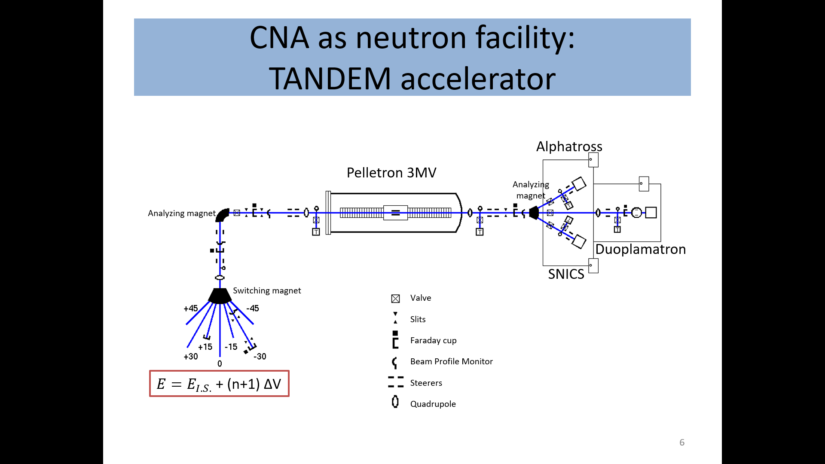
HiSPANoS at the 3 MV Tandem Accelerator
HiSPANoS is the first Accelerator-based neutron source in Spain and it is installed at the the 3 MV Tandem Accelerator.
Continuous & Pulsed

Slide 20
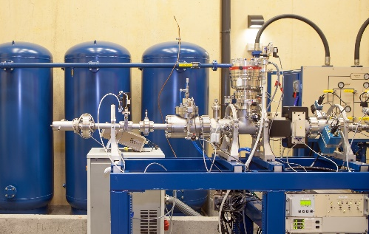
HiSPANoS at the 3 MV Tandem Accelerator
HiSPANoS is the first Accelerator-based neutron source in Spain and it is installed at the the 3 MV Tandem Accelerator.
Continuous & Pulsed
Neutron Time-Of-Flight line
Pick up
Wien Filter
Buncher
target
Chopper

Slide 21
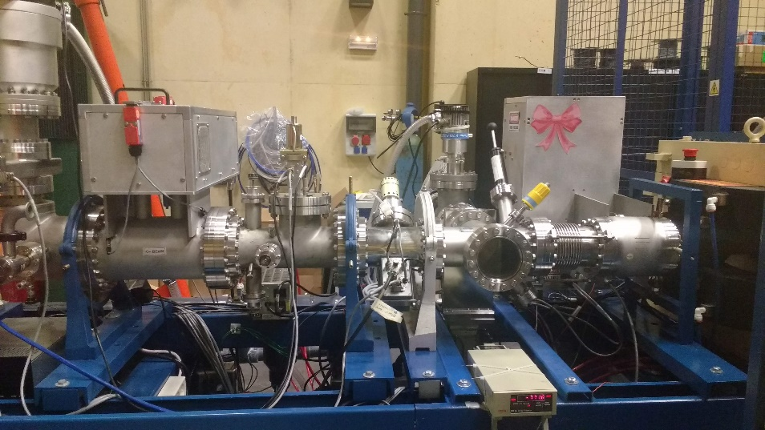
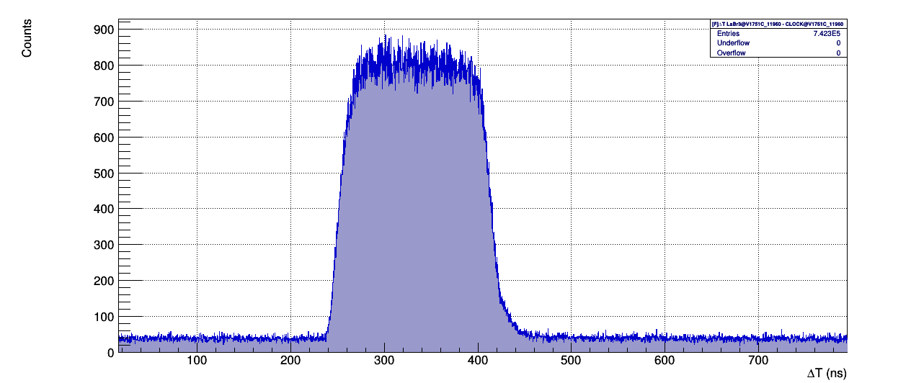
Pulsing system: p,d & α
Buncher
Chopper
Chopper:
Variable width: 40 ns-250 ns
RR: 31.25 kHz-2MHz
Switcher Voltage: 650 V
Beam
Pulse width verification
250 kHz
250 ns
4µs (250 kHz)
RR verification
B. Fernández XIII CPAN Days 21-23 Marzo 2022

Slide 22
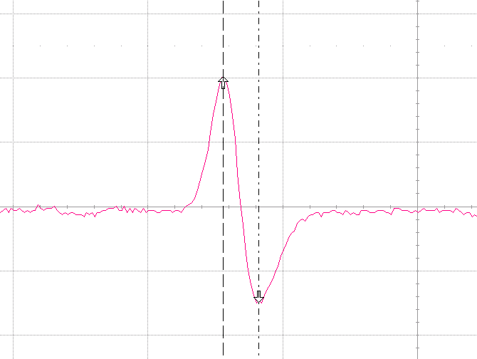
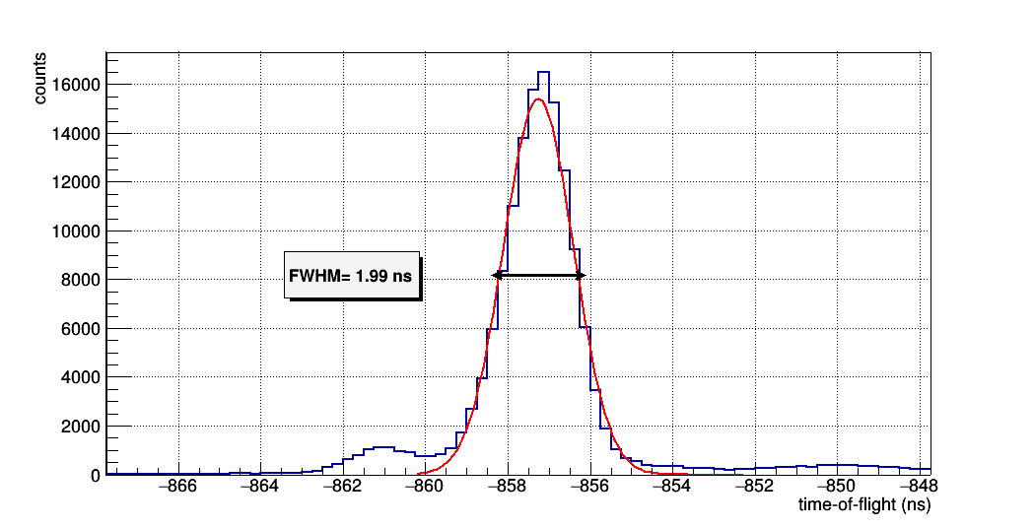
Pulsing system: p,d & α
Buncher
Chopper
Buncher:
Needs tuning (delay & power) for synchronization
Beam
1.5 ns
g-flash
Capacitive pickup signal
B. Fernández XIII CPAN Days 21-23 Marzo 2022

Slide 23
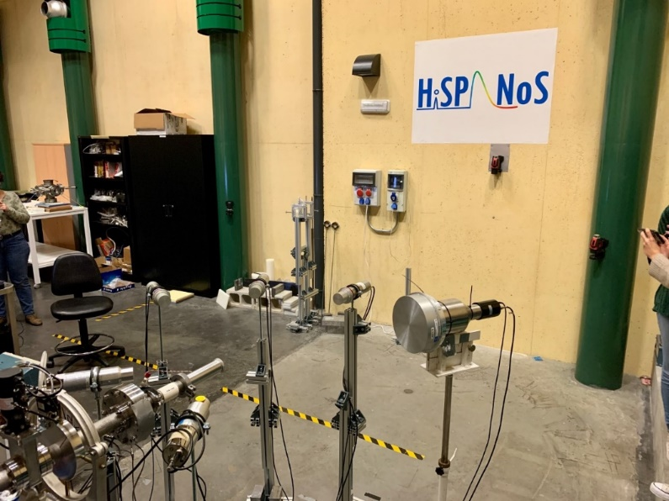
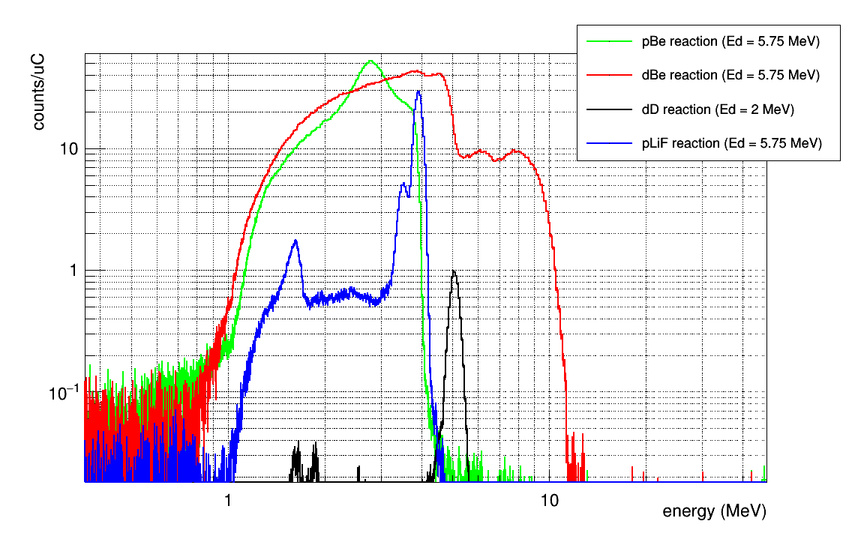
Neutron production targets/mechanism
Target | Geometry | Reaction [Q value] | E _{beam} (MeV) | Neutron spectra
Li (metallic) | Ø 10 mm Thickness < 1mm | ⁷Li(p,n) [-1.7 MeV] | E_{p}=1.912 | quasi-Maxwellian@kT=30keV Thermal by means of moderation
LiF (Evaporated on Cu) | Ø 30 mm Thickness: 16 µm
D:Ti >1.5 | Ø 30 mm D/Ti (500 µg/cm²) | D(d,n) [3.3 MeV] | E_{d}=0.5-6 | Quasi-monoenergetic between 3-9 MeV
Be | Square: 25 mm Thickness: 3 mm | ⁹Be(p,n) [-1.9 MeV] | E_{p}=2.1-6 | Continium from keV to E_{n}~E_{d}-2.1MeV
 |  | ⁹Be(d,n) [4.4 MeV] | E_{d}=0.5-6 | Fast between 4 and 10 MeV
HiSPANoS
EJ301 @30º
EJ301 @0º
monoenergetic
PickUp
100 cm
Be target

Slide 24
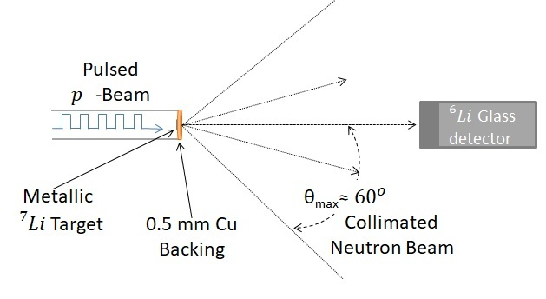
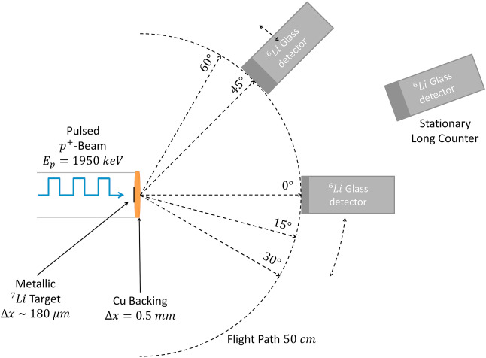
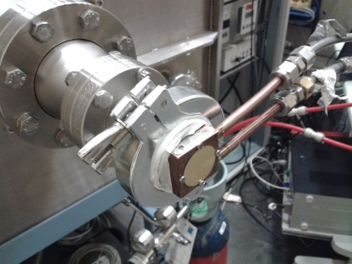
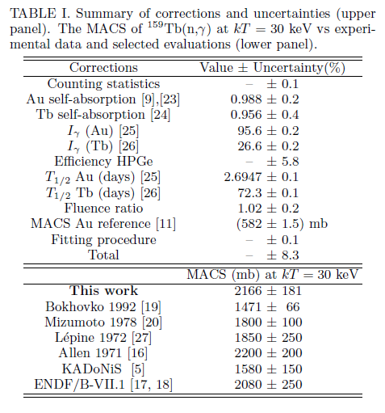
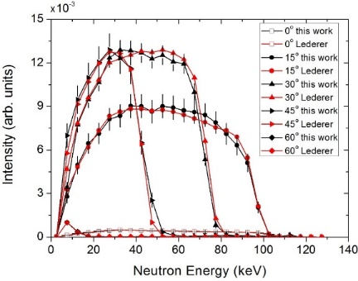
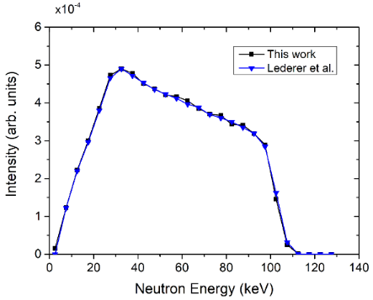
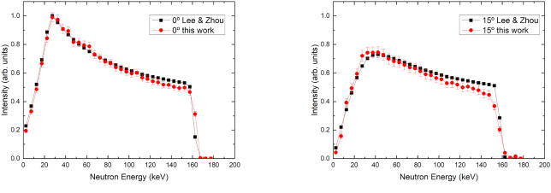
Neutron field and activation measurements for…
Astrophysics applications PULSED & CONTINUOUS
Medical Physics applications PULSED
⁷Li(p,n)⁷Be @1912 keV
⁷Li(p,n) ⁷Be@ 1950 keV for BNCT evaluation
10uA protons on a water cooled Li target

Slide 25
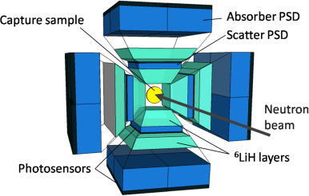
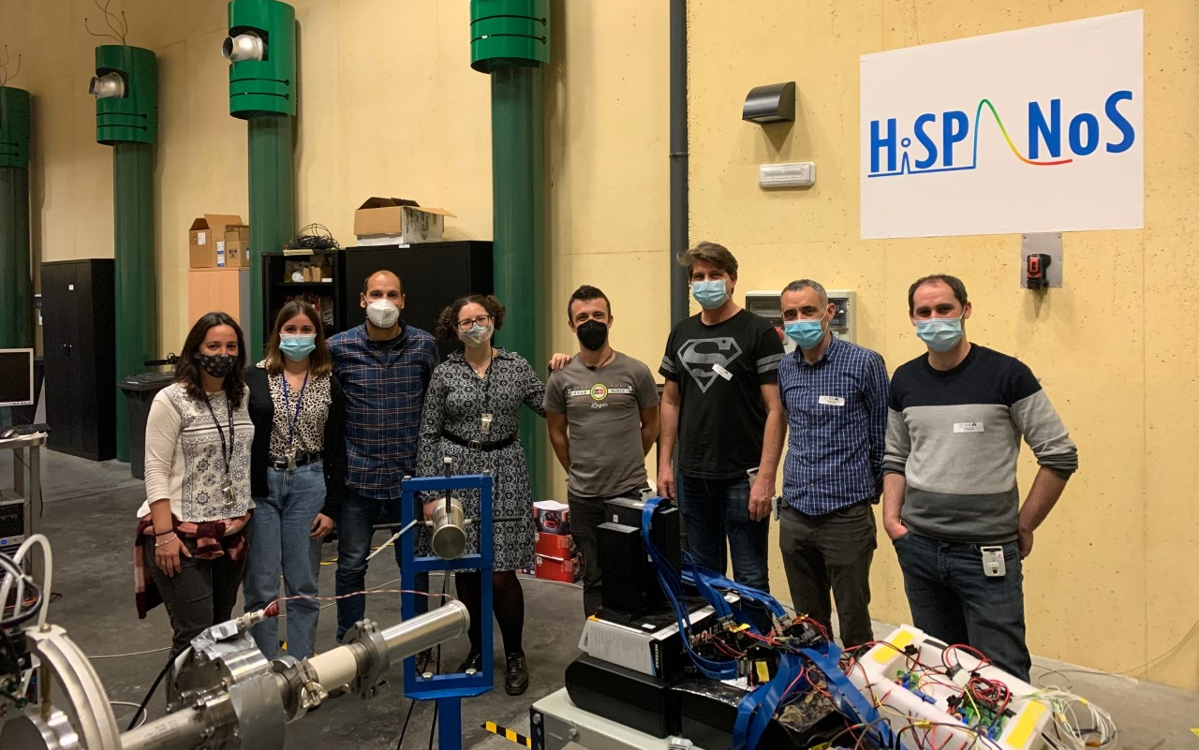
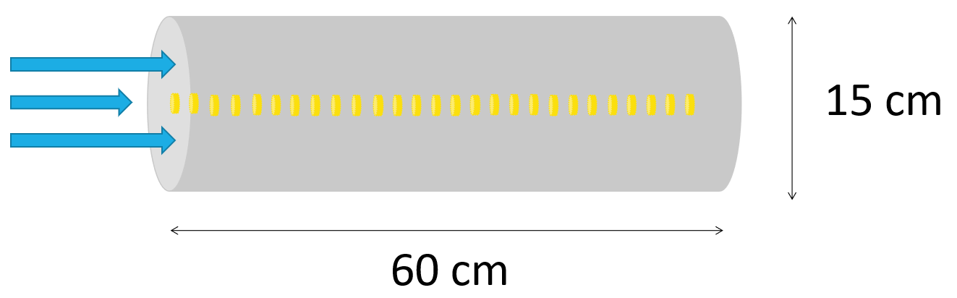
Detector characterization
Neutron sensitivity of i-TED for neutron capture at CERN n_TOF (with CSIC-IFIC) PULSED
Characterization of C7LYC for fast (2,5 MeV) neutron diagnostic in fusion (with INFN-MIB) PULSED
+ CERN n_TOF: s(n,g) measurements by ToF
+ Scattered neutrons: main background
Carachterization of detector response to epitermal neutrons => ⁷Li(p,n) + time-of-flight
  @HISPANOS: Be(d,n) + time-of-flight
  H2020-ARIEL TA => January 2022
Development of the ANTILOPE detector
(with CIEMAT & n_TOF) CONTINUOUS

Slide 26
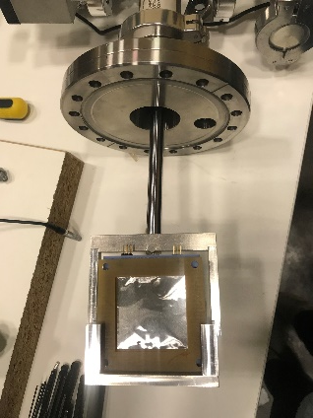
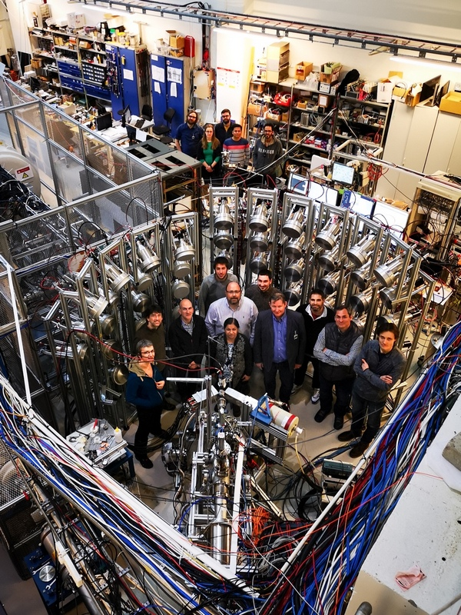
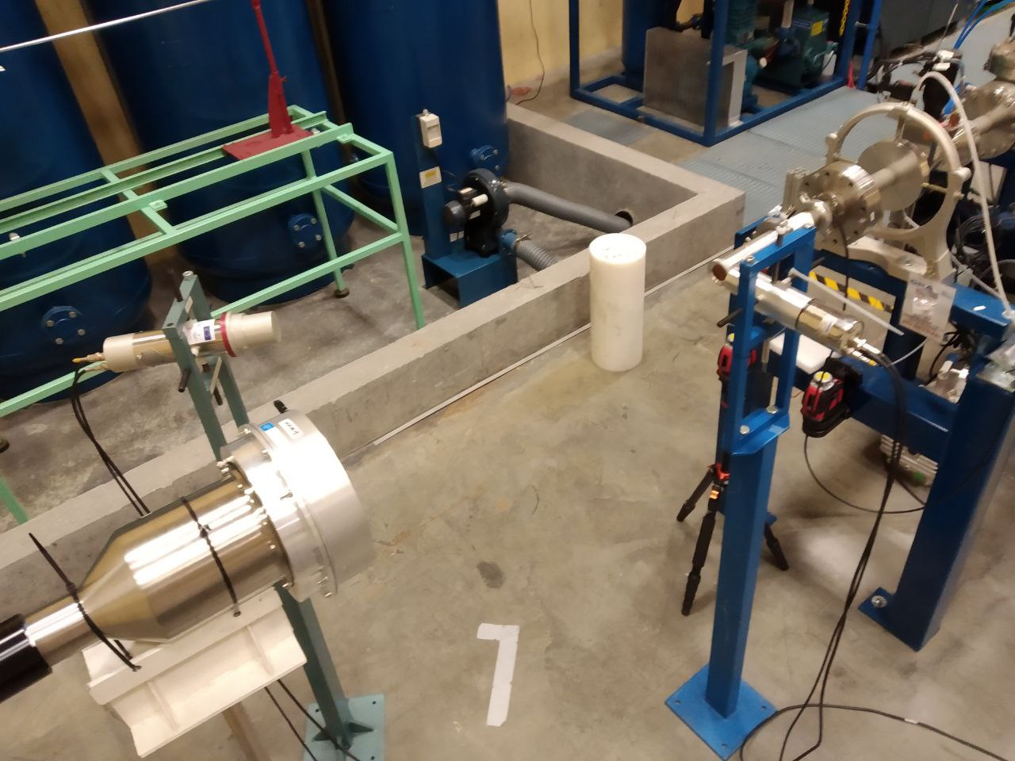
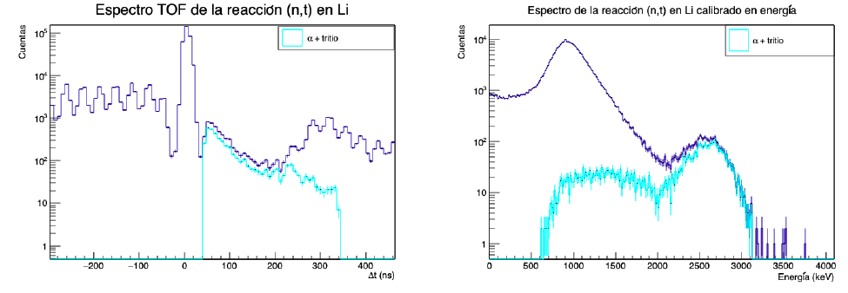
Cross sections measurements
Neutron production from (a,n) reactions for dark matter searches and astrophysics PULSED
(The MANY Collaboration: CNA, CMAM, CIEMAT, UPC, IFIC, UPM)
Development of the capabilities to measure (n,cp) reactions by ToF PULSED
Measurements at CNA (cont.& pulsed) and CMAM (cont. only) with the detectors:
miniBELEN
MONSTER
⁶Li(n,a)³H
a
³H
MONSTER module@HISPANOS
MONSTER@JYFL

Slide 27
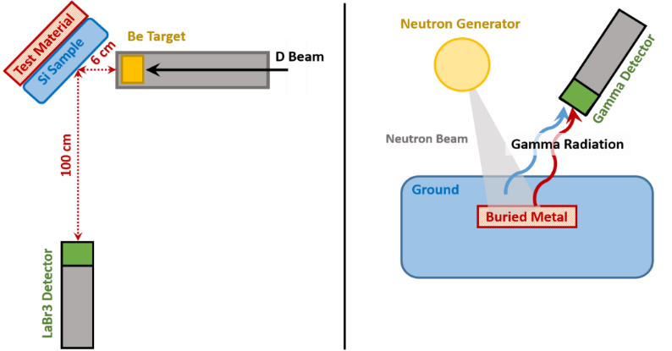
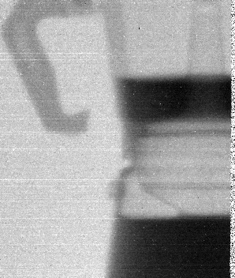
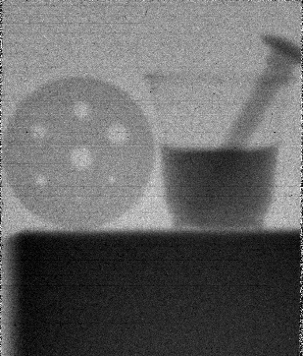
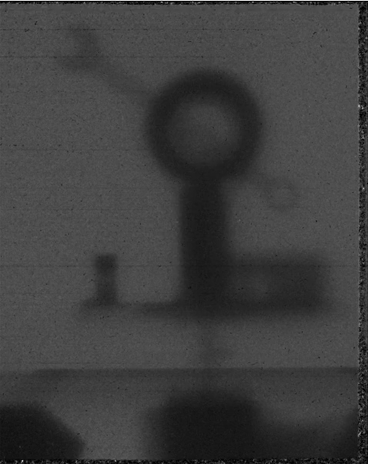
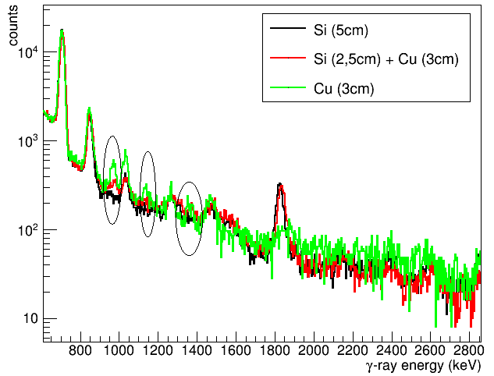
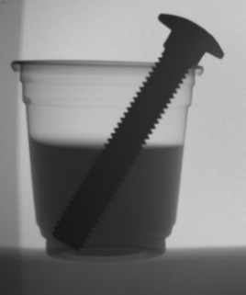
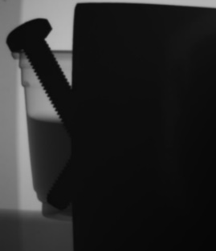

Imaging and material inspection
Identification of elements in large samples by PGA (with UPV & IDOM) CONTINUOUS
Neutron, gammas and x-ray imaging
CONTINUOUS
Neutron Imaging
X-ray imaging
Gammagraphy (⁶⁰Co irradiator)
B. Fernández XIII CPAN Days 21-23 Marzo 2022

Slide 28






Fast neutron irradiations & dosimetry
Electronic damage (soft error rate) by irradiation with protons and fast (MeV) neutrons CONTINUOUS
Buds irradiation with fast (MeV) neutrons
(Colab. ANECOOP & RadLab@CNA) CONTINUOUS
Dosimetric mapping & dosimeter intercomp. with fast (MeV) neutrons (with UPM) CONTINUOUS
  @100 cm & 0º:
  + LUPIN (UPM): 77(1) mSv/h/µA
  + BIOREM (CNA): 88(1) mSv/h/µA
13% agreement
B. Fernández XIII CPAN Days 21-23 Marzo 2022

Slide 29
HISPANOS for RD50?
A few examples found:
Kaska et al., Study on 150 um thick n- and p-type epitaxial silicon sensors irradiated with 24 GeV/c protons and 1 MeV neutrons, NIM-A 612 (2010)
Pacifico et al., Characterization of proton and neutron irradiated low resistivity p-on-n magnetic Czochralski ministrip sensors and diodes, NIM-A 658 (2011)
Kramberger et al, Modeling of electric field in silicon micro-strip detectors irradiated with neutrons and pions, JINS 9 (2014)
Gurimskaya et al., Radiation damage in p-type EPI silicon pad diodes irradiated with protons and neutrons, NIM-A 958 (2020)
Reactor neutrons (meV) from JSI in Slovenia, then normalized to 1 MeV neutron-equivalent values
Reminder: According to https://rd50.web.cern.ch/niel/, equivalent “Displacement Damage in Silicon” compared to 1 MeV neutrons is 0.001 for thermal neutrons and 2 for 5 MeV neutrons.
Fasts neutrons @HISPANOS => @ 10 cm with 10 uA
p+Li => 7x10⁶ n/cm/s
p+Be => 5x10⁶ n/cm/s
d+Be => 10⁷ n/cm/s
Transnational Access via H2020-EuroLABS & H2020-ARIEL
(see Palomo’s talk tomorrow)

Slide 30
THANK YOU

