Slide 2
High energy
muon acceleration chain
– issues and questions –
F. Batsch, H. Damerau, I. Karpov
22/02/22

Slide 3
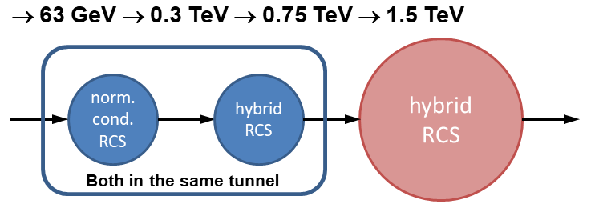
High-energy acceleration parameters
Input/output energy of RCS chain: 60 GeV → 1.5 TeV → 5 TeV
2 or 3 acceleration stages to 1.5 TeV? + 1 stage to 5 TeV
Combination of normal conducting and two hybrid RCS?
  First two RCS in the same tunnel?
  Major design constraints due to that choices?
  Options: HTS fast ramping magnets? What is ramp rate of cycling RCS magnets?
  Find transition energy between normal conducting and hybrid RCS!
How to optimize intermediate energies?
  Minimize losses through entire RCS chain
Make educated-guess assumptions for unknown parameters, e.g., feasibility of huge ramp rates?
  Shape of magnetic ramp?
  Power consumption?

Slide 4
Potential show-stoppers
Muon decay: could it exclude superconducting RF cavities?
→ Question for WP RF!
Are the huge ramp rates realistic?
→ Power converters? Expensive!
How strong is the induced voltage from the short-range wakefields? Possible cures?
→ Short range wake of TESLA cavities (K. Bane et al.)
Challenges of first hybrid RCS being built?

Slide 5
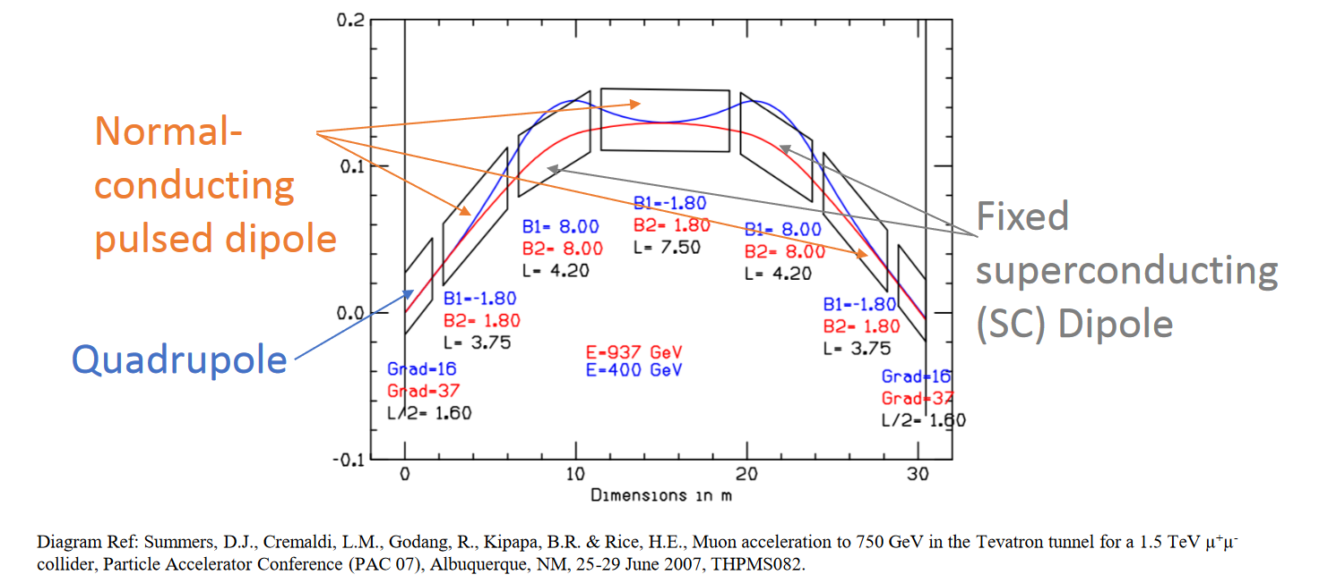
Transverse beam dynamics aspects
Impact of energy dependent trajectory?
  Required aperture
  Orbit length change due to hybrid RCS design?
Cell length is very important!
  Constraints on momentum compaction?
Separate vacuum chambers for μ⁺/ μ⁻?
From: https://indico.cern.ch/event/867138/contributions/3654250/attachments/2003892/3346162/RCS_MC_JAI_Presentation_FINAL.pdf

Slide 6
Longitudinal aspects and RF system design
Number of RF sections/stations?
  Just 1-2 or a large number distributed around the ring?
  Large synchrotron tune or small phase slip factor, η?
  Maximum energy difference of counter-rotating beams, before/after RF section?
  Consequences on energy gain per turn and synchrotron tune
Bunch rotation required to achieve short bunches?
Possible reuse of RF section(s) for at least two RCS stages?
Uncontrolled (longitudinal, and transverse) emittance blow-up during transfer between RCS. If unavoidable, by how much smaller emittance should be at the start of acceleration (smaller emittance → stronger collective effects)

Slide 7
Simulation techniques
Coordination of longitudinal and transverse simulations?
  BLonD code to explore longitudinal plane, then 6D-tracking?
Which assumptions built into conventional simulation codes may not be correct?
  Multiple RF stations per turn combined with intensity effects
  Very large energy gain per turn
  Impact of kA/s ramp rate? Betatron acceleration?

Slide 8
Agenda
How to define goals and plans, e.g.
  Self-consistent parameter table
  What do we consider as basic machine design?

