Slide 1


Summer Student Lectures 2022
Particle Accelerators and Beam Dynamics
Part 1
by
Michaela Schaumann
DESY, Accelerators (M) Department, MPY, PETRA III Operations
29.06.2022

Slide 2
Outline
3 Lectures
L1: Accelerators
  → Why we need (different) accelerators?
L2*: Transverse Beam Dynamics
→ How to circulate particles?
L3*: Longitudinal Beam Dynamics & Colliders
→ How to build a particle collider?
*With focus on synchrotrons and linear beam dynamics.

Slide 3
Acknowledgement
These lectures are based on lectures given at
CERN Accelerator School (CAS)
CERN Summer Student Program
AXEL – lecture series on particle accelerators, given at CERN within the framework of the Technical Training Program
Mainly by
Bernhard Holzer
Verena Kain
Frank Tecker
Rende Steerenberg
Lectures or proceedings of the above series are freely available on the web.

Slide 4
Some more references .....
Accelerators for Pedestrians
Author: Simon Baird
Reference: CERN-AB-Note-2007-014 (Free from the Web)
The Physics of Particle Accelerators, an introduction
Author: Klaus Wille
Reference: ISBN 0-19-850549-3 (CERN Book shop)
Particle Accelerator Physics (3rd edition)
Author: Helmut Widemann
Reference: ISBN 978-3-540-49043-2 (CERN Book shop)
Accelerator Physics (3rd edition)
Author: S. Y. Lee
Reference: ISBN 978-981-4374-94-1 (CERN Book shop)

Slide 5
What are Particle Accelerators?
Please write your associations and key words into the chat.

Slide 6
Why do we need accelerators?

Slide 7
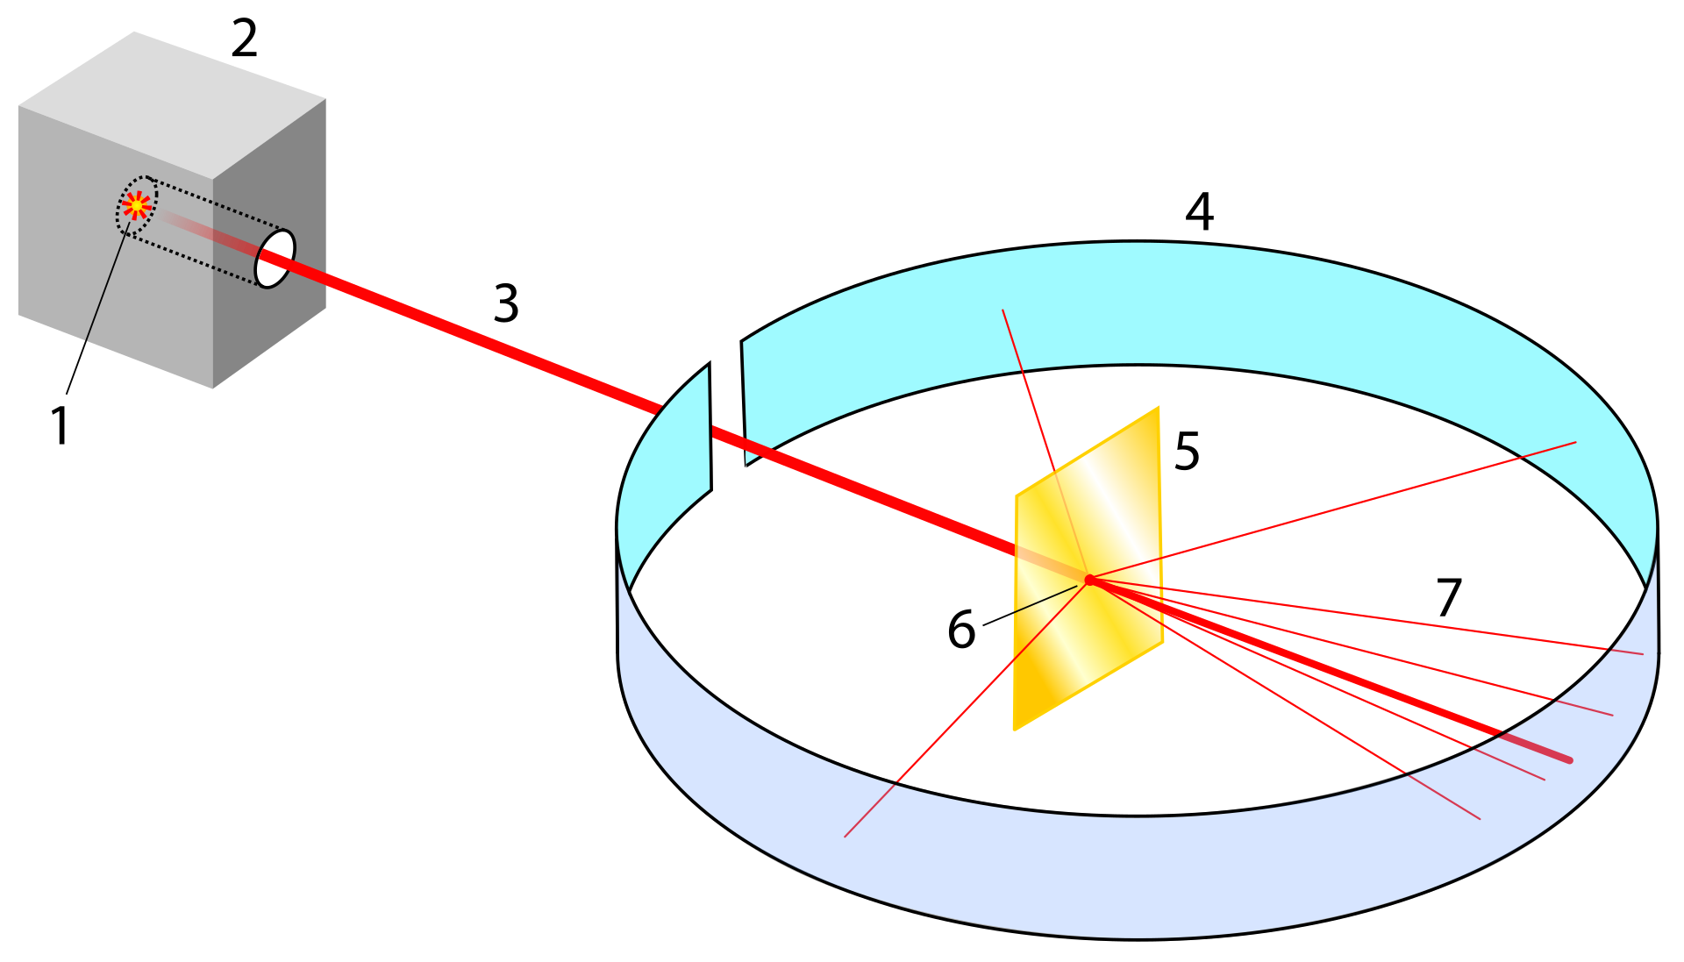
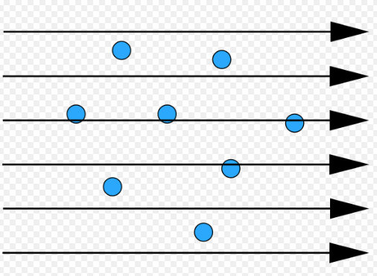
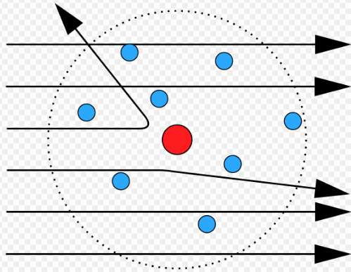
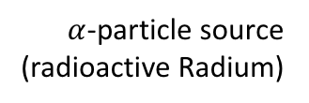

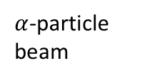
1st Particle Physics Experiment
1911
Rutherford Scattering
H. Geiger,
E. Marsden und
E. Rutherford
Fire alpha particles against a thin gold foil.
Observation of scattering behavior revealed entirely new understanding of the structure within atoms.
Atomic Model
Pb shielding & collimation
by Thomson
photographic screen
$α$-particle source (radioactive Radium)
$α$-particle beam
gold foil
by Rutherford
scattered particles
Source: Wikipedia
$α$-particle is identical to an
helium-4 nucleus (2 protons + 2 neutrons)
Source: Wikipedia (CC BY-SA 4.0)

Slide 8
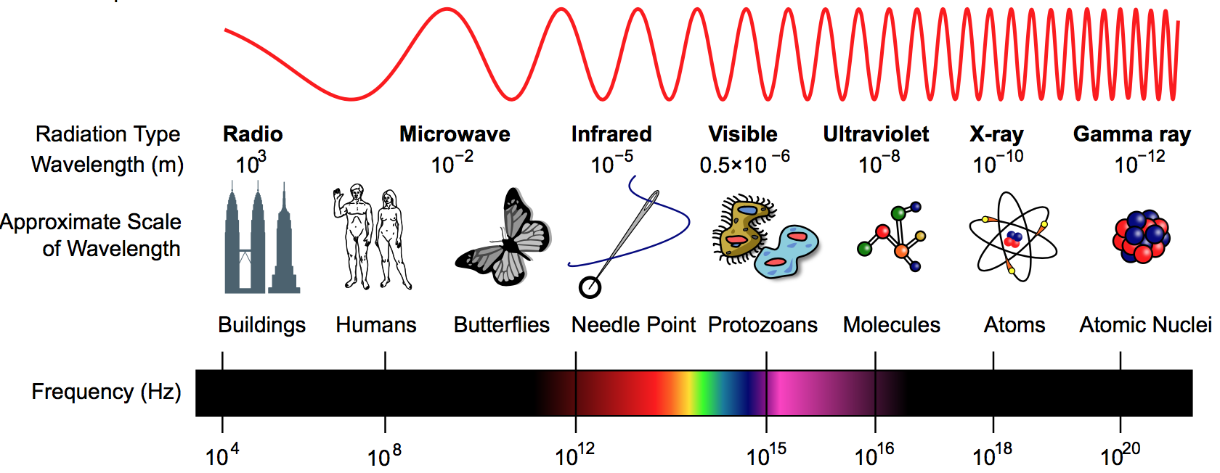
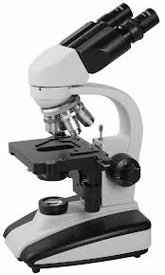
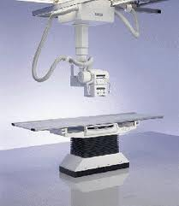
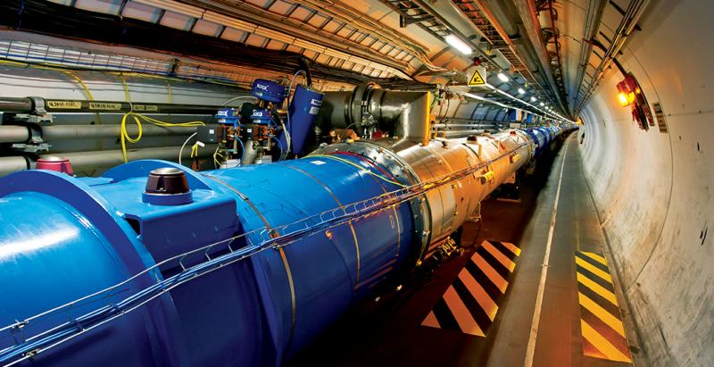
View into smaller dimensions
Study the inner structure of matter with scattering experiments.
The wavelength of the probe radiation needs to be smaller than the object to resolve.
Source: Wikipedia
(CC BY-SA 3.0)
λ =
h c
E
Particle accelerators
λ < 0.01 nm
Visible
λ = 400 ➔ 700 nm
X-ray
λ = 0.01 ➔ 10 nm

Slide 9
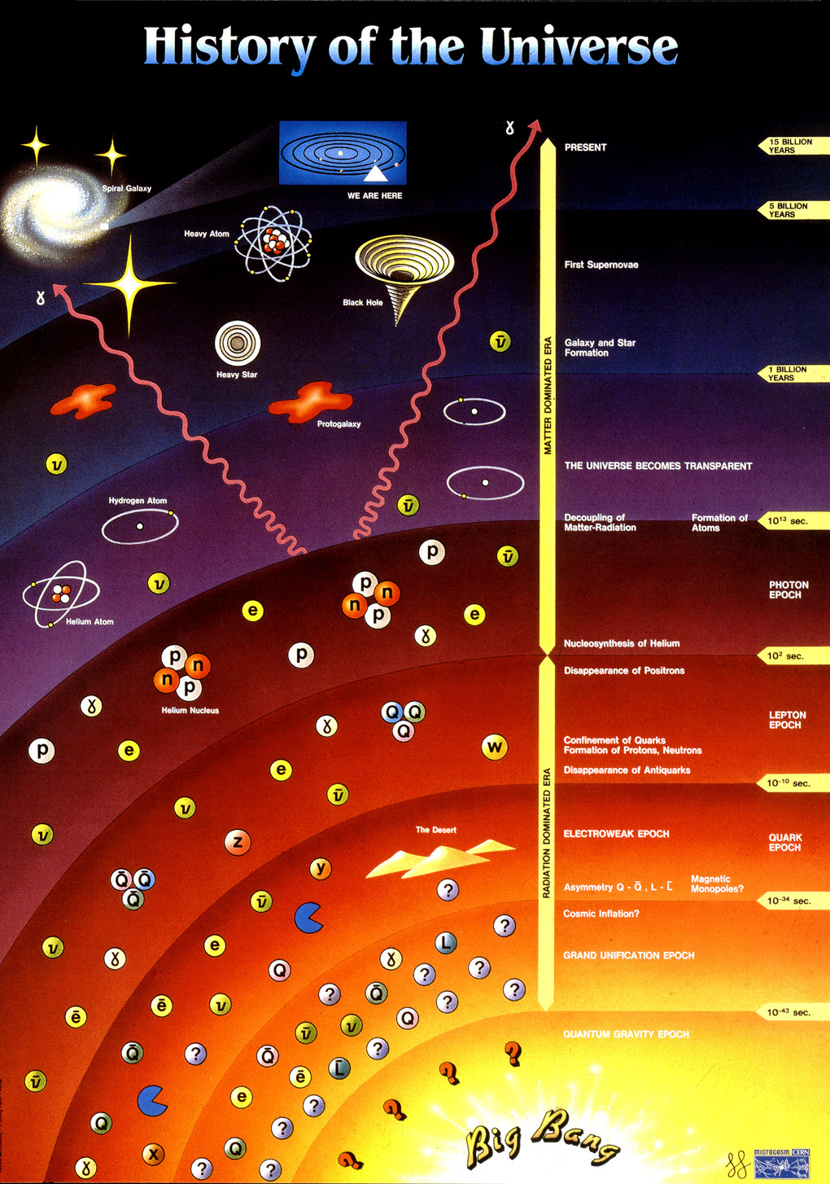
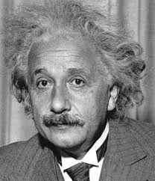
Production of new matter
E = m c²
Study of particles that do not exist in our natural environment, since they are too heavy or unstable.
Accelerators give energy to particles.
In particle collisions, this energy is transformed into matter that the detectors observe.
The higher the initial particle’s energy, the heavier new particles can be produced.

Slide 10
Where do we need accelerators?

Slide 11

Where are accelerators used?
Security
Airports & boarders
Nuclear security
Imaging
Energy
Destroying radioactive waste
Energy production
Nuclear fusion
Thorium fuel amplifier
Industry
Material studies and processing
Food sterilization
Ion implantation
World wide about >30’000 particle accelerators are in operation with a large variety of applications.
Health
Diagnostic and imaging
X-rays
Cancer therapy
Radioisotope production
Research (<1%)
Particle Physics
Storage rings & Colliders
Material science
Light sources
R&D
Sources:
A. Faus-Golfe, ‘The brave new world of accelerator application’, TUYPLS1, IPAC’19, Melbourne, Australia, 2019
APAE report, ‘Applications of particle accelerators in Europe’, http://apae.ific.uv.es/apae/
Dr. Suzie Sheehy, Applications of accelerators, CAS 2014, Prague

Slide 12
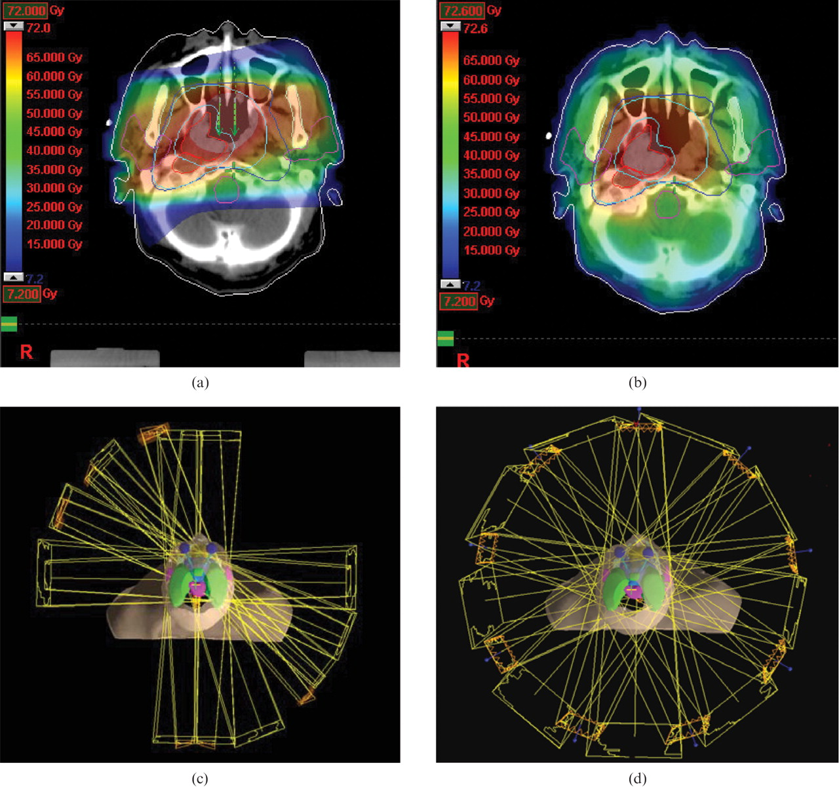
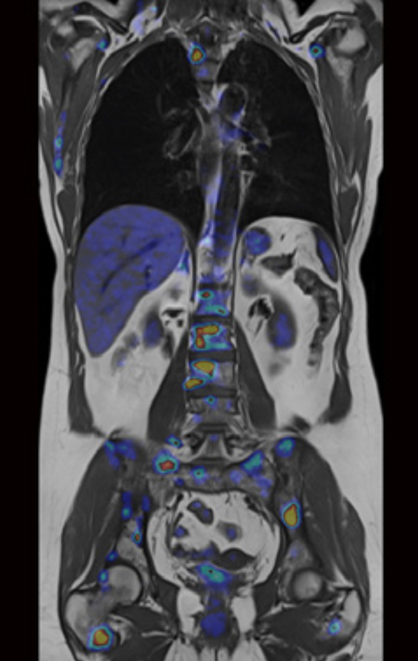
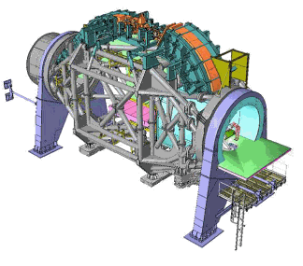
Applications - Health
Cancer therapy with photon, proton and ion beams
Hadrons
Photons
Dose
Photons
Ions
Bragg Peak
Reduced dose to healthy tissue with ion beam irradiation.
Radioisotope production
A combined PET/MRI image revealing cancer metastases
(credit: Siemens/TUM/LMU).
Gantry for beam transport and irradiation from different angles
Image sources:
APAE report, ‘Applications of particle accelerators in Europe’, http://apae.ific.uv.es/apae/
Dr. Suzie Sheehy, Applications of accelerators, CAS 2014, Prague

Slide 13
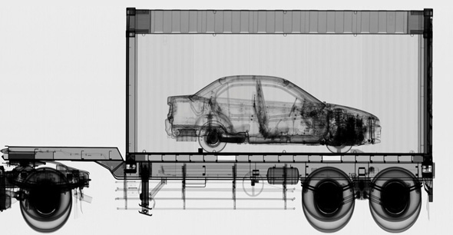
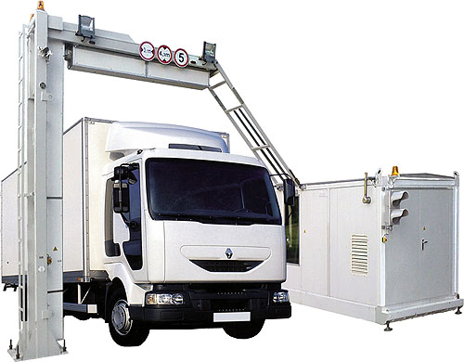
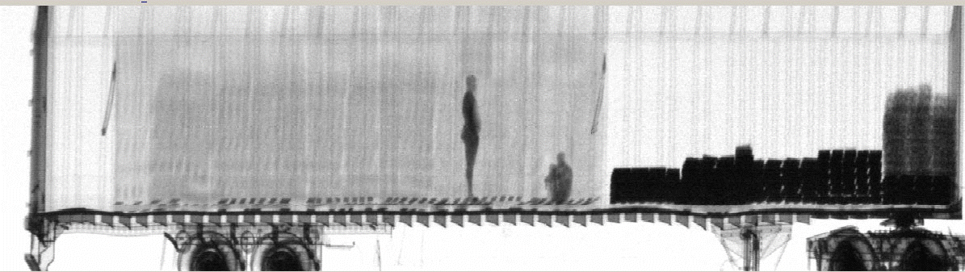
Application - Security
Airport & boarder control
Cargo containers scanned at ports and border crossings.
Accelerator-based sources of X-Rays can be far more penetrating (6MV) than Co-60 sources.
Container must be scanned in 30 seconds.
Image source: Varian medical systems
Image: dutch.euro
Slide of Dr. Suzie Sheehy, Applications of accelerators, CAS 2014, Prague

Slide 14
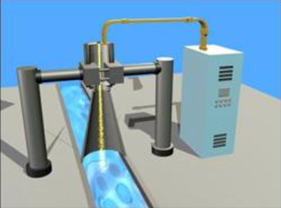
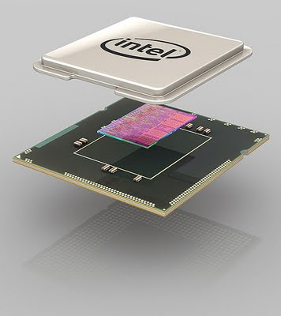
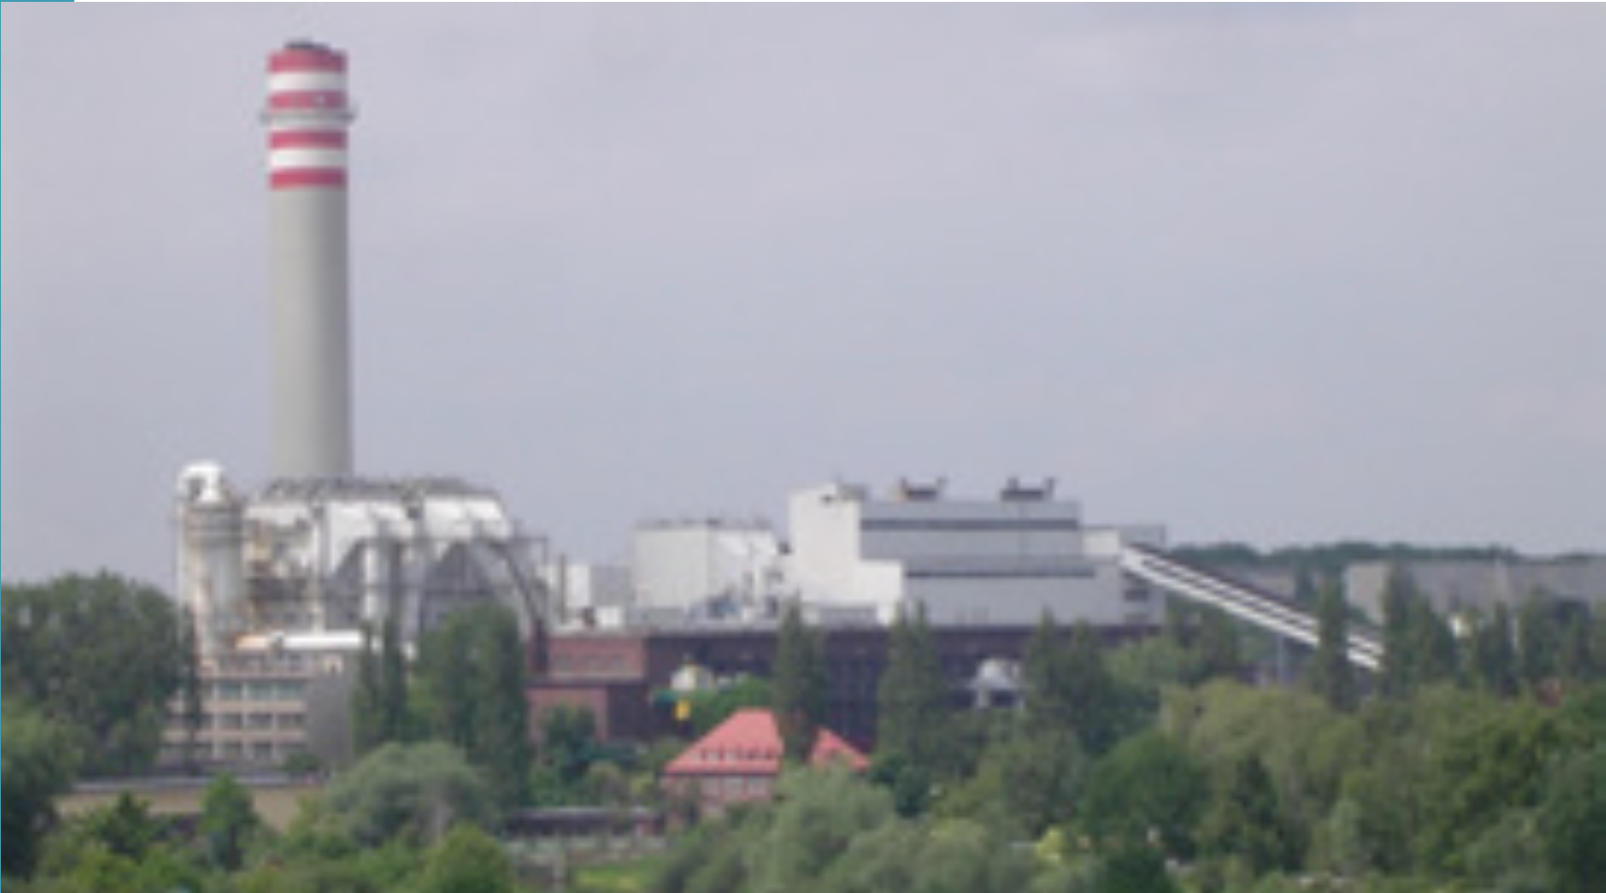
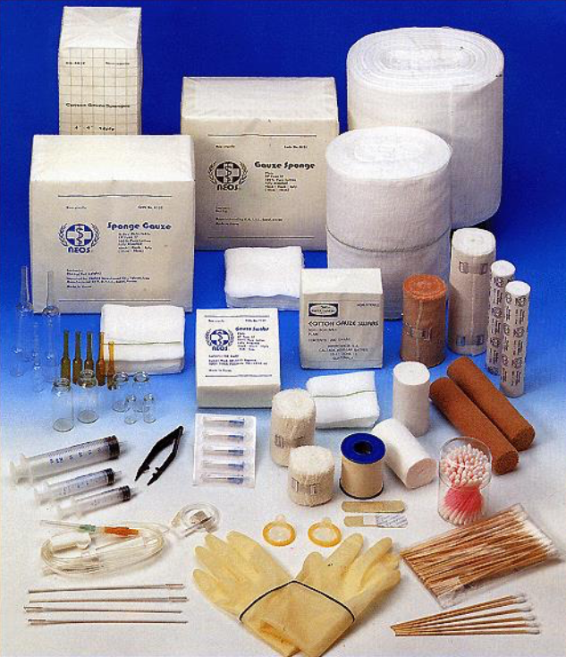
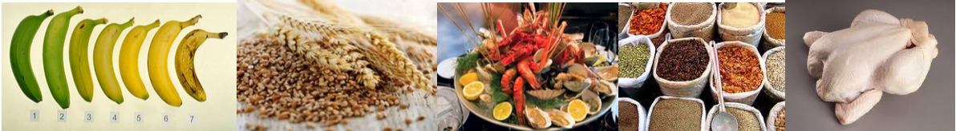
Application - Industry
Environmental applications
Ion implantation in semiconductors
Treating waste water or sewage
Purifying drinking water
Sterilization
Image courtesy of Intel
Removal of NO_{x} and SO₂ from flue gas emissions
‘Cold pasteurization’ - Food irradiation before packaging
Image Sources:
APAE report, ‘Applications of particle accelerators in Europe’, http://apae.ific.uv.es/apae/
Dr. Suzie Sheehy, Applications of accelerators, CAS 2014, Prague

Slide 15
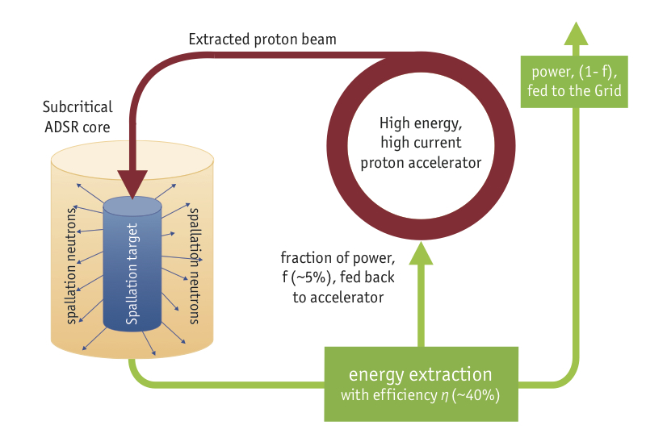
Application - Energy
Accelerator Driven System (ADS)
MYRRHA is a subcritical reactor which means that it has insufficient fissile material to spontaneously maintain the fission and it needs to be continuously fed by an external neutron source: a particle accelerator. This accelerator fires protons at a target, creating the neutrons that will maintain the fission chain reactions in the reactor.
Major challenges for accelerator technology: beam power (>10MW) and reliability.
Developed at the Belgian nuclear research center SCK-CEN in Mol.
Transmutation of nuclear waste isotopes or energy generation
General layout of a ADS
Sources:
APAE report, ‘Applications of particle accelerators in Europe’, http://apae.ific.uv.es/apae/
Dr. Suzie Sheehy, Applications of accelerators, CAS 2014, Prague
Webpage of SCK-CEN: http://sckcen.be/en/Technology_future/MYRRHA

Slide 16
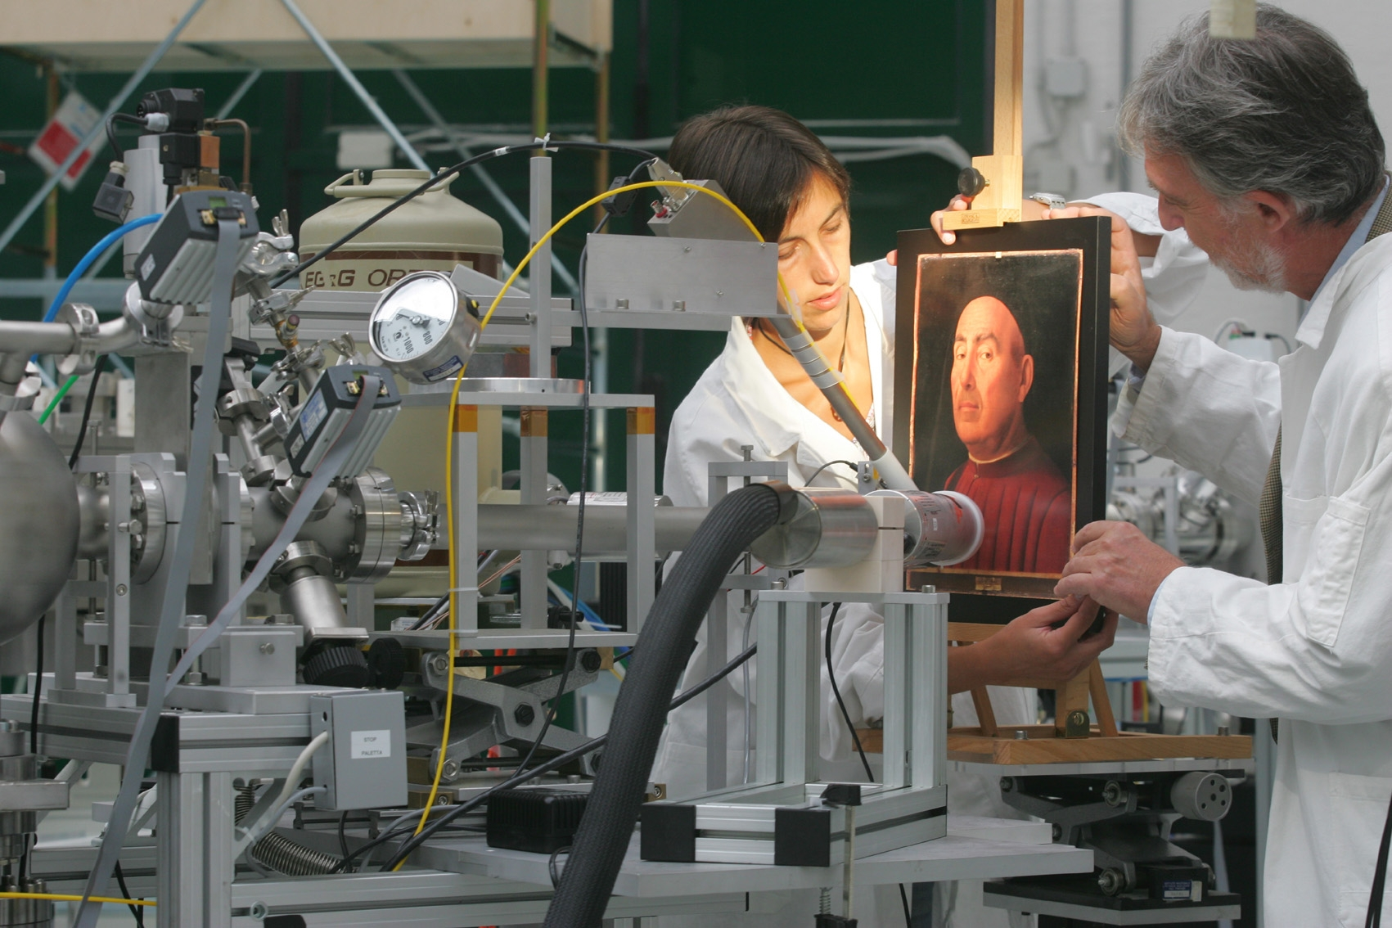
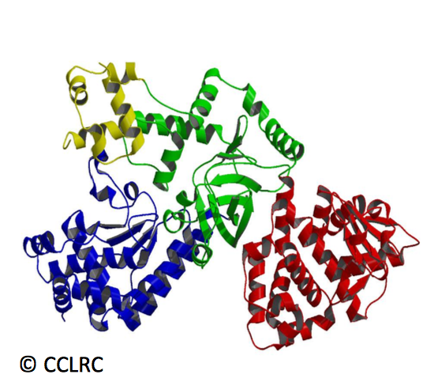

Application - Science
Archeology/Heritage
The “Ritratto Trivulzio” by Antonello da Messina during the analysis with particle accelerator. Image credit: LABEC, INFN's Laboratory for Cultural Heritage and Environment, Italy
Synchrotron Light Sources: Structure of Proteins
Diffraction pattern from pea lectin
Structure of Anthrax
Sources:
APAE report, ‘Applications of particle accelerators in Europe’, http://apae.ific.uv.es/apae/
Dr. Suzie Sheehy, Applications of accelerators, CAS 2014, Prague

Slide 17
How can we accelerate particles?

Slide 18
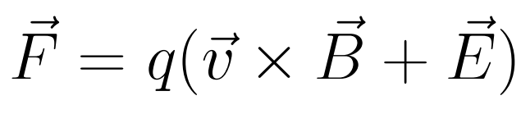
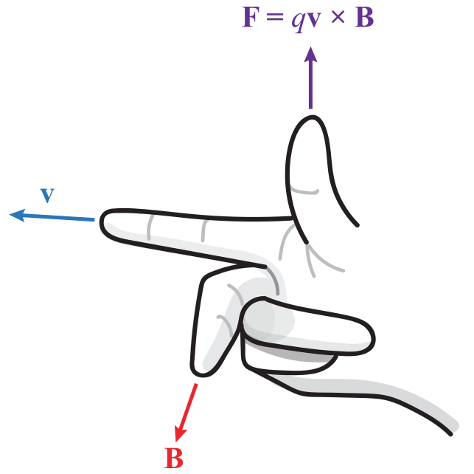

How can we increase the energy of a particle?
A charged particles that travels through an electro-magnetic field feels the Lorentz force:
Magnetic field B:
Force acts perpendicular to path.
→ Can change direction of particle
→ cannot accelerate
Electric field E:
Force acts parallel to path.
Can accelerate
not optimal for deflection
Numeric Example:
v = c, B = 1T
E = vB = 3x10⁸ m/s x 1T
E = 300 MV/m
Technical limit for el. field:
$$E∝1MV/m$$

Slide 19
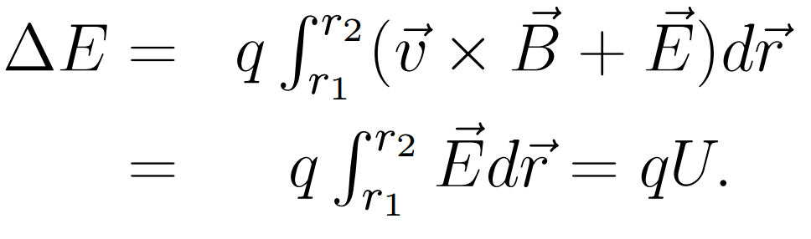

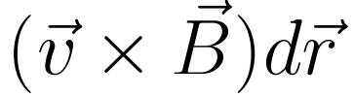
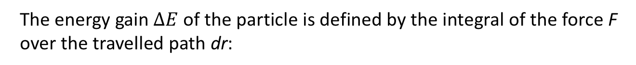
How can we increase the energy of a particle?
The energy gain $∆E$ of the particle is defined by the integral of the force F over the travelled path dr:
e-
= 0
1V
-
+
Energy is measured in units of electron Volts (eV).
Energy gain of an electron moved across a potential difference of 1 Volt.
1 eV = 1.602176565(35) x 10⁻¹⁹ x 1 J
With E = mc² unit of mass m is eV/c²
With E² = (mc²)² + p²c² unit of momentum p is eV/c
Definition
of Units

Slide 20
Which types of accelerators exist?
and
How do they work?

Slide 21
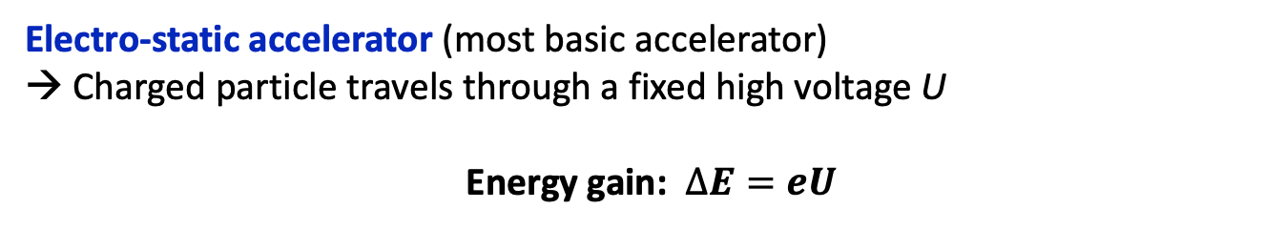
Basic Accelerator
Electro-static accelerator (most basic accelerator)
→ Charged particle travels through a fixed high voltage U
Energy gain: $∆E=eU$
Particle Source
Target
T
E- Field
Power supply
Vacuum chamber
to avoid scattering on gas particles
Final particle energy is limited by a maximum reachable voltage.
Max. voltage limited by corona formation and discharge to ~10MV.

Slide 22
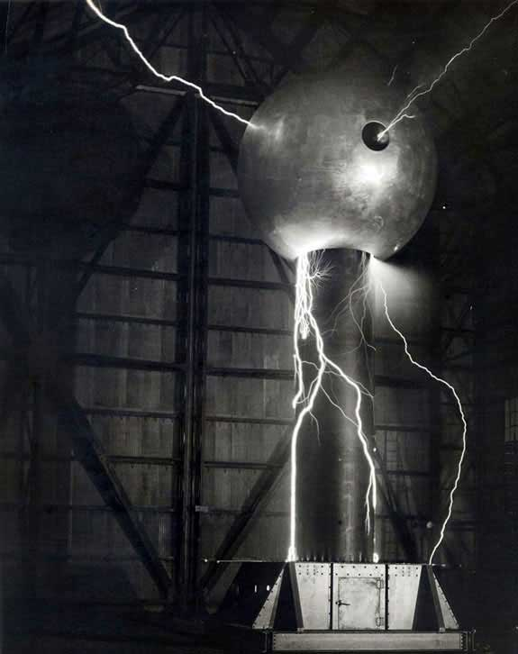
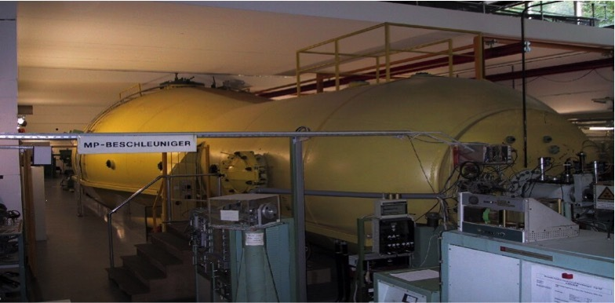
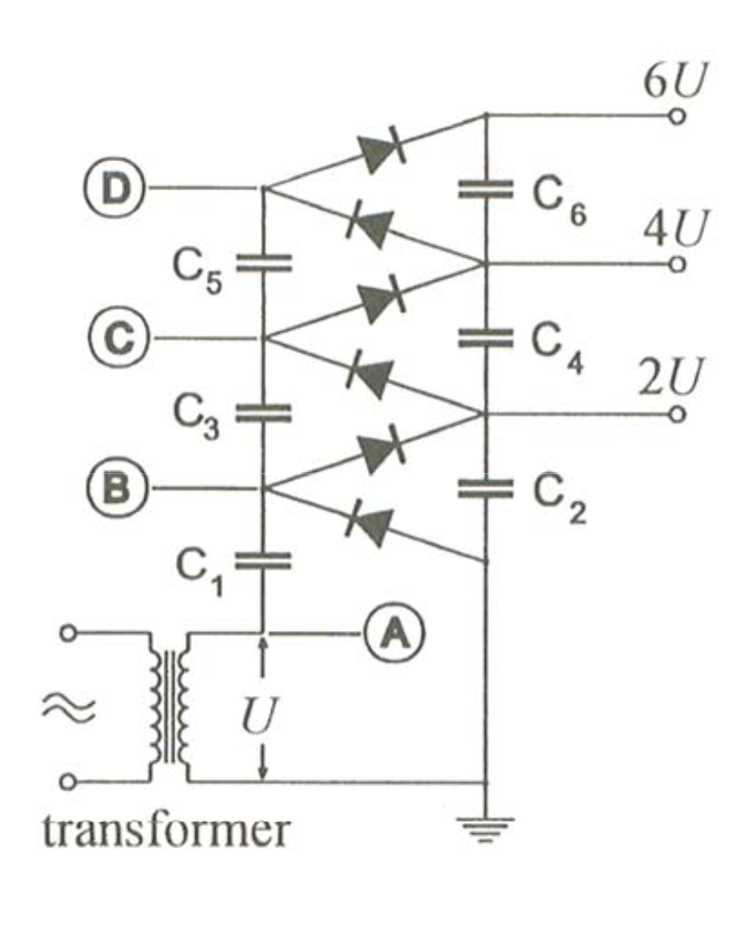
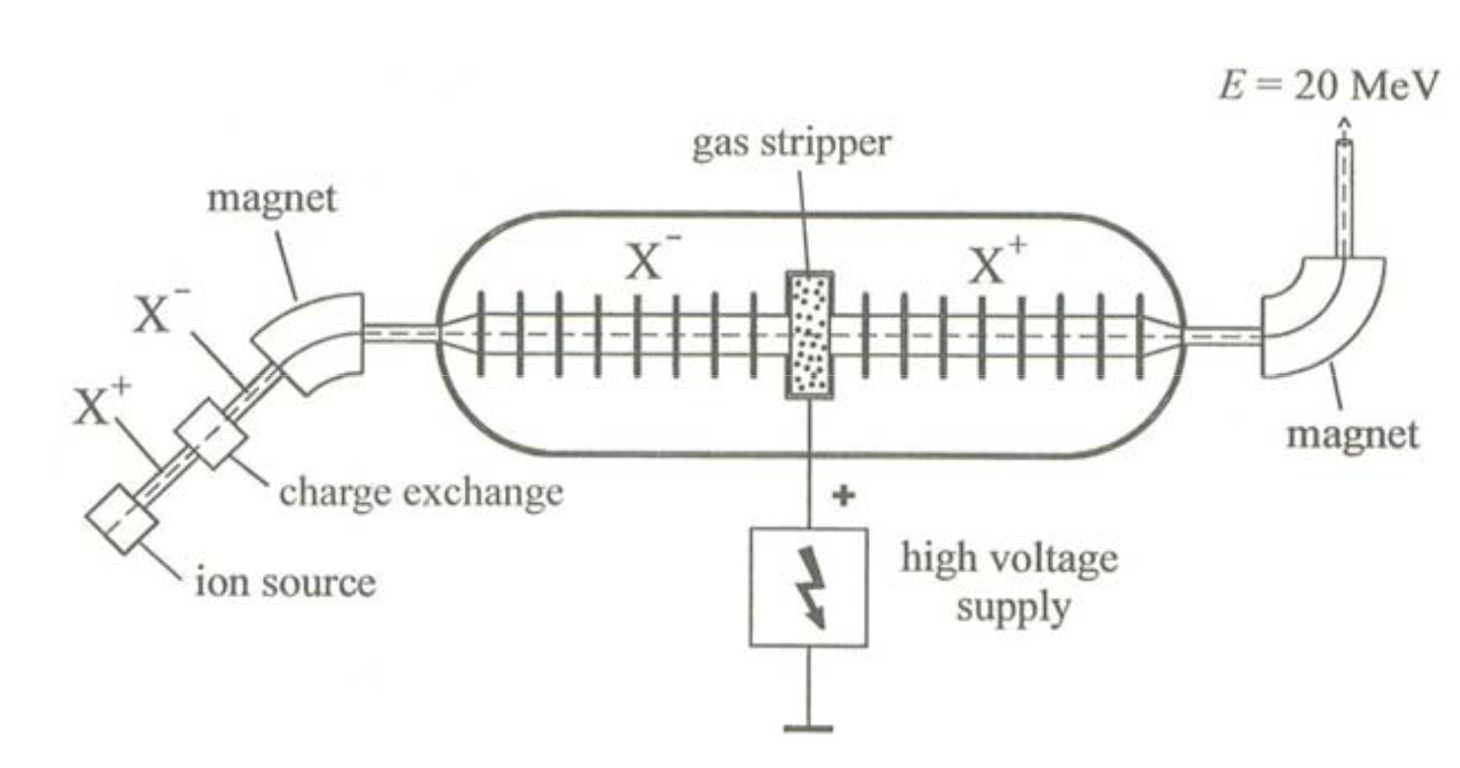
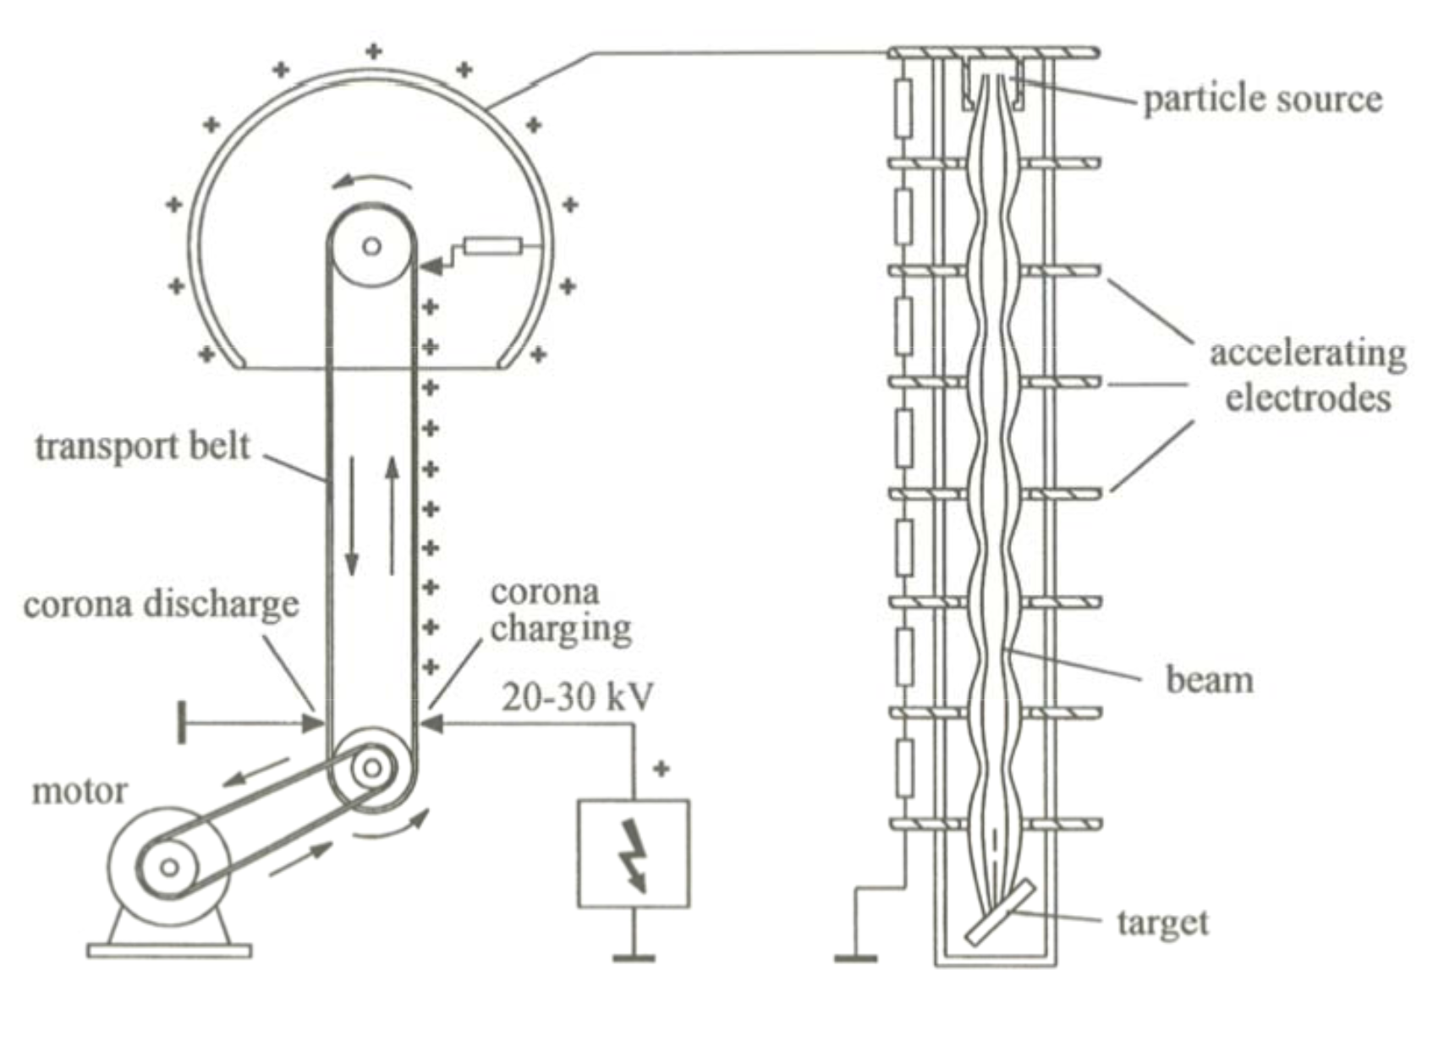
Electrostatic Accelerators – 1930s
Cockcroft-Walton cascade generator
Van de Graaff accelerator
Tandem Van de Graaff accelerator
1936
1928
1930
Concept:
mechanical transport of charges via rotating belt
Electrode in high pressure gas to suppress discharge (SF₆)
Max. Voltage ~ 1- 10 MV
at MPI Heidelberg
Image Credit: K. Wille
Concept:
rectifier circuit, built of capacitors and diodes (Greinacker circuit)
Limitation:
Electrical discharge in air
(Paschen Law)
Max. Voltage ~ 1 MV
Image Credit: K. Wille
Concept:
Generate negative ions, strip off electrons in the center, use voltage a 2nd time with now positive ions
Max. Voltage ~ 25 MV
Image Credit: K. Wille
Historically largely used as 1st stage accelerators for proton and ion beams.

Slide 23
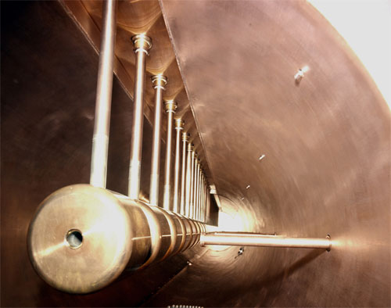
Electrostatic Accelerator Limitation
Electrostatic
Radio Frequency
Solution:
Use alternating (RF) voltages and pass the particles through many acceleration gaps of the same voltage.
1925 idea by Ising
1928 first working RF accelerator by Wideroe
Limitation:
Generation of max. (direct) voltage before sparking.
Acceleration over one stage or gap.

Slide 24
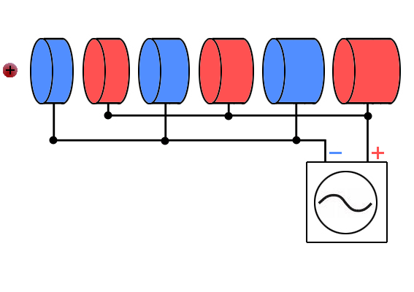
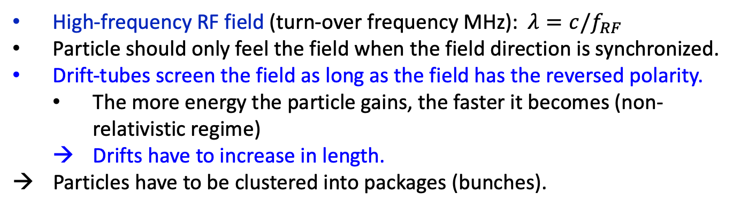
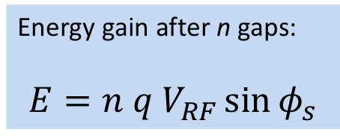
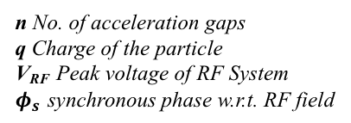
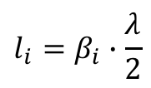
LINear ACcelerator (LINAC) - Functionality
Acceleration gaps (electrical field)
Drift-tubes (field free)
Energy gain after n gaps:
$$E=n q V_{RF}\sin{φ_{s}}$$
$$l_{i}=β_{i}∙\frac{λ}{2}$$
n No. of acceleration gaps
q Charge of the particle
V_{RF} Peak voltage of RF System
$φ_{s}$ synchronous phase w.r.t. RF field
High-frequency RF field (turn-over frequency MHz): $λ=c/f_{RF}$
Particle should only feel the field when the field direction is synchronized.
Drift-tubes screen the field as long as the field has the reversed polarity.
  The more energy the particle gains, the faster it becomes (non-relativistic regime)
  Drifts have to increase in length.
  Particles have to be clustered into packages (bunches).
Source gif: http://www.lhc-facts.ch
24

Slide 25
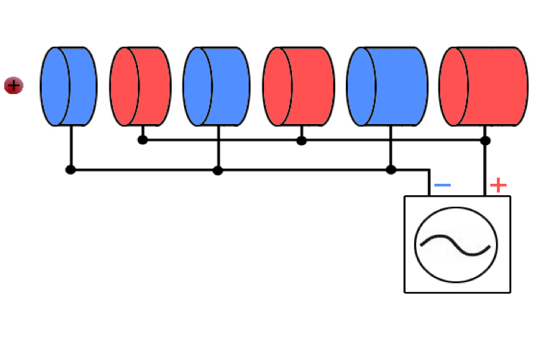

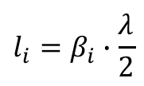
LINAC - Functionality
Acceleration gaps (electrical field)
Drift-tubes (field free)
Solutions are in the back up slides
Exercise:
Once build, can I use my LINAC to accelerate any particle I like?
$$l_{i}=β_{i}∙\frac{λ}{2}$$
  Particles have to be clustered into packages (bunches).
Source gif: http://www.lhc-facts.ch
Photo: https://kuk.verdi.de/darstellende-kunst/juedisches-leben-eine-stadt-in-aktion-585/
25

Slide 26
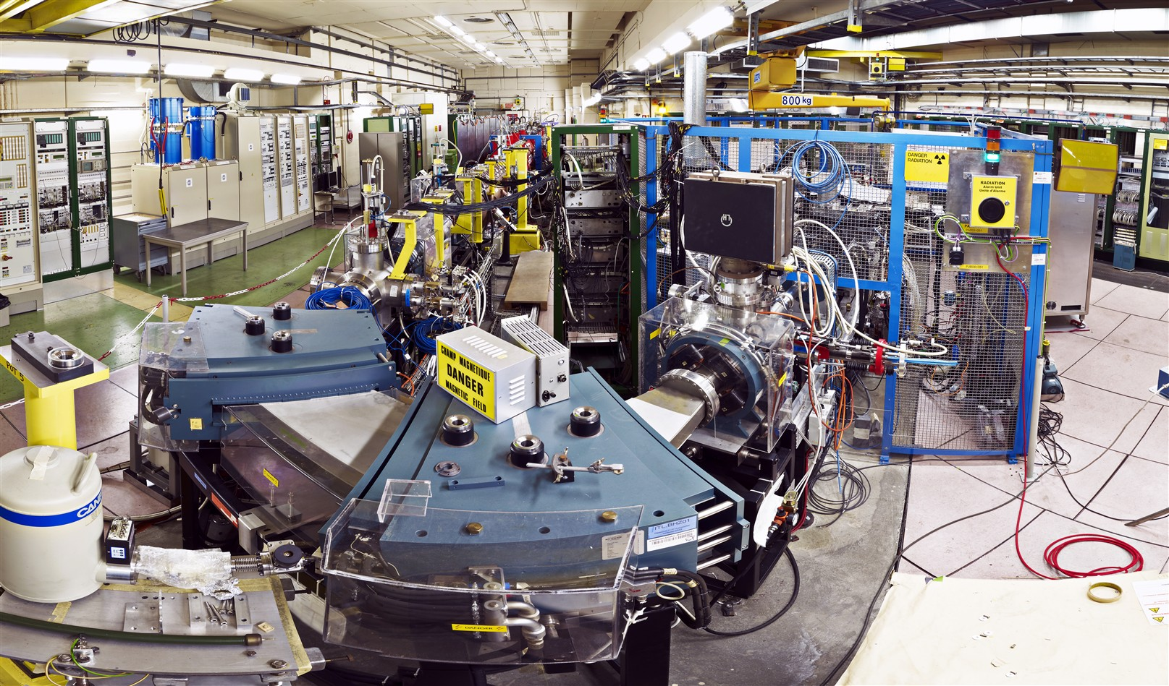
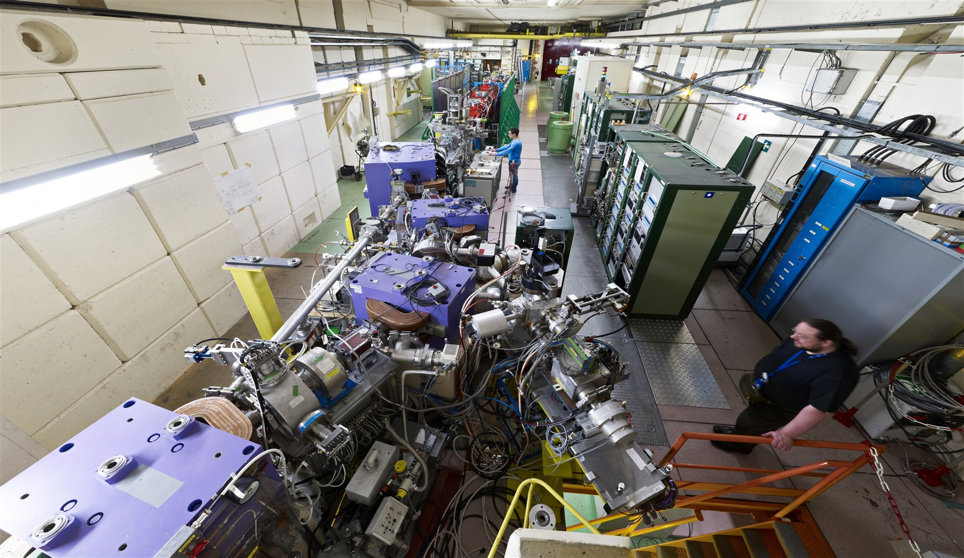
CERN Ion Source & LINAC 3
A LINAC is THE standard proton and ion beam pre-accelerator.
CERN LINAC 3 brings different ion species to LEIR
Ion source (blue cage)
Spectrometer (front)
LINAC (back)
Downstream part of LINAC 3:
Transfer and diagnostics (front)
Accelerating structures (back)

Slide 27
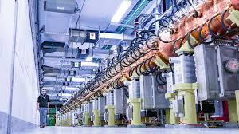
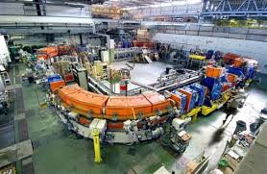
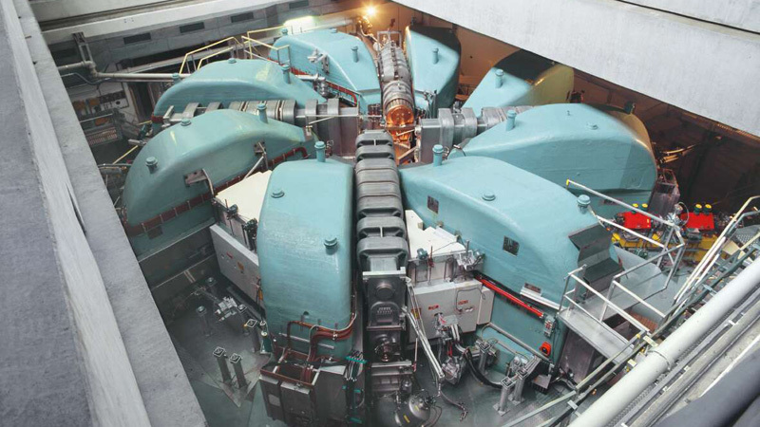

LINAC Limitation
Synchrotron
Linear
Circular
LINAC
Consists of a chain of many accelerating gaps placed on a straight line.
Particles pass the accelerator only ONCE.
The final energy is limited by length.
Cyclotron
Use magnets that bend particles on a circular orbit.
Particles circulate over MANY turns and can gain more energy at each passage through the acceleration gap.
27

Slide 28

Cyclotron - “Spiral version of a LINAC”
1929 proposed E.O. Lawrence
1931 built by Livingston
Acceleration gap
Extraction
D-shaped magnets
Particle Source in the middle
Acceleration gap connected to RF source between the two D-shaped magnets.
Constant vertical magnetic field to guide the particles in the horizontal plane. The radius of particle trajectory becomes larger and larger with larger energy.
Particles extracted with a deflector magnet or an electrode.
Top View
Particle source
ω_{RF} = ω_{cyclotron}
f_{RF} = const.
B = const.

Slide 29
Cyclotron Limitation
Constant revolution frequency for constant mass:
f_{RF} = const.
B = const.
But, for relativistic particles the mass is not constant!
The classical cyclotron only valid for particles up to few % of speed of light.
  → Not useful for electrons … already relativistic at ~500 keV.
Modifications:
  Synchro-cyclotron
  Isochronous cyclotron
f_{RF} (E)
B (E) or B = const.
f_{RF} = const.
B (r)
Common accelerator for medium energy protons and ions up to ~60MeV/n,
used for nuclear physics, radio isotope production, hadron therapy.
Modern cyclotrons can reach > 500 MeV (PSI, TRIUMF, RIKEN)

Slide 30


PSI Cyclotron
1974
Diameter ~15m
Injection energy 72 MeV
Accelerates protons
to E = 590 MeV (i.e. 0.8c) in 186 revolutions
8 sector magnets
4 acceleration cavities
First stage accelerator feeding a smaller cyclotron before the large PSI ring cyclotron is a Cockraft-Walton accelerator.
Source: Paul Scherrer Institute/ Photos: Markus Fischer

Slide 31
Cyclotron Limitation
Cyclotron
Synchrotron
Low energy limit.
Not useful for relativistic particles, especially electrons.
Particles pass the accelerator only ONCE.
Define ONE circular orbit (circumference) and vary magnetic field with energy.
Storage over MANY turns (hours).

Slide 32
Basic Synchrotron
Synchrotrons are THE accelerators to reach highest particle energies and are able to store the beam over many hours.
acceleration gap
dipole
(bending)
quadrupole
(focusing)
injektion kicker
extraktion kicker
transferelinie
Destination:
next accelerator
target/physics experiment
beam dump
injector/
pre-accelerator
physics experiment
beam pipe
(under high vacuum)

Slide 33


Most Famous Example
The largest machine in the world The Large Hadron Collider (LHC)
27 km circumference
100m underground
Accelerates protons and heavy-ions
to E = 6.8 Z TeV (2022).
Collides 2 counter-rotating beams
in 4 physics experiments.

Slide 34

Getting particles into the LHC
Protons on the way to LHC
Beam 2
Beam 1
1) Linear → Circular
2) The higher the particle‘s energy the larger the circumference.
Year Top energy Length
[GeV] [ m ]
Linac 1979 0.05 30
PSB 1972 1.4 157
PS 1959 26.0 628
SPS 1976 450.0 6’911
LHC 2008 7000.0 26’657

Slide 35
Getting particles into the LHC
Heavy-Ions on the way to LHC
Beam 2
Beam 1
1) Linear → Circular
2) The higher the particle‘s energy the larger the circumference.
Year Top energy Length
[GeV] [ m ]
Linac 1979 0.05 30
PSB 1972 1.4 157
PS 1959 26.0 628
SPS 1976 450.0 6’911
LHC 2008 7000.0 26’657

Slide 36




Summary of Accelerator Types and History
Limited by length
Limited by max. B-field & radius
Synchrotron
Linear
Circular
LINAC
Limited by const. mass & size
Limited by high voltage discharge
Cyclotron
Other types of circular accelerators (not discussed here)
electrostatic
accelerators
Betatron
Microtron

Slide 37



Bike Ride through PETRA III @ DESY
Injection, FoDo cell structure, acceleration cavities
Max von Laue Experimental hall: Double Bend Achromat cell structure and undulators for photon beam production

Slide 38

Everything clear! Hmm ….

Slide 39
Solutions to Exercises

Slide 40




Exercise: LINAC
Once build, can I use my LINAC to accelerate any particle I like?
This question could be rephrased to:
How does the drift tube length $l_{i}$ depend on the particle type?
Drift tubes provide shielding of the particles during the negative half wave of the RF.
Time span of the negative half wave: τ_{RF} /2
Length of the Drift Tube:
$$v_{i}= \sqrt{2E_{i}/m}$$
Kinetic Energy of the Particles
$$l_{i}= \frac{1}{f_{RF}} \sqrt{\frac{i q V_{RF} \sin{φ_{s}}}{2m}}$$
valid for non-relativistic particles ...
So the answer is no. The drift tube length depends on the charge-to-mass-ratio (q/m) of the particle and the RF system. For a given RF system bandwidth only a certain range of q/m leads to a synchronized acceleration. One knob to play could be the charge state for ions, which may allow to get closer to the design q/m.

