Slide 2
Particle Detectors
Summer Student Lectures 2022
Werner Riegler, CERN, werner.riegler@cern.ch
History of Instrumentation ↔ History of Particle Physics
The ‘Real’ World of Particles
Interaction of Particles with Matter
Tracking Detectors, Calorimeters, Particle Identification
Detector Systems

Slide 3
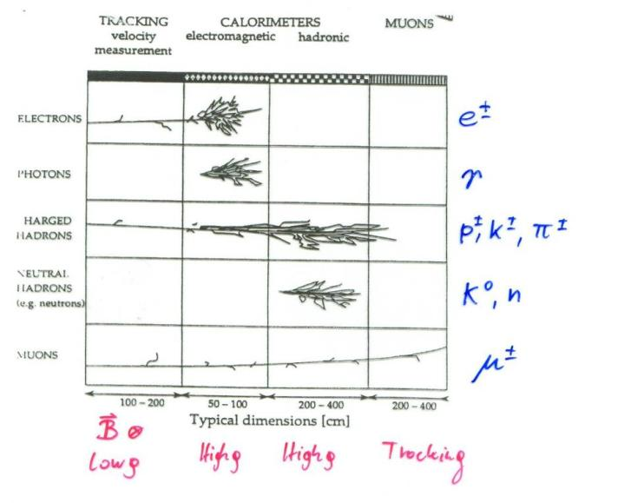
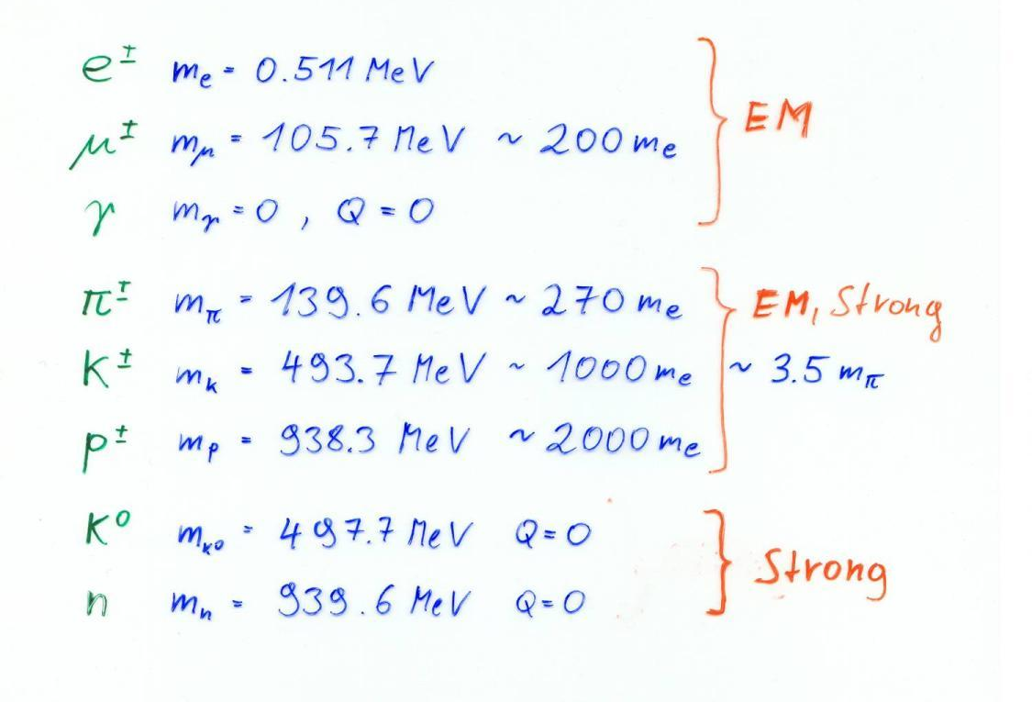
We have to know the details about all interactions to design our detectors !

Slide 4
Detector Physics
Precise knowledge of the processes leading to signals in particle detectors is necessary.
The detectors are nowadays working close to the limits of theoretically achievable measurement accuracy – even in large systems.
Due to available computing power, detectors can be simulated to within 5-10% of reality, based on the fundamental microphysics processes (atomic and nuclear cross-sections).

Slide 5
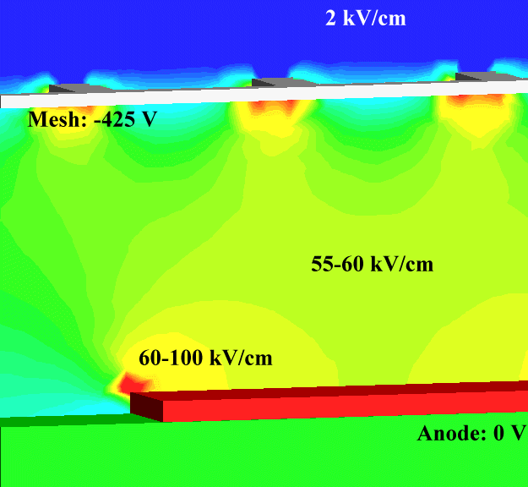
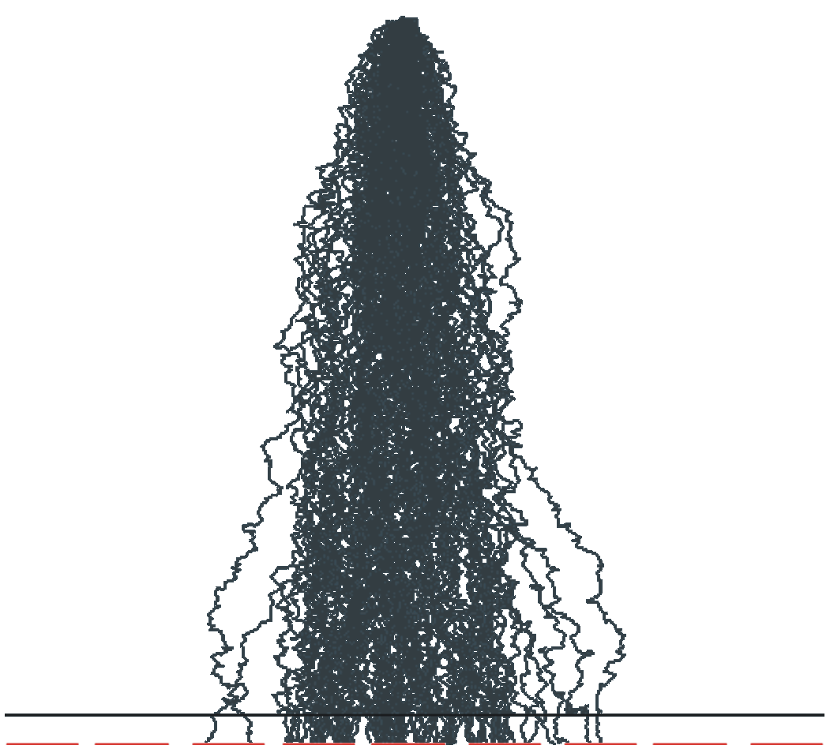
Particle Detector Simulation
CMS detector simulation GEANT
ATLAS detector simulation GEANT
Electrons avalanche multiplication, GARFIELD++
Electric Fields in a Micromega detector, e.g. COMSOL
Silicon sensor simulation, TCAD

Slide 6
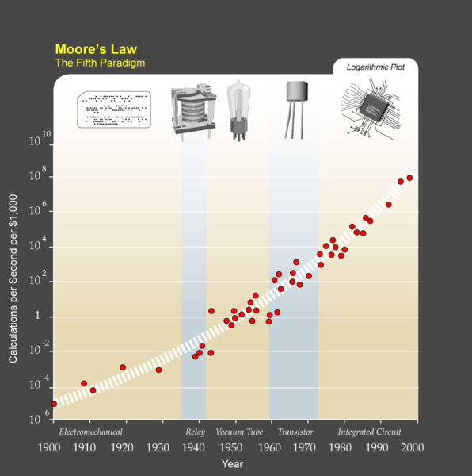
Particle Detector Simulation
I) C. Moore’s Law:
Computing power doubles 18 months.
II) W. Riegler’s Law:
The use of brain power for solving a problem is inversely proportional to the available computing power.
→ I) + II) = ...
Knowing the basics of particle detectors is essential …

Slide 7
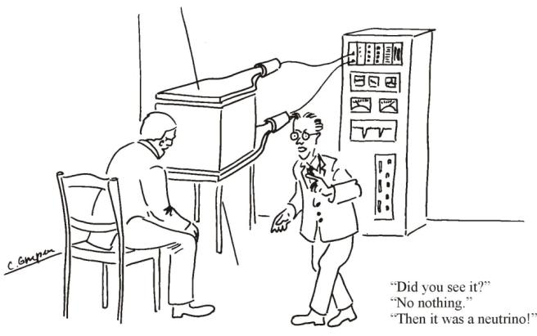
Interaction of Particles with Matter
Any device that is to detect a particle must interact with it in some way → almost …
In many experiments neutrinos are measured by missing transverse momentum.
E.g. e⁺e⁻ collider. P_{tot}=0,
If the Σ p_{i} of all collision products is ≠0 → neutrino escaped.
Claus Grupen, Particle Detectors, Cambridge University Press, Cambridge 1996 (455 pp. ISBN 0-521-55216-8)

Slide 8
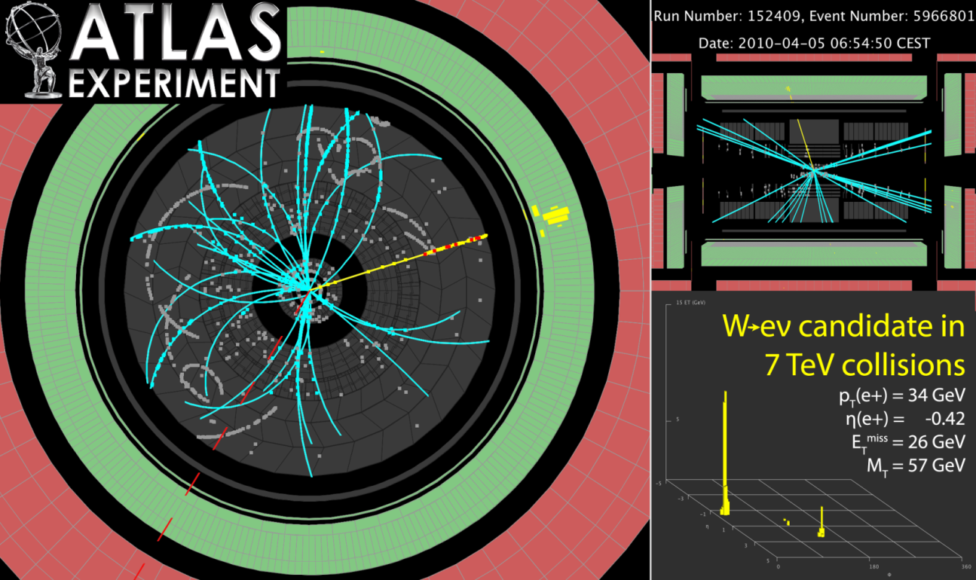
Neutrinos and other invisible particles
They are seen by missing momentum vectors – if you are sure your detector is hermetic !

Slide 9
Electromagnetic Interaction of Particles with Matter
Z₂ electrons, q=-e₀
M, q=Z₁ e₀
Interaction with the atomic electrons. The incoming particle loses energy and the atoms are excited or ionized.
Interaction with the atomic nucleus. The particle is deflected (scattered) causing multiple scattering of the particle in the material. During this scattering a Bremsstrahlung photon can be emitted.
In case the particle’s velocity is larger than the velocity of light in the medium, the resulting EM shockwave manifests itself as Cherenkov Radiation. When the particle crosses the boundary between two media, there is a probability of the order of 1% to produced and X ray photon, called Transition radiation.

Slide 10
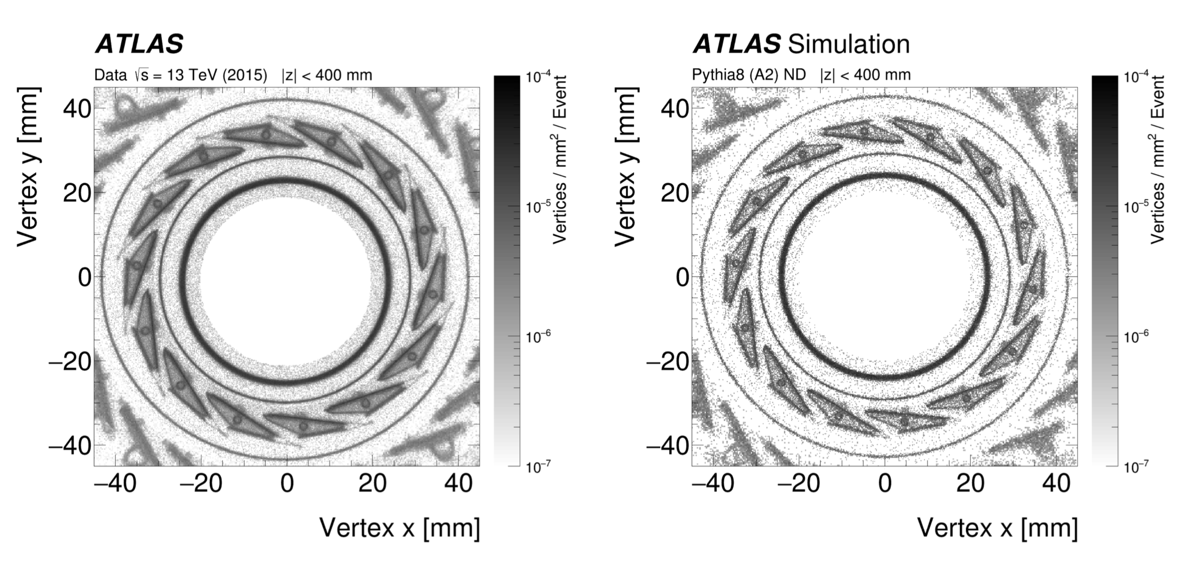
Hadronic Interaction of Particles with Matter
Z₂ electrons, q=-e₀
M, q=Z₁ e₀
Hadronic interactions with the nuclei produce a complex sequence of secondary particles. This is at the basis of hadron calorimetry.
Hadronic interactions taking place in the trackers are of course having bad an impact on the tracker measurements !
Tracing back these secondary particles to their origin gives the place of interaction. Making a map of these points we can image our detectors !

Slide 11
Electromagnetic Interaction of Particles with Matter
Z₂ electrons, q=-e₀
M, q=Z₁ e₀
Interaction with the atomic nucleus. The particle is deflected (scattered) causing multiple scattering of the particle in the material. During this scattering a Bremsstrahlung photon can be emitted.
In case the particle’s velocity is larger than the velocity of light in the medium, the resulting EM shockwave manifests itself as Cherenkov Radiation. When the particle crosses the boundary between two media, there is a probability of the order of 1% to produced and X ray photon, called Transition radiation.
Interaction with the atomic electrons. The incoming particle loses energy and the atoms are excited or ionized.

Slide 12
Ionization and Excitation
The charges particles leave a trail of excited and ionized atoms.
The electrons and holes produced in these interactions do themselves have sufficient energy ionize the gas or solid, but because there energy is small the loose all their energy over a very small distance, so in we get a trail of ionization-clusters along the way.
The de-excitation of the excited atoms and the movement of the electrons/holes/ions in electric field are the basis for signals in our particle detectors.
Let’s make a more quantitative assessment of this …
Electrons and ions in gases
Electrons and holes in solids
Primary interactions
Clusters of ionization

Slide 13



Ionization and Excitation
F
b
x
While the charged particle is passing another charged particle, the Coulomb Force is acting, resulting in momentum transfer
The relativistic form of the transverse electric field doesn’t change the momentum transfer. The transverse field is stronger, but the time of action is shorter
The transferred energy is then
→ The incoming particle transfer energy only (mostly) to the atomic electrons !

Slide 14


Ionization and Excitation
Target material: mass A, Z₂, density ρ [g/cm³], Avogadro number N_{A}
A gramm → N_{A} Atoms: Number of atoms/cm³ n_{a} =N_{A} ρ/A [1/cm³]
Number of electrons/cm³ n_{e} =N_{A} ρZ₂/A [1/cm³]
With ΔE(b) → db/b = -1/2 dE/E → E_{max}= ΔE(b_{min}) E_{min} = ΔE(b_{max})
E_{min} ≈ I (Ionization Energy)

Slide 15









Relativistic Collision Kinematics, E_{max}
θ
φ
1)
2)
1+2)

Slide 16
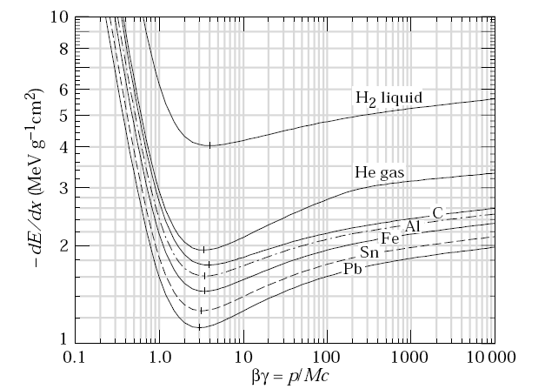
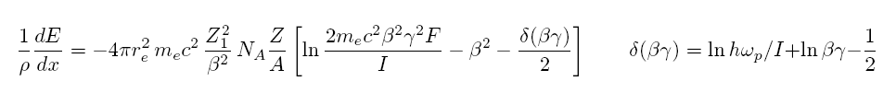
Classical Scattering on Free Electrons
This formula is up to a factor 2 and the density effect identical to the precise QM derivation →
Bethe Bloch Formula
1/ρ
Density effect. Medium is polarized
Which reduces the log. rise.
Electron Spin

Slide 17
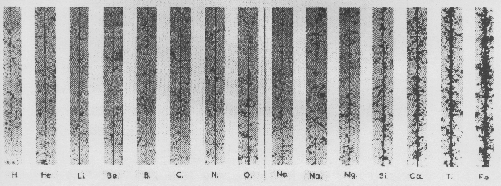
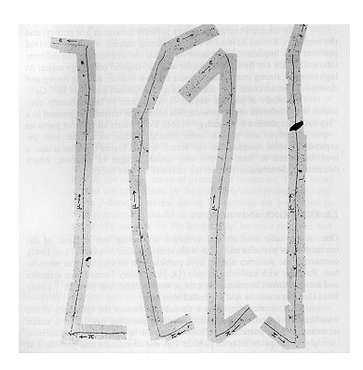
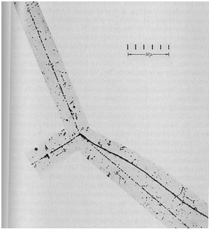
Bethe-Bloch formula
Small energy loss
→ Fast Particle
Cosmis rays: dE/dx α Z²
Small energy loss
→ Fast particle
Pion
Large energy loss
→ Slow particle
Pion
Discovery of muon and pion
Kaon
Pion

Slide 18
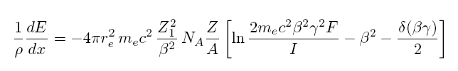
Bethe-Bloch formula
Für Z>1, I ≈16Z ^{0.9} eV
For Large βγ the medium is being polarized by the strong transverse fields, which reduces the rise of the energy loss → density effect
At large Energy Transfers (delta electrons) the liberated electrons can leave the material.
In reality, E_{max} must be replaced by E_{cut} and the energy loss reaches a plateau (Fermi plateau).
Characteristics of the energy loss as a function
of the particle velocity (βγ )
The specific Energy Loss 1/ρ dE/dx
first decreases as 1/β²
increases with ln γ for β =1
is ≈ independent of M (M>>m_{e})
is proportional to Z₁² of the incoming particle.
is ≈ independent of the material (Z/A ≈ const)
shows a plateau at large βγ (>>100)
dE/dx ≈ 1-2 x ρ [g/cm³] MeV/cm
1/ρ

Slide 19
Bethe-Bloch formula
Bethe Bloch Formula, a few Numbers:
For Z ≈ 0.5 A
1/ρ dE/dx ≈ 1.4 MeV cm ²/g for ßγ ≈ 3
Example:
Iron: Thickness = 100 cm; ρ = 7.87 g/cm³
dE ≈ 1.4 * 100* 7.87 = 1102 MeV
→ A 1 GeV Muon can traverse 1m of Iron
1/ρ
This number must be multiplied with ρ [g/cm³] of the Material → dE/dx [MeV/cm]

Slide 20
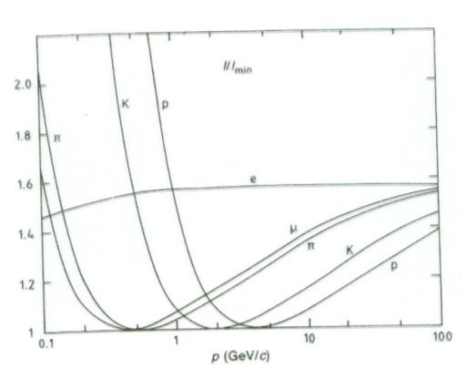
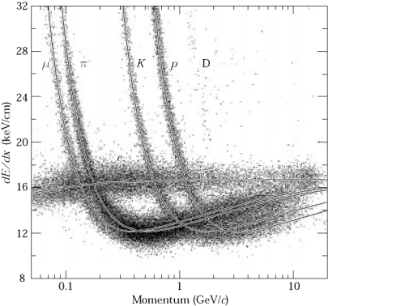
Energy loss as a function of the momentum
Energy loss depends on the particle velocity and is ≈ independent of the particle’s mass M.
The energy loss as a function of particle
momentum p = Mcβγ IS however
depending on the particle’s mass
By measuring the particle momentum
(deflection in the magnetic field) and
measurement of the energy loss on can
measure the particle mass
→ Particle Identification !

Slide 21
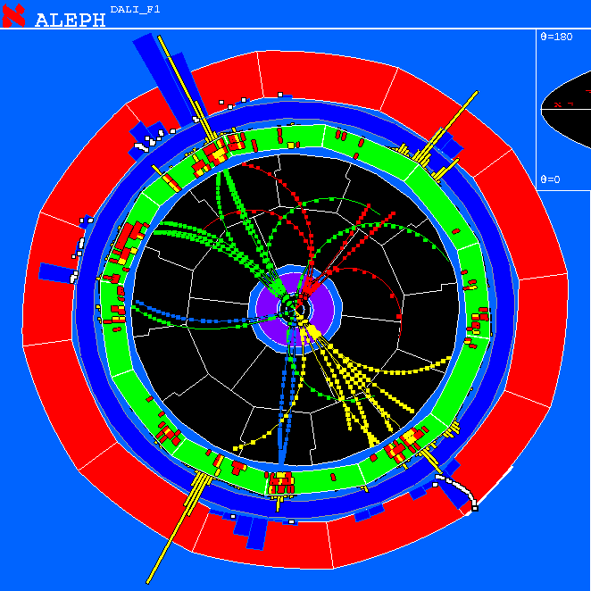
Energy loss as a function of the momentum
Measure momentum by curvature of the particle track.
Find dE/dx by measuring the deposited charge along the track.
→Particle ID

Slide 22
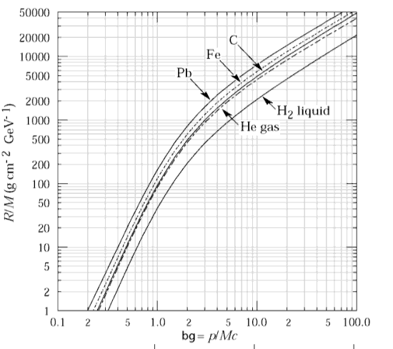

Range of Particles in Matter
Particle of mass M and kinetic Energy E₀ enters matter and looses energy until it comes to rest at distance R.
independent of the material
Bragg Peak:
For βγ>3 the energy loss is ≈ constant (Fermi Plateau)
If the energy of the particle falls below βγ=3 the energy loss rises as 1/β²
Towards the end of the track the energy loss is largest → Cancer Therapy.

Slide 23
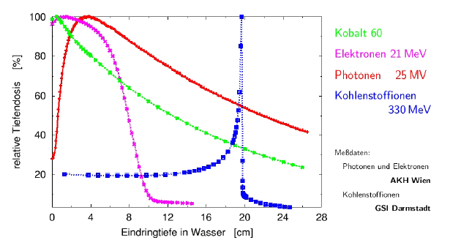
Range of Particles in Matter
Average Range:
Towards the end of the track the energy loss is largest → Bragg Peak → Cancer Therapy
Photons 25MeV
Carbon Ions 330MeV
Relative Dose (%)
Depth of Water (cm)

Slide 24
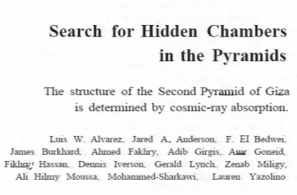
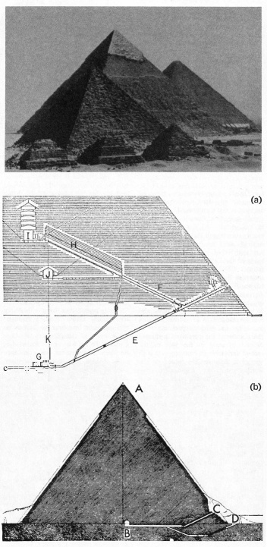
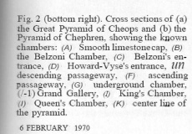
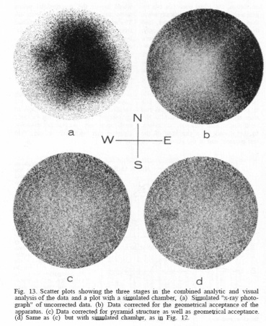
Luis Alvarez used the attenuation of muons to look for chambers in the Second Giza Pyramid → Muon Tomography
He proved that there are no chambers present.

Slide 25
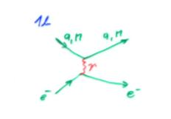


Crossection σ: Material with Atomic Mass A and density ρ contains
n Atoms/cm³
E.g. Atom (Sphere) with Radius R: Atomic Crossection σ = R²π
A volume with surface F and thickness dx contains N=nFdx Atoms.
The total ‘surface’ of atoms in this volume is N σ.
The relative area is p = N σ/F = N_{A} ρ σ /A dx =
Probability that an incoming particle hits an atom in dx.
What is the probability P that a particle hits an atom between distance x and x+dx ?
P = probability that the particle does NOT hit an atom in the m=x/dx material layers and that the particle DOES hit an atom in the m^{th} layer
Mean free path
Average number of collisions/cm
Intermezzo: Crossection
F
dx

Slide 26






Intermezzo: Differential Crossection
Differential Crossection:
→ Crossection for an incoming particle of energy E to lose an energy between E’ and E’+dE’
Total Crossection:
Probability P(E) that an incoming particle of Energy E loses an energy between E’ and E’+dE’ in a collision:
Average number of collisions/cm causing an energy loss between E’ and E’+dE’
Average energy loss/cm:

Slide 27


Fluctuation of Energy Loss
Up to now we have calculated the average energy loss. The energy loss is however a statistical process and will therefore fluctuate from event to event.
x=0 x=D
E
Δ
E - Δ
X X X X X
XX X X
X X X
XXX X XX
X XXX X
P(Δ) = ? Probability that a particle loses an energy Δ when traversing a material of thickness D
We have see earlier that the probability of an interaction occuring between distance x and x+dx is exponentially distributed

Slide 28
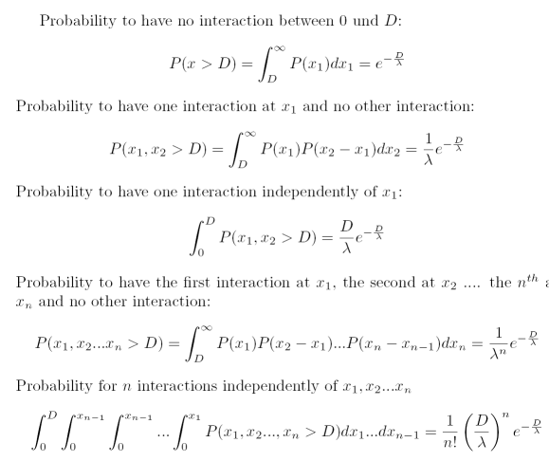
Probability for n Interactions in D
We first calculate the probability to find n interactions in D, knowing that the probability to find a distance x between two interactions is P(x)dx = 1/ λ exp(-x/λ) dx with λ = A/ N_{A}ρ σ

Slide 29



Probability for n Interactions in D
For an interaction with a mean free path of λ , the probability for n interactions on a distance D is given by
Poisson Distribution !
How do we find the energy loss distribution ?
If f(E) is the probability to lose the energy E’ in an interaction, the probability p(E) to lose an energy E over the distance D ?

Slide 30
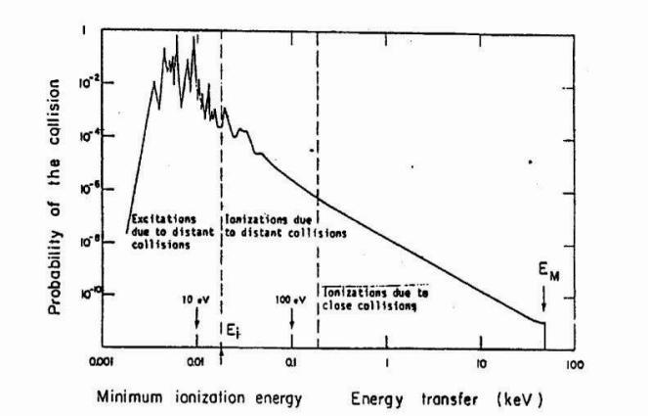

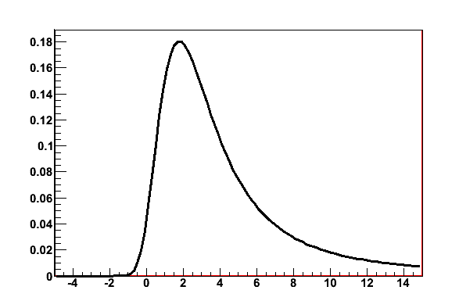


Fluctuations of the Energy Loss
Probability f(E) for loosing energy between E’ and E’+dE’ in a single interaction is given by the differential crossection dσ (E,E’)/dE’/ σ(E) which is given by the Rutherford crossection at large energy transfers
dσ (E,E’)/dE’/ σ(E)
Excitation and ionization
Scattering on free electrons
P(E,Δ)

Slide 31
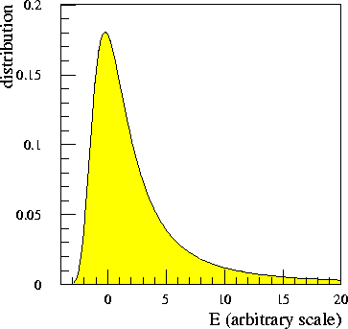
Landau Distribution
P(Δ): Probability for energy loss Δ in matter of thickness D.
Landau distribution is very asymmetric.
Average and most probable energy loss must be distinguished !
Measured Energy Loss is usually smaller that the real energy loss:
3 GeV Pion: E’_{max} = 450MeV → A 450 MeV Electron usually leaves the detector.

Slide 32
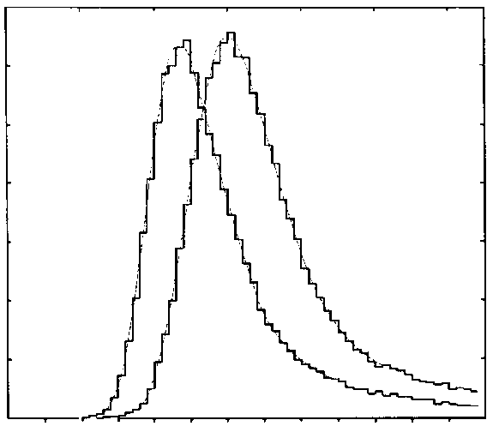
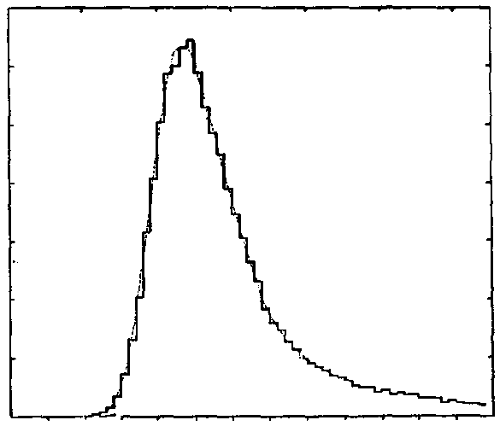
Landau Distribution
LANDAU DISTRIBUTION OF ENERGY LOSS:
PARTICLE IDENTIFICATION
Requires statistical analysis of hundreds of samples
Counts
4 cm Ar-CH4 (95-5)
5 bars
Counts
15 GeV/c
6000
6000
protons
electrons
N = 460 i.p.
4000
FWHM~250 i.p.
4000
2000
2000
0
0
0
500
1000
0
500
1000
N (i.p.)
N (i.p)
For a Gaussian distribution:
σ_{N} ~ 21 i.p.
FWHM ~ 50 i.p.
I. Lehraus et al, Phys. Scripta 23(1981)727

Slide 33
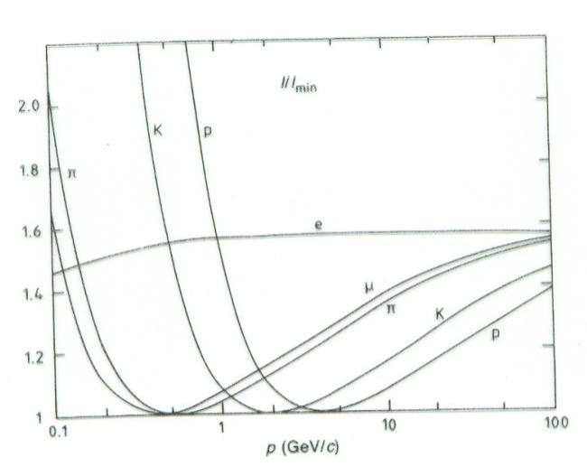

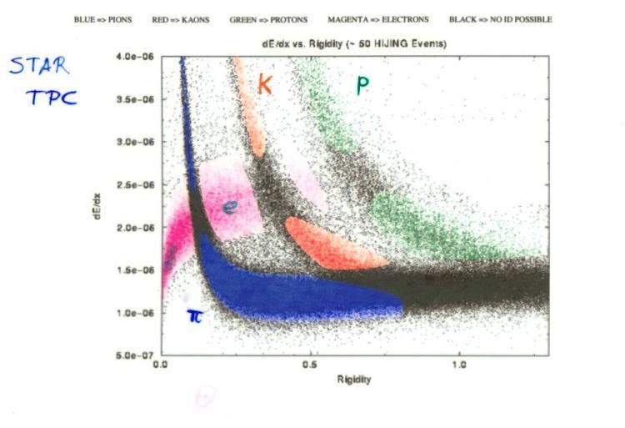
Particle Identification
Measured energy loss
‘average’ energy loss
In certain momentum ranges, particles can be identified by measuring the energy loss.

Slide 34
Electromagnetic Interaction of Particles with Matter
Z₂ electrons, q=-e₀
M, q=Z₁ e₀
Interaction with the atomic nucleus. The particle is deflected (scattered) causing multiple scattering of the particle in the material. During this scattering a Bremsstrahlung photon can be emitted.
In case the particle’s velocity is larger than the velocity of light in the medium, the resulting EM shockwave manifests itself as Cherenkov Radiation. When the particle crosses the boundary between two media, there is a probability of the order of 1% to produced and X ray photon, called Transition radiation.
Interaction with the atomic electrons. The incoming particle loses energy and the atoms are excited or ionized.

Slide 35
Bremsstrahlung
A charged particle of mass M and charge q=Z₁e is deflected by a nucleus of charge Ze which is partially ‘shielded’ by the electrons. During this deflection the charge is ‘accelerated’ and it therefore radiated → Bremsstrahlung.
Z₂ electrons, q=-e₀
M, q=Z₁ e₀

Slide 36
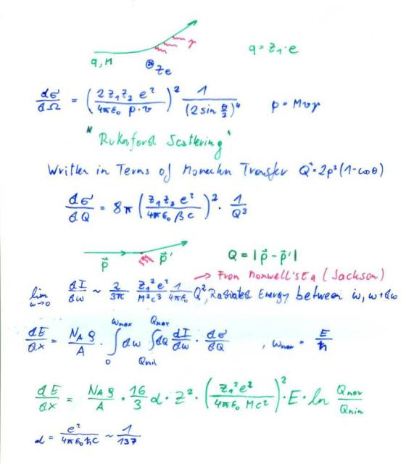
Bremsstrahlung, Classical
A charged particle of mass M and charge q=Z₁e is deflected by a nucleus of Charge Ze.
Because of the acceleration the particle radiated EM waves → energy loss.
Coulomb-Scattering (Rutherford Scattering) describes the deflection of the particle.
Maxwell’s Equations describe the radiated energy for a given momentum transfer.
→ dE/dx

Slide 37
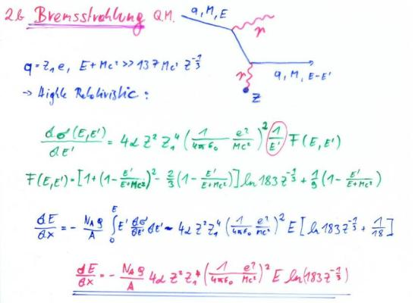
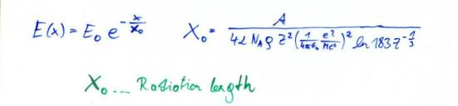
Bremsstrahlung, QM
Proportional to Z²/A of the Material.
Proportional to Z₁⁴ of the incoming particle.
Proportional to ρ of the material.
Proportional 1/M² of the incoming particle.
Proportional to the Energy of the
Incoming particle →
E(x)=Exp(-x/X₀) – ‘Radiation Length’
X₀ ∝ M²A/ (ρ Z₁⁴ Z²)
X₀: Distance where the Energy E₀ of the incoming particle decreases E₀Exp(-1)=0.37E₀ .

Slide 38
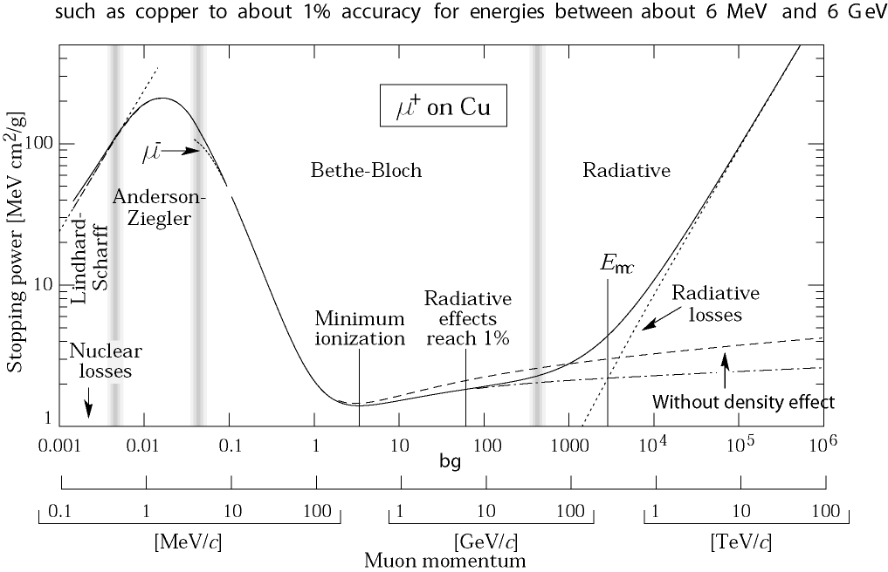
Critical Energy
For the muon, the second lightest particle after the electron, the critical energy is at 400GeV.
The EM Bremsstrahlung is therefore only relevant for electrons at energies of past and present detectors.
Electron Momentum 5 50 500 MeV/c
Critical Energy: If dE/dx (Ionization) = dE/dx (Bremsstrahlung)
Myon in Copper: p ≈ 400GeV
Electron in Copper: p ≈ 20MeV

Slide 39
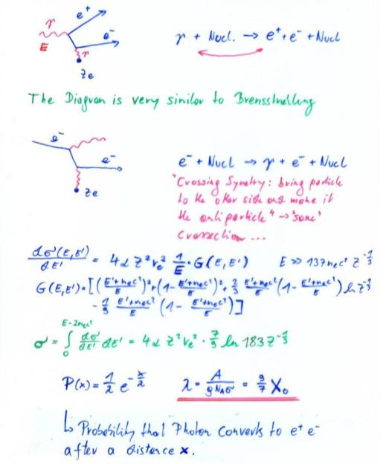
Pair Production, QM
For Eγ>>m_{e}c²=0.5MeV : λ = 9/7X₀
Average distance a high energy photon has to travel before it converts into an e⁺ e⁻ pair is equal to 9/7 of the distance that a high energy electron has to travel before reducing it’s energy from E₀ to E₀*Exp(-1) by photon radiation.

Slide 40
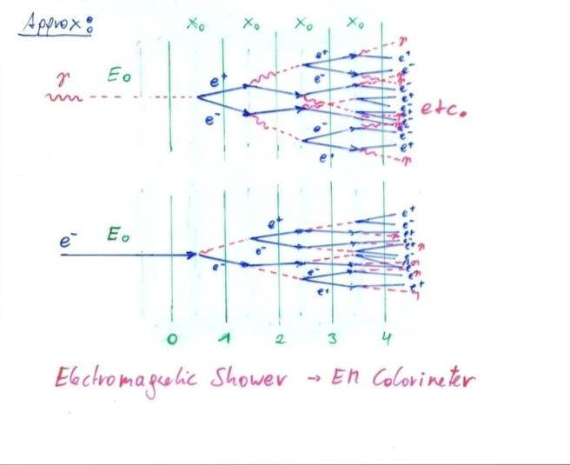
Bremsstrahlung + Pair Production → EM Shower

Slide 41
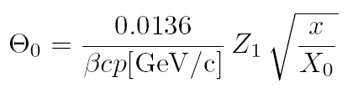
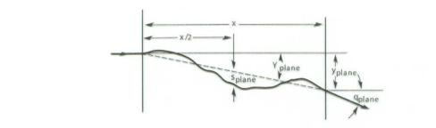
Multiple Scattering
Statistical (quite complex) analysis of multiple collisions gives:
Probability that a particle is defected by an angle θ after travelling a distance x in the material is given by a Gaussian distribution with sigma of:
X₀ ... Radiation length of the material
Z₁ ... Charge of the particle
p ... Momentum of the particle

Slide 42
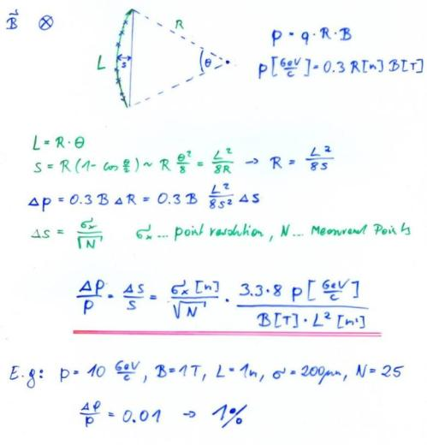
Multiple Scattering
Magnetic Spectrometer: A charged particle describes a circle in a magnetic field:
Limit → Multiple Scattering

Slide 43
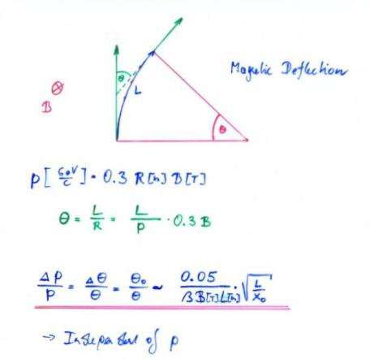
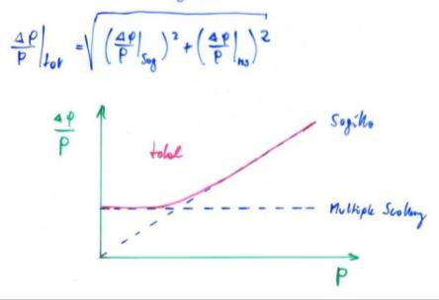
Multiple Scattering

Slide 44
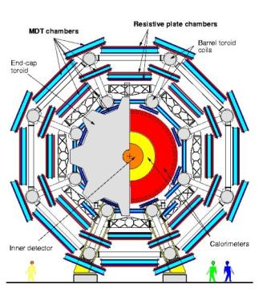
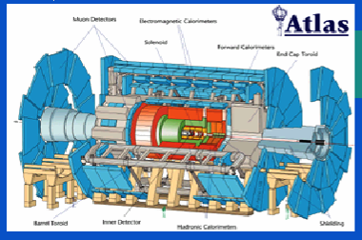
Multiple Scattering
ATLAS Muon Spectrometer:
N=3, sig=50μm, P=1TeV,
L=5m, B=0.4T
∆p/p ~ 8% for the most energetic muons at LHC

Slide 45

Cherenkov Radiation
If we describe the passage of a charged particle through material of dielectric permittivity ε (using Maxwell’s equations) the differential energy cross-section is >0 if the velocity of the particle is larger than the velocity of light in the medium is
N is the number of Cherenkov Photons emitted per cm of material. The expression is in addition proportional to Z₁² of the incoming particle.
The radiation is emitted at the characteristic angle θ_{c} , that is related to the refractive index n and the particle velocity by
M, q=Z₁ e₀

Slide 46
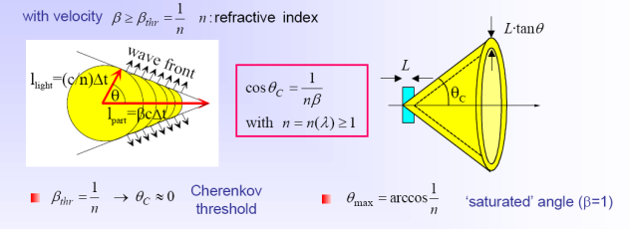
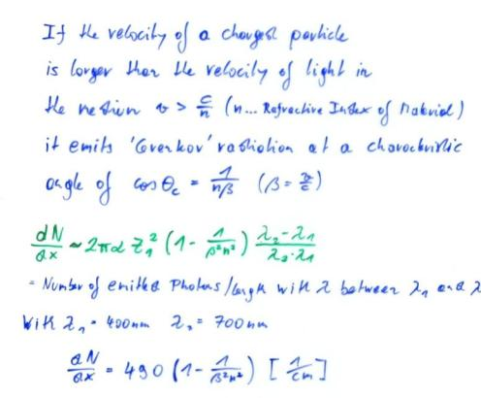
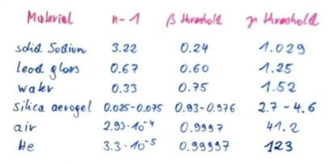
Cherenkov Radiation

Slide 47
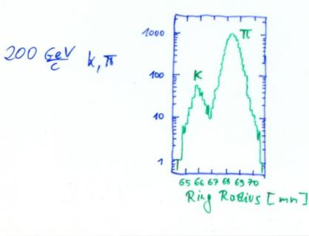
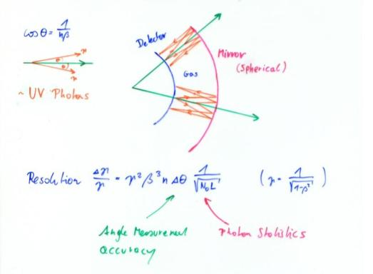


Ring Imaging Cherenkov Detector (RICH)
There are only ‘a few’ photons per event →one needs highly sensitive photon detectors to measure the rings !

Slide 48



LHCb RICH

Slide 49
Superkamiokande Cherekov Detector

Slide 50
IceCube Cherekov Detector

Slide 51
Transition Radiation
Z₂ electrons, q=-e₀
M, q=Z₁ e₀
When the particle crosses the boundary between two media, there is a probability of the order of 1% to produced and X ray photon, called Transition radiation.

Slide 52


Transition Radiation

Slide 53
Electromagnetic Interaction of Particles with Matter
Ionization and Excitation:
Charged particles traversing material are exciting and ionizing the atoms.
The average energy loss of the incoming particle by this process is to a good approximation described by the Bethe Bloch formula.
The energy loss fluctuation is well approximated by the Landau distribution.
Multiple Scattering and Bremsstrahlung:
The incoming particles are scattering off the atomic nuclei which are partially shielded by the atomic electrons.
Measuring the particle momentum by deflection of the particle trajectory in the magnetic field, this scattering imposes a lower limit on the momentum resolution of the spectrometer.
The deflection of the particle on the nucleus results in an acceleration that causes emission of Bremsstrahlungs-Photons. These photons in turn produced e+e- pairs in the vicinity of the nucleus, which causes an EM cascade. This effect depends on the 2nd power of the particle mass, so it is only relevant for electrons.

Slide 54
Electromagnetic Interaction of Particles with Matter
Cherenkov Radiation:
If a particle propagates in a material with a velocity larger than the speed of light in this material, Cherenkov radiation is emitted at a characteristic angle that depends on the particle velocity and the refractive index of the material.
Transition Radiation:
If a charged particle is crossing the boundary between two materials of different dielectric permittivity, there is a certain probability for emission of an X-ray photon.
→ The strong interaction of an incoming particle with matter is a process which is important for Hadron calorimetry and will be discussed later.

Slide 56
Electromagnetic Interaction of Particles with Matter
Z₂ electrons, q=-e₀
M, q=Z₁ e₀
Now that we know all the Interactions we can talk about Detectors !
Interaction with the atomic electrons. The incoming particle loses energy and the atoms are excited or ionized.
Interaction with the atomic nucleus. The particle is deflected (scattered) causing multiple scattering of the particle in the material. During this scattering a Bremsstrahlung photon can be emitted.
In case the particle’s velocity is larger than the velocity of light in the medium, the resulting EM shockwave manifests itself as Cherenkov Radiation. When the particle crosses the boundary between two media, there is a probability of the order of 1% to produced and X ray photon, called Transition radiation.

Slide 57
Now that we know all the Interactions we can talk about Detectors !

