Slide 2
Particle Detectors
Summer Student Lectures 2022
Werner Riegler, CERN, werner.riegler@cern.ch
History of Instrumentation ↔ History of Particle Physics
The ‘Real’ World of Particles
Interaction of Particles with Matter
Tracking Detectors, Calorimeters, Particle Identification
Detector Systems

Slide 3
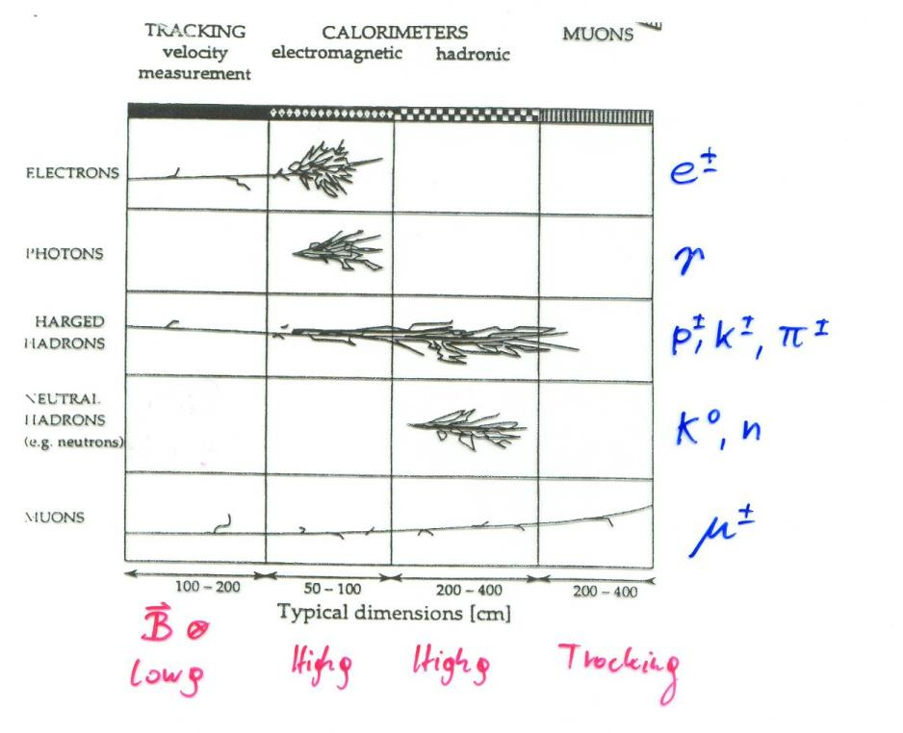
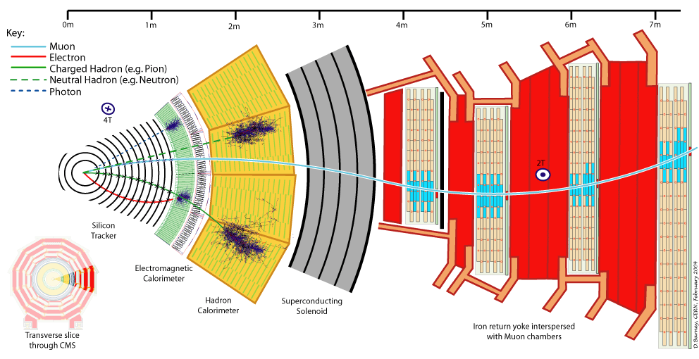
Calorimetry

Slide 4
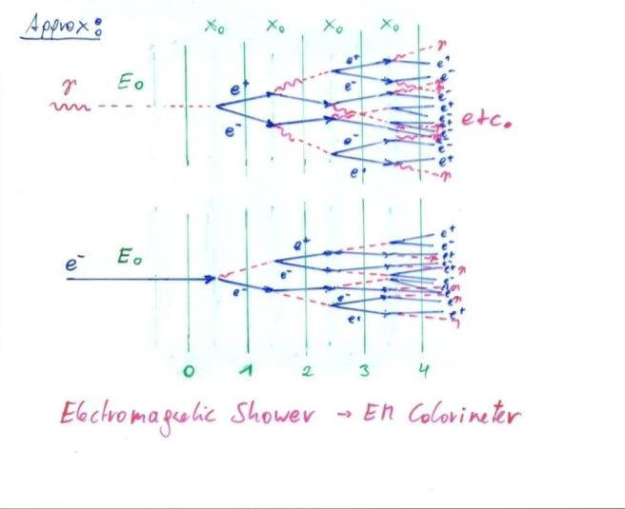
Bremsstrahlung + Pair Production → EM Shower

Slide 5
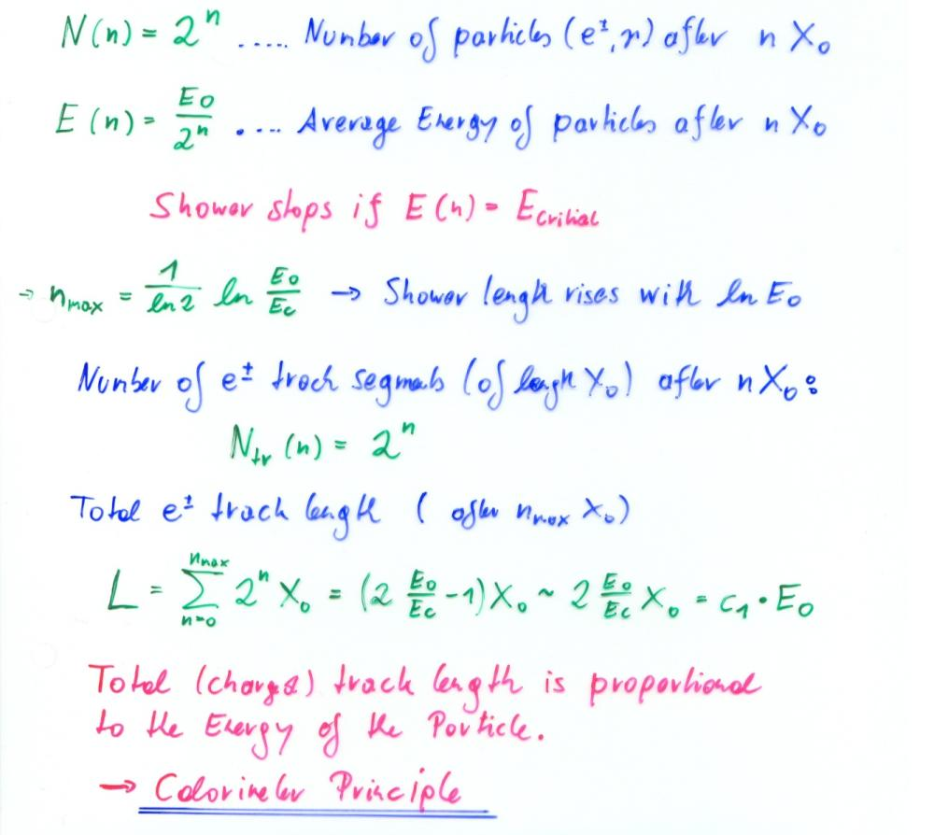
Electro-Magnetic Shower of High Energy Electrons and Photons

Slide 6
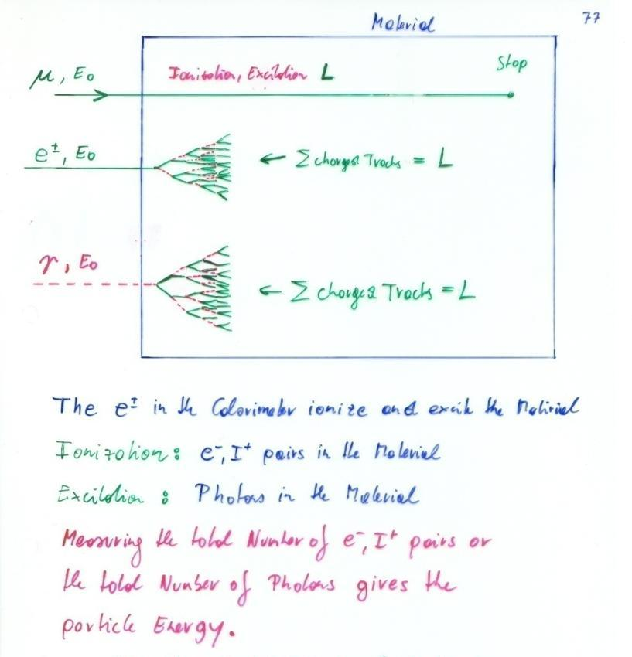
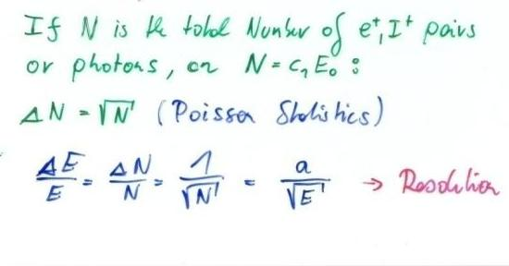
Calorimetry: Energy Measurement by total Absorption of Particles
Only Electrons and High Energy Photons show EM cascades at current GeV-TeV level Energies.
Strongly interacting particles like Pions, Kaons, produce hadonic showers in a similar fashion to the EM cascade
Hadronic calorimetry
Momentum Spectrometer: Δp/p α p
Calorimeter: Δ E/E α 1/ √ E
Energy measurement improves with higher particle energies – LHC !

Slide 7
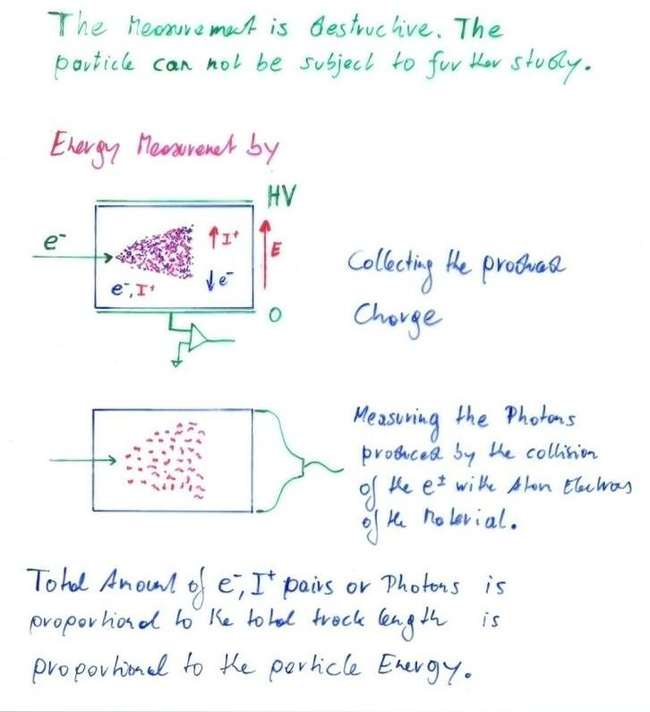
Calorimetry: Energy Measurement by total Absorption of Particles
Liquid Nobel Gases
(Nobel Liquids)
Scintillating Crystals,
Plastic Scintillators

Slide 8
Calorimetry
Calorimeters can be classified into:
Electromagnetic Calorimeters,
to measure electrons and photons through their EM interactions.
Hadron Calorimeters,
Used to measure hadrons through their strong and EM interactions.
The construction can be classified into:
Homogeneous Calorimeters,
that are built of only one type of material that performs both tasks, energy degradation and signal generation.
Sampling Calorimeters,
that consist of alternating layers of an absorber, a dense material used to degrade the energy of the incident particle, and an active medium that provides the detectable signal.
C.W. Fabjan and F. Gianotti, Rev. Mod. Phys., Vol. 75, N0. 4, October 2003

Slide 9
Calorimetry
Calorimeters are attractive in our field for various reasons:
In contrast with magnet spectrometers, in which the momentum resolution deteriorates linearly with the particle momentum, on most cases the calorimeter energy resolution improves as 1/√E, where E is the energy of the incident particle. Therefore calorimeters are very well suited for high-energy physics experiments.
In contrast to magnet spectrometers, calorimeters are sensitive to all types of particles, charged and neutral. They can even provide indirect detection of neutrinos and their energy through a measurement of the event missing energy.
Calorimeters are commonly used for trigger purposes since they can provide fast signals that are easy to process and interpret.
They are space and therefore cost effective. Because the shower length increases only logarithmically with energy, the detector thickness needs to increase only logarithmically with the energy of the particles. In contrast for a fixed momentum resolution, the bending power BL² of a magnetic spectrometer must increase linearly with the particle momentum.
C.W. Fabjan and F. Gianotti, Rev. Mod. Phys., Vol. 75, N0. 4, October 2003

Slide 10
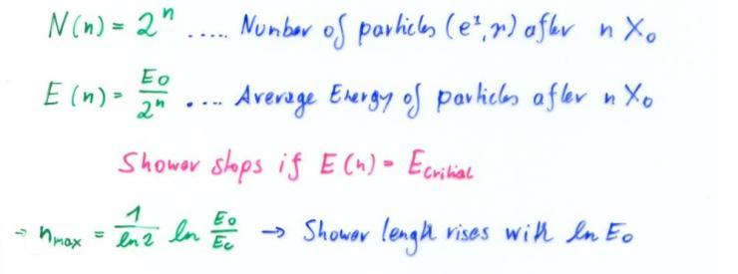
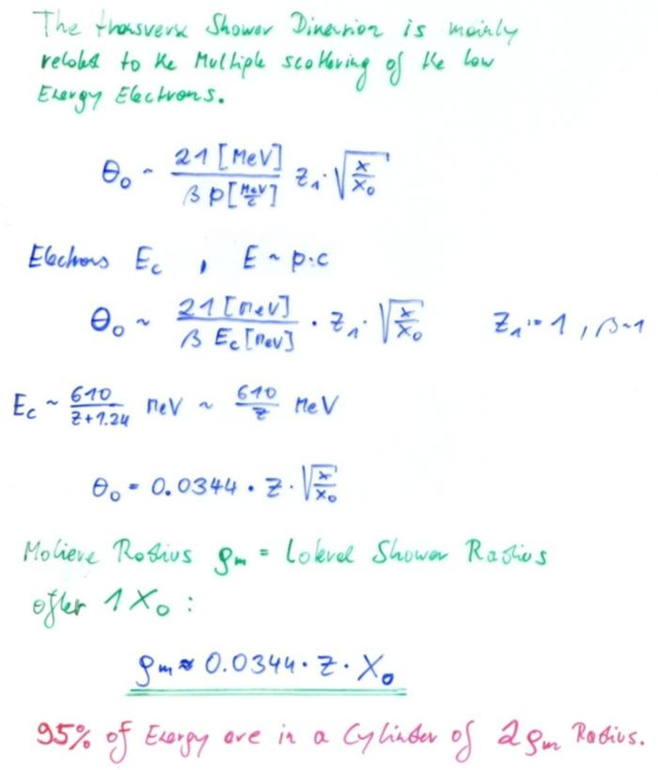
EM Calorimetry
Approximate longitudinal shower development Approximate transverse shower development
Radiation Length X₀ and Moliere Radius are two key parameters for choice of calorimeter materials

Slide 11
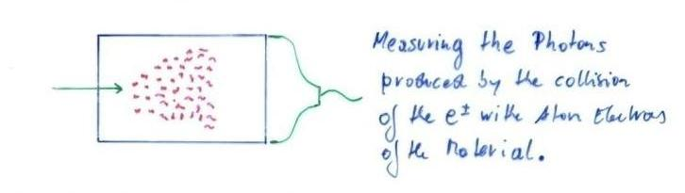
Crystals for Homogeneous EM Calorimetry
In crystals the light emission is related to the crystal structure of the material. Incident charged particles create electron-hole pairs and photons are emitted when electrons return to the valence band.
The incident electron or photon is completely absorbed and the produced amount of light, which is reflected through the transparent crystal, is measured by photomultipliers or solid state photon detectors.

Slide 12
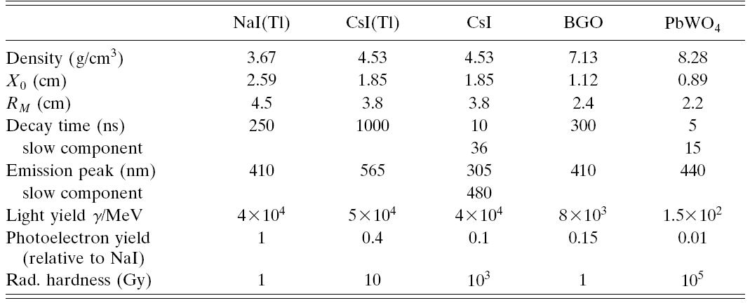
Crystals for Homogeneous EM Calorimetry
Barbar@PEPII,
10ms interaction rate, good light yield, good S/N
KTeV@Tevatron,
High rate,
Good resolution
L3@LEP, 25us bunch crossing,
Low radiation dose
CMS@LHC, 25ns bunch crossing,
high radiation dose

Slide 13
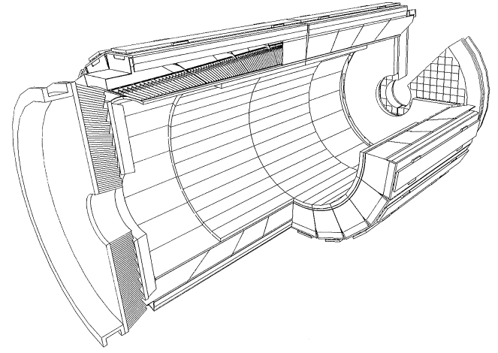
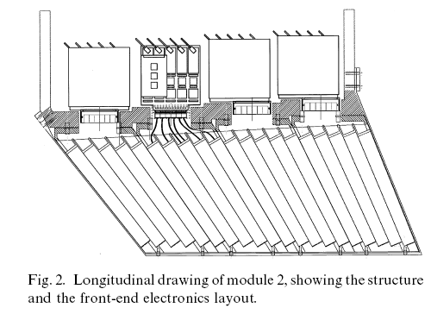
Crystals for Homogeneous EM Calorimetry

Slide 14
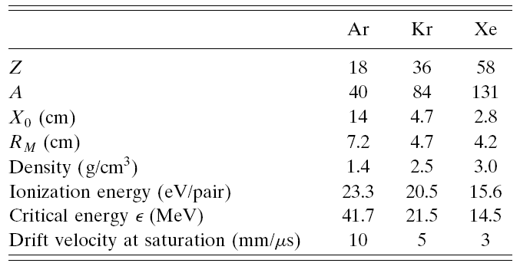
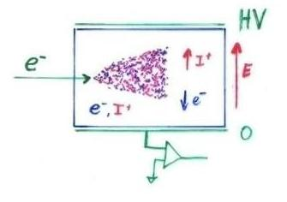
Noble Liquids for Homogeneous EM Calorimetry
When a charge particle traverses these materials, about half the lost energy is converted into ionization and half into scintillation.
The best energy resolution would obviously be obtained by collecting both the charge and light signal. This is however rarely done because of the technical difficulties to extract light and charge in the same instrument.
Krypton is preferred in homogeneous detectors due to small radiation length and therefore compact detectors. Liquid Argon is frequently used due to low cost and high purity in sampling calorimeters.

Slide 15
Noble Liquids for Homogeneous EM Calorimetry
I₂
Z=D
E
-q, v_{I}
q,v_{e}
Z=0
I₁
E.g. Liquid Argon, 5mm/ μs at 1kV/cm, 5mm gap → 1 μs for all electrons to reach the electrode.
The ion velocity is 10³ to 10⁵ times smaller → doesn’t contribute to the signal for electronics of μs integration time.
I₁(t)
T~1μs

Slide 16
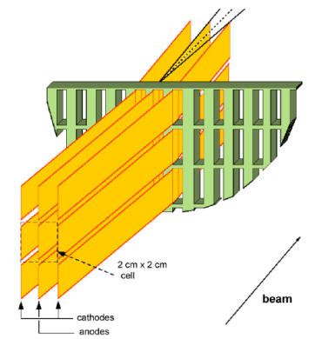
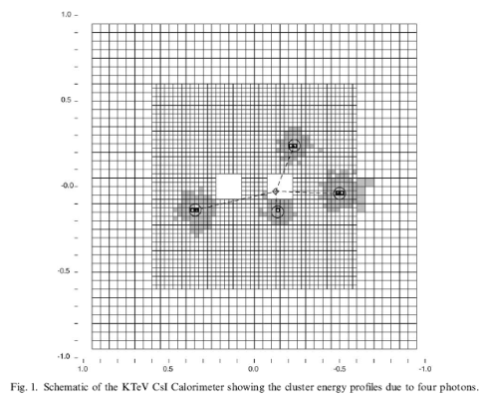
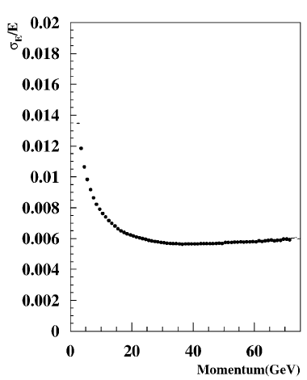
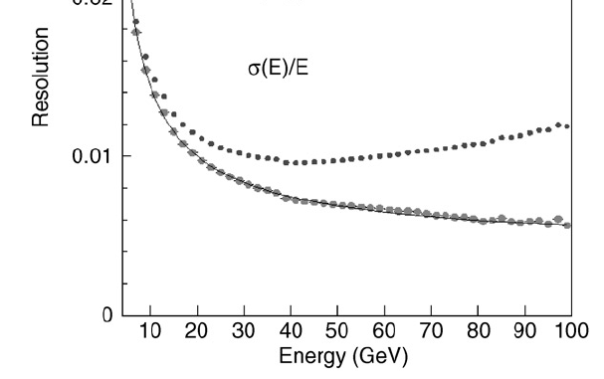
Homogeneous EM Calorimeters, Examples
NA48/62 Liquid Krypton
2cmx2cm cells
X₀ = 4.7cm
125cm length (27X₀)
ρ = 5.5cm
KTeV CsI
5cmx5cm and
X₀ = 1.85cm
2.5cmx2.5cm crystals
50cm length (27X₀)
ρ = 3.5cm
NA48 Experiment at CERN and KTeV Experiment at Fermilab, both built for measurement of direct CP violation. Homogenous calorimeters with Liquid Krypton (NA48) and CsI (KTeV). Excellent and very similar resolution.
1%
0.8%
0.6%
1%
0.8%
0.6%

Slide 17
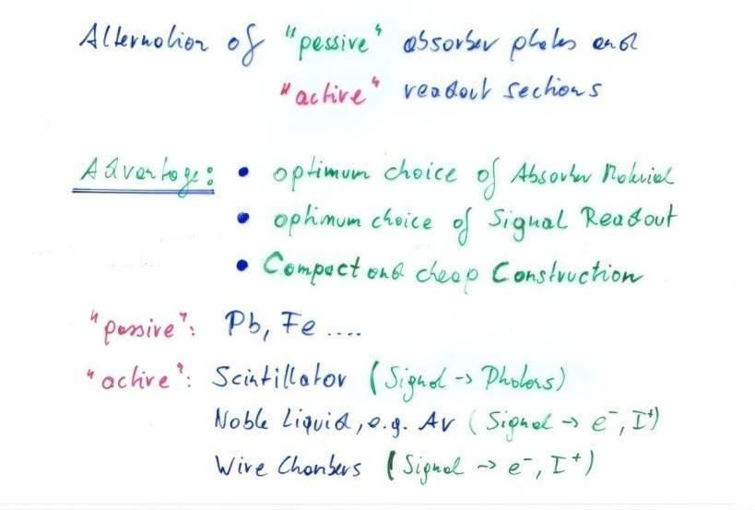
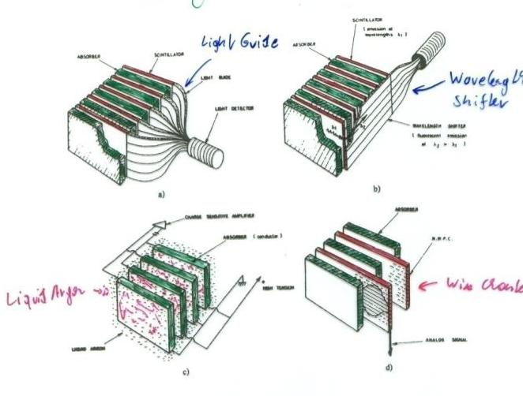
Sampling Calorimeters
Energy resolution of sampling calorimeters is in general worse than that of homogeneous calorimeters, owing to the sampling fluctuations – the fluctuation of ratio of energy deposited in the active and passive material.
The resolution is typically in the range 5-20%/Sqrt[E(GeV)] for EM calorimeters. On the other hand they are relatively easy to segment longitudinally and laterally and therefore they usually offer better space resolution and particle identification than homogeneous calorimeters.
The active medium can be scintillators (organic), solid state detectors, gas detectors or liquids.
Sampling Fraction = Energy deposited in Active/Energy deposited in passive material.

Slide 18
EM Calorimetry → Hadron Calorimetry
Similar process for Hadrons.
The equivalent to EM Bremsstrahlung is Pion radiation.
The equivalent to the radiation length is the nuclear interaction length.

Slide 19
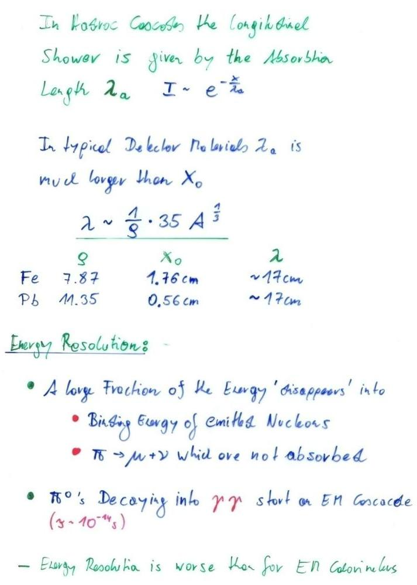
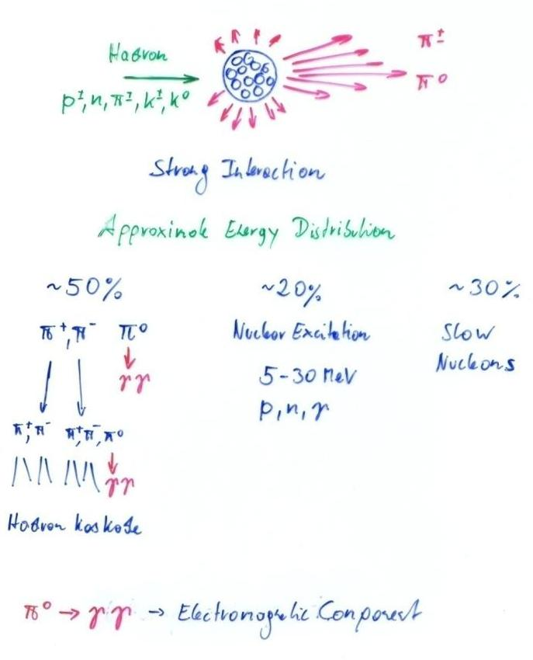
Hadronic Calorimetry

Slide 20
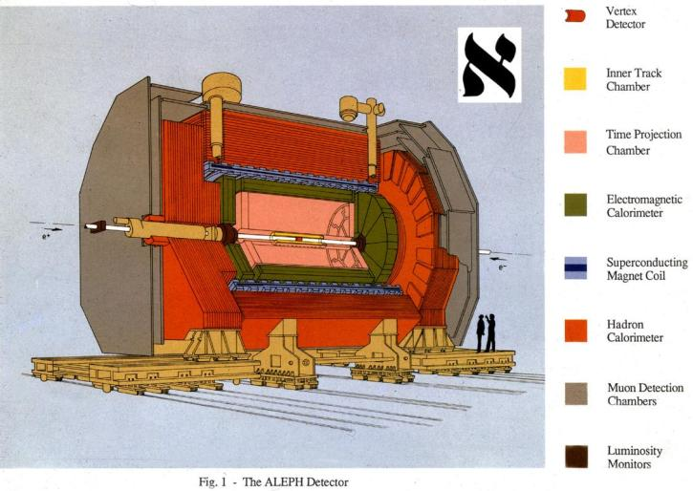
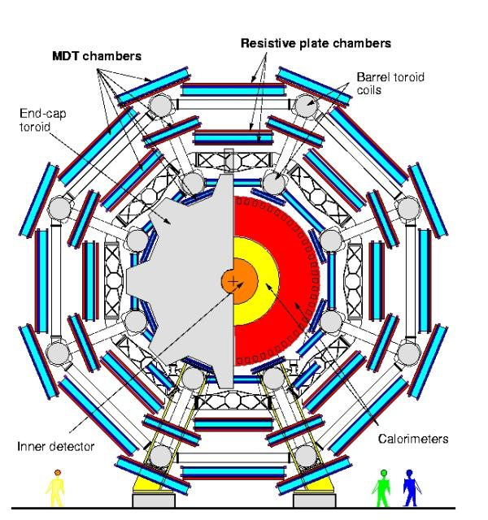
Hadron Calorimeters are Large because λ is large
Hadron Calorimeters are large and heavy because the hadronic interaction length λ, the ‘strong interaction equivalent’ to the EM radiation length X₀, is large (5-10 times larger than X₀)
Because part of the energy is ‘invisible’ (nuclear excitation, slow nucleons), the resolution of hadron calorimeters is typically worse than in EM calorimeters 20-100%/√E(GeV).

Slide 21
A few Reasons why you want to become an Experimental Particle Physicist
The Standard Model of Particles Physics, a theory that was established in the early 1970ies, is in excellent agreement with experiments. Experiments at LEP/Tevatron/LHC/KEK etc. verified the theory to impressive precision.
The Higgs Particle, a necessary element of the standard model, was found at the LHC.
Although the standard model is perfectly fitting the experiment, we know/think that it cannot be the final answer:
CP violation and the other CKM matrix elements are put into the model explicitly and they are not derived from a theory.
The Matter- Antimatter asymmetry in the Universe cannot be explained by the level of standard model CP violation.
The masses of the particles are also unexplained.
The cosmological constant predicted by the standard model differs by many orders of magnitude from the observed one.
The Higgs mass renormalization requires fine tuning operations etc. etc.

Slide 22
A few Reasons why you want to become an Experimental Particle Physicist
Substantial theory efforts did not really advance on these questions and did not touch base with experiment.
It is very difficult to find out what is wrong with the theory if all experimental results are in agreement with the theory.
The next step in advancing our knowledge will come from experiment. Maybe LHC or some telescope, or some astrophysics experiment or some other future accelerator …
We have to invent new technologies for future accelerators and experiments !

Slide 23
x 10¹³ → LHC
+
1.5V
_
e⁻
You
have to develop the tricks and technologies to advance on the most fundamental questions in Physics !

Slide 24
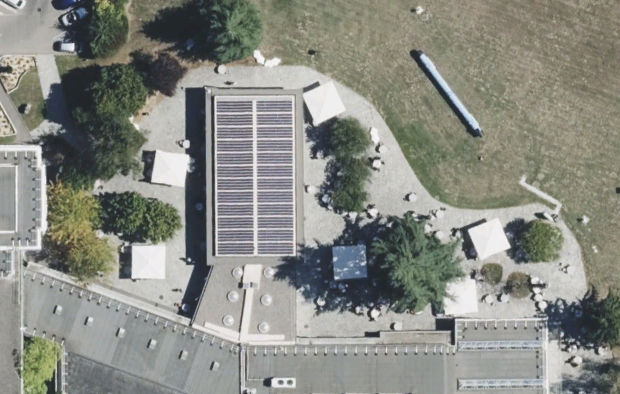
Today 14:00 – 15:30

Slide 26
Detector Systems

Slide 27
CMS Detector

Slide 28
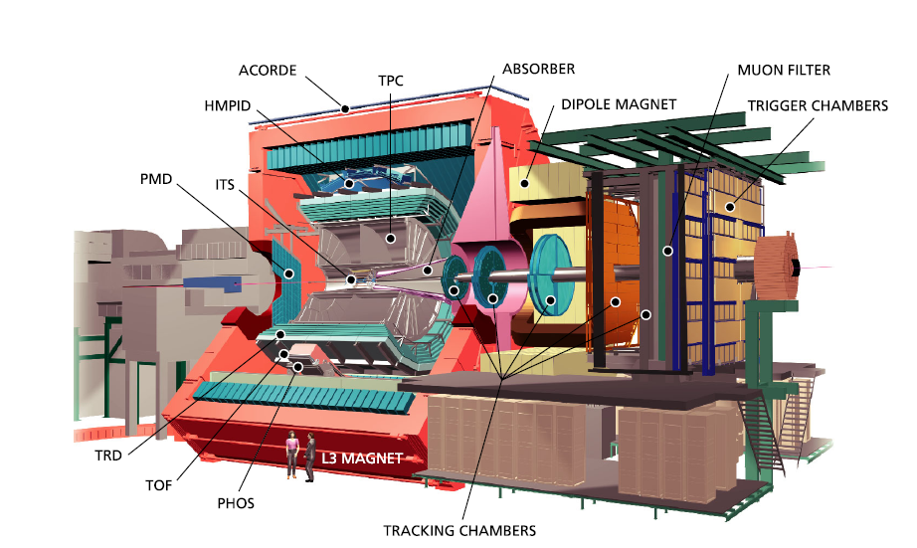
ALICE

Slide 29
ALICE Particle ID
Alice uses ~ all
known techniques!
TPC + ITS
(dE/dx)
π/K
K/p
e /π
TOF
e /π
π/K
K/p
HMPID
(RICH)
π/K
K/p
0 1 2 3 4 5 p (GeV/c)
TPC (rel. rise) π /K/p
TRD e /π
PHOS γ /π⁰
π/K
K/p
1 10 100 p (GeV/c)

Slide 30
MiniBooNE detector, Neutrinos
800 tons of mineral oil
1280 photomultipliers

Slide 31
Super-Kamiokande, Neutrinos

Slide 32
Daya Bay, Neutrinos
20 tons of liquid scintillator

Slide 33
NEXT experiment, double β decay

Slide 34
CERN Neutrino Gran Sasso
(CNGS)

Slide 35
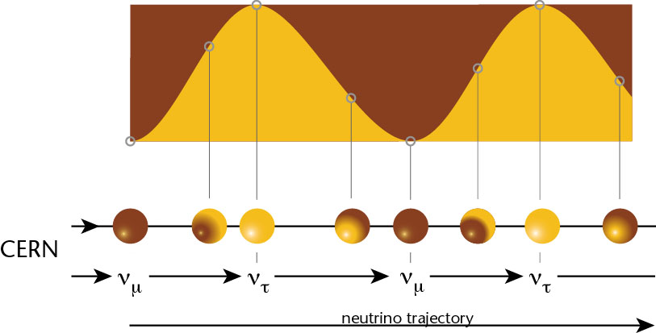
CNGS
If neutrinos have mass:
ν_{e}
Muon neutrinos produced at CERN.
See if tau neutrinos arrive in Italy.
ν_{μ}
ν_{τ}

Slide 36
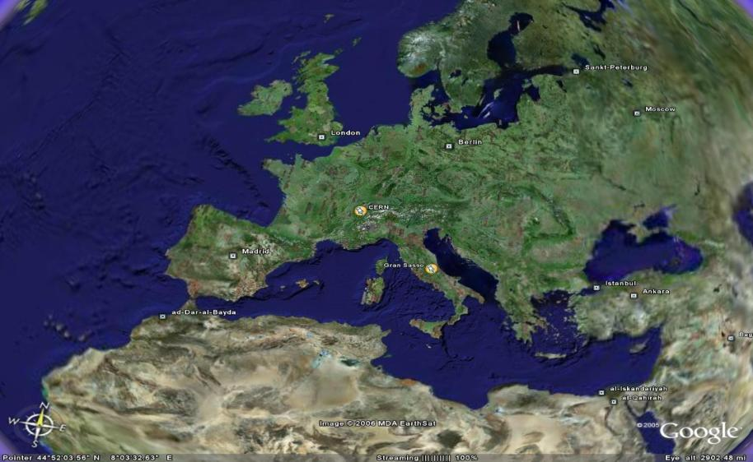
CNGS Project
CNGS (CERN Neutrino Gran Sasso)
  A long base-line neutrino beam facility (732km)
  send ν_{μ} beam produced at CERN
  detect ν_{τ} appearance in OPERA experiment at Gran Sasso
➔ direct proof of ν_{μ} - ν_{τ} oscillation (appearance experiment)

Slide 37
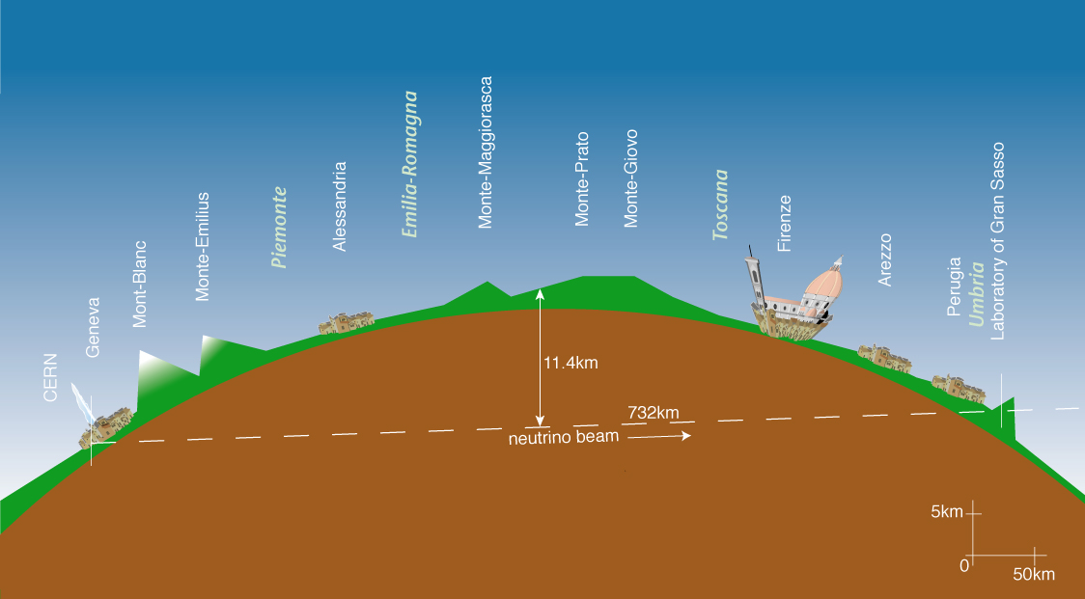
CNGS

Slide 38
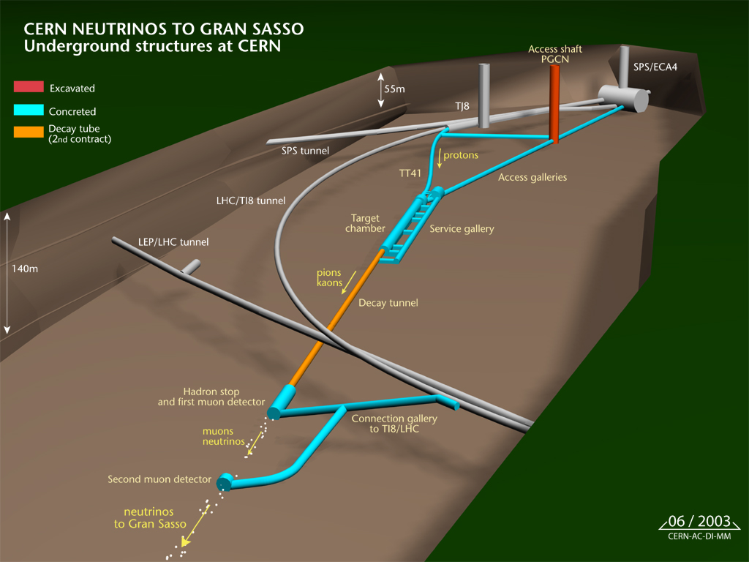
CNGS

Slide 39
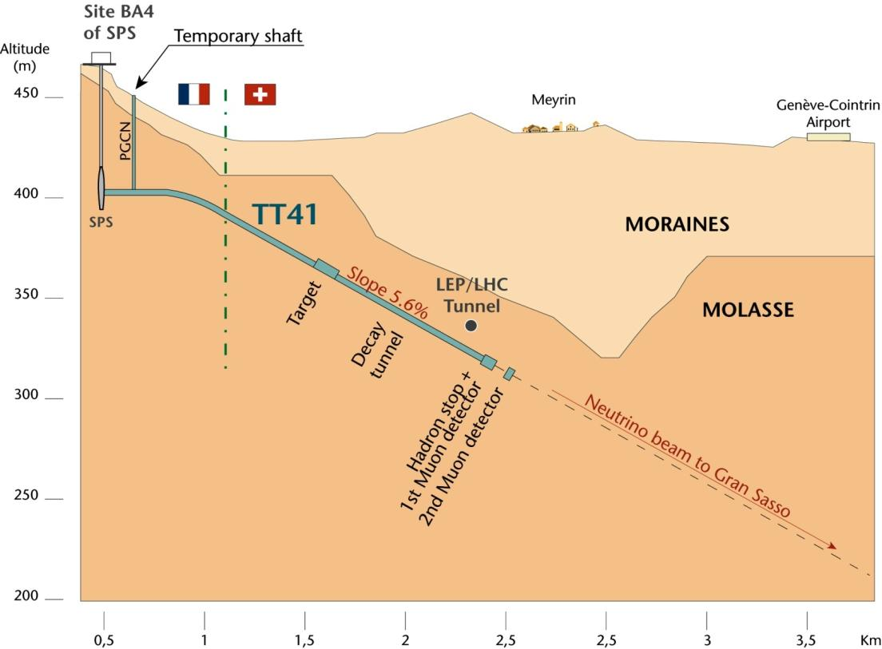
CNGS

Slide 40
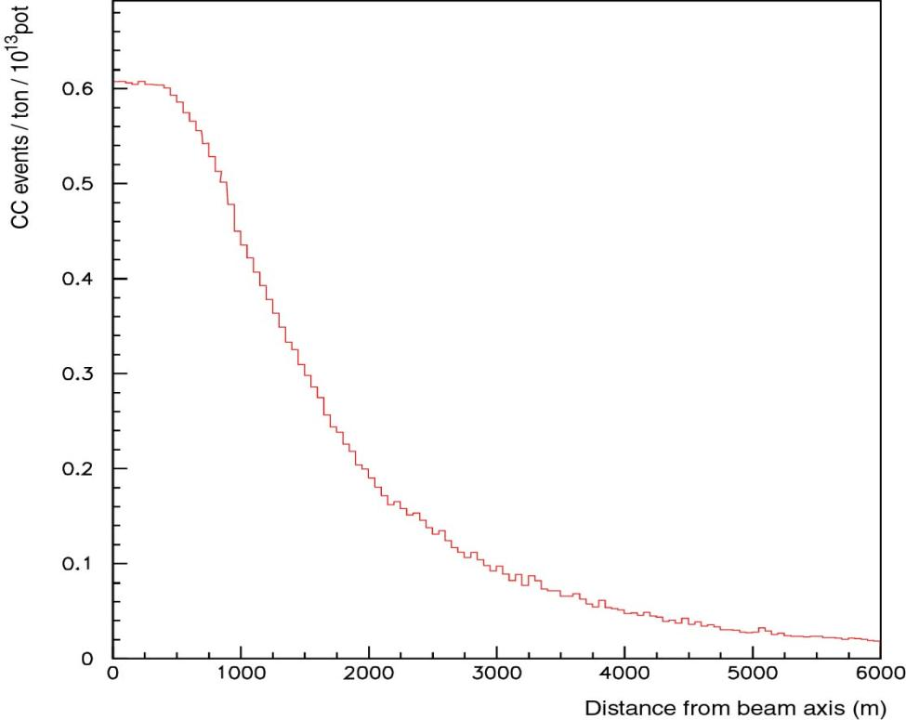
Radial Distribution of the ν_{μ}-Beam at GS
5 years CNGS operation, 1800 tons target:
30000 neutrino interactions
~150 ν_{τ} interactions
~15 ν_{τ} identified
< 1 event of background
Flat top: 500m
FWHM: 2800m
typical size of a detector at Gran Sasso
E. Gschwendtner, CERN

Slide 41
Neutrinos at CNGS: Some Numbers
For 1 year of CNGS operation, we expect:
protons on target 2 x 10¹⁹
pions / kaons at entrance to decay tunnel 3 x 10¹⁹
ν_{μ} in direction of Gran Sasso 10¹⁹
ν_{μ} in 100 m² at Gran Sasso 3 x 10¹⁴
ν_{μ} events per day in OPERA ≈ 2500
ν_{τ} events (from oscillation) ≈ 2

Slide 42
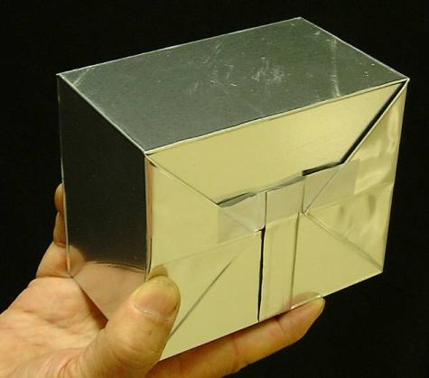
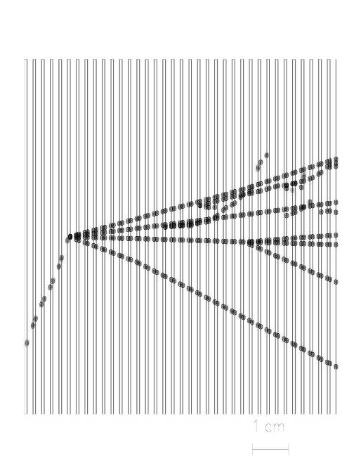
Opera Experiment at Gran Sasso
Basic unit: brick
56 Pb sheets + 56 photographic films (emulsion sheets)
Lead plates: massive target
Emulsions: micrometric precision
brick
Brick
1 mm
τ
8.3kg
ν
10.2 x 12.7 x 7.5 cm³
Pb
Couche de gélatine photographique 40 μm

Slide 43
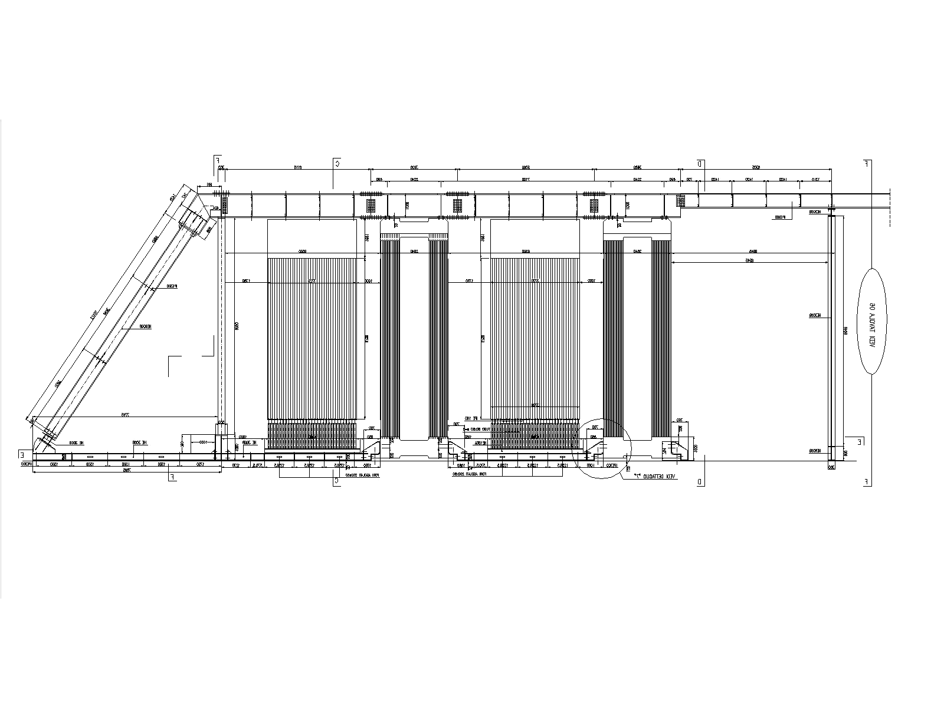
Opera Experiment at Gran Sasso
31 target planes / supermodule
In total: 206336 bricks, 1766 tons
SM1
SM2
υ
Targets
Magnetic Spectrometers
First observation of CNGS beam neutrinos : August 18th, 2006
Notes:
Lead makes target mass, emulsions allows to see tracks!
Walls are made of bricks, bricks are made of sandwiches, sandwiches are made of lead and emulsion sheets. (type of photographic film)

Slide 44
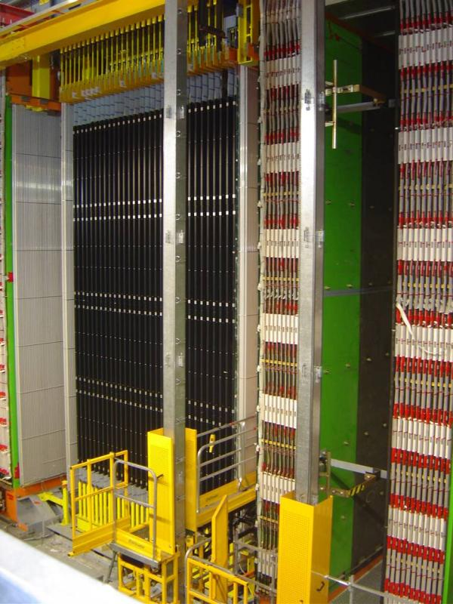
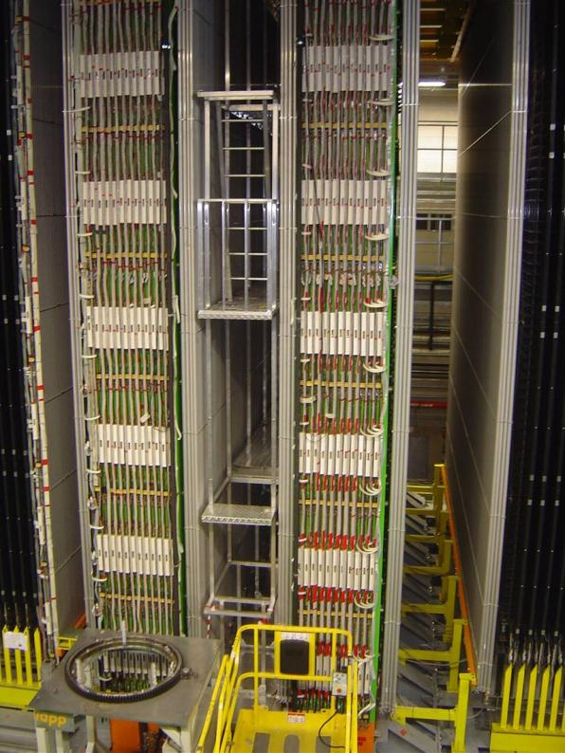
Opera Experiment at Gran Sasso
Second Super-module
Details of the first spectrometer
Scintillator planes 5900 m²
8064 7m long drift tubes
3050 m² Resistive Plate Counters
2000 tons of iron for the two magnets
Notes:
2 photos of OPERA, so we see, experiment exists!

Slide 45
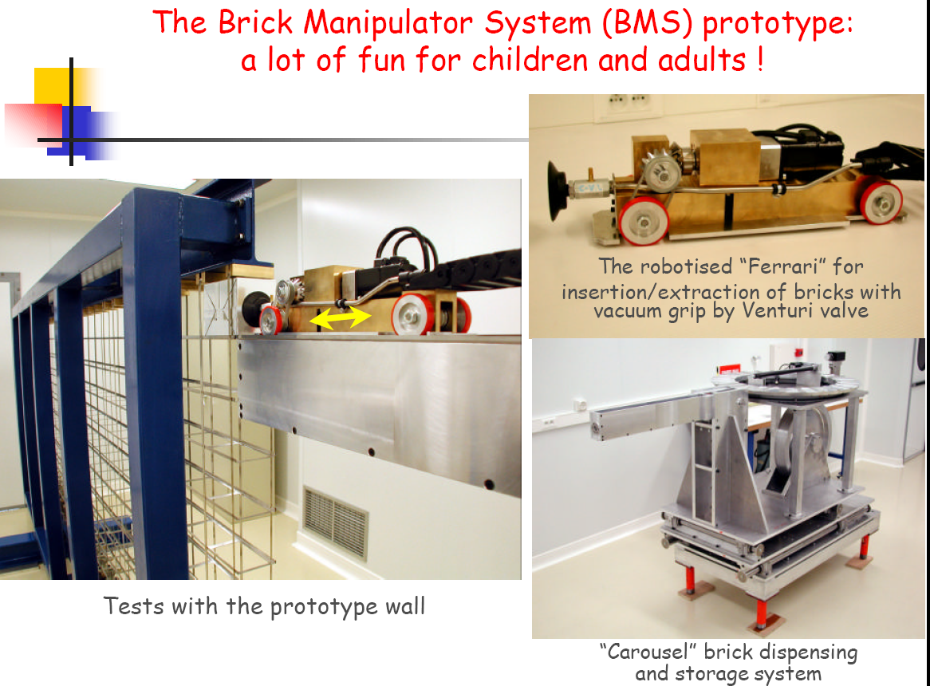
Opera Experiment at Gran Sasso

Slide 46
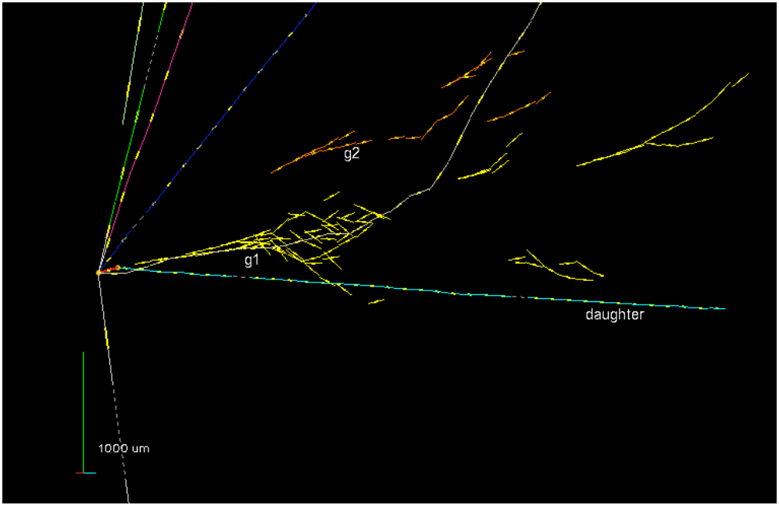
First Tau Candidate !

Slide 47

AMS
Alpha Magnetic Spectrometer
Try to find Antimatter in the primary cosmic rays.
Study cosmic ray composition etc. etc.

Slide 48
AMS
Installed on the space station.

Slide 49
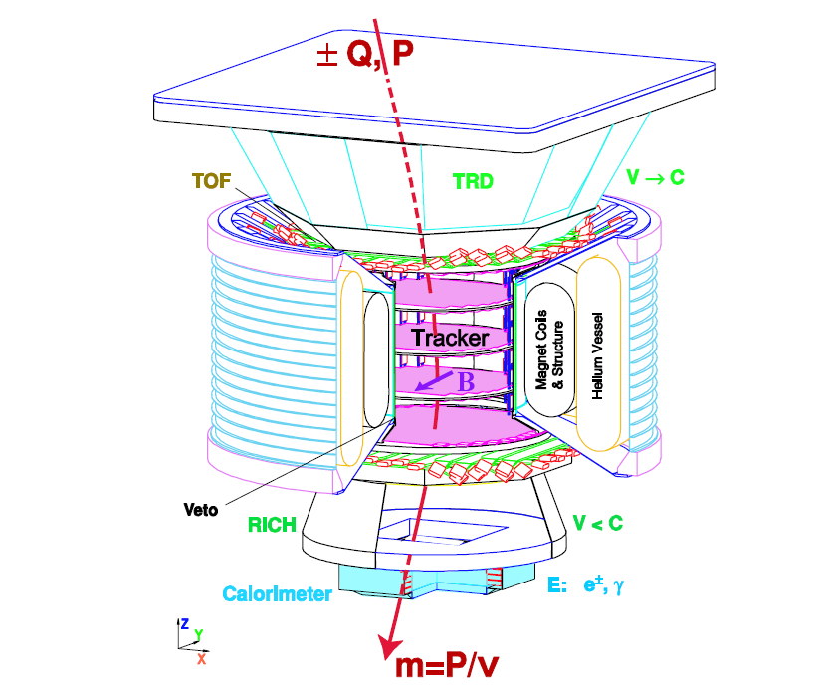
AMS

Slide 50
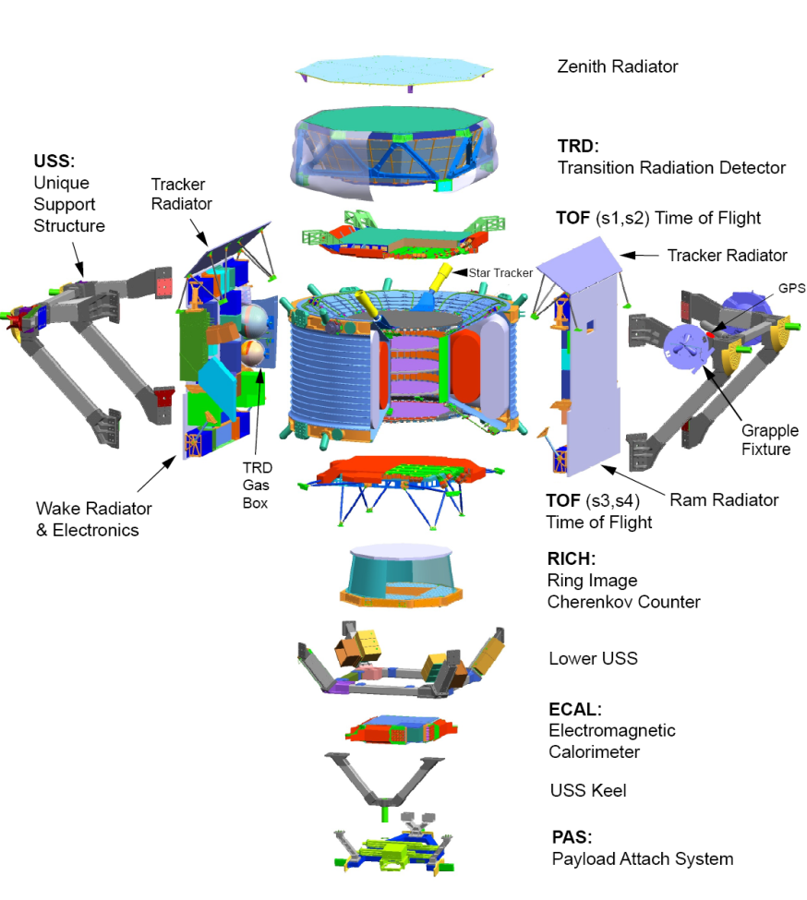
AMS

