Slide 1
Making Predictions for Hadron Colliders
Mike Seymour – University of Manchester

Slide 2
Making Predictions for Hadron Colliders
1. From Feynman Diagrams to Cross Sections

Slide 3
Phenomenology
Theoretical Physics
Experimental Physics
Phenomenology

Slide 4
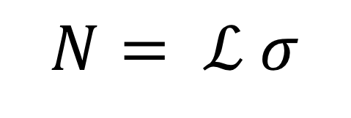
Calculating Event Rates
$$N= ℒ σ$$
Number of events
Integrated Luminosity
Cross section

Slide 5
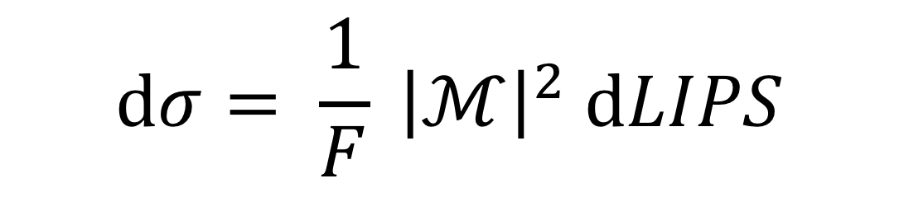

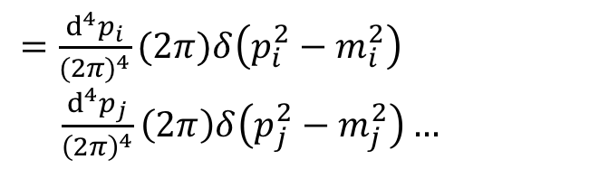

Calculating Cross Sections
$$dσ= \frac{1}{F} {\left|ℳ\right|}^{2} dLIPS$$
Flux factor
(Quantum mechanical) amplitude squared
Lorentz Invariant Phase Space
$=\frac{d^{4}p_{i}}{{(2π)}^{4}}(2π)δ\left(p_{i}^{2}−m_{i}^{2}\right)$ $\frac{d^{4}p_{j}}{{\left(2π\right)}^{4}}\left(2π\right)δ\left(p_{j}^{2}−m_{j}^{2}\right)…$
${(2π)}^{4}δ(p_{1}+p_{2}−p_{i}−p_{j}−$ … )
$$=2s=4E_{1}E_{2}$$
Notes:
Cf Fermi’s Golden Rule: rate = amplitude squared times density of states

Slide 6
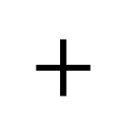
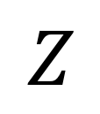
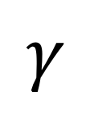
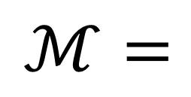

Calculating Cross Sections
$$dσ= \frac{1}{F} {\left|ℳ\right|}^{2} dLIPS$$
$$γ$$
$$Z$$
$$ℳ=$$
$$+$$
$$+$$
$$+$$
$$+…$$

Slide 7
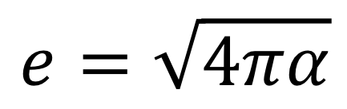
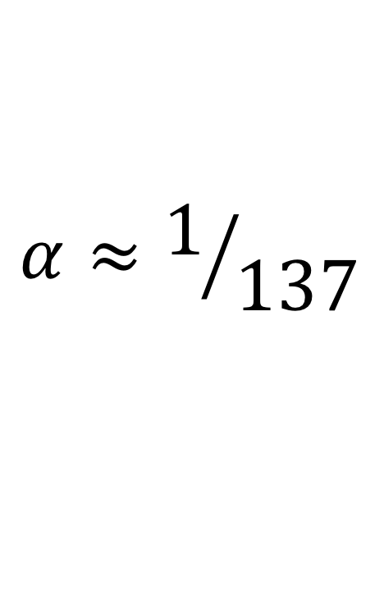
Feynman Rules
Elementary charge
$$e=\sqrt{4πα}$$
$$α≈1/{137}$$

Slide 8
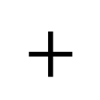
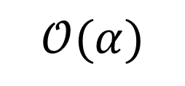
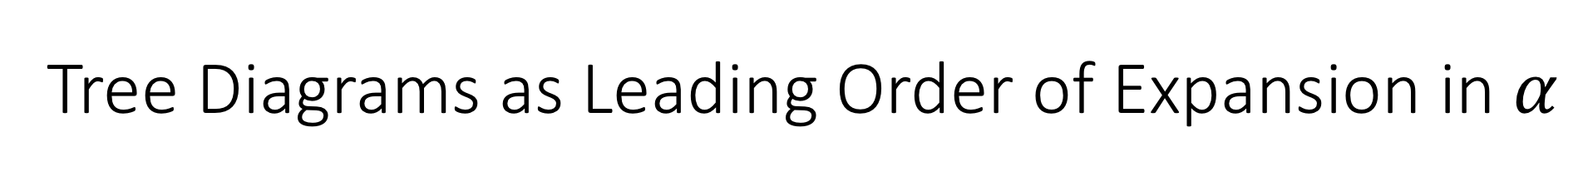
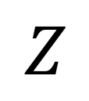
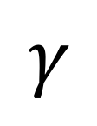
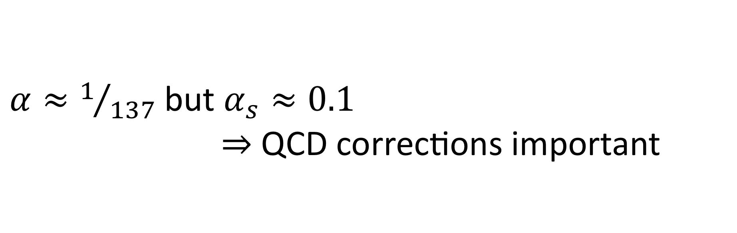

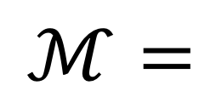
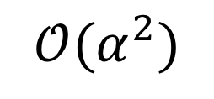
Tree Diagrams as Leading Order of Expansion in $α$
$$γ$$
$$Z$$
$$ℳ=$$
$$+$$
$$+$$
$$𝒪(α)$$
$$+$$
$$+…$$
$$𝒪(α^{2})$$
$α≈1/{137}$ but $α_{s}≈0.1$
$⇒$ QCD corrections important

Slide 9
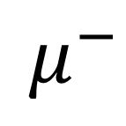

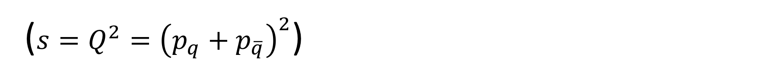
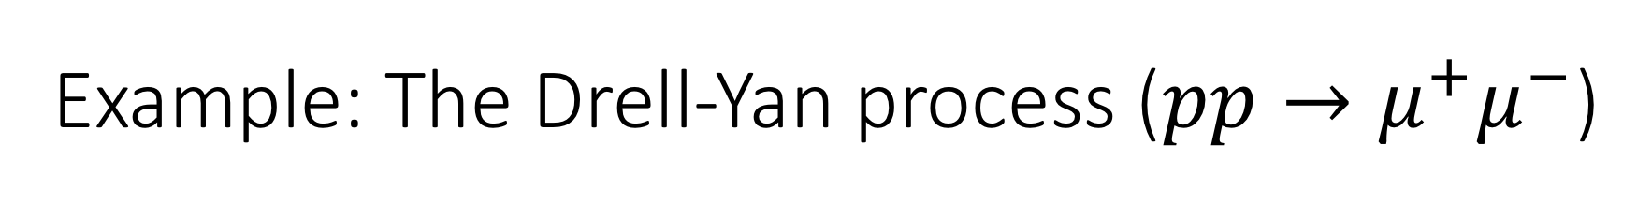
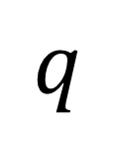
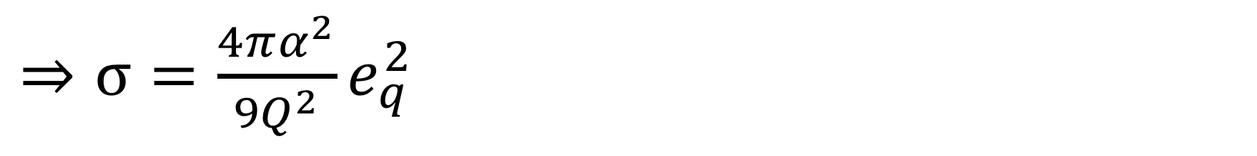
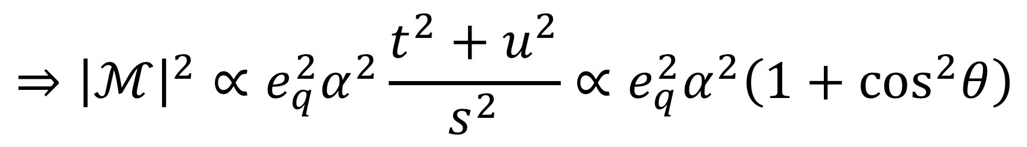
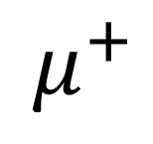
Example: The Drell-Yan process ($pp→μ^{+}μ^{−}$)
$$q$$
$$μ^{−}$$
$$γ$$
$$ℳ=$$
$$\overline{q}$$
$$μ^{+}$$
$$⇒{\left|ℳ\right|}^{2}∝e_{q}^{2}α^{2}\frac{t^{2}+u^{2}}{s^{2}}∝e_{q}^{2}α^{2}\left(1+\cos^{2}θ\right)$$
$⇒σ=\frac{4πα^{2}}{9Q^{2}}e_{q}^{2}$
($s=Q^{2}={\left(p_{q}+p_{\overline{q}}\right)}^{2}$)

Slide 10
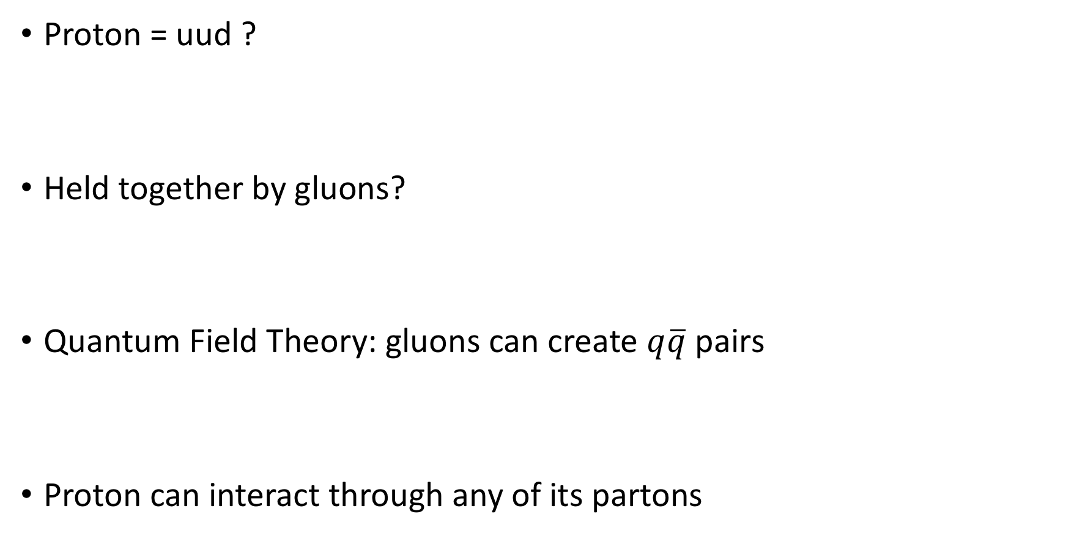
Proton structure
Proton = uud ?
Held together by gluons?
Quantum Field Theory: gluons can create $q\overline{q}$ pairs
Proton can interact through any of its partons

Slide 11

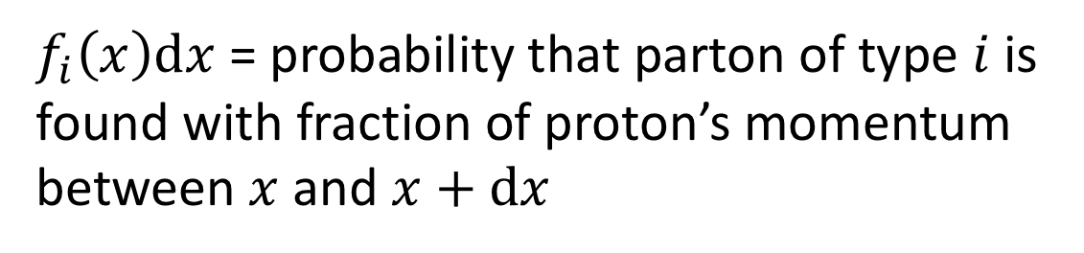
Proton structure: parton distribution functions
How is the proton’s energy shared between its parton constituents?
Measure in deep inelastic electron scattering
Quantify by parton distribution function
But how long do those quantum fluctuations live?
⇒ PDFs depend on the momentum scale of the probe $f_{i}\left(x,Q^{2}\right)dx$
$f_{i}\left(x\right)dx$ = probability that parton of type $i$ is found with fraction of proton’s momentum between $x$ and $x+dx$

Slide 12
Proton structure: parton distribution functions

Slide 13

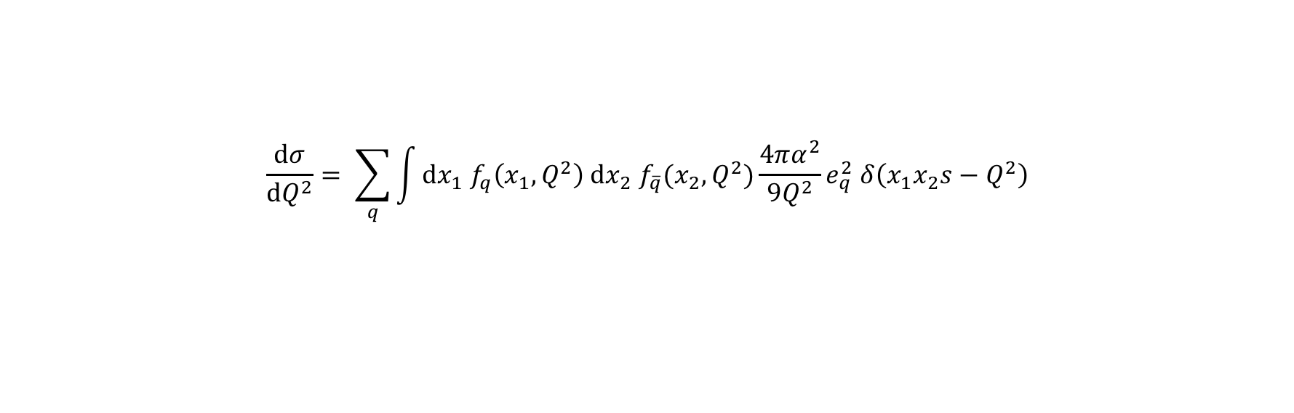
The Drell-Yan process ($pp→μ^{+}μ^{−}$)
$$\frac{dσ}{dQ^{2}}= \sum_{q}{\int{dx_{1} f_{q}\left(x_{1},Q^{2}\right) dx_{2} f_{\overline{q}}(x_{2},Q^{2})}\frac{4πα^{2}}{9Q^{2}}e_{q}^{2} δ\left(x_{1}x_{2}s−Q^{2}\right)}$$

Slide 14
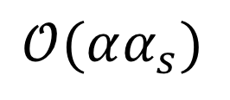
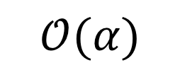

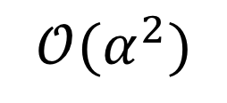
Loop Diagrams as Higher Order Corrections
Quantum mechanics: sum over unobserved quantum numbers
= integrate over gluon momenta
$$ℳ=$$
$$+$$
$$+…$$
$$𝒪(α)$$
$$𝒪(αα_{s})$$
$${\left|ℳ\right|}^{2}={\left|ℳ_{0}\right|}^{2}+2ℜ\left(ℳ_{0}^{∗}ℳ_{1}\right)+{\left|ℳ_{1}\right|}^{2}+…$$
$$𝒪(α^{2})$$
$$𝒪(α^{2}α_{s})$$

Slide 15
Loop Diagrams as Higher Order Corrections
Gluon momentum integral is divergent! (= minus infinity)
Divergence comes from:
  Momentum = 0
  Momentum = parallel to quark or antiquark
$$ℳ=$$
$$+$$
$$+…$$
$$𝒪(α)$$
$$𝒪(αα_{s})$$

Slide 16

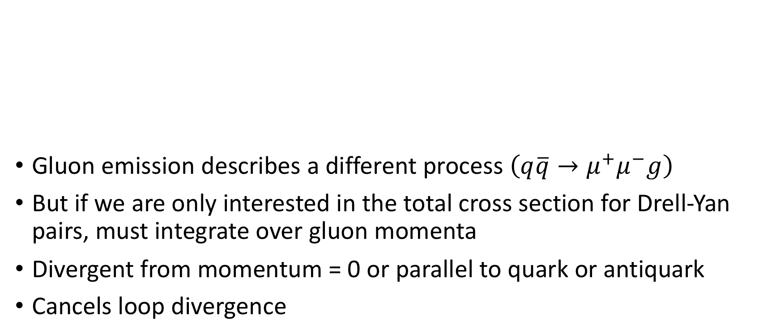
Gluon Emission as Higher Order Correction
Gluon emission describes a different process $\left(q\overline{q}→μ^{+}μ^{−}g\right)$
But if we are only interested in the total cross section for Drell-Yan pairs, must integrate over gluon momenta
Divergent from momentum = 0 or parallel to quark or antiquark
Cancels loop divergence
$$ℳ=$$
$$+$$
$$𝒪(α\sqrt{α_{s}})$$

Slide 17
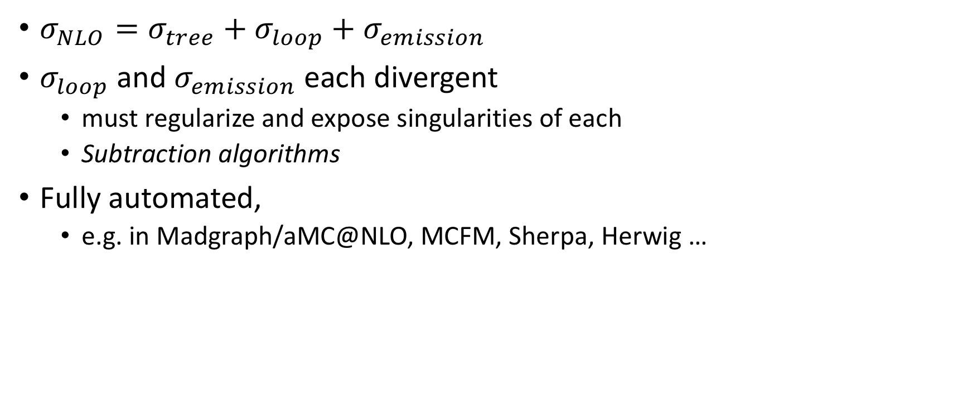
Next-to-Leading Order (NLO) cross section
$σ_{NLO}=σ_{tree}+σ_{loop}+σ_{emission}$
$σ_{loop}$ and $σ_{emission}$ each divergent
  must regularize and expose singularities of each
  Subtraction algorithms
Fully automated,
  e.g. in Madgraph/aMC@NLO, MCFM, Sherpa, Herwig …

Slide 18
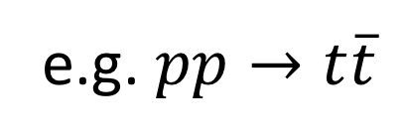
State of the Art – NNLO Calculations
e.g. $pp→t\overline{t}$

Slide 19
From Feynman Diagrams to Cross Sections
Major part of phenomenology = calculating cross sections
LO = write down all tree diagrams, integrate phase space numerically
Convolute with parton distribution functions (fitted to data)
NLO = one-loop diagrams, one-emission processes
  Extract singularities from integrals, integrate analytically
  Integrate remainders numerically
NNLO = two-loop diagrams, one-emission at one-loop, and two emissions
But LHC events contain hundreds of additional particles…

