Slide 2
BGC Regular meeting – CERN Updates
Krystian Sidorowski
February 2022, CERN, Geneva, Switzerland

Slide 3
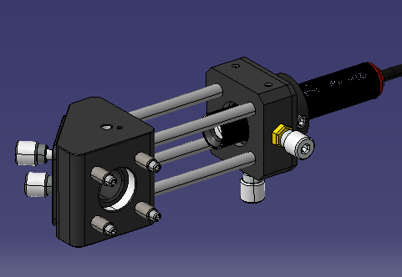
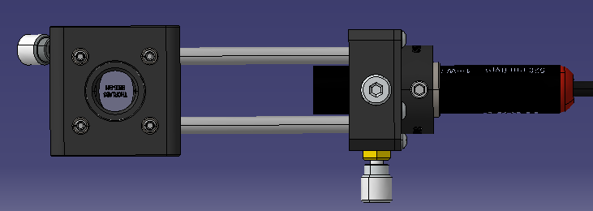
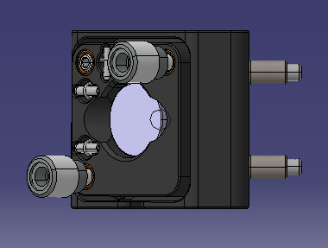
BGC Version 4 – Mirror and Laser assembly for the alignment
Mirror mount with 2 angles Adjustment
Laser
2 directions adjustment laser mount
138 mm
38 mm

Slide 4
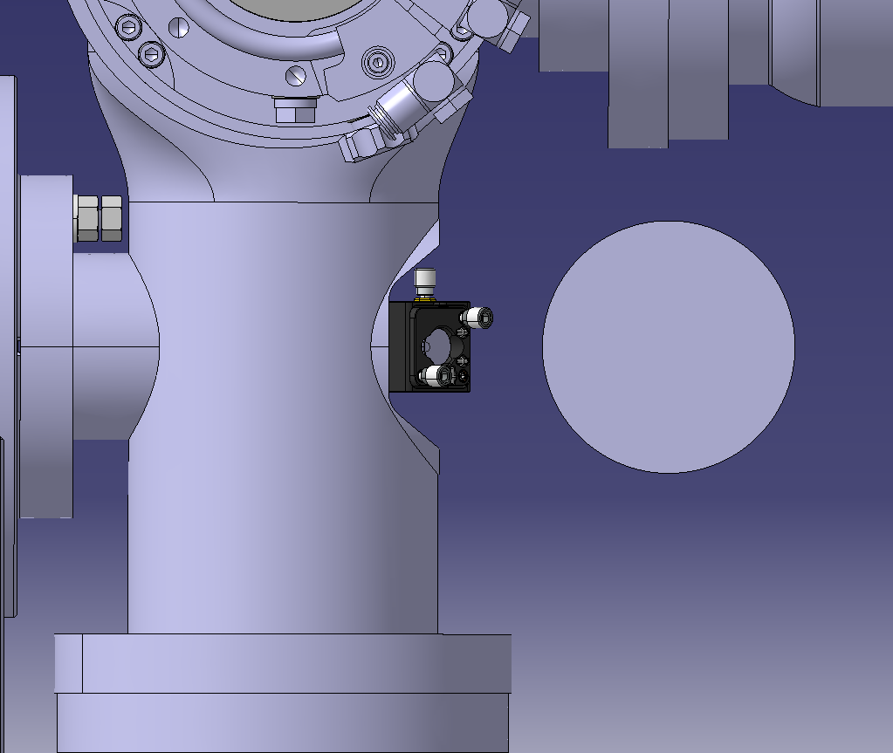
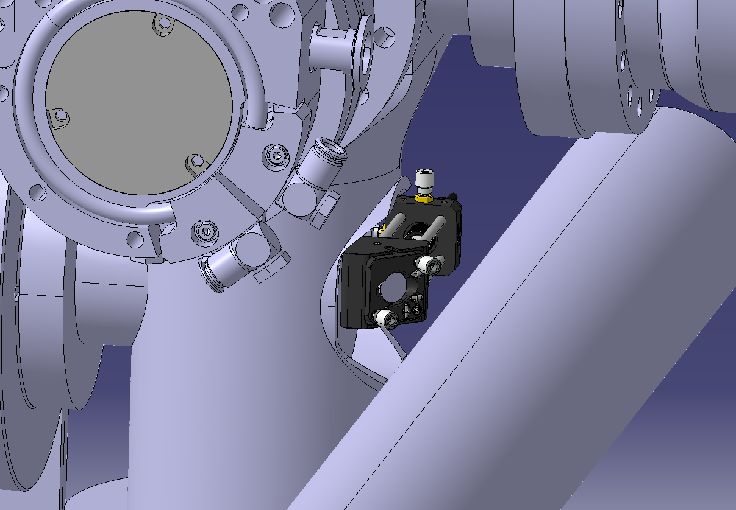
BGC Version 4 – Mirror and Laser assembly for the alignment
Mirror/laser assembly
Beam pipe
11mm
Gas injection chamber

Slide 5
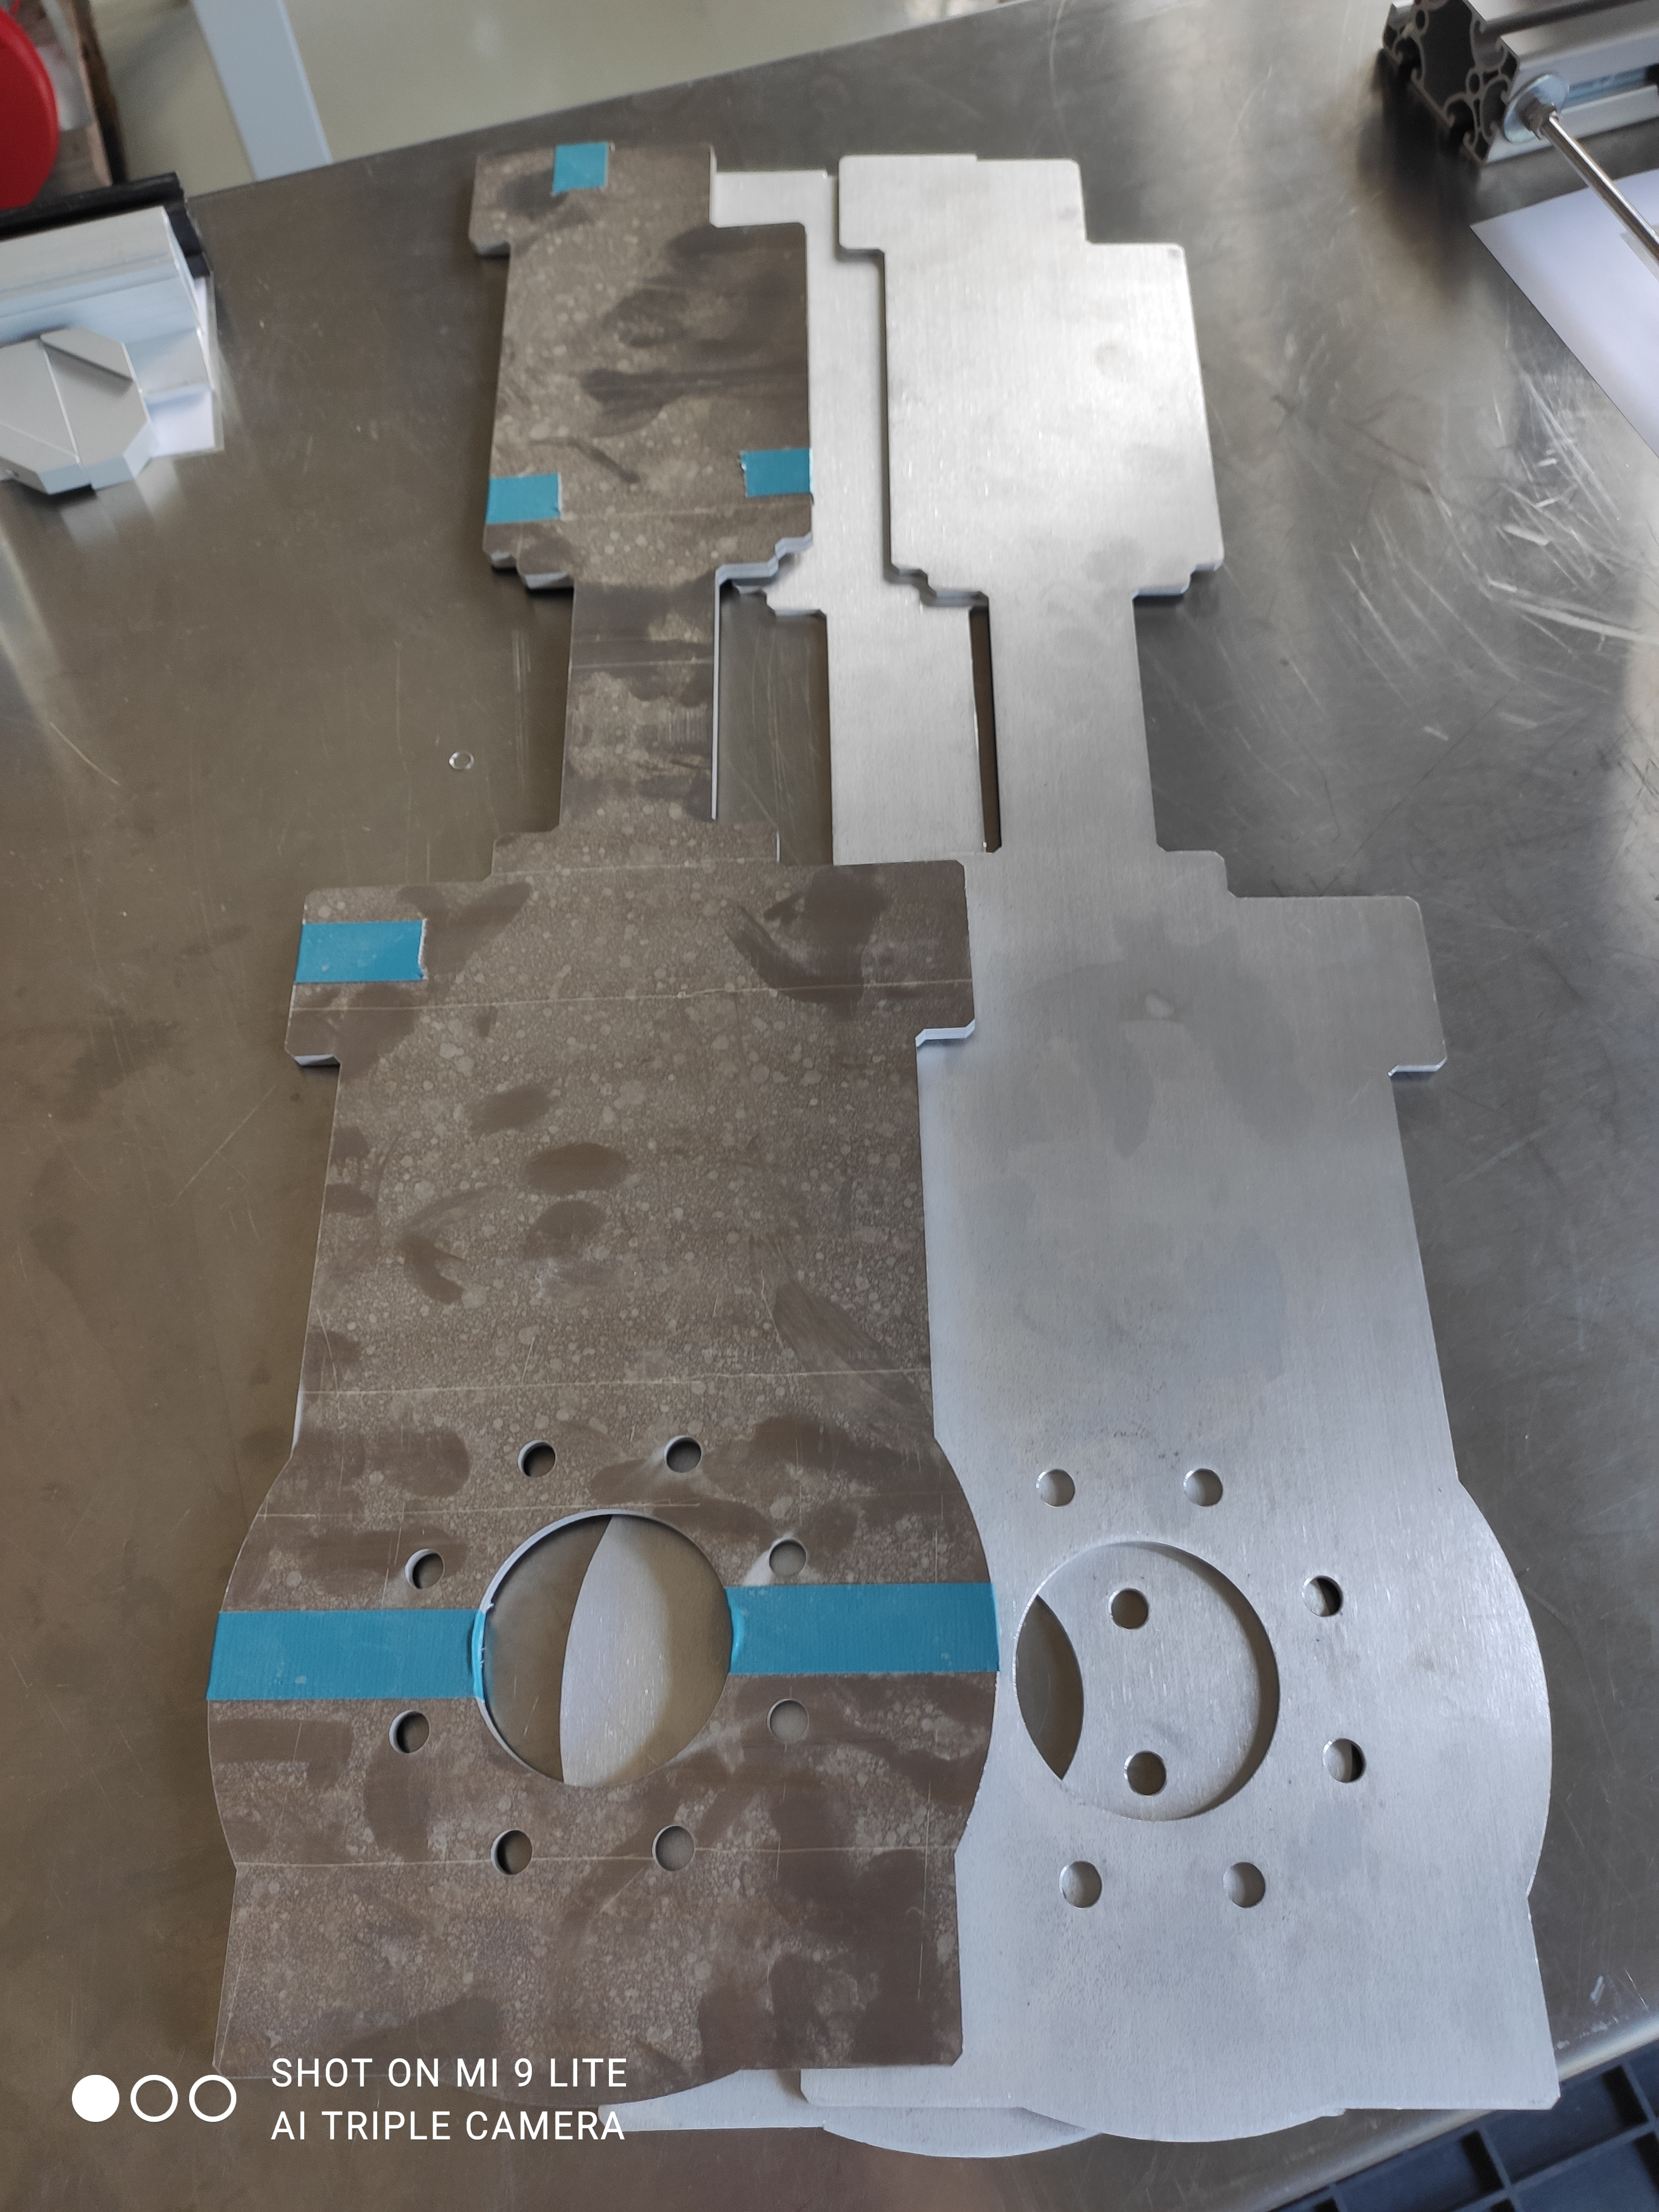
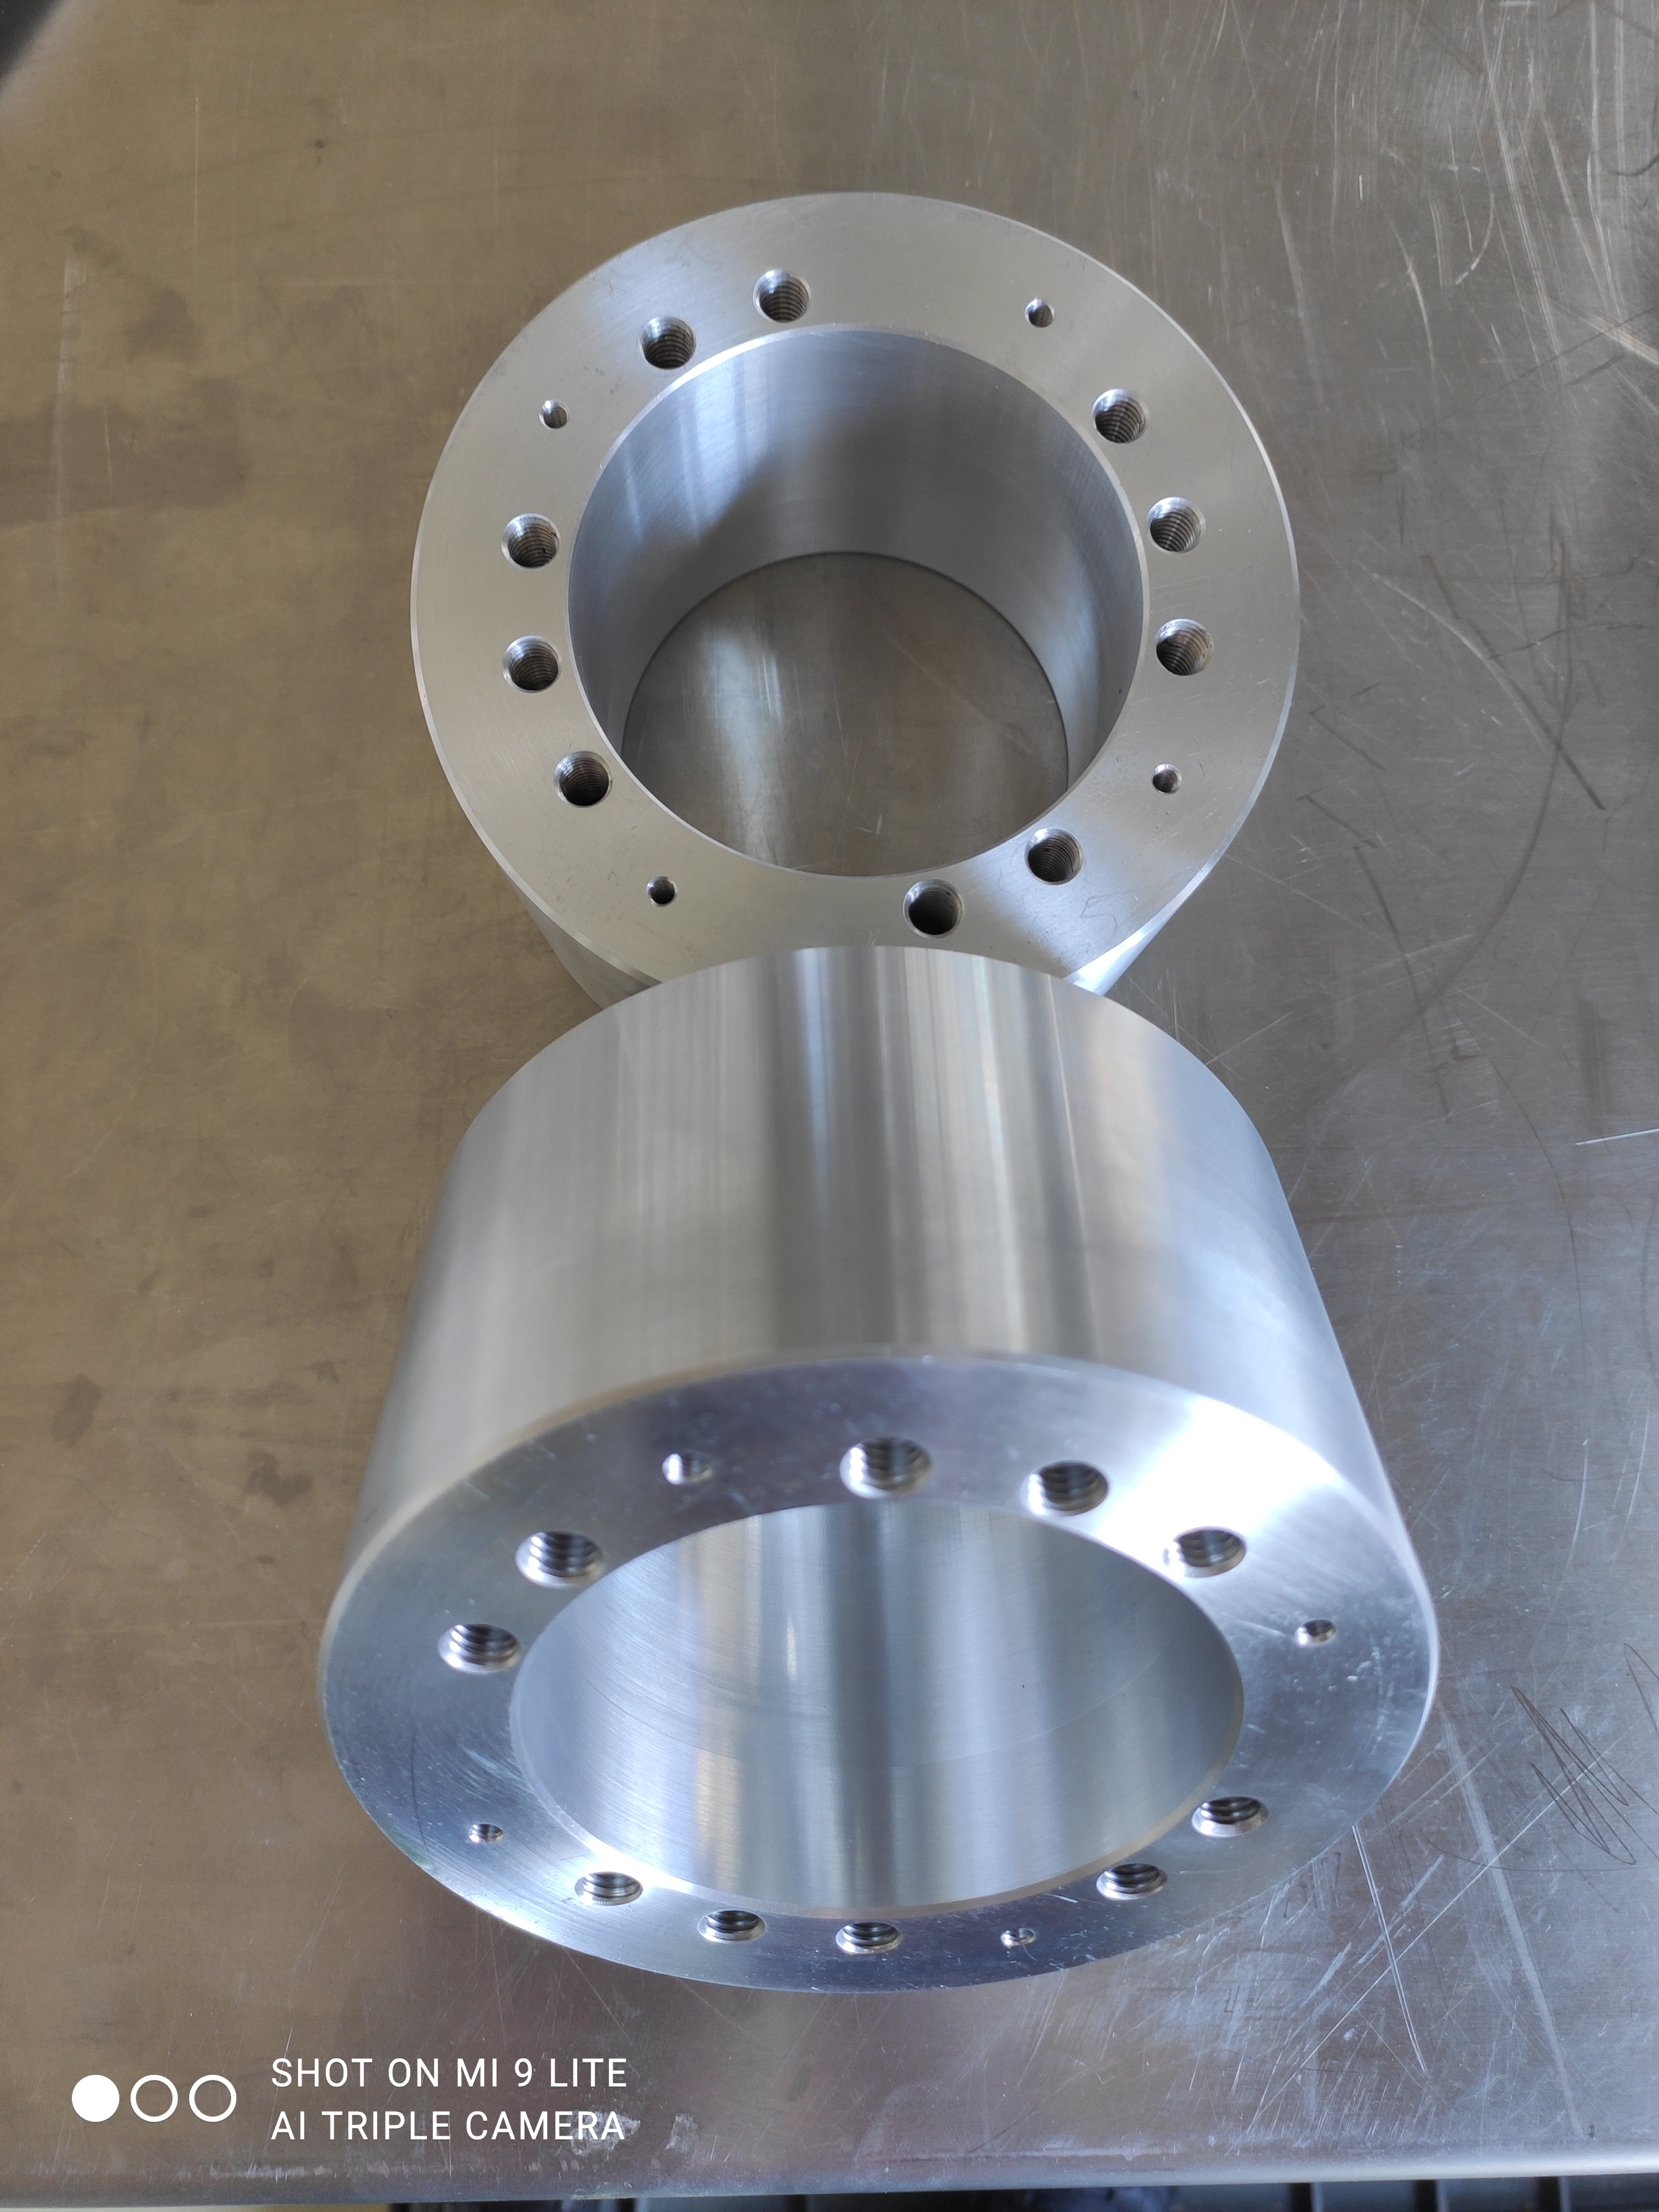
BGC Version 4 MockUp
New pieces were machined

Slide 6
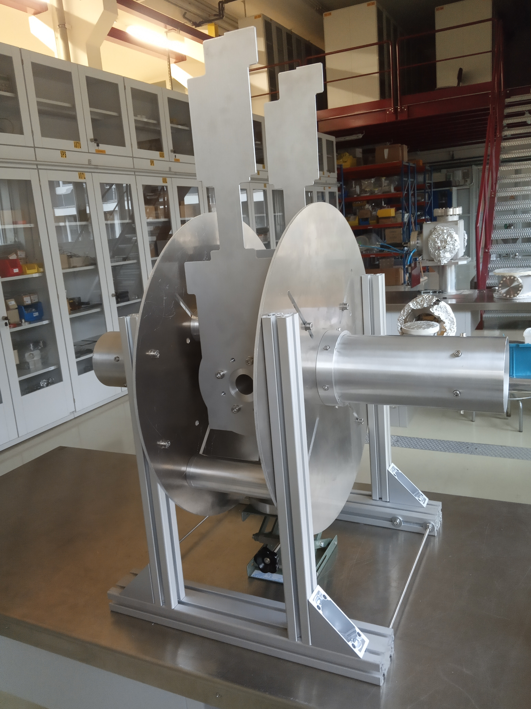
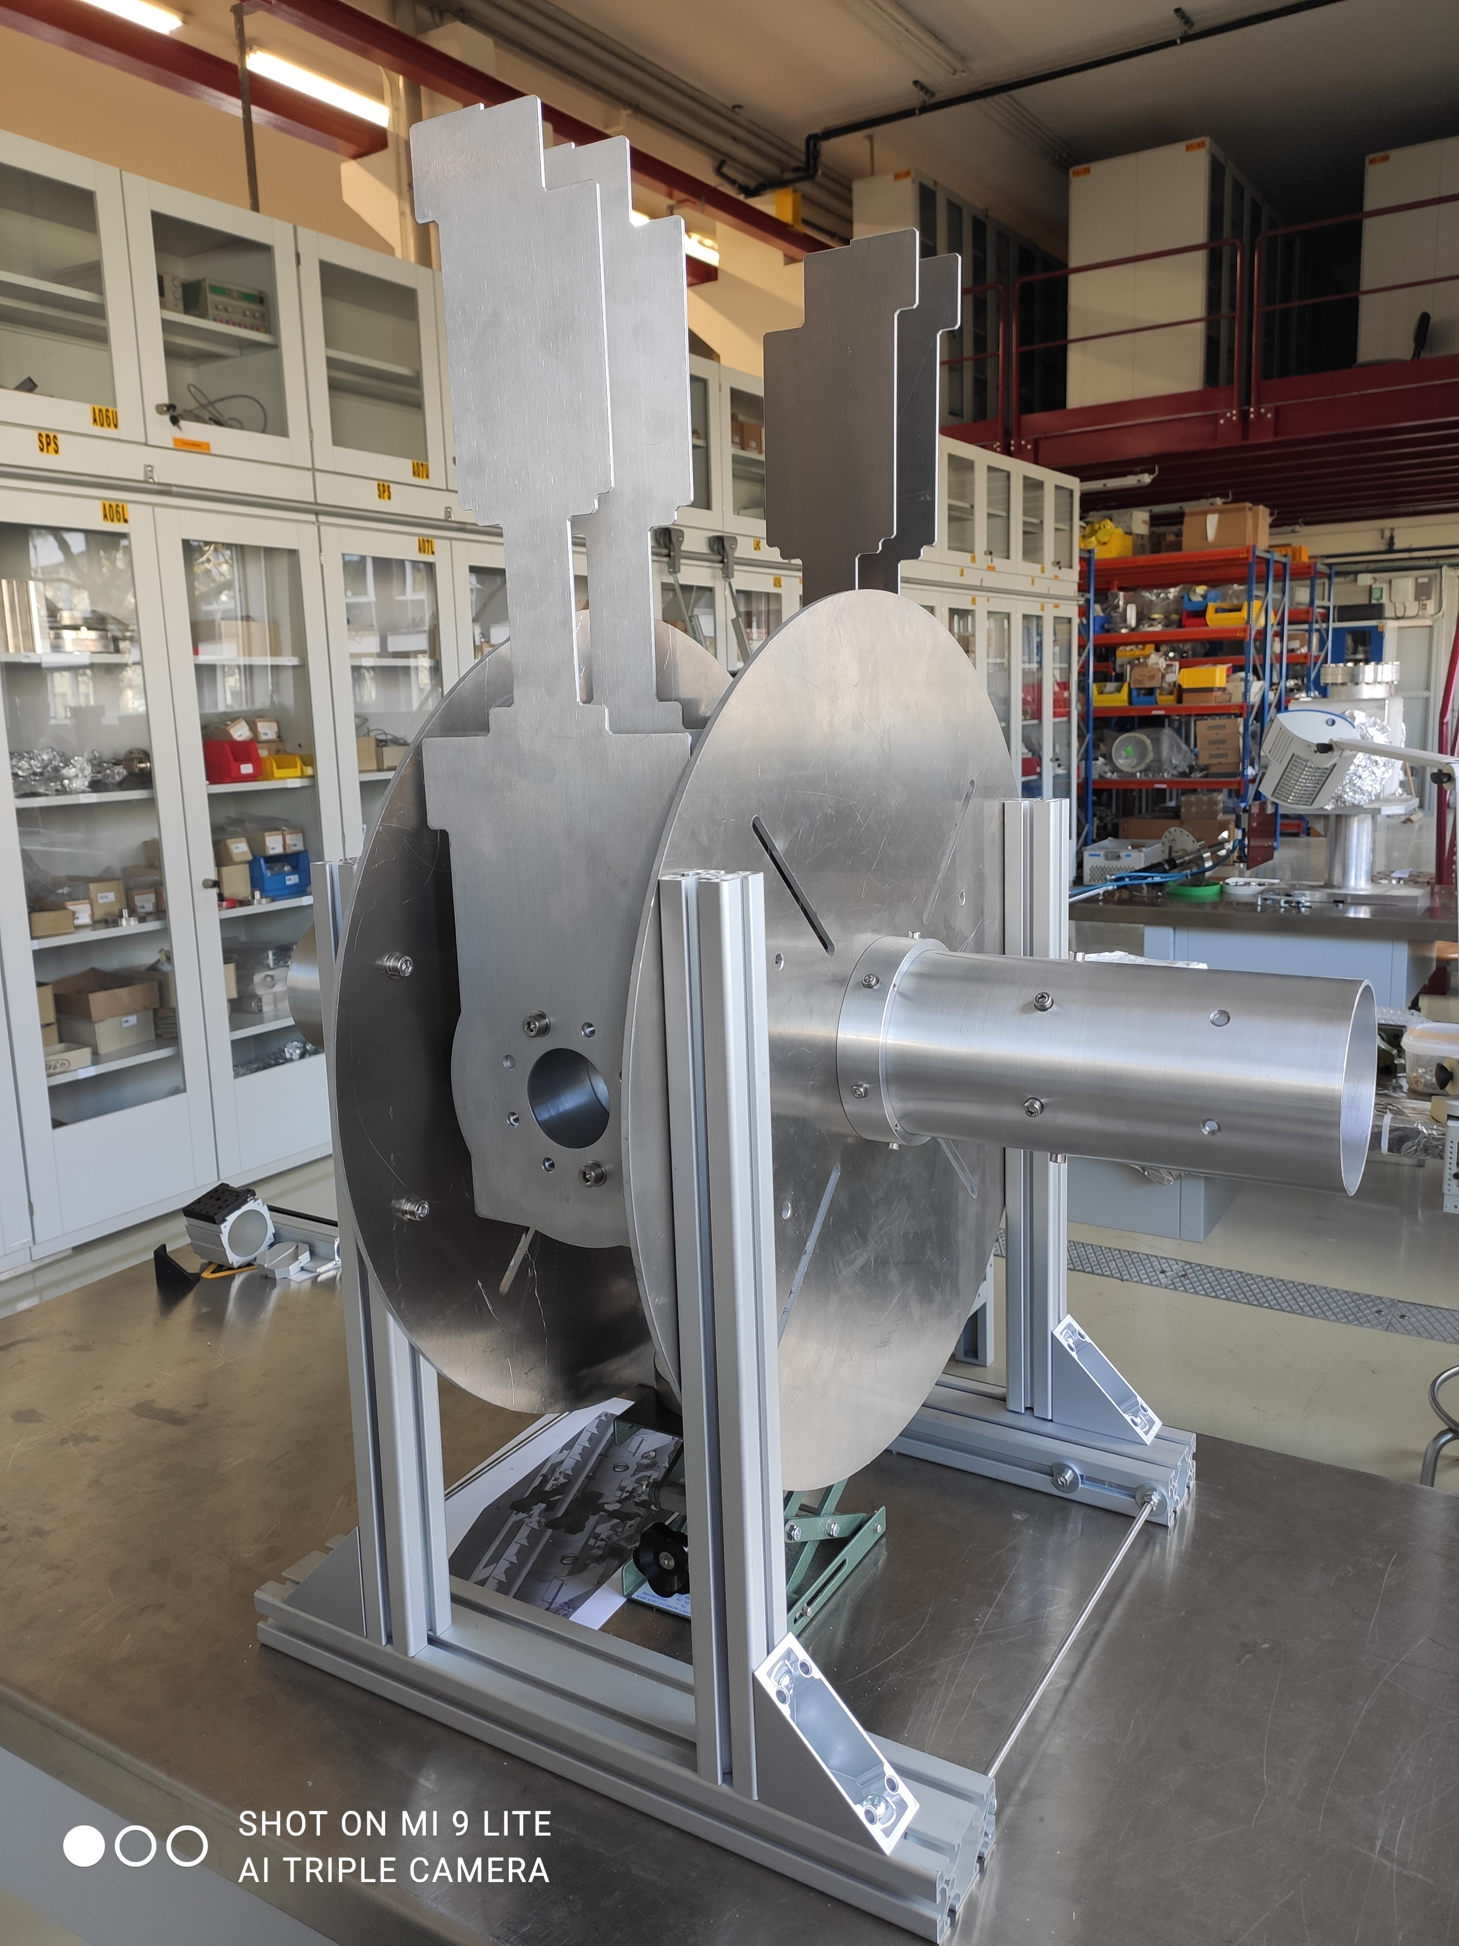
BGC Version 4 MockUp
Thanks to new pieces, gate valves imitations are in three dimensions instead of two
Previous Version
Updated

Slide 7
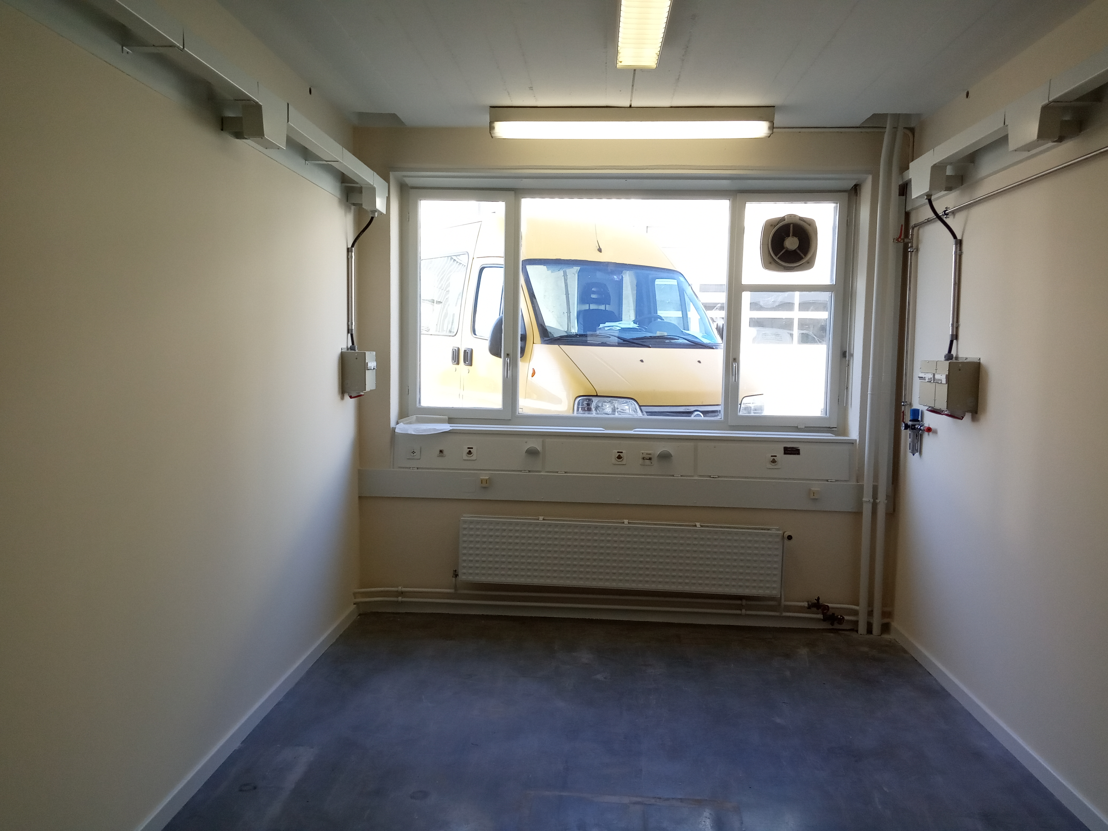
Lab 8-R-014 UpDate
Renovation is done

Slide 8
Are there any questions?

