Slide 1
CI Update
25/02/2022

Slide 2
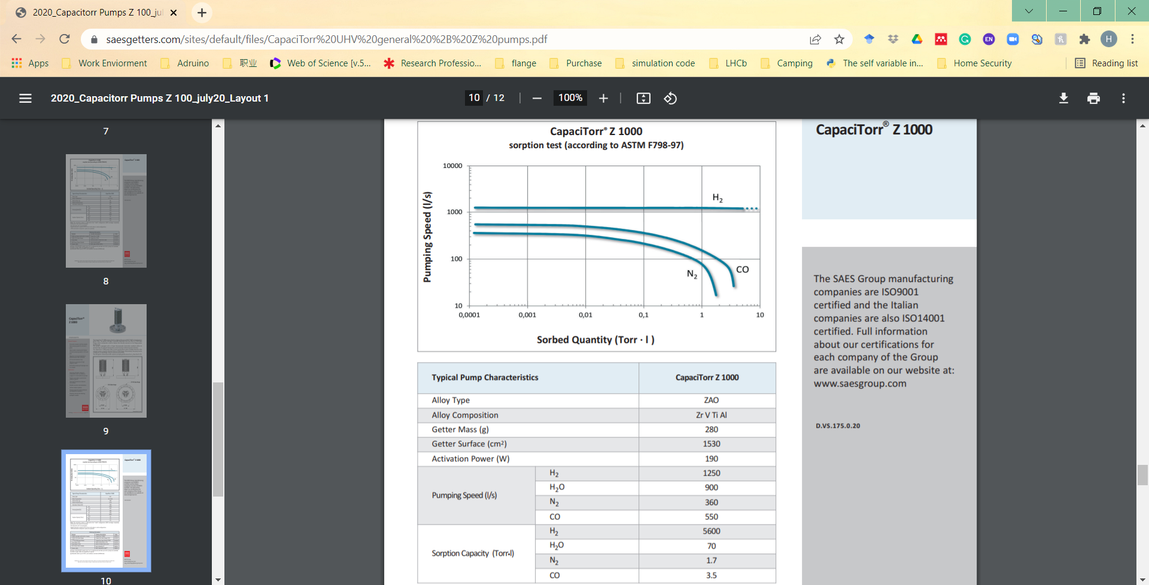
NEG property

Slide 3
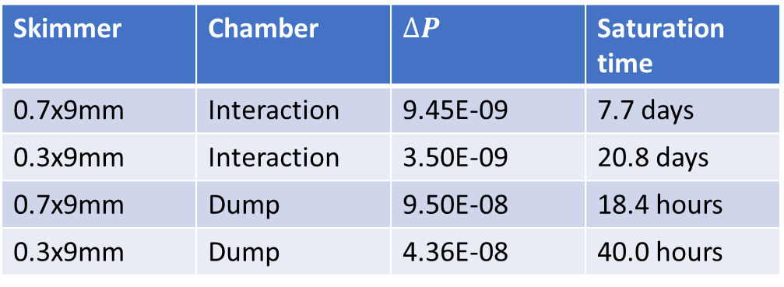

Saturation Estimates
$$t_{saturation}= \frac{Sorption capacity}{Pumping speed × ∆Pressure}$$
Where $∆Pressure= P_{Jet on} − P_{Jet off}$
Skimmer | Chamber | $$∆P$$ | Saturation time
0.7x9mm | Interaction | 9.45E-09 | 7.7 days
0.3x9mm | Interaction | 3.50E-09 | 20.8 days
0.7x9mm | Dump | 9.50E-08 | 18.4 hours
0.3x9mm | Dump | 4.36E-08 | 40.0 hours
Sorption capacity = 2.26mbar L
Pumping speed
= 360 L/s

Slide 4
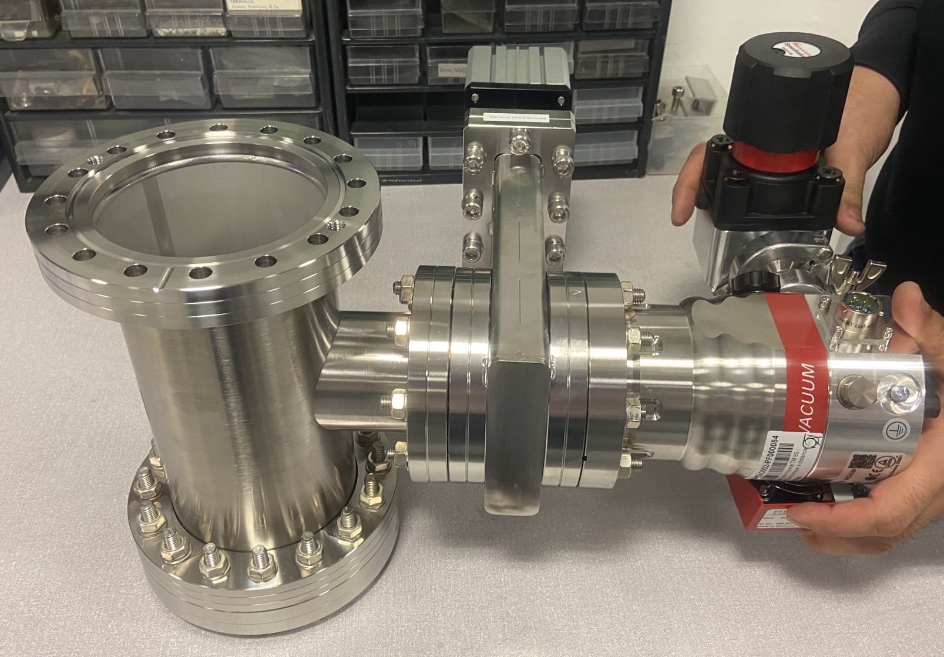
NEG subsystem

Slide 5
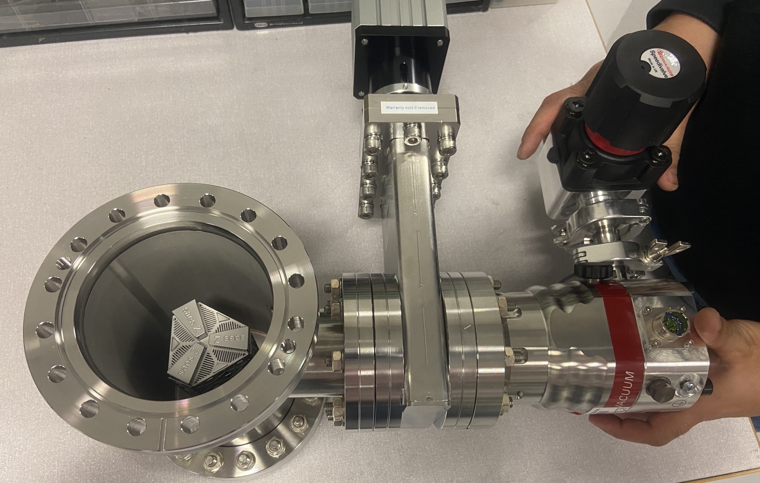
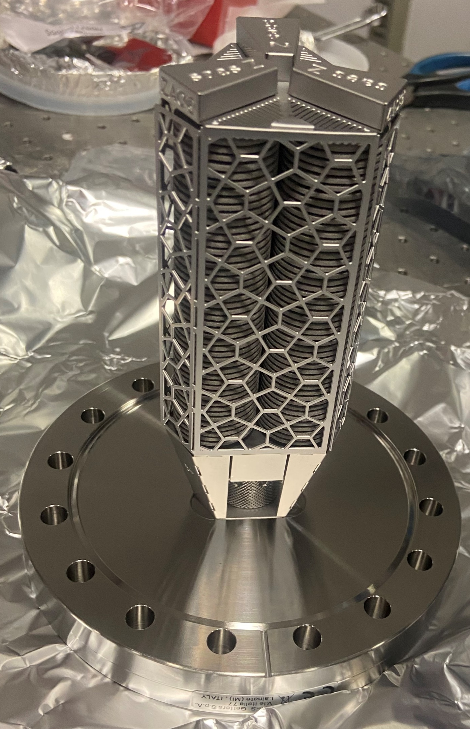
NEG subsystem

Slide 6
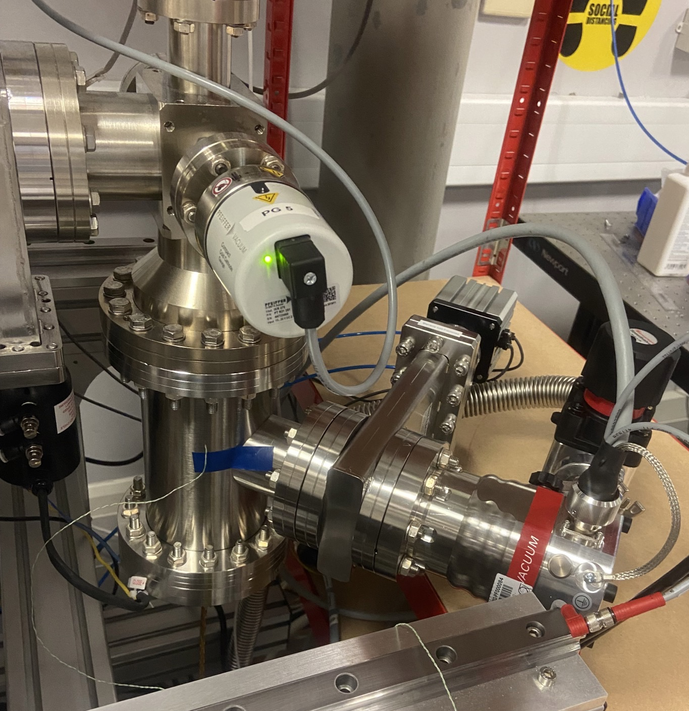
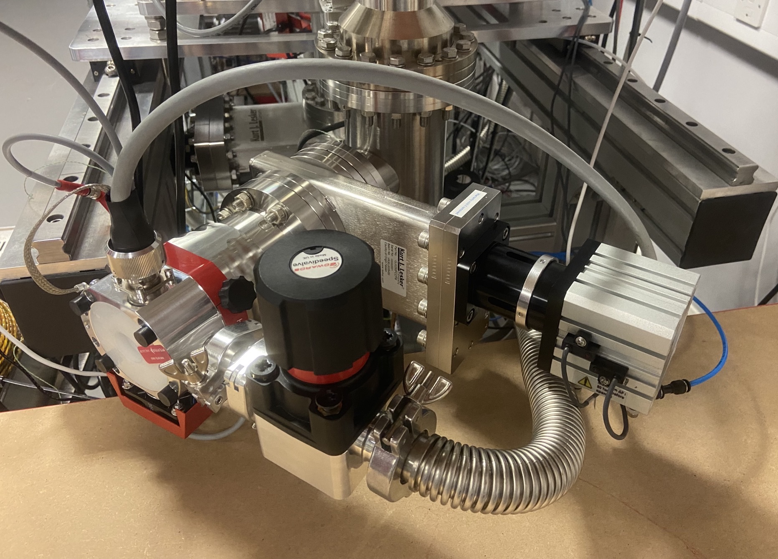
Neg pump installed in the Dump Chamber

Slide 7
Saturation Data (dump chamber)
Data missing for weekend due to Computer issue
Jet off
Before Jet on

Slide 8
Saturation Data (interaction chamber)
Outgas rate of the chamber is dropping
Before Jet on
Jet off

Slide 9
Nozzle chamber
TMP in the nozzle chamber is warm but ok. The pressure even dropped a bit. ??Might be from the fluctuation of the main regulator or gas supply.

Slide 10
Saturation Data
Predicted Saturation Time (T+40hours)
Chamber | Pressure / mbar | Pressure Change
Interaction | 3.80E-09 | 2.4%
Dump | 6.84E-08 | 27.5%
Most Recent Measurement (T+170hours)
Chamber | Pressure / mbar | Pressure Change
Interaction | 6.45E-09 | 73.9%
Dump | 1.97E-07 | 268.1%

Slide 11
Summary
Week long data shows the NEG is not saturated for 0.3*9 mm 3rd skimmer (5bar inlet pressure).
The saturation time is longer than the estimation
It is Ok to use the NEG pump in the dump chamber for the smaller skimmer.
Future work:
  Larger 3rd skimmer (0.7*9 mm)
  Preparation for shipping.

