Slide 1
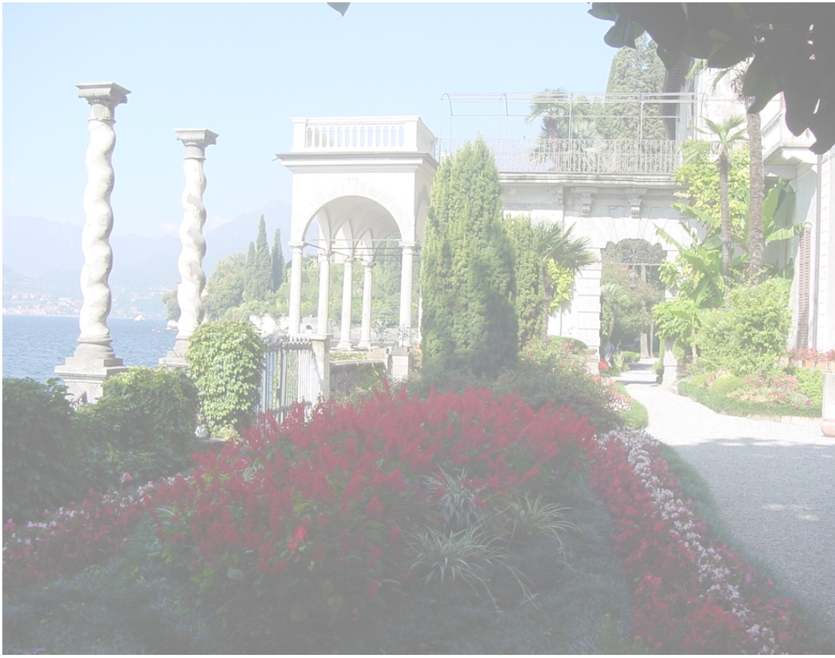
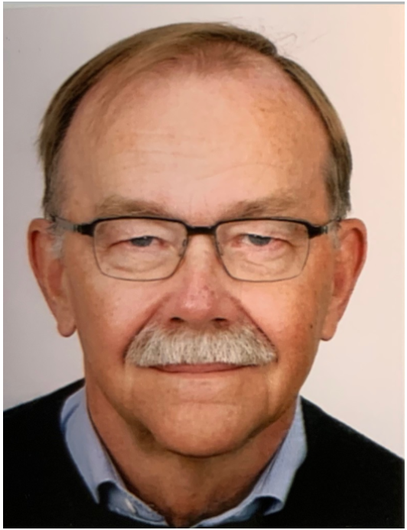
A due recognition for our colleague and friend Horst Lenske

Slide 2
My personal view point
From 1998 to date
An exciting journey from charge exchange reactions to the discovery of a genial scientist and a distinguished gentleman

Slide 3
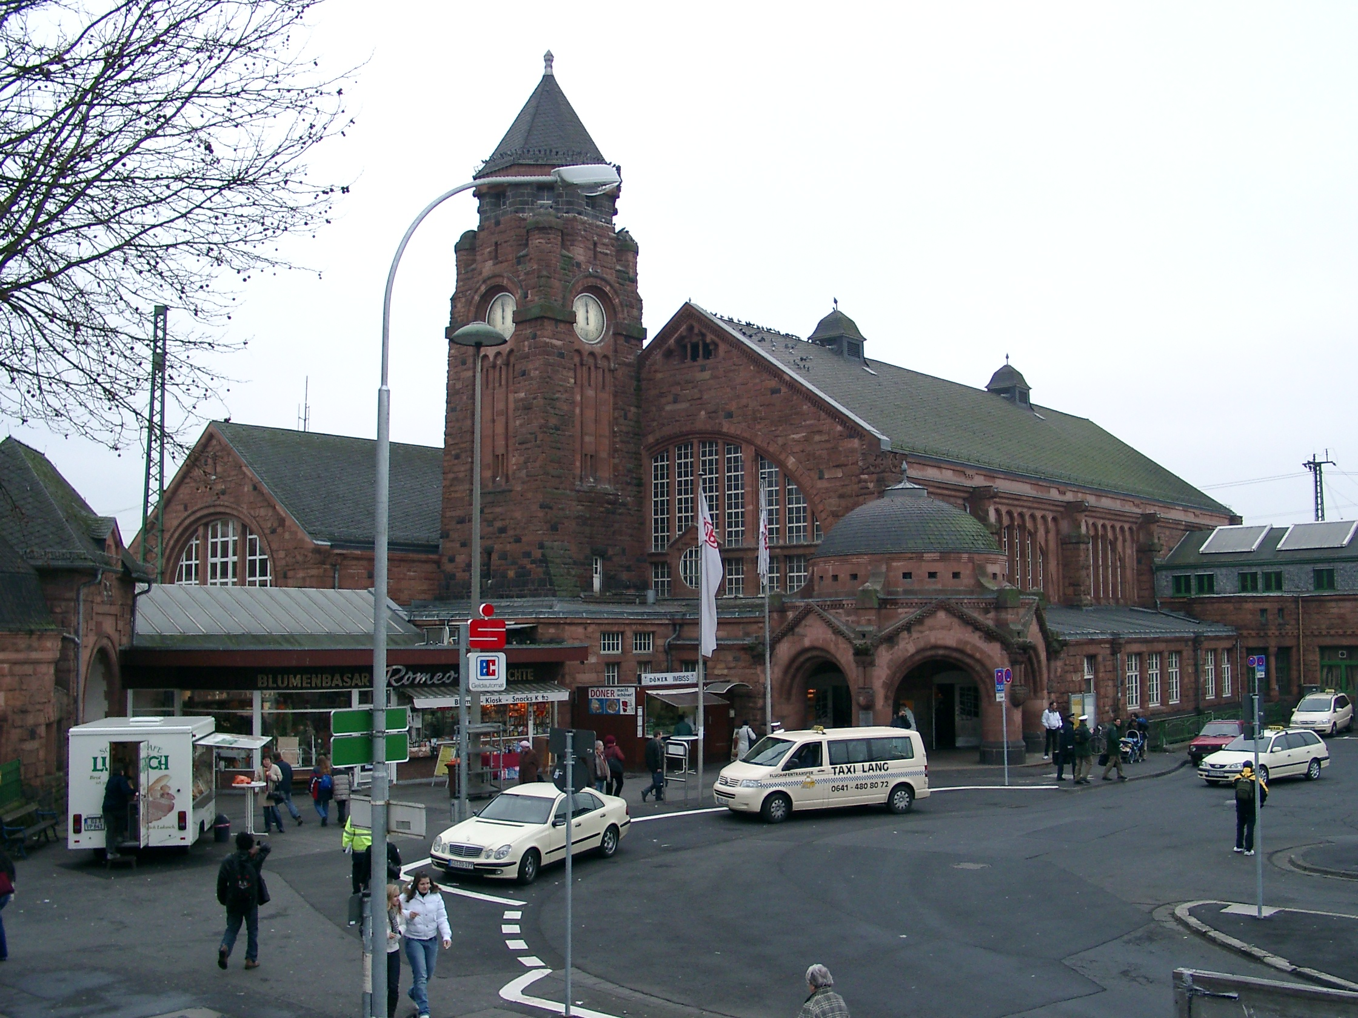
I knew Horst at the Giessen railway station in 1998, where he picked me up after my travel from Catania to Giessen University
I went there to do some charge exchange cross section calculations to analyse data for my PhD Thesis
I was a student on experimental nuclear physics and he already was a very famous professor, maybe the one knowing these reactions best
Surprisingly, he picked me up at the railway station, after having written me an e-mail with extremely detailed instructions on how to reach the meeting point!
He guested me at his house for two weeks, often inviting me at the restaurant for dinner

Slide 4
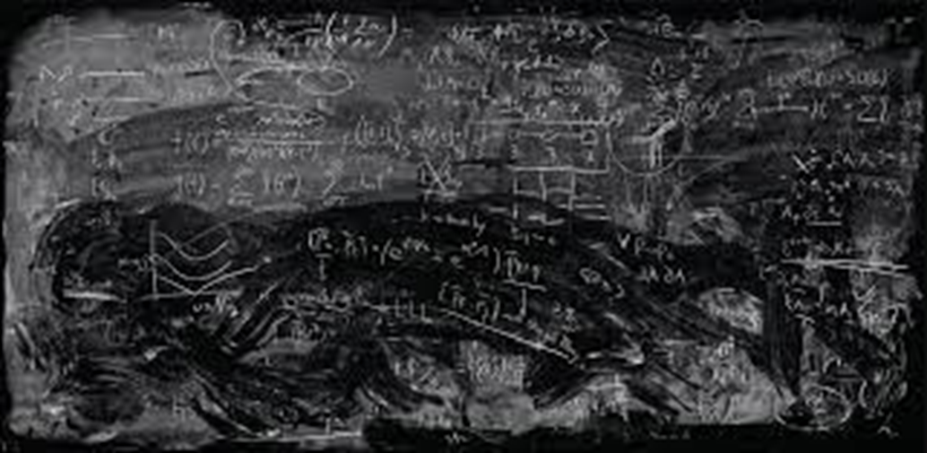

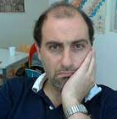
One hour later at the Horst office
After filling quickly his blackboard with
Ikeda sum rules,
isospin operator algebras,
charge exchange reaction factorization,
quenching of spin-isopsin nuclear response,
quasi-particle random phase approximation,
distorted wave Born approximation
he concluded as follows:
As you can see the description of charge exchange reactions is quite simple!
Yes, indeed it looks quite simple!
Although I tried to dissimulate, I should admit that I lost half of my hairs that afternoon in Giessen

Slide 5


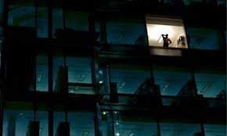
During the following two weeks I also discover that:
Horst did not like to drive a car! Often he moved by taxi, a feature making him quite unique in my world. He said that «it is boring to drive a car»
He typically did not have lunch. I discover that too late during my first day in Giessen, so I also missed my lunch!
He frequently worked until late evening
But what impressed me most was his deep and broad interest to life!
I clearly was in the presence of a brilliant man

Slide 6
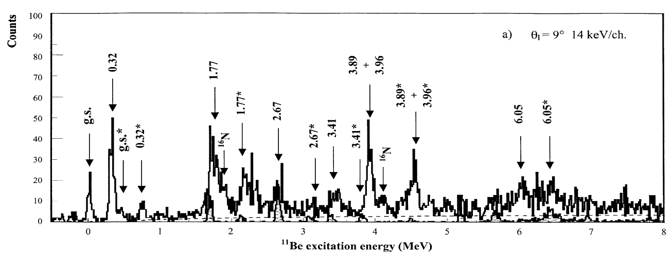
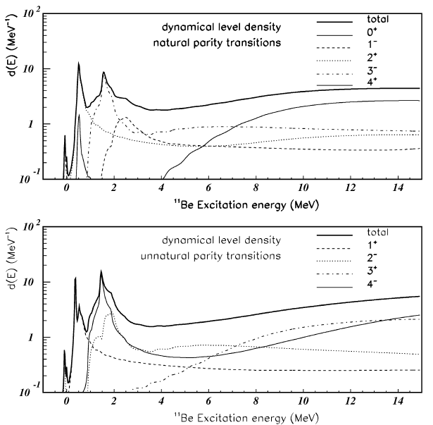
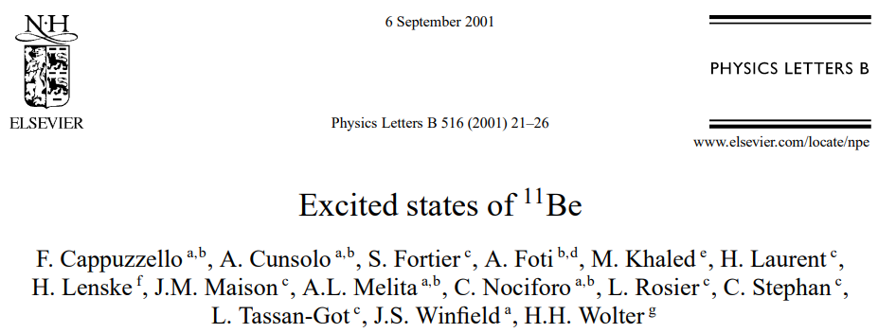
I learned and worked a lot under the Horst supervision
The results are a key part of my Ph.D. Thesis and of some articles we published later
Actually we were promoting a further development of a microscopic charge exchange theory including HFB mean field + QRPA and Dynamical Core Polarization correlations integrated in a DWBA framework
We were also pioneering a systematic nuclear spectroscopy program of neutron-rich nuclei via (⁷Li,⁷Be) charge exchange reactions not far above the Coulomb barrier
A theoretician with a natural aptitude for talking with experimentalists

Slide 7
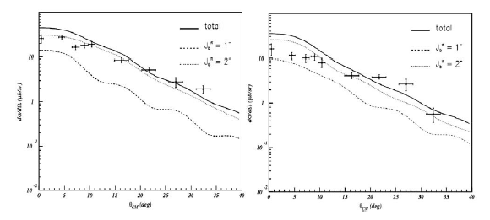
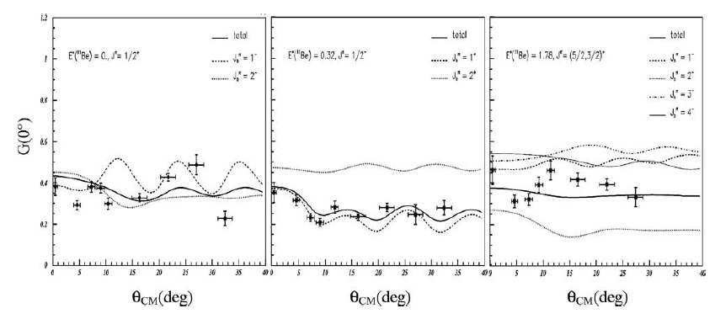
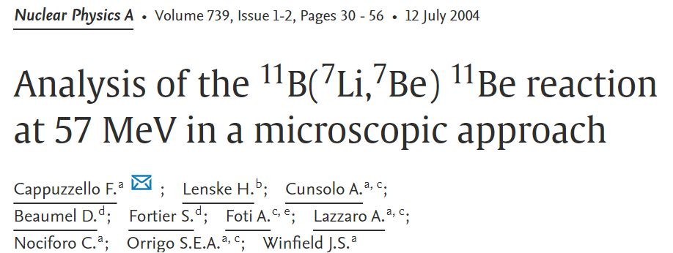
I learned and worked a lot under the Horst supervision
The results are a key part of my Ph.D. Thesis and of some articles we published later
Actually we were promoting a further development of a microscopic charge exchange theory including HFB mean field + QRPA and Dynamical Core Polarization correlations integrated in a DWBA framework
We were also pioneering a systematic nuclear spectroscopy program of neutron-rich nuclei via (⁷Li,⁷Be) charge exchange reactions not far above the Coulomb barrier
Absolute cross sections without arbitrary scaling factors
Spin transfer probabilities
A theoretician with a rare skill to handle both nuclear reaction and nuclear structure

Slide 8
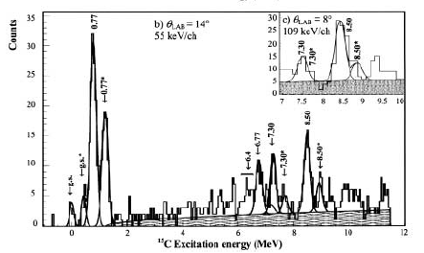
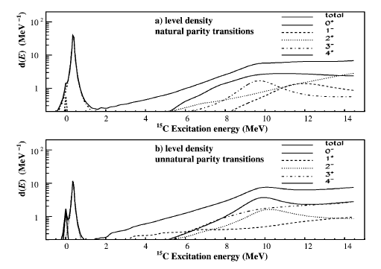
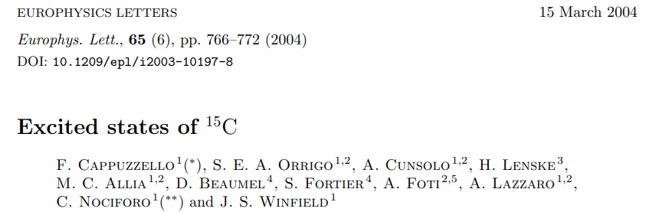
I learned and worked a lot under the Horst supervision
The results are a key part of my Ph.D. Thesis and of some articles we published later
Actually we were promoting a further development of a microscopic charge exchange theory including HFB mean field + QRPA and Dynamical Core Polarization correlations integrated in a DWBA framework
We were also pioneering a systematic nuclear spectroscopy program of neutron-rich nuclei via (⁷Li,⁷Be) charge exchange reactions not far above the Coulomb barrier
A scientist with a clear vision of research strategy and work organization

Slide 9
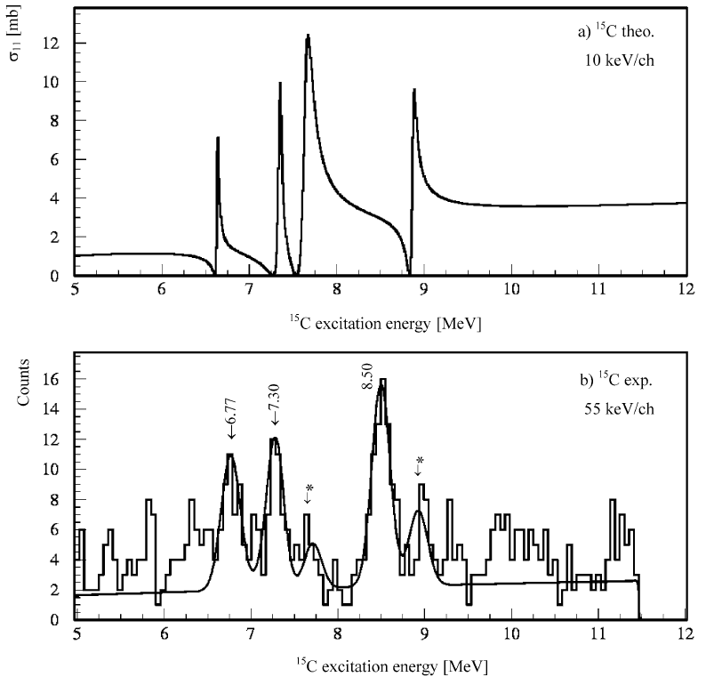
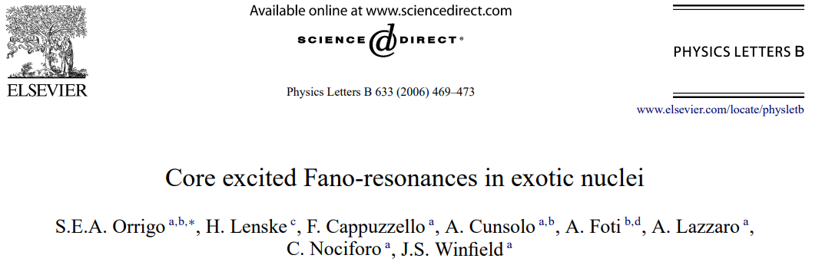
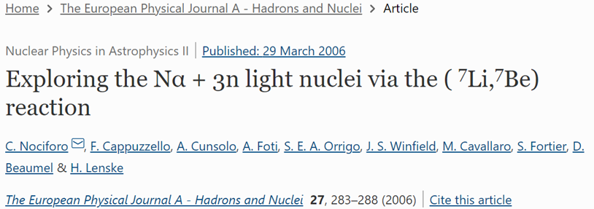
Also sending students of my group to Giessen
Chiara Nociforo, Sonja Orrigo and Manuela Cavallaro had a similar experience as mine with Horst
Going deeply into nuclear structure of open quantum systems, by introducing dynamical core polarization correlations and looking at quanto-mechanical inteference in the continuum by line shape Fano analyses

Slide 10
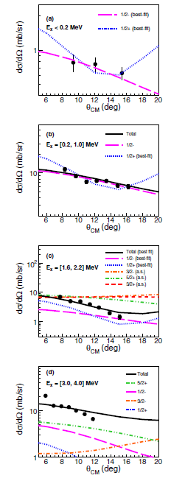
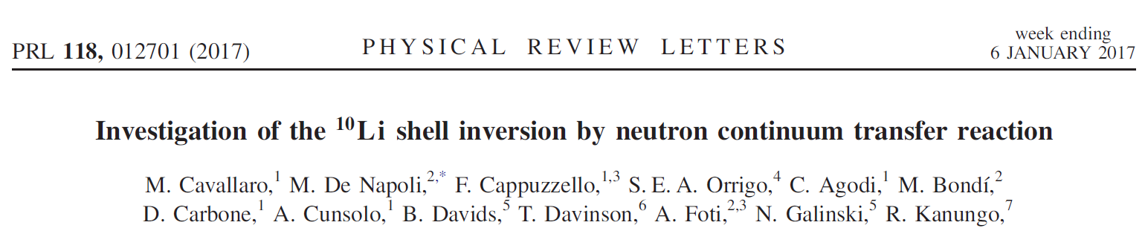
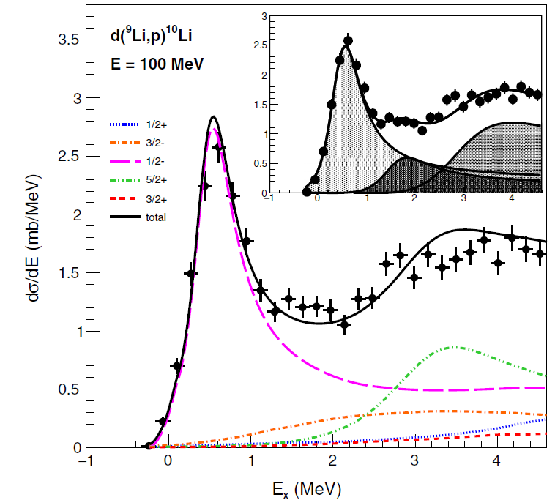
Also sending students of my group to Giessen
Chiara Nociforo, Sonja Orrigo and Manuela Cavallaro had a similar experience as mine with Horst
Going deeply into nuclear structure of open quantum systems, by introducing pairing in the continuum correlations and looking at line shape through Fano analyses

Slide 11



The NUMEN time and the challenge of double charge exchange reactions
In 2014 I called Horst to explain him our new project called NUMEN based on the study of DCE reactions to probe nuclear structure inputs relevant for 0νββ decay
My hope was to convince him to get on board of the project
Although the project could have appeared as an experimental one, the theory part was considered a pillar
The main goal would have been to extract nuclear response to second order isotensor operators from experimental DCE cross section
The little problem was that in practise the theory of DCE reactions did not exist in 2014 and had to be developed from scratch!
Horst accepted with enthusiasm demonstrating a high degree of bravery.
Part of the results you could have appreciated in his talk

Slide 12

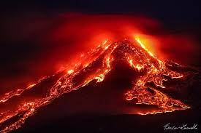
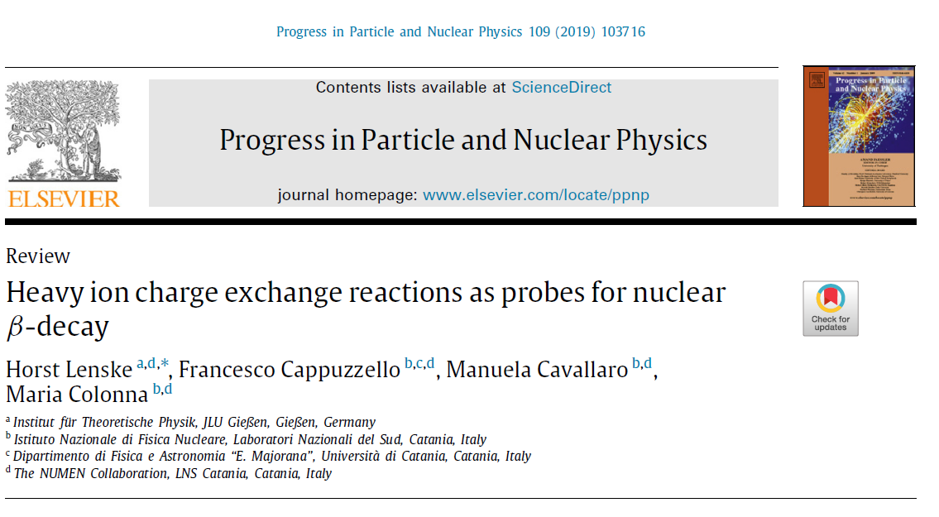
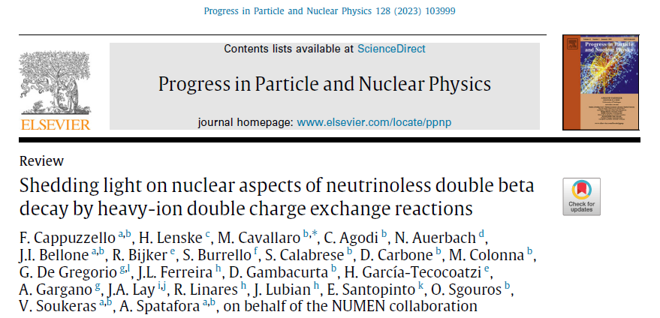
The NUMEN time and the challenge of double charge exchange reactions
A theory group clustered around NUMEN, profiting of the long experience in charge exchange reactions from Horst
He has largely contributed to establish a very smooth and productive atmosphere with senior scientists as Maria Colonna, Elena Santopinto, Angela Gargano, Jesus Lubian, Naftali Auerbach and many young researchers
Meanwhile he has erupted an impressive amounts of notes, models, codes, calculations, articles, talks, reviews ….
The main achievement is the formulation of a microscopic theory of DCE, which allows for different nuclear structure models to be used and probed against experimental DCE cross sections

Slide 13
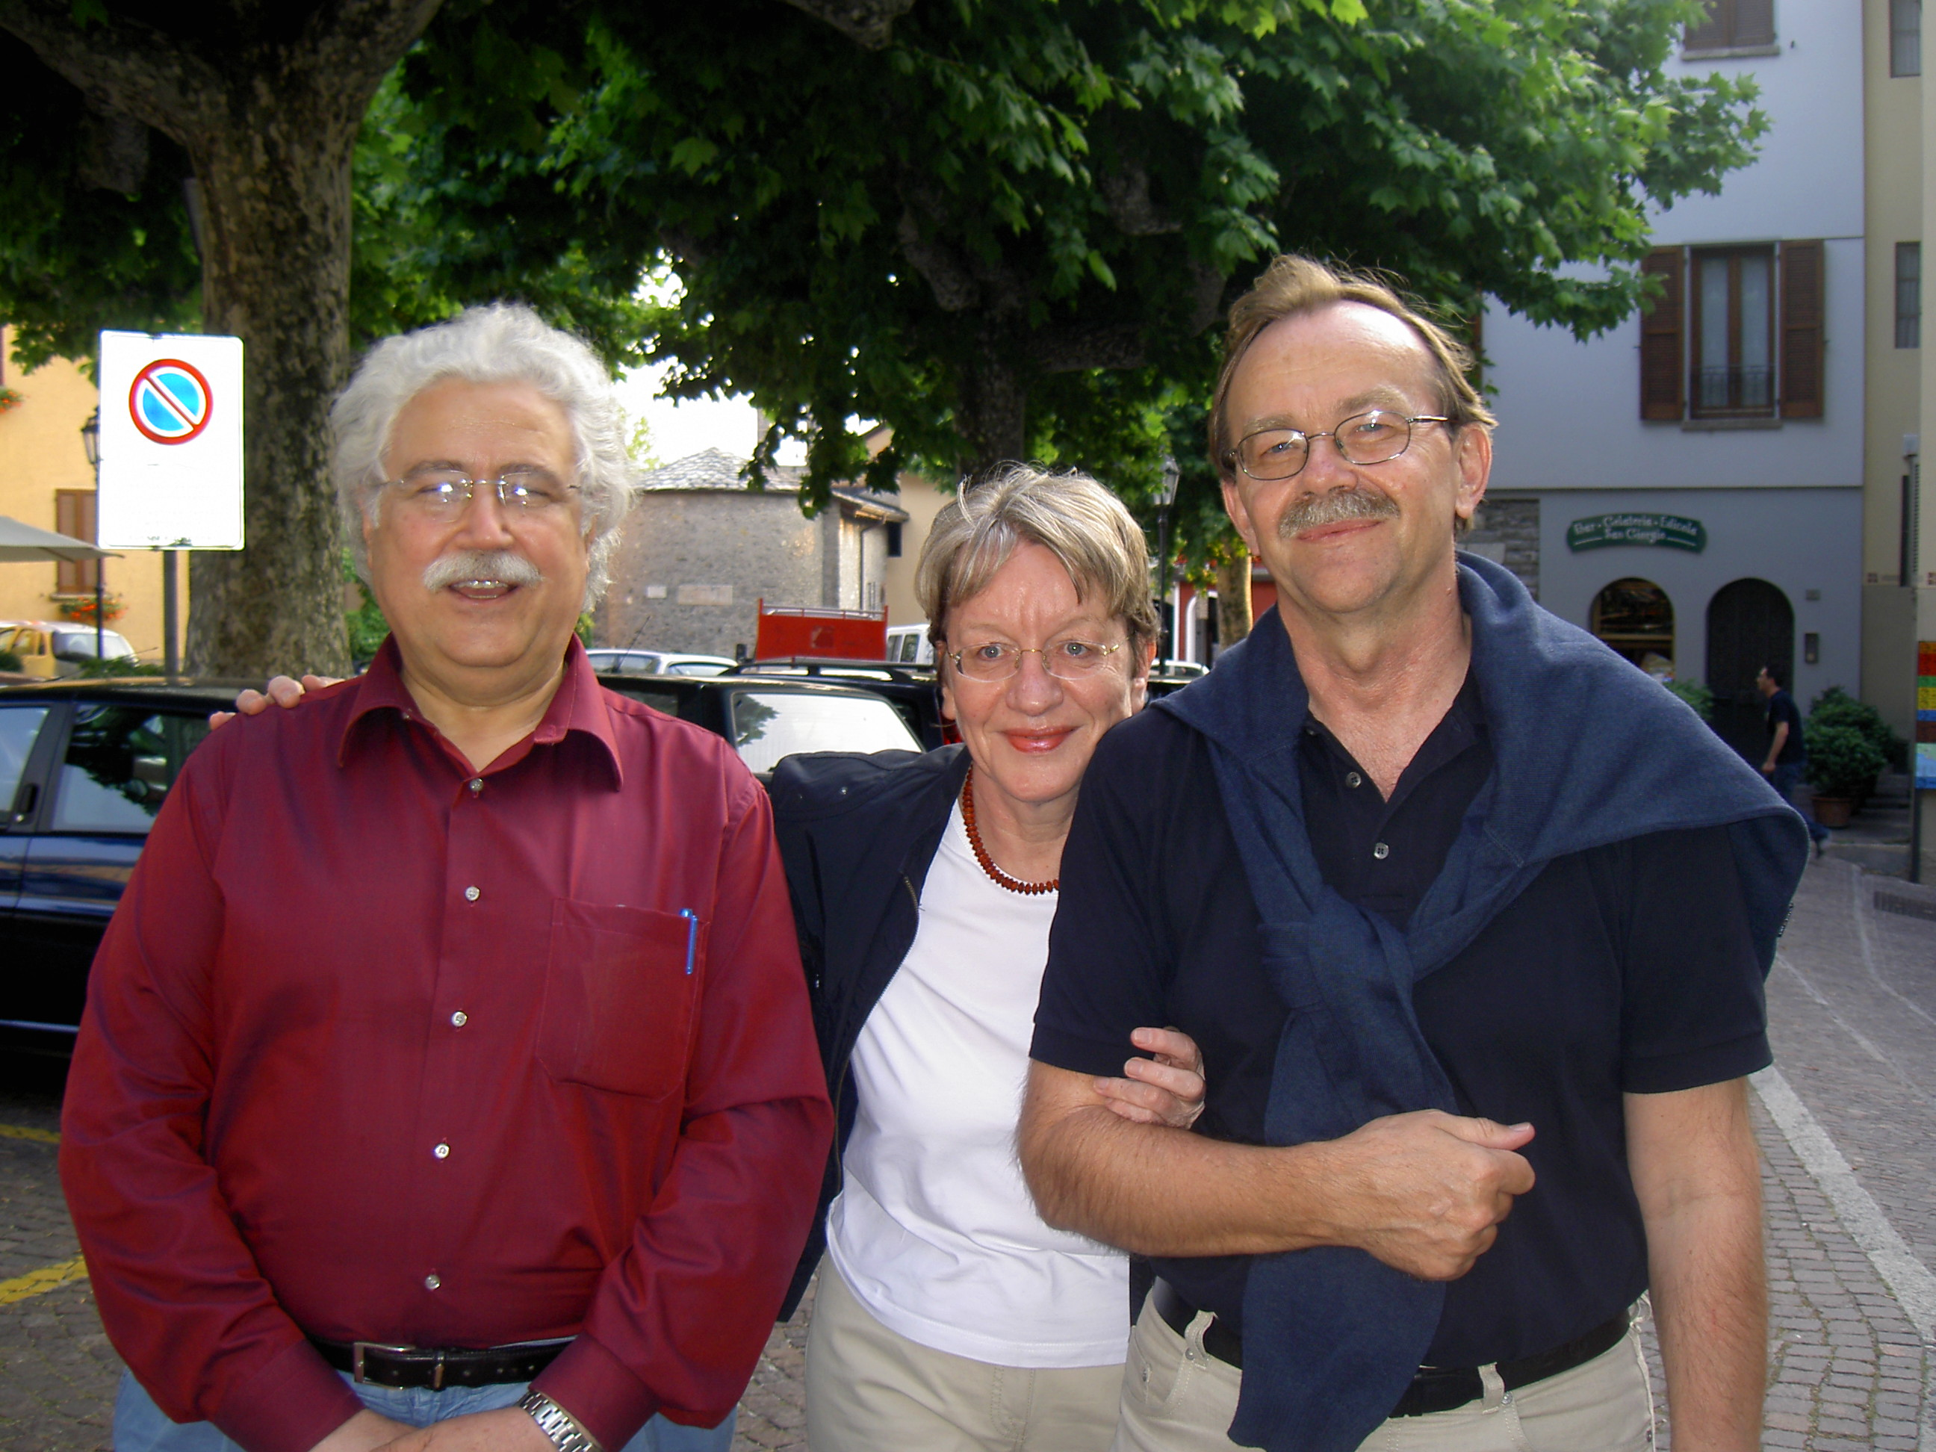
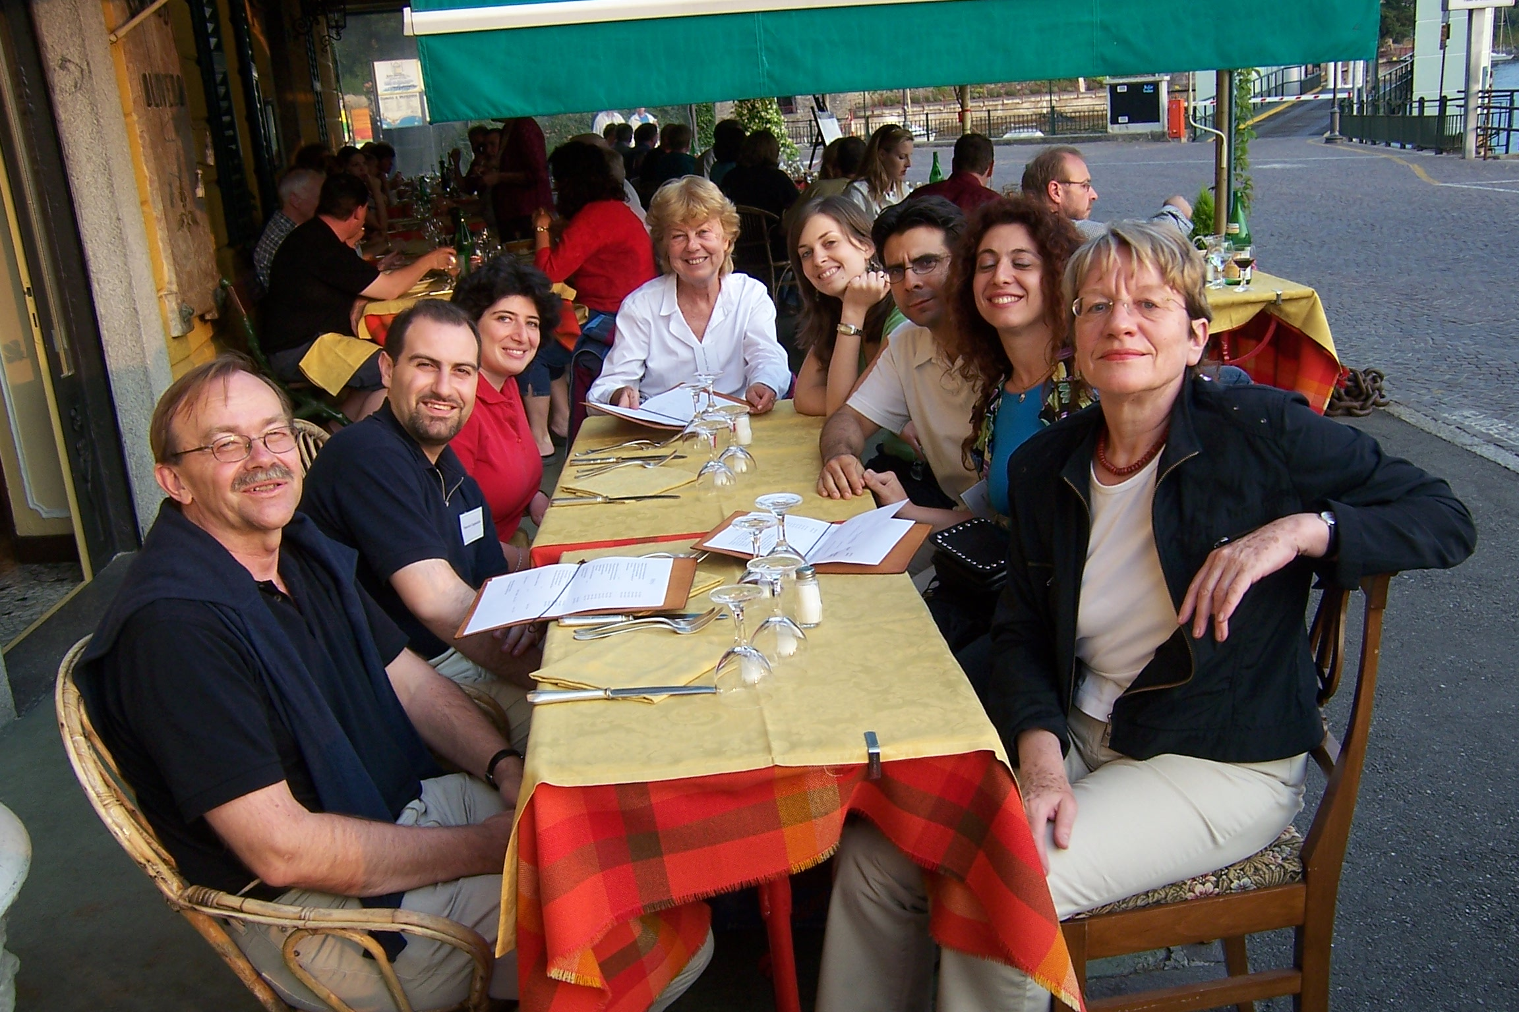
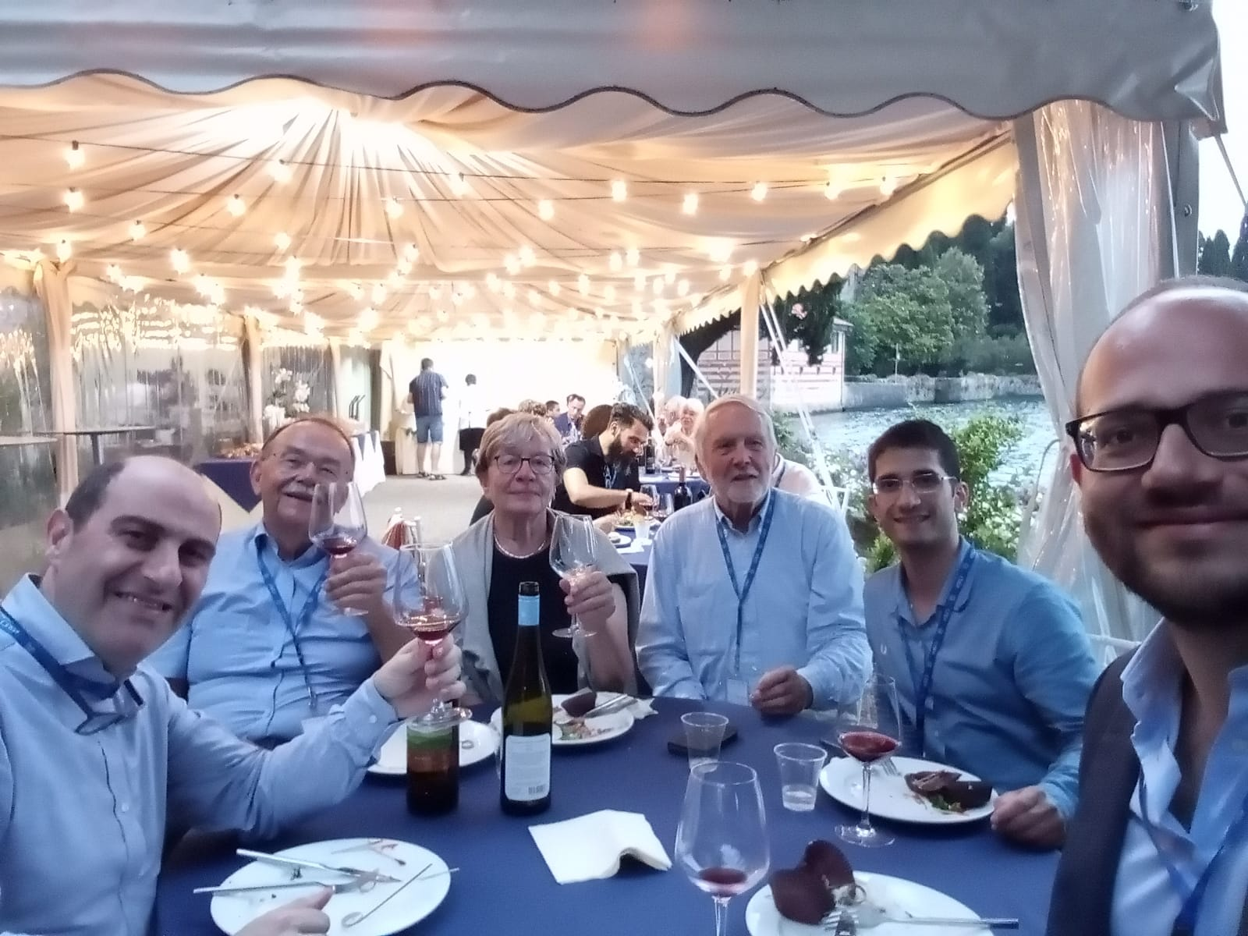
… and of course Varenna NRM conference
I think Horst holds the world record of participation to the NMR Varenna conference

Slide 14
My dear Horst,
I only wish to say thank you

