Slide 1
Status of the Experiments
Plenary RRB 54th Meeting
Joachim Mnich
April 25th, 2022

Slide 2

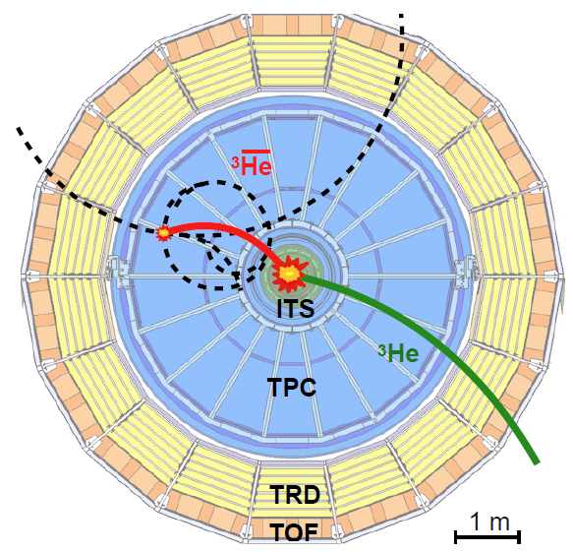
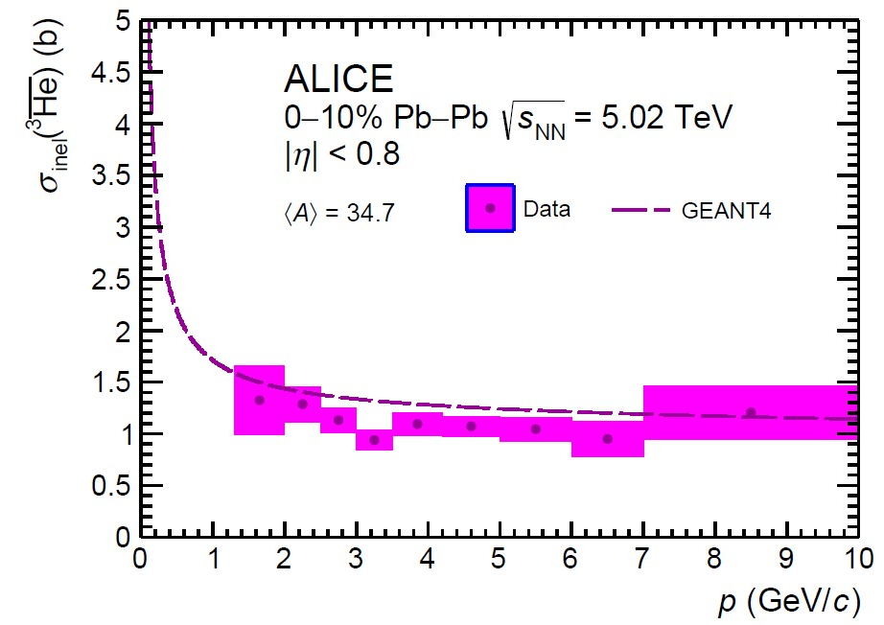
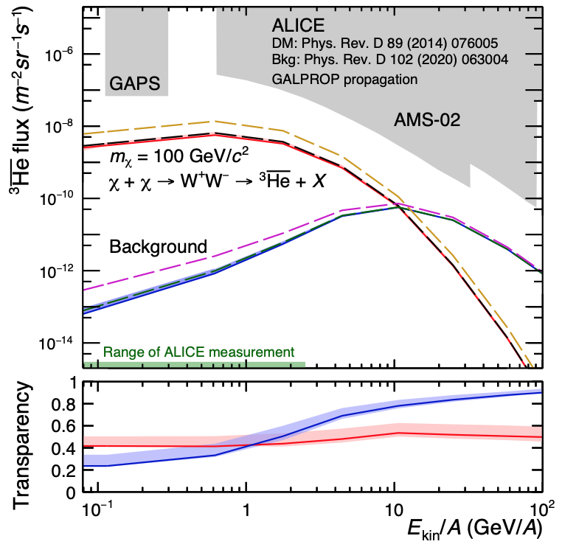

Anti-³He Absorption in ALICE and in the Galaxy
ALICE, arXiv:2202.01549
ALICE measured the anti-³He absorption cross section in the detector material, for the first time at low momentum
Search for anti-nuclei in space such as anti-³He is a very promising channel for the discovery of Dark Matter
essentially free from the background from ordinary collisions between cosmic rays and interstellar medium
ALICE result provides estimate of absorption probability of anti-nuclei from dark mattter decays and from cosmic-ray background in the Galaxy
Notes:
Conclusion:
anti-3He nuclei can travel long distances in the galaxy and can be used to study cosmic-ray interactions and dark-matter decays interactions and dark-matter decays

Slide 3
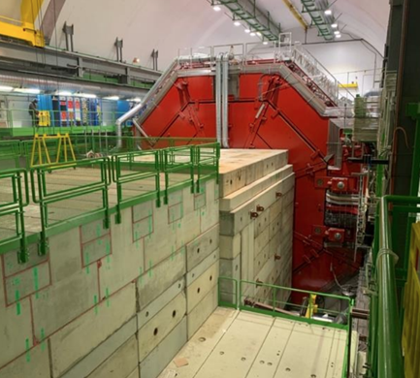
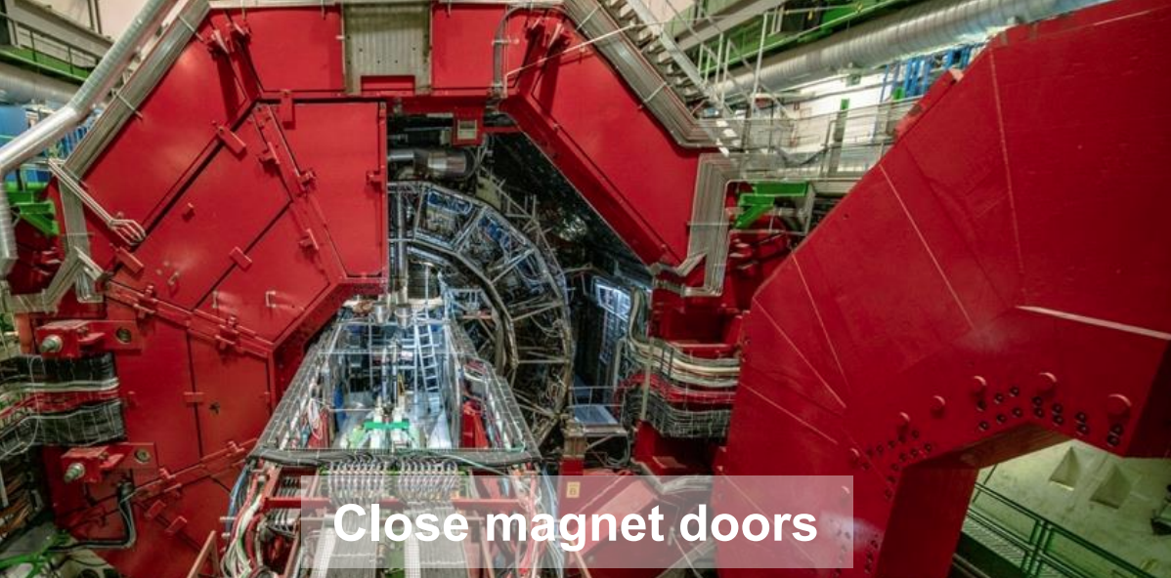
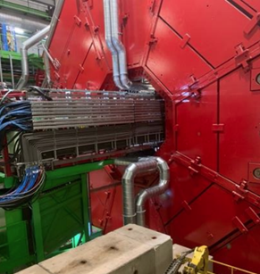
ALICE: LS2 Activities
Installation of new and upgraded detectors and maintenance activities completed
L3 doors closed (Feb 14), shielding installed the following week
ALICE closed on March 2 and magnets restarted on March 7
Underground access ended on March 24

Slide 4
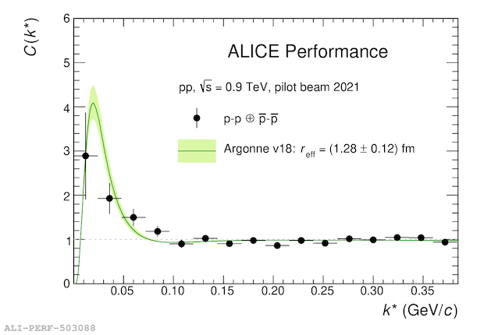
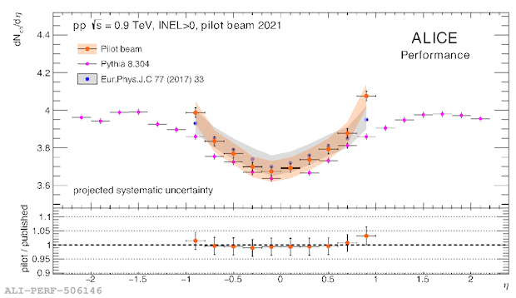
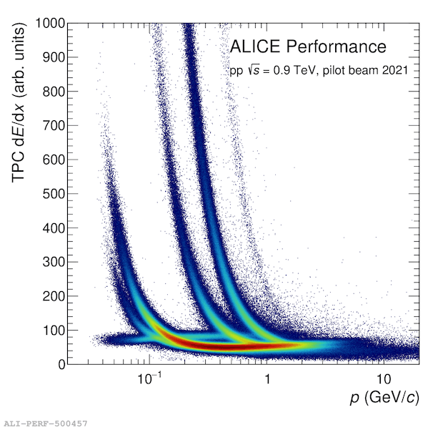
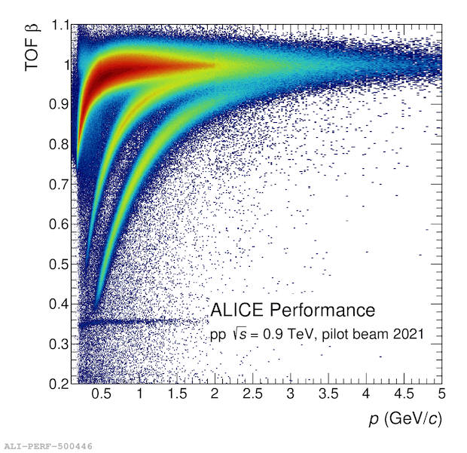
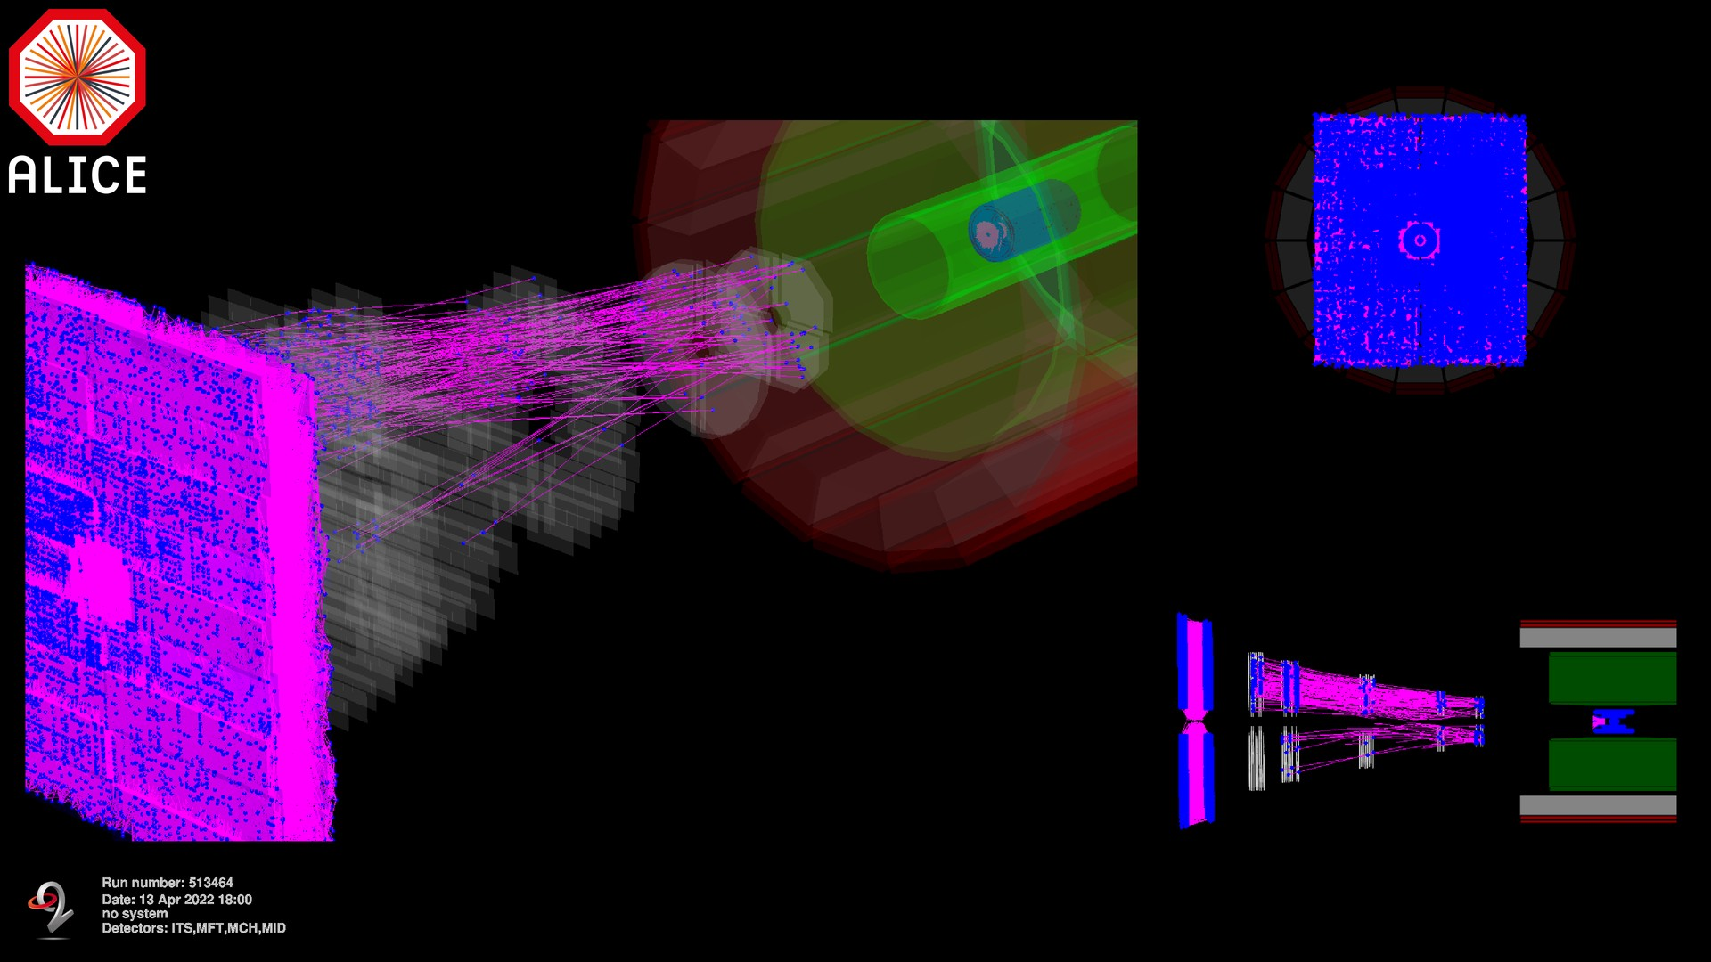
ALICE: Readiness at P2
Installation of new and upgraded detectors completed!
pp collisions from the pilot beam Oct 2021
First look at the p-p momentum correlation function
Measured dN_{ch}/dη compatible with previous results
Preliminary analysis of the pilot beam data of Oct 2021
PID capabilities fully available
Muon splash events (TED beam shots) – April ‘22
charged-particle multiplicity compared to measurement with 2010 data

Slide 5

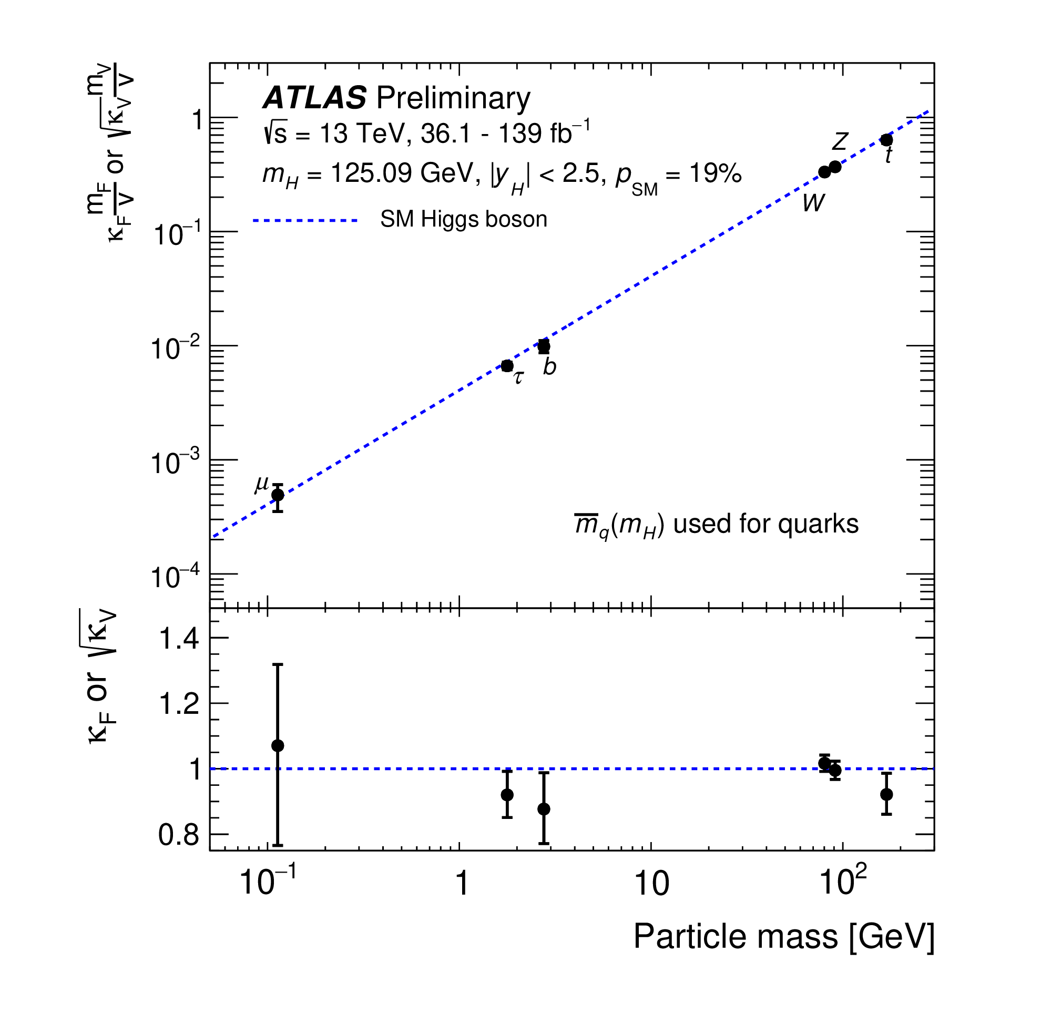
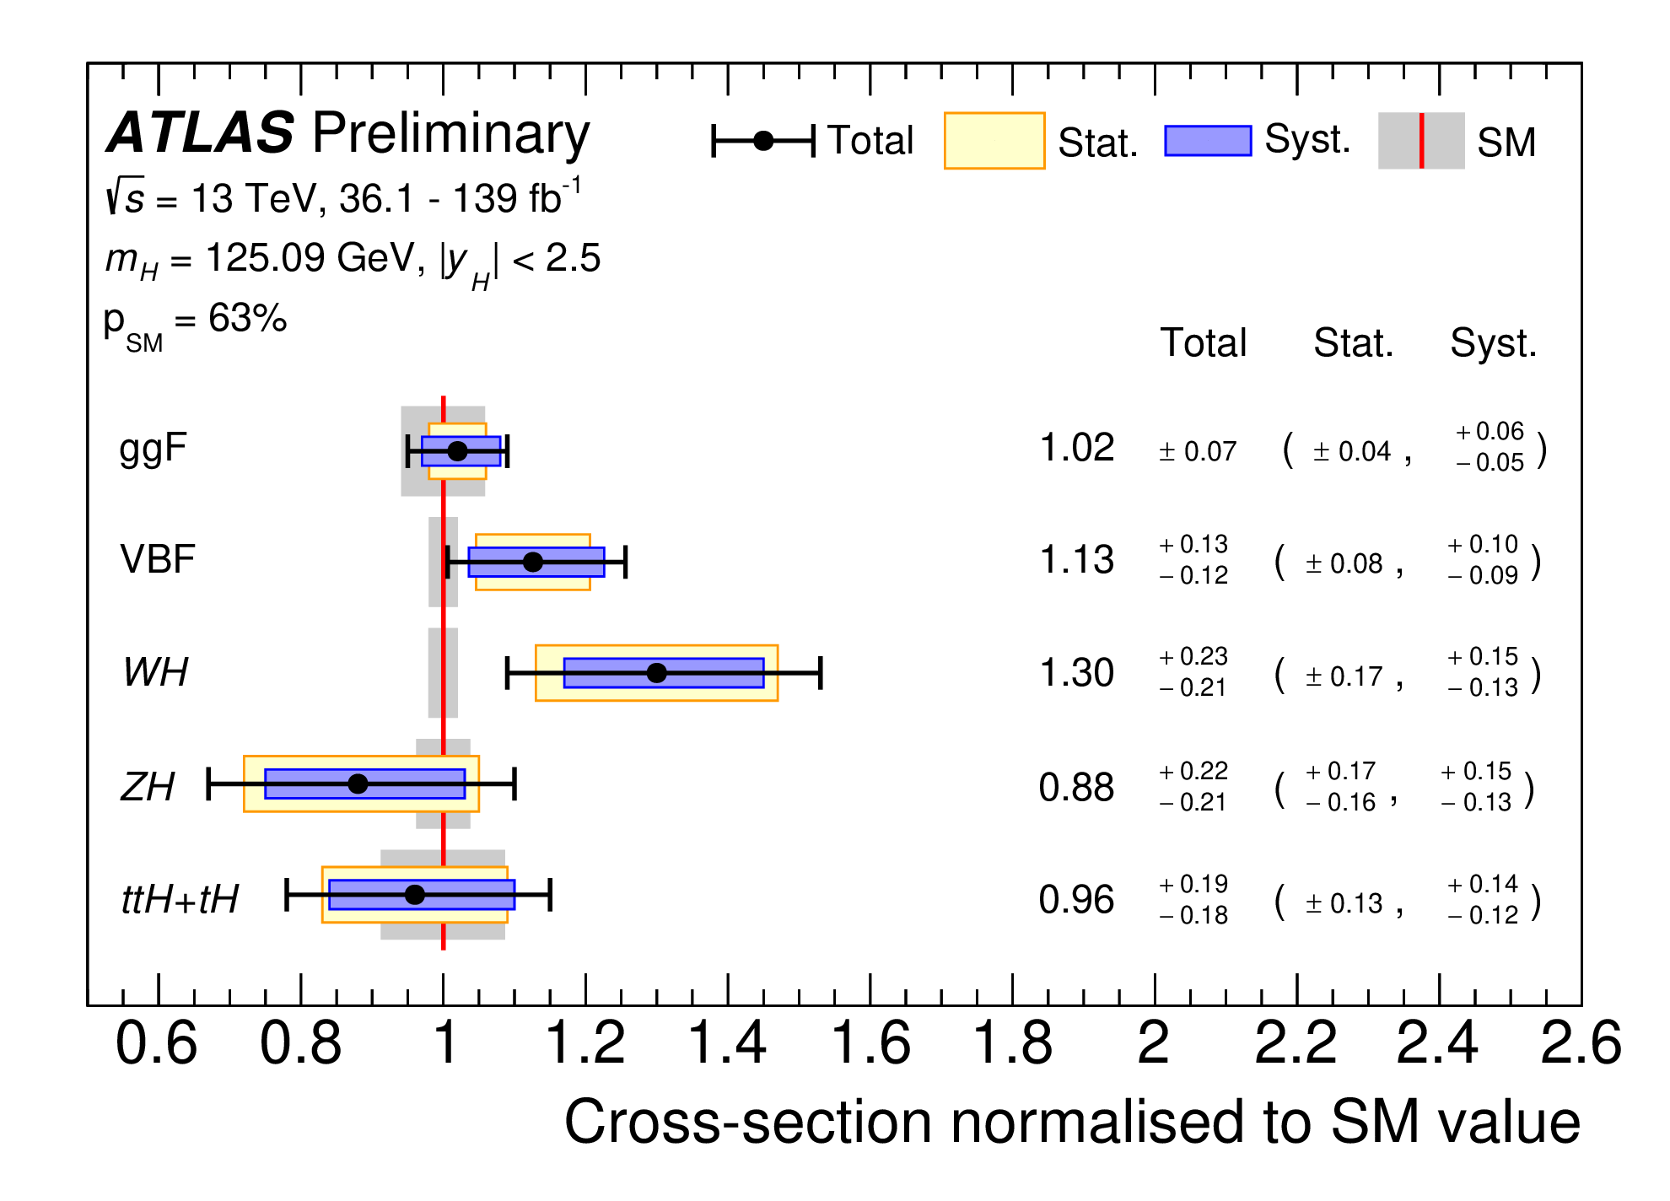
ATLAS: Higgs Boson Couplings
Coupling measurements (B_{i} = B_{u} = 0)
Based on complete Run 2 data set
Global fit: signal strength µ = 1.06 ± 0.06
+0.07
+0.31
κ_{𝛾} = 1.04 ± 0.06, κ_{g} = 0.92 , κ_{Z𝛾} = 1.37
–0.06
–0.37
Cross sections of main Higgs production modes
ATLAS-CONF-2021-053
ATLAS-CONF-2021-053
Precision on couplings reached
Yet unattained precision on Higgs boson couplings
κ_{µ} < 30%
κ_{𝜏} = 7%
κ_{b} = 11%
κ_{t} = 6%
κ_{W,Z} = 6%
Notes:
B_i and B_u: invisible and undetected Branching fractions

Slide 6
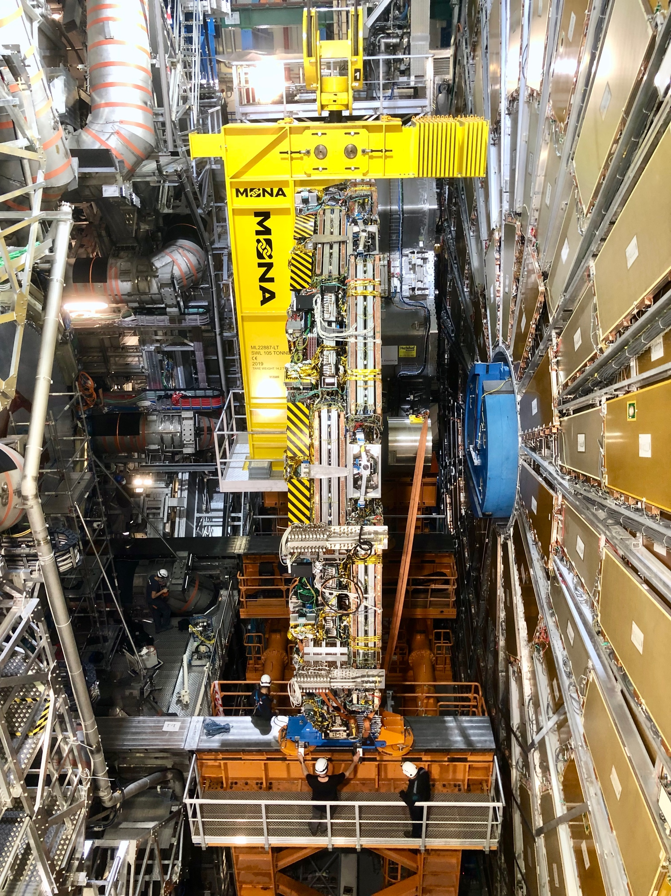
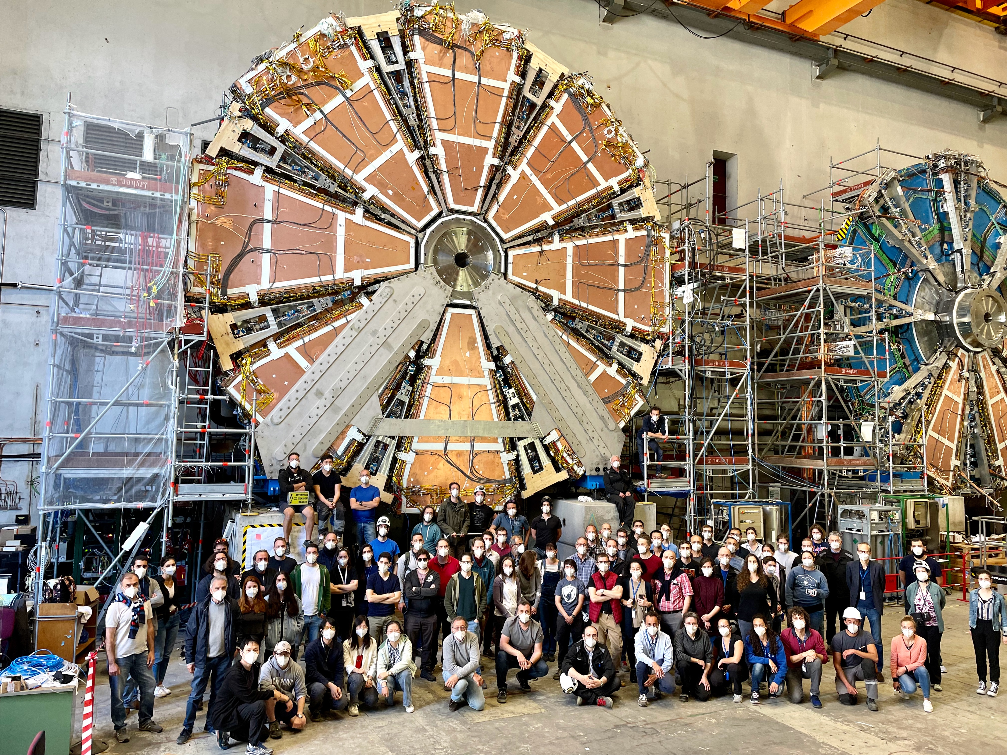
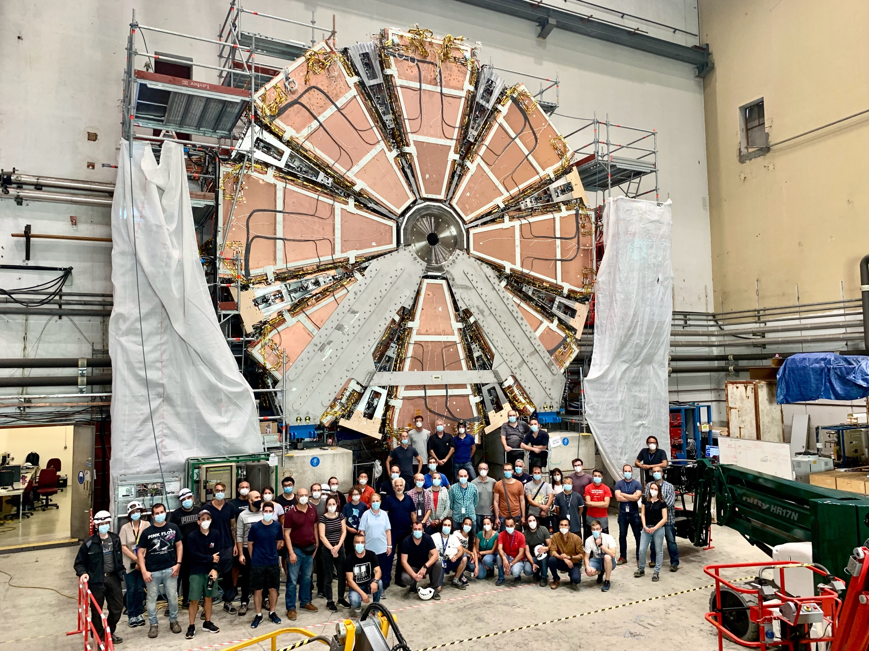
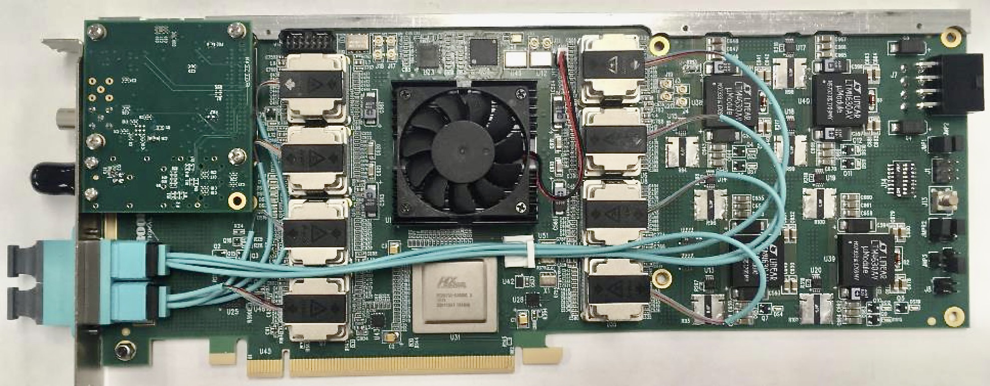
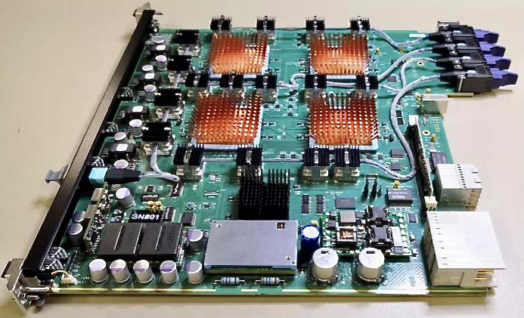
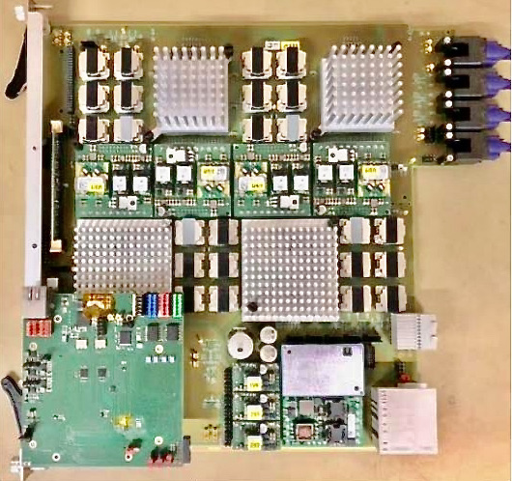
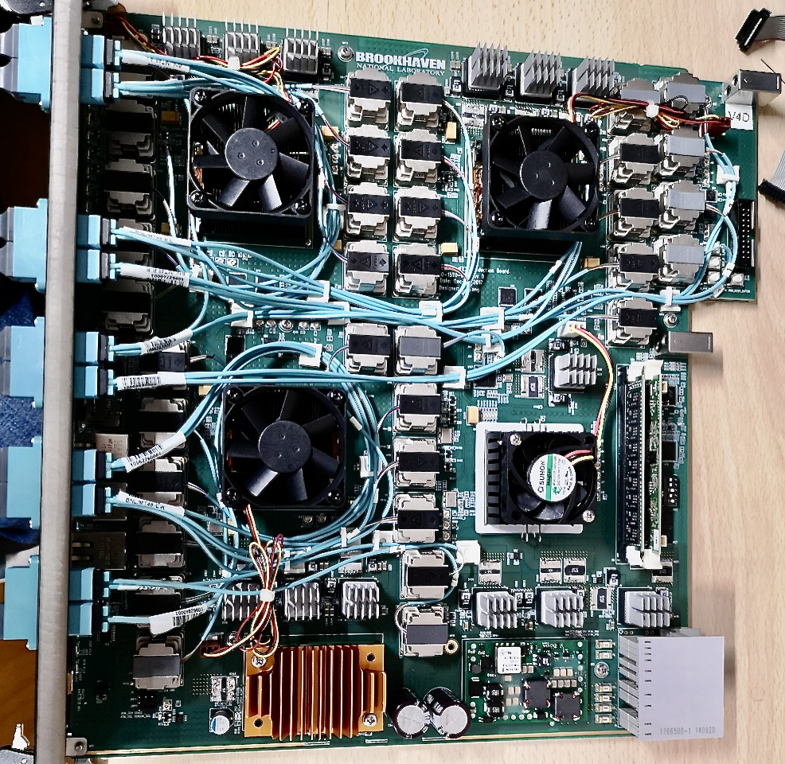
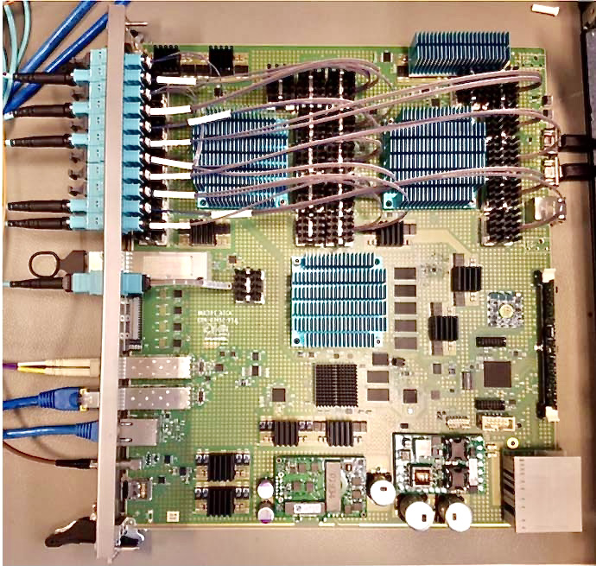
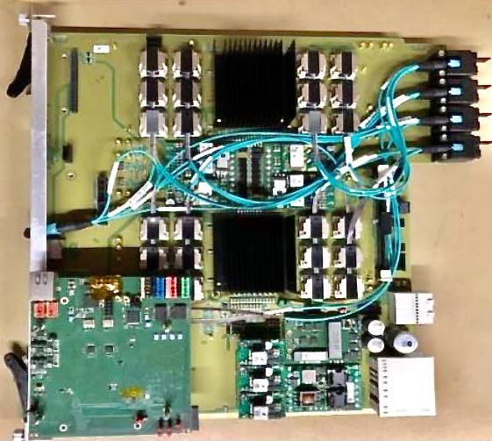
ATLAS — Phase-I upgrades completed
Both Muon New Small Wheels installed and under commissioning
Completion of NSW-A on 28 May 2021
Completion of NSW-C on 13 September 2021
Digital LAr trigger and new Trigger & DAQ boards installed and under commissioning
FELIX IO card
eFEX
jFEX
gFEX
MUCTPI
L1Topo

Slide 7

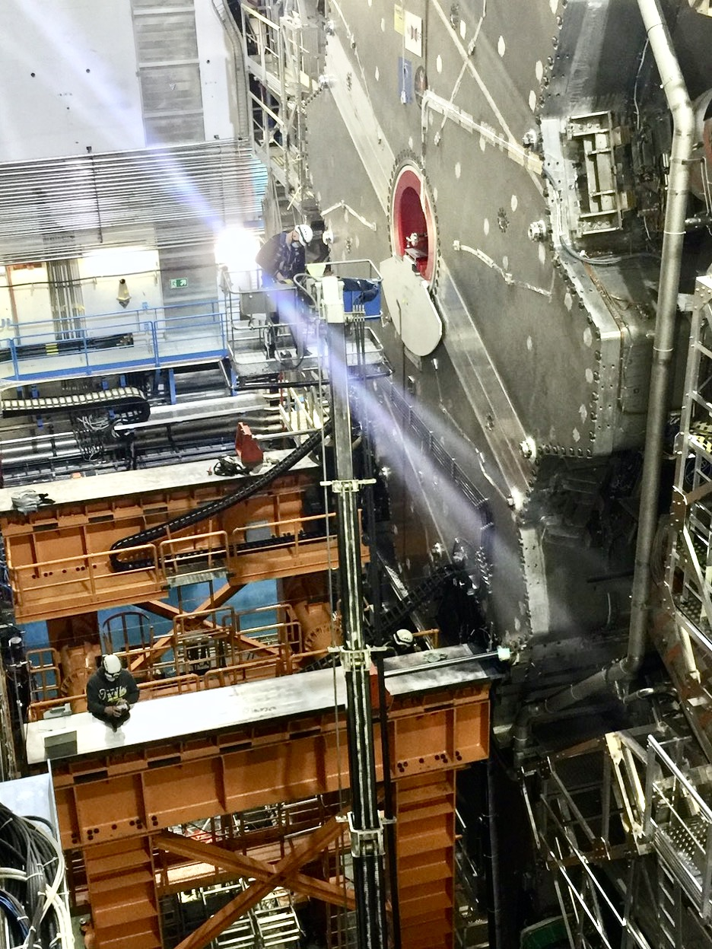
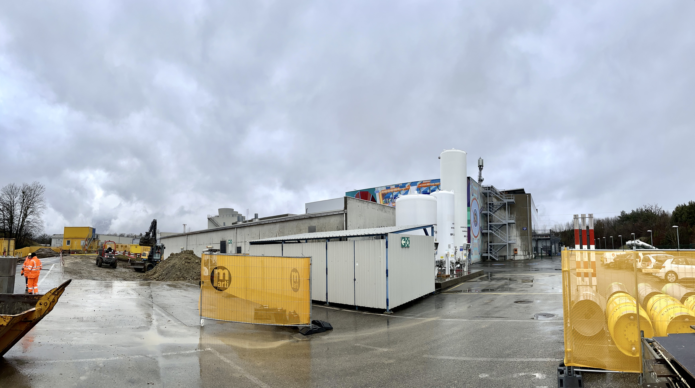
ATLAS: LS2 Work Beginning of 2022
Phase-I upgrades successfully completed
Side A with JFC1/2 shielding before closing
Endgame and cavern closure
8 Jan: start of detector closing
21 Jan both Endcap Toroids on beam line
End of Jan: begin of new CO₂ building construction at P1
1 Feb: endcaps in run position, begin of Central Solenoid test
10 – 17 Feb: successful beampipe bake-out
Feb 23: M11 and cavern cleaning (40 volunteers will help, thanks!)
10 Mar: begin of final closing and installation of forward shielding
24 March: final patrol and cavern closed
Since 21 March two weeks M12, including long cosmic run for barrel alignment of the muons
20 April: Toroid and solenoid ramp, both magnets are kept ON
Side B ECT-C in run position
Construction of new CO₂ building at P1 (for Phase-II)
Members of beampipe bake-out team, Feb 2022

Slide 8
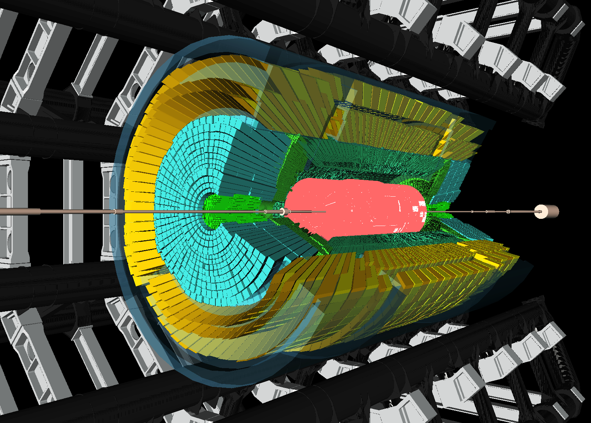
A beam splash event recorded on 22 Apr 2022

Slide 9

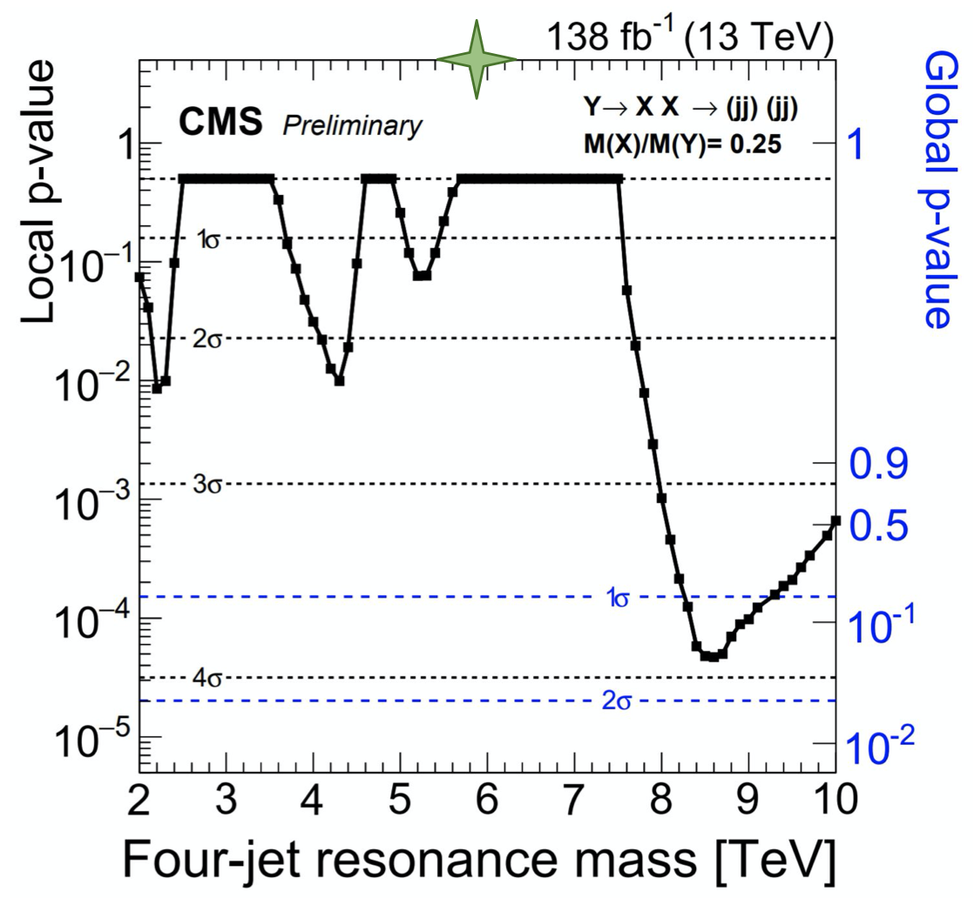
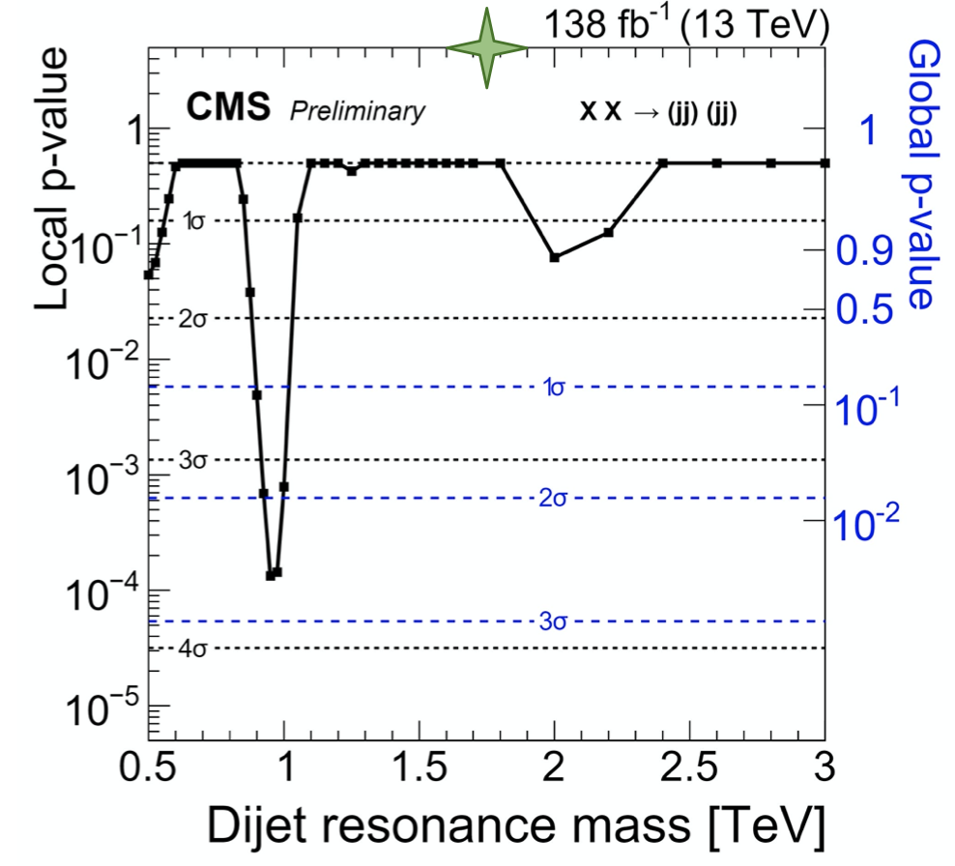
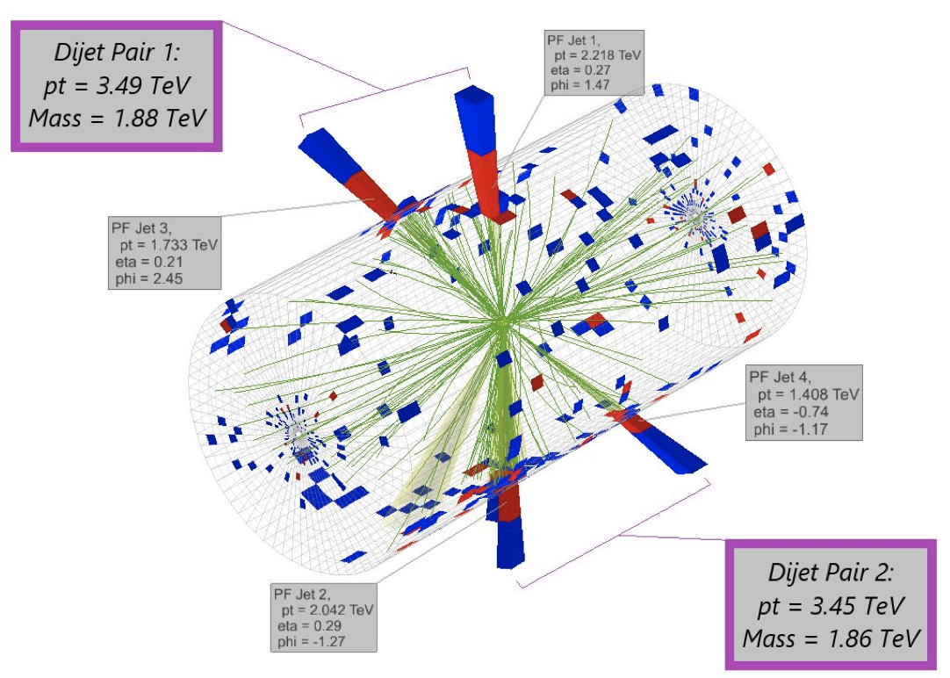
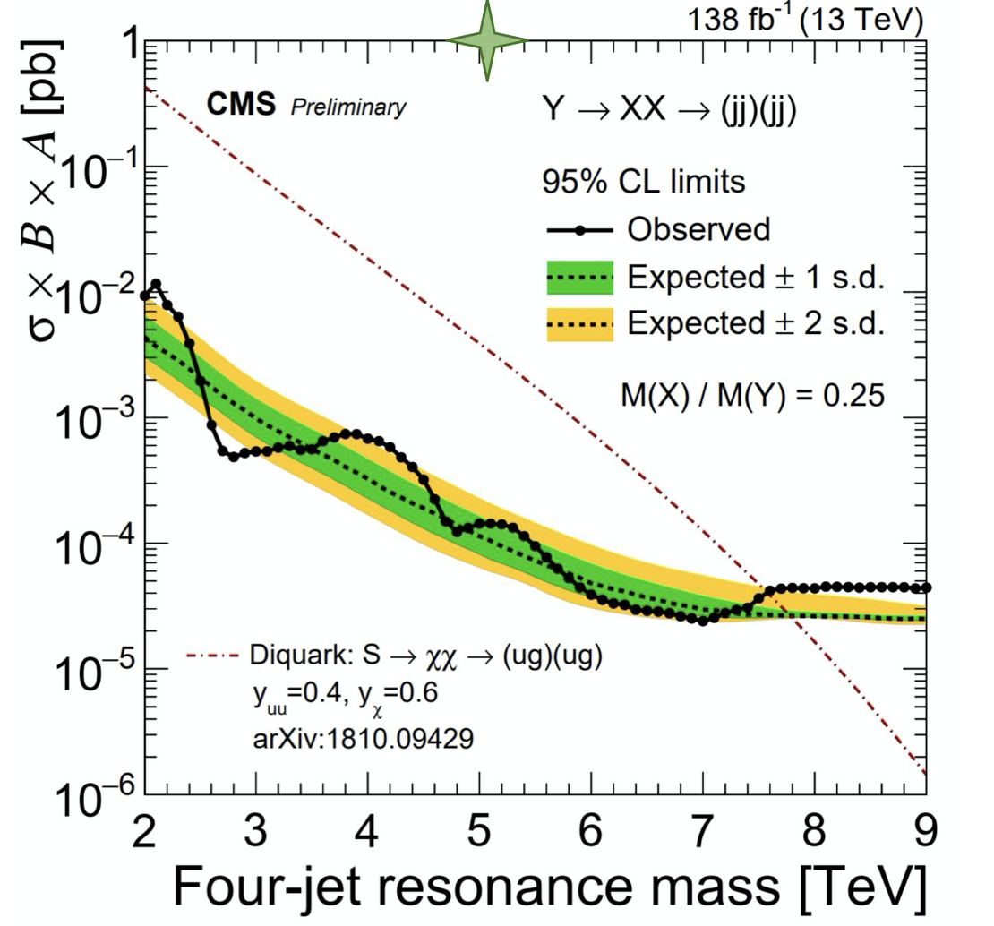
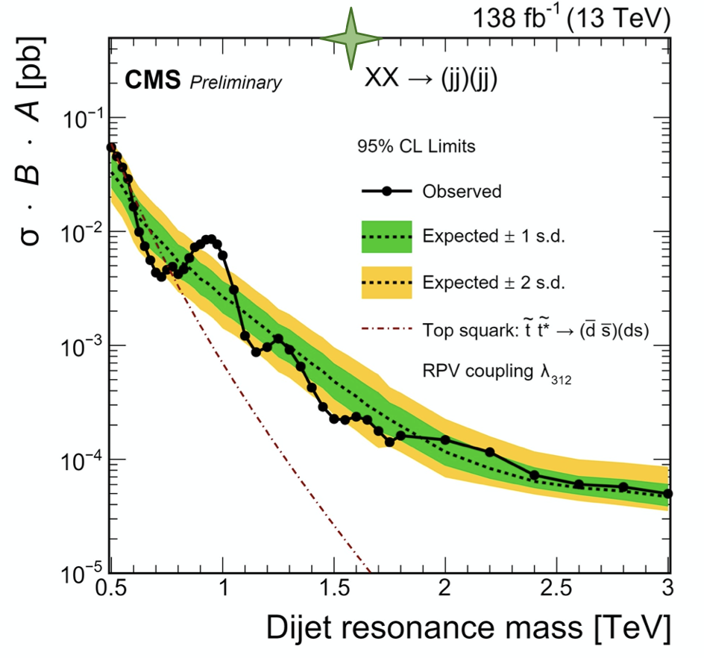
CMS: Search for Paired Di-jet Resonances
CMS-PAS-EXO-21-010
Search for resonant and non-resonant production of pairs of di-jet resonances
full Run-2 dataset
data driven background estimate
3.9σ
3.6σ
Limits with benchmark models:
non-resonant: RPV stops
resonant: diquarks
9
Notes:
3.9 standard deviations and a global significance of 1.6 standard deviations if interpreted as a signal
local significance is 3.6 standard deviations and the global significance is 2.5 standard deviations

Slide 10
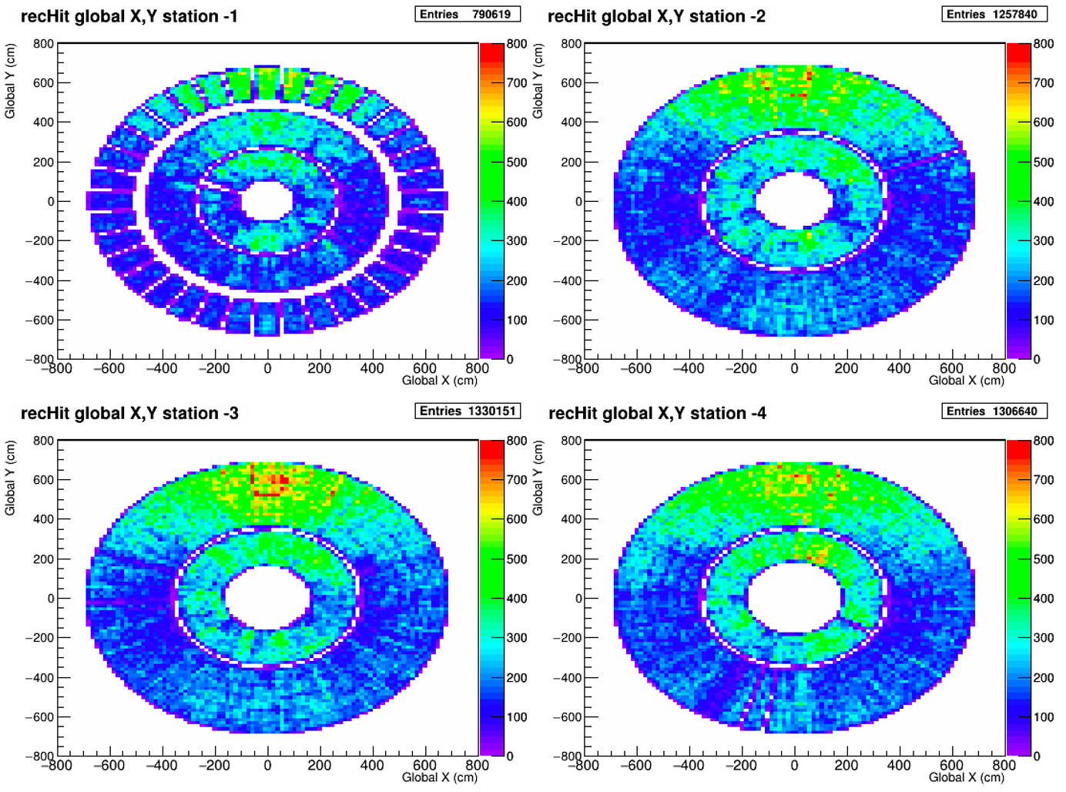
CMS: Readiness at Point 5
Pixels
Successful time and spatial alignment using the 900 GeV data, resolution nearly optimal
Strip Tracker
Finalised timing, alignment and calibration with cosmic ray and 900 GeV data
Muon System
Commissioning in cosmic rays,
overall excellent performance
ECAL
commissioning with cosmic rays
HCAL
All, including HF, participating in global runs
BRIL
Phase-2 demonstrators installed:
BCML (diamond, sapphire) and BLM (ionisation chambers)
PPS
New 3D-pixel detectors in horizontal RP installed
CSC occupancy
@ 2022 MWGR #1

Slide 11
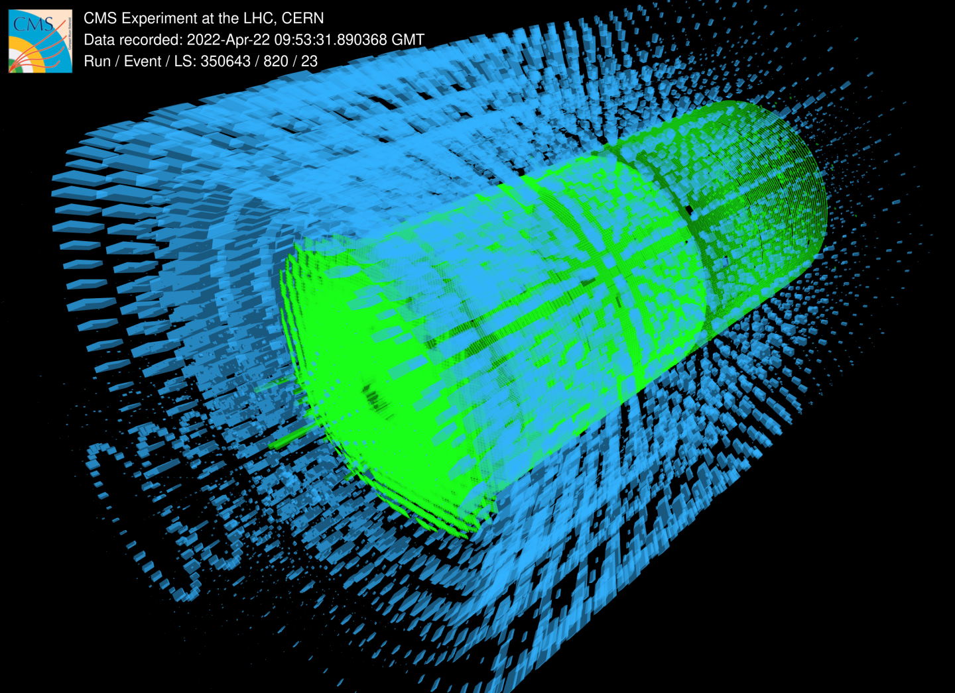

Slide 12

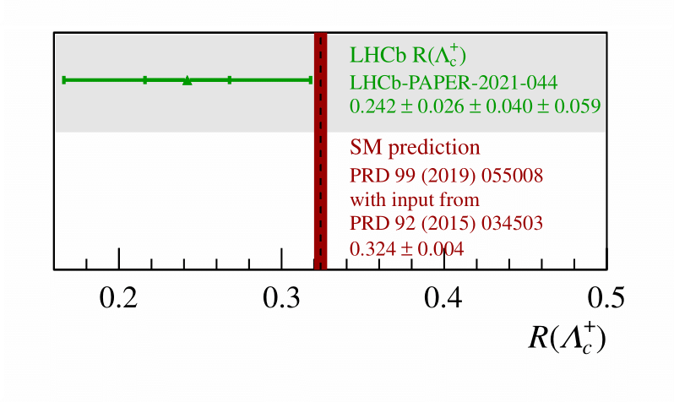
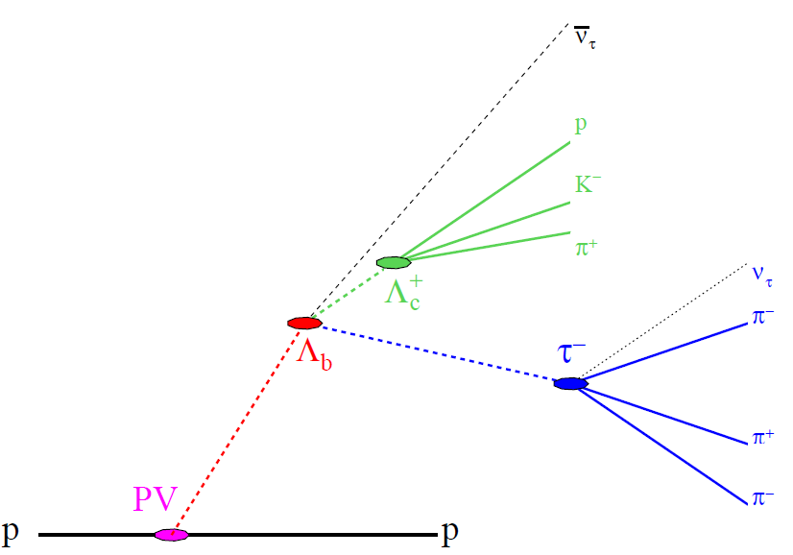
LHCb: Semi-leptonic Lepton Flavour Test
LHCb-PAPER-2021-044
The other lepton flavour anomalies (outside b→sll)
R(Λ_{c}⁺) decays of baryon to tau lepton
compared with muon
First observation of this channel and first test of ratios with semi-leptonic baryon decays
Notes:
30% accuracy

Slide 13
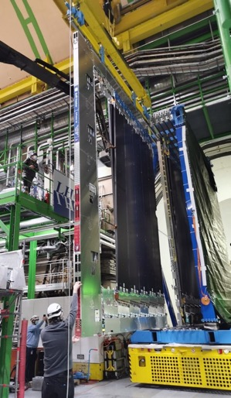
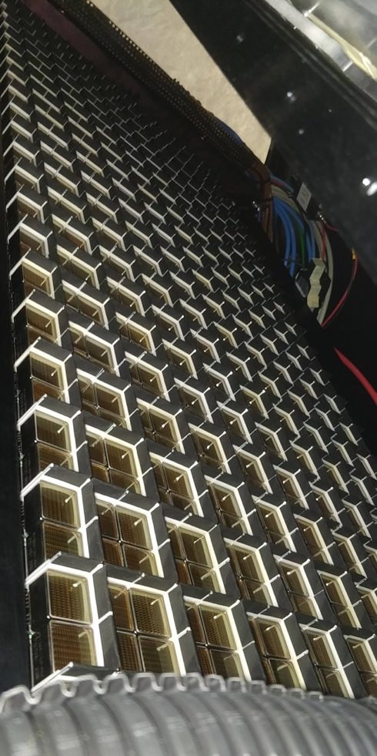
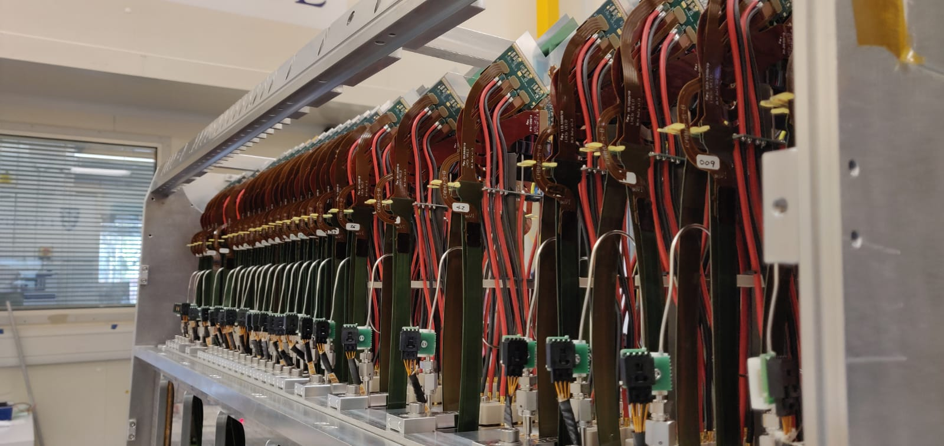
LHCb Upgrade I
Largest CERN particle physics detector project
since LHC completion
  despite pandemic, is being completed on-budget and
  near schedule
Completed installation in first months of 2022:
  RICH1, Scintillating Fibre main tracker,
  first-half of VELO, luminometer
Minor issues with cooling circuit led to a delay in VELO second-half
  construction of second half of VELO has now been completed
  will be transported to CERN this week
  installation foreseen in next weeks, with minimal effect on LHC schedule
  upstream tracker not essential for initial operation and will be installed at a later stage
2nd half of of VELO ready to be shipped to CERN

Slide 14
Risks Associated with the War Against Ukraine
Russian (and Ukraine) institutes are strong and important partners in the CERN programme
Close to 7% of the members of the LHC collaborations are from institutes in Russia (incl. JINR)
They are essential for the operation of the experiments Most critical examples:
  ALICE: Fast Interaction Trigger, Photon Spectrometer, …
  ATLAS: Inner Detector, Tile Calo., TDAQ, Technical Coordination, …
  CMS: HCAL, CSC, BRIL, Technical Coordination,…
  LHCb: Muon systems, ECAL, HCAL, ..
More than 100 scientists, engineers and technicians are crucial for the operation of the four detectors
Members from Russian institutes in the LHC collaborations
 | Total | Russia (incl. JINR) |  | JINR
ALICE | 1942 | 167 | 8.5% | 34 | 1.7%
ATLAS | 5917 | 364 | 6.2% | 147 | 2.5%
CMS | 5365 | 306 | 5.4% | 88 | 1.6%
LHCb | 1500 | 148 | 9.9% | 0 | 0%
Sum | 14724 | 985 | 6.7% | 269 | 1.8%
Collaborators essential for the operation
of the LHC experiments
 | Russia (incl. JINR) | JINR
ALICE | 20 | 5
ATLAS | 44 | 15
CMS | 34 | 10
LHCb | 15 | 0
Sum | 113 | 30
Recall the HUGE contributions Russian, JINR (also Belarus, Ukrainian) technicians, engineers and physicists made to the construction and operation of the detectors

Slide 15
More Information on Russian Engagement in LHC Experiments
M&O A and B contributions (w/o electricity)
Core contributions to current detectors, incl. Phase I
[kCHF] | 2022 total | Russia (incl. JINR) |  | JINR
ALICE | 6401 | 562 | 8,8% | 107 | 1.7%
ATLAS | 19240 | 720 | 3.7% | 266 | 1.4%
CMS | 19455 | 1231 | 6.3% | 376 | 1.9%
LHCb | 4220 | 438 | 10.4% | 0 | 0.0%
Sum | 49316 | 2951 | 6.0% | 749 | 1.5%
[MCHF] | 2022 total | Russia (incl. JINR) |  | JINR
ALICE | 216 | 21.7 | 10% | 3.1 | 1.4%
ATLAS | 569 | 29.7 | 5.2% | 8.7 | 1.5%
CMS | 588 | 26.0 | 4.4% | 7.9 | 1.3%
LHCb | 128 | 10.3 | 8.0% | 0 | 0,0%
Sum | 1501 | 87.7 | 5.8% | 19.7 | 1.3%
Students from Russian institutes in the LHC experiments
Note that for CMS all JINR numbers include the institutes from JINR member states which are part of the RDMS collaboration
 | Russia (incl. JINR) |  | JINR
 | PhD | Master/ Bachelor/ Engineering | PhD | Master/ Bachelor/ Engineering
ALICE | 32 | 14 | 5 | 0
ATLAS | 41 | 39 | 14 | 14
CMS | 32 | 14 | 5 | 0
LHCb | 33 | 8 | 0 | 0
Sum | 138 | 75 | 24 | 14

Slide 16
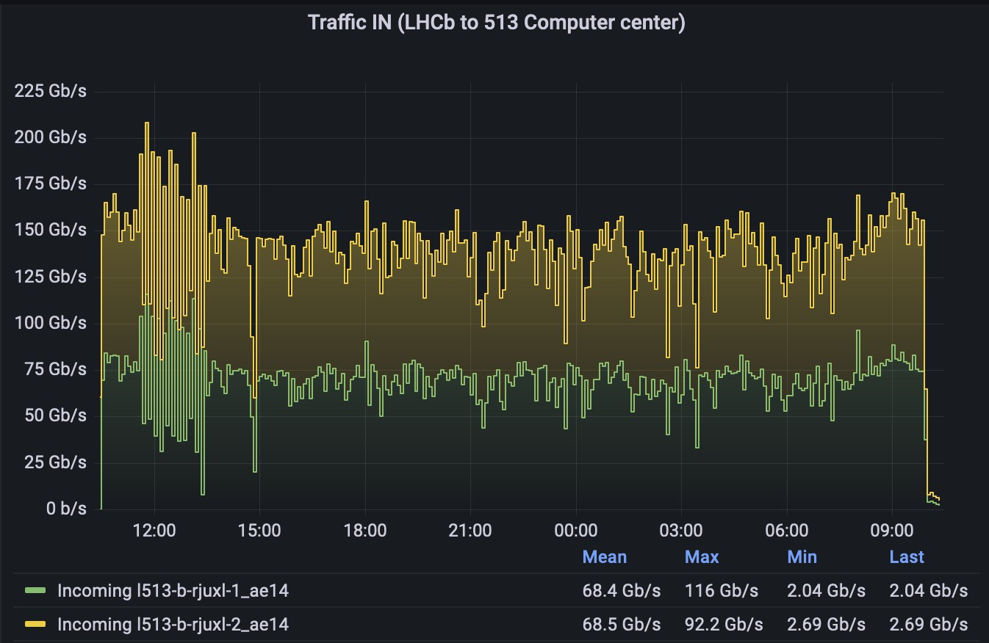
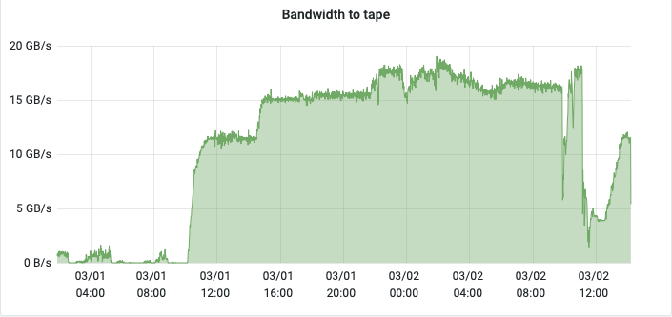
WLCG: Readiness for Run 3
March 2022: LHCb P8 to T0 disk
In 2021 we tested extensively the WLCG services in preparation for Run 3
network & archive storage tests
no standing concerns while final tests are ongoing
The combined tests of the experiments have shown that we have enough infrastructure in place for the start of Run-3
additional hardware has been deployed after the challenges and some is still being deployed
A final commissioning campaign is happening in March 2022, with excellent results so far
10 GB/s nominal target
March 2022: LHCb T0 disk to tape
10 GB/s nominal target

Slide 17
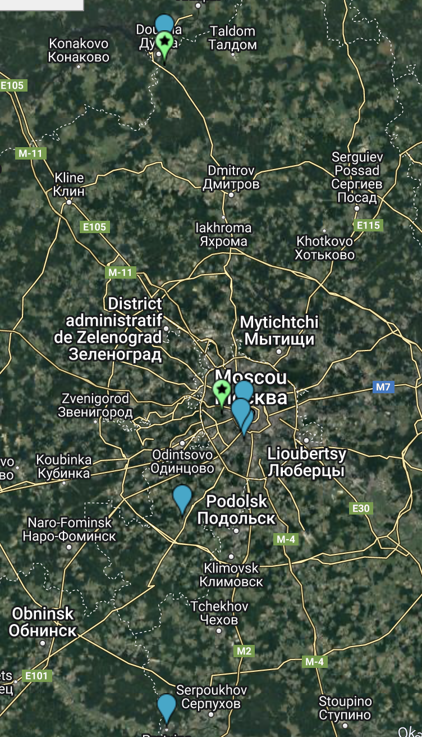
Impact of War Against Ukraine on WLCG
Russia participates in the Worldwide LHC Computing Grid (WLCG) and has two Tier-1 centres at the Kurchatov Institute in Moscow (RRC-KI) and at JINR in Dubna:
RRC-KI: Tier-1 for ALICE, ATLAS and LHCb
JINR: Tier-1 for CMS
In total, the two centres contribute about 10% of the total Tier-1 resources
not equally shared between experiments, e.g. JINR provides ≈ 30% of CPU for CMS
In addition, there are eight Tier-2 centres in the Moscow and St Petersburg region, supporting all four LHC experiments:
RRC-KI, JINR which serve also as Tier-2 centres,
FIAN (the Lebedev institute), ITEP (Institute of Theoretical and Experimental Physics), the Troitsk institute for Nuclear Research and IHEP Protvino
Saint Petersburg State University (SPbSU) and the Petersburg Nuclear Physics Institute
Ukraine supports two Tier-2 centres in Kiev and Kharkiv

Slide 18
Impact of War Against Ukraine on WLCG
Associated risks:
loss of about 10% Tier-1 resources (less critical for Tier-2)
even more serious: Russian experts contribute to the development and operations of WLCG software and services, in the experiments (about 30 people) and at the WLCG sites
connectivity: on pressure from several EU countries GEANT has discontinued the connection to Russia dedicated to LHC (LHCONE);
currently connection through public internet
The most valuable unique data sets in Russian Tier-centres were replicated also at other sites by the experiments
An extra-ordinary WLCG Overview Board was held on March 28th

Slide 19
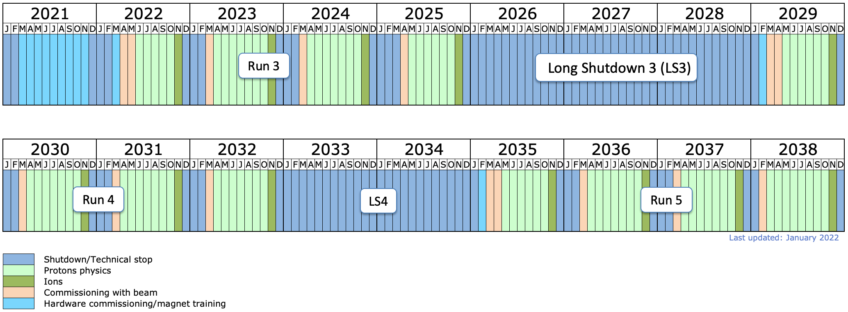
Phase II: LHC Schedule
Phase II upgrade
ATLAS & CMS
Recall schedule discussion of December 2021:
following recommendations of LHCC and
HL-LHC Cost & Schedule Review CERN management
proposed to extend Run 3 by 1 year and LS3 by ½ year
feedback from funding agencies (RRB) was supportive
Thank you very much for your many useful comments
and your support!
CERN management decided in January 2022 to adapt
the schedule as proposed
underlining that any further shift of LS3 is technically excluded!
CERN measures to help experiments to consolidate the Phase II schedule:
CERN EP, ATLAS and CMS established a priority list and roadmap for electronics
CERN will try to continue the CHIPS initiative and support it with experienced workforce
discussion with Fraunhofer IPA in Germany started
this institute is specialized on (industrial) process optimization
plan for workshops with experiments once re-baselining is completed (hopefully Q2 2022)
In addition, both experiments are working hard to consolidate the schedule
ALICE 3 & LHCb upgrade II

Slide 20
Risks Associated with the War Against Ukraine
Phase II: very significant contributions from Russian institutes are part of the Phase II projects
approx. 20 MCHF core contributions
key in-kind contributions depend on their workforce and expertise
Some examples:
Phase II core contributions from institutes in Russia
[MCHF] | Total | Russia (incl. JINR) |  | JINR
ATLAS | 248.8 | 8.3 | 3.3% | 3.1 | 1.2%
ATLAS common fund | 24.4 | 1.2 | 5.0% | 0.4 | 1.6%
CMS | 283.5 | 9.2 | 3.2% | 2.4 | 0,8%
CMS common fund | 25.0 | 1.5 | 6.1% | 0.4 | 1.7%
Sum | 581.7 | 20.2 | 3.5% | 6.2 | 1.1%
ATLAS: needed in 2022
ITK: delivery of manifolds, start of flip-chip qualification and pre-production of pixel end-cap modules
RPC: shipping to CERN of prototype transport frames and the pre-production of installation equipment, temporary export of RPC readout panels for assembly at JINR
CMS: by far largest project with Russia is the HGCAL with 8.2 MCHF core contributions expected
already blocked collaboration between Russia and Ukraine: moulded scintillators (Russia), machined scintillator (Ukraine), copper-tungsten base-plates for silicon modules (Russia), copper cooling plate prototypes (Belarus)
These components are all needed for pre-series activities this year
→ Significant budget and schedule risk

Slide 21
Summary
LHC experiments continue to produce excellent physics results from Run 2 data
  10th anniversary of Higgs discovery 4th of July, 2022
Experiments are ready for Run 3
  cavern closed since March 24th
  computing ready for Run 3
Russian war against Ukraine constitutes a significant risk
  to the LHC and non-LHC experiments at CERN and
  to our Ukrainian and Russian colleagues who contributed and are still contributing to the scientific programme of CERN
  if the International Collaboration Agreements (ICAs) and MoUs are suspended
  Russian contributions will have to be covered by the other FAs pro-rata
LHC and HL-LHC are the highest priority projects for CERN and particle physics
  we are working very hard to keep the projects on schedule and on budget
  we are grateful to the continuous support of the Funding Agencies

Slide 22
Backup

Slide 23
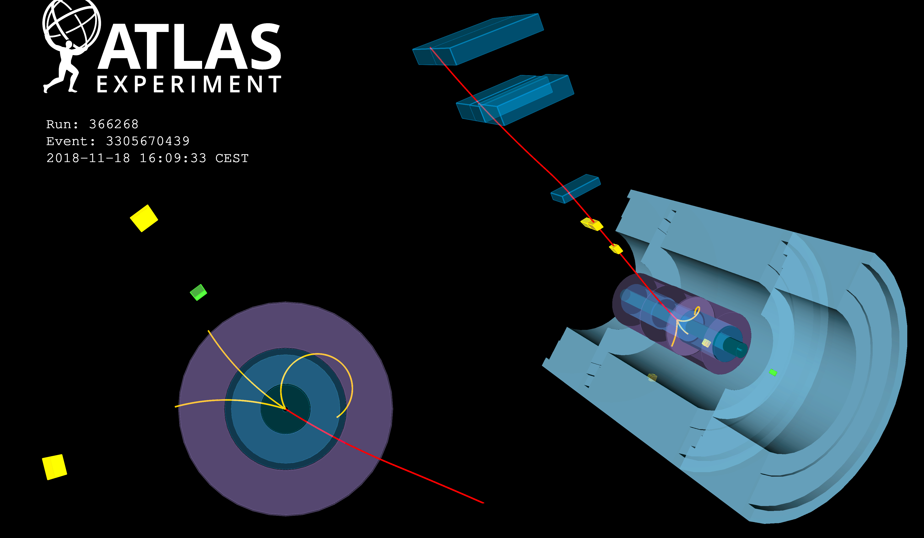
Observation of γγ → ττ in Pb-Pb collisions and constraint on tau anomalous magnetic moment
Observation of γγ → ττ in Pb-Pb collisions and constraint on a_{τ} [ Physics Briefing, Interview ]

Slide 24
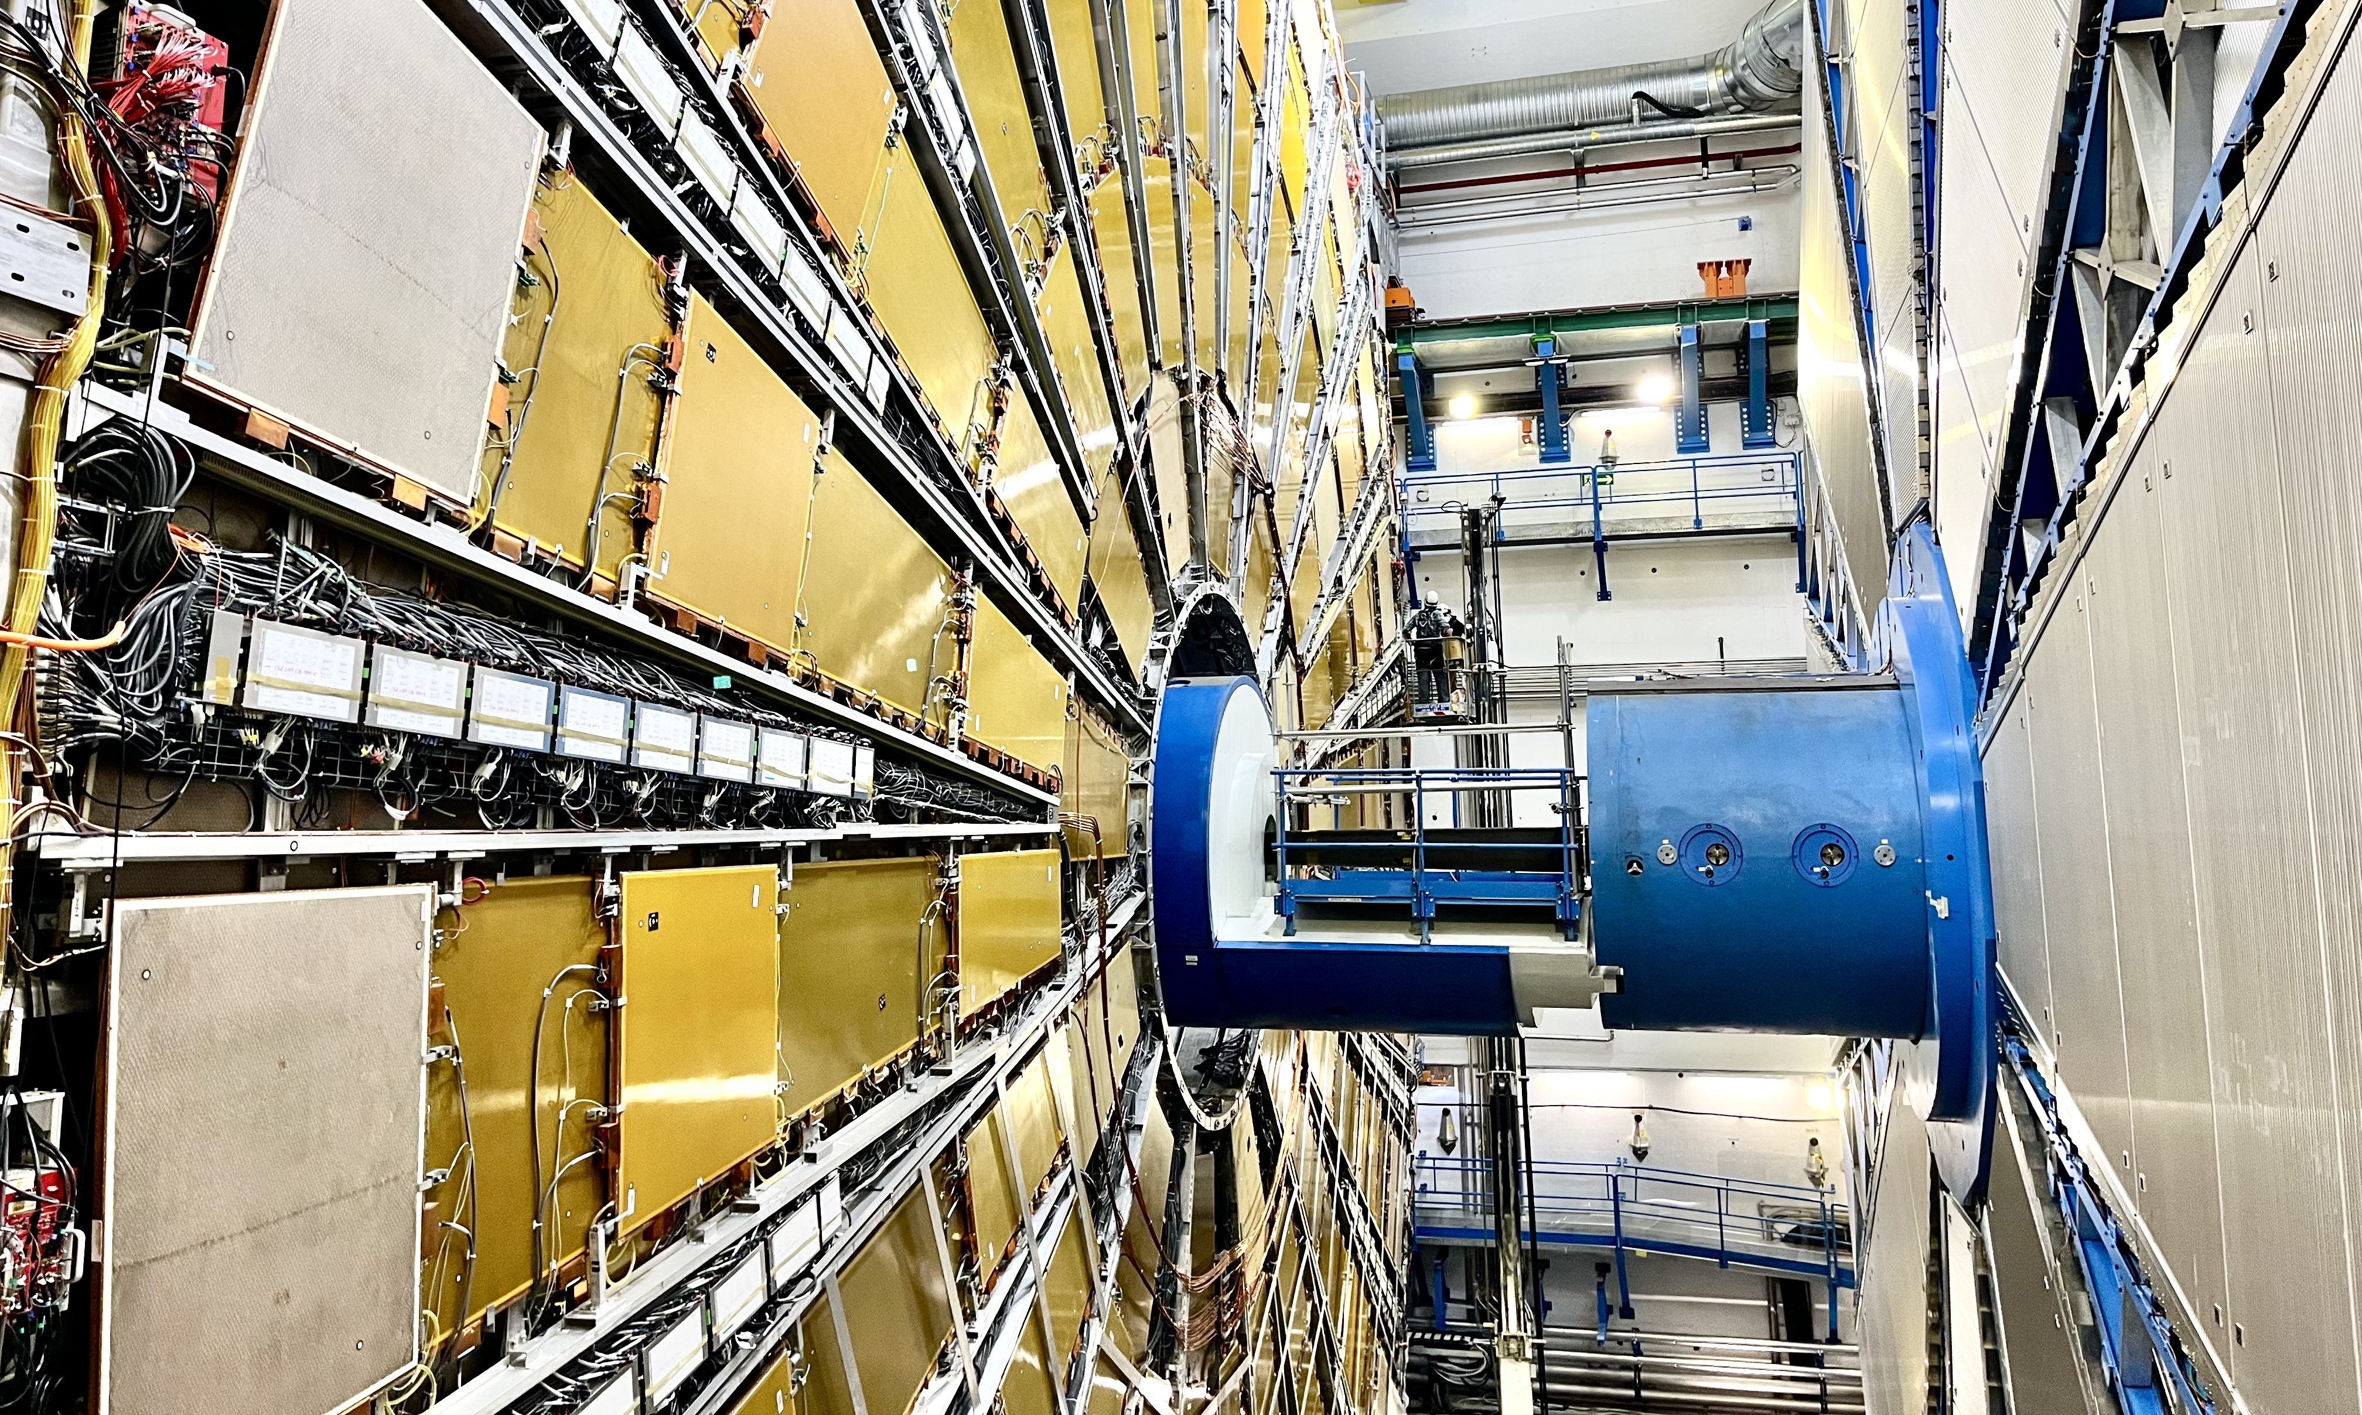
ATLAS is closed and ready for Run 3
Side A on 3 Feb 2022

Slide 25
More Information on Russian Engagement in CERN Experiments
Detector components relying most critically on Russian experts and workforce:
ALICE:
  Fast Interaction Trigger (FIT): Russian groups have major responsibilities in the FIT detector, the main level-0 trigger detector; large part of the detector was developed and built by them
  Photon Spectrometer (PHOS) is entirely under the responsibility of the Russian groups and JINR, who are the only ones in ALICE to have the technical expertise for its maintenance and operation.
  Important contributions to inner Tracking System (ITS), the Muons Forward Tracker (MFT) and the Muon Spectrometer detector (Muon), but less critical
ATLAS:
  Inner Detector
  Tile Calorimeter (incl. project leadership)
  TDAQ
  Technical Coordination
  JINR colleagues contribute to the commissioning of the Muon New Small Wheel, and more generally to the Muon Spectrometer, and to the Liquid-Argon Calorimeter

Slide 26
More Information on Russian Engagement in CERN Experiments
Detector components relying most critically on Russian experts and workforce:
CMS:
  Fast Interaction Trigger (FIT): Russian groups have major responsibilities in the FIT detector, the main level-0 trigger detector; large part of the detector was developed and built by them
  Hadron Calorimeter (HCAL), incl. JINR
  Cathode Strip Chambers (CSC)
  BRIL
  Technical Coordination, in particular JINR
LHCb:
  Russian experts are crucial for the operation of the Muon Systems and Calorimeters (ECAL and HCAL). In these systems Russian institutes have leadership roles and both rely heavily on the Russian teams for maintenance and calibration during Run 3, including some elements where all knowledge currently resides in the Russian teams. Replacement muon chambers are currently under construction in Russia.
  Scintillating Fibre Tracker (SciFi): fibre mat production in Russia (approx. 9% of the total system)
  Data Monitoring and processing
  Technical Coordination

Slide 27
Ukraine in LHC Experiments
ATLAS: no Ukrainian institute
ALICE: 2 institutes
Bogolyubov Institute for Theoretical Physics (Kiev)
Scientific Research Technological Institute of Instrument Engineering (Kharkiv)
Important contribution to LS3 upgrade: the group of Kharkiv has developed the technology for the fabrication of aluminum-based electrical substrates for the FoCal detector
CMS: Ukraine contributes to RDMS collaboration (Russia and Dubna member states)
National Scientific Center, Kharkov Institute of Physics and Technology
Institute for Scintillation Materials of National Academy of Science of Ukraine (Kharkov)
Kharkov State University
Important contributions to Phase II: HGCAL
LHCb: four institutes from the Ukraine
Institute for Nuclear Research (KINR, Kyiv)
National Science Center Kharkiv Institute of Physics and Technology
Taras Shevchenko National University of Kyiv
Institute for Scintillation Materials (Kharkiv) (the latter 2 groups joined recently)
Contribution to the calorimeter pre-shower detector of the Run 1 and 2 detector, and the radiation monitoring system
For LHCb Upgrade I they have designed and produced a new radiation monitoring
Leading role in the design, testing, installation and commissioning of the Plume luminometer system

