Slide 1
CERN Status and News
Plenary RRB 54th Meeting
Joachim Mnich
April 25, 2022

Slide 2
Covid Cases at CERN (Personnel + Contractors)
Xmas break
14.03.2022 Green level
(with some additional measures)

Slide 3
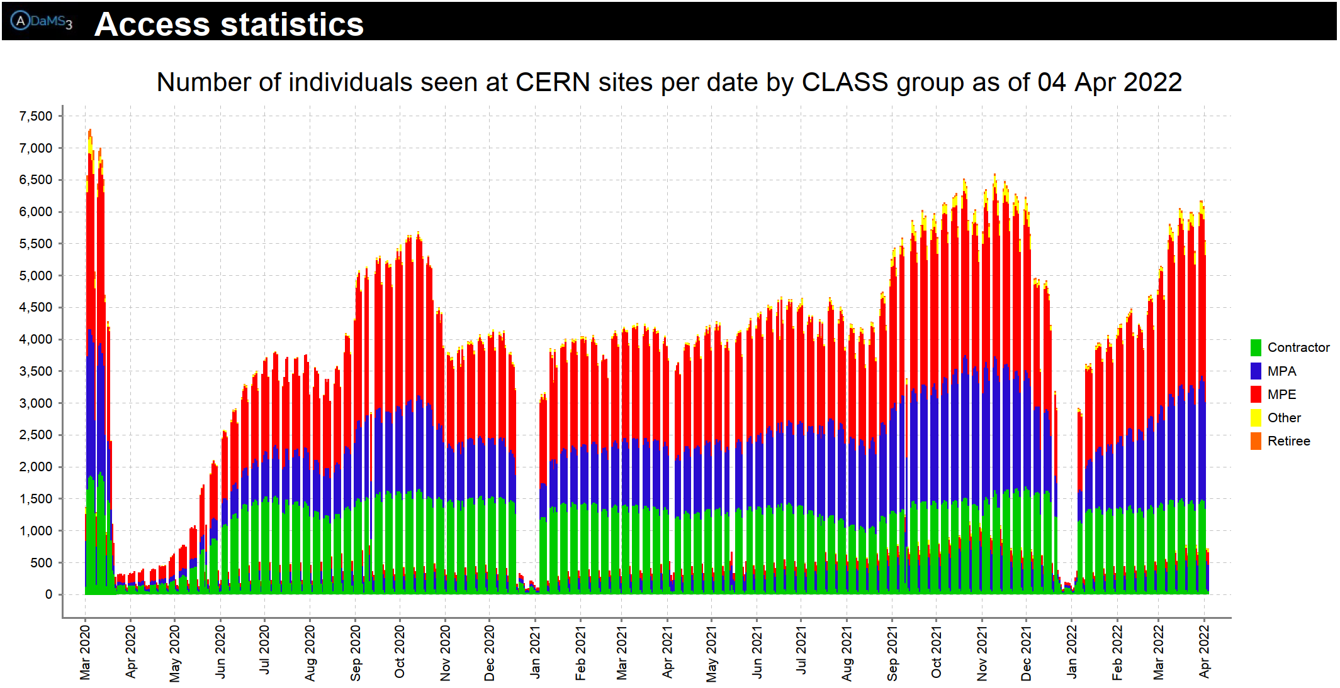
K. Foraz,
ED 05.04.2022

Slide 4

10th Anniversary of Higgs Boson Discovery
On 4 July 2022, CERN will mark 10 years since the ATLAS and CMS experiments announced the discovery of the Higgs boson.
The centrepiece is a full-day scientific symposium in CERN’s main auditorium. This will celebrate the discovery, give an overview of what’s been learned since then, and take a look forward at what’s still to come.
Full details will be published soon but, in the meantime, save the date of 4 July 2022!

Slide 5
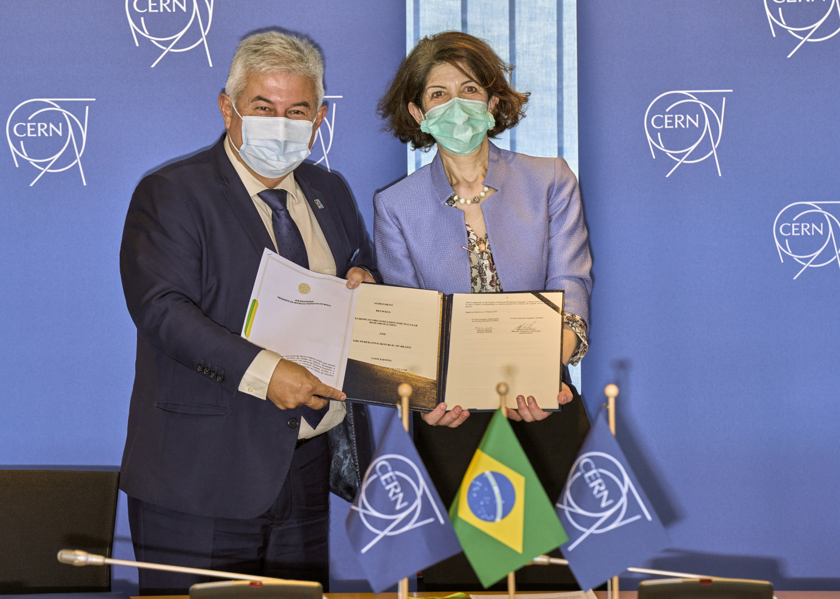
CERN Family
23 Member States:
Austria, Belgium, Bulgaria, Czech Republic, Denmark, Finland, France,
Germany, Greece, Hungary, Israel, Italy, Netherlands, Norway, Poland,
Portugal, Romania, Slovak Republic, Serbia, Spain, Sweden, Switzerland,
United Kingdom
10 Associate Member States:
Croatia, Cyprus*, Estonia*, India, Latvia, Lithuania, Pakistan, Slovenia*,
Turkey, Ukraine
* in the pre-stage to Membership
4 Observers:
Japan, USA, European Union, UNESCO
(Russia and JINR suspended on 8 and 25 March, respectively)
~60 ICA (International Cooperation Agreements):
with non-Member States, some with countries with developing particle
physics communities (CERN mission is also to help build capacity
and foster growth of particle physics worldwide).
March 3, 2022: CERN Director-General Fabiola Gianotti and Brazilian Minister for Science, Technology and Innovation Marcos Pontes signed an agreement admitting Brazil as an Associate Member State of CERN
Agreement awaiting ratification by the Government

Slide 6
Main issues 54th LHC RRB
Status preparation Run 3
  Including M&O reports and requests
Status Phase II Upgrades
  New schedule released in January 2022
Russian War on Ukraine
  Potential impact on the LHC scientific programme

Slide 7
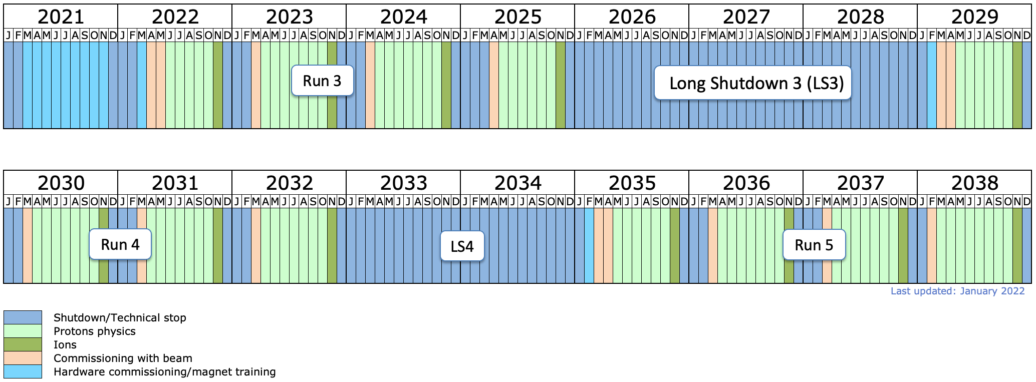
LHC Schedule
Phase II upgrade
ATLAS & CMS
Recall schedule discussion of December 2021:
following recommendations of LHCC and
HL-LHC Cost & Schedule Review CERN management
proposed to extend Run 3 by 1 year and LS3 by ½ year
feedback from funding agencies (RRB) was supportive
Thank you very much for your many useful comments
and your support!
CERN management decided in January 2022 to adapt
the schedule as proposed
underlining that any further shift of LS3 is technically excluded!
CERN measures to consolidate the Phase II schedule:
CERN EP, ATLAS and CMS established a priority list and roadmap for electronics
CERN will try to continue the CHIPS initiative and support it with experienced workforce
discussion with Fraunhofer IPA in Germany started
this institute is specialized on (industrial) process optimization
plan for workshops with experiments once re-baselining is completed (hopefully Q2 2022)
In addition, both experiments are working hard to consolidate the schedule
ALICE 3 & LHCb upgrade II

Slide 8
Russian War on Ukraine:
Measures taken by CERN Council
Statement from 25 March:
https://home.cern/news/news/cern/cern-council-takes-further-measures-response-invasion-ukraine
In response to the military invasion of Ukraine by the Russian Federation, the 23 Member States of CERN today decided to:
suspend the participation of CERN scientists in all scientific committees of institutions located in the Russian Federation and the Republic of Belarus, and vice versa;
suspend or, failing that, cancel all events jointly arranged between CERN and institutions located in the Russian Federation and the Republic of Belarus;
suspend the granting of contracts of association as associated members of the CERN personnel to any new individuals affiliated to home institutions in Russia and Belarus.

Slide 9
Measures taken by CERN Council
Regarding relations with the Joint Institute for Nuclear Research (JINR), with which CERN holds reciprocal Observer status, the CERN Council decided:
to suspend the participation of CERN scientists in all JINR scientific committees, and vice versa;
to suspend or, failing that, cancel all events jointly arranged between CERN and JINR;
that CERN will not engage in new collaborations with JINR until further notice;
that the Observer status of JINR at the Council is suspended and CERN will not exercise the rights resulting from its Observer status at JINR, until further notice.
Council have asked for more information with a view to making a decision in June on the possible suspension of international coooperation agreements

Slide 10
Guidance on publications
Following the Russian invasion of Ukraine, the spokespersons of the four big LHC experiments proposed a suspension of publications.
CERN management will not interfere with the publication choices of the Collaborations, but supported this approach as being pragmatic given the current circumstances.
CERN management can now pass on guidance from the closed Council session regarding publications:
“Authorship should be based on scientific grounds, and that Council would be favourable of having a cover statement that a given paper is based on work performed before Feb 24th 2022”
The Collaboration Boards of the four large LHC experiments considered proposals based on this guidance, and aiming to align their policies.

Slide 11
Agreement among the 4 LHC Collaborations
Until the guidance or rule changes issued from the 16/17 June CERN Council have been implemented:
• Submit papers to arXiv.org and to CDS with “The XYZ Collaboration” only, that is, without author list nor acknowledgments.
• Submit the papers without author list and acknowledgments to journals for review. If a paper is accepted for publication before the June CERN Council meeting, a delay in publication will be requested.
The submitted papers would contain final results. Any release of preliminary results is continued in the usual manner.

Slide 12
Backup

Slide 13
Long-term LHC Schedule
Run 3 will be extended by 1 year until end 2025
and LS3 by ½ year until end 2028
Note:
no further extension of Run 3 or LS3 possible!
for technical and political reasons
Measures are taken to make the new schedule as solid as possible
engagement of external professionals in process optimisation
work on a combined prioritized schedule for ASICs design and production
CERN will help as much as possible
but will not be able to solve all current and undoubtedly arising future problems
full engagement of entire collaborations is required
Important:
success of Run3 and the Phase II upgrades are of crucial importance for CERN and the field
keeping the Phase II schedule is a key element!

Slide 14
Long-term LHC Schedule
the HL-LHC goal of providing 3000 fb⁻¹ integrated luminosity to ATLAS and CMS would require HL-LHC operation until ≈ 2041
ending HL-LHC in 2038 would provide ≈ 2500 fb⁻¹ per experiment
More details on long-term schedule are being worked on
luminosity predictions
HI running included in the current planning
upgrades of ALICE and LHCb in LS 4
  Currently under LHCC scrutiny
  Discussions with Funding Agencies starting
and others
Boundary condition:
no HL-LHC running beyond ≈ 2041
in light of the need for a future large project
Final decision on the long-term HL-LHC schedule will have to be taken at the next (or next-to-next?) strategy update in light of:
performance and results from the LHC, progress with the next project (FCC), …

