Slide 1
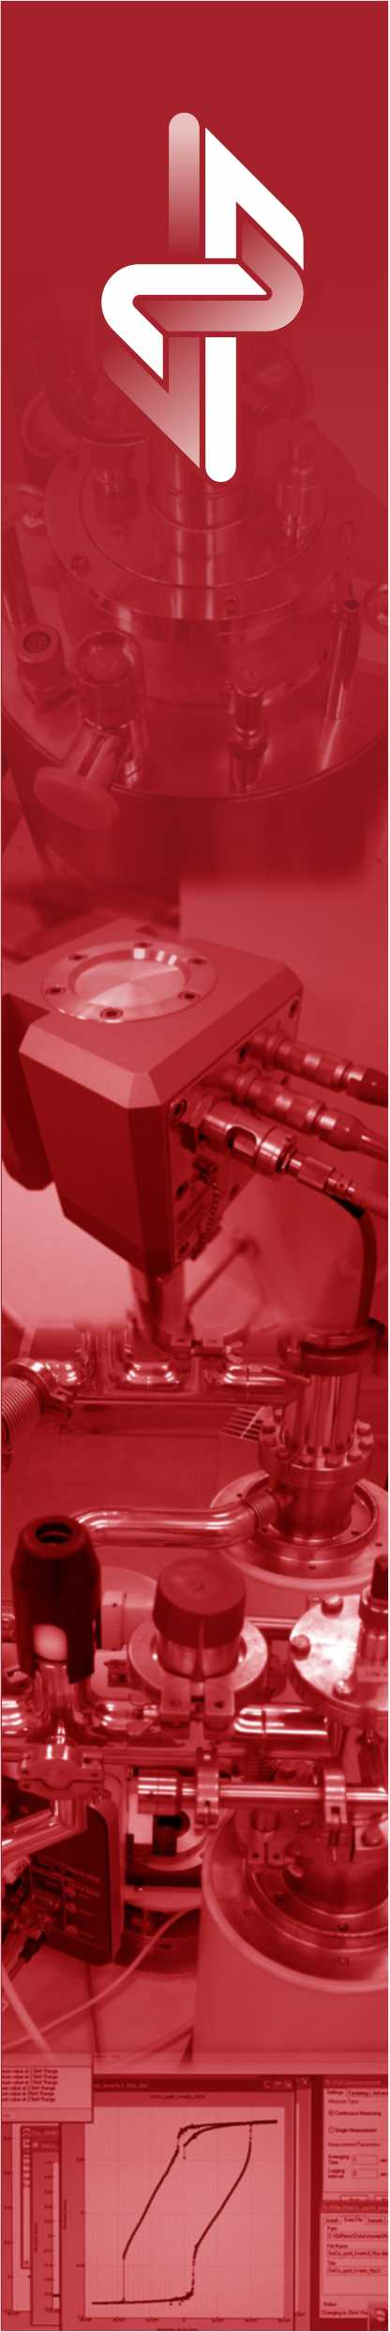

NICPB activities towards FCC
Mario Kadastik and Martti Raidal
NICPB, Tallinn

Slide 2
NICPB
National Institute of Chemical Physics and Biophysics (NICPB), KBFI in Estonian
National research institute - a public body established by the NICPB law
Does not belong to any university, collaborates with all Estonian universities
1996 – First cooperation agreement and MoU with CMS

Slide 3
4 pillars of the scientific collaboration
Theory
CMS data analyses
CERN
WLCG computing: Tier-2 CS for CMS
Detector development: muon DT and trigger

Slide 4
The NICPB theory group
25 researchers in TH including PhD students
Top researchers program:
    John Ellis
    Abdelhak Djouadi
    Alessandro Strumia
    Emidio Gabrielli
Research topics:
    Collider physics, including the LHC, FCC and CLIC research programs
    DM, astroparticle physics and cosmology in all of its forms
    More in general: NP beyond the SM in all of its forms
    Gravitational Waves, Black Holes etc

Slide 5
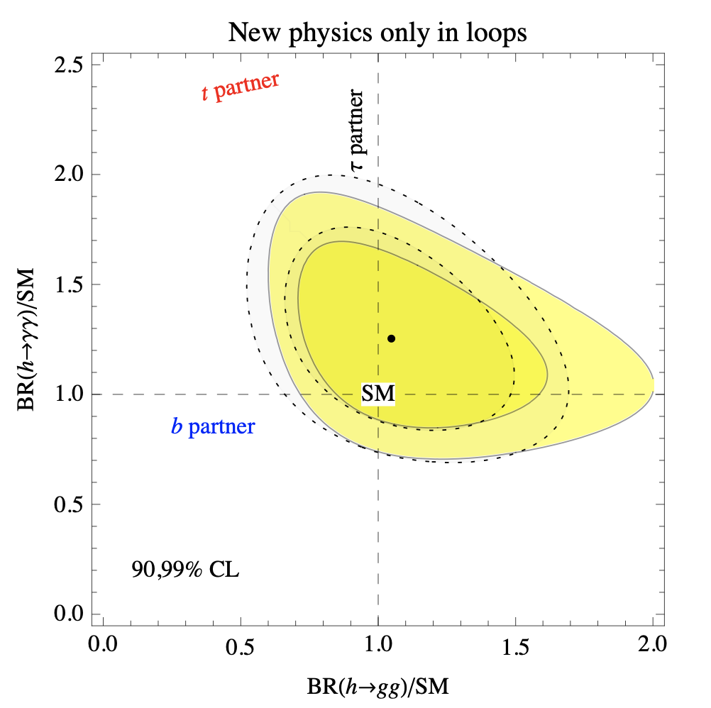
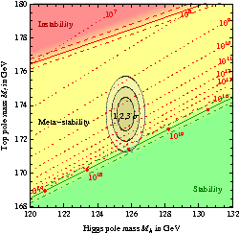
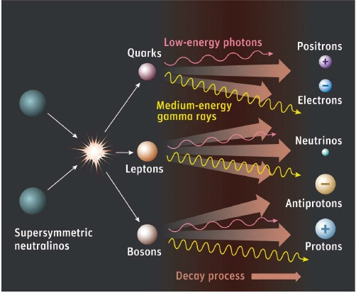
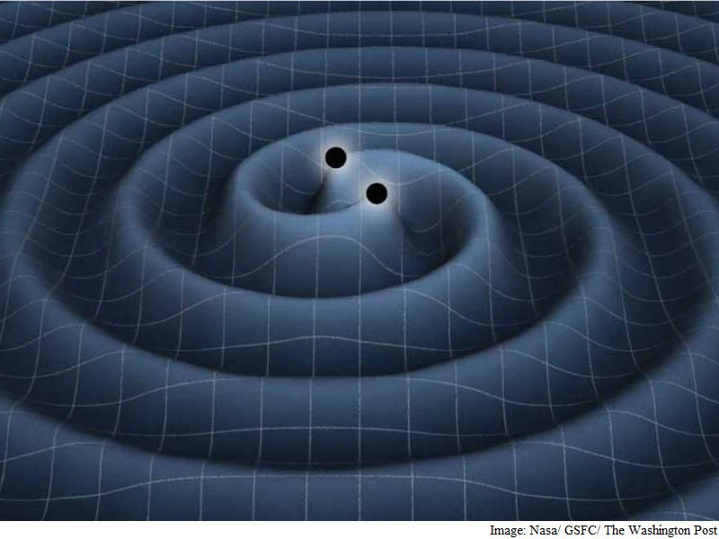
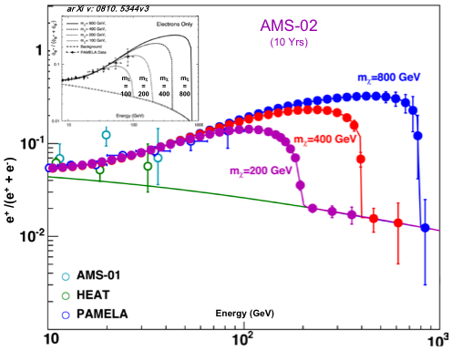
Examples of TH results
Higgs fits and Higgs criticality studies
DM indirect detection – astroparticle physics
Primordial BH DM – fits, CMB and GW constraints

Slide 6
The NICPB CMS group
12 researchers in CMS including PhD students
Research topics:
  Historically BSM Higgs (H++ to leptons) and top quark searches (single top polarization, tt cross section)
  Higgs related searches – ttH and HH production modes and with leptons (emphasis on tau leptons) in the final state
  Trigger development at L1 and HLT
  RECO maintenance
  Graph based neural networks and particle flow

Slide 7
FCC plans
Example planned research:
We’ve developed machine learning algos
to do particle flow at CMS
If fully demonstrated to give equivalent results could give an easy option to implement same algo at FCC future detectors

Slide 8
Summary
Coordinated the CERN activities for close to 25 years
Well established research program that entails
  theory
  phenomenology
  experimental analysis
  future experiment development
Expected to pursue a wide program at FCC as well, but transitioning will happen over time from existing CMS programs

