Slide 1
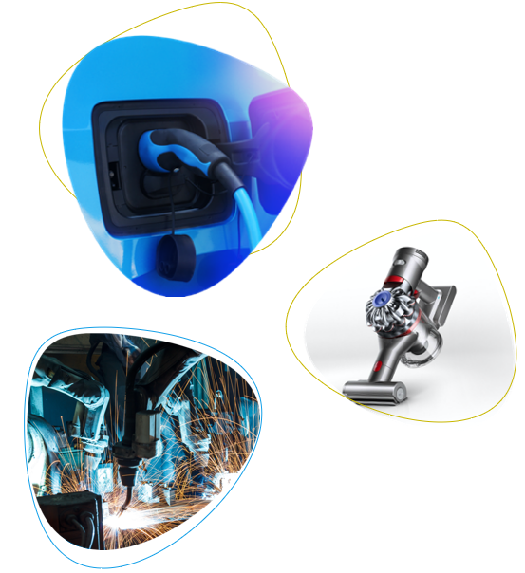
NPM Silmet
2.March 2022
Estonia

Slide 2
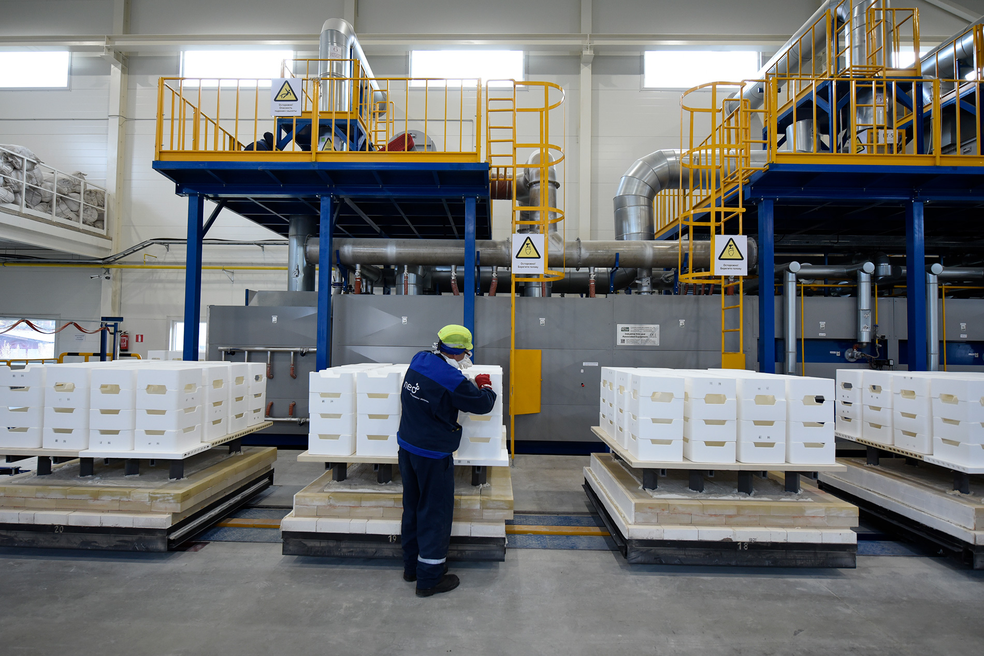
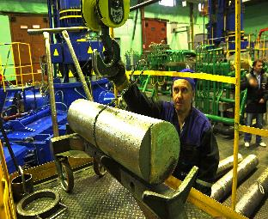
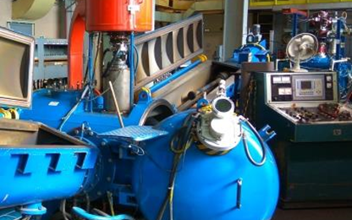

NPM Silmet
Europe’s Only Operating REE Separations Facility
Activities:
  Rare Earths production (2500 tpa)
  Pr,Nd,La,Ce, Sm-Eu-Gd ....
  Rare Metals production (1400 tpa)
  Ta and Nb
  Research & Development
  State-of-the-Art Analytical Laboratory

Slide 3
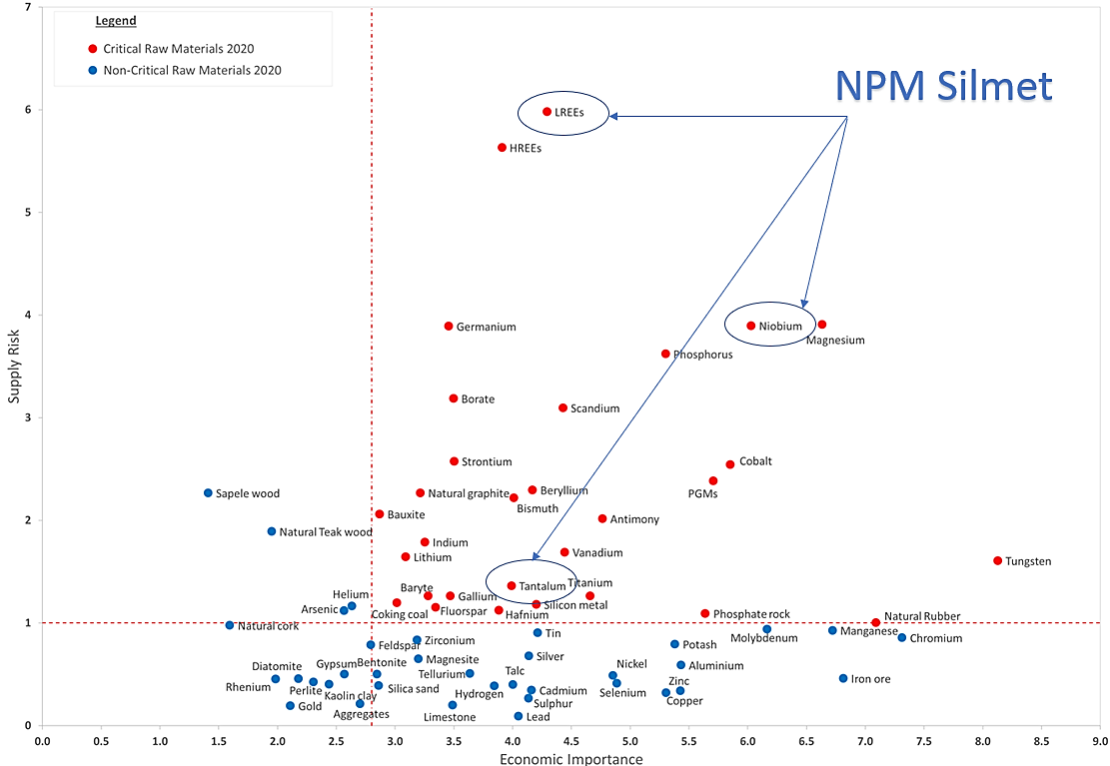
European critical
raw materials

Slide 4
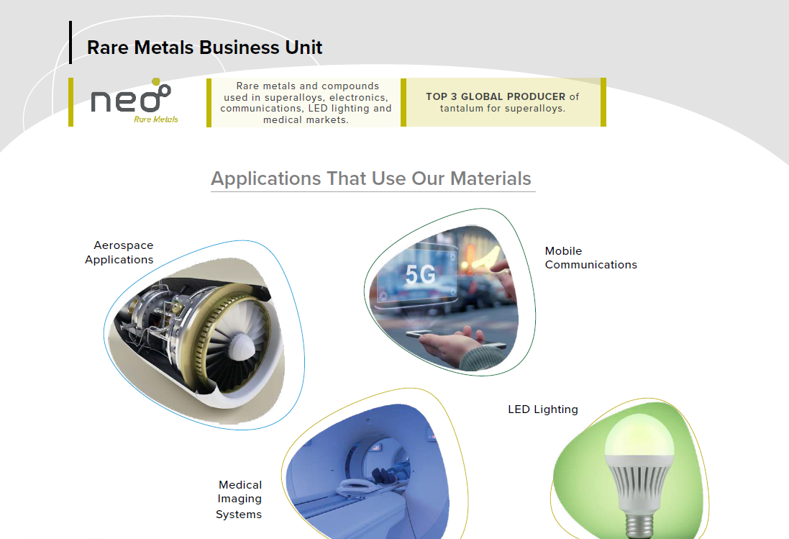

Slide 5
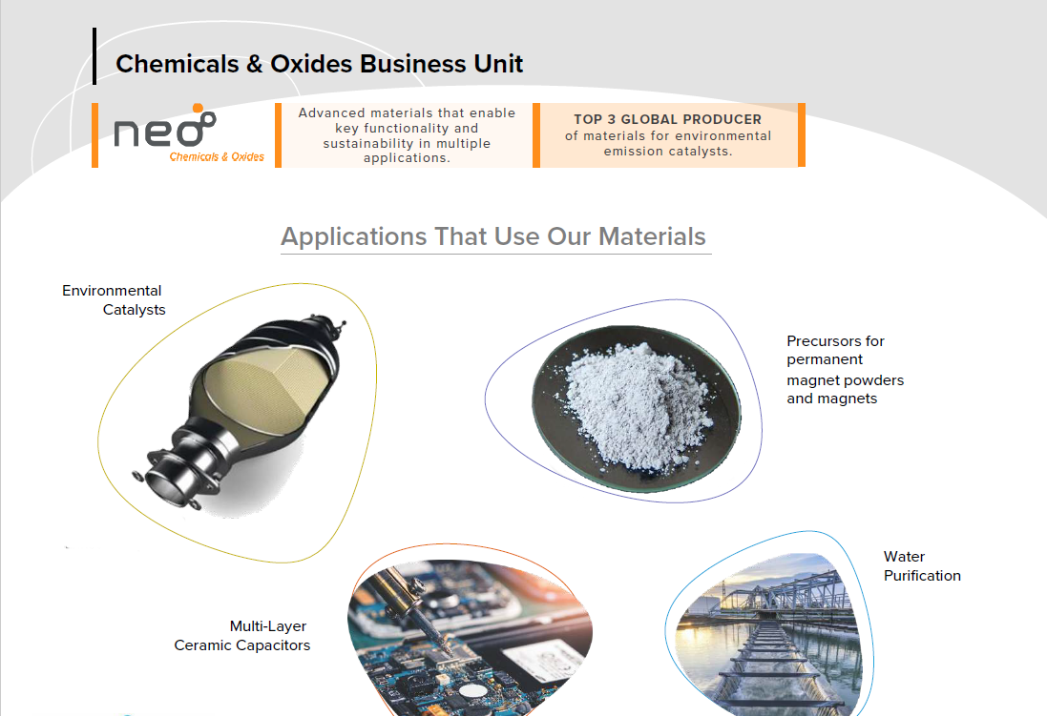

Slide 6
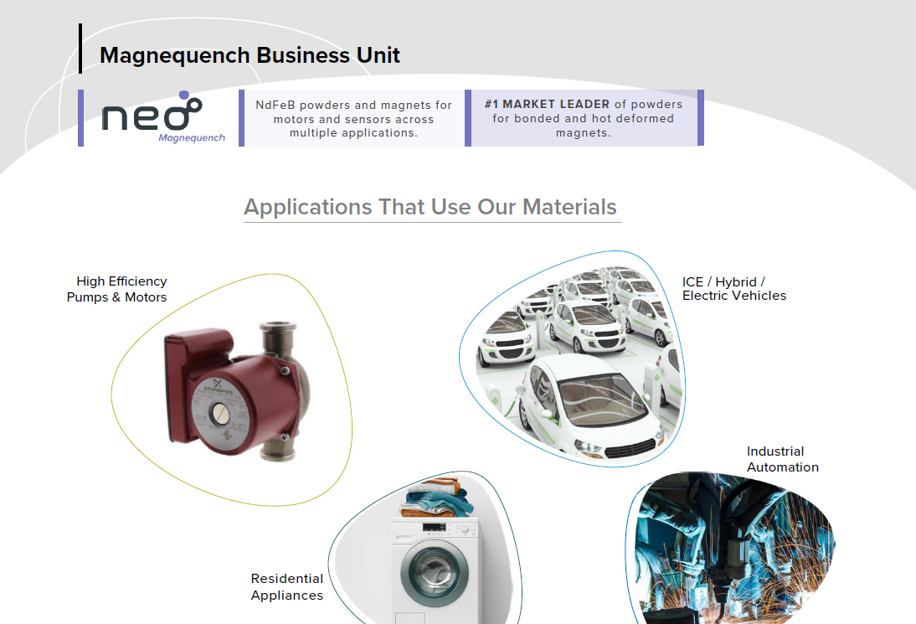

Slide 7
Disclaimers
Forward-Looking Information
The presentation contains “forward-looking information” within the meaning of applicable securities laws in Canada. Forward-looking information may relate to future events or future performance of Neo. All statements in this presentation, other than statements of historical facts, with respect to Neo's objectives and goals, as well as statements with respect to its beliefs, plans, objectives, expectations, anticipations, estimates, and intentions, are forward-looking information. Specific forward-looking statements in this presentation include, but are not limited to: expectations regarding certain of Neo's future results and information, including, among other things, revenue, expenses, revenue growth, capital expenditures, and operations; statements with respect to expected use of cash balances; continuation of prudent management of working capital; source of funds for ongoing business requirements and capital investments; expectations regarding sufciency of the allowance for uncollectible accounts and inventory provisions; analysis regarding sensitivity of the business to changes in exchange rates; impact of recently adopted accounting pronouncements; risk factors relating to intellectual property protection and intellectual property litigation; and, expectations concerning any remediation efforts to Neo's design of its internal controls over financial reporting and disclosure controls and procedures. Often, but not always, forward-looking information can be identified by the use of words such as “plans”, “expects”, “is expected”, “budget”, “scheduled”, “estimates”, “continues”, “forecasts”, “projects”, “predicts”, “intends”, “anticipates” or “believes”, or variations of, or the negatives of, such words and phrases, or state that certain actions, events or results “may”, “could”, “would”, “should”, “might” or “will” be taken, occur or be achieved. This information involves known and unknown risks, uncertainties and other factors that may cause actual results or events to differ materially from those anticipated in such forward-looking information. Neo believes the expectations reflected in such forward-looking information are reasonable, but no assurance can be given that these expectations will prove to be correct and such forward-looking information included in this discussion and analysis should not be unduly relied upon. For more information on Neo, investors should review Neo's continuous disclosure filings that are available under its profile at www.sedar.com. Information contained in forward-looking statements in this Presentation is provided as of the date hereof and Neo disclaims any obligation to update any forward-looking statements, whether as a result of new information or future events or results, except to the extent required by applicable securities laws.

