Slide 1



FPGA-based
Design & Test
Celebrating 15 years of innovation

Slide 2

Testonica’s Key Competencies
Design of embedded systems: HW and SW, FPGA design
Fault tolerance, monitoring and health management
Test strategy optimization and testability improvement
COMPETENCIES
FPGA / SoC / MCUs
VHDL / Verilog
Fault Tolerance
Fault Management
BIST / POST
BERT / HSIO Test
Test & Measurement
Functional Test
Embedded Test
Test Instrumentation
JTAG / IJTAG
Boundary Scan
Flying Probe Test
IEEE 1149 / IEEE 1687

Slide 3

Outline
FPGA-based Projects for Accelerators
CMS: Custom BERT Equipment – 2013
CMS: Tau lepton decay triggering algorithm – 2020…
ESS/ERIC: FPGA-Based I/O and Control System – 2016…
In collaboration with

Slide 4
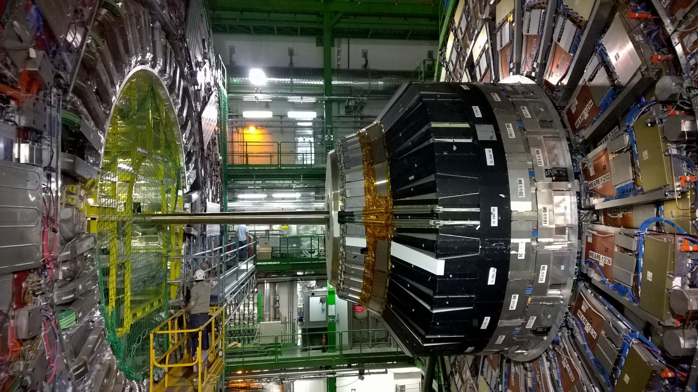
BERT Equipment for CMS Data Links
Signal translation boards
Data acquisition system
On-detector (CMS) electronics
Problem:
- signal integrity
- full custom design
Needs:
- end-to-end test
- push-button start
- autonomous exec
- HW and SW dev
ROS
40m
60m
TSC
Copper twisted pairs
→ ROS: 240 Mbps
→ TSC: 480 Mbps
Optical Fiber
Copper twisted pairs
ROS – Read Out Server
TSC – Trigger Sector Collector

Slide 5
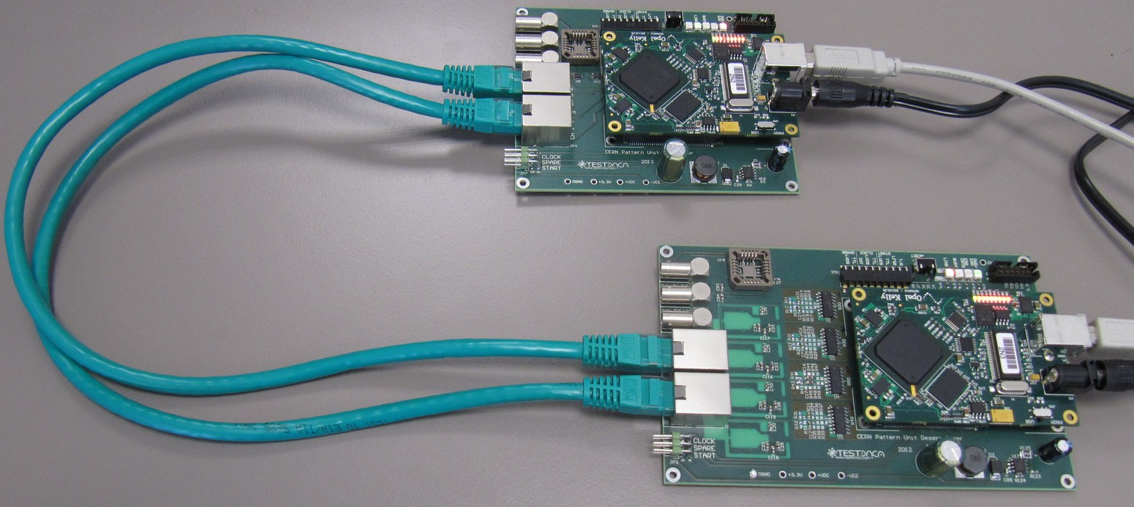

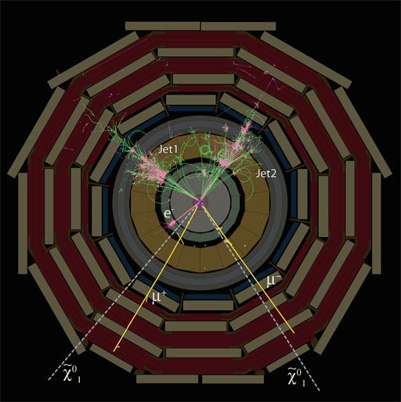
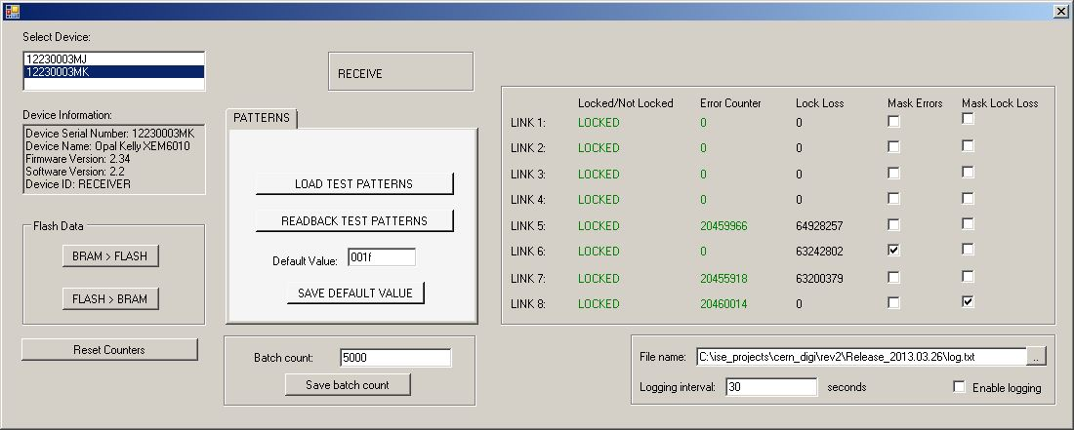
Compact Muon Solenoid (CMS)
Transmitter and test generator
Receiver and BER counter
The Control Software
http://cms.web.cern.ch/news/how-cms-detects-particles
Delivered: custom Bit Error Rate (BER) Test Equipment
System Under Test: communication channels of LHC/CMS
Usage: test and certification of communication channels of LHC/CMS
Hardware and FPGA design, software, final integration, and test by Testonica and TalTech (subcontractor)
Successfully delivered in 2013 with positive feedback from the CMS group

Slide 6

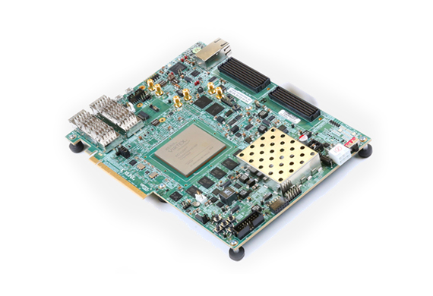
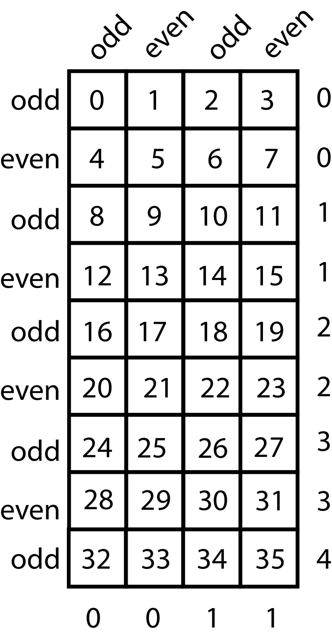
Tau lepton decay triggering algorithm
Key challenge: process 10 billion objects (particle data) per second on a single FPGA
Platform
  VirtexUltrascale+ FPGA (the most advanced on the market)
  Tool-chain: Vivado and Vivado HLS (High-Level Synthesis)
  Used languages: C++ (HLS version) and VHDL
Allowed latency
  1uS (max time before the processing results must be ready)
Design clock frequency: 360MHz
Development in collaboration with NICPB and TalTech

Slide 7
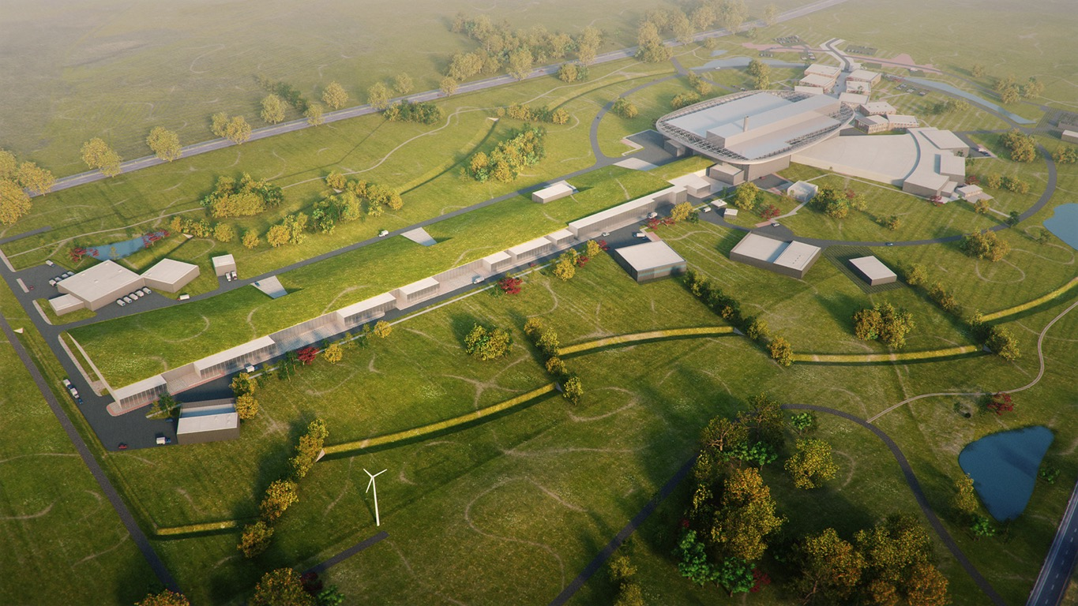

Embedded control SW, driver extensions, FPGA design and test strategy development in 2016-2022
In collaboration with
    High speed multi-channel GSPs data acquisition platform for BPM and BCM
    Development FPGA-Based I/O and Control System
    Embedded software development and HW design
    Implementation of an EtherCAT slave card
Projects are run by TalTech whereas Testonica provides consultancy and engineering support

Slide 8
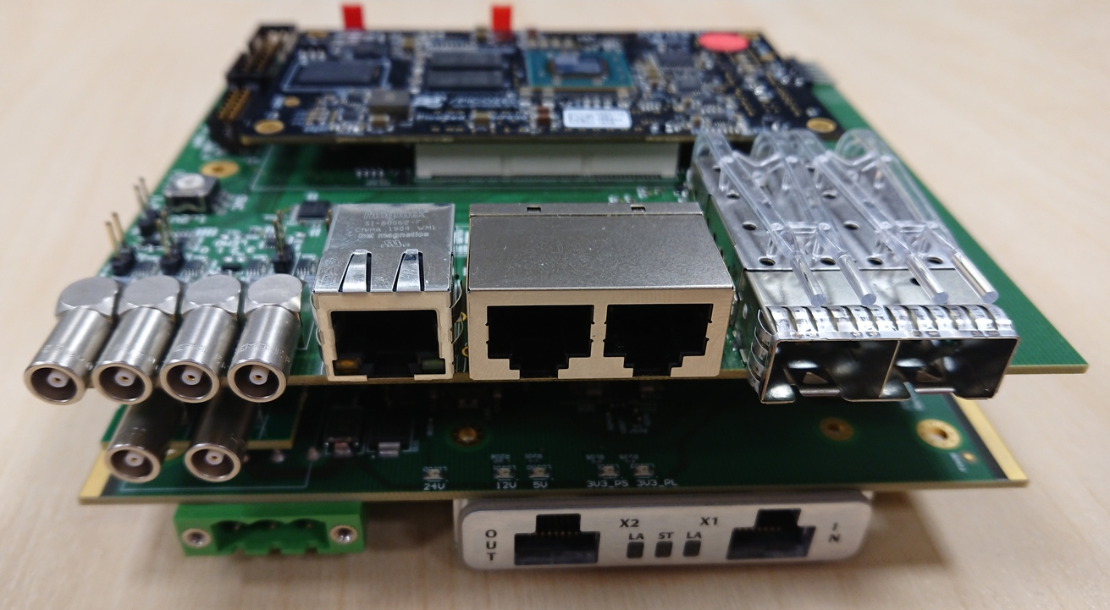
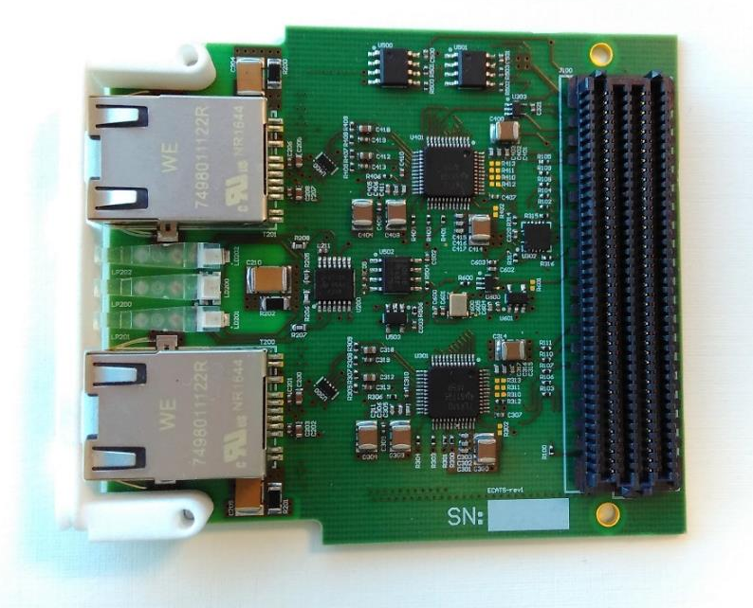
FPGA-Based I/O and Control System
Technical Specifications
  Zynq7000 SoC-FPGA
  System-on-Module (SoM) based
  Ready-made Linux SW package
  1GB DDR3 memory
  128Mbit QSPI Flash (boot)
  8GB eMMC Flash (application)
Interfaces
  +24V DC, passive cooling
  Gigabit Ethernet
  2x SFP (up to 6.6Gbps)
  2x RS232 UART (RJ45)
  4x LEMO connectors
  FMC slot (1.2V/1.5V/1.8V)
  MRF expansion slot
  JTAG interface
LAN
PicoZed Zynq7000 System-on-Module
(1GB/128Mbit/8GB)
2x RS232
2x SFP
Supervisor MCU
4x LEMO
FMC Expansion
MRF

Slide 9


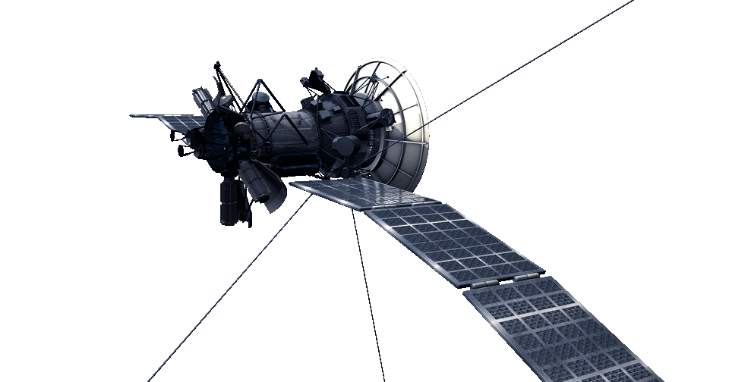



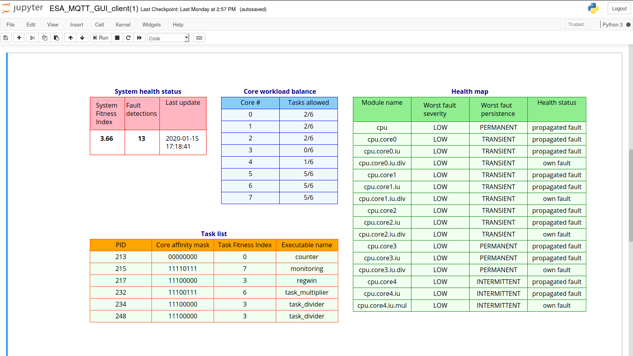
SoC-HEALTH: On-Chip Health Monitoring and Fault Management for SoC Health-Awareness in Space Missions
Health Management
for Satellites
Linux OS running on 8-core LEON3 CPU on FPGA
Health Monitoring hardware
  1262 checkers in ALU, registers, pipeline, etc.
Health Monitoring Software
  Fault-managed tasks are running on health-managed resources
  Task scheduling w.r.t. system health and task requirements
Demonstrator
  Combination of both HW and SW
  Human operator readable telemetry

Slide 10
System Health-Awareness
(AI-driven) predictive maintenance
Self-healing
Self-adaptation to damage
Instant failure recovery
Fault/error immediate reporting
Event-triggered monitoring data filtering
Distributed fitness data collection
Smart on-chip sensors/checkers
Systematic approach
Effective Fitness Data Collection Is the Cornerstone

Slide 11
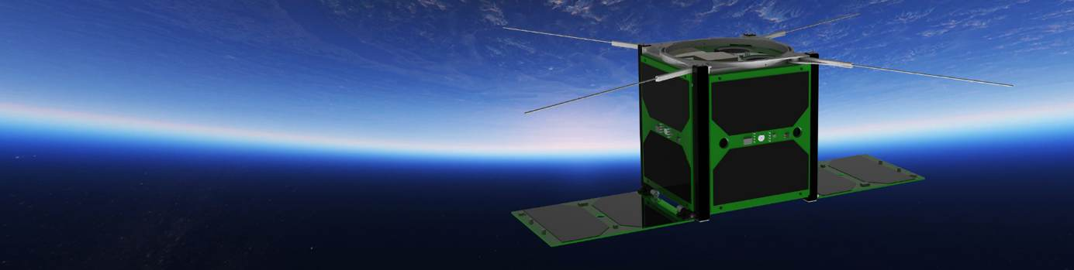
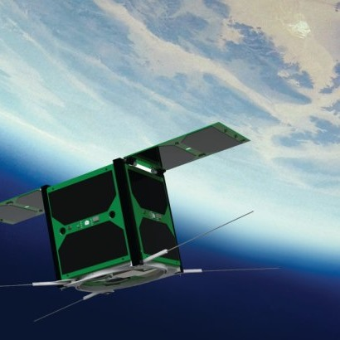

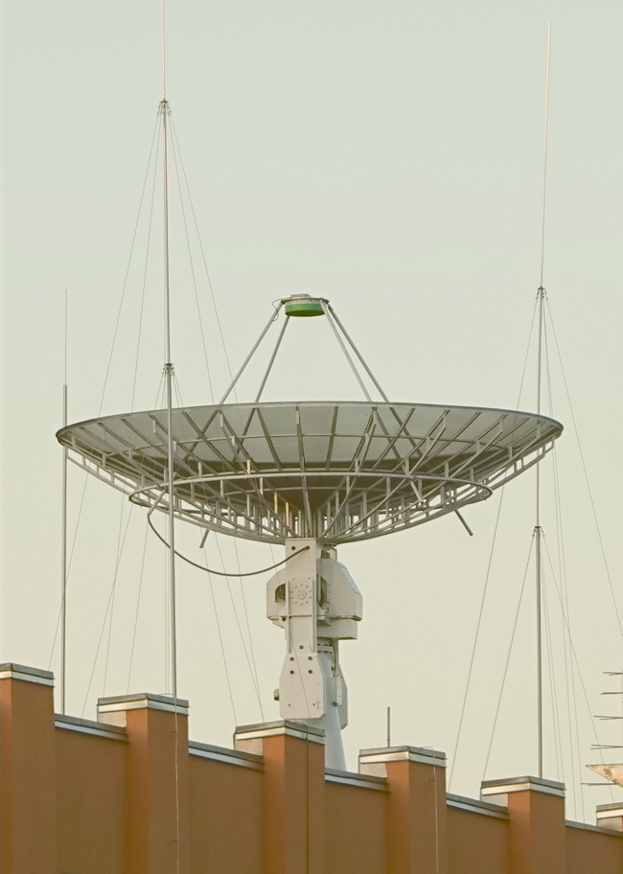
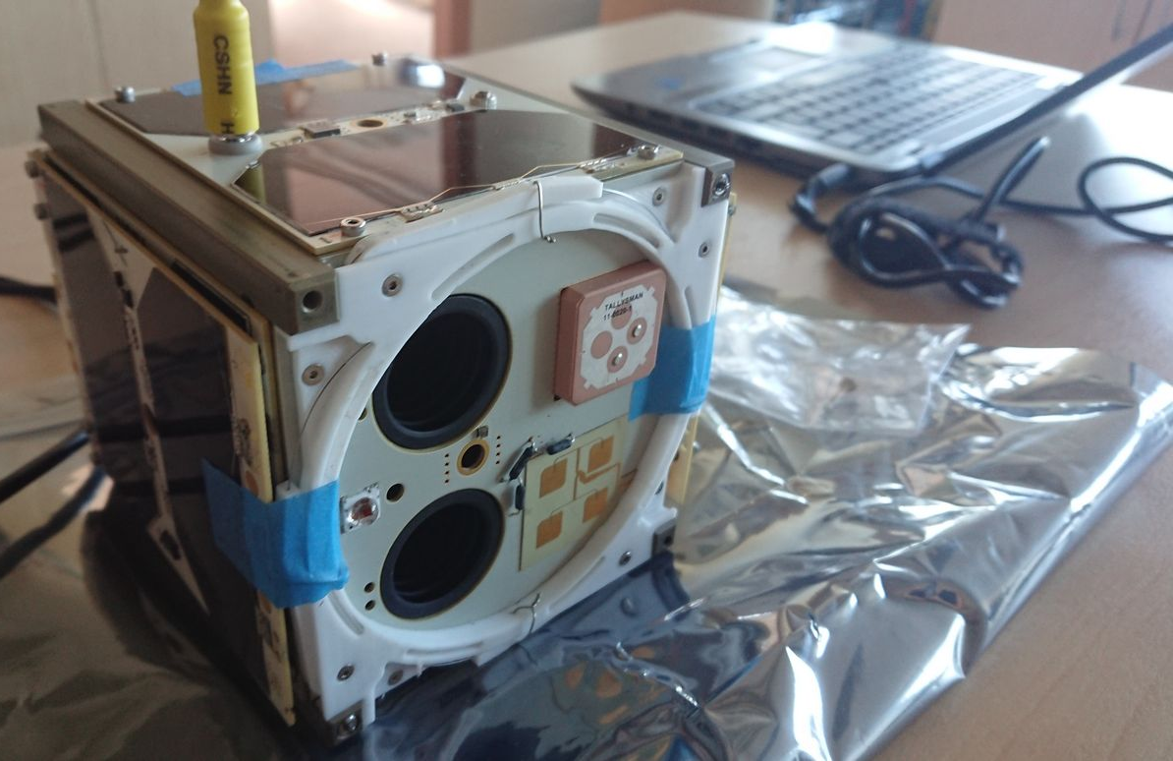
SW Dev Support for TalTech’s CubeSat
1U Earth Observation CubeSat with RGB and NIR cameras
Ground station 5m parabolic antenna
2 identical operational CubeSats are in orbit:
- Soyuz launch on July 5, 2019
- Vega VV16 launch on Sept. 3, 2020

Slide 12
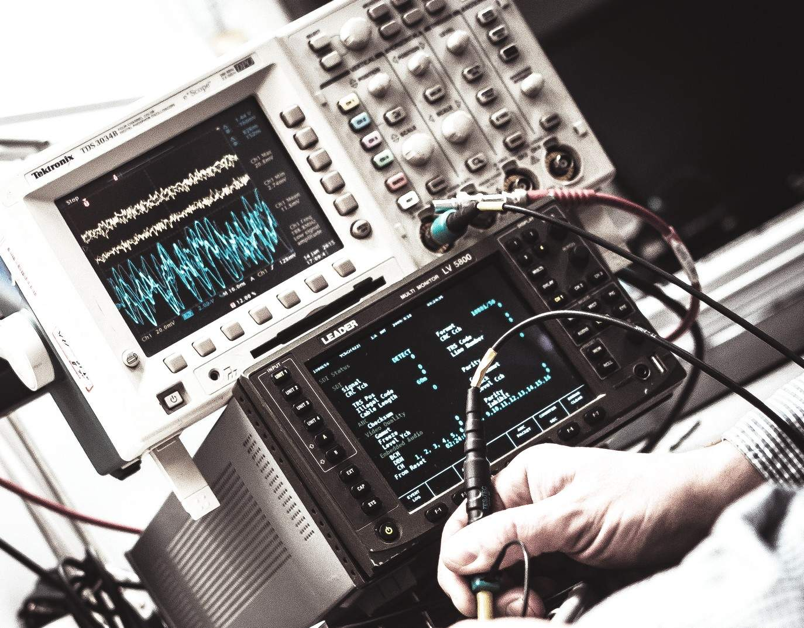


Testing Right From the Inside
Tester
on Chip
External Tester
At Speed. Always.

Slide 13

Inventor of Embedded Virtual Instruments
Solutions in
20+ countries
Patented
in 2013

Slide 14
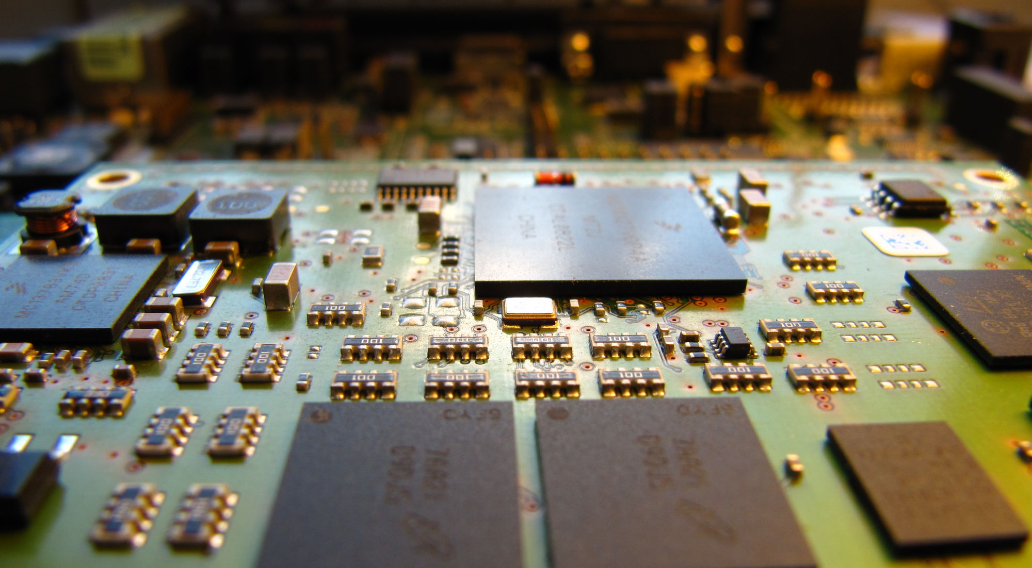
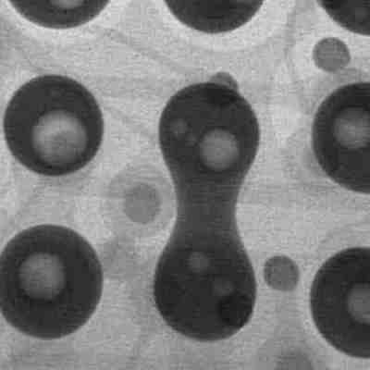
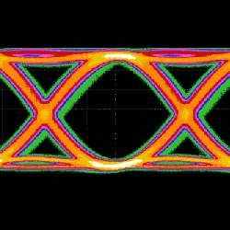
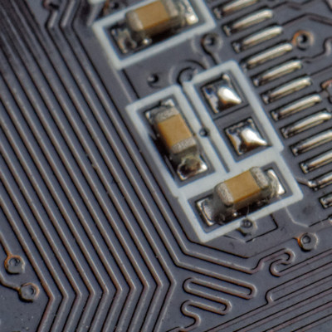
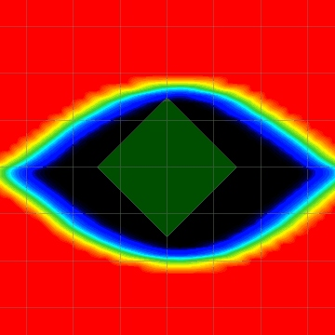
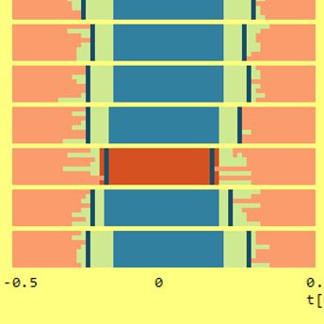
Quick Defect Screening
Prototyping
Production
Lifetime
Maintenance

Slide 15

Thank You!
We love solving problems

